Slide 1



Gaseous detectors principles and performance comparison
Aielli

Slide 2
Strating from the basics
Any radiation detector exploits the physics of the interaction of radiation with matter to achieve the quantum decoherence (old: collapse of the quantum wave function).
the release of electromagnetic energy can be detected by a transducer
In order to have a sufficient S/N i.e. to discriminate a signal above the random electronic fluctuations of the readout, the original signal, made of light or moving electrons is transferred to an amplification element
Amplification is obtained by a combination of the following ways:
  By an amplifying physical process within the detector structure
  By an electronic amplifier
Any radiation detector couples a sample of matter as target, a transport mechanism and a transduction and amplification structures.
Gaseous detector are characterized by using a gaseous target…
The many types of gaseous detectors are differentiated by transport, transduction and amplification structures…
Quantum radiation
Material target
e.m. energy
Transport and internal amplification
Trans-duction
Electronic amplification

Slide 3
Why gaseous detectors?
Technologically simpler than other solid state detectors, in facts they have been the first single particle detector “in real time” (Geiger counter 1908)
Gas can be replaced so the target is not subject to deterioration
They can be shaped easily in very different ways
They can have very large and continuous targets (true also for liquid target detectors which are close relatives of gaseous detectors…)
They cost for unit surface or volume is low compared to other technologies
For the characteristics above they have been used successfully in large spectrometers and tracking systems
One iconic type the MWPC was awarded with Nobel Prize ☺ (Charpak 1992)

Slide 4
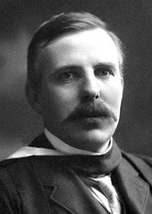
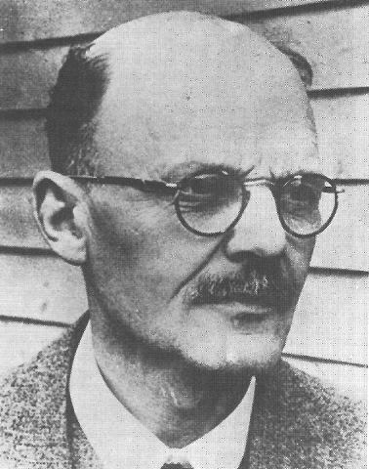
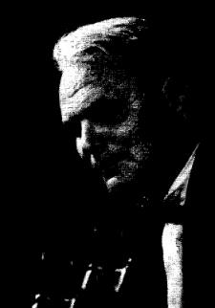
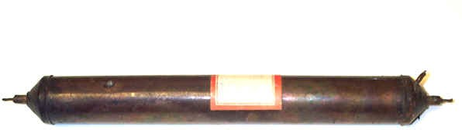
The ancestor: the Geiger counter
It contains all the element of the list in slide 2 (see later)
Detects radiation by electron discharge;
can count α, β and γ particles (at low rates ...)
1908: Ernest Rutherford and Hans Geiger
1928: Hans Geiger and Walther Müller
20 years from ideation to a versatile implementation
A Geiger-Muller counter built in 1939 and used in the 1947-1950 for cosmic ray studies in balloons and on board B29 aircraft by Robert Millikan et al.
E(a)rnest Rutherford (1871-1937)
Hans Geiger (1882-1945)
Walt(h)er Müller (1905-1979)
Made of copper, 30 cm long

Slide 5
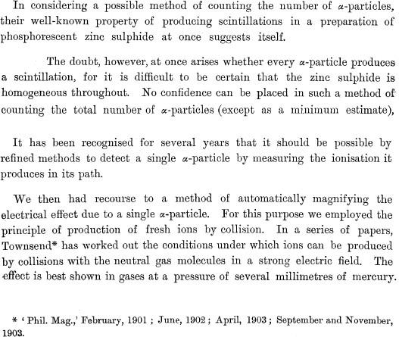
Motivation for the Geiger counter
Interesting story:
The authors successfully used phosphorescence in the famous Rutherford experiment
They found out the limits and that something new was needed to really progress
Made use of the new physics of electron multiplication at low pressure as discovered a few years before in 1901 by JS Townsend.
.
[E. Rutherford and H. Geiger, An Electrical Method of Counting the Number of α-Particles from Radio-Active Substances, Proc. R. Soc. Lond. A 81 (1908) 141-161]

Slide 6
Overview of the physics principles

Slide 7
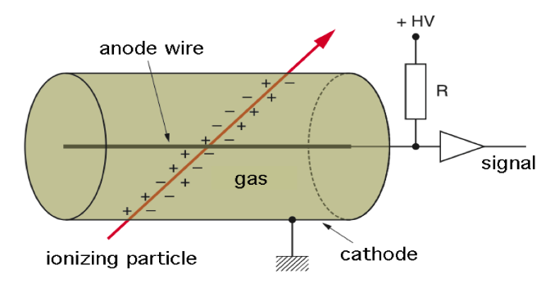
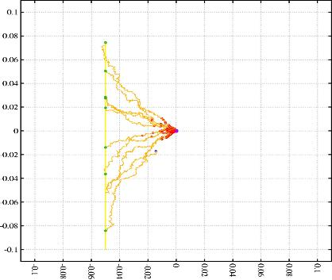



A notable template
Any radiation detector exploits the physics of the interaction of radiation with matter
incident radiation
Material target
Energy
deposit
Transport and amplification
Radiation ionize the gas atoms, their number proportional to dE/dx of the particle
In presence of an applied electric field in the gas volume electron drift at about 10^3 higher speed than ions
With wire as anode and cylinder as cathode the field is:
Close to the wire the field grows and the electron multiplication starts
Signal is induced between anode and cathode by the moving electrons -> current is conserved… $i(t)=𝒩(t)ℯv$ at any instant
Trans-duction
Electronic amplification

Slide 8
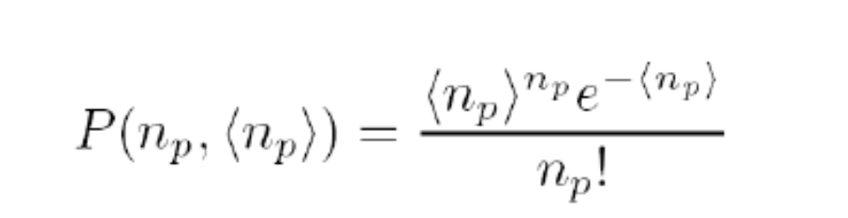
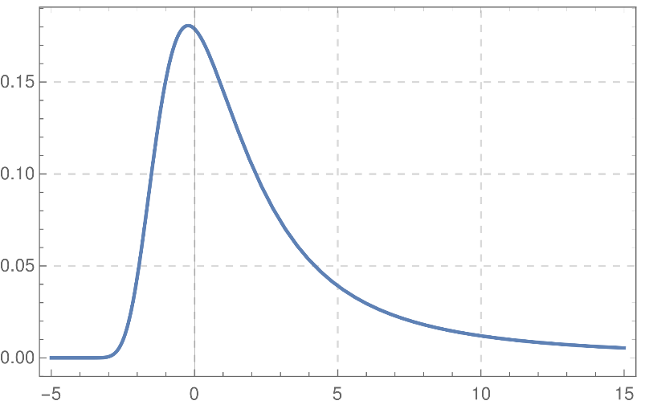

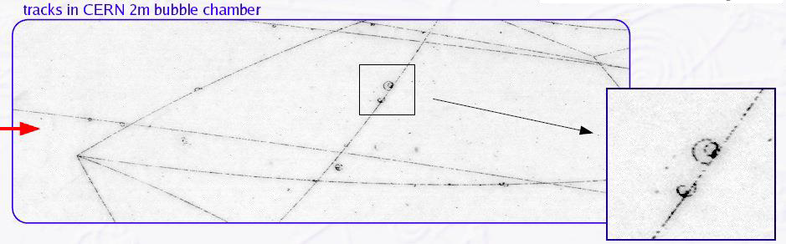
PRIMARY AND SECONDARY IONIZATION
Primary ionization: a charged particle deposits energy by ionizing the gas molecules
The position of the ionization points is described by the Poisson statistics:
<np> is the number of expected points per unit length
The total energy deposited has a wide distribution (typically modelled with the Landau distribution) so the primary electron can generate secondary electrons → Total ionization per unit length > primary ionization per unit lenght
The Landau distribution describes the energy loss of fast, charged particles passing through thin layers of matter due to ionization. It is characterized by a narrow peak and a long high-energy tail caused by rare, large energy transfers, making the distribution asymmetric.
Electrons are not evenly spaced, not even exponentially

Slide 9
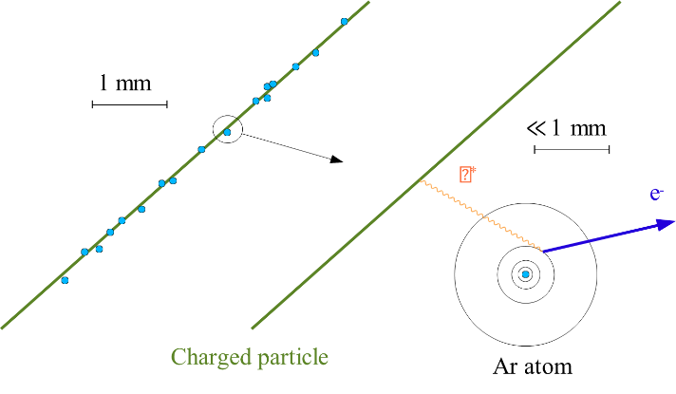
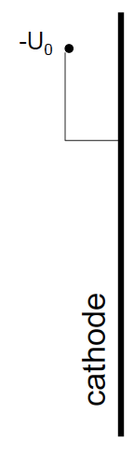
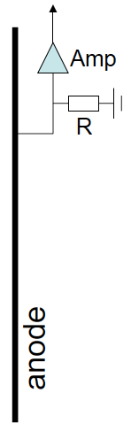
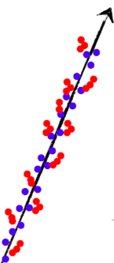

PRIMARY AND SECONDARY IONIZATION
An important fraction of the electron/ion pairs is from 𝜹-electons: knocked-out through a virtual photon exchange
Example:Ar at normal pressure:A energy of 1cm･dE/dx = 2.44 keV creates 29.4 e/ion pairs per cm (83 eV/pair). Secondary ionization accounts for the difference to 94 pairs/cm (x 3!), such that the average energy to create an e/ion pair is w_{i} = 26 eV (See next slide).

Slide 10
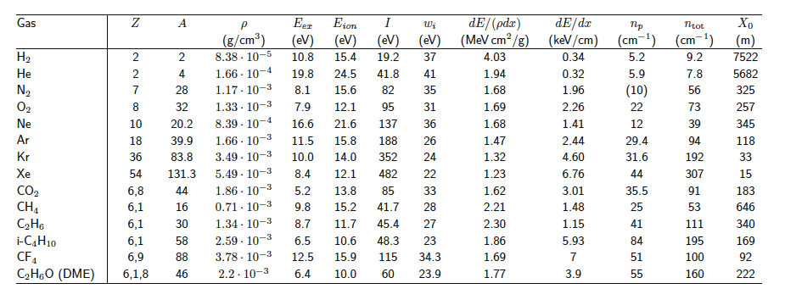
Gaseous detectors parameters
E_{ex} … excitation energy threshold
E_{ion} … ionisation threshold
w_{i} … average energy to create an e⁻/h⁺ pair
I … average Ionization energy (Bethe Bloch)
n_{p}, n_{tot} … primary /total ionisations per cm (difference because of 𝜹-electrons)
w_{i} … average energy to create an e/h pair
X₀ … radiation length
DME … Dimethylether

Slide 11
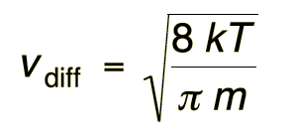

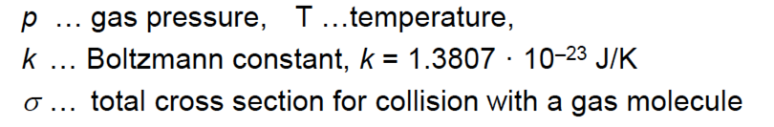

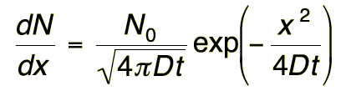


Diffusion
In the absence of an external field the electrons and ions diffuse around the release point driven by Brownian motion
The electrons and ions loose energy by multiple scattering until thermal equilibrium is reached.
e- v_{diff} ≈ 10⁶ cm/s = 10 𝝁m/ns ions v_{diff} ≈ 10⁴ cm/s
The diffusion coefficient is determined by the average free path length λ of e- and ions in the gas:
Solving the Boltzman equation for a initial point-like ionization deposit, the charge carrier distribution evolves as a time-dependent Gaussian (projected in 1D)
from where one can extract the width 𝛔_{x} and the volume diffusion

Slide 12

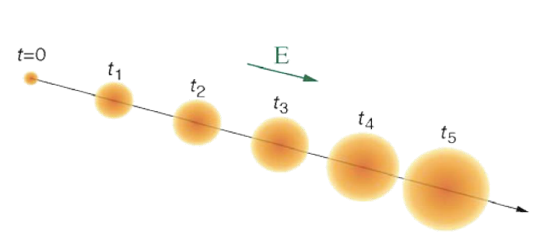
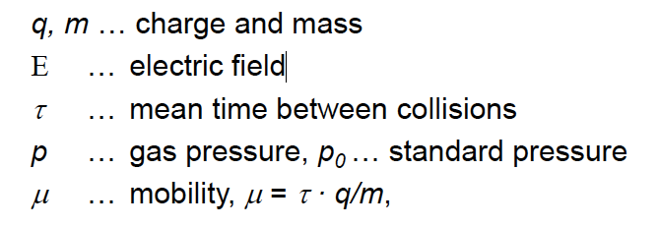
Drift in electric field
If an external electric field is applied the electrons and ions are accelerated and move along the field lines ⟶ a drift is induced
  The drift is superimposed onto the diffusion movement
Acceleration is interrupted by collision with gas atoms, this limits the drift velocity.
The mean drift velocity v_{D} is
where
and typical values 10-100 𝝻m/ns.

Slide 13
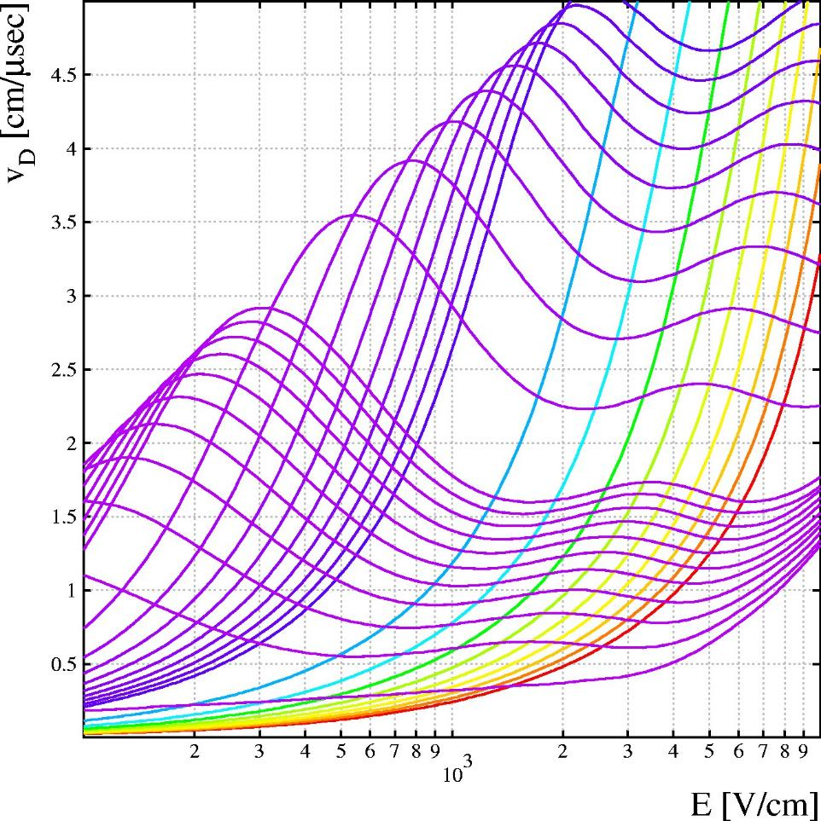
Adding CO₂
CO₂ makes the gas faster, dramatically.
2
2-10 % CO
Drift velocities calculated by Magboltz for Ar/CO₂ at 3 bar.
(Note where the arrow is !)
2
We assume that the drift is in presence of an electric field constantly providing energy to the electrons
This energy is accumulated in between collisions, and dissipated
The electron energy distribution function is shaped by the dissipation provided by molecules rich of vibrational modes
Depending on it the electron energy distribution is concentated in a permitted band, in this case optimal to minimize the scattering wiht Ar molecules
This «cooling effect» depends on the respective concentrations, on the dissipation cross-sections and on how the interacion cross section depends on the electron velocity.
0.1-1 % CO
20-100 % CO₂
Pure Ar

Slide 14
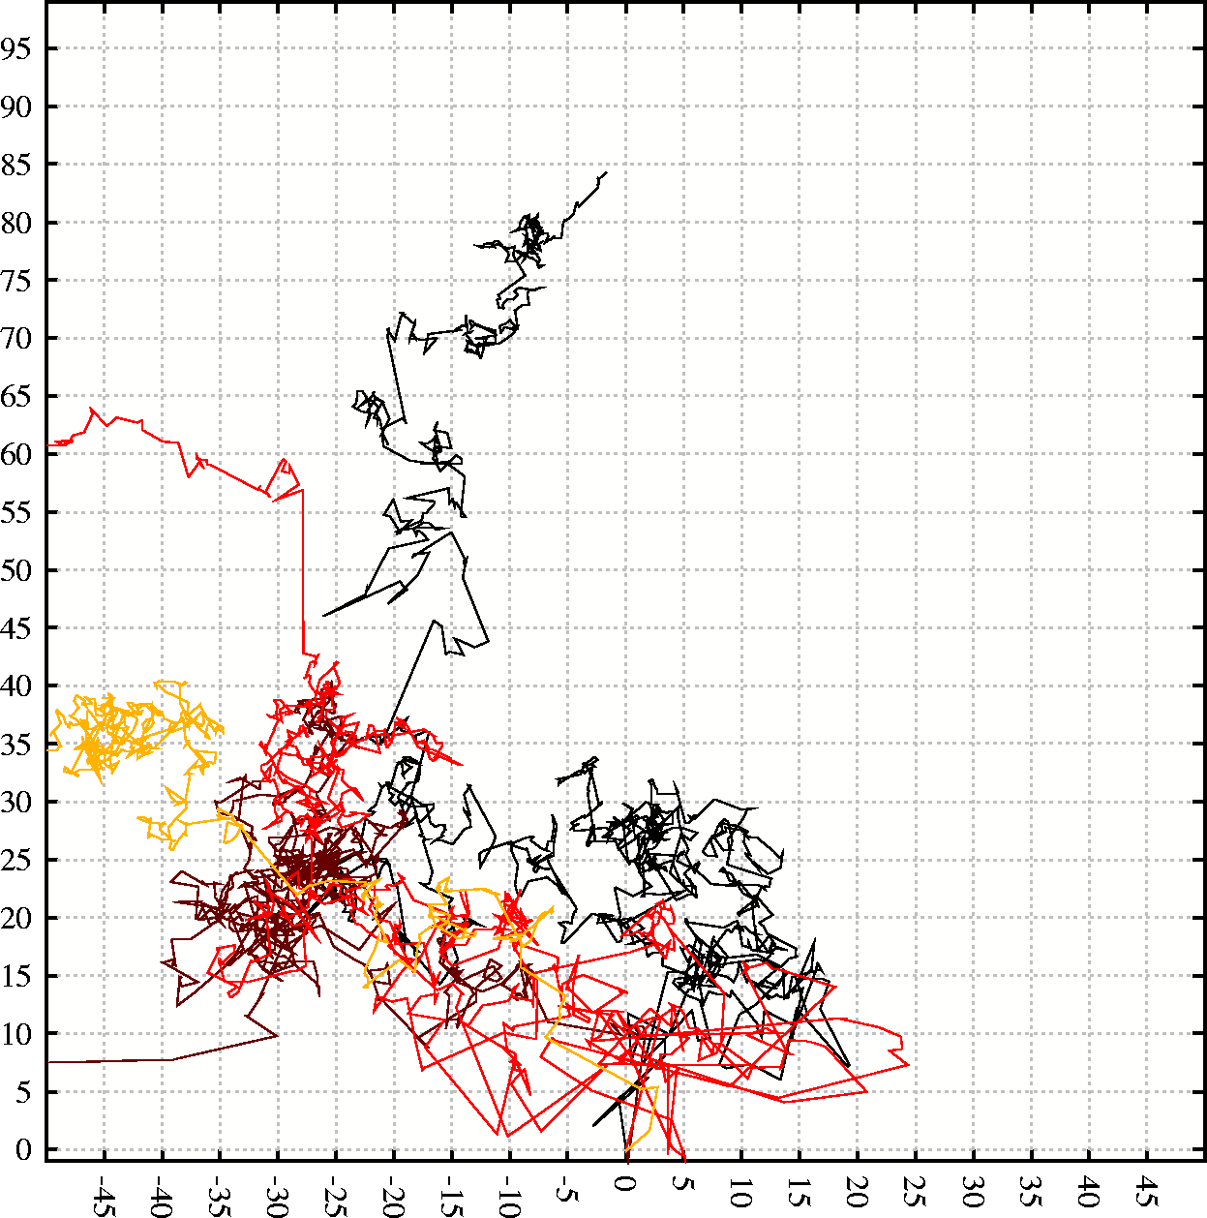
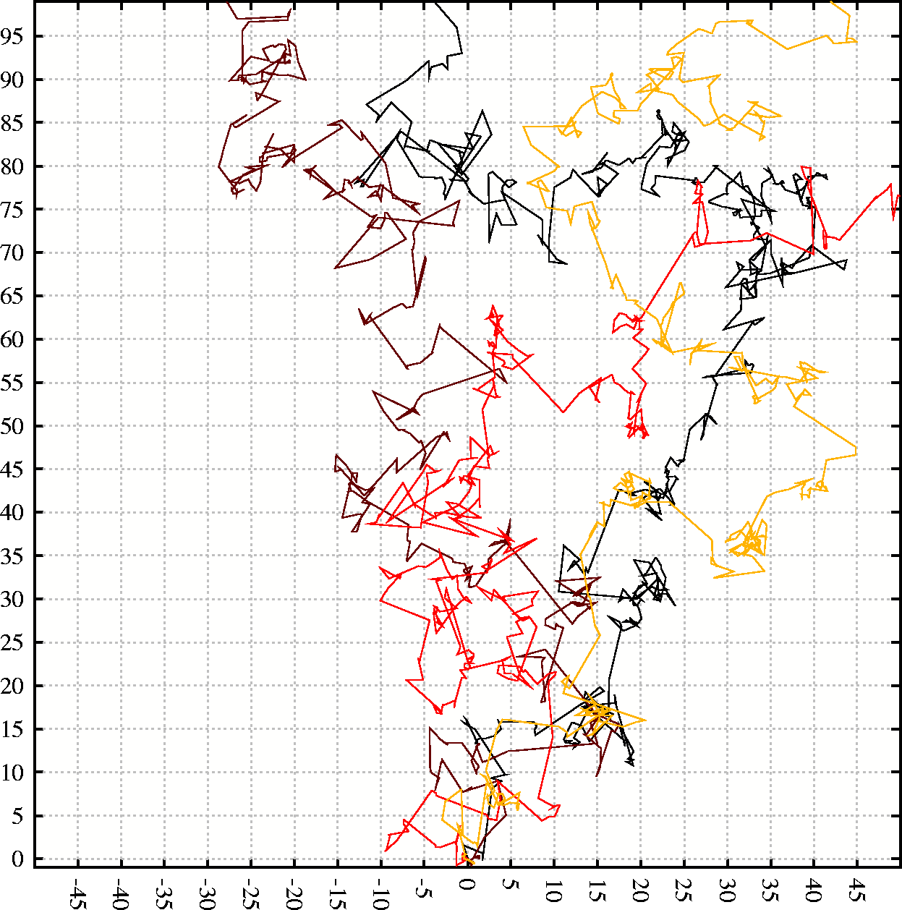
Electrons in Ar/CO₂ at E=1 kV/cm
0 % CO₂
E
10 % CO₂
Starting point
Starting point

Slide 15
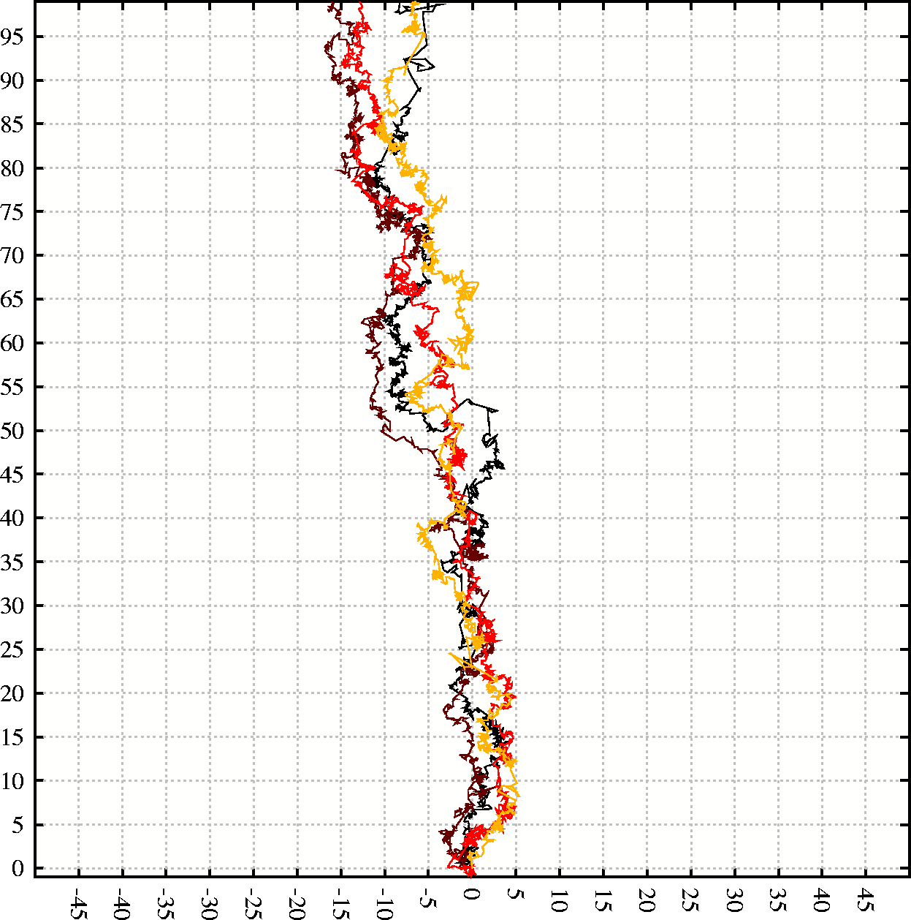
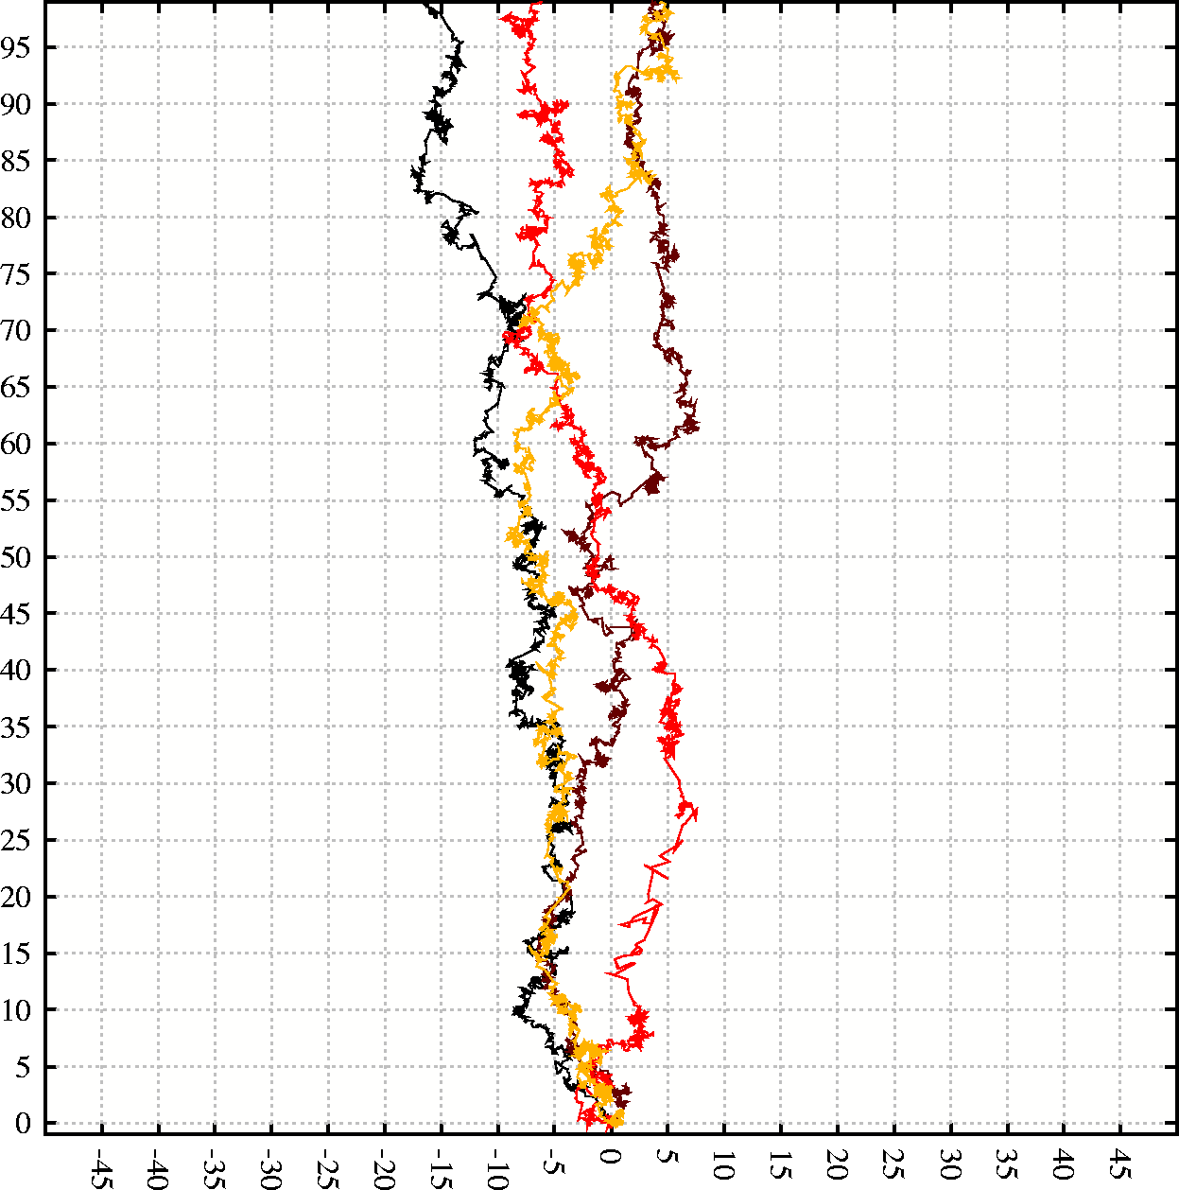
Electrons in Ar/CO₂ at E=1 kV/cm
40 % CO₂
50 % CO₂
Starting point
Starting point

Slide 16
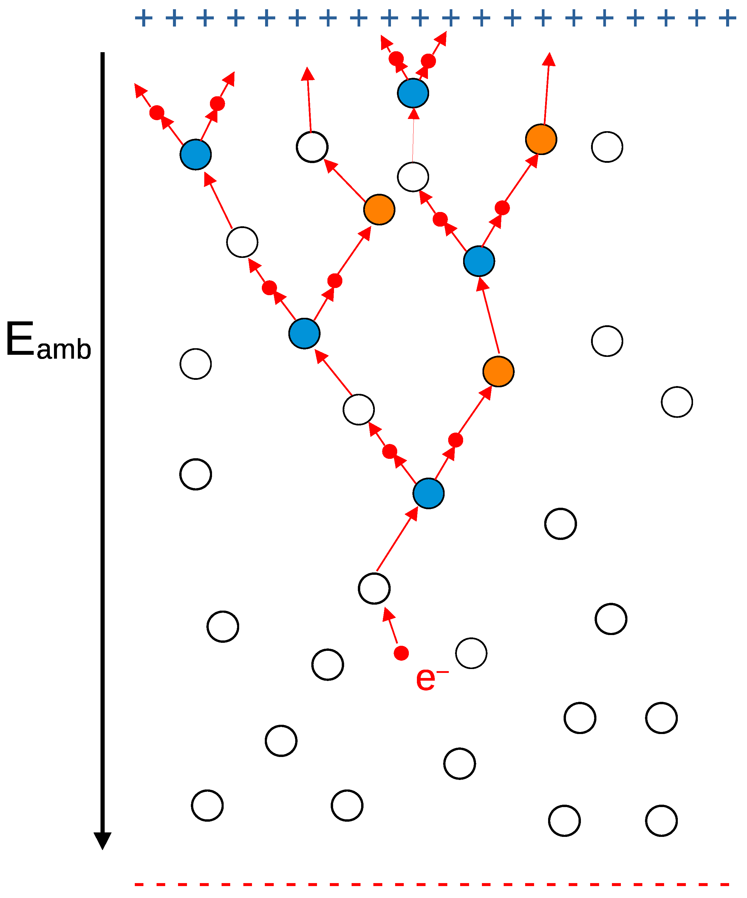

Importance of mixtures
Gaseous detectors “secret” are the mixtures of gases, specifically tailored
The previous example shows how different molecules can influence the drift velocity but there are many aspects influenced by the gas mixture components, often dependent on the electron energy distribution:
  The Attachment: the capture cross section of electronegative components
  The multiplication length: the distance between two consecutive ionizing collisions → depends on the trade-off between energy accumulation and dissipation
  The photon quenching: the photon capture cross section. This last has not to do with electron velocity, but energetic photons produced by atom recombination, can ionize at distance from the generation point, seeding other clusters of secondary ionization

Slide 17

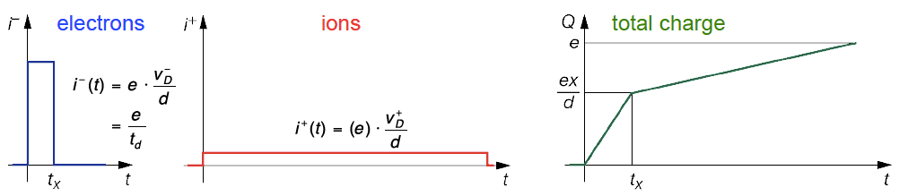
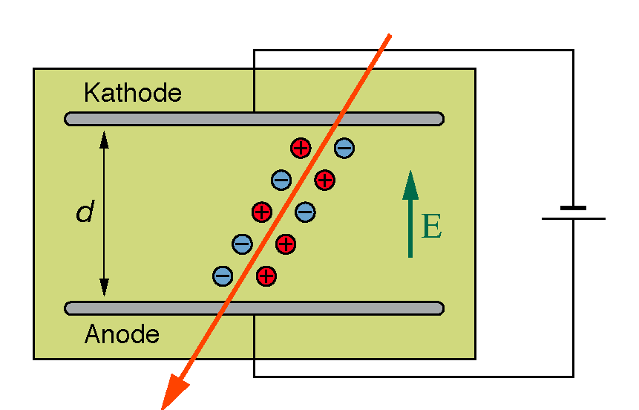
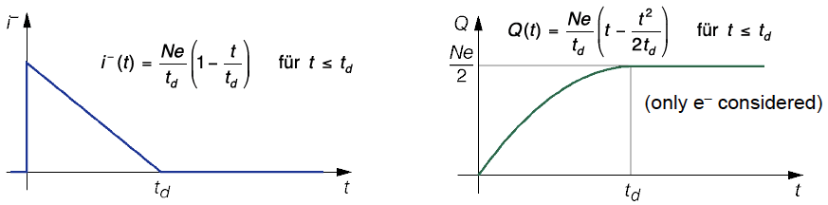
The case of ionization chamber
An ionization chamber is operated at a voltage which allows full collection of charges, but below the threshold of amplification.
Shockley–Ramo theorem:
The instantaneous current i induced on a given electrode due to the motion of a charge is given by .
i is NOT given by the arrival of the electrons!
For a typical field strength 500 V/cm and typical drift velocities the collection time
for 10 cm drift is about 2 μs for e– and 2 ms for the ions.
Ionization chambers are used in nuclear industry but rarely in particle physics (too low signal, too slow, not possible to measure single particles: C_{min}≈10⁴e ≈1 fC).
ICs however illustrate that the basic concepts to be applied also for the gaseous amplification
Planar ionization chambers,

Slide 18
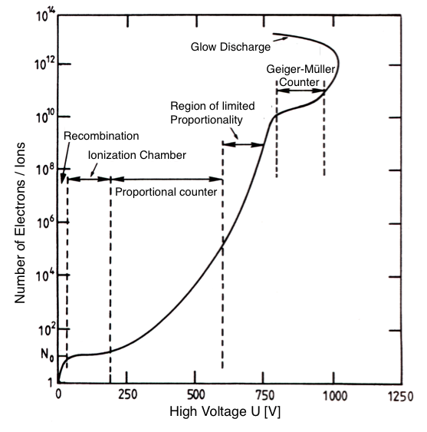
Discharge in gases
The gain G is defined as the ratio of electrons delivered
at the anode N_{A} to the number of primary electrons N, G=N_{A}/N.
G<1: Recombination
  most of the e/ion pairs recombine or get attached by an electronegative atom
G≈1: Ionisation chamber
  no amplification, only primary particles collected. Useful for dosimetry/flux meas.
G≈10³-10⁵: Proportional counter / proportional mode
  An avalanche develops which G is statistically constant and independent on the primary ionization
G≈10⁵-10⁸: Region of limited proportionality or saturated avalance
  The electrons of the developing avalanche build up space charge limiting the effective field. The growth is not exponential i.e. electrons are not independent
G ≳ 10⁸: Geiger (or streamer) region
  The signal is independent on the primary ionization. The detector counts.
note: numbers only exemplary.
Strong dependence on gas and geometry
discharge operation: triggered by a single e⁻/ion pair, the electrodes connect by a streamer build up a self sustaining discharge triggered by extraction of electrons from the cathode, which is heated by the discharge itself

Slide 19
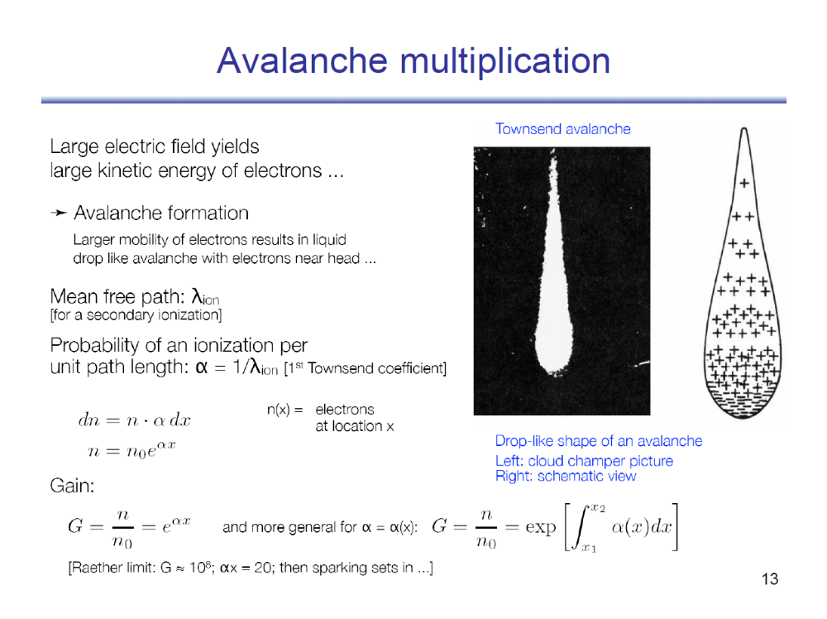

Slide 20
The logistic saturated avalanche model

Slide 21
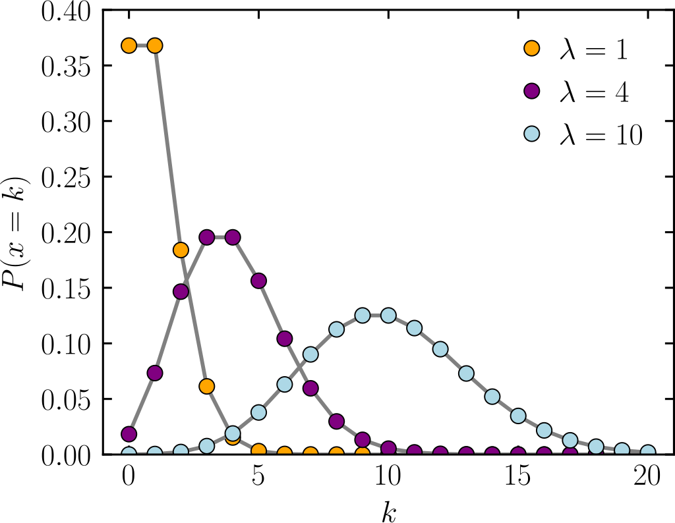



Resistive Plate Chamber avalanche
Primary ionization follow the Poisson distribution
Driven by the gas electron density
The amount of energy released in each point follows a power law, typically for RPCs 70% of clusters has a single electron
1-P(0) should be the ma efficiency
Proportional regime: $α=1/{λ_{ion}}=constant$
$dn=n∙α dx ⇒n\left(x\right)=n_{0}e^{αx}$
$G=\frac{n(x)}{n_{0}}=e^{αx}$
Valid for $G<{10}^{5}$
Attachment: η is the probability that an electron is captured by an electronegative molecule and depends on the electric field as α
$dn=n∙(α−η) dx ⇒n\left(x\right)=n_{0}e^{(α−η)x}$
$G=\frac{n(x)}{n_{0}}=e^{(α−η)x}$
Due to the attachment, a fraction of the primary ions are captured before the avalanche can develop

Slide 22
Saturated Logistic Avalanche
Townsend, Rather, Meek et. al developed a description of the avalanche growth in approximation of independent electrons
This is very suitable for describing proportional detectors
It fails in case of larger avalanches since electron field is relevant
RPCs strong and uniform electric represents an ideal template for the study of this process
The experimentally observed growth of the avalanche charge recalls the Logistic function introduced firstly in 1845 by Verhulst [8] to describe the growth of a biological population, that tend to become stationary in presence of a limited flow of food resources due to the fact that the number of individuals able to reproduce become constant.
In our case the experimental data on the total charge can be compared with the integral of the logistic function, accounting for the total population: the multiplicating (active) electrons and the spectator electrons

Slide 23
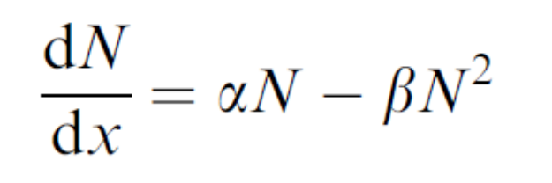
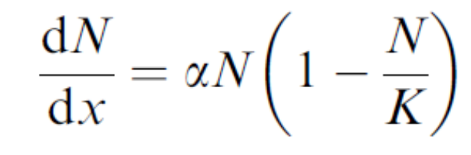
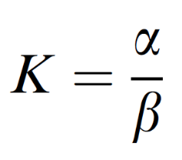
The logistic avalanche model
The Logistic equation is obtained by the lowest order non-linear correction to the usual exponential growth equation (equivalent to the Townsend theory)
In the proportional case the N electrons are independent on each other, in the Logistic avalanche case N electrons interact with themselves linearly → proportionally to N^2
α and β mean the rate at which the free electrons are created and lost from the active avalanche front.
The free running variable x in represents system evolution parameters such as the applied field or the avalanche path.
the growth rate tends to zero as N reaches K
For β =0 the equations is the classic one

Slide 24
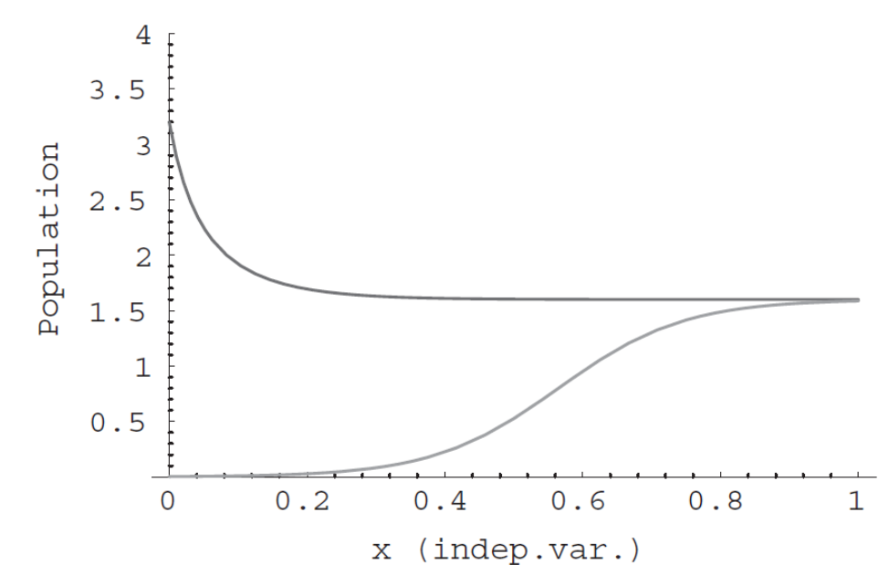
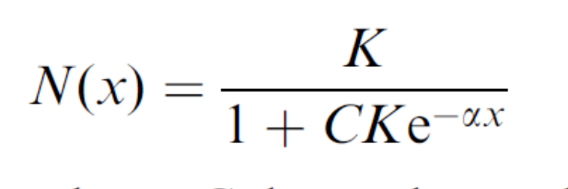

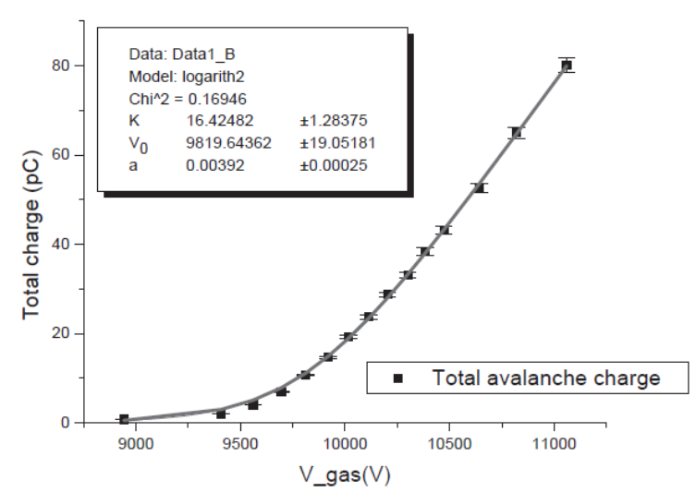


The logistic avalanche model
γ
Average $G \left(gain\right)= {Current}/{ionizing events rate}$
$Ionizing events rate = source intensity ∗ solid angle ∗ sensitivity$
For a constant irradiation $I∝G$
It describes Qact, the ‘active’’ avalanche, responsible for the creation of further ionization.
Qact is a fraction of Qtot the total amount of free electrons
x and V are conjugated variables
  Increasing the avalanche length at fixed field
  Increasing α(V) at fixed gap
$$⇕$$

Slide 25

Signal induction: Qtot/Qprompt ratio
Qtot it the “price” to pay in charge to deliver a signal Qprompt (the charge induced by the moving electrons)
SPECIAL CASES
Streamer: a conductive filament of plasma connecting anode to cathode → electron path = d → Rq =1
For the saturated avalanche, Rq depends on the field,
And will decrease from αg to 2 (extreme case)
Extreme saturation: Qact = K at the cathode → Qprompt increases linearly along x → Qtot=2*Qprompt
Simplest case, the ionization chamber: no multiplication
When an electron and the ion reach the respective electrodes, a charge Q=1e has been induced in the circuit
  electron path=x →
  Qprompt $∝$ x/d
  Rq=Qprompt/Qtot $∝$ x
Qtot/Qprompt =1
Streamer
d-x
x
Ionization chamber
Qtot
V
Qtot/Qprompt =2
Q active

Slide 26
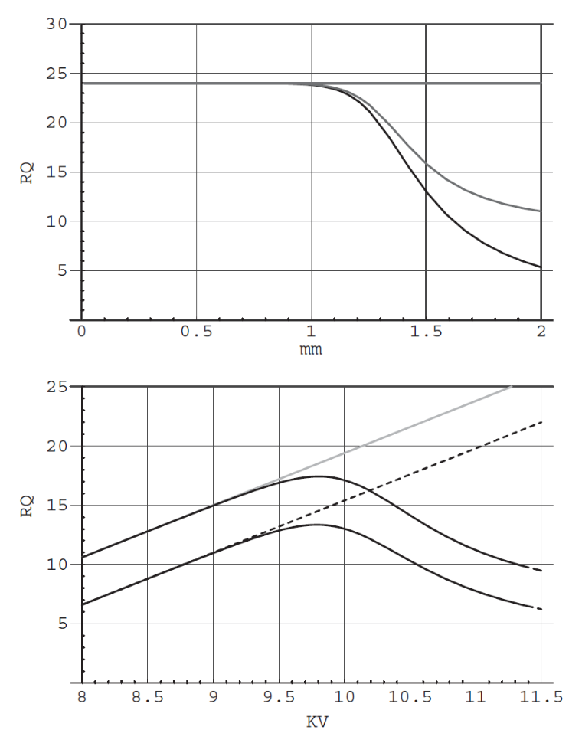





The Qtot to Qprompt ratio
$$R_{Q}={Q_{tot}}/{Q_{prompt}}$$
Saturated region
Rq = lowers with increasing saturation
Exponential region
Rq =αg
Qtot/Qprompt =2
$$x_{0 }$$
$$x$$
In the proportional regime:
$$Q_{tot}\left(x\right)≅\int_{0}^{g}{n_{0}e^{αx}}=n_{0}{αg⋅e}^{αx}$$
Example: $G=5⋅{10}^{4}⟹$ $αg≅11$
$G=5⋅{10}^{6}⟹$ $αg≅15$ proportional mode limit
$G=5⋅{10}^{8}⟹$ $αg≅20$ Meek limit
For a completely saturated avalanche, i.e.
$x≫x_{0 }\underset{→}{\text{yields}}Q_{tot}\left(x\right)≅K∝x$ and RQ is
found to decrease down to the limit value 2

Slide 27
Comparison of the main gaseous detector families

Slide 28
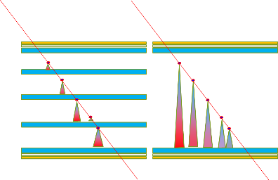
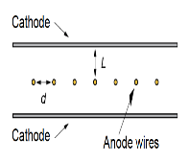
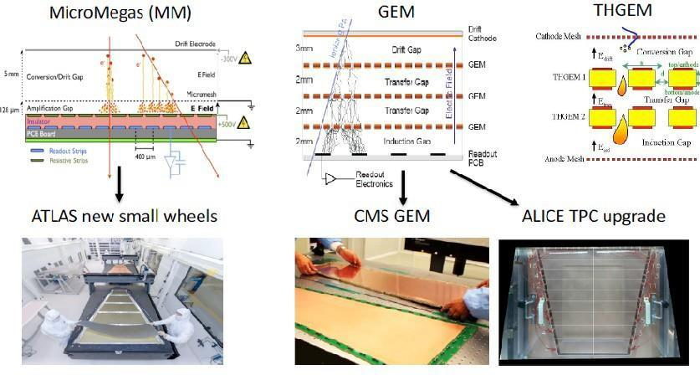
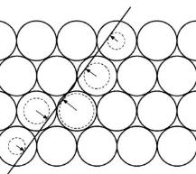
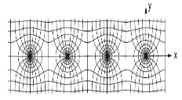
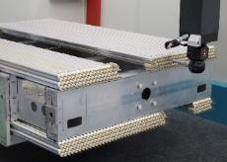
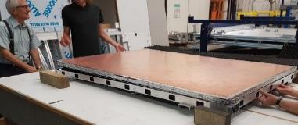
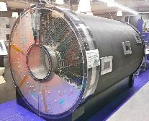


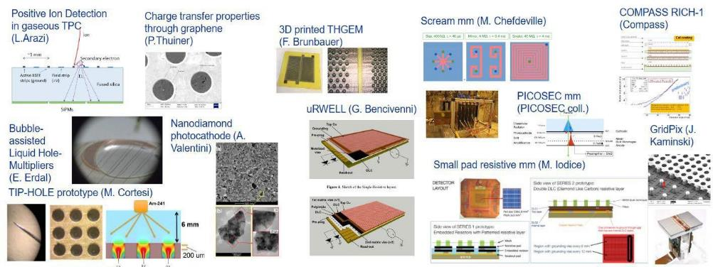

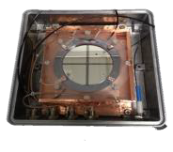



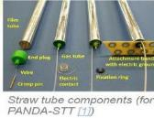

Muon detector technologies
sMDT
RPC
ATLAS Ph1 + Ph2 upgrade
ATLAS Ph1 + Ph2 upgrade and CMS RE3/1 & RE4/1
,
And new ideas
sRPC (Bencivenni
single gap semi-conductor
R. Cardarelli
RCC Cardarelli

Slide 29




Basic principles of gaseous detectors
All gaseous detectors designed for muons share the same base principle:
  A gaseous target thick enough for a MIP to release a sufficient primary ionization
  An electric field sufficiently strong to start an avalanche multiplication
  A segmented pick-up electrode to readout the signal and extact a space-time information
Wire chamber
MPGD
RPC
drift
$$E1$$
$$E=constant$$
$$E≈\frac{1}{r}$$
$$E2≫E1$$
avalanche
Pick-up strips
Resistive electrode

Slide 30






Multi wire proportional chamber
A repetitive pattern of Geiger tubes without walls…
Narrow wires allow a higher rate capability (typically 10 kHz/cm^2)
Typical gas amplification in MWPC is 10⁵
Space in between wires is 1-5 mm and sets the space resolution (like strips in RPCs)
  By using the wire position: 𝛔_{x} ≈ d/√12 ≈ 500 𝝁m
  Using also the charge centroid: 50 𝝁m achievable.
A variant of the MWPC to improve the space resolution is the Cathode strip chamber
MWPC was the first electronic detector (1968)!
Georges Charpak (1924-2010)
Nobel prize 1992

Slide 31



Drift chambers
Operating principle:
Take into account e⁻ drift time and separate drift and amplification
Charged particle traversing the chamber produce ionization.
  Need to be supplemented with e.g. an scintillator signal that starts a timer (t = t₀), or other subdetector components provide a trigger.
Electrons drift to the anode wire.
Electrons reaching the wire create secondary ionization (avalanche) and trigger a signal (t = t₁).
  From the time difference the distance of the traversing particle to the wire is deduced:
    Δt = t₁-t₀, x = v∙Δt

Slide 32
MWPC Strength vs. weakness diagram
Metallic bulk and wires structure
Gaseous target and multiplication separated. Large target space
Very good structural properties
Avalanche very much delayed
Good avalanche charge uniformity
Good charge collection efficiency
Spark free
Moderate charge per count helping to achieve a fair rate reolution.
Multiplication confined around the wire
Expensive and difficult
Classic design recipe: “low” resistivity electrodes + electronegative gases+ sensitive electronics
Easy to scale single module dimension to a few m^2 at constant unit cost and complexity
Excellent mechanical properties for a built-in high space resolution

Slide 33

Resistive Plate chambers at a glance
Feature RPC vs MRPC
# of gaps → 1-2 – 4 to tens
Gap size →~1mm – ~ 0.1 mm
ρ(Ω cm) → 5x10¹⁰ – 5x10¹²
Module size →2 m² – 0.1 m²
Hz/cm² → 10⁴ – 5x10²
$σ_{t}$→ 300 ps – 50 ps
Electrode HPL – glass
Gas R134A+ SF6 mix
Common features
high ρ electrodes → Spark less
Uniform electrode → simple
uniform field → prompt signal
Target and multiplication gap coincide → low latency
Working at atm. Pressure
Up to 0.1mm 2D localization
Gas mixture

Slide 34
RPC Strength vs. weakness diagram
Continuous resistive electrode structure
Gaseous target and multiplication coincide
Simple and robust construction
prompt avalanche → high time resolution and efficiency
Very variable avalanche dynamic range
Inefficient charge collection (Ramo)
Spark free
High average <Q> → limitation in rate capability
No micro-structures helping to define the avalanche growth space
Low cost
Classic design recipe: “low” resistivity electrodes + electronegative gases+ sensitive electronics
Easy to scale single module dimension to a few m^2 at constant unit cost and complexity
It is challenging to maintain the space resolution on a large size module since is “plastic”

Slide 35






GEM and Micromegas at a glance
Common features
Resistive layers→ Spark safe
micropattern → industry
Target and amplification separated → small <Q>
Working at atm. Pressure
0.1mm 2D localization
Works with simple gases
Micro Mesh Gaseous structure (Micromegas)
Separate ionization region (6mm) from amplification region (100 𝝁m)
Fast signal: Collect electrons within 10 ns
100𝝁m spatial resolution achievable
Feature GEM vs MMGAS
The gas volume is separated into a drift gap and an induction gap by a GEM foil.
A MSGC plane (readout board) is underneath.
≈ 400 V applied on the 0.05mm GEM. Triple GEM are common with G=10⁴ - 10⁵
# of gaps → > 3 – 1
Gap size →~a few mm target + 0.05 mm multiplication
ρ(MΩ/square) → 100
Module size →0.1 m² – 0.5 m²
Hz/cm² → 10⁵ – 10⁵
$σ_{t}$→ 10 ns – 10 ns
Electrode PCB – mesh
Gas Ar + CO2 + iC4H10

Slide 36
MPGD Strength vs. weakness
Gaseous target and multiplication separated
Micro-pattern electrode
Industrially printable
delayed avalanche → moderate time resolution
Very constant avalanche dynamic range
Efficient charge collection (Ramo)
Spark safe (with resistive layers)
High efficiency
Low average <Q> → high rate capability
Expensive
Space resolution limited by delta rays with a large target gap
Resistive layers limit the potential rate capability but remains > 100 kHz/c^2
Not Easy to scale single module dimension to a few m^2 at constant unit cost and complexity
It is challenging to maintain the space resolution on a large size module since is “plastic”

Slide 37
Performance

Slide 38




Space resolution principles
MPGD
Space resolution is driven by 2 factors
  Intrinsic localization of the event
  Precision of the chamber geometry
RPCs
Wire chamber
$$E≈\frac{1}{r}$$
Tubes and MWPC exploit the R-t relation of the ions drifting in the gas and rely on their metallic bulks which can be easily machined to offer a precise reference frame. Can obtain high precision with low channel density
RPCs and MPGD exploit electrostatic induction of the moving charges to calculate the charge centroid. The resolution is driven by the readout system segmentation and mechanical precision preserving it on large multi-layer chambers made of composite materials. Can obtain high precision with high channel density

Slide 39


The Physics model

Slide 40



Space resolution performance
RPCs and MPGDs
ATLAS MMGAS
  resolution ~ 100μm with 0.4 mm strips
The drift gap is large → impact angle worsen resolution corrections needed (micro-TCP method)
Affected by the B field
A lot of care needed in construction
Proof of principle on a small MRPC
  resolution ~ 50μm with 4 mm strips
  RPC less sensitive to the angle → smaller gas gaps and a single dominant cluster
1m2 1mm gas gap ATLAS prototype reaching 1mm space resolution with 2.7cm strip pitch! Up to 10 kHz/cm^2 at GIF++
Space resolution is not a classic RPCs performance, though physics is not preventing it...
MMGAS
MRPC
Planar technologies need further R&D for a simple and reliable structures to emulate DTs
Atlas upgrade prototype
Space resolution

Slide 41




Space resolution performance
Drift tubes (ATLAS case – CMS is similar)
Examples: ATLAS and CMS DT systems
Great improvement by reducing the drift length
Wire accuracy 20μm, resolution < 80μm
Angular resolution independent on the track angle
Self calibrating
Angular resolution < 70 mrad with 2x4 tube layers
Mechanically stable over large areas
Drift tubes are at the moment a more reliable and simpler tracking technology with respect to planar detectors

Slide 42

Yet another method: strip drift time
Challenging readout for future colliders
$$∆x_{1}=v/{\sqrt{2}}∆t$$
t1
x1
t0
Fast leading signals for thin gas gaps
New generation of inexpensive ~ 1ps TDCs
Propagation speed 15 cm/ns
100 μm precision is the target
Can be replicated in 2D
Accurate reconstruction of multiple tracks
x2
t2
G. Aielli et al 2017 JINST 12 C01057

Slide 43


Time resolution principles
Time resolution is driven by
  Avalanche statistical fluctuations
  Drift time (velocity x gap size)
  Electronics noise
Wire chamber
MPGD
$$E≈\frac{1}{r}$$
MWPC and MPGD work on similar principles: the separation of the drift and multiplication introduces irreducible uncertainty on the time resolution, dependent on the drift width
RPCs and MRPCs drift and multiplication space coincide. The multi-micro gap RPC segments the gas gap to further reduce the drift time

Slide 44




RPC time resolution
Time resolution is one of the main RPC features
Golden standards: MRPCs ~50 ps -- RPCs ~500 ps
complex physics behind: cluster statistics, multiplication dynamics, electronic noise
Empirically smaller gas gaps → higher resolution
  Smaller gas gaps can be operated at higher electric field and have a faster multiplication dynamics compressing noise fluctuations
As one learn from other detectors the electronics noise plays a role
ATLAS Upgrade 5 pC → 4 $f$C FE th. → 4x10³ e-
ATLAS Upgrade 6 pC → 40 $f$C FE th. → 4x10⁴ e-
ATLAS and CMS 30 pC 50 $f$C FE th. → 5x10⁴ e-
Challenge: resolution beyond 50 ps
with more and thinner gas gaps, e.g, 20 ps with 24, 0.16 mm gaps [10.1016/j.nima.2008.06.013]
Thinner electrodes → higher signal
Low noise high resolution FEE (picoTDC) https://kt.cern/technologies/picotdc
Innovative approach →
going beyond the gas gap width law
extract hidden information beyond discr. and slew correction
Promising the use of DNN to filter the complex avalanche dynamics → 16 ps achieved! [arXiv:2005.03903v1 [physics.ins-det] 8 May 2020]

Slide 45


Drift based detectors time resolution
DT drift spectrum is by construction unsuitable for timing as a long drift time is used for high space accuracy
ATLAS Thin gap chambers → 6-7 ns
Typical Micromegas, GEM, μRWELL 10 ns
A proposal to get rid of the drift variations is to hybridize a MMGAS with a photo-cathode and a Cherenkov radiator. Resolution ~ 50 ps driven just by the single avalanche process, like in MRPC
Atlas MMGAS
Atlas sMDT
Drift detectors and limited in time resolution and an optimal strategy is combining a drift detector with an RPC to have a combined performance.
MPGD have a barely sufficient resolution for identifying the BC at 25 ns but it can be improved by using multiple layers for the 5ns scenario

Slide 46
Present limits – rate and longevity
Rate capability [RPCs and MPGDs]
Electrode resistivity to prevent discharges in RPCs and MPGDs but limits rate capability:
  ΔV = <Q> x freq. x R
<Q> is very favorable in MPGDs because the multiplication gap is fixed
Longevity: Bulk materials insensitive to radiation, but
  radicals produced in RPC avalanches
  High gain may induce discharges in MPGDs
Rate capability(drift chambers)
Limited by the space-charge effect
Effect reduced with R^3 → R=1/2 → rate = 8x (drift time x cross section)
Longevity: Bulk materials insensitive to radiation, but
  Gas purity is very important to avoid ageing
  no discharges possible (geometrical quenching)
  No observed ageing in such conditions
Reduction of <Q> improves rate capability and longevity at the same time
  by improving the S/N on the FE electronics
  by improving the signal collection efficiency
Lowering R improves rate capability only
  Lower resistivity materials
  Thinner electrodes
Achieving high rate by brute force reduction of R (without reducing at the same time the E field) may lead to instable detectors
Gas with reduced chemical impact on the detector bulk and clean are keys to longevity

Slide 47
Technology state of the art evaluation
(my personal view)
Useless = *
Poor = **
Sufficient = ***
Good = ****
Excellent = *****
Incremental R&D = *
Disruptive R&D = *
State of the art | Rate capability | Longevity (hadrons) | Space resolution | Time Resolution | Cost | Industrialization | Scalability
DT | *** | **** | **** | * | *** | *** | ****
sTGC | **** | *** | *** | *** | *** | ** | ***
RPC | *** | *** | *** | ***** | ***** | *** | ****
MPGD | **** | *** | *** | *** | ** | *** | ***
R&D potential | Rate capability | Longevity (hadrons) | Space resolution | Time Resolution | Cost | Industrialization | Scalability
DT | **** | **** | **** | ** | *** | **** | ****
sTGC | **** | *** | **** | *** | *** | *** | ****
RPC | ***** | **** | **** | ***** | ***** | **** | *****
MPGD | ***** | **** | **** | **** | ** | **** | ****

Slide 48
Backup

Slide 49


Introduction on muon systems
Typical features for HL-LHC
measure of track curvature → thousands of m^2 instrumented surface
Particle rate << than innermost detectors
Typical tracking precision ⁓ 100 μm (with B ⁓1T and R=5m)
Typical trigger detector resolution < 5 ns
How this will evolve in FFC scenarios and what are the consequences on the muon detector design?
Muon systems is whatever comes after the hadronic calorimeter, wrapping all the other detectors
It is designed to provide a primary trigger on muons and measure their momentum spectrum
It is done by measuring the muon trajectory deflection in a magnetic field

Slide 50

Constraints from the new Accelerators
Main Cases at study
pp-collider (FCC-hh)
→ main emphasis, defining infrastructure requirements
~16 T ⇒ 100 TeV pp in 100 km
~100 km tunnel infrastructure in Geneva area, site specific
e⁺e⁻ collider (FCC-ee) as potential first step
p-e (FCC-he) option, integration one IP, e from ERL
HE-LHC with FCC-hh technology (LHC Ring 8→16T, 14→28TeV)
LHC
HE-LHC
PS
SPS
FCC
photo: J. Wenninger

Slide 51
FFC-hh parameters and constraints
parameter | FCC-hh |  |  | HE-LHC | HL-LHC | LHC
collision energy cms [TeV] | 100 |  |  | 27 | 14 | 14
dipole field [T] | 16 |  |  | 16 | 8.33 | 8.33
circumference [km] | 97.75 |  |  | 26.7 | 26.7 | 26.7
beam current [A] | 0.5 |  |  | 1.12 | 1.12 | 0.58
bunch intensity [10¹¹] | 1 |  | 1 (0.2) | 2.2 (0.44) | 2.2 | 1.15
bunch spacing [ns] | 25 |  | 25 (5) | 25 (5) | 25 | 25
synchr. rad. power / ring [kW] | 2400 |  |  | 101 | 7.3 | 3.6
SR power / length [W/m/ap.] | 28.4 |  |  | 4.6 | 0.33 | 0.17
long. emit. damping time [h] | 0.54 |  |  | 1.8 | 12.9 | 12.9
beta* [m] | 1.1 | 0.3 |  | 0.25 | 0.20 | 0.55
normalized emittance [μm] | 2.2 (0.4) |  |  | 2.5 (0.5) | 2.5 | 3.75
peak luminosity [10³⁴ cm⁻²s⁻¹] | 5 |  | 30 | 25 | 5 | 1
events/bunch crossing | 170 |  | 1000 (200) | ~800 (160) | 135 | 27
stored energy/beam [GJ] | 8.4 |  |  | 1.3 | 0.7 | 0.36
Highlighted in red → drivers for muon systems
A factor 6 higher average rate w.r.t HL-LHC
Physics boosted in the forward regions → muon precision |η|~4
Combined muon tracking
Stand-alone muon trigger
X10 pileup → option to lower at 5 ns the BC to reduce the bunch intensity
Constraints given by FCC-ee are less challenging for that concern the background rate and similar for the rest

Slide 52



FFC-hh reference detector
4T 10m solenoid
Forward solenoids
Silicon tracker
Barrel ECAL Lar
Barrel HCAL Fe/Sci
Endcap HCAL/ECAL LAr
Forward HCAL/ECAL Lar
MUONS?
  Barrel
  Encap
  Forward
Various gaseous detectors

Slide 53


Muon tracking performance
Three methods for the muon momentum measurement
Tracker only with identification in the muon system
Muon system only by measuring the muon angle where it exits the coil
Tracker combined with the position of the muon where it exists the coil
70 µrad muon detector angular resolution:
  < 10% standalone momentum resolution up to 3 TeV, equal to tracker resolution
50 µm muon detector spatial resolution:
  < 10% combined momentum resolution up to 20 TeV.
Multiple scattering limit for track combination (infinite muon detector resolution)
L₁
Analytical calculation, Werner Riegler, FCC Week 2017
L_{Calo}
L₀

Slide 54

Muon system contribution
Tracking
Improvement by muon system for p_{T} > 1 TeV and |η| < 2.5.
Muon and Barrel endcap fully included
Forward is meant principally for muon identification
Trigger
Momentum resolution at pT < 100 GeV dominated by multiple scattering, independent of detector resolution.
For 200 X0 of scattering material in front of the muon system and perfect chamber resolution 5 - 25% standalone pT resolution from η =0 up to | η | = 2.5 for 1st level muon trigger.
Solenoidal B field in forward direction (|η| > 2.5) not suitable for precise standalone momentum measurement for trigger (p_{T} resolution > 80%).

Slide 55

Particle Fluence @ L=30x10³⁴cm⁻²s⁻¹
  Barrel muon chambers: ~300 cm⁻²s⁻¹ to ~500 cm⁻²s⁻¹
Charged rates
  Up to 500 cm⁻²s⁻¹ (R>3m |η|<1.5)
  up to 10⁴ cm⁻²s⁻¹ (R>1m 1.5<|η|<3.5)
  ~ 5x10⁵ cm⁻²s⁻¹ (R<1m |η|>4)
photon rates
  ~ 5x10⁶⁻⁸ cm⁻²s⁻¹
N fluence
  Up to10¹⁴ cm⁻² (shielding to mitigate the effect)
Charged particles Fluence
|η|=1.5
|η|=4
  Endcap Muon Chambers: 10⁴ cm⁻²s⁻¹
  Forward Muon Chambers: 5x10⁵ cm⁻²s⁻¹
Present muon detectors close to fully satisfy this requirement → further R&D needed for completing

Slide 56



Pileup of 1000 (25ns Bunchcrossing)
HL-LHC average distance between vertices at z=0 is
≈ 1mm in space and 3ps in time.
For 6 times higher luminosity at FCC-hh (an HE-LHC) this would become
≈ 170μm in space and 0.5ps in time.
x=0.8mm, X₀=35.28cm (Be), p=1GeV
θ₀
Beampipe
η
r = 2.5cm
Beam
Δz
Even having a perfect tracking detector, the error due to multiple scattering in the beampipe for η > 1.7 is already larger than the average vertex distance !
Timing, very clever new ideas needed …
W. Riegler; FCC-hh Accelerator and Detectors, Nov. 21 2017

Slide 57

Vertexing at Pileup of 1000, Timing
W. Riegler; FCC-hh Accelerator and Detectors, Nov. 21 2017

Slide 58

Pileup mitigation - consequences
Shorter BC spacing proposal:12.5 and 5 ns
Correspondingly lower bunch intensity
Pileup reduction
Most of internal detector are developing at least sub ns timing
The BC id. Will require sub-ns timing in the muon system too
At the moment just RPCs can provide this performance among the classical muon detectors → drive of new R&D effort

Slide 59
Constraints from LLP and DM searches

Slide 60

Beyond the muon detector: LLPs
Detector for long-lived particles at high energy of 100 TeV
Has ca 500 times more sensitivity; 150 due to increased cross section and luminosity and factor 3-4 due to moving detector closer to IP
Impact on the muon system
Local vertex identification
3D tracking
~ 100 ps ToF capabilities

Slide 61



A dream LLP detector?
Adding a good timing and tracking layer extending the muon system...
Ryu Sawada’s first example at the LLP workshop in November-2020

Slide 62

Muon detector technologies
sMDT
RPC
ATLAS Ph1 + Ph2 upgrade and CMS RE3/1 & RE4/1
Several experiments at GSI and RICH
ATLAS Ph1 + Ph2 upgrade
,
And new ideas
sRPC (Bencivenni
single gap semi-conductor
R. Cardarelli
RCC Cardarelli

Slide 63



sMDT Rate Capability
15 mm tube diameter, optimum for aluminum drift tube technology at high rates:
• Effect of space charge fluctuations eliminated for drift radii r < 7.1 mm (linear r-t relation). • Gain loss suppressed proportional to r³, i.e. by factor 8 compared to MDTs. • 4 x shorter max. drift time, 2 x smaller tube cross section, i.e. 8 x lower occupancy.
MDT
Space-to-drift time relation in Ar:CO₂ (93:7), 3 bar
sMDT
Gas gain
185 ns
MDT
700 ns
Measurements performed at the CERN Gamma Irradiation Facility.
63

Slide 64
Conclusion block (spoiler...)
Most of the FFC-hh requirements on muon detectors are fulfil
In the regions with higher radiation a substantial improvement is needed
Potential competitor: new generation of Si detectors
Fine timing is needed in the 5 ns BC scenario and for the LLP searches
Muon detector community is sparling new ideas

Slide 65

R&D summary
Time resolution: sub-ns

Slide 66
Technology state of the art evaluation
(my personal view)
Useless = *
Poor = **
Sufficient = ***
Good = ****
Excellent = *****
Incremental R&D = *
Disruptive R&D = *
State of the art | Rate capability | Longevity (hadrons) | Space resolution | Time Resolution | Cost | Industrialization | Scalability
DT | *** | **** | **** | * | *** | **** | ****
sTGC | **** | *** | *** | *** | *** | ** | ****
RPC | *** | *** | *** | ***** | ***** | **** | ****
MPGD | **** | *** | *** | *** | ** | *** | ***
R&D potential | Rate capability | Longevity (hadrons) | Space resolution | Time Resolution | Cost | Industrialization | Scalability
DT | *** | **** | **** | ** | *** | **** | ****
sTGC | **** | *** | **** | *** | *** | *** | *****
RPC | ***** | **** | **** | ***** | ***** | **** | *****
MPGD | ***** | **** | **** | **** | ** | **** | ****

Slide 67



A working proposal (doable now)
Barrel and outer endcaps of FFC-hh:
2 x 4 layers of 2.8 m long drift tubes (axial in barrel, radial in outer endcaps) with 1.4 m multilayer distance provide 40 µm spatial resolution, 60 µrad angular resolution, 100% tracking efficiency up to the maximum background rates.
Monolithic sMDT construction, no optical alignment of multilayers needed. Chambers well accessible.
Embedded new RPCs for trigger, timing, and second coordinate

Slide 68

New Ideas

Slide 69




The Resistive Cylindrical Chamber (RCC)
R. Cardarelli “Future RPC developments”, RPC2020 Roma 10-14 /02/2020 proceeding on JINST
Geometry defined by two concentric pipes spaced by a gas gap
The radial field introduce the concept of geometrical quenching, can be tuned by playing with R1 and R2
No need of expensive and high GWP electronegative gases to keep the avalanche stable
No chemical driven ageing effects
Cylindrical geometry supports high pressure operation i.e.
  Full efficiency in a single micro gap even with light gases
  Time resolution proportional to pressure
  Can exploit large experience in MDT chambers…
Aiming to a fully efficient sparkles ~5 ps resolution detector…
Can be combined with a sMDT tube by adding a wire…
First test in Roma2 lab
$$E\left(r\right)=−\frac{V}{rlog\frac{R_{1}}{R_{2}}}$$

Slide 70



A new method: the planar drift chamber
Planar detectors can generate signals with accurate position information → discharge cell footprint ~ 100μm² (10.1088/1748-0221/7/11/P11012)
Same limitations of micro-pattern detectors coming from
  the readout system precision
  Expensive readout electronics
  A lot of readout channels
Efficient and innovative readout systems
Applications: PET, muon tomography, future tracking devices
A new Idea → Planar drift chamber
Measuring the impact position from the diffusion wave time walk difference on the graphite electrode
10.1088/1748-0221/11/11/C11008
R. Cardarelli et Al. Track resolution in the RPC chamber NIM A572, vol. 1 170-172 (2007).
Can reach sub mm precision
Suitable for large area low rate environment (rate is limited to about 100 Hz/cm²)
Very low cost readout electronics

Slide 71



High rate for single gap RPCs
limited by Ramo theorem (~1/20 of <Q> is usable)
low resistivity electrodes made of HPL (~10¹⁰ Ω cm)
SiGe FE tech. with 4k e- noise to reduce <Q>
Reaching up to 10 kHz/cm² in production chambers
Suitable for safe operation with eco-gas mixture
Up to~10 kHz/cm²
FFC full TARGET → improve by a further order of magnitude by increasing S/N and lowering R:
Last generation SiGe etero-junction technologies (fT 0.7 THz) announce a further x 10 leap in the FE → 500 e- noise reduction
A new device: single gap semi-conductor RPC
[electronic carriers can not be depleted]
  0.6 mm GaAs electrodes
  Resistivity 1.4×10^8 Ωcm
  Tested up to > 40 kHz/cm²
  > 1 MHz/cm² is possible
  Active area 6.25 cm²
  10.1088/1748-0221/15/12/C12004
LHC → 30pC
For further exploiting the electronics:
Faster avalanche
Very efficient grounding
1mm gas gap
HL-LHC → 5pC
FFC → 1-2 pC

Slide 72
New Ideas

Slide 73
The Resistive Cylindrical Chamber (RCC)
R. Cardarelli “Future RPC developments”, RPC2020 Roma 10-14 /02/2020 proceeding on JINST
Geometry defined by two concentric pipes spaced by a gas gap
The radial field introduce the concept of geometrical quenching, can be tuned by playing with R1 and R2
No need of expensive and high GWP electronegative gases to keep the avalanche stable
No chemical driven ageing effects
Cylindrical geometry supports high pressure operation i.e.
  Full efficiency in a single micro gap even with light gases
  Time resolution proportional to pressure
  Can exploit large experience in MDT chambers…
Aiming to a fully efficient sparkles ~5 ps resolution detector…
Can be combined with a sMDT tube by adding a wire…
First test in Roma2 lab
$$E\left(r\right)=−\frac{V}{rlog\frac{R_{1}}{R_{2}}}$$

