Slide 1
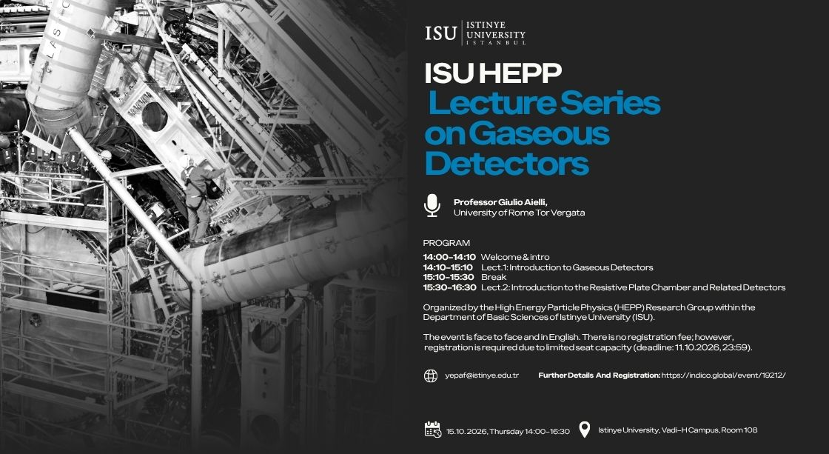

Slide 2
About the speaker
Professor Giulio Aielli is a faculty at the Physics Department of University of Rome Tor Vergata and also adjunct professor at Istinye University. He is a member of the ATLAS Experiment at CERN.
His research focuses on developing detectors capable of identifying particles produced in ultra-high-energy collisions, with a particular emphasis on RPC detectors.
He has coordinated major projects to upgrade the ATLAS Experiment and is investigating new technologies -offering greater precision, speed, and sustainability- for future particle physics experiments.
His work combines fundamental research, technological innovation, and the training of young researchers.

Slide 3
