Slide 1
Time-based Computed Tomography - a possible new approach to CT
M. Campbell^{1,2}, S. Huotari³, M. Kalliokoski², L. Tlustos^{1,4}
¹ CERN, ² Helsinki Institute of Physics, ³ University of Helsinki, ⁴ IEAP CTU, Prague
Notes:
I am going to talk about the hybrid pixel detector readout chips that have been designed at CERN in the framework of the Medipix2 and 3 collaborations.

Slide 2
Outline
Inspiration and context
      - Nanovision development
      - First photon study by Saphörster et al.
- Varex imaging MBX white paper
Concept
Status

Slide 3
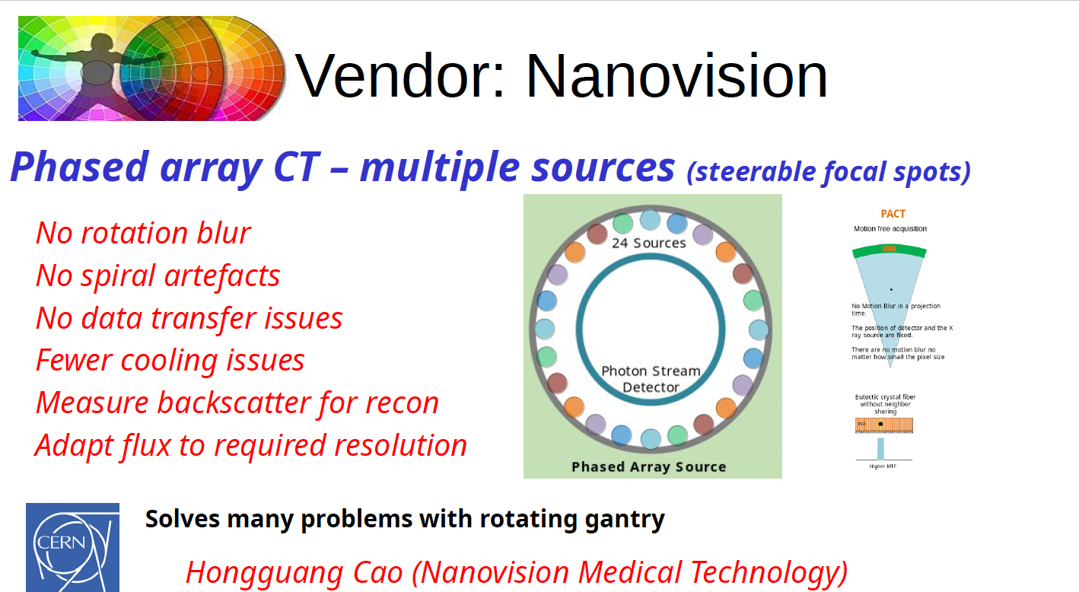
Fixed gantry CT
A. Butler, specxray workshop summary 2026

Slide 4
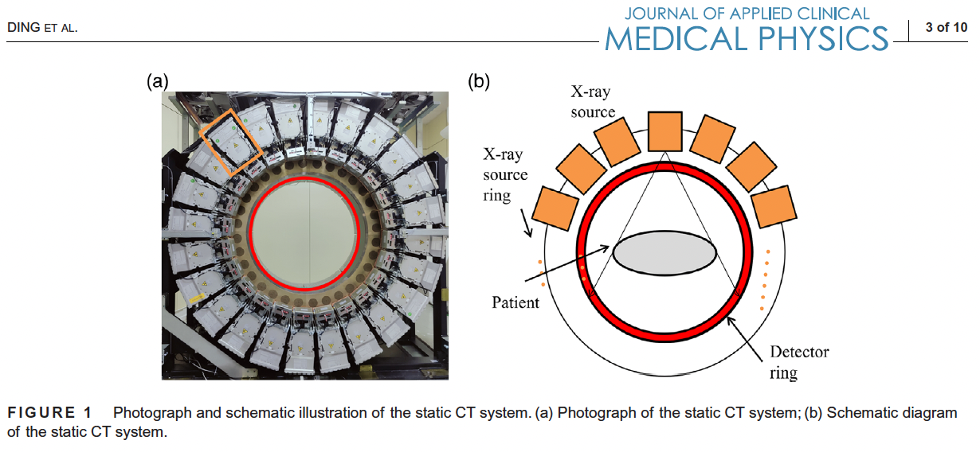
Nanovision fixed geometry CT
Ding et al. J Appl Clin Med Phys. 2026;27:e70456.

Slide 5
Key features of Nanovision system
Fixed gantry setup – no (or very few moving) parts
No need to send High Voltage signals over the slip ring
Uses pulsed thermionic (conventional) sources
KVp is also varied from shot to shot and/or source to source to permit spectroscopic imaging (70keV - 140keV) using integrating detectors
Uses a ‘streaming detector’ but does not do photon counting readout
They have built and are evaluating full clinical systems in China

Slide 6
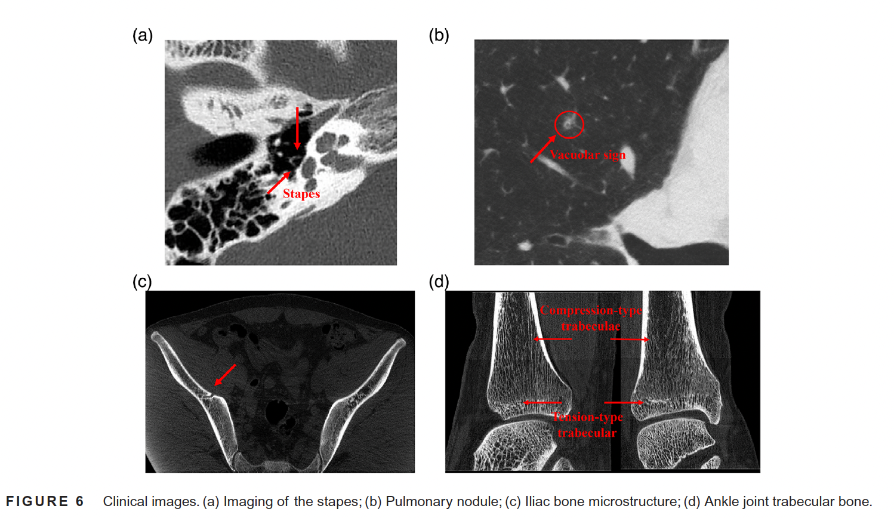
It seems to work
Ding et al. J Appl Clin Med Phys. 2026;27:e70456.

Slide 7
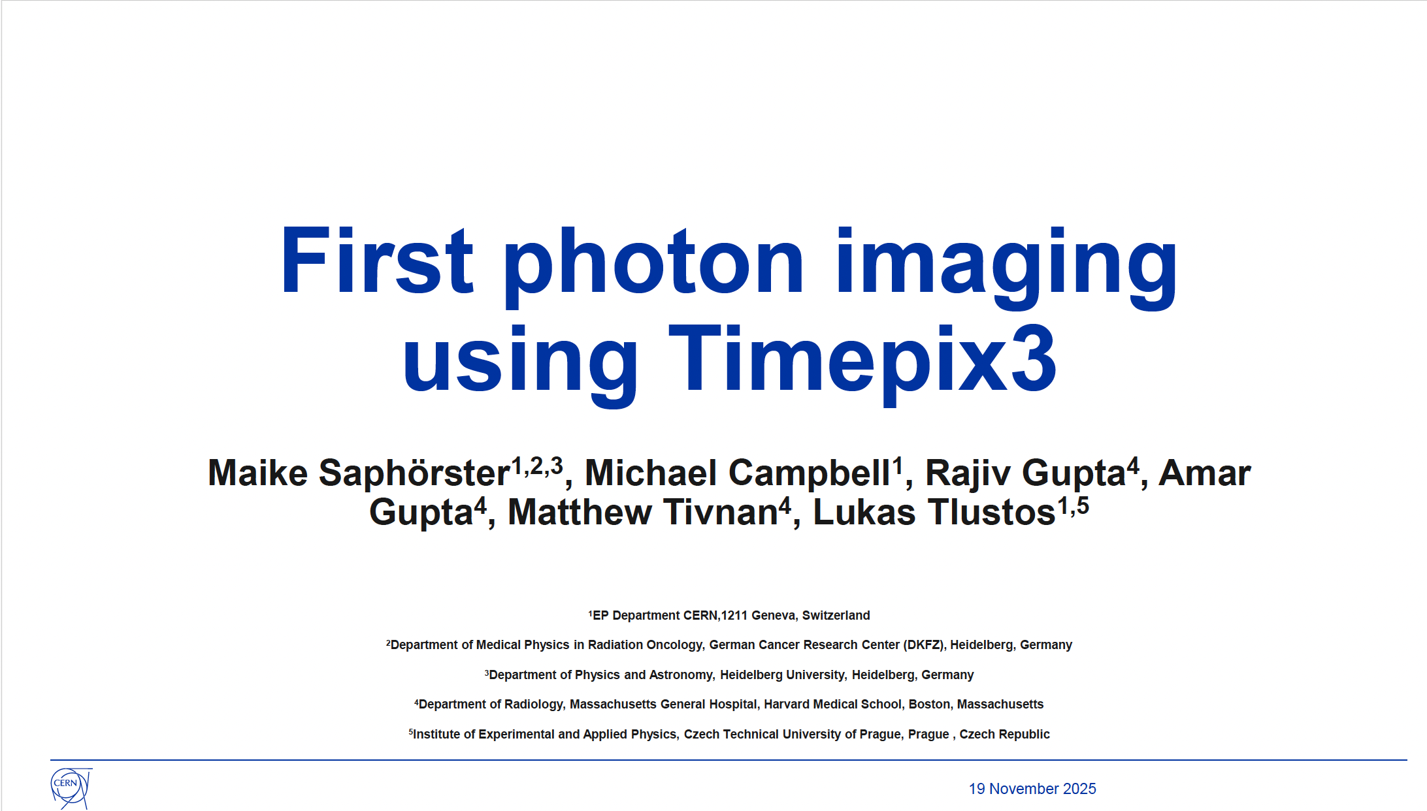
Maike’s work with Raj Gupta Group at MGH
Presentation by Maike Saphörster – November 2025 Medipix meeting

Slide 8
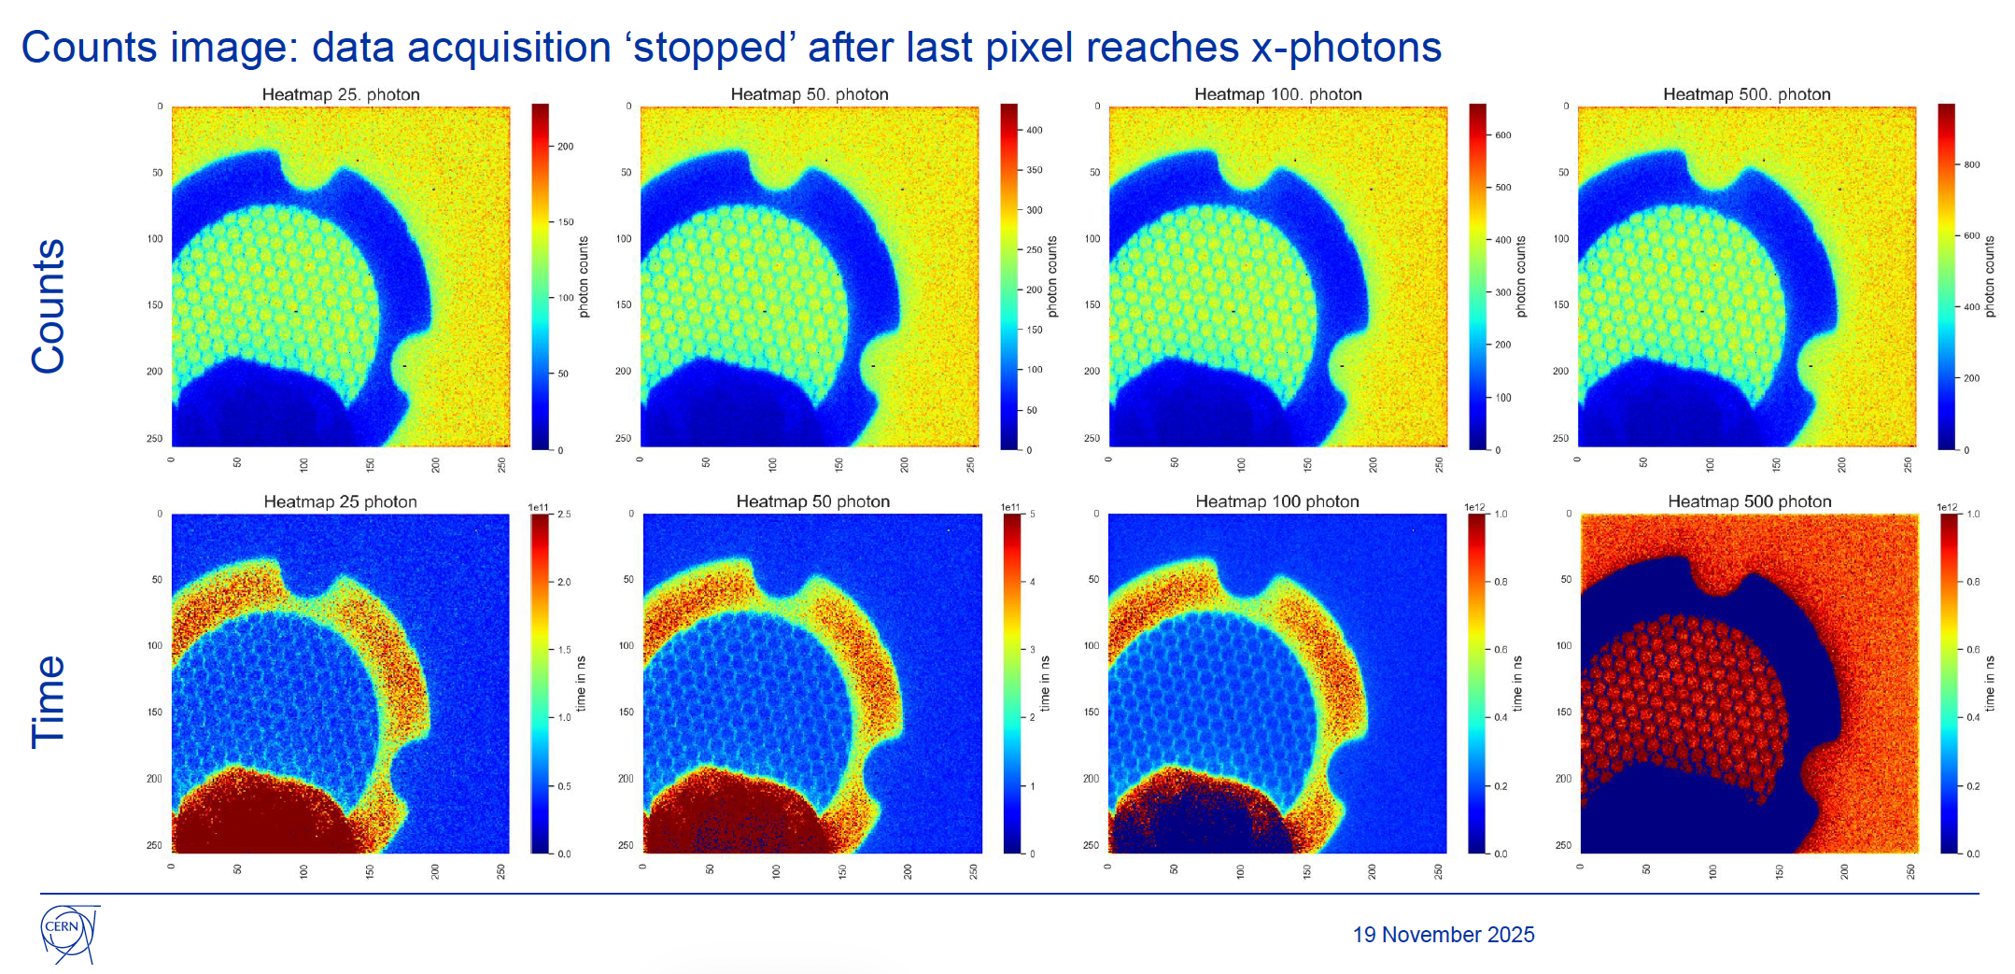
Counts versus Time
Presentation by Maike Saphörster – November 2025 Medipix meeting

Slide 9
CNT X-ray tubes - Advantages and disadvantages
Cold cathode – no DC current – low power
Can be pulsed at high speed and frequency < μsec pulses
Can be physically small
Limited maximum current output
A number of small-scale suppliers are active

Slide 10
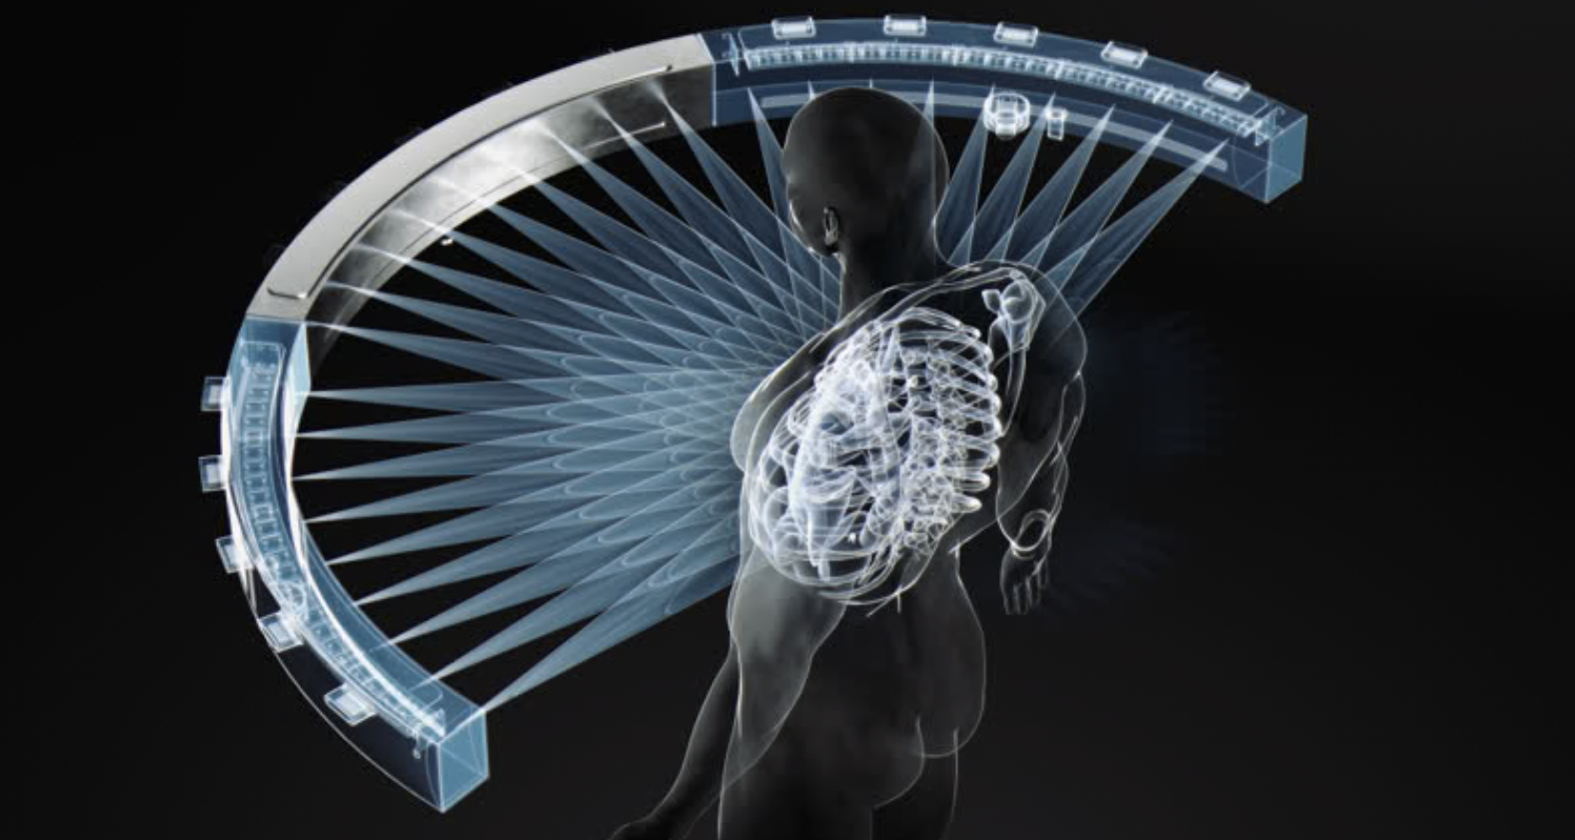
Varex Imaging white paper
REPLACING MECHANICAL MOTION IN X-RAY IMAGING: VAREX MULTI-BEAM X-RAY (MBX) TECHNOLOGY
30 June 2026
https://www.vareximaging.com/news/replacing-mechanical-motion-in-x-ray-imaging-varex-multi-beam-x-ray-mbx-technology/

Slide 11
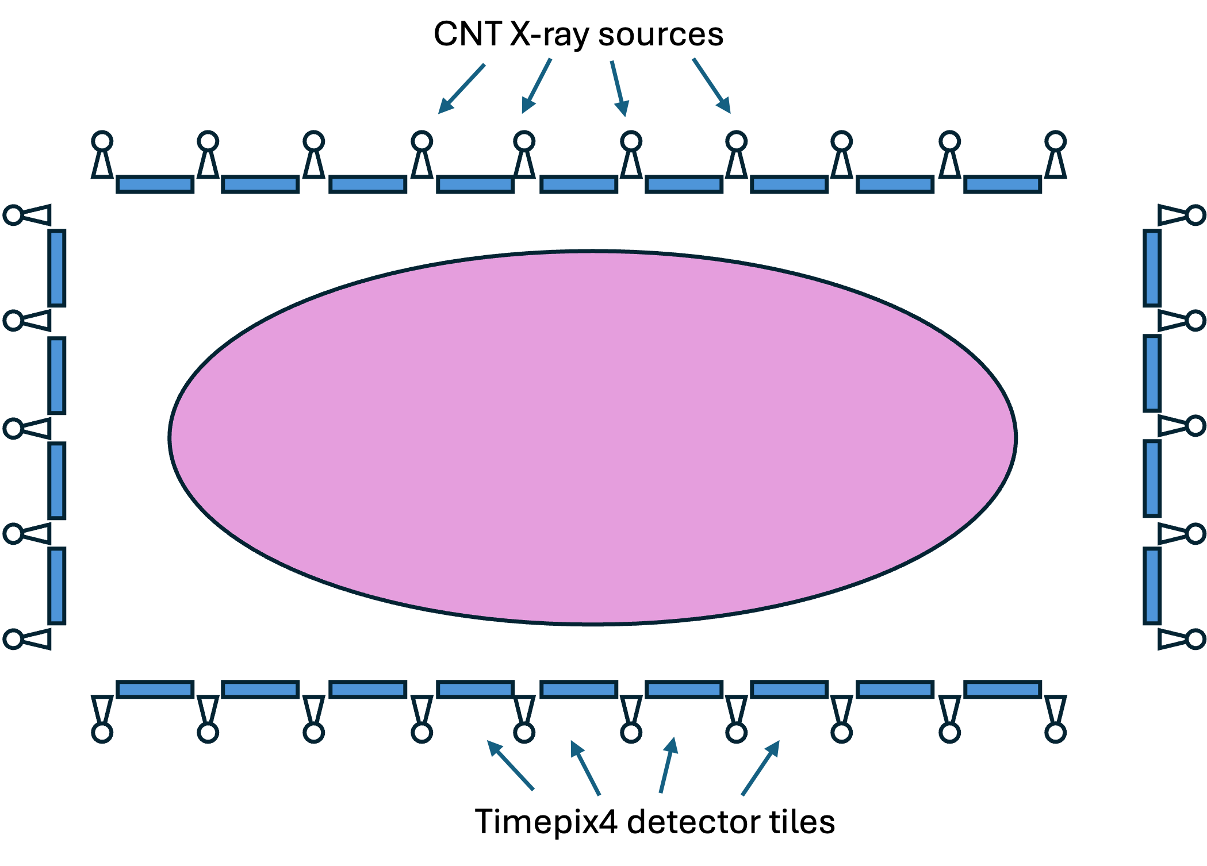
T-bCT concept

Slide 12
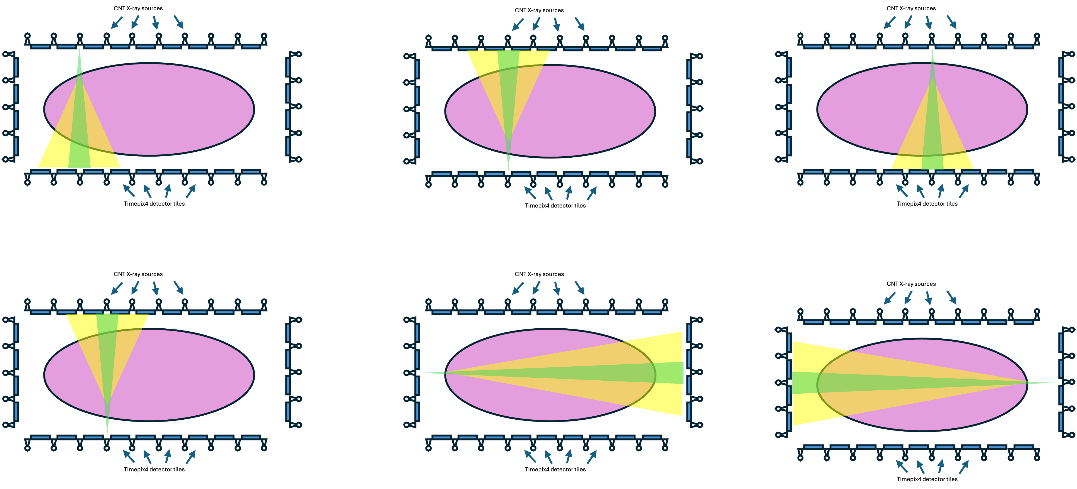
T-bCT concept

Slide 13
Potential benefits - technical
For every photon arriving at the sensor as much information as possible is extracted: arrival time – which indicates source position, as well as deposited energy
Where photon counting can be thought of as adding the energy dimension to x-ray CT, T-bCT adds another dimension, time
Completely novel geometries can be envisaged
Sub pixel resolution may even be possible offline
No image blurring because of the rotating gantry
Pile-up at the pixel level no longer becomes an issue improving spectral fidelity even in hot pixels
Scattered and direct beam can be (mostly) well separated. Scattered radiation may be used in the reconstruction

Slide 14
Potential benefits - clinical
Possibility of very short frame times and/or super high-resolution images per projection
Possible development of protocols adapted by patient and by organs to be imaged
Precise perfusion imaging
Pulse intensity can be modified on-the-fly for optimised dose
Dose reduction due to more efficient use of photons
Motion artefacts due to gantry movement eliminated

Slide 15
Potential drawbacks
A large number of sources and detectors may be costly in the beginning
How precisely in time can the sources be pulsed and at what uniformity for short pulses?
How long will it take to accumulate enough statistics per pixel?
Huge amounts of data will need to be processed, but perhaps ML/AI techniques could play a role

Slide 16
What they said about photon counting circa 2011
Photon counting is impossible
  Too difficult
  Too expensive
  There was even one publication demonstrating that it was pointless
Even if it could be achieved technically it wouldn’t add any value diagnostically

Slide 17
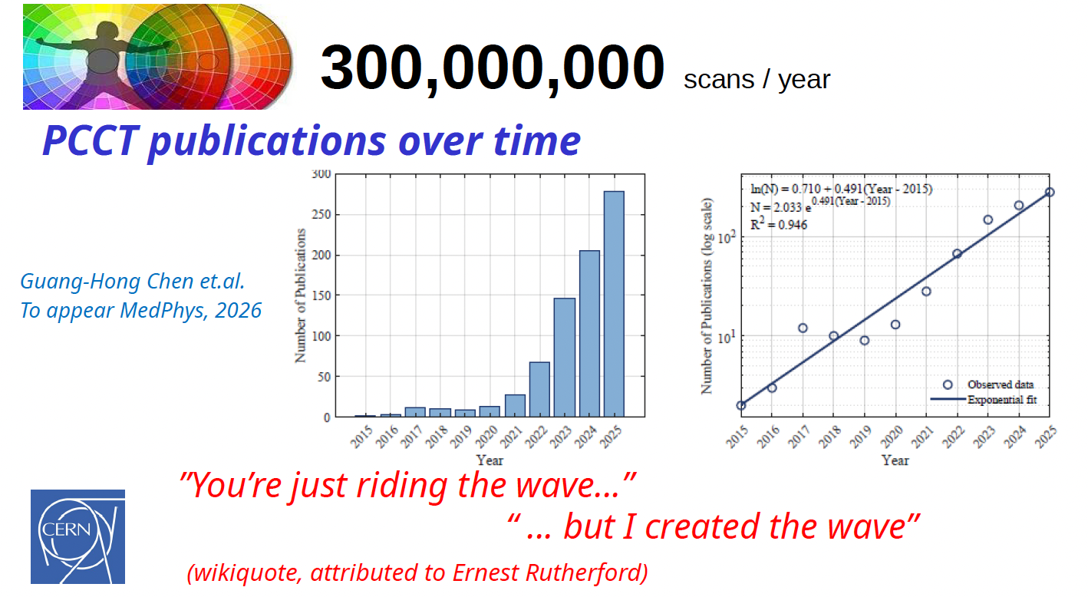
Photon counting status in 2026
Over 3.5M patients have been scanned with the Siemens Naeotom Apha
A. Butler, specxray workshop summary 2026
“The introduction of photon counting detectors to clinical practice will modify patient pathways in such a profound way that in my opinion the textbooks for radiologists may have to be rewritten” Quote from a senoir medical physicist

Slide 18
T-bCT status
Current project plan – proof of principle
  GEANT/Allpix/GATE (?) simulations
  Reconstruction
  Measurements with Timepix3
If funding can be found
  Selecting/procuring sources
  Procuring detectors
  Build single source detector prototype
  Built small multi-detector source prototype

Slide 19
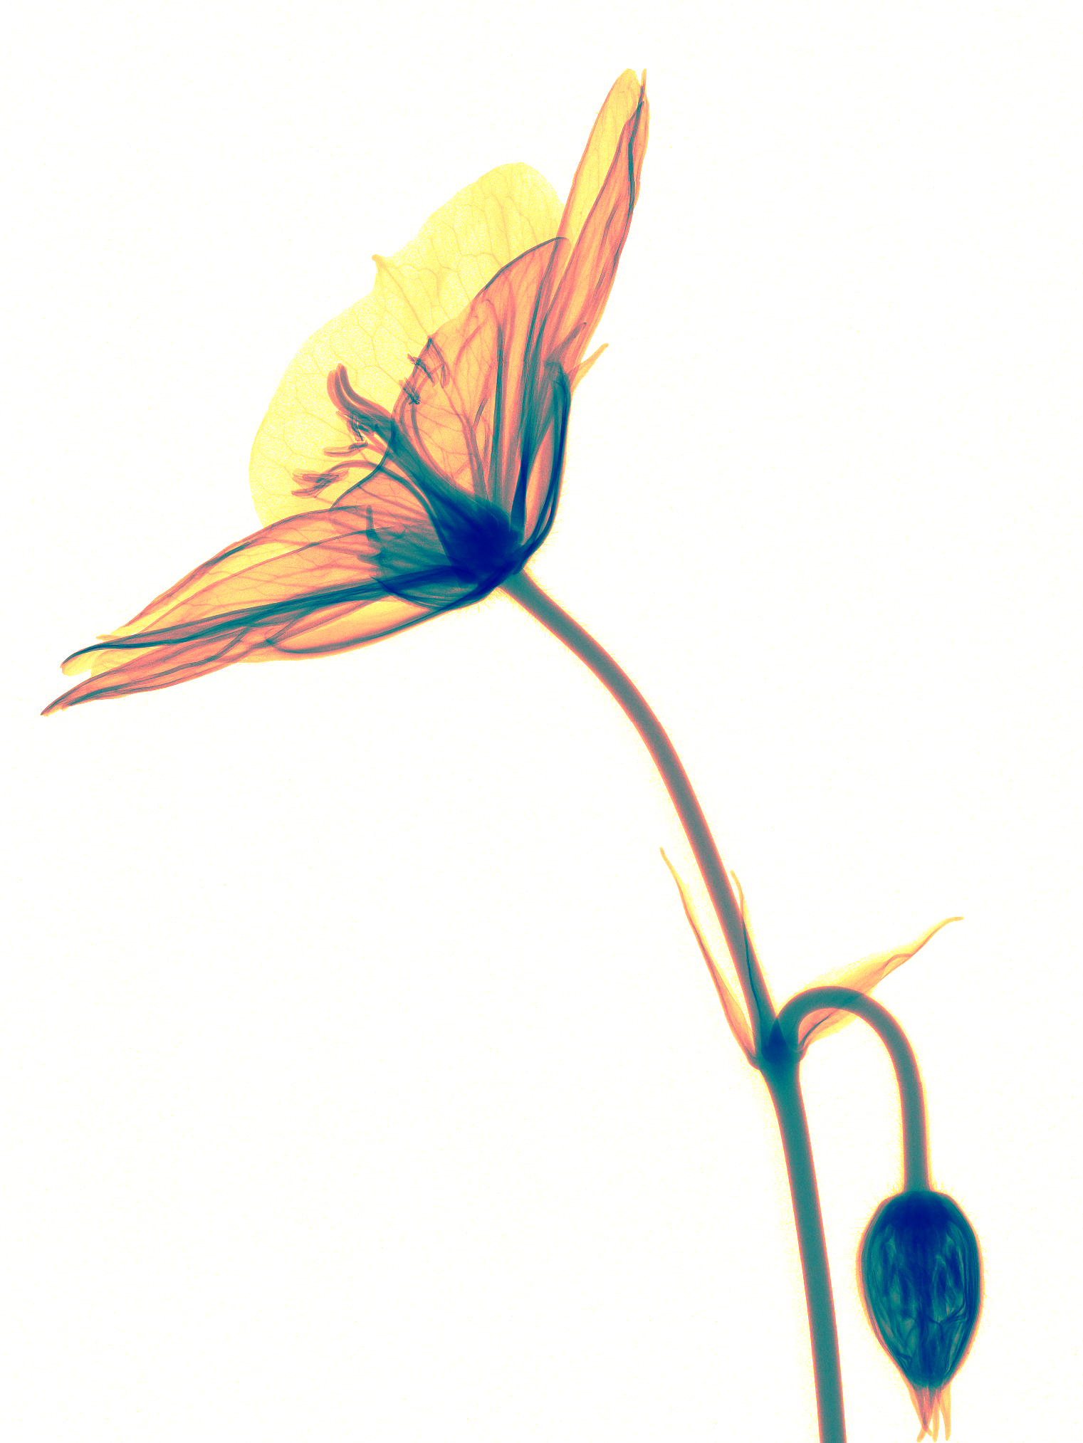

Thank you for your attention!
Medipix3RX images: S. Procz et al.

