Slide 1
GEM-Timepix detector for MoEDAL

Slide 2
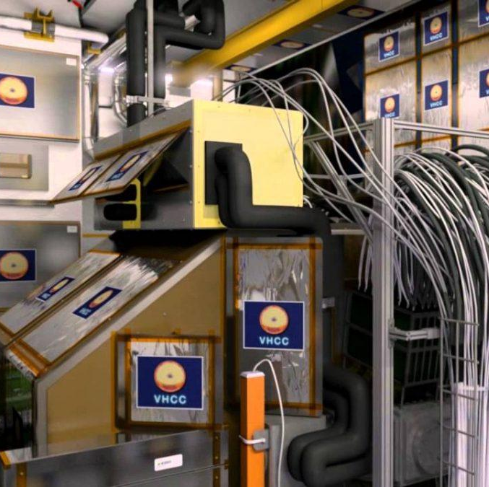
MoEDAL detectors
For Runs 2 and 3 the MoEDAL experiment consisted of NTDs, MMTs and some Timepix detectors
For Run4 the planned luminosity will increase at least by factor 5
This will increase the radiation background
New detectors that can be adjusted to cope the changes are proposed

Slide 3
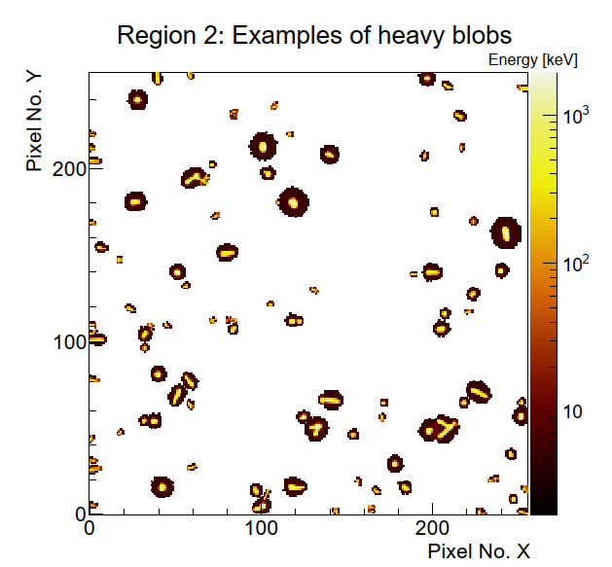
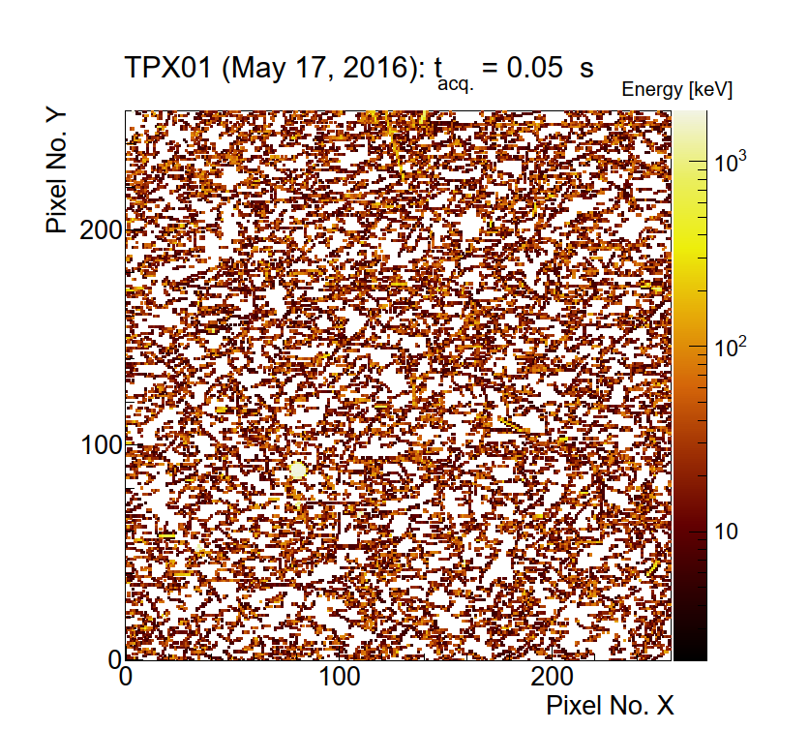
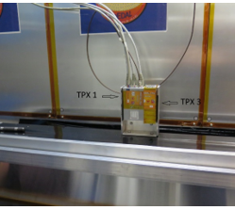
Timepix detectors at MoEDAL
Timepix detectors have been used in the MoEDAL experiment for background radiation measurements.
Several detectors have been installed at selected locations.
The detectors are capable of monitoring changes in the radiation environment throughout the experimental runs.
B. Bergmann et al., arXiv:2605.05936

Slide 4
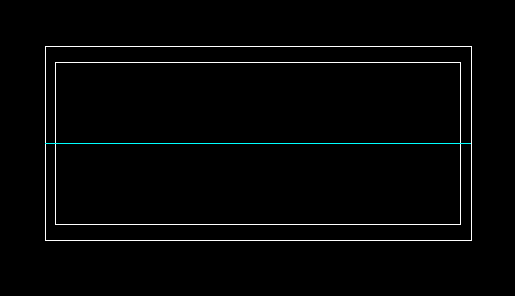
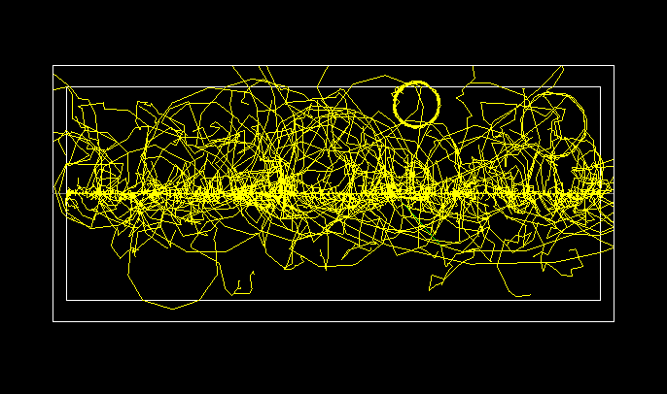
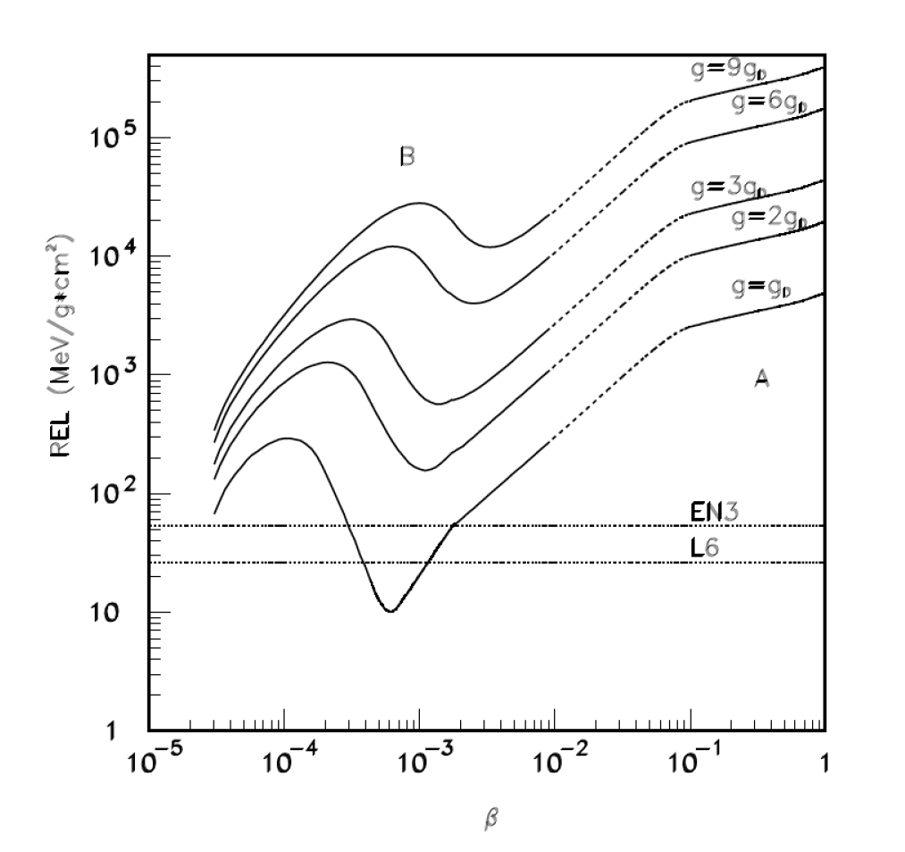
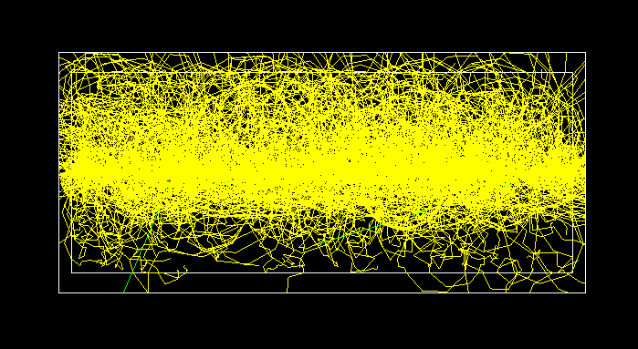
Charge deposition from highly ionizing particles
The properties of the enclosure have been studied using Geant4 simulations.
The background radiation is simulated using Pythia8.
Magnetic monopoles and other exotic particles are simulated using optimized classes from the SUMMA software.
The response of the GEM stage and the charge collection process are simulated using Garfield++.
Proton
In average, 4 secondary electrons / particle
Mean energy deposition 5 keV/mm
⁸²Pb⁸²⁺
In average, 11 000 secondary electrons / particle
Mean energy deposition 1.4 MeV/mm
1 TeV monopole
In average, 67 000 secondary electrons / particle
Mean energy deposition 6 MeV/mm
Restricted energy loss of magnetic monopoles
Int. J. Mod Phys. A 29 (2014) 1430050.

Slide 5
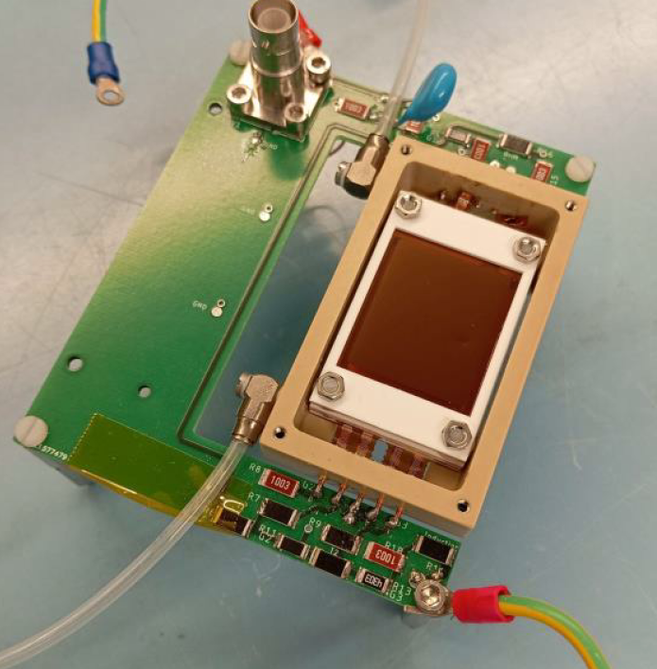
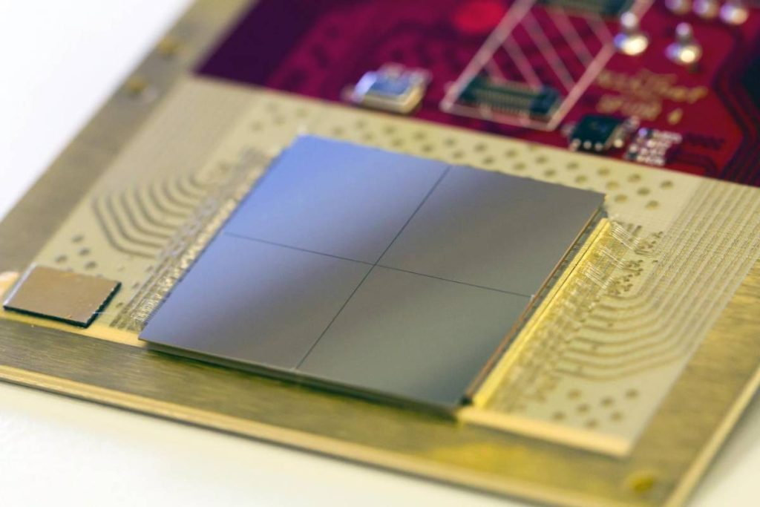
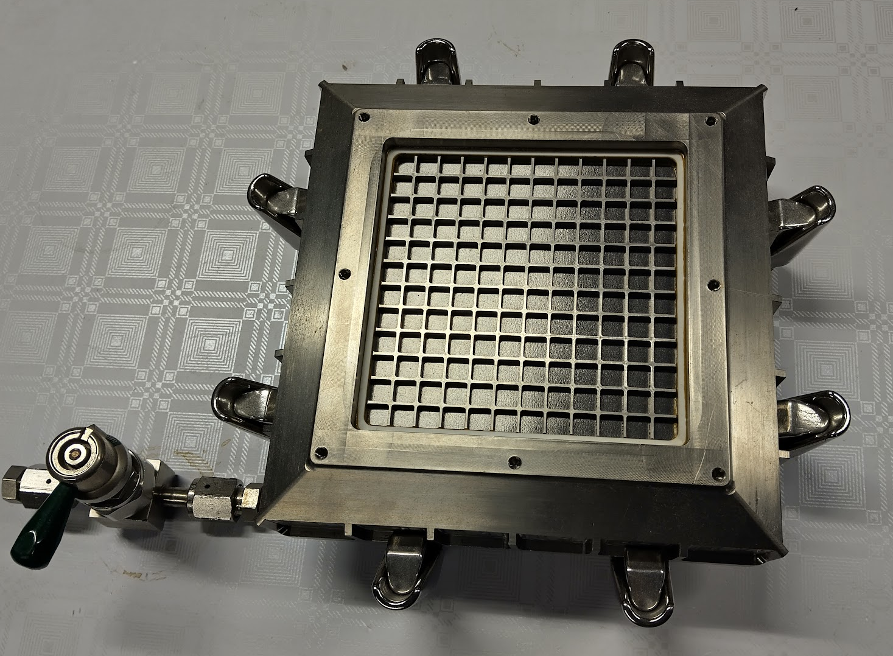
Planar GEM-setup
Since Timepix4 allows multiple chips to be placed next to each other, a straightforward approach would be to build a large-area detector using multiple chips.
A standard triple-GEM setup could be placed on top of the sensors.
This configuration can be scaled to cover large areas.
  However, it would require a relatively large number of Timepix4 chips.
L. Scharenberg et al, MPGD 2024: https://indi.to/GVhSF
Corresponding paper: https://doi.org/10.1088/1748-0221/20/03/C03025
Triple-GEM detector developed at HIP.
Was able to operate months without replacement gas

Slide 6
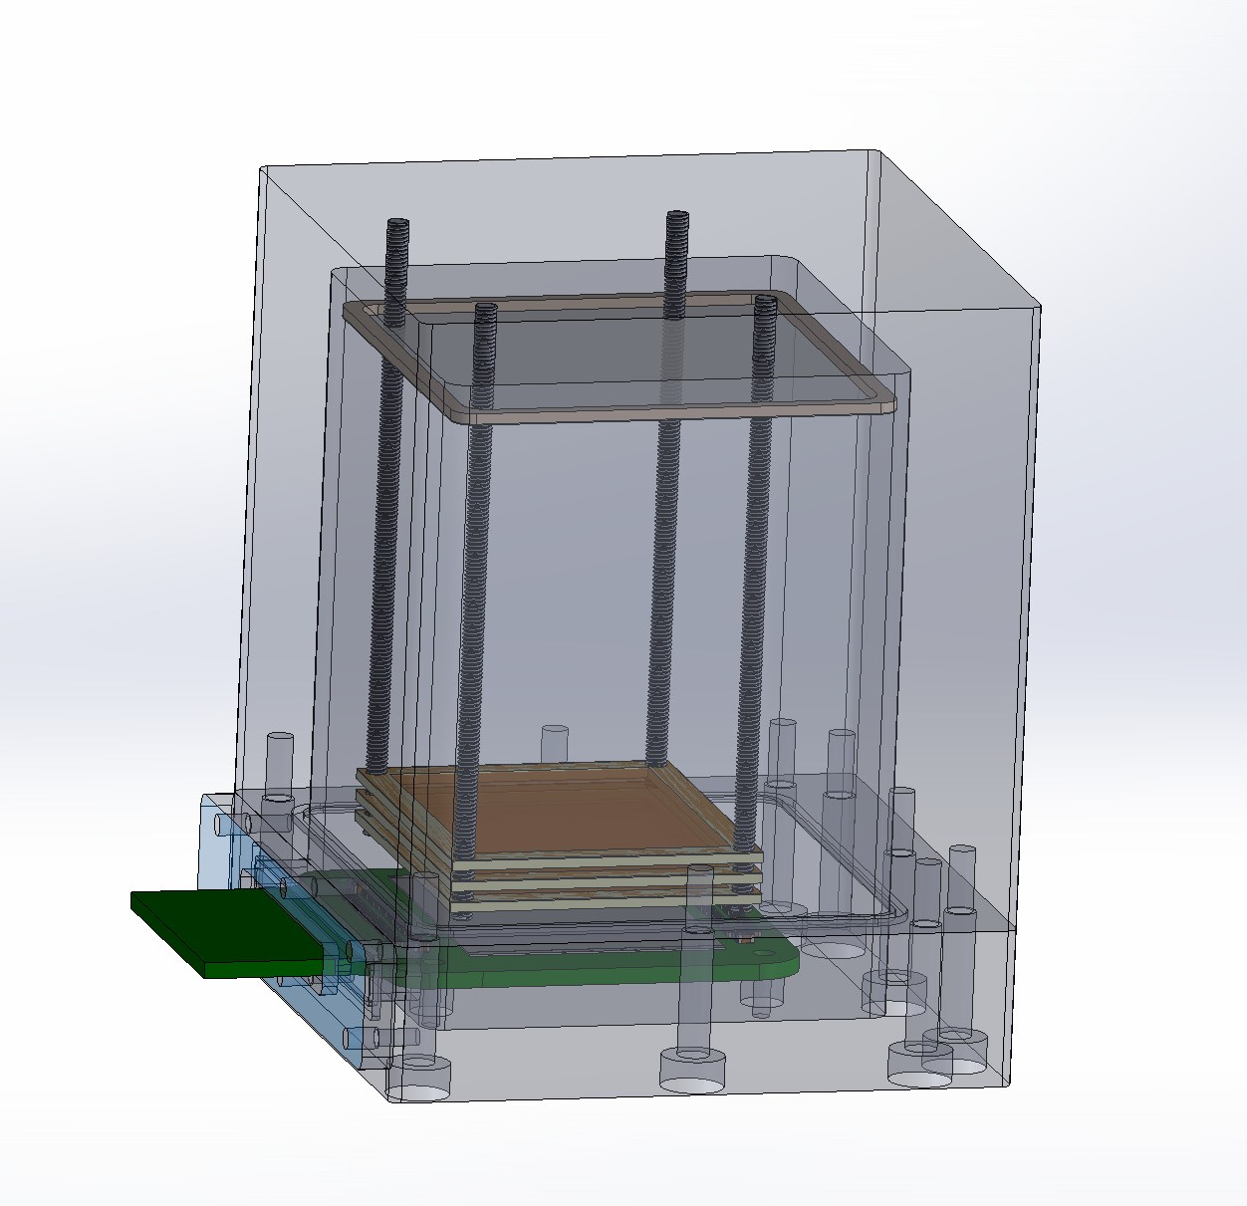
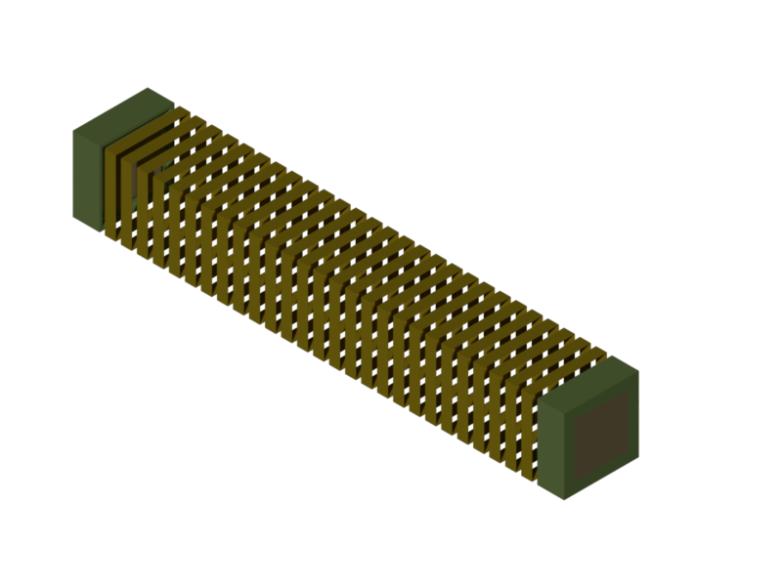
TPC type prototype design
IP8
The detector could be oriented with its side facing the IP.
A triple-GEM design will be used.
  The induction gap will be 1 cm.
  Standard transfer gaps of 1–2 mm will be used.
  A long drift volume will be used.
  The need for a field cage will be investigated through simulations.
The GEM and Timepix will be biased from opposite ends of the setup.
Gas will flow from top to bottom through sealable inlet and outlet ports.
Ar/CO₂ (70:30) will be used as the primary gas mixture.
  The possibility of adding nitrogen to the gas mixture will be investigated
5 cm
10 cm +
Two GEM-stack readout without drift foil

Slide 7
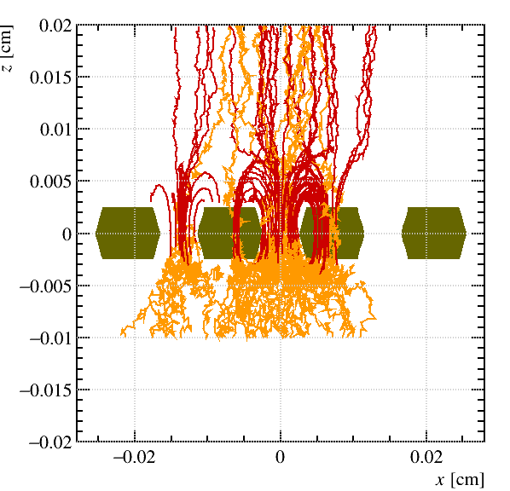
Next steps
Modify the design and print a mock-up to test the assembly
Select the components for feedthroughs
Simulation of the performance in beam tests and in MoEDAL environment
  GEM amplification

Slide 8
Low-weight Aranda-based Gamma-ray and Environmental Radiation system (LAGER)

Slide 9
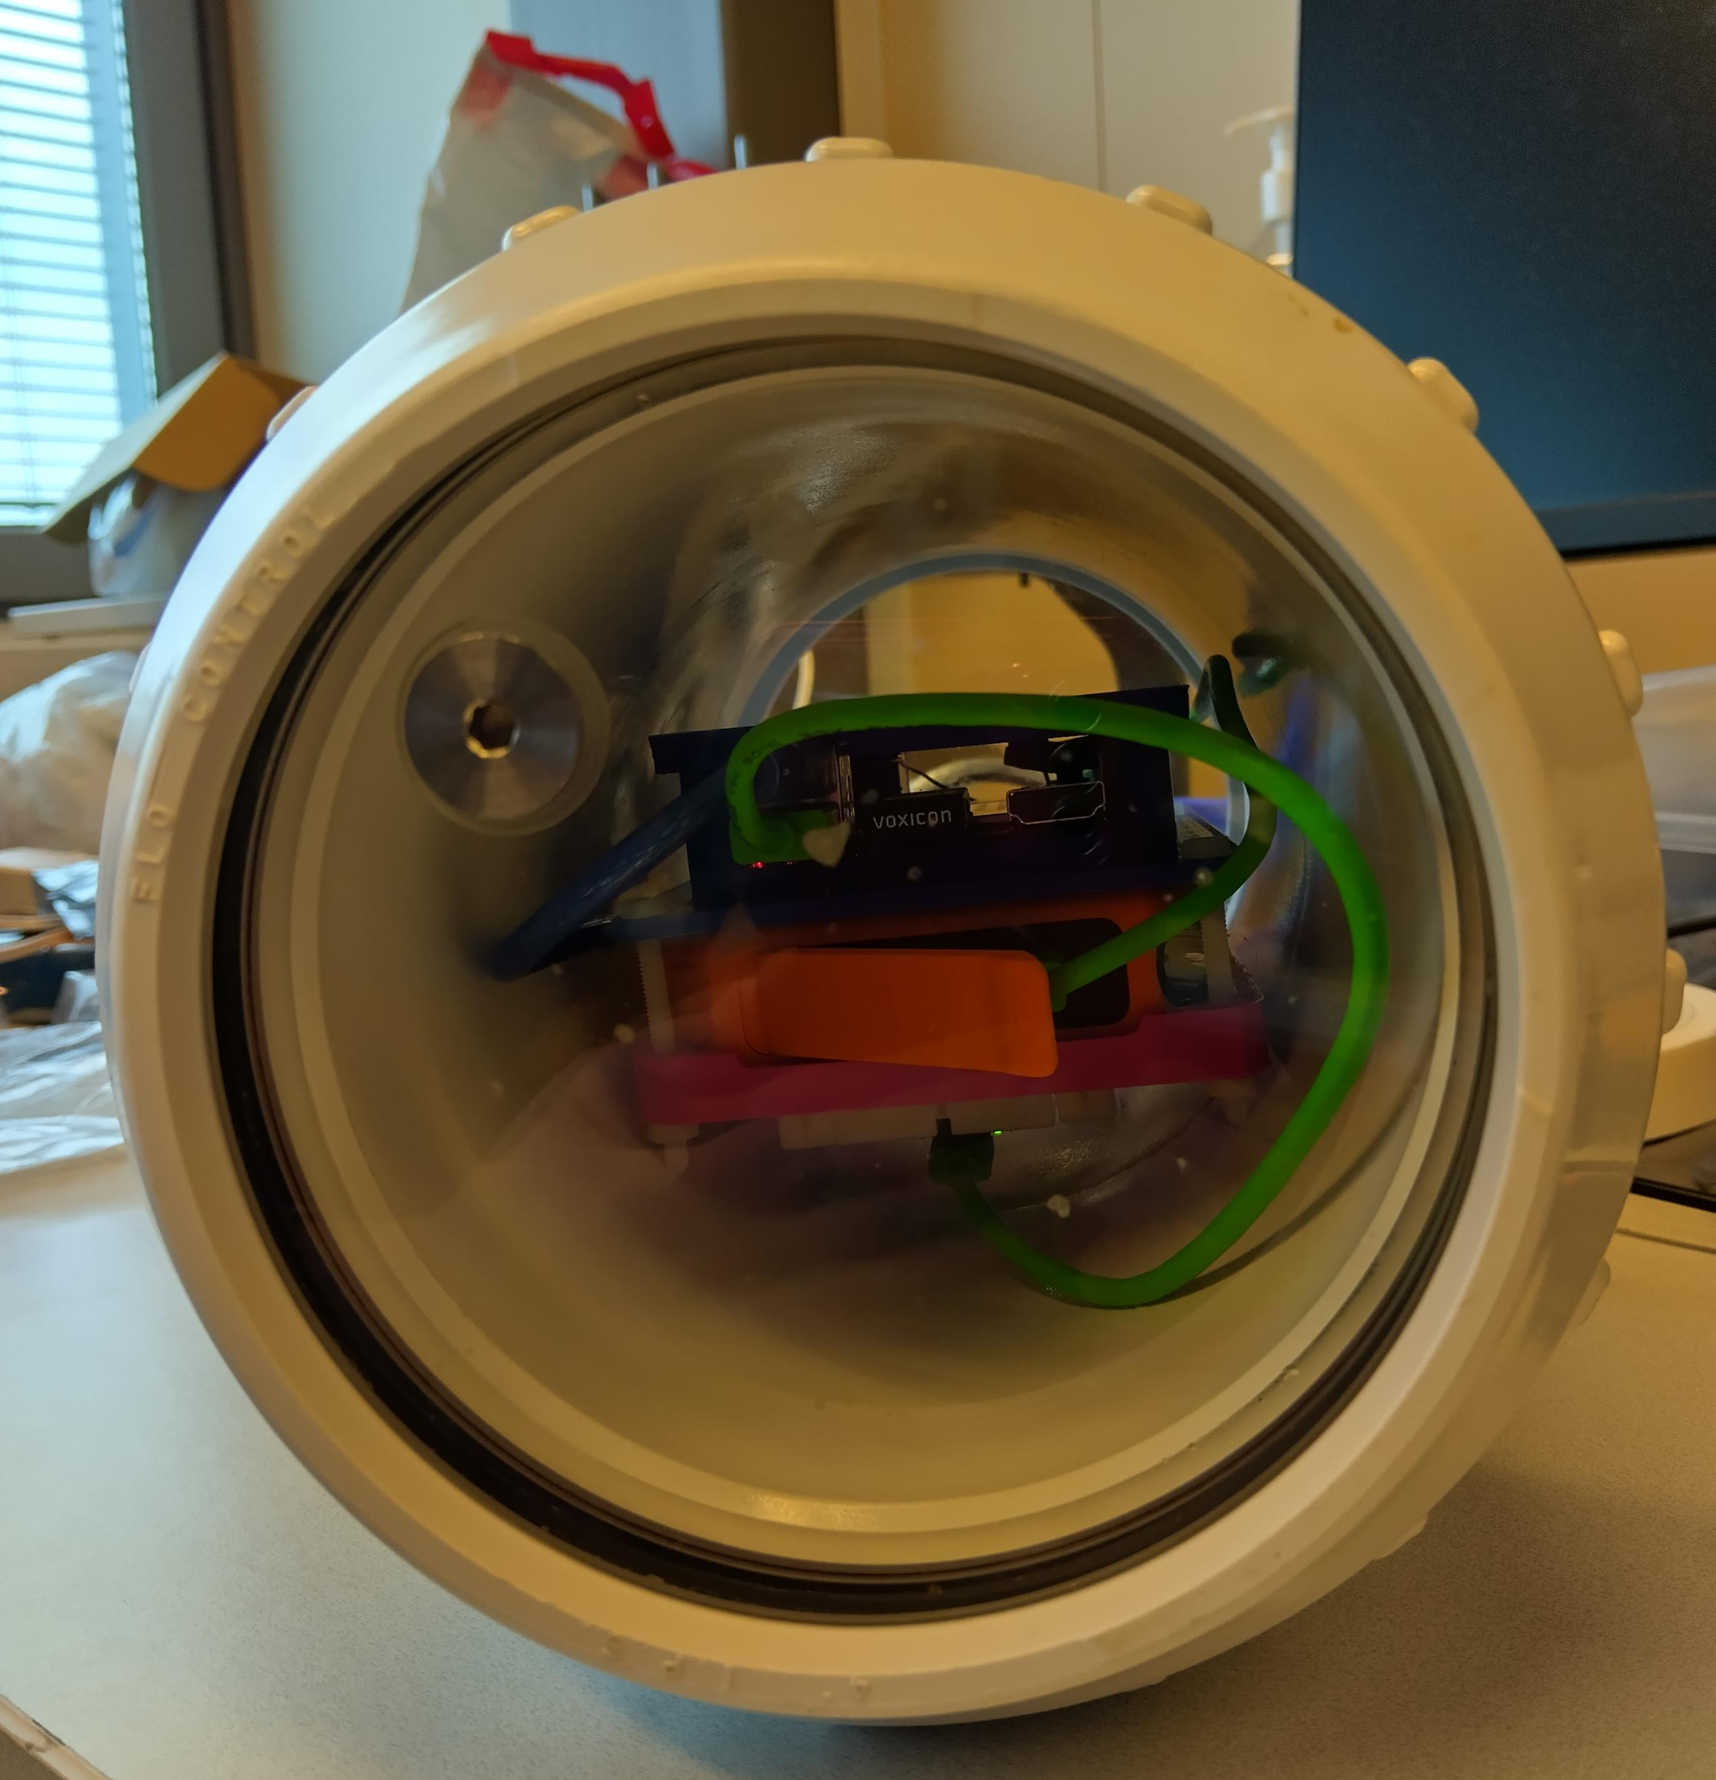
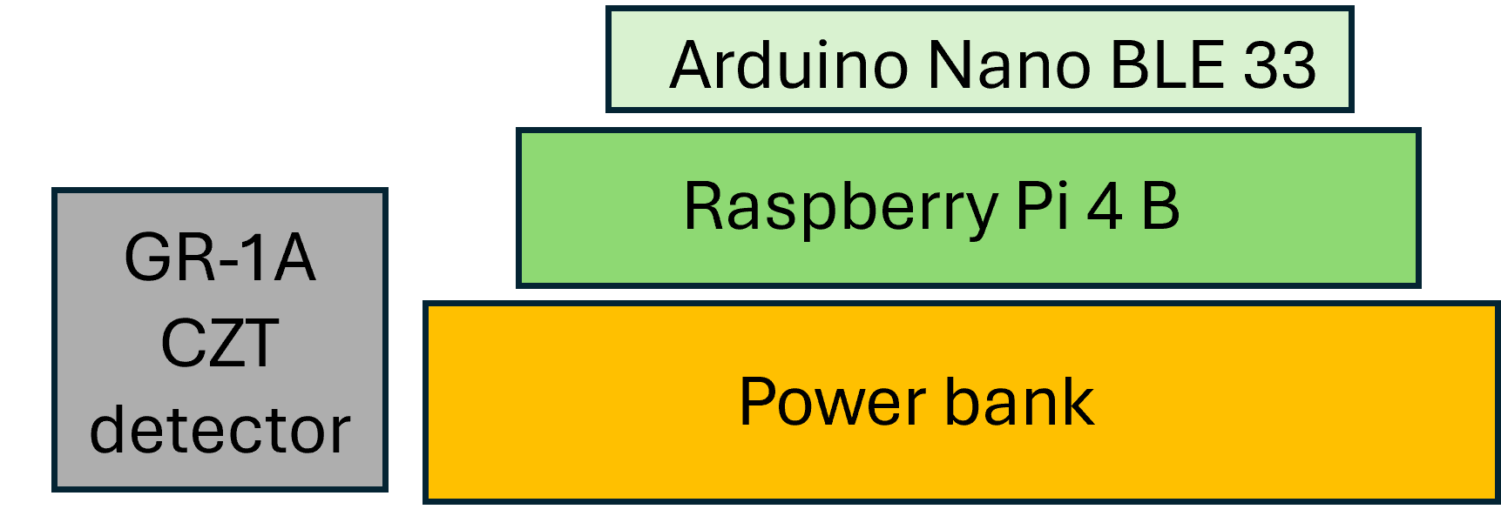
LAGER setup
Kromek GR-1A detector
  1 cm³ CZT crystal
DAQ and control through Raspberry Pi 4B
Auxilliary environmental monitoring through Arduino Nano 33 BLE Sense (Rev 2) microcontroller
  Temperature, magnetic field, pressure, humidity, accelerometer and gyroscope
Powered by a 10,000 mAh power bank
Measurement rate 1 Hz, data stored to RasPi and external USB flash drive simultaneously

Slide 10
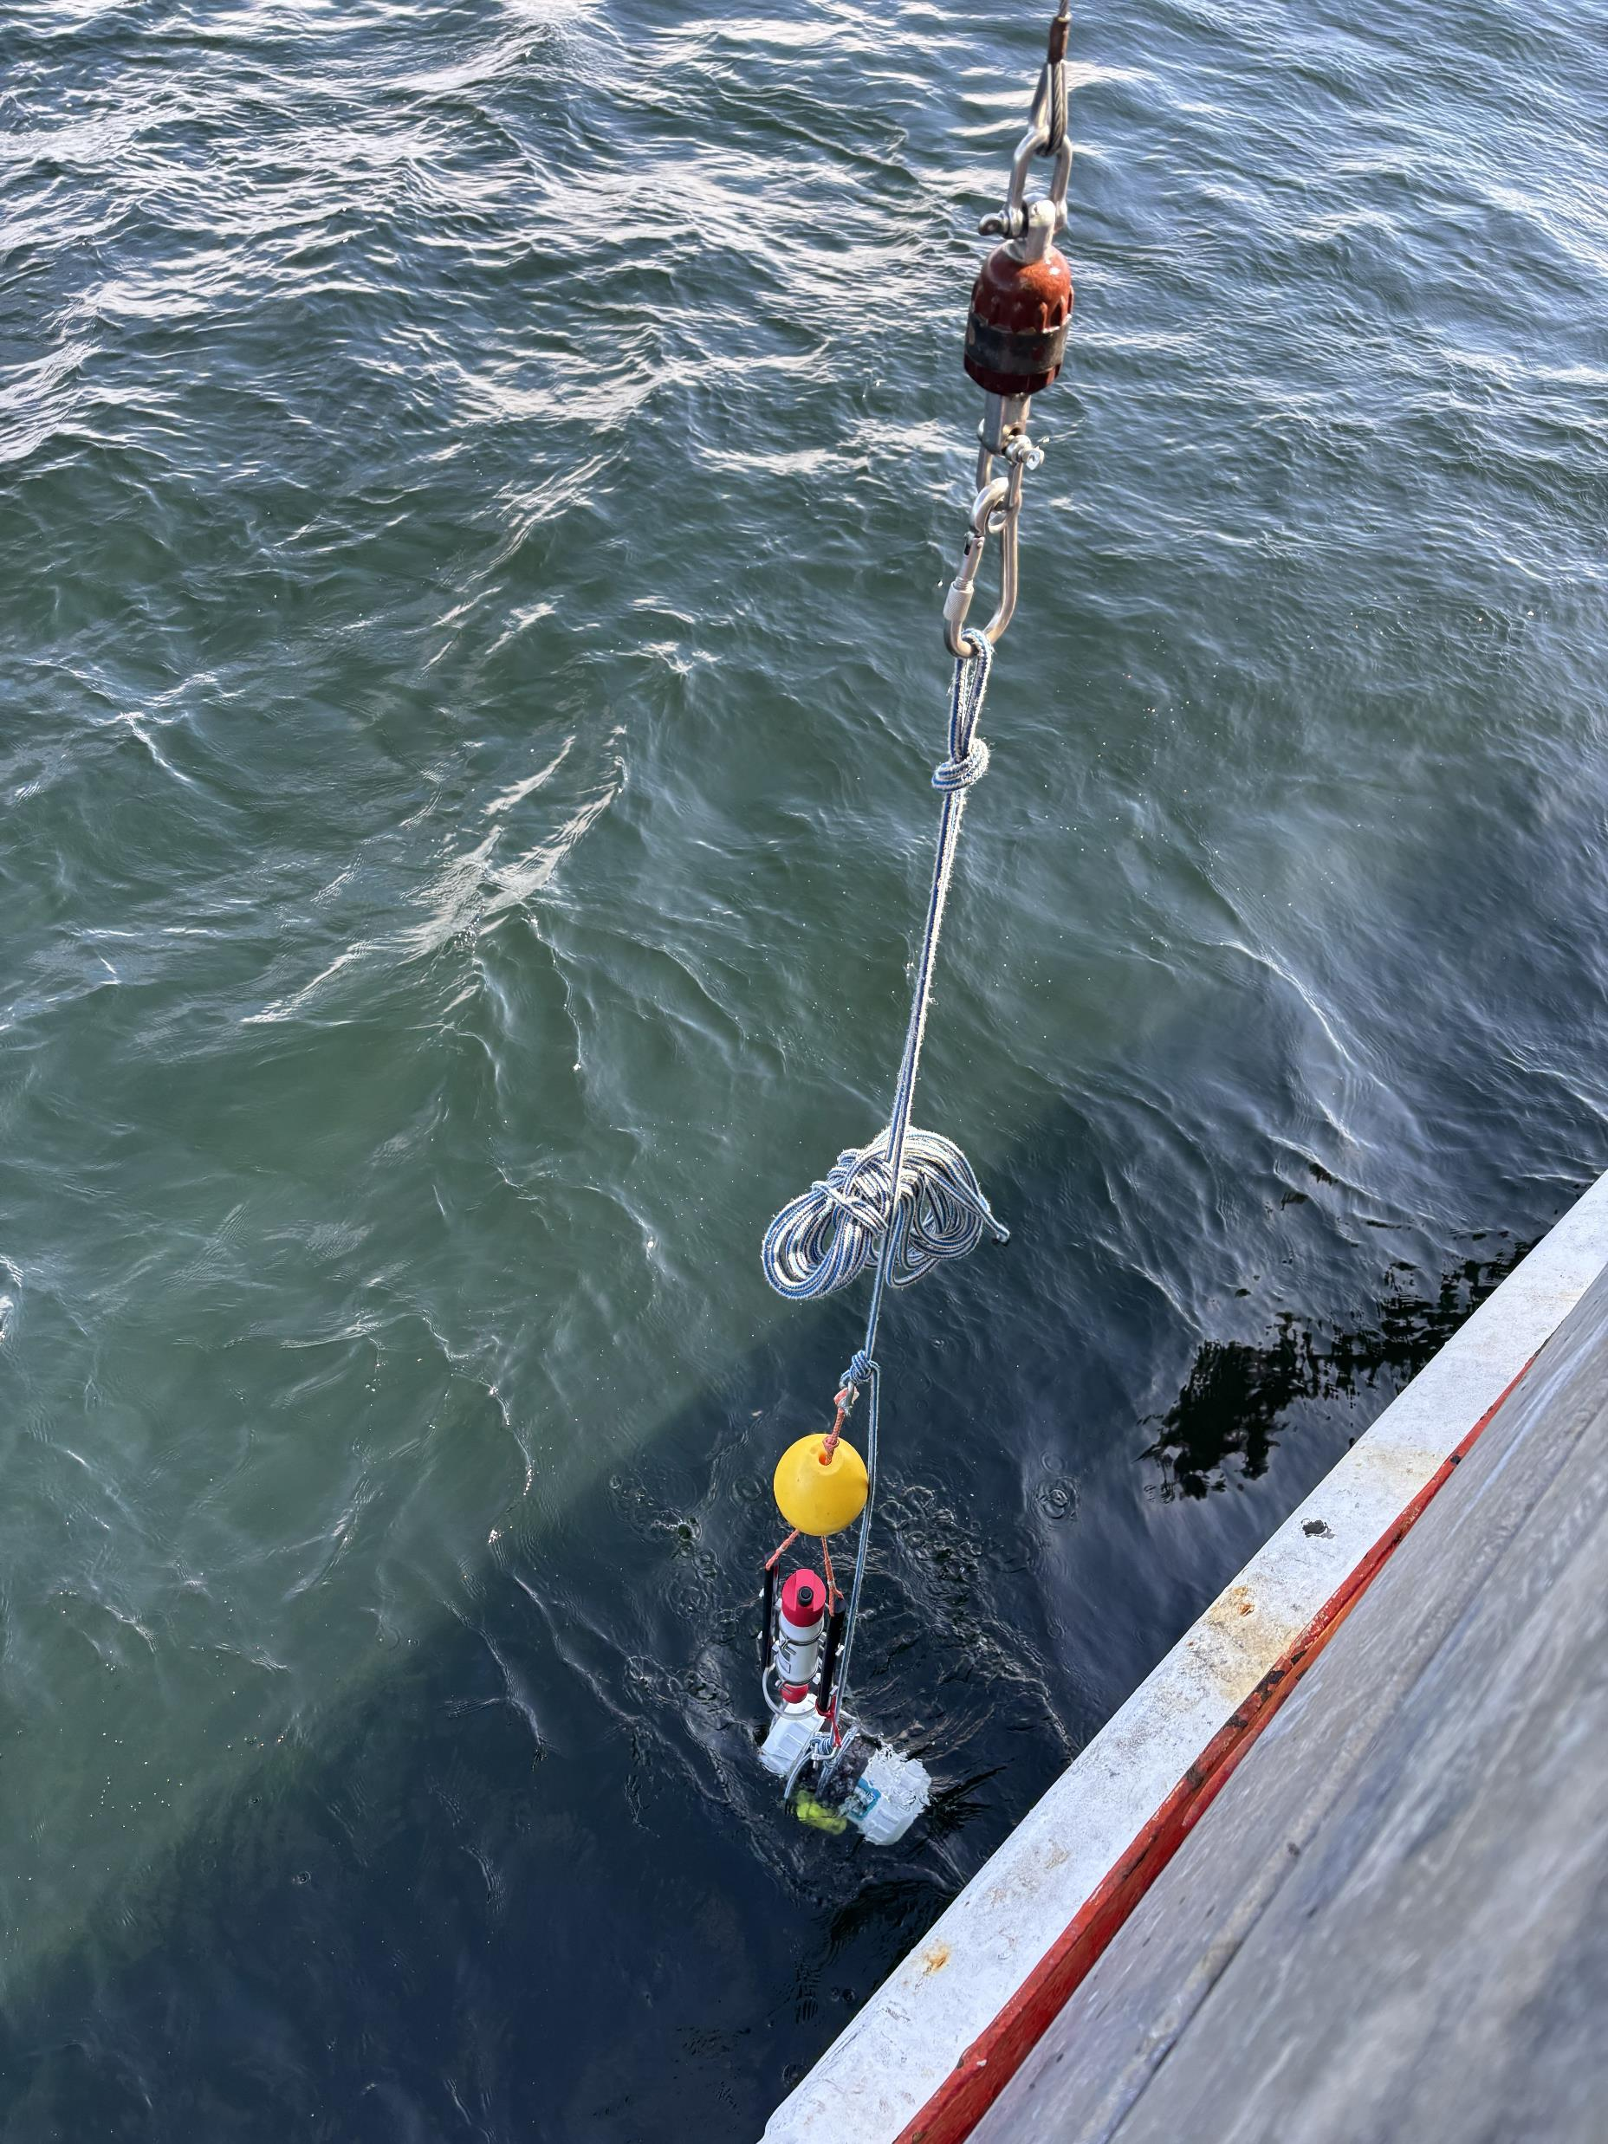
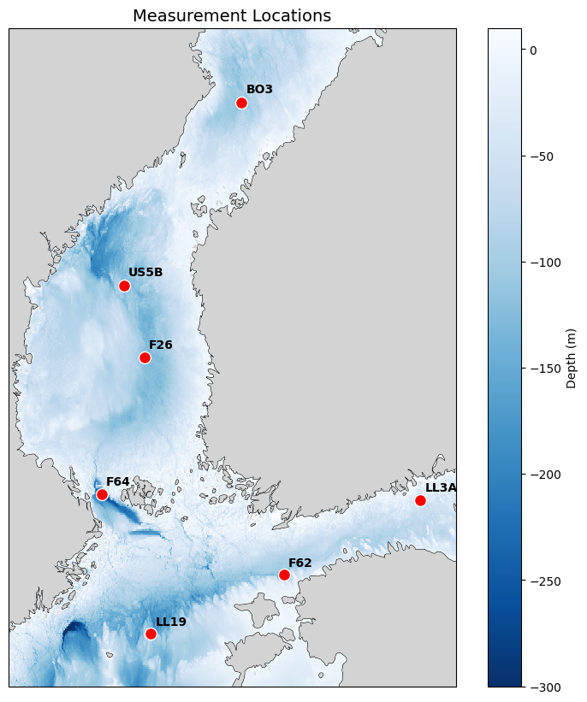
Measurements
In total 8 measurements were made
First measurement failed due to software error
  Most likely was caused by Arduino which was broken down after second measurement
Date | Station | Depth [m] | At seafloor | Duration
Apr 15 | LL3A | 69 | Yes | 99 min
Apr 16 | F62 | 95 | Yes | 60 min
Apr 17 | LL19 | 163 | Yes | 36 min
Apr 17 | F64 | 277 | No | 30 min
Apr 20 | BO3 | 109 | Yes | 46 min
Apr 20 | US5B | 221 | Yes | 32 min
Apr 21 | F26 | 138 | Yes | 15 min
Apr 21 | LL12 | 82 | Yes | 4 min

Slide 11
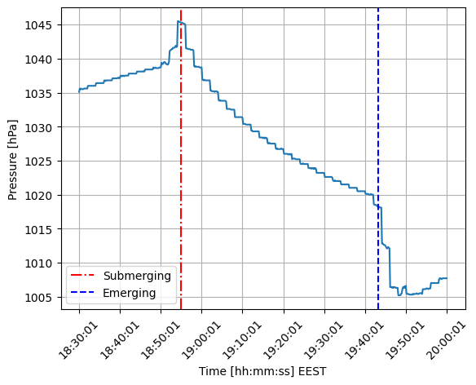
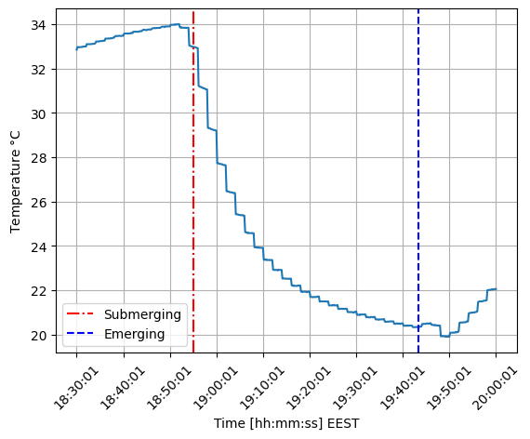
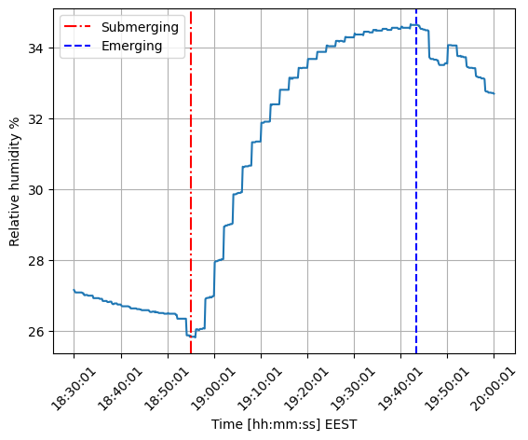
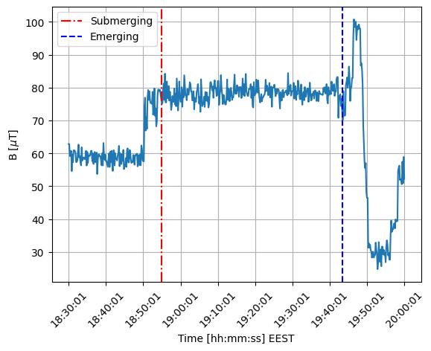
Environmental conditions
Pressure
Temperature
Humidity
B-Field

Slide 12
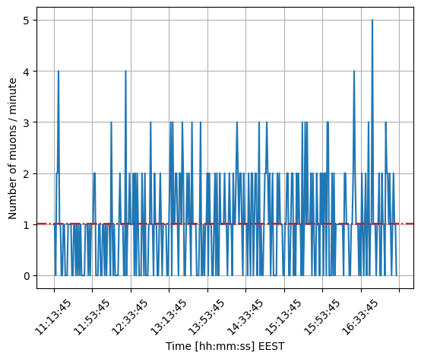
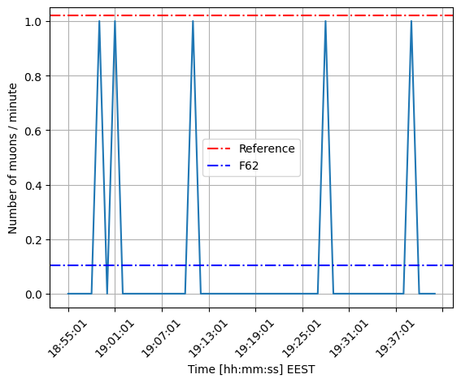
Average muon rates
Kumpula
F62

Slide 13
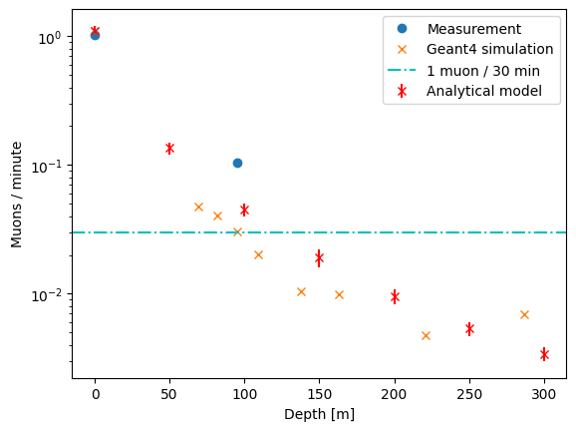
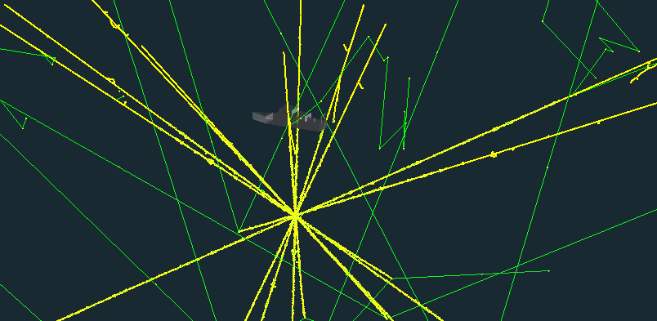
Expected muon rates
Muon rate was counted from the saturation bit of the detector spectrum
Overlying water column attenuates the muon rate in submerged detector
At depths below 100 meters no muons were expected to be seen based on the Geant4 simulations

Slide 14
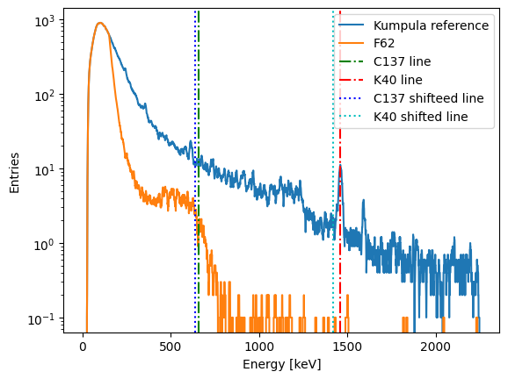
Radiation measurements
First two measurements were done together with Arduino
In addition, a Mirion RDS-32 was lowered along the LAGER setup
This created low-energy electronic noise to each measurement

Slide 15
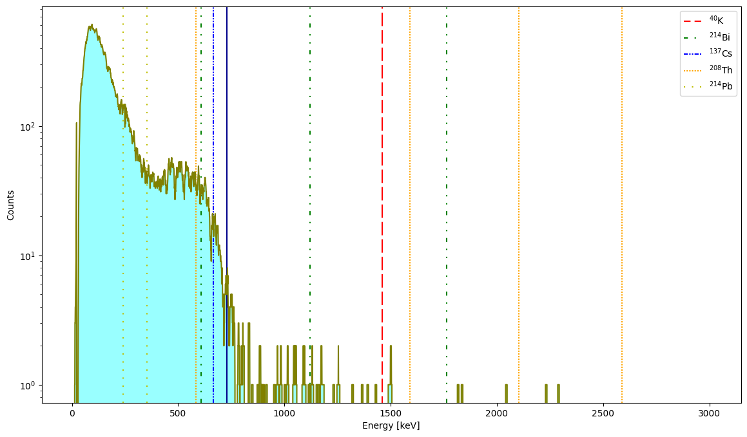
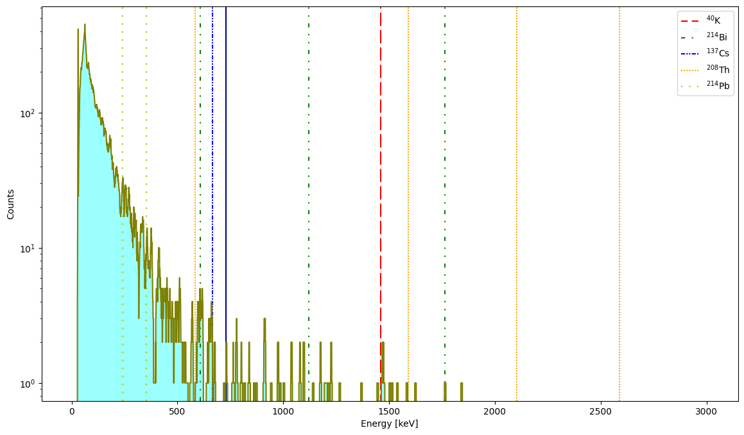
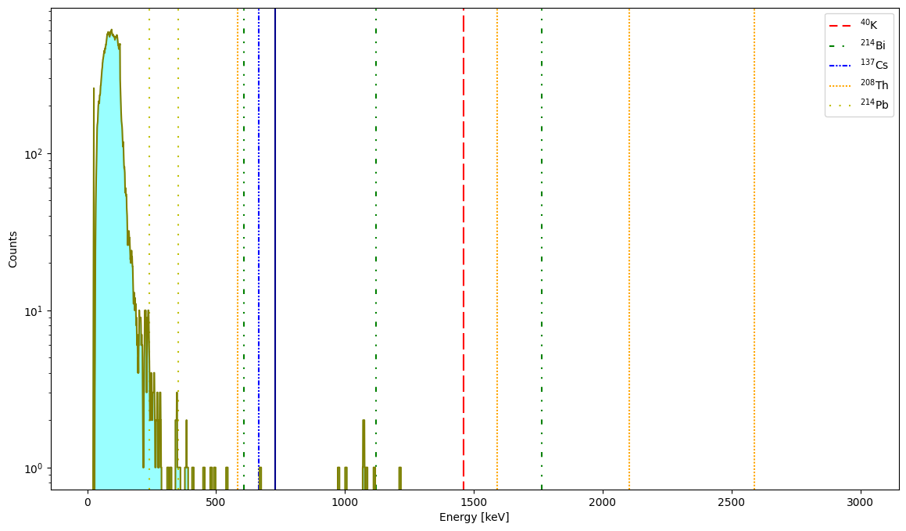
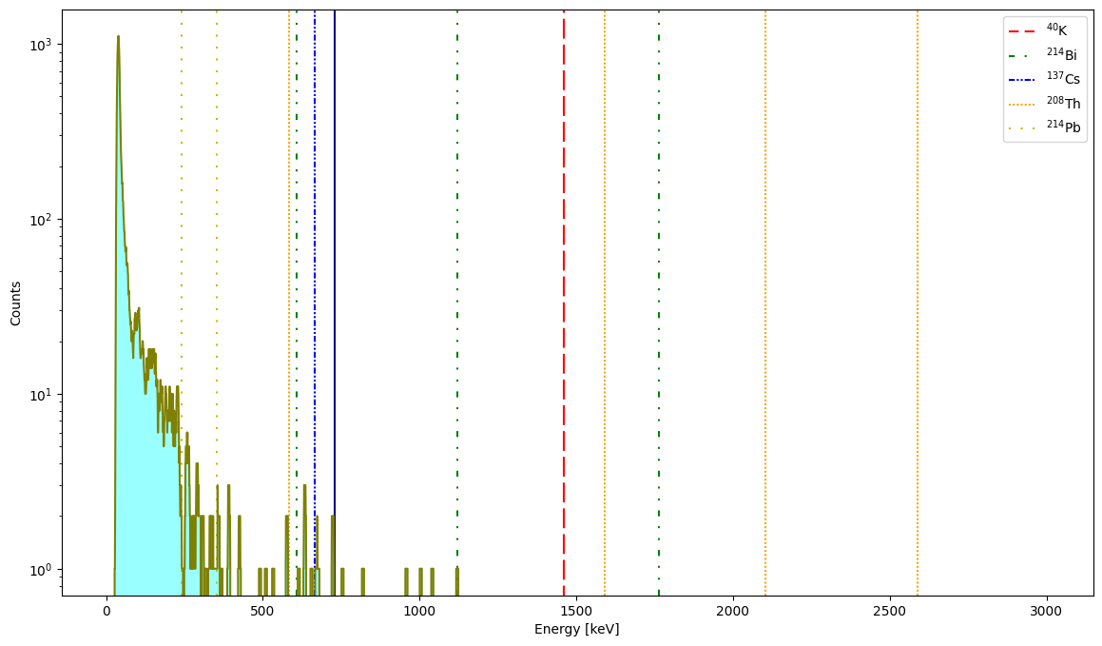
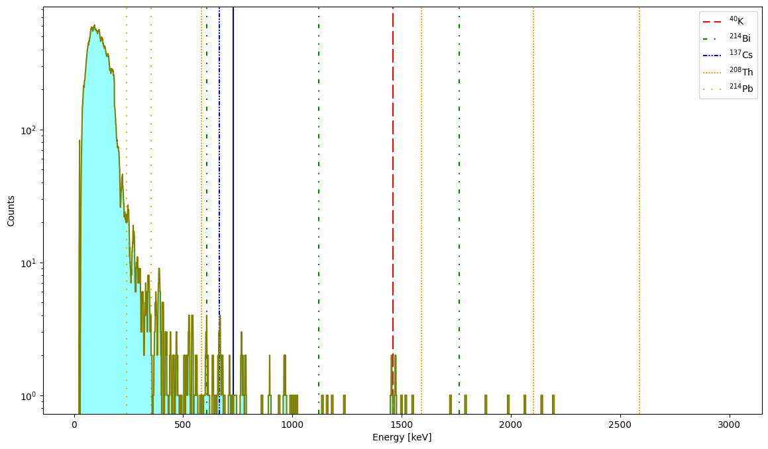
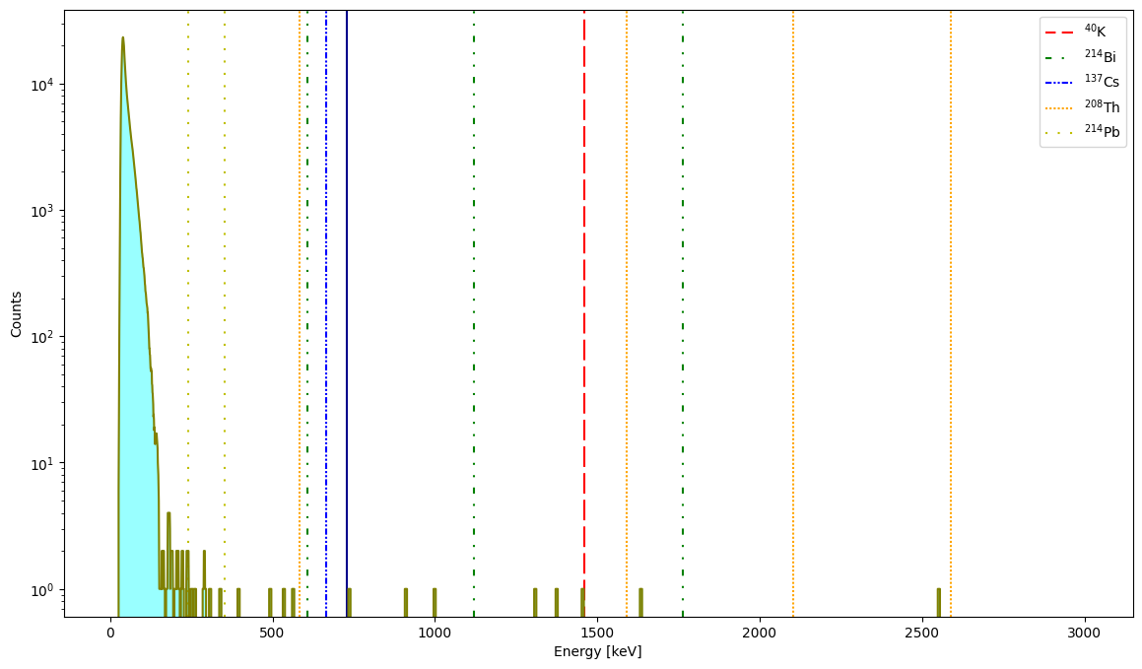
F62
BO3
F64
LL12
LL19
US5B

Slide 16
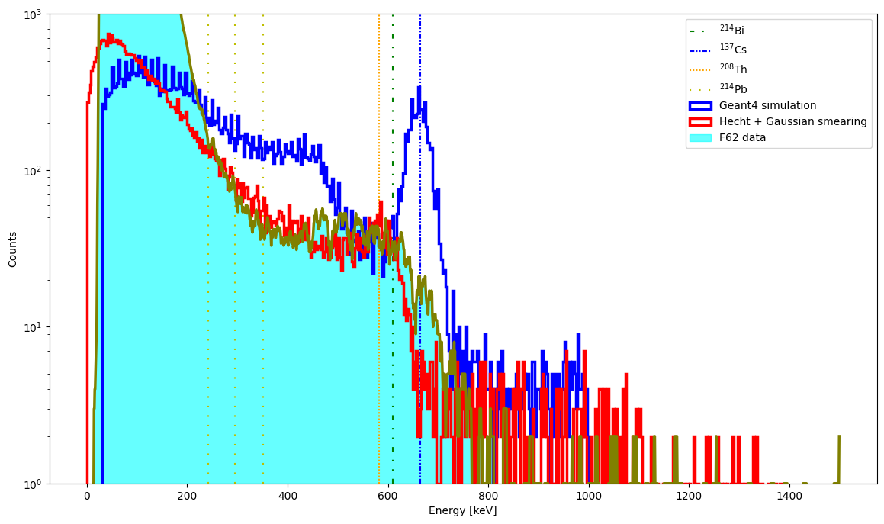
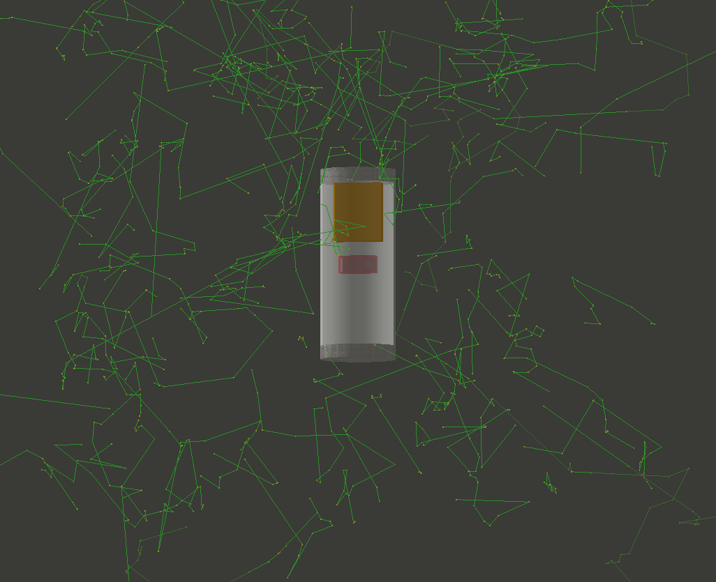
Comparison to Geant4 simulations
Full Geant4 simulation shows perfect spectrum when the detector is placed at the seafloor
When introducing Gaussian smearing and Hecht equation for incomplete drift, the resemblance between the distributions increase

Slide 17
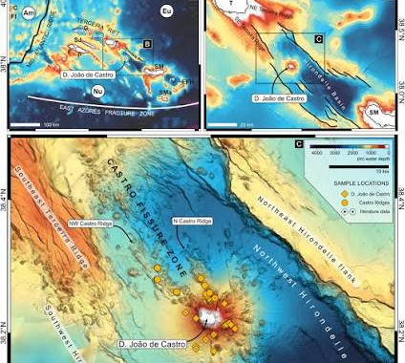
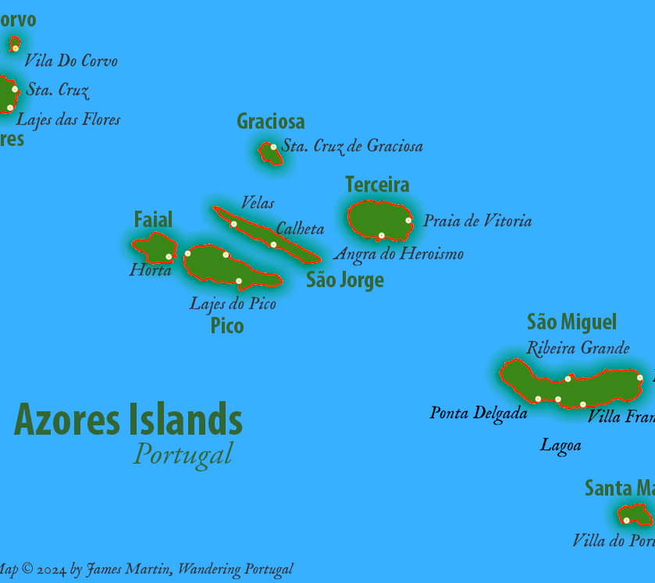
Next steps
The setup should be remeasured in the temperature cycle chamber
  Set the chamber temperature to 30 degrees and lower it down to 20
  Changes in the spectral properties
New design with a heater and a Faraday cage needs to be studied
  Must still fit in the same enclosure
Radon measurements in FMI pool
  Depth about 3 meters
Finalize design for possible ocean floor measurements
  Depths down to 1500 meters
  Fix the problems with Arduino
  Install camera system to the setup
Come up with a new name for the setup e.g.
  LAGER-ALE (Azores Low-energy Environmental spectrometer)
  LAGER-PORTER (Pelagic Oceanic Radiological Tracer and Environmental Reader)

