Slide 1




From Data-Driven Alloy Design to Characterisation: Machine Learning in Materials Science
Swati Mahato
Postdoctoral Researcher
Erich Schmid Institute of Materials Science | Österreichische Akademie der Wissenschaften
swati.mahato@oeaw.ac.at
15 October 26
1

Slide 2

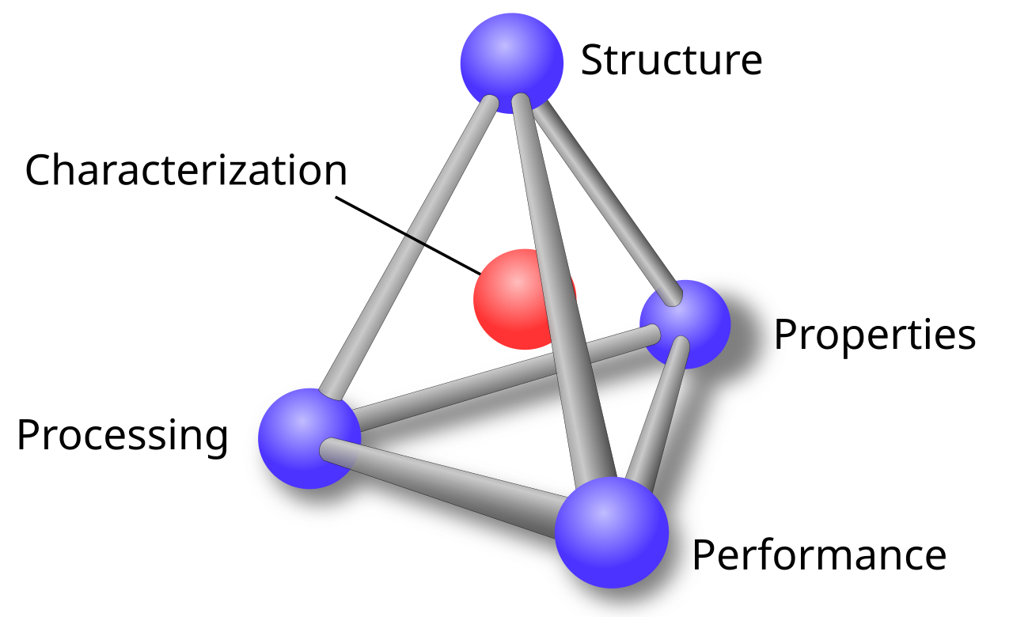
Materials Science Tetrahedron
Foundational framework of materials science is the materials tetrahedron
Arrangement of a material’s components at every scale
central hub, providing the analytical tools needed to observe, measure, and connect these vertices
Inherent, measurable responses and characteristics of a material,
Methods and treatments used to synthesise, shape, heat-treat, modify a material
How well a material behaves and functions in a specific real-world application
1

Slide 3
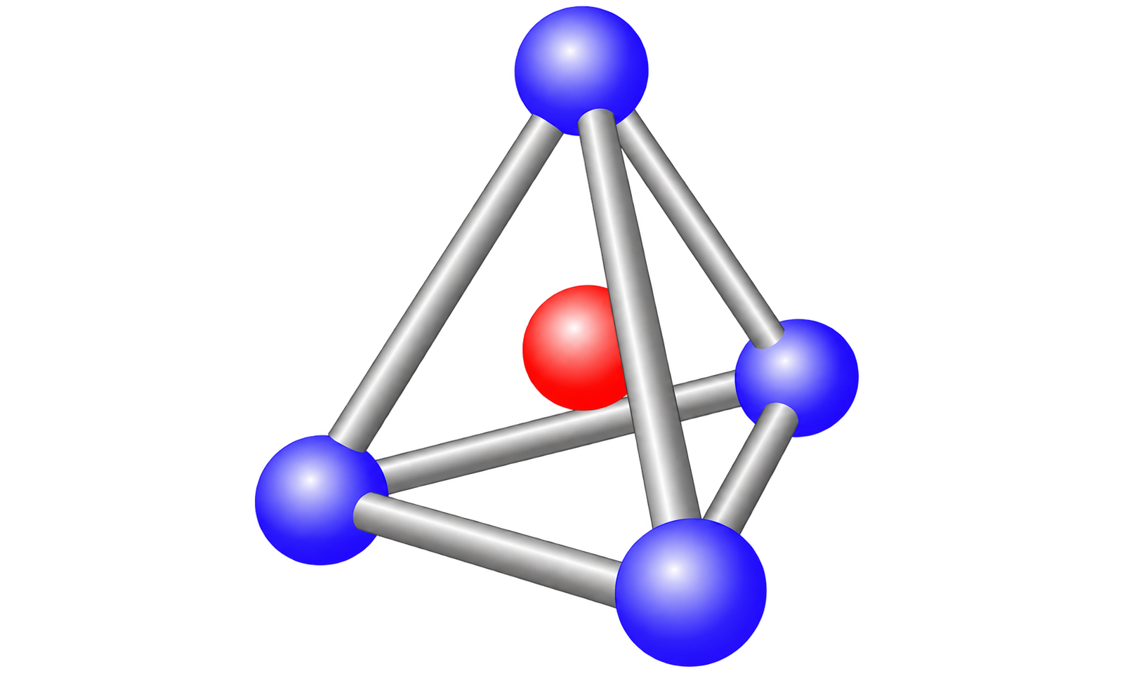
Machine learning
Machine learning → overlay across the entire materials tetrahedron, accelerating every stage of materials development and optimisation overcoming hit and trial route
Machine learning enable to accelerate the experimentation with informed predictions
Data: Experiments, Simulations, large literature databases
2

Slide 4
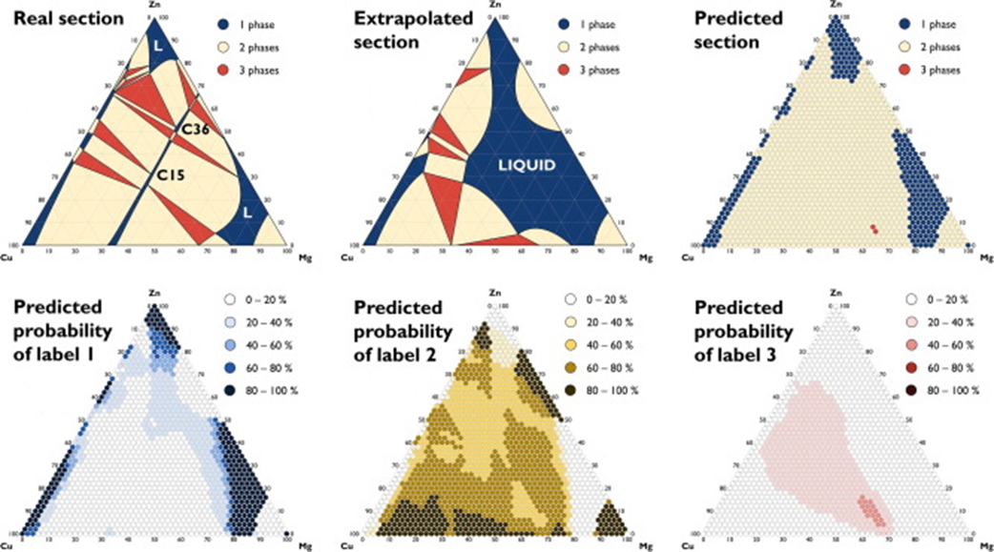
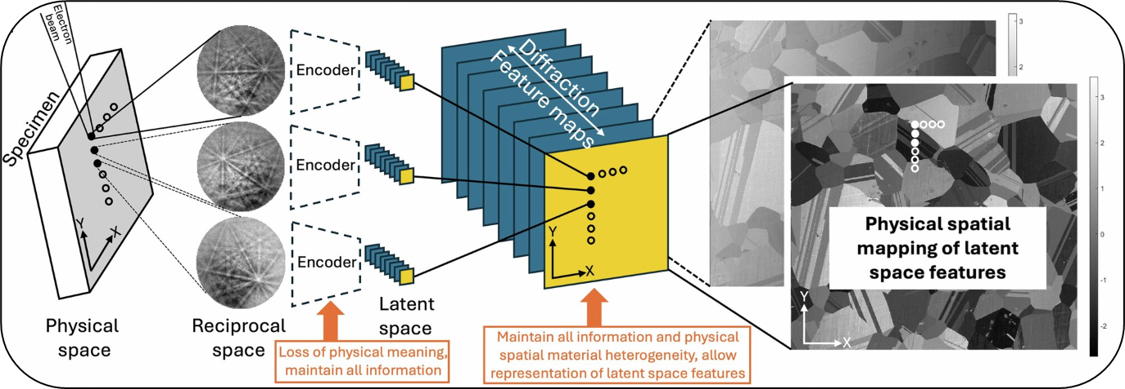
Structure
Phase prediction
Microstructure reconstruction or analysis
Deffrennes et al. Mat & Des 2022
Calvat et al. npj Comp. Mat, 2025
3

Slide 5
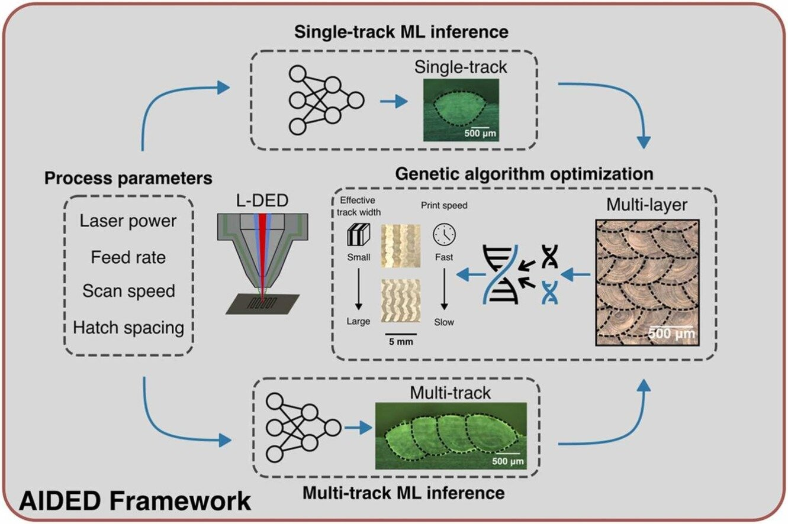
Processing
Optimising process parameters
Defining heat treatment temperatures
4
Shang et al. Additive Manuf. 2025

Slide 6
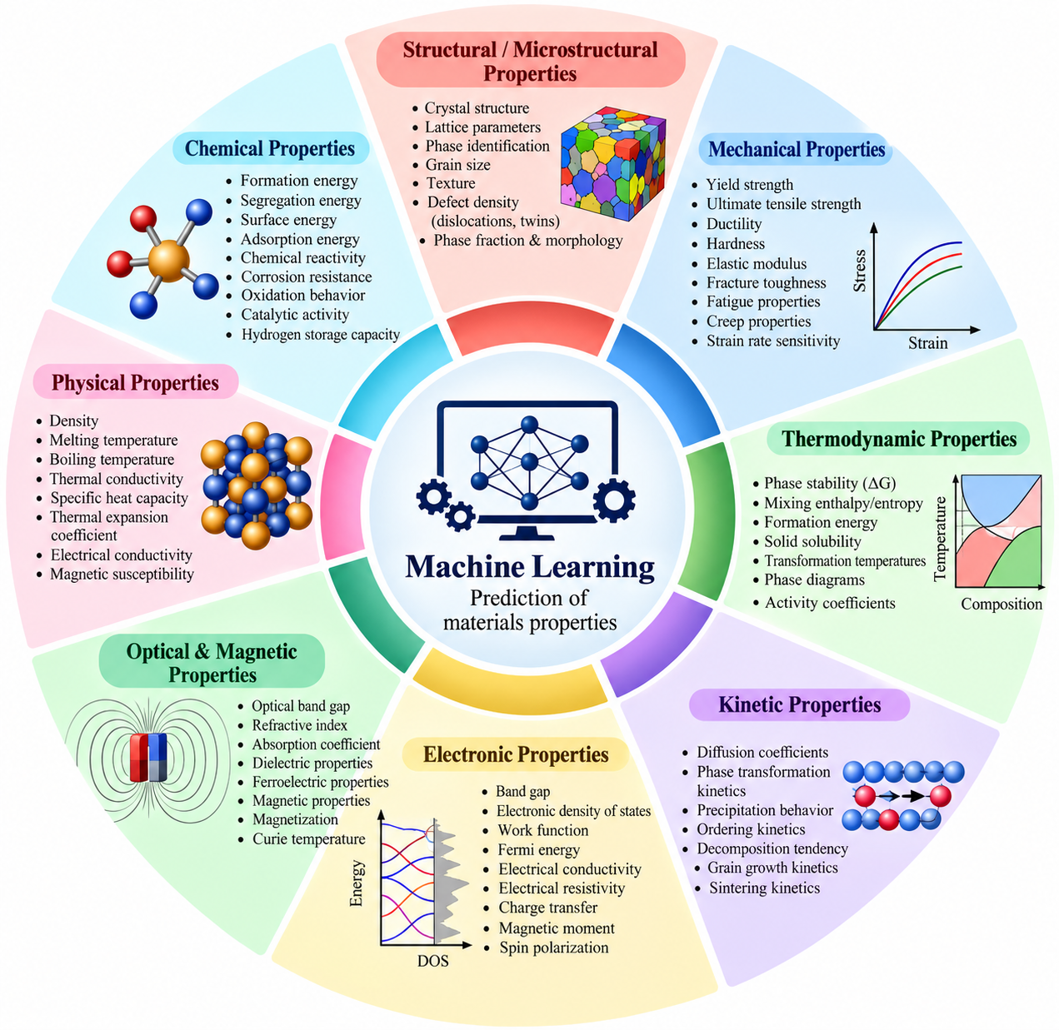
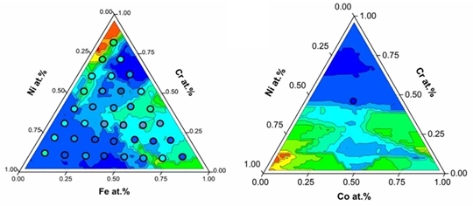
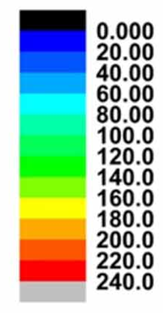
Properties
Mechanical properties
Functional properties and many more
5
Mahato et al. MSMSE 2023

Slide 7
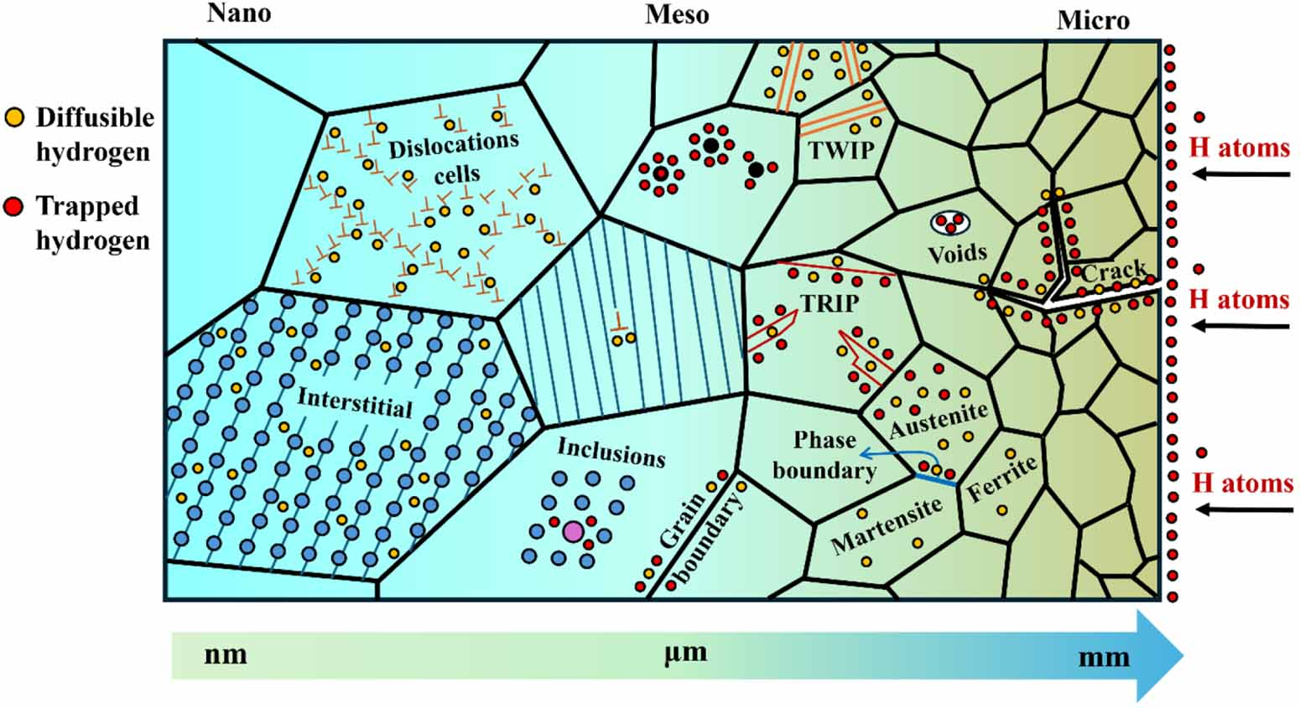
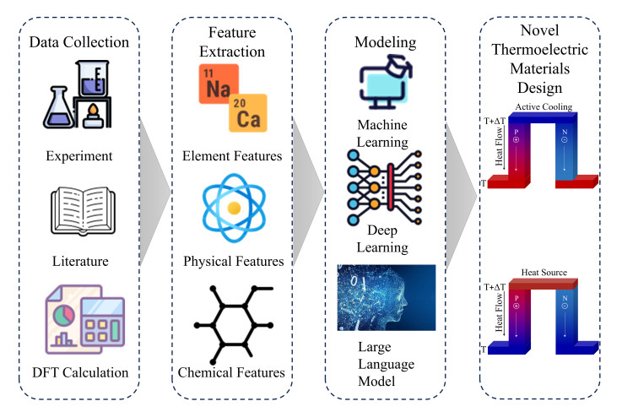
Performance
life of the material under certain load and conditions
Wang et al. J. Mater. Inf. 2025
Chandrakar et al. MSMSE 2025
6

Slide 8
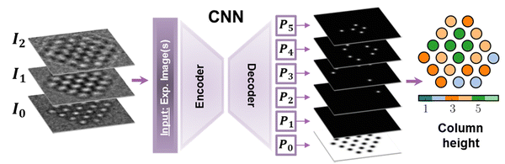
Characterisation
Advanced microscopes and detectors→ Faster → Huge data
Automated analysis of microscopy and diffraction data
Trained CNN model on atomic resolution images to predict the column height
Counts the atoms in each column directly from the images provided
Faster and more efficient way to analyse this huge dataset collected
7
Botifoll et al. Nanoscale Horiz., 2022

Slide 9
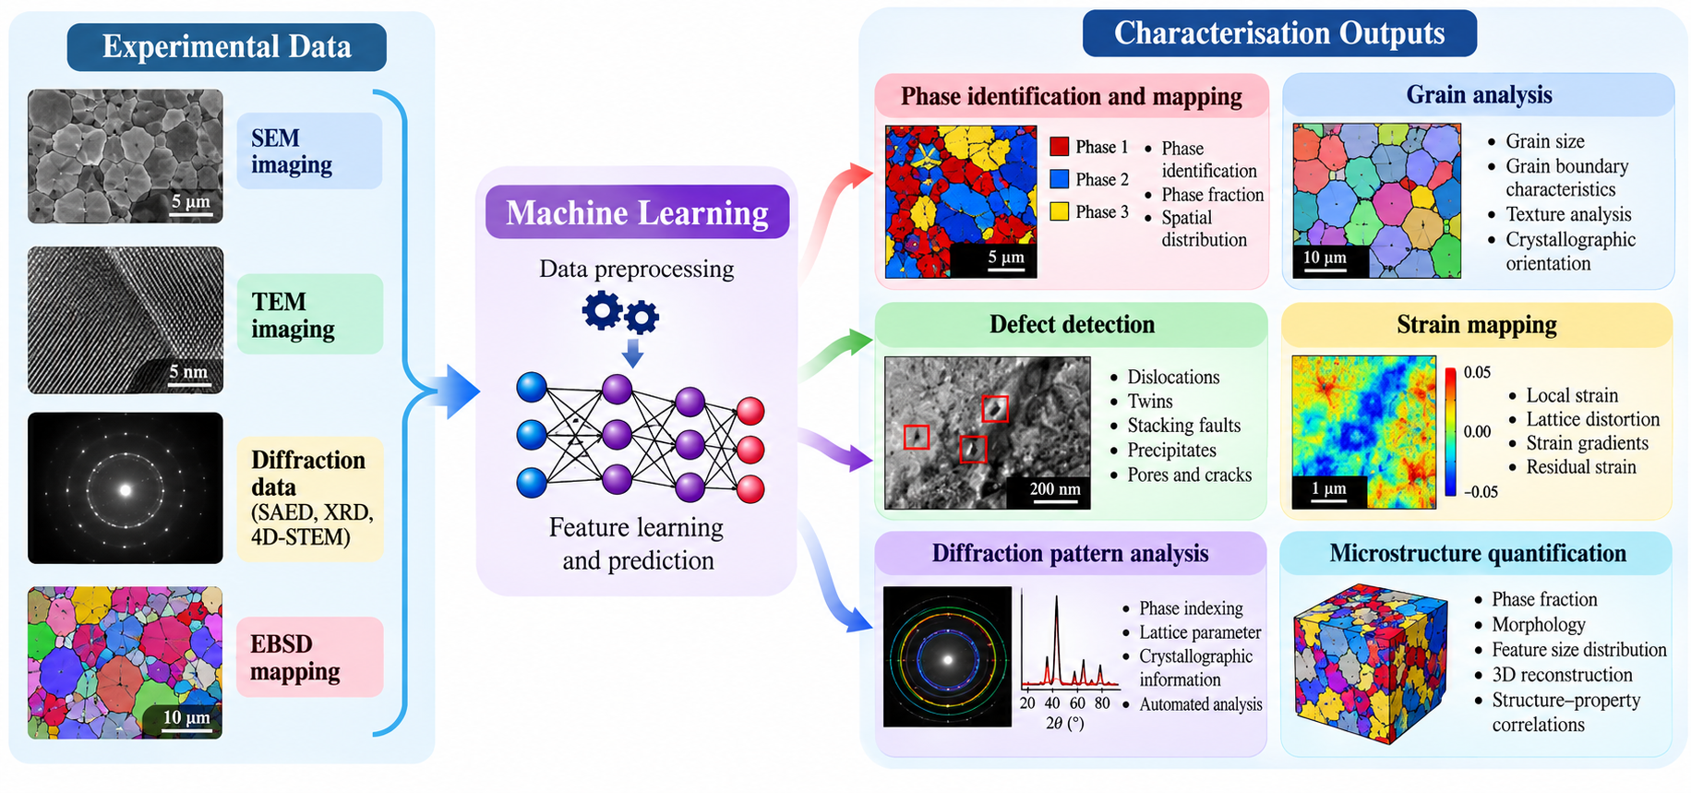
Machine learning in Characterisation
8

Slide 10

Machine learning in Characterisation
Case Study: Physics- Guided Latent Representation Learning for Nanobeam Electron Diffraction via Strain- Conditioned Convolutional Variational Autoencoder

Slide 11
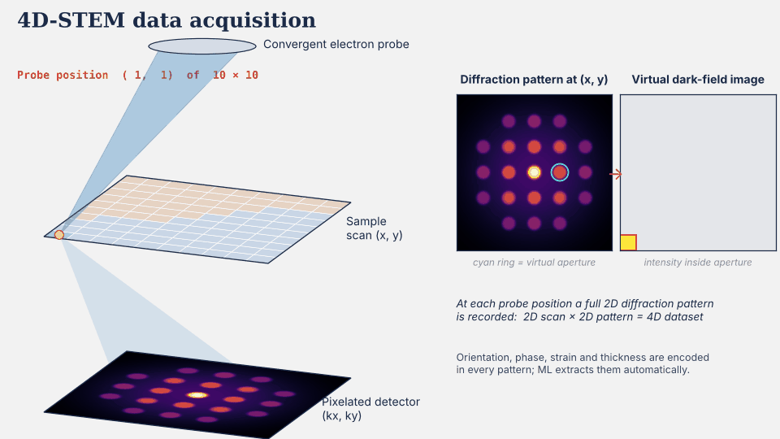
4D STEM Characterisation
10

Slide 12
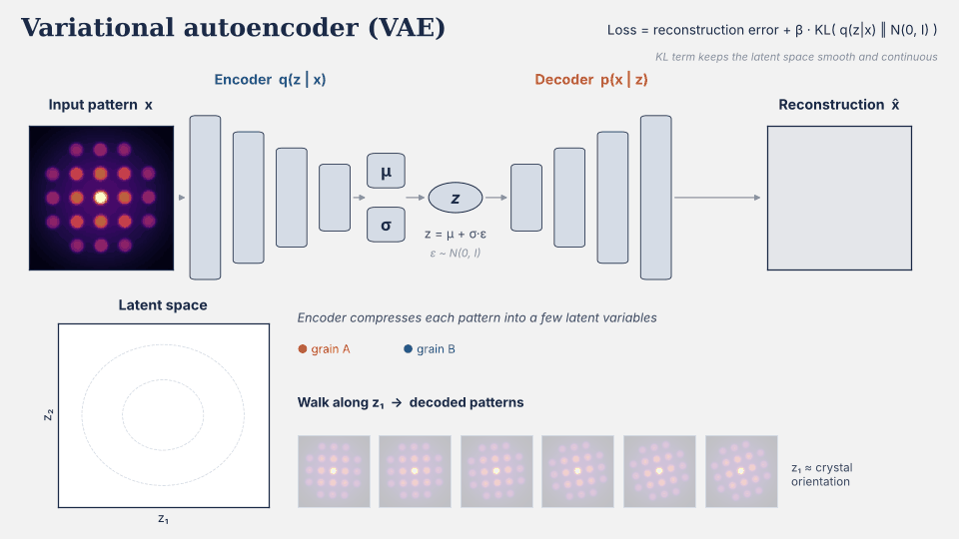
4D STEM Data Analysis
4D-STEM captures the full reciprocal-space signal at every probe position → Analysis still leans on conventional scalar descriptors: VBF, centre-of-mass, and sharpness
11

Slide 13
Questions
1
Can a generative model learn physically meaningful latent representations directly from experimental NBED data?
2
What reciprocal-space information do individual latent variables actually encode?
3
Can physics-informed supervision improve the organisation and interpretability of the latent manifold?
12

Slide 14
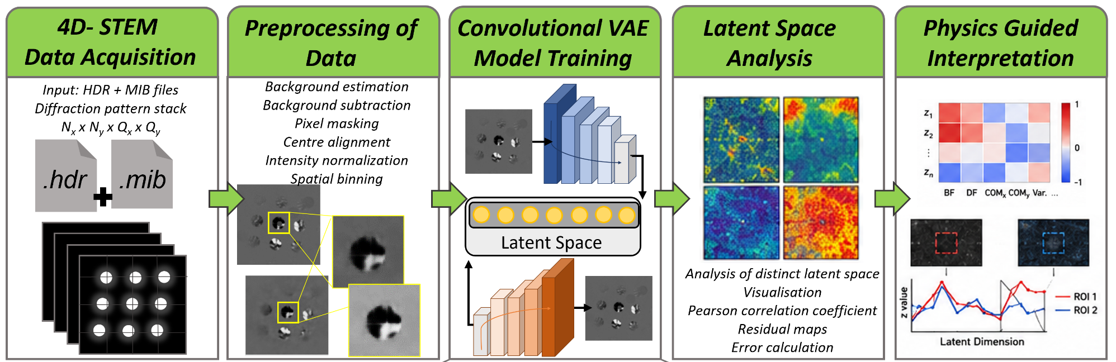
Work Flow
13
Mahato et al. Small Str. (under revision), 2026

Slide 15
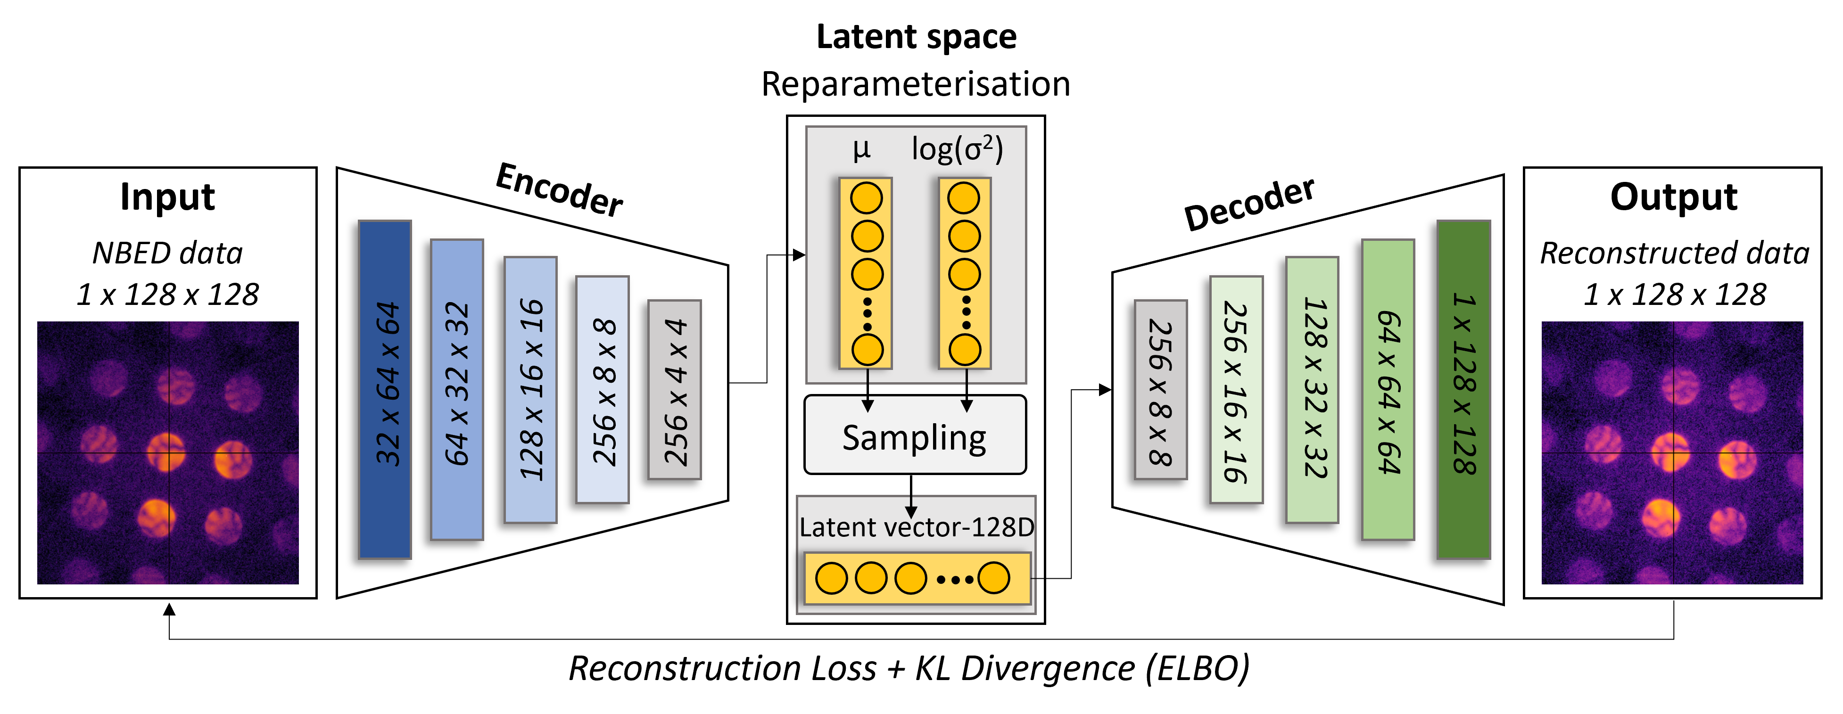
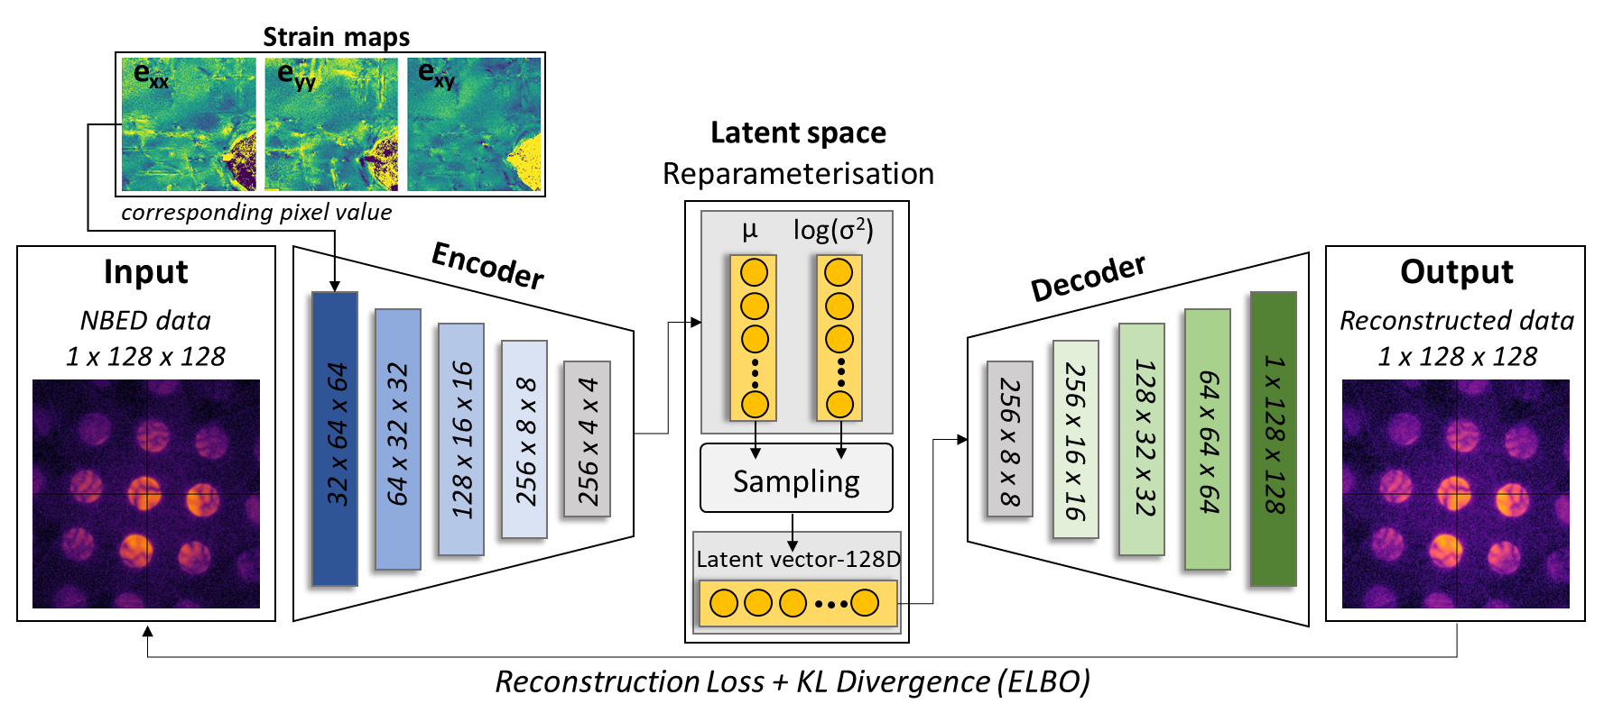
Work Flow
Reconstruction- only
Reconstruction-only
NBED pattern → 128-D latent code → NBED pattern→ Trained purely to minimise reconstruction error
Strain- conditioned
Strain-conditioned
Same backbone, but eₓₓ, eᵧᵧ, eₓᵧ strain values condition the encoder → as auxiliary input
14

Slide 16
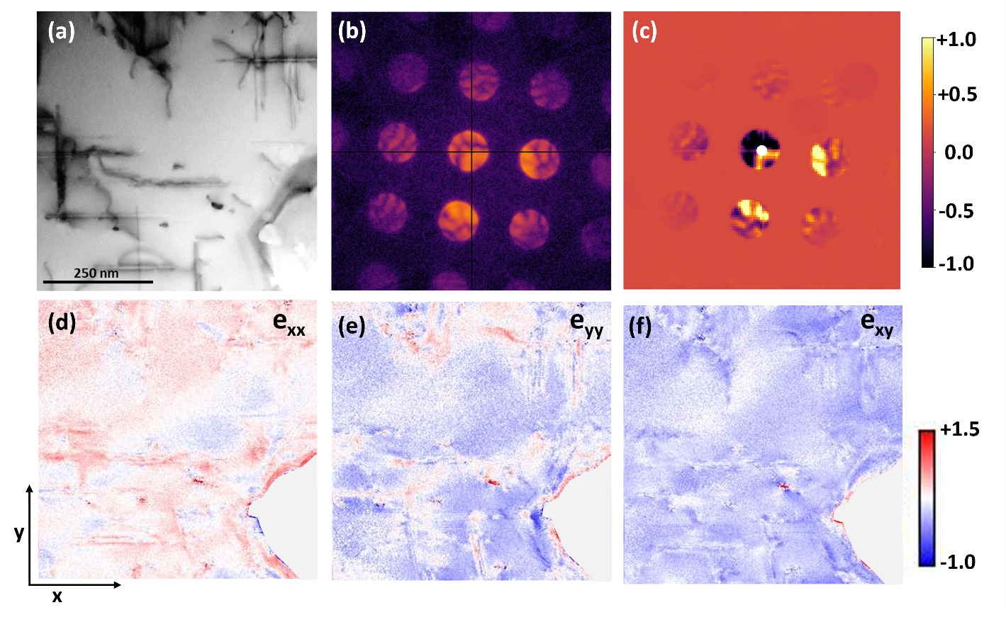
Input Data
Material
Heat-treated Al-3.5Cu-1.5Mg-1Si (T6)
Scan size
256 × 256 probe positions = 65,536 patterns
Detector
512×512, 12-bit → binned to 128×128
Conditioning
eₓₓ, eᵧᵧ, eₓᵧ strain maps, registered per-pixel
15
Mahato et al. Small Str. (under revision), 2026

Slide 17
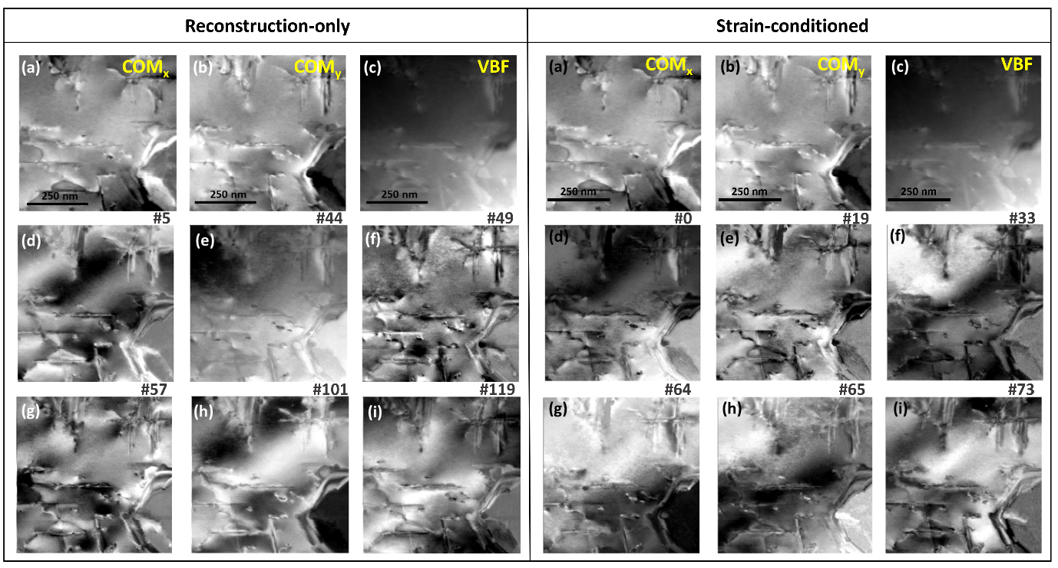
Latent Maps vs. Conventional Descriptors
Both models recover microstructure without labels → strain-conditioned latent maps are more localised and complementary, sharpening precipitates, interfaces, and dislocations rather than repeating broad intensity contrast
16

Slide 18
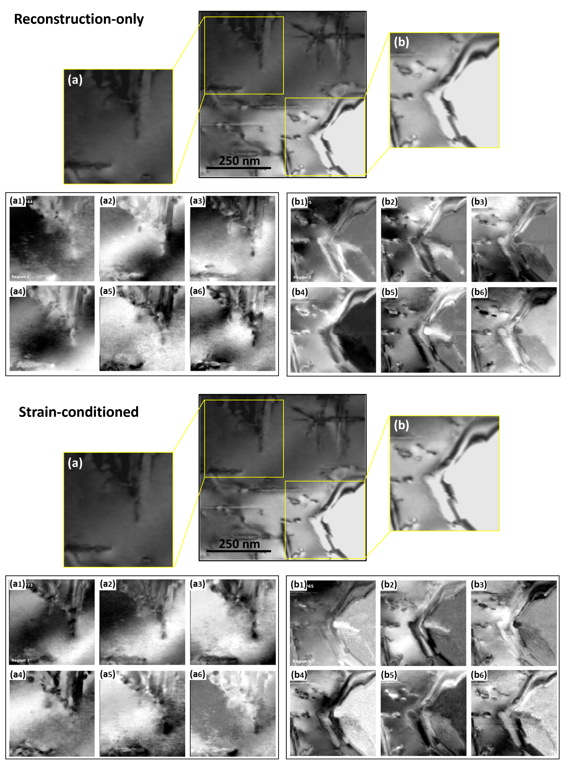
Microstructural Heterogeneity Sensitivity
Two regions of interest: a relatively homogeneous grain interior and an interface-rich region, compared across the same latent dimensions
Reconstruction-only: several latent channels overlap, spreading reconstruction-related information across diffuse intensity gradients
Strain-conditioned: individual dimensions selectively emphasise interfaces, dislocations, precipitates, and localised strain concentrations
Diffuse background activation is markedly reduced : phase boundaries appear as narrower, higher-contrast features.
17
Mahato et al. Small Str. (under revision), 2026

Slide 19
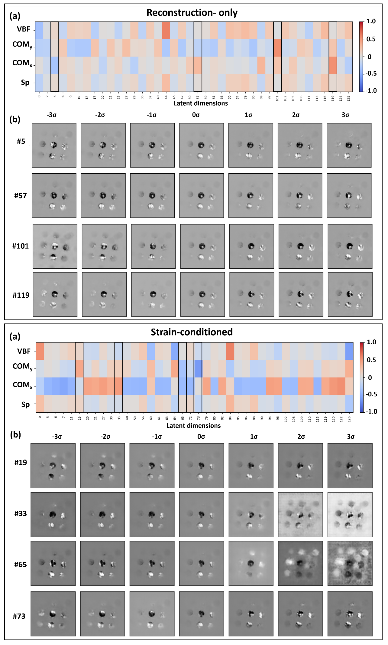
Physical Interpretation: Correlation & Traversals
Reconstruction-only latents show weak, broadly distributed correlation with VBF / COM/sharpness
Strain conditioning concentrates correlation into specialised dimensions → without ever collapsing to a near-perfect match to any descriptor
Reconstruction-only dimensions mainly redistribute intensity smoothly across the central disk
Strain-conditioned dimensions show localised, reflection-specific, nonlinear changes→ consistent with sensitivity to real lattice distortion
18

Slide 20
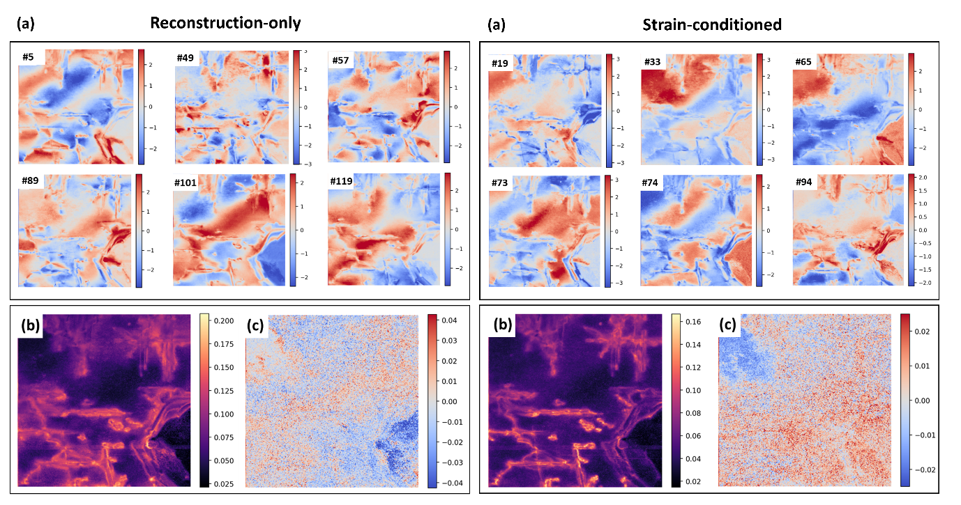
RMSE and residual maps
RMSE and residual maps are comparable between the two models→ errors concentrate at boundaries and precipitates in both
Strain conditioning redistributes latent capacity toward deformation features without sacrificing reconstruction fidelity
19
Mahato et al. Small Str. (under revision), 2026

Slide 21
Conclusions
Strain conditioning fundamentally reorganises the latent space
Transforming it from a reconstruction-driven into a microstructure-aware representation of reciprocal-space scattering, with reduced redundancy and stronger localisation of precipitates, dislocations, and interfaces
Interpretability improves without sacrificing fidelity
Despite the added supervision, reconstruction quality remains as high as (or higher than) the reconstruction-only model, showing that the gain comes from smarter allocation of latent capacity, not added model complexity
latent variables encode real physics, not just statistics
Correlation analysis, latent traversals, and RMSE maps consistently show that learned dimensions track lattice distortion and diffraction-vector variation rather than merely reproducing conventional descriptors like VBF or COM
Establishes a general, physics-guided strategy for explainable AI in electron microscopy
Providing a robust foundation for quantitative 4D-STEM analysis and a pathway toward interpretable, AI-assisted microstructural characterisation
20

Slide 22


Thankyou
Any questions?

