Slide 1
HEP InP Thin Films Update
September 15, 2026
Richville Fagaragan

Slide 2
Arrhenius Plot - CLS

Slide 3
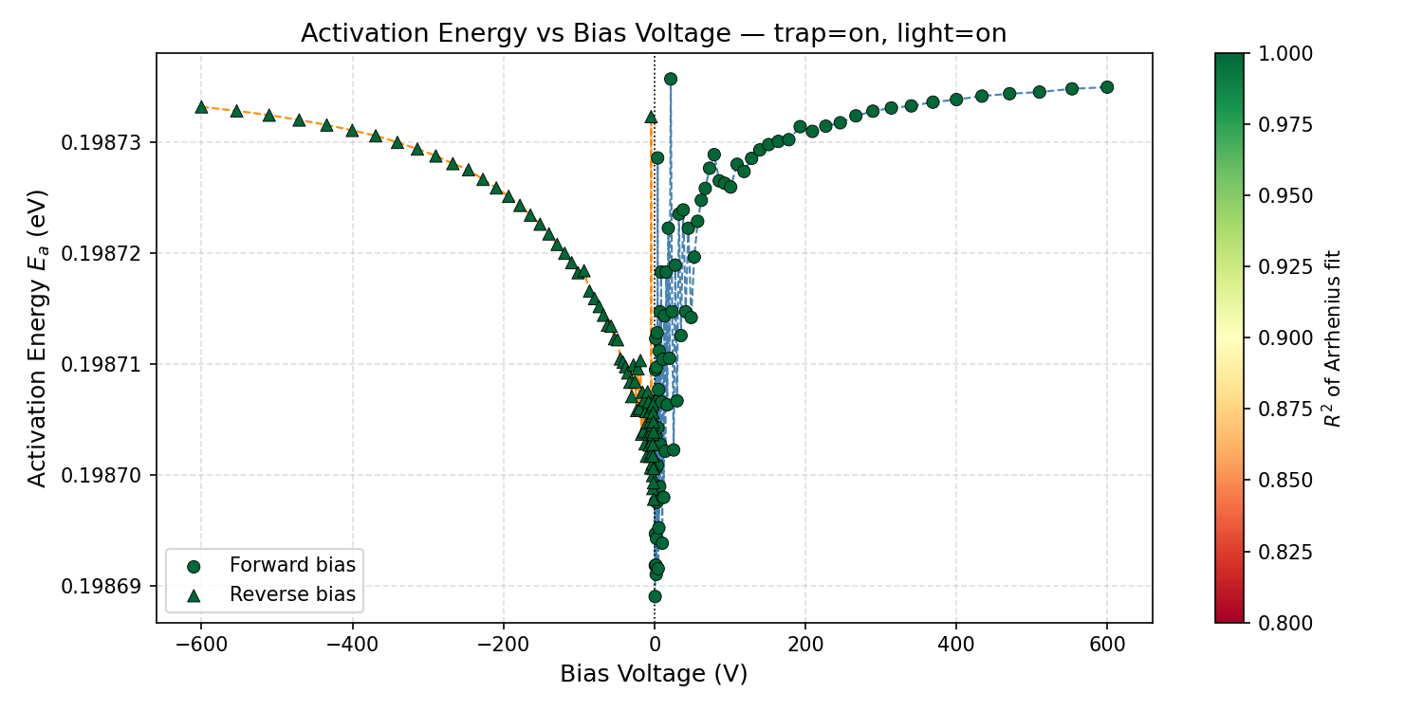

$$E_{a}=0.1987eV$$

Slide 4
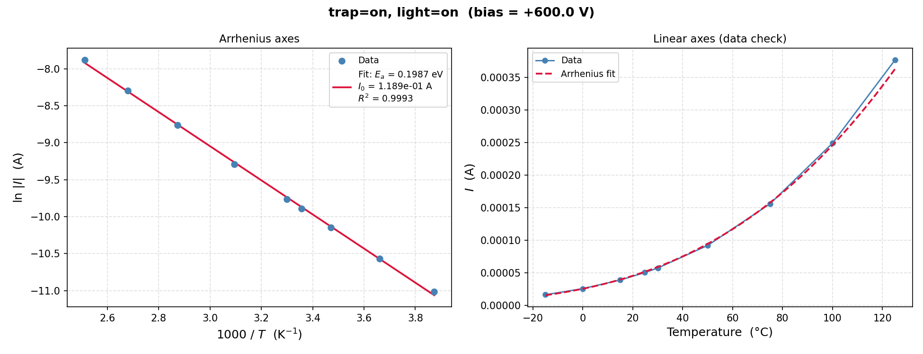

Slide 5
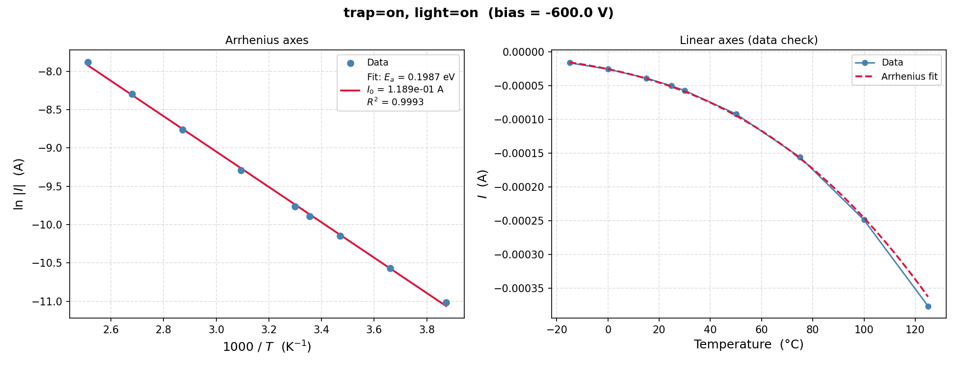

Slide 6
Arrhenius Plot - DLS

Slide 7


$$E_{a}=0.1987eV$$

Slide 8


Slide 9


Slide 10
Backup

Slide 11
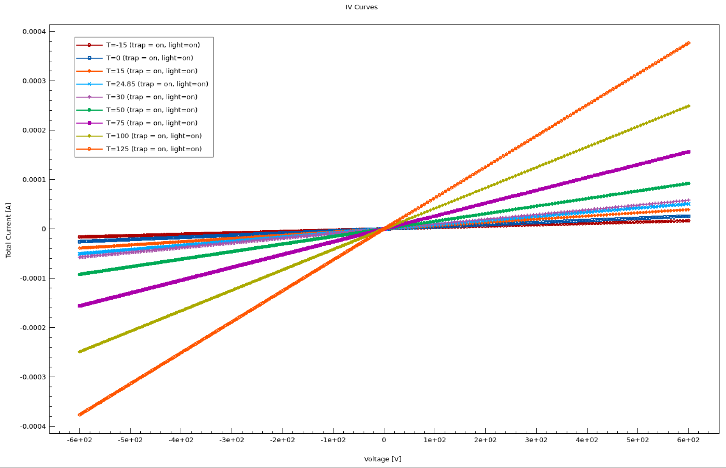
CLS Light On, Trap On (Linear)

Slide 12
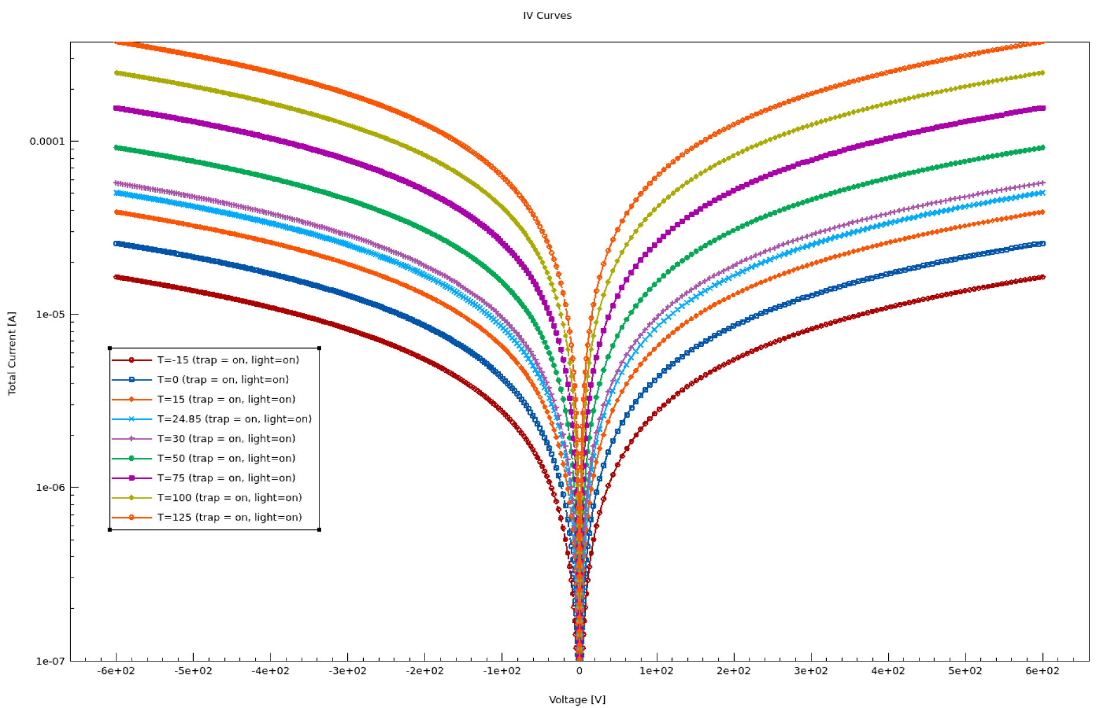
CLS Light On, Trap On (Log)

Slide 13
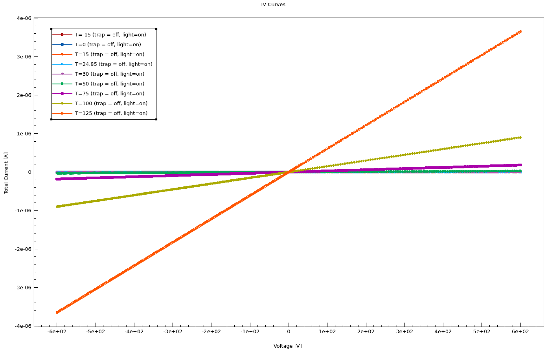
CLS Light On, Trap Off (Linear)

Slide 14
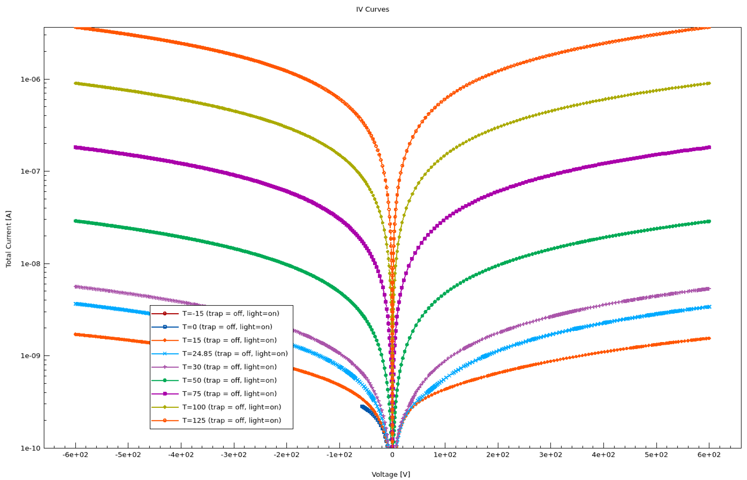
CLS Light On, Trap Off (Log)

Slide 15
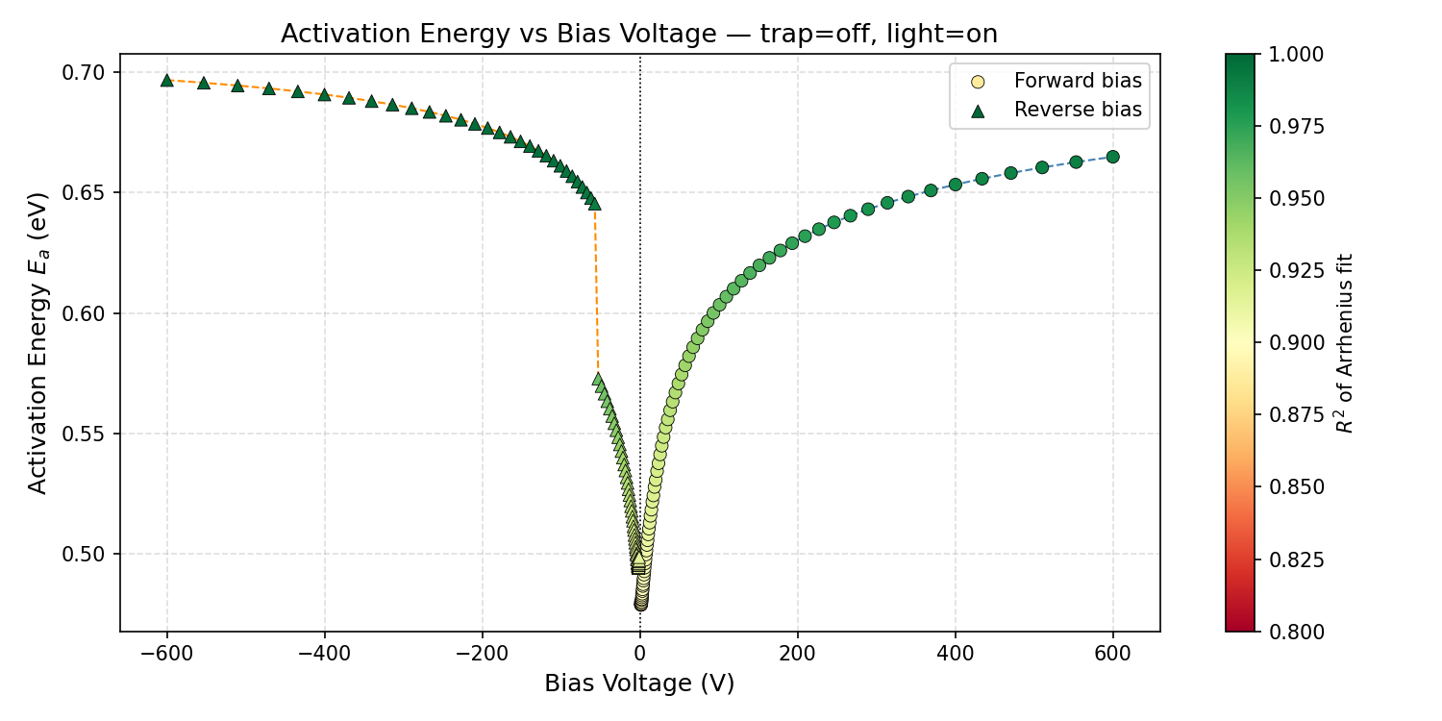

CLS
$$E_{a}=0.6966eV$$

Slide 16
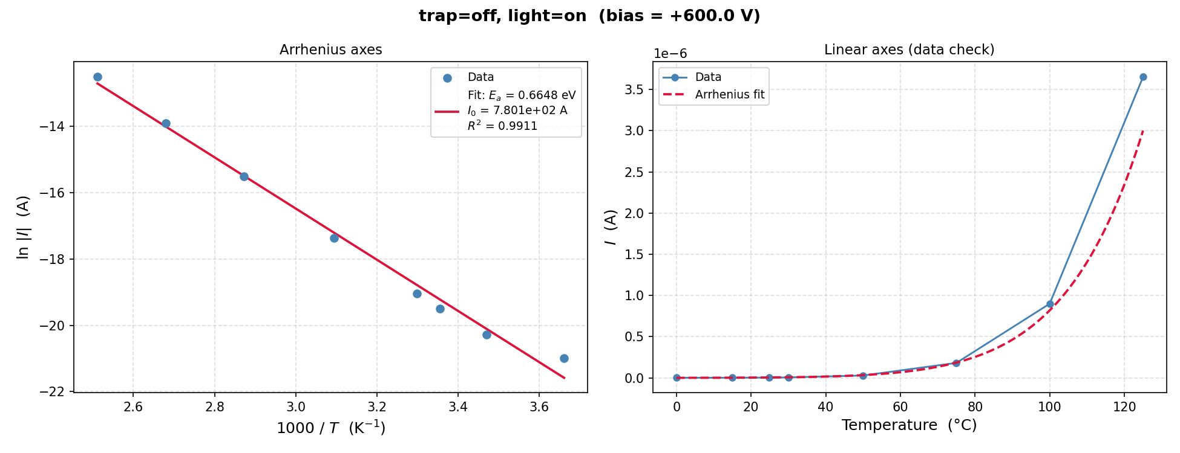
CLS

Slide 17
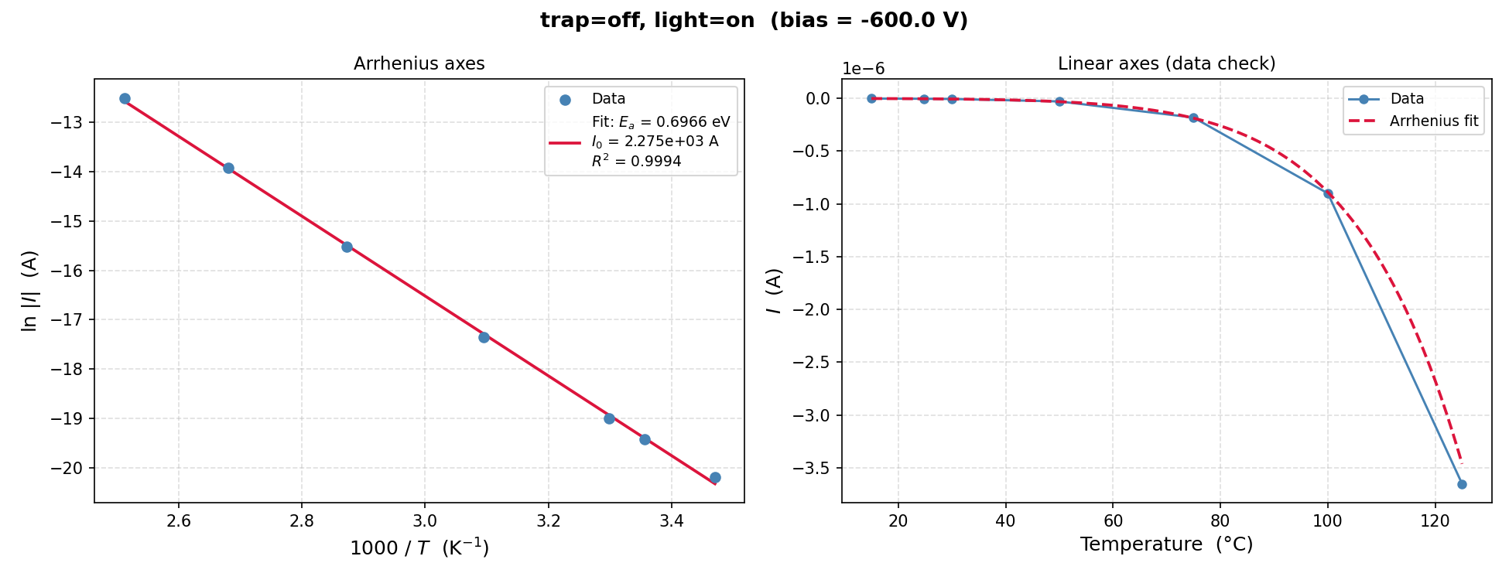
CLS

Slide 18
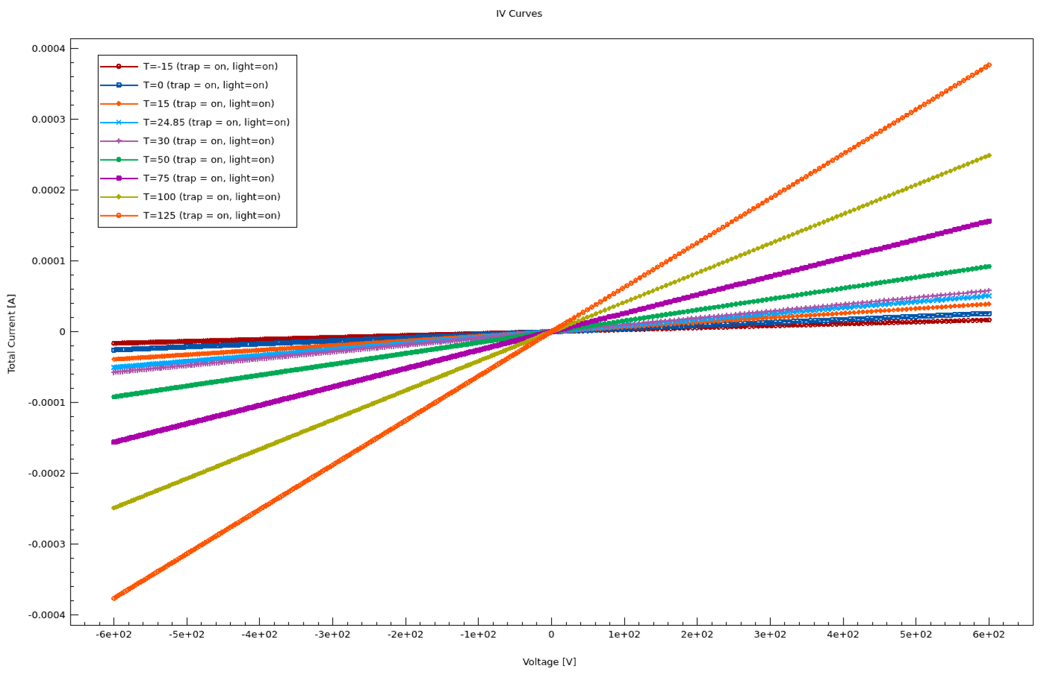
DLS Light On, Trap On (Linear)

Slide 19
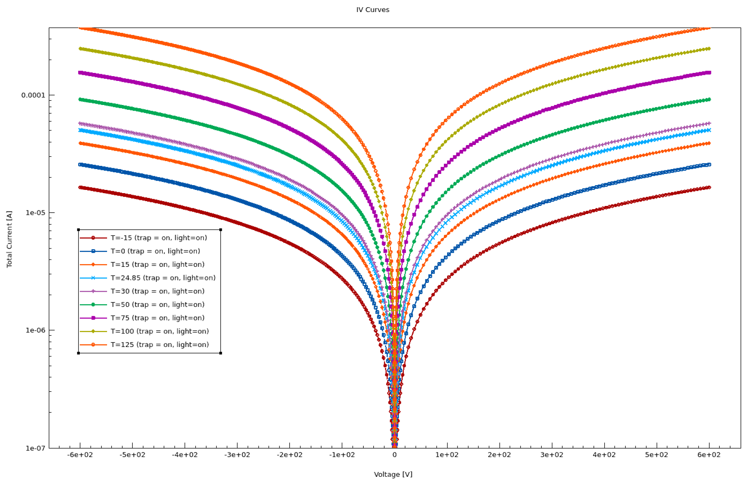
DLS Light On, Trap On (Log)

Slide 20
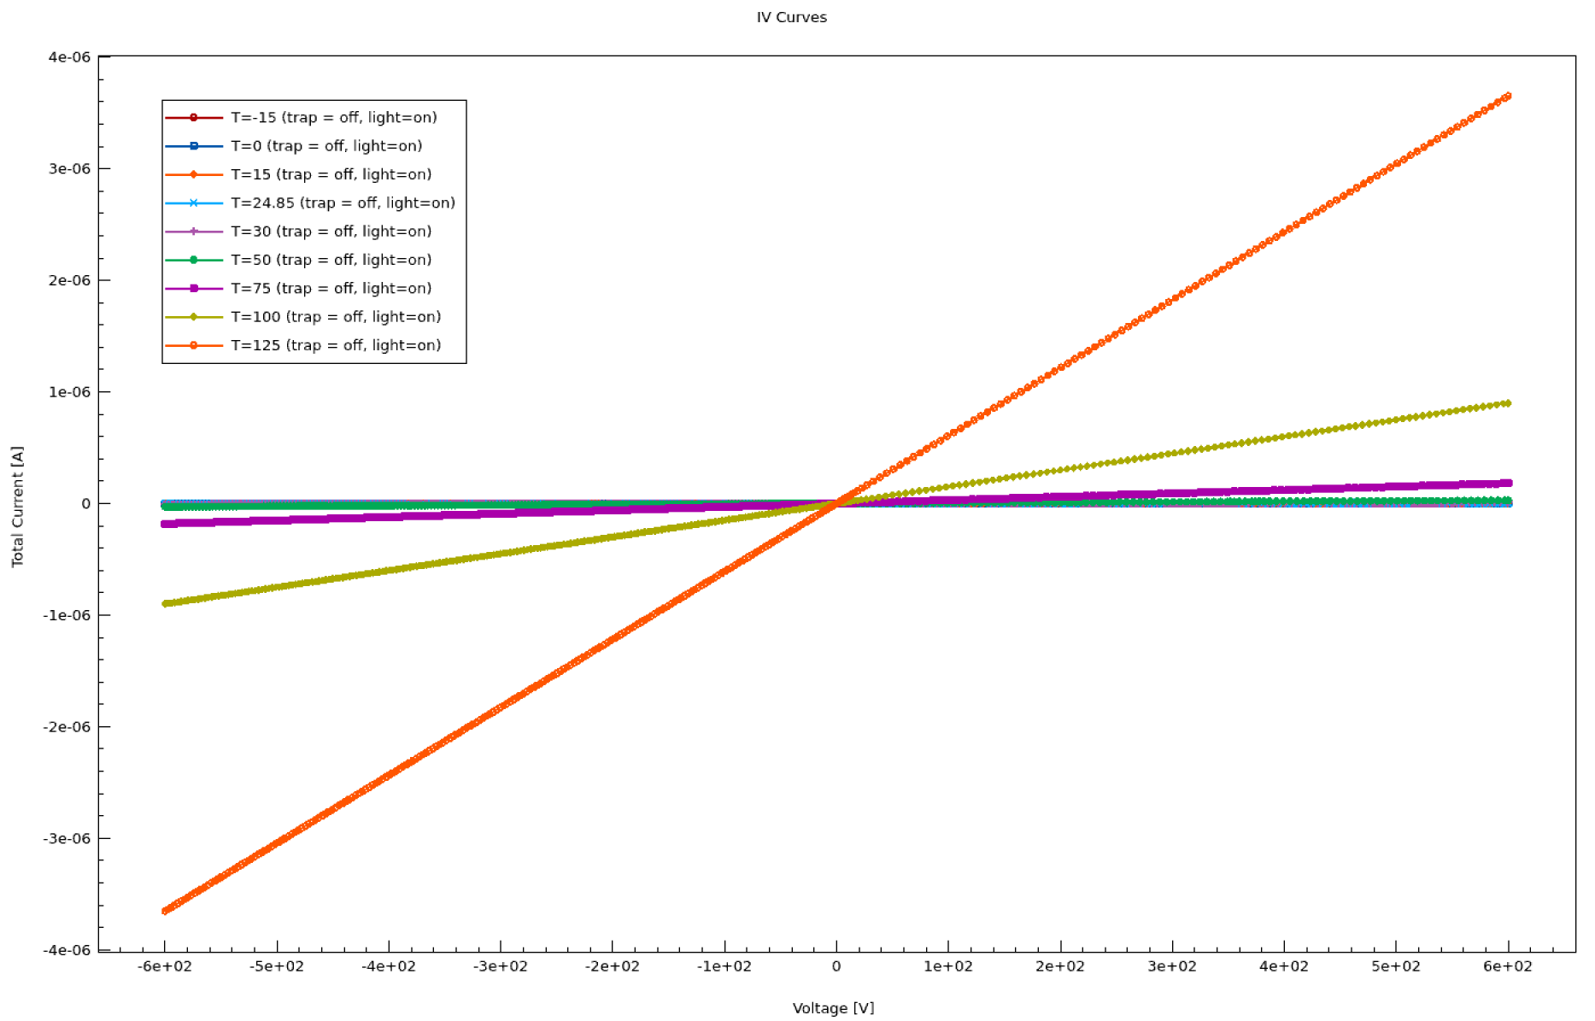
DLS Light On, Trap Off (Linear)

Slide 21
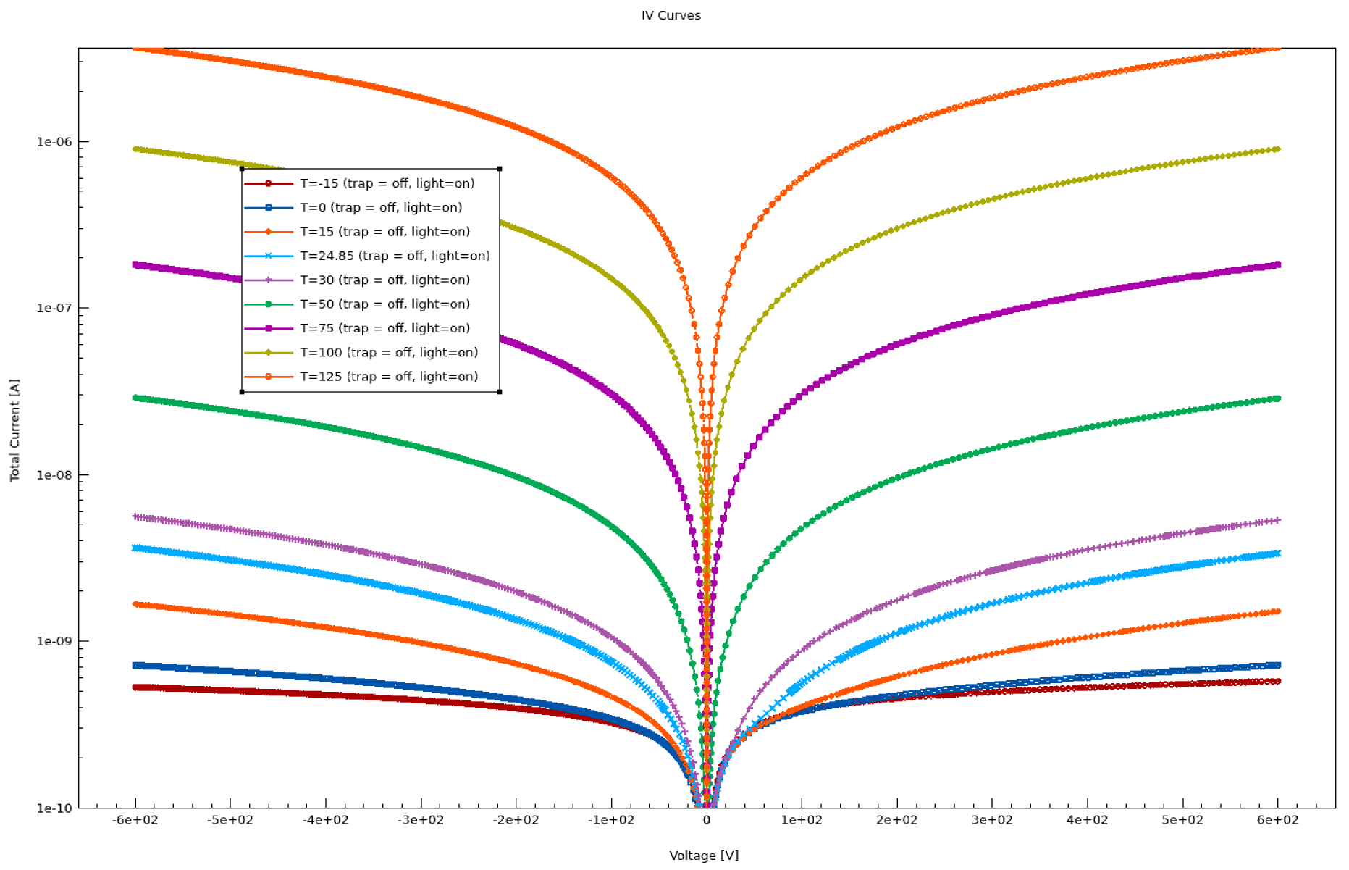
DLS Light On, Trap Off (Log)

Slide 22


DLS
$$E_{a}=0.6966eV$$

Slide 23
DLS

Slide 24
DLS

Slide 25
Original Arrhenius Plot

Slide 26
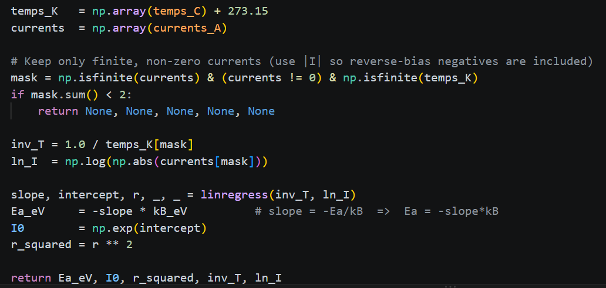
Python Script
Based on ‘IvsT_<node>_T<temp>_VHV<value>.csv’
  Temp such as -15.0000 or 15.0000
  VHV such as 100 or 600
Parses the filename
Compute the Arrhenius fit

Slide 27
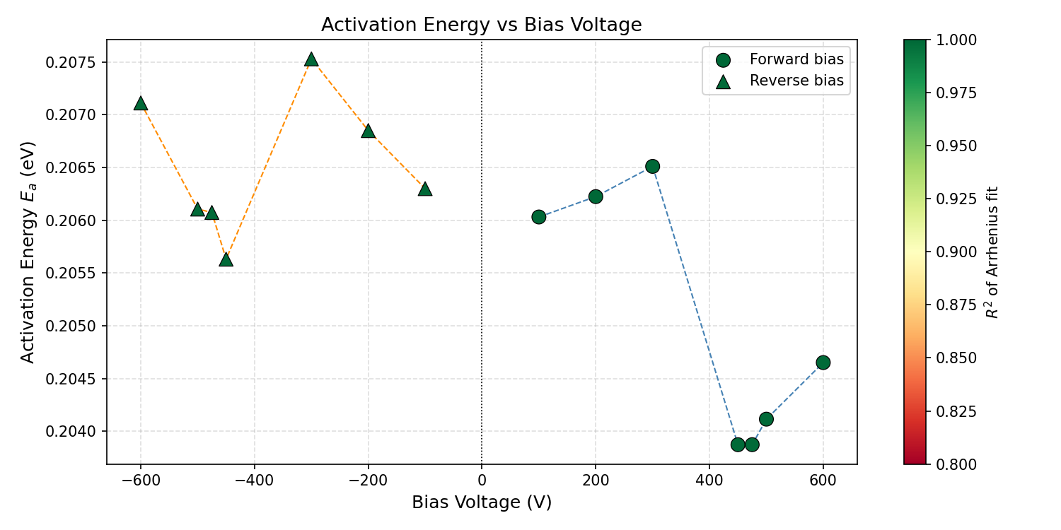

Slide 28
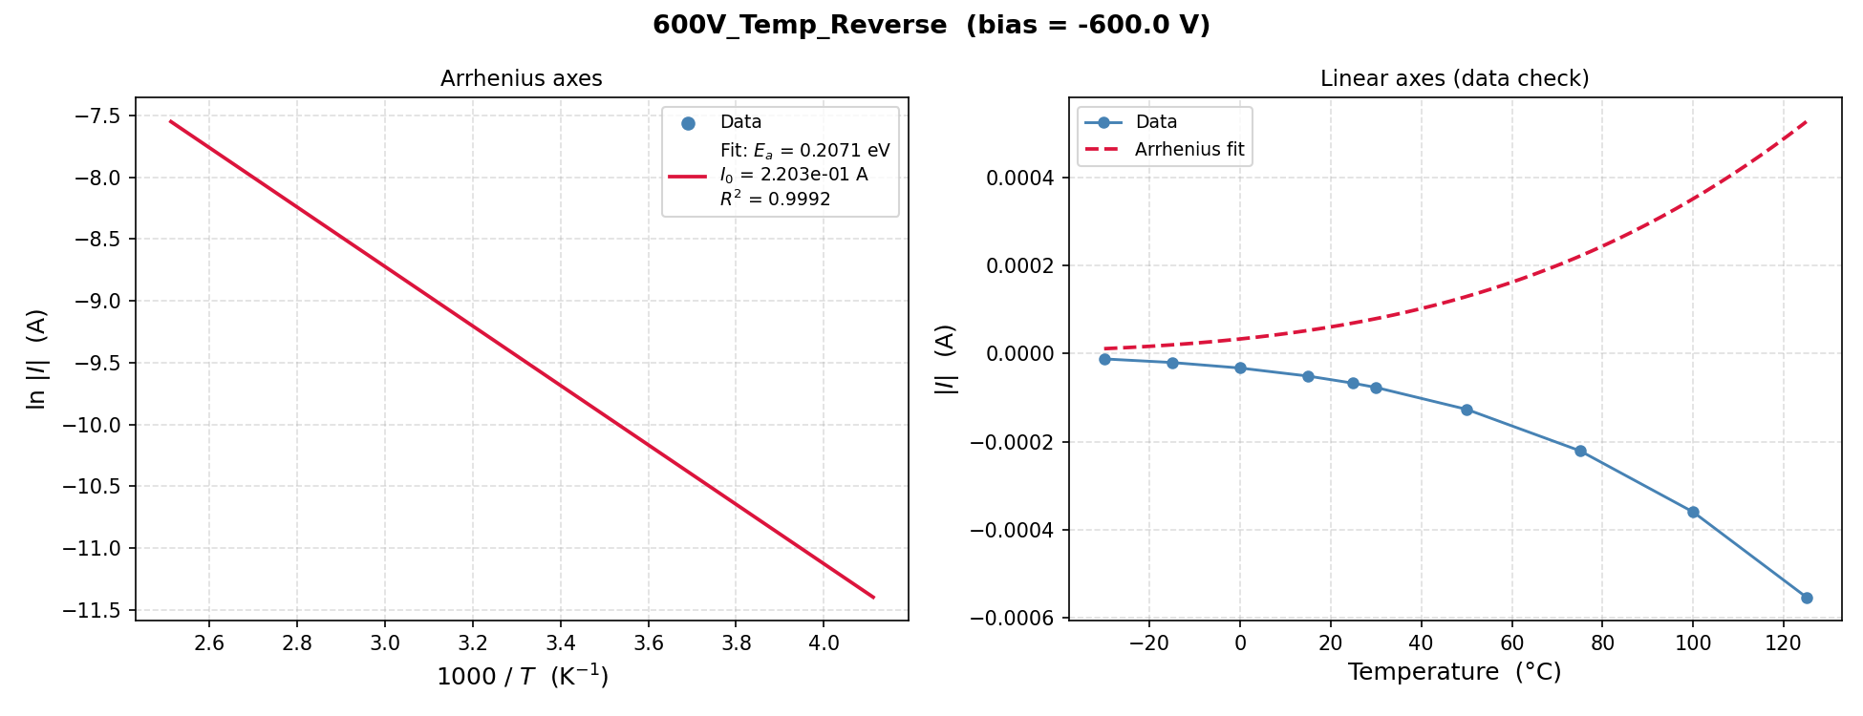

Slide 29
