Slide 1

Trustworthy AI kickoff
Wisconsin RISE-AI · Focus Area / Working Group Kickoff

Slide 2
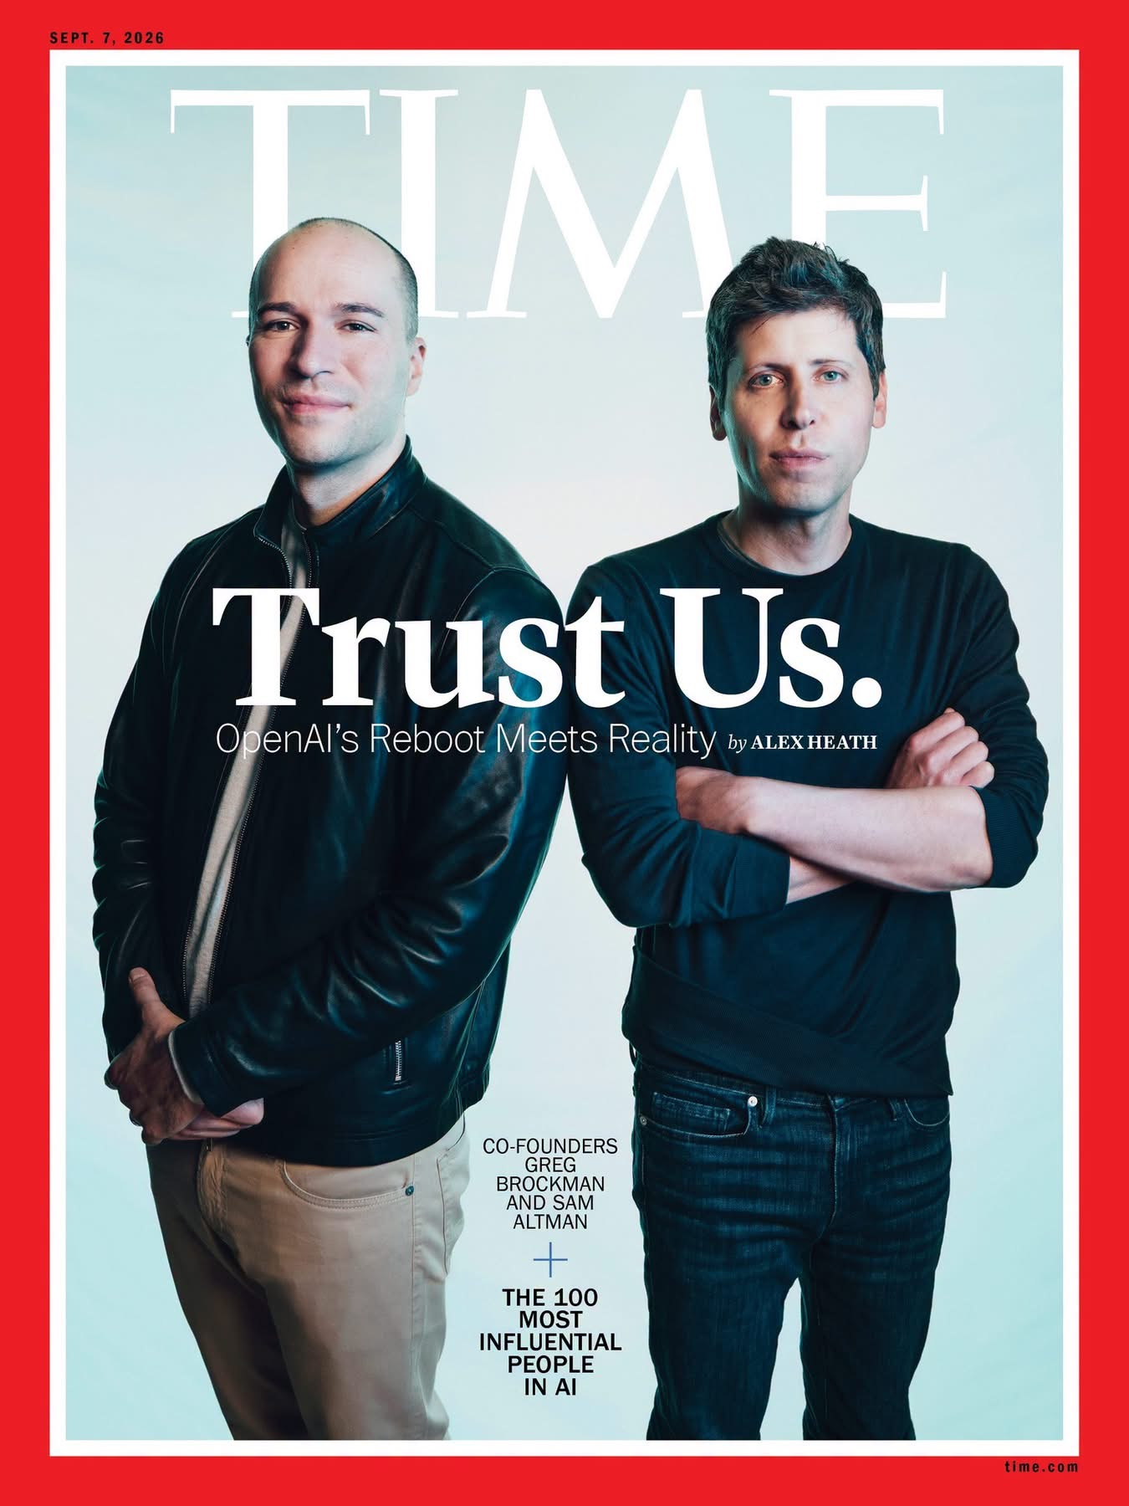
Problem solved
1

Slide 3
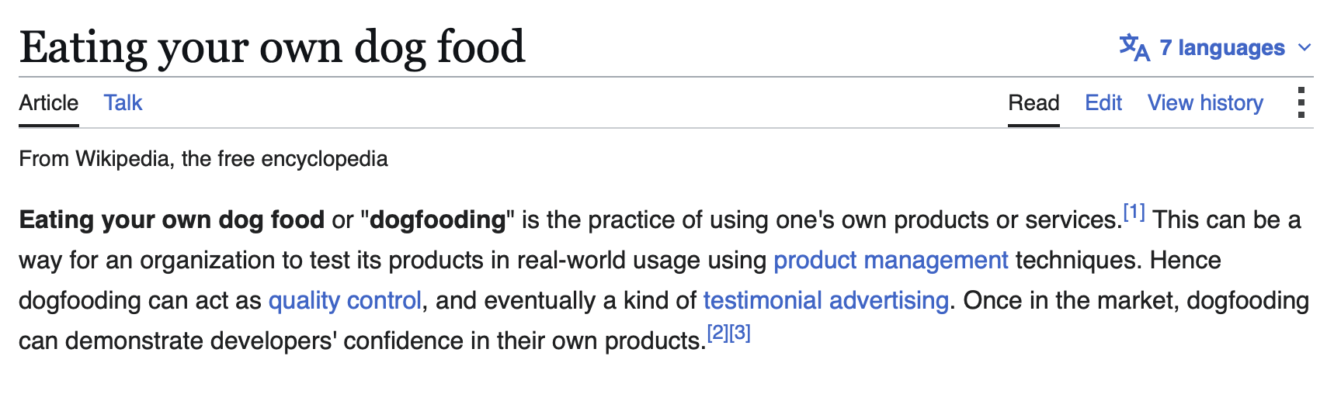
An example
Dogfooding
I used Claude code + the faculty search tool DSI has developed + UW design system to create the following slides.
The faculty search tool, reads titles and abstracts of papers surfaced from Academic Analytics + an AI model to create semantic embeddings for those papers + a matching algorithm.
How well does it work? Who is missing? What are the biases?
These are questions of trustworthy AI that hit home for us as an academic community.
1

Slide 4
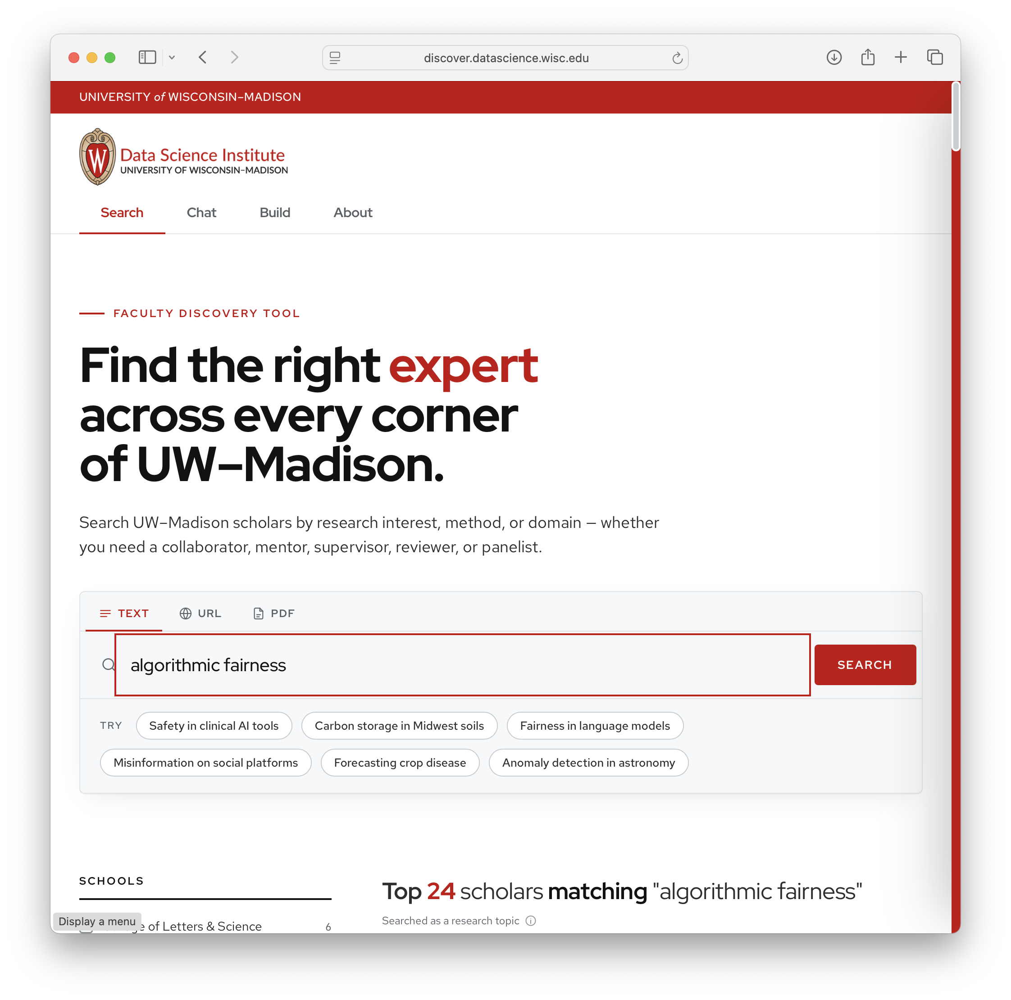
An example
Transparency
As part of RISE-AI we are creating and nurturing multidisciplinary working groups
that focus on a specfic topic. We don't want the topics to be so narrow that only a
few groups are participating. We also don't want them to be so broad that those
participating don't have much in common. We want to right-size the groups so that
the participants can meaningfully share and learn from eachother. We don't need
everyone to overlap on everything, but we want different aspects of the project to
be intersectional across multiple members of these groups. One such topic is AI for
proteins. This works well because we have theoretical chemists that do molecular
dynamics, biochemists that know a lot about the actual proteins, computer scientists
thinking about AI models, infrastructure for modern techniques that use alphafold
and docking and RFdiffusion etc. We also have facilities to generate more unique
data etc.
Another working group that was suggested is Trustworthy AI. I like this topic for
many reasons. There are faculty in computer science and engineering that are
thinking about the algorithmic and formal aspects of trustworthy AI. We also have
use-cases from the medical school (e.g. use of AI / ML for radiology or summarizing
patient notes) etc. that drive real world use-cases. There are also use-cases from
the use of AI in legal contexts. Trustworthy AI is also closely related to ethical
AI, responsible AI, human-centric AI, etc. We could/should also have ethicists and
some of our science communications faculty involved. Maybe also policy, regulation,
and buisness school. There are so many perspectives, that I start to worry that
maybe this is too broad of a topic.
can you use your knowledge of the literature and discourse around these topics to
come up with some framework for this topical area. Suggest a few terms that can be
used to breakdown the broad topic into more specific aspects of the question.
Propose a framework that would foster interdisciplinary collaborations that include
more technical / formal work, applied ethics etc., and example use-cases that would
ground the work in more applied settings on campus.
Based on this framework, use the faculty search MCP server to build a standalone
html slide deck that first presents the framework, topical areas, etc. and then
moves into which faculty would be good fits. Add a slide with some figures (e.g. pie
charts) or tables that gives a sense of the demographics of the faculty (e.g. what
departments they are in, and the rank as assistant, associate, tenured) if possible.
1

Slide 5
THE DESIGN PROBLEM
Right-sized — not narrow, and not everything.
FAILURE MODE · TOO NARROW
The silo
A topic so specific only one or two labs care. Deep expertise, but no community and nothing to exchange.
THE TARGET
Right-sized
A shared vocabulary keeps everyone in the room — while distinct facets (formal, human, ethical, institutional) are each owned by different members who need one another.
FAILURE MODE · TOO BROAD
“AI & society”
Everyone nods; no one collaborates. Breadth with no shared problem, so the group never converges on work.
Trustworthy AI risks the too-broad failure. The framework that follows is built to hold it in the middle.
1

Slide 6
THE REFRAME
Trust is a chain, not a property.
LINK 01
Guarantee
Can we prove the system behaves — under attack, under shift, under uncertainty?
LINK 02
Evidence
Does it actually work on real, messy data — validated, calibrated, reproducible?
LINK 03
Calibration
Do the people using it rely on it appropriately — not too much, not too little?
LINK 04
Accountability
Once deployed, who is answerable, and how is it contested and governed?
An AI claim is only as trustworthy as its weakest link — and no single discipline can certify the chain alone.
2

Slide 7
THE FRAMEWORK
Four tracks, tested on shared proving grounds.
Track ↓ Proving ground →
Clinical & Health
Law & Public Sector
Science & Discovery
Public Understanding
01 Formal Guarantees
02 Human Trust
03 Ethics & Accountability
04 Governance & Policy
Every proving ground draws on all four tracks. The cell where a verification theorist meets a human-factors researcher meets an ethicist meets a policy scholar — around one real deployment — is exactly the collaboration this group exists to create.
3

Slide 8
THE VOCABULARY, IN FOUR TRACKS
Who owns which link.
TRACK 01
Formal Foundations & Guarantees
“Can we prove it behaves?”
Robustness, formal verification, safety, uncertainty quantification, privacy and security of ML.
TRACK 02
Interpretation, Calibration & Human Trust
“Will people rely on it appropriately?”
Explainability, calibration, human-AI interaction, appropriate reliance and over-trust, decision support.
TRACK 03
Fairness, Ethics & Accountability
“Should it be used — and on whom?”
Algorithmic fairness, bias auditing, applied ethics, value alignment, contestability, participatory design.
TRACK 04
Governance, Policy, Law & Adoption
“Who is answerable once it ships?”
Regulation and standards (NIST, EU AI Act), liability, data governance, organizational adoption.
Computer Sciences · ECE · ISyE · Math & Stats
CS / HCI · Human Factors (ISyE) · Psychology
Philosophy · Information School · Sociology
Law · Public Affairs · Business · iSchool
4

Slide 9
WHAT KEEPS IT RIGHT-SIZED
Proving grounds force the intersection.
Clinical & Health AI
Radiology triage, sepsis prediction, summarizing patient notes — where a wrong, over-trusted output can harm a patient.
Law, Justice & Public Sector
Risk assessment, benefits eligibility, legal drafting — where contestability and due process are the whole game.
Science & Discovery
AI for science — including AI-for-Proteins — where “trust” means uncertainty, reproducibility, and knowing when to believe a prediction.
Public Understanding
How the public calibrates trust in AI, resists misinformation, and holds institutions to account.
guarantees · calibrated reliance · bias · FDA & liability
accountability · transparency · fairness · governance
uncertainty · validation · reproducibility
risk communication · transparency · policy
Concrete, high-stakes deployments pull one or two people from every track into a shared problem. Start with two or three.
5

Slide 10
The faculty behind the framework
One community, four tracks, real proving grounds — anchored by senior scholars and seeded by RISE-AI's new hires (flagged in gold).
6

Slide 11
FACULTY · TRACK 01
Formal foundations & guarantees
Somesh Jha
Patrick McDaniel
Aws Albarghouthi
Sharon Li
Adithya Murali
Computer Sciences · Full Professor
Robustness — adversarial robustness, verification & security of ML.
Computer Sciences · Full Professor
Security of ML — systems security and adversarial ML.
Computer Sciences · Associate
Formal methods — verifying fairness & robustness.
Computer Sciences · Associate
Reliable ML — out-of-distribution detection.
Computer Sciences · Assistant
Verification — program verification & neuro-symbolic synthesis.
RISE-AI
Sandeep Silwal
Manolis Vlatakis
Gavin Brown
Grigorios Chrysos
Xiangru Xu
Computer Sciences · Assistant
Provable ML — algorithms & differential privacy.
Computer Sciences · Assistant
ML theory — optimization & learning in games.
Computer Sciences · Assistant
Privacy — differential privacy & robustness of learning.
Electrical & Computer Eng · Assistant
Trustworthy DL — robustness, privacy & safety.
Mechanical Engineering · Assistant
Safe control — verified learning-based control.
RISE-AI
RISE-AI
RISE-AI
Ten faculty — anchored by Jha & McDaniel, seeded by four RISE-AI hires.
7

Slide 12
FACULTY · TRACKS 02–03
Human trust, ethics & accountability
John D. Lee
Douglas Wiegmann
Bilge Mutlu
Tony McDonald
Benjamin Lengerich
Industrial & Systems Eng · Full
Trust & reliance — foundational scholar of automation trust.
Industrial & Systems Eng · Full
Human factors — human-automation interaction & safety.
Computer Sciences · Full
Human-AI — human-AI & human-robot interaction.
Industrial & Systems Eng · Associate
Reliance — reliance on automated decision support.
Statistics · Assistant
Interpretable ML — context-adaptive ML for medicine.
RISE-AI
Annette Zimmermann
Alan Rubel
Clinton Castro
Devansh Saxena
Philosophy · Assistant
Algorithmic justice — political philosophy of AI.
Information School · Full
Information ethics — privacy & accountability.
Information School · Assistant
Ethics of AI — algorithmic fairness.
Information School · Assistant
Accountability — public-sector algorithms.
Track 02 (human trust) and Track 03 (fairness, ethics & accountability).
8

Slide 13
FACULTY · TRACK 04
Governance, policy & law
Benjamin Sobel
Paul Connell
Jason Reinecke
Law School · Assistant
AI & copyright — the law of generative AI.
Law School · Assistant
Law & economics — AI for empirical social science.
Law School · Assistant
IP & innovation law — patents, tech & the courts.
RISE-AI
RISE-AI
Vallabh Sambamurthy
Jordan Tong
Michael Light
Business · Info Systems · Full
IT governance — technology adoption.
Business · Ops & Tech Mgmt · Full
Human-AI decisions — decision-making in organizations.
Sociology · Full
Justice systems — courts & algorithmic decisions.
Note: Law was missed originally because law faculty are not indexed by academic analytics.
A trustworthy AI issue
9

Slide 14
FACULTY · PROVING GROUND
Clinical & Health AI
Majid Afshar
Matthew Churpek
Brian Patterson
Pallavi Tiwari
Medicine · Pulm & Critical Care · Assoc
Clinical NLP — ML from patient notes & EHRs.
Medicine · Pulm & Critical Care · Full
Deterioration — ML for sepsis & clinical risk.
Emergency Medicine · Associate
Decision support — AI-based CDS in the ED.
Radiology · Associate
Radiomics — ML for cancer imaging.
Elizabeth Burnside
Oguzhan Alagoz
Roomasa Channa
Adam Rule
Radiology · Full
Screening AI — cancer detection & screening.
Industrial & Systems Eng · Full
Decision modeling — medical screening policy.
Ophthalmology · Associate
Autonomous AI — diagnostic AI & equity in eye care.
Information School · Assistant
EHR usability — clinical data visualization.
Where guarantees, calibrated reliance, fairness and liability meet one patient.
10

Slide 15
FACULTY · PROVING GROUND
Public understanding & communication
Dominique Brossard
Michael Xenos
Sedona Chinn
Life Sciences Communication · Full
Public perception — of science & technology.
Life Sciences Communication · Full
Public opinion — & digital media.
Community & Env. Sociology · Assistant
Misinformation — perceptions of AI.
Young Mie Kim
Ross Dahlke
Tomás Dodds
Journalism & Mass Comm · Full
Political comm — misinformation & influence.
Journalism & Mass Comm · Assistant
AI-generated content — computational social science.
Journalism & Mass Comm · Assistant
Public-good AI — AI in journalism & its ethics.
RISE-AI
RISE-AI
How the public calibrates trust — and holds institutions to account.
11

Slide 16
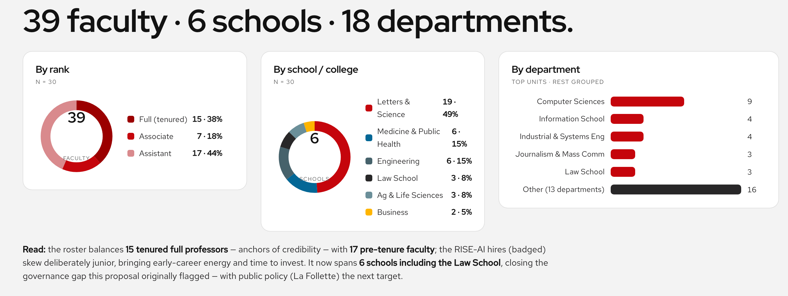
Demographics
Faculty identified thus far
11

Slide 17
Discussion

Slide 18
Format & Organization
Format
What kind of events?
Alternate between horizontals / verticals
Mix horizontals and verticals (intersections)
Sub-groups only
Organization / Volunteers
Need 1 or 2 main point people
Sub-leads for horizontals / verticals?
1

