Slide 1
MaCh3's User Interface
From a zoo of binaries to one coherent CLI
MaCh3 CLI | Unified User Interface
1
Notes:
Open by linking directly to the previous talk's thesis - today a 'user' needs developer-level knowledge just to run a fit. This talk is about the first concrete step to fix that: the interface layer.

Slide 2
Picking Up Where the Last Talk Left Off
● MaCh3 serves at least three audiences:
– Users
– Developers
– In-betweeners
● Today's reality: the boundary between these is blurry at best
  Users almost need to know as much as developers just to use the software.
● Goal: More of a clear distinction between these types.
MaCh3 CLI | Unified User Interface
2
Notes:
This is the hinge slide connecting the two talks - the UI is the thing that either enforces or erases the user/developer split.

Slide 3
What “The User Interface” Means Today
● Three layers a MaCh3 user currently has to deal with, in increasing order of required expertise:
1
Executables
A large, flat collection of standalone binaries: MCMCTutorial, ProcessMCMC, RHat, CombineMaCh3Chains, PlotLLH, MatrixPlotter, PredictivePlotting, GetPostfitParamPlots, …
2
YAML Configuration
e.g. MaCh3Tutorial/TutorialConfigs — covering fitter settings, sample definitions, systematic models, binning
3
C++ Source Code
e.g. registering a “functional parameter“ etc…
MaCh3 CLI | Unified User Interface
3
Notes:
Walk through these three in order - this is literally the brief's structure. Emphasise that today, layer 3 is used far more often than it should be.

Slide 4
What “The User Interface” Means Today
● What will this talk address?
1
Executables
A large, flat collection of standalone binaries: MCMCTutorial, ProcessMCMC, RHat, CombineMaCh3Chains, PlotLLH, MatrixPlotter, PredictivePlotting, GetPostfitParamPlots, …
2
YAML Configuration
e.g. MaCh3Tutorial/TutorialConfigs — covering fitter settings, sample definitions, systematic models, binning
3
C++ Source Code
e.g. registering a “functional parameter“ etc…
MaCh3 CLI | Unified User Interface
3
Notes:
Walk through these three in order - this is literally the brief's structure. Emphasise that today, layer 3 is used far more often than it should be.

Slide 5
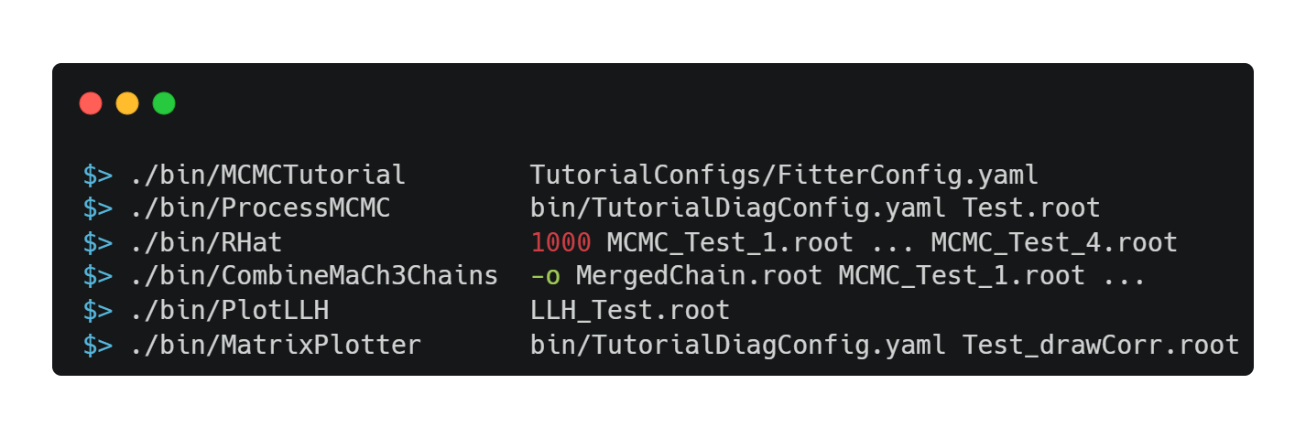
Motivation Problem 1: A Sprawl of Binaries
Before this work, MaCh3 shipped one executable per task, each with its own argument conventions:
● No shared argument parsing conventions — some take configs first, some take ROOT files first, some take raw numbers
● No shared --help, no tab-completion, no discoverability
● Every new tool = a new ad-hoc CLI to learn
MaCh3 CLI | Unified User Interface
4
Notes:
Point out the inconsistency: compare the positional-argument order across these examples live - it's different in each one. That's the actual pain, not just 'there are many binaries.'

Slide 6
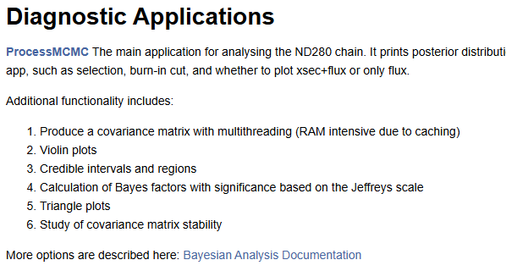
Motivation Problem 2: Inconsistent User Experience
For a user of the CLI tools, if help is needed then the main source would be the doxygen.
While this is very detailed in terms of implementational details it’s not always clear about usage instructions.
MaCh3 CLI | Unified User Interface
5
Notes:
Configs are the aspiration, not the problem - the problem is how much still can't be expressed there.

Slide 7
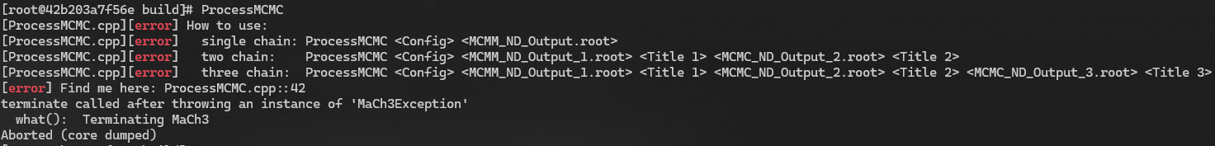
Motivation Problem 2: Inconsistent User Experience
For a user of the CLI tools, if help is needed then the main source would be the doxygen.
While this is very detailed in terms of implementational details it’s not always clear about usage instructions.
The CLI tools have some inline help, but it is limited and also aborts in an unfriendly way.
MaCh3 CLI | Unified User Interface
5
Notes:
Configs are the aspiration, not the problem - the problem is how much still can't be expressed there.

Slide 8
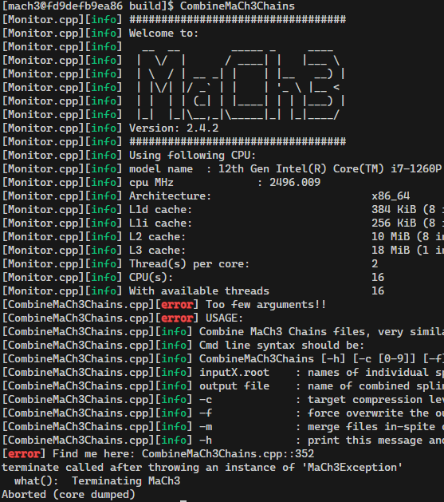
Motivation Problem 2: Inconsistent User Experience
For a user of the CLI tools, if help is needed then the main source would be the doxygen.
While this is very detailed in terms of implementational details it’s not always clear about usage instructions.
The CLI tools have some inline help, but it is limited and also aborts in an unfriendly way.
It can also be obfuscated with other output.
MaCh3 CLI | Unified User Interface
5
Notes:
Configs are the aspiration, not the problem - the problem is how much still can't be expressed there.

Slide 9
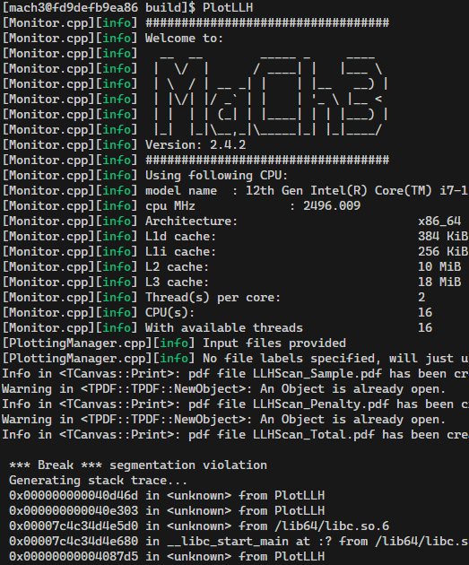
Motivation Problem 2: Inconsistent User Experience
For a user of the CLI tools, if help is needed then the main source would be the doxygen.
While this is very detailed in terms of implementational details it’s not always clear about usage instructions.
The CLI tools have some inline help, but it is limited and also aborts in an unfriendly way.
It can also be obfuscated with other output.
In some cases, the tool will crash
MaCh3 CLI | Unified User Interface
5
Notes:
Configs are the aspiration, not the problem - the problem is how much still can't be expressed there.

Slide 10
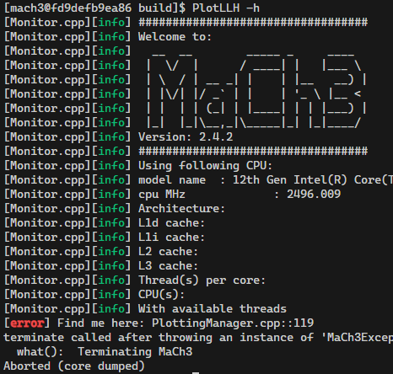
Motivation Problem 2: Inconsistent User Experience
For a user of the CLI tools, if help is needed then the main source would be the doxygen.
While this is very detailed in terms of implementational details it’s not always clear about usage instructions.
The CLI tools have some inline help, but it is limited and also aborts in an unfriendly way.
It can also be obfuscated with other output.
In some cases, the tool will crash
Or not have help at all
MaCh3 CLI | Unified User Interface
5
Notes:
Configs are the aspiration, not the problem - the problem is how much still can't be expressed there.

Slide 11
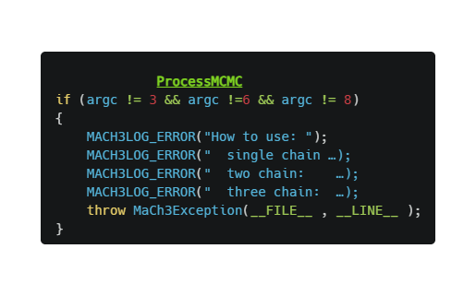
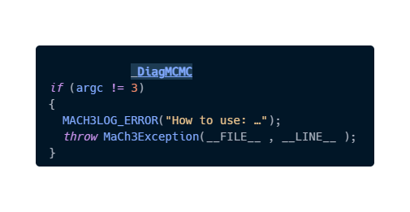
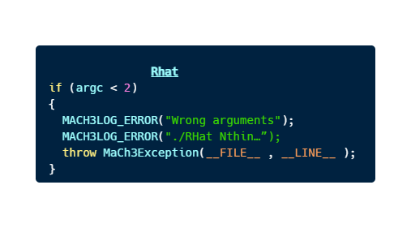
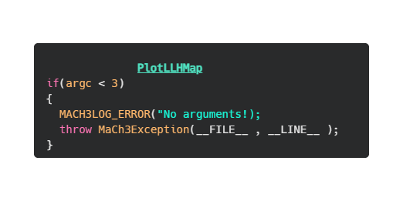
Motivation Problem 3: Repeated Boilerplate
As each app is standalone:
They must parse and sanitise their own arguments.
They must manually provide usage information
MaCh3 CLI | Unified User Interface
4
Notes:
Point out the inconsistency: compare the positional-argument order across these examples live - it's different in each one. That's the actual pain, not just 'there are many binaries.'

Slide 12
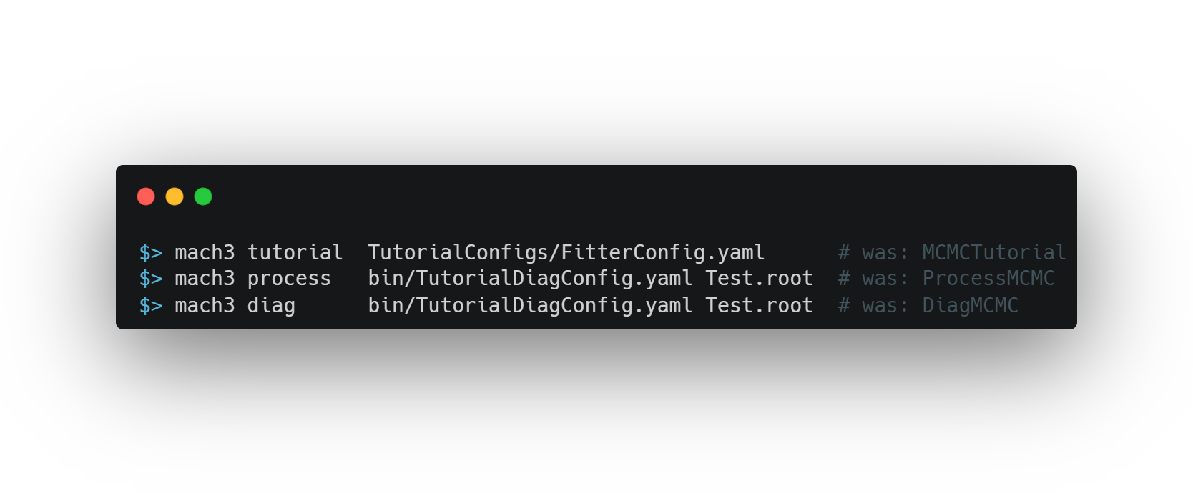
The Model: Look at git
● git is one binary with sub-commands: git commit, git log, git rebase — each with its own flags but a shared feel
● New functionality (git lfs, git flow) plugs in without bloating the core binary
● This is exactly the UX model adopted for MaCh3:
● One mach3 binary, with sub-commands for every task
MaCh3 CLI | Unified User Interface
10
Notes:
This is the single sentence that frames the rest of the talk: 'we did to MaCh3 what git did to a pile of scripts.'

Slide 13
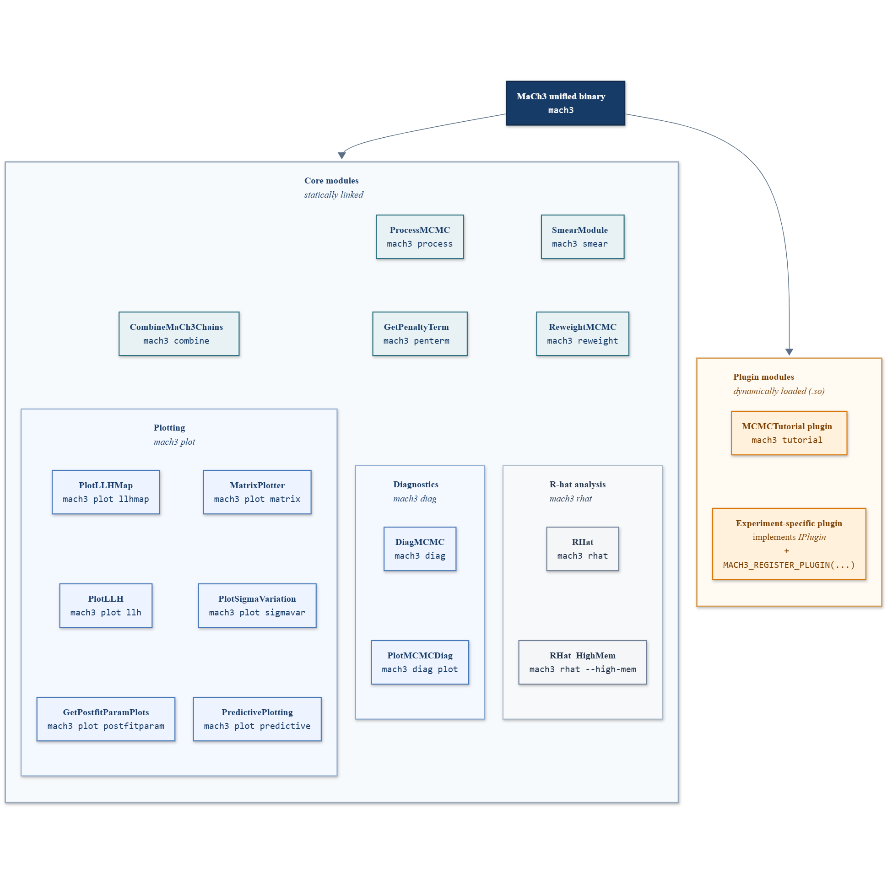
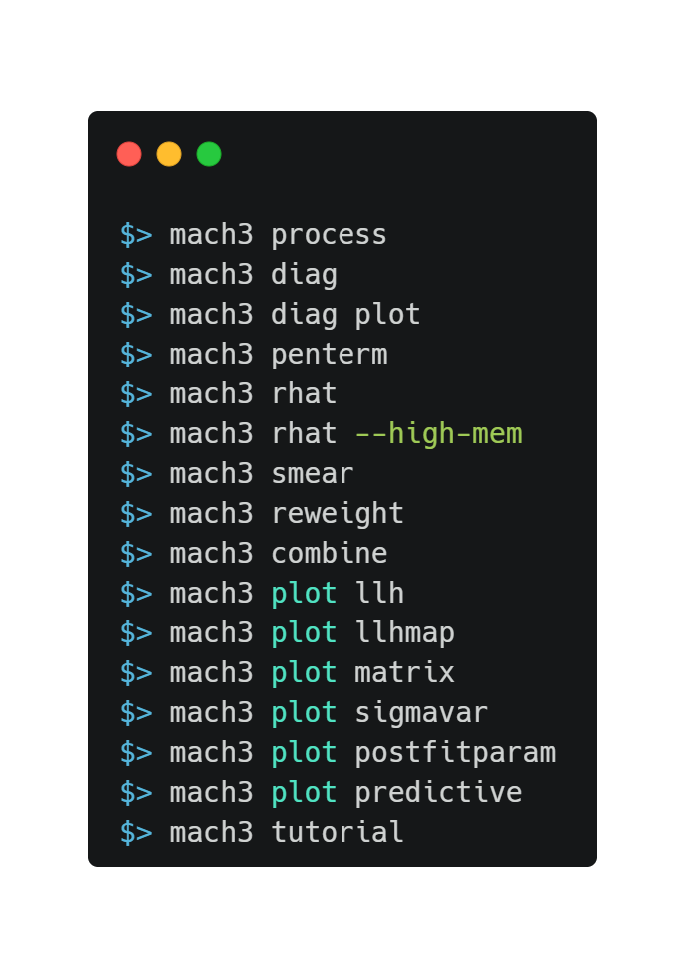
Unifying MaCh3 binaries
MaCh3 CLI | Unified User Interface
11
Notes:
Everything on this slide maps 1:1 to real classes in /CLI - not a conceptual sketch. Walk left to right: one binary, a fixed set of built-in modules, and an open-ended set of plugins loaded from .so files.

Slide 14
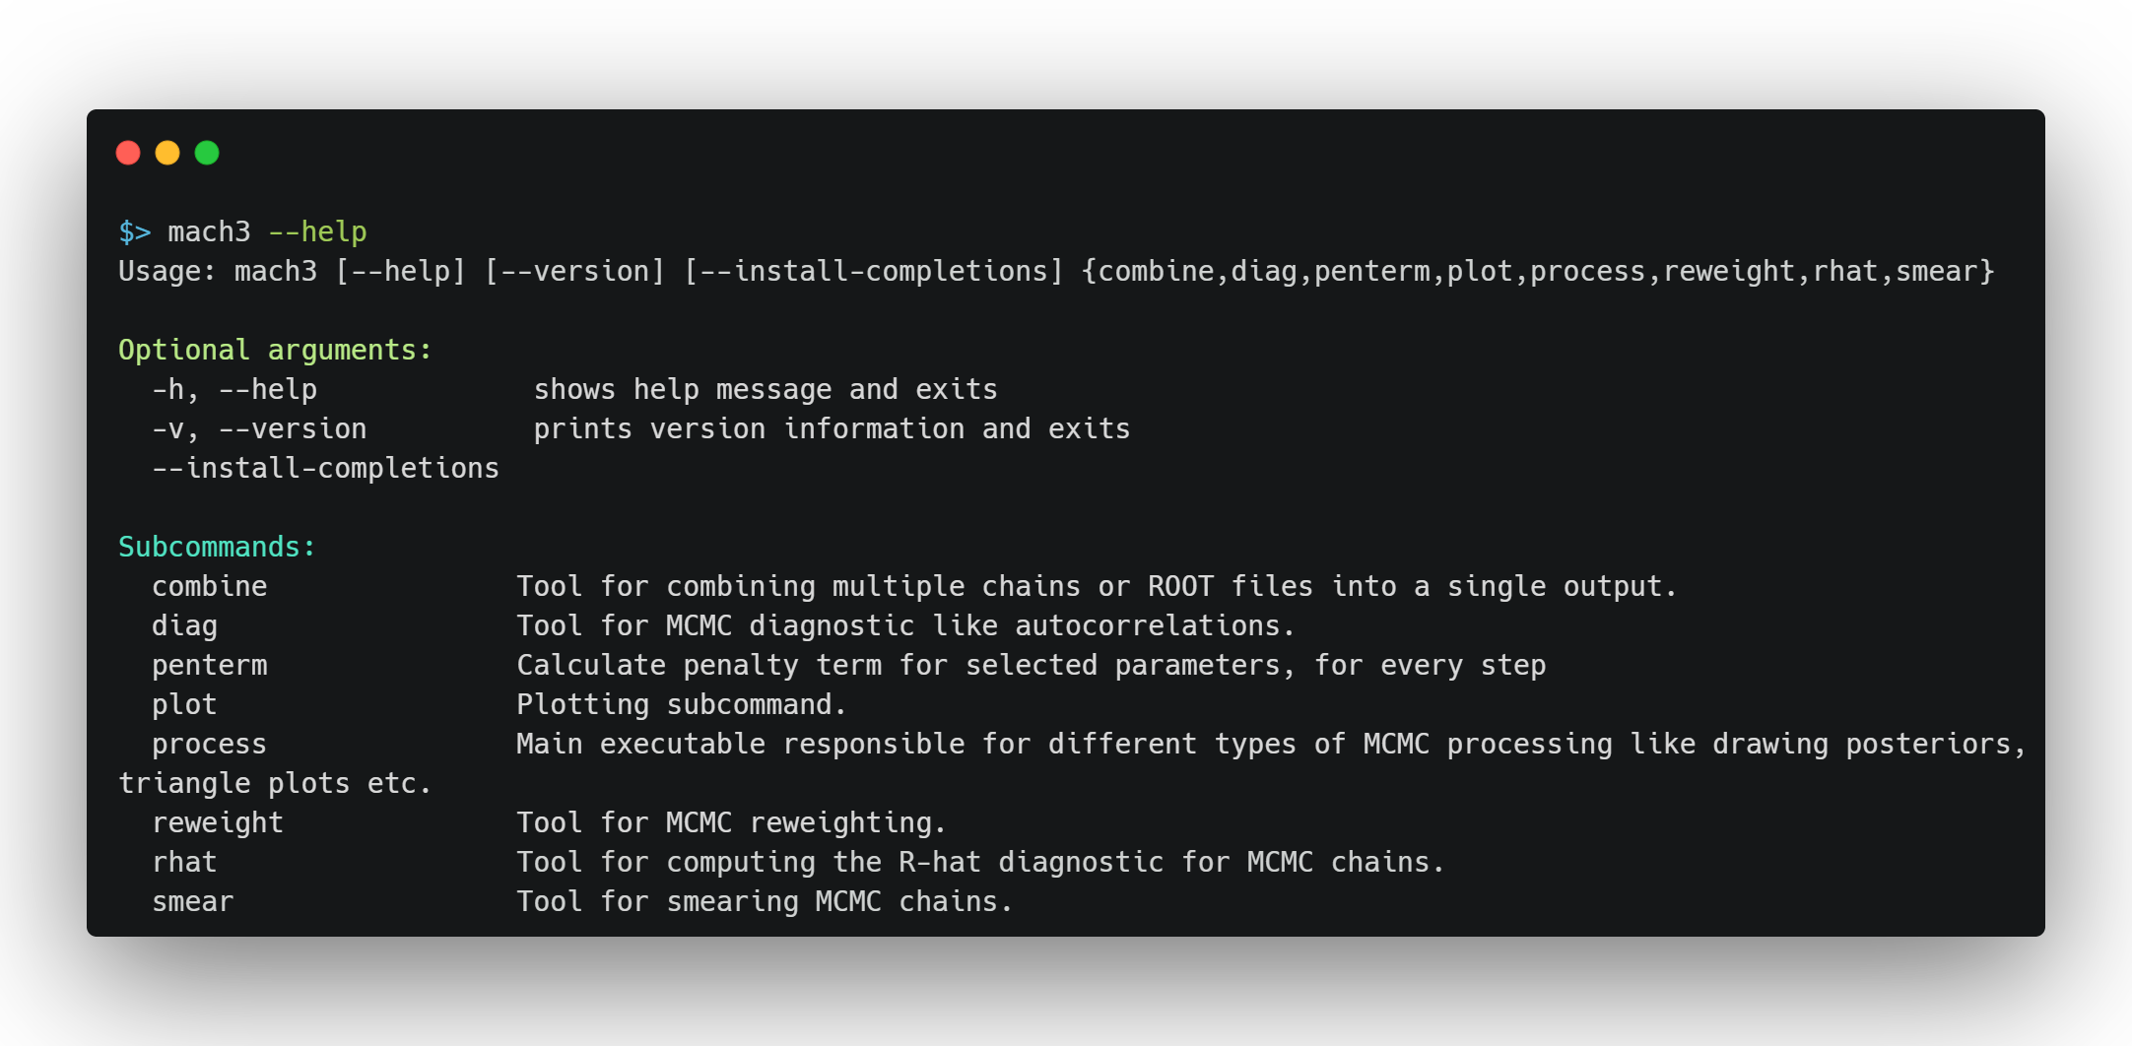
Coherent User interface
New unified structure gives a single coherent entry point with detailed inline help
MaCh3 CLI | Unified User Interface
11
Notes:
Everything on this slide maps 1:1 to real classes in /CLI - not a conceptual sketch. Walk left to right: one binary, a fixed set of built-in modules, and an open-ended set of plugins loaded from .so files.

Slide 15
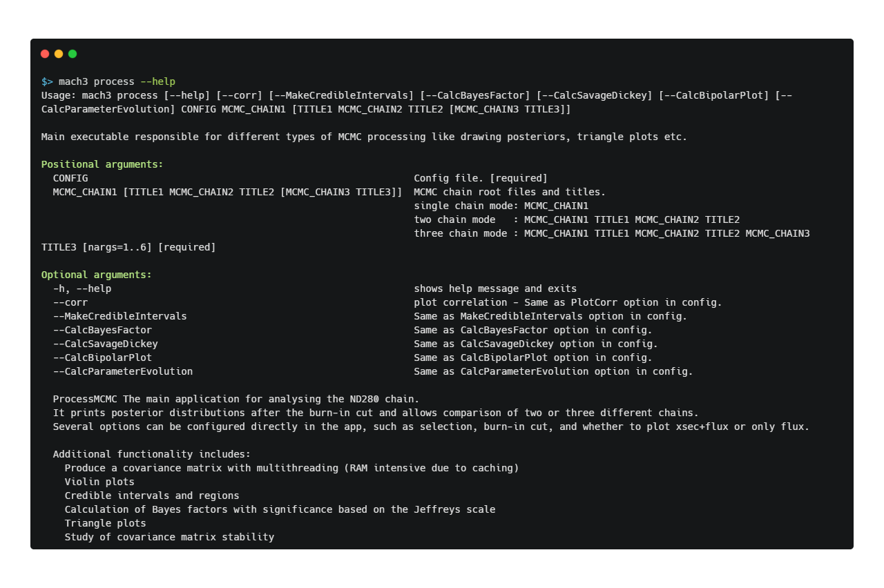
Coherent User interface
This extends to subcommands as well.
MaCh3 CLI | Unified User Interface
11
Notes:
Everything on this slide maps 1:1 to real classes in /CLI - not a conceptual sketch. Walk left to right: one binary, a fixed set of built-in modules, and an open-ended set of plugins loaded from .so files.

Slide 16
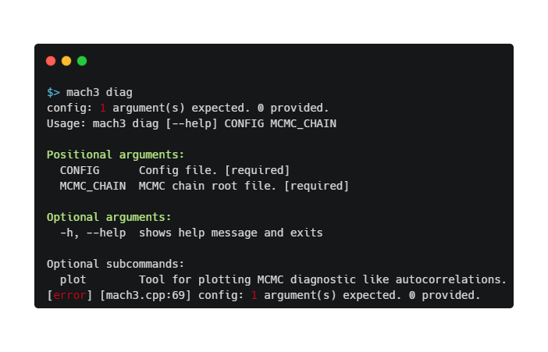
Coherent User interface
Incorrect usage will also print help along with a description of the usage error.
11
MaCh3 CLI | Unified User Interface
Notes:
Everything on this slide maps 1:1 to real classes in /CLI - not a conceptual sketch. Walk left to right: one binary, a fixed set of built-in modules, and an open-ended set of plugins loaded from .so files.

Slide 17
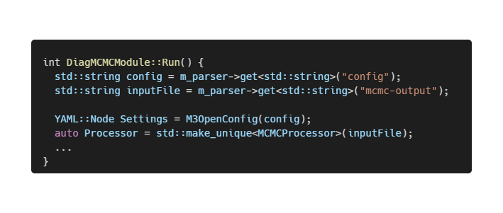
What about the boilerplate
Developer boilerplate problem required:
Module developers must parse and sanitise their own arguments.
MaCh3 CLI | Unified User Interface
11
Notes:
Everything on this slide maps 1:1 to real classes in /CLI - not a conceptual sketch. Walk left to right: one binary, a fixed set of built-in modules, and an open-ended set of plugins loaded from .so files.

Slide 18
What about the boilerplate
Developer boilerplate problem required:
Module developers must parse and sanitise their own arguments.
Parsers responsible for gathering and sanitising correct arguments and developers can just use them.
MaCh3 CLI | Unified User Interface
11
Notes:
Everything on this slide maps 1:1 to real classes in /CLI - not a conceptual sketch. Walk left to right: one binary, a fixed set of built-in modules, and an open-ended set of plugins loaded from .so files.

Slide 19
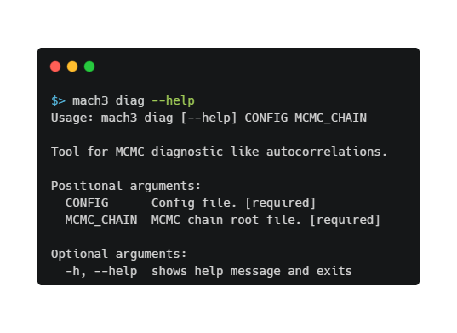
What about the boilerplate
Developer boilerplate problem required:
Module developers must parse and sanitise their own arguments.
Module developers must manually provide usage information
Parsers responsible for gathering and sanitising correct arguments and developers can just use them.
MaCh3 CLI | Unified User Interface
11
Notes:
Everything on this slide maps 1:1 to real classes in /CLI - not a conceptual sketch. Walk left to right: one binary, a fixed set of built-in modules, and an open-ended set of plugins loaded from .so files.

Slide 20
What about the boilerplate
Developer boilerplate problem required:
Module developers must parse and sanitise their own arguments.
Module developers must manually provide usage information
Parsers responsible for gathering and sanitising correct arguments and developers can just use them.
Sort of… Developers need to provide descriptions, but formatting and concatenation of options is provided.
MaCh3 CLI | Unified User Interface
11
Notes:
Everything on this slide maps 1:1 to real classes in /CLI - not a conceptual sketch. Walk left to right: one binary, a fixed set of built-in modules, and an open-ended set of plugins loaded from .so files.

Slide 21
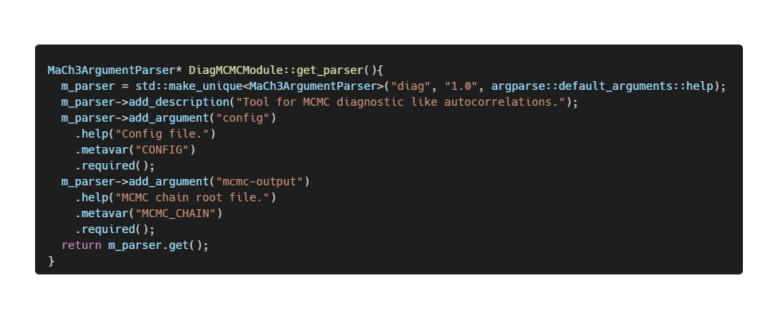
Nothing comes completely for free
Developers must still define the parsers options and descriptions:
However, …
This is more declarative (and easier to follow) than mysterious number of argc and argv
This should be familiar to Python programmers.
Hopefully you agree, It’s worth it for the achieved unified binary + subcommands style
Gives the possibility to consider creating one shot tools to create common options further negating excessive developer burden.
Can possibly use this to autogenerate Doxygen documentation for the cli commands meaning documentation is always up to date and in sync with interactive help, without the need for specific Doxygen comments
MaCh3 CLI | Unified User Interface
11
Notes:
Everything on this slide maps 1:1 to real classes in /CLI - not a conceptual sketch. Walk left to right: one binary, a fixed set of built-in modules, and an open-ended set of plugins loaded from .so files.

Slide 22
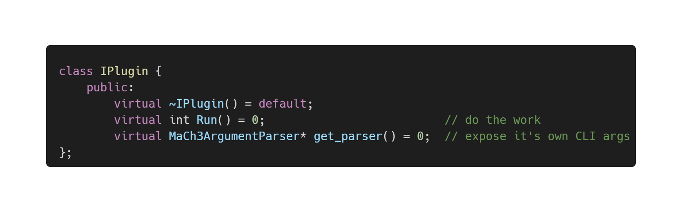
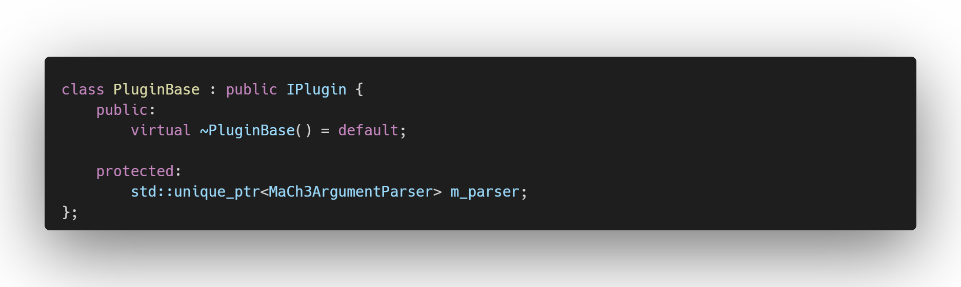
Under the hood: The Plugin Interface
Every sub-command, built in or external implements the same tiny interface
Aliased to IModule for core application sub-commands as this terminology was preferred by developers
Convenience abstract base class takes care of ensuring that all plugins (modules) have a parser member
Provides a layer for future abstraction
MaCh3 CLI | Unified User Interface
12
Notes:
Two methods. That's the entire contract a new sub-command has to satisfy. This simplicity is deliberate - it's what makes both 'core modules' and 'external plugins' the same concept underneath.

Slide 23
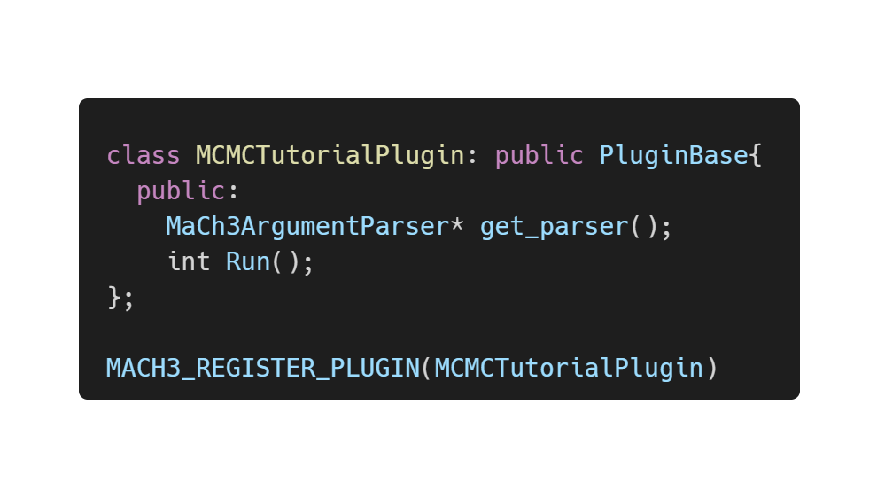
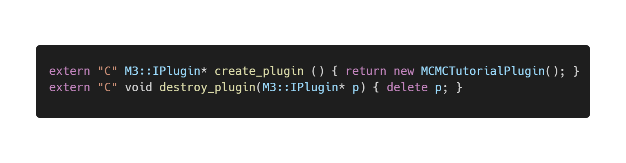
Example: Registering an External Plugin in One Macro
For code that lives outside the core MaCh3 repository (experiment-specific tools, tutorials, …):
Inherit from PluginBase
Compiled to shared library (.so)
A single macro MACH3_REGISTER_PLUGIN exposes a plain C ABI so it can be dlopen'd
MACH3_REGISTER_PLUGIN(MCMCTutorialPlugin) expands to:
MaCh3 CLI | Unified User Interface
13
Notes:
This macro is the entire bridge between 'code an experiment maintains privately' and 'a first-class mach3 sub-command.' No forking core MaCh3 required.

Slide 24
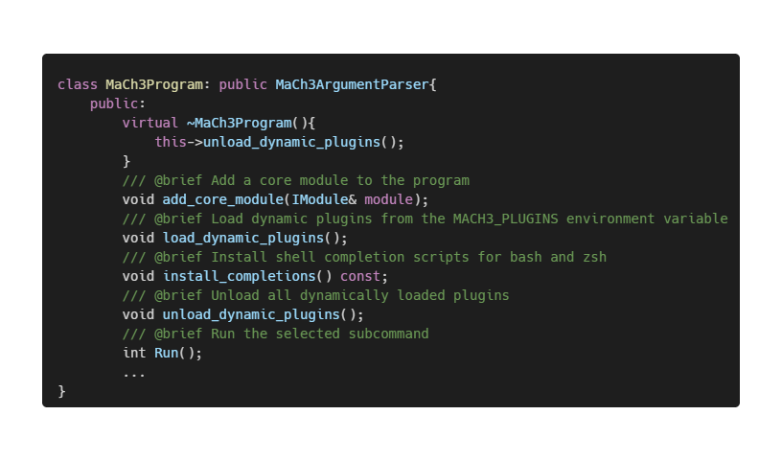
MaCh3Program: The top-level dispatcher
MaCh3Program is the top-level dispartcher as well as argparser. It is responsible for:
Collecting together arguments for the top-level mach3 binary
Accumulating core modules for dispatch
Loading and unloading dynamic plugins for dispatch
Setting up parser tree from core modules and plugins
Parsing command line arguments
Dispatching to the correct sub-command
Installing completion scrips and running completions
● add_core_module
registers a compiled-in module as a sub-parser
● load_dynamic_plugins
reads MACH3_PLUGINS (colon-separated paths/dirs), dlopen's each .so, calls its create_plugin, and registers it exactly like a core module
● Run
finds whichever sub-command the user actually typed and forwards to its Run(), whether that's a built-in module or a dynamically loaded plugin — the dispatcher does not care which
● install_completions
shell tab-completion support (bash & zsh)
MaCh3 CLI | Unified User Interface
15
Notes:
Highlight that built-in and dynamic sub-commands are indistinguishable to the dispatcher - this is what makes the plugin system a real extensibility point rather than a bolt-on.

Slide 25
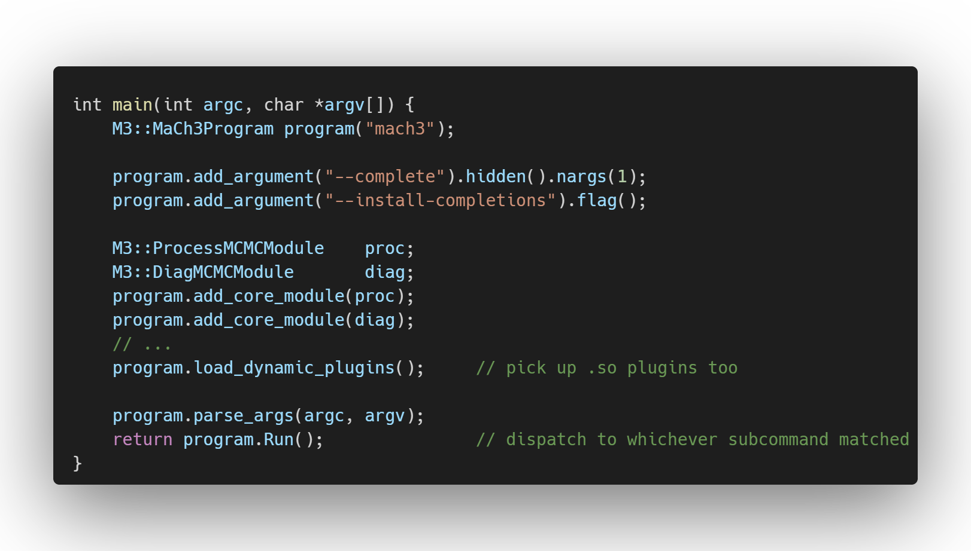
mach3.cpp: Wiring It All Together
The main mach3 executable code is now streamlined and concise.
MaCh3 CLI | Unified User Interface
14
Notes:
This is the actual, current main(). Point out how uniform it is - adding a brand-new built-in tool is 'write a module, add two lines here.' Contrast directly with the binary-sprawl slide's six independent main()s.

Slide 26
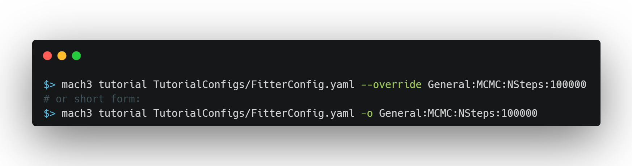
Nice Side-Effects of Unifying the CLI
Because there's now exactly one binary and one argument-parsing framework:
● We provide shell tab-completion for free:
  mach3 --install-completions, then
  mach3 <TAB> lists sub-commands
  mach3 process --<TAB> lists that sub-command's flags
● Discoverability: mach3 --help, mach3 tutorial --help, mach3 process --help all behave consistently
● One install / one PATH entry, rather than a bin/ directory full of loosely related executables
● Uniform way of implementing config overrides across sub-commands (see example below)
● Previously overrides were only viable for binaries using the main config file as other binaries would interpret the extra command line args as input files
MaCh3 CLI | Unified User Interface
16
Notes:
These are the 'boring but high value' UX wins - the kind of thing a user notices on day one even if they never read the source.

Slide 27
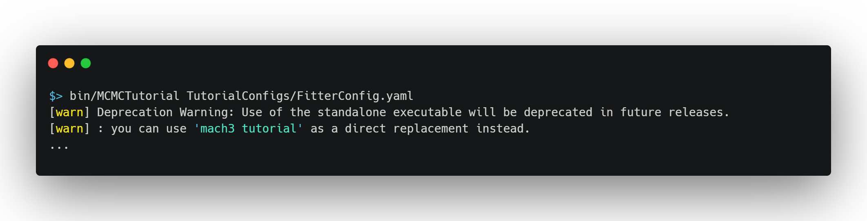
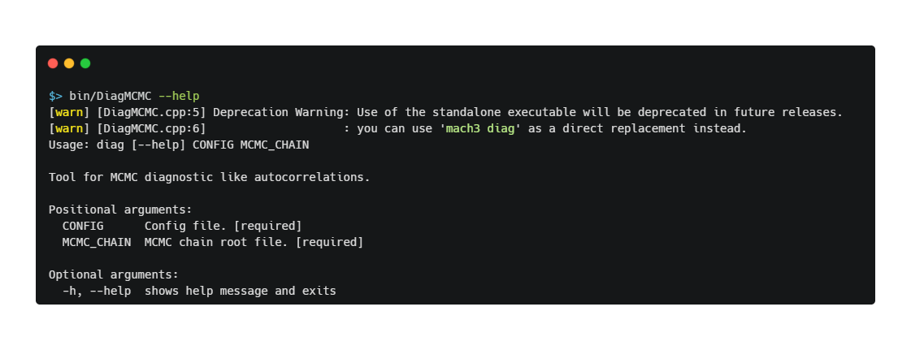
Smooth Migration …
The rollout is intentionally incremental:
● Old standalone binaries still exist for now but print a deprecation warning pointing at the new sub-command (see below)
● The old binaries are simple wrappers around the new sub-commands with the added benefit of getting new-style help for free
MaCh3 CLI | Unified User Interface
17
Notes:
Reassure collaborators in the audience: nothing breaks overnight, and migrating an experiment's private executable is a small, local change they can do themselves.

Slide 28
Smooth Migration …
The rollout is intentionally incremental:
● Not every old executable has an equivalent sub-command yet — the tutorial docs explicitly flag this
May not actually be true by the time of this talk – PR basically ready
● Experiment-specific executables can be migrated independently, at their own pace, by wrapping
existing logic in an IPlugin and registering it — no need to wait for a core MaCh3 release
MaCh3 CLI | Unified User Interface
17
Notes:
Reassure collaborators in the audience: nothing breaks overnight, and migrating an experiment's private executable is a small, local change they can do themselves.

Slide 29
Summary
● MaCh3's user interface has three layers: binaries, YAML, and C++ — and we have been addressing the first
● The new mach3 CLI improves the user’s day to day experience
  Single binary gives a cohesive feel to software
  git-style sub-commands
  Shell completion
  Ability to have uniform config overrides (including explicit options for common flags)
● It does not address the other UI layers — but it gives us the stable foundation to consider improvements to them.
  A shared IPlugin interface
  A stable plugin ABI (IPlugin + MACH3_REGISTER_PLUGIN) with dynamic plugin loading to ship extensions as plugins without bloating the main executable.
  A single, consistent argument-parsing surface is the natural place to have CLI schema definition and validation
Try it today: mach3 tutorial TutorialConfigs/FitterConfig.yaml
MaCh3 CLI | Unified User Interface
20
Notes:
End on the call to action - get people to actually run the one-liner during/after the talk.

Slide 30
Questions?
Thank you.
MaCh3 CLI | Unified User Interface
21
Notes:
Open the floor. Keep the tutorial one-liner from the summary slide visible if possible while taking questions.

