Slide 1
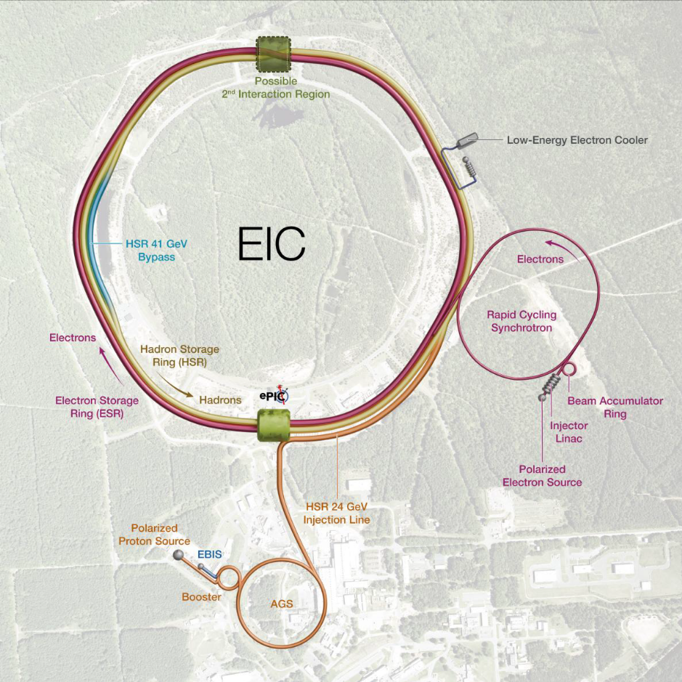


New optics for IR12 developed by the EIC UG 2nd detector WG
IR12
Pawel Nadel-Turonski
Vasily Morozov
IR8
IR6
Supported by NSF award PHY-2514907.
EIC IR12 meeting, September 2, 2026

Slide 2
The EIC user group 2nd detector working group
Formed in 2022 following DPAP and the establishment of the ePIC collaboration
The current focus is on developing the far-forward detection and a strawman design of the central detector to be used in simulation tools reflecting the envisioned capabilities of a 2nd detector
We aim for a short publication early next year and then starting the work on a longer white paper
Conveners
  Anselm Vossen (Duke U) anselm.vossen at duke.edu (chair of the EIC UG steering committee)
  Björn Schenke (BNL) bschenke at bnl.gov
  Charles Hyde (ODU) chyde at odu.edu
  Pawel Nadel-Turonski (U of SC) turonski at sc.edu
  Simonetta Liuti (UVA) sl4y at virginia.edu
  Vasiliy Morozov (ORNL) morozovvs at ornl.gov
  Wenliang “Bill” Li (MS State U) wenliang.li at msstate.edu
  Liaison from the EIC UG SC: Charlotte van Hulse (Vrije Universiteit) charlotte.barbara.van.hulse at cern.ch

Slide 3
Science impact of an IR with a second focus
3D imaging of the proton and gluon saturation in nuclei are key goals of the EIC program
A detector with improved forward detection enabled by a second focus can help the EIC to deliver on both the goals above and create many new opportunities for eA.
The impact of the improved forward detection on saturation studies can exceed that of an electron beam energy upgrade.

Slide 4
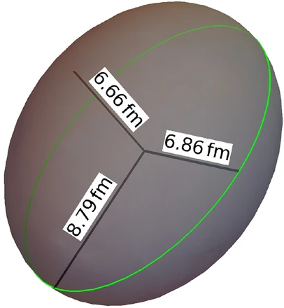
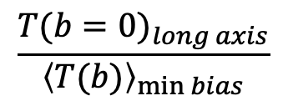
²³⁸U – using deformed nuclei to increase the effective nuclear thickness
At the EIC, nuclei will be used to probe the transition to gluon saturation
  where T(b) is the nuclear thickness as a function of the impact parameter
  and E_{e} and E_{A} are the electron and ion beam energies, respectively.
²³⁸U
$$Q_{s}^{2}∼A^{1/3}/x^{0.3}∼T(b)∙{\left(E_{e}E_{A}\right)}^{0.3}$$
Striking the nucleus centrally along the long axis creates an enhancement
$$\frac{{T(b=0)}_{long axis}}{{\left\langle T(b)\right\rangle }_{\min{bias}}}$$
This is equivalent to a very substantial increase in E_{e}.
  A preliminary study showed that selecting a subsample of a few percent of the events using the final-state information from the second focus could be equivalent to a factor 4.5 increase in E_{e}.
  A more comprehensive evaluation using ML-methods is underway (Fanelli, Schmookler, Li, Vossen, PNT)
PNT et al, POETIC8, Regensburg, Germany (2018)

Slide 5
The nuclear final state
In high-energy eA scattering most nuclei can fission, but ²³⁸U fissions most of the time.
B. Schmookler et al.
Evaporation
An event with a large thickness is likely to produce more breakup, but the forward activity is more than ”evaporation” neutrons.
  Fission fragment produce neutrons. The number depends on which fragments are produced.
  Protons and light ions are also emitted.
Fission fragments
e + ²³⁸U from BeAGLE
5
With a second focus we can detect the complete final state including the fission fragments.
This will also make it possible to study the fragments themselves in search of rare isotopes.
Gamma photons from their de-excitation can reveal the internal structure
Of interest to the FRIB community.

Slide 6
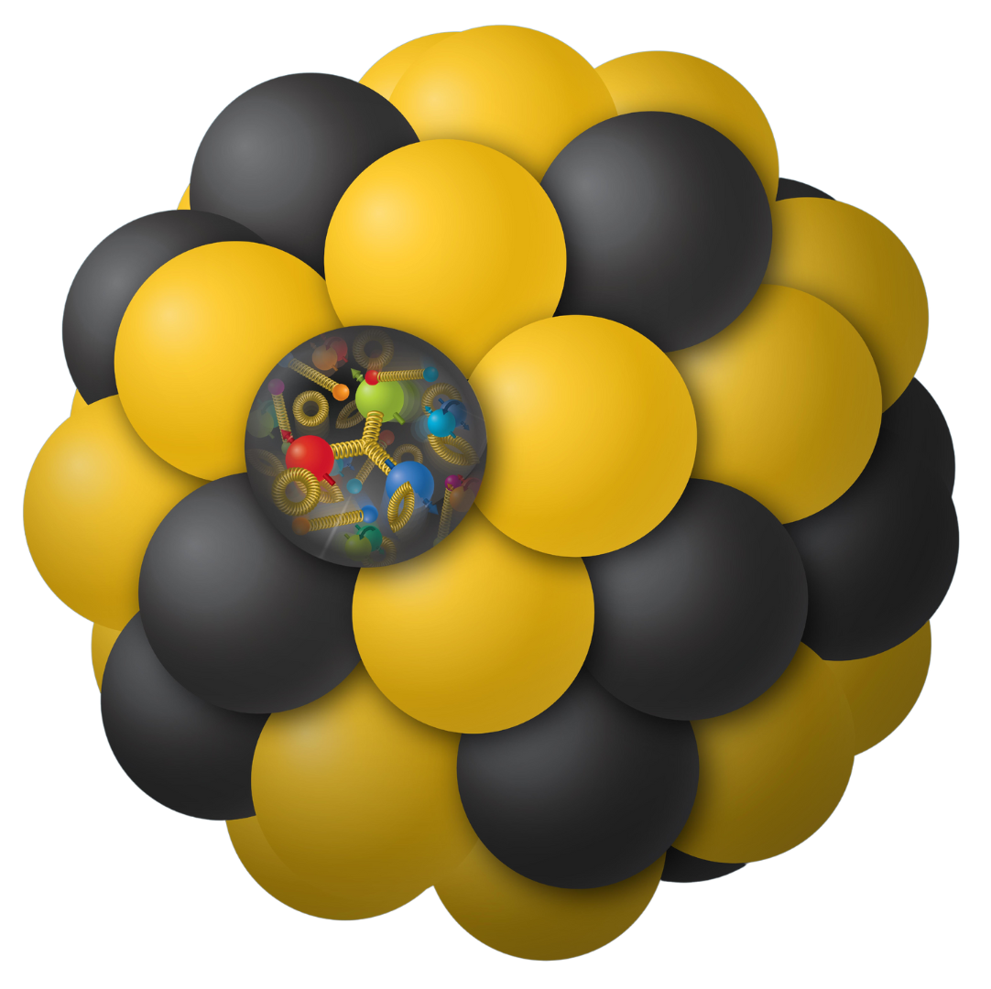
Bound and quasi-free nucleon structure through spectator tagging
The EIC forward detectors make it possible to measure processes on a single nucleon in coincidence with spectator nucleons and nuclei.
  Due to final-state interactions this is essential for interpretation.
Quasi-free neutron structure can be accessed by measuring the spectator proton(s) in deuterium or polarized ³He.
Bound nucleon structure can be accessed by measuring the spectator nucleus (A-1 system).
The ePIC forward detectors are good for spectator protons, but a 2nd EIC detector would be able measure A-1 nuclei over the full mass range.

Slide 7
Coherent nuclear processes
Light ions
Access to 3D structure (GPDs)
  Exclusive reactions like DVCS, DVMP
  Combines spin and nuclei
Recoiling ion is detected in Roman pots
  ePIC can detect ³He over a range in t, but a second focus would be essential for heavier light ions such as ⁴He and Li. (⁶Li and ⁷Li could be polarized in the future).
⁴He
Medium- and heavy ions
1 fm⁻¹ = 0.2 GeV
1 fm⁻² = 0.04 GeV²
10 fm⁻² = 0.4 GeV²
20 fm⁻² = 0.8 GeV²
Coherent diffraction
  Spacing of minima is reduced at larger A
Incoherent events are separated by vetoing of breakup
  Detection of neutrons, protons, and photons
  With a 2nd detector also light ions and nuclear fragments

Slide 8
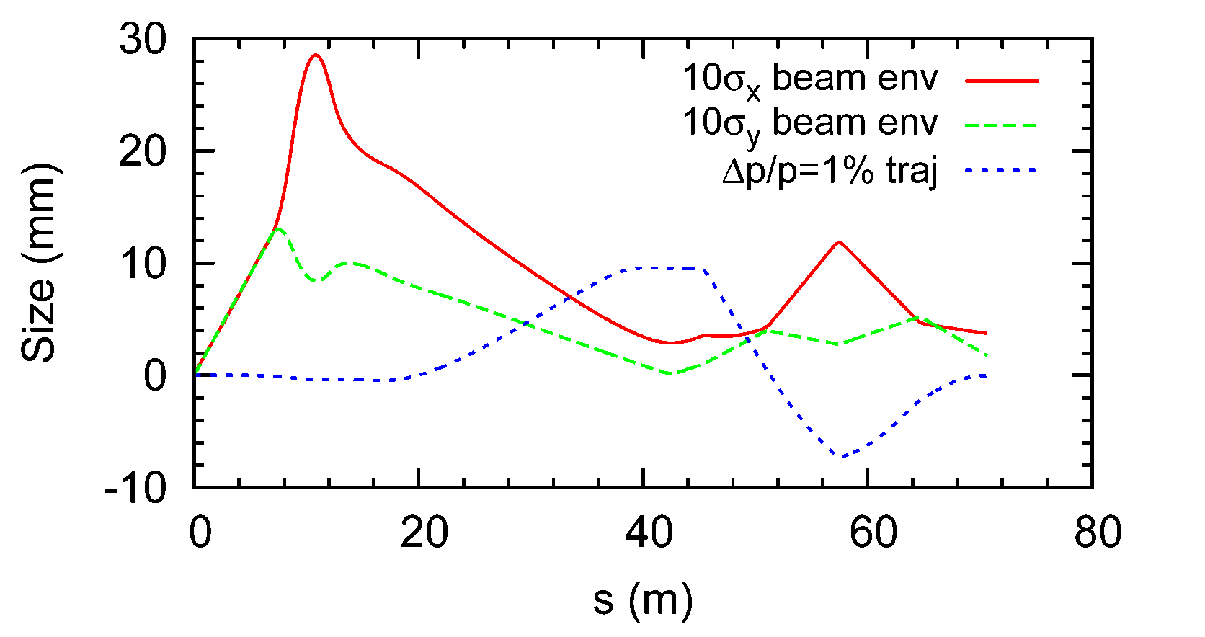
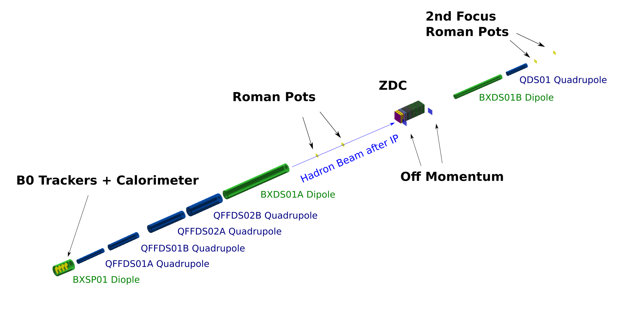
How the second focus works (older optics)
Idea: make the beam small at the location where the transverse displacement of scattered particles is the greatest
  Displacement: dr = dispersion * dp/p
  In DIS, dp/p ~ x_{B}
Trajectory in the dispersive (x) plane
A particle (blue) initially scattered at 0 degrees (p_{T} = 0) briefly emerges from the beam at the second focus about 40 m downstream where it can be detected
  Compare trajectory with horizontal (red) beam size
  Particles with p_{T} > 0 emerge earlier

Slide 9
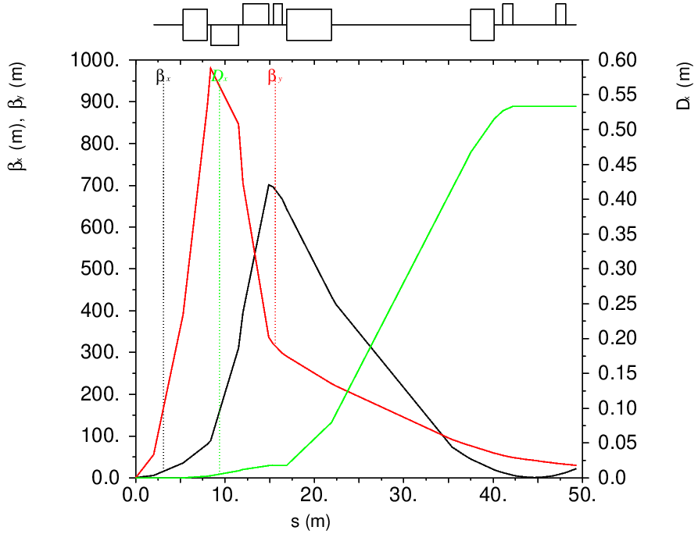
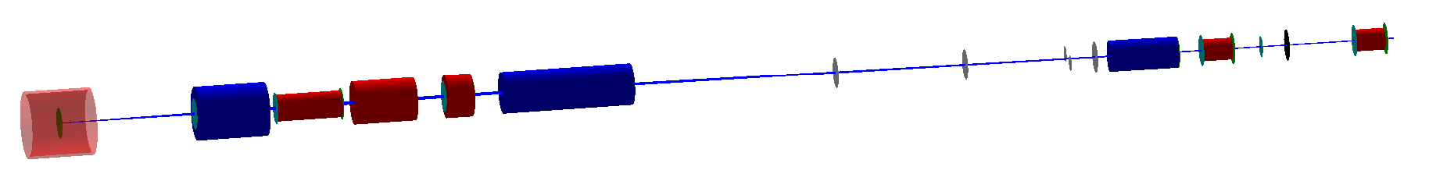
New ion optics for forward detection with a second focus in IR12
An IR featuring the the novel idea of having a second focus to enhance the forward detection was originally developed for the JLab version of the EIC by V. Morozov and PNT.
(horizontal) dispersion
It was then quickly adapted by V. Morozov for IR8 of the EIC @ BNL before moving from JLab to ORNL. Then the design was prematurely frozen.
As part of the EIC UG D2 WG activities, an updated design of the forward ion optics for IR12 is now ready to be implemented in the simulation tools for a 2nd detector that the WG is developing.
second focus
detector solenoid
Geant simulation
B0 dipole
B1 dipole
second focus
off-momentum detectors
FFQ: final-focus quadrupoles

Slide 10
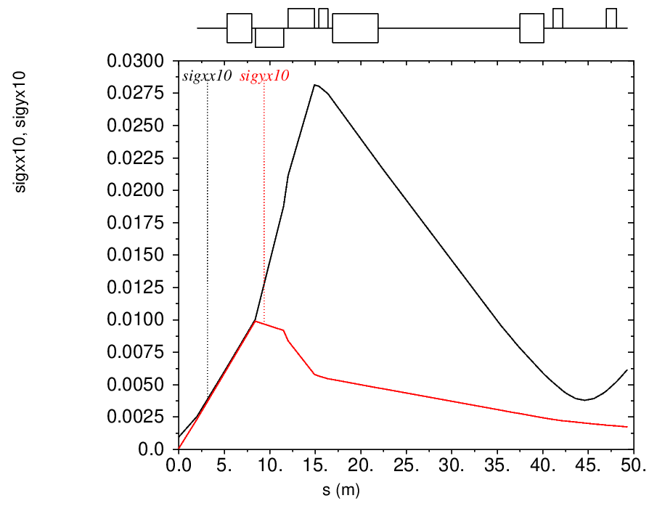
Beta functions and beam sizes
(horizontal) dispersion
275 GeV proton beam
10σ beam stay clear
second focus
second focus
V. Morozov
The new optics reduces (horizontal) $β_{x}^{max}$ by half, improving both acceptance and accelerator integration.
Due to different h/v emittances and no vertical dispersion, the vertical beam size is still smaller at the second focus.
This allows shifting the vertical focus beyond the horizontal, dispersive one (the location of the Roman pots).

Slide 11
New ion optics for IR8 or IR12
A second focus with a large horizontal dispersion improves low-p_{T} acceptance.
  Enables detection of particles with dp/p > 0.7% even at zero degrees (p_{T} = 0)
  The dispersion shifts particles out of the beam and spreads them out along the trackers
  The second focus makes the beam smaller at the Roman pot location.
  The balance between dispersion and focusing is relatively straightforward to adjust.
(horizontal) dispersion
second focus
A more compact B0/FFQ/B1 “block” improves high-p_{T} acceptance and reduces magnet specs
detector solenoid
Geant simulation
B0 dipole
B1 dipole
second focus
off-momentum detectors
FFQ: final-focus quadrupoles

Slide 12
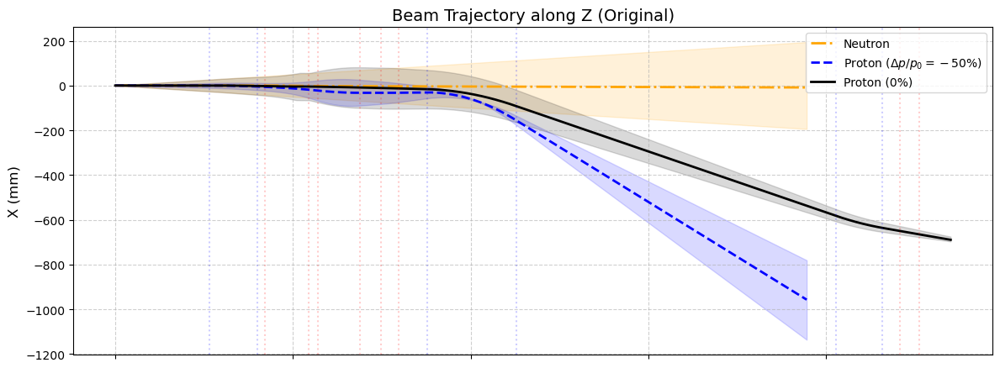
Large-p_{T} acceptance (first pass)
First-pass apertures
  Full transport for +/- 5 mrad neutrons.
  Full transport for spectator protons from deuterium.
  Losses for recoil protons only in first quadrupole.
+/- 5 mrad neutrons
spectator protons
recoil protons
Quad peak fields equal to or smaller than for ePIC@IR6.
V. Morozov, T. Roth, K. Gopal, PNT
detector solenoid
B1 dipole
B0 dipole
second focus
off-momentum detectors
FFQ: final-focus quadrupoles

Slide 13
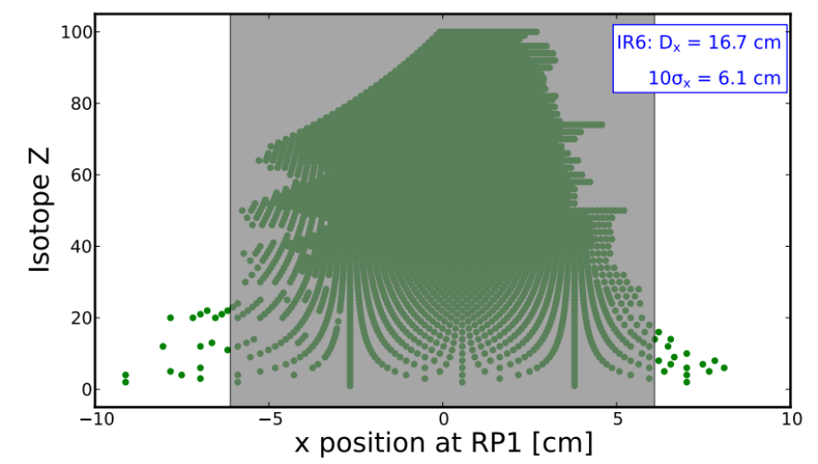
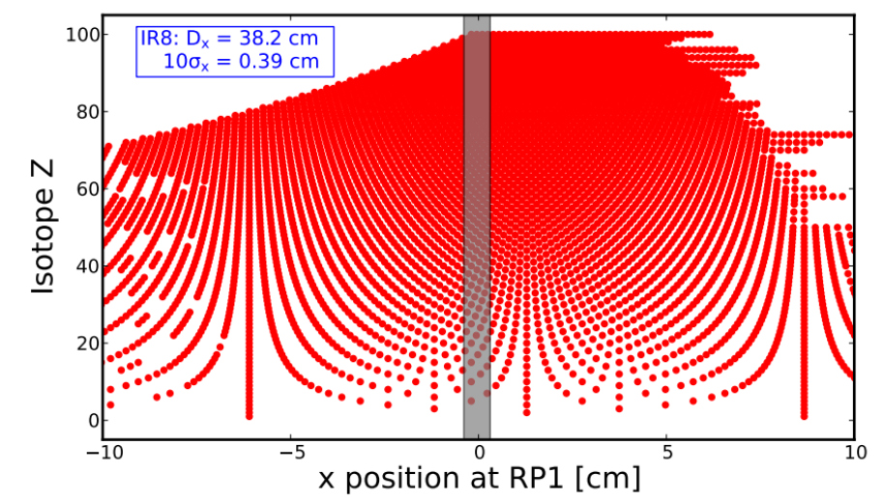
EIC far-forward acceptance with and without a second focus (older optics)
Ion fragments from ²³⁸U
Exclusive protons
IR6
(x_{L} = p’ / p_{beam} ~ 1 – x)
$$p_{⊥}$$
Excluded
Without 2nd focus: (ePIC @IR6)
Detected
IR6
Detected
Detected
Excluded
0
< 0.9
1
$$x_{L}$$
Limited by D and second focus (β₂)
Limited by angular spread at IP (β*)
$$p_{⊥}$$
With 2nd focus: (Detector 2 @ IR8/12)
excluded
Order-of-magnitude improvement in forward acceptance
Detected
IR8/12
detected
detected
Excluded
0
0.99
1
$$x_{L}$$
IR8/12
x position ~ A/Z
Horizontal log scale

Slide 14
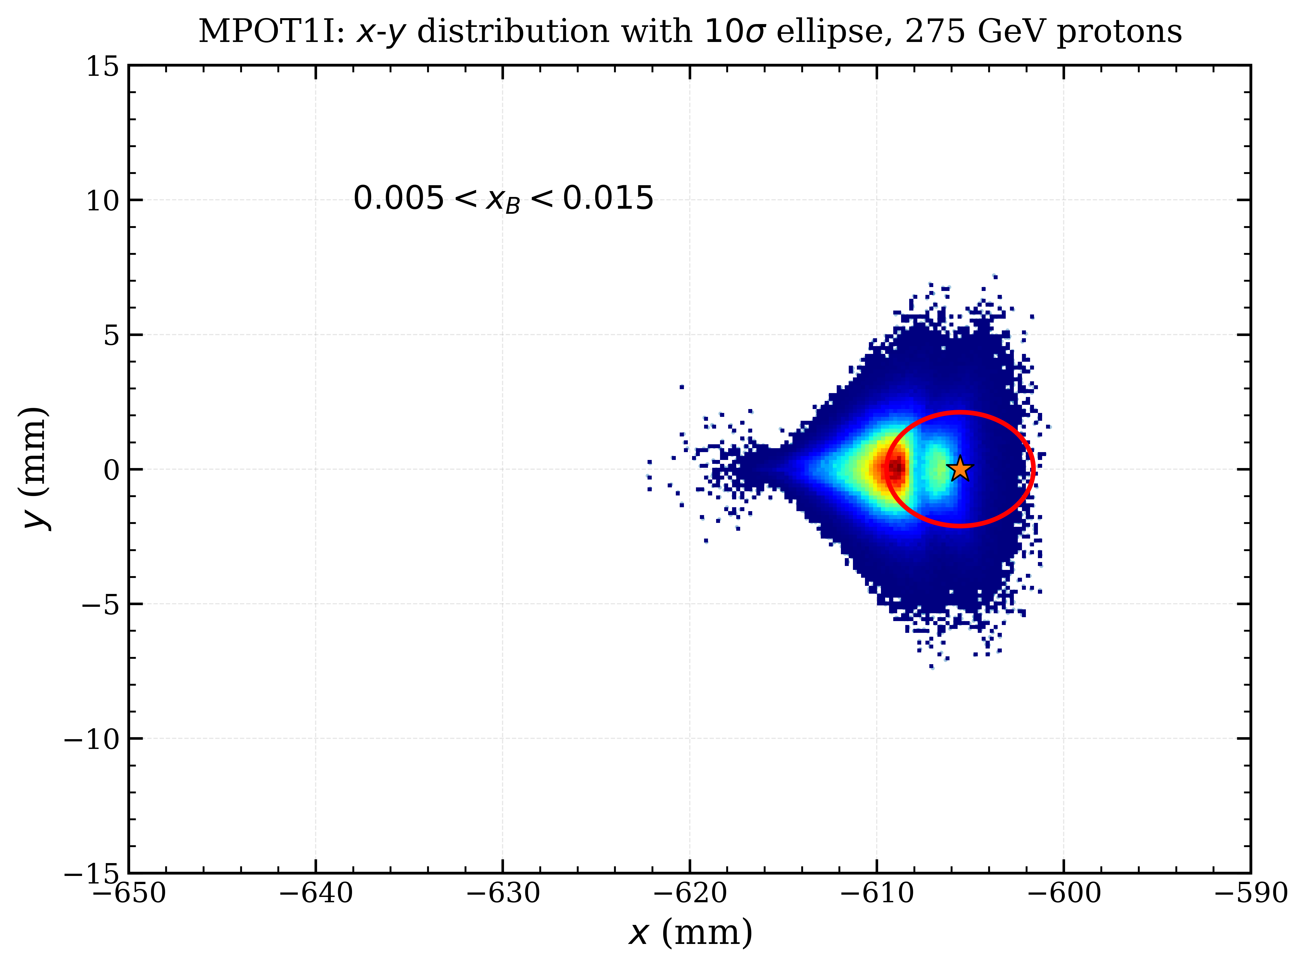
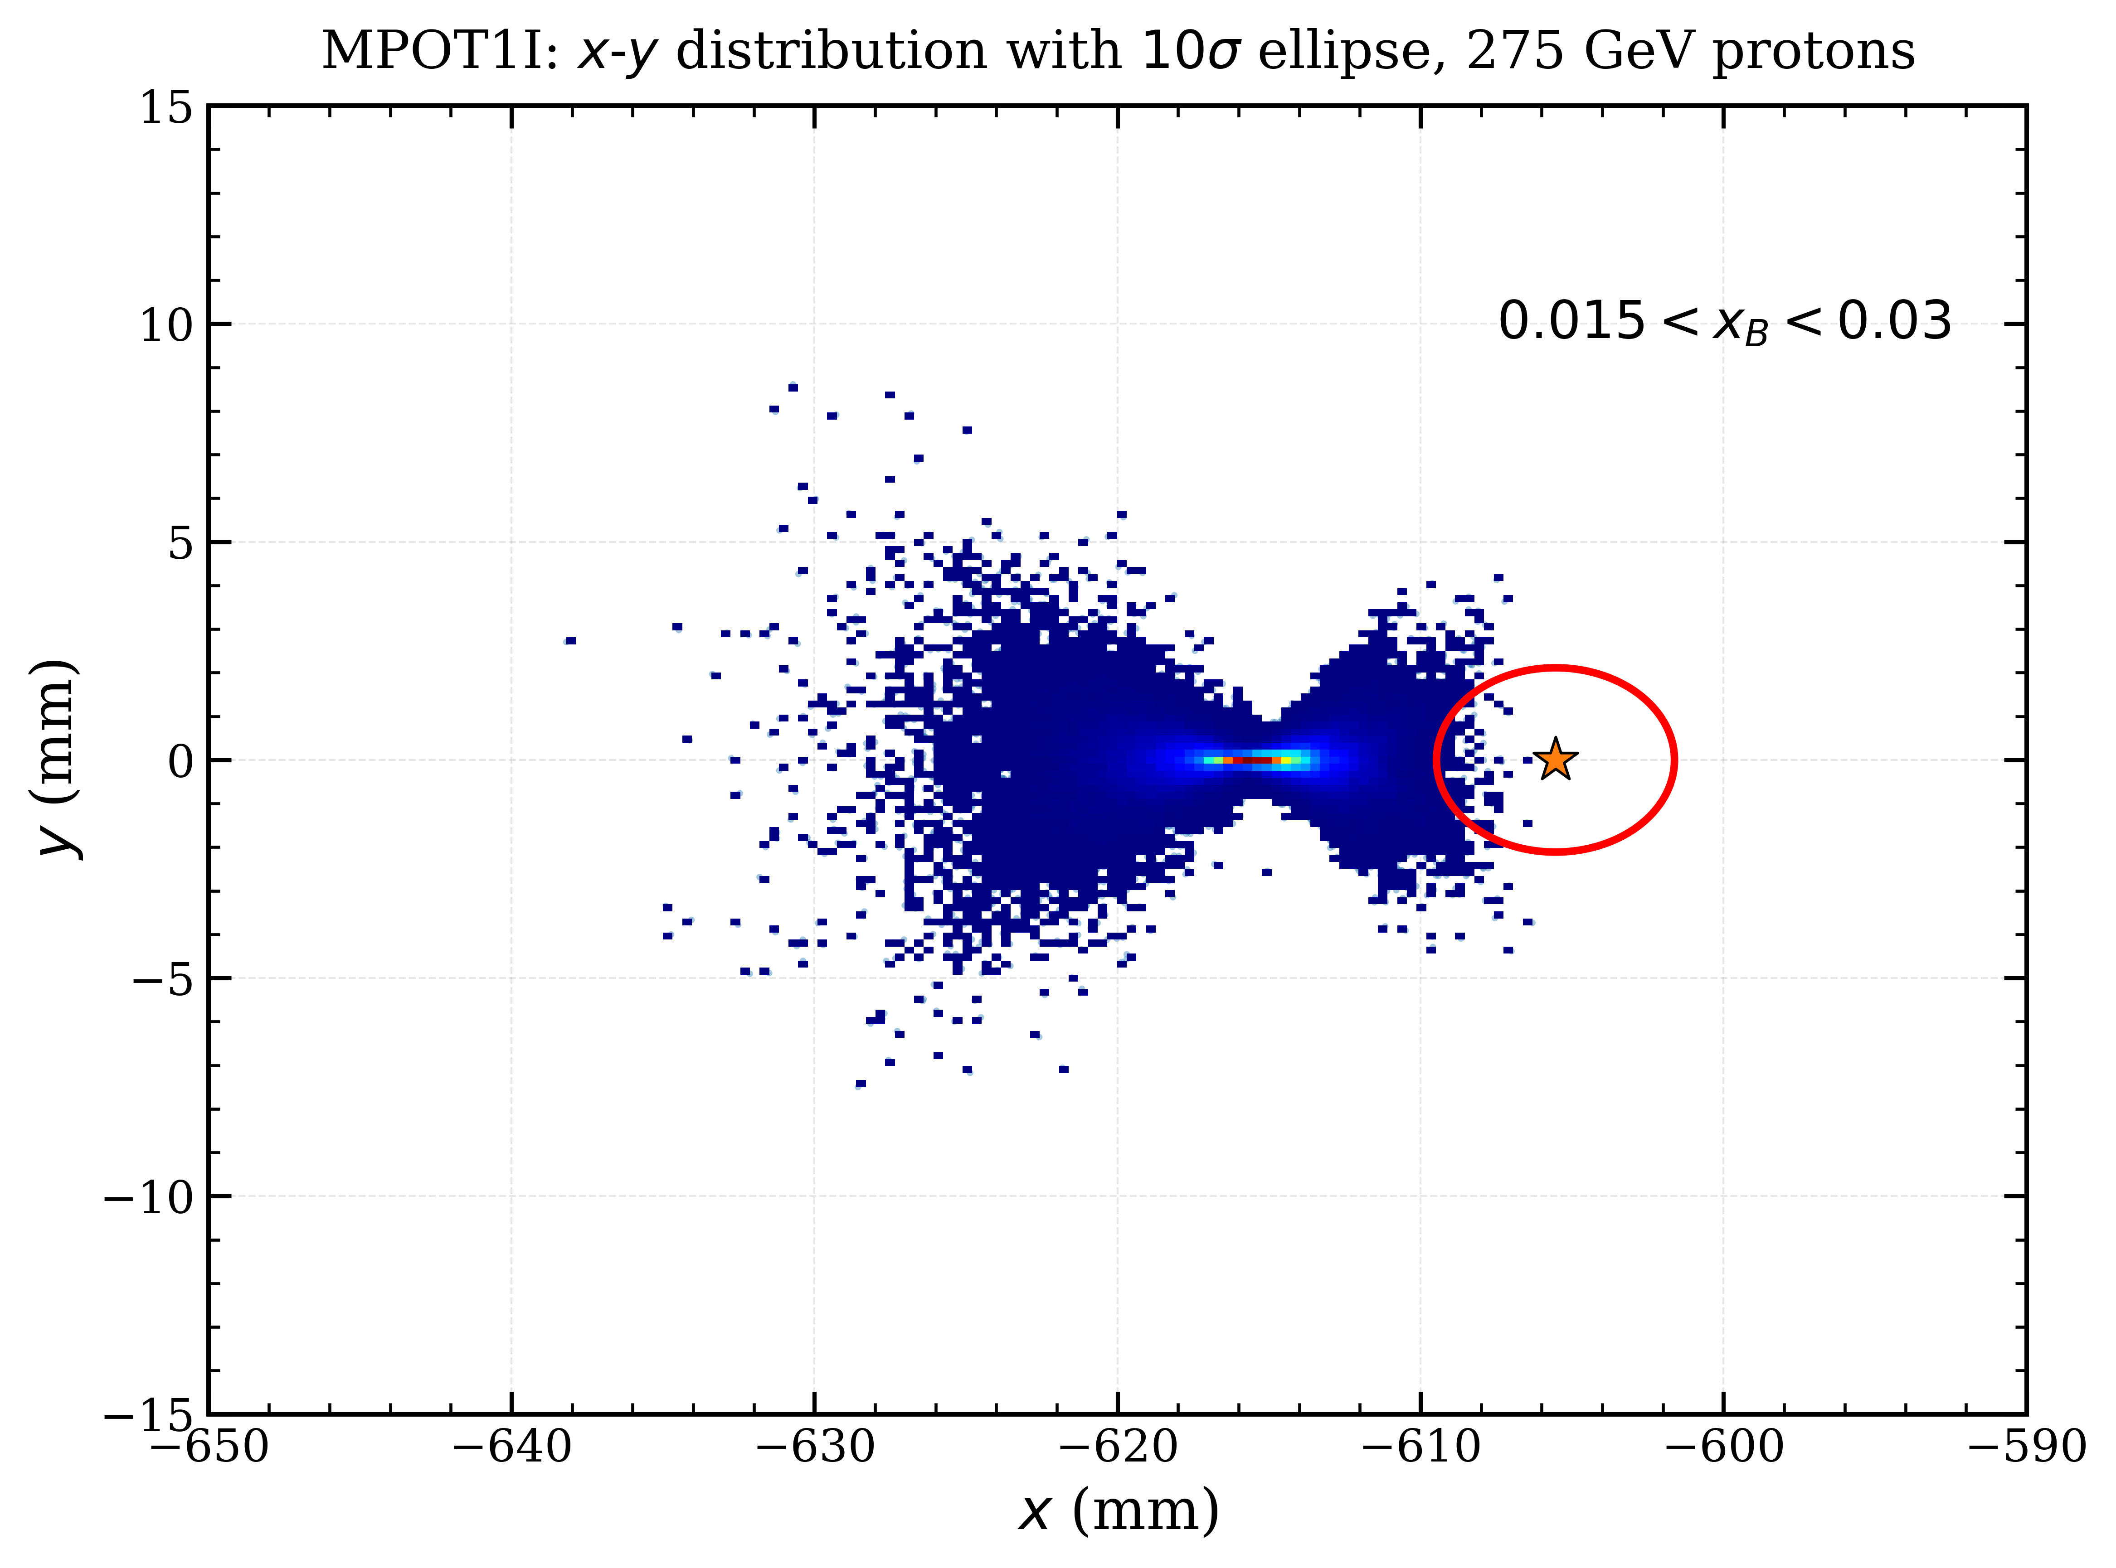
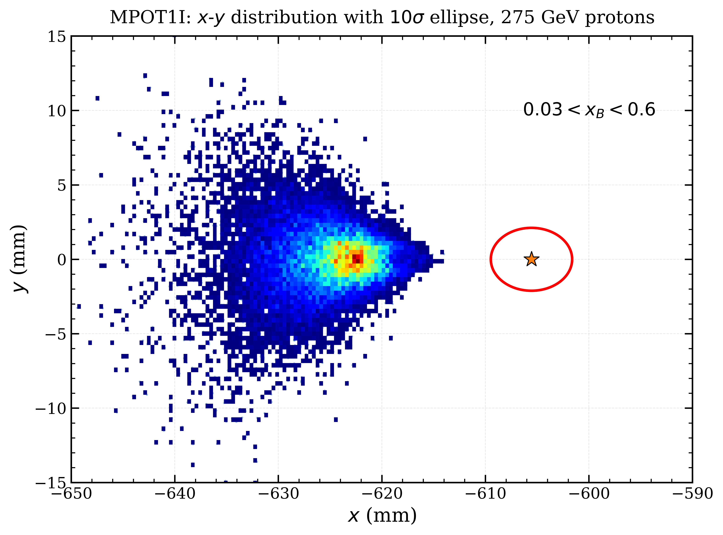
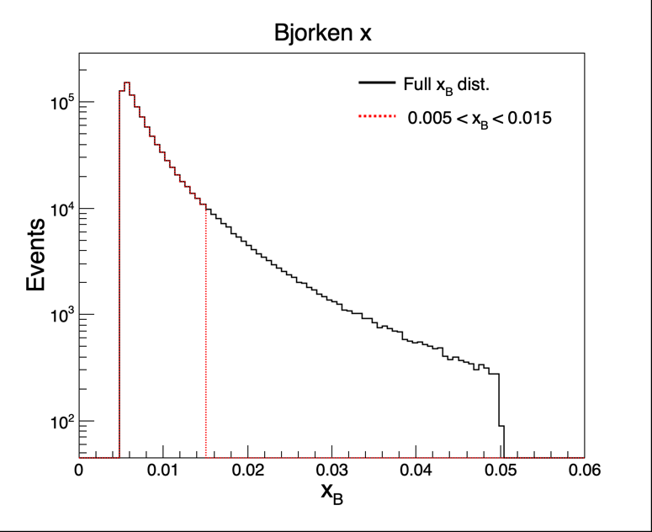
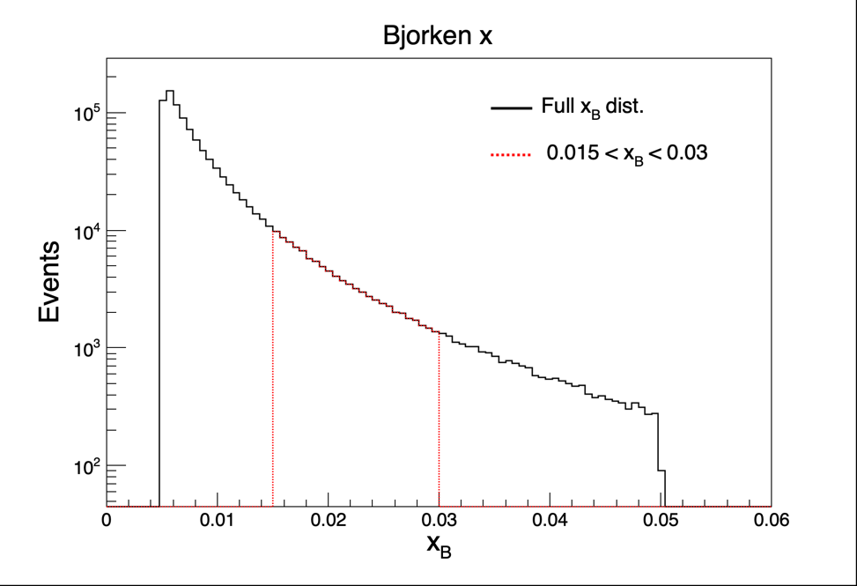
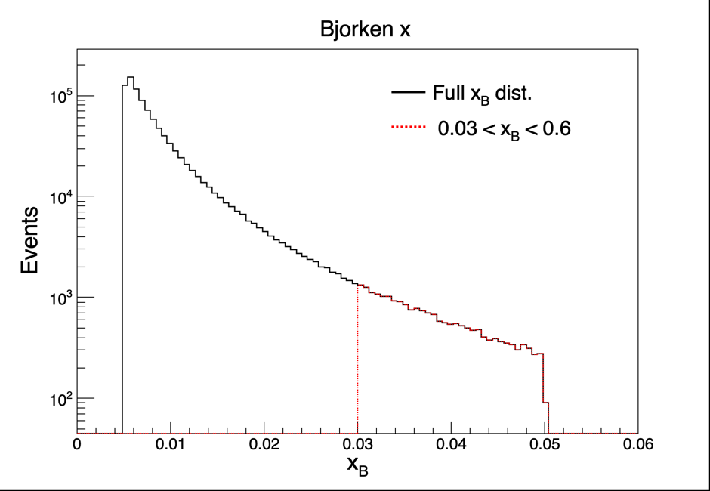
DVCS events for 275 GeV protons from the EPIC generator at RPs
K. Gopal
10σ BSC
Most detected
All detected
All detected
Recoil protons on the focal plane. Full acceptance at higher x (lower x_{L}, the main region of interest) even for p_{T} = 0.
In IR6 the 10s beam-stay-clear (BSC) is much larger and the dispersion smaller.

Slide 15
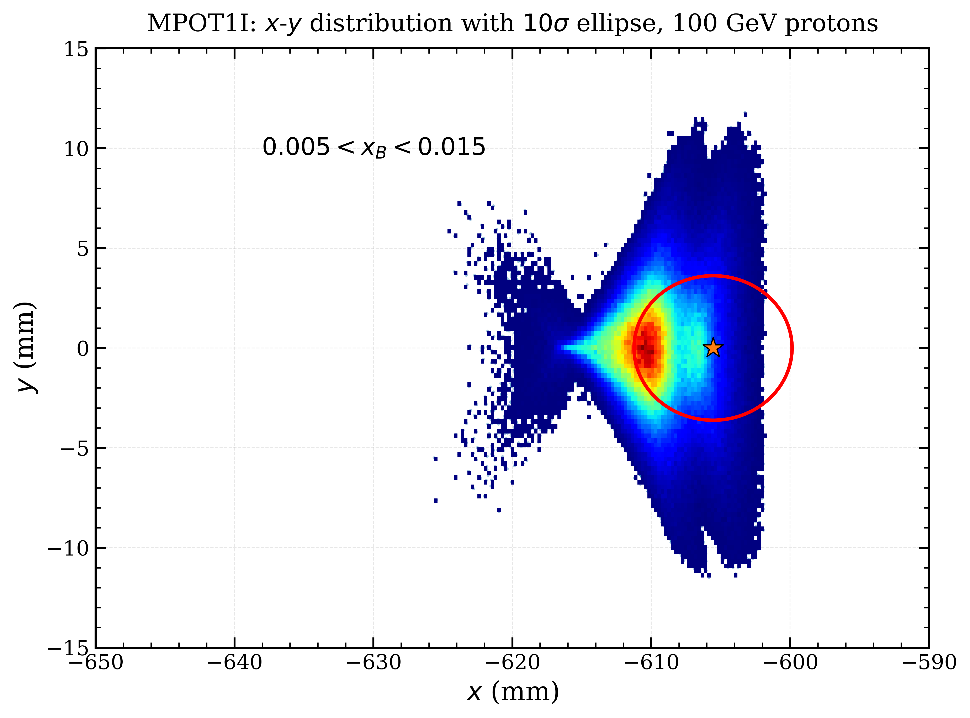
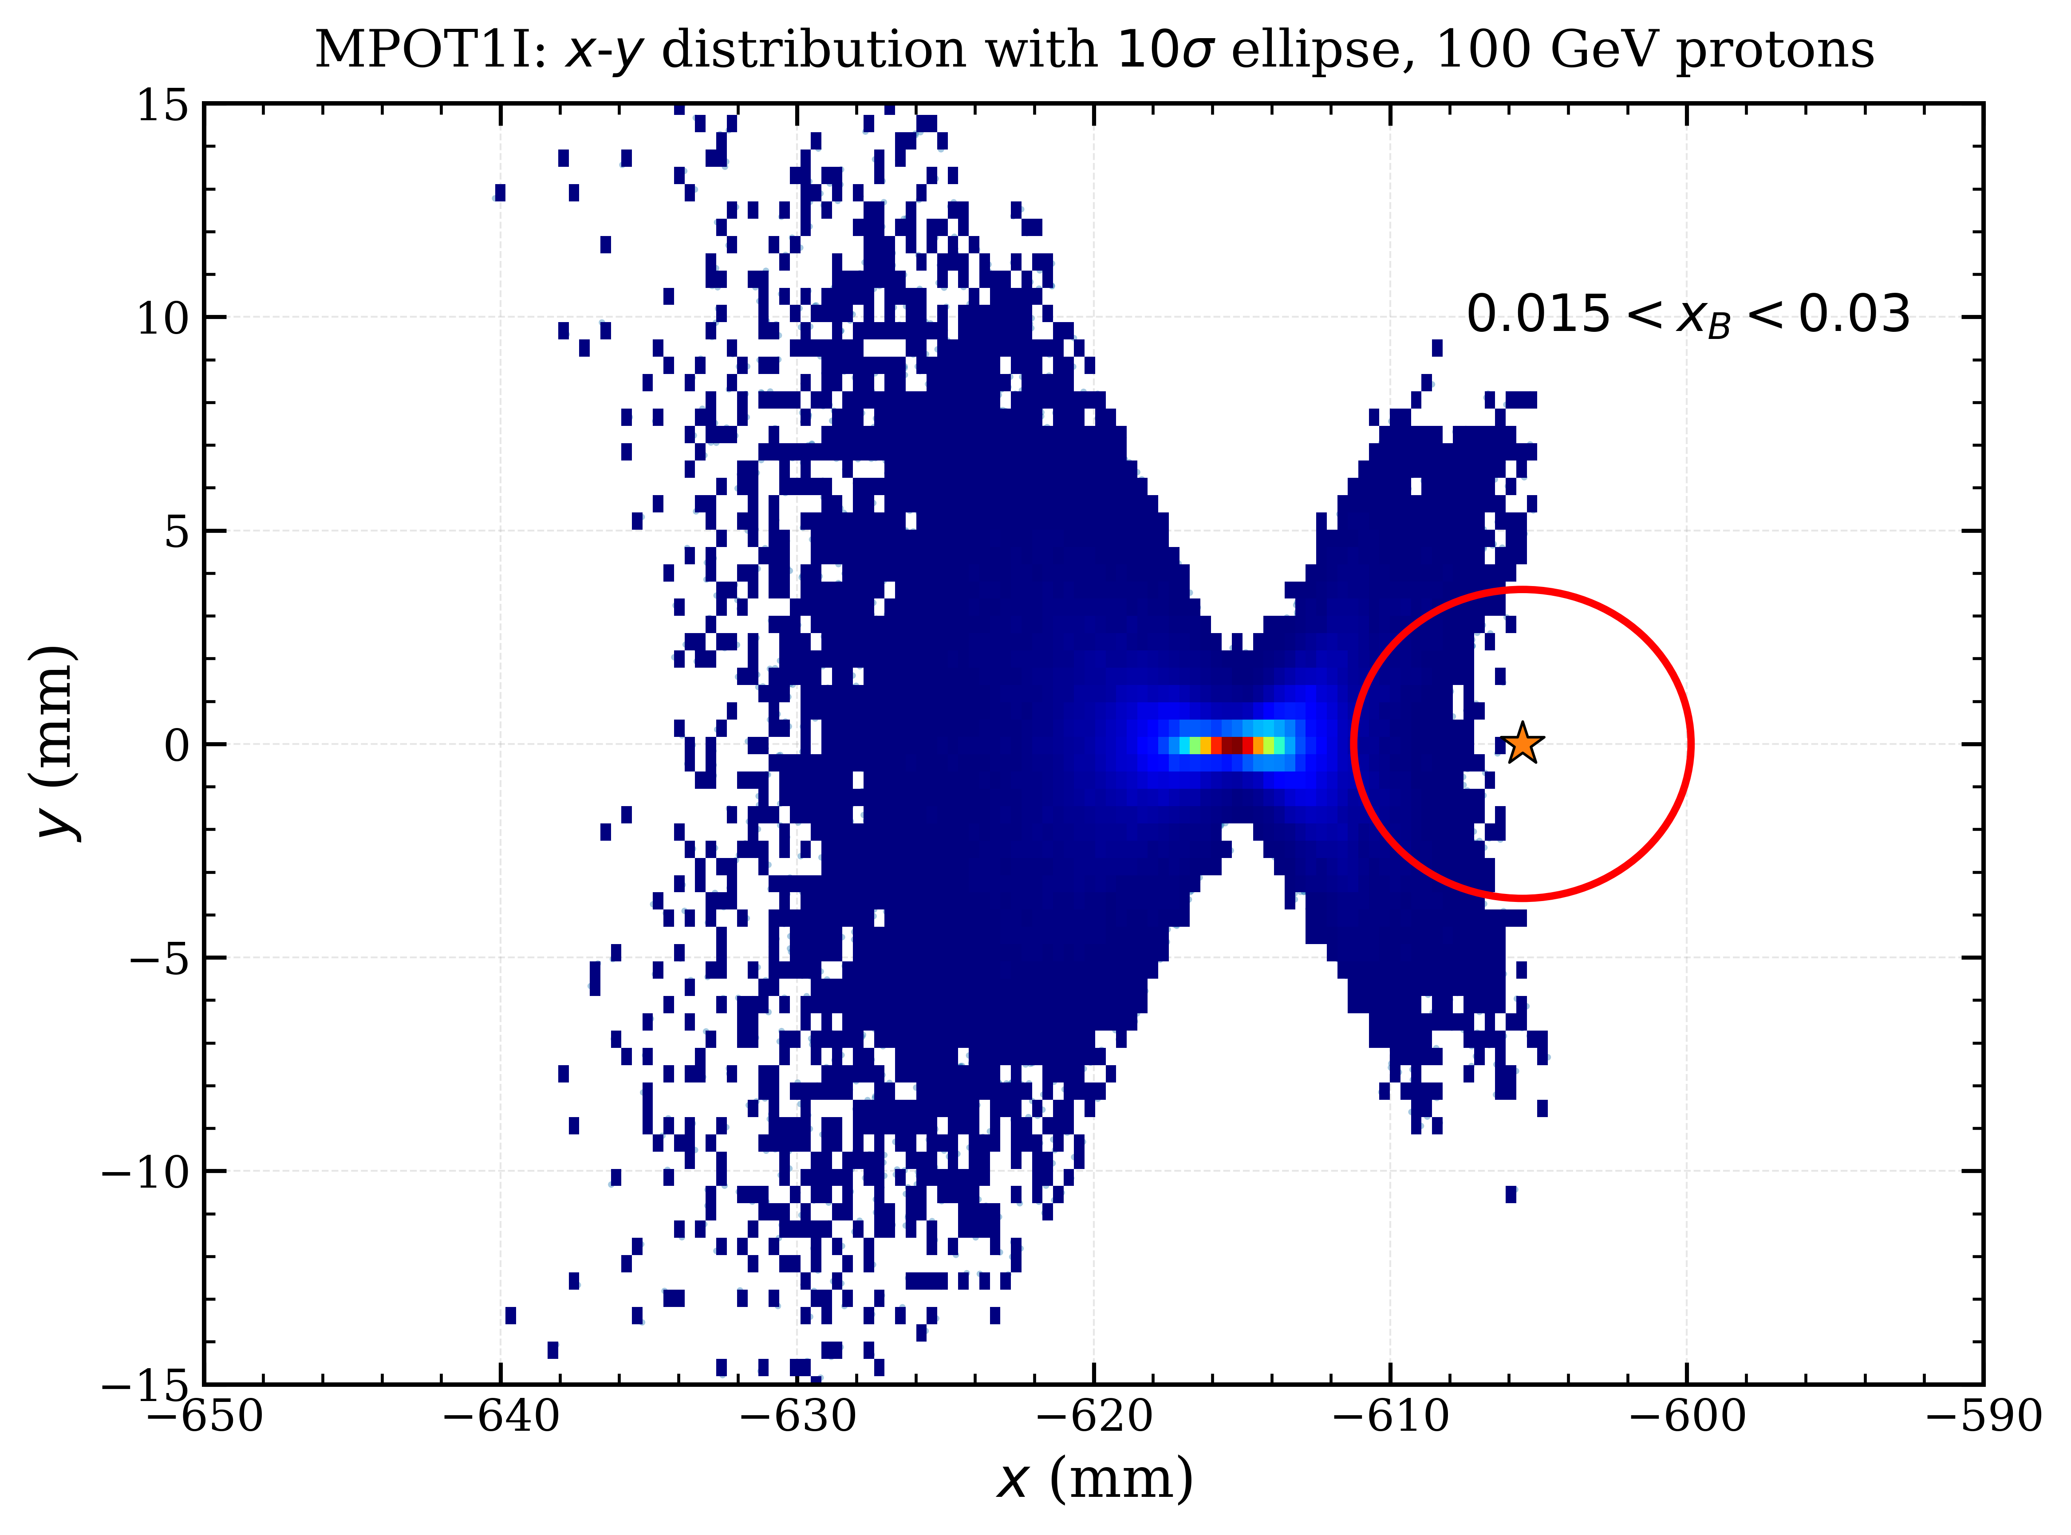
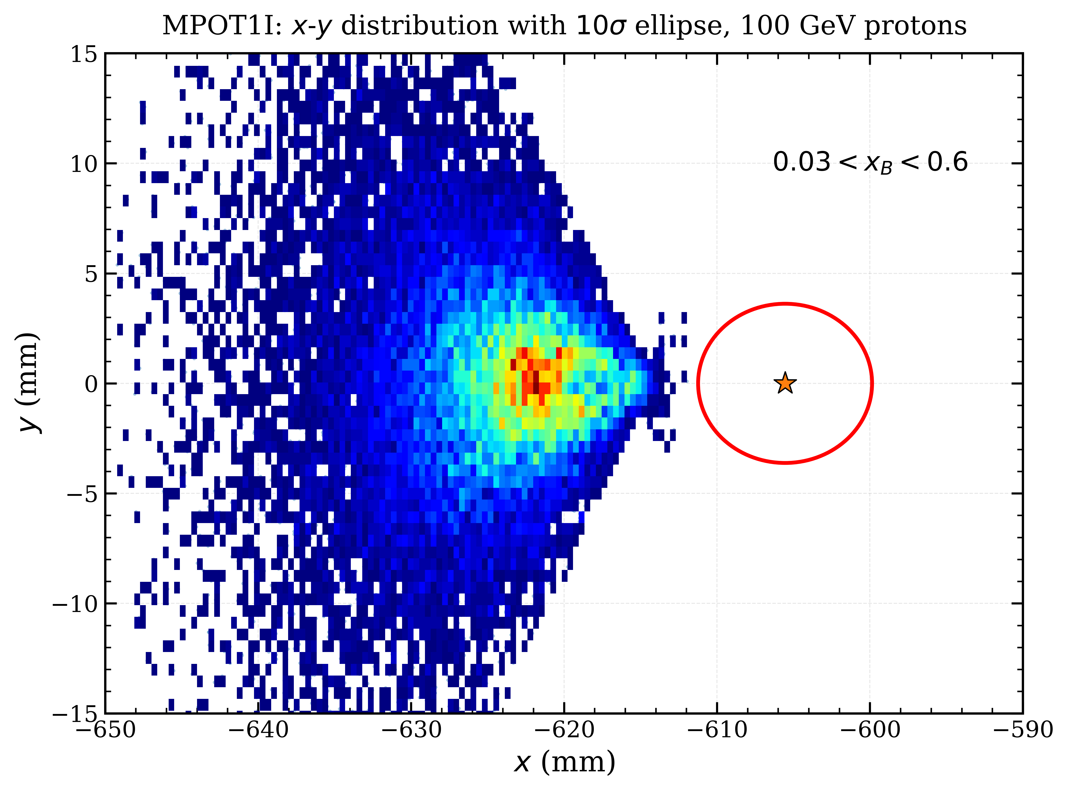
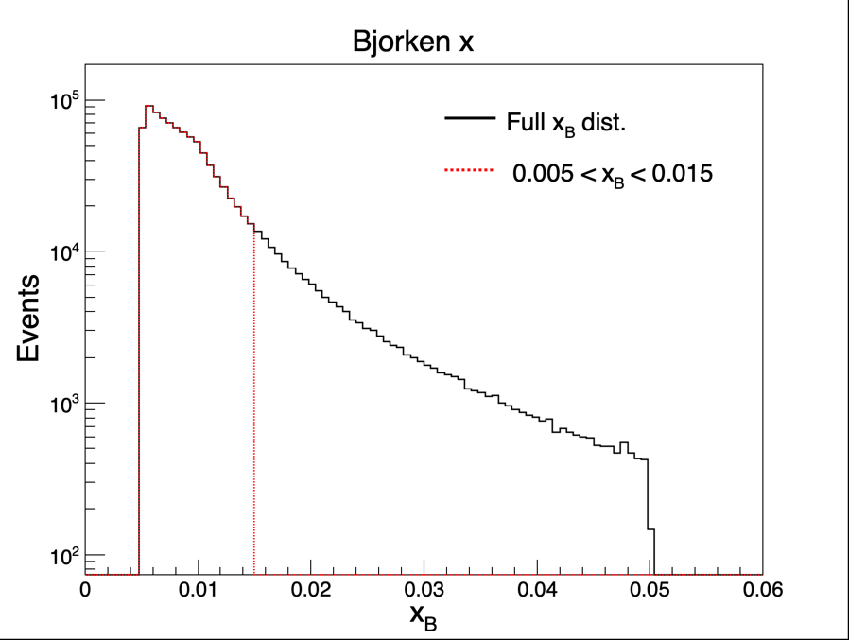
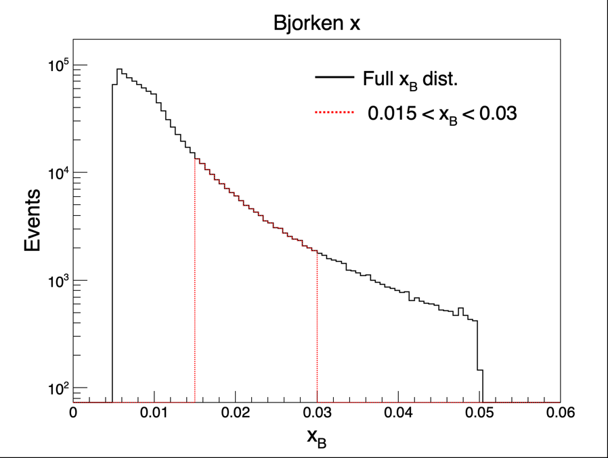
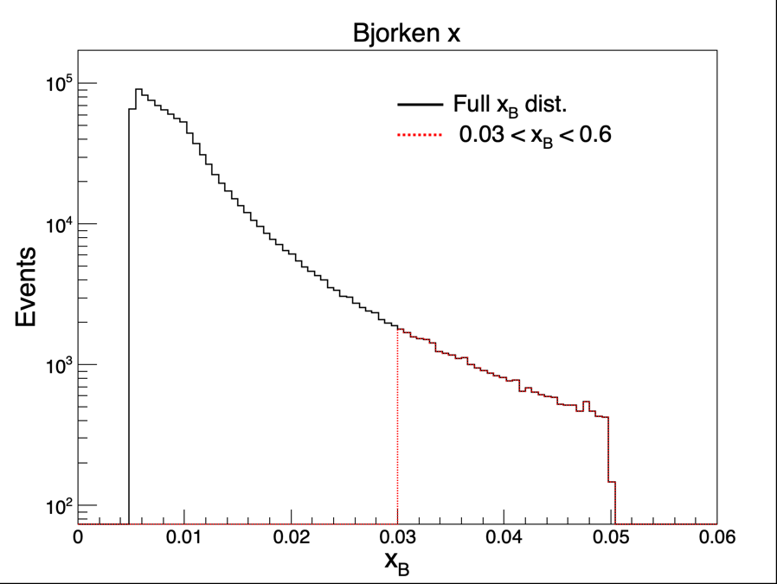
DVCS events for 100 GeV protons from the EPIC generator at RPs
At 100 GeV the beam emittance is larger but one still has full acceptance at mid- to large x.

Slide 16
B0 dipole magnet
The IR6 B0 design uses a short, strong dipole followed by a counterbending dipole used at lower energies.
  A similar arrangement was also proposed for the IR8 layout, where the combined length was 2.7 m.
Since tracking resolution depends on Bdl, resolution per layer, # of tracking layers, and distance traveled, the IR6 design works well for 100 GeV protons, but is not ideal for 275 GeV protons and all ions.
The counterbending scheme also created an energy-dependent transverse shift of the beam position requiring a more stringent spec on field uniformity in the FFQs.
A longer, weaker B0 providing the same bending angle that can be used for all energies addresses both the detection and accelerator issues. As pointed out by Brett Parker, it would also make it easier to shield the electron quad. The length of 2.7 is, however, chosen to make both options interchangeable.
Parameter | IR6 Forward Hadron Magnets |  |  |  |  |  |  | IR12 Proposed Forward Hadron Magnets
 | B0PF | B0APF | Q1APF | Q1BPF | Q2PF | B1PF | B1APF | BXSP0 | QFFDS01 | QFFDS02 | QFFDS03 | BXDS01
Length (m) | 1.2 | 0.6 | 1.46 | 1.6 | 3.8 | 3.0 | 1.5 | 2.7 | 3.1 | 2.9 | 1 | 5
Inner radius (cm) | 20 | 4.3 | 5.6 | 7.8 | 13.1 | 13.5 | 16.8 | ? | 5.8 | <7.5 | <18.8 | ?
Peak field (T) | -1.3 | -3.3 | 4.07 | 5.16 | 5.34 | -3.4 | -2.7 | 0.58 | 4.6 | <4.6 | <4.6 | 4.6
Field gradient (T/m) | 0 | 0 | -72.61 | -66.18 | 40.74 | 0 | 0 | 0 | -79.97 | 61.66 | 24.4 | 0
IR6 magnet parameters taken from Table 3.7 on page 111 of the EIC CDR and may not be the most current

Slide 17
Other magnet specs
Transport for high-p_{T} particles is optimized by keeping the initial quad(s) which are defocusing in the dispersive plane as strong and short as possible. Splitting it in two, as was done in the preliminary IR8 layout (so that the polarity of some FFQs could be reversed at low energy) creates potential inefficiencies.
The new IR12 optics has 3 m long first quad with a peak field of 4.6 T, allowing the following quads to be weaker. Their apertures could be reduced further without a significant degradation in performance.
Overall, the proposed IR12 magnets are less challenging than the CDR parameters for IR6 and could be relaxed further. The main performance driver lies in the parameters of the first quad.
As we optimize the IR12 layout further and match it specifically to the geometry of IR12 the magnet parameters can change, but the changes would likely be towards less demanding specs.
Parameter | IR6 Forward Hadron Magnets |  |  |  |  |  |  | IR12 Proposed Forward Hadron Magnets
 | B0PF | B0APF | Q1APF | Q1BPF | Q2PF | B1PF | B1APF | BXSP0 | QFFDS01 | QFFDS02 | QFFDS03 | BXDS01
Length (m) | 1.2 | 0.6 | 1.46 | 1.6 | 3.8 | 3.0 | 1.5 | 2.7 | 3.1 | 2.9 | 1 | 5
Inner radius (cm) | 20 | 4.3 | 5.6 | 7.8 | 13.1 | 13.5 | 16.8 | ? | 5.8 | <7.5 | <18.8 | ?
Peak field (T) | -1.3 | -3.3 | 4.07 | 5.16 | 5.34 | -3.4 | -2.7 | 0.58 | 4.6 | <4.6 | <4.6 | 4.6
Field gradient (T/m) | 0 | 0 | -72.61 | -66.18 | 40.74 | 0 | 0 | 0 | -79.97 | 61.66 | 24.4 | 0
IR6 magnet parameters taken from Table 3.7 on page 111 of the EIC CDR and may not be the most current

Slide 18
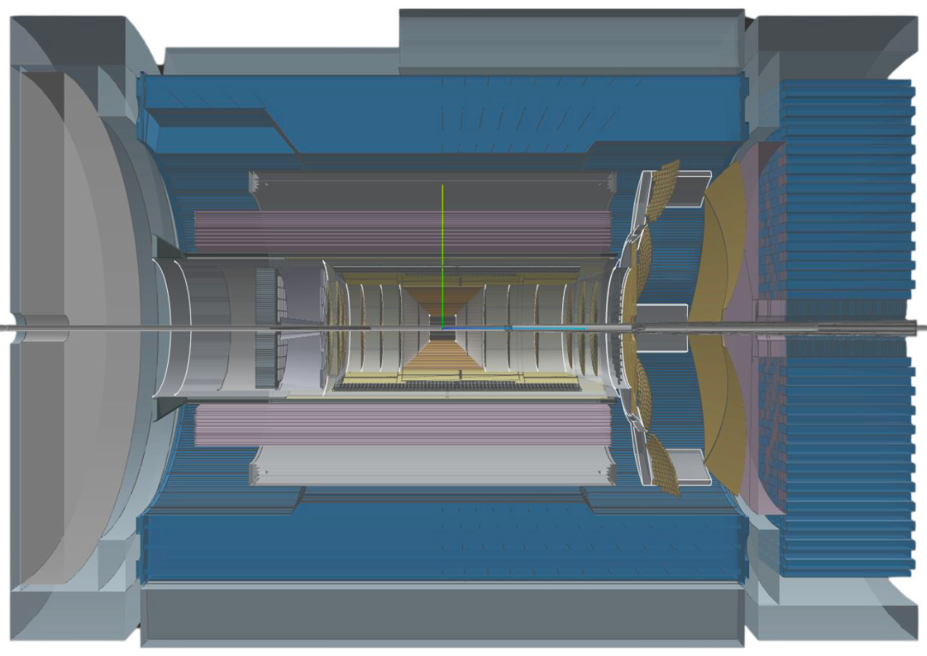
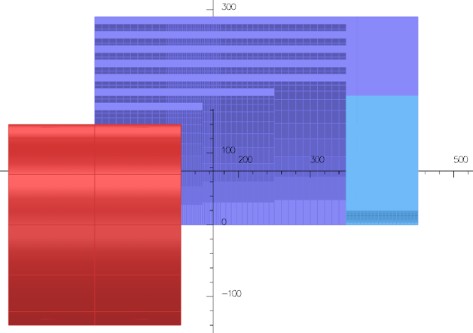
Initial study of a 3 T Detector-2 solenoid
A shorter 3 T solenoid creates more internal space
  30% (1 m) shorter
  15% smaller inner (bore) radius
  The high-field region is matched to the tracker
  Cables can be routed to the outer parts of the detector much earlier than in ePIC
  Improves tracking on the (outgoing) electron side
The ePIC 1.7 T MARCO solenoid is similar to the BaBar solenoid.
For structural reasons it covers both the tracker and the pfRICH PID detector.
ePIC
Barrel Hcal optimized for muon identification R. Kelleher et al, NIM A 1092, 171820 (2026)
2nd detector solenoid
Interior space
pfRICH
(not to scale)
Outer size of 3 T solenoid
Upper right quarter of symmetric flux return
1.7 T solenoid
p/A
e
Paul Brindza

Slide 19
Thank you!

Slide 20
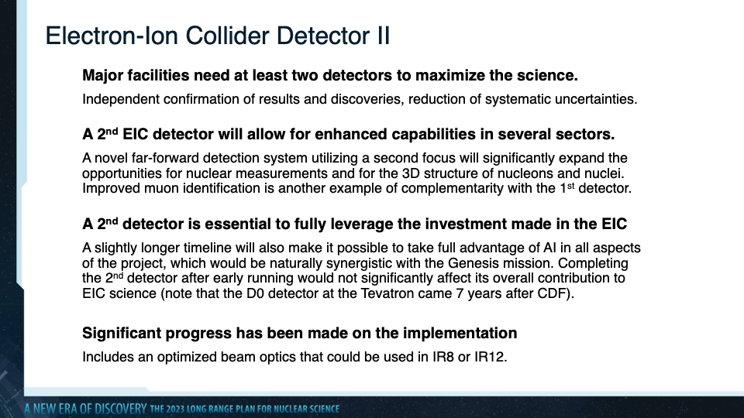
Slide by the EIC UG 2nd detector WG presented to the SCAC in May 2026.

