Slide 1
Materials for Accelerator Technology
MAT
PI Prof. Flyura Djurabekova
Dr. h.c. Tartu University

Slide 2

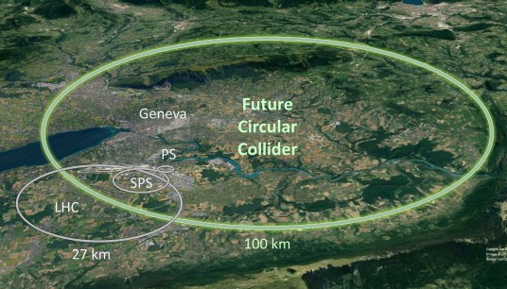

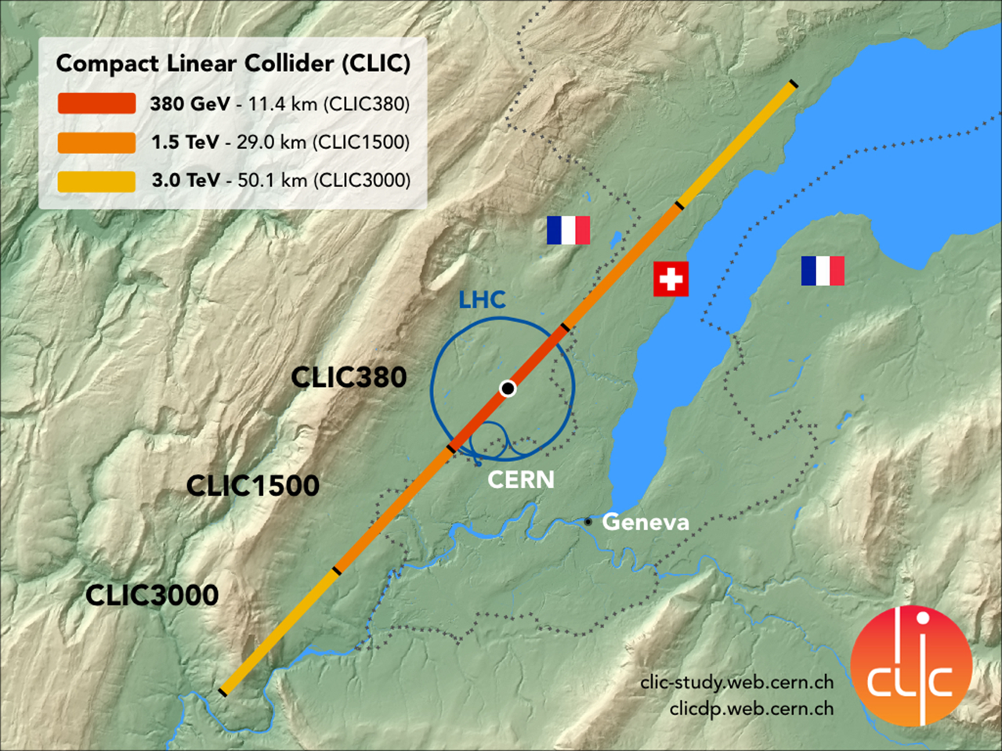
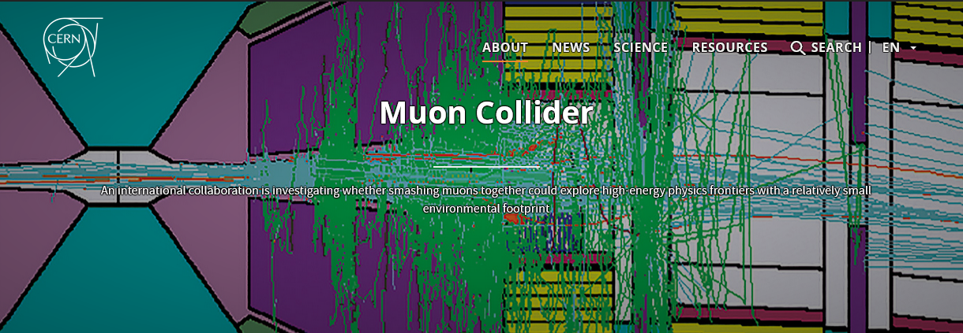
Accelerator technologies at CERN
Mark Thompson: ”Beyond HiLumi LHC, the FCC-ee would be a visionary global research infrastructure for the next decades that will deepen our knowledge of the fundamental building blocks of the universe through ultra-precise measurements of the Higgs boson and other elementary particles.”

Slide 3
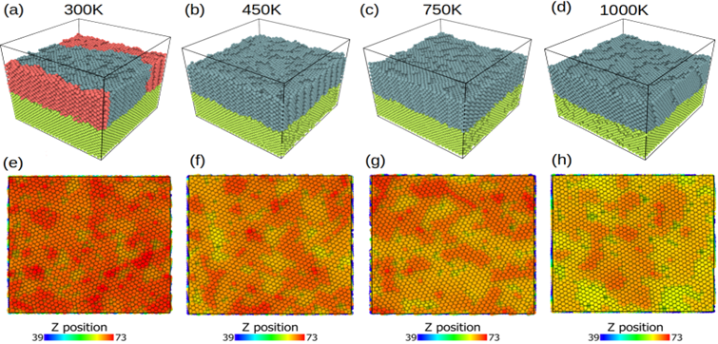
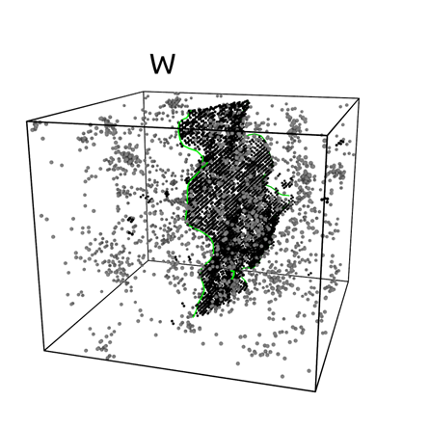
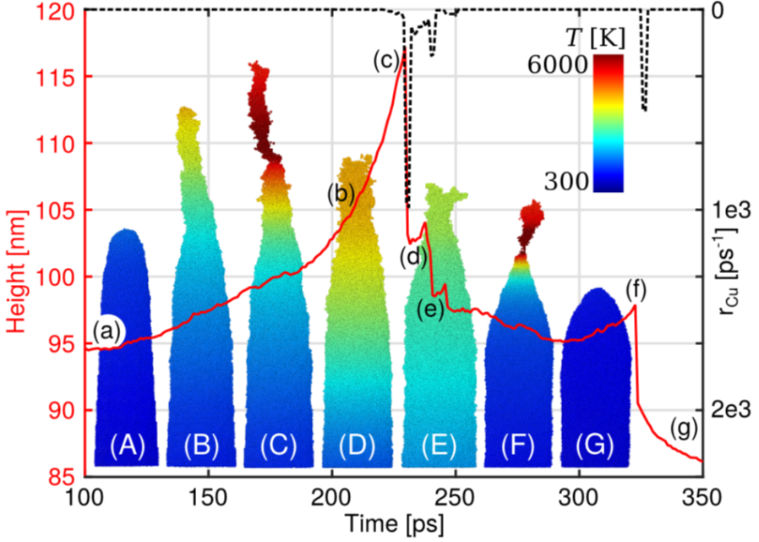
Materials for Accelerator Technology (MAT) in a nutshell
FCC
Growth of high quality HiPIMS grown Nb (Nb₃Sn) films for superconducting cavities (a priority at CERN)
IMCC: Radiation effects
In MUC Targetry and beam intercepting device technology
CLIC/IMCC: vacuum arcs
In more demanding environment including focusing magnetic fields

Slide 4
MAT project details:
Current project members:
Dr Aleksi Leino (University Researcher, Faculty of Science funding , IMCC project): 2024 – 2028
MSc Marzhan Toktaganova (Doctoral researcher, MAT, CLIC/IMCC projects): 2024 – 2027
MSc Werner Lipsunen (Doctoral researcher, MAT, IMCC project): 2025 – 2028
MSc Lorenzo Miola (Doctoral researcher, FCC): 2027 – 2029
A Doctoral researcher to be hired for the upcoming K-contract with CLIC/IMCC (CERN)
Dr Federico Ledda (Structural properties of High-temperature superconductors): 2029
Current collaborations:
Tartu University, Estonia (regular meetings, joint Doctoral researcher)
Three different groups at CERN: CLIC project, FCC/LHC project, IMCC both for
accelerating structures and development of muon targetry
Finances:
  K-contract with FCC successfully finished (ongoing discussion on possible continuation)
  K-contract is currently re-negotiated with CLIC and Muon Collider projects (confirmed)

Slide 5
Graduations:
Dr Catarina Serafim (Doctoral researcher, funded by CERN, LHC/FCC projects): graduated, June 2025
Dr Anders Körsback (Funded by CERN, CLIC project): graduated, June 2025
MSc Milad Ghaemikermani (Doctoral researcher, funded via FCC (CERN) K-contract, FCC project): to graduate in September 2026
MSc Roni Koitermaa (Doctoral researcher, cotutelle with Tartu University, mainly funded by Tartu University, CLIC/IMCC projects): to graduate in October 2026
MSc Heidi Laitinen (graduated with MSc, July 2025)
Anastasia Laurson (to be graduated with the BSc in autumn 2026)

Slide 6
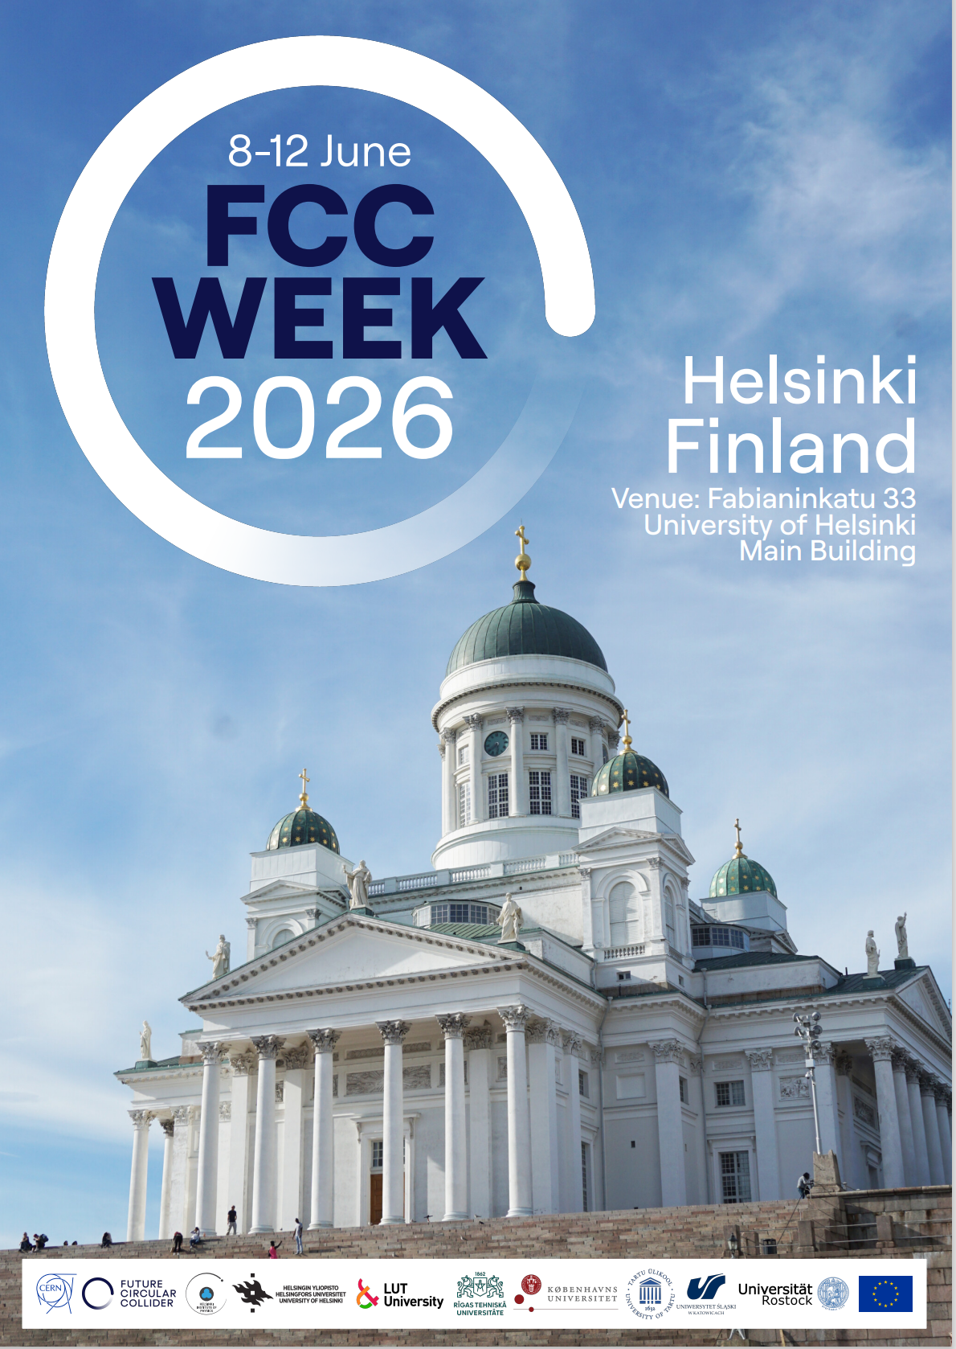
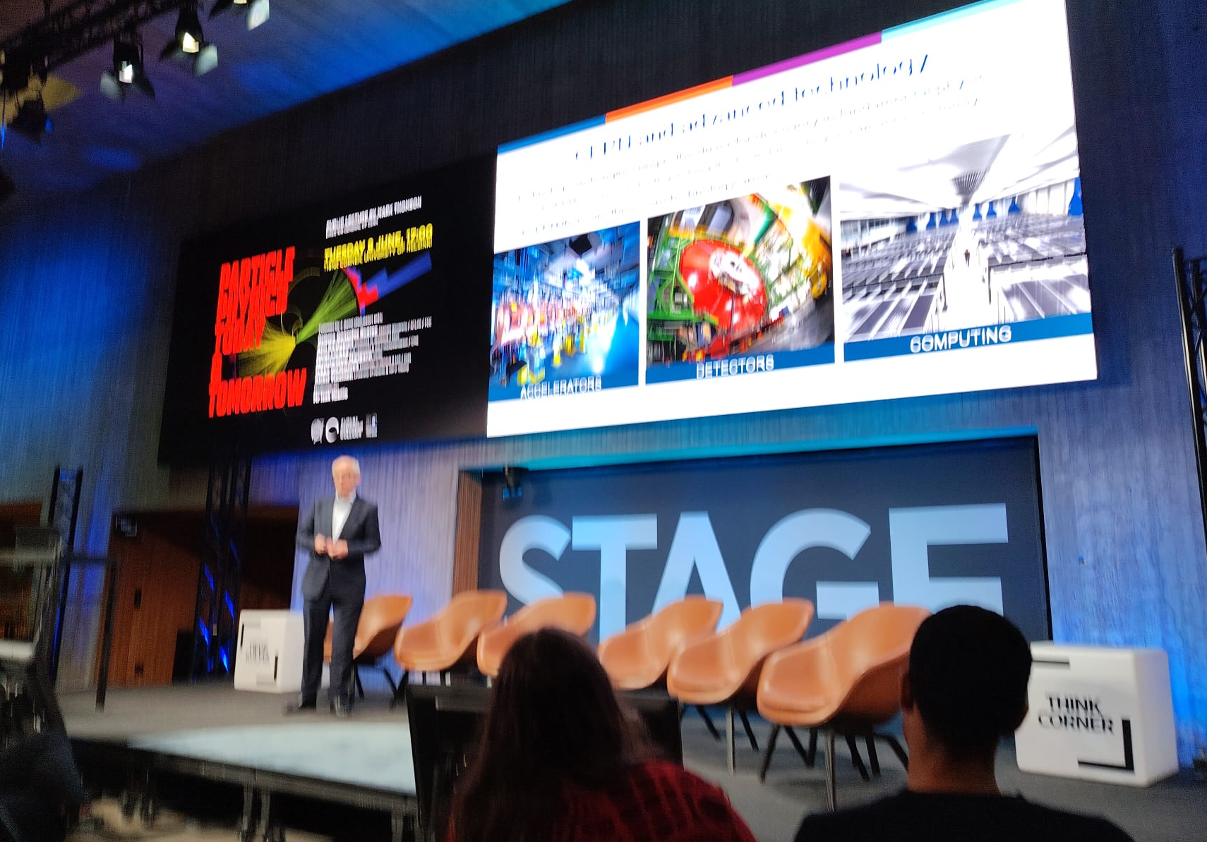
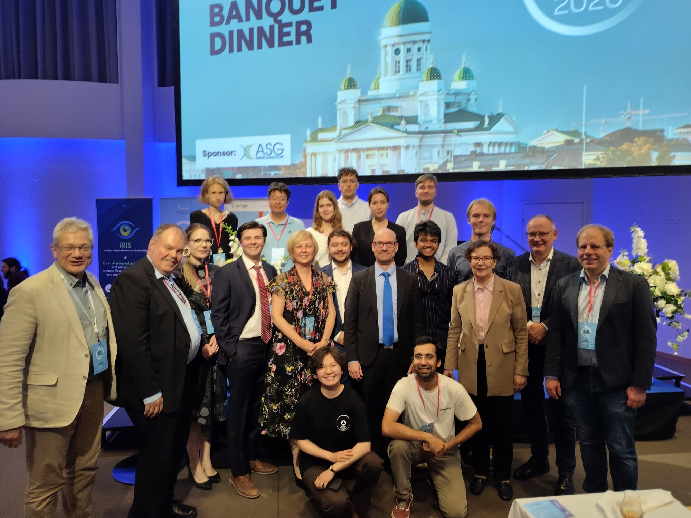
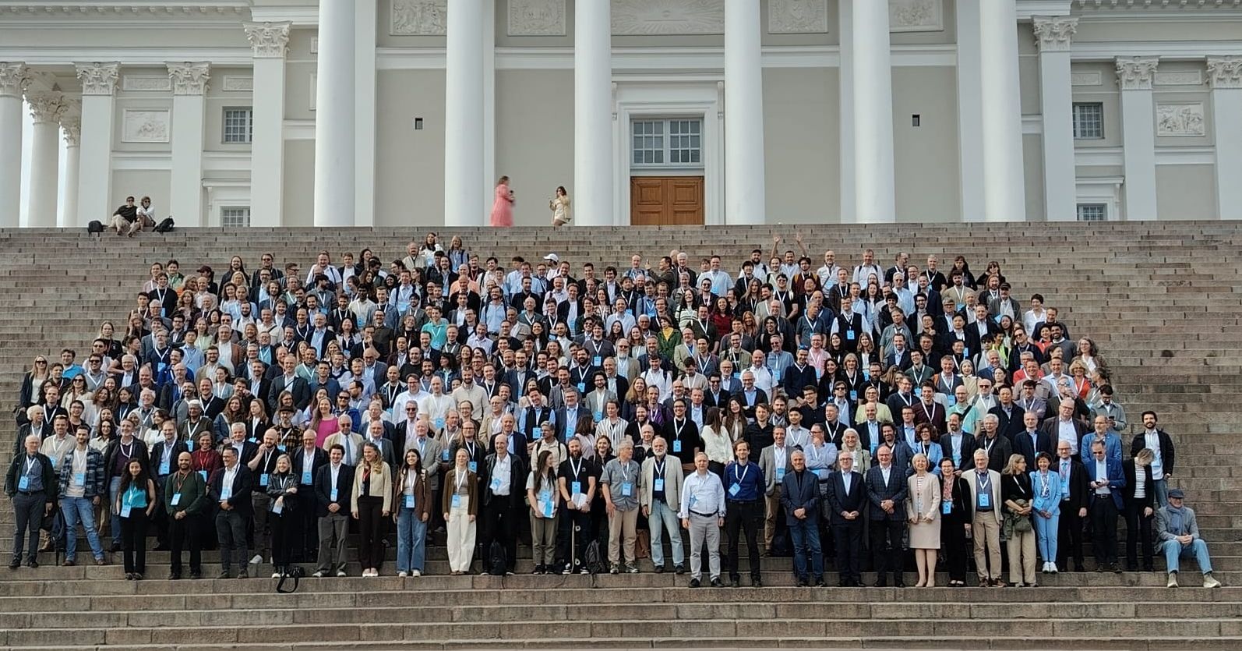
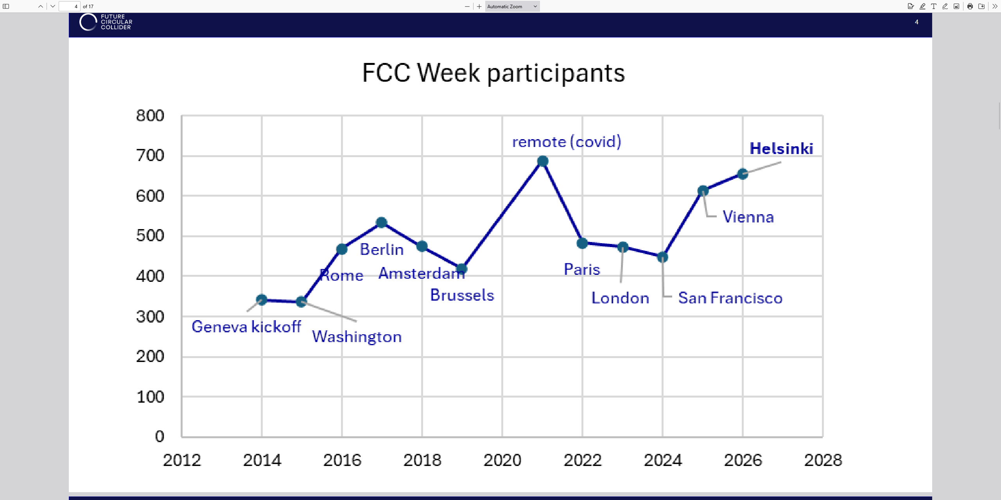
Future Circular Collider week in Helsinki!
The MAT group (F. Djurabekova) with the colleagues from HIP (K. Huitu, A. Väihkönen, K. Österberg, H. Kirschenmann, S.Lehti) successfully hosted the FCC community at the FCC week that was organized in collaboration with other Nordic and Baltic countries.
The FCC week was held first time in the region, and attracted the record number of participants this far.

Slide 7
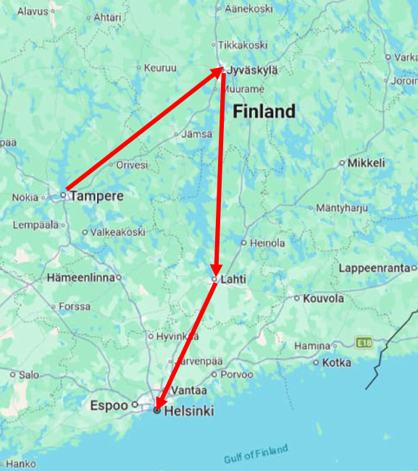
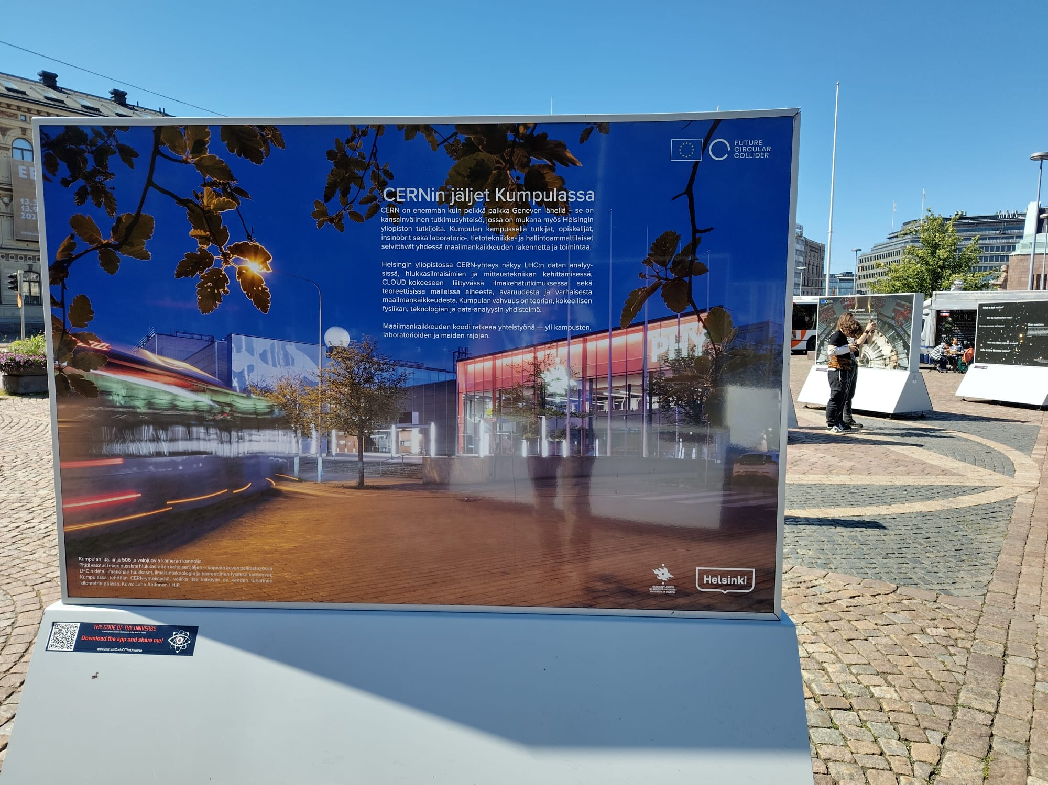
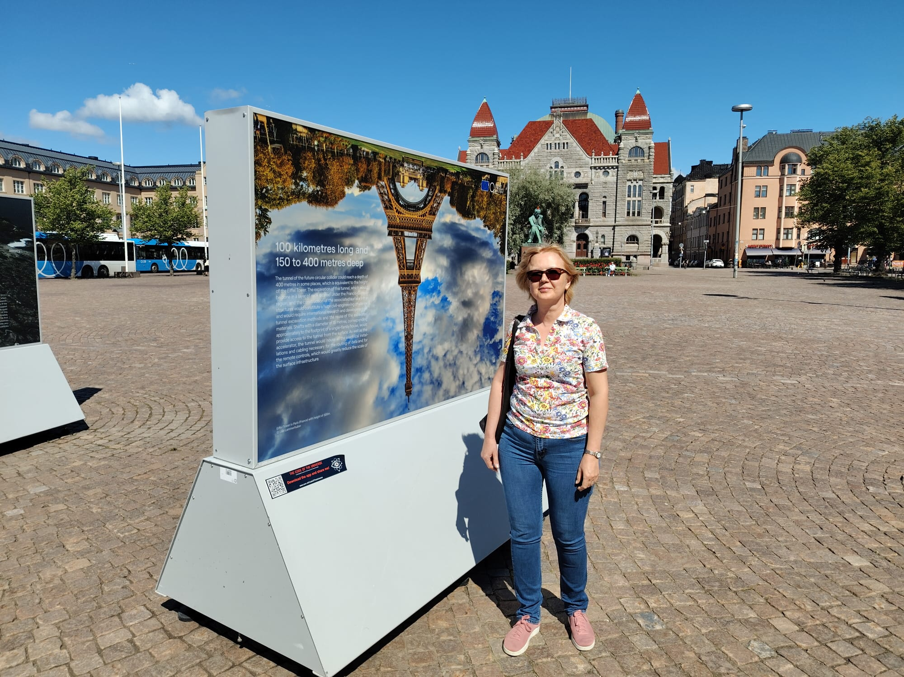
Travelling CERN exhibition
CERN has organized publicizing travelling exhibition, promoting the future FCC project which has made quite a strong impact on the Finnish general public since the exhibition travelled from
1 May – 16 July, 2026:
Tampere - Jyväskylä - Lahti - Helsinki, Rautatientori.

Slide 8
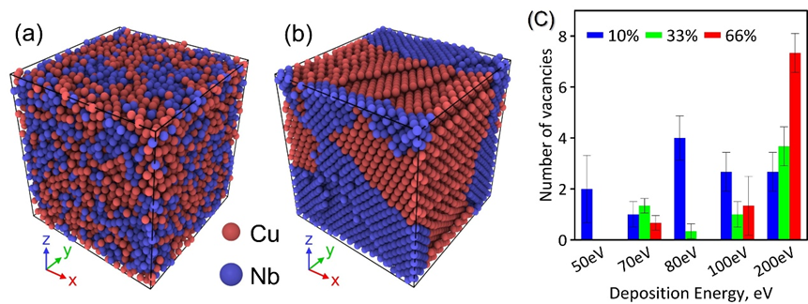
A New Design Rule for the Nb/Cu Interface
SUPERCONDUCTING RF CAVITIES for FCC
MD simulations reveal a U-shaped relationship between interface composition and residual defects, pinpointing the best HiPIMS window for near-defect-free Nb/Cu interfaces.
Residual Vacancy Defects vs. Interface Cu Content
Why: atomic packing, not just mixing
Disordered, as-mixed interface
Relaxes to phase-separated Cu / Nb
OPTIMAL PROCESS WINDOW
Ionization fraction ≈ 33%, ion energy ≈ 70–100 eV → Cu₄₅Nb₅₅ interface stoichiometry → minimum trapped-defect density for H, magnetic flux, and thermal coupling.
Sweet spot: minimum defect density at ~45 at.% Cu, about 7% fewer vacancies than an over-mixed (60% Cu) interface.
The method is currently considered to be applied for Non-Evaporable Getter Thin Film Coatings (TiZrV) for Vacuum Applications

Slide 9
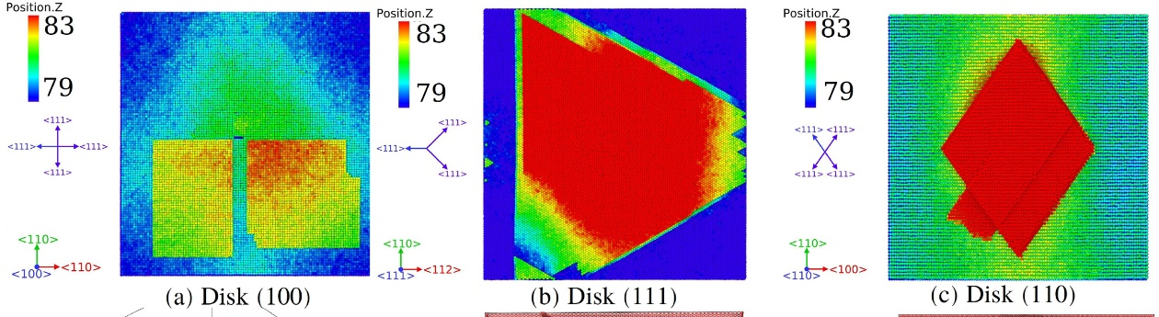
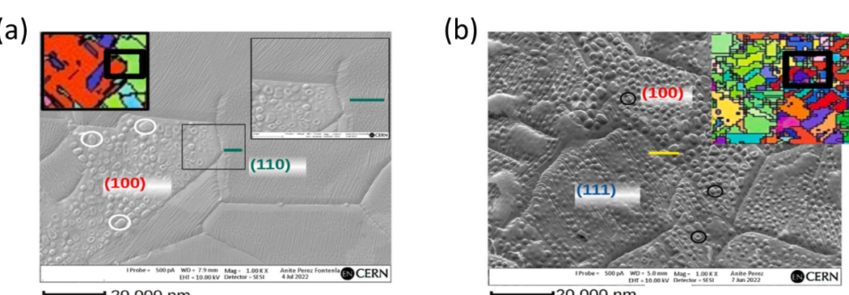
Predicting Exactly Where Blistering Begins
We found that crystallographic orientation of grains at the surface controls blister onset and shape, and simulation matches the scanning electron microscope.
MD SIMULATION: predicted blister footprint
SEM: irradiated polycrystalline Cu (CERN)
{100} square {111} triangle {110} rhombus
{100} grains blister first and densest, {110} shows the strongest resistance.
WHY IT MATTERS
Blistering is a known precursor to reduced field-holding capacity and vacuum-arc breakdown on H⁻-irradiated RFQ Cu vanes. The mechanism identified here, hydrogen and vacancies co-localise within ~12 nm in {100}, but separate by 140–180 nm in {111}/{110}, pinpoints exactly which grains are at risk, and why.
HYDROGEN-INDUCED BLISTERING IN RFQ structures for H beam injectors (LHC)

Slide 10
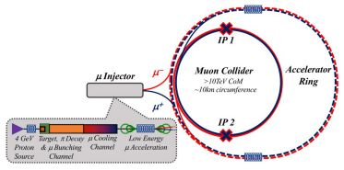
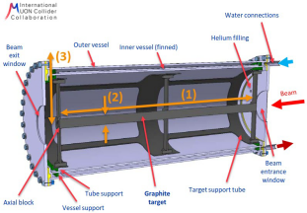
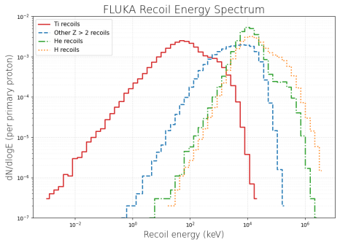
Simulations of Beam-window Materials
A Muon Collider is considered at CERN as one of the alternative colliders to reach high energy of collisions of point-like particles, since muons can accelerate without the limitation of synchrotron radiation.
An important part of this machine is the targetry, which is designed to produce muons by using GeV-energy proton beams
The beam windows separating the beam source from the target material chamber must meet quite demanding requirements:
  To be stable and durable for extended time of beam exposure
  Be transparent to the beam
Proton beam passes through a beam window, inducing radiation damage in the material
  Recoil atoms are generated by the protons and the spectrum of the recoils can be computed using FLUKA (courtesy of Anton Lechner@CERN)
  In our team we model the damage produced in Ti according to the spectrum in a broad range of energies using multiscale atomistic simulations

Slide 11
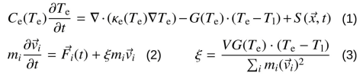
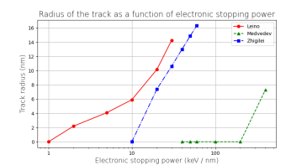
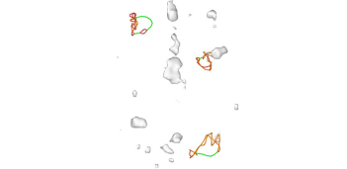
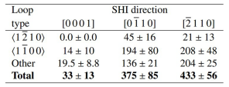
Recoils of MeV energy in Ti
To examine effect of MeV-energy recoils (swift heavy ion, SHI, regime) from the FLUKA spectrum, we apply the two-temperature molecular dynamics (2T-MD).
  Here the heat deposited to electronic subsystem of the material by a MeV recoil dissipates in material while being coupled with the atomic lattice (Eq. 1-3)
No previous literature on 2T-MD simulations for HCP metal
To test the model, we performed the simulations using 845 MeV Pb ions with different stopping power values and tested three first-principles based parameterizations of the two-temperature model, which unfortunately resulted in different track formation threshold => better theory now under development
The simulations with the most commonly used parameters revealed a strong dependence of damage size on the crystallographic direction in the HCP lattice
Next step is to combine the collision cascade simulations with the SHI simulations in Ti according to FLUKA recoil spectrum in collaboration with the group at CERN

Slide 12

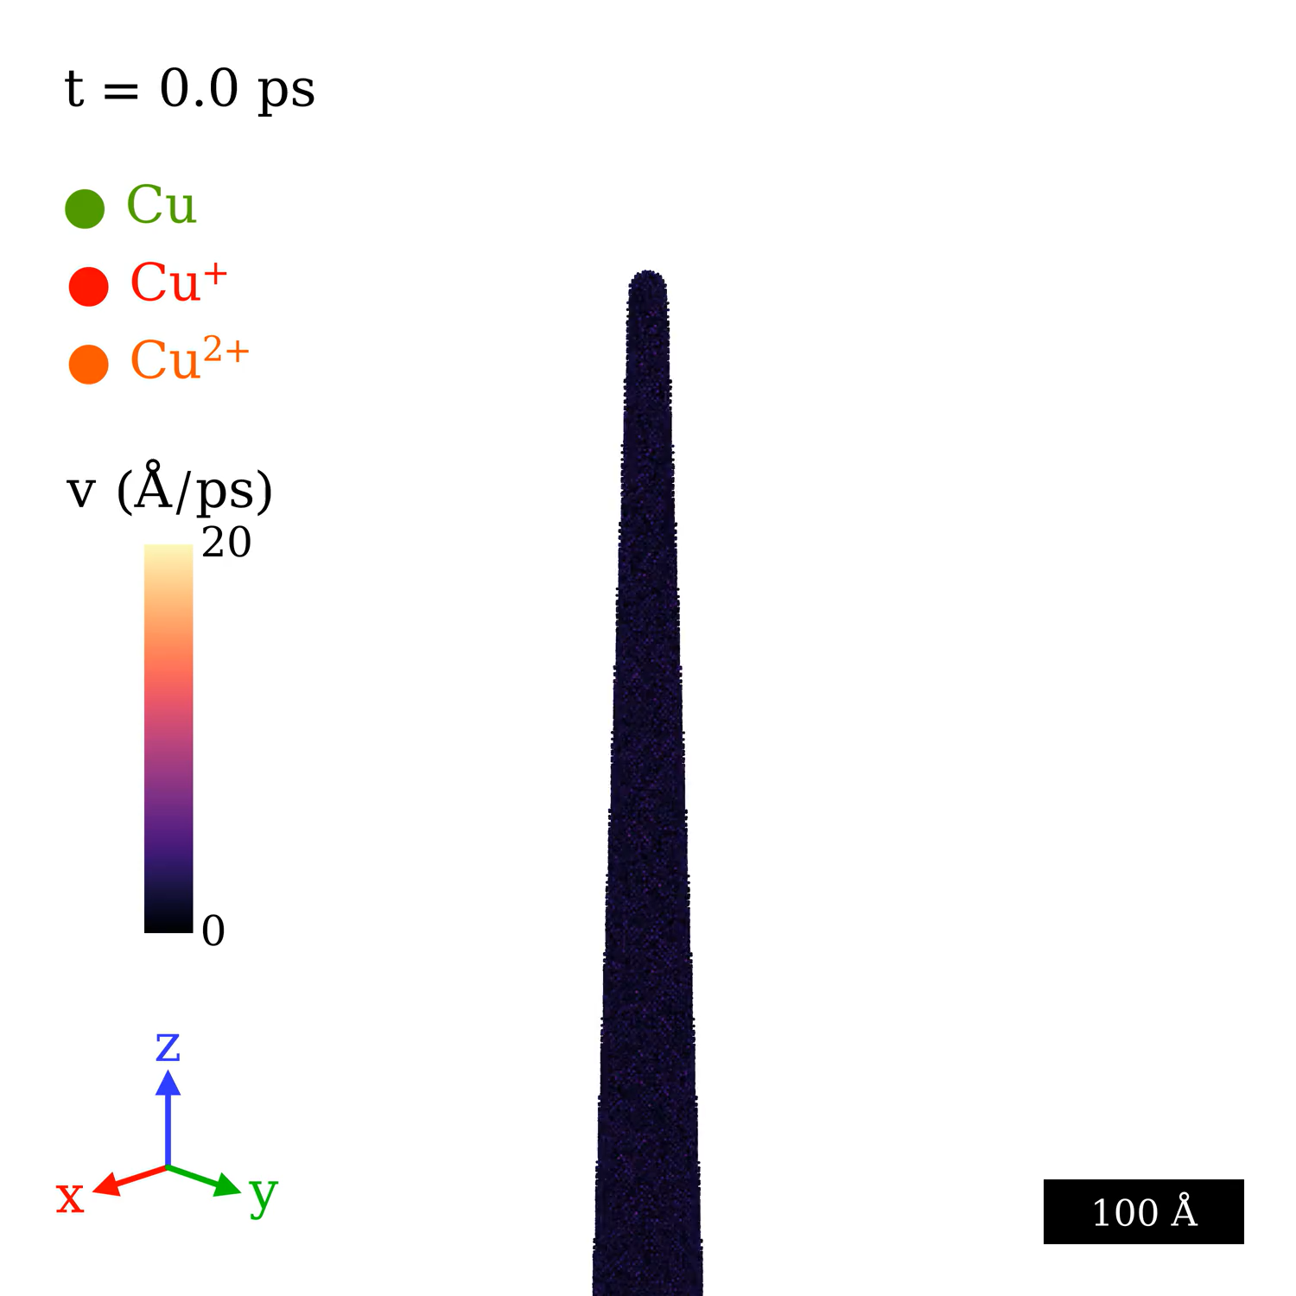
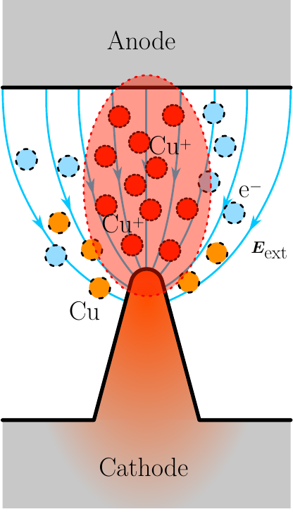
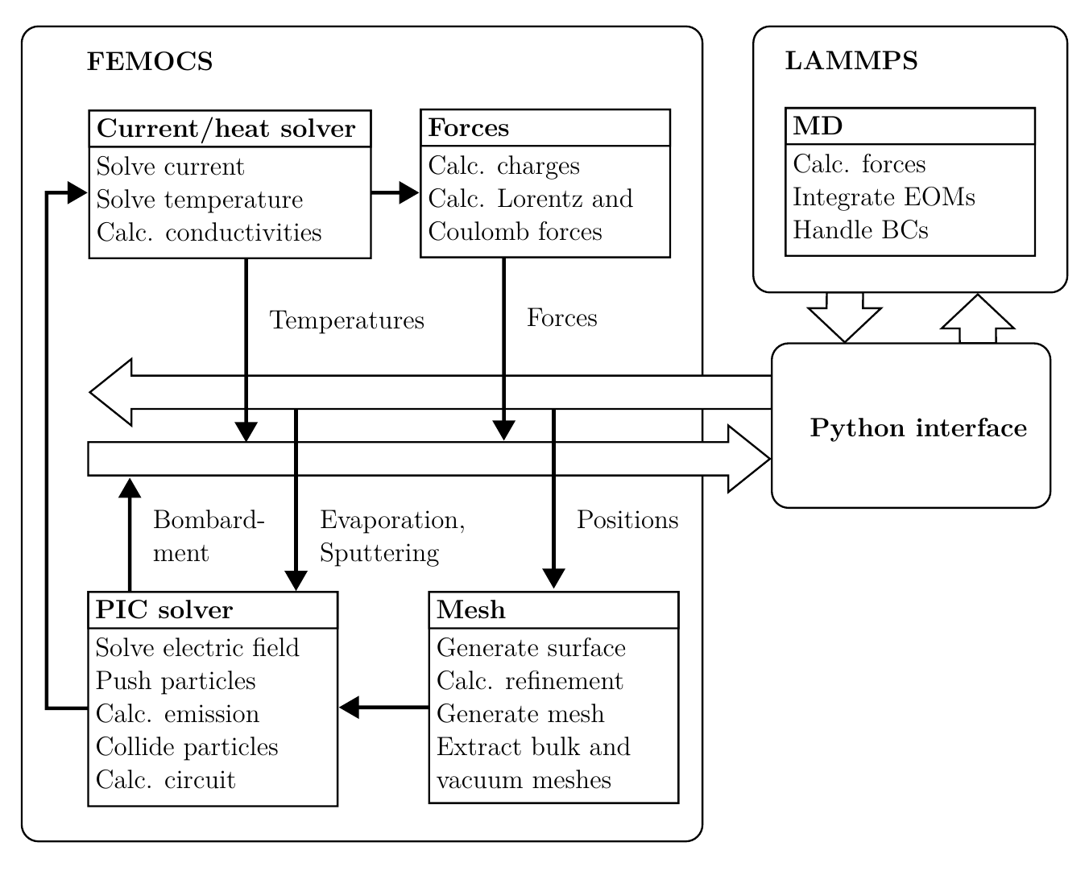
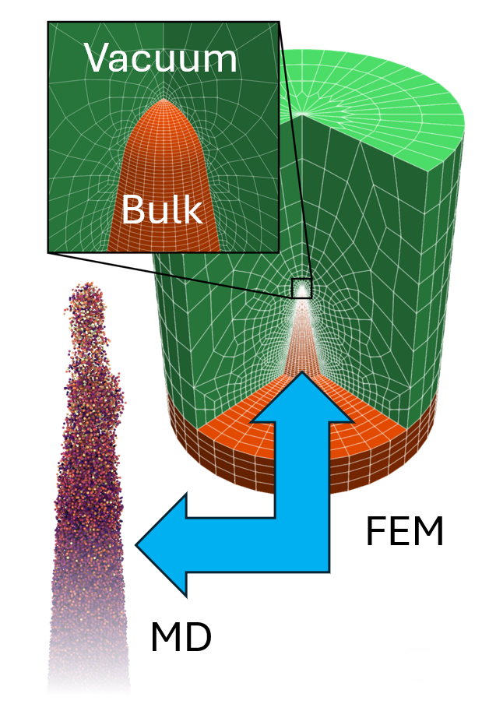
Simulations of vacuum arcing under high electrostatic fields
Fundamental vacuum arc initiation mechanism discovery using multiphysics simulations (FEMOCS)
Full coupling between arc plasma and atomistic surface (FEM-PIC-MD)
Design materials/structures more resistant to arcing
  Accelerators: CLIC, FCC, MuCol
Atomistic Cu nanotip under 500 MV/m external field with simulation of plasma.
In collaboration with Tartu University
Work was included in: W. Wuensch, S. Calatroni, F. Djurabekova, A. Kyritsakis, and Y. Ashkenazy. “Fundamentals of Vacuum Breakdown in High-Gradient Accelerator Structures.” Reviews of Modern Physics 98, no. 2 (2026): 025004. https://doi.org/10.1103/h8wb-y278.

Slide 13
Publications produced within the MAT project 2024-2026
M. Ghaemikermani, A. Lopez-Cazalilla, F. Djurabekova, K. Sarakinos, G. J. Rosaz, and S. Calatroni, Growth of Nb ﬁ lms on Cu for superconducting radio frequency cavities by direct current and high power impulse magnetron sputtering: a molecular dynamics and experimental study, Surface & Coatings Technology 476, 130199 (2024)
A. Lopez-Cazalilla, C. Seraﬁ m, F. D. J. Kimari, M. Ghaemi, A. T. Perez-Fontenla, S. Calatroni, and W. Wuensch, Effect of surface orientation on Cu blistering under high ﬂ uence H ion irradiation, Acta Materialia 266, 119699 (2024)
R. Koitermaa, A. Kyritsakis, T. Tiirats, V. Zadin, and F.Djurabekova, Simulating vacuum arc initiation by coupling emission, heating and plasma processes, Vacuum 224, 113176 (2024)
C. Seraﬁ m, R. Peacock, S. Calatroni, F. Djurabekova, A. T. P. Fontenla, W. Wuensch, S. Sgobba, A. Grudiev, A. Lombardi, E. Sargsyan, S. Ramberger, and G. Bellodi, Investigation on different materials after pulsed high ﬁ eld conditioning and low-energy H-irradiation, Frontiers in Physics 12 (2024)
T. F. Bouvier, V. Jantunen, S. Vihuri, A. L. Cazalilla, and F. Djurabekova, Atomistic insights on P implantation by using molecular ion beams for scalable spin-qubit arrays, journal of physics D: Applied physics 58, 105105 (2024)Y. Li, B. Xiao, F. Djurabekova, Y. Cheng, and G. Meng, Review of electron emission and electrical breakdown in nanogaps, Physics of Plasma 31, 040502 (2024),
C. Seraﬁ m, S. Calatroni, F. Djurabekova, M. C. Giordano, M. Himmerlich, V. Bjelland, C. Kouzios, P. C. Pinto, A. T. Perez-Fontenla, W. Wuensch, A. Grudiev, and S. Sgobba, Plasma treated metals after H- irradiation and its effect on vacuum breakdown behaviour, Phys. Rev. Accel. Beams 28, (2025)
K. Nordlund, F. Kong, F. Djurabekova, M. Heikinheimo, K. Tuominen, and N. Mirabolfathi, Spontaneous damage annealing reactions as a possible source of low energy excess in semiconductor detectors, Phys. Rev. Materials 9, 113603 (2025)
W. Liu, A. Leino, A. Persaud, Q. Ji, K. Jhuria, E. Barnard, S. Aloni, C. Trautmann, M. Tomut, R. Wunderlich, C. Nozais, S. Mogan, H. Ocker, N. Anand, Z. Hao, F. Djurabekova, and T. Schenkel, Optical and spin properties of nitrogen vacancy centers in diamond formed along high-energy heavy ion tracks, Communications materials 6, (2025)
Y. Li, L. Xia, N. Li, S. Tang, Y. Ge, J. Wang, B. Xiao, D. Xie, Y. Cheng, Z. Shan, F. Djurabekova, and G. Meng, Unveiling size-dependent morphology evolution dynamics in metal nanostructures steered by electric ﬁ elds, Nature Communications 16, 11575 (2025)
E. Makkonen, A. Lopez-Cazalilla, and F. Djurabekova, Fast machine learned α-Fe-H interatomic potential for hydrogen embrittlement, Physical Review Materials (2025),submitted for publication
R. Koitermaa, M. Toktaganova, A. Kyritsakis, T. Tiirats, A. Grudiev, V. Zadin, and F. Djurabekova, Inﬂuence of an external static magnetic ﬁ eld on prebreakdown electron emission, Physical Review Accelerators and Beams 29, 074301, (2026)
M. Ghaemi, K. Sarakinos, F. Djurabekova, A. Lopez-Cazalilla, G. J. Rosaz, and S. Calatroni. “Crystallization Dynamics and Interfacial Structure during Growth of Thin Nb Films on Cu by High-Power Impulse Magnetron Sputtering: A Molecular Dynamics Study.” Materials Today Communications 54 (June 2026): 115373. https://doi.org/10.1016/j.mtcomm.2026.115373.
W. Wuensch, S. Calatroni, F. Djurabekova, A. Kyritsakis, and Y. Ashkenazy. “Fundamentals of Vacuum Breakdown in High-Gradient Accelerator Structures.” Reviews of Modern Physics 98, no. 2 (2026)

