Slide 1



HIP-ISOLDE activities
HIP-SAB meeting
25 August 2026
Janne Pakarinen
HIP-ISOLDE project leader
University of Jyväskylä
Finland

Slide 2
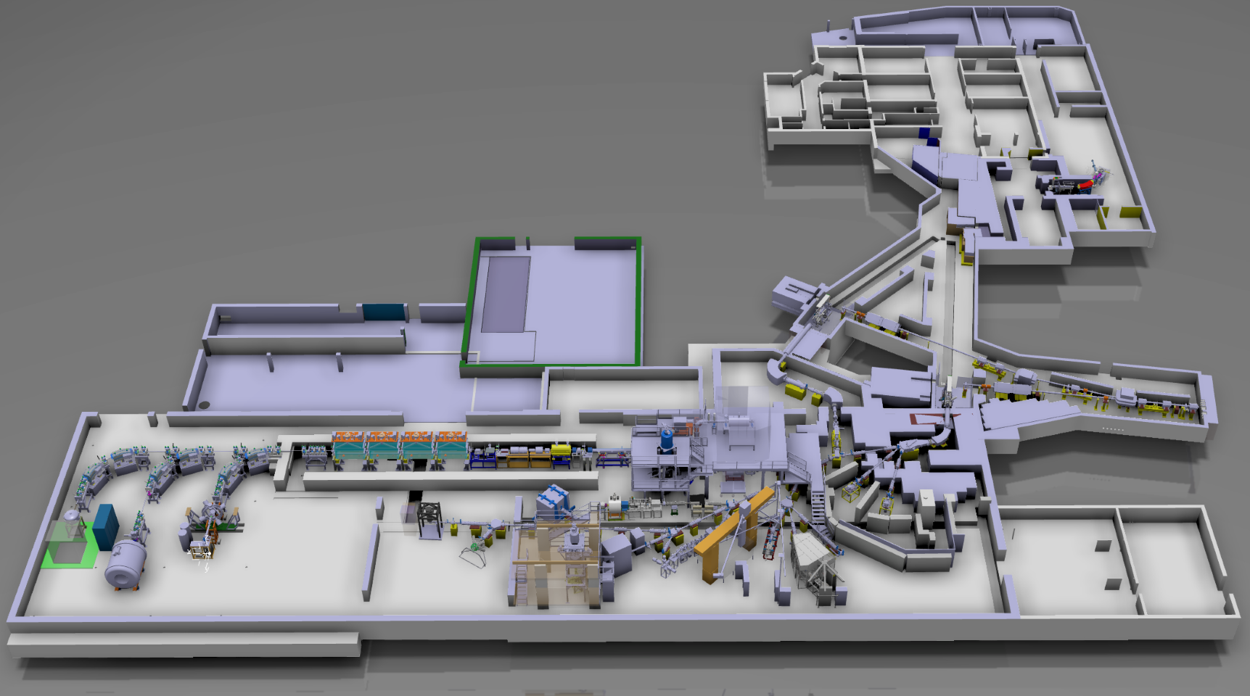
ISOLDE facility lay-out
Nearly 1300 isotopes available from 74 chemical elements
(largest choice for any ISOL facility in the World)
In 2025: 51 different experiments, 505 shifts
Miniball
ISOLTRAP
IDS
CRIS
ISS

Slide 3
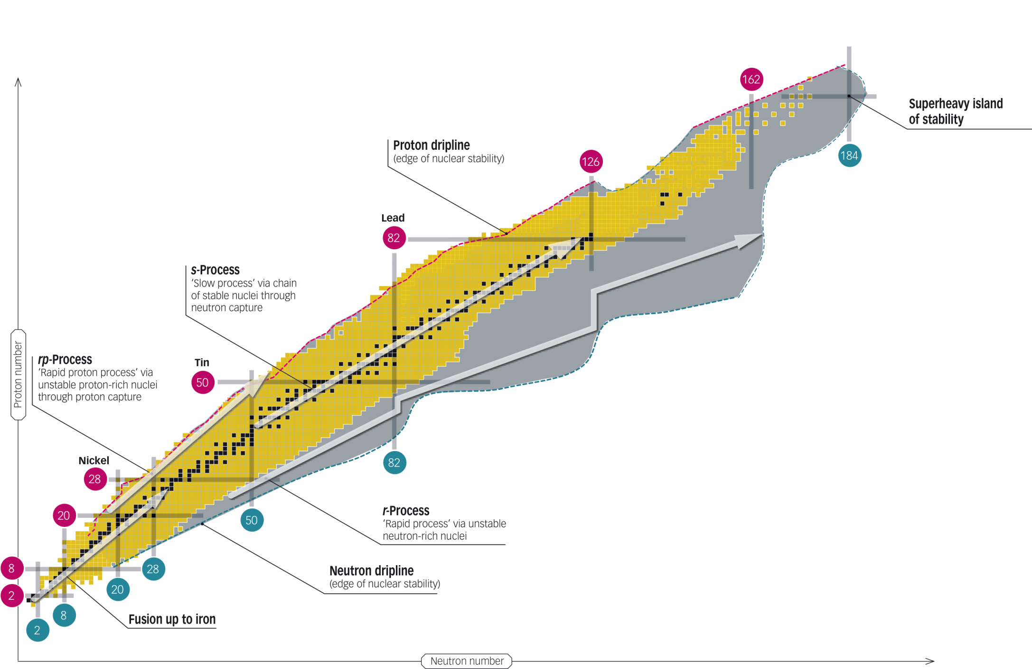
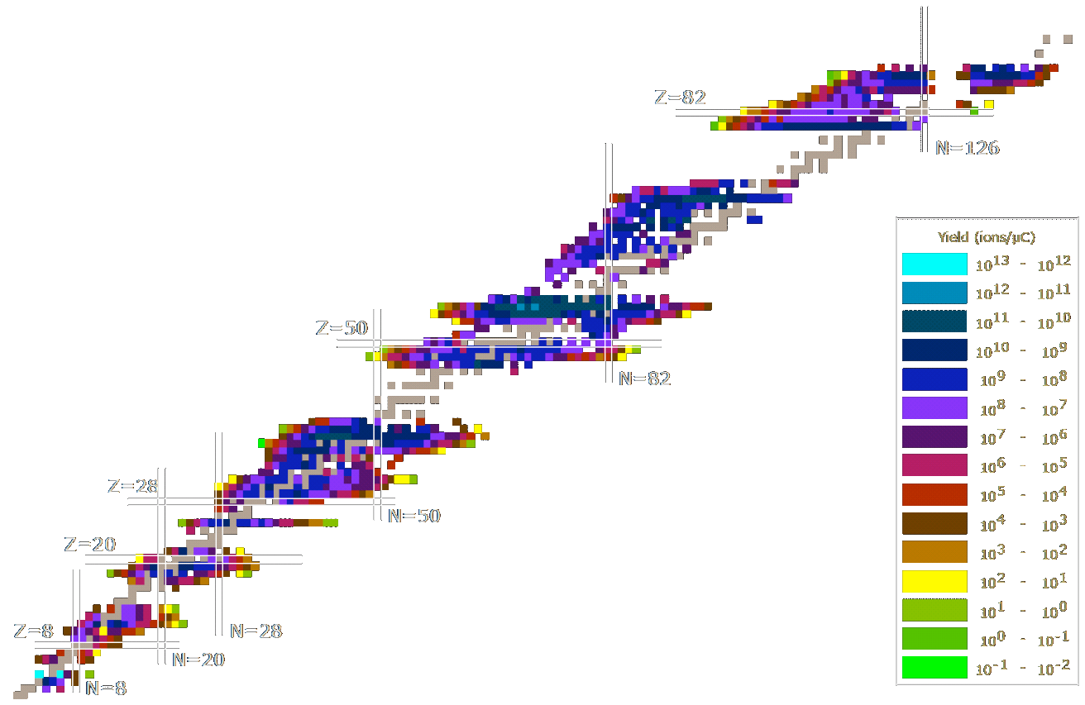
Isotope production at ISOLDE
spallation
+
²⁰¹Fr
Proton number
1.4 GeV protons
fragmentation
+
+
¹¹Li
²³⁸U
X
fission
n
+
+
p
Neutron number
¹⁴³Cs
Y

Slide 4
Techniques available at ISOLDE
Experimental programme
Nuclear and
atomic physics
Material and
life sciences
Ion traps
Decay spectro-scopy
Laser spectro-scopy
decay pattern
mass
Transition probability
Spin, parity
e-m moments
half-life
radius
Nucleon-transfer reactions
Beta-detected NMR
Coulomb excitation
Fundamental interactions
Nuclear astrophysics

Slide 5
Current ISOLDE key personnel
ISOLDE physics group leader
  Prof. Luis Fraile, Universidad Complutense de Madrid, Spain
ISOLDE technical group leader
  Dr. Joachim Vollaire, CERN
ISOLDE Scientific Coordinator
  Dr. Hanne Heylen, CERN
ISCC chair
  Docent Janne Pakarinen, University of Jyväskylä, Finland
INTC chair
  Prof. Silvia Leoni, University of Milan and INFN, Italy
    Physics group:
      ~10 fellows, ~5 PhD students, ~2 scientific associates, 2 ERC grantees, ~10 externals
    ISOLDE collaboration:
      17 member countries, 800+ users

Slide 6
Helsinki Institute of Physics – ISOLDE team 2026
Docent Janne Pakarinen
  HIP-ISOLDE project leader, ISCC chair, IDS and MINIBALL steering committee member, ISS collaboration member
Prof. Anu Kankainen
  INTC member 2023-2026
Prof. Paul Greenlees
  INTC member 2026-2029
Other HIP affiliated active members:
    A. Jokinen, prof., adj. senior scientist (JYU)
    I. Moore, prof., adj. senior scientist (JYU)
    T. Grahn, prof., adj. senior scientist (JYU)
    K. Auranen, adj. scientist (JYU)
    M. Reponen, adj. scientist (JYU)
    P. Rahkila, adj. scientist (JYU)
    P. Ruotsalainen, adj. scientist (JYU)
    J. Ojala, adj. scientist (JYU)
    H. Kokkonen, adj. grad. Student (JYU)
    E. Uusikylä, adj. grad. Student (JYU)
    S. Chinthakayala, adj. grad. Student (JYU/Cotutelle)
CERN fellow from JYFL-ACCLAB:
A. Tolosa-Delgado (LD Staff, EP)
A. Jaries (ISOLDE)
HIP summer student:
J. Burbach
FRB representative
K. Huitu, prof. (HIP)

Slide 7
HIP affiliated personnel

Slide 8

Roles in expert committees
ISOLDE Collaboration Committee (ISCC)
  Docent Janne Pakarinen 2015 – present (chair since 2025)
  Prof. Paul Greenlees, 2012 – 2015
  Prof. Ari Jokinen, 1999 - 2012
ISOLDE Scientific Committee
  Prof. Juha Äystö, 1991-1994
ISOLDE and Neutron Time-of-Flight Experiments Committee (INTC)
  Prof. Paul Greenlees, 2026 – 2030
  Prof. Anu Kankainen, 2022 – 2026
  Prof. Iain Moore, 2019 - 2022
  Prof. Jacek Dobaczewski, 2013 – 2016
  Prof. Rauno Julin, 2007 – 2011
  Prof. Juha Äystö, 2003 - 2006 (chair)
  Prof. Jouni Suhonen, 2000 - 2004
Science Policy Committee at CERN
  Juha Äystö, 2008 - 2014
HIE-ISOLDE physics coordination group
  Docent Janne Pakarinen 2015-2019
Miniball steering committee
  Docent Janne Pakarinen 2015 - present
IDS steering committee
  Docent Janne Pakarinen 2018 - present
  Prof. Paul Greenlees 2013 - 2018

Slide 9

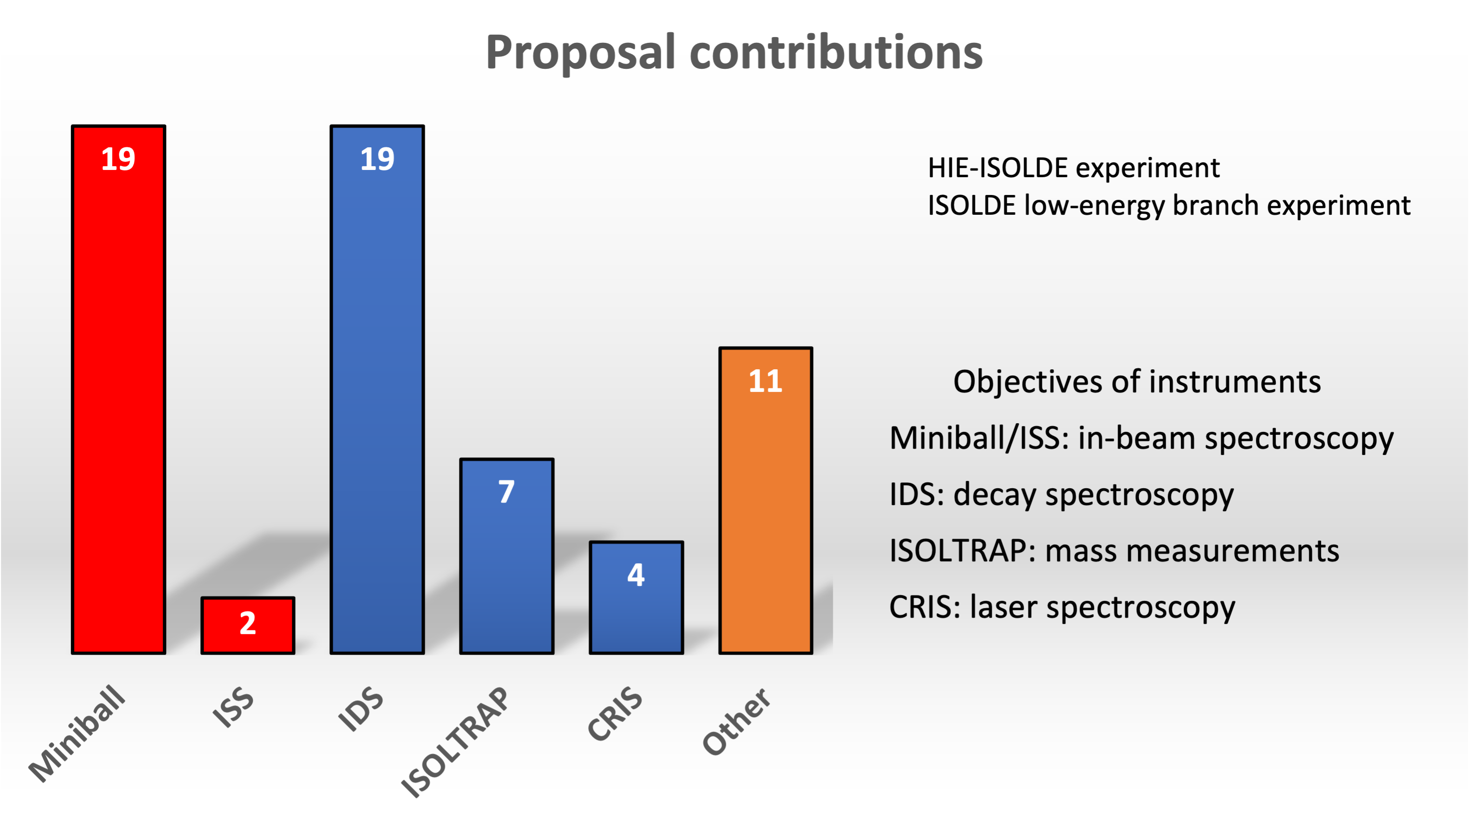



Finnish physics program
Charge-radii measurements
https://isolde-cris.web.cern.ch/index.html
Nuclear masses
https://isoltrap.web.cern.ch/
Decay studies
http://isolde-ids.web.cern.ch/
In-beam spectroscopy at HIE-ISOLDE
https://miniball.web.cern.ch/

Slide 10
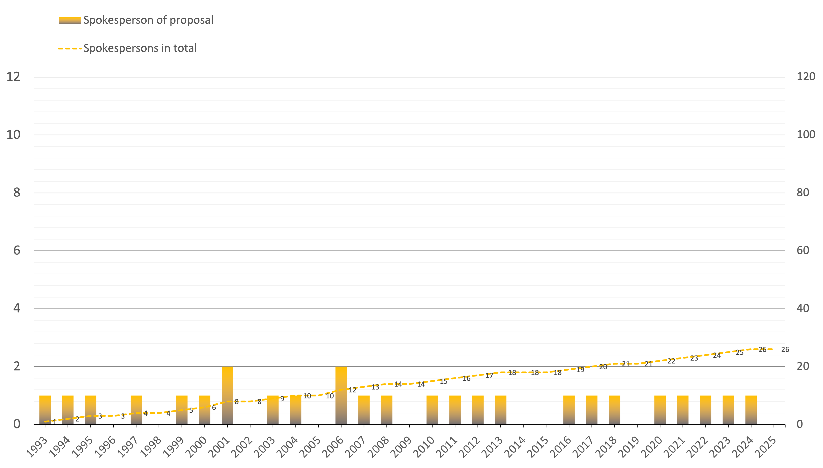
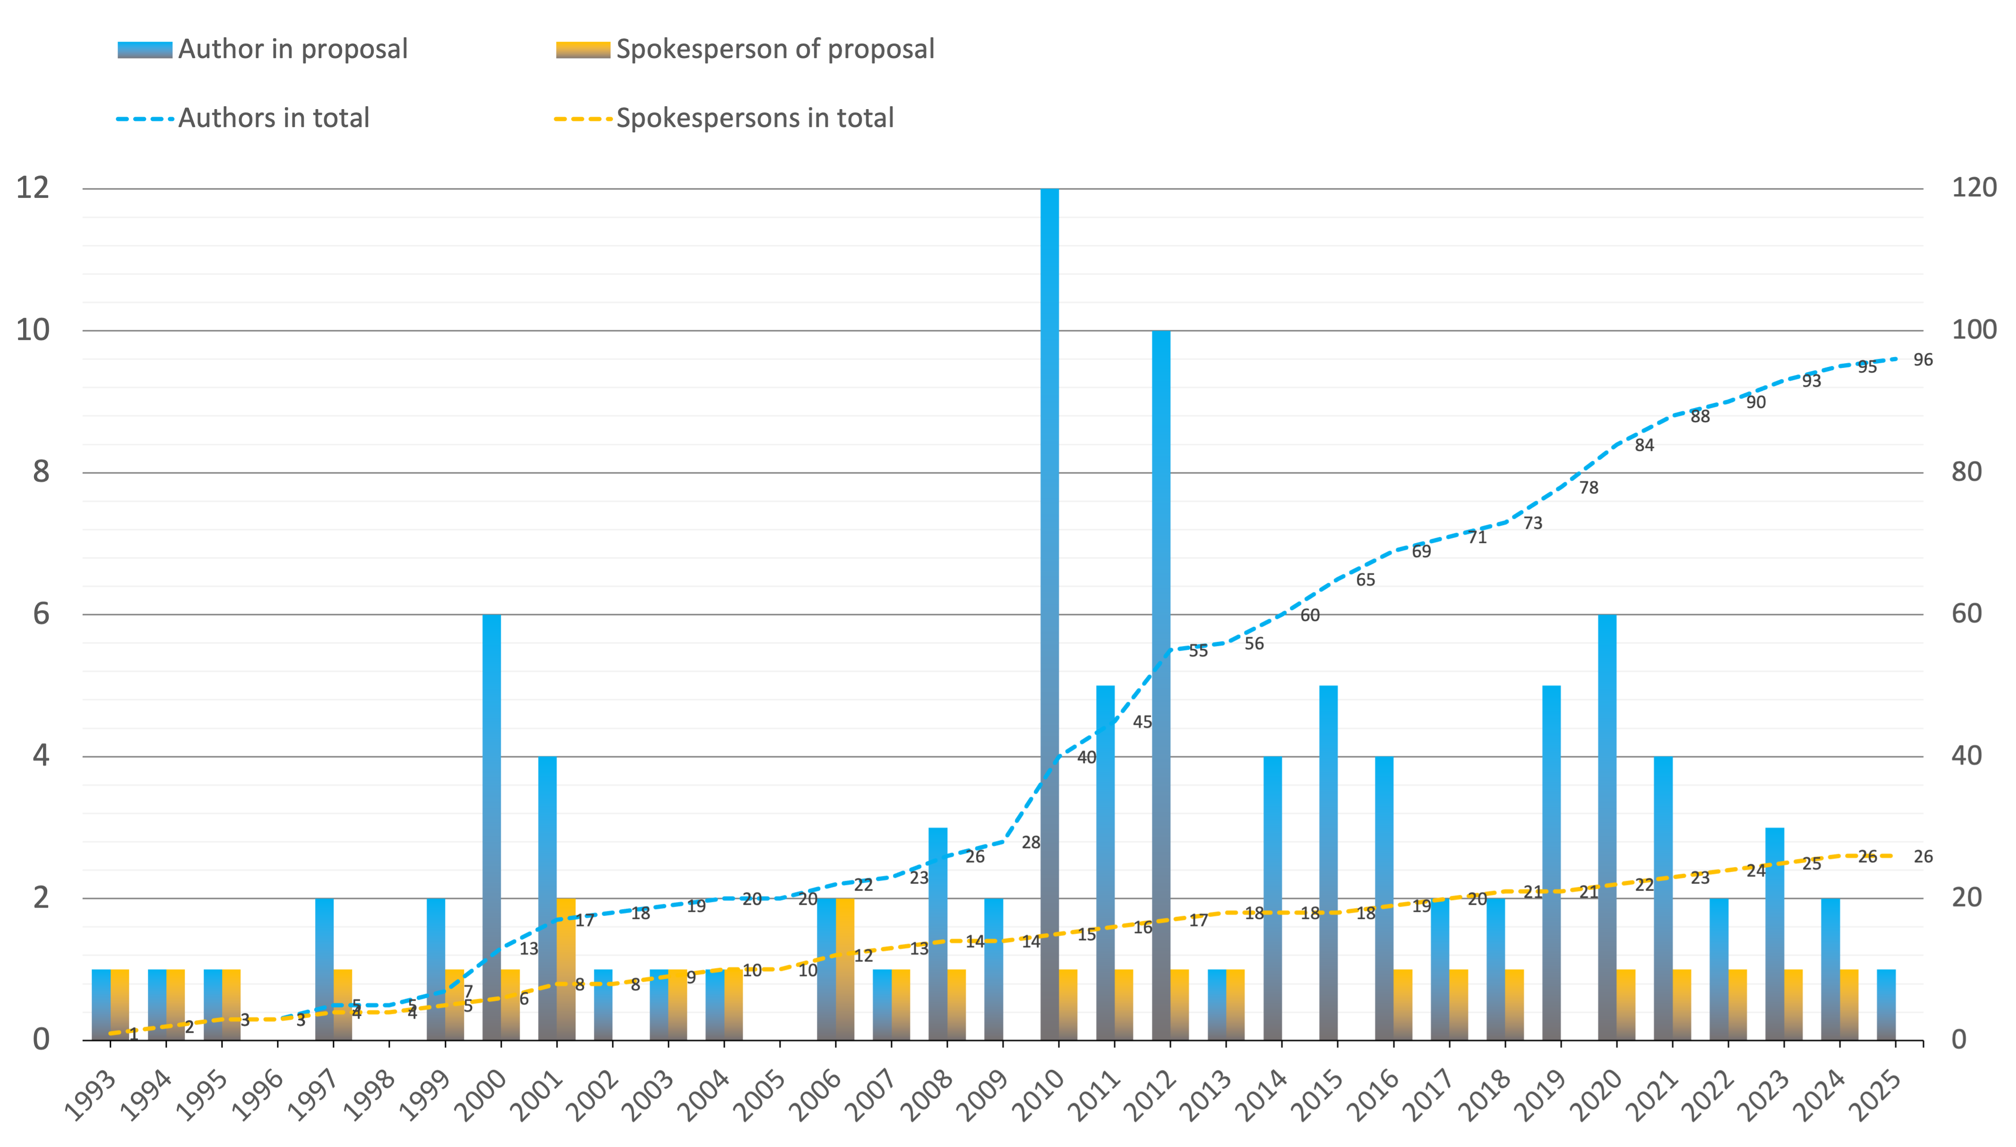
Proposals with Finnish contributions

Slide 11
HIP-ISOLDE publication records
200+ papers
5000+ citations

Slide 12
Publications since January 2025
Publication title | Journal (with a link) | Scope
The ⁷⁶Cu conundrum remains unsolved | Physics letters B | Nuclear structure
Nuclear level density and 𝛾-ray strength function of ⁶⁷Ni and the impact on the 𝑖 process | Physical review C | Nuclear structure
Structure of ¹²⁸Sn selectively populated in the β decay of the ¹²⁸In ground state | Physical review C | Nuclear structure
New upper limits for β-delayed fission probabilities of ^{230,232}Fr and ^{230,232,234}Ac | Physical review C | Nuclear structure
Revealing the Nature of yrast States in Neutron-Rich Polonium Isotopes | Physical review letters | Nuclear structure
Charge radii and electromagnetic moments of ²¹⁴⁻²¹⁸Bi: Exploring the “southern” border of the 𝑍>82 octupole-deformation region | Physical review C | Nuclear structure
Electromagnetic moments of ^{215,217}Bi: Probing shell evolution beyond N = 126 | Physics letters B | Nuclear structure
First Measurement of the Quadrupole Moment of the 2⁺₁ State in ¹¹⁰Sn | Physical review letters | Nuclear structure
First 𝛽-Delayed Two-Neutron Spectroscopy of the 𝑟-Process Nucleus ¹³⁴In and Observation of the 𝑖_{13/2} Single-Particle Neutron State in ¹³³Sn | Physical review letters | Nuclear structure
Electron correlation and relativistic effects in the excited states of radium monofluoride | Nature communications | Atoms and molecules
Enhanced sensitivity for electron affinity measurements of rare elements | Nature communications | Atoms and molecules
Laser spectroscopy and CP-violation sensitivity of actinium monofluoride | Nature | Atoms and molecules
Observation of the distribution of nuclear magnetization in a molecule | Science | Atoms and molecules
𝛽- and 𝛼-decay spectroscopy of ¹⁸²Au | Physical review C | Nuclear structure
Search for β-delayed fission of ¹⁷⁸Au^{g,m} and an updated systematics in the region of neutron-deficient nuclei | Physical review C | Nuclear structure
Ionization potential of radium monofluoride | Physical review research | Nuclear structure
Precision mass measurement of ⁶¹Zn and updated Ft value for conserved vector current tests | Physical review C | Nuclear structure

Slide 13
Experiments since previous HIP-SAB
IS709 experiment at IDS (Exploring shape coexistence across N=60 in ¹⁰⁰Sr₆₂ using IDS), 10-14 September
  Janne Pakarinen
IS772 experiment at CRIS (Collinear resonance ionization of neutron-deficient indium: closing up on N = 50), 17-23 September
  Saikumar Chinthakayala
IS753 experiment at ISS (Mapping single-particle neutron strength towards the mid-shell in semi-magic lead isotopes), 29 October – 2 November
  Joonas Ojala, Janne Pakarinen, Panu Rahkila
IS747 experiment at IDS (Laser and nuclear decay spectroscopy study of the neutron-rich high-spin states in the ^{212,213}Bi isotopes with LIST)
IS741 experiment at IDS (Detailed decay spectroscopy of ²²⁵Ac and its daughters to support its use in medical applications), 5-7 December
  Janne Pakarinen

Slide 14
Timely affairs
20-Year Roadmap for the Non-Collider Physics Programme at CERN
“The Non-Collider Physics Programme is considered a critical component of CERN’s scientific portfolio, complementing the main LHC experiments and playing an important role as CERN moves towards future flagship projects.”
The roadmap will:
    Align the Non-Collider Physics with CERN’s overall scientific strategy and planning cycles.
    Establish a prioritised and scientifically driven programme, aligning technical feasibility, and resource considerations.
    Identify key milestones and decision points over the coming decades.
    Provide indicative long-term resource strategy including material and personnel requirements, to support strategic planning and infrastructure development.
    Set up a transparent framework for future initiatives which maintains flexibility for new ideas yet within a clearly defined decision structure.
Call for Expressions of Interest – dedicated task force to work in close contact with INTC
Run 3 and earlier proposals will be closed at end of LS3. Many are expected to be resubmitted, including ¹⁸⁸Pb Coulex. This requires additional manpower.
A HIP-funded doctoral student/researcher at CERN, working on ¹⁸⁸Pb, would meet this need while supporting the broader push for increased experimental campaign support.

Slide 15
Summary
ISOLDE is the world leading ISOL facility
Broad Finnish contribution over the years
  Focus on nuclear structure studies
  Various roles in expert committees
  Transfer of knowledge in R&D
Experimental programme complementary to that at JYFL-ACCLAB
  In-beam experiments (Miniball, ISS)
  Decay studies (IDS)
  Laser spectroscopy (CRIS, COLLAPS, RILIS, MIRACLS)
  Mass measurements (ISOLTRAP)
Ambitious future development plans

Slide 16
Thank you for listening!

Slide 17
JYFL – ISOLDE personnel exchange
Fellow
Alvaro Tolosa Delgado
Software R&D
Fellow
Markus Vilen
MR-ToF
Fellow
Joonas Konki
Miniball
CERN Associate
Ari Jokinen
ISCOOL
CERN associate
Janne Pakarinen
Miniball
SPEDE
2013
1999
2000
2001
2002
2003
2004
2005
2006
2007
2008
2009
2010
2011
2012
2015
2016
2017
2018
2019
2020
2021
2022
2023
1998
2014
1995
1996
1997
1994
CERN associate
Mikael Reponen
MIRACLS
CERN Associate
Juha Äystö
ISOLDE physics group leader
Juha Äystö
Fellow
Pekka Suominen
Ion sources
Fellow
Pekka Suominen
Ion sources
Fellow
Ville Toivanen
Ion sources
Fellow
Ari Jokinen
Post-doc
Markku Oinonen
ISOLTRAP
Post-doc
Kari Peräjärvi
Decays
Fellow
Janne Pakarinen
Miniball
CERN associate
Janne Pakarinen
Miniball
SPEDE
Andreas Illana
NucSpec
Post-doc
Teemu Siiskonen
Theory
Wouter Gins
IGISOL
Ruben De Groote
IGISOL
Agi Koszorus
IGISOL
Marek Stryjczyk
IGISOL
Maxime Mougeot
IGISOL
Current JYFL-ACCLAB personnel participating in CERN/HIP summer training
Janne Pakarinen Tommi Eronen Mikko Laitinen Ville Virtanen Mikko Kivekäs
Sami Rinta-Antila Sonja Kujanpää Vili Pesonen

Slide 18
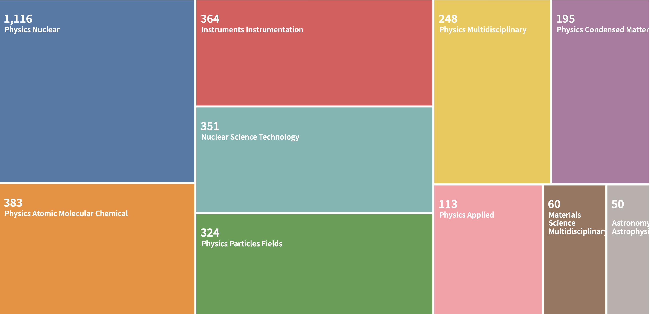
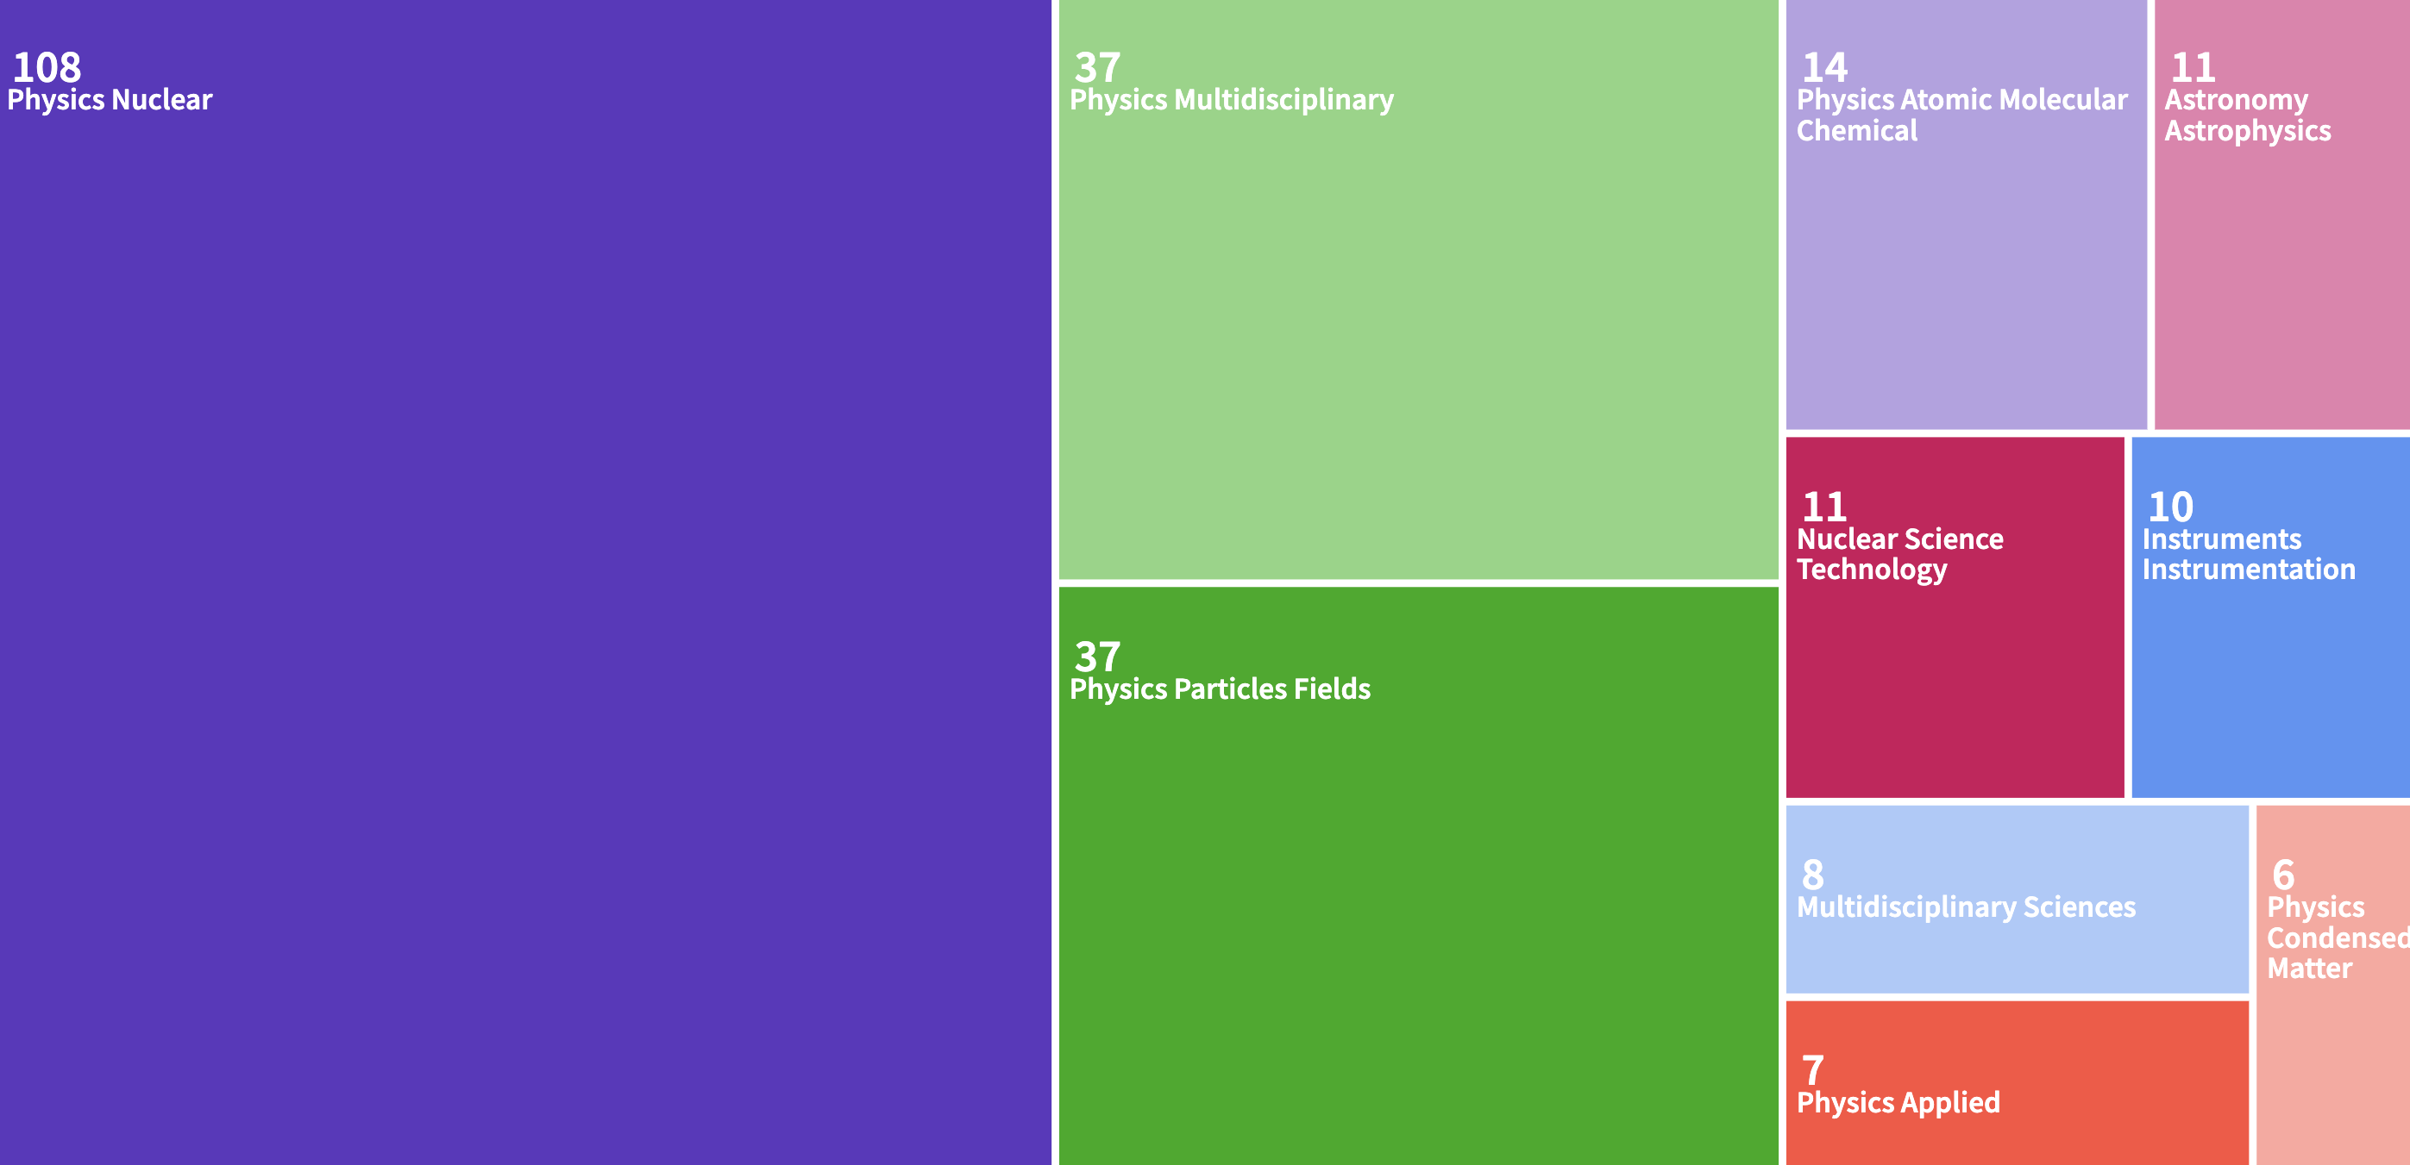
Diverse multi-disciplinary science program
Analysis of Web of Science search for ISOLDE publications
Analysis of Web of Science search for HIP-ISOLDE publications

Slide 19

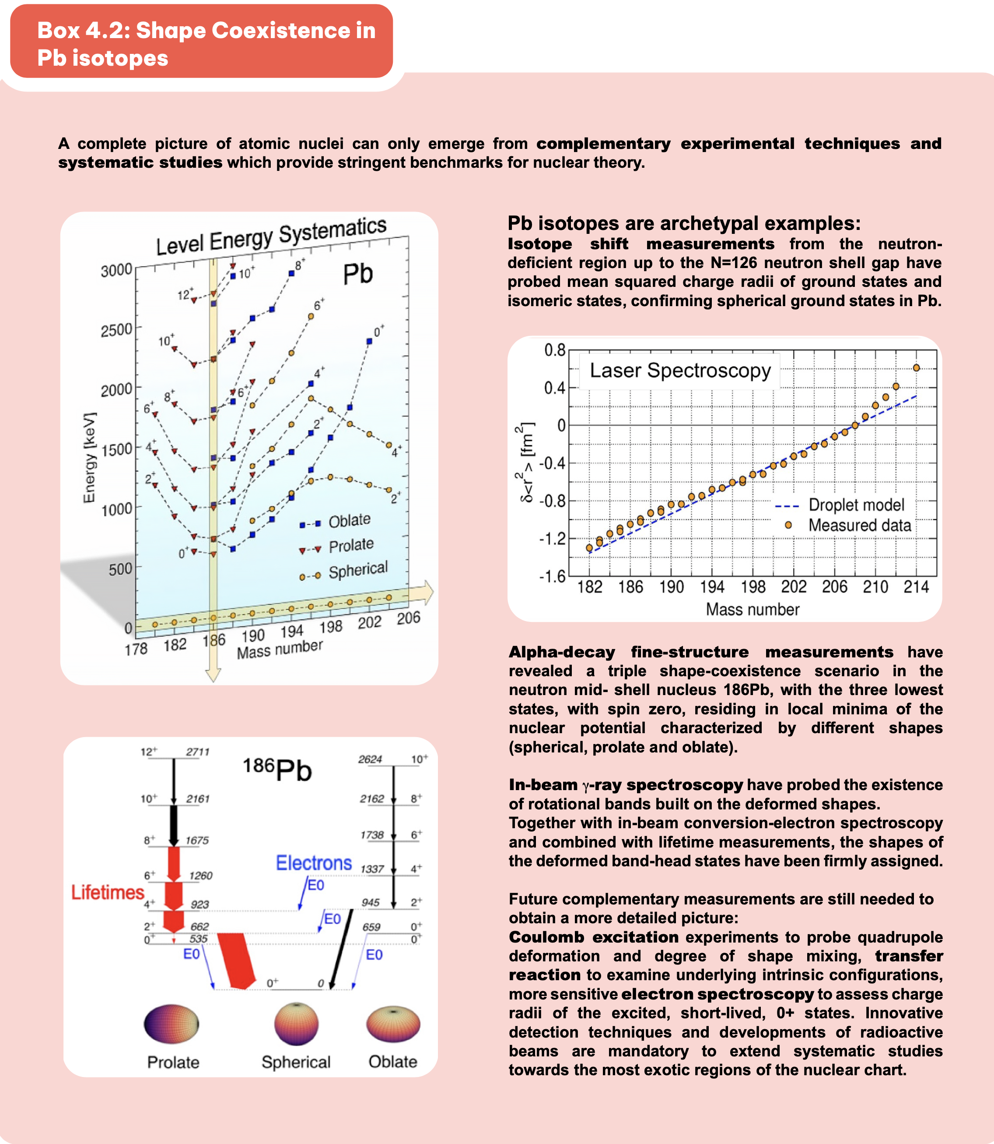
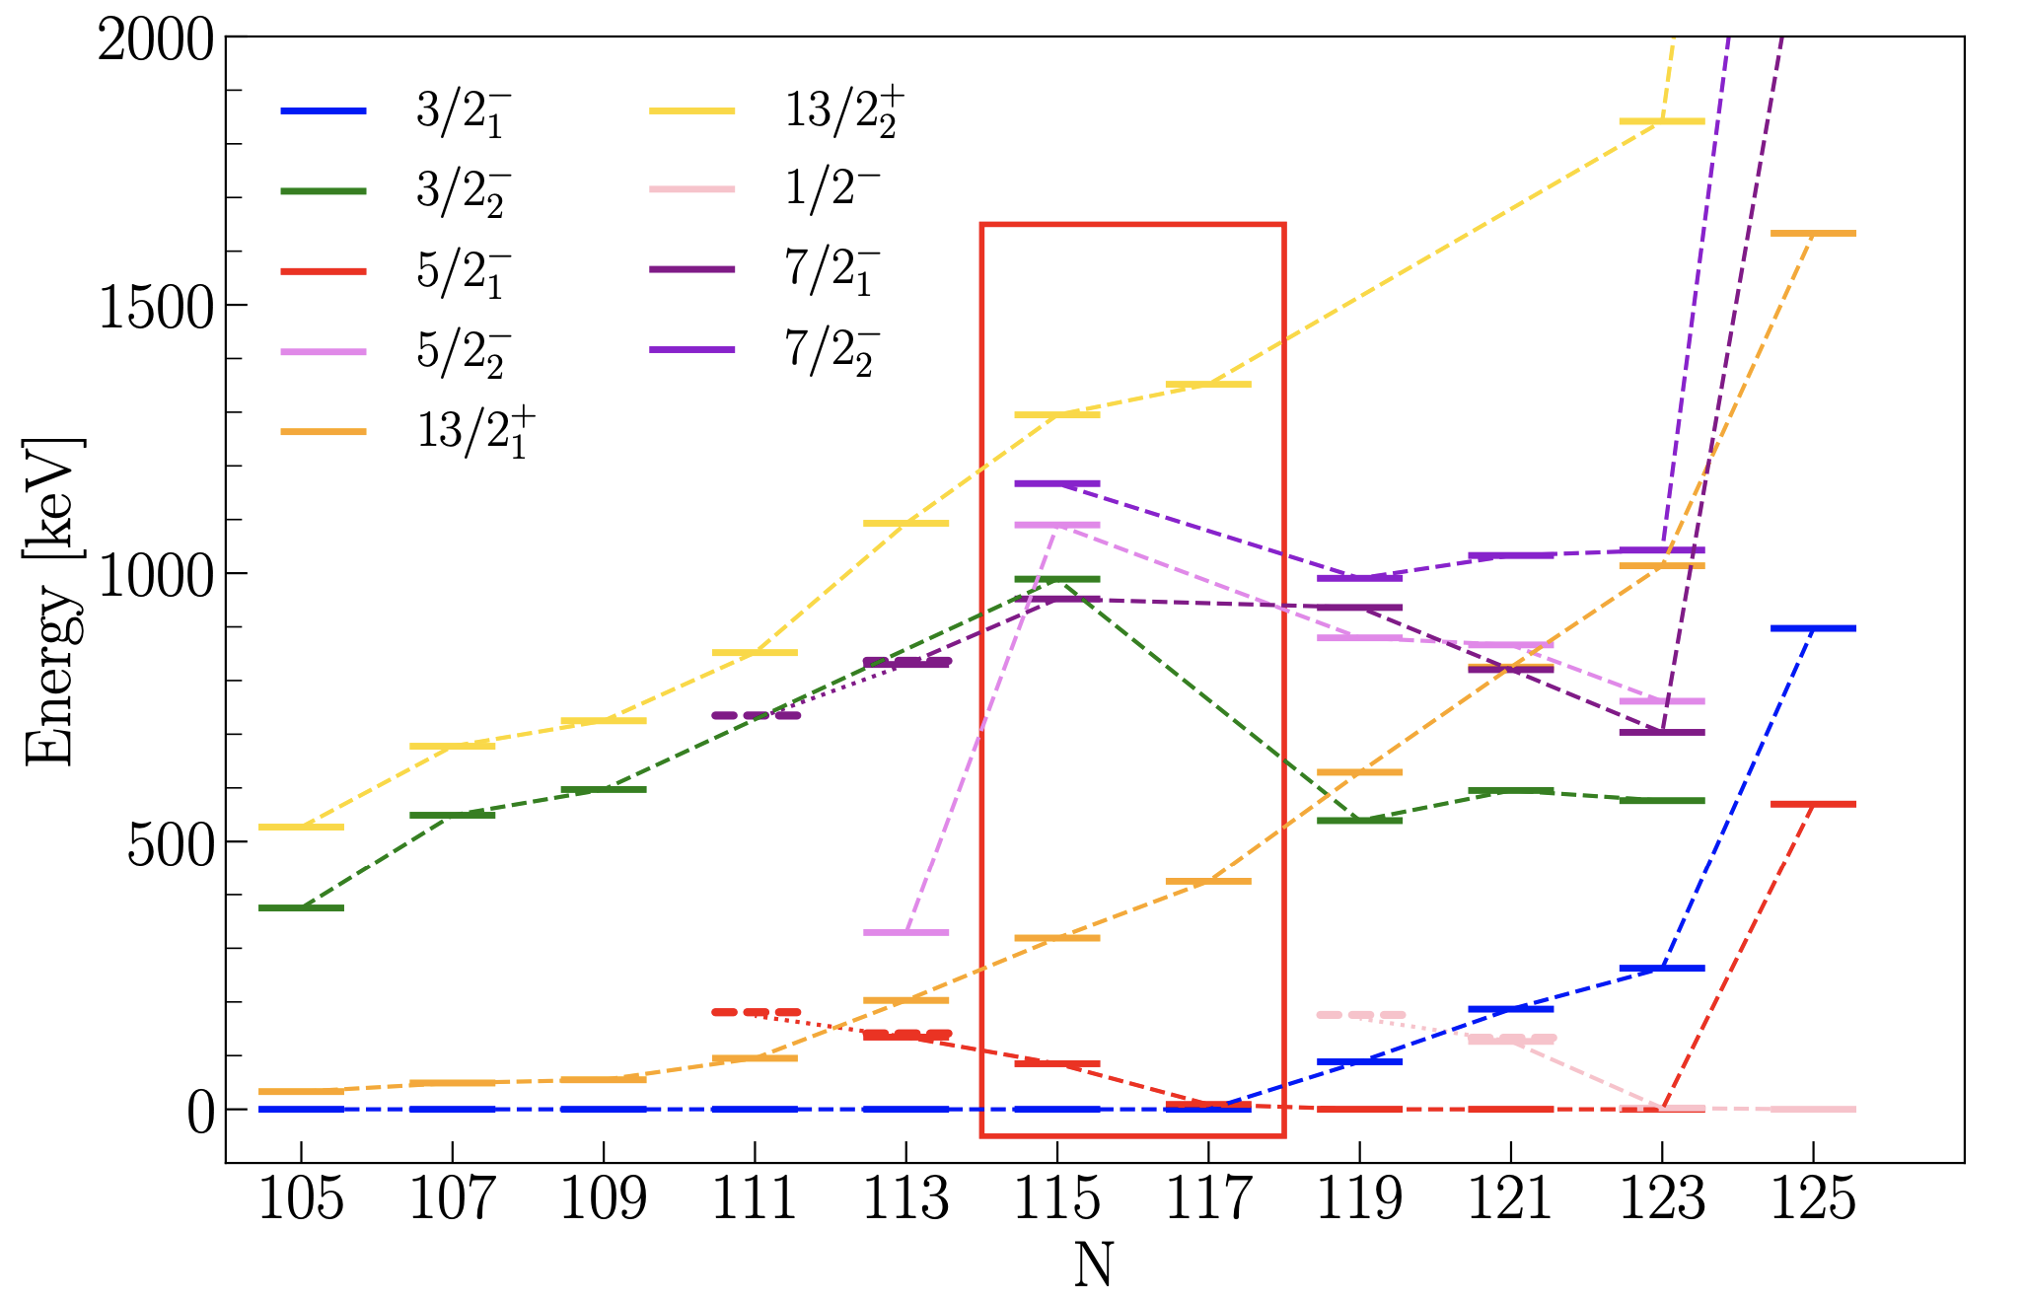
Motivation
- complementarity -
NuPECC long range plan 2024
IS753 experiment at ISS in November 2025
Mapping single-particle neutron strength towards the mid-shell in semi-magic lead isotopes

Slide 20
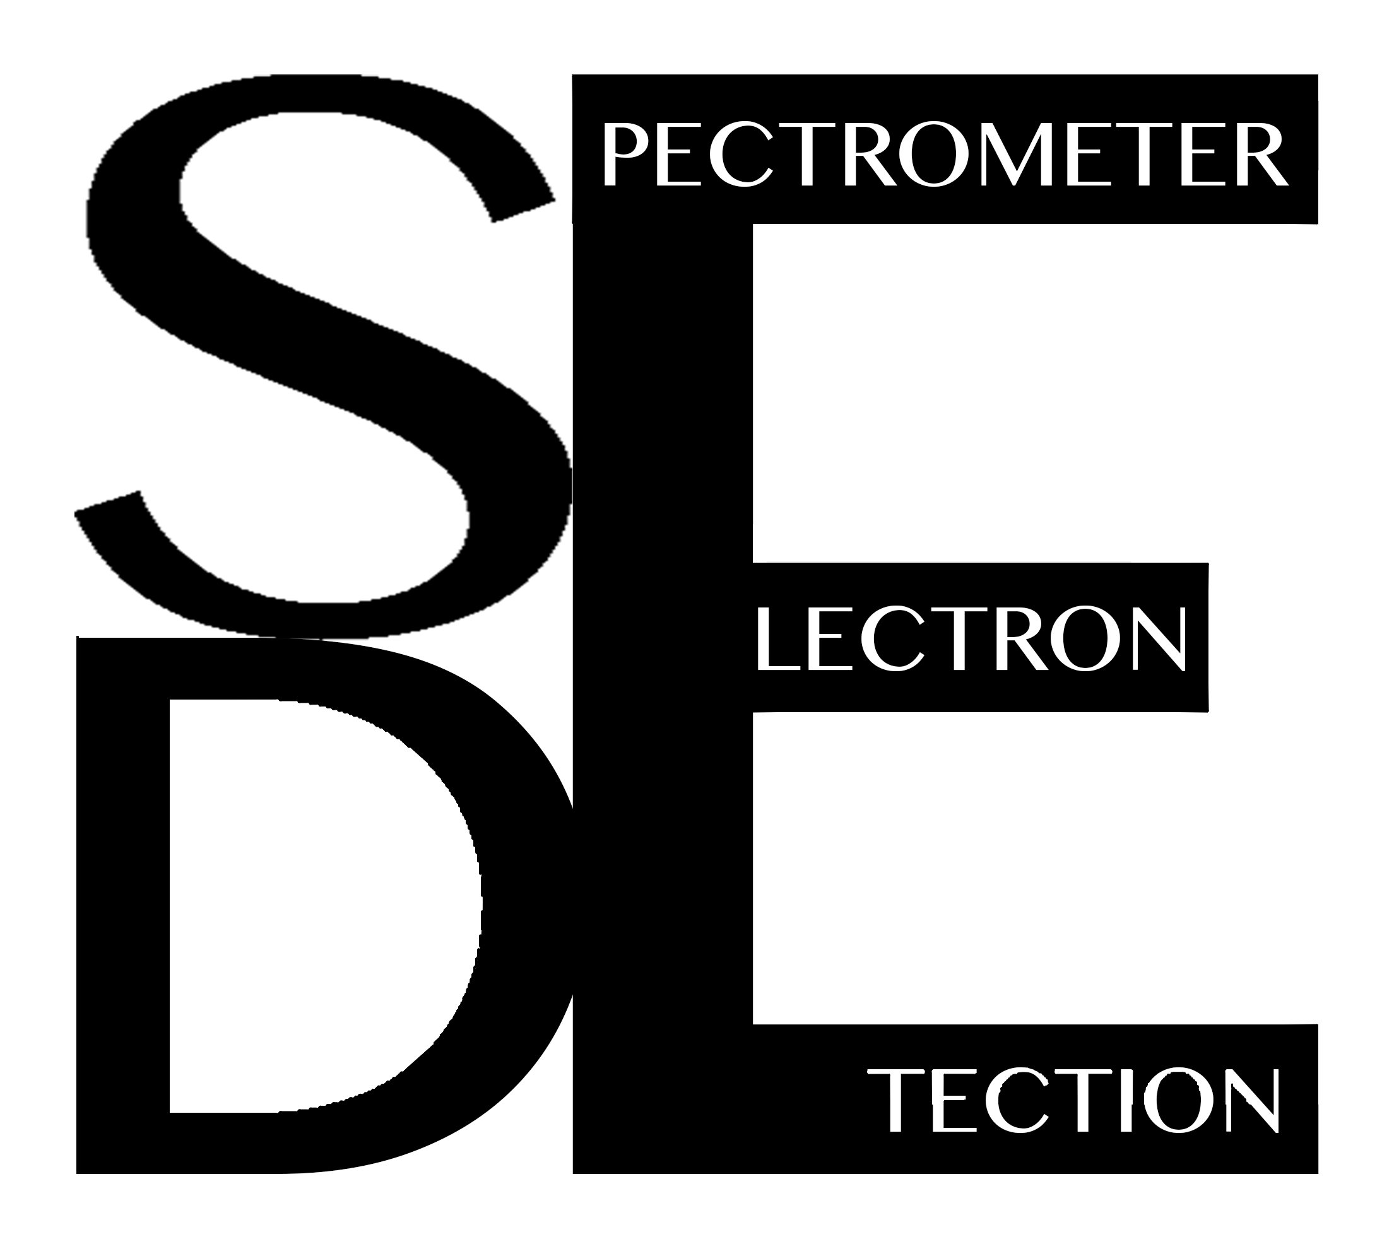
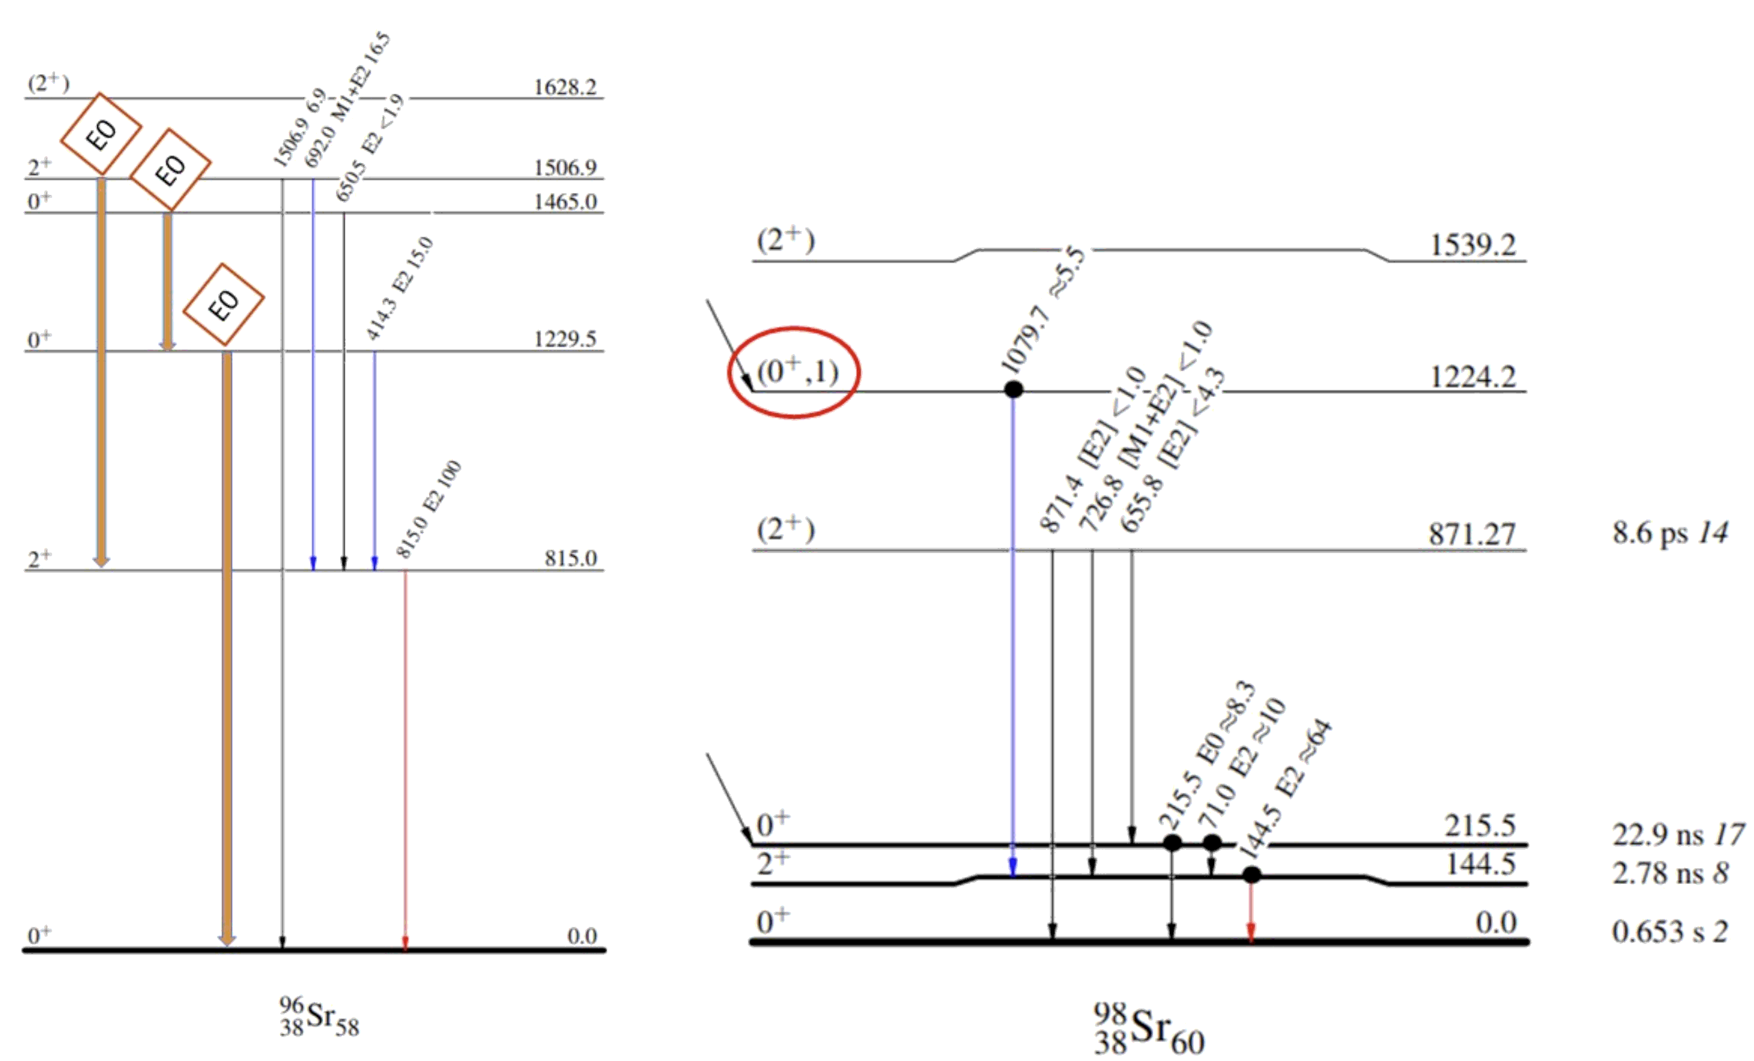
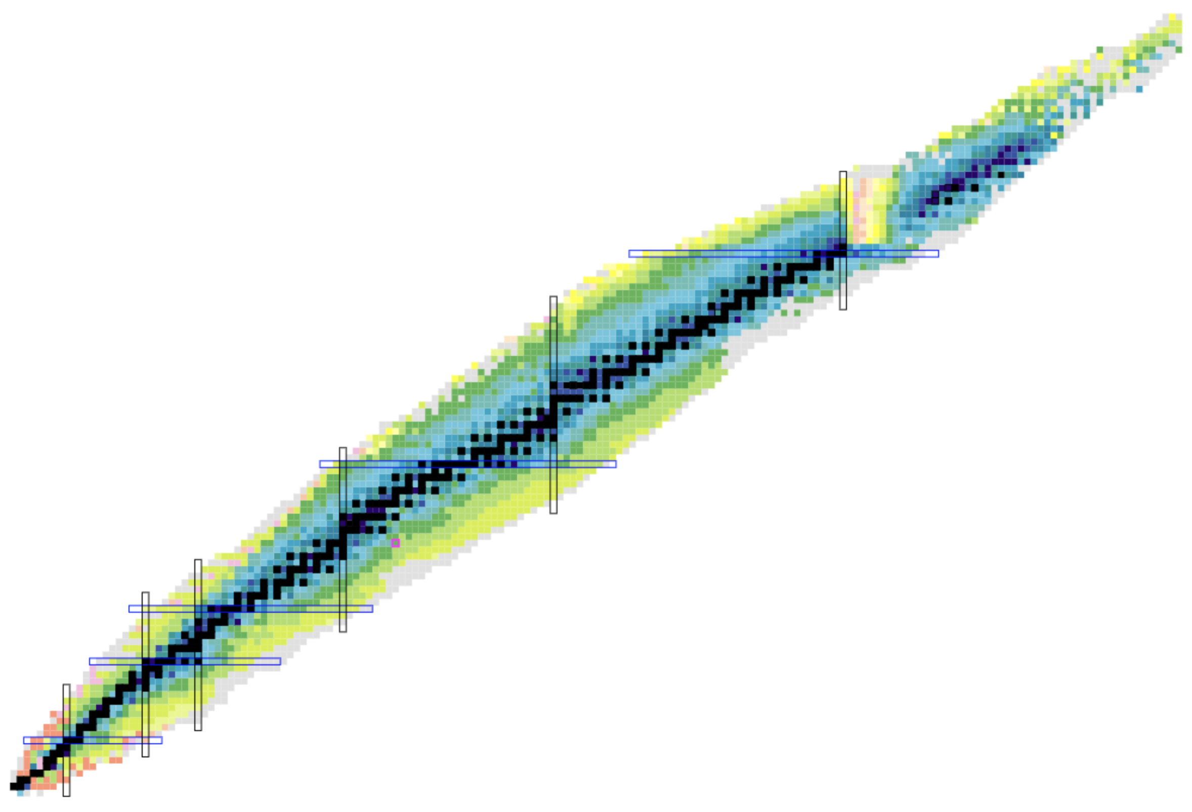
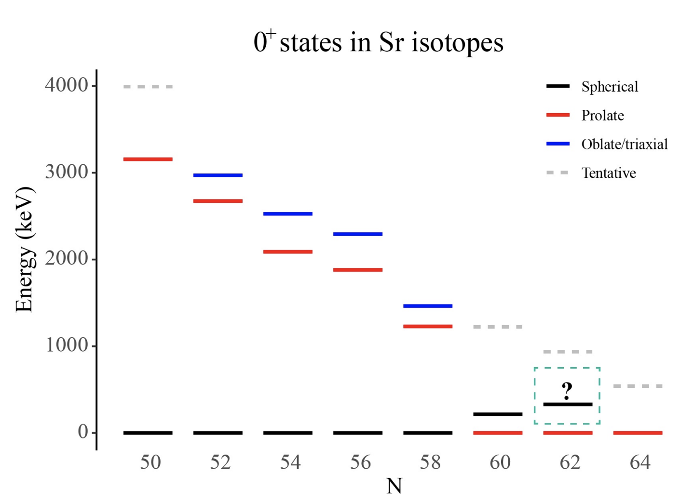
Shape coexistence in ^{96,98}Sr
IS709 - Exploring shape coexistence across N=60 using IDS in September
Objectives:
The first electron spectroscopy for ⁹⁶Sr
The firm assignment of the spin-parity for the 1224keV level in ⁹⁸Sr
Proton number
Neutron number

