Slide 1
EPFL Framework for EIC
Leon van Riesen-Haupt, Tirsi Prebibaj, Lara Sievert, Tatiana Pieloni

Slide 2
EPFL Framework
Xsuite workflow that
  Applies user specified field errors and misalignments
  Runs global orbit and optics correction algorithms
More details in Tirsi’s slides
Xsuite allows for
  Readily install other perturbations including beam-beam effects, electron cloud, impedance and space charge
  Spin tracking
  Accessibility for other European collaborators – HL-LHC control room tool
  Complement and strengthen BMAD results

Slide 3
Requirements
Lattices in Xsuite
  Conversion from MADX built in but needs to be tested
Magnet errors
  Do EIC estimates exist?
  Adapt from other large colliders LHC, FCC, RHIC?
BPMs, correctors and optics tuning knobs
  Either installed in lattice or locations for thin kicks/markers
  Multiple approaches possible

Slide 4
Xsuite Lattices
All MADX elements recognized by Xsuite
  Need to make sure this is the case when more details added e.g. complicated solenoid geometries
Most robust test – compare Xsuite optics to BMAD
  Beta functions and dispersion
  Both HSR and ESR
  Check geometry

Slide 5
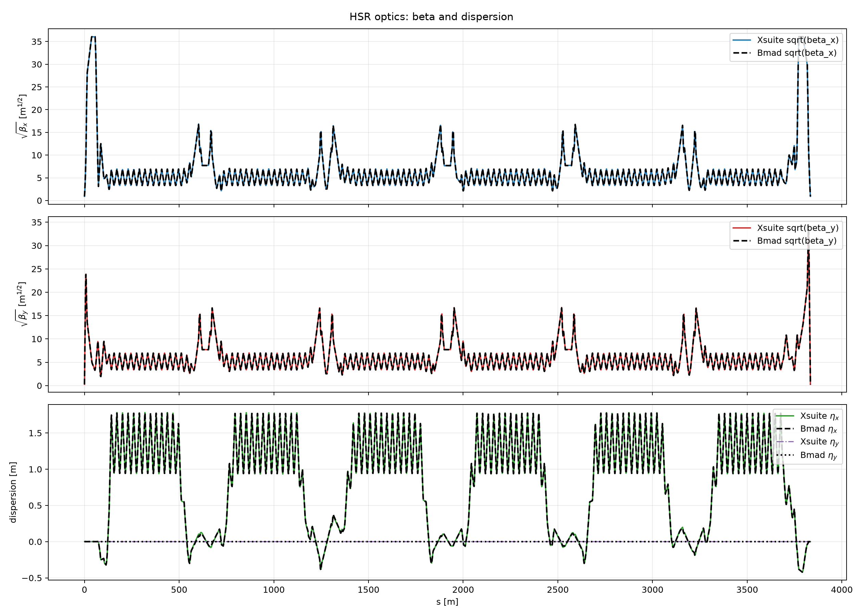

Slide 6
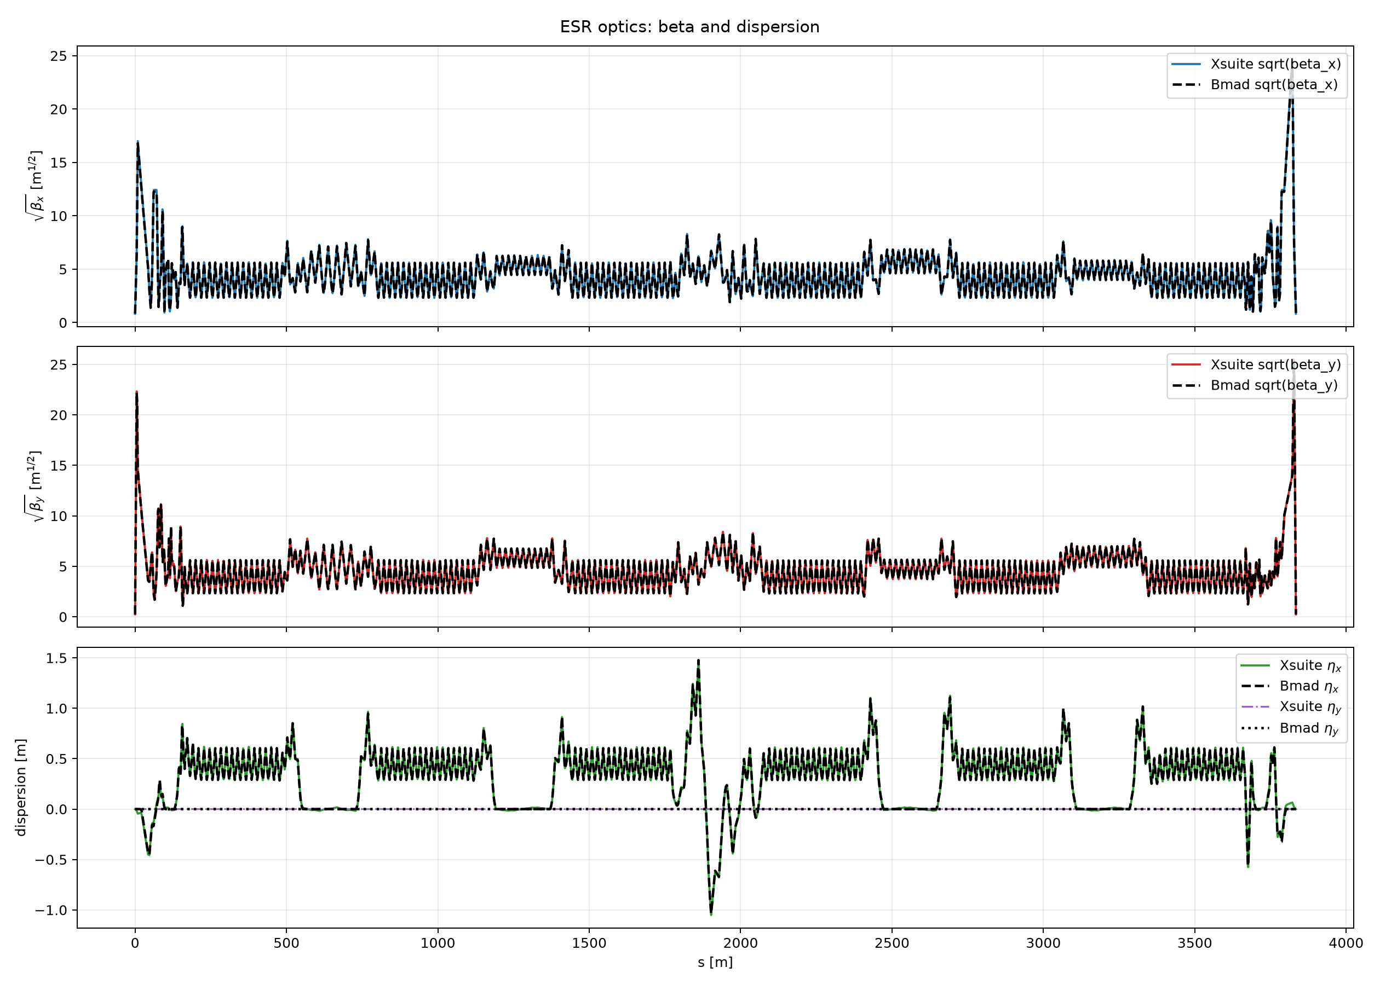

Slide 7
Correctors and BPMs
Could place correctors and BPMs manually
  Start with conservative approach next to every quadrupole
  Remove systematically and observe change in beam quality
Implement baseline scheme once available
Ability to evaluate efficacy of different designs including
  Different error seeds and distributions
  BPM tolerances
  Other effects in the long run
Also indication of space requirements and radiation

