Slide 1
Single Cube
PEN vs ArCLight

Slide 2
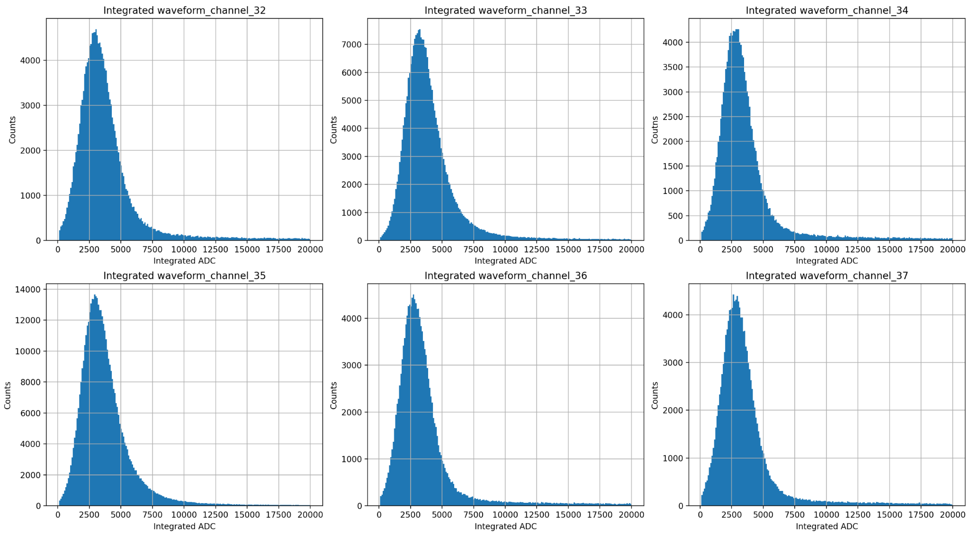
Integrated Waveform

Slide 3
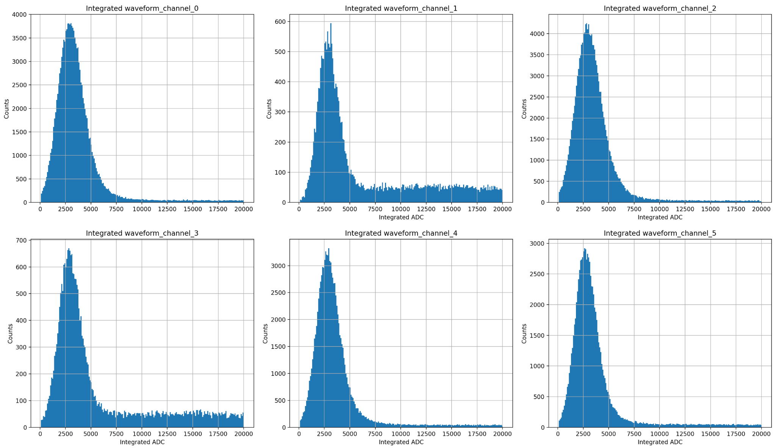
Integrated Waveform

Slide 4
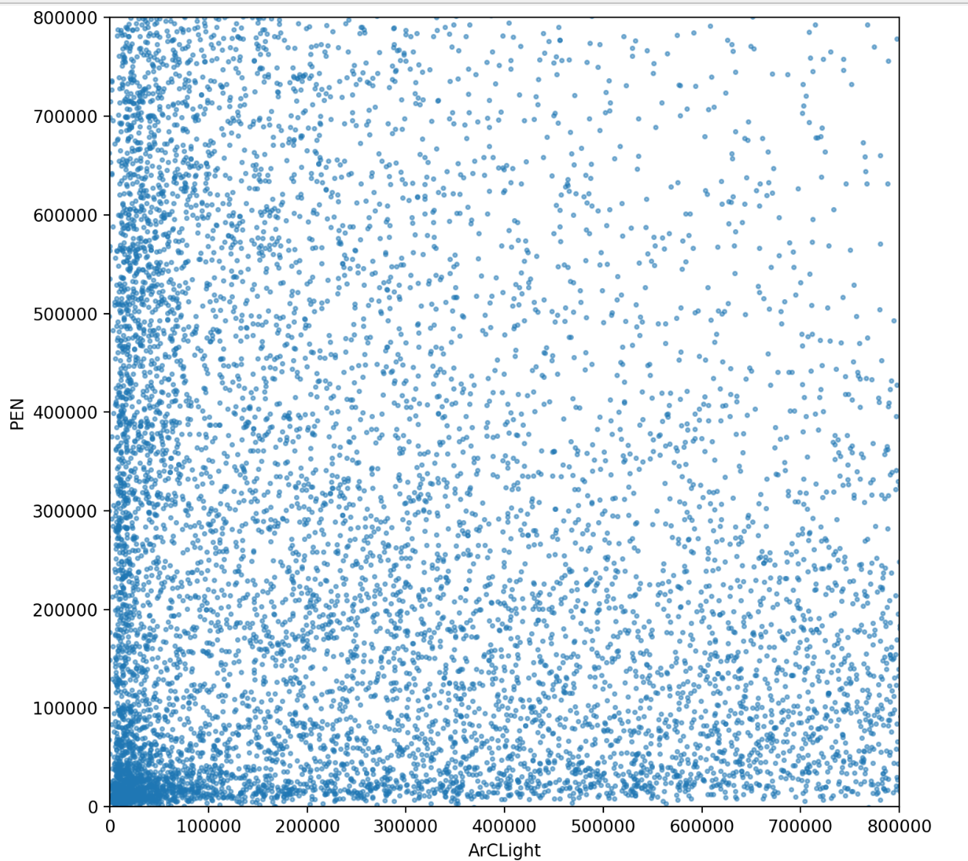
PEN vs ArCLight
Looking at Run 108 with
Vgain = 1750
Vbias = 1250
Threshold = 300
Showing integrated waveform
For PEN and ArCLight events with same timestamp within 200 ticks
Number of correlated events: 21530

Slide 5
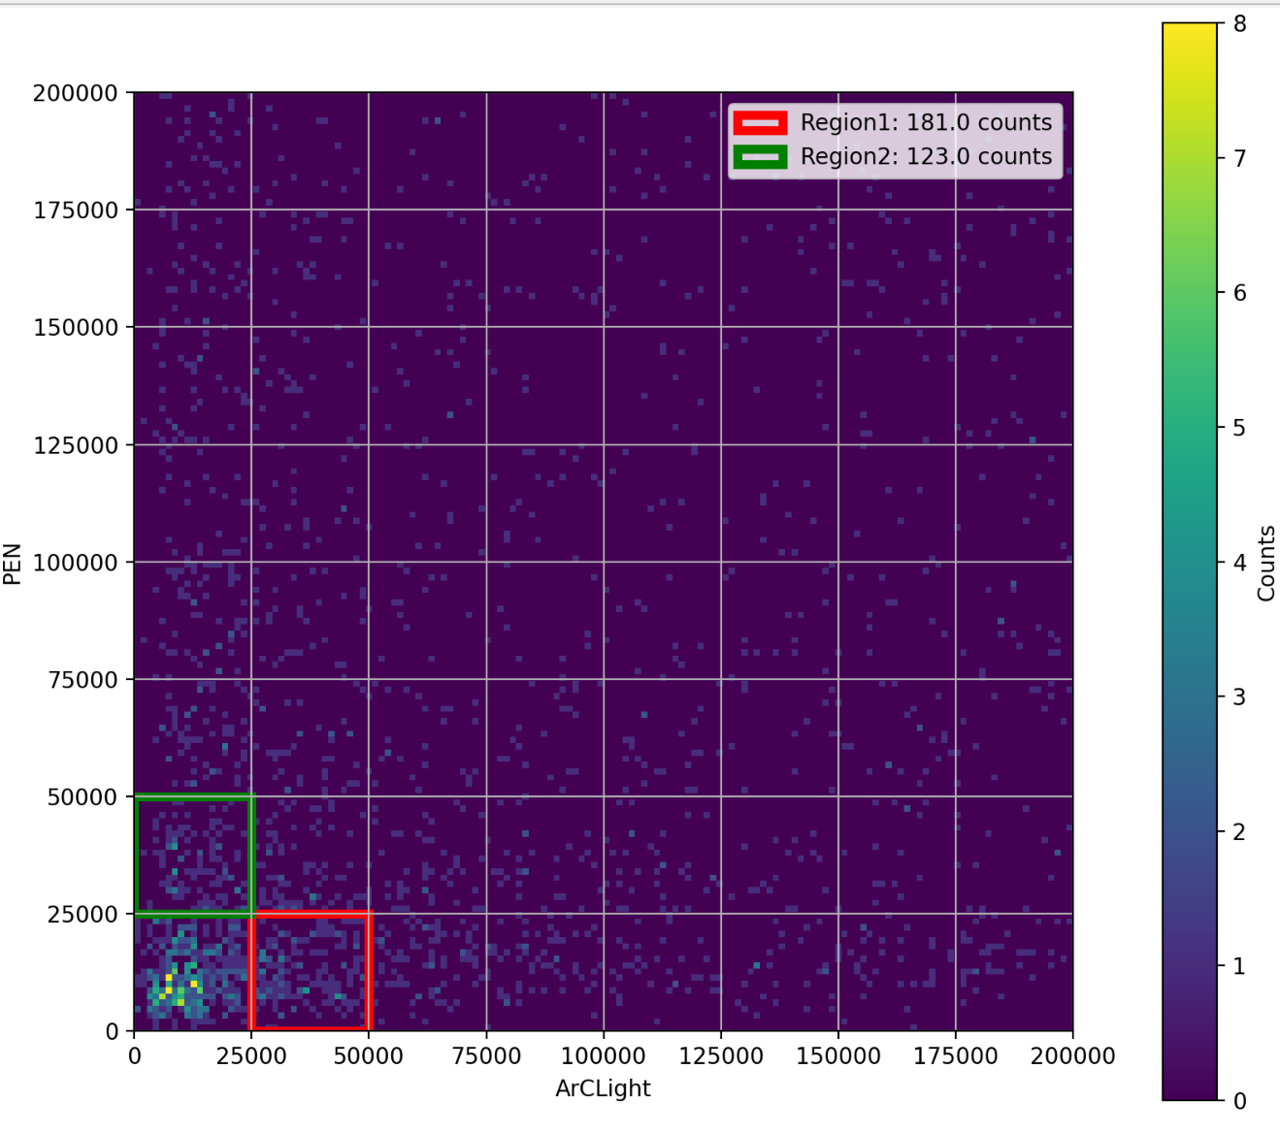
PEN vs ArCLight
Compare two diagonal regions to “compare” ArCLight and PEN
  ArCLight/PEN = 1.47

Slide 6
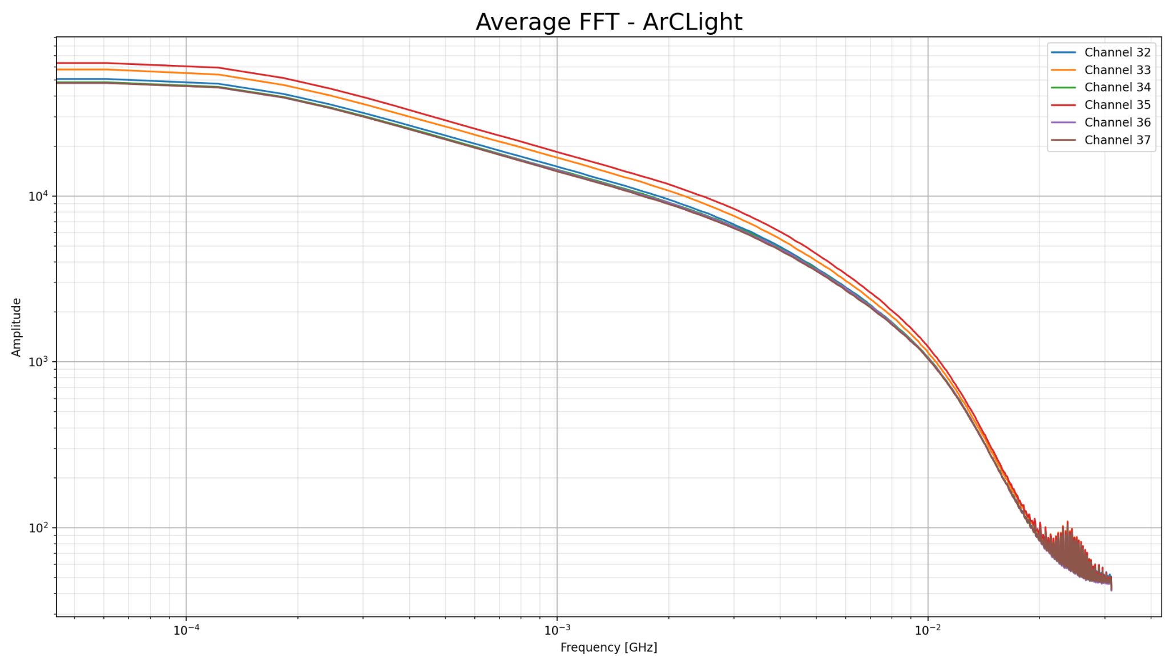
FFT Analysis
Run: 108
Vgain: 1750
Vbias: 1250
Threshold: 300

Slide 7
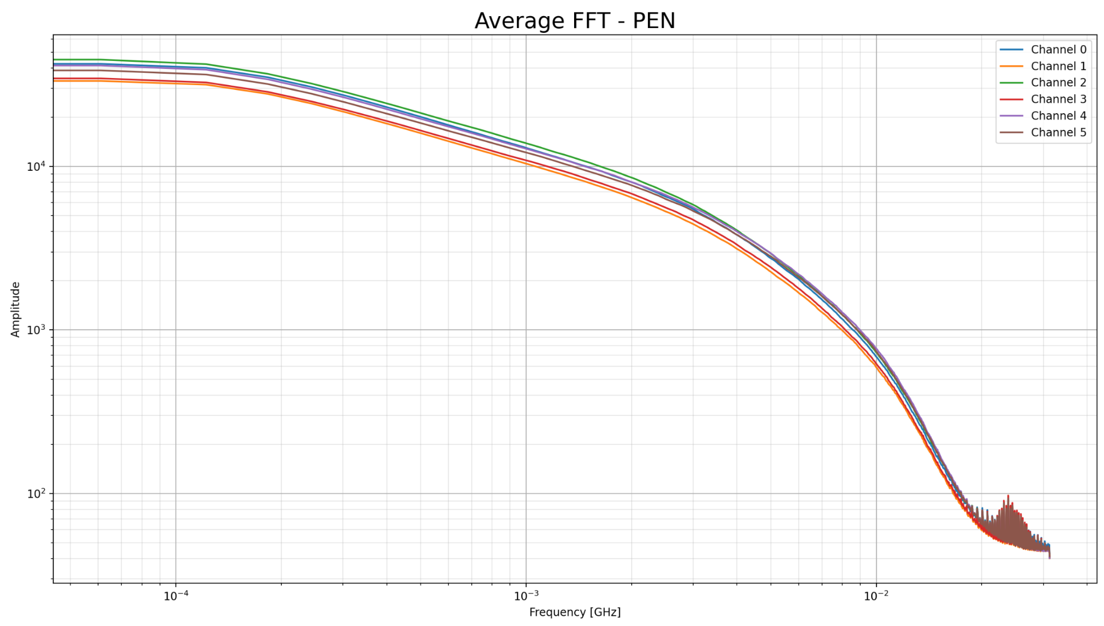
FFT Analysis

Slide 8
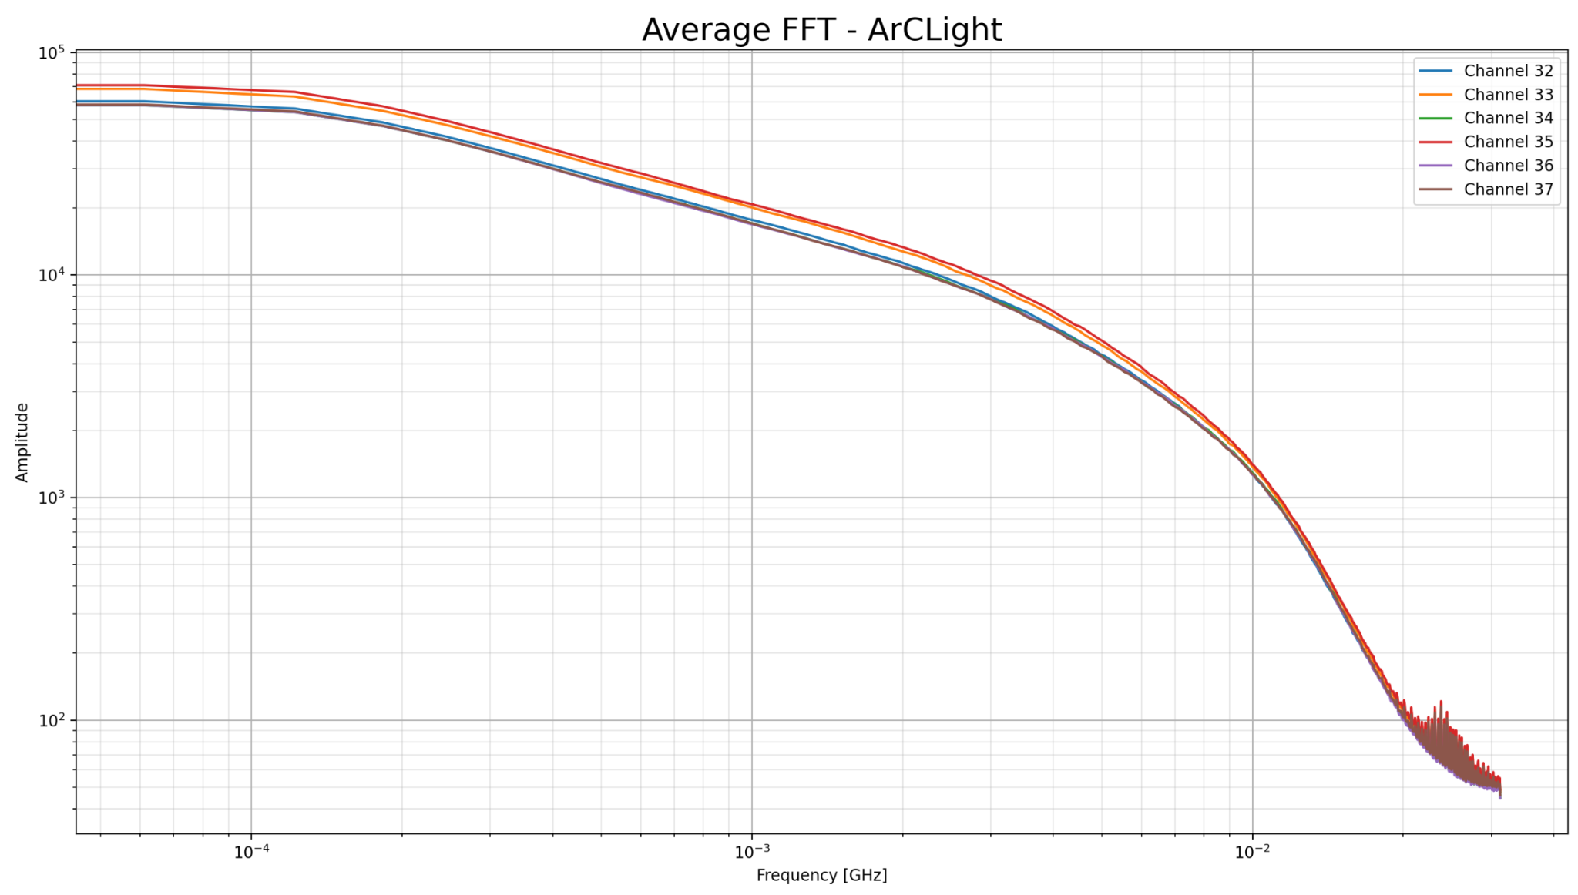
FFT Analysis
Run: 107
Vgain: 1500
Vbias: 1250
Threshold: 300

Slide 9
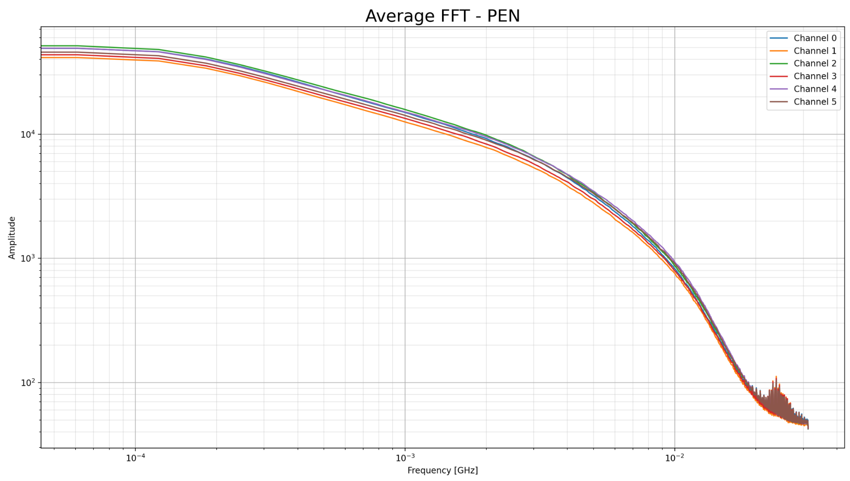
FFT Analysis

Slide 10
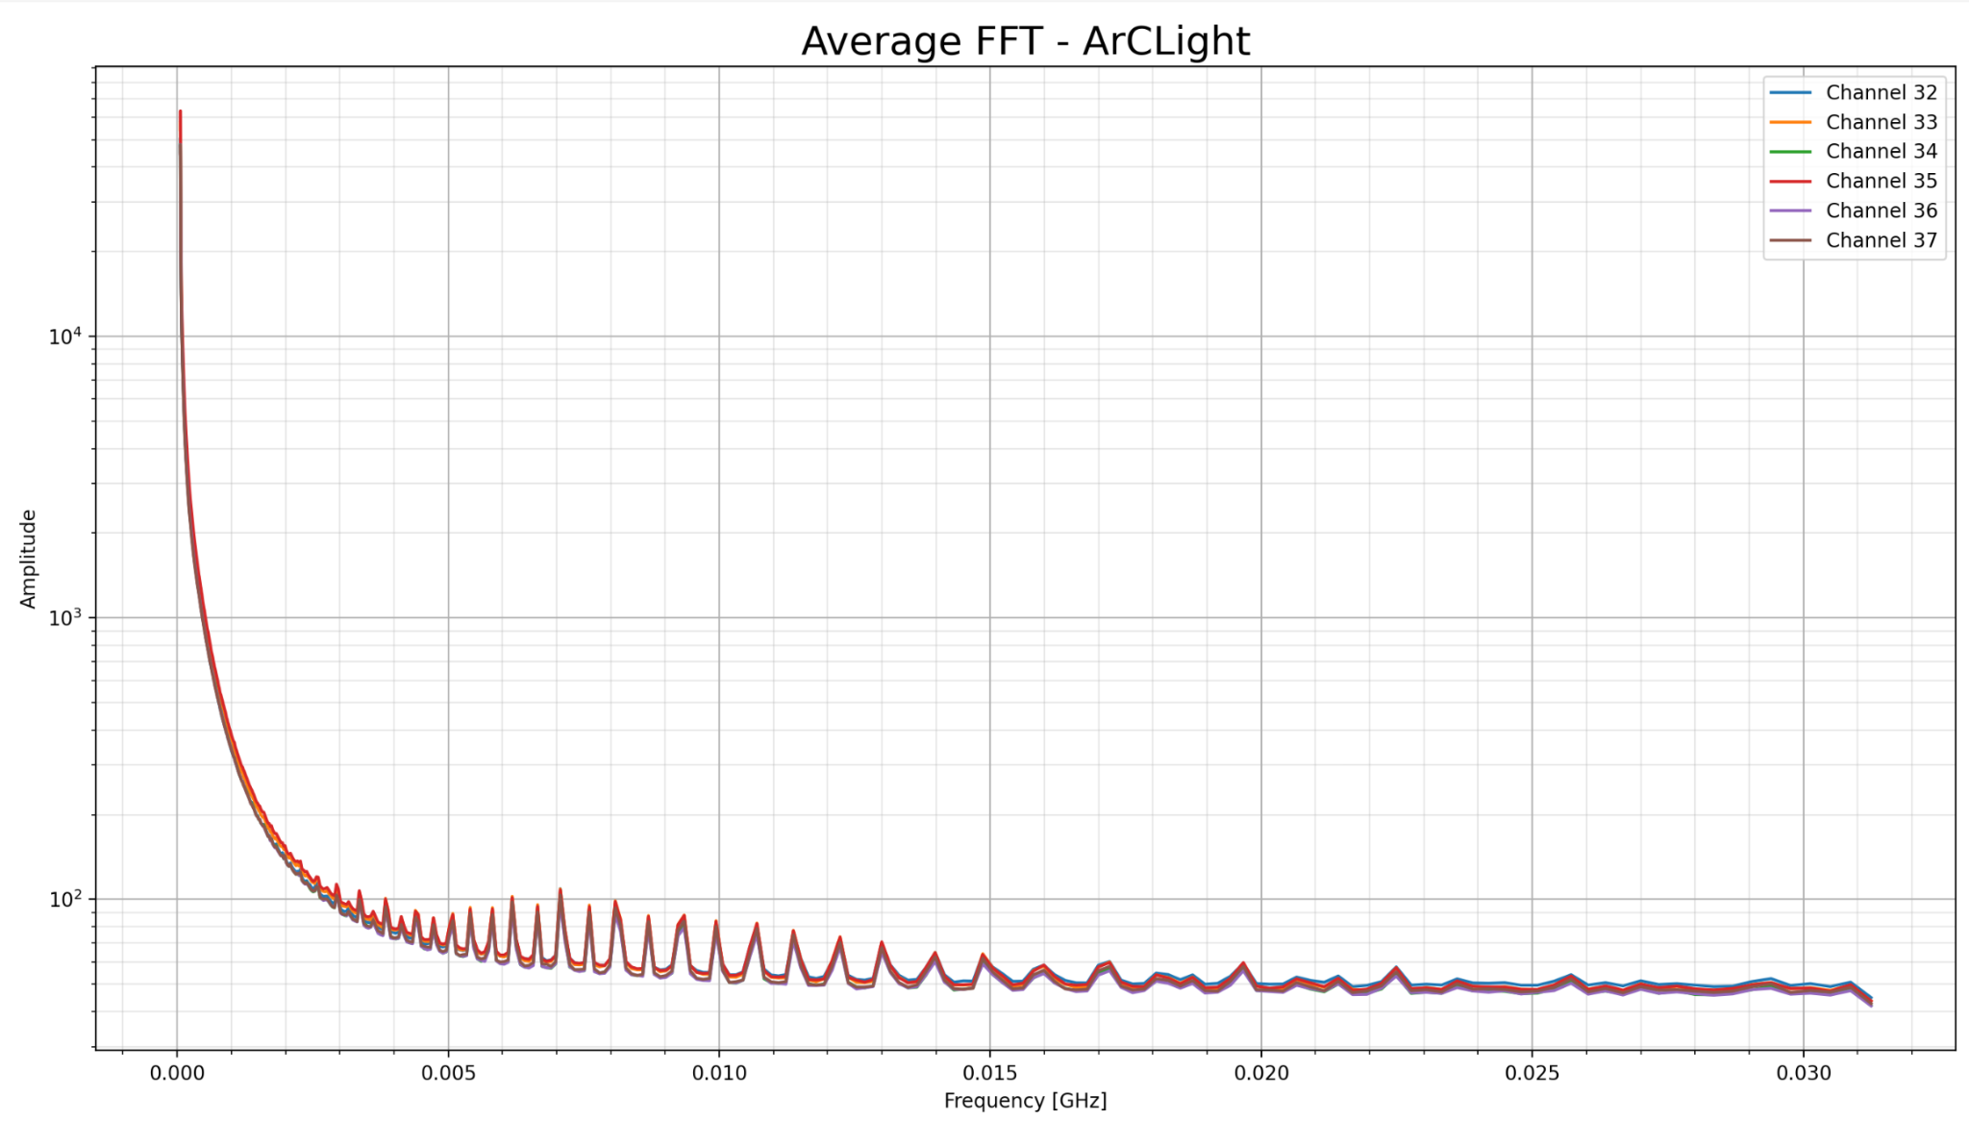
FFT Analysis: Frequency log-scaled
Run: 108
Vgain: 1750
Vbias: 1250
Threshold: 300

Slide 11
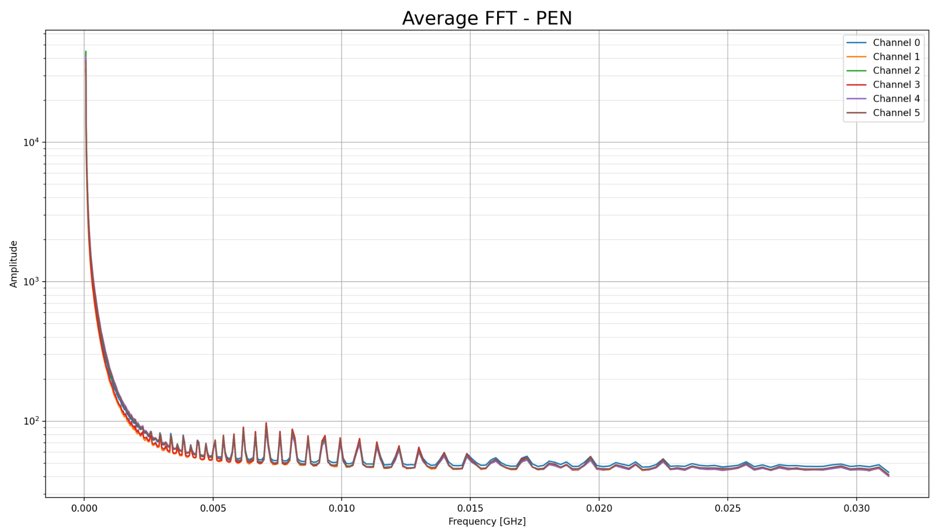
FFT Analysis: Frequency log-scaled

Slide 12
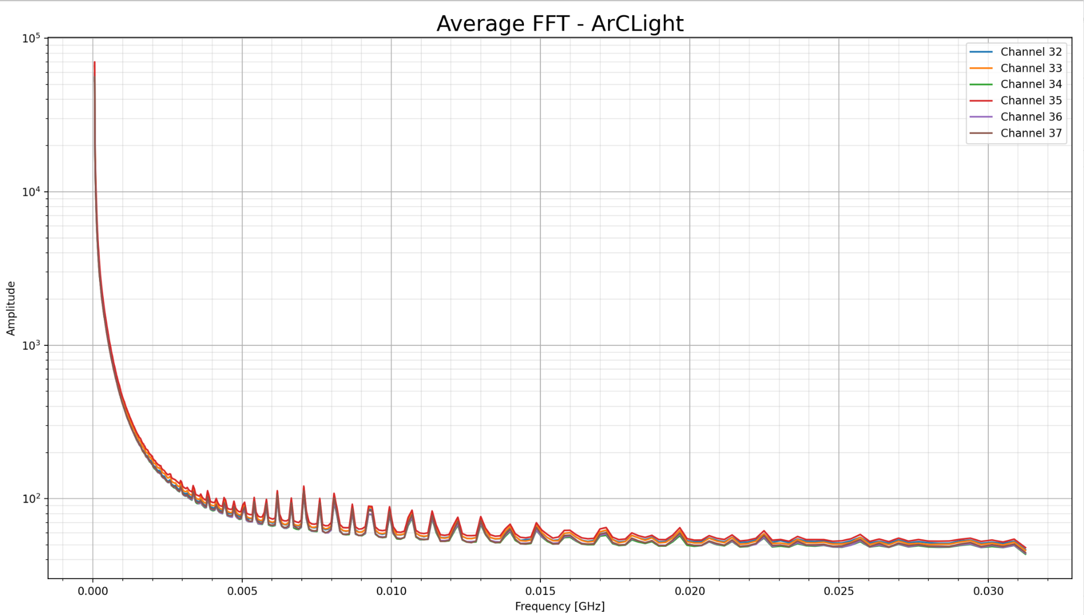
FFT Analysis: Frequency log-scaled
Run: 107
Vgain: 1500
Vbias: 1250
Threshold: 300

Slide 13
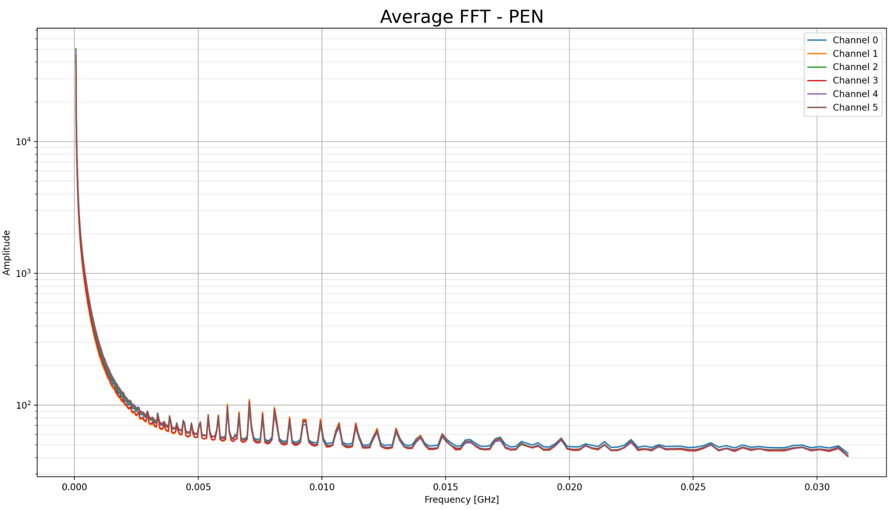
FFT Analysis: Frequency log-scaled

