Slide 1
Sustainable Artificial Intelligence:
Nature Orientation as an Ethical Principle
First PEARLS Days, Freiburg
September 22, 2026
Dr. Philipp Höfele
Fellow "Young Academy for Sustainability Research" (YAS)
Freiburg Institute for Advanced Studies (FRIAS)
University of Freiburg
https://uni-freiburg.de/frias/dr-philipp-hoefele/
e-mail: philipp.hoefele@frias.uni-freiburg.de

Slide 2

About me and my research interests
Postdoctoral research fellow within the framework of the “Young Academy for Sustainability Research” (YAS) at the “Freiburg Institute for Advanced Studies” (FRIAS), University of Freiburg
Main areas of research: practical philosophy and ethics, with a historical focus on the 19th and 20th centuries and a systematic focus on environmental philosophy, technology ethics, and the Anthropocene discourse
© Peter Herrmann

Slide 3
Sustainable Artificial Intelligence:
Nature Orientation as an Ethical Principle
Structure of my presentation
1. Nature Orientation as an Ethical Principle
a) Challenges in 21st Century Bio-engineering
b) Challenges of AI in terms of sustainability
2. Normative attitudes towards nature in the present age
3. Tasks of technology ethics: The pragmatic relation of technical behaviour
4. What are ethical values (a. values in technology, b. values of nature for sustainability)?
5. Sustainable Artificial Intelligence as nature-oriented technology
a) The supposed immateriality of intelligence
b) Situatedness of intelligence
c) Relational and implicit ethical values of nature
6. How can nature-ethical values be included (a. The value sensitive-design approach, b. Cognitive-affective mapping)?

Slide 4
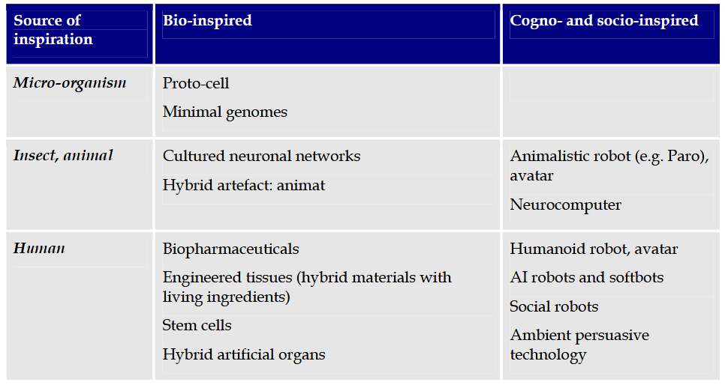
1. Nature Orientation as an Ethical Principle a) Challenges in 21st Century Bio-engineering
Synthetic Biology
Nature orientation as challenge
Biomimetics
van Est, Rinie et al. 2012: Making Perfect Life. European Governance Challenges in 21st Century Bio-engineering. Brussels. https://www.europarl.europa.eu/RegData/etudes/etudes/join/2012/471574/IPOL-JOIN_ET%282012%29471574_EN.pdf

Slide 5
1. Nature Orientation as an Ethical Principle b) Challenges of AI in terms of sustainability
AI for Sustainability
Sustainability of AI
Nature orientation as
solution:
linking the ethics of nature and technology
Reduced need for resources
Reduction of greenhouse gases
Efficiency of transport, e-mobility, autonomous driving, digitalized car sharing
Electricity savings thanks to smart grids
Digital approaches for the optimal use of technologies (sustainable energy sources, agriculture)
Digital building control systems, smart home systems
Location-independent and generally accessible knowledge and learning
Holistic understanding of the Earth system
Increasing demand for electronic devices (demand for rare earths, digital waste)
Large server and data centers with high energy consumption
Trust in technological progress as an obstacle to efforts to achieve sustainability
Western, capitalist biases (or even ontologies) that can lead to unsustainability
Creutzig, F. et al. (2022). Digitalization and the Anthropocene. In: Annu. Rev. Environ. Resour. 47, 479-509.
van Wynsberghe, A. (2021). Sustainable AI: AI for sustainability and the sustainability of AI. AI Ethics 1, 213–218. https://doi.org/10.1007/s43681-021-00043-6
Höfele

Slide 6
2. Normative attitudes towards nature in the present age
The central thesis of the Anthropocene debate is that, through technology-driven actions, humans are currently leaving an irreversible mark on nature in ways that are, in some cases, ecologically irresponsible.
This debate frequently emphasizes the need for a ‘different,’ ‘new’ relationship between humans, technology, and nature. At the heart of this demand lie normative concepts that advocate recognizing a ‘symbiotic’ relationship with nature, increasingly ‘orienting’ oneself toward nature, or living more ‘in harmony with nature’ – concepts that are historically and interculturally conditioned and can only be understood within that context. (cf. e.g. the briefing of the „European Environment Agency“: https://www.eea.europa.eu/publications/exiting-the-anthropocene).
Against this backdrop, I aim (1) to examine and to evaluate the relationship between nature and technology in the present day and (2) to explore which normative relationships with nature can be observed here (a), and whether and under what conditions these are justified (b) [cf. ‘naturalistic fallacy’].
In order to achieve this overarching goal, it is necessary to examine the discourses on normative orientations toward nature from a historical and intercultural perspective [‘ethical naturalism’], and to relate this line of discourse within the framework of ethics of nature, with the one in the context of technology ethics, specifically in the wake of the Anthropocene debate and the environmental challenges discussed here.
This results in a plea for an intertwining of the disciplines of nature ethics (esp. discourse on the climate crisis) and technology ethics (esp. desicourse on AI), based on the shared methodological foundation of value ethics.
Köchy, K. 2003: Perspektiven des Organischen. Biophilosophie zwischen Natur- und Wissenschaftsphilosophie. Paderborn/München/Wien/Zürich.
Marzi, Thomas et al. 2018 Fragen zu einer biologischen Technik. Oberhausen, https://www.umsicht.fraunhofer.de/ con-tent/dam/umsicht/de/dokumente/publikationen/2018/umsicht-diskurs-biologisierung.pdf

Slide 7
3. Tasks of technology ethics:
The pragmatic relation of technical behaviour
Actor (technology user) (+) instrumental relation Material (technical device) (-) anthropomorphic / slavish
+ norm-compliant, value-rational relation increasing convergence
- instrumentalistic (e.g. biomimetics, synthetic biology, AI)
Co-subjects (humans, animals, environment)
Ott, K. (2005). Technikethik. In: Nida-Rümelin, J. (ed.): Angewandte Ethik. Die Bereichsethiken und ihre theoretische Fundierung. 2nd ed. Stuttgart: Kröner, 568-647.
van Est, Rinie et al. 2012: Making Perfect Life. European Governance Challenges in 21st Century Bio-engineering. Brüssel. https://www.europarl.europa.eu/RegData/etudes/etudes/join/2012/471574/IPOL-JOIN_ET%282012%29471574_EN.pdf

Slide 8
4. What are ethical values?
Other values
Value ethics have a tradition dating back to ancient Stoicism. In the 20th century, they were primarily represented by Scheler (1916) and Hartmann (1926), and recently they have been playing an increasingly important role in environmental and technology ethics.
Values reflect an explicit or implicit preference behavior: they are relational with regard to the persons, societies or cultures advocating them.
Ethical values: “what is important to people in their lives, with a focus on ethics and morality” (Friedman/Hendry 2019, p. 24). They have to be accepted (by persons or groups of persons who tolerate an action, do nothing about it or consent to it) and acceptable (conform with societal principles, values, priorities, adopted norms).
Three sorts of values (with fluid transition):
  Intrinsic value: inherent worth of someone or something as end in and of her- or itself
  Instrumental value: means to an end, usefulness for someone
  Relational value: something is of fundamental, eudaimonistic or instrumental importance for a person, a society or a culture
Aesthetic values
Economic values
Ethical values
1.Intrinsic values
2.Instrumental values
3.Relational values
Friedman, B., and Hendry, D.G. (2019). Value Sensitive Design: Shaping Technology with Moral Imagination. Cambridge: MIT.
Hartmann, N. (1926). Ethik. 3rd ed., Berlin: de Gruyter.
Muraca, B. (2016). Relational Values. A Whiteheadian Alternative for Environmental Philosophy and Global Environmental Justice. In: Balkan Journal of Philosophy 8(1), 19-38.
Scheler, M. (1916). Der Formalismus in der Ethik und die materiale Wertethik: Neuer Versuch der Grundlegung eines ethischen Personalismus. Halle: Max Niemeyer.

Slide 9
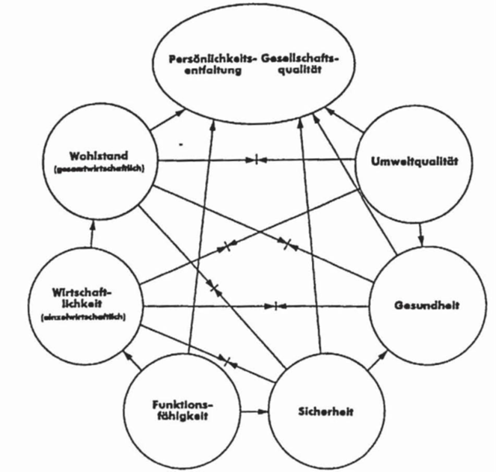
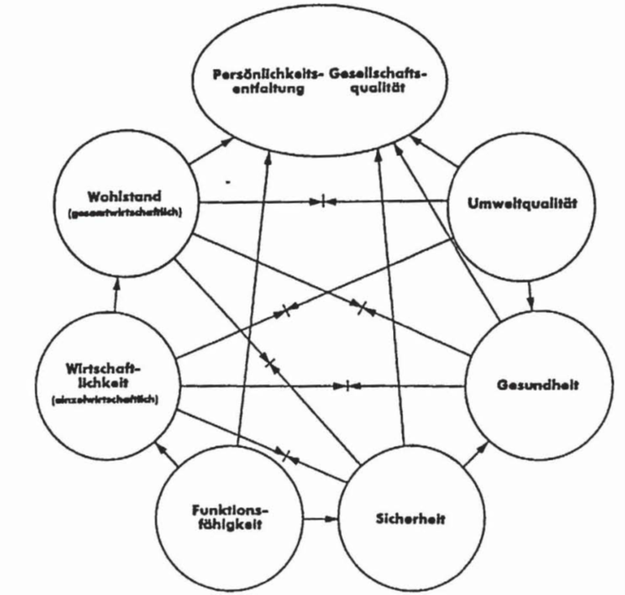
a) Values in technology
4. What are values
Technology producer
Technological device
Technology user
Personal development / social quality
Prosperity
Envir-on-mental quality
Hubig (1993) lists values for technologies, based on VDI 3780:
  Functionality, economic efficiency, prosperity, safety, health, environmental quality, personal development and social quality
Not only values in humans, but also embedded in technical devices (1. in the form of the original use plan, 2. as properties that trigger actions to realize values, 3. as values autonomously generated by technical devices, esp. in AI and life-like systems)
Pluralism of values that makes it necessary to weight the values
Conflicts between values
Option and legacy values as fundamental values, with legacy values being more fundamental in cases of doubt
  Option values: options for action, variability spectra and future viability
  Legacy values: identity-forming social structures and traditions
Hubig (1993), VDI 3780 and VSD only look at the effects or consequences for nature (cf. ontology of the vulnerable nature), but they do not focus on natural-ethical values in a broader sense, some of which are culturally or group-specific.
Econ-omic effici-ency
health
Functionality
safety
Hubig, C. (1993). Technik- und Wissenschaftsethik. Ein Leitfaden. Berlin et al.: Springer, 142.
Friedman, B., and Hendry, D.G. (2019). Value Sensitive Design: Shaping Technology with Moral Imagination. Cambridge: MIT.
VDI 3780. 2000. Technikbewertung: Begriffe und Grundlagen = Technology assessment. Düsseldorf: VDI.

Slide 10
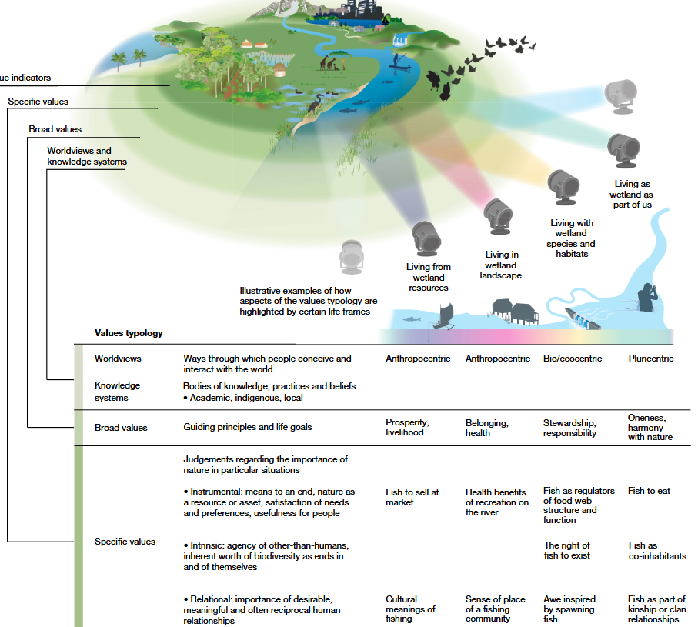
b) Diverse values of nature for sustainability
4. What are values?
On the one hand, technical devices rely on nature-ethical values in form of procurement chains, ecosystem services, etc.
On the other hand, they should take into account their influence on images, understandings, and prejudices regarding what nature and the natural are.
They have explicitly or implicitly influence on nature-ethical values that are dependent on or relational to culturally differing worldviews and knowledge systems.
Pascual, U., Balvanera, P., Anderson, C.B. et al. (2023). Diverse values of nature for sustainability. In: Nature 620, 813–823. https://doi.org/10.1038/s41586-023-06406-9

Slide 11
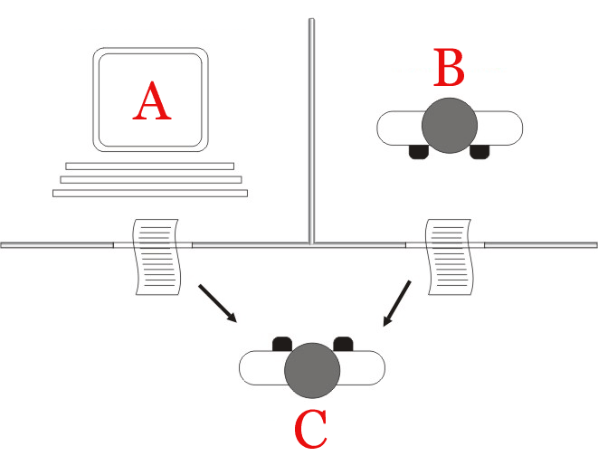
5. Sustainable Artificial Intelligence as nature-oriented technology
a) The supposed immateriality of intelligence
From the outset, AI was conceived as a nature-oriented technology in a narrow sense, insofar as it is intended to imitate natural human intelligence (cf. Turing Test).
However, AI is not yet a nature-oriented technology in a broader sense: AI is often not sustainable, integrated into nature, and does not take nature-ethical values into account, some of which are culturally or group-specific.
This has to do with the fact that (1) nature-ethical values are often not explicitly present in our technical relationship with the world and that (2) AI is often considered immaterial and contextless.
Cf. Chinese Room Argument: “it is Cartesian in the sense that it insists that what is specifically mental about the mind has no intrinsic connection with the actual properties of the brain..” (Searle 1980, 424; my emphasis) → nature-culture distinction, ontology of nature as ‘other’
https://en.wikipedia.org/wiki/Turing_test#/media/File:Turing_test_diagram.png
Turing, A.M. (1950). Computing Machinery and Intelligence. In: Mind LIX(236), 433-460.
Searle J.R. (1980). Minds, brains, and programs. Behavioral and Brain Sciences 3(3):417-424. doi:10.1017/S0140525X00005756

Slide 12
5. Sustainable Artificial Intelligence as nature-oriented technology
b) Situatedness of intelligence
“human experience as being-already-in-a-situation” (Dreyfus 1972, 202)
“need for essential/inessential discrimination” (Dreyfus 1972, 210)
“computers are not in a situation” (Dreyfus 1972, 211)
“this problem [i.e. the simulation of the environment] is avoided by human beings because their model of the world is the world itself” (Dreyfus 1972, 212)
“symbiosis between computers and human beings” (Dreyfus 1972, 213)
Dreyfus’ criticism is no longer relevant, as stages III and IV of intelligent activities can now be implemented by AI to a greater or lesser extent.
However, Dreyfus does not sufficiently take into account the concept of “relevance (Bewandtnis)”, another aspect of Heidegger’s concept of “being-in-the-world”, which is important in terms of implicit values implemented in technologies.
Dreyfus, H. (1972). What Computers Can’t Do: A Critique of Artificial Reason. New York et al.: Harper & Row.

Slide 13
5. Sustainable Artificial Intelligence as nature-oriented technology c) Relational and implicit ethical values of nature
The nature-ethical values that AI systems (and other technical devices) should take into account are inherent in each individual’s being-in-the-world, i.e., they are dependent on or relational to culturally differing worldviews and knowledge systems.
There is no single nature; nature is different for different people and cultures and has different values for them.
At the same time, in Heidegger’s sense, these values are often present without being thematized, even though they are of fundamental significance. They are implicit and, in some cases, marginalized or suppressed.
The aim is to recognize a context of reference consisting of explicit significance and implicit relevance. In this way, the unthematized nature-ethical values on which AI systems (and other technical devices) depend and which they should take into account also become visible.
Pascual, U., Balvanera, P., Anderson, C.B. et al. (2023). Diverse values of nature for sustainability. In: Nature 620, 813–823. https://doi.org/10.1038/s41586-023-06406-9
Mensah, J.O., Van Wynsberghe, A. Where are the missing values: an exploration of the need to incorporate Ubuntu values into African AI policy. AI Ethics 5, 4365–4375 (2025). https://doi.org/10.1007/s43681-025-00746-0

Slide 14
6. How can nature-ethical values be included?
a) The value-sensitive design approach
Stakeholder Analysis
Stakeholder Tokens
Value Source Analysis
Co-evolve Technology & Social Structure
Value Scenario
Value Sketch (problem: only stakeholders’ non-verbal understandings, views, and values; anthropocentric and interest-focused)
Value-oriented semi-structured interview
Scalable Assessments of Information Dimension
Value-oriented Coding Manual
Value-oriented Mock-up, Prototype, or Field Deployment
Ethnographically Informed Inquiry on Values and Technology (challenge: in-depth engagement in the situated contexts over longer periods of time)
Model for Informed Consent Online
Value Dams and Flows
Value Sensitive Action Reflection Model
Multi-lifespan Timeline
Multilifespan Co-design
Envisioning cards
Friedman, B., and Hendry, D.G. (2019). Value Sensitive Design: Shaping Technology with Moral Imagination. Cambridge: MIT.
https://vsdesign.org/vsd/

Slide 15
6. How can nature-ethical values be included?
a) The Value-sensitive design approach
Although the value sensitive design (VSD) approach (Friedmann/Hendry 2019) and the value-ethical design of AI systems proposed by Spiekermann (2019; 2024) are promising approaches.
VSD distinguishes among designer values, values explicitly supported by the technology, and stakeholder values; considers individual, group, and societal levels of analysis; and caries out integrative and iterative conceptual, technical, and empirical investigations.
However, these approaches are limited in that they require an innovation team to use scenario methods to put themselves in the future system world. The implicit and culturally differing nature-ethical values are not the focus here.
Friedman, B., and Hendry, D.G. (2019). Value Sensitive Design: Shaping Technology with Moral Imagination. Cambridge: MIT.
Spiekermann, S. (2019). Digitale Ethik: Ein Wertesystem für das 21. Jahrhundert. München: Droemer.
Spiekermann, S. (2024). Digitale Ethik und die Künstliche Intelligenz. In: Mainzer, K. (ed.). Philosophisches Handbuch Künstliche Intelligenz. Wiesbaden: Springer, 741-764.
https://vsdesign.org/vsd/

Slide 16
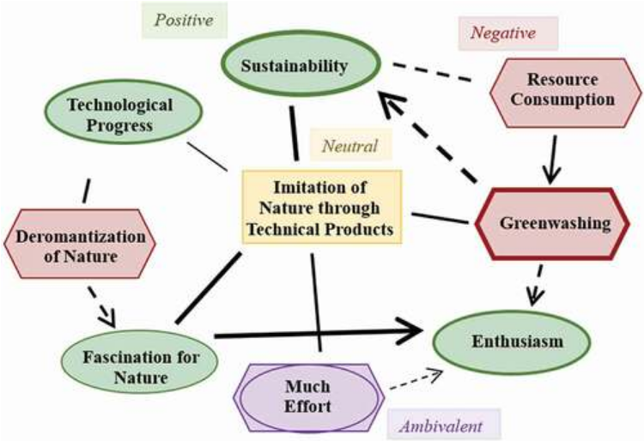
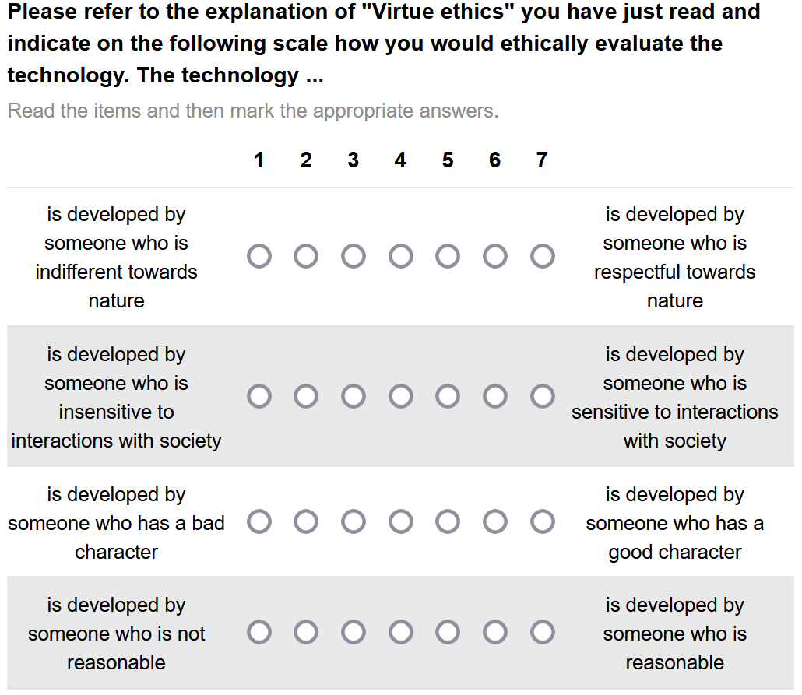


6. How can nature-ethical values be included?
b) Cognitive-affective mapping
Empirical ethics: In addition to generally acceptable ethical principles, it takes into account the acceptance by various stakeholder groups and the greatest possible conformity with their values
Co-author:
Dr. Lisa Reuter
Psychology
Co-author:
Dr. Julius Fenn
Psychology
Höfele, P.*, Reuter, L.*, Estadieu, L., Livanec, S., Stumpf, M., & Kiesel, A. (2022). Connecting the methods of psychology and philosophy: Applying Cognitive-Affective Maps (CAMs) to identify ethical principles underlying the evaluation of bioinspired technologies. In: Philosophical Psychology, 1-24. doi: 10.1080/09515089.2022.2113770
Fenn, J.*, Höfele, P.*, Sölder, P., Kiesel, A. (in prep.): Development and Validation of an Empirical Ethics Scale for Technology Assessment - Challenges and Perspectives for a Real Time Ethics for Emerging Technologies.

Slide 17
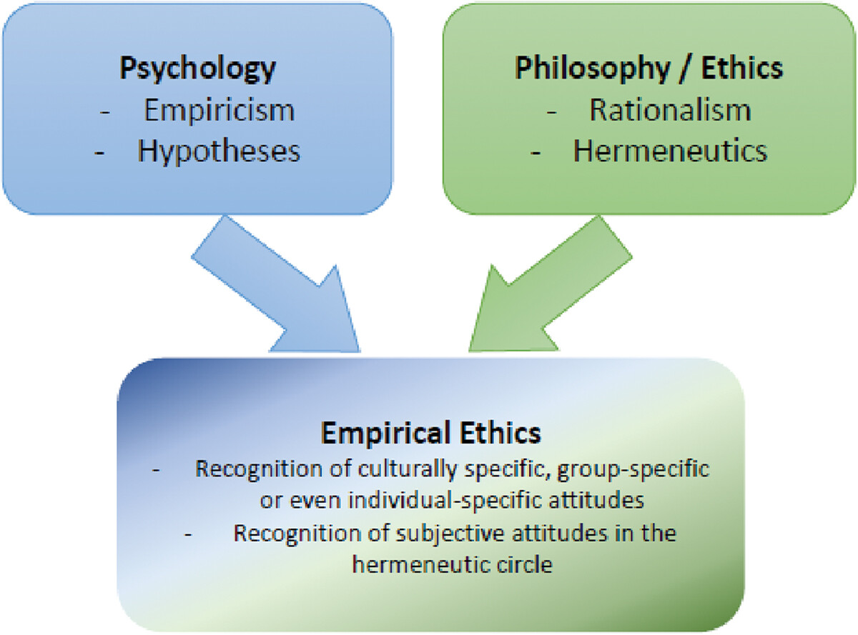
6. How can nature-ethical values be included?
b) Cognitive-affective mapping
Acceptance Acceptability
On the one hand, CAMs, due to their associative-affective nature, also allow implicit or marginal ethical values to be made visible, which should be taken into account by AI systems.
On the other hand, laypeople of all kinds and backgrounds who have not received ethical training can also be surveyed; CAMs thus enable a broadening of perspectives, especially towards partly marginalized groups (e.g. indigenous peoples) who are more focused on the natural environment.
At the same time, however, CAMs need to be interpreted by experts with regard to ethically relevant aspects (acceptability).
Höfele, P., Reuter, L., Estadieu, L., Livanec, S., Stumpf, M., & Kiesel, A. (2022). Connecting the methods of psychology and philosophy: Applying Cognitive-Affective Maps (CAMs) to identify ethical principles underlying the evaluation of bioinspired technologies. In: Philosophical Psychology, 1-24. doi: 10.1080/09515089.2022.2113770
Höfele
Ethics of Sustainability
22.09.2026

Slide 18
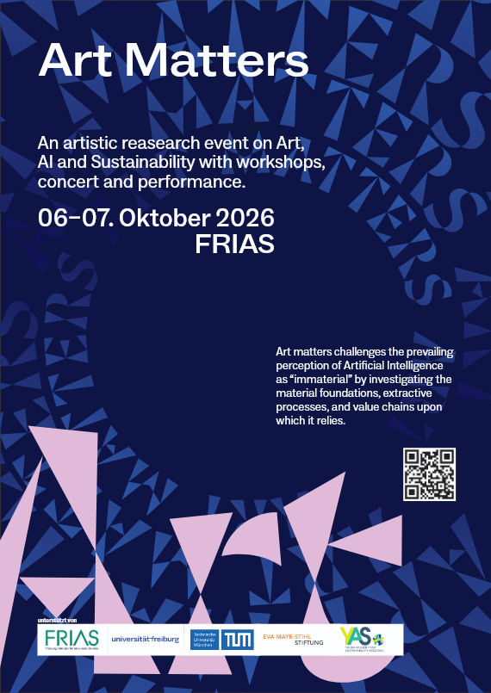
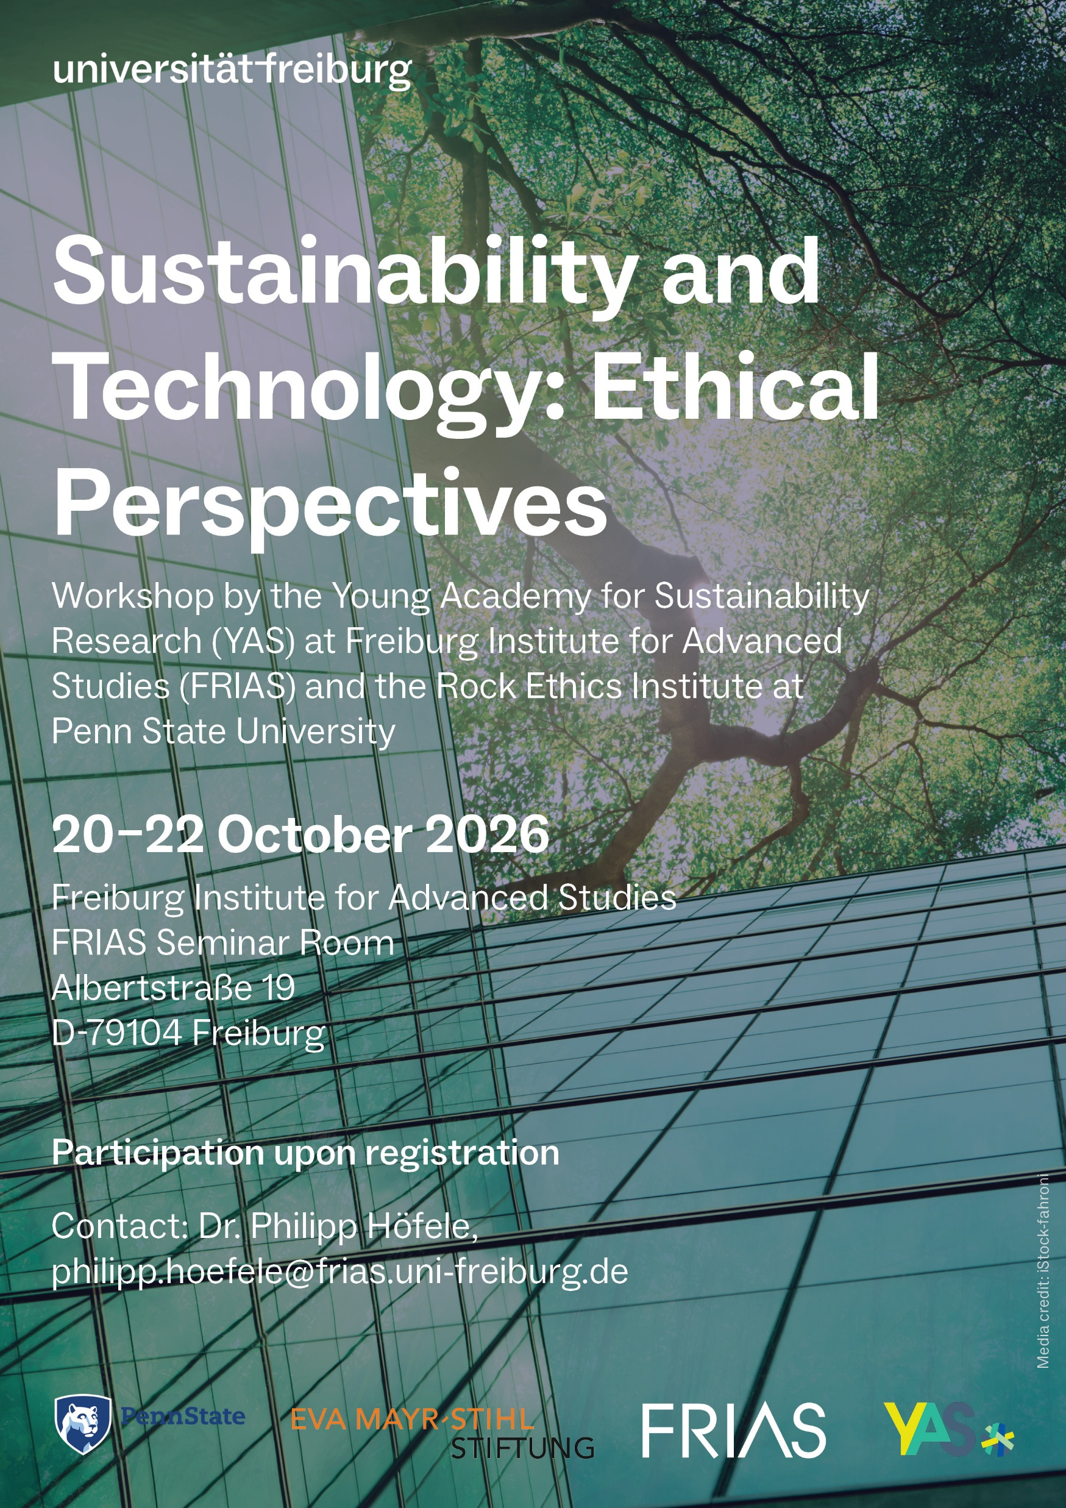
https://uni-freiburg.de/frias/art-matters/
https://uni-freiburg.de/frias/sustainability-and-technology-ethical-perspectives/

Slide 19
Sustainable Artificial Intelligence:
Nature Orientation as an Ethical Principle
Thank you for your attention!
Questions?
Dr. Philipp Höfele
Fellow “Young Academy for Sustainability Research” (YAS)
Freiburg Institute for Advanced Studies (FRIAS)
University of Freiburg
https://uni-freiburg.de/frias/dr-philipp-hoefele/
e-mail: philipp.hoefele@frias.uni-freiburg.de

