Slide 1
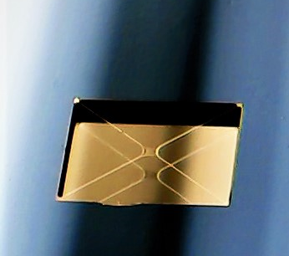






The Invisible Drummer: membrane accelerometer search for vector dark matter: transition to phase II
Dalziel J. Wilson
Wyant College of Optical Sciences, University of Arizona
Optomechanical sensing for AP Searches, Queen’s 26
Notes:
Add outline

Slide 2
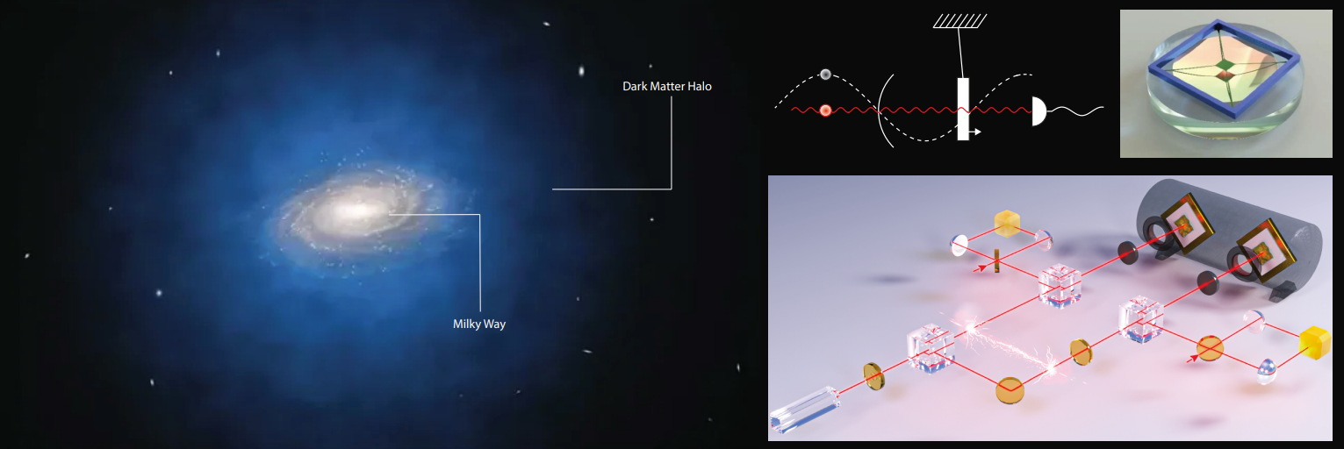
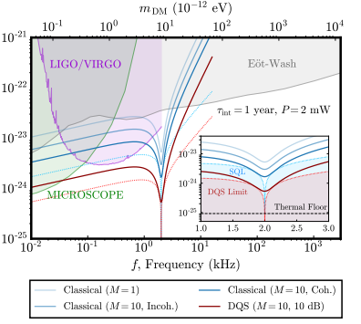
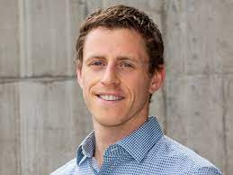
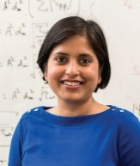
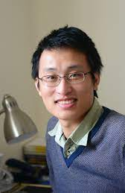
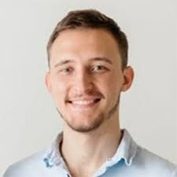
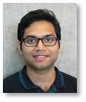
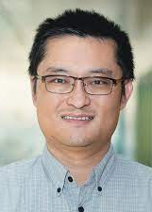
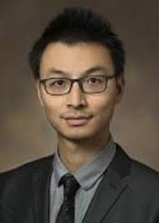
Big picture
"Searching for vector dark matter with an optomechanical accelerometer."
Physical Review Letters 126.6, 061301 (2021).
"Entanglement-enhanced optomechanical sensor array for dark matter searches." Communication Physics 6, 237 (2023)
“Optomechanical accelerometer search for ultralight dark matter"
Physical Review D 113, L121303 (2026).
Notes:
Add outline

Slide 3
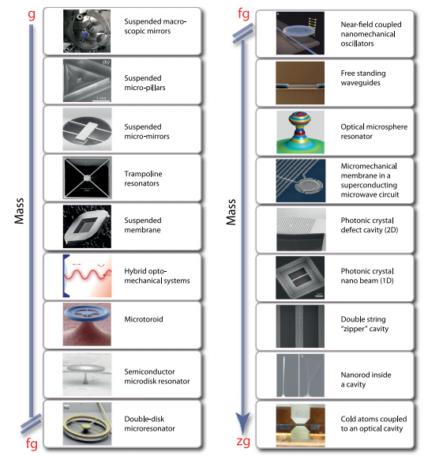
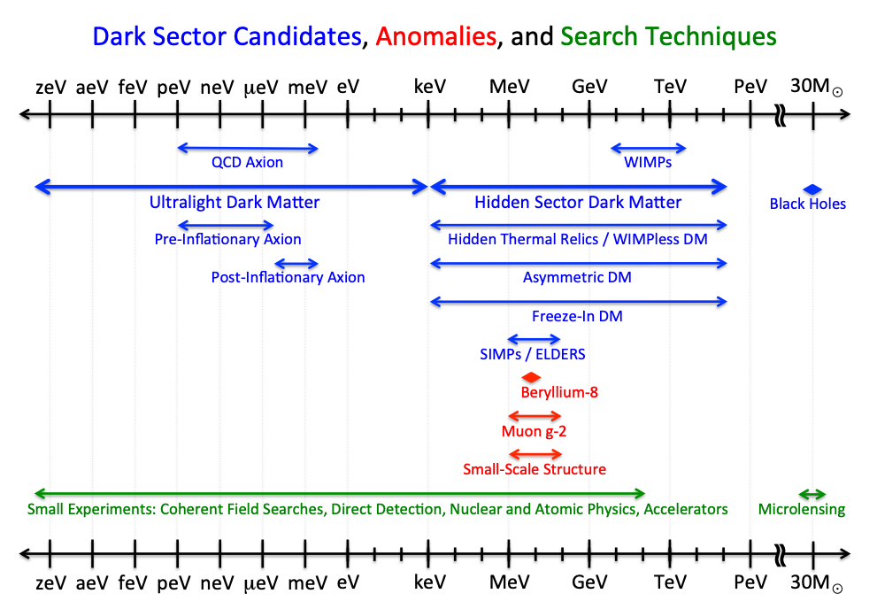
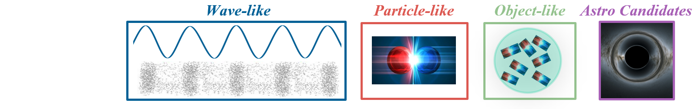
Ultralight dark matter in the “optomechanics” band
100 Hz
100 MHz
US Cosmic Visions: New Ideas in Dark Matter 2017 : Community Report, arXiv:1707.04591

Slide 4

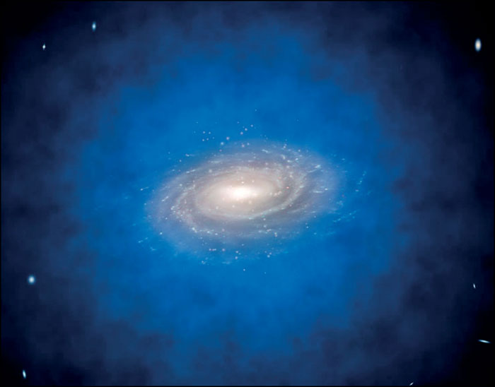
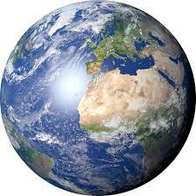

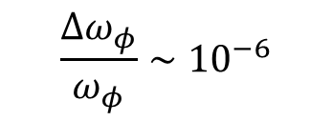


Ultralight dark matter in the “optomechanics” band
100 Hz
100 MHz
$$φ\left(r,t\right)=g\sqrt{ρ_{dm}}cos(ω_{φ}t−k_{φ}⋅r)$$
$$v≈200 km/s$$
$$\frac{Δω_{φ}}{ω_{φ}}∼{10}^{−6}$$
${\left|φ_{ω}\right|}^{2}$
$$1 km ≤λ_{φ}<{10}^{6} km$$
$$ω−ω_{φ}$$

Slide 5
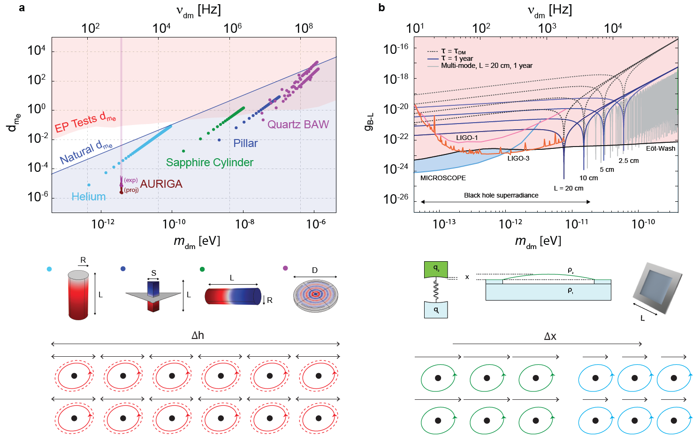

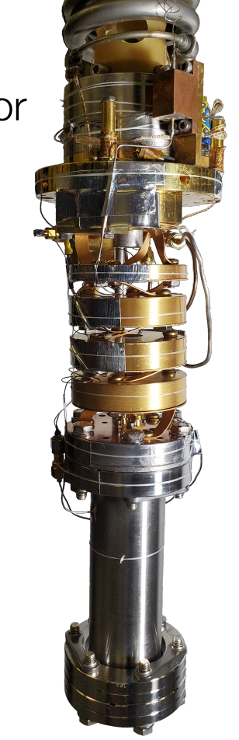
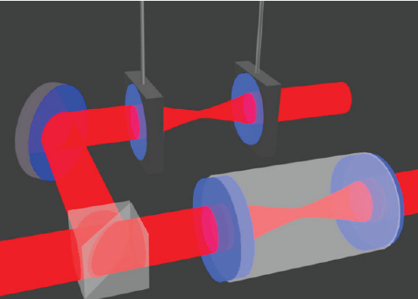
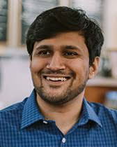
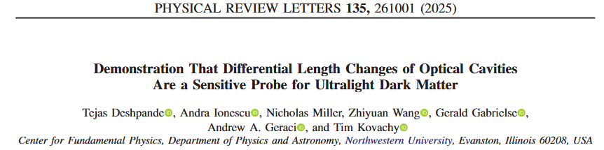
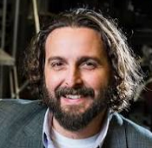
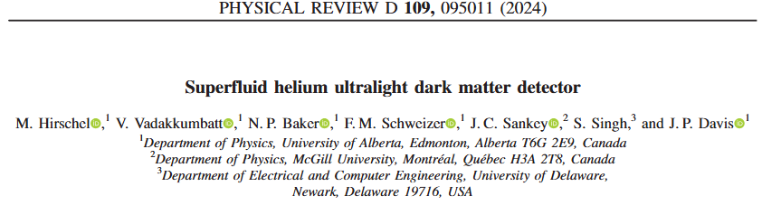
Scalar and Vector ULDM forces

Slide 6
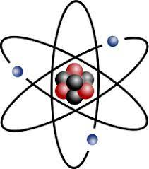
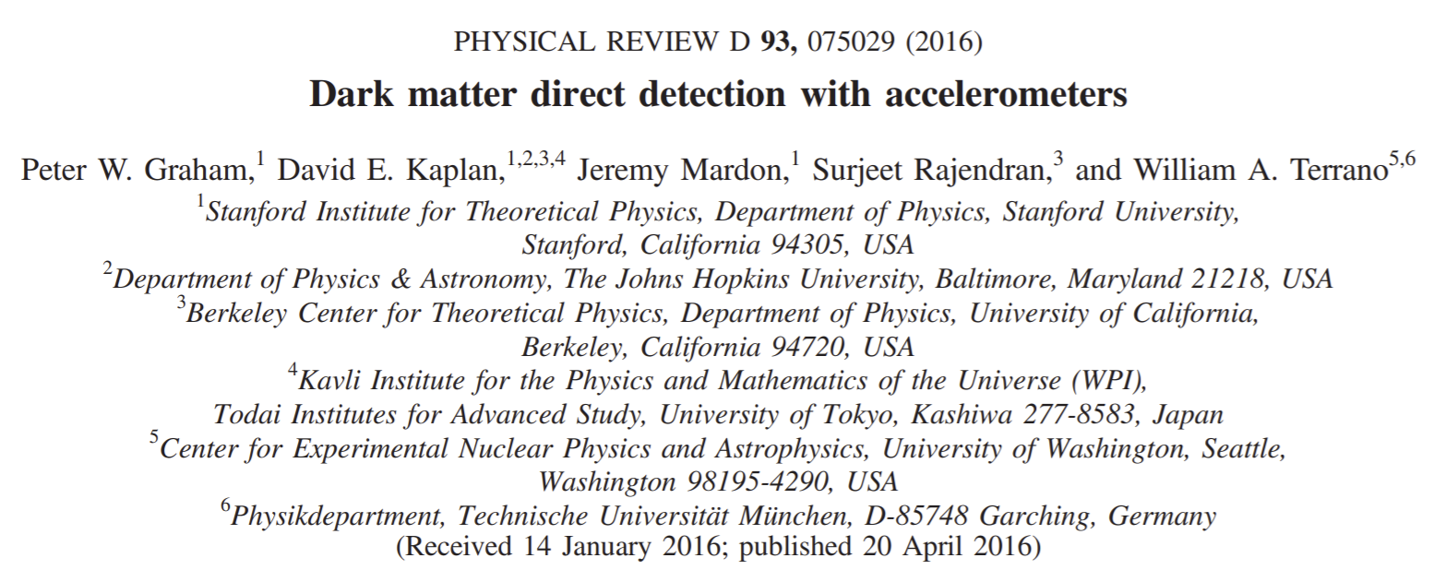
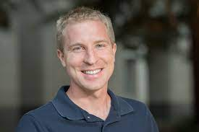
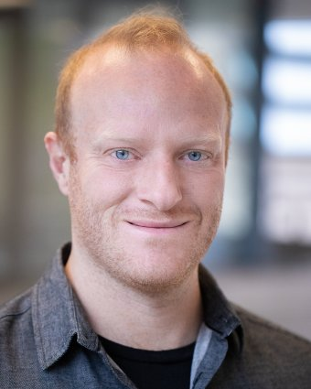


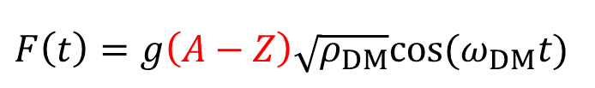
Dark matter might produce a material dependent force
$F\left(t\right)=g\left(A−Z\right)\sqrt{ρ_{DM}}cos⁡(ω_{DM}t)$
$$F$$
$$A−Z$$

Slide 7
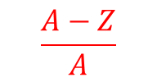


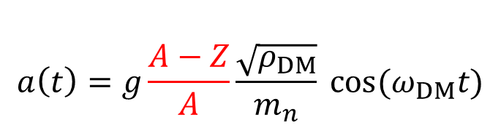
Dark matter might produce a material dependent force
$$a\left(t\right)=g\frac{A−Z}{A}\frac{\sqrt{ρ_{DM}}}{m_{n}} cos⁡(ω_{DM}t)$$
acceleration
$a=F/m$
$$a$$
$$\frac{A−Z}{A}$$

Slide 8
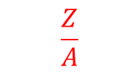


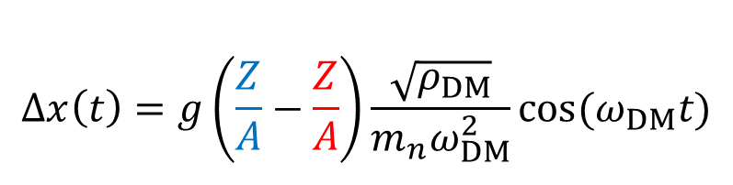
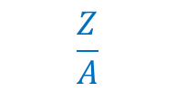
Dark matter might produce a material dependent force
$$Δx\left(t\right)=g\left(\frac{Z}{A}−\frac{Z}{A}\right)\frac{\sqrt{ρ_{DM}}}{m_{n}ω_{DM}^{2}}cos⁡(ω_{DM}t)$$
displacement
$a=\ddot{x}$
$$Δx$$
$$\frac{Z}{A}$$
$$\frac{Z}{A}$$

Slide 9
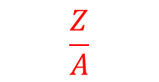
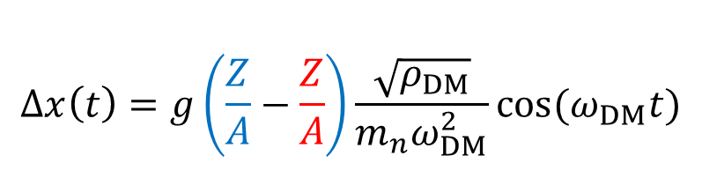
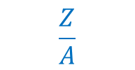
Dark matter might produce a material dependent force
$$Δx\left(t\right)=g\left(\frac{Z}{A}−\frac{Z}{A}\right)\frac{\sqrt{ρ_{DM}}}{m_{n}ω_{DM}^{2}}cos⁡(ω_{DM}t)$$
displacement
$a=\ddot{x}$
$$Δx$$
$$\frac{Z}{A}$$
$$\frac{Z}{A}$$

Slide 10

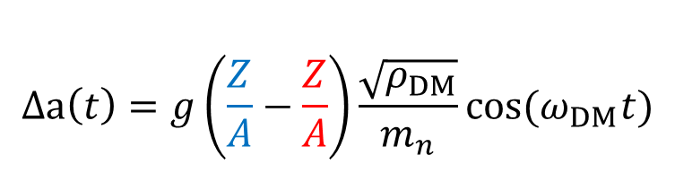
DM might produce a material dependent acceleration
$$Δa\left(t\right)=g\left(\frac{Z}{A}−\frac{Z}{A}\right)\frac{\sqrt{ρ_{DM}}}{m_{n}}cos⁡(ω_{DM}t)$$
$$Δa$$
$$\frac{Z}{A}$$
$$\frac{Z}{A}$$

Slide 11
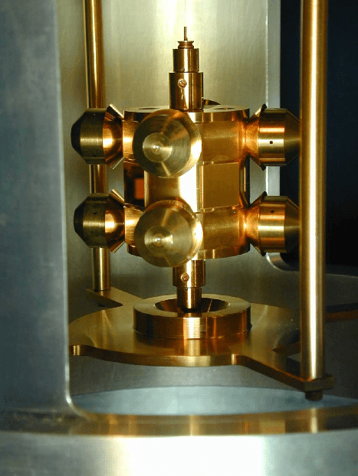
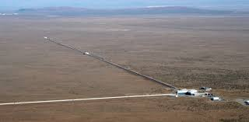
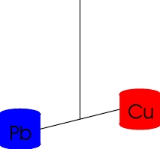
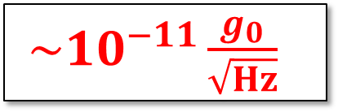

The acceleration signal is extremely weak
$$Δa\left(t\right)=g\left(\frac{Z}{A}−\frac{Z}{A}\right)\frac{\sqrt{ρ_{DM}}}{m_{n}}cos⁡(ω_{DM}t)$$
$\sim {10}^{−11}\frac{g_{0}}{\sqrt{Hz}}$
GW interferometer
Torsion balance
(Eöt-Wash experiment)
$${L∇φ}_{0}$$

Slide 12
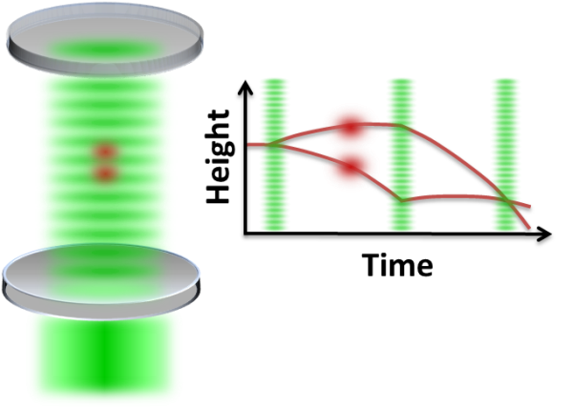

Dark matter might produce a material dependent force
$$Δx\left(t\right)=g\left(\frac{Z}{A}−\frac{Z}{A}\right)\frac{\sqrt{ρ_{DM}}}{m_{n}ω_{DM}^{2}}cos⁡(ω_{DM}t)$$
displacement
$a=\ddot{x}$
$${L∇φ}_{0}$$
Atom interferometer
GW interferometer
Torsion balance
(Eöt-Wash experiment)

Slide 13
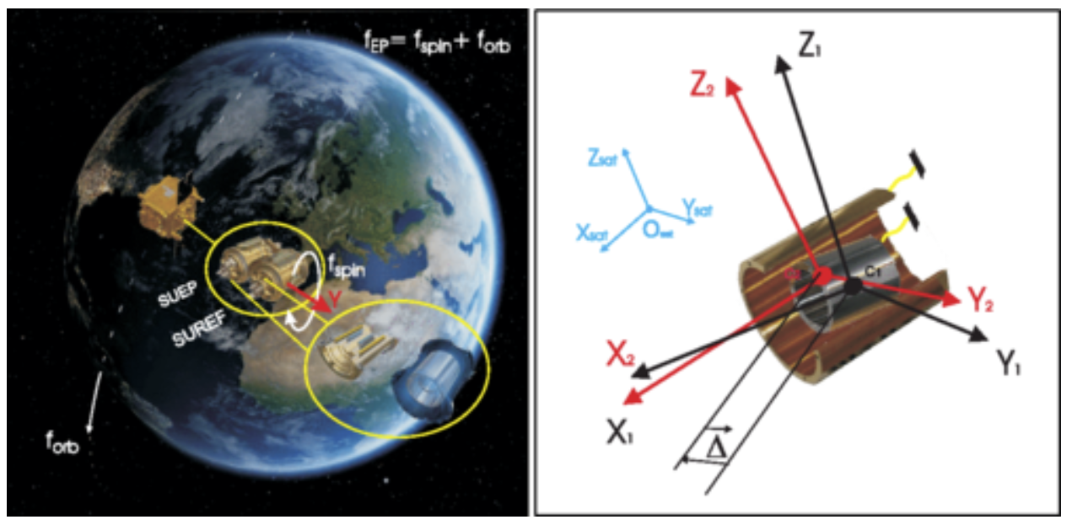


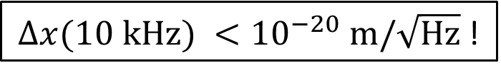

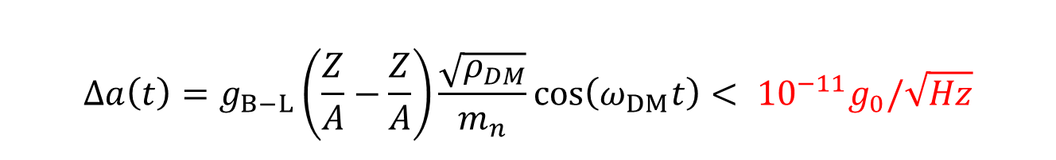
The acceleration signal is extremely weak
$$Δa\left(t\right)=g_{B−L}\left(\frac{Z}{A}−\frac{Z}{A}\right)\frac{\sqrt{ρ_{DM}}}{m_{n}}\cos\left(ω_{DM}t\right)< {10}^{−11}g_{0}/\sqrt{Hz}$$
${Δx(10 kHz) <10}^{−20} m/\sqrt{Hz}$ !
$${L∇φ}_{0}$$
LIGO
How to enhance
this signal?
Eöt-Wash
${Δx\left(100 Hz\right)\sim 10}^{−20} m/\sqrt{Hz}$
$${Δa<10}^{−11}g_{0}/\sqrt{Hz}$$
MICROSCOPE: space-based EP test

Slide 14

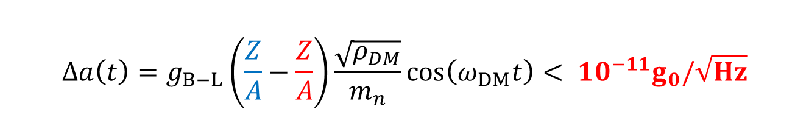
The acceleration signal is extremely weak
$$Δa\left(t\right)=g_{B−L}\left(\frac{Z}{A}−\frac{Z}{A}\right)\frac{\sqrt{ρ_{DM}}}{m_{n}}\cos\left(ω_{DM}t\right)< {10}^{−11}g_{0}/\sqrt{Hz}$$
${Δx(10 kHz) <10}^{−20} m/\sqrt{Hz}$ !
$${L∇φ}_{0}$$
LIGO
How to enhance
this signal?
Eöt-Wash
${Δx\left(100 Hz\right)\sim 10}^{−20} m/\sqrt{Hz}$
$${Δa<10}^{−11}g_{0}/\sqrt{Hz}$$
MICROSCOPE: space-based EP test

Slide 15
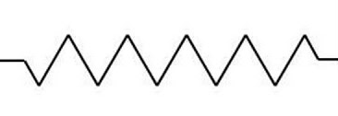
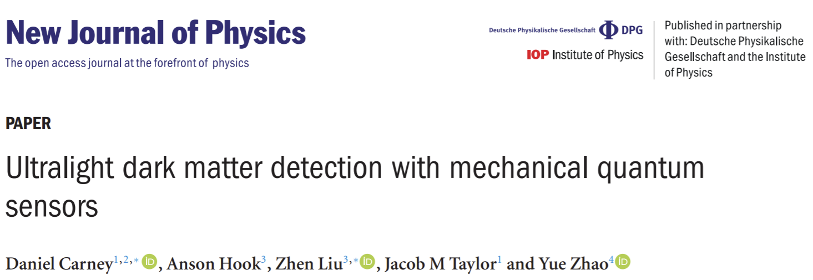
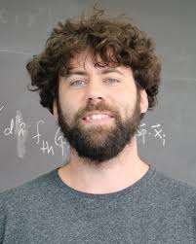
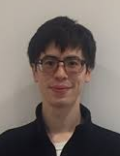








Mechanical resonance can be used to enhance the signal
$$\ddot{x}+\frac{ω_{m}}{Q_{m}}\dot{x}+ω_{m}^{2}x=g\left(\frac{Z}{A}−\frac{Z}{A}\right)\frac{\sqrt{ρ_{DM}}}{m_{n}}\cos\left(ω_{DM}t\right)$$
$${m,ω}_{m},Q_{m}$$
Heterogenous
mechanical resonator!
$$x$$
$$\frac{Z}{A}$$
$$\frac{Z}{A}$$

Slide 16




Mechanical resonance can be used to enhance the signal
$$\ddot{x}+\frac{ω_{m}}{Q_{m}}\dot{x}+ω_{m}^{2}x=g\left(\frac{Z}{A}−\frac{Z}{A}\right)\frac{\sqrt{ρ_{DM}}}{m_{n}}\cos\left(ω_{DM}t\right)$$
$${m,ω}_{m},Q_{m}$$
$$x$$
$$x\left(t\right)=Q_{m}⋅g\left(\frac{Z}{A}−\frac{Z}{A}\right)\frac{\sqrt{ρ_{DM}}}{m_{n}ω_{DM}^{2}}\cos\left(ω_{DM}t\right)$$
Resonance
($ω_{m}=ω_{DM}$)
Bandwidth
Tradeoff
$$ω_{m}→\frac{ω}{Q_{m}}$$

Slide 17


Mechanical resonance can be used to enhance the signal
$$\ddot{x}+\frac{ω_{m}}{Q_{m}}\dot{x}+ω_{m}^{2}x=g\left(\frac{Z}{A}−\frac{Z}{A}\right)\frac{\sqrt{ρ_{DM}}}{m_{n}}\cos\left(ω_{DM}t\right)$$
$${m,ω}_{m},Q_{m}$$
$$x$$
$$a_{noise}(ω_{m})=\sqrt{\frac{4k_{B}Tω_{m}}{Q_{m}m}}+{\frac{ω_{m}^{2}}{Q_{m}}x}_{meas}$$
Noise
Thermal noise
Measurement noise

Slide 18



Mechanical resonance can be used to enhance the signal
$$\ddot{x}−\frac{ω_{m}}{Q_{m}}\dot{x}+ω_{m}^{2}x=g\left(\frac{Z}{A}−\frac{Z}{A}\right)\frac{\sqrt{ρ_{DM}}}{m_{n}}\cos\left(ω_{DM}t\right)$$
$${m,ω}_{m},Q_{m}$$
$$x$$
g
$$a_{noise}(ω_{m})=\sqrt{\frac{4k_{B}Tω_{m}}{Q_{m}m}}+{\frac{ω_{m}^{2}}{Q_{m}}x}_{meas}$$
Low noise
Big, soft, cold, high Q
Low noise readout

Slide 19








Cavity optomechanical dark matter detectors?
$$a_{th}\sim {10}^{−7}\frac{g_{0}}{\sqrt{Hz}}$$
$$a_{th}\sim {10}^{−14}\frac{g_{0}}{\sqrt{Hz}}$$
$$a_{th}\sim {10}^{−10}\frac{g_{0}}{\sqrt{Hz}}$$

Slide 20






A membrane-based optomechanical DM detector
$$Δa\left(t\right)=g\left(\frac{Z}{A}−\frac{Z}{A}\right)\frac{\sqrt{ρ_{DM}}}{m_{n}}cos⁡(ω_{DM}t)$$

Slide 21


















Why Membranes?
Low mechanical loss
$$Q→{10}^{10}$$
Low optical loss
$$ℱ→{10}^{5}$$
Moderate stiffness
$$m→μg$$
$$f→10 kHz$$
Monolithic $→$ PtC mirrors
Cryogenic compatible
$$T→10 mK$$

Slide 22









Model Detector
10 cm
$$ℱ=100$$
SiN
1 cm
Be
$$\left|\frac{Z}{A}−\frac{Z^{′}}{A^{′}}\right|=0.055$$
$$T=10 mK$$
$$Q\sim {10}^{9}$$
$$m \sim 0.1 mg$$
$$f \sim 10 kHz$$
$${\tilde{a}}_{th}=\sqrt{\frac{4k_{B}Tω_{m}}{Q_{m}m}} \sim {10}^{−11}\frac{g_{0}}{\sqrt{Hz}}$$
$${\tilde{x}}_{imp}∝\frac{λ}{ℱ}\sqrt{\frac{100 μW}{P}} \sim {10}^{−17}\frac{m}{\sqrt{Hz}}≪{\tilde{x}}_{th}$$

Slide 23





Sensitivity projections
$$τ=τ_{DM}≈90s$$
$τ=1$ year
$$m_{DM} ({10}^{−12} eV/c^{2})$$
integration time
frequency tuning
array of detectors
multi-mode read-out
Phys. Rev. Lett. 126, 061301 (2021)

Slide 24







Theory to Experiment
Jack Manley
Swati Singh
Daniel Grin
Mitul Dey Chowdhury
Mitul
Jack
Charles Condos
Aman Agrawal

Slide 25


Low fidelity prototype
Phys. Rev. D 113, L121303 (2026)

Slide 26








Membrane-based accelerometer
$$a_{th}∼{10}^{−7}\frac{g}{\sqrt{Hz}}@ 40 kHz$$
2.5 mm

Slide 27








Ultra-high-Q silicon nitride trampoline resonators
$$Q=50,000,000$$
$$Ω=2π×40 kHz$$
$$m=10 ng$$
$$a_{th}≈5×{10}^{−7} g/\sqrt{Hz}$$

Slide 28



Sub-$μg$acceleration sensitivity at 40 kHz
P
$$a_{th}∼5×{10}^{−7} g_{0}/\sqrt{Hz}$$
$$Δf_{th} \sim 1 kHz$$

Slide 29


Feedback cooling and integration
d
300 K
$$a_{th}≈5×{10}^{−8}g_{0}/\sqrt{Hz}$$
4.5 mK
$$a_{th}≈5×{10}^{−7} g_{0}/\sqrt{Hz}$$
$$Δf_{th} \sim 1 kHz$$

Slide 30





Accelerometry in low vibration* dry cryostat
*$T_{eff}=1000 K$
Janus RGC4
ST500-UHV
292 K
excess
vibration
4 K
Winter 2023

Slide 31






Vibration isolation
~ 1 Hz cut-off
2 ft.
Bluefors LD-4K

Slide 32




Optical assembly
cavity alignment module
assembly
loaded device

Slide 33










Thermalization to 3.4 K
Alignment survived (!)
VIS works (?)
$a_{th}=30 ng/\sqrt{Hz}$
$Q≈60,000,000 (!)$
Device thermalized (!)
${δa}_{th}∼10 ng/\sqrt{Hz}$

Slide 34


Pathfinder dark matter search

Slide 35









800 second measurement
$$5σ_{a}$$
$$\overline{a}$$
$$Δf_{DM}$$
$$σ_{a}$$
2$×{10}^{−8} g$
2$×{10}^{−8} g$
$$\sqrt{S_{a}^{BA}}≈5×{10}^{−12} g$$

Slide 36



Photothermal frequency scan
$$40 K$$
25 Hz

Slide 37

Photothermal frequency scan
$$40 K$$
25 Hz

Slide 38






Photothermal frequency scan
$$5σ_{a}$$
$$\overline{a}$$
$$σ_{a}$$
$$40 K$$
25 Hz
2$×{10}^{−8} g$

Slide 39











DM Search: Threshold and limit setting
No detection events
$$S_{a}$$
$5σ (CL=95\%,{all 10}^{4} pts)$
$2σ$ $(CL=95\%, each point)$
$$− {\overline{S}}_{a}$$
$$1σ$$
$$\left\langle {\hat{a}}_{DM}^{2}\right\rangle$$
$$=δS_{a}$$
$$ρ\left(\frac{\left\langle {\hat{a}}_{DM}^{2}\right\rangle }{σ\left[\left\langle {\hat{a}}_{DM}^{2}\right\rangle \right]}\right)$$
$$× S_{a_{DM}}$$
$$CL^{1/N}=\int_{0}^{DT}{ρ({\hat{a}}_{DM}^{2})d\left\langle {\hat{a}}_{DM}^{2}\right\rangle }$$
Phys. Rev. D 113, L121303 (2026)

Slide 40






Where we stand
POLONAISE
$∼1 mg$, cryo-$levitated magnet$
Phys Rev Lett 134, 251001 (2025)
Phys. Rev. D 113, L121303 (2026)

Slide 41








Phase II - Next steps
Increase mass
Increase reflectivity
20 cm
(proposed)
Upgrade cryostat & vibration isolation
Arrays & Squeezed Light

Slide 42

Phase II - Next steps
Increase mass
Increase reflectivity
20 cm
(proposed)
Upgrade cryostat & vibration isolation
Arrays & Squeezed Light

Slide 43









Phase II Proposals
Entanglement-Enhanced Optomechanical
Dark Matter Detector*
Ultralow-loss Torsion Microbalances as New Physics Probes

Slide 44




Entanglement-enhanced OMDM Detector

Slide 45








Entanglement-enhanced optomechanical sensing
100 um
Yi Xia
Prof. Z. Zhang
$$f\sim 1 MHz$$
$$m \sim 10 ng$$
$$SNR∝\frac{1}{\sqrt{N}}→\frac{1}{N}$$

Slide 46





Wafer-scale PtC membrane cavities
100 um
100 um
$$f\sim 1 MHz$$
$$m \sim 10 ng$$
$$f\sim 10 kHz$$
$$m \sim 10 μg$$

Slide 47
Wafer-scale PtC membrane cavities
100 um
100 um
$$f\sim 1 MHz$$
$$m \sim 10 ng$$
$$f\sim 10 kHz$$
$$m \sim 10 μg$$

Slide 48


Wafer-scale PtC membrane cavities
100 um
100 um
$$f\sim 1 MHz$$
$$m \sim 10 ng$$
$$f\sim 10 kHz$$
$$m \sim 10 μg$$

Slide 49
Wafer-scale PtC membrane cavities
100 um
100 um
$$f\sim 1 MHz$$
$$m \sim 10 ng$$
$$f\sim 10 kHz$$
$$m \sim 10 μg$$

Slide 50



Wafer-scale PtC membrane cavities
100 um
100 um
$$f\sim 1 MHz$$
$$m \sim 10 ng$$
$$f\sim 10 kHz$$
$$m \sim 10 μg$$

Slide 51
Phase II Proposals
Entanglement-Enhanced Optomechanical
Dark Matter Detector*
Ultralow-loss Torsion Microbalances as New Physics Probes

Slide 52






Ultralow-loss torsion micropendula
$$m=1 mg, Q>{10}^{6}$$
$$a_{th}∼{10}^{−10} g_{0}/\sqrt{Hz} @ 300 K$$
Notes:
Add outline

Slide 53
Ultralow-loss torsion micropendula
Notes:
Add outline

Slide 54



Ultralow-loss torsion micropendula
Notes:
Add outline

Slide 55



Vibration immune double micropendula
Notes:
Add outline

Slide 56



Torsion micropendula DM search
$$∼1\frac{pg}{\sqrt{Hz}} , 4 K$$
Notes:
Add outline

Slide 57

Thank you

Slide 58






















Aman
Agrawal
Charles
Condos
Jack
Manley
Christian
Pluchar
Mitul
Dey
Chowdhury
Diego
Torres
Morgan
Choi
Atkin
Hyatt
Daniel
Allepuz-
Requena

Slide 59
Vibration Isolation upgrade

Slide 60


Frequency scanning

Slide 61







Centimeter-scale, Bayesian Optimized Trampolines
$$∼{5×10}^{−8}g_{0} \text{@ }300K$$
$$0.01 μg$$
$$1 μg$$
$$a_{th}∼{10}^{−9}g/\sqrt{Hz} @ 4 K$$

Slide 62



Concave membrane metamirrors

Slide 63

Future: Membrane Arrays

Slide 64
Phase II - Next steps
Increase mass
Increase reflectivity
20 cm
0.2 mm
2 cm
(current)
(State of the art)
(proposed)
Upgrade cryostat & vibration isolation
Arrays
Y. Xia, Nature Photonics (2023): 1-8.

Slide 65












Sensitivity Predictions
$${\tilde{a}}_{min}≈{\tilde{a}}_{th}+{\left({{(ω}^{2}{−ω}_{0}^{2})}^{2}+\frac{ω^{2}ω_{0}^{2}}{Q_{0}^{2}}\right){\tilde{x}}_{imp}}_{ }^{ }$$
$$τ=τ_{DM}≈90s$$
$${\tilde{a}}_{imp}$$
$${\tilde{a}}_{imp}$$
$${\tilde{a}}_{imp}$$
$${\tilde{a}}_{min}$$
$${\tilde{a}}_{imp}$$
$${\tilde{a}}_{th}$$
$${\tilde{a}}_{DM}$$
$${\tilde{a}}_{th}$$
L = 20 cm
$$ω_{0}$$
$$g_{B−L,min}=\frac{\sqrt{3/2}}{βf_{12}a_{0}}\sqrt{\frac{4k_{B}Tω_{DM}^{2}}{{m_{0}Q}_{0}Q_{DM}}}$$
Phys. Rev. Lett. 126, 061301 (2021)

Slide 66







Detection Bandwidth – Quantum Noise Limits
${\tilde{a}}_{RPSN}{\tilde{x}}_{imp}=$ constant (SQL)
detection bandwidth
$$\frac{f_{DM}}{Q_{DM}}$$
$a ({ms}^{−2}/{Hz}^{1/2}$)
$$g_{B−L }$$
$a ({ms}^{−2}/{Hz}^{1/2}$)
$$f−f_{0} (Hz)$$
$$f−f_{0} (Hz)$$
Phys. Rev. Lett. 126, 061301 (2021)

Slide 67



How to improve sensitivity-bandwdith?
d
$$τ=τ_{DM}≈90s$$
$τ=1$ year
$$Δx^{2}$$
${\left(\frac{τ_{DM}}{τ}\right)}^{1/2}$ $,τ≤τ_{DM}$
$$g_{B−L, min}∝$$
${\left(\frac{τ_{DM}}{τ}\right)}^{1/4}$ $,τ≫τ_{DM}$
integration time
Phys. Rev. Lett. 126, 061301 (2021)

Slide 68

Model sensitivity
$$τ=τ_{DM}≈90s$$
$τ=1$ year
$$m_{DM} ({10}^{−12} eV/c^{2})$$
integration time
frequency tuning
array of detectors
multi-mode read-out
Phys. Rev. Lett. 126, 061301 (2021)

Slide 69


Ultralow-loss torsion micropendula
$$m=1 mg, Q>{10}^{6}$$
$$a_{th}∼{10}^{−10} g_{0}/\sqrt{Hz} @ 300 K$$
Notes:
Add outline

Slide 70





Optomechanical Dark Matter Detection
$$a_{DM}=gΔ_{12}a_{0}sin(ω_{DM}t+φ)$$
$$∼1\frac{pg}{\sqrt{Hz}} , 4 K$$
“Searching for vector dark matter with an optomechanical accelerometer” PRL (2021)
“Optomechanical accelerometer search for ultralight dark matter” PRD (2026)

Slide 71
Entanglement-enhanced ULDM Search?
Notes:
Add outline

Slide 72









Sensitivity Predictions
$${\tilde{a}}_{min}$$
$${\tilde{a}}_{imp}$$
$${\tilde{a}}_{th}$$
$$τ=τ_{DM}≈90s$$
$${\tilde{a}}_{DM}$$
$${\tilde{a}}_{imp}$$
$${\tilde{a}}_{imp}$$
$$ω_{0}$$
$${\tilde{a}}_{min}≈{\tilde{a}}_{th}+{\left({{(ω}^{2}{−ω}_{0}^{2})}^{2}+\frac{ω^{2}ω_{0}^{2}}{Q_{0}^{2}}\right){\tilde{x}}_{imp}}_{ }^{ }$$
$${\tilde{a}}_{th}$$
$${\tilde{a}}_{imp}$$
L = 20 cm
$$g_{B−L,min}=\frac{\sqrt{3/2}}{βf_{12}a_{0}}\sqrt{\frac{4k_{B}Tω_{DM}^{2}}{{m_{0}Q}_{0}Q_{DM}}}$$
Phys. Rev. Lett. 126, 061301 (2021)

Slide 73











Other (better?) architectures
Mass-loaded membranes
Monolithic silica/silicon
Levitated micro-particles
$${m\sim 10 mg, f\sim 10 kHz, Q \sim {10}^{4}, a}_{th}\sim {10}^{−8}\frac{g_{0}}{\sqrt{Hz}}$$
$${m\sim 10 μg, f\sim 10 Hz, Q \sim 100, a}_{th}\sim {10}^{−8}\frac{g_{0}}{\sqrt{Hz}}$$

Slide 74





Detection Bandwidth – Quantum Noise Limits
$${\tilde{a}}_{min}$$
$${\tilde{a}}_{imp}$$
$${\tilde{a}}_{RPSN}{\tilde{x}}_{imp}=constant (SQL)$$
$${\tilde{a}}_{th}$$
$${\tilde{a}}_{DM}$$
$${\tilde{a}}_{RPSN}$$
$$ω_{0}$$
$a ({ms}^{−2}/{Hz}^{1/2}$)
$$g_{B−L }$$
$${\tilde{a}}_{min}≈{\tilde{a}}_{th}+{\left({{(ω}^{2}{−ω}_{0}^{2})}^{2}+\frac{ω^{2}ω_{0}^{2}}{Q_{0}^{2}}\right){\tilde{x}}_{imp}}_{ }^{ }$$
$$+{\tilde{a}}_{RPSN}$$
$${\tilde{a}}_{imp}$$
$$g_{B−L,min}=\frac{\sqrt{3/2}}{βf_{12}a_{0}}\sqrt{\frac{4k_{B}Tω_{DM}^{2}}{{m_{0}Q}_{0}Q_{DM}}}$$
$$f−f_{0} (Hz)$$
Phys. Rev. Lett. 126, 061301 (2021)

Slide 75










Ultralowloss torsion micropendula ($∼0.1 mg$)
$$a_{th}∼{10}^{−9}g_{0}/\sqrt{Hz}$$
$$Γ_{m}\sim 10 μHz$$

Slide 76

A rudimentary dark matter search

Slide 77


Feedback cooling and noise integration
d
${Δa}_{th}∼{10}^{−8}g_{0}$
$$Δf_{th} \sim 1 kHz$$

Slide 78







Entanglement-enhanced optomechanical sensing
$$Y_{1}$$
⌇
⌇
Yi Xia
Prof. Z. Zhang
$$Y_{2}$$
IM
$$S_{Y_{1}Y_{1}}\left(ω\right),S_{Y_{2}Y_{2}}(ω)$$
$$S_{Y_{+}Y_{+}}(ω)$$

Slide 79




Entanglement improves SNR and bandwidth
$$S_{\overline{F}\overline{F}}(ω)∝\frac{S_{Y_{+}Y_{+}}(ω)}{{|χ}_{m}(ω){\left.​\right|}^{2}}$$
$$S_{Y_{+}Y_{+}}(ω)$$
Yi Xia
Prof. Z. Zhang
Increased
bandwidth
Classical
Entangled

Slide 80























Entangled sensor networks
Classical sensor network
Quntao Zhuang
Jeff Shapiro
PRL 111, 070403(2013)
PRL 121, 043604 (2018)
PRL 120, 080501 (2018)
Sensor 1
Sensor 2
Sensor 3
Sensor M
…
Signal power
$$S$$
$$S$$
$$S$$
$$S$$
$$SNR = \frac{MS}{var(𝒩)}$$
Uncorrelated noise
$$𝒩_{1}$$
$$+$$
$$+$$
$$+$$
$$𝒩_{2}$$
$$𝒩_{3}$$
$$𝒩_{M}$$
Entangled sensor network
⌇
⌇
⌇
⌇
⌇
⌇
⌇
⌇
⌇
⌇
⌇
⌇
…
Signal power
$$SNR = \frac{M^{2}S}{var(𝒩)}$$
$$S$$
$$S$$
$$S$$
$$S$$
Correlated noise
$$𝒩_{1}$$
$$+$$
$$+$$
$$+$$
$$𝒩_{2}$$
$$𝒩_{3}$$
$$𝒩_{M}$$

Slide 81

Entangled optomechanical sensor networks?
⌇
⌇
⌇
plant
plant
⌇
⌇
⌇

