Slide 1
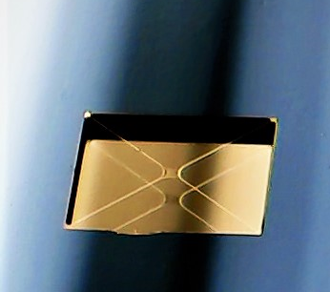






The Invisible Drummer: membrane accelerometer search for vector dark matter: transition to phase II
Dalziel J. Wilson
Wyant College of Optical Sciences, University of Arizona
Optomechanical sensing for AP Searches, Queen’s 26
Notes:
Add outline

Slide 2
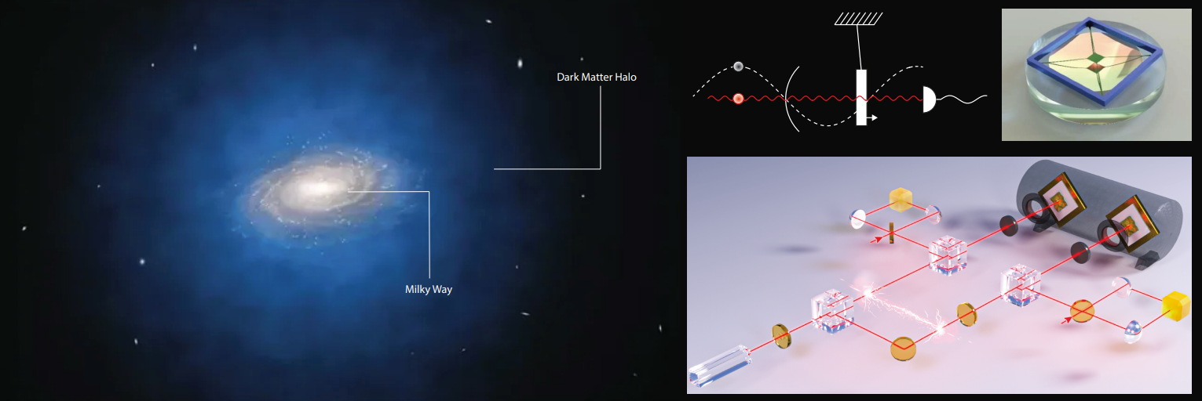
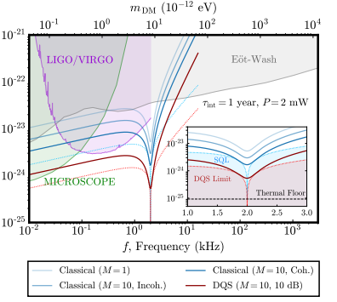
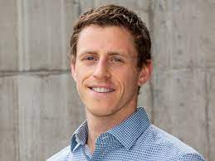
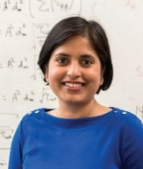
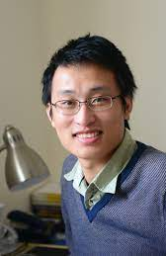
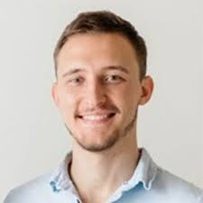
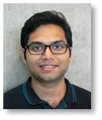
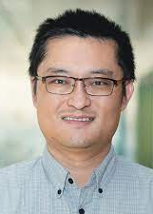
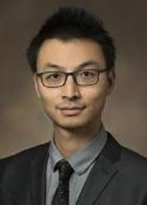
Big picture
"Searching for vector dark matter with an optomechanical accelerometer."
Physical Review Letters 126.6, 061301 (2021).
"Entanglement-enhanced optomechanical sensor array for dark matter searches." Communication Physics 6, 237 (2023)
“Optomechanical accelerometer search for ultralight dark matter"
Physical Review D 113, L121303 (2026).
Notes:
Add outline

Slide 3
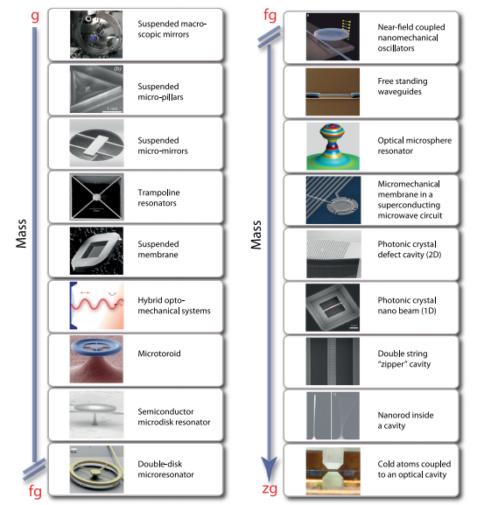
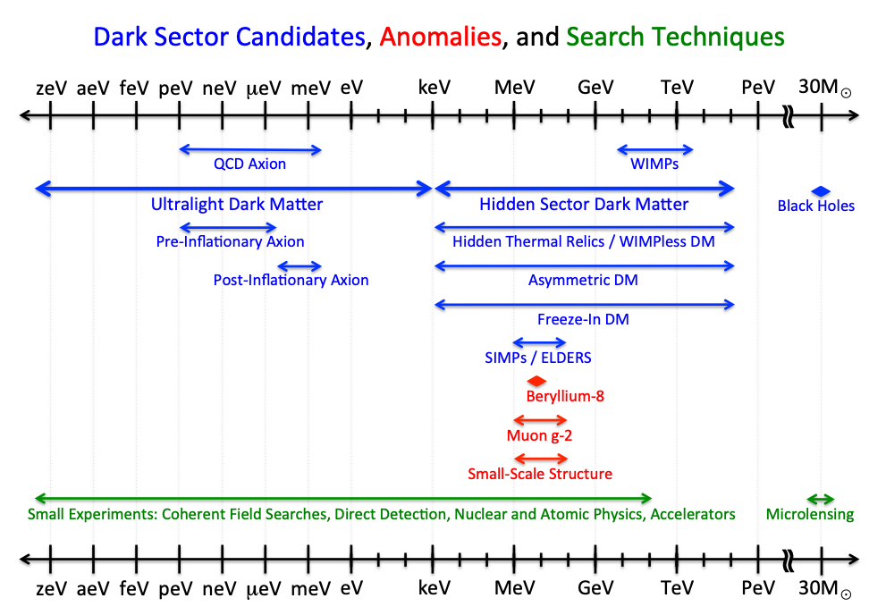
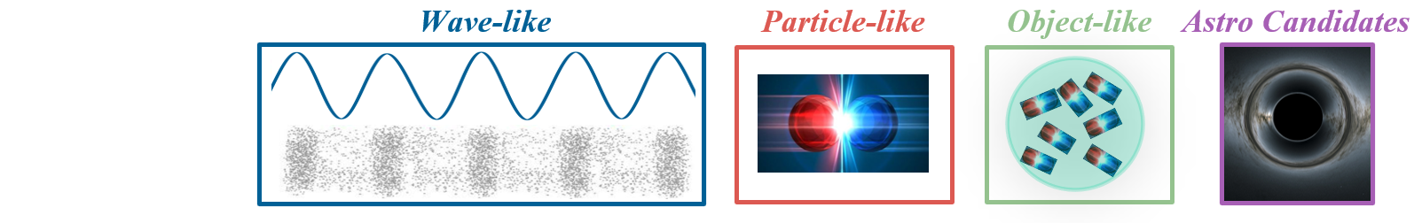
Ultralight dark matter in the “optomechanics” band
100 Hz
100 MHz
US Cosmic Visions: New Ideas in Dark Matter 2017 : Community Report, arXiv:1707.04591

Slide 4

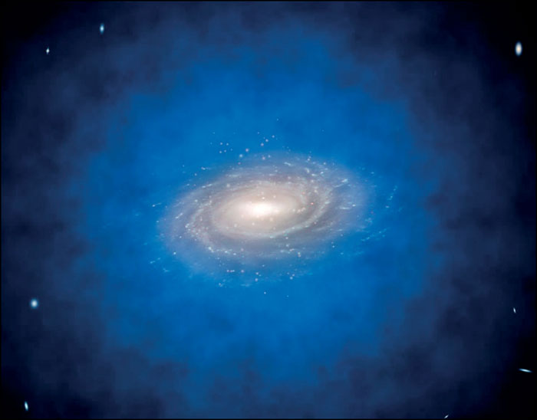
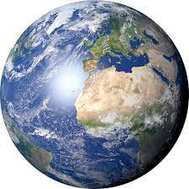

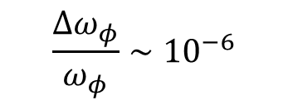


Ultralight dark matter in the “optomechanics” band
100 Hz
100 MHz
$$φ\left(r,t\right)=g\sqrt{ρ_{dm}}cos(ω_{φ}t−k_{φ}⋅r)$$
$$v≈200 km/s$$
$$\frac{Δω_{φ}}{ω_{φ}}∼{10}^{−6}$$
${\left|φ_{ω}\right|}^{2}$
$$1 km ≤λ_{φ}<{10}^{6} km$$
$$ω−ω_{φ}$$

Slide 5
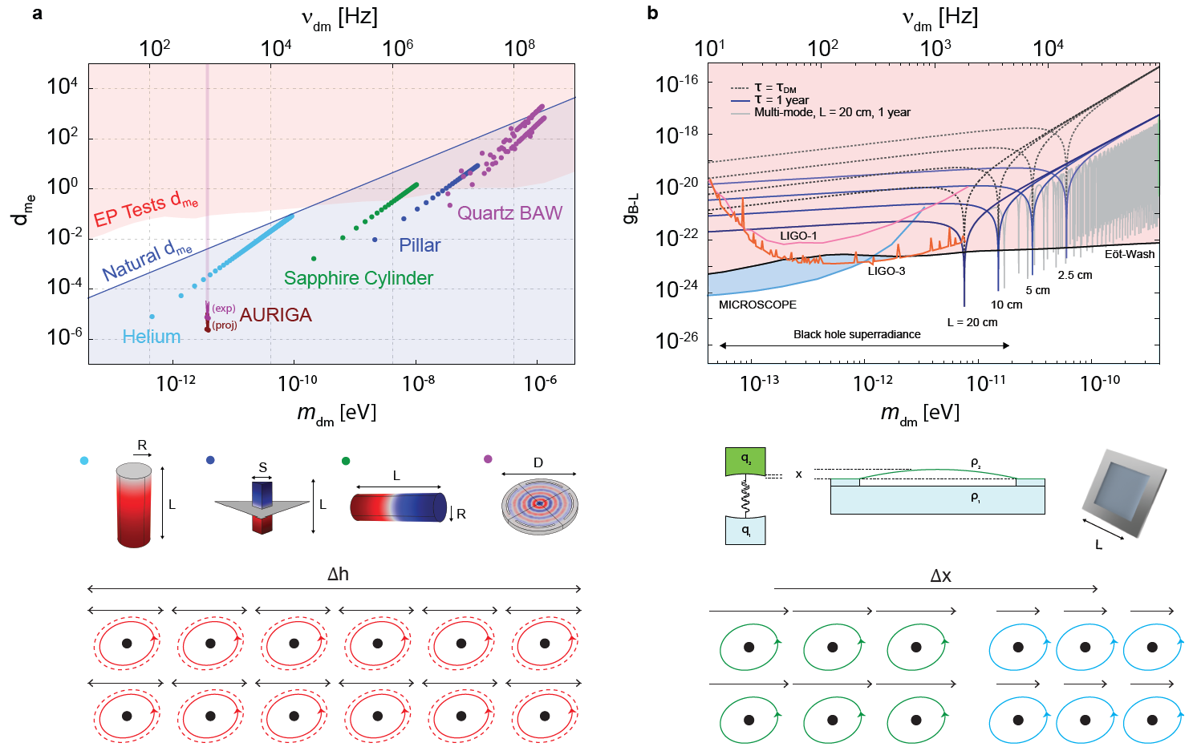

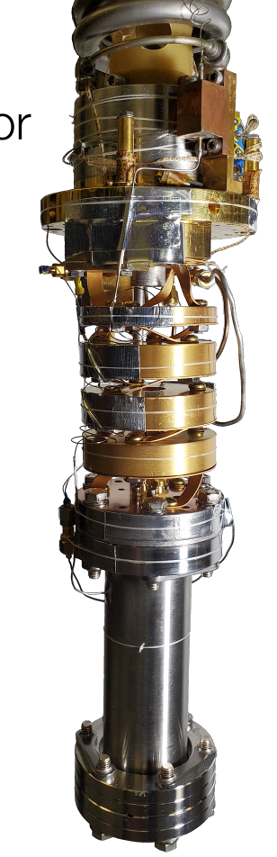
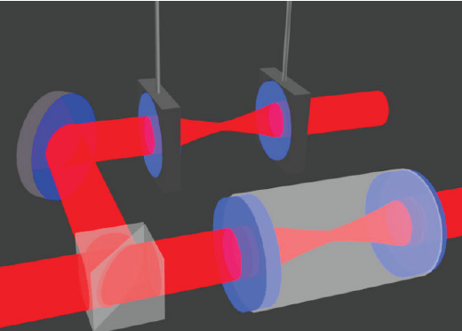
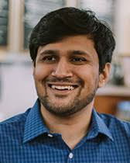
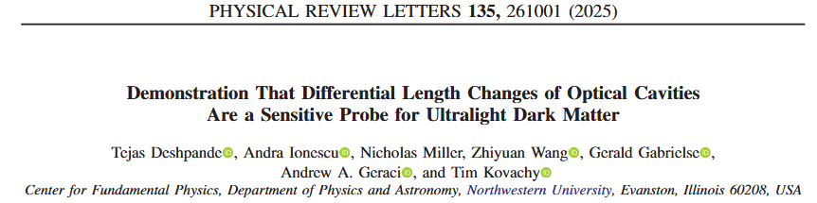
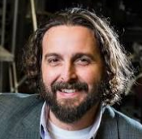
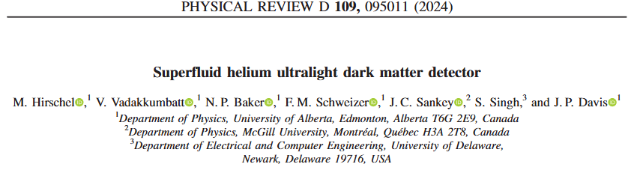
Scalar and Vector ULDM forces

Slide 6
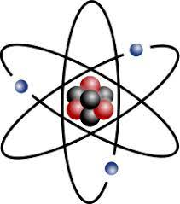
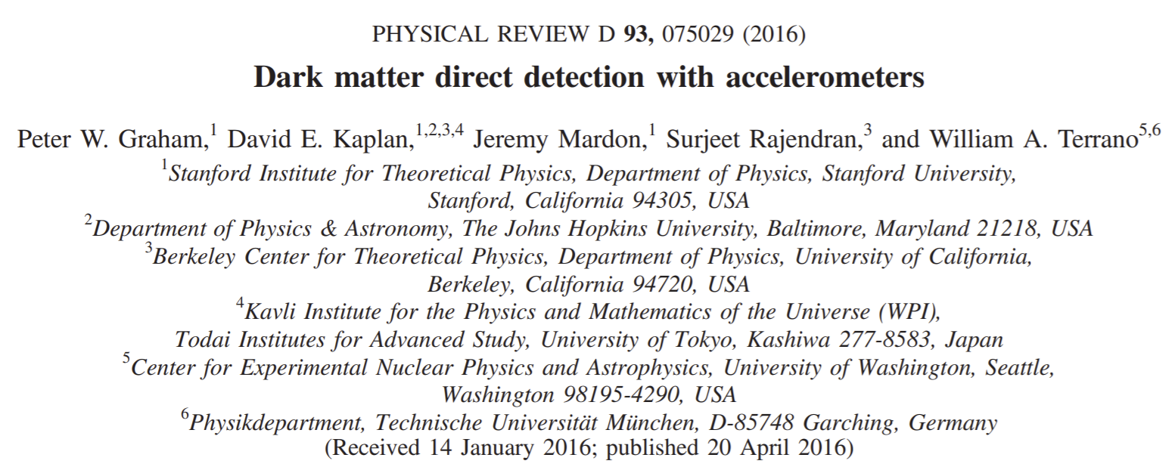
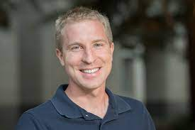
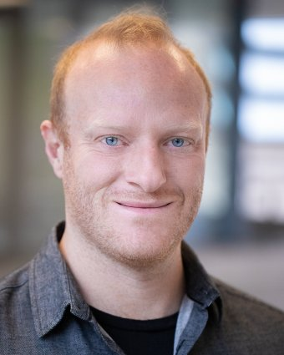


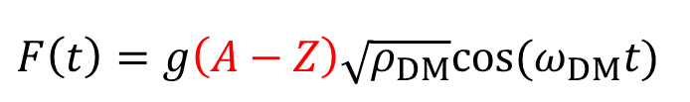
Dark matter might produce a material dependent force
$F\left(t\right)=g\left(A−Z\right)\sqrt{ρ_{DM}}cos⁡(ω_{DM}t)$
$$F$$
$$A−Z$$

Slide 7
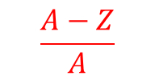


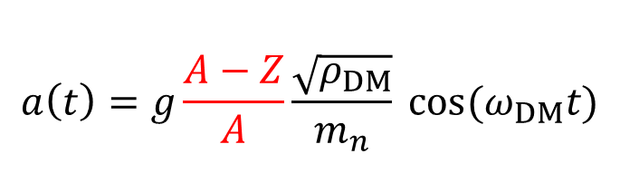
Dark matter might produce a material dependent force
$$a\left(t\right)=g\frac{A−Z}{A}\frac{\sqrt{ρ_{DM}}}{m_{n}} cos⁡(ω_{DM}t)$$
acceleration
$a=F/m$
$$a$$
$$\frac{A−Z}{A}$$

Slide 8
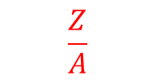


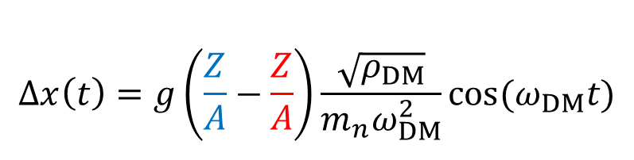
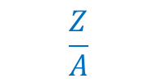
Dark matter might produce a material dependent force
$$Δx\left(t\right)=g\left(\frac{Z}{A}−\frac{Z}{A}\right)\frac{\sqrt{ρ_{DM}}}{m_{n}ω_{DM}^{2}}cos⁡(ω_{DM}t)$$
displacement
$a=\ddot{x}$
$$Δx$$
$$\frac{Z}{A}$$
$$\frac{Z}{A}$$

Slide 9
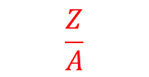
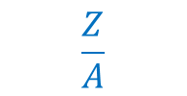
Dark matter might produce a material dependent force
$$Δx\left(t\right)=g\left(\frac{Z}{A}−\frac{Z}{A}\right)\frac{\sqrt{ρ_{DM}}}{m_{n}ω_{DM}^{2}}cos⁡(ω_{DM}t)$$
displacement
$a=\ddot{x}$
$$Δx$$
$$\frac{Z}{A}$$
$$\frac{Z}{A}$$

Slide 10

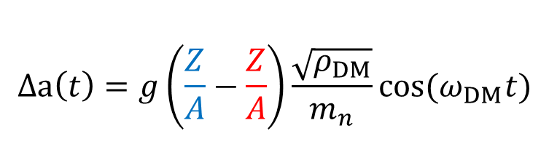
DM might produce a material dependent acceleration
$$Δa\left(t\right)=g\left(\frac{Z}{A}−\frac{Z}{A}\right)\frac{\sqrt{ρ_{DM}}}{m_{n}}cos⁡(ω_{DM}t)$$
$$Δa$$
$$\frac{Z}{A}$$
$$\frac{Z}{A}$$

Slide 11
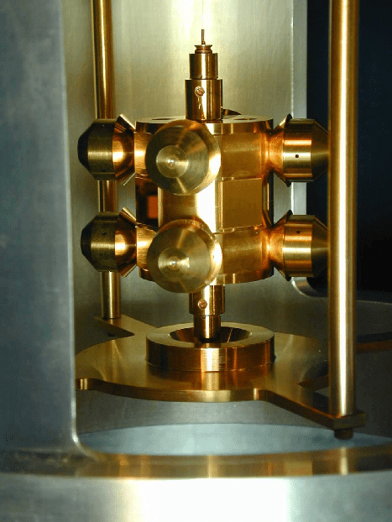
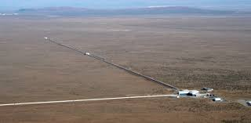
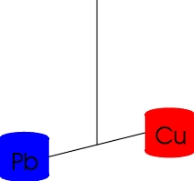
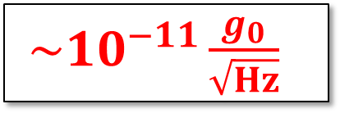

The acceleration signal is extremely weak
$$Δa\left(t\right)=g\left(\frac{Z}{A}−\frac{Z}{A}\right)\frac{\sqrt{ρ_{DM}}}{m_{n}}cos⁡(ω_{DM}t)$$
$\sim {10}^{−11}\frac{g_{0}}{\sqrt{Hz}}$
GW interferometer
Torsion balance
(Eöt-Wash experiment)
$${L∇φ}_{0}$$

Slide 12
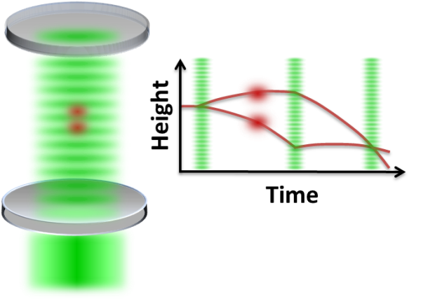

Dark matter might produce a material dependent force
$$Δx\left(t\right)=g\left(\frac{Z}{A}−\frac{Z}{A}\right)\frac{\sqrt{ρ_{DM}}}{m_{n}ω_{DM}^{2}}cos⁡(ω_{DM}t)$$
displacement
$a=\ddot{x}$
$${L∇φ}_{0}$$
Atom interferometer
GW interferometer
Torsion balance
(Eöt-Wash experiment)

Slide 13
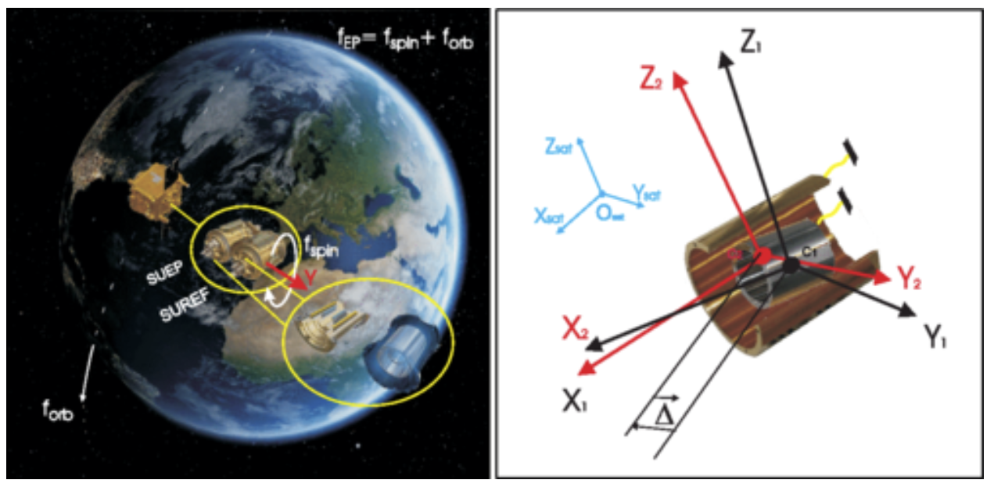



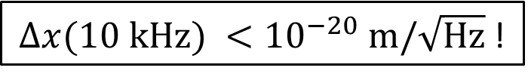
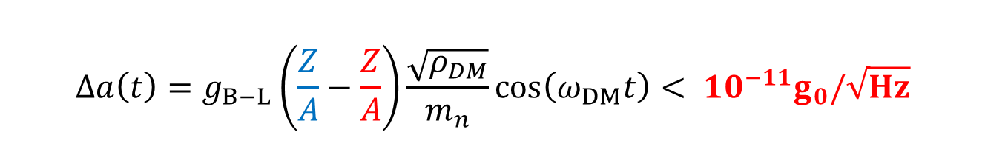
The acceleration signal is extremely weak
$$Δa\left(t\right)=g_{B−L}\left(\frac{Z}{A}−\frac{Z}{A}\right)\frac{\sqrt{ρ_{DM}}}{m_{n}}\cos\left(ω_{DM}t\right)< {10}^{−11}g_{0}/\sqrt{Hz}$$
${Δx(10 kHz) <10}^{−20} m/\sqrt{Hz}$ !
$${L∇φ}_{0}$$
LIGO
Eöt-Wash
${Δx\left(100 Hz\right)\sim 10}^{−20} m/\sqrt{Hz}$
$${Δa<10}^{−11}g_{0}/\sqrt{Hz}$$
MICROSCOPE: space-based EP test

Slide 14
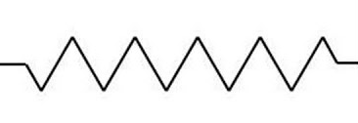
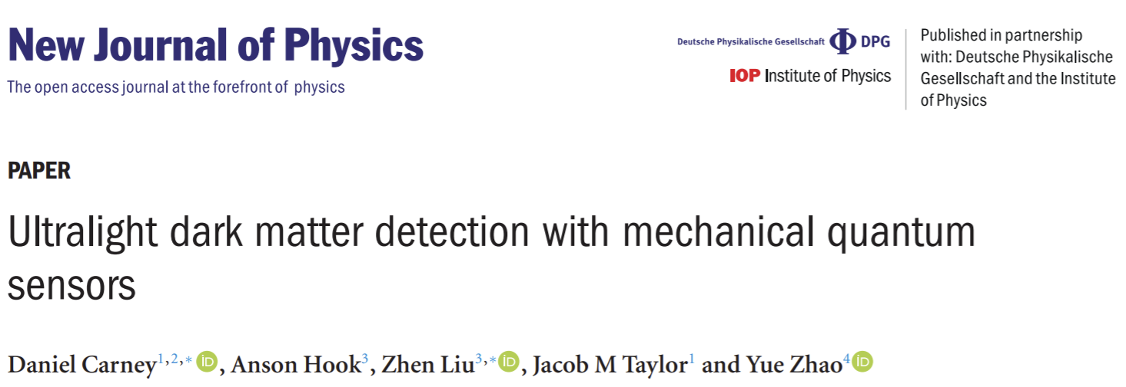
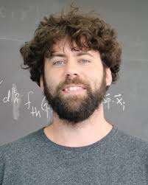
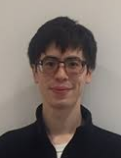
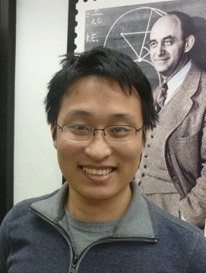
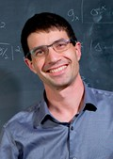






Mechanical resonance can be used to enhance the signal
$$\ddot{x}+\frac{ω_{m}}{Q_{m}}\dot{x}+ω_{m}^{2}x=g\left(\frac{Z}{A}−\frac{Z}{A}\right)\frac{\sqrt{ρ_{DM}}}{m_{n}}\cos\left(ω_{DM}t\right)$$
$${m,ω}_{m},Q_{m}$$
Heterogenous
mechanical resonator!
$$x$$
$$\frac{Z}{A}$$
$$\frac{Z}{A}$$

Slide 15




Mechanical resonance can be used to enhance the signal
$$\ddot{x}+\frac{ω_{m}}{Q_{m}}\dot{x}+ω_{m}^{2}x=g\left(\frac{Z}{A}−\frac{Z}{A}\right)\frac{\sqrt{ρ_{DM}}}{m_{n}}\cos\left(ω_{DM}t\right)$$
$${m,ω}_{m},Q_{m}$$
$$x$$
$$x\left(t\right)=Q_{m}⋅g\left(\frac{Z}{A}−\frac{Z}{A}\right)\frac{\sqrt{ρ_{DM}}}{m_{n}ω_{DM}^{2}}\cos\left(ω_{DM}t\right)$$
Resonance
($ω_{m}=ω_{DM}$)
Bandwidth
Tradeoff
$$ω_{m}→\frac{ω}{Q_{m}}$$

Slide 16


Mechanical resonance can be used to enhance the signal
$$\ddot{x}+\frac{ω_{m}}{Q_{m}}\dot{x}+ω_{m}^{2}x=g\left(\frac{Z}{A}−\frac{Z}{A}\right)\frac{\sqrt{ρ_{DM}}}{m_{n}}\cos\left(ω_{DM}t\right)$$
$${m,ω}_{m},Q_{m}$$
$$x$$
$$a_{noise}(ω_{m})=\sqrt{\frac{4k_{B}Tω_{m}}{Q_{m}m}}+{\frac{ω_{m}^{2}}{Q_{m}}x}_{meas}$$
Noise
Thermal noise
Measurement noise

Slide 17



Mechanical resonance can be used to enhance the signal
$$\ddot{x}−\frac{ω_{m}}{Q_{m}}\dot{x}+ω_{m}^{2}x=g\left(\frac{Z}{A}−\frac{Z}{A}\right)\frac{\sqrt{ρ_{DM}}}{m_{n}}\cos\left(ω_{DM}t\right)$$
$${m,ω}_{m},Q_{m}$$
$$x$$
g
$$a_{noise}(ω_{m})=\sqrt{\frac{4k_{B}Tω_{m}}{Q_{m}m}}+{\frac{ω_{m}^{2}}{Q_{m}}x}_{meas}$$
Low noise
Big, soft, cold, high Q
Low noise readout

Slide 18








Cavity optomechanical dark matter detectors?
$$a_{th}\sim {10}^{−7}\frac{g_{0}}{\sqrt{Hz}}$$
$$a_{th}\sim {10}^{−14}\frac{g_{0}}{\sqrt{Hz}}$$
$$a_{th}\sim {10}^{−10}\frac{g_{0}}{\sqrt{Hz}}$$

Slide 19






A membrane-based optomechanical DM detector
$$Δa\left(t\right)=g\left(\frac{Z}{A}−\frac{Z}{A}\right)\frac{\sqrt{ρ_{DM}}}{m_{n}}cos⁡(ω_{DM}t)$$

Slide 20


















Why Membranes?
Low mechanical loss
$$Q→{10}^{10}$$
Low optical loss
$$ℱ→{10}^{5}$$
Moderate stiffness
$$m→μg$$
$$f→10 kHz$$
Monolithic $→$ PtC mirrors
Cryogenic compatible
$$T→10 mK$$

Slide 21









Model Detector
10 cm
$$ℱ=100$$
SiN
1 cm
Be
$$\left|\frac{Z}{A}−\frac{Z^{′}}{A^{′}}\right|=0.055$$
$$T=10 mK$$
$$Q\sim {10}^{9}$$
$$m \sim 0.1 mg$$
$$f \sim 10 kHz$$
$${\tilde{a}}_{th}=\sqrt{\frac{4k_{B}Tω_{m}}{Q_{m}m}} \sim {10}^{−11}\frac{g_{0}}{\sqrt{Hz}}$$
$${\tilde{x}}_{imp}∝\frac{λ}{ℱ}\sqrt{\frac{100 μW}{P}} \sim {10}^{−17}\frac{m}{\sqrt{Hz}}≪{\tilde{x}}_{th}$$

Slide 22





Sensitivity projections
$$τ=τ_{DM}≈90s$$
$τ=1$ year
$$m_{DM} ({10}^{−12} eV/c^{2})$$
integration time
frequency tuning
array of detectors
multi-mode read-out
Phys. Rev. Lett. 126, 061301 (2021)

Slide 23







Theory to Experiment
Jack Manley
Swati Singh
Daniel Grin
Mitul Dey Chowdhury
Mitul
Jack
Charles Condos
Aman Agrawal

Slide 24


Low fidelity prototype
Phys. Rev. D 113, L121303 (2026)

Slide 25








Membrane-based accelerometer
$$a_{th}∼{10}^{−7}\frac{g}{\sqrt{Hz}}@ 40 kHz$$
2.5 mm

Slide 26








Ultra-high-Q silicon nitride trampoline resonators
$$Q=50,000,000$$
$$Ω=2π×40 kHz$$
$$m=10 ng$$
$$a_{th}≈5×{10}^{−7} g/\sqrt{Hz}$$

Slide 27



Sub-$μg$acceleration sensitivity at 40 kHz
P
$$a_{th}∼5×{10}^{−7} g_{0}/\sqrt{Hz}$$
$$Δf_{th} \sim 1 kHz$$

Slide 28


Feedback cooling and integration
d
300 K
$$a_{th}≈5×{10}^{−8}g_{0}/\sqrt{Hz}$$
4.5 mK
$$a_{th}≈5×{10}^{−7} g_{0}/\sqrt{Hz}$$
$$Δf_{th} \sim 1 kHz$$

Slide 29





Accelerometry in low vibration* dry cryostat
*$T_{eff}=1000 K$
Janus RGC4
ST500-UHV
292 K
excess
vibration
4 K
Winter 2023

Slide 30






Vibration isolation
~ 1 Hz cut-off
2 ft.
Bluefors LD-4K

Slide 31




Optical assembly
cavity alignment module
assembly
loaded device

Slide 32










Thermalization to 3.4 K
Alignment survived (!)
VIS works (?)
$a_{th}=30 ng/\sqrt{Hz}$
$Q≈60,000,000 (!)$
Device thermalized (!)
${δa}_{th}∼10 ng/\sqrt{Hz}$

Slide 33


Pathfinder dark matter search

Slide 34









800 second measurement
$$5σ_{a}$$
$$\overline{a}$$
$$Δf_{DM}$$
$$σ_{a}$$
2$×{10}^{−8} g$
2$×{10}^{−8} g$
$$\sqrt{S_{a}^{BA}}≈5×{10}^{−12} g$$

Slide 35



Photothermal frequency scan
$$40 K$$
25 Hz

Slide 36

Photothermal frequency scan
$$40 K$$
25 Hz

Slide 37






Photothermal frequency scan
$$5σ_{a}$$
$$\overline{a}$$
$$σ_{a}$$
$$40 K$$
25 Hz
2$×{10}^{−8} g$

Slide 38











DM Search: Threshold and limit setting
No detection events
$$S_{a}$$
$5σ (CL=95\%,{all 10}^{4} pts)$
$2σ$ $(CL=95\%, each point)$
$$− {\overline{S}}_{a}$$
$$1σ$$
$$\left\langle {\hat{a}}_{DM}^{2}\right\rangle$$
$$=δS_{a}$$
$$ρ\left(\frac{\left\langle {\hat{a}}_{DM}^{2}\right\rangle }{σ\left[\left\langle {\hat{a}}_{DM}^{2}\right\rangle \right]}\right)$$
$$× S_{a_{DM}}$$
$$CL^{1/N}=\int_{0}^{DT}{ρ({\hat{a}}_{DM}^{2})d\left\langle {\hat{a}}_{DM}^{2}\right\rangle }$$
Phys. Rev. D 113, L121303 (2026)

Slide 39






Where we stand
POLONAISE
$∼1 mg$, cryo-$levitated magnet$
Phys Rev Lett 134, 251001 (2025)
Phys. Rev. D 113, L121303 (2026)

Slide 40








Phase II - Next steps
Increase mass
Increase reflectivity
20 cm
(proposed)
Upgrade cryostat & vibration isolation
Arrays & Squeezed Light

Slide 41

Phase II - Next steps
Increase mass
Increase reflectivity
20 cm
(proposed)
Upgrade cryostat & vibration isolation
Arrays & Squeezed Light

Slide 42









Phase II Proposals
Entanglement-Enhanced Optomechanical
Dark Matter Detector*
Ultralow-loss Torsion Microbalances as New Physics Probes

Slide 43




Entanglement-enhanced OMDM Detector

Slide 44








Entanglement-enhanced optomechanical sensing
100 um
Yi Xia
Prof. Z. Zhang
$$f\sim 1 MHz$$
$$m \sim 10 ng$$
$$SNR∝\frac{1}{\sqrt{N}}→\frac{1}{N}$$

Slide 45





Wafer-scale PtC membrane cavities
100 um
100 um
$$f\sim 1 MHz$$
$$m \sim 10 ng$$
$$f\sim 10 kHz$$
$$m \sim 10 μg$$

Slide 46
Wafer-scale PtC membrane cavities
100 um
100 um
$$f\sim 1 MHz$$
$$m \sim 10 ng$$
$$f\sim 10 kHz$$
$$m \sim 10 μg$$

Slide 47


Wafer-scale PtC membrane cavities
100 um
100 um
$$f\sim 1 MHz$$
$$m \sim 10 ng$$
$$f\sim 10 kHz$$
$$m \sim 10 μg$$

Slide 48
Wafer-scale PtC membrane cavities
100 um
100 um
$$f\sim 1 MHz$$
$$m \sim 10 ng$$
$$f\sim 10 kHz$$
$$m \sim 10 μg$$

Slide 49



Wafer-scale PtC membrane cavities
100 um
100 um
$$f\sim 1 MHz$$
$$m \sim 10 ng$$
$$f\sim 10 kHz$$
$$m \sim 10 μg$$

Slide 50
Phase II Proposals
Entanglement-Enhanced Optomechanical
Dark Matter Detector*
Ultralow-loss Torsion Microbalances as New Physics Probes

Slide 51






Ultralow-loss torsion micropendula
$$m=1 mg, Q>{10}^{6}$$
$$a_{th}∼{10}^{−10} g_{0}/\sqrt{Hz} @ 300 K$$
Notes:
Add outline

Slide 52
Ultralow-loss torsion micropendula
Notes:
Add outline

Slide 53



Ultralow-loss torsion micropendula
Notes:
Add outline

Slide 54



Vibration immune double micropendula
Notes:
Add outline

Slide 55



Torsion micropendula DM search
$$∼1\frac{pg}{\sqrt{Hz}} , 4 K$$
Notes:
Add outline

Slide 56

Thank you

Slide 57






















Aman
Agrawal
Charles
Condos
Jack
Manley
Christian
Pluchar
Mitul
Dey
Chowdhury
Diego
Torres
Morgan
Choi
Atkin
Hyatt
Daniel
Allepuz-
Requena

Slide 58
Vibration Isolation upgrade

Slide 59


Frequency scanning

Slide 60







Centimeter-scale, Bayesian Optimized Trampolines
$$∼{5×10}^{−8}g_{0} \text{@ }300K$$
$$0.01 μg$$
$$1 μg$$
$$a_{th}∼{10}^{−9}g/\sqrt{Hz} @ 4 K$$

Slide 61



Concave membrane metamirrors

Slide 62

Future: Membrane Arrays

Slide 63
Phase II - Next steps
Increase mass
Increase reflectivity
20 cm
0.2 mm
2 cm
(current)
(State of the art)
(proposed)
Upgrade cryostat & vibration isolation
Arrays
Y. Xia, Nature Photonics (2023): 1-8.

Slide 64












Sensitivity Predictions
$${\tilde{a}}_{min}≈{\tilde{a}}_{th}+{\left({{(ω}^{2}{−ω}_{0}^{2})}^{2}+\frac{ω^{2}ω_{0}^{2}}{Q_{0}^{2}}\right){\tilde{x}}_{imp}}_{ }^{ }$$
$$τ=τ_{DM}≈90s$$
$${\tilde{a}}_{imp}$$
$${\tilde{a}}_{imp}$$
$${\tilde{a}}_{imp}$$
$${\tilde{a}}_{min}$$
$${\tilde{a}}_{imp}$$
$${\tilde{a}}_{th}$$
$${\tilde{a}}_{DM}$$
$${\tilde{a}}_{th}$$
L = 20 cm
$$ω_{0}$$
$$g_{B−L,min}=\frac{\sqrt{3/2}}{βf_{12}a_{0}}\sqrt{\frac{4k_{B}Tω_{DM}^{2}}{{m_{0}Q}_{0}Q_{DM}}}$$
Phys. Rev. Lett. 126, 061301 (2021)

Slide 65







Detection Bandwidth – Quantum Noise Limits
${\tilde{a}}_{RPSN}{\tilde{x}}_{imp}=$ constant (SQL)
detection bandwidth
$$\frac{f_{DM}}{Q_{DM}}$$
$a ({ms}^{−2}/{Hz}^{1/2}$)
$$g_{B−L }$$
$a ({ms}^{−2}/{Hz}^{1/2}$)
$$f−f_{0} (Hz)$$
$$f−f_{0} (Hz)$$
Phys. Rev. Lett. 126, 061301 (2021)

Slide 66



How to improve sensitivity-bandwdith?
d
$$τ=τ_{DM}≈90s$$
$τ=1$ year
$$Δx^{2}$$
${\left(\frac{τ_{DM}}{τ}\right)}^{1/2}$ $,τ≤τ_{DM}$
$$g_{B−L, min}∝$$
${\left(\frac{τ_{DM}}{τ}\right)}^{1/4}$ $,τ≫τ_{DM}$
integration time
Phys. Rev. Lett. 126, 061301 (2021)

Slide 67

Model sensitivity
$$τ=τ_{DM}≈90s$$
$τ=1$ year
$$m_{DM} ({10}^{−12} eV/c^{2})$$
integration time
frequency tuning
array of detectors
multi-mode read-out
Phys. Rev. Lett. 126, 061301 (2021)

Slide 68


Ultralow-loss torsion micropendula
$$m=1 mg, Q>{10}^{6}$$
$$a_{th}∼{10}^{−10} g_{0}/\sqrt{Hz} @ 300 K$$
Notes:
Add outline

Slide 69





Optomechanical Dark Matter Detection
$$a_{DM}=gΔ_{12}a_{0}sin(ω_{DM}t+φ)$$
$$∼1\frac{pg}{\sqrt{Hz}} , 4 K$$
“Searching for vector dark matter with an optomechanical accelerometer” PRL (2021)
“Optomechanical accelerometer search for ultralight dark matter” PRD (2026)

Slide 70
Entanglement-enhanced ULDM Search?
Notes:
Add outline

Slide 71









Sensitivity Predictions
$${\tilde{a}}_{min}$$
$${\tilde{a}}_{imp}$$
$${\tilde{a}}_{th}$$
$$τ=τ_{DM}≈90s$$
$${\tilde{a}}_{DM}$$
$${\tilde{a}}_{imp}$$
$${\tilde{a}}_{imp}$$
$$ω_{0}$$
$${\tilde{a}}_{min}≈{\tilde{a}}_{th}+{\left({{(ω}^{2}{−ω}_{0}^{2})}^{2}+\frac{ω^{2}ω_{0}^{2}}{Q_{0}^{2}}\right){\tilde{x}}_{imp}}_{ }^{ }$$
$${\tilde{a}}_{th}$$
$${\tilde{a}}_{imp}$$
L = 20 cm
$$g_{B−L,min}=\frac{\sqrt{3/2}}{βf_{12}a_{0}}\sqrt{\frac{4k_{B}Tω_{DM}^{2}}{{m_{0}Q}_{0}Q_{DM}}}$$
Phys. Rev. Lett. 126, 061301 (2021)

Slide 72











Other (better?) architectures
Mass-loaded membranes
Monolithic silica/silicon
Levitated micro-particles
$${m\sim 10 mg, f\sim 10 kHz, Q \sim {10}^{4}, a}_{th}\sim {10}^{−8}\frac{g_{0}}{\sqrt{Hz}}$$
$${m\sim 10 μg, f\sim 10 Hz, Q \sim 100, a}_{th}\sim {10}^{−8}\frac{g_{0}}{\sqrt{Hz}}$$

Slide 73





Detection Bandwidth – Quantum Noise Limits
$${\tilde{a}}_{min}$$
$${\tilde{a}}_{imp}$$
$${\tilde{a}}_{RPSN}{\tilde{x}}_{imp}=constant (SQL)$$
$${\tilde{a}}_{th}$$
$${\tilde{a}}_{DM}$$
$${\tilde{a}}_{RPSN}$$
$$ω_{0}$$
$a ({ms}^{−2}/{Hz}^{1/2}$)
$$g_{B−L }$$
$${\tilde{a}}_{min}≈{\tilde{a}}_{th}+{\left({{(ω}^{2}{−ω}_{0}^{2})}^{2}+\frac{ω^{2}ω_{0}^{2}}{Q_{0}^{2}}\right){\tilde{x}}_{imp}}_{ }^{ }$$
$$+{\tilde{a}}_{RPSN}$$
$${\tilde{a}}_{imp}$$
$$g_{B−L,min}=\frac{\sqrt{3/2}}{βf_{12}a_{0}}\sqrt{\frac{4k_{B}Tω_{DM}^{2}}{{m_{0}Q}_{0}Q_{DM}}}$$
$$f−f_{0} (Hz)$$
Phys. Rev. Lett. 126, 061301 (2021)

Slide 74










Ultralowloss torsion micropendula ($∼0.1 mg$)
$$a_{th}∼{10}^{−9}g_{0}/\sqrt{Hz}$$
$$Γ_{m}\sim 10 μHz$$

Slide 75

A rudimentary dark matter search

Slide 76


Feedback cooling and noise integration
d
${Δa}_{th}∼{10}^{−8}g_{0}$
$$Δf_{th} \sim 1 kHz$$

Slide 77







Entanglement-enhanced optomechanical sensing
$$Y_{1}$$
⌇
⌇
Yi Xia
Prof. Z. Zhang
$$Y_{2}$$
IM
$$S_{Y_{1}Y_{1}}\left(ω\right),S_{Y_{2}Y_{2}}(ω)$$
$$S_{Y_{+}Y_{+}}(ω)$$

Slide 78




Entanglement improves SNR and bandwidth
$$S_{\overline{F}\overline{F}}(ω)∝\frac{S_{Y_{+}Y_{+}}(ω)}{{|χ}_{m}(ω){\left.​\right|}^{2}}$$
$$S_{Y_{+}Y_{+}}(ω)$$
Yi Xia
Prof. Z. Zhang
Increased
bandwidth
Classical
Entangled

Slide 79























Entangled sensor networks
Classical sensor network
Quntao Zhuang
Jeff Shapiro
PRL 111, 070403(2013)
PRL 121, 043604 (2018)
PRL 120, 080501 (2018)
Sensor 1
Sensor 2
Sensor 3
Sensor M
…
Signal power
$$S$$
$$S$$
$$S$$
$$S$$
$$SNR = \frac{MS}{var(𝒩)}$$
Uncorrelated noise
$$𝒩_{1}$$
$$+$$
$$+$$
$$+$$
$$𝒩_{2}$$
$$𝒩_{3}$$
$$𝒩_{M}$$
Entangled sensor network
⌇
⌇
⌇
⌇
⌇
⌇
⌇
⌇
⌇
⌇
⌇
⌇
…
Signal power
$$SNR = \frac{M^{2}S}{var(𝒩)}$$
$$S$$
$$S$$
$$S$$
$$S$$
Correlated noise
$$𝒩_{1}$$
$$+$$
$$+$$
$$+$$
$$𝒩_{2}$$
$$𝒩_{3}$$
$$𝒩_{M}$$

Slide 80

Entangled optomechanical sensor networks?
⌇
⌇
⌇
plant
plant
⌇
⌇
⌇

