Slide 1
Low-noise levitated oscillators and calorimetry with levitated superconductors
OSSAPP
24/09/26
Thomas Penny

Slide 2
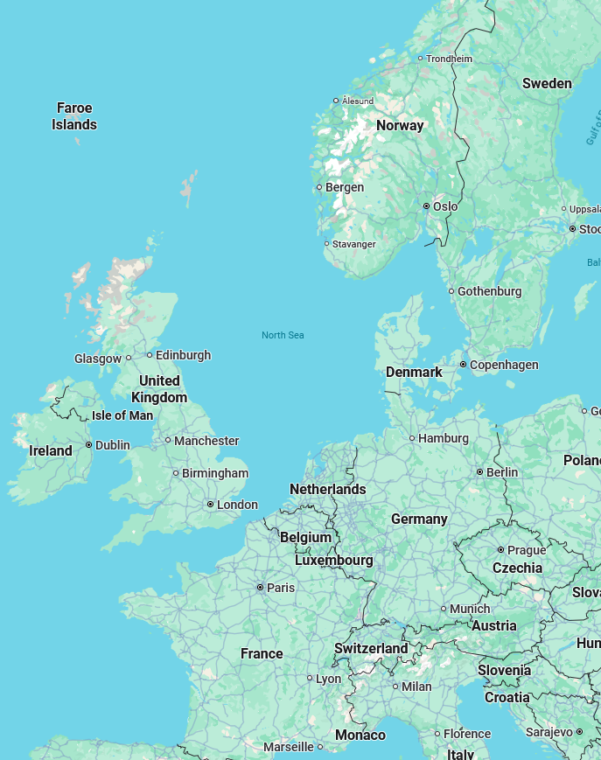
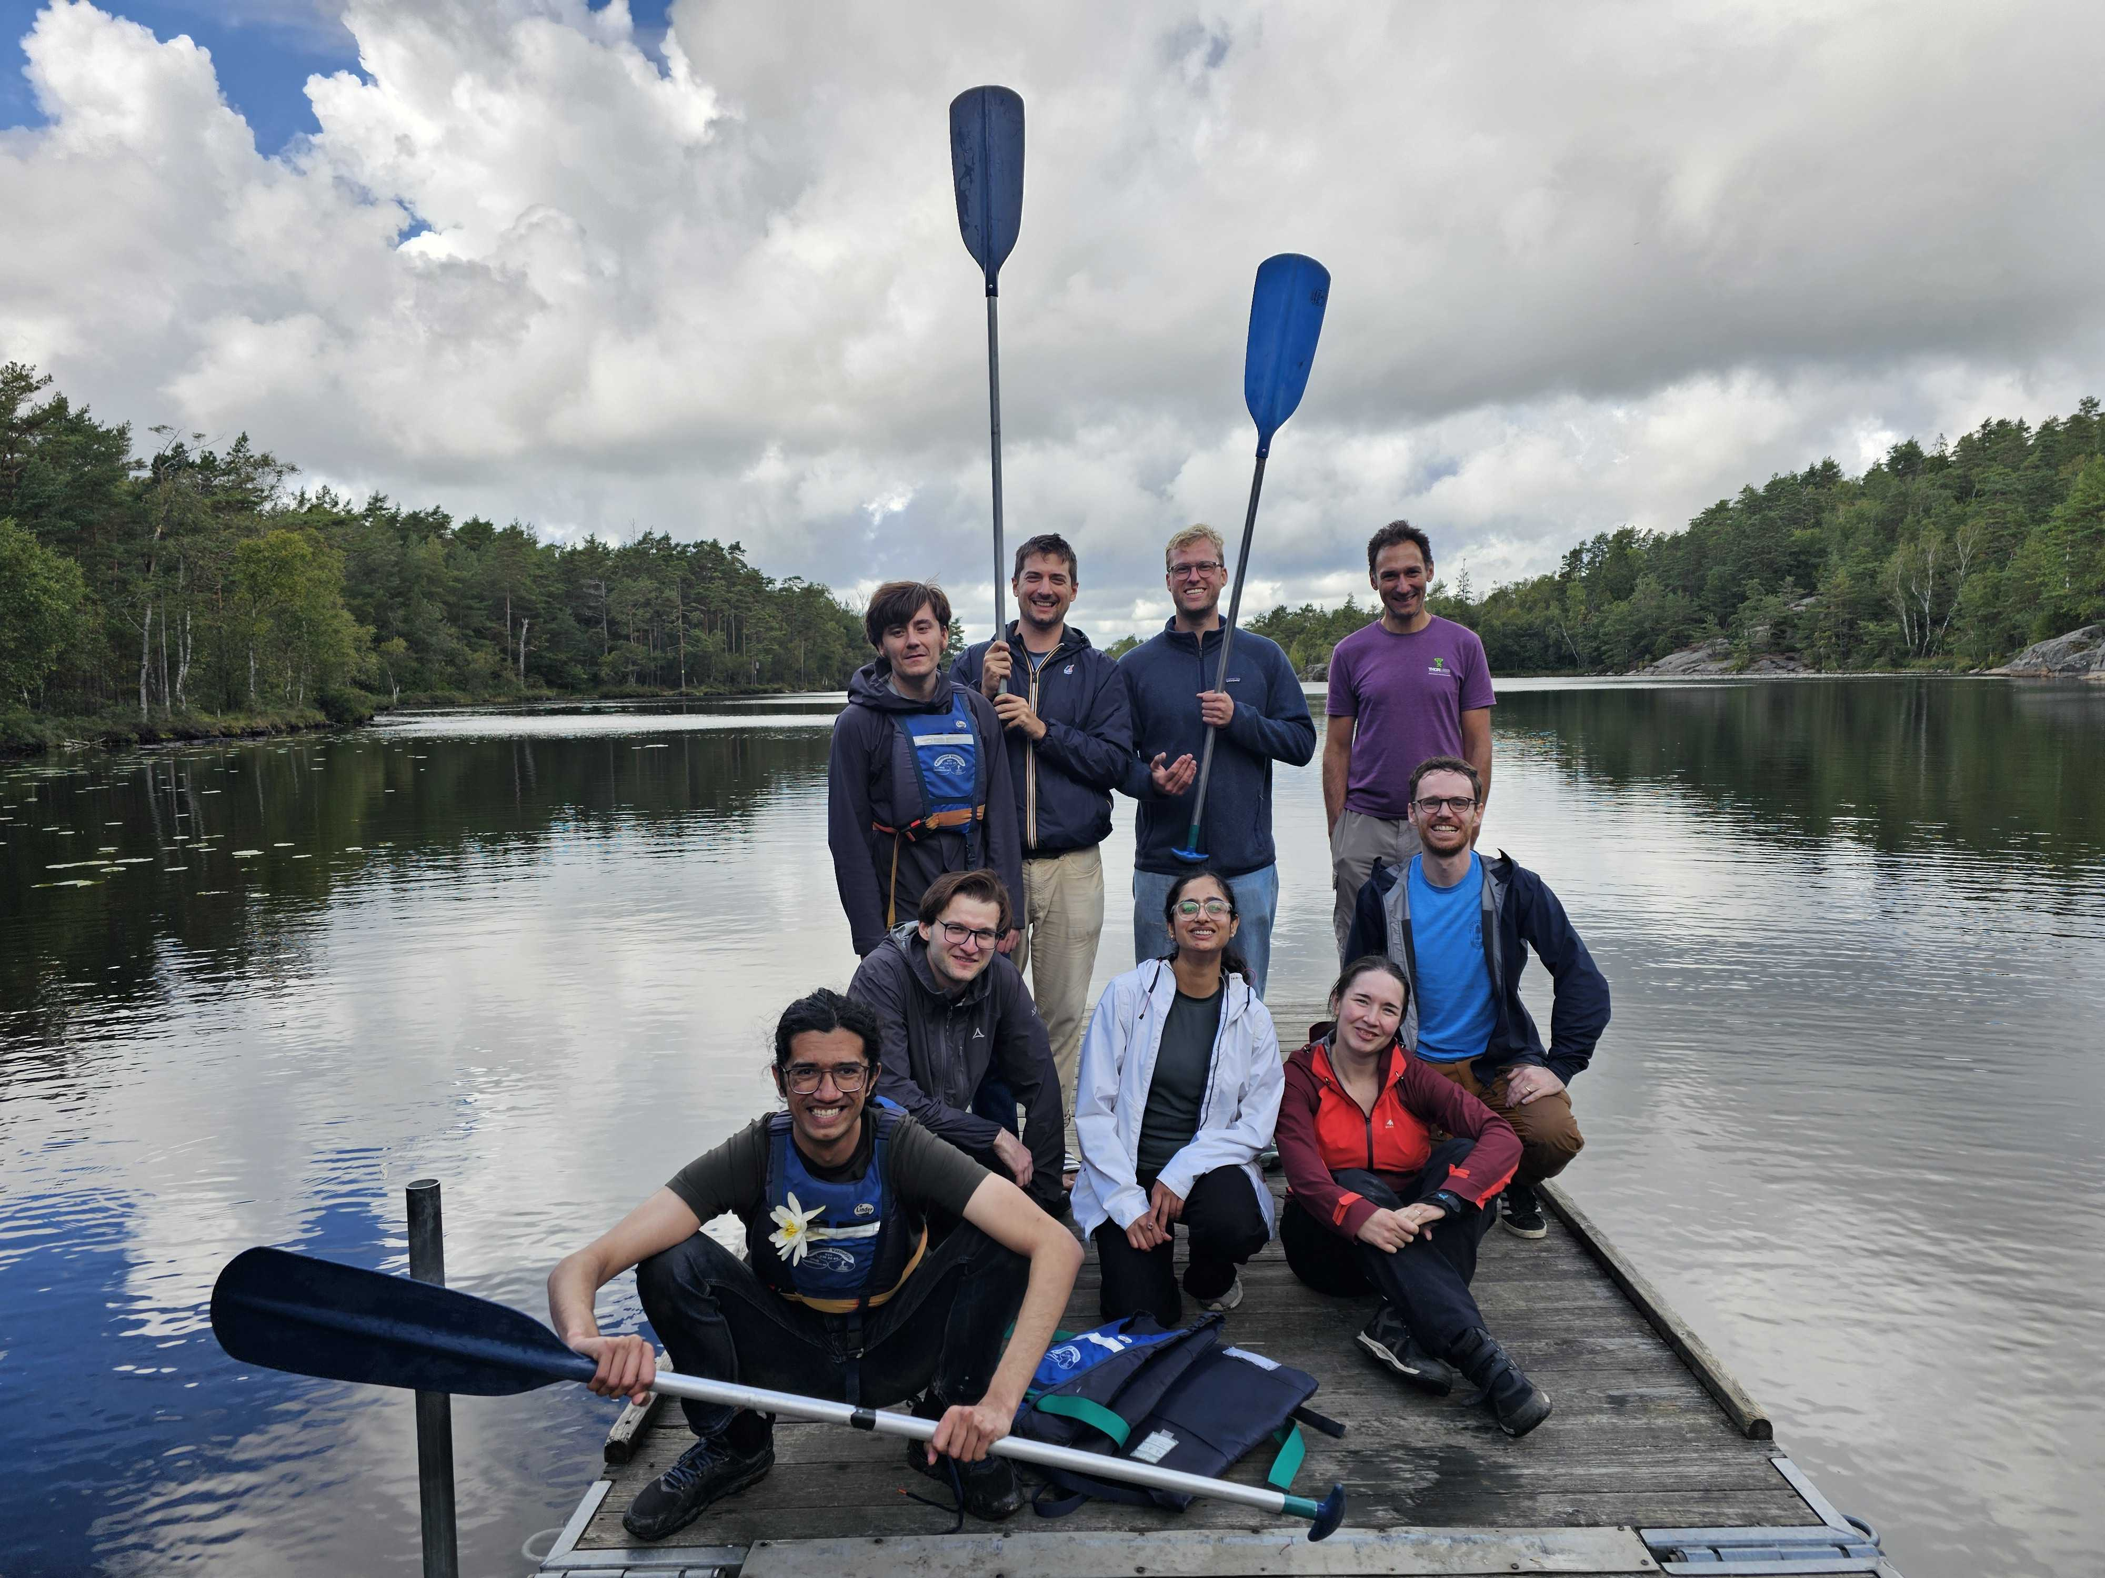


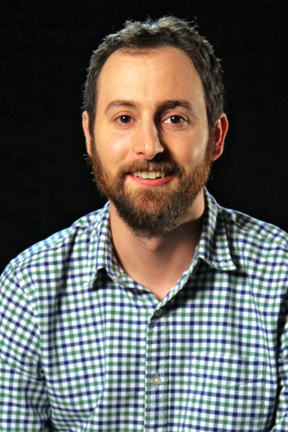
Outline
Chip-based magnetic levitation
Chalmers University of Technology
Microcalorimetry with levitated superconductors
Chalmers/MIT/Yale
Notes:
Talk of two halves
Work from group I’m in at Chalmers – Witlef
Chalmers in Göteborg
Rain
Work I’m doing with MIT/Yale on calorimety with levitated superconductors

Slide 3
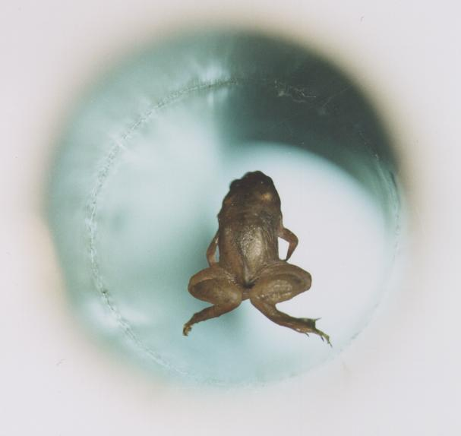
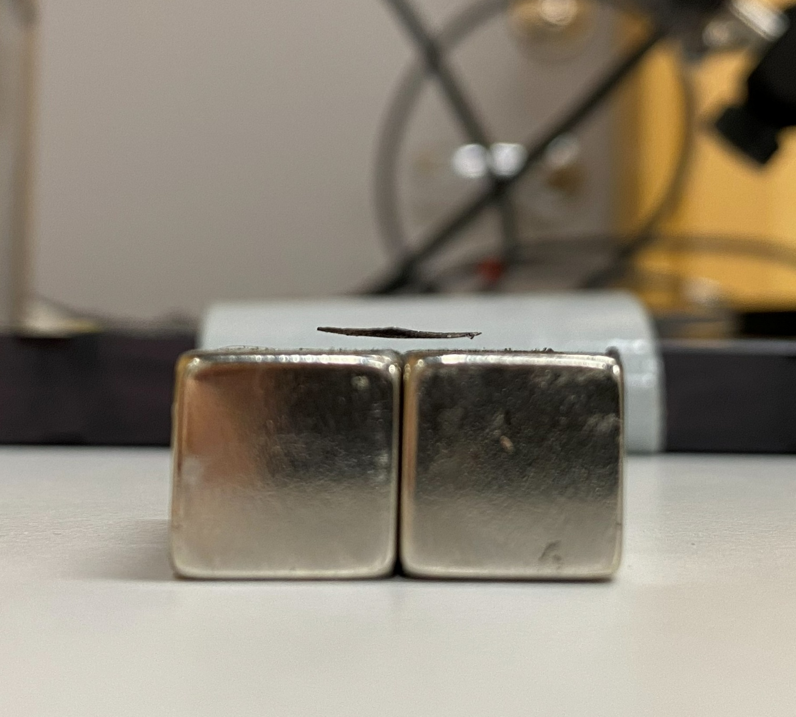
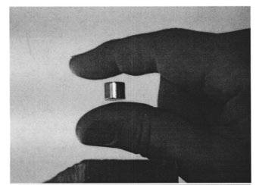
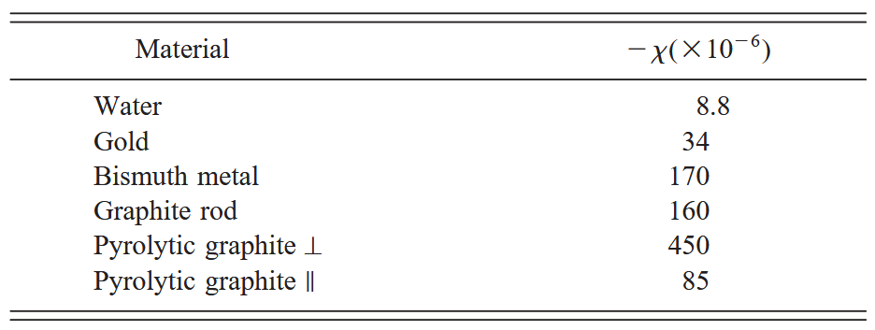
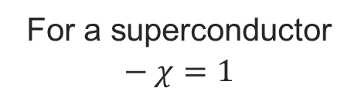
Magnetic levitation
For a superconductor
$$− χ=1$$
M. D. Simon et. al. Am. J. Phys. 69, 702–713 (2001)
Notes:
Static magnetic fields levitate diamagnets
Superconductors are perfect diamagnets – higher frequencies/lower fields
Use coils – tuneable
No back action from trapping field!!!
Typically detect with SQUID – can’t turn off
Use FTR or laser instead
Used for a looooong time in sensing

Slide 4
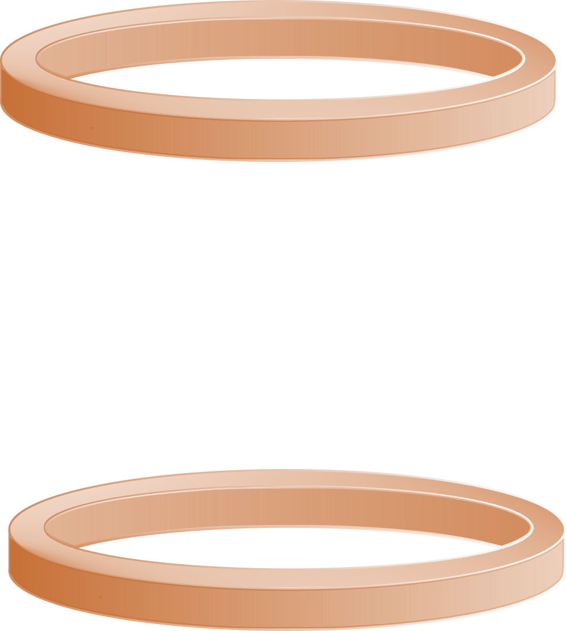

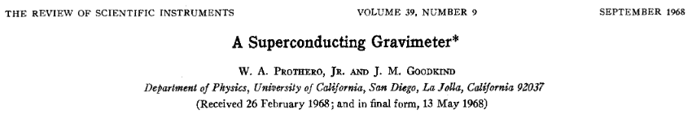
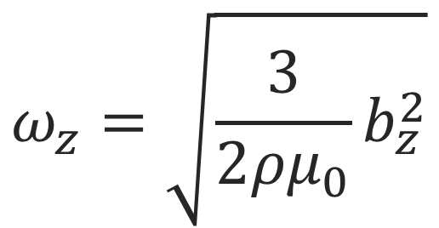
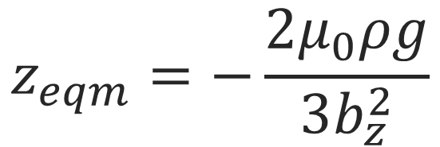
Magnetic levitation
The levitation field creates no back-action noise on the sphere
$$ω_{z}=\sqrt{\frac{3}{2ρμ_{0}}b_{z}^{2}}$$
$$z_{eqm}=−\frac{2μ_{0}ρg}{3b_{z}^{2}}$$
Notes:
Static magnetic fields levitate diamagnets
Superconductors are perfect diamagnets – higher frequencies/lower fields
Use coils – tuneable
No back action from trapping field!!!
Typically detect with SQUID – can’t turn off
Use FTR or laser instead
Used for a looooong time in sensing

Slide 5

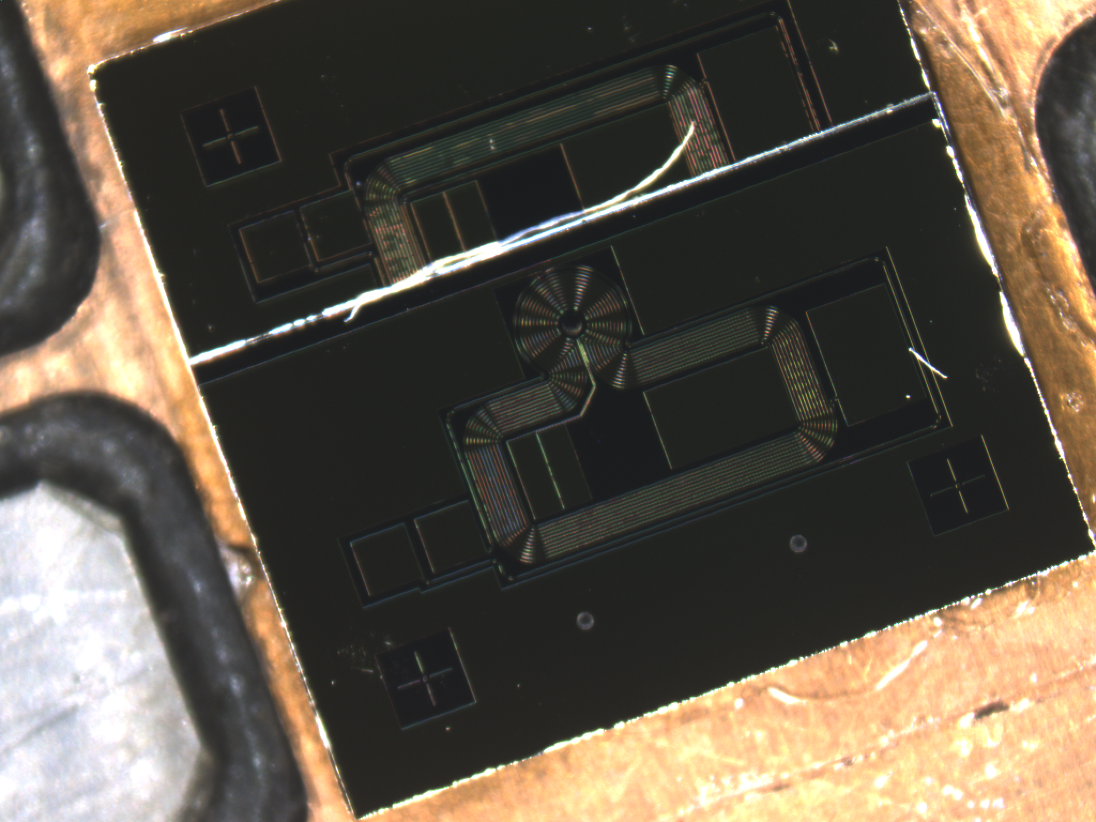
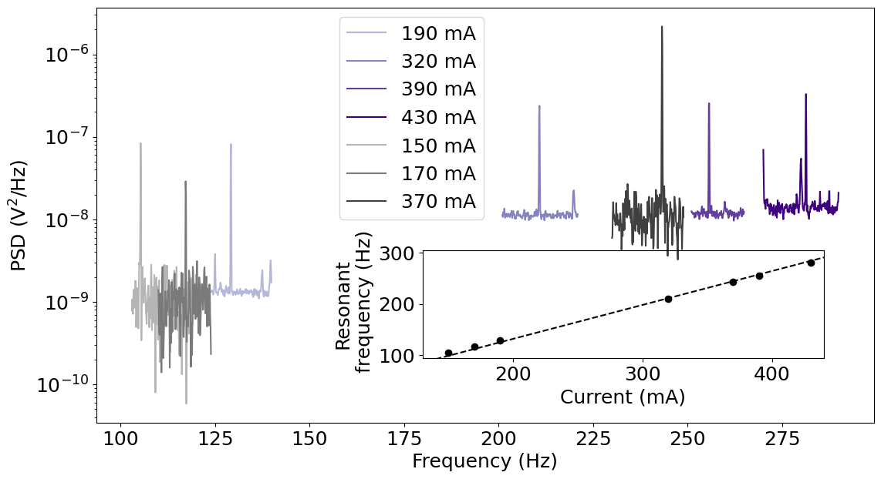
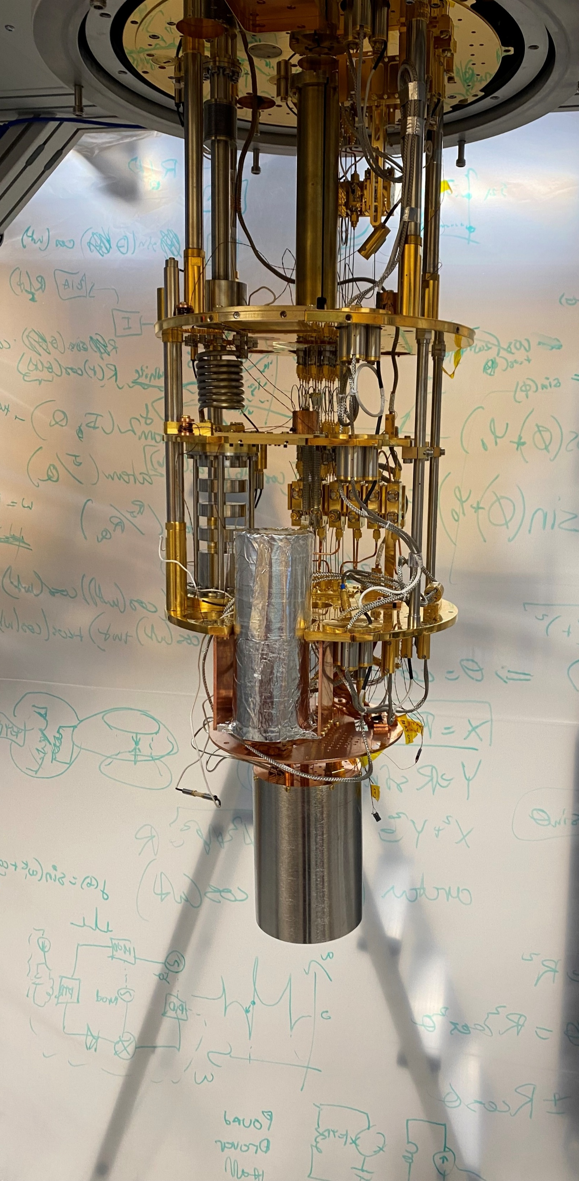
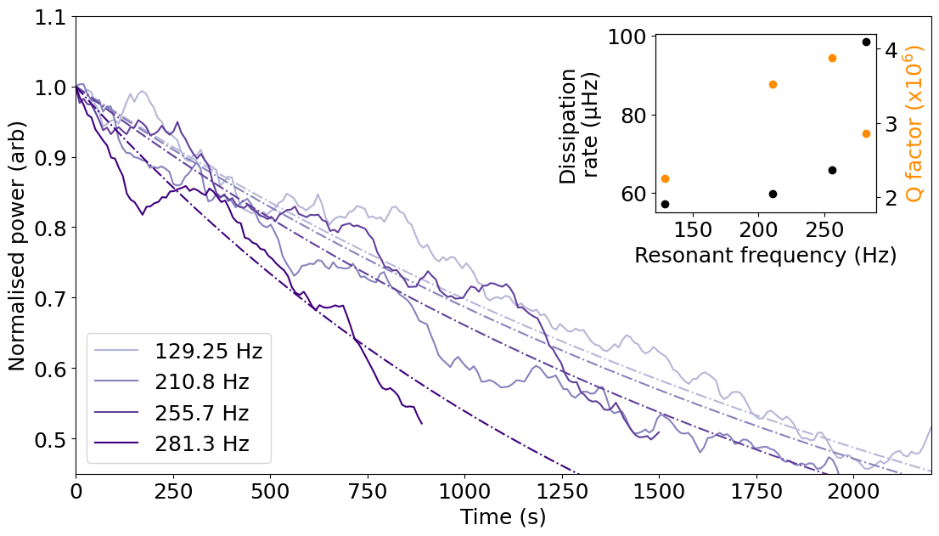
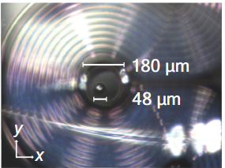
Chip-based magnetic levitation
Bottom coils
Trap centre
7 mm
Top coils
Vibration isolation stage
Sn63Pb37 Particle
Magnetic shielding
Notes:
Fabian leading
Explain chips
Zoom in – usually use lead-tin
In dil fridge
When levitates its great
Bz 50 T/m to 150 T/m
Dissipation <100 µHz

Slide 6
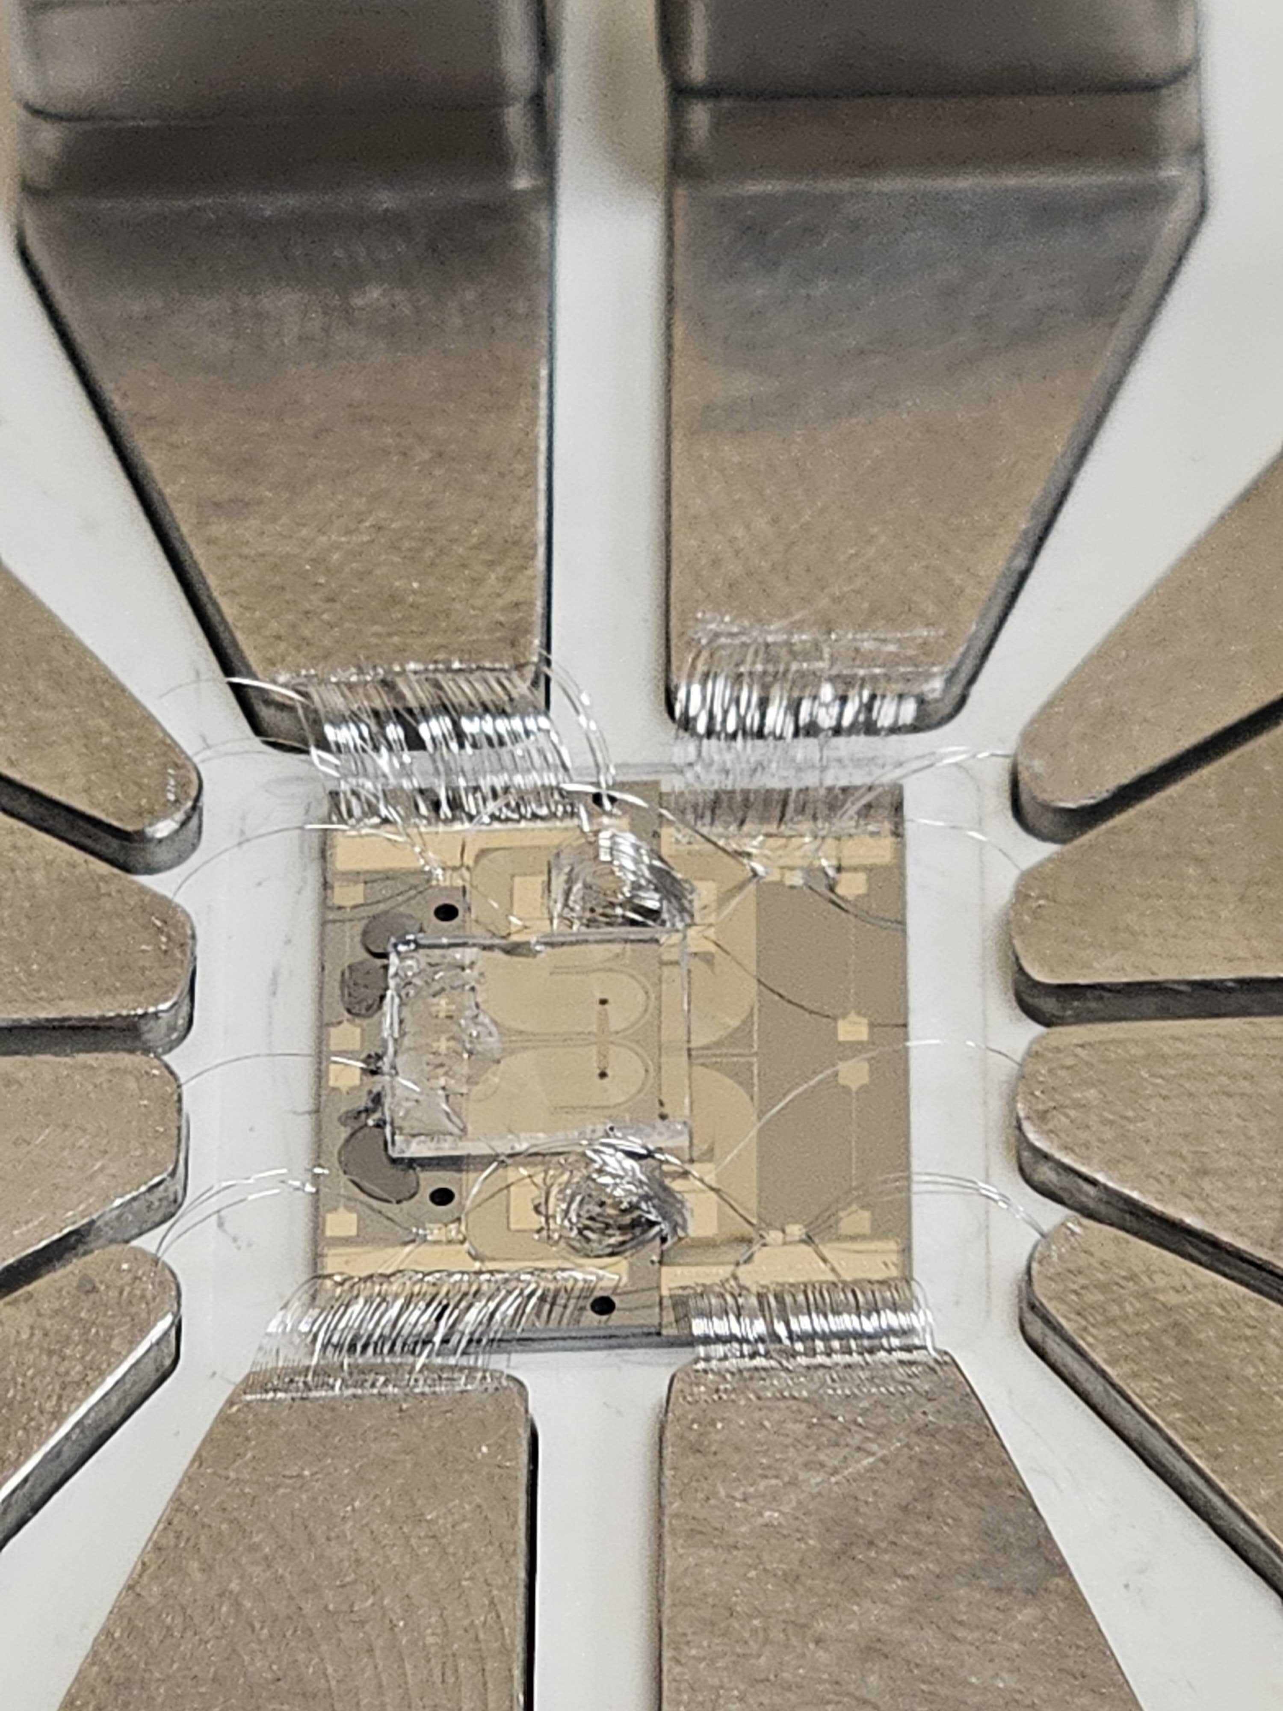


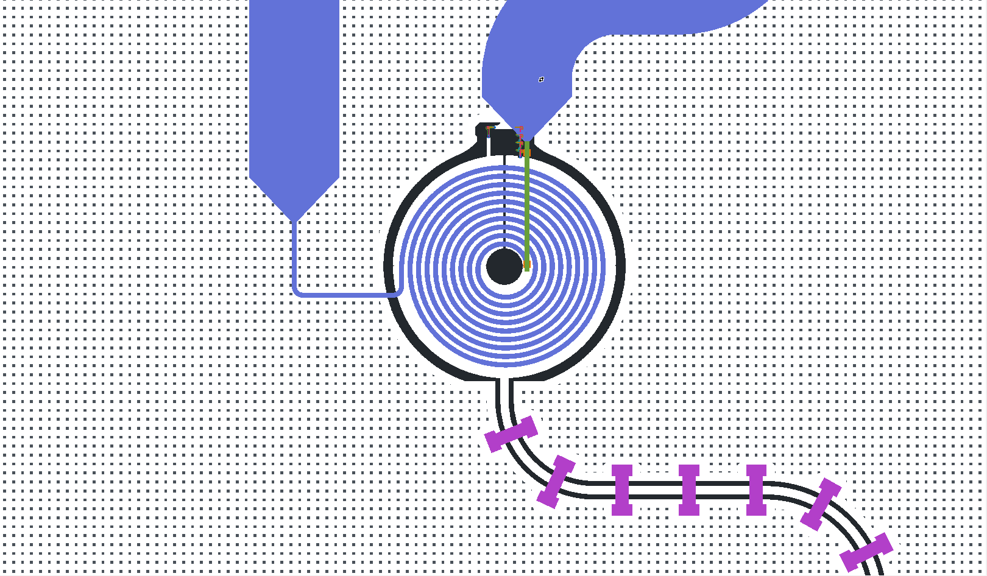
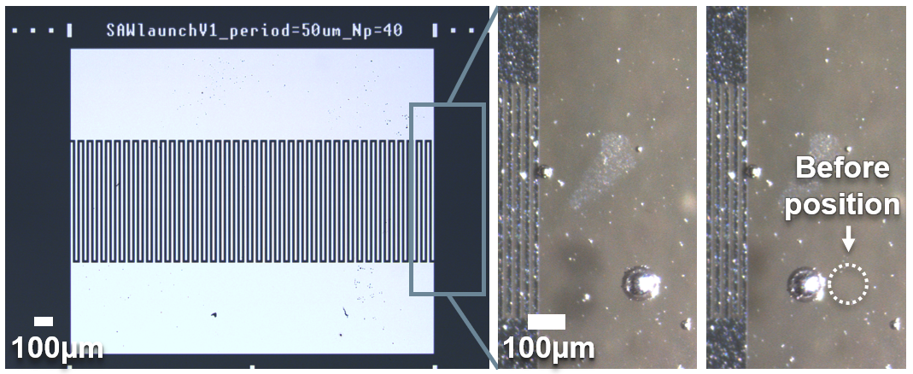
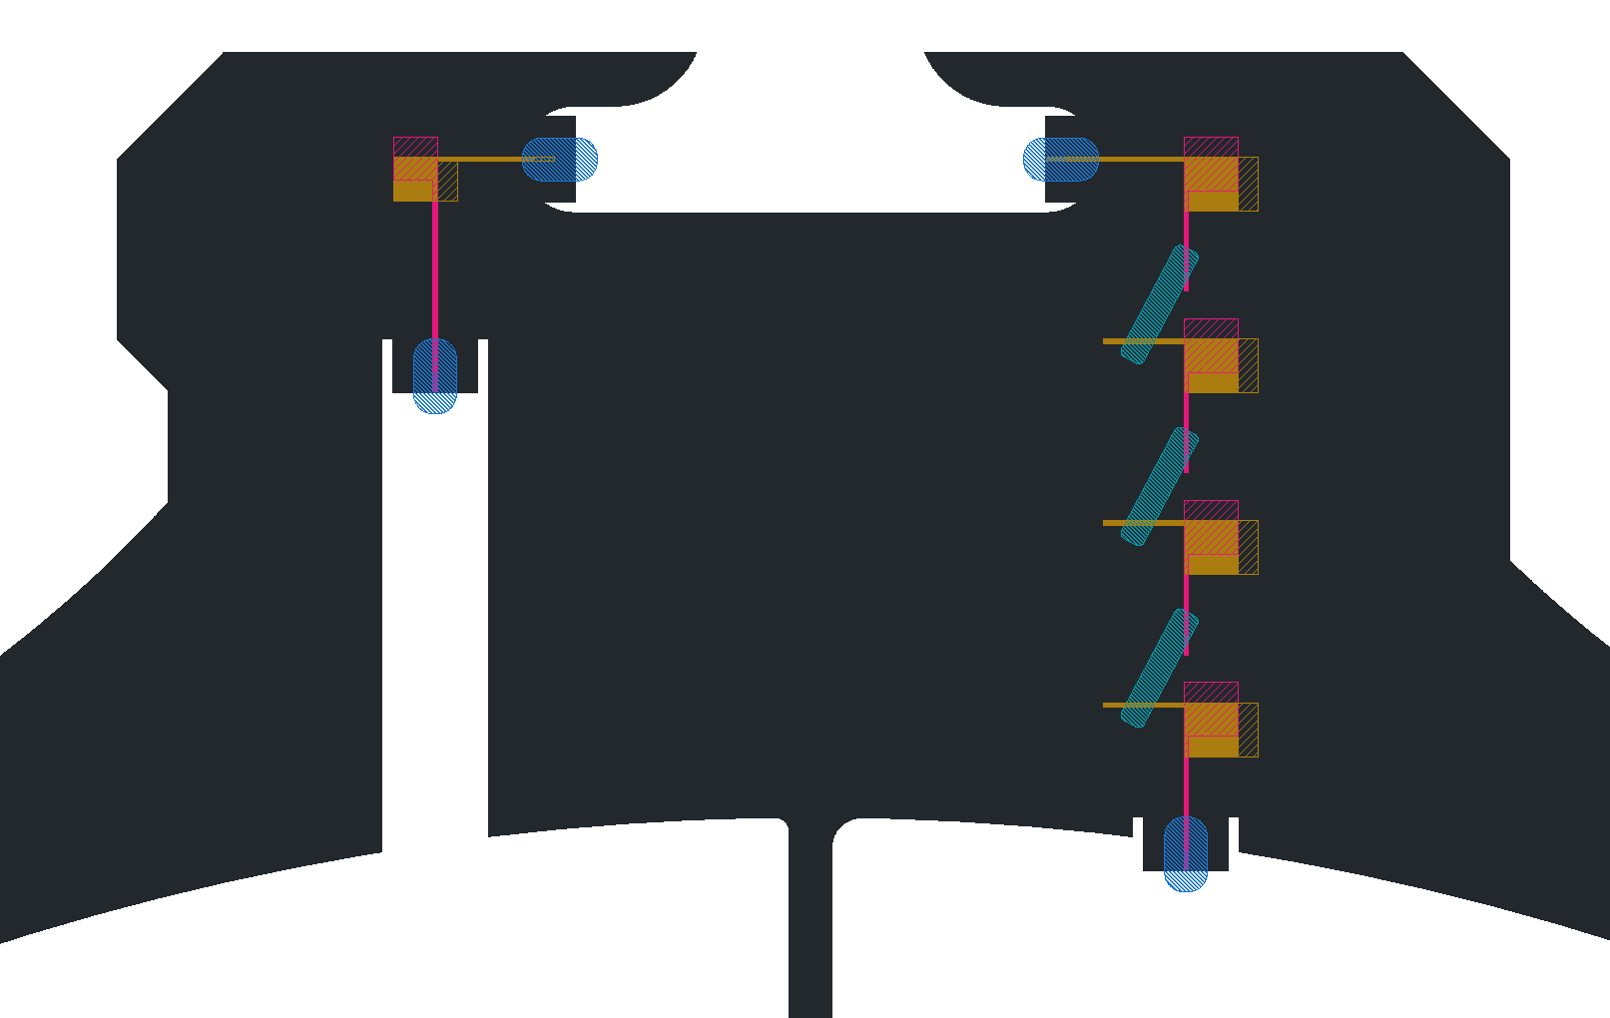
Current projects
Resonant circuits
SAW loading
Multi-trap chips
SNAIL loop
Input coil on flip chip
Josephson
junctions

Slide 7
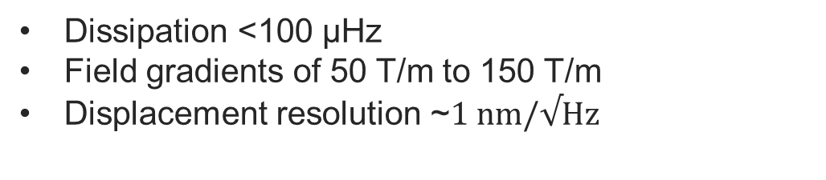
Summary
Current traps:
Dissipation <100 µHz
Field gradients of 50 T/m to 150 T/m
Displacement resolution ~$1 nm/√Hz$
Future traps:
Integrated SAW launchers
Multi-trap chips
Tunable resonators for displacement sensing

Slide 8
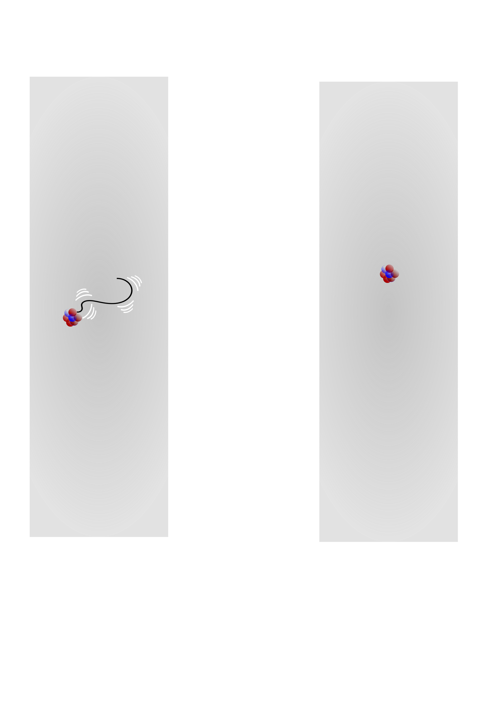
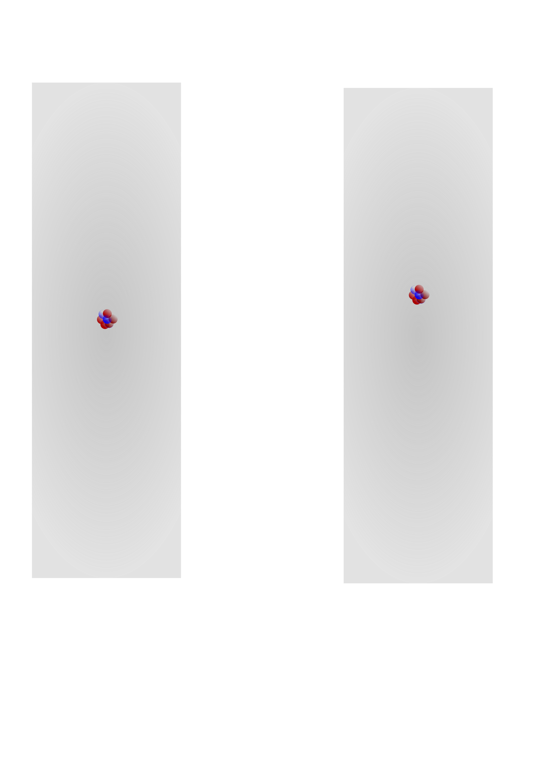
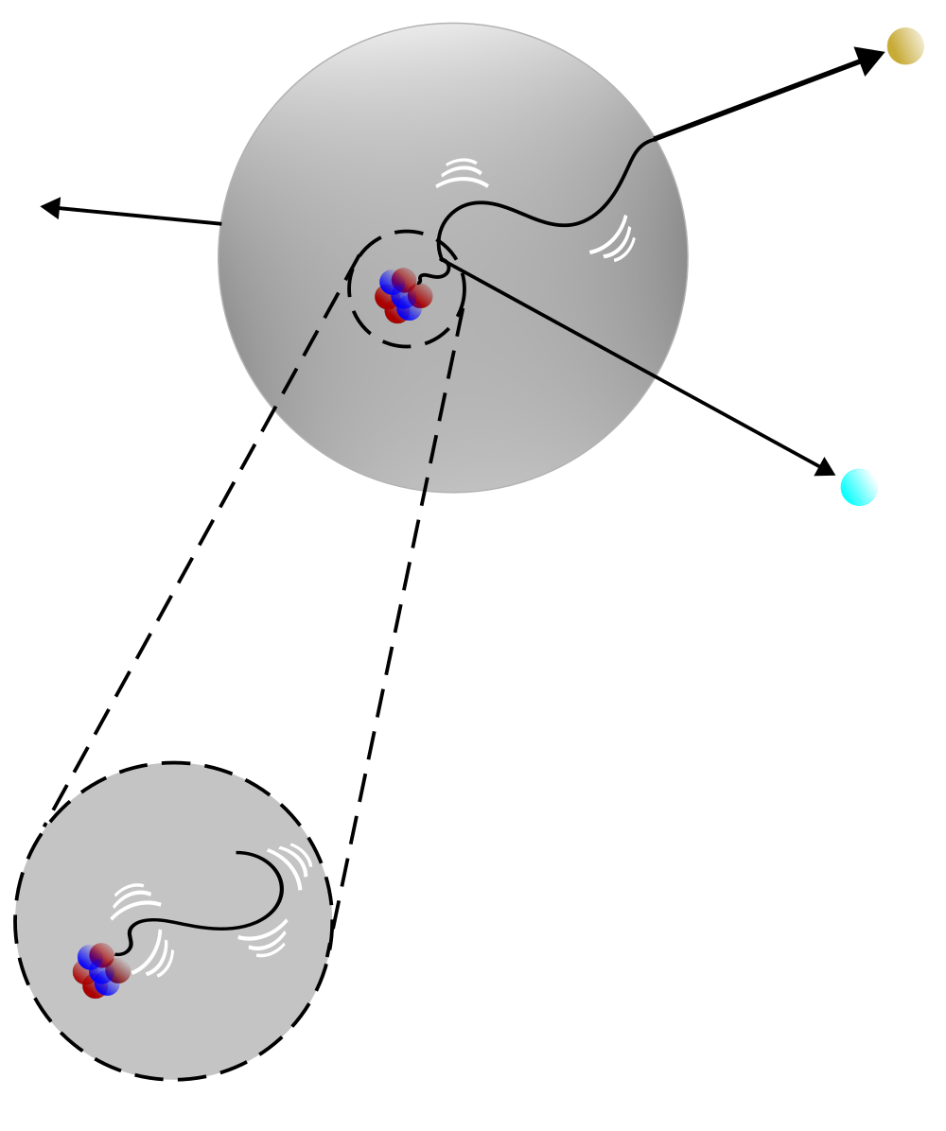









Energy measurement in nuclear decays
$$e^{−}$$
$$e^{−}$$
$$m$$
$$γ$$
$$ν_{e}$$
$$γ$$
$$ν_{e}$$
$$ν_{e}$$
Minimum phonon energy: ~30 meV

Slide 9
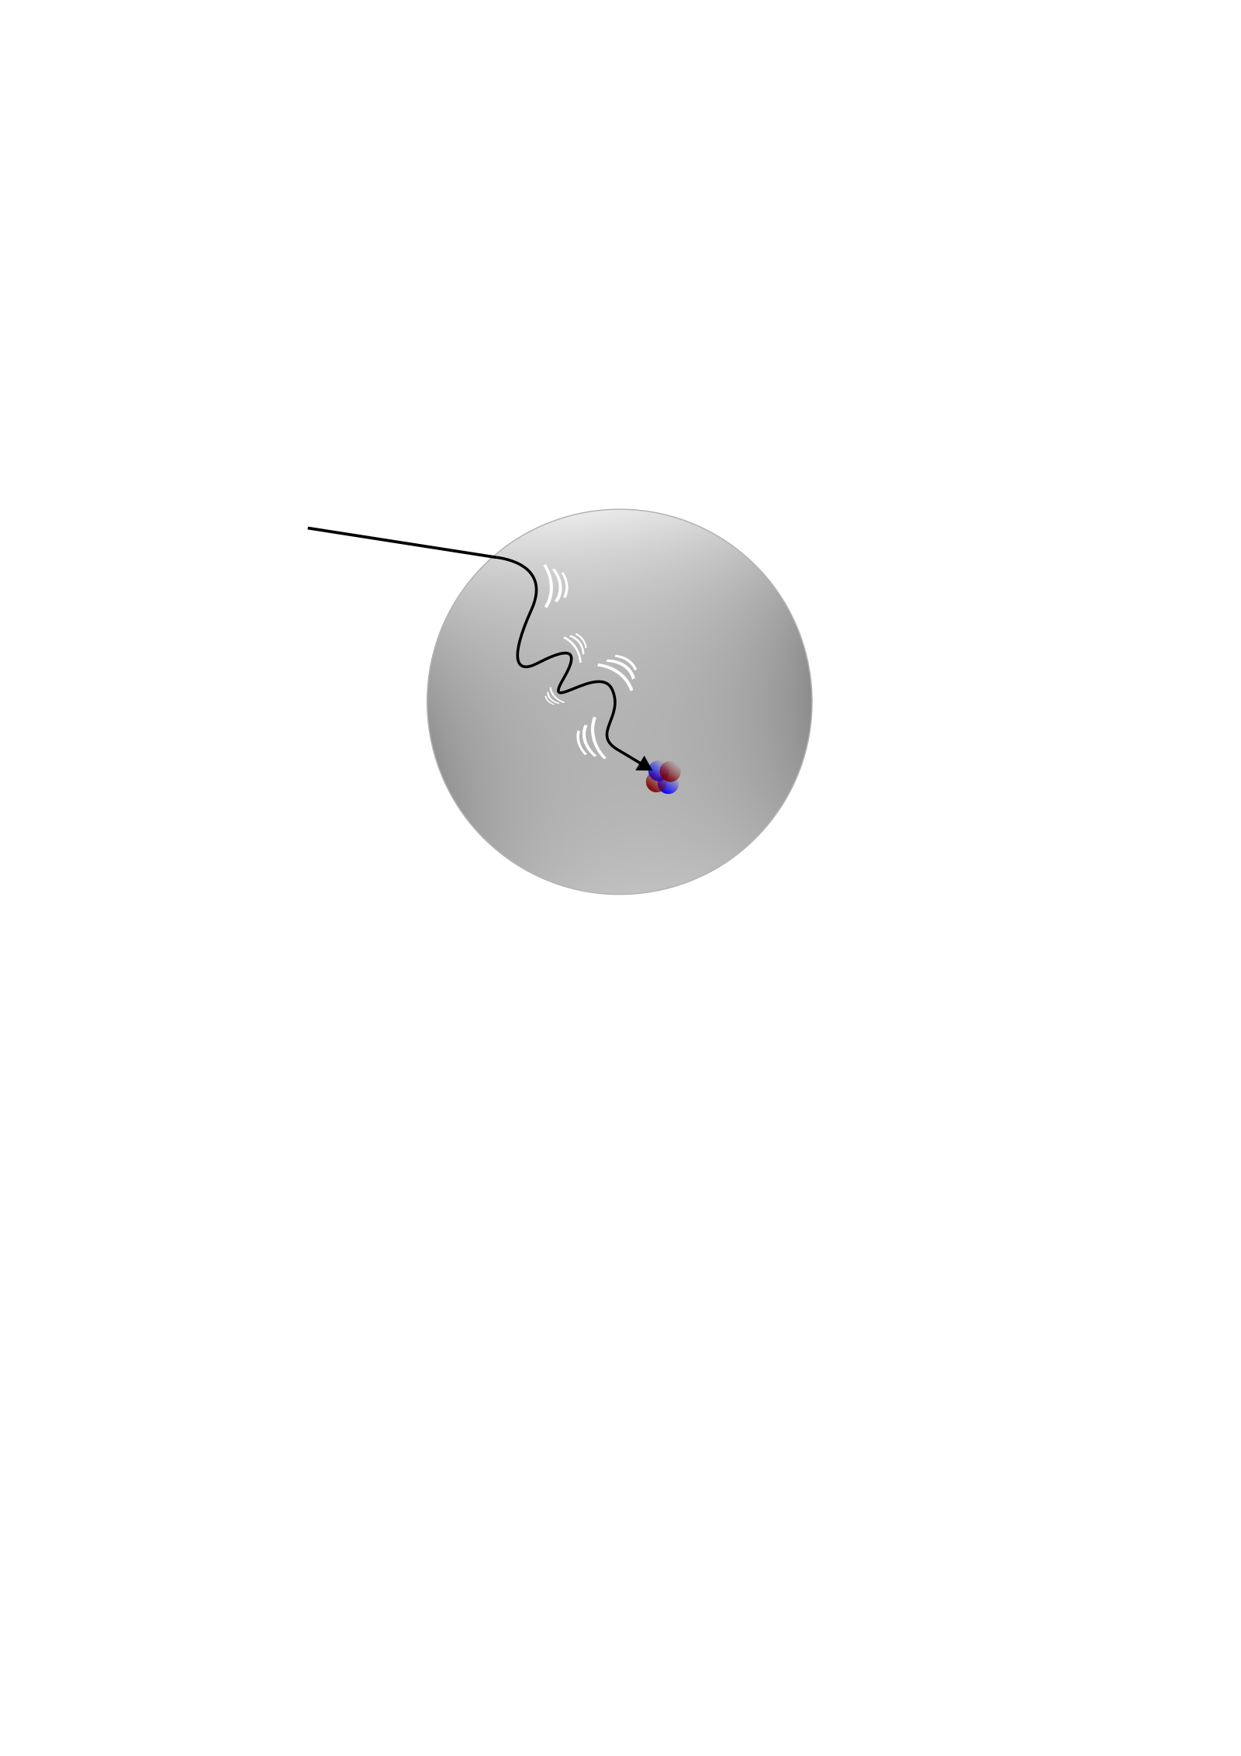
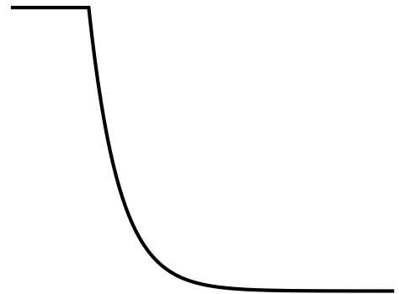

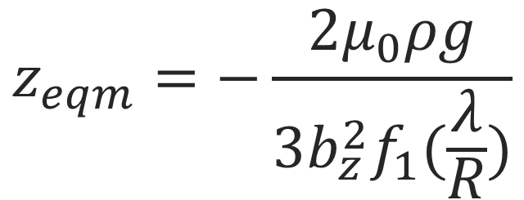
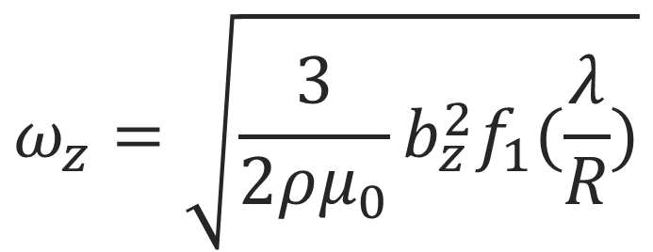
Microcalorimetry with levitated superconductors
$$R$$
$$ω_{z}=\sqrt{\frac{3}{2ρμ_{0}}b_{z}^{2}f_{1}(\frac{λ}{R})}$$
$${B_{0}e}^{−\frac{R−r}{λ}}$$
$$z_{eqm}=−\frac{2μ_{0}ρg}{3b_{z}^{2}f_{1}(\frac{λ}{R})}$$

Slide 10
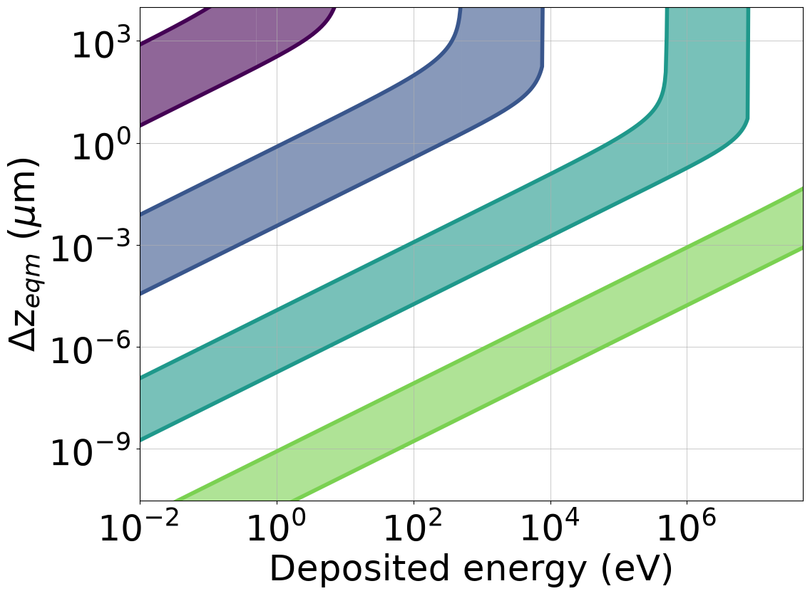
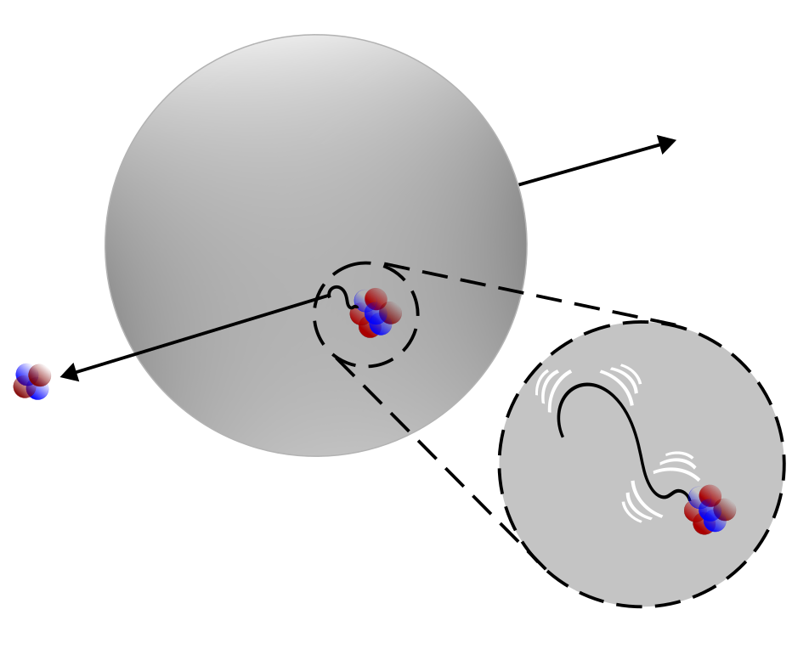
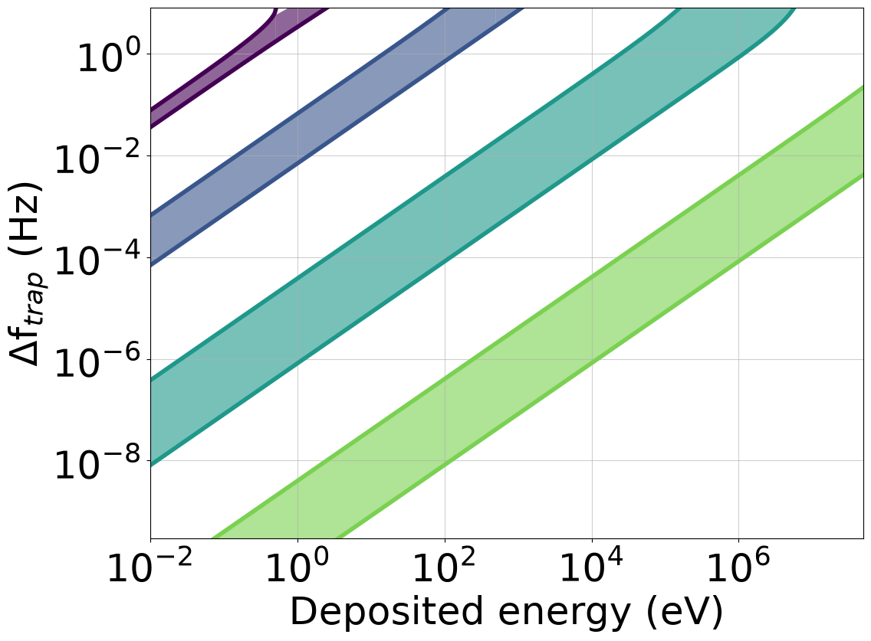
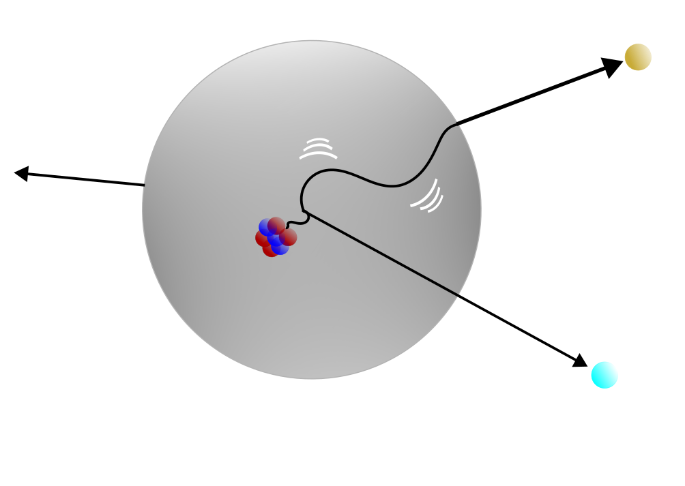


Energy depositions
50 nm
Impact from external alpha source
~MeV scale energy
Requires larger particle (>25 µm)
500 nm
Recoil from implanted alpha emitter
Alpha leaves with little interaction
~100 keV energy
$b_{z}=50$ T/m
Electron emitted from implanted isotope
Electron deposits energy as in leaves
~1 keV energy
5 µm
9.1 K
5 K
Nuclear recoil from implanted emitter
Beta leaves with little interaction
~eV scale energy
50 µm
$b_{z}=150$ T/m

Slide 11
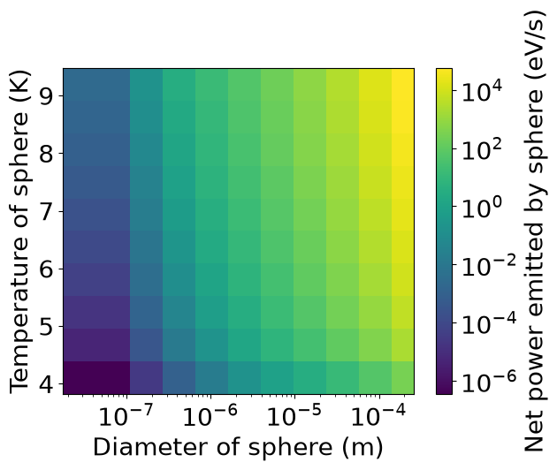
Blackbody radiation
10 MeV scale energy
10/0.1 s measurement
20000 s energy loss
Environment at 4K
BCS analysis (niobium)
100 keV energy
0.3/0.03 s measurement
50000 s energy loss
1 keV energy
50/0.3 s measurement
500 s energy loss
eV scale energy
50/0.3 s measurement
100 s energy loss
Notes:
Add contours
1)
60/200 eV/s energy loss
25/50 µm particle, 9.1K
0.1/0.02 Hz change, 20nm/10nm shift
2)
2 eV/s
5 µm particle, 9.1K
3 Hz/1µm shift
3)
2 eV/s
5 µm particle
0.02 Hz, 10nm shift
4)
200 meV/s / 10 meV/s energy loss
500 nm particle, 9.1 K/5 K
0.02 Hz, 10 nm shift

Slide 12
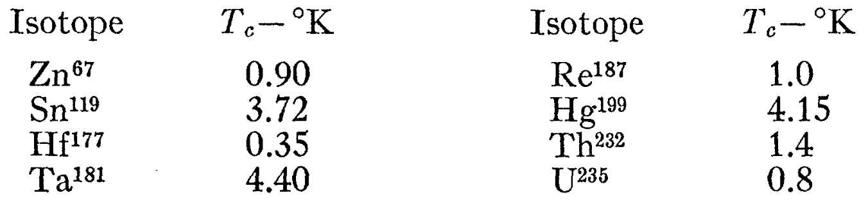
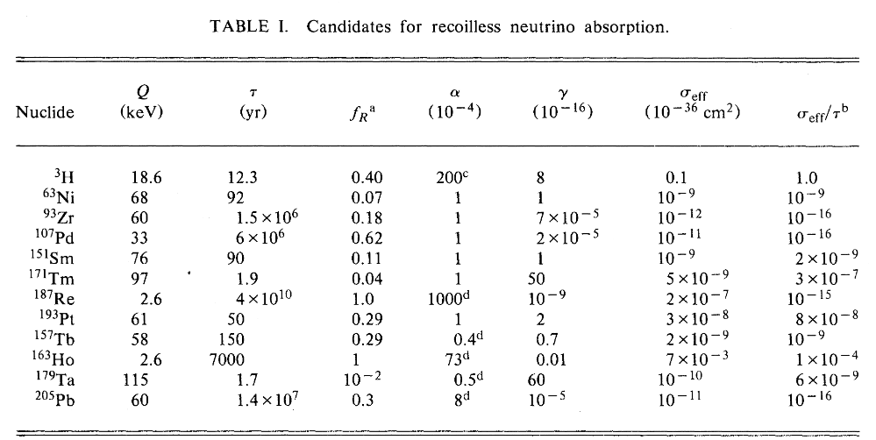
Mössbauer candidates
Superconducting materials that are candidates for recoiless gamma emission
M. Yaqub et. al., Phys. Rev., 127, 2028, 1962
W. Kells et. al., Phys. Rev. C, 28, 5, 1983

Slide 13
Outlook
Theory:
Analyse different superconducting materials
Identify promising nuclear decays
Experiment:
Can levitate larger spheres with required properties
Working towards levitating smaller spheres

Slide 14
Back-up slides

Slide 15
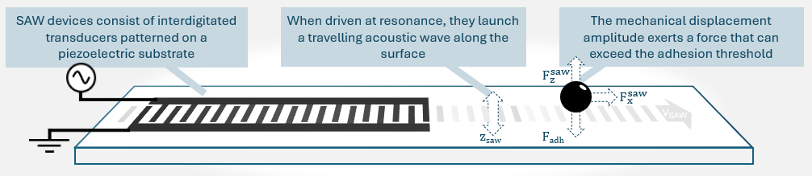
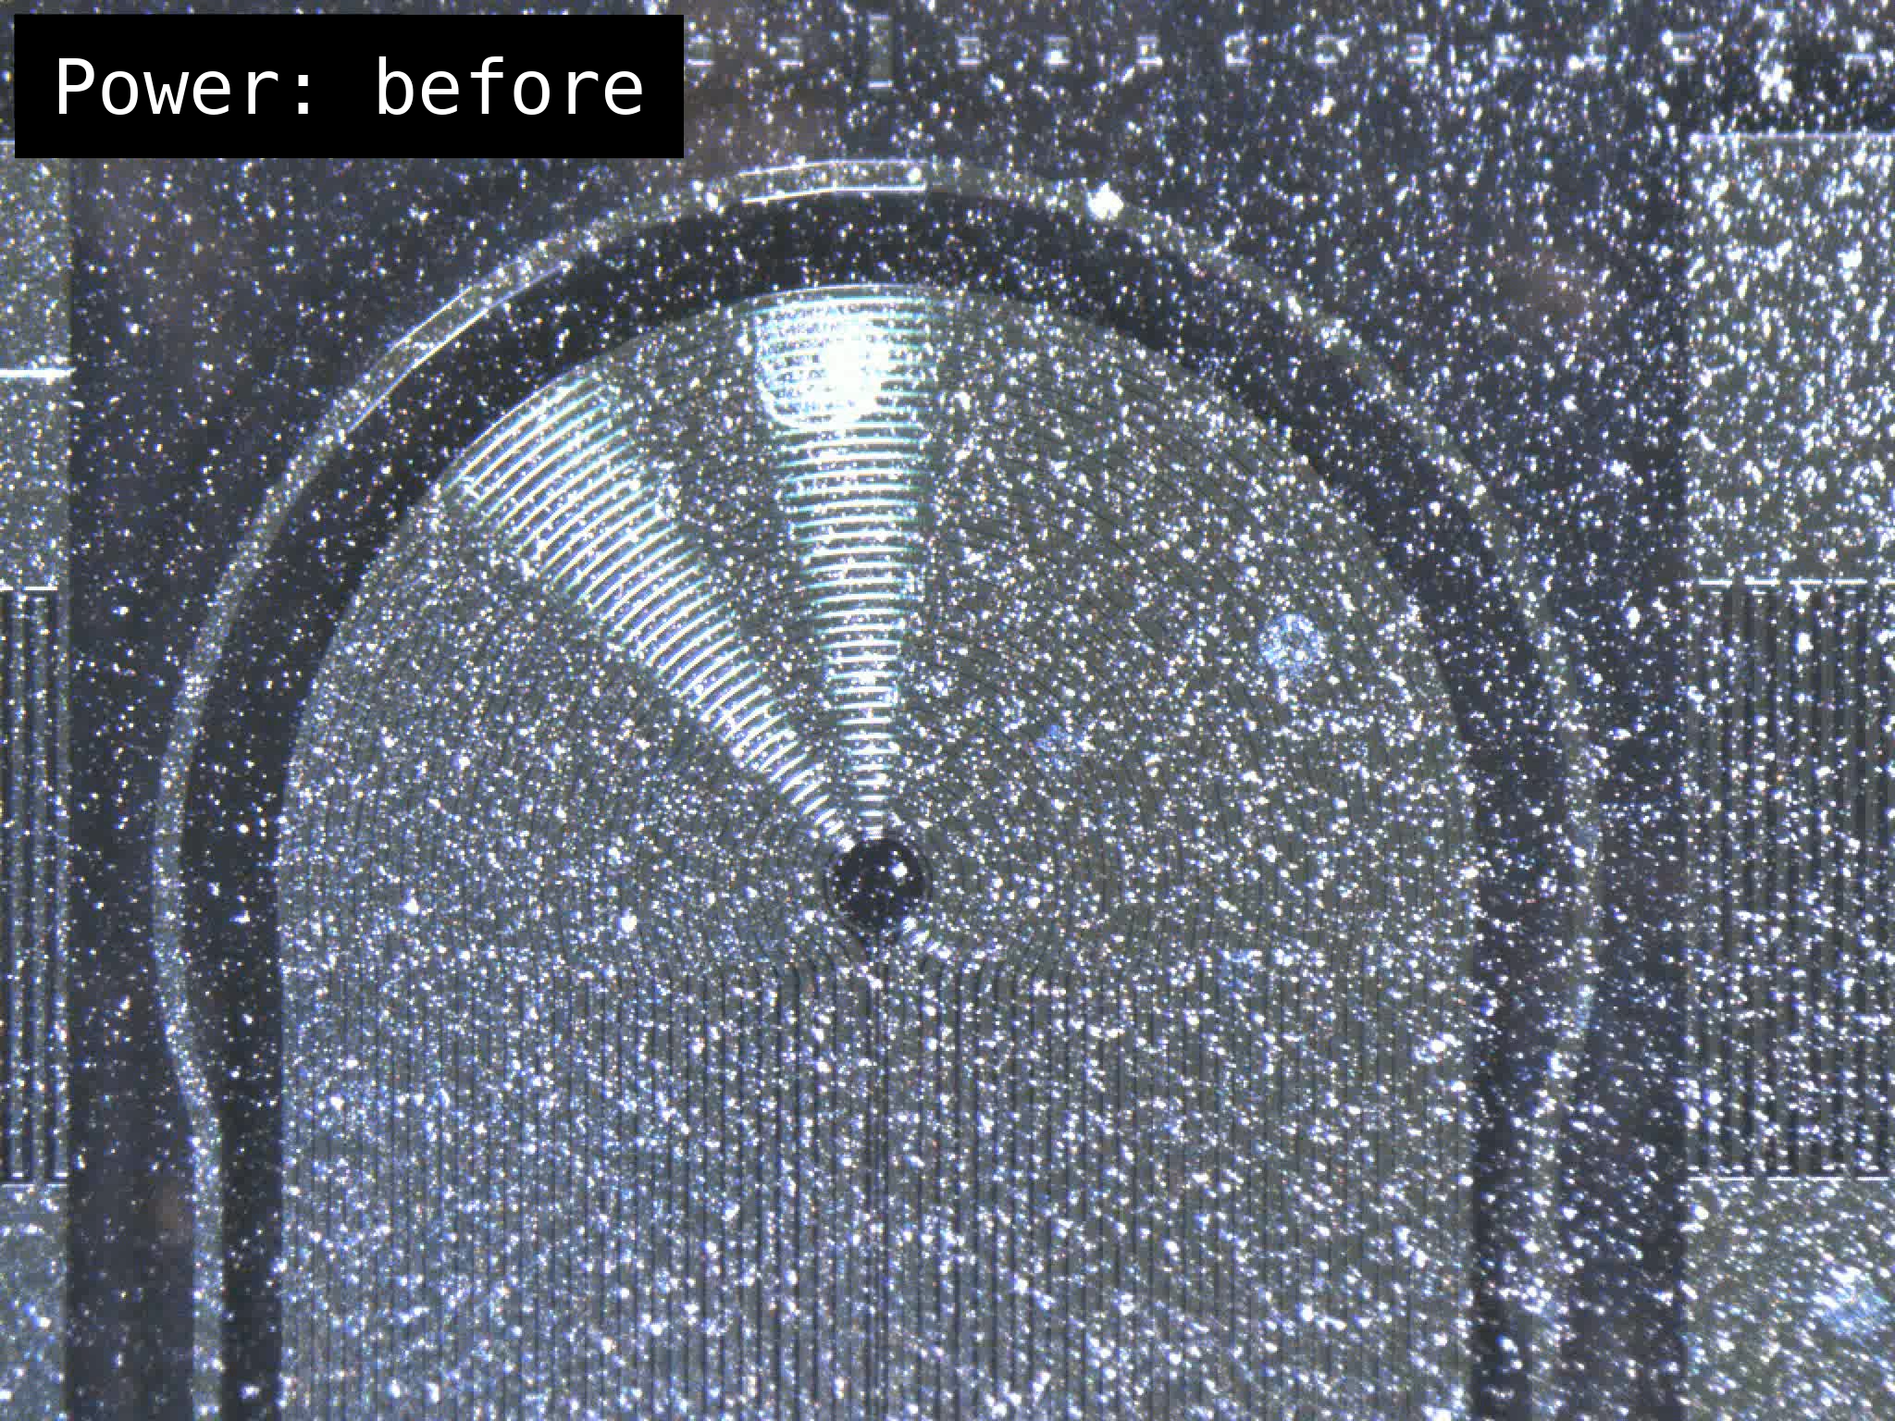
SAW launchers
Moving 100 μm particle
Moving 10 μm particles in trap

Slide 16
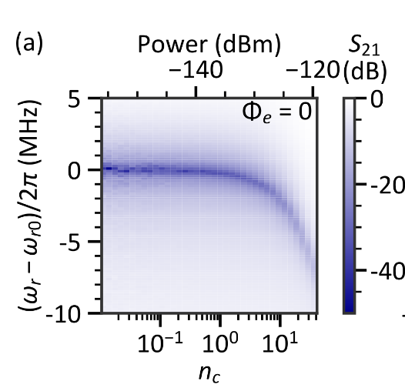

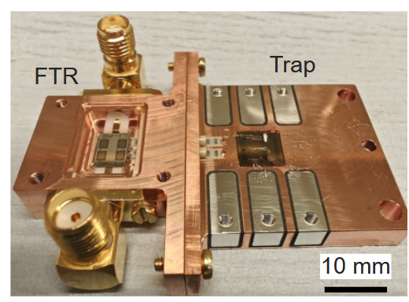
Tunable displacement detection
Flux-tunable resonator
SNAIL based FTR
SNAIL loop
Input coil on flip chip
Josephson
junctions
Notes:
2e-2 vs 4e-5

Slide 17
Multi-trap chips
Differential sensing
More detector mass
Mixed particle arrays
In phase
Out of phase
8.35 mm

Slide 18
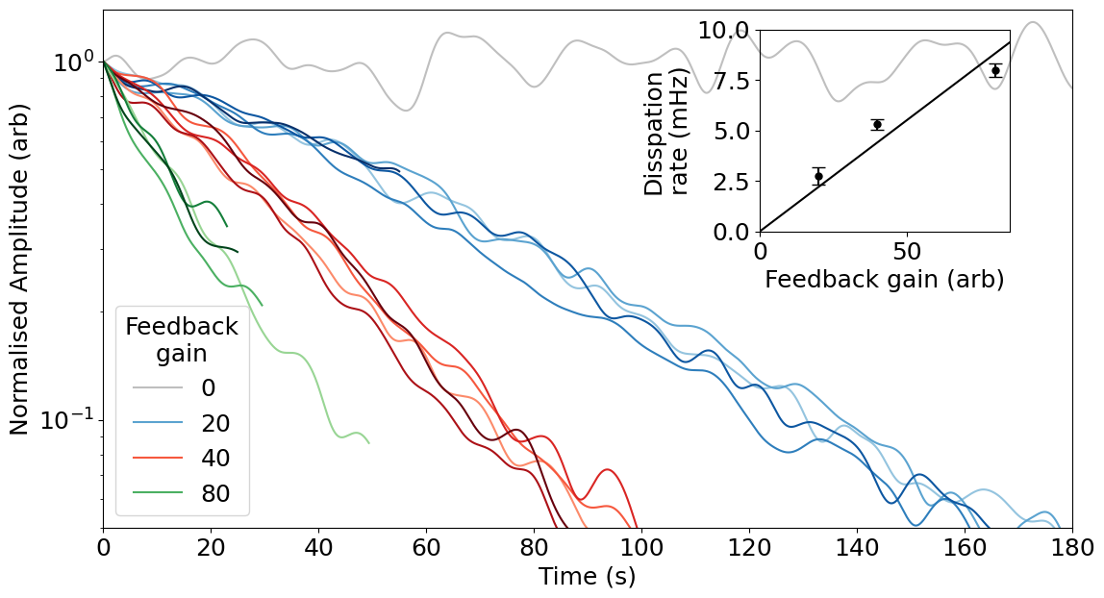
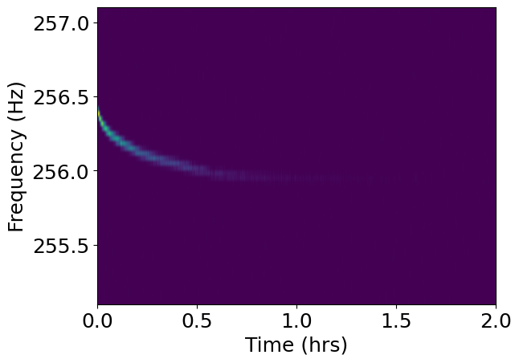
Cooling and non-linearity

Slide 19
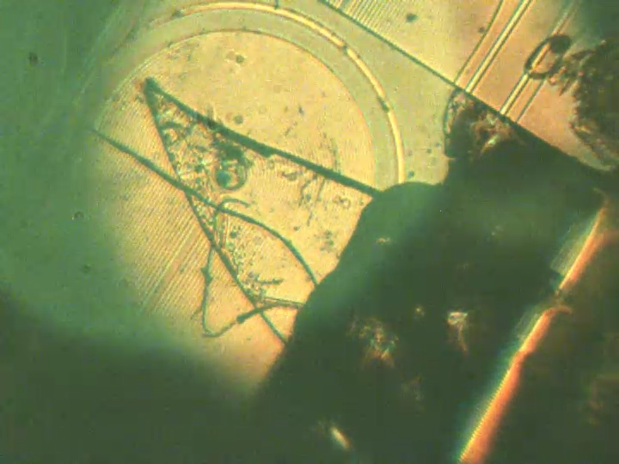
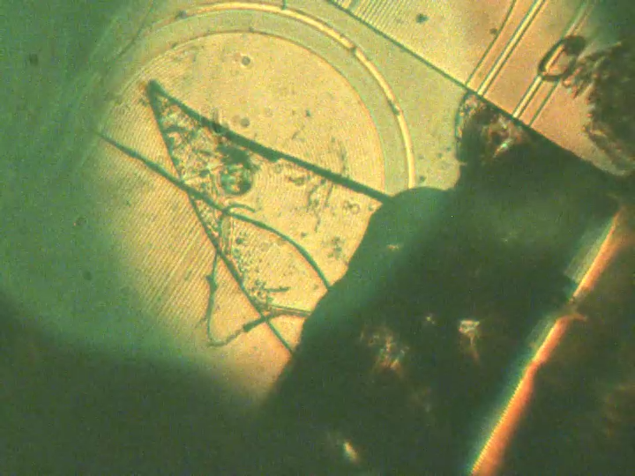
Levitation in 4K I

Slide 20
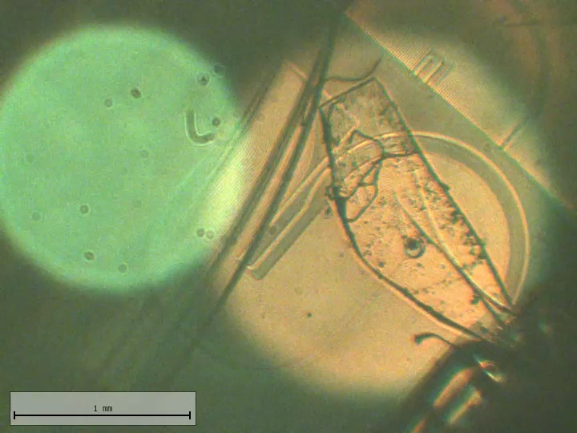
Levitation in 4K II

Slide 21
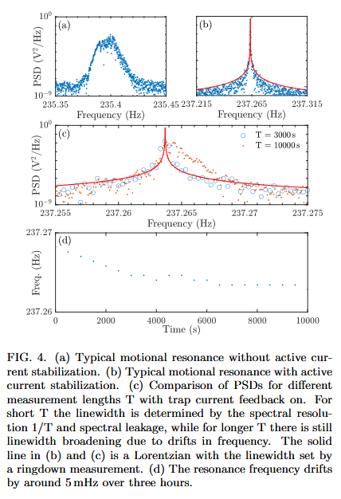

Are these measurable?
Q-factor?
Displacement resolution?
$$1 nm/√Hz$$
Displacement drift?
Frequency stability?
Energy loss?

Slide 22
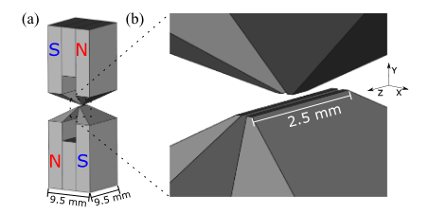
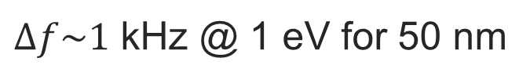
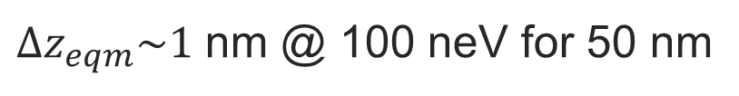
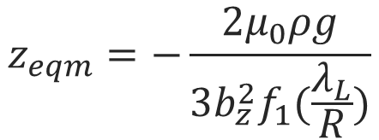







Pushing the limits
Permanent magnet trap
$b_{z}\sim {10}^{4}$ T/m
$$ω_{z}=\sqrt{\frac{3}{2ρμ_{0}}b_{z}^{2}f_{1}(\frac{λ_{L}}{R})}$$
$f\sim$ 20 kHz
$Δf\sim 1$ kHz @ 1 eV for 50 nm
$Δf\sim 1$ mHz @ 1 µeV for 50 nm
B. R. Slezak et. al., NJP, 20, 6, 2018
$b_{z}\sim 5$ mT/m
$$z_{eqm}=−\frac{2μ_{0}ρg}{3b_{z}^{2}f_{1}(\frac{λ_{L}}{R})}$$
$f\sim$ 10 Hz
$Δz_{eqm}\sim 10$ mm @ 1 eV for 50 nm
$Δz_{eqm}\sim 1$ nm @ 100 neV for 50 nm
Notes:
Need sub-micron particle for top
Need better detection for bottom

Slide 23
Different materials
Material | Specific heat capacity at low T | Critical temperature
Lead | 0.0115 T^3 J/kg/K | 7.2 K
Niobium | 0.0015 T^3 J/kg/K | 9.2 K
Tantalum | 7e-4 T^3 J/kg/K (vibrational) | 4.48 K
Aluminium | 0.1 T^3 J/kg/K | 1.2 K
Tin | 0.006 T^3 J/kg/K (vibrational) | 3.72 K

Slide 24



Lead
50 nm
500 nm
Eliashberg analysis (lead)
7.1 K
5 µm
50 µm
4 K

Slide 25



Will the material being superconducting affect the recoiless emission?

Slide 26

Different models – energy depositions

Slide 27

How to scale down traps

