Slide 1









Response of a Fabry-Perot optical trap to a gravitational wave:
The case for fully relativistic detector analyses
Andrew Laeuger (Caltech), Nancy Aggarwal (University of California, Davis), and the LSD Collaboration (Northwestern University, Clarkson University)
Optomechanical Sensing for Subatomic and Astroparticle Physics, Kingston, ON, Canada, Sep 2026

Slide 2
Gravitational-Wave Response of Optically Levitated Sensors in Fabry–Pérot Cavities
Abstract:
Optically levitated sensors inside a Fabry–Pérot cavity have been proposed for high-frequency gravitational-wave detection, but their optimal configuration exhibits a counterintuitive spatial asymmetry. We provide a fully relativistic derivation of the interaction between a gravitational wave and a levitated object in an optical cavity, demonstrating that the GW response is maximized when the sensor is located near the input mirror. We then explain this asymmetry from multiple gauge perspectives and highlight some important consequences for noise couplings in the experiment. Finally, we consider finite-sized dielectric sensors and show that even with modest dimensions, the dielectric can substantially modify the cavity fields, impacting both the optical trapping frequency and system transfer functions.

Slide 3
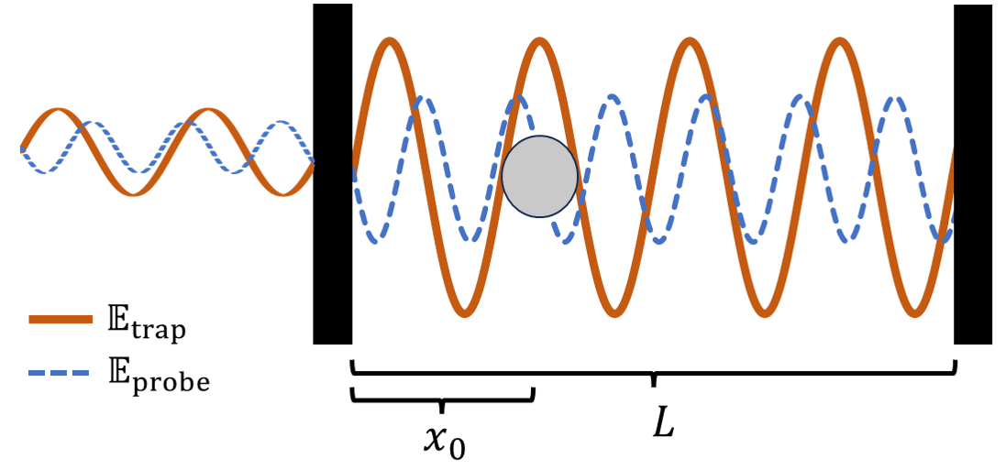
Levitated sensors for high frequency GW detection
Levitated sensors are a promising platform for searches for high frequency GWs
  GW displaces the optical trap site, inducing driving force on sensor

Slide 4
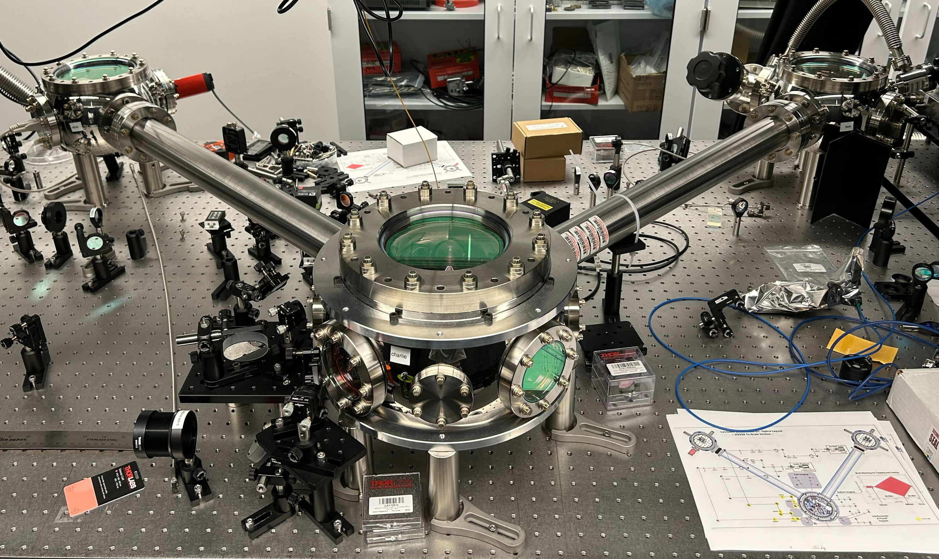
Levitated sensors for high frequency GW detection
Levitated sensors are a promising platform for searches for high frequency GWs
  GW displaces the optical trap site, inducing driving force on sensor
  Inherently narrowband detection concept, but the band can be scanned
    A few tens to hundreds of kHz is possible by varying sensor mass, laser power

Slide 5
Relativistic response in small particle limit
How can we derive the GW-induced displacement of the trap potential minimum relative to a levitated sensor?
arXiv:2603.07302

Slide 6
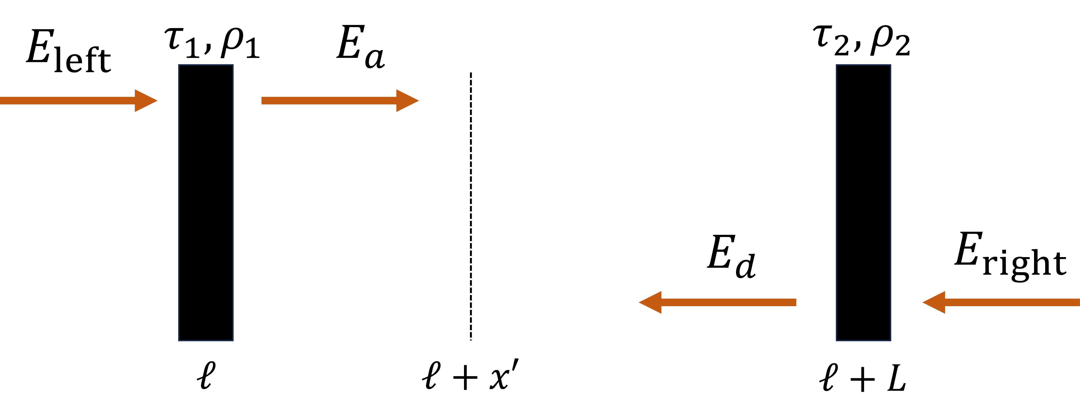
Relativistic response in small particle limit
How can we derive the GW-induced displacement of the trap potential minimum relative to a levitated sensor?
arXiv:2603.07302

Slide 7
Relativistic response in small particle limit
How can we derive the GW-induced displacement of the trap potential minimum relative to a levitated sensor?
$$E_{a}\left(t\right)=τ_{1}E_{left}\left(t\right)−ρ_{1}E_{d}\left(t−T\left(ℓ+L,ℓ\right)\left[t\right]\right),$$
arXiv:2603.07302

Slide 8

Relativistic response in small particle limit
How can we derive the GW-induced displacement of the trap potential minimum relative to a levitated sensor?
$$E_{a}\left(t\right)=τ_{1}E_{left}\left(t\right)−ρ_{1}E_{d}\left(t−T\left(ℓ+L,ℓ\right)\left[t\right]\right),$$
a
$$E_{d}\left(t\right)=−ρ_{2}E_{a}(t−T(ℓ,ℓ+L)[t]),$$
arXiv:2603.07302

Slide 9
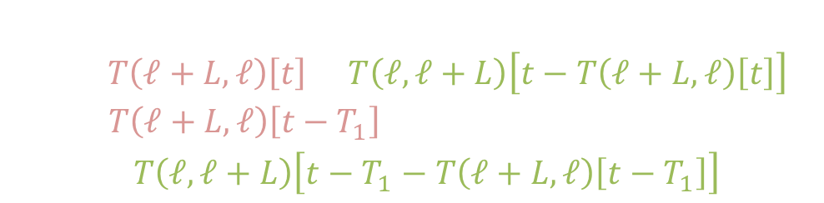
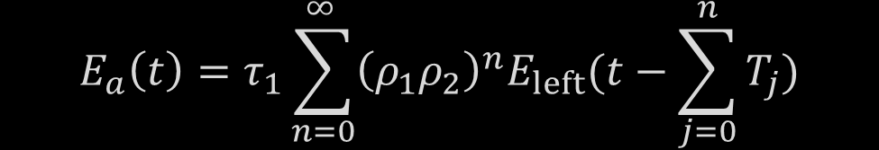
Relativistic response in small particle limit
$$\begin{aligned}\begin{aligned}&T_{0}=0, \\ &T_{1}=T\left(ℓ+L,ℓ\right)\left[t\right]+T\left(ℓ,ℓ+L\right)\left[t−T\left(ℓ+L,ℓ\right)\left[t\right]\right], \\ &T_{2}=T\left(ℓ+L,ℓ\right)\left[t−T_{1}\right] \\ & + T\left(ℓ,ℓ+L\right)\left[t−T_{1}−T\left(ℓ+L,ℓ\right)\left[t−T_{1}\right]\right],\end{aligned}\end{aligned}$$
$$E_{a}\left(t\right)=τ_{1}\sum_{n=0}^{∞ }{{\left(ρ_{1}ρ_{2}\right)}^{n}E_{left}(t−\sum_{j=0}^{n}{T_{j}})}$$
(outbound and return trips in cavity)

Slide 10

Relativistic response in small particle limit
$$\begin{aligned}\begin{aligned}&T_{0}=0, \\ &T_{1}=T\left(ℓ+L,ℓ\right)\left[t\right]+T\left(ℓ,ℓ+L\right)\left[t−T\left(ℓ+L,ℓ\right)\left[t\right]\right], \\ &T_{2}=T\left(ℓ+L,ℓ\right)\left[t−T_{1}\right] \\ & + T\left(ℓ,ℓ+L\right)\left[t−T_{1}−T\left(ℓ+L,ℓ\right)\left[t−T_{1}\right]\right],\end{aligned}\end{aligned}$$
$$E_{a}\left(t\right)=τ_{1}\sum_{n=0}^{∞ }{{\left(ρ_{1}ρ_{2}\right)}^{n}E_{left}(t−\sum_{j=0}^{n}{T_{j}})}$$
(outbound and return trips in cavity)
No GW $→T_{1}, T_{2}, …=2L/c$

Slide 11
Relativistic response in small particle limit
$$\begin{aligned}\begin{aligned}&T_{0}=0, \\ &T_{1}=T\left(ℓ+L,ℓ\right)\left[t\right]+T\left(ℓ,ℓ+L\right)\left[t−T\left(ℓ+L,ℓ\right)\left[t\right]\right], \\ &T_{2}=T\left(ℓ+L,ℓ\right)\left[t−T_{1}\right] \\ & + T\left(ℓ,ℓ+L\right)\left[t−T_{1}−T\left(ℓ+L,ℓ\right)\left[t−T_{1}\right]\right],\end{aligned}\end{aligned}$$
$$E_{a}\left(t\right)=τ_{1}\sum_{n=0}^{∞ }{{\left(ρ_{1}ρ_{2}\right)}^{n}E_{left}(t−\sum_{j=0}^{n}{T_{j}})}$$
(outbound and return trips in cavity)
Transverse-Traceless (TT) Gauge
Free masses stay at fixed comoving coordinates, distances change through metric

Slide 12

Relativistic response in small particle limit
$$\begin{aligned}\begin{aligned}&T_{0}=0, \\ &T_{1}=T\left(ℓ+L,ℓ\right)\left[t\right]+T\left(ℓ,ℓ+L\right)\left[t−T\left(ℓ+L,ℓ\right)\left[t\right]\right], \\ &T_{2}=T\left(ℓ+L,ℓ\right)\left[t−T_{1}\right] \\ & + T\left(ℓ,ℓ+L\right)\left[t−T_{1}−T\left(ℓ+L,ℓ\right)\left[t−T_{1}\right]\right],\end{aligned}\end{aligned}$$
$$E_{a}\left(t\right)=τ_{1}\sum_{n=0}^{∞ }{{\left(ρ_{1}ρ_{2}\right)}^{n}E_{left}(t−\sum_{j=0}^{n}{T_{j}})}$$
(outbound and return trips in cavity)
Transverse-Traceless (TT) Gauge
Free masses stay at fixed comoving coordinates, distances change through metric
Modified coordinate velocity of light
$$\begin{aligned}−c^{2}\frac{d^{2}t}{dξ^{2}}+\left(1+h\left(t\right)\right)\frac{d^{2}x}{dξ^{2}}=0 \\ →\frac{dt}{dx}≈\frac{1}{c}\left(1+\frac{h\left(t\right)}{2}\right)\end{aligned}$$

Slide 13

Relativistic response in small particle limit
$$\begin{aligned}\begin{aligned}&T_{0}=0, \\ &T_{1}=T\left(ℓ+L,ℓ\right)\left[t\right]+T\left(ℓ,ℓ+L\right)\left[t−T\left(ℓ+L,ℓ\right)\left[t\right]\right], \\ &T_{2}=T\left(ℓ+L,ℓ\right)\left[t−T_{1}\right] \\ & + T\left(ℓ,ℓ+L\right)\left[t−T_{1}−T\left(ℓ+L,ℓ\right)\left[t−T_{1}\right]\right],\end{aligned}\end{aligned}$$
$$E_{a}\left(t\right)=τ_{1}\sum_{n=0}^{∞ }{{\left(ρ_{1}ρ_{2}\right)}^{n}E_{left}(t−\sum_{j=0}^{n}{T_{j}})}$$
(outbound and return trips in cavity)
Transverse-Traceless (TT) Gauge
Free masses stay at fixed comoving coordinates, distances change through metric
Modified coordinate velocity of light
Local Lorentz (LL) Gauge
Now, free masses move the familiar $x→x(1+h\left(t\right)/2)$ while coordinates remain fixed
$$\begin{aligned}−c^{2}\frac{d^{2}t}{dξ^{2}}+\left(1+h\left(t\right)\right)\frac{d^{2}x}{dξ^{2}}=0 \\ →\frac{dt}{dx}≈\frac{1}{c}\left(1+\frac{h\left(t\right)}{2}\right)\end{aligned}$$

Slide 14

Relativistic response in small particle limit
$$\begin{aligned}\begin{aligned}&T_{0}=0, \\ &T_{1}=T\left(ℓ+L,ℓ\right)\left[t\right]+T\left(ℓ,ℓ+L\right)\left[t−T\left(ℓ+L,ℓ\right)\left[t\right]\right], \\ &T_{2}=T\left(ℓ+L,ℓ\right)\left[t−T_{1}\right] \\ & + T\left(ℓ,ℓ+L\right)\left[t−T_{1}−T\left(ℓ+L,ℓ\right)\left[t−T_{1}\right]\right],\end{aligned}\end{aligned}$$
$$E_{a}\left(t\right)=τ_{1}\sum_{n=0}^{∞ }{{\left(ρ_{1}ρ_{2}\right)}^{n}E_{left}(t−\sum_{j=0}^{n}{T_{j}})}$$
(outbound and return trips in cavity)
Transverse-Traceless (TT) Gauge
Free masses stay at fixed comoving coordinates, distances change through metric
Modified coordinate velocity of light
Local Lorentz (LL) Gauge
Now, free masses move the familiar $x→x(1+h\left(t\right)/2)$ while coordinates remain fixed
Beyond lowest order, photon coordinate velocity is modified again
Furthermore, GW changes the clock ticking rate at fixed coordinates
$$\begin{aligned}−c^{2}\frac{d^{2}t}{dξ^{2}}+\left(1+h\left(t\right)\right)\frac{d^{2}x}{dξ^{2}}=0 \\ →\frac{dt}{dx}≈\frac{1}{c}\left(1+\frac{h\left(t\right)}{2}\right)\end{aligned}$$

Slide 15

Relativistic response in small particle limit
$$\begin{aligned}\begin{aligned}&T_{0}=0, \\ &T_{1}=T\left(ℓ+L,ℓ\right)\left[t\right]+T\left(ℓ,ℓ+L\right)\left[t−T\left(ℓ+L,ℓ\right)\left[t\right]\right], \\ &T_{2}=T\left(ℓ+L,ℓ\right)\left[t−T_{1}\right] \\ & + T\left(ℓ,ℓ+L\right)\left[t−T_{1}−T\left(ℓ+L,ℓ\right)\left[t−T_{1}\right]\right],\end{aligned}\end{aligned}$$
$$E_{a}\left(t\right)=τ_{1}\sum_{n=0}^{∞ }{{\left(ρ_{1}ρ_{2}\right)}^{n}E_{left}(t−\sum_{j=0}^{n}{T_{j}})}$$
(outbound and return trips in cavity)
Transverse-Traceless (TT) Gauge
Free masses stay at fixed comoving coordinates, distances change through metric
Modified coordinate velocity of light
Local Lorentz (LL) Gauge
Now, free masses move the familiar $x→x(1+h\left(t\right)/2)$ while coordinates remain fixed
Beyond lowest order, photon coordinate velocity is modified again
Furthermore, GW changes the clock ticking rate at fixed coordinates
$→$Much more algebraically complex than TT Gauge
$$\begin{aligned}−c^{2}\frac{d^{2}t}{dξ^{2}}+\left(1+h\left(t\right)\right)\frac{d^{2}x}{dξ^{2}}=0 \\ →\frac{dt}{dx}≈\frac{1}{c}\left(1+\frac{h\left(t\right)}{2}\right)\end{aligned}$$

Slide 16
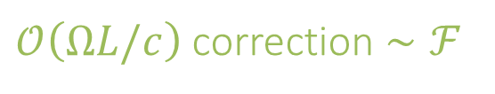
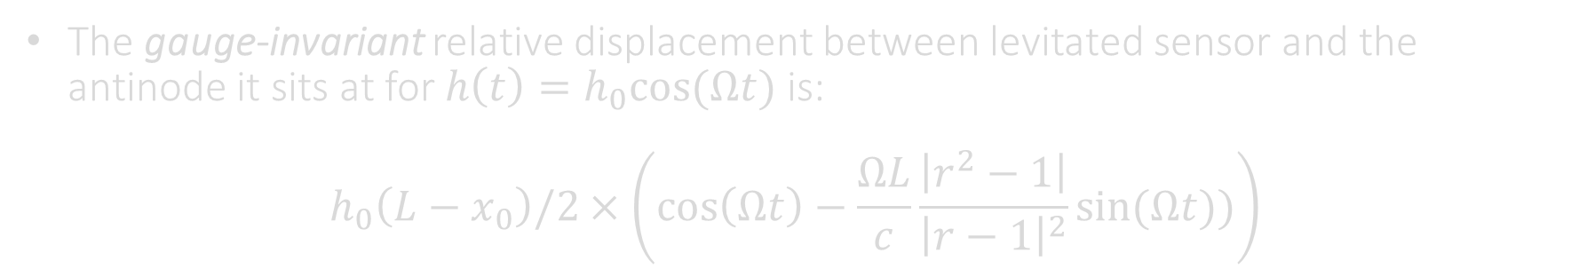
Relativistic response in small particle limit
The gauge-invariant relative displacement between levitated sensor and the antinode it sits at for $h\left(t\right)=h_{0}cos⁡(Ωt)$ is:
$$h_{0}\left(L−x_{0}\right)/2×\left(\cos\left(Ωt\right)−\frac{ΩL}{c}\frac{\left|r^{2}−1\right|}{{\left|r−1\right|}^{2}}\sin{(Ωt)})\right)$$
$𝒪\left(ΩL/c\right)$ correction $∼ℱ$
arXiv:2603.07302

Slide 17
Relativistic response in small particle limit
The gauge-invariant relative displacement between levitated sensor and the antinode it sits at for $h\left(t\right)=h_{0}cos⁡(Ωt)$ is:
$$h_{0}\left(L−x_{0}\right)/2×\left(\cos\left(Ωt\right)−\frac{ΩL}{c}\frac{\left|r^{2}−1\right|}{{\left|r−1\right|}^{2}}\sin{(Ωt)})\right)$$
$𝒪\left(ΩL/c\right)$ correction $∼ℱ$
Ideally want sensor levitated as close to the input mirror as possible!
arXiv:2603.07302

Slide 18
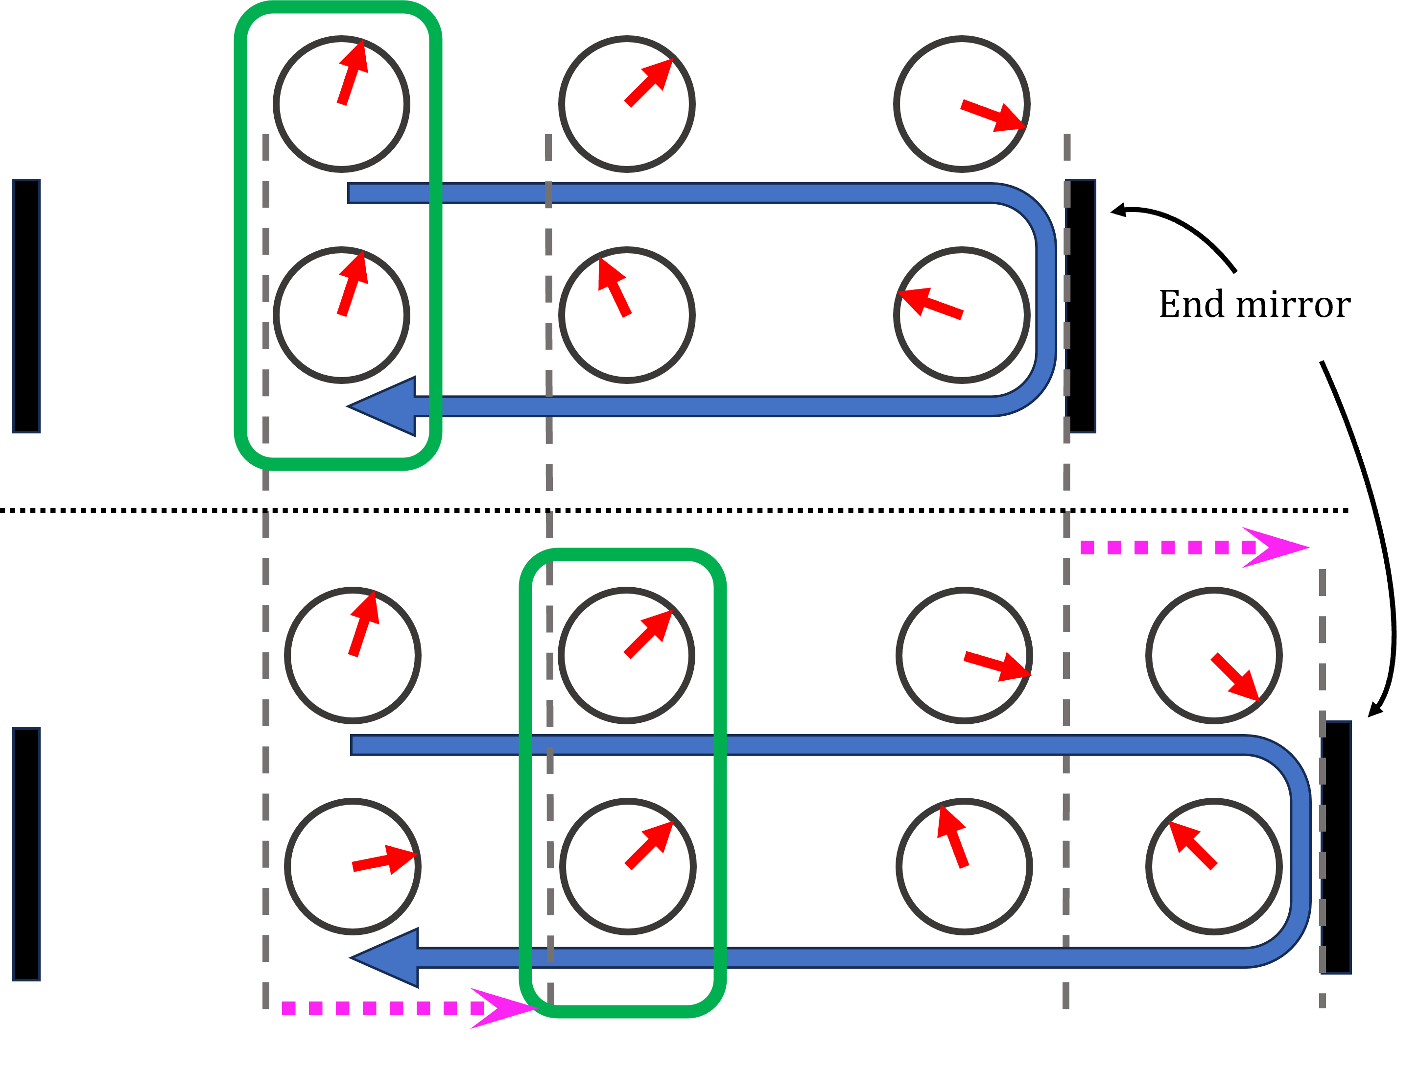
Input/End-mirror asymmetry and consequences
Phasors of the light field
Light propagation path
arXiv:2603.07302

Slide 19
Input/End-mirror asymmetry and consequences
Phasors of the light field
Antinodes appear where counterpropagating waves are in phase
Phase offset is simple for end mirror reflection
Light propagation path
arXiv:2603.07302

Slide 20
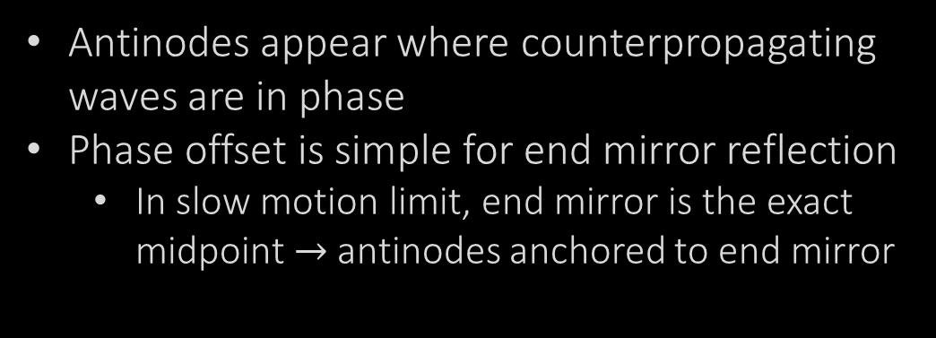
Input/End-mirror asymmetry and consequences
Phasors of the light field
Antinodes appear where counterpropagating waves are in phase
Phase offset is simple for end mirror reflection
  In slow motion limit, end mirror is the exact midpoint $→$antinodes anchored to end mirror
Light propagation path
arXiv:2603.07302

Slide 21
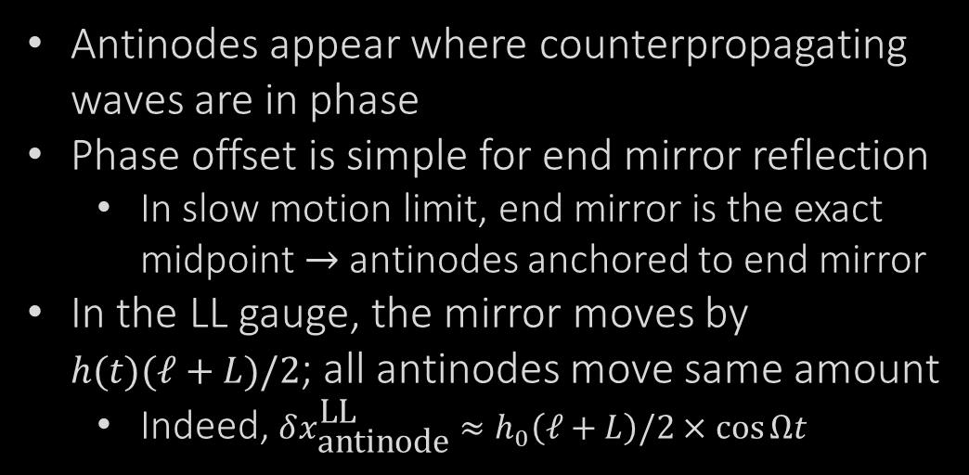
Input/End-mirror asymmetry and consequences
Phasors of the light field
Antinodes appear where counterpropagating waves are in phase
Phase offset is simple for end mirror reflection
  In slow motion limit, end mirror is the exact midpoint $→$antinodes anchored to end mirror
In the LL gauge, the mirror moves by
$h(t)(ℓ+L)/2$; all antinodes move same amount
  Indeed, $δx_{\text{antinode}}^{\text{LL}}≈h_{0}\left(ℓ+L\right)/2×\cos{Ωt}$
Light propagation path
arXiv:2603.07302

Slide 22
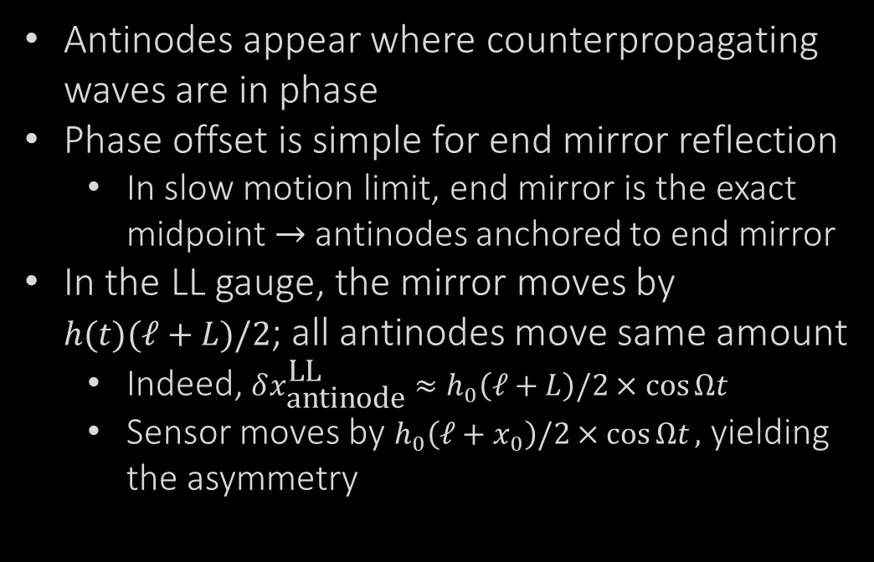
Input/End-mirror asymmetry and consequences
Phasors of the light field
Antinodes appear where counterpropagating waves are in phase
Phase offset is simple for end mirror reflection
  In slow motion limit, end mirror is the exact midpoint $→$antinodes anchored to end mirror
In the LL gauge, the mirror moves by
$h(t)(ℓ+L)/2$; all antinodes move same amount
  Indeed, $δx_{\text{antinode}}^{\text{LL}}≈h_{0}\left(ℓ+L\right)/2×\cos{Ωt}$
  Sensor moves by $h_{0}\left(ℓ+x_{0}\right)/2×\cos{Ωt},$ yielding the asymmetry
Light propagation path
arXiv:2603.07302

Slide 23
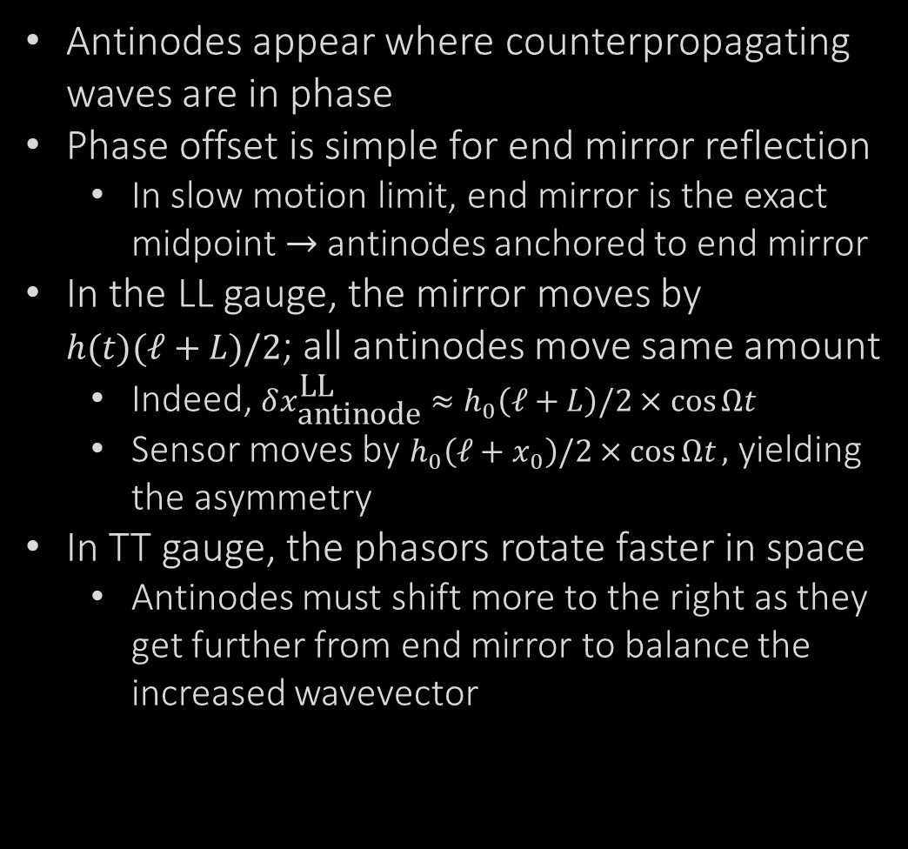
Input/End-mirror asymmetry and consequences
Phasors of the light field
Antinodes appear where counterpropagating waves are in phase
Phase offset is simple for end mirror reflection
  In slow motion limit, end mirror is the exact midpoint $→$antinodes anchored to end mirror
In the LL gauge, the mirror moves by
$h(t)(ℓ+L)/2$; all antinodes move same amount
  Indeed, $δx_{\text{antinode}}^{\text{LL}}≈h_{0}\left(ℓ+L\right)/2×\cos{Ωt}$
  Sensor moves by $h_{0}\left(ℓ+x_{0}\right)/2×\cos{Ωt},$ yielding the asymmetry
In TT gauge, the phasors rotate faster in space
  Antinodes must shift more to the right as they get further from end mirror to balance the increased wavevector
Light propagation path
arXiv:2603.07302

Slide 24
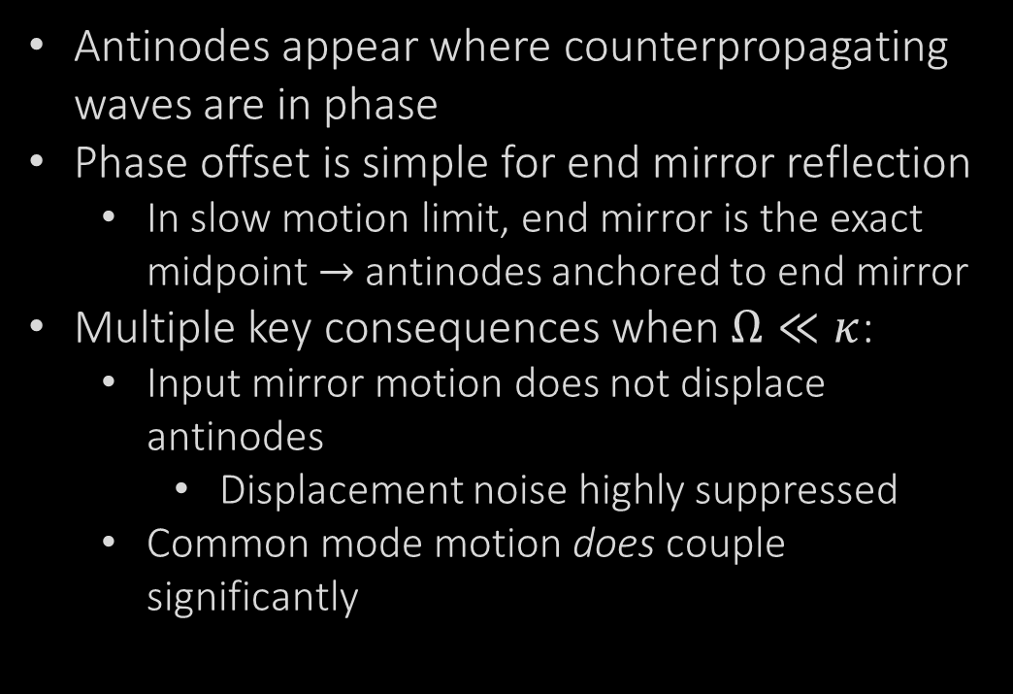
Input/End-mirror asymmetry and consequences
Phasors of the light field
Antinodes appear where counterpropagating waves are in phase
Phase offset is simple for end mirror reflection
  In slow motion limit, end mirror is the exact midpoint $→$antinodes anchored to end mirror
Multiple key consequences when $Ω≪κ$:
  Input mirror motion does not displace antinodes
    Displacement noise highly suppressed
  Common mode motion does couple significantly
Light propagation path
arXiv:2603.07302

Slide 25
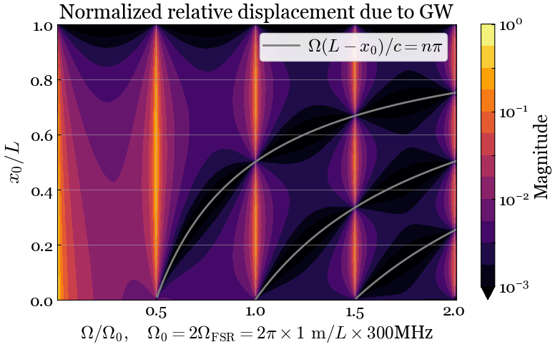

Relativistic antinode-sensor displacement at high $Ω$

Slide 26
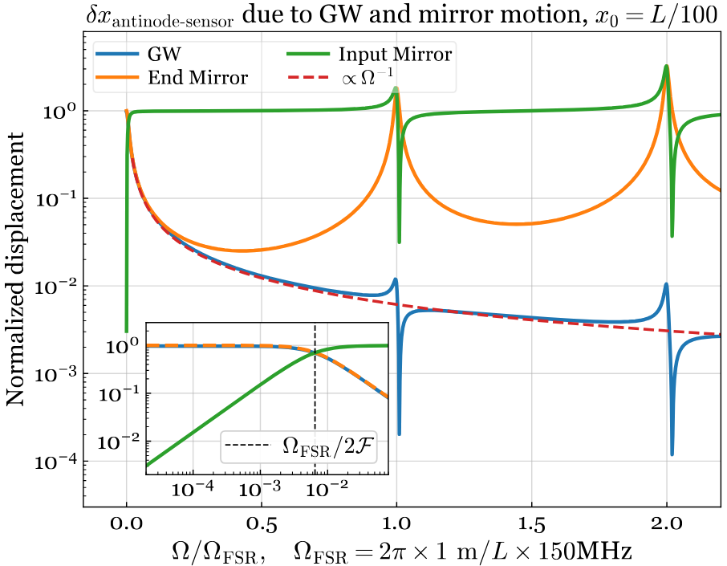
Relativistic antinode-sensor displacement at high $Ω$

Slide 27
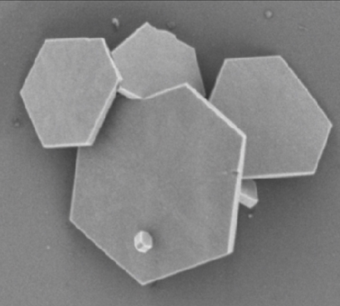
Moving beyond the small particle limit
What if the levitated sensor is large enough to affect the global cavity fields?
  Plate-like sensors have been proposed for more efficient detection
arXiv:2204.10843

Slide 28
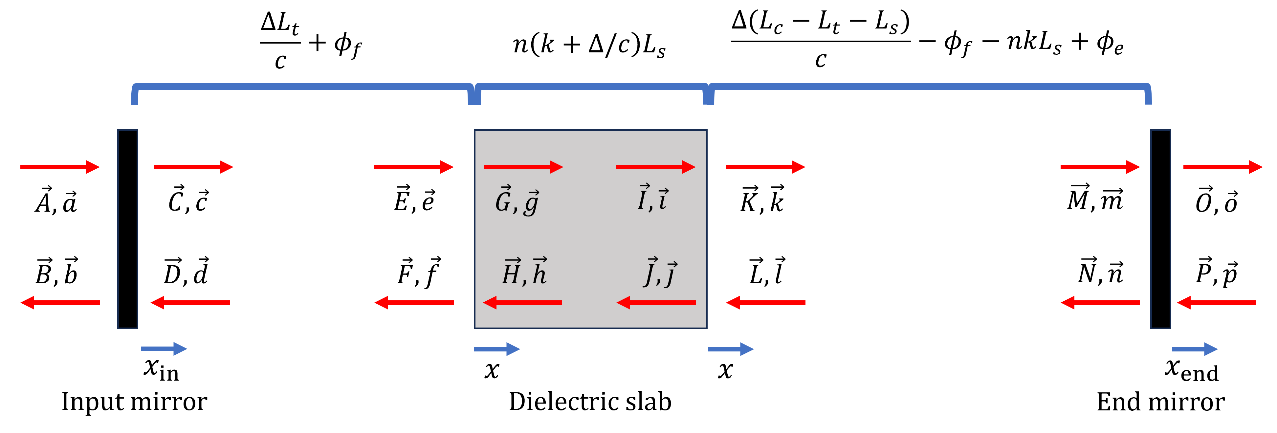
Moving beyond the small particle limit
What if the levitated sensor is large enough to affect the global cavity fields?
  Plate-like sensors have been proposed for more efficient detection
Aim to compute full field solutions rather than standard perturbative methods

Slide 29
Moving beyond the small particle limit
What if the levitated sensor is large enough to affect the global cavity fields?
  Plate-like sensors have been proposed for more efficient detection
Aim to compute full field solutions rather than standard perturbative methods
Operating in between the levitated particle / membrane spaces requires careful calculation of optical forces

Slide 30
Moving beyond the small particle limit
What if the levitated sensor is large enough to affect the global cavity fields?
  Plate-like sensors have been proposed for more efficient detection
Aim to compute full field solutions rather than standard perturbative methods
Operating in between the levitated particle / membrane spaces requires careful calculation of optical forces
Forthcoming paper on transfer function calculation in the two-photon formalism

Slide 31
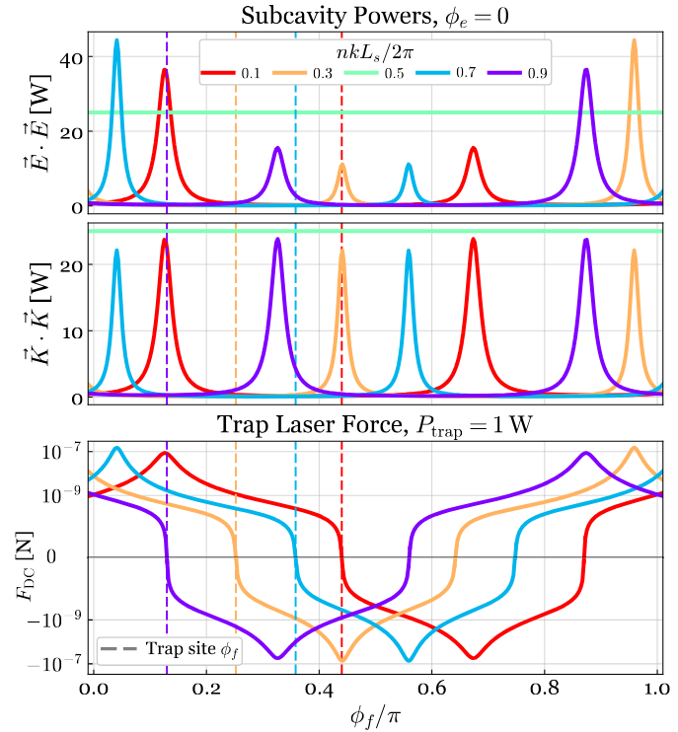
Cavity splitting due to thin plate-like dielectrics
Inserting the dielectric plane into cavity heavily modifies internal fields
  Position-dependent split Lorentzian

Slide 32
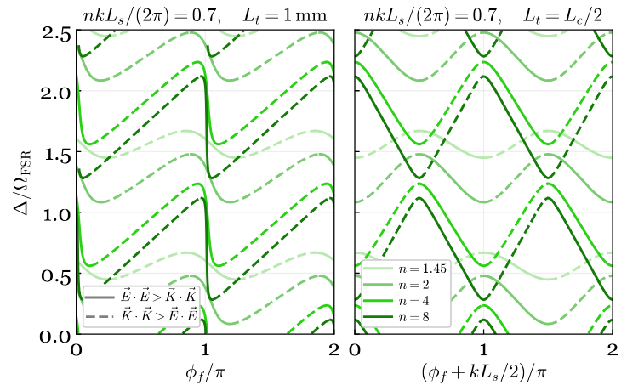
Cavity splitting due to thin plate-like dielectrics
Inserting the dielectric plane into cavity heavily modifies internal fields
  Position-dependent split Lorentzian
Dielectric has effectively split system into two subcavities which can each resonate

Slide 33
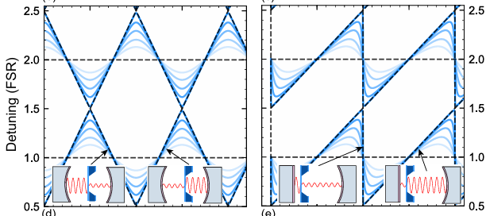
Cavity splitting due to thin plate-like dielectrics
Inserting the dielectric plane into cavity heavily modifies internal fields
  Position-dependent split Lorentzian
Dielectric has effectively split system into two subcavities which can each resonate
A thin membrane-in-the-middle:
Internal non-vacuum propagation gives vertical shifts
Dumont, V., et al. Flexure-Tuned Membrane-at-the-Edge Optomechanical System (2019).

Slide 34
Further shortcomings of perturbation theory
Optomechanical coupling computed perturbatively: $δω_{c}≈\frac{∫d^{3}\vec{x} δε\left(\vec{x}\right){\vec{E}}_{0}^{2}(\vec{x})}{∫d^{3}\vec{x} {\vec{E}}_{0}^{2}(\vec{x})}$, $g_{0}≡\frac{∂ω_{c}}{∂x}$

Slide 35
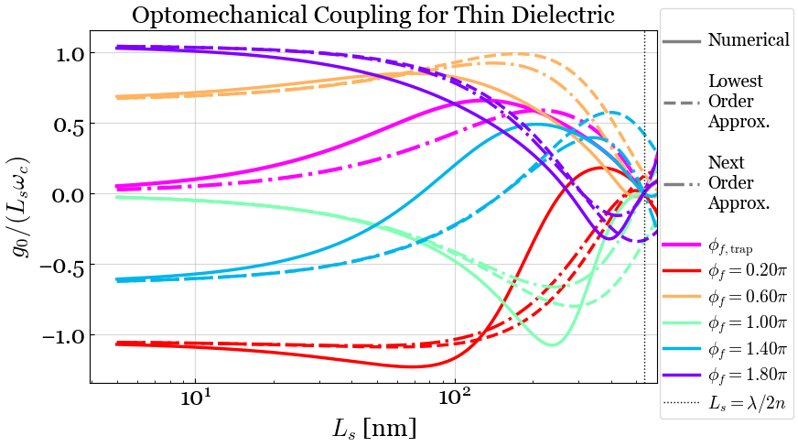
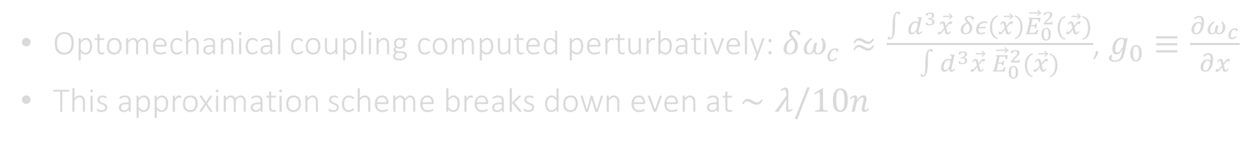
Further shortcomings of perturbation theory
Optomechanical coupling computed perturbatively: $δω_{c}≈\frac{∫d^{3}\vec{x} δε\left(\vec{x}\right){\vec{E}}_{0}^{2}(\vec{x})}{∫d^{3}\vec{x} {\vec{E}}_{0}^{2}(\vec{x})}$, $g_{0}≡\frac{∂ω_{c}}{∂x}$
This approximation scheme breaks down even at $∼λ/10n$

Slide 36
Conclusions
Levitated sensors appear to be a promising avenue for high-frequency GW detection
We are closing gaps in our knowledge of how to design and operate such detectors
A careful derivation of the gauge-invariant trap site offset due to a GW clarifies the origin of a non-intuitive, yet exploitable, asymmetry in the result
It also reveals phenomena at higher frequencies which must be accounted for in designs of future iterations of these experiments
alaeuger@caltech.edu

Slide 37
Conclusions
Levitated sensors appear to be a promising avenue for high-frequency GW detection
We are closing gaps in our knowledge of how to design and operate such detectors
A careful derivation of the gauge-invariant trap site offset due to a GW clarifies the origin of a non-intuitive, yet exploitable, asymmetry in the result
It also reveals phenomena at higher frequencies which must be accounted for in designs of future iterations of these experiments
When the sensor is large and captures entire beam cross-section, a new procedure for computing full field response to incident perturbations is needed
We demonstrated this system can easily violate perturbative expectations used to analyze more typical levitated sensor experiments
alaeuger@caltech.edu

Slide 38
Additional Slides

Slide 39
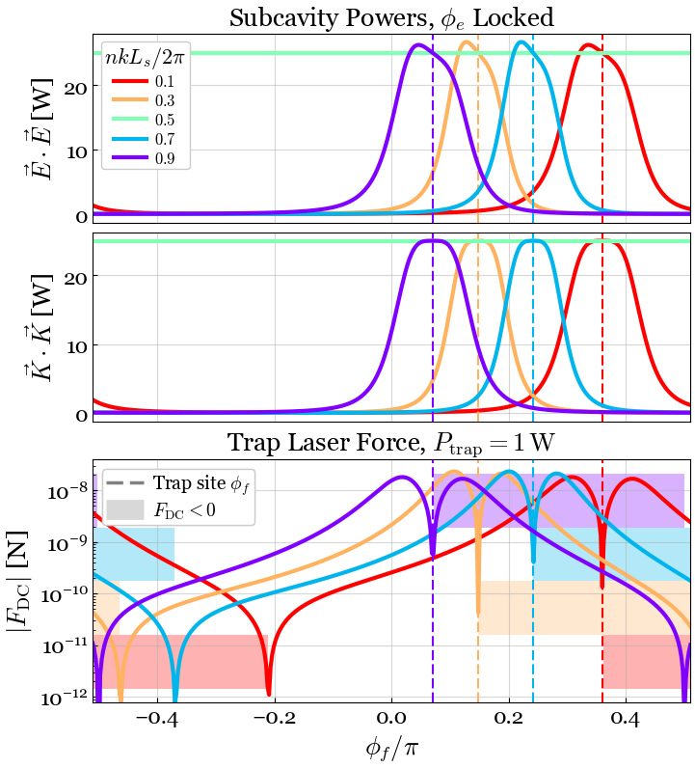
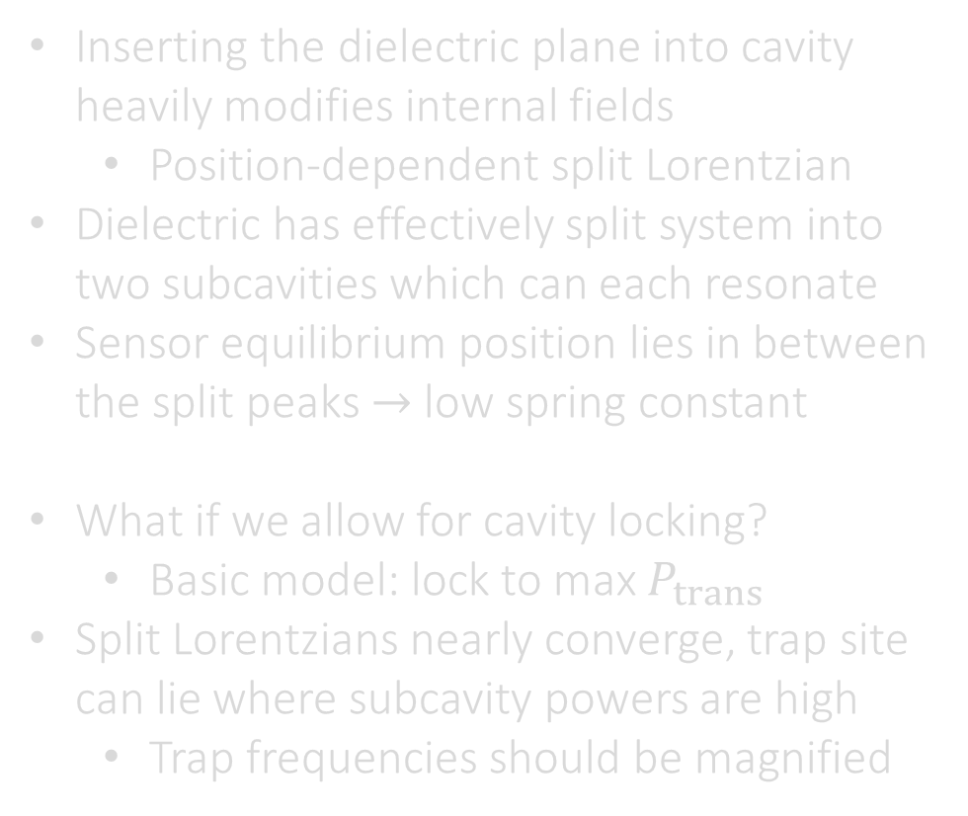
Cavity splitting due to thin plate-like dielectrics
Inserting the dielectric plane into cavity heavily modifies internal fields
  Position-dependent split Lorentzian
Dielectric has effectively split system into two subcavities which can each resonate
Sensor equilibrium position lies in between the split peaks $→$ low spring constant
What if we allow for cavity locking?
  Basic model: lock to max $P_{trans}$
Split Lorentzians nearly converge, trap site can lie where subcavity powers are high
  Trap frequencies should be magnified

Slide 40
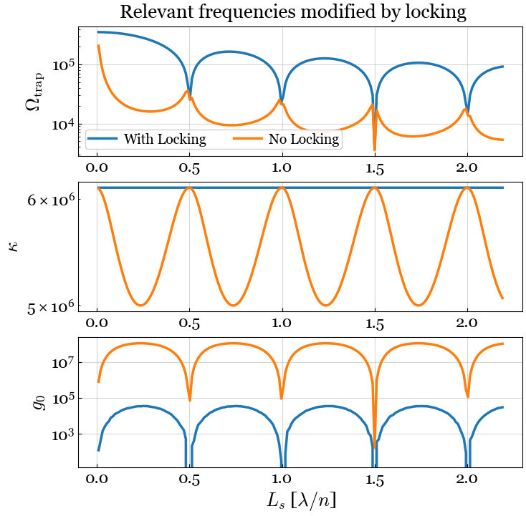
Cavity splitting due to thin plate-like dielectrics

Slide 41
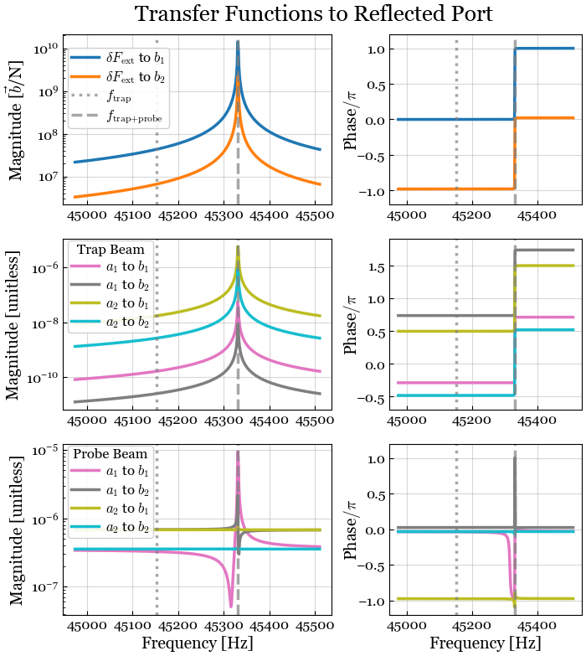
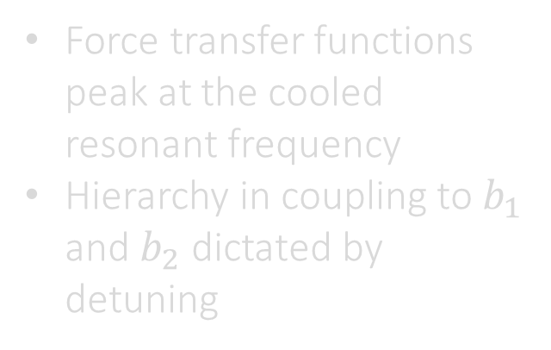
Transfer functions from GW and noise ports
Force transfer functions peak at the cooled resonant frequency
Hierarchy in coupling to $b_{1}$ and $b_{2}$ dictated by detuning

Slide 42
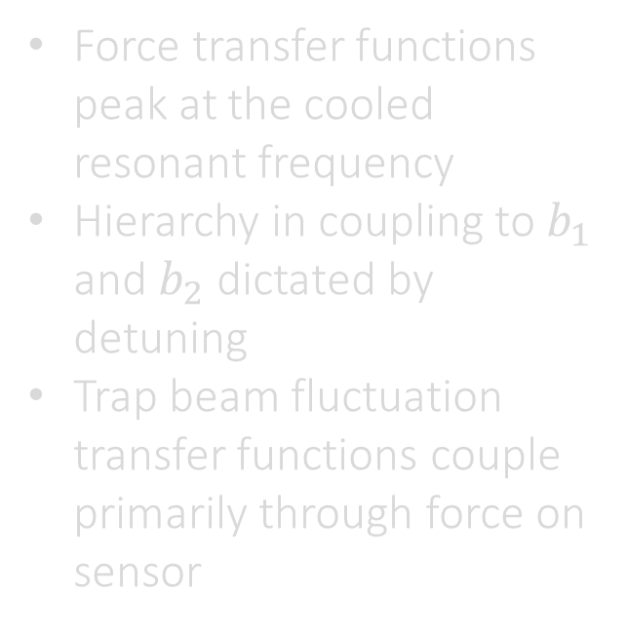
Transfer functions from GW and noise ports
Force transfer functions peak at the cooled resonant frequency
Hierarchy in coupling to $b_{1}$ and $b_{2}$ dictated by detuning
Trap beam fluctuation transfer functions couple primarily through force on sensor

Slide 43
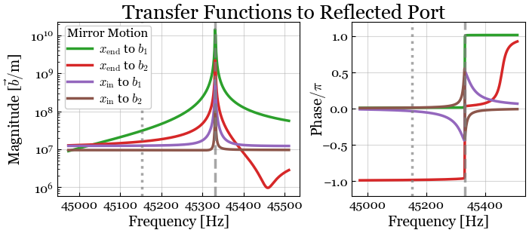
Transfer functions from GW and noise ports
Mirror displacement transfer functions feature a direct and indirect component

Slide 44
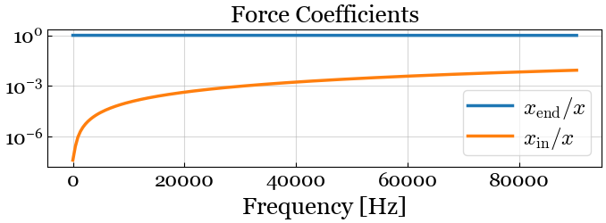
Transfer functions from GW and noise ports
Mirror displacement transfer functions feature a direct and indirect component
We can compute effective trap site displacement due to mirror motion by normalizing by force TF
Even with the cavity split into subcavities, the low frequency results of relativistic calculation hold!

