Slide 1
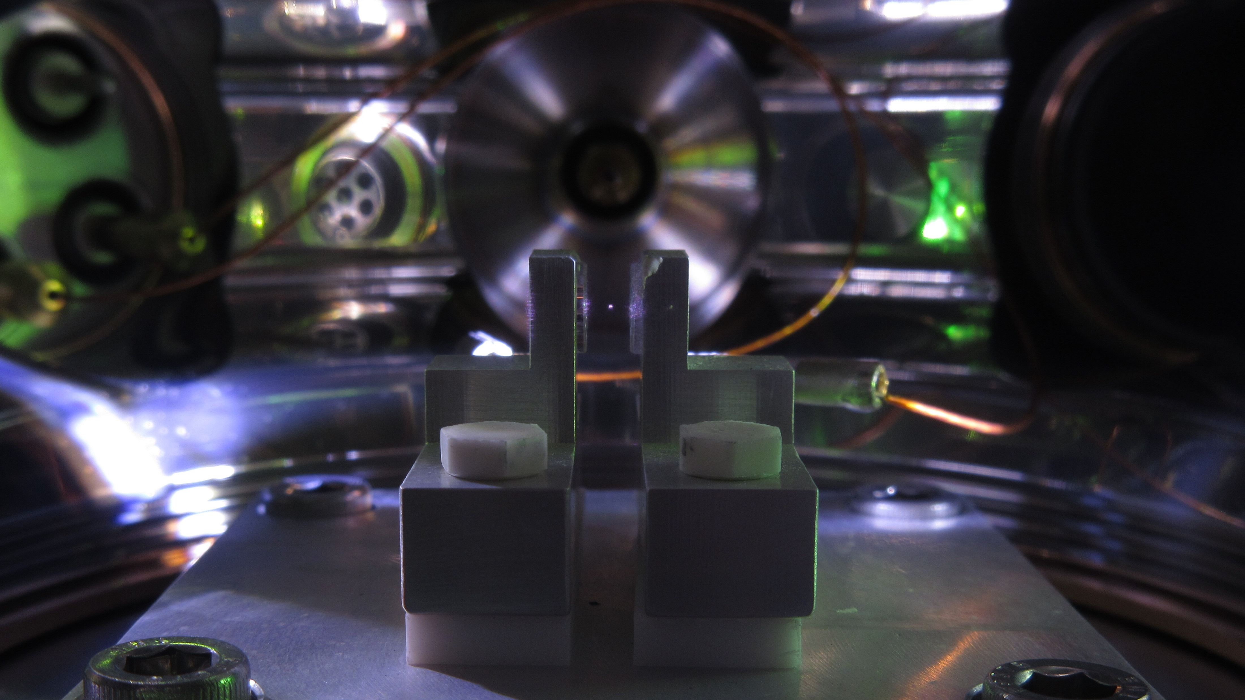


Experimental platforms for fundamental physics applications
David Moore, Yale
Queen’s University
September 24, 2026

Slide 2
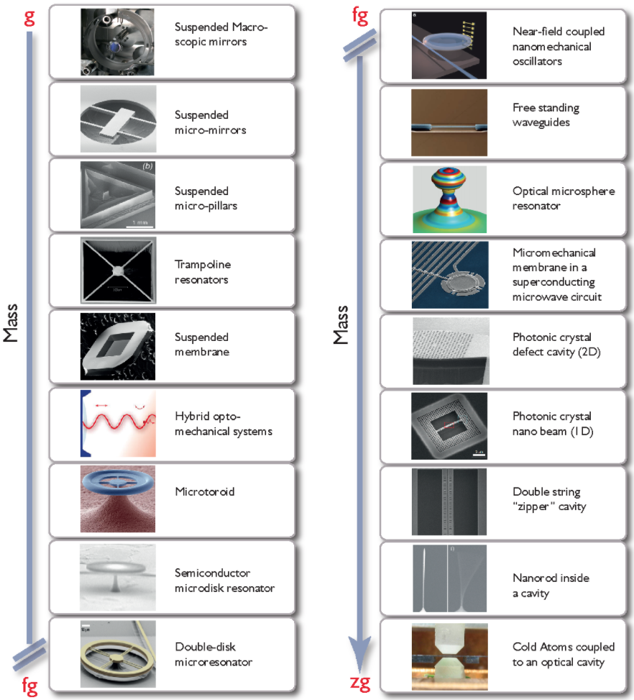
LIGO, VIRGO, KAGRA
Mechanical systems
A wide variety of mechanical quantum systems are revolutionizing how we measure tiny forces
Huge variety of systems now allow mechanical DOF to be read out in the quantum regime
These sensors can detect extremely tiny forces or accelerations
  In the large mass range, excellent accelerometers (e.g. gravity, dark matter, …)
  In the sub-ng range, reaching sensitivity to the forces imparted by single sub-atomic particles
See also yesterday’s talk by Zhen Liu for theory motivation
See also, e.g.:
  “Snowmass 2021: Quantum Sensors for HEP Science,” arXiv:2203.07250.
  "Mechanical Quantum Sensing in the Search for Dark Matter,” Quant. Sci. Tech. 6 024002 (2021), arXiv:2008.06074
  “Searching for new physics using optically levitated sensors,” Quant. Sci. Tech. 6 014008 (2021), arXiv:2008.13197
  “Quantum sensing for particle physics,” Nature Reviews Physics 6, 329 (2024)
  …
Aspelmeyer et al., Rev. Mod. Phys. 86, 1391 (2014)
D. Moore, Yale

Slide 3
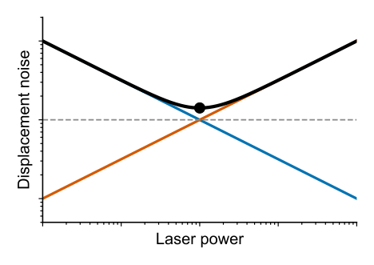
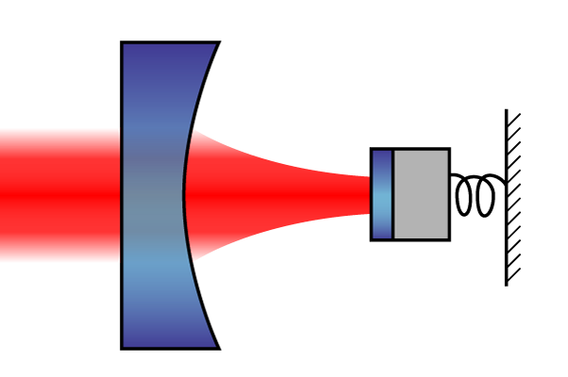
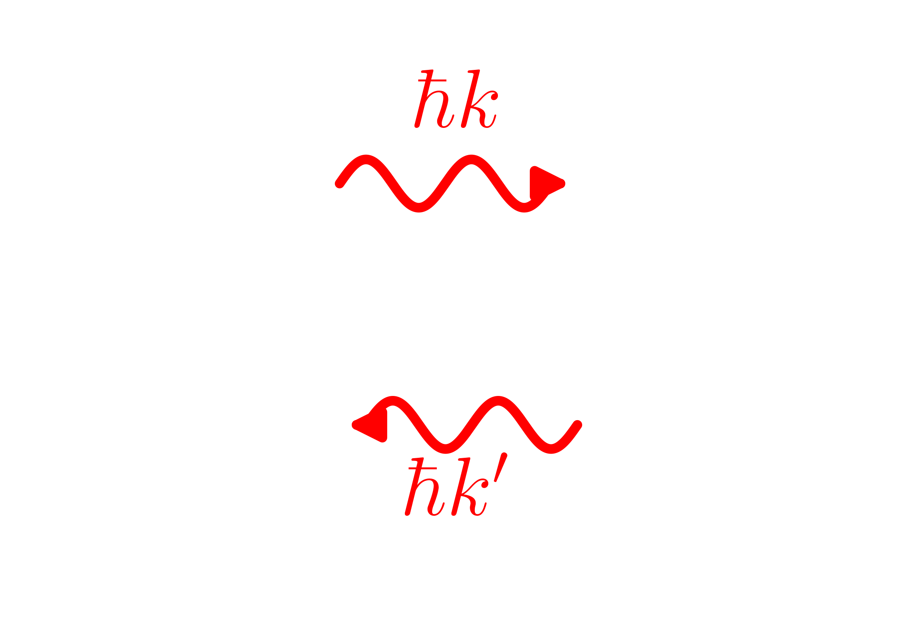
Noise and sensitivity
To make a precise sensor with a mechanical system, need two things:
  Need to have enough precision to detect tiny changes in its motion (“displacement sensitivity”)
  Need to minimize any forces acting on the mass that could otherwise obscure what we want to sense (“force noise”)
Many sources of noise can contribute to these (e.g. thermal noise, noisy electronics, …), but noise from the measurement itself is a fundamental contributor to both:
“Canonical” optomechanical system:
Cartoon of SQL:
SQL
x_{zpf}
Backaction
Imprecision
  Imprecision: Uncertainty in mirror position due to shot noise fluctuations in measured phase
  Backaction: Fluctuations in mirror position due to shot noise in radiation pressure
D. Moore, Yale

Slide 4
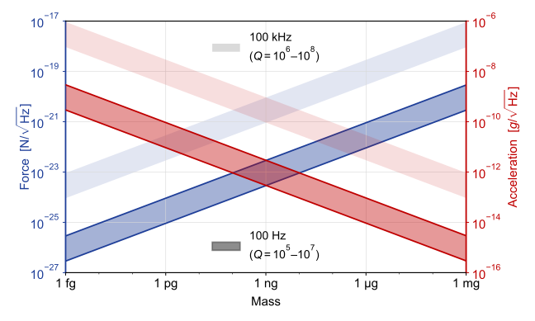
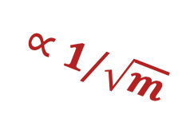
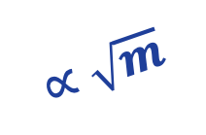
Sensitivity at SQL
While not a fundamental limit (see e.g. talks by M. Rossi, V. Sudhir), the standard quantum limit (SQL) represents a sensitivity benchmark that is often of interest
On-resonance SQL vs. mass, frequency:
Increasing Q
Example physics targets:
Forces from fundamental particles
Particle dark matter
Neutrinos
…
Lower frequency
Example physics targets:
Gravity
Ultra-light dark matter
Gravitational waves
…
$$∝\sqrt{m}$$
$$∝1/\sqrt{m}$$
D. Moore, Yale

Slide 5
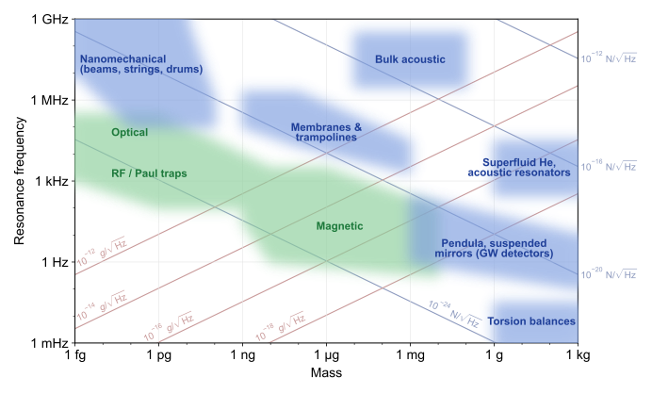
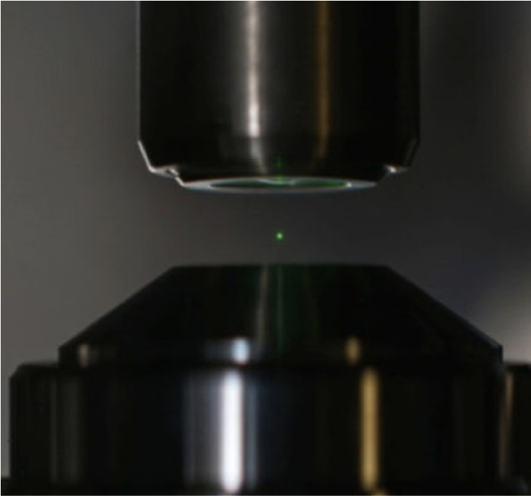
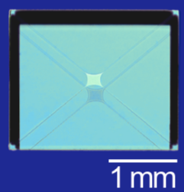
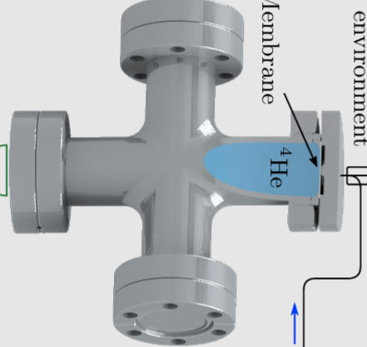
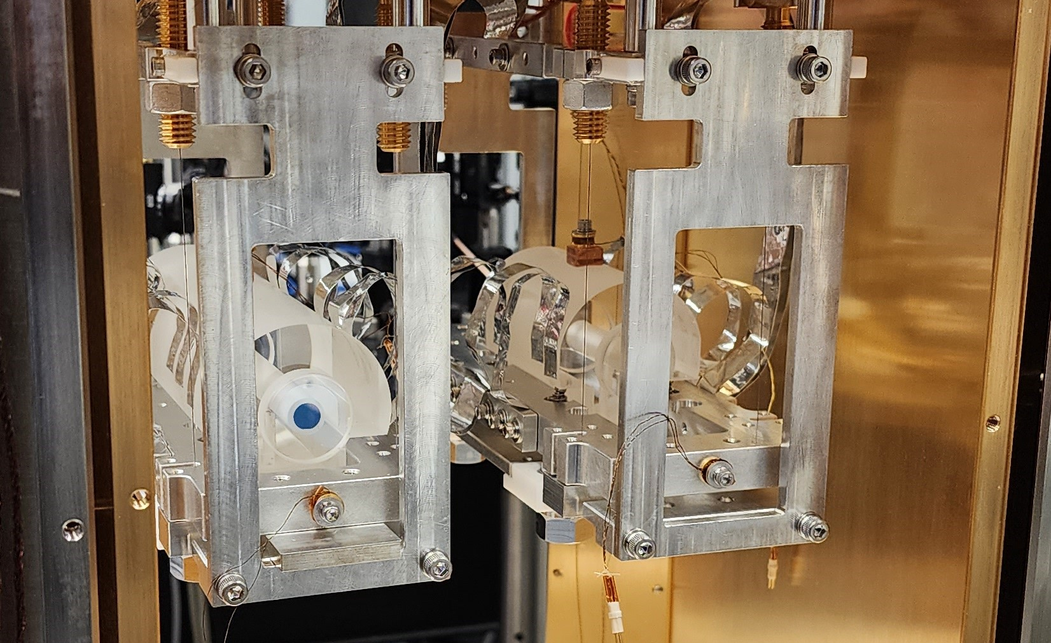
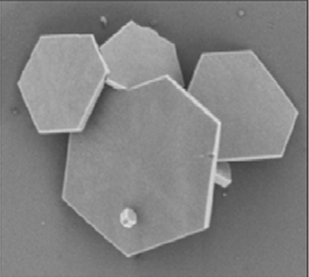
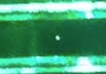
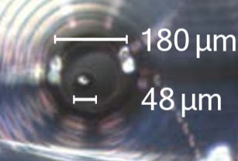
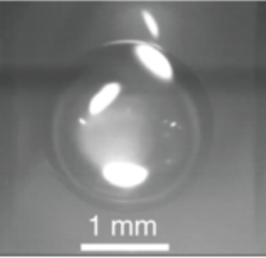
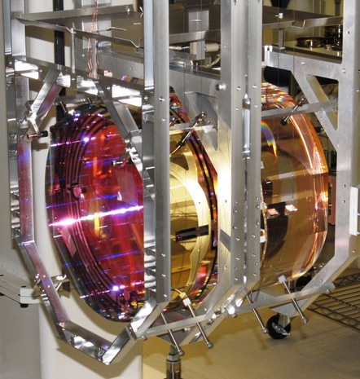

Survey of experimental systems
Summary of experimental platforms:
SQL ($Q= {10}^{7}$)
Single atoms/ions
Tethered
Talks by Rossi, Kodroff
Talk by Wilson
Talk by Deshpande
Talk by Davis
Talks by Laeuger, Geraci
1906.09580
Talks by Juan, Sangiorgio
Talk by Penny
Levitated
Talks by Harris, Darroch
Talk by Sudhir
D. Moore, Yale

Slide 6
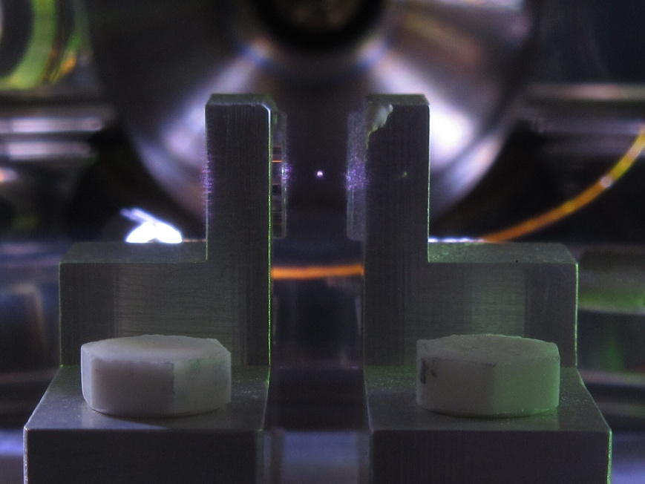
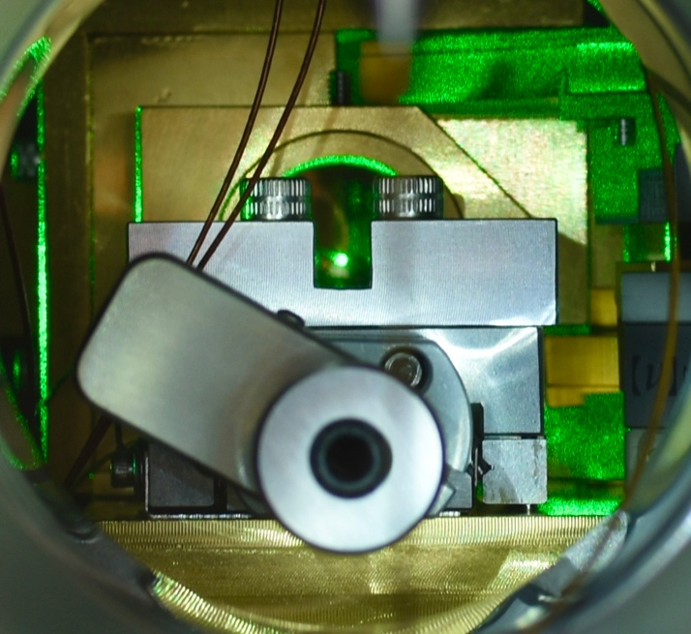
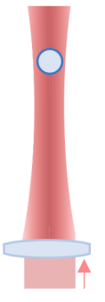
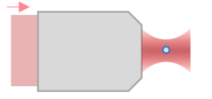
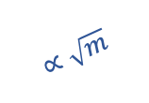

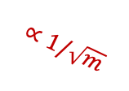


Photographs of trapped nano/micro particles at Yale:
Optical levitation
Nano- to micro-sized dielectric masses can be optically trapped with ~100 mW of laser power
Levitated masses are isolated both electrically and thermally
  Ultra-low decoherence allows quantum control of motional degrees of freedom
  Force sensitivities at the zN level, with acceleration sensitivities near a nano-g
Levitation trap
(~1 – 30 𝜇m):
Highly focused tweezers (~0.1 – 1𝜇m):
~1 pg – 30 ng
~1 fg – 1 pg
Force and acceleration sensitivity vs particle mass:
10⁻¹⁸
$$∝\sqrt{m}$$
10⁻⁵
10⁻¹⁹
10⁻⁶
Force sensitivity [N/$\sqrt{Hz}$]
Accel. sensitivity [g/$\sqrt{Hz}$]
10⁻²⁰
10⁻⁷
$$∝1/\sqrt{m}$$
10⁻²¹
10⁻⁸
$$\vec{g}$$
fg
pg
ng
Particle mass
Moore and Geraci, Quantum Sci. Technol. 6 014008 (2021)
D. Moore, Yale

Slide 7
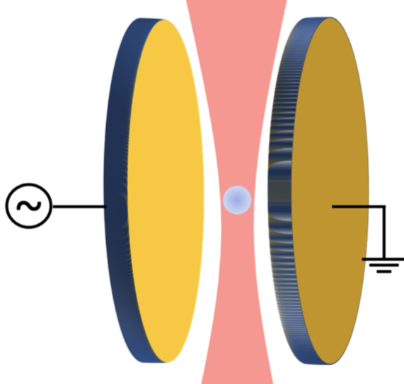
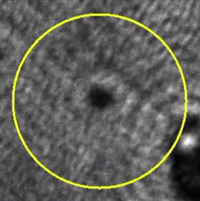
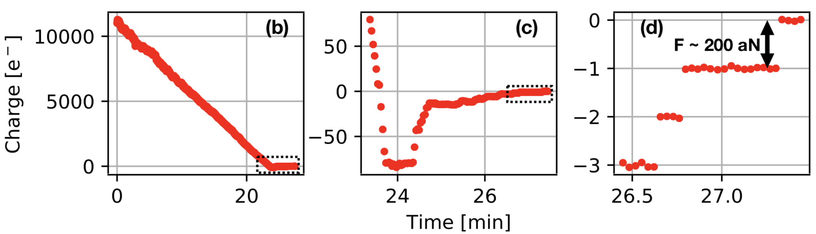
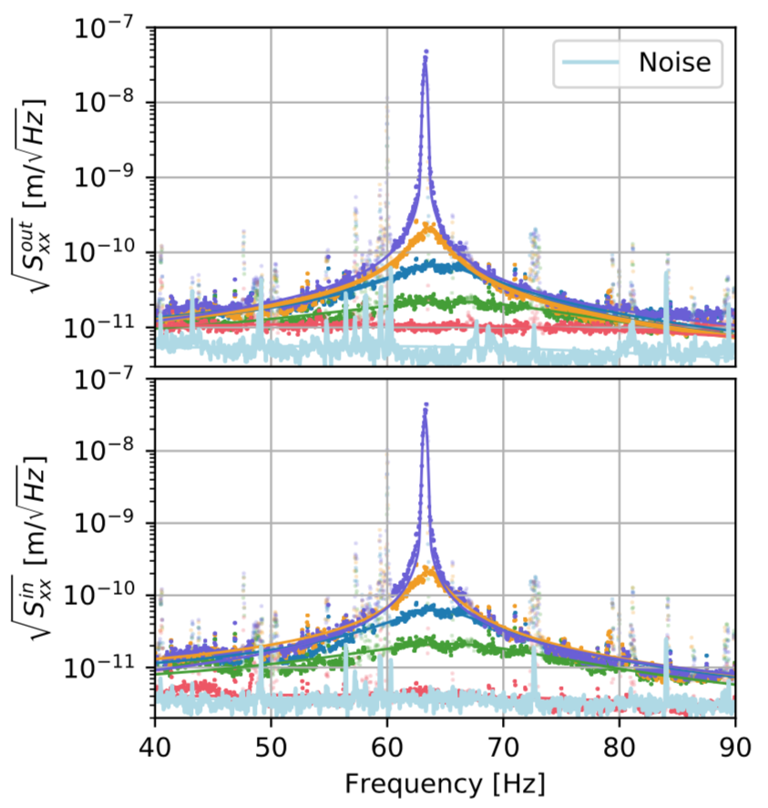
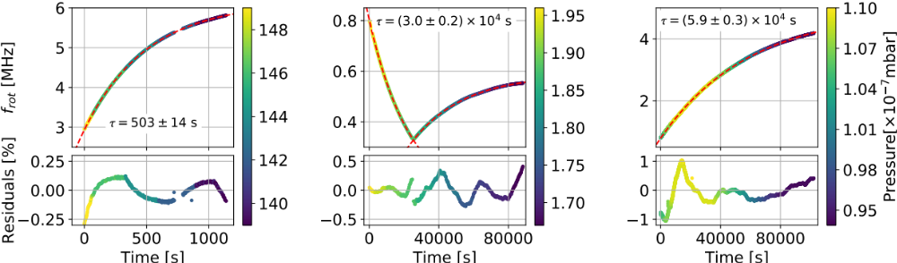
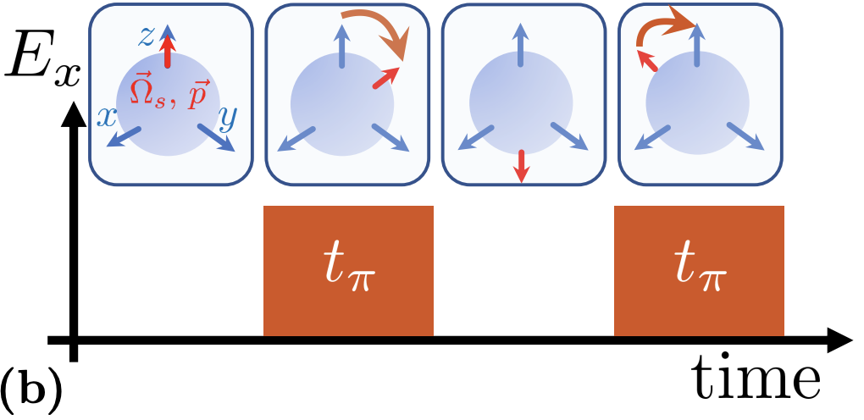

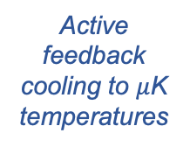


Experimental sequence (>ng spheres)
25 mm
Step 1: Trap sphere (~1 mbar)
Step 2: Electrically neutralize
q_{init} >10⁴ e⁻
~1-10 mm
Pump to $≲$10⁻⁷ mbar
E ~ 1 V/mm
Piezo stack
Monteiro et al., PRA 101, 053835, arXiv:2001.10931(2020)
Monteiro et al., PRA 101, 053835, arXiv:2001.10931(2020)
Step 4: Cool center-of-mass mode
Step 5: Orient electric dipole moment
Step 3: Stabilize spin
Optically spin to >MHz frequency
$$ω\sim MHz$$
Active feedback cooling to $μ$K temperatures
Out-of-loop sensor
Apply electric field (if desired)
$50±22 μ$K
p₀
Afek et al., PRA 104, 053512, arXiv:2108.04406 (2021)
Monteiro et al., PRA 97, 051802(R), arXiv:1803.04297 (2018)
Monteiro et al., PRA 101, 053835, arXiv:2001.10931(2020)
Monteiro et al., PRA 96, 063841, arXiv:1711.04675 (2017)

Slide 8
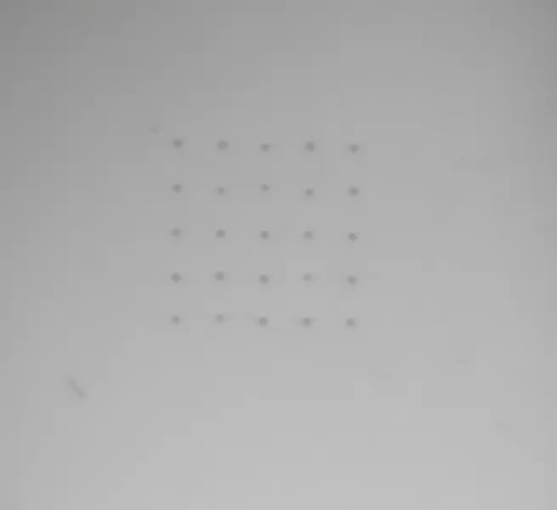
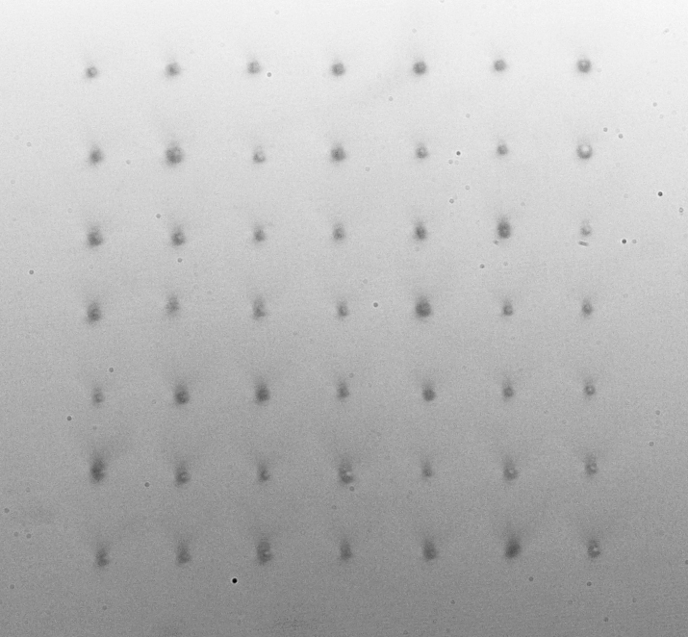

Microsphere arrays
Also upgraded our system with high power laser (100 W) to demonstrate first microparticle arrays up to ~10 x 10 in vacuum
Similar technology to tweezer arrays for neutral atom quantum computing
  Additionally require closed loop feedback on trap positions
25 spheres = 10¹⁵ atoms!
7x7 array of spheres in vacuum:
Simplified schematic:
~500 $μ$m
Played at 8x speed
D. Moore, Yale
8
Siegel et al. PRA 111, 033514 (2025)

Slide 9
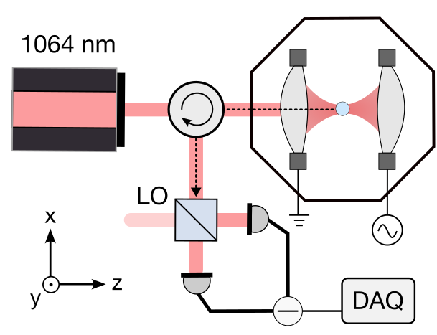
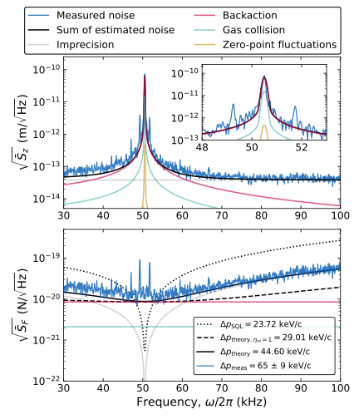
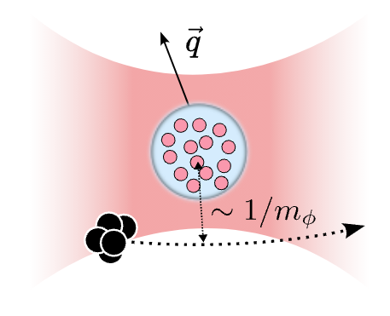
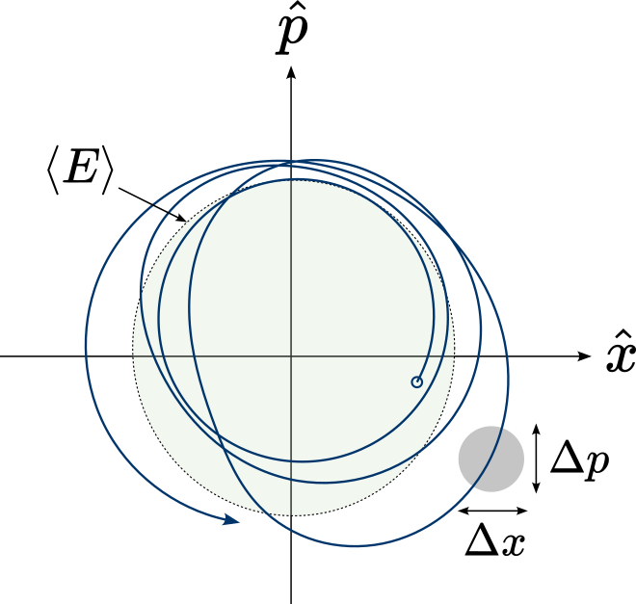
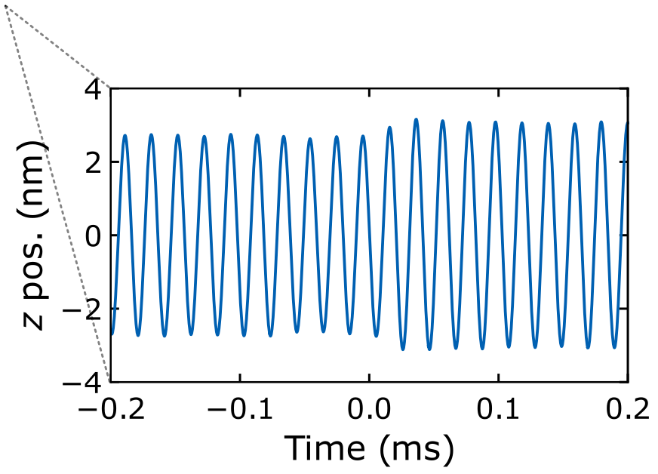
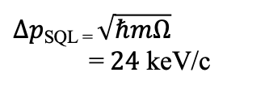

Impulse sensing
Levitated sensors are now reaching sufficient sensitivity to detect the tiny forces imparted by single sub-atomic particles
Schematic of impulse measurement:
Measured force noise, 5 fg particle:
Phase space trajectory:
Backaction
$Δpmeas \text{= 65}±9$ keV/c
$Δp\text{SQL = }\sqrt{ℏmΩ} \text{=} 24$ keV/c
Imprecision
PRX Quantum 6, 040367 (2025), arXiv:2508.00815
See, e.g.:
See talk by M. Rossi for how to do even better!
→ Also applications in talks by S. Sangiorgio, D. Kodroff
Magrini et al., Nature 595, 373 (2021)
Tebbenjohanns et al., Nature 595, 378 (2021)
D. Moore, Yale

Slide 10

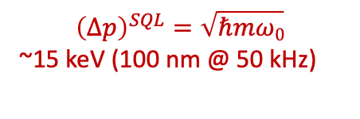
Impulse sensing
Levitated sensors are now reaching sufficient sensitivity to detect the tiny forces imparted by single sub-atomic particles
Schematic of impulse measurement:
Measured force noise, 5 fg particle:
Phase space trajectory:
Backaction
$Δpmeas \text{= 65}±9$ keV/c
$Δp\text{SQL = }\sqrt{ℏmΩ} \text{=} 24$ keV/c
Imprecision
$$Δp_{imp}$$
PRX Quantum 6, 040367 (2025), arXiv:2508.00815
$${\left(Δp\right)}^{SQL}=\sqrt{ℏmω0}$$
~15 keV (100 nm @ 50 kHz)
See, e.g.:
See talk by M. Rossi for how to do even better!
→ Also applications in talks by S. Sangiorgio, D. Kodroff
Magrini et al., Nature 595, 373 (2021)
Tebbenjohanns et al., Nature 595, 378 (2021)
D. Moore, Yale

Slide 11
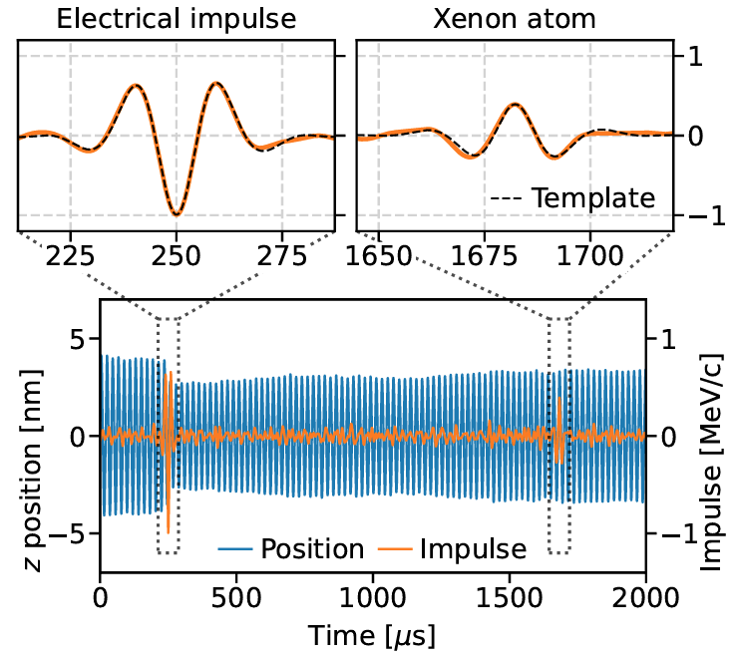
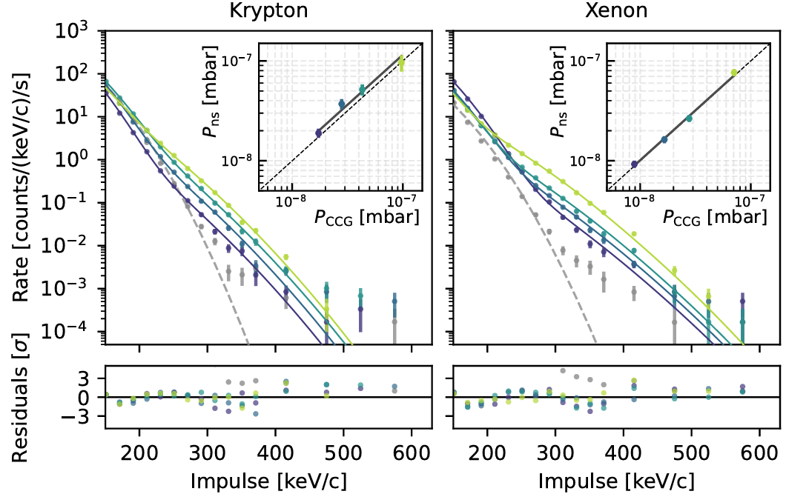
Proof-of-principle (gas collisions)
Sensitivity needed to see single room temperature gas molecules collide with the particle similar to 𝜈
  Injected trace levels of heavy gases (Kr, Xe, SF₆) and reconstructed the momentum transfers from individual collisions
Example measured gas collision:
Collision spectrum vs. pressure:
Increasing p
D. Moore, Yale
arXiv:2604.18371

Slide 12
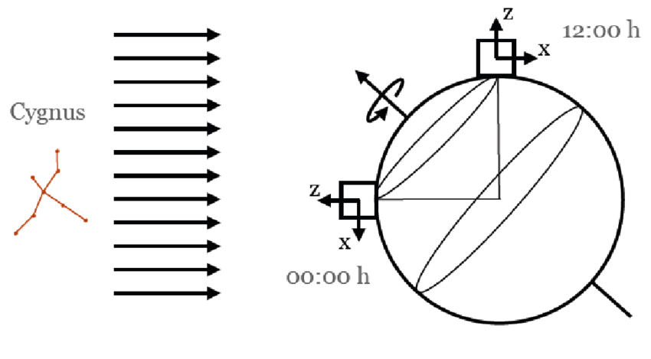
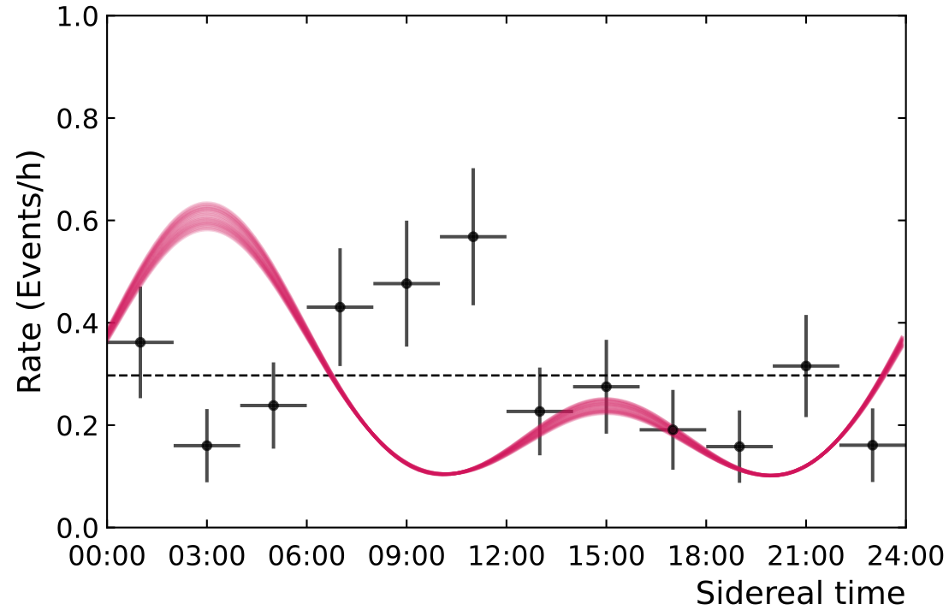
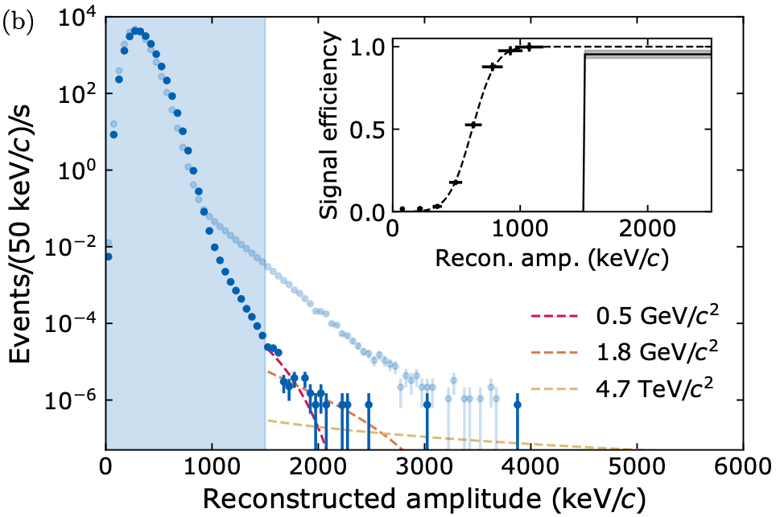
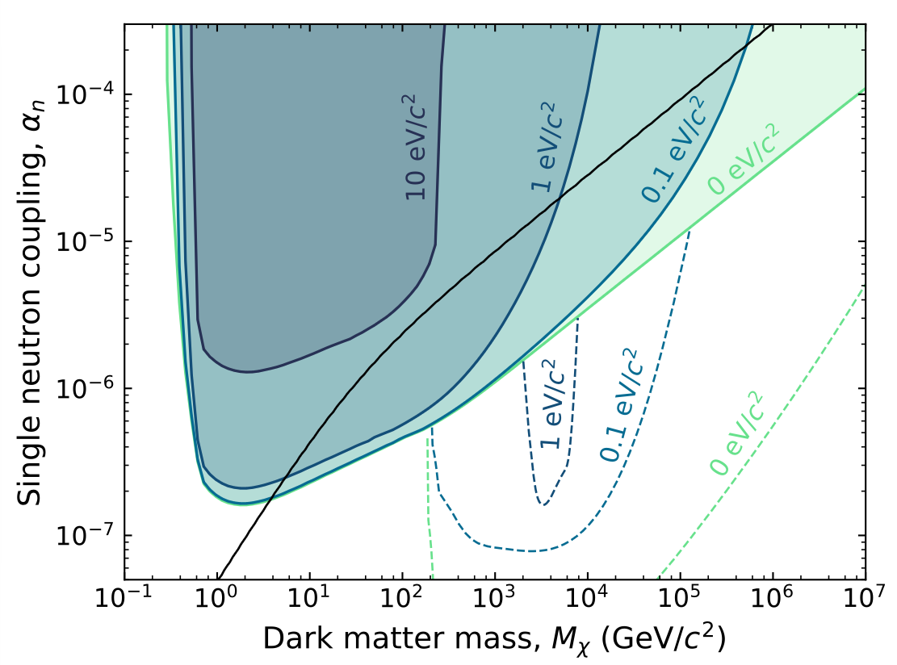
Natural directionality → any detection would be definitive!
Dark matter search (nanospheres)
Event rate vs sidereal time:
Performed search for dark matter with two nanospheres (total exposure ~5 fg x month)
  Tail of events above Gaussian noise background observed
  Conservatively set new limits on dark matter-neutron coupling, assuming events could either be dark matter or unidentified backgrounds
Measured recoil spectrum:
Limits on dark matter/neutron coupling:
See also recent results from POLONAISE at heavier mass, smaller coupling: arXiv:2608.20464
Sphere 2
Sphere 1
D. Moore, Yale
PRX Quantum 6, 040367 (2025), arXiv:2508.00815

Slide 13
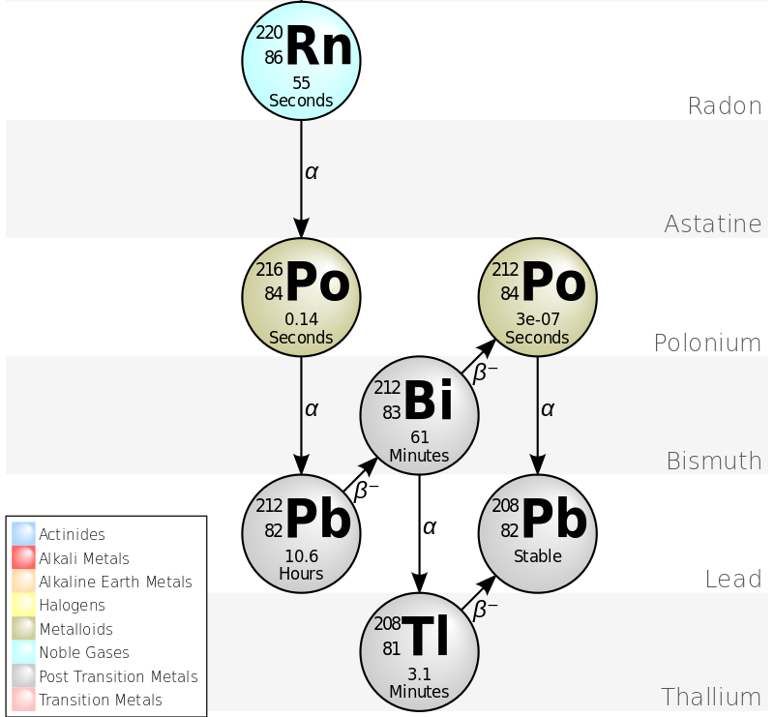


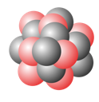


Radioisotope loading ($α$ decays)
As a proof-of-principle, we have detected single 𝛼 decays with >$μ$m sized spheres
  Momentum is ~200 MeV/c (compared to 0.1-1 MeV/c for typical $ν, γ$)
Have demonstrated loading of small quantities of ²¹²Pb into trapped microspheres
Rn-220 decay chain:
Schematic of loading scheme:
²²⁰Rn
²¹⁶Po⁺
Drift in E-field
~100 nm
²¹²Pb
T_{1/2} = 56 s
T_{1/2} = 0.14 s
T_{1/2} = 10.6 h
3 $μ$m diameter SiO₂ sphere
PRL133, 023602 (2024), arXiv:2402.13257
D. Moore, Yale

Slide 14
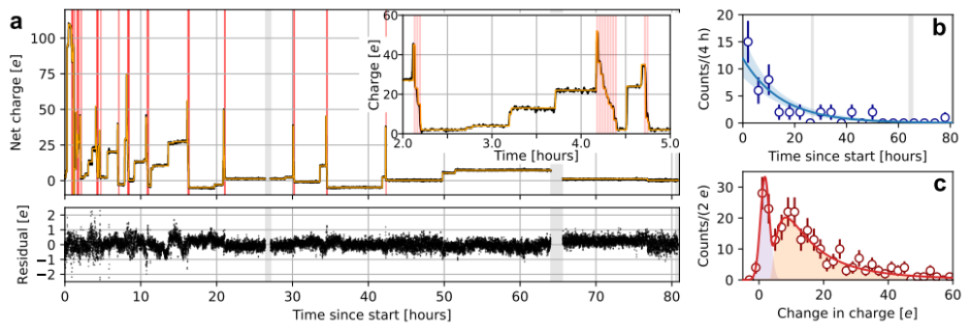

Detection of single nuclear decays (charge)
Can detect single nuclear decays through the change in net charge of the particle
Example of measured charge changes vs. time:
Auto-discharge
$α/β$ decays
PRL133, 023602 (2024), arXiv:2402.13257

Slide 15
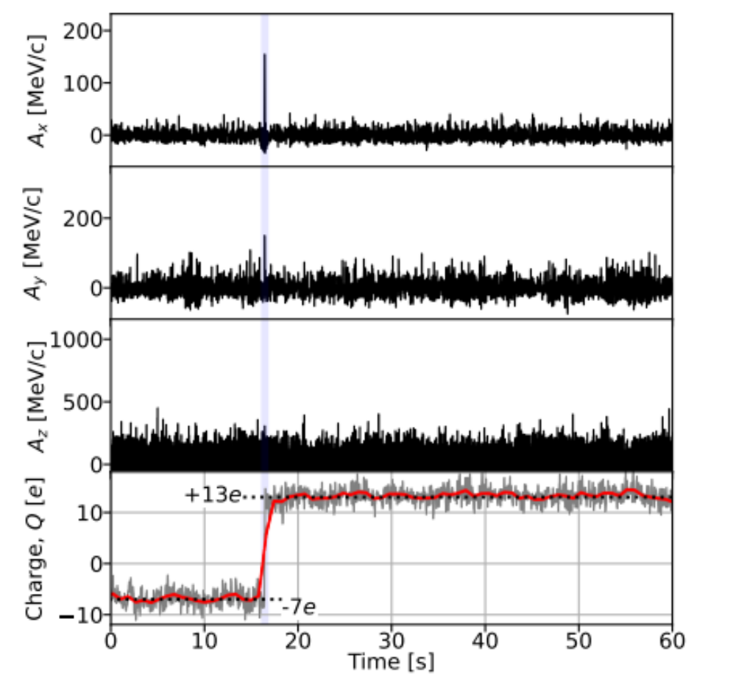

Detection of single nuclear decays (recoil)
Reconstruct recoil of the entire particle correlated with the decay time
Recoil coincident with charge change:
Zoom to decay time:
Signal to noise = 13
PRL133, 023602 (2024), arXiv:2402.13257

Slide 16


Family tree of magnetic trapping techniques (from Bas Hensen):
Magnetic levitation
Magnetic levitation typically allows larger objects to be trapped:
  $μ$g-mg up to “frog scale”
Diverse set of platforms now exist, giving lots of engineering freedom
Benefits:
  Can trap charge neutral particles (unlike RF traps, similar to optical traps)
  No need for a laser (and associated heating)
  Possibly read out directly with superconducting circuits (see talks by M. Juan, T. Penny)
Possible challenges:
  Displacement sensitivity (at least to date)
  Some options need cryogenics (+ low vibrations)
  Low trapping frequencies (similar to others in this mass range)
Talk by T. Penny
Talk by J. Harris
xenon
Talk by L. Darroch
D. Moore, Yale
https://benasque.org/2026qels/talks_contr/1710_2026-08_Benasque.pdf

Slide 17




Magnetic levitation (optical detection)
Vienna group has recently demonstrated optical detection of the motion of a levitated micromirror
  Previous work shining lasers directly on a superconductor quickly heats it and the particle drops
Magnetically levitated mirror ($m≈30μ$g):
Displacement sensitivity at ~10 pm/$\sqrt{Hz}$:
Levitators (PbSn)
Micromirror
To cool to ground state (or reach broadband SQL at this freq) requires ~10⁻¹⁷ m/$\sqrt{Hz}$ :
To keep improving need:
  Higher reflectivity
  More laser power
  Optical cavity
Or non-optical readout with sufficiently strong coupling (?)
D. Moore, Yale
Koller et al., arXiv:2609.17787 (2026)

Slide 18




Vibration isolation + ULDM (POLONAISE)
Additional challenge in many cryogenic setups is vibrations from cryostat
POLONAISE/Leiden group have reached 110 to 130 dB vibration isolation at 27 Hz resonance (acceleration noise at ~${10}^{−11} g$/$\sqrt{\text{Hz}}$)
Vibrations are about 20 dB above thermal noise at 50 mK, 40 dB above off-res SQL
Magnetically levitated 400 $μ$g mass:
Current and projected ULDM sensitivity:
2025 result
D. Moore, Yale
Amaral et al., PRL 134, 251001 (2025)
Uitenbroek et al., arXiv:2605.28479 (2026)

Slide 19





Charged particle trapping (Paul traps)
For charged particles, also possible to levitate with RF fields (see talks by M. Juan, S. Sangiorgio)
Additional examples (not comprehensive, see also Barker group [UCL], Millen group [KCL]):
Northup group (Innsbruck):
Hétet group (ENS Paris):
Novotny group (ETH Zurich):
Trap microdiamonds with NVs while avoiding heating
Spin cooling of diamond libration
Hybrid RF + optical trap
Aim for large state expansion in dark trap (no photon recoil)
Co-trapping of nanosphere + ion
Demonstrated ultra-high Q = 10¹⁰
See e.g. PRL 132, 133602 (2024)
See e.g. Nature 580, 56 (2020), as well as work by T. Li (Purdue)
See e.g. PRL 132, 253602 (2024)
Benefits:
Deep, large traps for a range of particle sizes (from ions to microparticles)
Dark traps are possible, with no recoil heating or internal heating from laser
    Alternatively, can combine with optical detection or trapping
Co-trapping with ions possible (Northup group)
Possible challenges:
  Particles are electrically charged and may couple to stray fields
  Charge changes (e.g. from nuclear decays) can produce impulses
D. Moore, Yale

Slide 20



Tethered oscillators (isolation without levitation)
Levitation is only one method for decoupling force noise (thermal noise, vibrations, etc)
Tethered systems also reach extreme performance with a number of techniques, e.g.:
Bulk acoustics (Chu, ETH Zurich):
  Cool environment to low temperatures (10 mK ~ 200 MHz)
  Decouple from phonon bath using a phononic crystal (with bandgap)
  Reach extremely high Q (e.g. via dissipation dilution and soft clamping, see talk by D. Wilson)
Excited state population ~1e-5 in GHz modes, PRL 136, 180802 (2026)
Membranes at room temp (Kippenberg, EPFL):
Isolated membrane near ground state at room temp, Nature 626, 512 (2024)
Ultra-high aspect ratio Si₃N₄ strings (Norte, Delft):
D. Moore, Yale
3 cm long, 70 nm thick string with Q = 6.6x10⁹, Nat Commun 15, 4255 (2024)

Slide 21


High-Q superfluid He resonator (Schwab, Caltech):
Tethered oscillators (cont’d)
  Use extremely low-loss materials (e.g., superfluid He, high-purity sapphire/quartz, etc, see talks by J. Davis, J. Harris, T. Deshpande)
  “Win with mass”
    Especially for accelerations, classical masses can significantly outperform smaller “quantum limited” masses
      Anyone who has ever tried to “beat Eot-Wash” in a fundamental physics measurement probably knows this
    Tethers often allow much larger masses to be used
Q >10⁸ for acoustic modes in superfluid He, J. Low Temp. Phys. 186, 233 (2017)
Eot-Wash Torsion Balance:
(Differential) acceleration sensitivity ~10⁻¹⁴ g/$\sqrt{\text{Hz}}$ at mHz frequencies for ~cm scale mass
D. Moore, Yale

Slide 22

Summary
Optomechanical systems are revolutionizing how we measure tiny forces and accelerations acting on masses in the lab
These systems have significant potential to impact searches for various weakly coupled phenomena in fundamental physics, with many applications already underway
There is a huge experimental toolbox already developed, which is likely only to grow in its capabilities in future years
Many of the best ideas are likely still to be identified, so excellent time to be creative
D. Moore, Yale

