Slide 1
Noble Gas Optomechanical Sensors
Lucas Darroch, Siddhant Mehrotra, Sylvie Sanok Dufallo, Jackie Baeza-Rubio, Joaquin Fernandez Odell, Clarke Hardy, Cecily Lowe, Aaron Markowitz, Yu-Han Tseng, Molly Watts, and David Moore

Slide 2
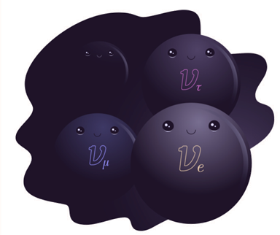
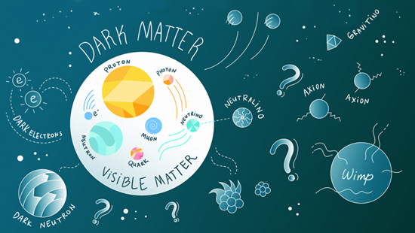
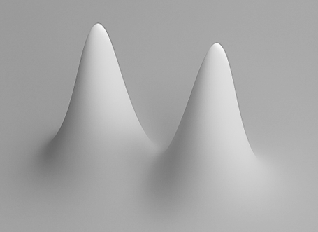
Why measure the faintest forces?
Big questions share a theme: weak coupling → weak forces
Neutrinos
Dark Matter
Gravity
https://www.symmetrymagazine.org/article/the-hidden-neutrino
https://www.symmetrymagazine.org/article/december-2013/four-things-you-might-not-know-about-dark-matter
Are there heavy, right-handed neutrinos that haven’t been observed?
Can we detect dark matter directly through it gravitational interactions?
What is the gravitational field sourced by a massive, delocalized particle?
These questions remain unanswered largely due to the extremely weak interactions of interest

Slide 3
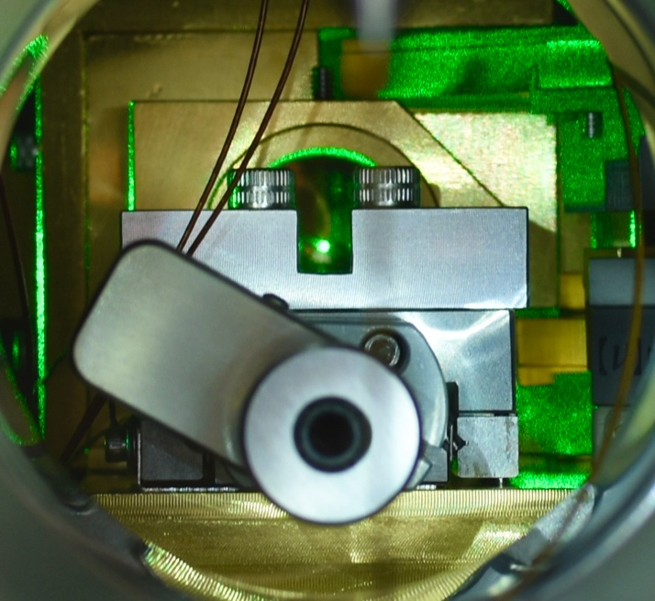
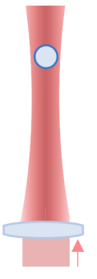
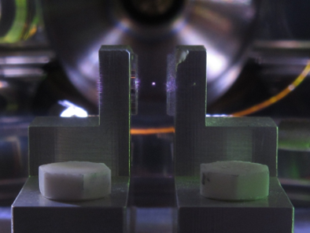
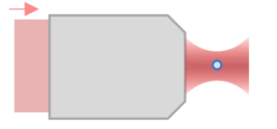
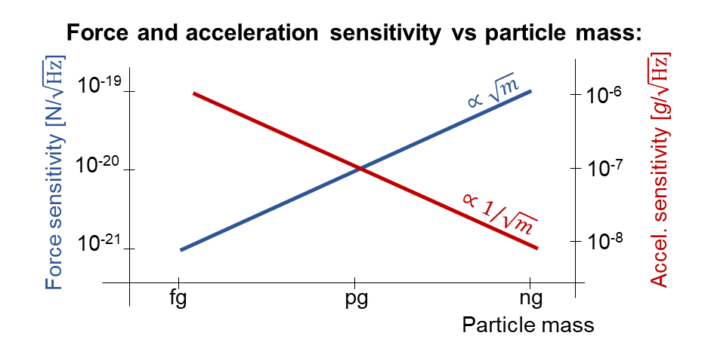


Optically levitated sensors
Levitation trap
(~1 – 30 𝜇m):
Highly focused tweezers
(~0.1 – 1𝜇m):
(~1 pg – 30 ng)
(~1 fg – 1 pg)
$$\vec{g}$$
$$\vec{g}$$
Trap with light (~ 100 mW): gradient forces create a stable potential well
Read out motion optically: scattered light → position signal
Force sensor: external forces shift the particle’s motion in the trap

Slide 4
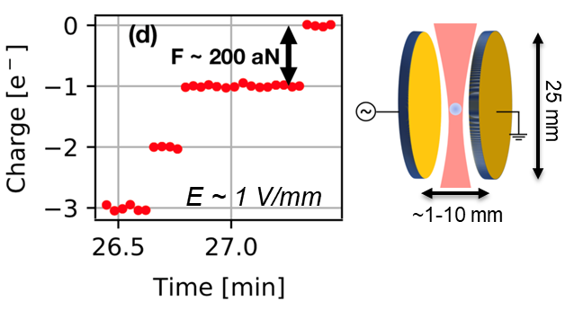
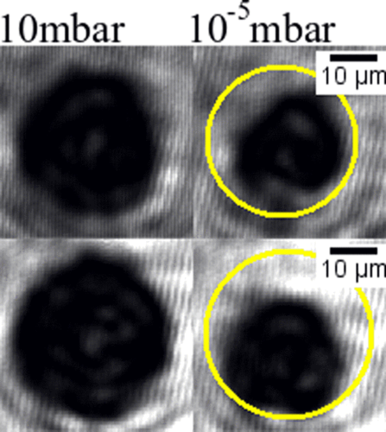
Silica challenges: heating and residual electrostatics
Net zero charge
Permanent multipole moments
High vacuum
Monteiro, et al. "Optical levitation of 10-ng spheres with nano-g acceleration sensitivity." Phys. Rev. A 96.6 (2017): 063841.
Notes:
Many of our experiments are searches for rare interactions, and the residual multipoles can interact more strongly than the forces we are searching for. Our calculations have shown that for the particles to vaporize at these pressure, the absorption must be ~ 3 orders of magnitude higher than what is achievable in high purity silica used in optical fibers.

Slide 5
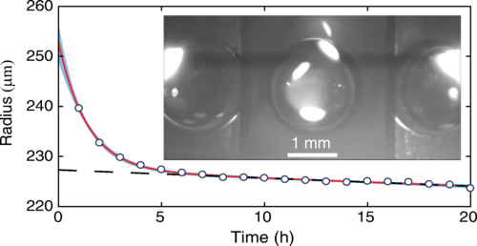
Noble gas sensors
Technology demonstrated in high vacuum
Noble gas properties
High bandgap
High purity
No optical phonons
Van der Waals attraction
Scintillation
Isotopically enrichable
A levitated droplet of superfluid He can cooled below its initial temperature, in equilibrium with its saturated vapor, through evaporative cooling in high vacuum
Optical levitation of superfluid He has been demonstrated by Weilbert, et al.:
Brown, et al. "Superfluid helium drops levitated in high vacuum." Phys. Rev. Lett. 130.21 (2023): 216001.
Weilert, et al. "Laser levitation of superfluid helium." Journal of low temp. phys. 98.1 (1995): 17-35.
Notes:
An alternative to optical grade silica particles is noble gas or hydrogen solid particles. Optical and magnetic trapping of levitated helium droplets in high vacuum has been demonstrated. To our knowledge this has not been done with solid hydrogen or nobles.

Slide 6
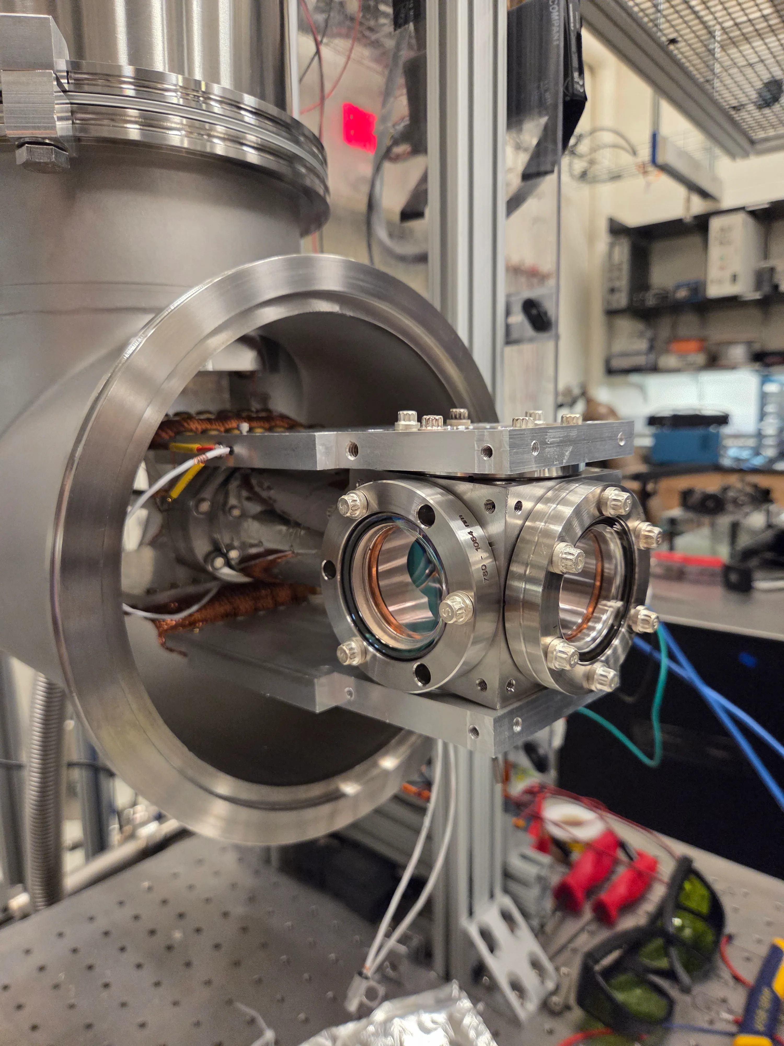
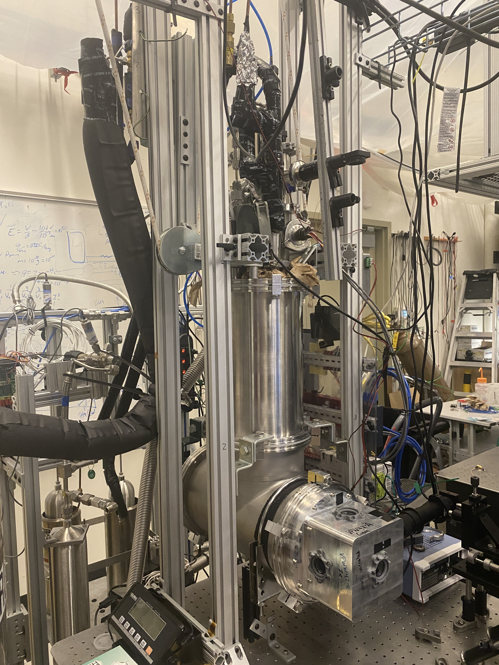
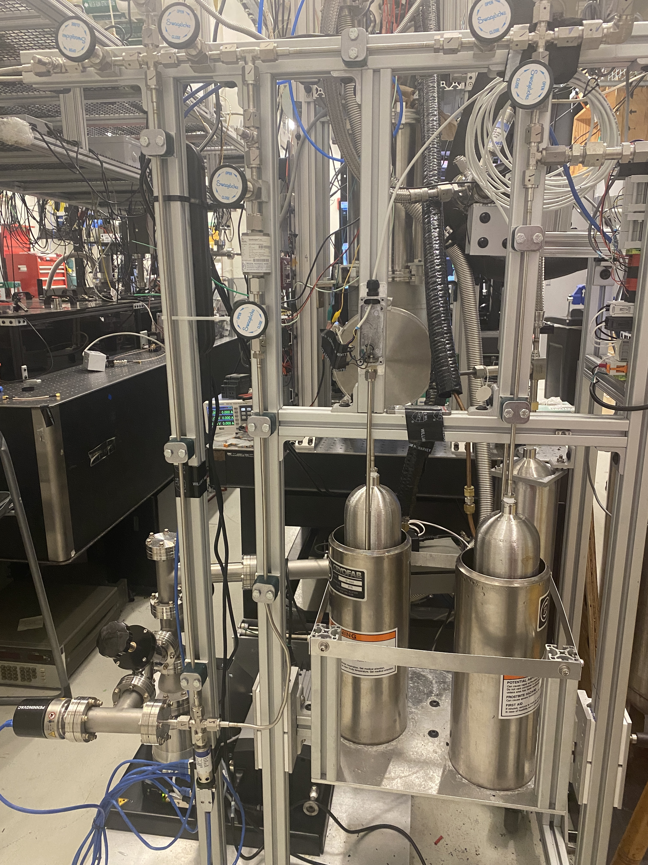
Optical cryostat

Slide 7
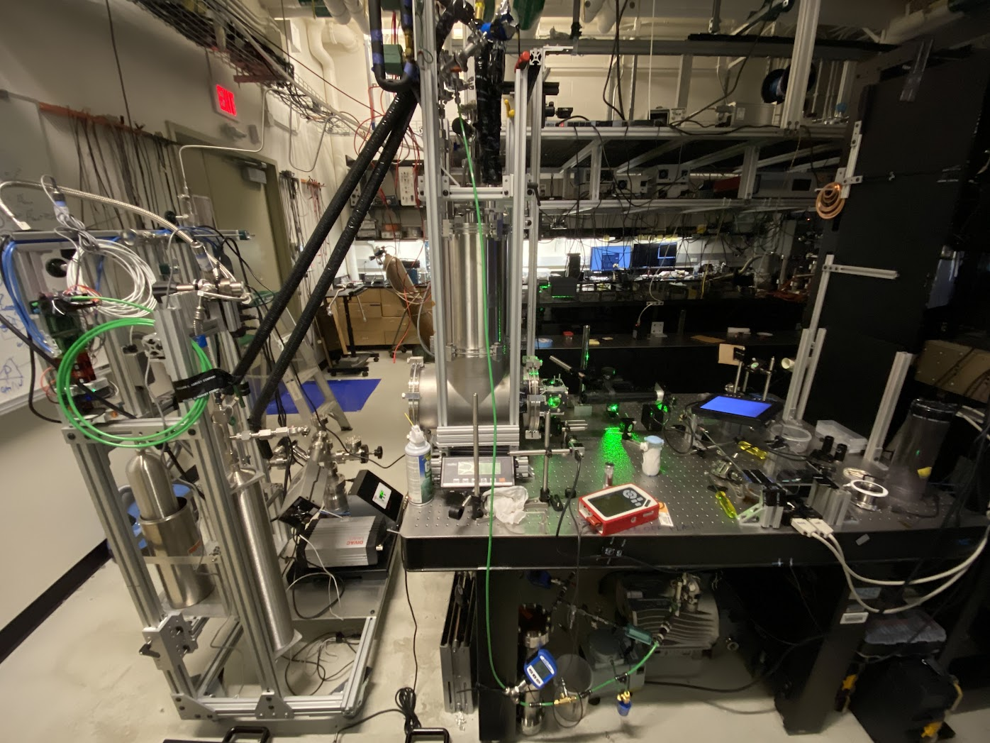
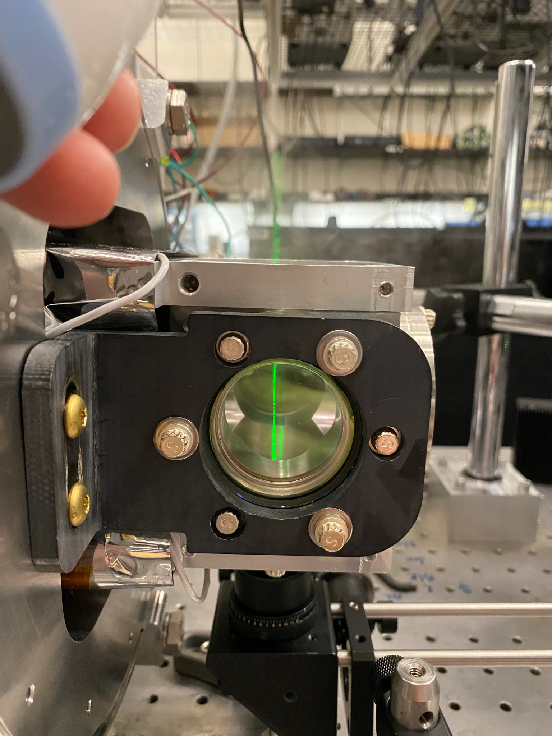
Tests with water

Slide 8
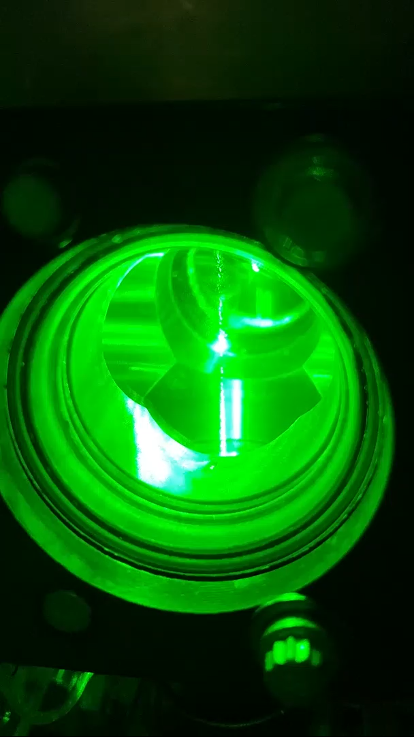
Tests with water

Slide 9
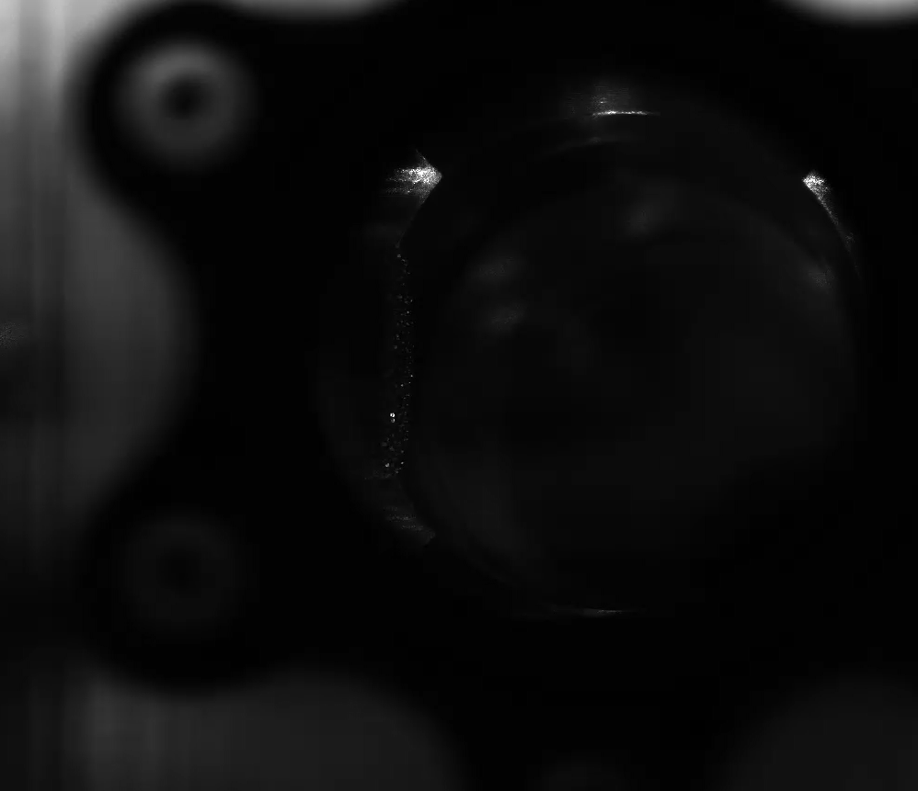
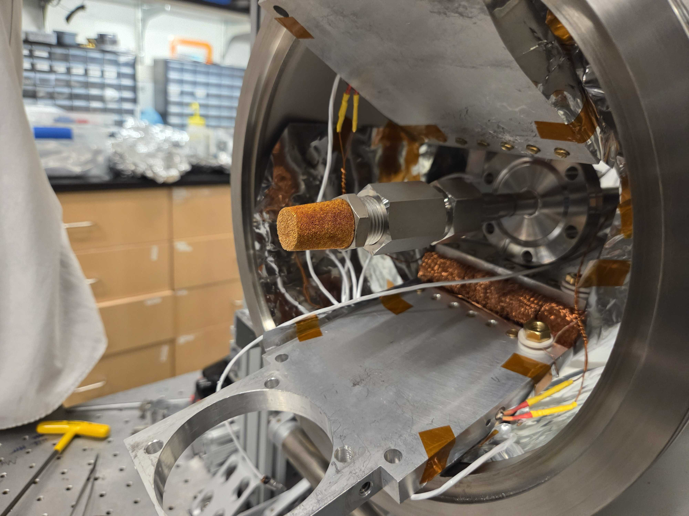
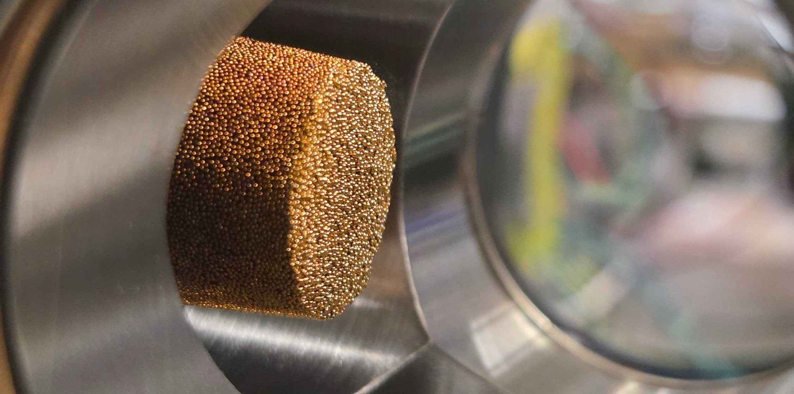
Nozzle for nucleating condensed xenon
Rayleigh scattering of xenon vapor shows beam
Flashes are xenon droplets passing through beam
Sintered brass ball nozzle (50 μm pores)

Slide 10
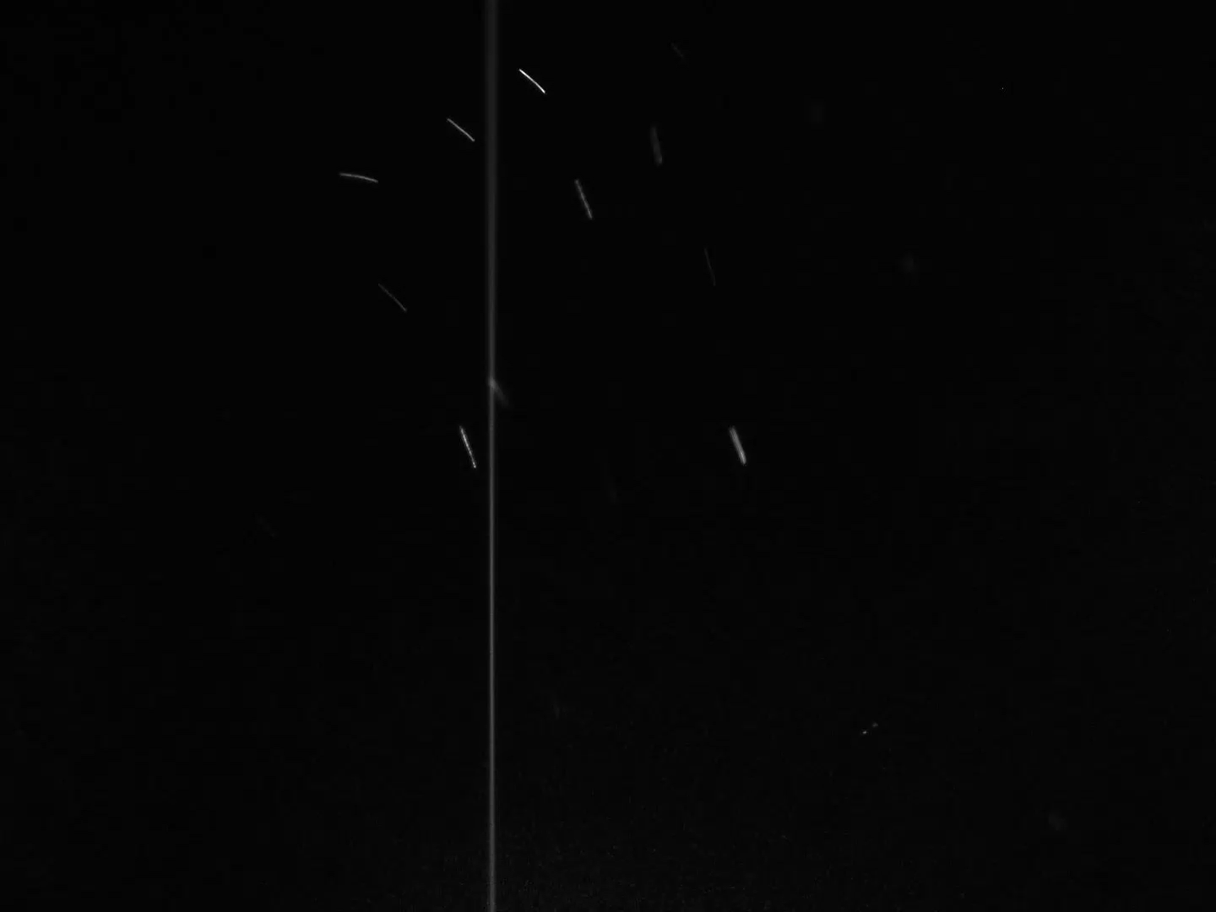
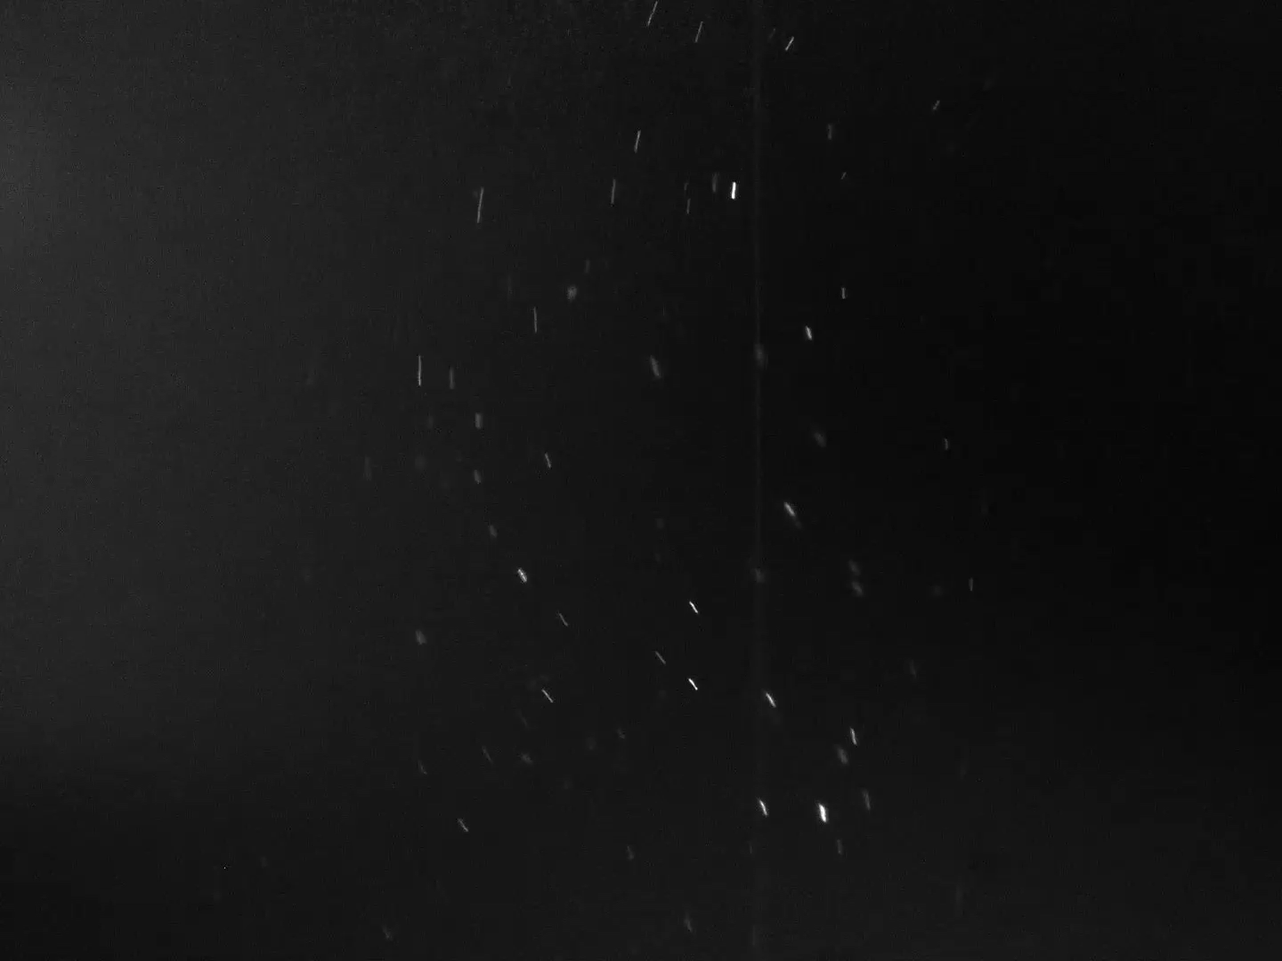
Initial results with xenon

Slide 11
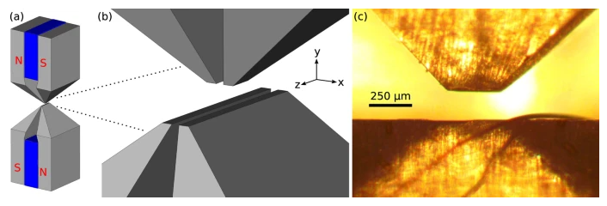
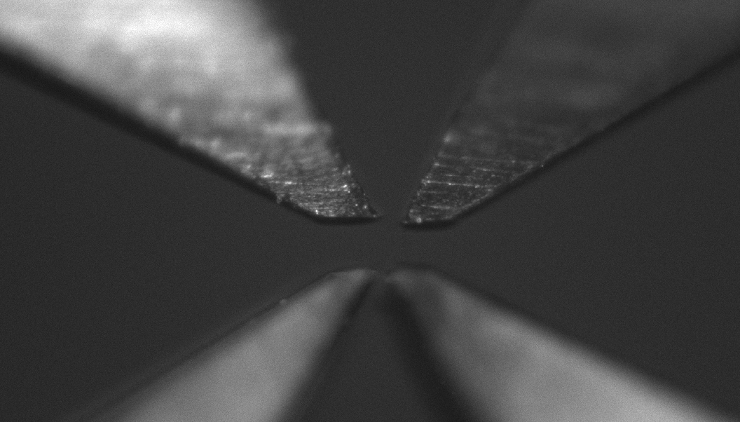
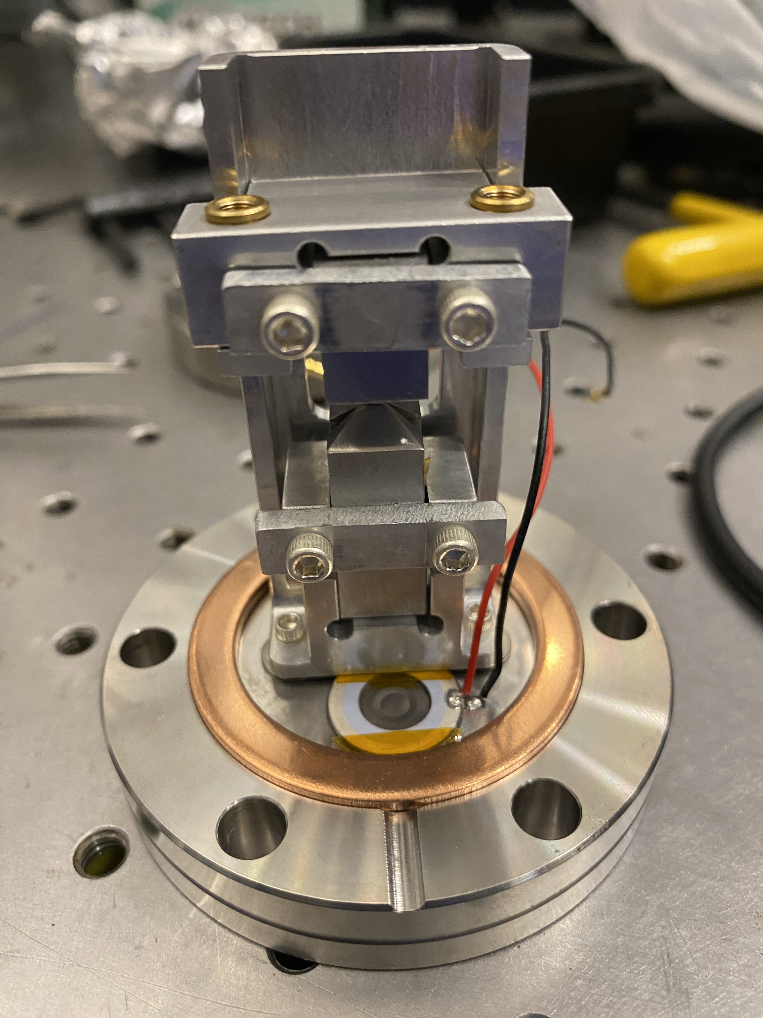
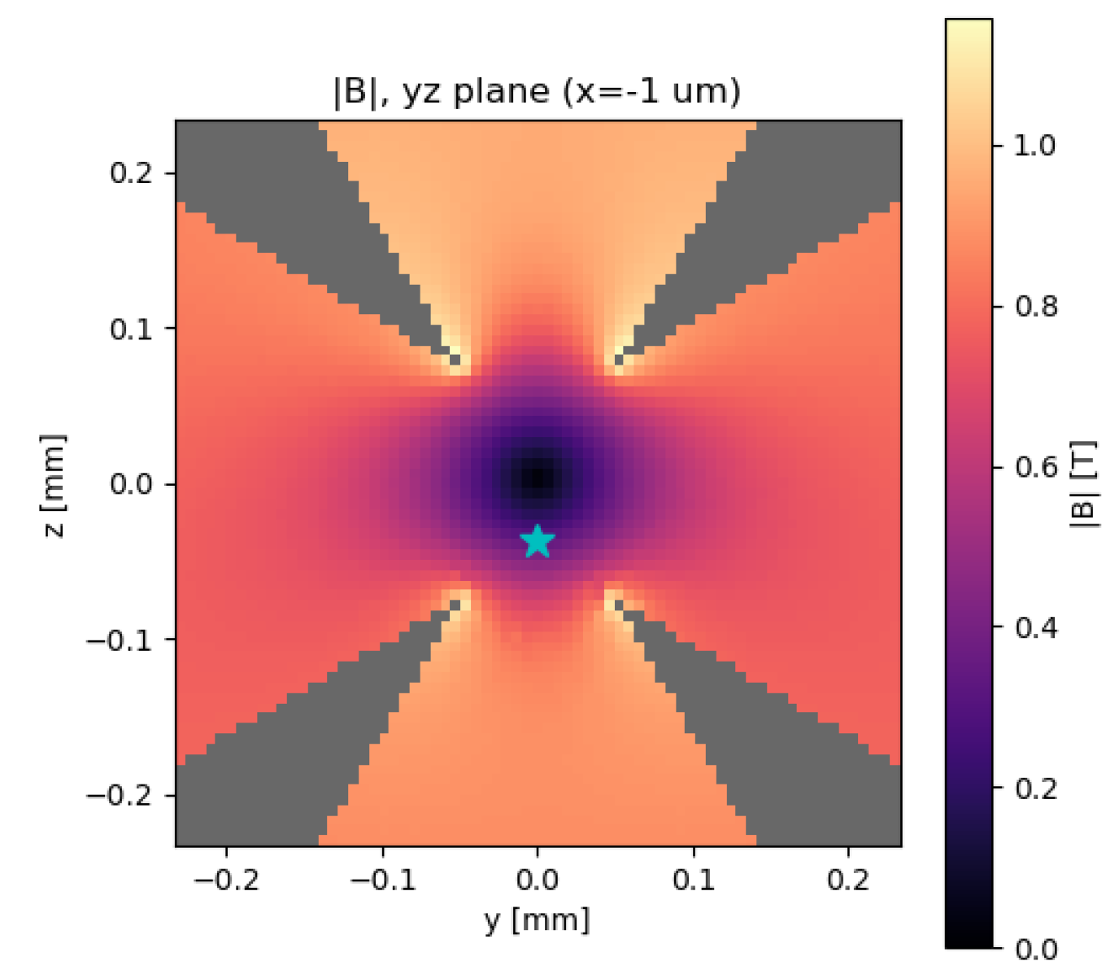
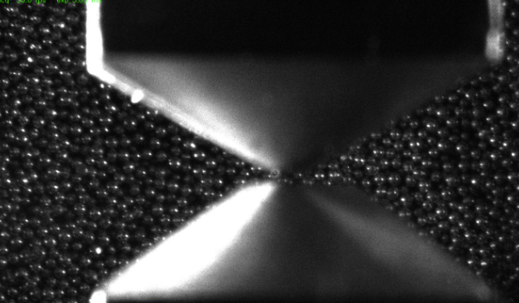
Magnetic Trap
200 µm
Hsu, JF., Ji, P., Lewandowski, C. et al. Cooling the Motion of Diamond Nanocrystals in a Magneto-Gravitational Trap in High Vacuum. Sci Rep 6, 30125 (2016). https://doi.org/10.1038/srep30125
2 mm

Slide 12
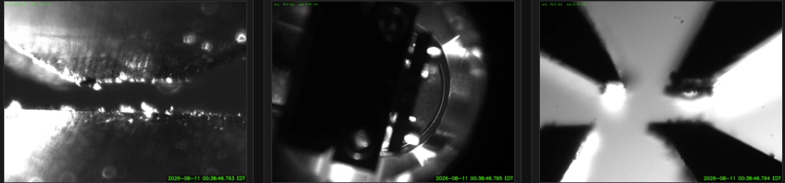
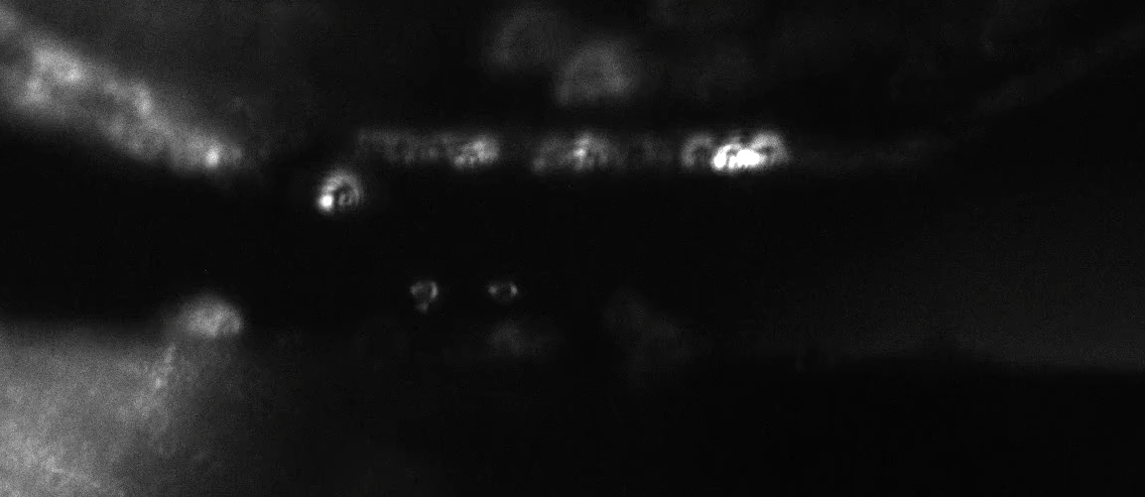
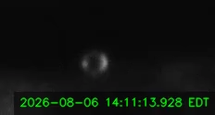
Initial results with magnetic trap

Slide 13
Magnetic Trap
200 µm
Hsu, JF., Ji, P., Lewandowski, C. et al. Cooling the Motion of Diamond Nanocrystals in a Magneto-Gravitational Trap in High Vacuum. Sci Rep 6, 30125 (2016). https://doi.org/10.1038/srep30125
2 mm

Slide 14
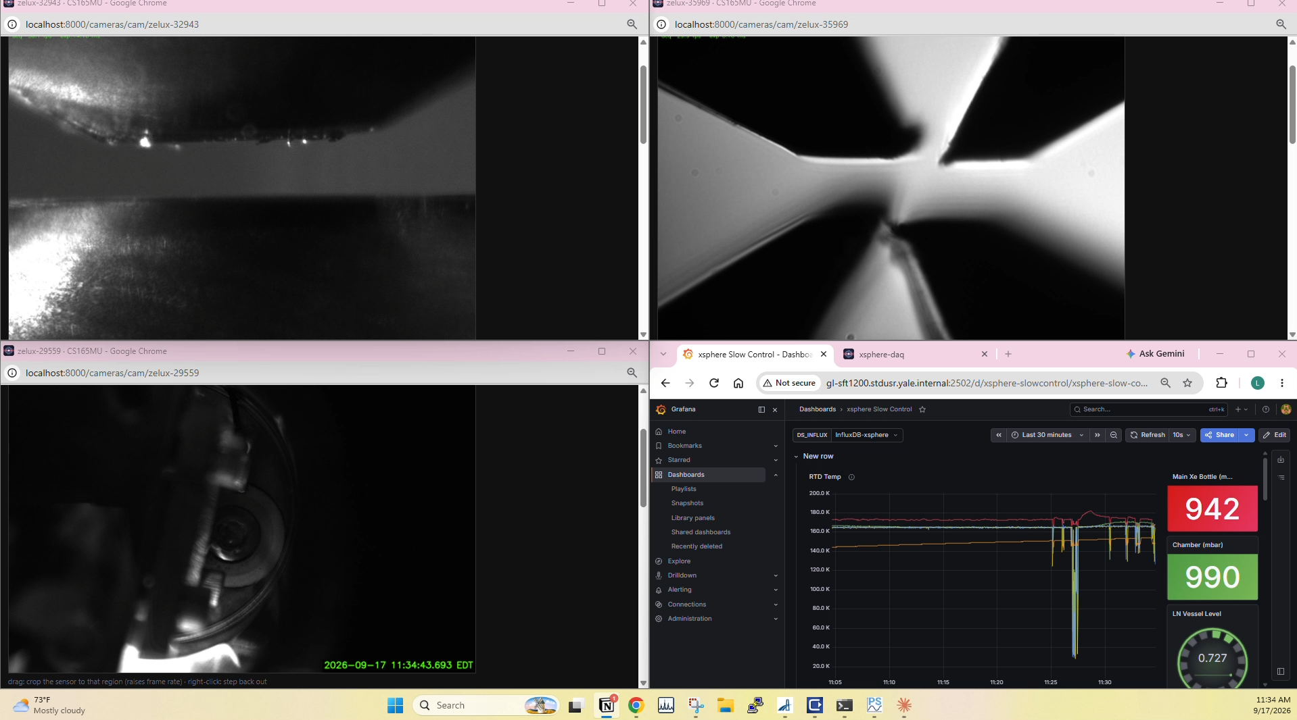
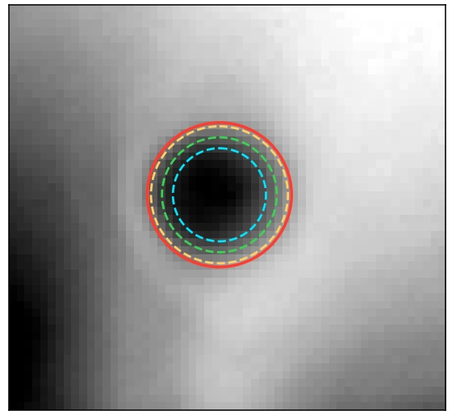
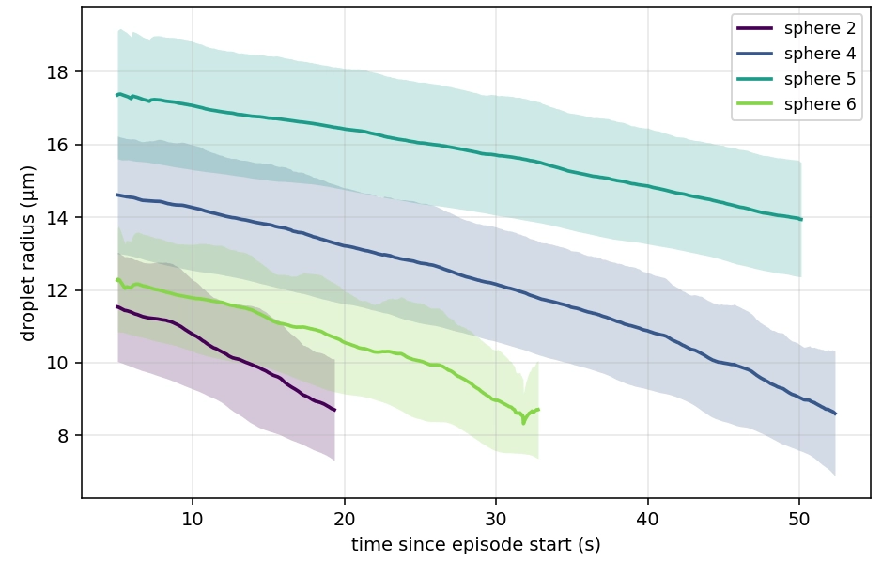
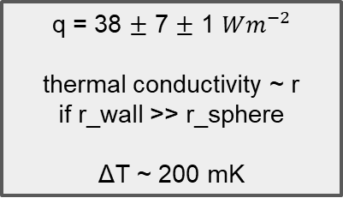
Initial results with nebulizer
q = 38 $±$ 7 $±$ 1 ${Wm}^{−2}$
thermal conductivity ~ r
if r_wall >> r_sphere
ΔT ~ 200 mK
Stat.
Sys.

Slide 15
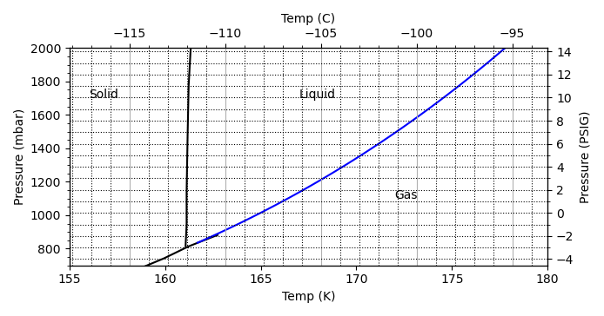
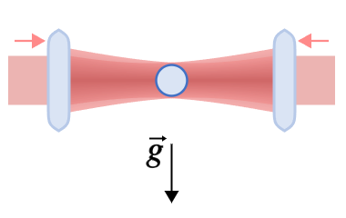
Next Steps
Pump sphere to high vacuum
  Have demonstrated with water before evaporating (medium vac.)
    Must pump fast enough to reduce heat load from environment
    Slow enough to reduce effects of wind
Setup counter propagating beam
  Measure position and control through feedback loop
  Cool cryostat to minimum temperature
  Shrink xenon via sublimation
  How small of a particle can remained trapped?
Counter-propagating trap
(? – 100 𝜇m):
(? – 30 ng)

Slide 16
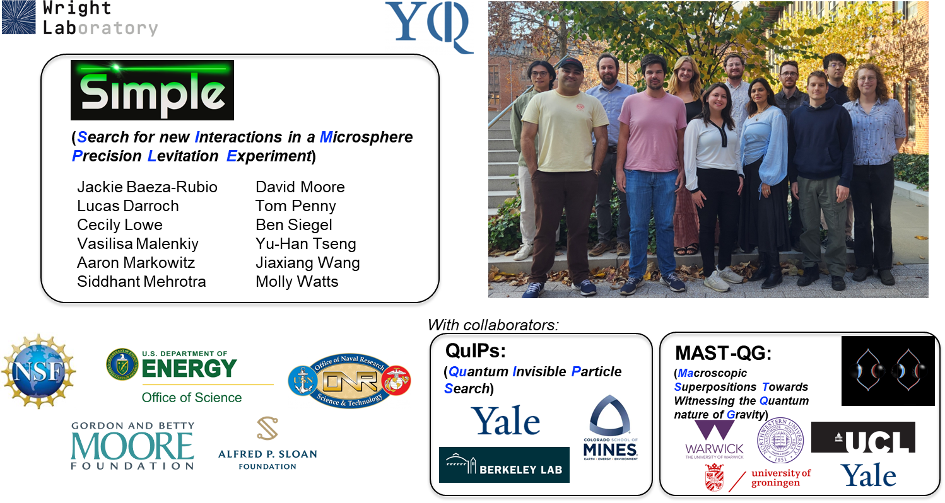
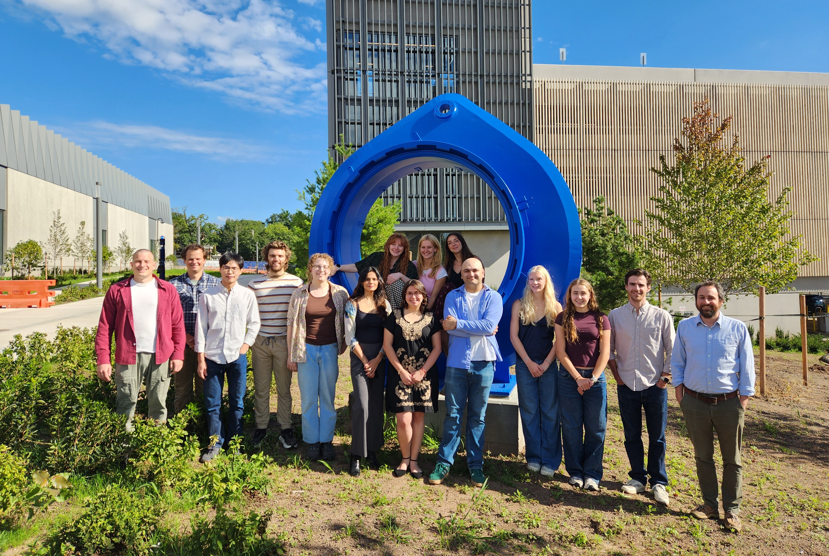
Thank you

Slide 17
Backup slides

Slide 18
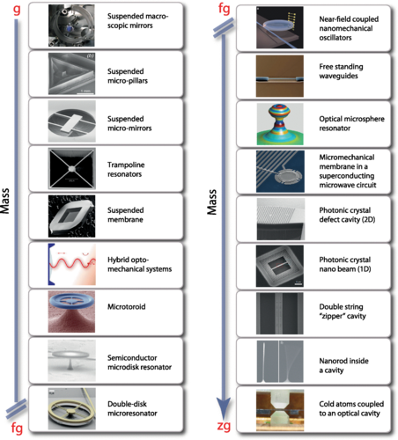
Optomechanical force-sensing landscape
Optomechanical systems are revolutionizing how we measure tiny forces
  Pioneering work by the gravitational wave community
  A wide range of “optomechanical” sensors are now reaching quantum measurement limits
These sensors are extremely sensitive to tiny forces or accelerations
  In the sub-ng range, reaching sensitivity to the forces imparted by single sub-atomic particles!
For more details see, e.g.:
        “Snowmass 2021: Quantum Sensors for HEP Science,” arXiv:2203.07250.
        "Mechanical Quantum Sensing in the Search for Dark Matter,” Quant. Sci.
        Tech. 6 024002 (2021), arXiv:2008.06074
        “Searching for new physics using optically levitated sensors,” Quant. Sci. Tech.
        6 014008 (2021), arXiv:2008.13197
        “Quantum sensing for particle physics,” Nature Reviews Physics 6, 329 (2024)
        …
Levitated objects: ~fg to mg
Aspelmeyer, et al. "Cavity optomechanics." Rev. Mod. Phys. 86.4 (2014): 1391-1452.

Slide 19
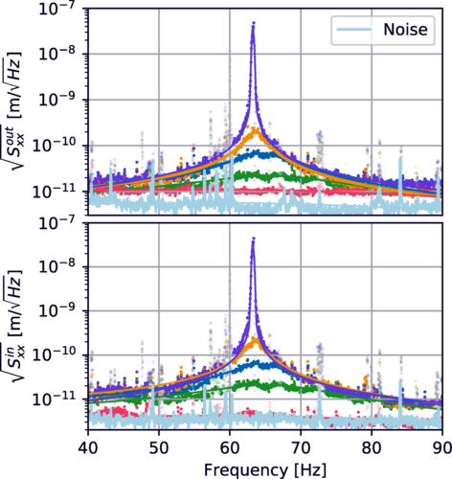
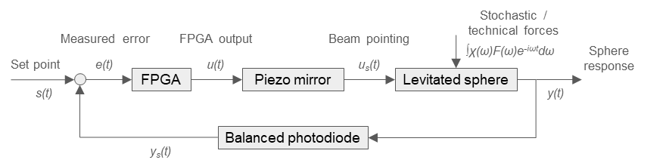
Cold damping of a levitated mass
Microsphere detection and feedback
Readout: scattered light encodes x(t)
Controller: estimate velocity v(t) and apply negative damping
Actuation: modulate beam pointing or trap power
Outcome: lower COM temperature / amplitude
Wang, et al. "Mechanical detection of nuclear decays." Phys. Rev. Lett. 133.2 (2024): 023602.
Monteiro, et al. "Force and acceleration sensing…" Phys. Rev. A 101.5 (2020): 053835.

Slide 20
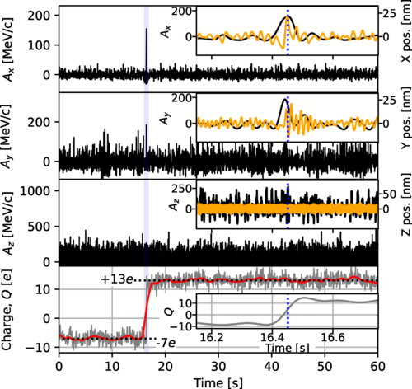
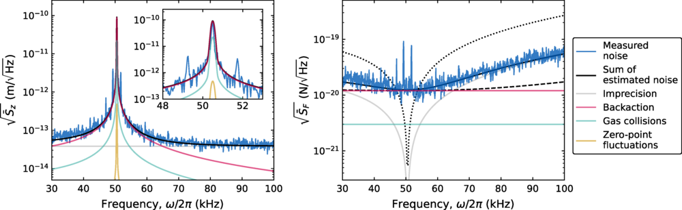
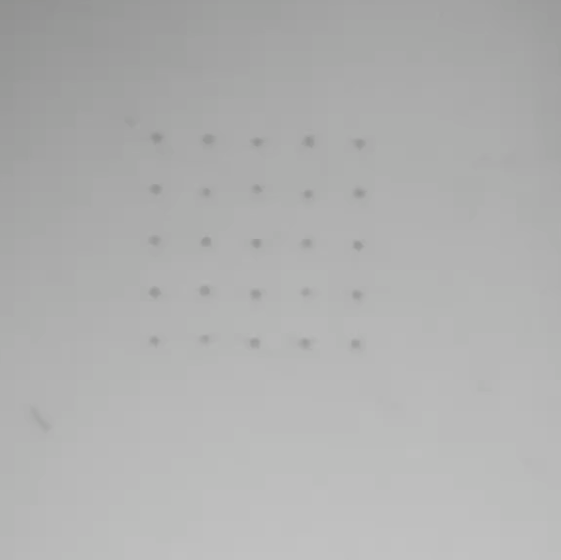

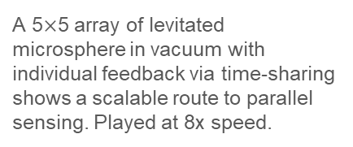

Techniques with levitated sensors
Control charge state with single electron accuracy. Calibrate forces with dynamic electric fields.
Mechanical detection of nuclear decay recoil; a large charge step coincident with a motional “kick” from an escaping alpha particle.
Monteiro, et al. "Force and acceleration sensing…" Phys. Rev. A 101.5 (2020): 053835.
Wang, et al. "Mechanical detection of nuclear decays." Phys. Rev. Lett. 133.2 (2024): 023602.
Optical tweezer nanosphere readout approaches the SQL, demonstrating quantum-sensing performance in a levitated platform.
A 5$×$5 array of levitated microsphere in vacuum with individual feedback via time-sharing shows a scalable route to parallel sensing. Played at 8x speed.
100 $μ$m
Tseng, et al. "Search for dark matter scattering from optically levitated nanoparticles." PRX Q. 6.4 (2025): 040367.
Siegel, et al. "Optical levitation of arrays of microspheres." Phys. Rev. A 111.3 (2025): 033514.

Slide 21
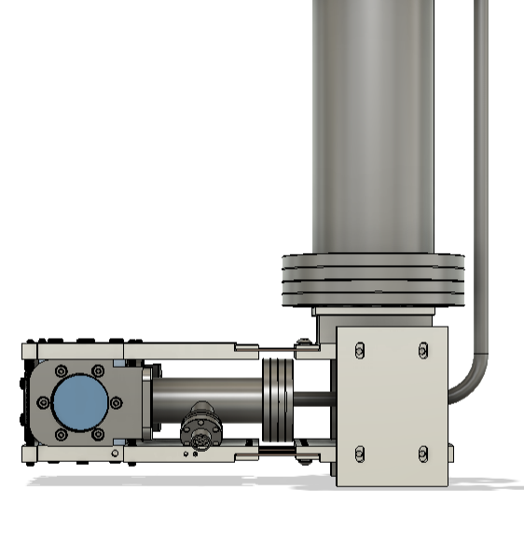
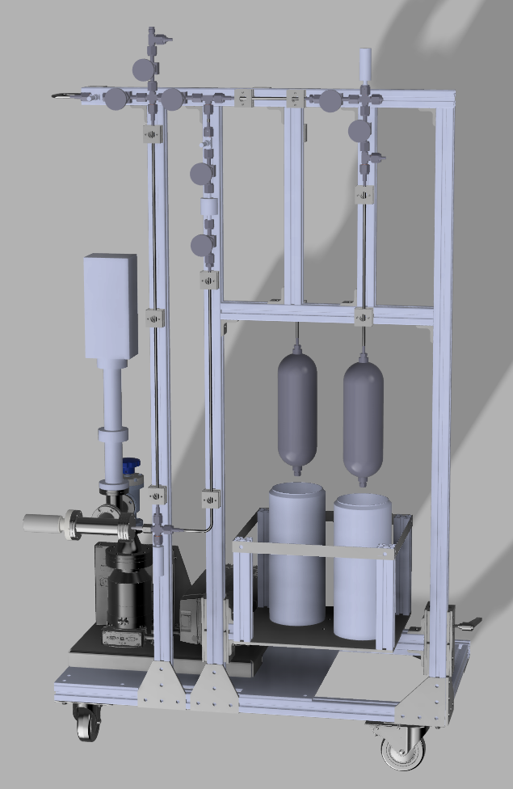
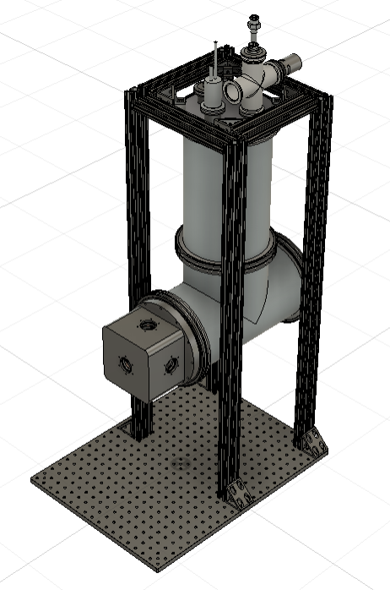
Optical cryostat for levitating solid nobles
Gas handling system
Xe supply
LN
Heat
Outer vacuum

Slide 22
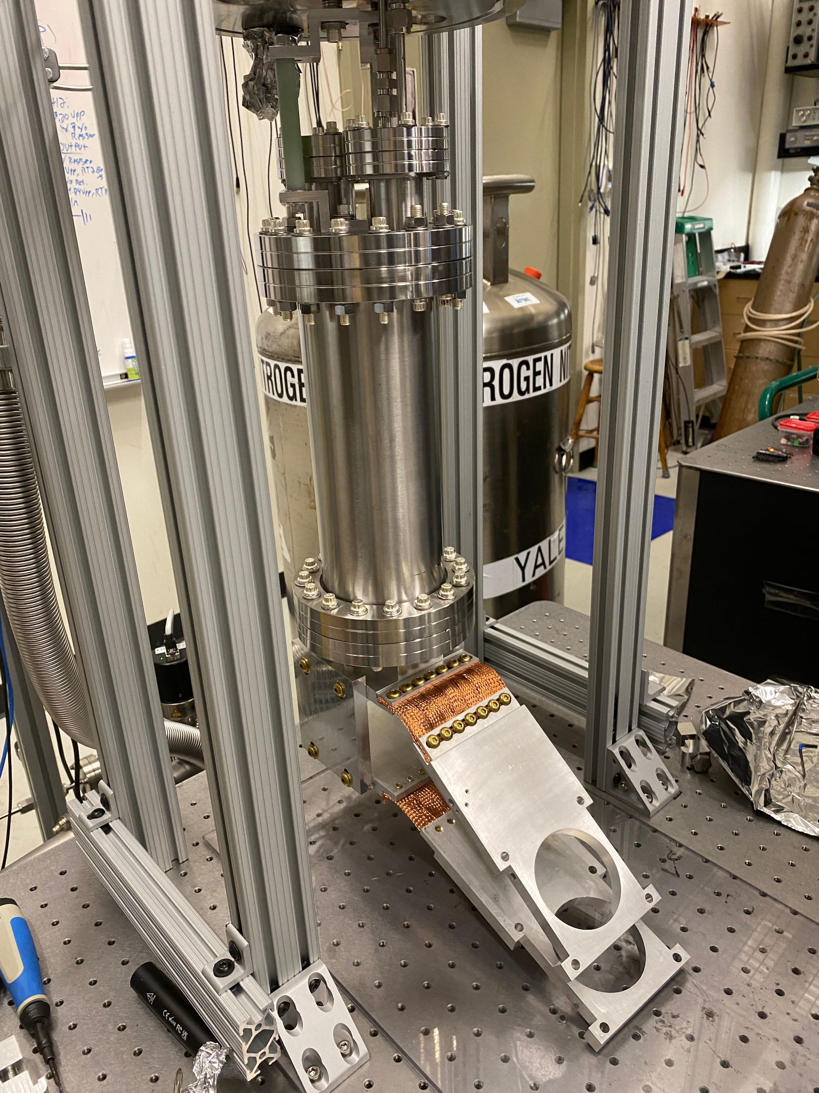
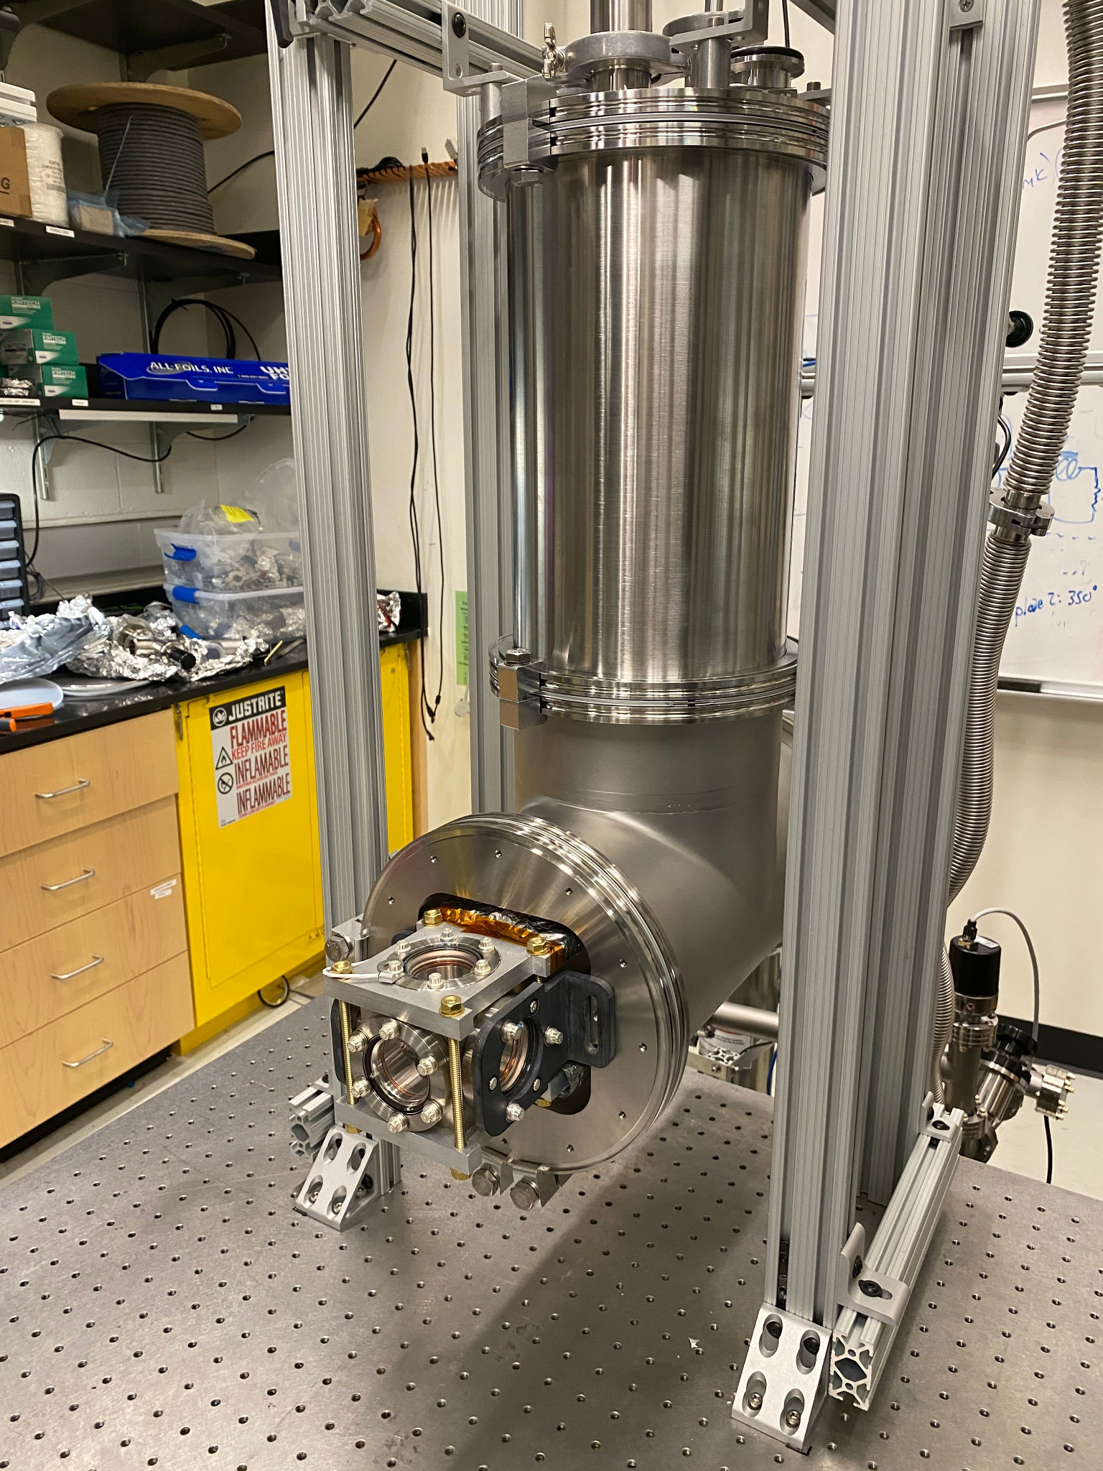

Slide 23

Commissioning cryostat
Can cool cell to ~ 110 K (Kr/Xe trapping)
Froze xenon to chamber walls with first run → temperature sensors ~ 10 K hotter than internal wall temperature
Calibrate temperature sensors to phase transition and triple point → primary thermometer
Frozen xenon

Slide 24
Solid xenon temperature and sublimation time
Dominant heat source likely thermal radiation from walls exciting phonons
Assume ε = 1 for thermal radiation → calculate sphere temperature and sublimation time

Slide 25

Sensitivity for various experiments
Moore, David C., and Andrew A. Geraci. "Searching for new physics using optically levitated sensors." Quantum Science & Technology 6.1 (2021): 014008.

Slide 26



Demonstration with water droplets
Optical trapping of water droplets extensively studied, e.g.,
Gain experience trapping liquid from a cloud
100 μm
50 μm

Slide 27


Geometric patterns in xenon ice

Slide 28



Coherent enhancement
Recoil felt by any number nuclei if λ $≪$ L
Recoil felt by whole sphere is λ $≈$ L
Bound state beta decay emits only $\overline{υ_{e}}$
Can the entire sphere recoil with exactly $Q_{β}$

