Slide 1


Searching for Dark Matter with Two-Stage Atomic Transitions
Andrew Buchanan

Slide 2
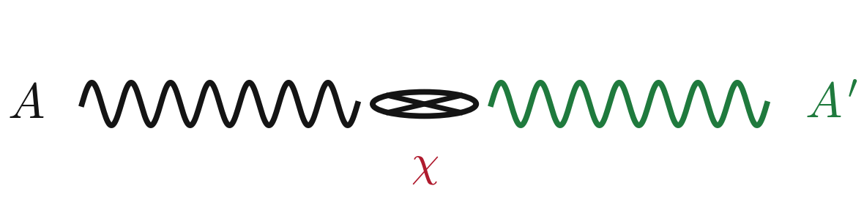
Dark Photon
Partner to photon with nonzero mass
Photon can transition to dark photon and vice versa
Could make up bulk of dark matter mass
Could be a mediator between SM and DM
Could just exist

Slide 3
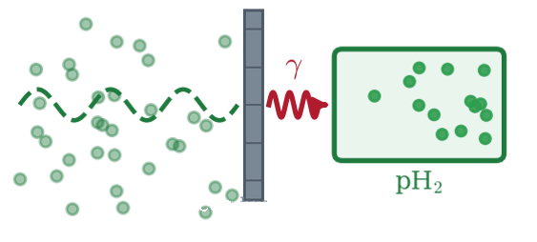
Dark Photon Searches
From the Halo

Slide 4
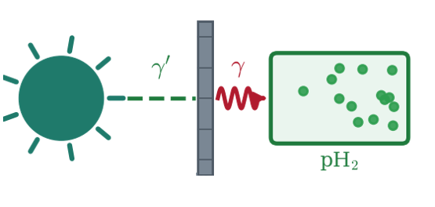
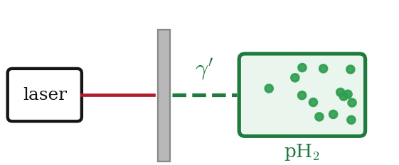
Dark Photon Searches
Light Shining Through a Wall
From the Halo
From the Sun

Slide 5
Dark Photon Searches
New detection method
Light Shining Through a Wall
From the Halo
From the Sun

Slide 6


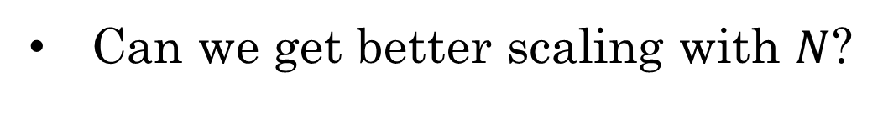

Quantum Detection
$$Signal=NΓt$$
$$Γ≈n_{x}v_{x}A^{4}σ_{nx}$$
$$N=\#Argon,Xenon$$
Can we get better scaling with $N$?

Slide 7
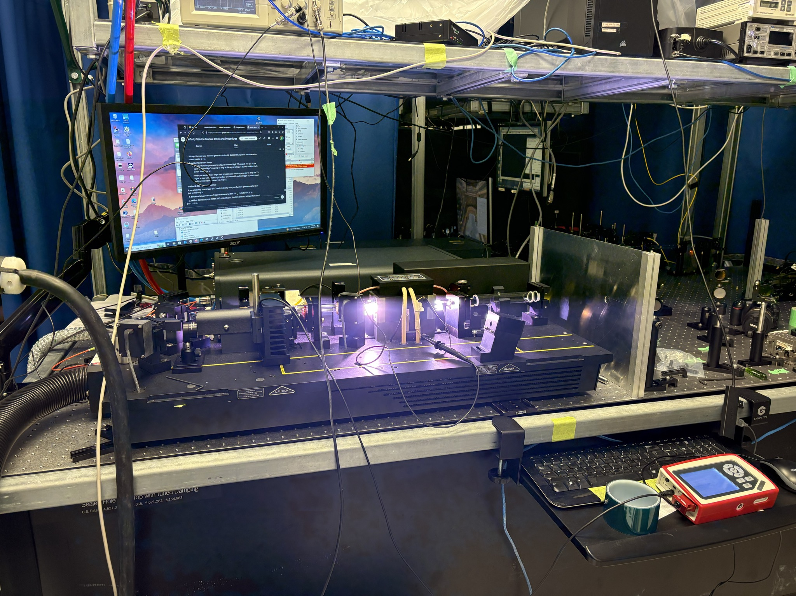
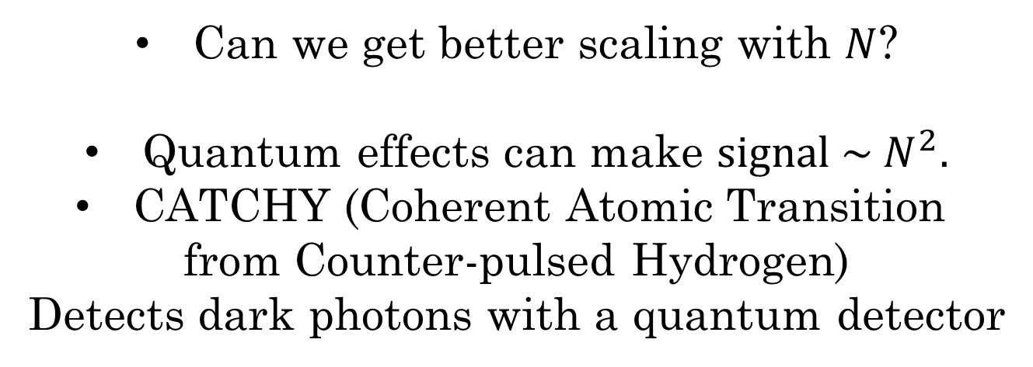
Quantum Detection
$$Signal=NΓt$$
$$Γ≈n_{x}v_{x}A^{4}σ_{nx}$$
$$N=\#Argon,Xenon$$
Can we get better scaling with $N$?
Quantum effects can make ${signal \sim N}^{2}.$
CATCHY (Coherent Atomic Transition
from Counter-pulsed Hydrogen)
Detects dark photons with a quantum detector

Slide 8
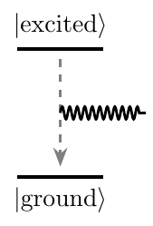
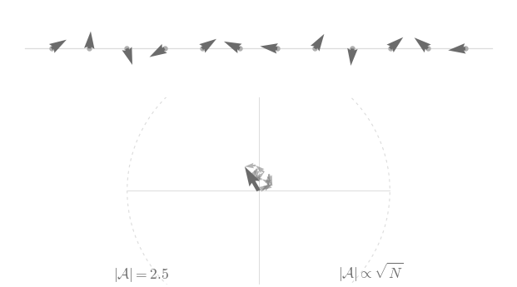
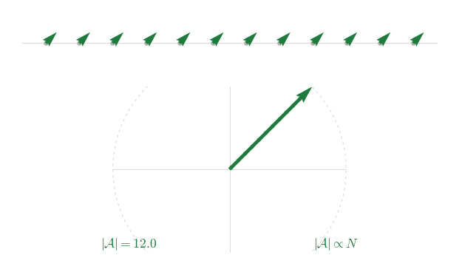
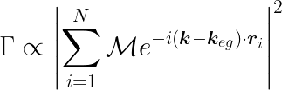

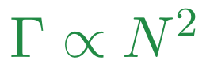
Coherent Atomic Emission
RANDOM QUANTUM PHASES
LOCKED QUANTUM PHASES
Emission triggered by an
incoming dark photon
5

Slide 9
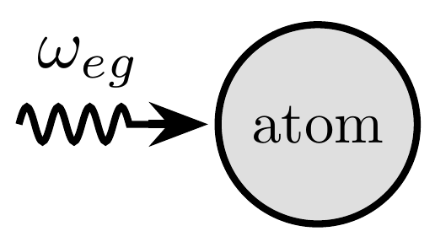
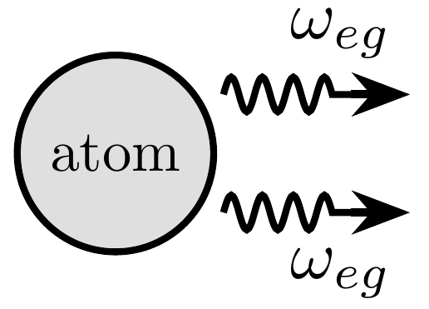
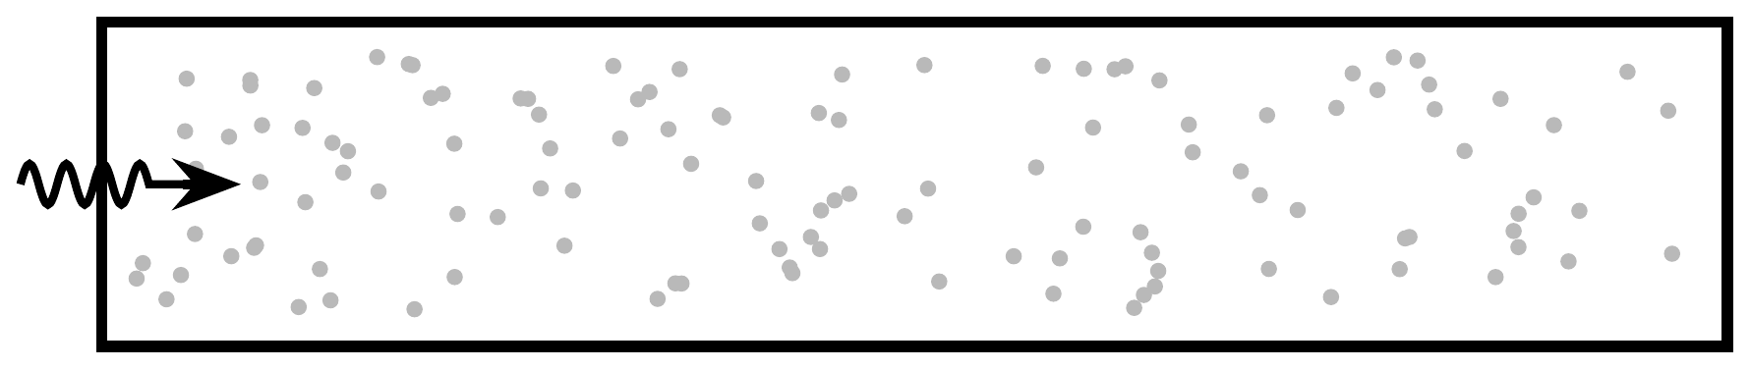
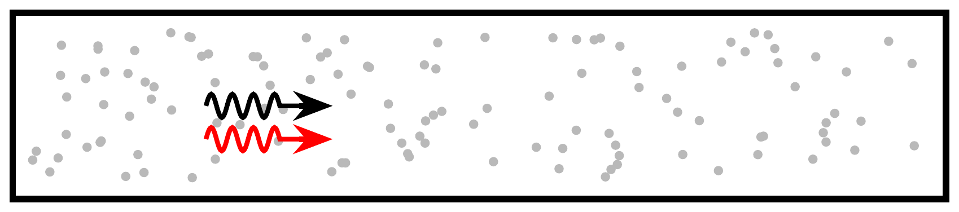
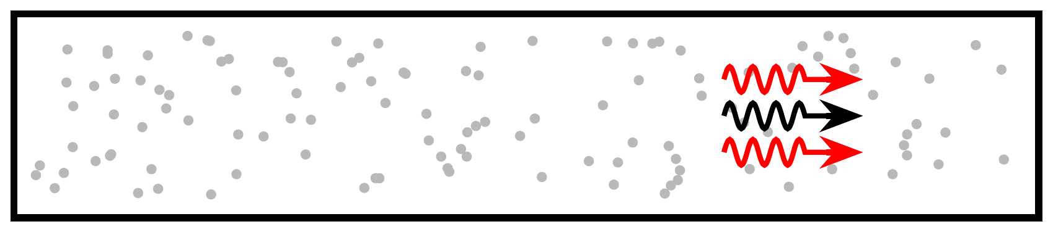
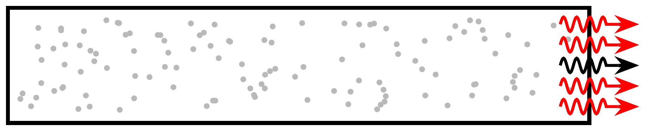

Stimulated One-Photon Emission
Dark Photon
Photon Signal

Slide 10
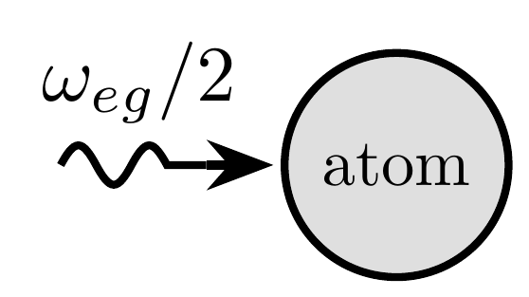
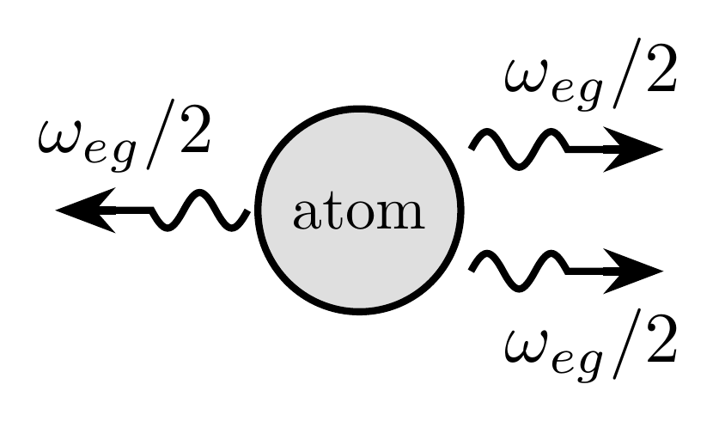
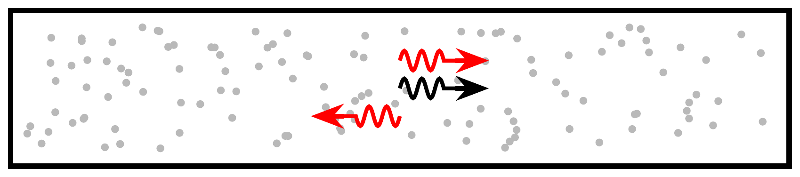
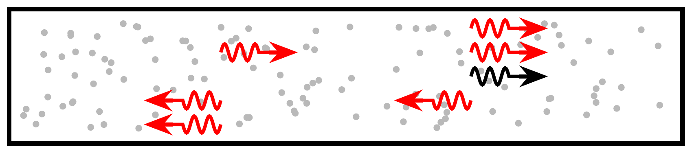
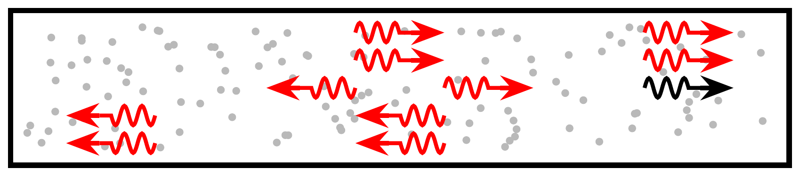
Stimulated Two-Photon Emission
Dark Photon
Building signal
in centre

Slide 11
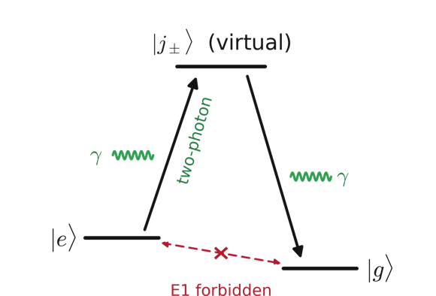
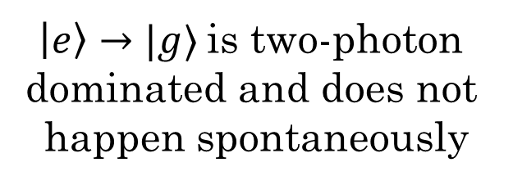

Two-Stage Emission
Need atom/molecule with this structure
$\left|e\right\rangle →|g⟩$ is two-photon
dominated and does not
happen spontaneously
$ω_{eg}≪ω_{jg},ω_{je}$

Slide 12
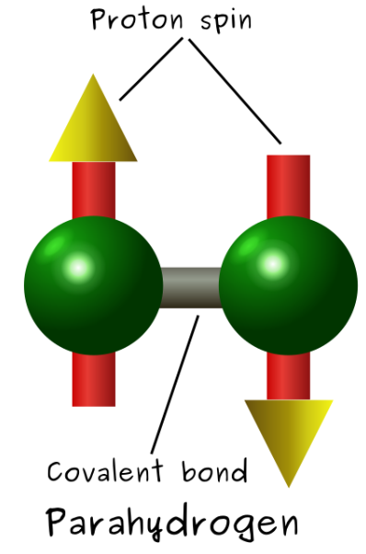
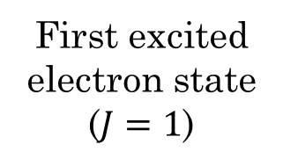
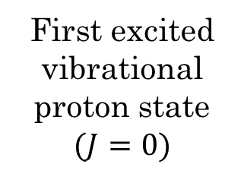
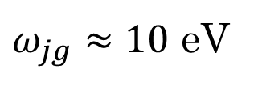
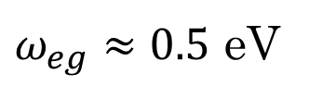

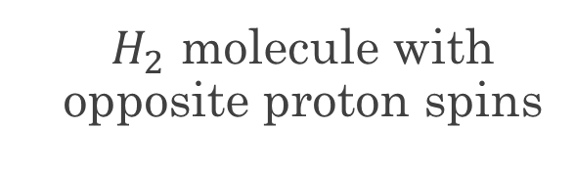
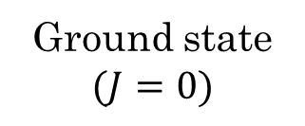
A Candidate: Parahydrogen
  $H_{2}$ molecule with opposite proton spins
$$T_{spontaneous}=100 Myr$$
First excited electron state
($J=1$)
$ω_{jg}≈10$ eV
First excited vibrational
proton state
$$(J=0)$$
$ω_{eg}≈0.5$ eV
Ground state
$$(J=0)$$

Slide 13
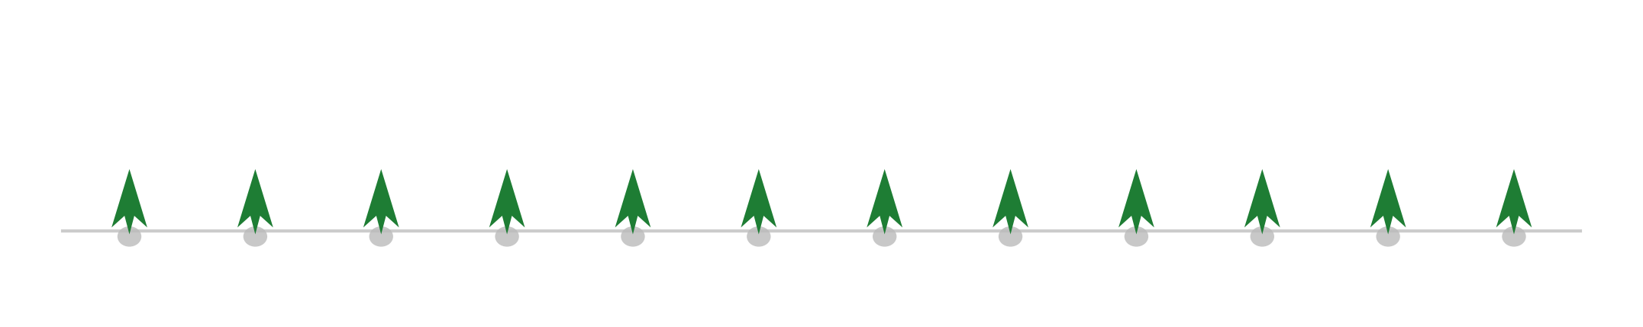
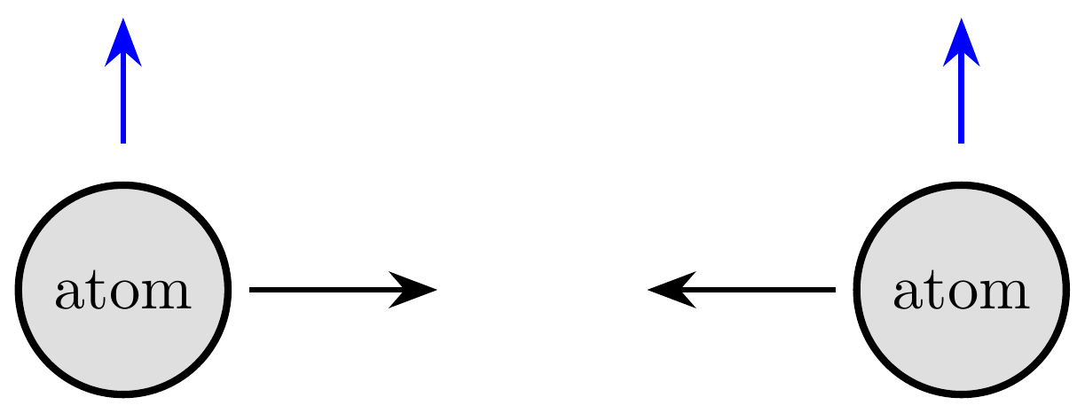

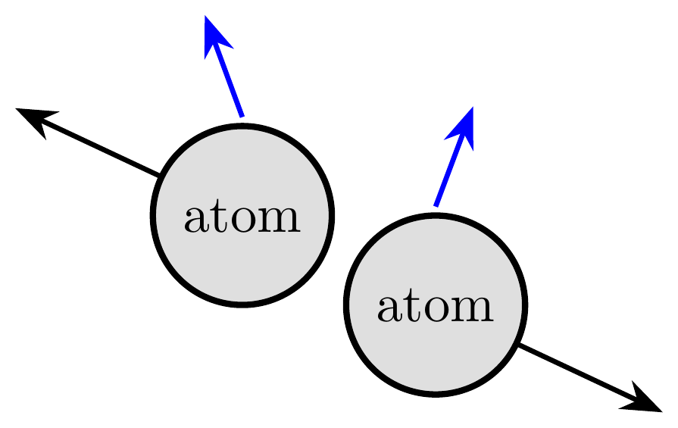

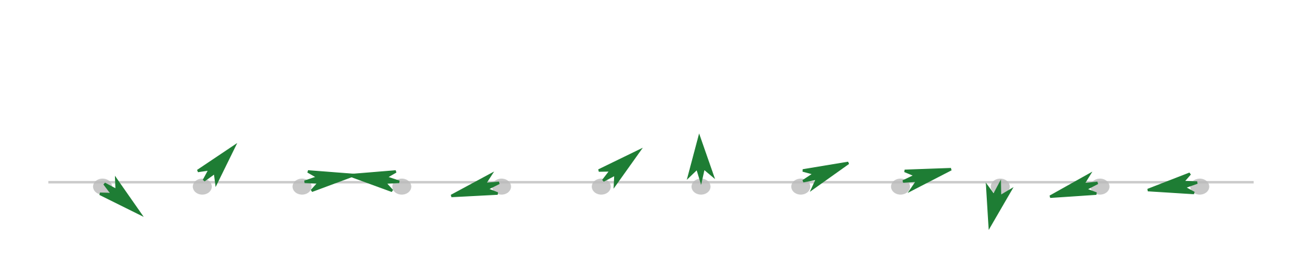
Collisional Decoherence
Atoms collide and their dipoles misalign
Enough collisions kill the overall coherent signal
No infinite gain
Want to minimize temperature—
many
collisions

Slide 14



The Protocol
(a) Pump Phase — two counter-propagating lasers phase-lock the sample
pump
$2.5\frac{MW}{{cm}^{2}}$.
$2.5\frac{MW}{{cm}^{2}}$.
pump
R
L
signal
(b) Trigger Phase — a trigger laser deexcites the sample
R
signal
L
L
trigger
$0.25\frac{MW}{{cm}^{2}}$ in pilot run
All light is circularly polarized has $ω=\frac{E_{e}−E_{g}}{2ℏ}=0.26 eV$ and $4.8 μ$m.

Slide 15
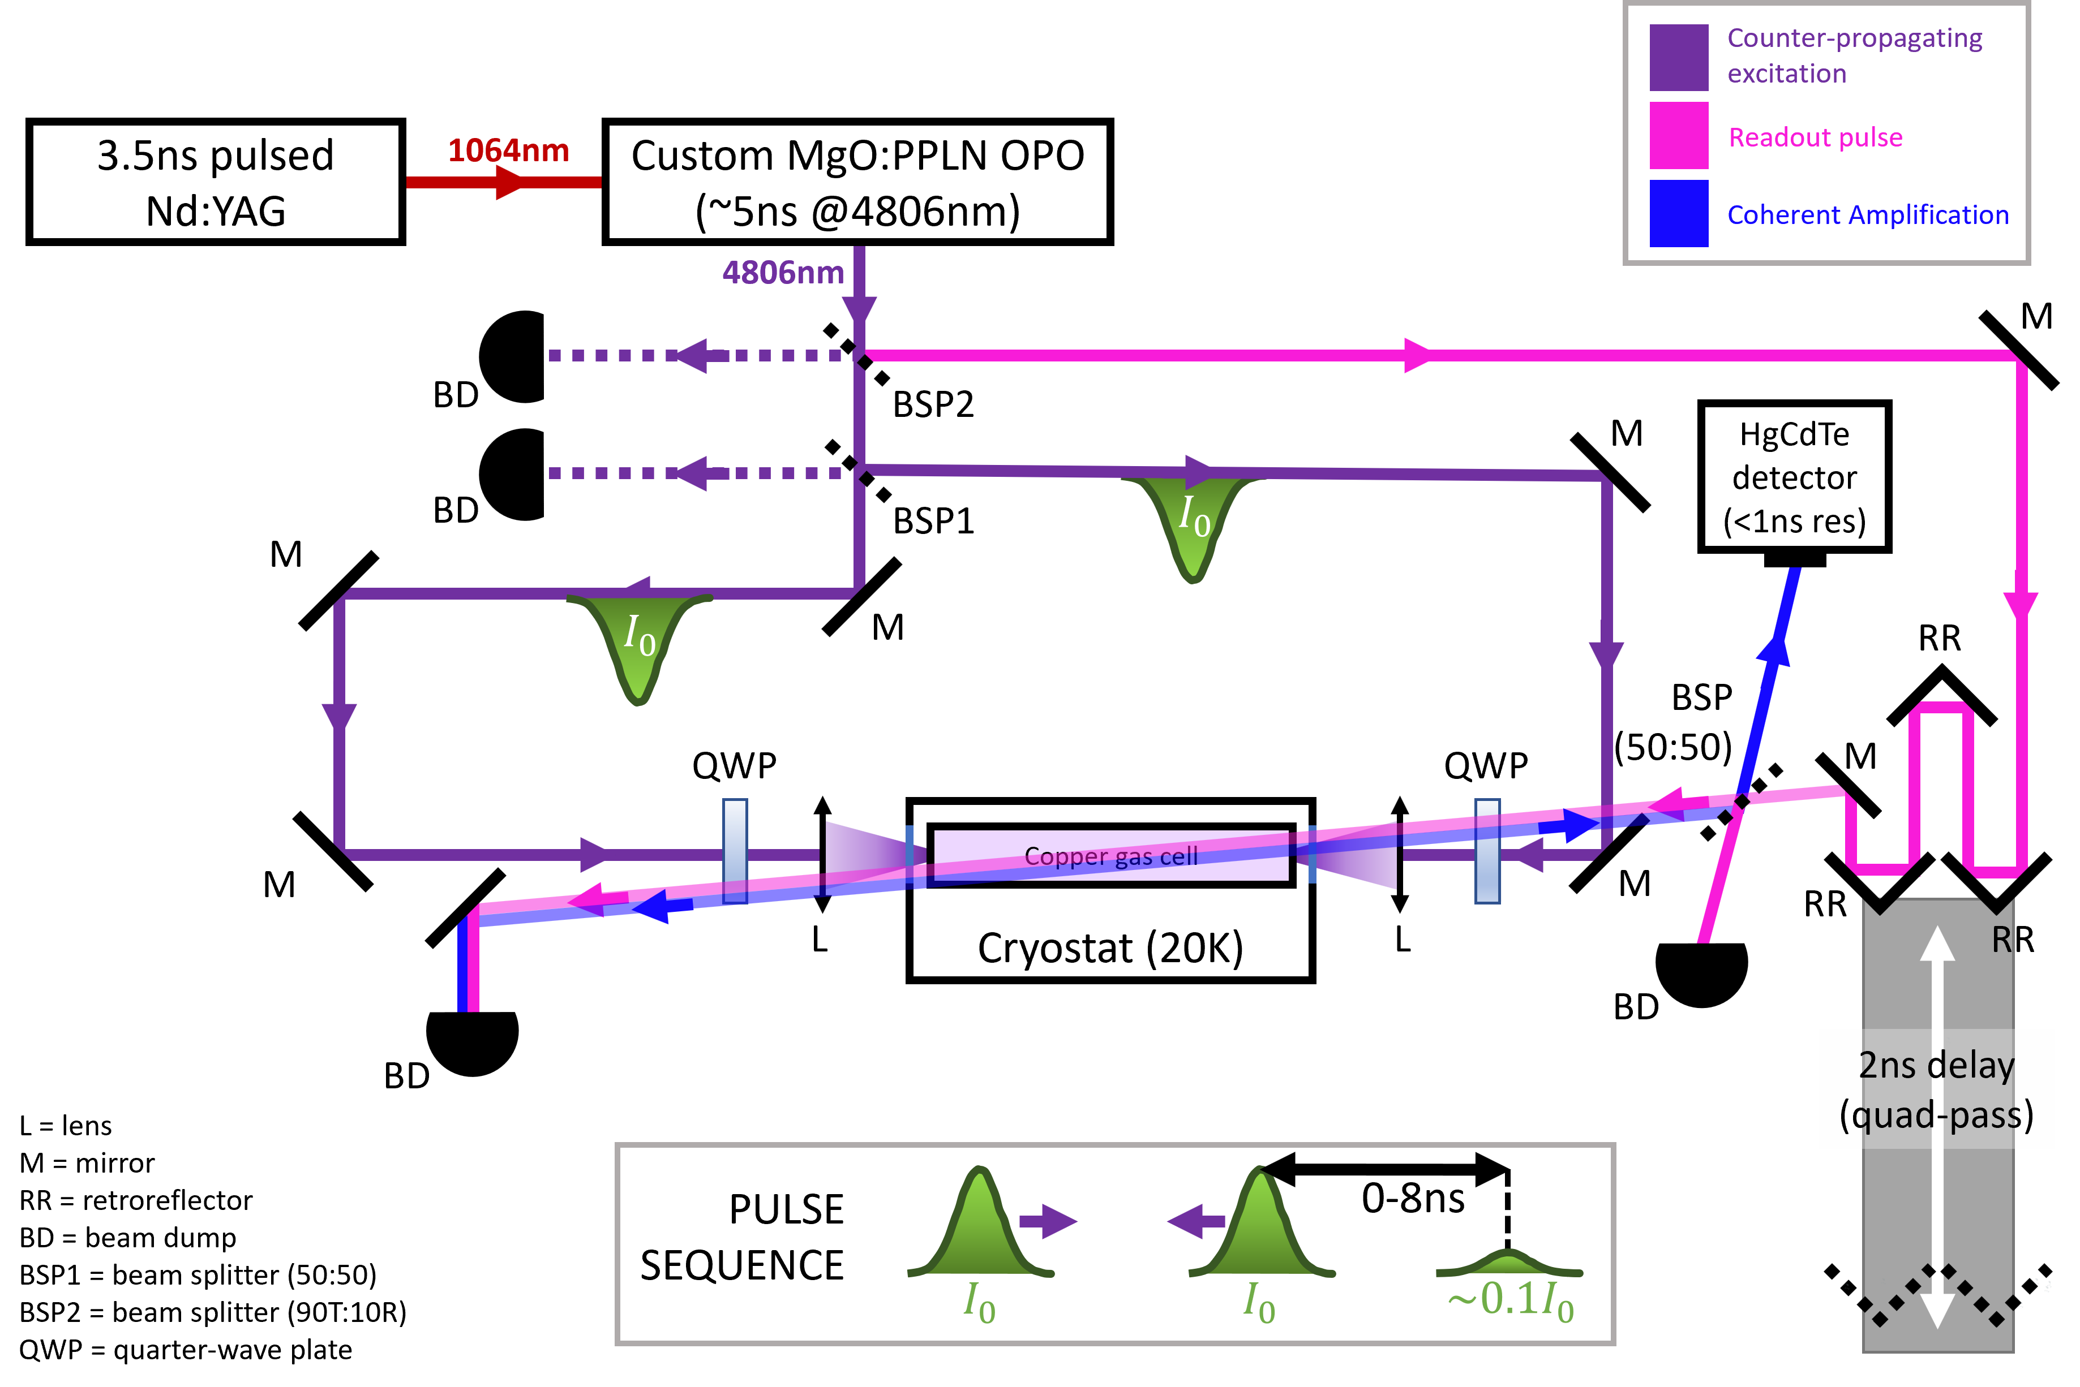
Experimental Setup
https://www.proquest.com/docview/3161889593
pump
detector
trigger

Slide 16
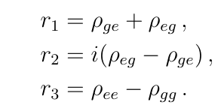
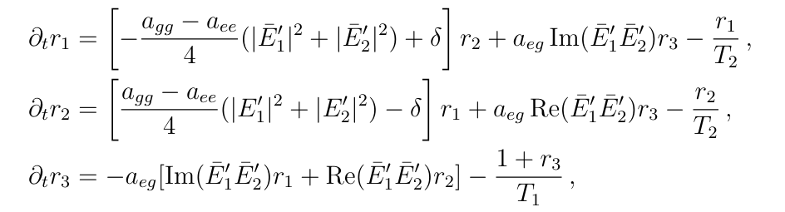
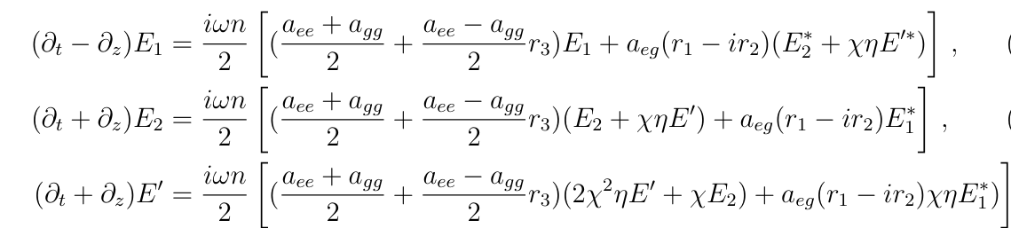
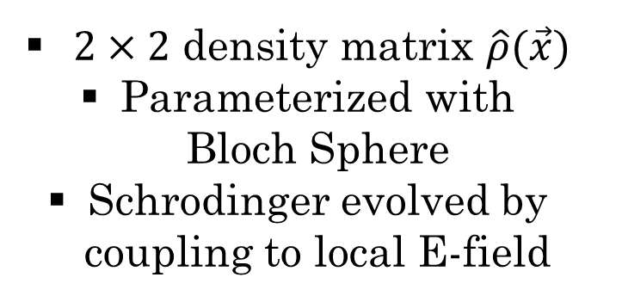
Maxwell-Bloch Equations
Atoms
Fields
$2×2$ density matrix $\hat{ρ}(\vec{x})$
Parameterized with Bloch Sphere
Schrodinger evolved by coupling to local E-field
Atoms induce a polarization
Acts as a source for E-fields

Slide 17
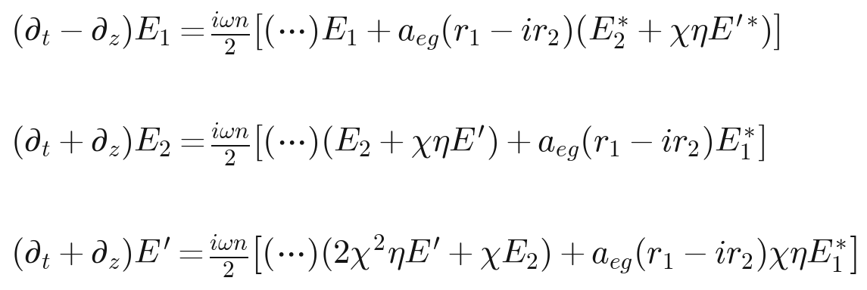

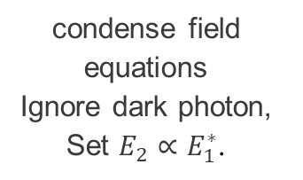
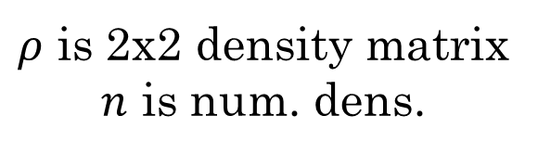
The Importance of Phase Alignment
condense field equations
Ignore dark photon, Set $E_{2}∝E_{1}^{∗}$.
$ρ$ is 2x2 density matrix
$n$ is num. dens.

Slide 18

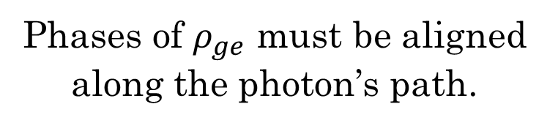

The Importance of Phase Alignment
condense field equations
Ignore dark photon, Set $E_{2}∝E_{1}^{∗}$.
$ρ$ is 2x2 density matrix
$n$ is num. dens.
$ρ_{ge}$
Phases of $ρ_{ge}$ must be aligned along the photon’s path.

Slide 19
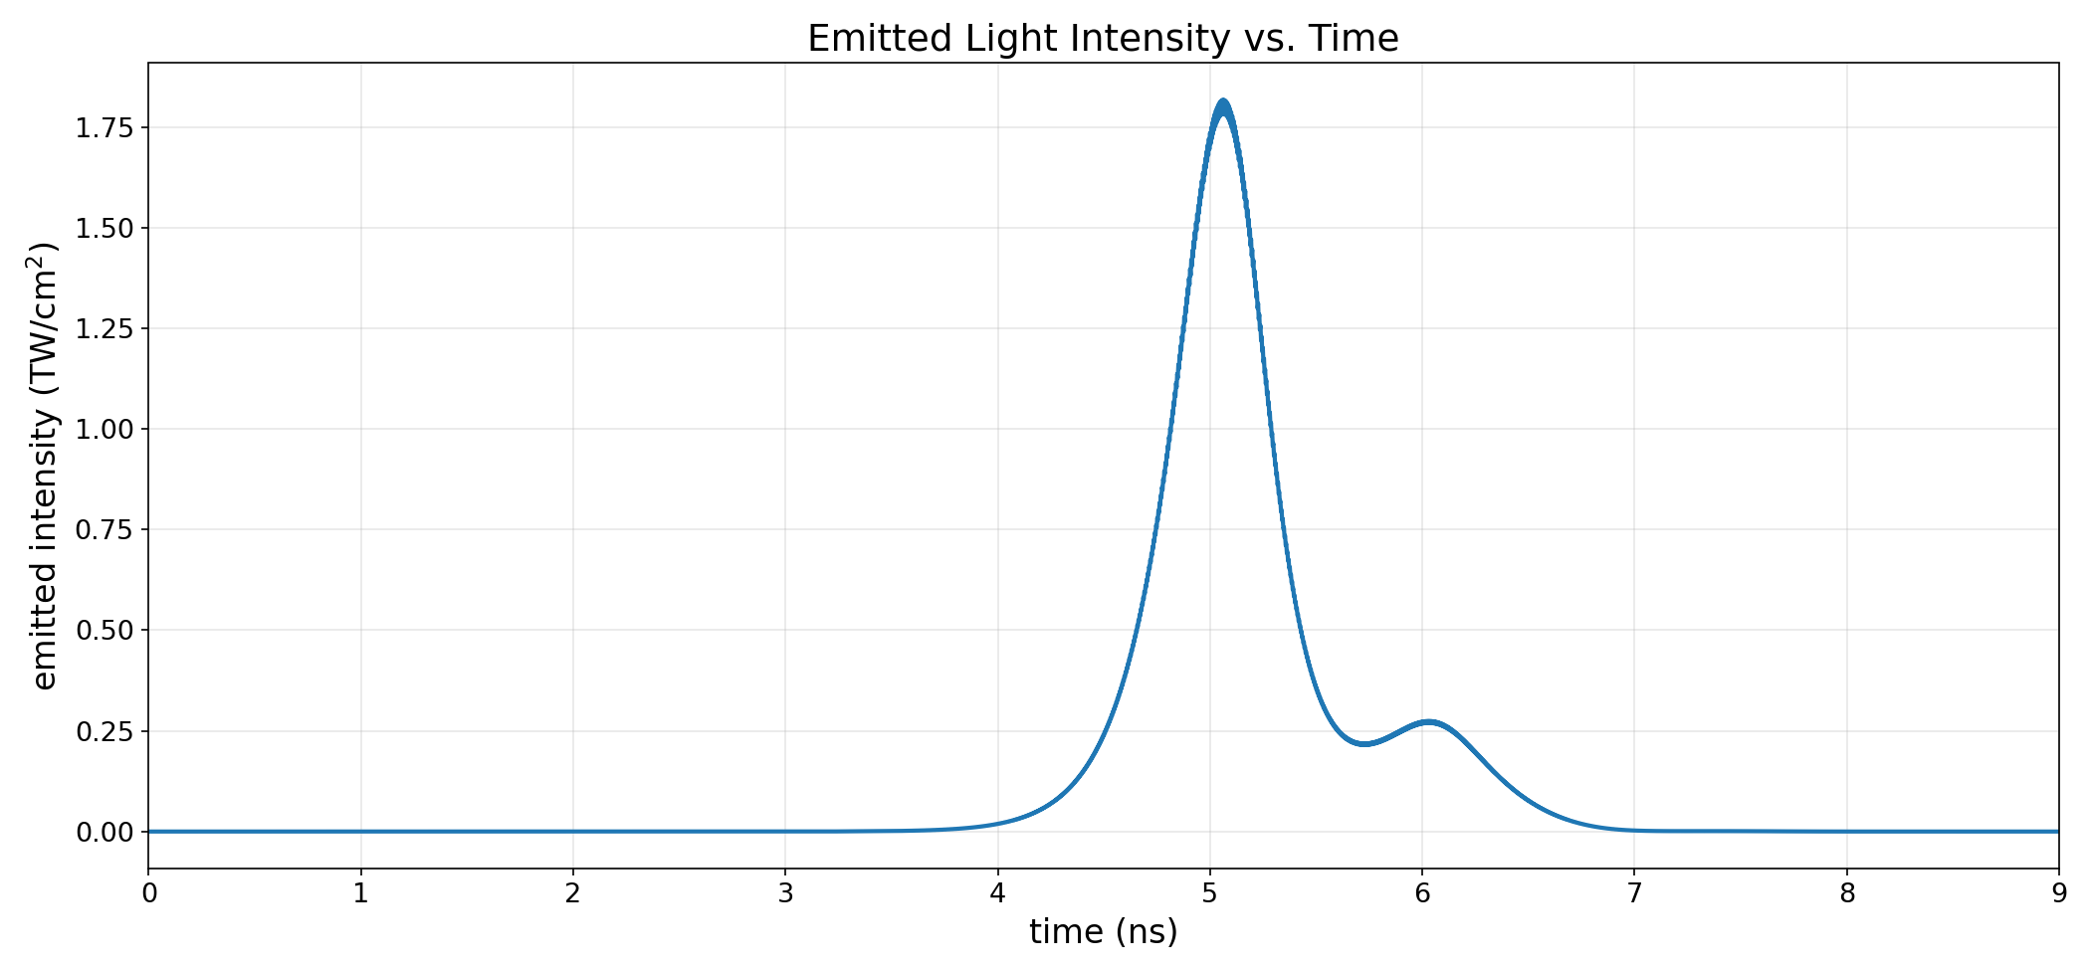
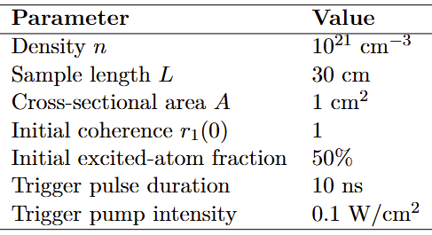
The Intensity Spike from Laser Trigger

Slide 20
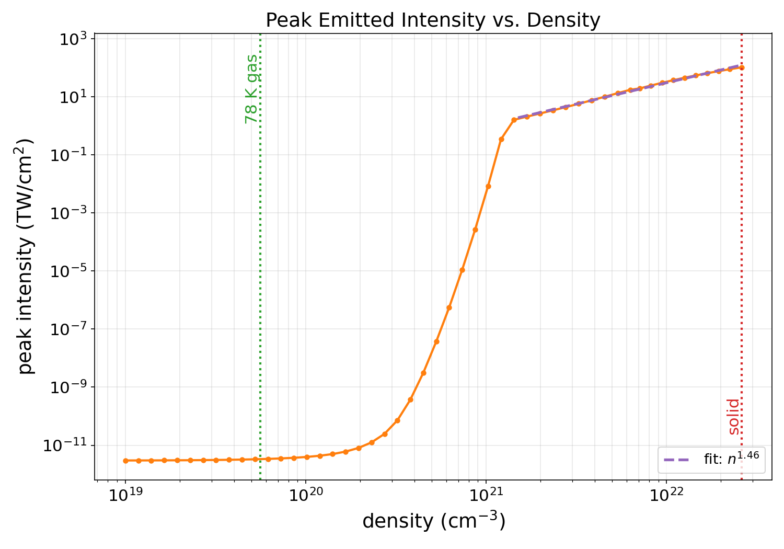

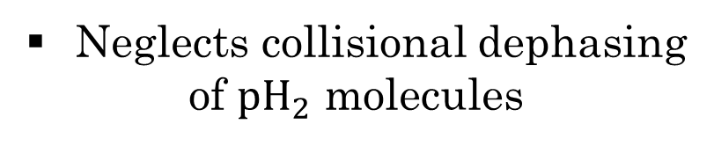
Is the Sensitivity $N^{2}$?
Max intensity is super-linear
for fixed length
Reminiscent of other quantum
coherent processes
(e.g. Dicke Superadiance)
Neglects collisional dephasing
of ${pH}_{2}$ molecules

Slide 21
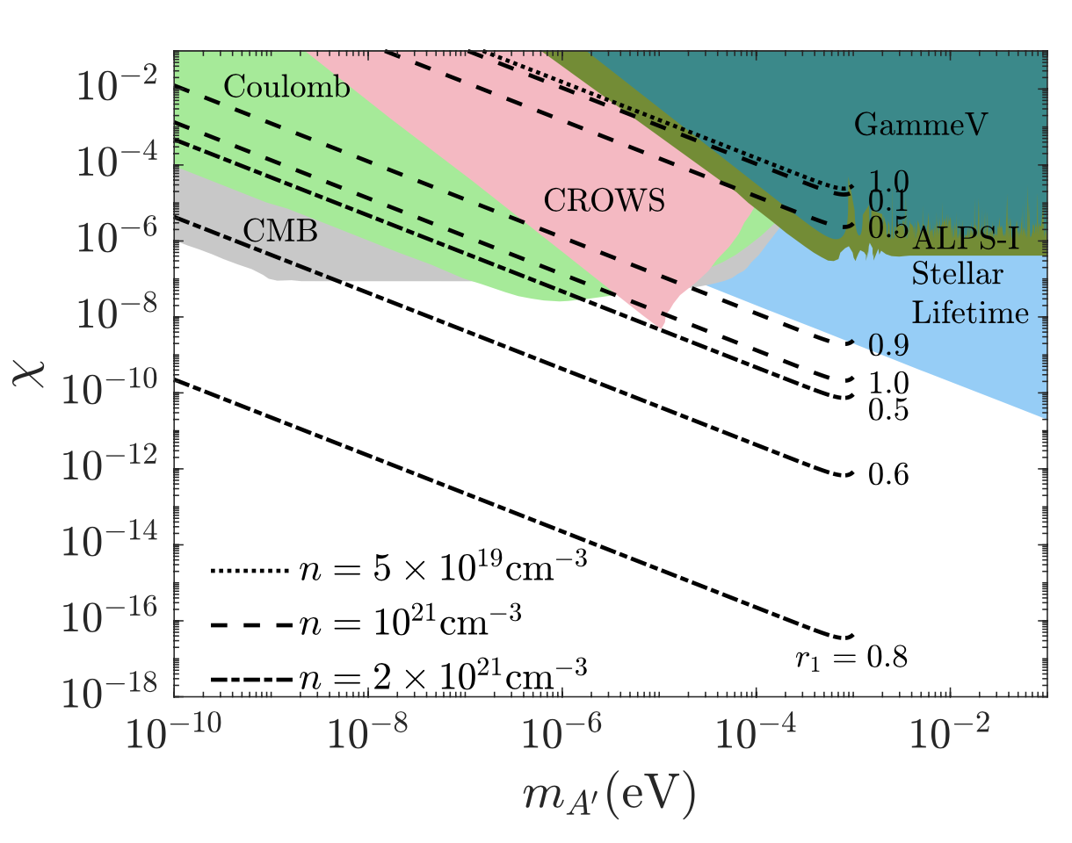



Prospective LSW Sensitivity
Improved reach as the
number density of pH2
or initial polarization $r_{1}$.

Slide 22

Prospective Haloscope Sensitivity

Slide 23

Prospective Helioscope Sensitivity

Slide 24
Conclusion
  CATCHY: ongoing project for a new kind of quantum detection at Queen’s University
  Search for dark photons with coherently prepared parahydrogen
  An incoming dark photon produces a cascade of two-photon emissions, producing an observable spike in intensity
  Sensitivity limits scales super-linearly with number density

Slide 25
EXTRA SLIDES

Slide 26

Evolution of the Electric Field (GIF)

Slide 27




The Power Law Depends on Trigger Strength
$n^{1.97}$ for strong field vs. $n^{1.46}$ for weak field

Slide 28



Peak Times vs. Density
Time of peak intensity vs
density (idealized no decoherence)
Can safely ignore decoherence
if $t_{peak}<t_{dec}$
Collisional decoherence matters a bit for
gaseous ${pH}_{2}$ and not at all for solid ${pH}_{2}$

Slide 29



Quantum Noise
Random vacuum fluctuations may trigger detector spontaneously
Likely dominant background
May be circumvented by using a stronger laser
$$1 W/{mm}^{2}$$
$${10}^{4} W/{mm}^{2}$$
$${10}^{8} W/{mm}^{2}$$

Slide 30



Dependence on Signal on Constant Phase
More aligned
dipoles give
stronger signal
Random dipoles
completely destroy
signal

