Slide 1


Search for scalar ultralight dark matter using cryogenic optical cavities
Tejas Deshpande
Optomechanical Sensing for Subatomic & Astroparticle Physics
(September 23, 2026)
TD, A. Ionescu, N. Miller, Z. Wang, G. Gabrielse, A. Geraci and T. Kovachy. Phys. Rev. Lett. 135, 261001

Slide 2
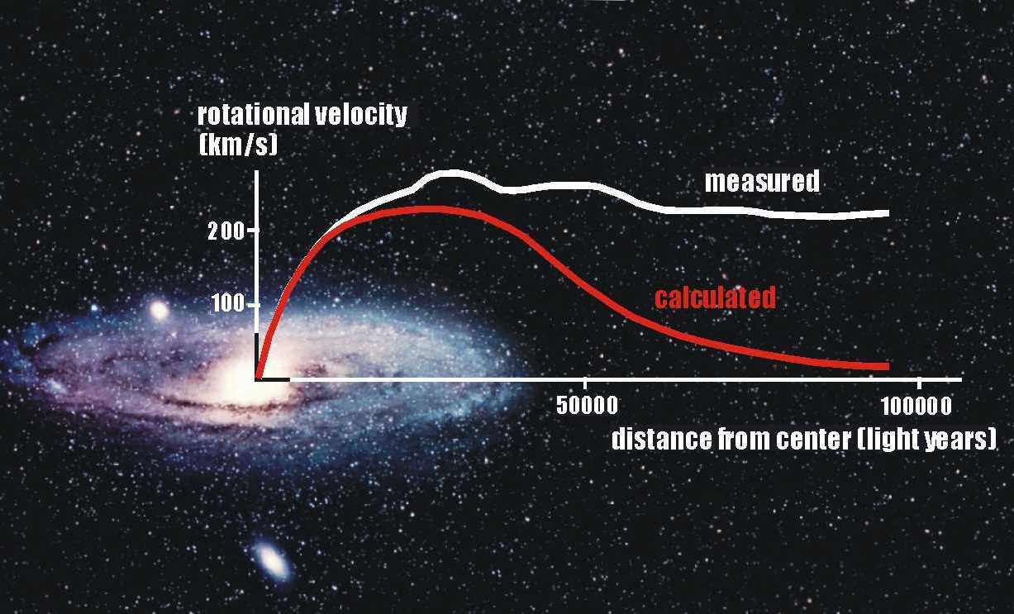
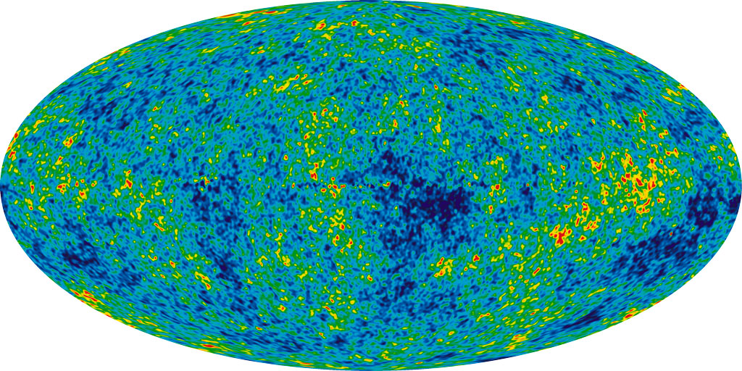
Evidence “dark matter” in the Universe
Normal matter (5%)
Dark matter (25%)
Dark energy (70%)
Galaxy rotation curves
Cosmic Microwave Background
https://w3.lnf.infn.it/the-problem-of-dark-matter
https://en.wikipedia.org/wiki/Cosmic_microwave_background#/media/File:WMAP_2012.png

Slide 3
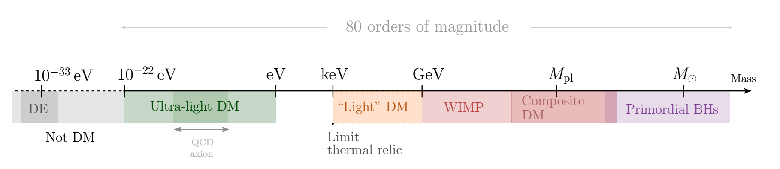
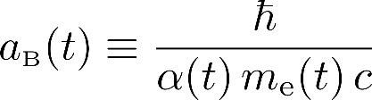
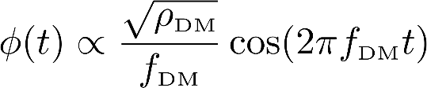
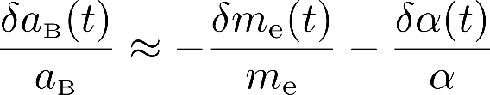
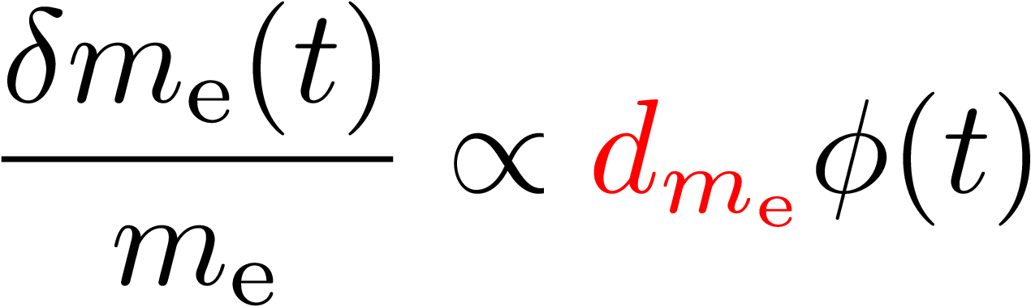
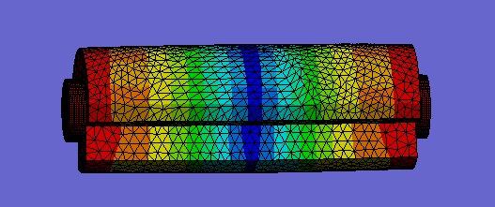
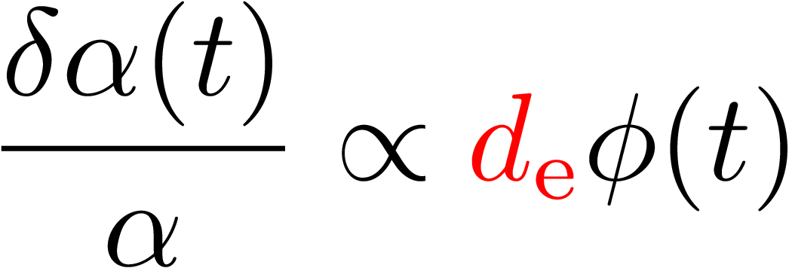

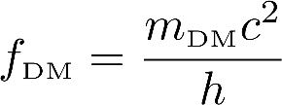
Introduction to bosonic (scalar) ultralight dark matter
Ferreira (2021). Astron. Astrophys. Rev. 29, 7
BH: Black Hole
DM: Dark Matter
DE: Dark Energy
WIMP: Weakly Interacting Massive Particle
Bohr radius:
Scalar field:
Electron mass:
Fine structure constant:
Definitions
(Galactic halo)

Slide 4
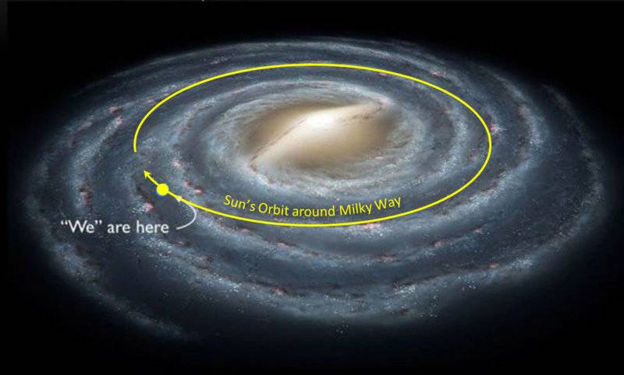
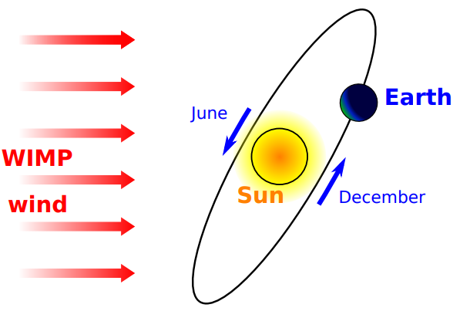
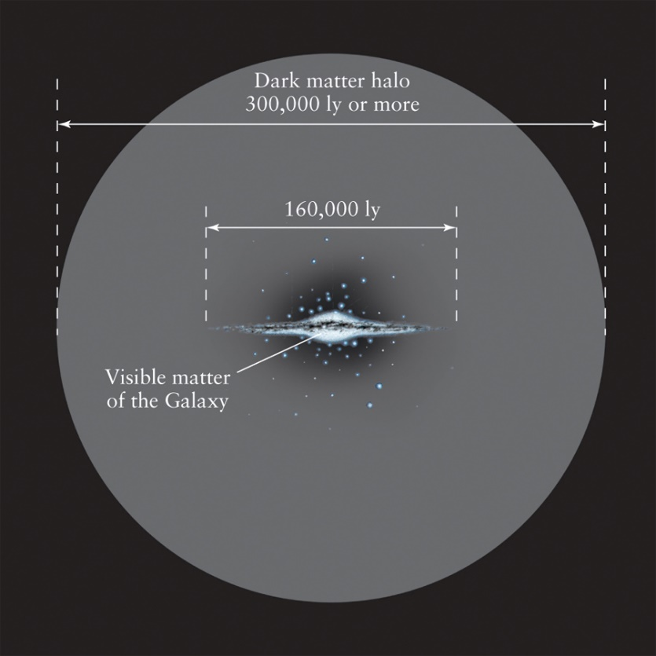
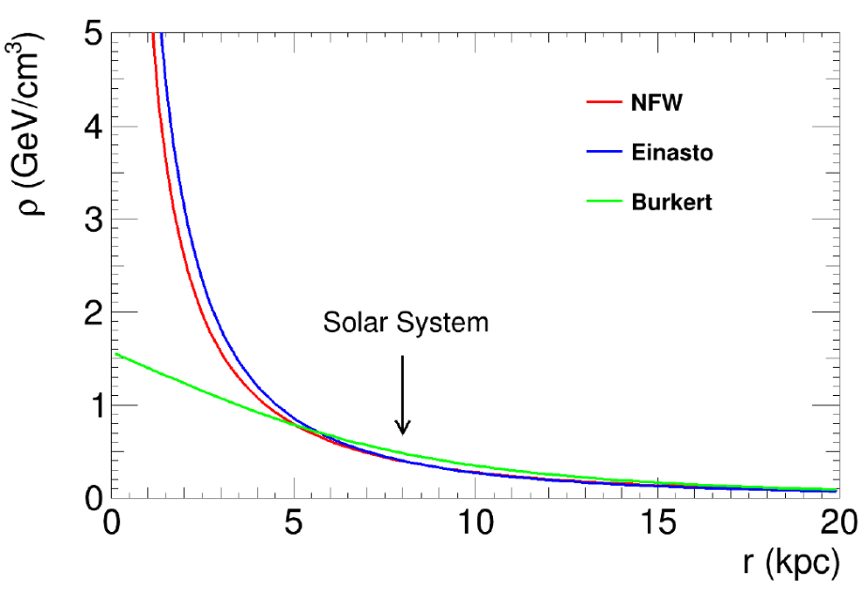
Earth moving through the galactic halo
Freese et al. (2013). Rev. Mod. Phys. 85, 1561-1581
https://digfir-published.macmillanusa.com/slater2e/asset/img_ch13/c13_fig19.html
https://cosmosatyourdoorstep.com/2023/01/18/how-massive-is-the-milky-way/
Dark matter
wind
“Standard halo model” (SHM)
Arbey et al. (2021). Progress in Particle and Nuclear Physics 119, 103865

Slide 5
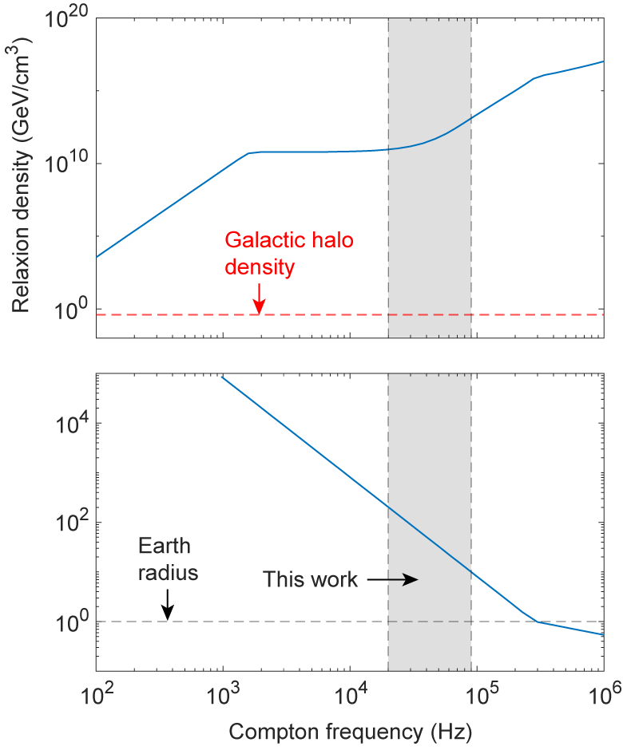
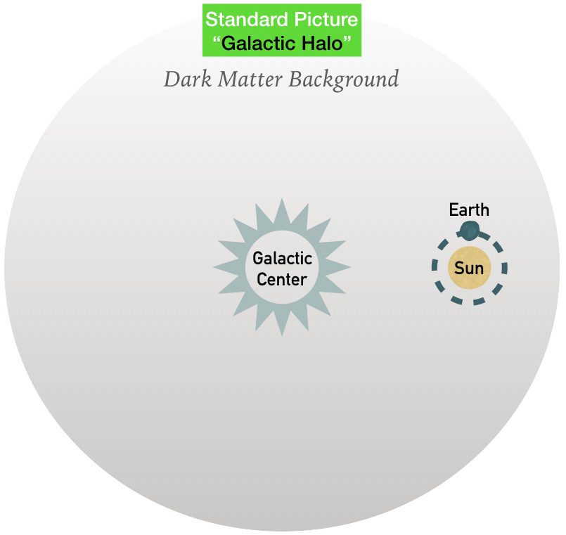
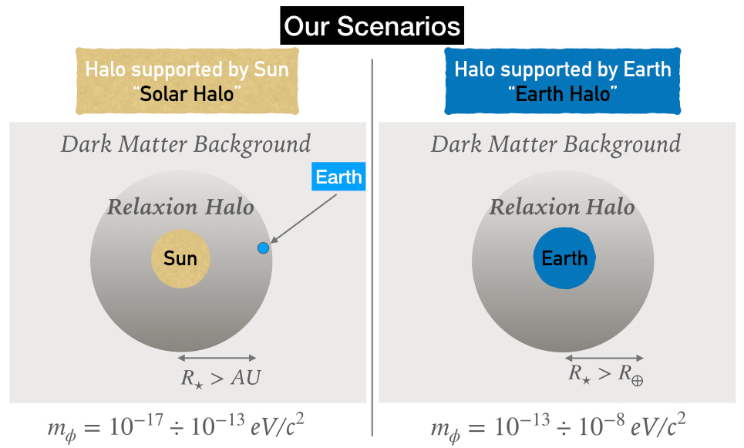
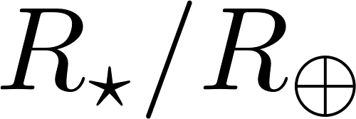

Relaxion stars bound to the Earth
6 orders of magnitude greater!
Banerjee et al. (2020). Communications Physics 3, 1
12 orders of magnitude greater!
https://communities.springernature.com/posts/dark-matter-bound-to-our-solar-system

Slide 6
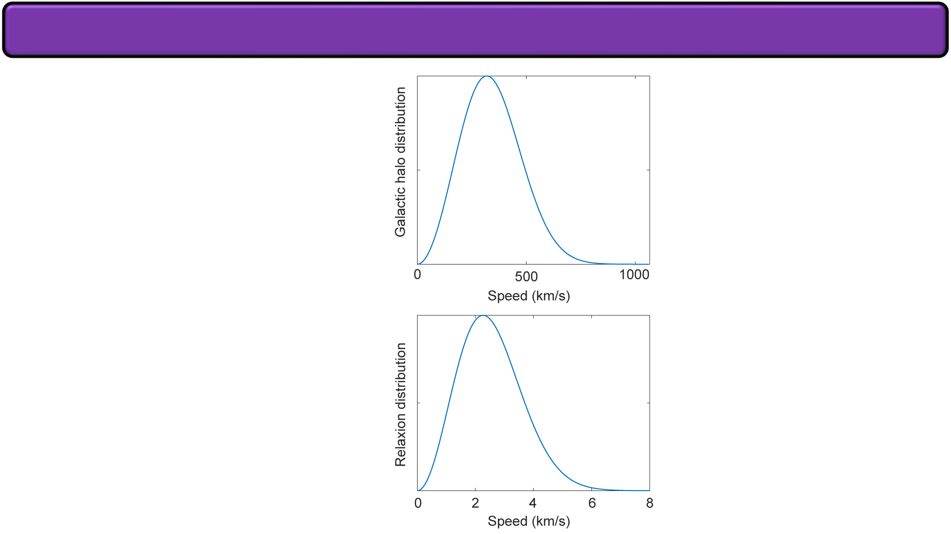
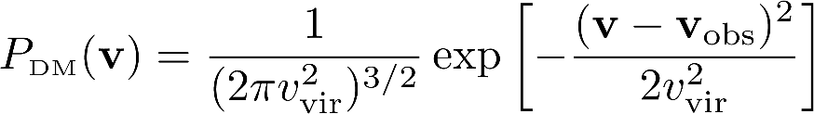

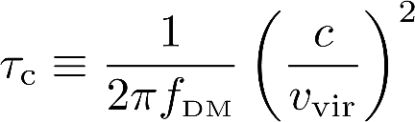

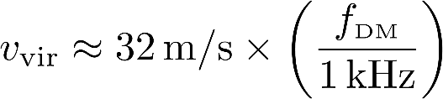
Velocity dispersion of the “virialized” ultralight dark matter field
Maxwell-Boltzmann distribution
v_{vir} ~ 166 km/s
Galactic orbit speed (v_{obs}) ~ 230 km/s
Statistical property: “coherence time”
https://communities.springernature.com/posts/dark-matter-bound-to-our-solar-system
https://cosmosatyourdoorstep.com/2023/01/18/how-massive-is-the-milky-way/
~2 orders of magnitude narrower than standard halo model

Slide 7
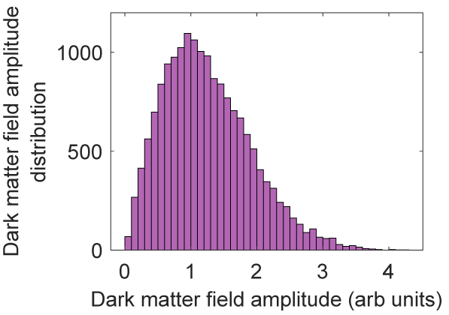
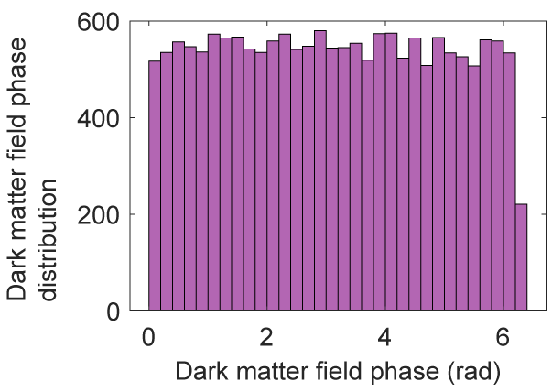
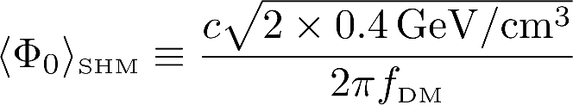

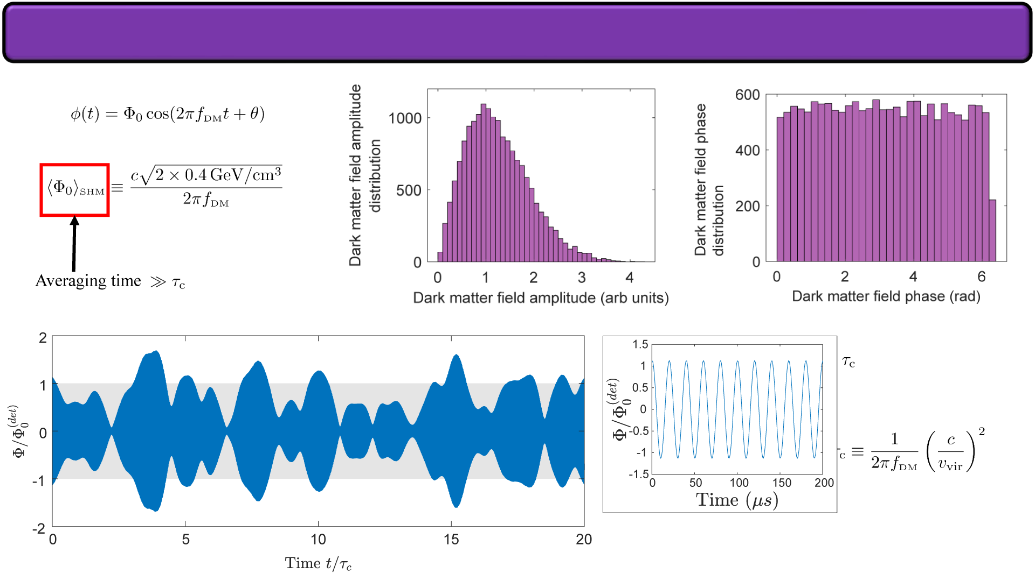

Stochastic nature of the virialized ultralight dark matter field
Averaging time
Notes:
…
Coherence time
The dark matter detectors need to account for

Slide 8
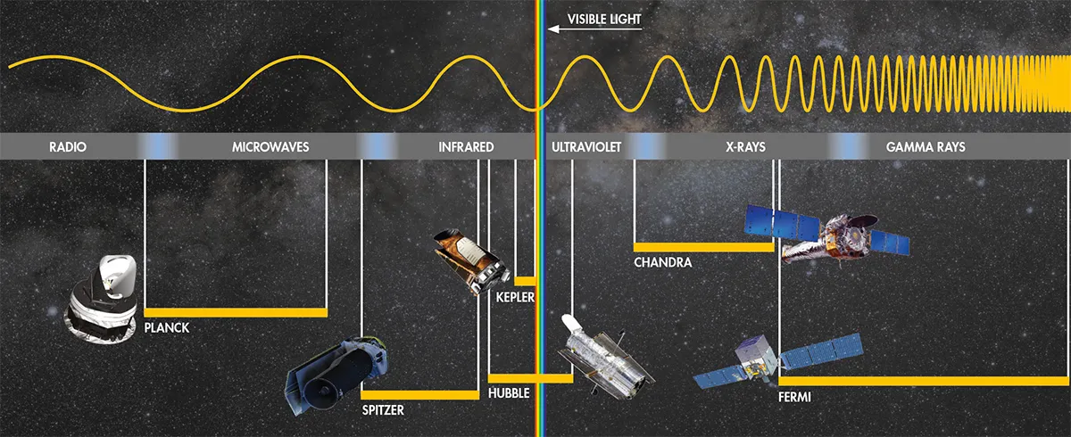
Probes of astronomical visible matter
https://c02.purpledshub.com/uploads/sites/48/2020/09/Electromagnetic-spectrum-a0f874b.jpg

Slide 9
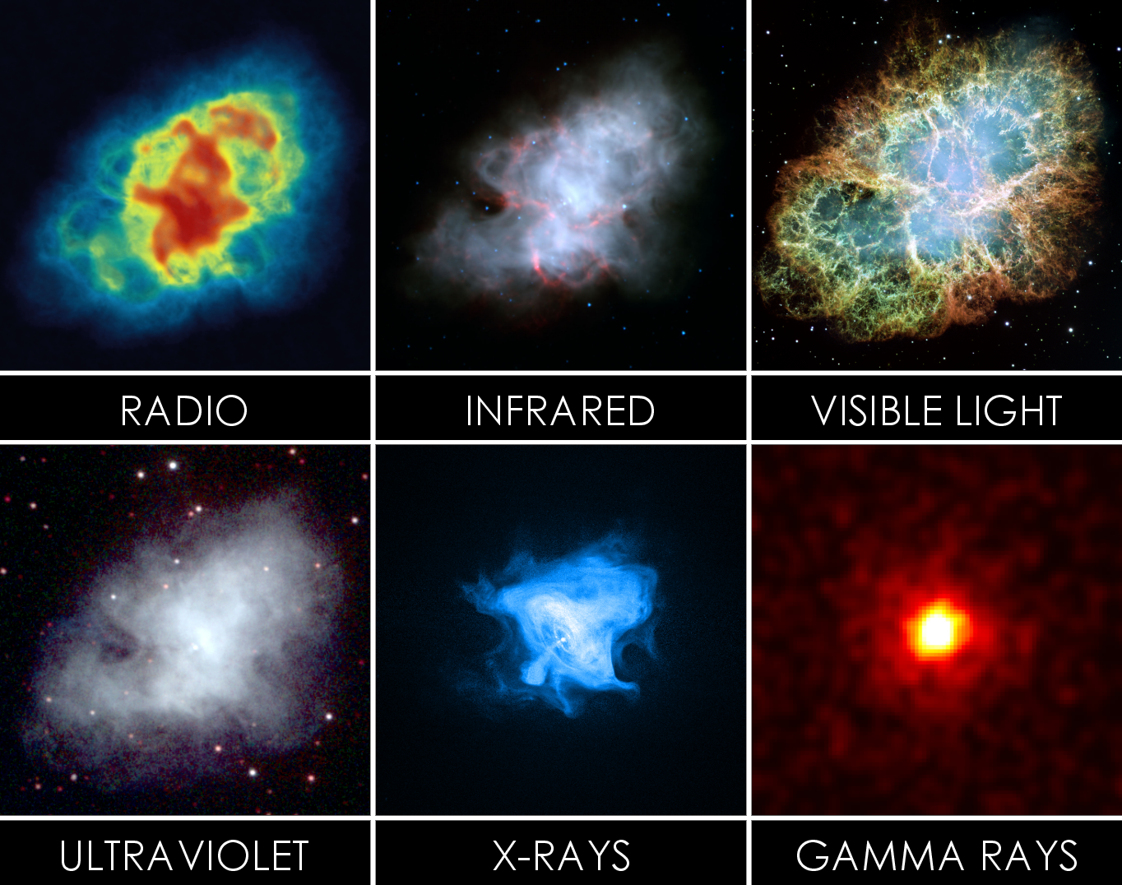
Complementary observations of astronomical visible matter
https://upload.wikimedia.org/wikipedia/commons/2/21/Crab_Nebula_in_Multiple_Wavelengths_2.png

Slide 10
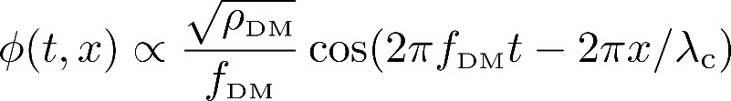
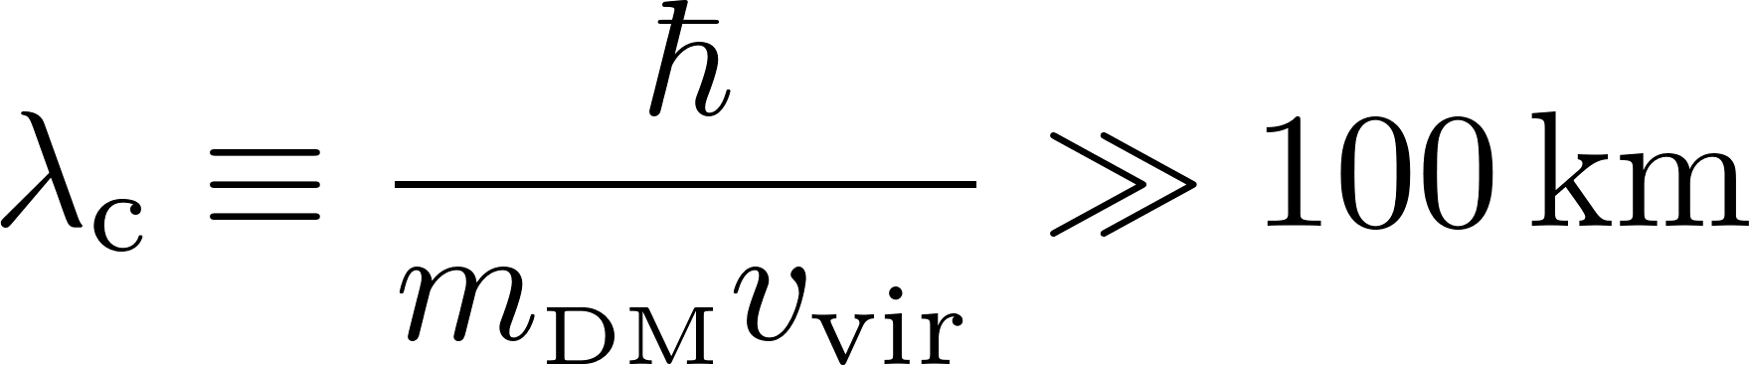
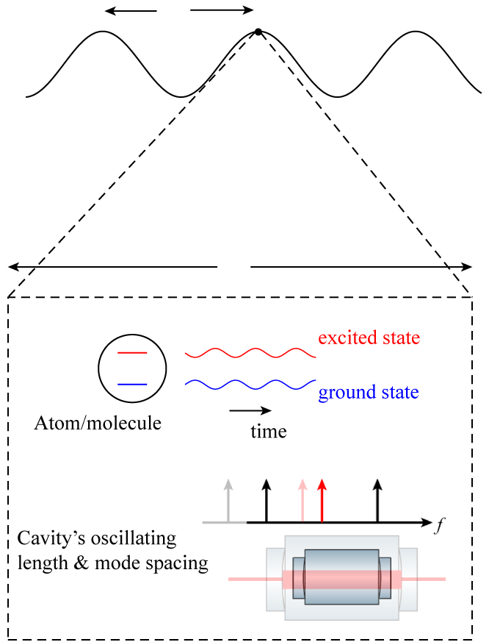
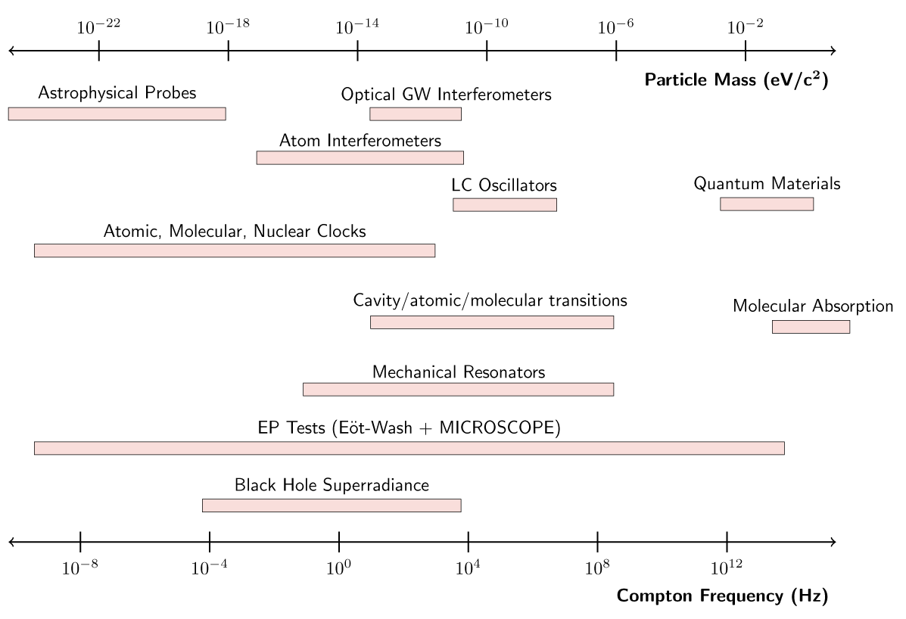
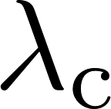
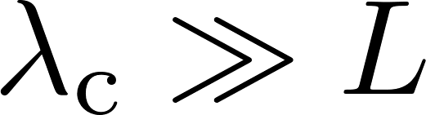
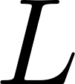

Probes of astronomical dark matter
Dark matter field
Cannot shield against dark matter
Antypas et al. (2022). arXiv:2203.14915

Slide 11
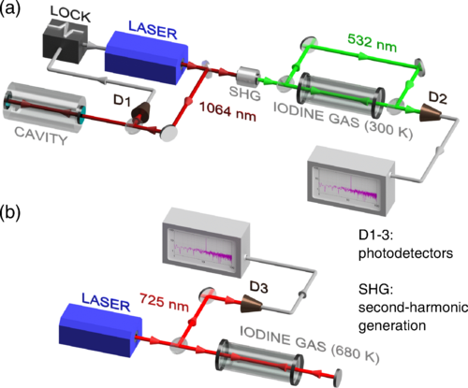
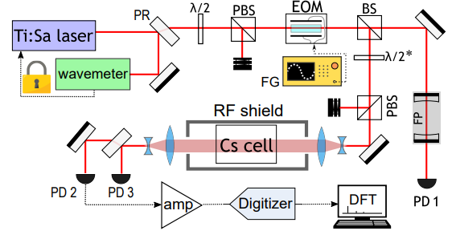
Atom/molecule-cavity comparison
Tretiak et al. (2022). Phys. Rev. Lett. 129, 031301
Oswald et al. (2022) Phys. Rev. Lett. 129, 031302

Slide 12
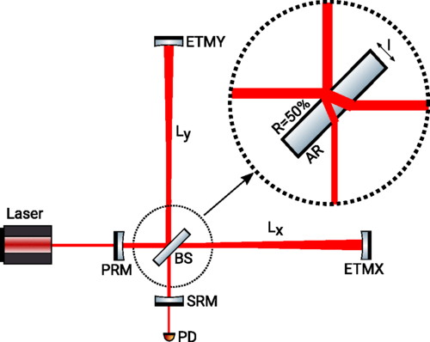
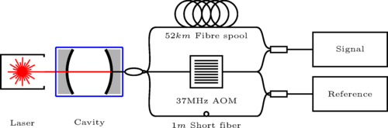
Cavity-cavity comparisons
Michelson interferometer:
Cavity-cavity comparison in space
Cavity-fiber:
Cavity-cavity comparison in time
Holometer
GEO600
LIGO
Savalle et al. (2021) Phys. Rev. Lett. 126, 051301
Vermeulen et al. (2021). Nature 600, 424
Göttel et al. (2024). Phys. Rev. Lett. 133, 101001
Aiello et al. (2022). Phys. Rev. Lett. 128, 121101
Grote et al. (2019). Phys. Rev. Research 1, 033187

Slide 13

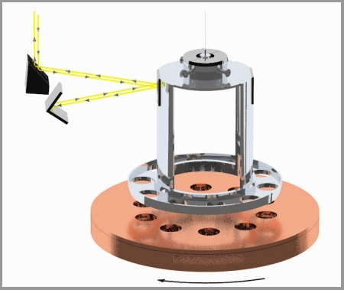
Indirect dark matter detection: equivalence principle violation
as a fifth force mediator
Antypas et al. (2022). arXiv:2203.14915
https://www.npl.washington.edu/eotwash/inverse-square-law

Slide 14
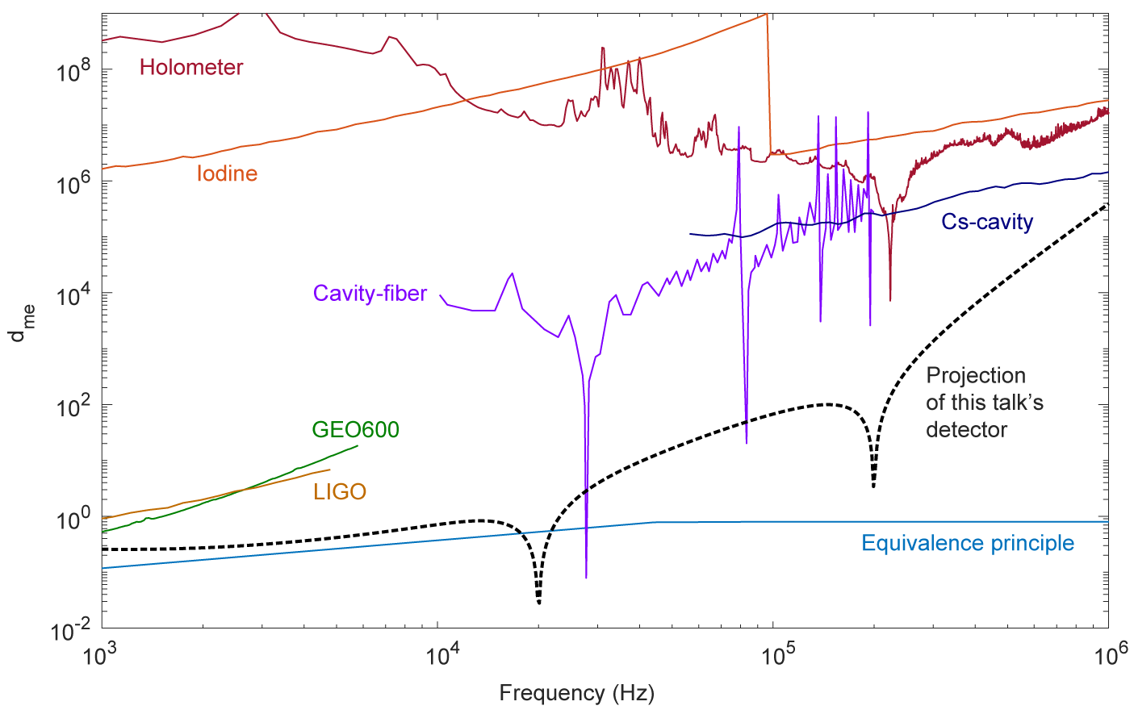
Dark matter coupling constant parameter space
(Galactic halo)

Slide 15
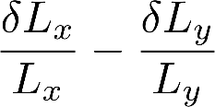
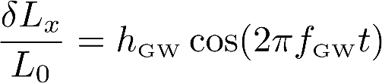
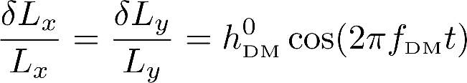
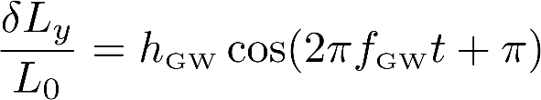
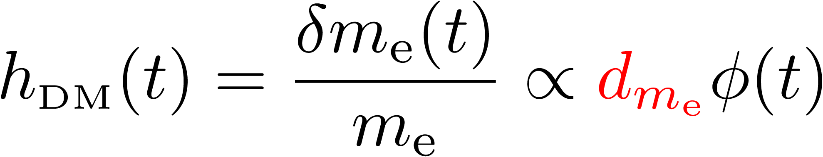
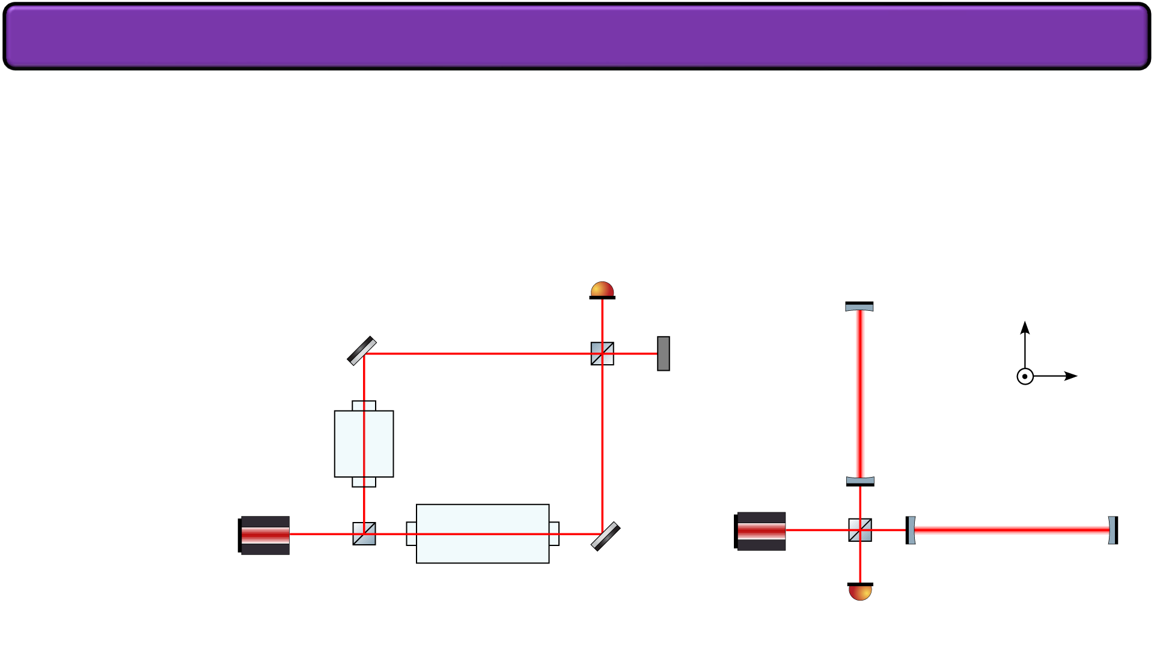



Detecting dark matter analogously to gravitational waves
Dark matter “strain”
Gravitational waves are quadrupolar (spin 2)
Photodetector signal =
In-phase oscillation
Scalar dark matter (spin 0)
Mach-Zehnder interferometer
Michelson interferometer

Slide 16
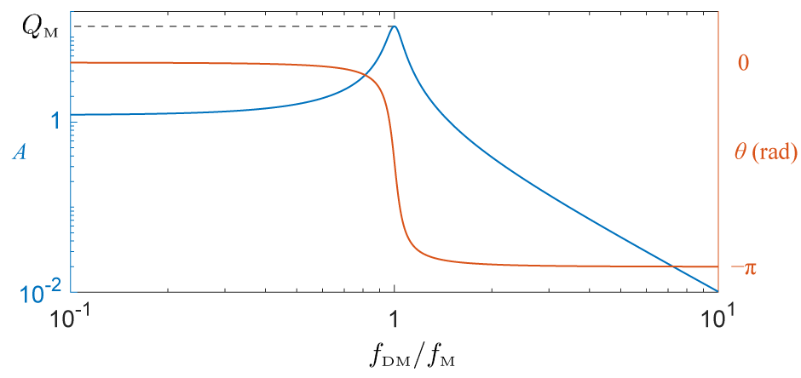
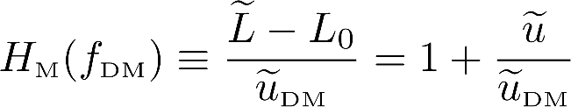
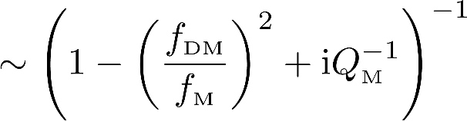



Response of single cavity driven by the dark matter field
Mechanical resonance frequency
Effectively shielded from dark matter

Slide 17









Fabry-Perot cavities as optomechanical sensors

Slide 18





















“Coherent” response of two cavities driven by dark matter
Incoherent
180°
“Coherent” difference transfer function
TD, A. Ionescu, N. Miller, Z. Wang, G. Gabrielse, A. Geraci and T. Kovachy. Phys. Rev. Lett. 135, 261001
Speed of sound:

Slide 19





Oscillation amplitude of cavities across mechanical resonances
Length reference
Note: oscillation of background objects is not shown for visual clarity
Speed of sound:

Slide 20

Photograph of ultralight dark matter detector apparatus
Cryostat
1 foot

Slide 21



Overview sketch of the apparatus
Side viewing direction
Side view
Top view

Slide 22


Dark matter sensitivity for a simple two-cavity setup

Slide 23

Dark matter sensitivity after adding optical filtering

Slide 24

Dark matter sensitivity after adding vibration isolation
GAS: geometric anti-spring
IP: inverted pendulum

Slide 25

Dark matter sensitivity after adding cryogenics
GAS: geometric anti-spring
IP: inverted pendulum

Slide 26




Passive vibration isolation assembly and performance
Geometric anti-spring (GAS)
Inverted pendulum (IP)
8 inches
20 inches

Slide 27





Closed-cycle 4 K cryostat with vibration isolation
Short cavity
Long cavity
29 inches
Soft thermal links

Slide 28







Laser frequency noise mitigation via optical filtering
TD, A. Ionescu, N. Miller, Z. Wang, G. Gabrielse, A. Geraci and T. Kovachy. Phys. Rev. Lett. 135, 261001

Slide 29
Apparatus summary
Side viewing direction
Side view
Top view

Slide 30








Beat note detection and data collection for dark matter observation

Slide 31






Detector noise spectrum and dark matter search
TD, A. Ionescu, N. Miller, Z. Wang, G. Gabrielse, A. Geraci and T. Kovachy. Phys. Rev. Lett. 135, 261001
Detection threshold
Expected dark matter signal shape
Derived from Maxwell-Boltzmann distribution

Slide 32












Dark matter exclusion limit using Bayesian parameter estimation
Dark matter strain
TD, A. Ionescu, N. Miller, Z. Wang, G. Gabrielse, A. Geraci and T. Kovachy. Phys. Rev. Lett. 135, 261001
Optical strain
Probability distribution function of
95% probability
Expected dark matter signal shape

Slide 33




Exclusion limit plots for the standard halo model (SHM)
https://digfir-published.macmillanusa.com/slater2e/asset/img_ch13/c13_fig19.html
https://cosmosatyourdoorstep.com/2023/01/18/how-massive-is-the-milky-way/
New exclusions
Up to 2 order of magnitude improvement
EP: equivalence principle
TD, A. Ionescu, N. Miller, Z. Wang, G. Gabrielse, A. Geraci and T. Kovachy. Phys. Rev. Lett. 135, 261001
Freese et al. (2013). Rev. Mod. Phys. 85, 1561-1581

Slide 34






Exclusion limit plots for relaxion star bound to Earth
https://communities.springernature.com/posts/dark-matter-bound-to-our-solar-system
Banerjee et al. (2020). Communications Physics 3, 1
EP: equivalence principle
12 orders of magnitude greater!
Stochastic dark matter field
Grows with
Average of stochastic amplitude
TD, A. Ionescu, N. Miller, Z. Wang, G. Gabrielse, A. Geraci and T. Kovachy. Phys. Rev. Lett. 135, 261001

Slide 35


Summary and outlook
Standard halo model
New approach to detecting ultralight dark matter by measuring differential length change of optical cavities
Up to two orders of magnitude improvement in sensitivity for:
  Standard halo model
  Relaxion star bound to Earth
Additional sensitivity enhancement by five orders of magnitude possible with upgrades

Slide 36






Acknowledgements: Northwestern CFP collaboration
Northwestern professors
TD, A. Ionescu, N. Miller, Z. Wang, G. Gabrielse, A. Geraci and T. Kovachy. Phys. Rev. Lett. 135, 261001
Northwestern graduate students
Helpful discussions with:
Andrei Derevianko (University of Nevada, Reno)
Caleb Schreibeis (Four Nine Design)
Riccardo DeSalvo (Vibration isolation consultant)
Garrett Cole (Thorlabs Crystalline Mirror Solutions)
Seth Catano (Thorlabs Crystalline Mirror Solutions)
Koji Arai (LIGO)
Yuta Michimura (LIGO)
Gautam Venugopalan (former LIGO student)
Jeremy Bourhill (University of Western Australia)

Slide 37
Thank you for your attention

Slide 38
Backup slides

Slide 39





Scalar ultralight dark matter field coupling to standard model
Ferreira (2021). Astron. Astrophys. Rev. 29, 7
Dark matter energy density in standard halo model:
Scalar field:
Dark matter Compton frequency:
Plack energy:
Electron mass:
Bohr radius:
BH: Black Hole
DM: Dark Matter
DE: Dark Energy
WIMP: Weakly Interacting Massive Particle
Fine structure constant:

Slide 40




Bayesian inference for limits on dark matter coupling constant
Dark matter strain
TD, A. Ionescu et al. (2024). arXiv:2412.20623
Derevianko. (2018). Phys. Rev. A 97, 042506
Optical strain
Probability distribution function of
95% probability

Slide 41





Impact of noise sources on dark matter sensitivity
Cavity as an optomechanical sensor:
Multi-stage pendulums
Two-cavity differential strain dependence on dark matter strain
Length fluctuation
Vibrations
Thermal noise
Frequency fluctuations
Laser frequency noise
Optimized support points

Slide 42

Passive vibration isolation: 3 types of pendulums
Single-wire pendulum
Flexure
GAS
Payload
Inverted pendulum

Slide 43









Properties of the 3 types of vibration isolation systems
Geometric anti-spring (GAS) motion
Pendulum transfer functions
Inverted pendulum (IP) motion
Single-wire pendulum motion

Slide 44
Passive vibration isolation assembly and performance
8 inches

Slide 45





Impact of noise sources on dark matter sensitivity
Cavity as an optomechanical sensor:
Brownian motion of atoms in a solid
Two-cavity differential strain dependence on dark matter strain
Length fluctuation
Vibrations
Thermal noise
Frequency fluctuations
Laser frequency noise
https://iscience9.wordpress.com/2014/05/14/4-solids
Crystalline GaAs/AlGaAs coatings
Fluctuation dissipation theorem
T: temperature
Q: quality factor
Sapphire

Slide 46
Closed-cycle 4 K cryostat with vibration isolation
Short cavity
Long cavity
29 inches
Soft thermal links

Slide 47





Trade-off between cooling power and vibration isolation
High vibration
> 99.9999% aluminum
Low vibration
Vibration attenuation
Thermal conductance

Slide 48


Impact of noise sources on dark matter sensitivity
Cavity as an optomechanical sensor:
Two-cavity differential strain dependence on dark matter strain
https://qmetrology.quantumlah.org/img/basicclock2.png
https://www.toptica.com/application-notes/phase-and-frequency-locking-of-diode-lasers/error-signal-generation/locking-to-a-reference-resonator
Length fluctuation
Vibrations
Thermal noise
Frequency fluctuations
Laser frequency noise
Ultra-stable cavity
Pound-Drever-Hall
technique

Slide 49









Pound-Drever-Hall technique as phase/frequency discriminator
Transmitted or “filtered” light?
Photon storage time
TD, A. Ionescu, N. Miller, Z. Wang, G. Gabrielse, A. Geraci and T. Kovachy. Phys. Rev. Lett. 135, 261001

Slide 50




Detour: cavity mechanical transfer functions & vibrations
Empirically estimate mechanical transfer function
Quality factor
Dashed curves are empirical uncertainty
Mechanical resonance
Excitation from piezoelectric transducer
Notes:
Cavity DM meeting (2024-07-26)

Slide 51



Thermal noise mitigation: low-vibration cryogenics
Vibration
isolation
Cryocooler
Cold box

Slide 52



Alternative cavity-based dark matter (DM) detection scheme
Now: two rigid cavities
Standard halo model
Upgrade: rigid vs. non-rigid cavity

Slide 53



Mirror actuation using recoil mass
Test Mass
Passive Damping: Eddy Current Dampers
Gap
Akutsu et al. (2020). Rev. Sci. Inst. 91, 115001.
Active Damping: Electromagnetic Actuators
Recoil Mass

Slide 54






Optical sensor electromagnetic (OSEM) actuator
I
Sensor Test
Range: ∼0.5 mm
Resolution: ∼0.5 µm
Flag (on test mass)
Magnetic Force
Coil
Magnet
OSEM body (on recoil mass)
Actuator Test
LED
Photodiode

Slide 55


Actuator tests
Lock Off
Lock On
Lock On

Slide 56



Fabry-Perot cavity with suspended mirrors (prototype)
TEM00
First mirror: Suspended
Transmission Data
Pendulum motion
(∼ 8 µm)
Second mirror:
Fixed, on kinematic mount

