Slide 1

OPTOMECHANICAL SENSING FOR SUBATOMIC & ASTROPARTICLE PHYSICS
Welcome to Kingston
Workshop logistics & practical information
Wouter Van De Pontseele · Colorado School of Mines
Queen's University · McDonald Institute · 23–25 September 2026
The only schedule that counts: indico.global/event/18677/timetable
OSSAP 2026 · Queen's University, Kingston
Notes:
9:15–9:30. Kyle and Art have just done the official welcome; this is the practical part. Keep it light and fast: ~1 minute per slide.

Slide 2
LAND ACKNOWLEDGEMENT
Where we are
Queen’s University is situated on the territory of the Haudenosaunee and Anishinaabek.
Ne Queen’s University e’tho nón:we nikanónhsote tsi nón:we ne Haudenosaunee táhnon Anishinaabek tehatihsnonhsáhere ne onhwéntsya.
Gimaakwe Gchi-gkinoomaagegamig atemagad Naadowe miinwaa Anishinaabe aking.
We are grateful to gather, learn and work on these lands this week as guests, and we recognize the Indigenous Peoples who have lived here since long before Kingston and Queen’s existed, and who continue to live here today.
Wording from the Queen’s Office of Indigenous Initiatives (queensu.ca/indigenous/land-acknowledgement)
OSSAP 2026 · Queen's University, Kingston
Notes:
Spoken version suggested by Queen’s: “To begin, let us acknowledge that Queen’s is situated on traditional Anishinaabe (Ah-nish-in-ah-bay) and Haudenosaunee (Ho-den-o-show-nee) territory. We are grateful to be able to live and learn on these lands.” If Kyle or Art already did the acknowledgement in the 9:00 welcome, keep this to one sentence rather than repeating it. If Mark sends the McDonald Institute's own version, swap the text (MI signature wording: 'The McDonald Institute and Queen’s University are situated in the traditional territory of the Anishinaabe & Haudenosaunee First Nations').

Slide 3
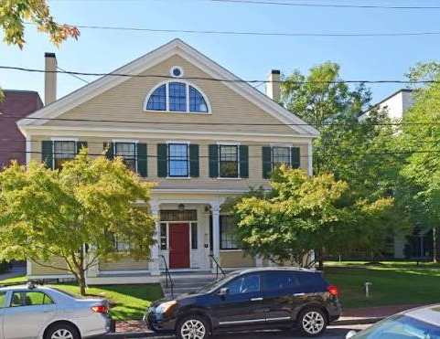
BEFORE WE START
My perspective
Cambridge, MA, 2019. A Harvard professor, Melissa Franklin, comes back from a visit to Yale and tells a room full of collider physicists that the most exciting new idea she has seen in a long time is a levitated sphere, looking for dark matter.
That was the first time I heard of any of this.
My day job: Ricochet, Project 8 and, lately, BeEST. Nothing in my lab floats. I am quite possibly the least levitated person in this room.
Seven years later I get to help bring the people behind those ideas into one room.
Thank you for coming — I look forward to be immersed!
OSSAP 2026 · Queen's University, Kingston
Notes:
Say the colleague's name and the actual line in person (Melissa Franklin: "most physics is not novel enough these days… except those levitated spheres"). The slide keeps it soft so a photo of it can't be misread. PhD was Oxford, three of those years spent at Harvard — no need to go into that.

Slide 4
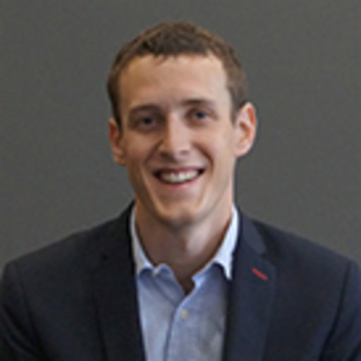
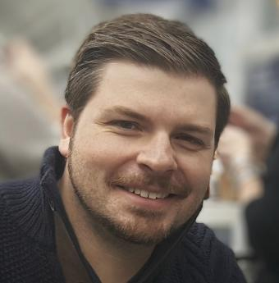
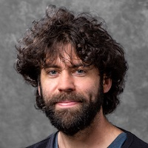
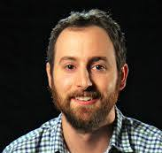
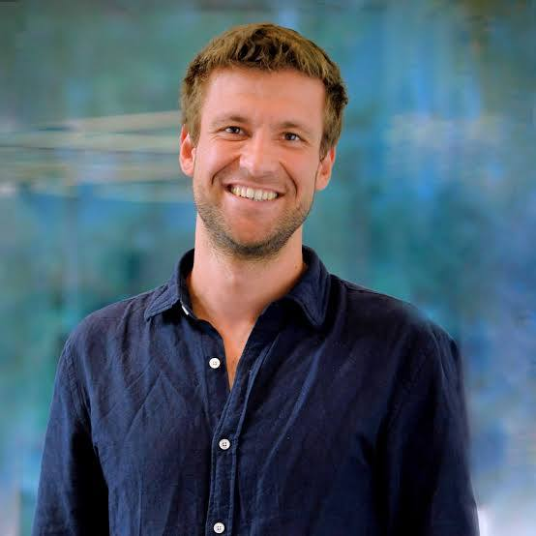
ORGANIZING COMMITTEE
The people who sent each other ~300 emails
headshot
headshot
headshot
headshot
headshot
Louis Hamaide
Kyle Leach
Dan Carney
David Moore
Wouter Van De Pontseele
JGU Mainz
Queen's · McDonald Institute
LBNL
Yale
Colorado School of Mines
Co-lead · joining in spirit
Local host
Co-lead
Special thanks to Louis, who did a huge share of the invitations, Indico and announcements and can't be here this week. He is watching the Indico refresh from Mainz.
The people who actually made it happen
Mark Richardson · Edward Thomas · Zach Kenny
McDonald Institute — venue, rooms, food, poster, Indico timetable
Further thanks to bringing this conference into existence:
Joe Formaggio (MIT) and Giorgio Gratta (Stanford).
OSSAP 2026 · Queen's University, Kingston
Notes:
Ask for a round of applause for Louis (remote). Point out the McDonald Institute team in the room — they are the ones to ask about anything practical.

Slide 5
SPEAKERS, GROUPED BY THEME
Who you will hear from (1/2)
Setting the stage
Gravity & gravitational waves
Superfluid helium
Zhen Liu
Wed 9:30 · overview
Broad scope & theory
Vivishek Sudhir
MIT · Wed
Quantum back-action on GW detectors
John Davis
Alberta · Wed
Tunable acoustic Weber bars
David Moore
Yale · Thu 9:00 · overview
Modalities & experiments
Andrew Laeuger
Caltech · Thu
Levitated sensors in Fabry–Pérot cavities
Jack Harris
Yale · Fri
A levitated superfluid drop
Andrew Geraci
Northwestern · Thu
Gravity, dark matter & axions
OSSAP 2026 · Queen's University, Kingston
Notes:
Don't read every name — point at the columns and say "we have theory and overviews, we have gravity, we have helium." Geraci also fits the ultralight-DM theme on the next slide.

Slide 6
SPEAKERS, GROUPED BY THEME
Who you will hear from (2/2)
Ultralight dark matter
Levitated platforms & control
Nuclear decays & new sensors
Tejas Deshpande
Northwestern · Wed
Cryogenic sapphire cavities
Massimiliano Rossi
TU Delft · Thu
Quantum-limited force & recoil sensing
Dan Kodroff
LBNL · Fri
QuIPS: sterile neutrinos via recoils
Samuele Sangiorgio *
LLNL · Wed
Levitated tritiated nanoparticles
Dalziel Wilson
Arizona · Thu
Membrane accelerometers, phase II
Thomas Penny
Chalmers · Thu
Magnetic traps & levitated calorimetry
Lucas Darroch *
Yale · Wed
Trapping solid noble gases
Mathieu Juan
Sherbrooke · Thu
Laser-free magnetomechanics
Andrew Buchanan *
Queen's · Wed
Dark photons via two-photon transitions
* contributed talks (15 + 5)
OSSAP 2026 · Queen's University, Kingston
Notes:
The third column is the part of the program closest to my own world (nuclear decays, neutrinos, calorimetry) — say so.

Slide 7
SCHEDULE · KINGSTON TIME
The three days at a glance
Wednesday 23
Thursday 24
Friday 25
9:00
Welcome · Kyle & Art
9:00
Dave Moore — overview
9:00
Kodroff · Harris
9:15
This talk
10:15
Geraci · Laeuger · Rossi
10:35
Dan Carney — working groups
9:30
Zhen Liu — overview
13:30
Penny · Juan
10:50
Breakout groups
10:45
Sudhir · Davis
15:05
Wilson
11:50
Report back
13:00
Deshpande · Buchanan · Sangiorgio · Darroch
15:45
Breakouts / free discussion
12:30
Closing · Kyle
evening
Workshop dinner —
details Thu morning
12:45
Out of the room, off to lunch
14:40
Working session: free discussion + coffee, until 16:00
evening
On your own — see next slide
The only schedule you can trust: indico.global/event/18677/timetable
Every PDF, Google doc and Word file you have seen (including this slide) is archaeology.
OSSAP 2026 · Queen's University, Kingston
Notes:
Coffee breaks are 15 min mid-morning and mid-afternoon; lunch in the Donald Gordon buffet hall. Friday we need to be out of the room by 12:45.

Slide 8
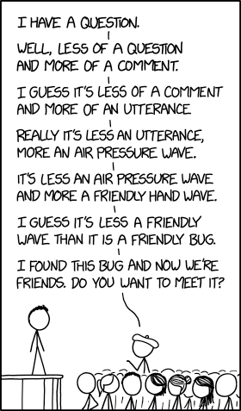
HOW WE RUN THE SESSIONS
House rules
1
We built in slack.
Finish your thought — nobody gets cut off mid-sentence. Session chairs will keep the day in shape; please don't make them work for it.
2
Slides go on Indico.
Upload your presentation to your contribution page before your talk.
3
Interrupt.
Slot lengths (60 / 40 / 20 min) already include discussion time. This is a workshop, not a conference: questions during talks are welcome.
OSSAP 2026 · Queen's University, Kingston
Notes:
Chairs: Wouter (Wed), Joe Formaggio (Thu AM), Junior Pena (Thu PM), Dan Carney (Fri) — confirm with Kyle before saying it aloud.

Slide 9
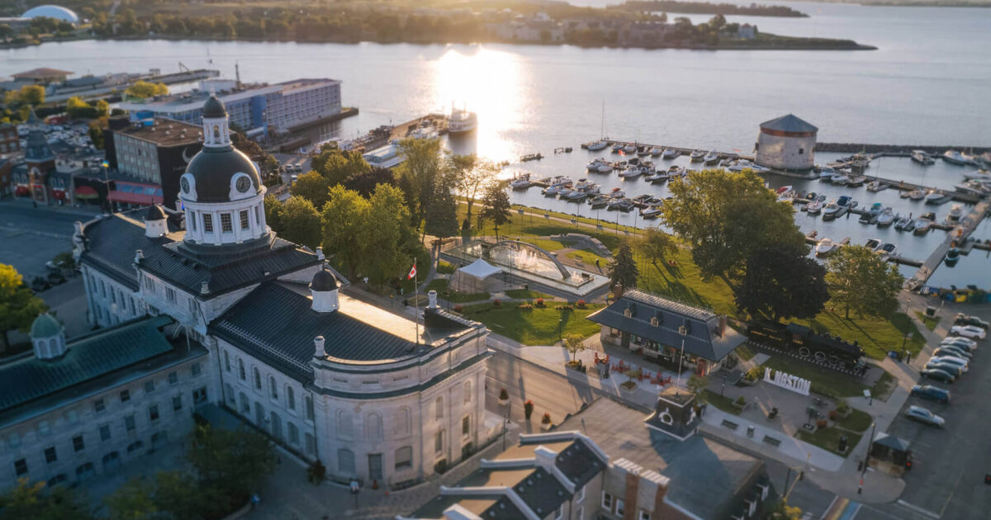
SOCIAL PROGRAM
Evenings
Wednesday · self-organized
Thursday · workshop dinner
Talks end 14:40, then a working session with coffee and free discussion until 16:00.
After that, no program — on purpose. Explore Queen's campus and the lakefront, walk into downtown Kingston, and have dinner in small groups.
Our local team knows where the good food is. Pull on them, they've agreed to be pulled on.
All together, in town. Where and when: announced Thursday morning. A venue is currently being negotiated with — bring patience and an appetite.
Suggested: form groups of 4–8 during the 4 pm coffee to find tables at restaurants.
OSSAP 2026 · Queen's University, Kingston
Notes:
Dietary requirements are on file for the buffet; for off-site dinners people should mention their own. Don't promise a pub name yet.

Slide 10
PRACTICAL MATTERS
Questions I will confidently answer wrong
What's the Wi-Fi password?
Where is the coffee, and is it bottomless?
Is lunch here or somewhere else?
Does the projector take USB-C, HDMI, or faith?
When do I check out on Friday?
Is there a vegan / gluten-free option tonight?
How do I get to the train station / airport?
Where is the nearest bathroom?
Ask the McDonald Institute team
Kyle · Mark · Edward · Zach
Check-in desk just outside the room.
I arrived by train last night and know exactly one street. Kyle knows all of them.
OSSAP 2026 · Queen's University, Kingston
Notes:
Have Mark or Edward wave when you point at this slide.

Slide 11
WORKING GROUPS
Friday: we plant some seeds
10:35
10:50
11:50
12:30
Dan Carney
frames the working-group topics
Breakouts
small groups, one hour
Report back
five minutes each, no slides required
Closing
Kyle Leach
Start thinking now
The format is deliberately open. Workshops like this one have a habit of producing new experiments and collaborations. No pressure — but the coffee breaks are where it starts.
Which measurement would you build with the person sitting next to you?
Which physics target is under-served by the sensors in this room?
What does this community need that no single lab can provide?
OSSAP 2026 · Queen's University, Kingston
Notes:
Hand-off to Dan: he owns the Friday structure; you are just planting the idea early.

Slide 12

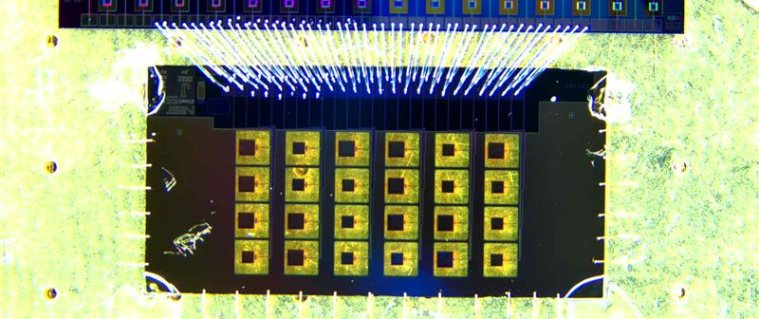
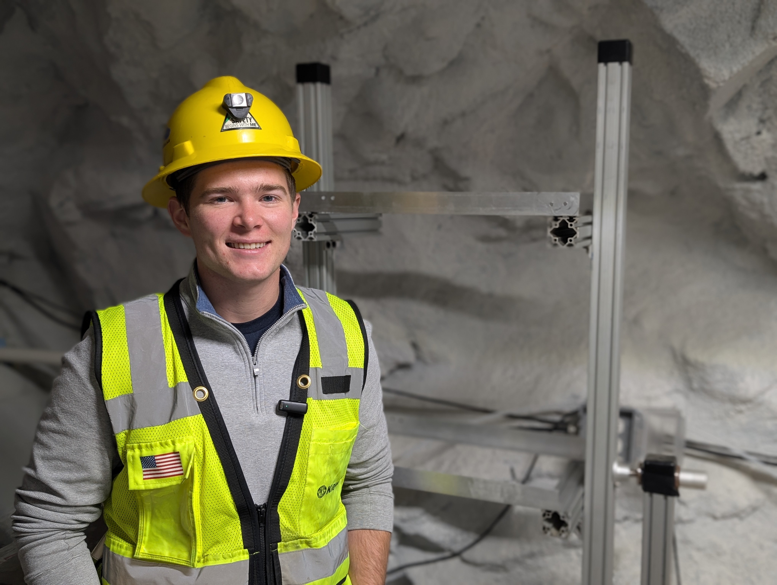
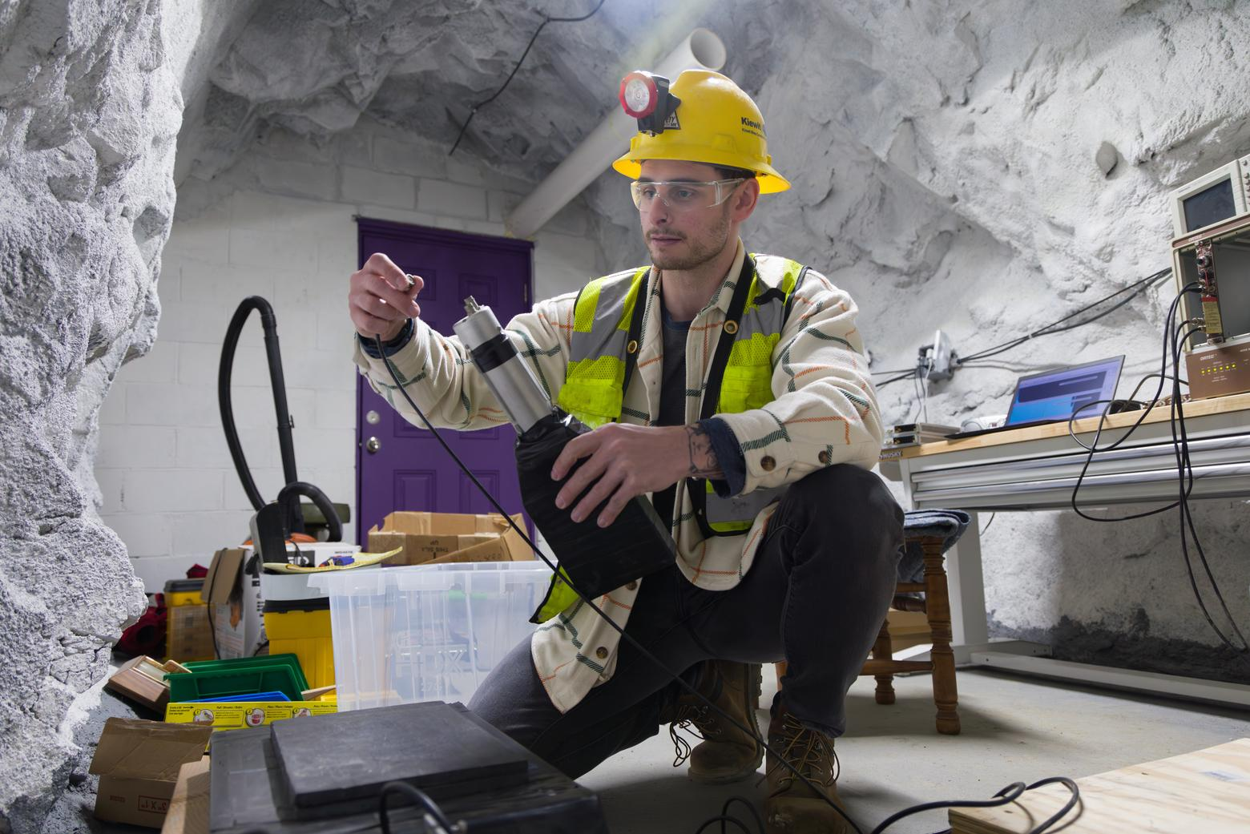
ONE SLIDE OF SHAMELESS ADVERTISING
Meanwhile, in Colorado
PHOTO
Mines campus / quantum lab
PHOTO
CURIE Cryolab I
PHOTO
our fridge / group
Quantum Engineering @ Mines
CURIE — the underground lab
My Research
One of the first quantum-engineering graduate programs in the US, now with an undergraduate track. Physics × EE × CS, hands-on and cryogenic.
Colorado Underground Research Institute, in the Edgar Mine. First cryolab ready for two dilution refrigerators; a second cavern being excavated. Low-background home for quantum devices and rare-event searches.
Ricochet (reactor CEνNS), Project 8 (neutrino mass), BeEST (superconducting-sensor decay spectroscopy). Cryogenic sensors, µMUX readout, underground backgrounds.
quantum.mines.edu
curie.mines.edu
qtsf.mines.edu
We are hiring — soon. A postdoc and a tenure-track faculty position at the boundary of subatomic physics and novel sensing. Not posted yet, so the application process is: come talk to me at a coffee break. Same for Ricochet, Project 8, BeEST or CURIE.
OSSAP 2026 · Queen's University, Kingston
Notes:
Keep it under a minute. The point is: serious program, serious facility, and an open door — not a sales pitch.

Slide 13

SAVE THE DATE · THE CONVERSATION CONTINUES
Next stop: Mainz, January 2027
Organized by Hannah Banks (NYU), Louis Hamaide (JGU Mainz), Dmitry Budker (JGU Mainz), Joachim Kopp (JGU Mainz) — Louis couldn't be here this week; you can be there in his.
indico.mitp.uni-mainz.de/event/472
MQS2027@uni-mainz.de
OSSAP 2026 · Queen's University, Kingston
Notes:
Check with Louis whether late applications are still being considered before showing the deadline line — if not, delete that line and just point to the URL. The event logo could not be pulled automatically; grab the header image from the Indico page.

Slide 14
Have a great workshop.
Up next: Zhen Liu — Overview of broad scope and theory
indico.global/event/18677/timetable
OSSAP 2026 · Queen's University, Kingston
Notes:
Hand over to Zhen.

