Slide 1
Complexity of Black Hole Microstate Geometries
Sebastián Moreno Chalacá

Slide 2




Complexity of Black Hole Microstate Geometries
Sebastián Moreno Chalacá
In collaboration with: Andrew R. Frey, Evan McDonough, Smit Panchal, Marcelo Katayama and Gregory Holloway

Slide 3
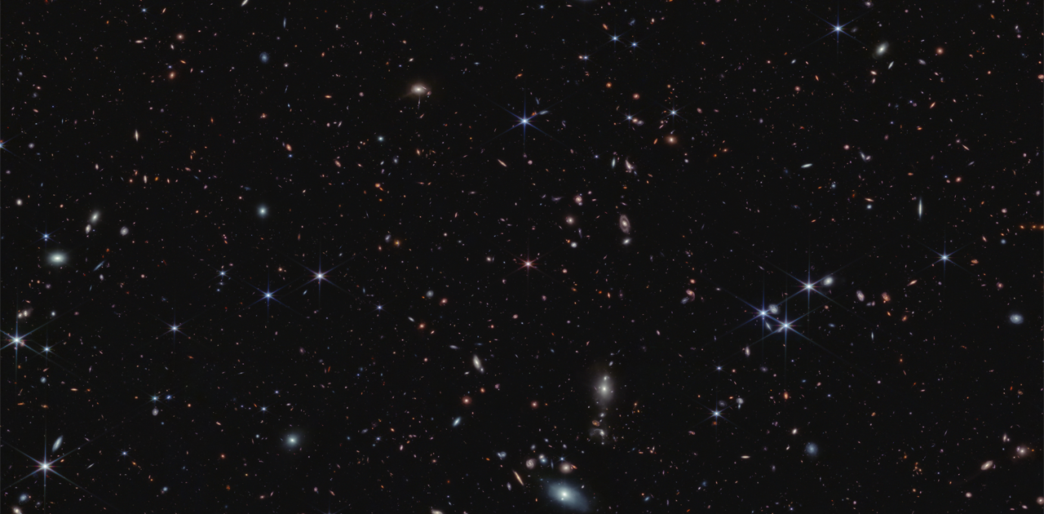
CHAPTER ONE
CHAPTER TWO
Geometry of Black Hole Microstates
Complexity of Black Hole Microstates

Slide 4
CHAPTER ONE
CHAPTER TWO
Motivation
Superstrata families
Geometry of Black Hole Microstates
Complexity of Black Hole Microstates
Properties

Slide 5
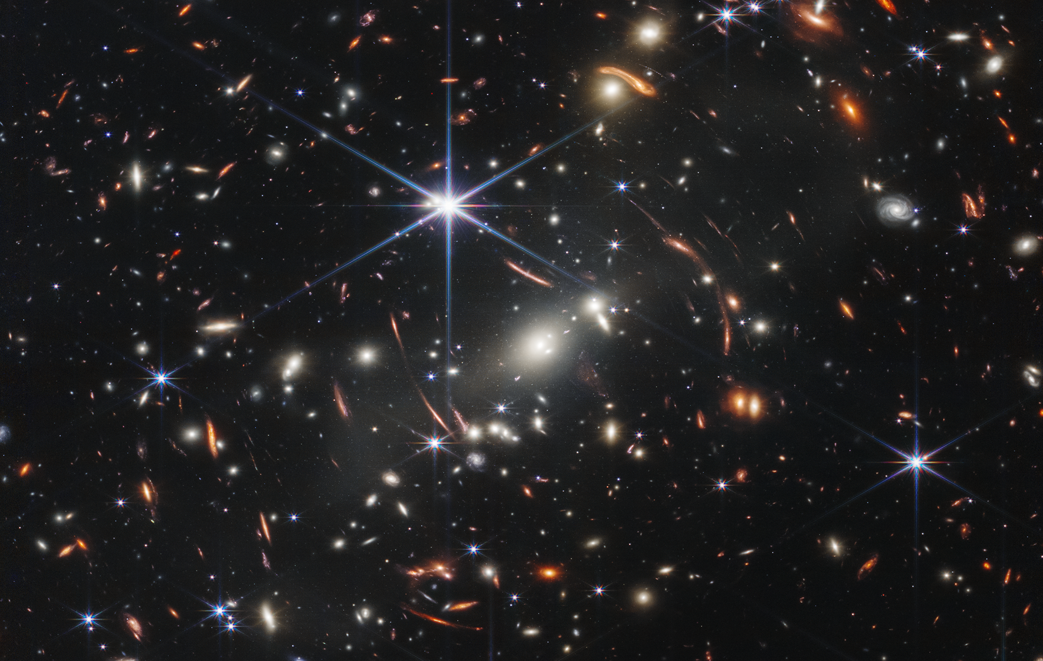
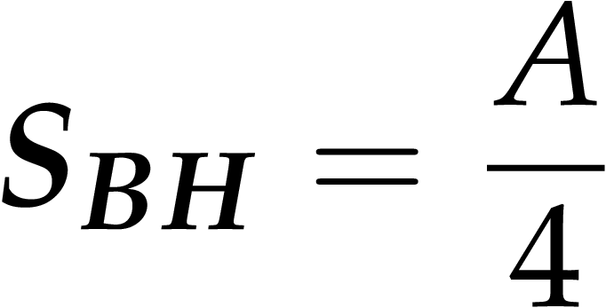
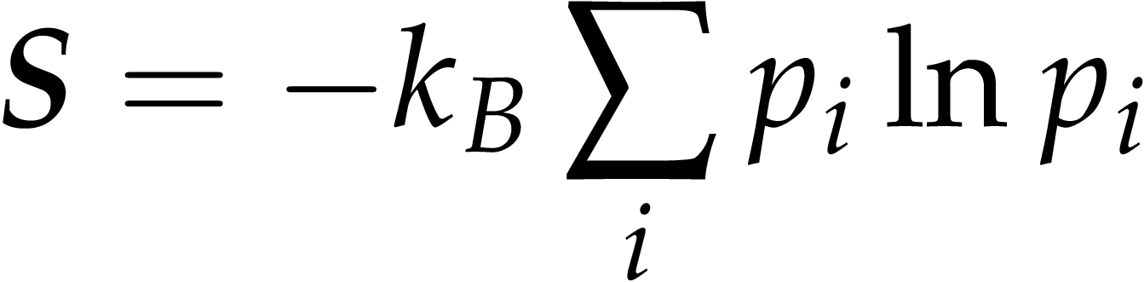
Challenge:
Bekenstein-Hawking Entropy
Black holes have entropy and non-zero temperature. This entropy is related to the area of the black hole by
Bekenstein-Hawking formula:
Then, black holes must be an ensemble of microstates since
Statistical mechanics formula:
1
Motivation

Slide 6
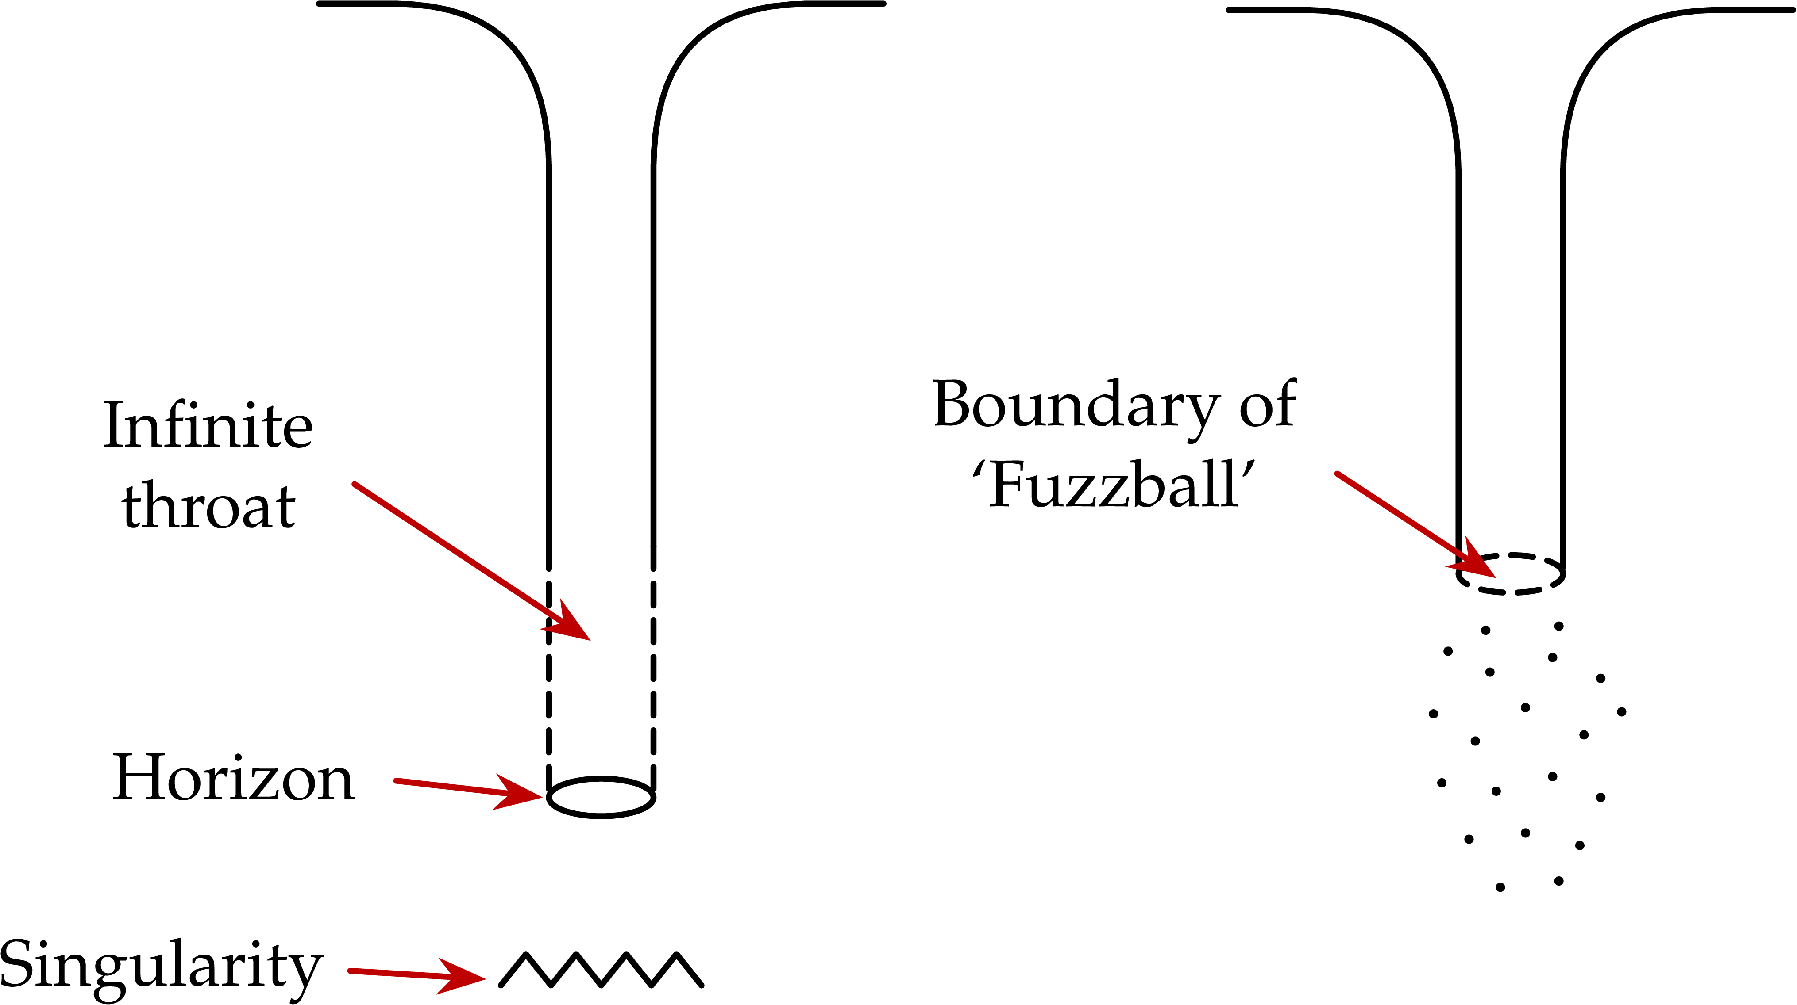
Proposal:
Microstate geometries, the ‘Fuzzball’ Picture of the Black Hole
Samir D. Mathur. “The fuzzball paradigm for black holes: FAQ”
2
Motivation

Slide 7
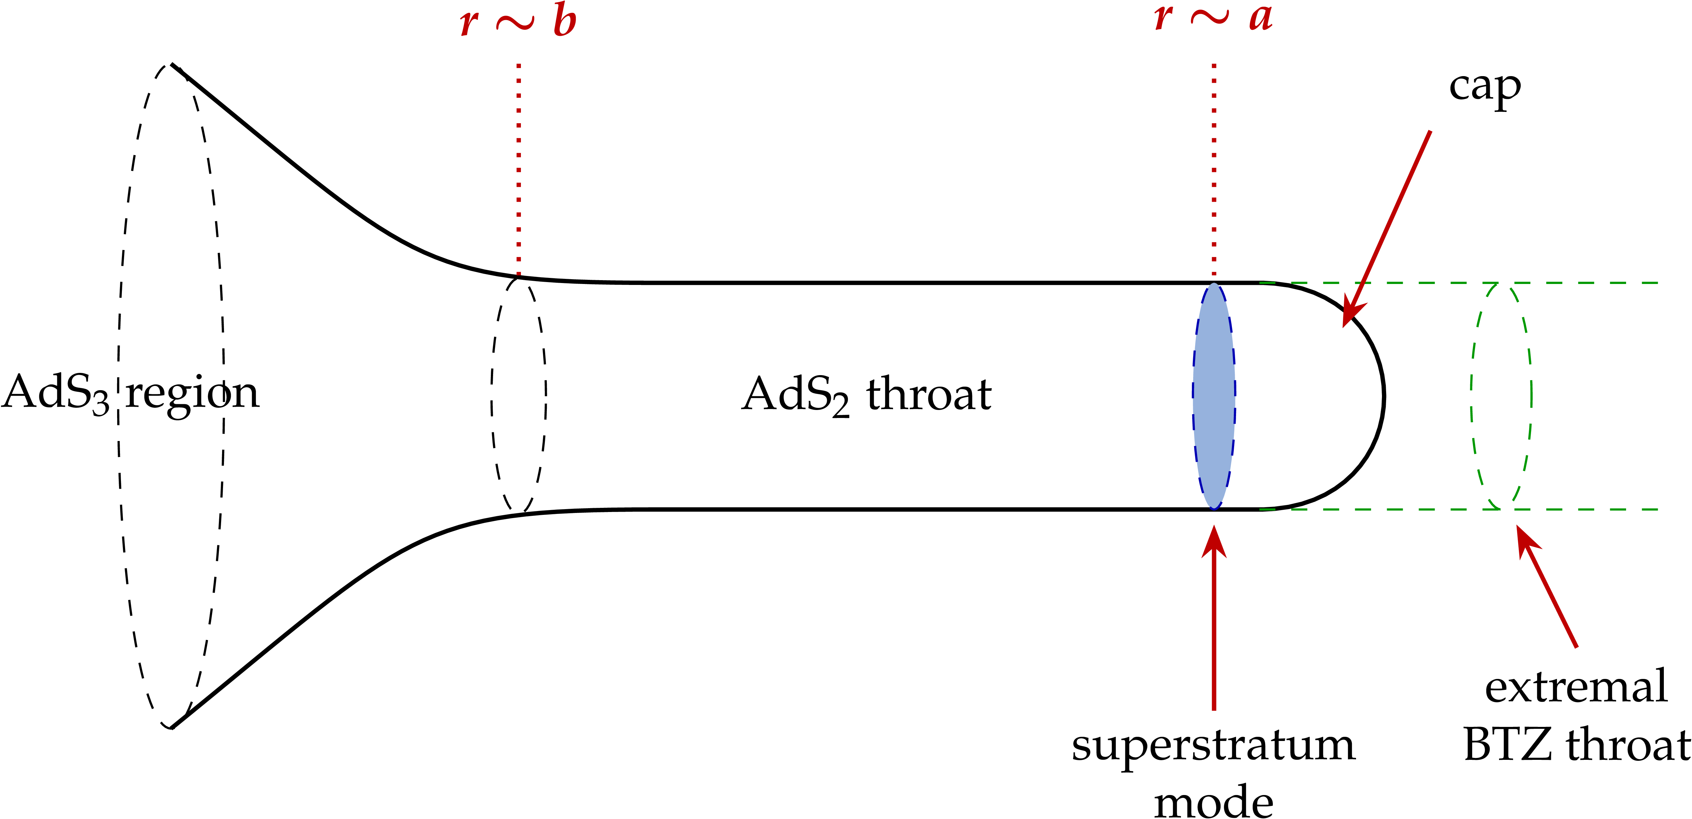
Proposal:
Superstrata: a smooth cap instead of a horizon
Iosif Bena, et. al. “Smooth horizonless geometries deep inside the black-hole regime”
2
Motivation

Slide 8
Proposal:
Microstate geometries, the ‘Fuzzball’ Picture of the Black Hole
Fuzzballs represent a new phase that emerges when matter is compressed to black-hole densities, and this new phase prevents the formation of a horizon or singularity. A fuzzball does not have an information problem because the internal states of the fuzzball are in causal communication with distant observers.
Iosif Bena, et. al. “Fuzzballs and Microstate Geometries: Black-Hole Structure in String Theory”
3
Motivation

Slide 9
CHAPTER ONE
Motivation
Superstrata families
Geometry of Black Hole Microstates
Properties

Slide 10
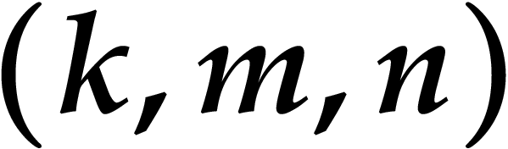

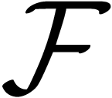


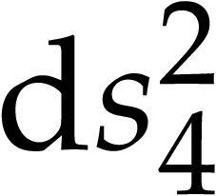
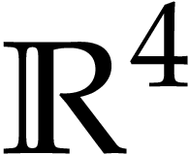
General Superstrata Metric
Superstrata is the name given to a special class of proposed fuzzballs for the BTZ black hole.
where and are functions; and are vectors and is the flat metric on written as
Iosif Bena, et. al. “Smooth horizonless geometries deep inside the black-hole regime”
4
Superstrata families

Slide 11
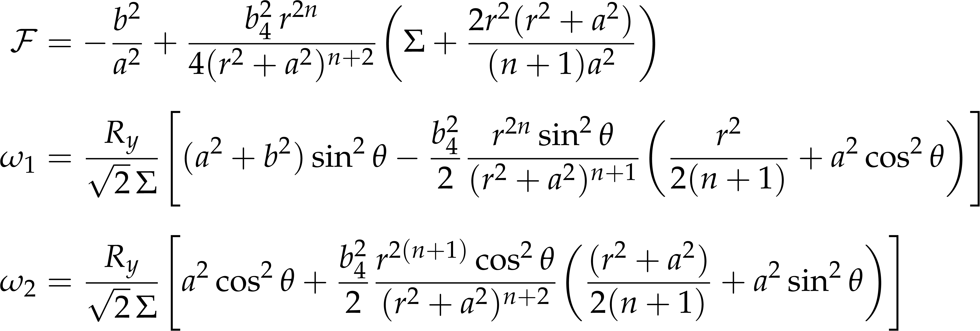
Special Families of Superstrata Metrics
Parameters
Iosif Bena, et. al. “Integrability and Black-Hole Microstate Geometries”
4
Superstrata families

Slide 12
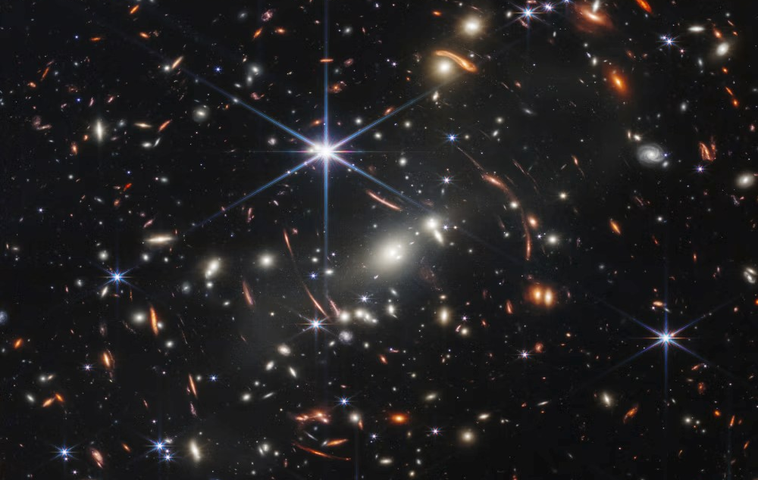
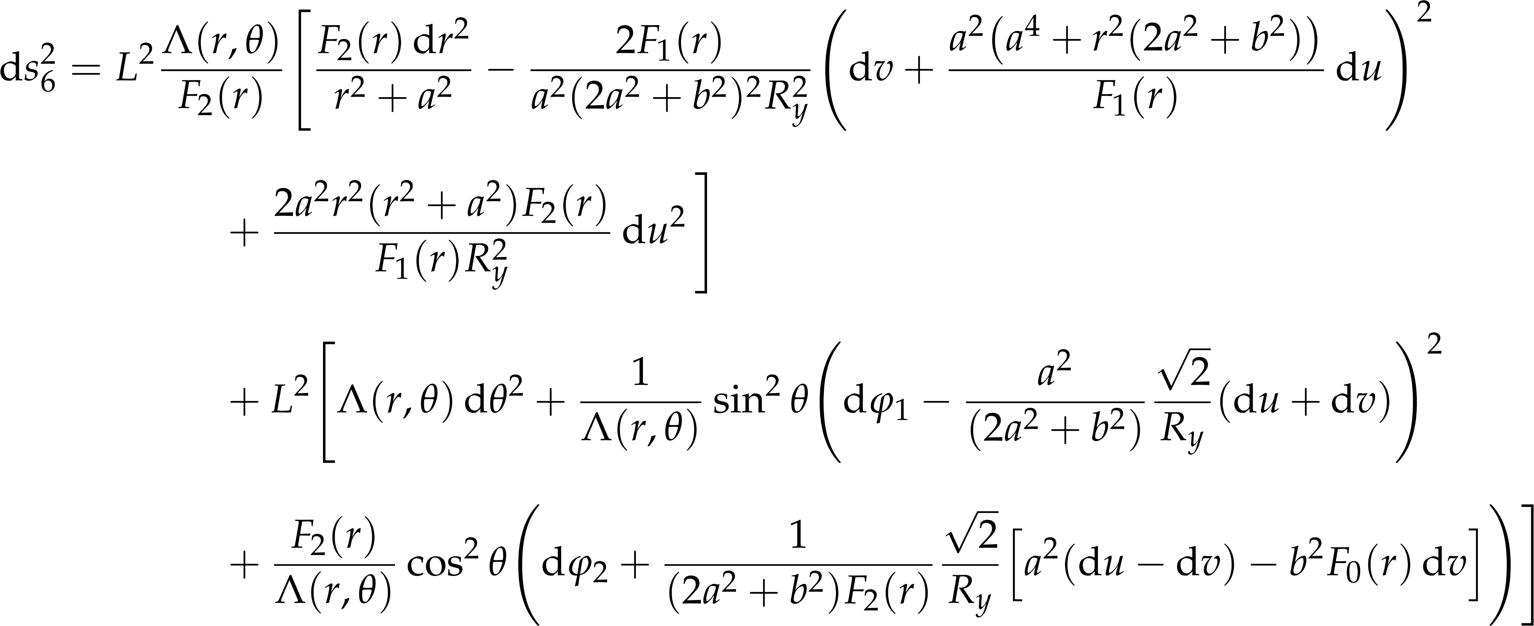
Special Families of Superstrata Metrics
The (1, 0, n) family of solutions
Iosif Bena, et. al. “Integrability and Black-Hole Microstate Geometries”
5
Superstrata families

Slide 13
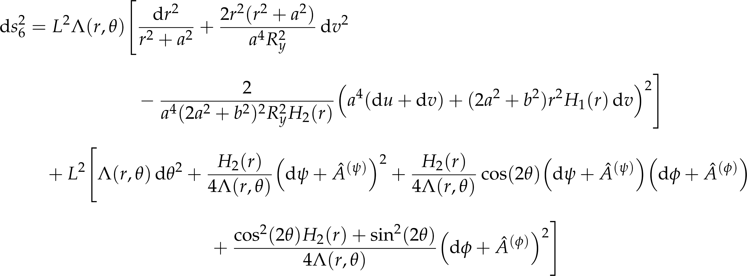
Special Families of Superstrata Metrics
The (2, 1, n) family of solutions
Iosif Bena, et. al. “Integrability and Black-Hole Microstate Geometries”
6
Superstrata families

Slide 14
CHAPTER ONE
Motivation
Superstrata families
Geometry of Black Hole Microstates
Properties

Slide 15
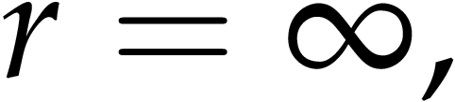
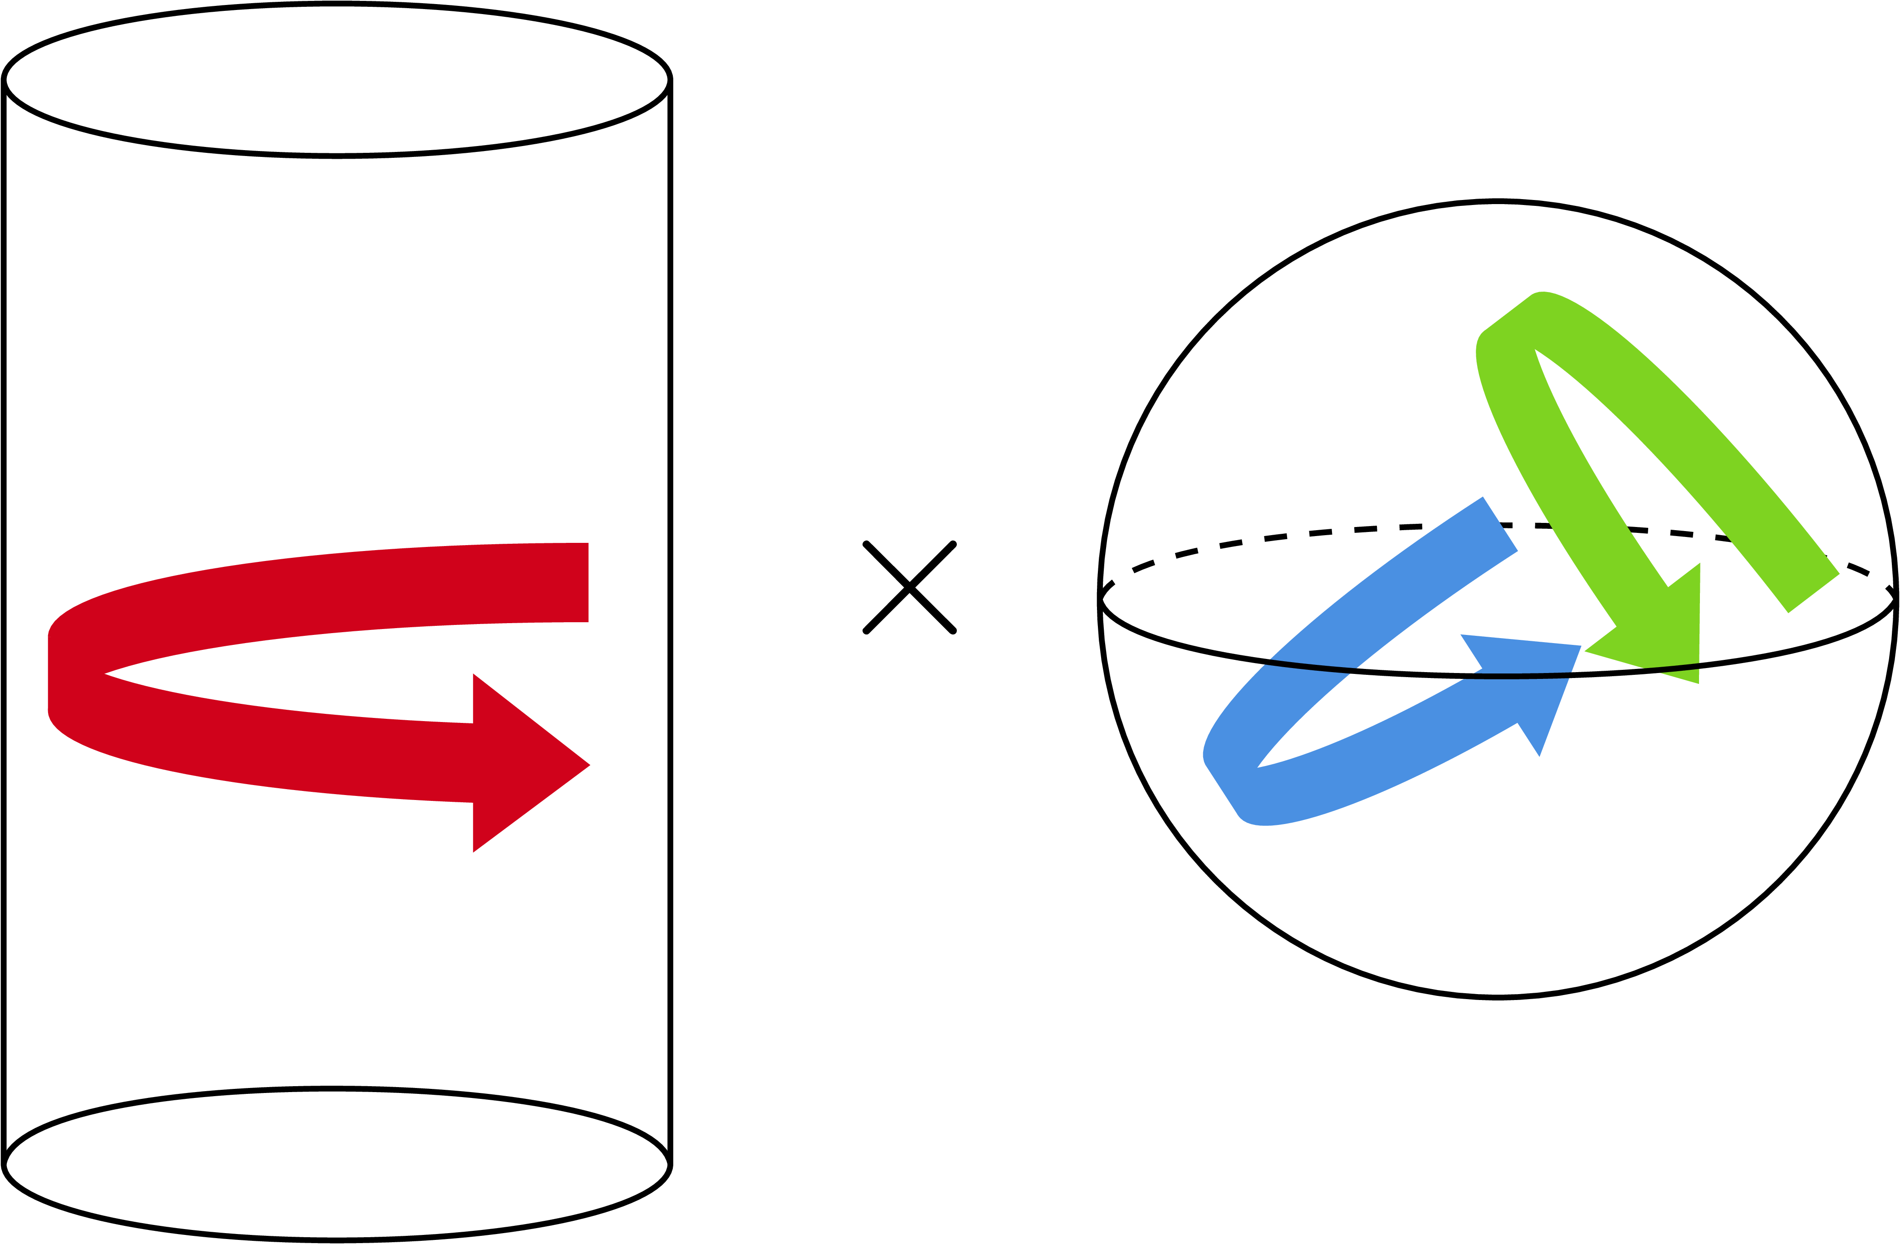

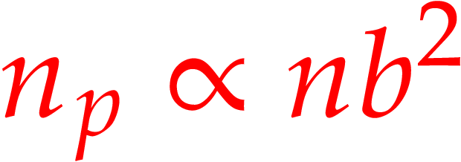
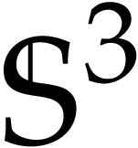
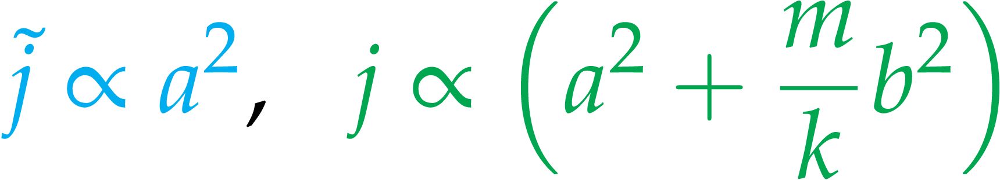
Properties of Black Hole Microstates
Expanding the microstate metric at the correction terms relate to the stress-energy tensor yielding the following
Linear momenta in the direction
Angular momenta in directions
Energy density
7
Properties

Slide 16

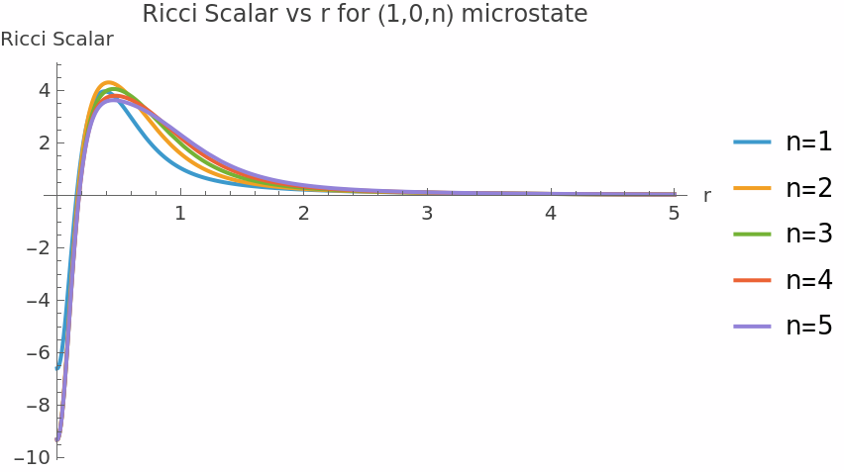
Curvature
The curvature of these microstates is peaked positively and negatively on a neighbourhood around 0 and quickly flattens out as grows larger.
8
Properties

Slide 17
CHAPTER ONE
CHAPTER TWO
Geometry of Black Hole Microstates
Complexity of Black Hole Microstates

Slide 18
CHAPTER ONE
CHAPTER TWO
Quantum to Holography
Complexity of Formation
Geometry of Black Hole Microstates
Results
Complexity of Black Hole Microstates
Outlook

Slide 19



Prerequisite:
Anti-de Sitter Spacetime
AdS space is a solution to Einstein’s equations
with cosmological constant
Light can go from the “centre” to its “edge” and back in finite time!
9
Quantum to Holography

Slide 20




Prerequisite:
Anti-de Sitter Spacetime
Geometries we are interested in asymptotically become so their metric turns into
at large
10
Quantum to Holography

Slide 21
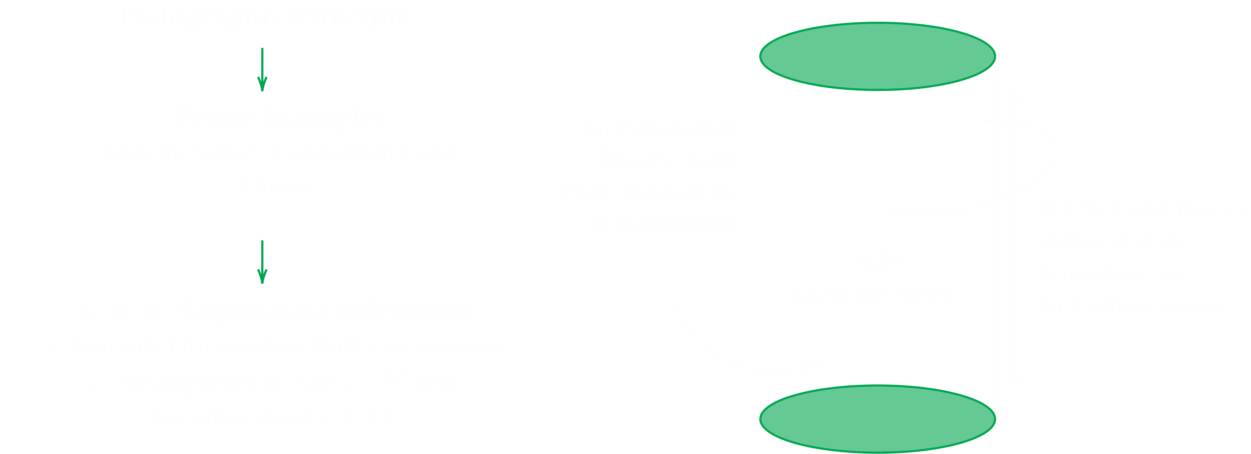
From Holography to a Microstate
11
Quantum to Holography

Slide 22
CHAPTER TWO
Quantum to Holography
Complexity of Formation
Results
Complexity of Black Hole Microstates
Outlook

Slide 23
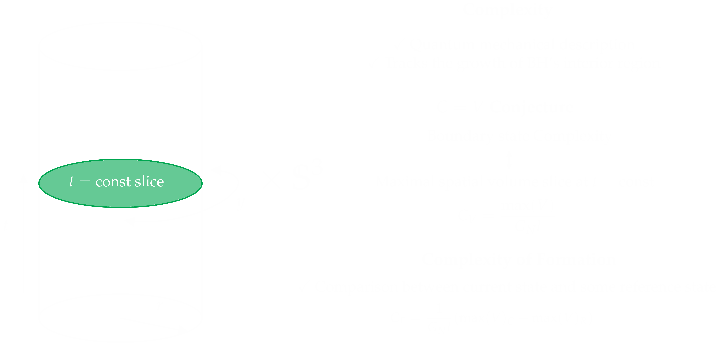
Complexity = Volume Proposal
12
Complexity of Formation

Slide 24

Computing the Complexity of Formation
13
Complexity of Formation

Slide 25
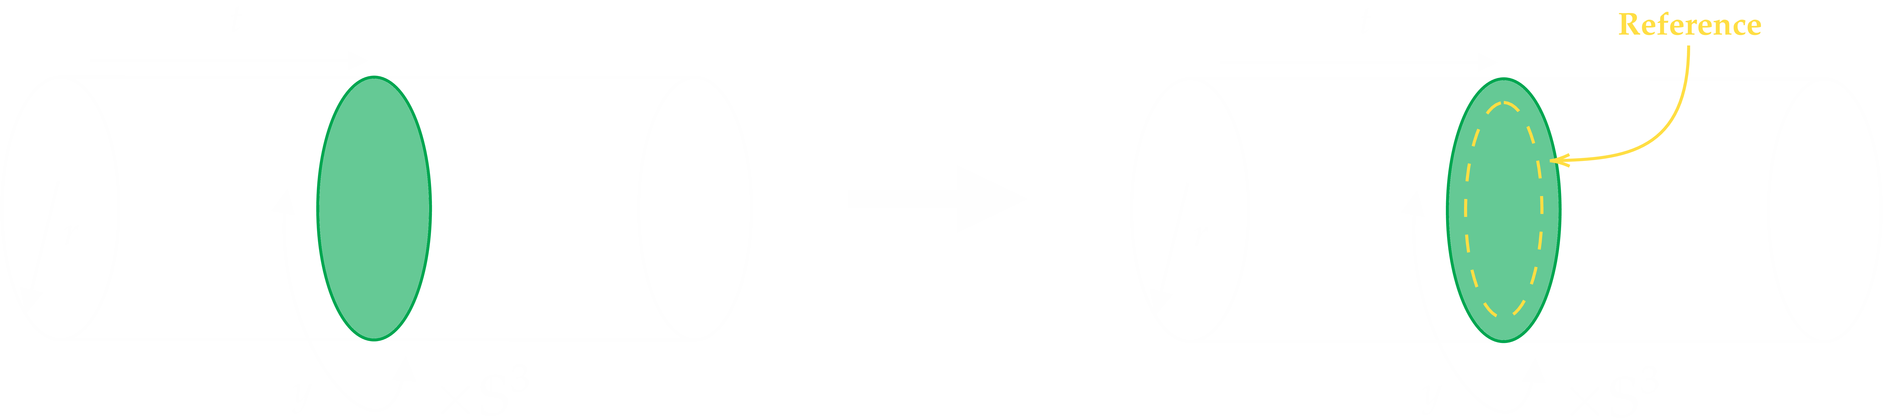
Computing the Complexity of Formation
13
Complexity of Formation

Slide 26
CHAPTER TWO
Quantum to Holography
Complexity of Formation
Results
Complexity of Black Hole Microstates
Outlook

Slide 27

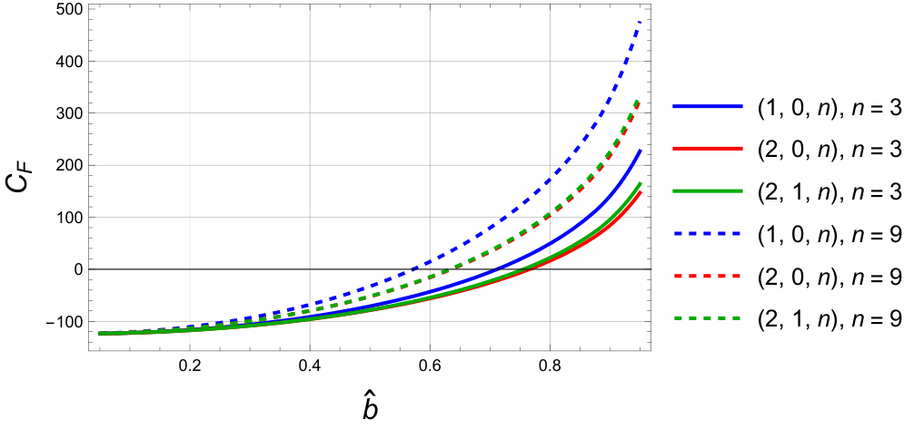
Across the Superstrata Families
14
Results

Slide 28

6D vs 3D: Data Mismatch
15
Results

Slide 29

6D vs 3D: Data Mismatch
15
Results

Slide 30
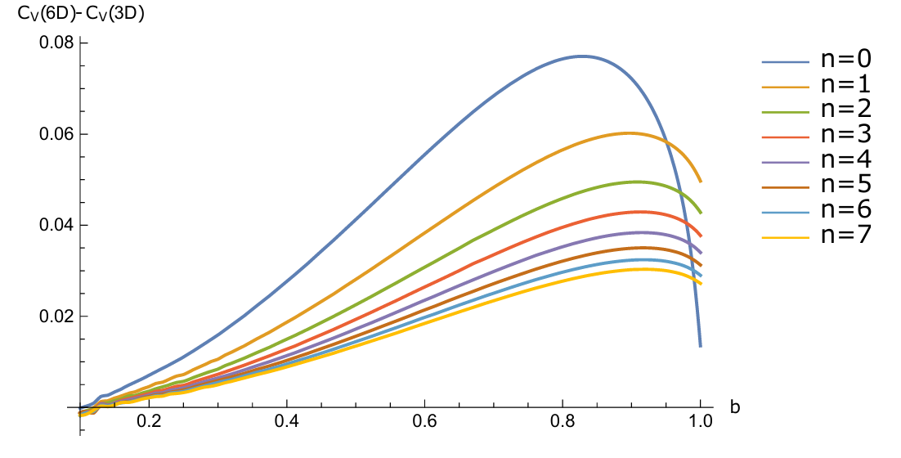
6D vs 3D: Data Mismatch
16
Results

Slide 31

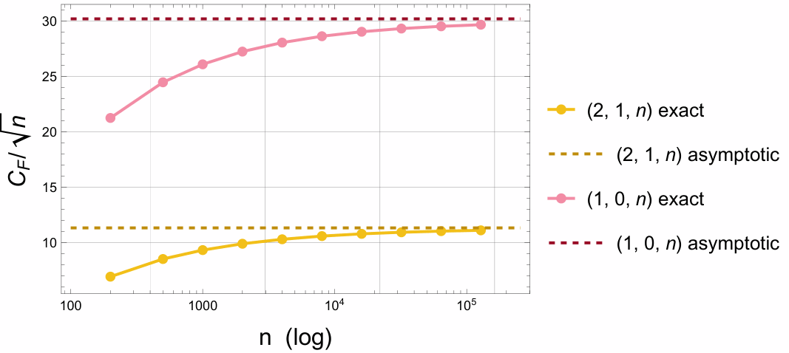
The Large Limit: Scaling of
17
Results

Slide 32
CHAPTER TWO
Quantum to Holography
Complexity of Formation
Results
Complexity of Black Hole Microstates
Outlook

Slide 33

Conclusions
We calculated the Complexity of Formation for different Superstrata families of solutions
In the limit of large n, the Complexity of Formation have the same behavior for the different families studied.
The 3D and 6D descriptions agree only at leading order: the proposal is not invariant under dimensional reduction.
18
Outlook

Slide 34



Next Steps
General fibration: Extend the complexity calculation to the full superstrata family.
limit: grows sharply as , understanding this analytically, and what it signals about the geometry’s regularity bound is still in process.
Open question: What does the 3D/6D mismatch tell us about holographic complexity and the proposal itself?
19
Outlook

Slide 35
¡Muchas gracias!

