Slide 1

Proving the OSV conjecture with the gravitational path integral
Luca V. Iliesiu

Slide 2
Based on work with
Nikolay Bobev, Jan Boruch, and Dawid Maskalaniec
building on earlier work with
Jan Boruch, Murat Kologlu, Sameer Murthy, and Gustavo J. Turiaci

Slide 3
The gravitational path integral (GPI) has become a precision tool for understanding quantum properties of black holes.

Slide 4
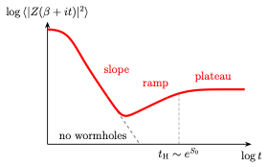
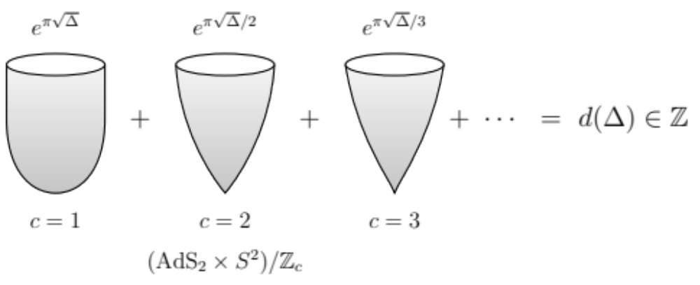
The gravitational path integral as a precision tool
Without supersymmetry: fine-grained statistics of black hole observables
(e.g., the Page curve and spectral statistics)
With supersymmetry: The GPI can reproduce exact degeneracies
(e.g., 1/8-BPS BHs in 𝒩 = 8 supergravity)
[Page `93; Penington `19, Almheiri et al. `19, Penington, Shenker, Stanford, Yang `19, LVI, Murthy, Turiaci `22]

Slide 5
What is still missing? The UV
In both settings, the GPI is insensitive to the interplay between UV corrections to the gravitational theory and the sum over spacetimes.
Without supersymmetry: UV effects, captured by higher-derivative corrections, are not under sufficient calculational control.
𝒩 = 8 supergravity: the higher-derivative corrections coming from string theory truncate at tree level.
A useful middle ground:
1/2-BPS black holes in 𝒩 = 2 supergravity, obtained from a Calabi–Yau compactification of type IIA string theory where higher-derivative corrections are highly non-trivial.

Slide 6
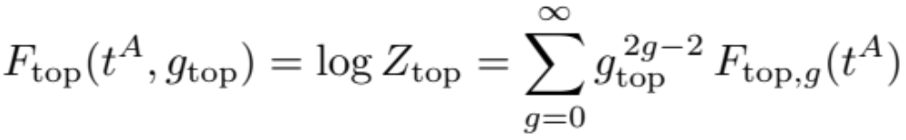
An exact prediction for 𝒩 = 2 supergravity: the OSV conjecture
Ooguri, Strominger and Vafa conjectured an exact formula for the black hole partition function that should include all stringy effects:
Z_{top} is the topological string partition function evaluated at the attractor values of the moduli, fixed by the charges and chemical potentials, and has a genus expansion with each order exact in α′:
[Ooguri, Strominger, Vafa `04; Bershadsky, Cecotti, Ooguri, Vafa `93, Gopakumar, Vafa `98]

Slide 7
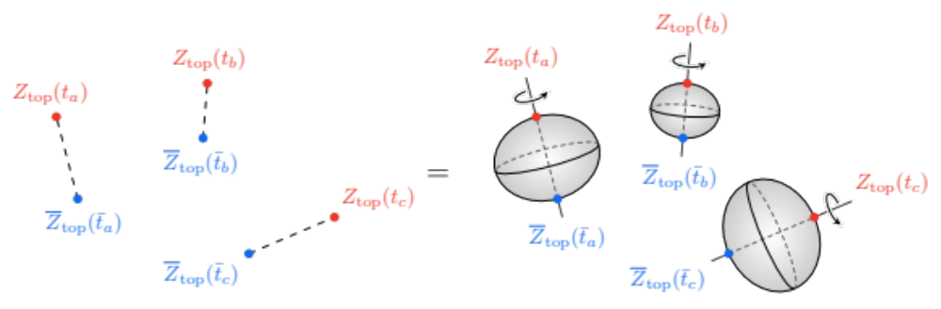
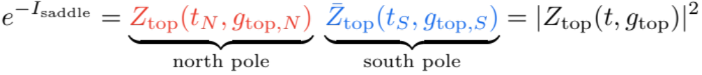
What we prove
We use the GPI to prove the OSV conjecture to all orders in the topological string coupling and at leading order in G_{N}.
New 4d supergravity saddles that compute the index to all orders in the derivative expansion:
smooth supersymmetric Euclidean black holes with an S¹_{β} × S² boundary at finite β.
Action localizes to the north and south poles of the horizon:
Note: Not the extremal (β = ∞) geometries, whose entropy counts bosons plus fermions: at finite β, the saddles directly compute their difference.

Slide 8
Why do we need a refinement?
The GPI also contains saddles whose contributions are non-perturbatively small, ∼ e^{−#S}, compared to the leading saddle:
1. Shifted saddles: gauge-field configurations that need additional patches — responsible for the quantization of electric charges.
2. Multi-center saddles: several finite-temperature rotating black holes in equilibrium.
These are especially relevant when the single-center black hole is absent or subdominant.

Slide 9
A non-perturbative refinement of OSV
For all saddles we prove,
to all orders in the topological string coupling for each non-perturbative correction in G_{N}.

Slide 10
What tools do we need?
1. Index saddles: finite-temperature, supersymmetric (complex) Euclidean black holes that directly compute the index — to all orders in the derivative expansion.
[LVI, Kologlu, Turiaci `21, Boruch, LVI, Murthy, Turiaci `23, `25, Adhikari et al. `25]
2. Equivariant localization of the gravitational action.
[Benetti Genolini et al. `19, `24, `26, Sparks et al. `26]
Key property: the Killing vector built from the Killing spinor has only isolated fixed points — the north and south poles of each horizon.

Slide 11

How do we compute indices directly in gravity?
Euclidean angular velocity Ω_{E} = iΩ_{H}: rotating by 2π(1+2n) around the thermal circle makes the fermions periodic.
[for the purposes of this talk there is no need to distinguish the index and the helicity supertrace]
[Bizet, Cassani, Martelli, Murthy `18, Bobev, Charles, Min `20, LVI, Kologlu, Turiaci `21]

Slide 12
Simplest example:
Pure (super)gravity

Slide 13
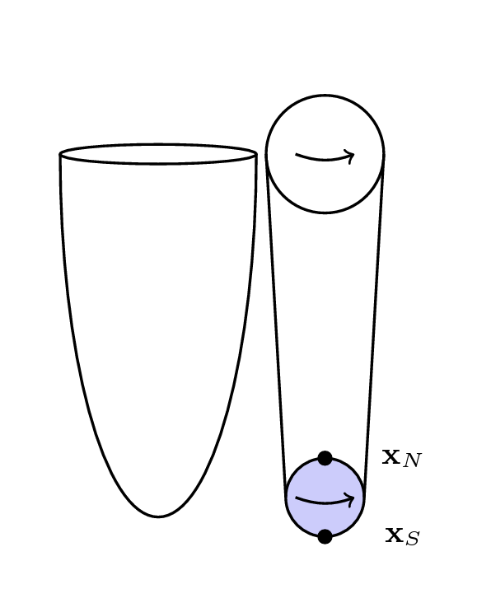


A black hole solution that we all hate (too complicated):
the Kerr–Newman solution
[LVI, Kologlu, Turiaci `21]

Slide 14
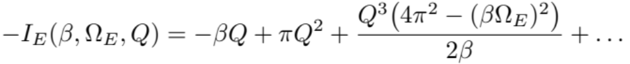
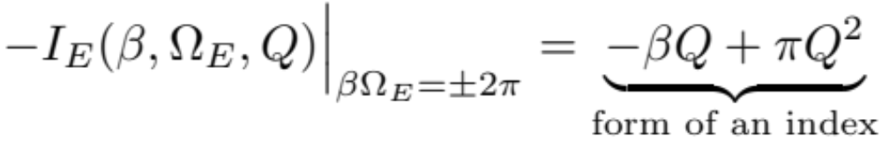
A black hole solution that we all hate (too complicated):
the Kerr–Newman solution
(exact
calculation)
While the geometry is not spherically symmetric,
it has Killing spinors (i.e. it is supersymmetric).
[LVI, Kologlu, Turiaci `21]

Slide 15
Are there other supersymmetric saddles in pure (super)gravity?

Slide 16
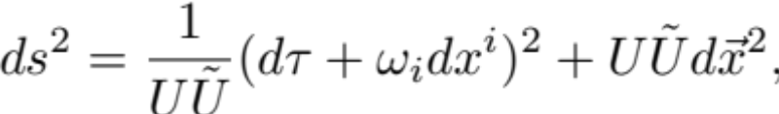

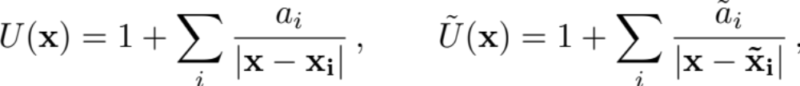



General solution with Killing spinors:
The Israel–Wilson solution
#
#
[Hartle, Hawking `72, Israel, Wilson `72, Whitt `84, Todd `85, Yuille `87,
Maldacena, Michelson, Strominger `98, Dunajski, Hartnoll `06, …]

Slide 17


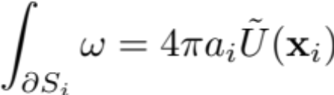
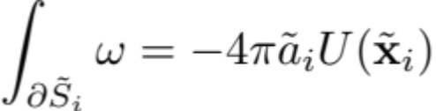


Imposing smoothness
If,
Singularity?

Slide 18
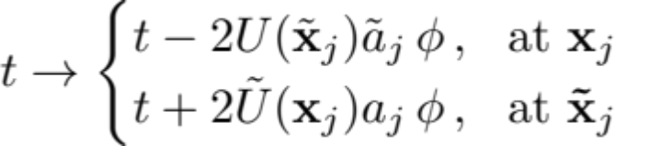


Imposing smoothness
If,
We can perform a coordinate transformation

Slide 19
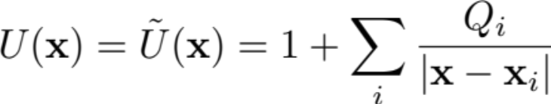
Imposing smoothness
Assuming poles are different, we can perform a coordinate transformation
Lorentzian:
Majumdar–Papapetrou
extremal solution
(AdS fragmentation)

Slide 20
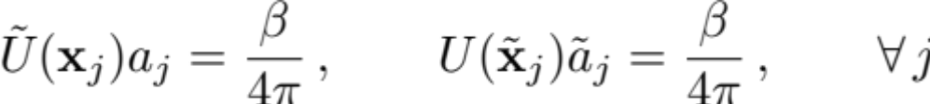



Imposing smoothness
Assuming poles are different, we can perform a coordinate transformation
Euclidean:
,
At each horizon:
Once again,
One smoothness condition for each pole.

Slide 21
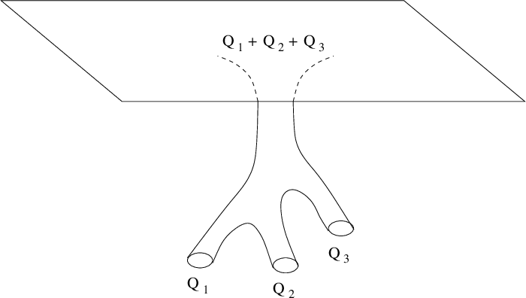



Lorentzian solution
Time
with
Euclidean solution

Slide 22
The most basic example:
A north pole and a south pole
Back to the basic example:
If there are only two poles,
we find that this is just the finite-β Kerr–Newman solution with Killing spinors that we discussed earlier.

Slide 23
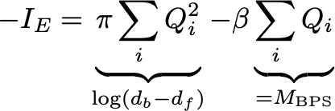

The index for the black hole ensemble
For more than two poles, the geometry has no Killing horizon and we cannot apply the quantum statistical relation to compute the free energy [Wald].
This takes precisely the form of the free energy associated with an index.
Once again, each individual area depends very non-trivially on , but overall the
Euclidean on-shell action has trivial dependence.
[Boruch, LVI, Murthy, Turiaci `23]

Slide 24

How about black holes in string theory on
?
[Bershadsky, Cecotti, Ooguri, Vafa `93, Antoniadis, Gava, Narain, Taylor `93, Lopes Cardoso, de Wit, Mohaupt `98]

Slide 25

Black holes in string theory
Two complications:
1) Black holes in 𝒩 = 2 supergravity with vector multiplets (with scalar moduli X^{I}): generalizations of the attractor solutions [Ferrara, Kallosh, Strominger `95].
…
[Bershadsky, Cecotti, Ooguri, Vafa `93, Antoniadis, Gava, Narain, Taylor `93, Lopes Cardoso, de Wit, Mohaupt `98]

Slide 26
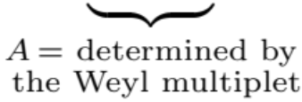
Black holes in string theory
2) UV (higher-derivative) corrections of the Calabi–Yau compactification are non-trivial and are encoded in the prepotential:
First few terms:
[Bershadsky, Cecotti, Ooguri, Vafa `93, Gopakumar, Vafa `98, Mariño, Moore `98, Faber, Pandharipande `98]

Slide 27
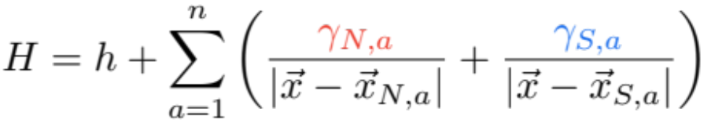
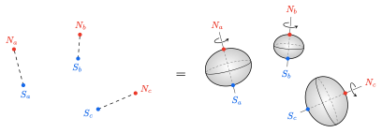
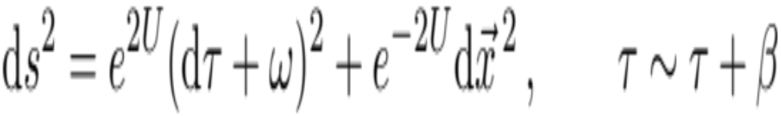
The supersymmetric solutions, to all orders in derivatives
Supersymmetric solutions with a Killing spinor are specified by harmonic functions on ℝ³:
where each pair of poles of H is a BH with charges Γ_{a}
Determines
the gauge fields
the scalars
What determines
[Denef `00, Bates, Denef `03, Denef, Moore `07, Boruch, LVI, Murthy, Turiaci `23, `25, Adhikari et al. `25]

Slide 28

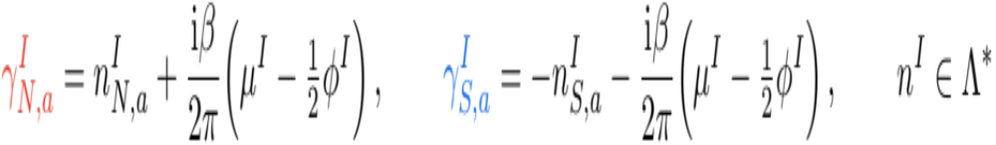
The attractor mechanism to all orders in derivatives
At finite β each horizon has a north and a south pole, where the scalars are attracted to:
Fixed charges:
Fixed electric chemical potential:
The scalars at the poles are fixed by the local charges alone — independent of the scalar moduli at infinity, the temperature and the other black holes.
Nevertheless, the black hole geometry is highly dependent on these parameters.
[Boruch, LVI, Murthy, Turiaci `23, `25, Adhikari et al. `25, Bobev, Boruch, LVI, Maskalaniec `26]

Slide 29

Computing the action with Dirichlet boundary conditions
Dirichlet boundary conditions for all fields — the natural boundary conditions of the OSV ensemble:
In this ensemble,

Slide 30
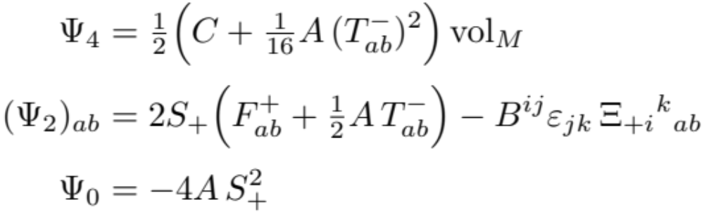
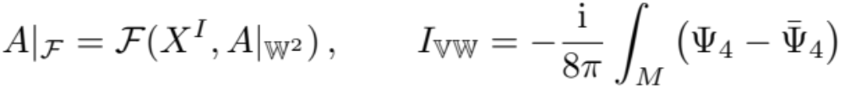
Equivariant localization: the polyform
[Benetti Genolini et al. `26, Sparks et al. `26]
Killing spinor bilinears:
Supersymmetry completes the Lagrangian of any weight-two chiral multiplet into an equivariantly closed polyform:
This follows from the off-shell supersymmetry transformations alone. For the action, the multiplet is built from the prepotential:

Slide 31
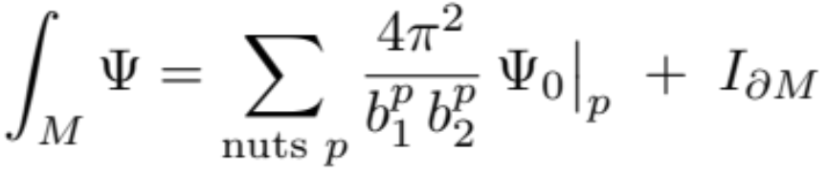
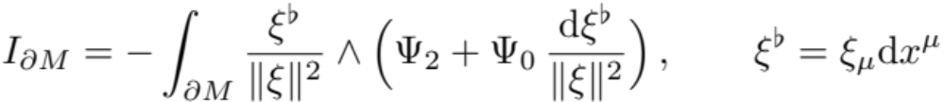
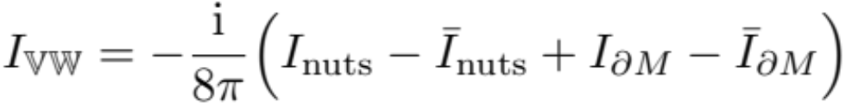
The BVAB fixed-point formula
Equivariantly closed forms localize onto the fixed points of up to a boundary term:
The fixed points are the north and south poles of each horizon.
Hence:
[Berline, Vergne `82, Atiyah, Bott `84, Benetti Genolini et al. `26]

Slide 32
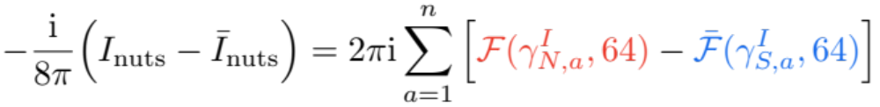
Contribution of the fixed points
Only north poles contribute to I_{nuts} and only south poles to Ī_{nuts}:
Two copies of the prepotential, evaluated at the attractor values at the north and south poles.

Slide 33
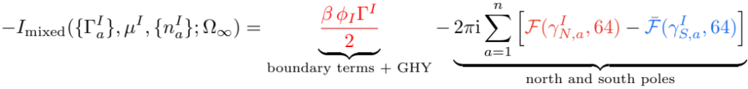
The action in the mixed ensemble
Three contributions that still need to be computed: compensating hypermultiplets, BVAB boundary terms and GHY term.
Collecting the fixed points and boundary terms we find:
The second term is what OSV predicts.
The first term has no interpretation within OSV: it depends non-trivially on β through the potentials φ_{I}.
Why do we get an answer that disagrees with OSV?

Slide 34

Three ensembles
Dirichlet b.c. weigh BPS states by their mass: the wrong ensemble for OSV.
Mixed
Dirichlet b.c.
Canonical
fixed charges
OSV
the conjecture

Slide 35
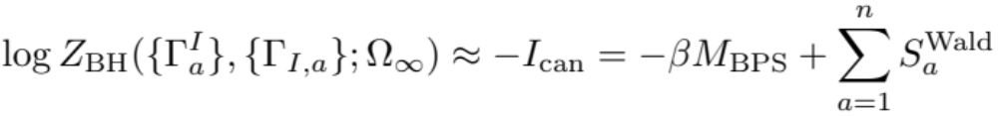


From the mixed to the canonical ensemble
Saddle point over the shifts (a Legendre transform at leading order in G_{N}):
[Wald `93, Lopes Cardoso, de Wit, Mohaupt `98, Sen `05, Boruch, LVI, Murthy, Turiaci `25]

Slide 36
From the canonical to the OSV ensemble
Remove the BPS mass and Fourier transform in the electric charges:
The action depends only on the data at the north and south poles, and not on the moduli at infinity.

Slide 37
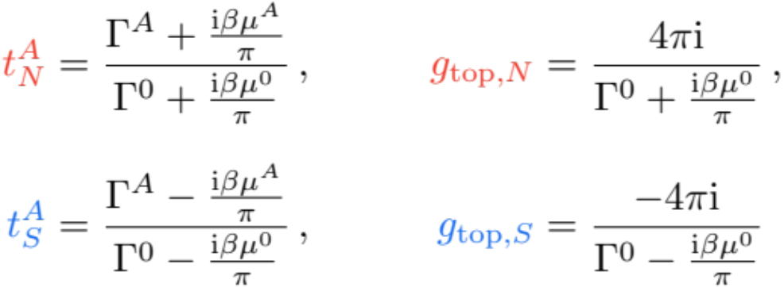
Proving OSV: focus on a single saddle
The prepotential is the topological string free energy:
Single-center saddle with n^{I} = 0 (continues to the extremal Lorentzian black hole as β → ∞ at fixed βμ^{I}):
⇒ OSV holds to all orders in g_{top} for the unshifted single-center saddle, at leading order in G_{N}.

Slide 38
A non-perturbative refinement of OSV
The same localization formula applies to every saddle that contributes to the helicity supertrace:
Two new kinds of saddles: shifted saddles and multi-center black holes.

Slide 39
Shifted saddles and the quantization of electric charges
The unshifted saddle alone is not periodic in βμ^{I}, as quantized electric charges would require. Single-center saddles with n^{I} ≠ 0 have
They still factorize into north × south pole contributions, now with t_{N} ≠ t_{S}.
⇒ The sum over shifted saddles restores periodicity and charge quantization:
The sum is formal (the Wald entropy grows fast with the charges): it diverges, since both the OSV and mixed ensembles are technically ill-defined.

Slide 40
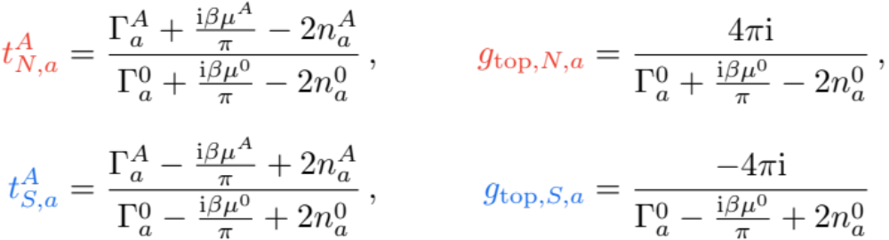
Multi-center black holes
[Boruch, LVI, Murthy, Turiaci `25]
Multi-center saddles have a moduli space, yet their action again localizes on all north and south poles:
In the OSV ensemble, the total electric charge depends on how the magnetic charges are split.

Slide 41
A comment on AI: why human verification is still needed
While AI was not used to derive this result, I did use all frontier models to try to reproduce it for the purpose of verification.
The problem is technically difficult but well-posed and verifiable, so it should be in the wheelhouse of frontier models.
Prompt: Use the index saddles found by Boruch et al. together with equivariant localization for the on-shell action to prove the OSV conjecture to all orders in the topological string coupling.
Result: frontier models got this wrong even with adversarial agents, because they stopped at
with Dirichlet boundary conditions.
Likely culprit: ease of cheating and non-rigorous statements in training data.
AI was, however, useful in proving that the D-terms vanish.

Slide 42
Summary
We can now find the index saddles to all orders in the derivative expansion; the attractor values at their poles are completely fixed by the prepotential.
Equivariant localization: the action localizes to the north and south poles of each black hole.
In the OSV ensemble, e^{−I} = Z_{top}(N) Z̄_{top}(S) ⇒ OSV to all orders in g_{top}, at leading order in G_{N}.
We also defined a non-perturbative refinement for all saddles of the index.
Discussion: Can we do more and perform the GPI exactly for these geometries?

Slide 43
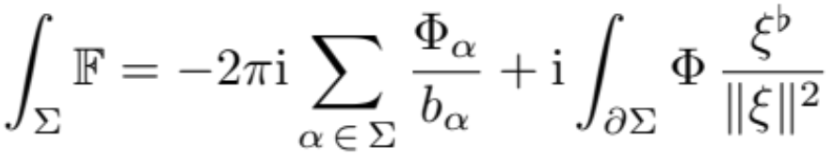
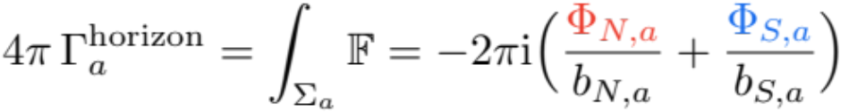
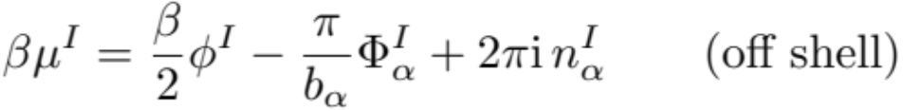
On-shell vs. off-shell
Equivariant localization applies to any configuration with a Killing spinor, not only to saddles. The electromagnetic polyform is equivariantly closed on any ξ-invariant surface Σ, even off shell:
Horizon Σ_{a} (compact):
Σ_{α} from a pole to infinity:
[Benetti Genolini et al. `26]

Slide 44
In the OSV ensemble, the action is the same off shell
The action depends only on the pole data — fixed by the chemical potentials, the shifts and the magnetic charges through the Killing spinor equations alone:
⇒ I_{OSV} is unchanged under any off-shell deformation that preserves the Killing spinor.
In the canonical ensemble, by contrast, the fixed-point values are determined only on shell (Maxwell).
This suggests that, in the OSV ensemble, the contribution of each saddle is one‑loop exact.

Slide 45
Why the answer looks one-loop exact
If the action is the same for all supersymmetric configurations, a Q-exact deformation localizes the GPI and leaves a one‑loop determinant:
Evidence: in 𝒩 = 4 and 𝒩 = 8 string theories, Z^{OSV} can be computed from the exact microscopic degeneracies:
|Z_{top}|² times a simple measure, summed over shifts — no further perturbative corrections.
[Shih, Yin `05]

Slide 46
What remains: the one-loop determinant
If factorization extends to quantum corrections, Z_{1-loop} should factorize into north and south pole contributions.
The Atiyah–Bott formula localizes the equivariant index of the fluctuation complex onto the same nuts as the action:
Requires care with boundary conditions, boundary contributions and zero modes on these complex saddles — and fixes the measure of the Laplace transforms between ensembles.
[Atiyah, Bott `67, Pestun `07, Jeon, Murthy `18, LVI, Murthy, Turiaci `22]

Slide 47
Appendix

Slide 48
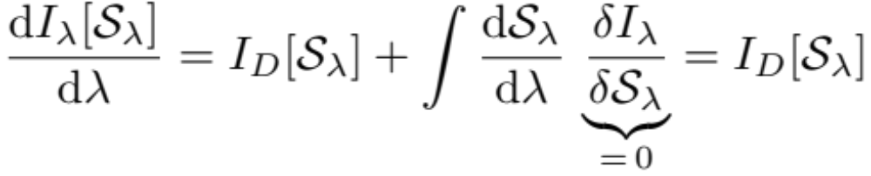
The vanishing of D-terms
D-terms (full-superspace integrals) can be rewritten with kinetic multiplets, i.e. as a 𝕋-log dependence of the prepotential:
Following the family of saddles 𝒮_{λ} as the D-terms are turned on:
I_{D} localizes to the nuts, where
[de Wit, Katmadas, van Zalk `10, Murthy, Reys `13, Benetti Genolini et al. `26]

