Slide 1
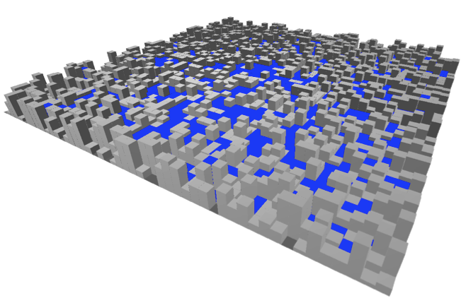
The “State” of Quantum Cosmology
[Cotler, Ivo, Maldacena ‘26] 2609.38052
[Cotler, Ivo, Maldacena ‘26] 2608.26244
Jordan Cotler
Harvard University

Slide 2



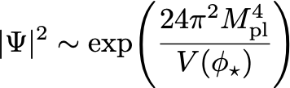
1-loop
No-boundary state favors as few e-folds of inflation as possible!
e.g. in 3+1:
(see e.g. [Maldacena ‘24])

Slide 3




Very slow roll limit of inflation
Linear roll limit: constant (no tensor fluctuations)
[Creminelli, Dubovsky, Nicolis, Senatore, Zaldarriaga, ‘08]
Flat gauge:
[Chen, Penington, 24]
Reheating surface:
complicated surface since the inflaton can reheat in different spatial regions for different t

Slide 4

Very slow roll limit of inflation
Linear roll limit: constant (no tensor fluctuations)
[Creminelli, Dubovsky, Nicolis, Senatore, Zaldarriaga, ‘08]
Flat gauge:
[Chen, Penington, 24]
Reheating surface:

Slide 5
Very slow roll limit of inflation
Linear roll limit: constant (no tensor fluctuations)
[Creminelli, Dubovsky, Nicolis, Senatore, Zaldarriaga, ‘08]
Flat gauge:
[Chen, Penington, 24]
Reheating surface:

Slide 6
Very slow roll limit of inflation
Linear roll limit: constant (no tensor fluctuations)
[Creminelli, Dubovsky, Nicolis, Senatore, Zaldarriaga, ‘08]
Reheating gauge:
[Chen, Penington, 24]
Reheating surface:

Slide 7
Very slow roll limit of inflation
Linear roll limit: constant (no tensor fluctuations)
Reheating gauge:
Reheating surface is at constant t but has non-trivial scale factor
Reheating surface:

Slide 8







Wavefunctional for reheating geometry
Global slicing:
Holds for any (!)
Invariant under CKVs:
conformally covariant kinetic operator and generalized curvature
at short distances
2+1 dimensions:
Notes:
In even dimensions, P and Q are the critical GJMS operator and Branson Q-curvature, respectively

Slide 9

Wavefunctional for reheating geometry
Global slicing:
Holds for any (!)
Invariant under CKVs:
conformally covariant kinetic operator and generalized curvature
at short distances
2+1 dimensions:
d = 2 Liouville with no CC (!)
Notes:
In even dimensions, P and Q are the critical GJMS operator and Branson Q-curvature, respectively

Slide 10

Wavefunctional for reheating geometry
Global slicing:
Holds for any (!)
Invariant under CKVs:
conformally covariant kinetic operator and generalized curvature
at short distances
3+1 dimensions:
d = 3 Liouville with no CC (!)
Notes:
In even dimensions, P and Q are the critical GJMS operator and Branson Q-curvature, respectively
They are called higher-dimensional Liouville theories because they generalize the defining geometric structure of two-dimensional Liouville gravity: a fluctuating conformal factor, a conformally covariant kinetic operator, a background-charge coupling to curvature
Or: the action is mathematically the Wess–Zumino functional obtained by integrating a generalized Q-curvature Weyl anomaly
(connects to conformal anomaly in even d spatial dimensions)

Slide 11
1-loop effects
No additional 𝜁-dependence in the probability measure is generated at one loop
The inflaton potential is linear, so its quadratic fluctuation operator is independent of the classical inflaton solution
1.
Gravity also decouples
The one-loop factors are independent of the boundary value of the inflaton
Asymptotic time-reparameterization invariance relates changes in the boundary inflaton to Weyl rescalings of the boundary metric
2.
Since one-loop factors are independent of the inflaton, the symmetry implies that one-loop factors should also be independent of the conformal factor
Subtlety: regularization of one-loop determinants can acquire an apparent Weyl anomaly, but boundary measure should cancel it with opposite anomaly

Slide 12



1-loop effects
2+1 dimensions: Let
Object of Weyl-anomaly coefficient c transforms as
Inner product:
invariant
Change evaluation surface:

Slide 13
Transition to eternal inflation
Global slicing:

Slide 14




Transition to eternal inflation
See Victor Ivo’s talk
Global slicing:
Eternal inflation phase transition at (!) infinite reheating volume
c.f. [Creminelli, Dubovsky, Nicolis, Senatore, Zaldarriaga, ‘08]
In two dimensions this coincides with the barrier in Liouville
( )
Notes:
Q^2 = 26 – c_{matter}
Why is this the c = 1 barrier?

Slide 15
Norm of the no-boundary state
Pure Einstein gravity:

Slide 16


Norm of the no-boundary state
Note: in neither case does the norm equal aaaaiiithe sphere partition function
[Cotler, Jensen ‘26]
[Cotler, Jensen, Shi, Turiaci WIP]
Pure Einstein gravity:
[Cotler, Jensen ‘25]
Einstein gravity plus very slow roll inflaton:
[Cotler, Ivo, Maldacena ‘26]
Notes:
In pure gravity, the round de Sitter saddle has a noncompact residual stabilizer, and division by its infinite volume causes the sphere contribution to the no-boundary norm to vanish.
With an inflaton, the noncompact de Sitter boosts act nontrivially on the conformal factor of the reheating surface. They generate the \ell = 1 components of \zeta, which we can gauge fix with a finite Faddeev-Popov determinant.

Slide 17

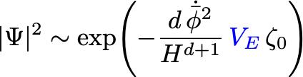

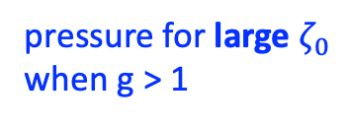
The e-fold problem, reprised
2+1 dimensions, genus g:
But: such spacetimes violate KSW for g > 0
subdominant
pressure for large $ζ_{0}$ when g > 1
More general story:
[Cotler, Ivo, Maldacena ‘26]
KSW implies that higher-topology contributions to the no-boundary state prefer as few e-folds of inflation as possible
[Kontsevich, Segal ‘21]
[Hertog, Janssen, Karlsson ‘23]
[Witten ‘21]

Slide 18



Volume enhancements from observers
[Hartle, Hawking, Hertog ‘07, ‘08]
Suppose the probability that an observer like us arises in a particular Hubble-sized region is
If a reheating universe contains approximately independent Hubble-sized regions, the probability that at least one observer arises is
Pressure for small number of e-folds everywhere outside of eternal regime
Volume becomes infinite in eternal regime, so not clear if there is a controlled calculation in that regime
[Cotler, Ivo, Maldacena ‘26]

Slide 19
Discussion
The very slow roll limit of inflation gives rise to a probability functional for the reheating surface described by (higher-dimensional) Liouville without a CC
The eternal inflation phase transition occurs at Q = 2
The norm of the no-boundary state with an inflaton is positive (and thus non-zero)
KSW implies that higher-topology contributions to the no-boundary state prefer as few e-folds of inflation as possible
The volume-enhancement of probabilities due to condition in the presence of an observer does not alleviate the e-fold problem in the non-eternal regime

