Slide 1
AI for Accelerators:
Current Challenges and Future Directions
September 14, 2026
Katsuya Yonehara
CLARIPHY Collaboration Meeting

Slide 2
Where AI can contribute to accelerator systems
AI can extract useful information from large, heterogeneous datasets and support complex accelerator decisions
Applications span accelerator operations, beam diagnostics, and component design
Operations and reliability
Measurement and design
Beam tuning and operating-point optimization
Anomaly detection and equipment protection
Predictive maintenance and fault diagnosis
Beam diagnostics and virtual instruments
Phase-space reconstruction from distributed measurements
Accelerator component and target design
Most accelerator AI applications use local measurements to optimize an individual machine or subsystem.
Unique focus of this talk: Integrate accelerator instrumentation with measurements from physics detectors to optimize beam delivery and experimental performance

Slide 3
Experimental Configuration Defines Accelerator AI Priorities
Optimal accelerator performance depends on how the experiment uses the beam
Fixed-target experiments: extracted single-pass beam
Circular colliders: circulating beams
The experiment receives each extracted pulse only once
Beam conditions must be reconstructed rapidly from distributed measurements
Tuning decisions must occur between pulses or spills
Experimental performance depends on the target and downstream detector response
Beams circulate and collide over many turns
Repeated measurements enable continuous feedback
Phase-space errors affect stability, luminosity, and collision-energy resolution
AI supports orbit correction, phase-space control, and long-term optimization
Accelerator AI should optimize experimental performance by connecting accelerator, target, and detector measurements

Slide 4

Current Challenges and Future Directions
Current challenges
Future directions
Sparse fault data and incomplete labels
Different data rates, timing systems, formats, and calibrations
Synchronizing accelerator, target, and physics-detector measurements
Changing machine configurations and operating conditions
Requirements for reliability, interpretability, and response time
Secure access across controls and machine-protection networks
Physics-informed models and accelerator emulators
Common timing and metadata across accelerator instrumentation and physics-detectors
Uncertainty-aware operator decision support
Common data standards and reusable benchmark datasets
Staged deployment with continuous validation and human oversight
These needs also align with the Genesis Mission
Operational value requires trustworthy predictions under changing machine conditions

Slide 5
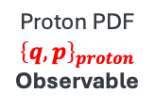
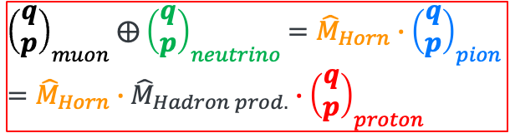

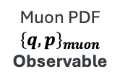
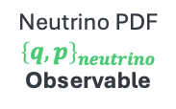
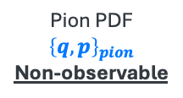
Experiment-Integrated Digital Ecosystem for LBNF
Probability Density Function (PDF)
Horn
Neutrino ND
Muon Monitor
Beam
Target
${\left(\begin{matrix}q \\ p\end{matrix}\right)}_{muon}$ $⨁$ ${\left(\begin{matrix}q \\ p\end{matrix}\right)}_{neutrino}$ $={\hat{M}}_{Horn}∙{\left(\begin{matrix}q \\ p\end{matrix}\right)}_{pion}$
$$={\hat{M}}_{Horn}∙{\hat{M}}_{Hadron prod.}{∙\left(\begin{matrix}q \\ p\end{matrix}\right)}_{proton}$$
Proton PDF
$${\left\{q,p\right\}}_{proton}$$
Observable
Pion PDF
$${\left\{q,p\right\}}_{pion}$$
Non-observable
Muon PDF
$${\left\{q,p\right\}}_{muon}$$
Observable
Horn operator
$${\hat{M}}_{Horn}$$
Neutrino PDF
$${\left\{q,p\right\}}_{neutrino}$$
Observable
Surrogate model emulates magnetic-horn focusing
Acquire bunch-resolved accelerator data
  Synchronize fast beam instrumentation, such as Wall Current Transformer (WCT), Beam Position Monitor (BPM), and Beam Loss Monitor (BLM) with beam and machine settings
Use AI-assisted muon monitors (e.g. MuMS) to infer the unobserved pion phase space
Integrate measurements from the SAND ND, including its liquid-argon volume, into the accelerator data ecosystem

Slide 6
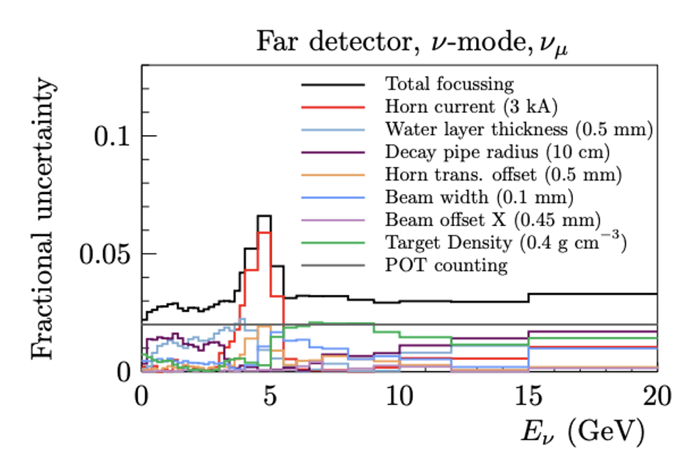
Beam-related Flux Uncertainty and Measurement Goals
An experiment-integrated digital ecosystem could reduce beam-related uncertainty for LBNF/DUNE
Protons on Target
Improve uncertainty from 2 to 0.1%
Introduce new current transformer
Peak on-axis neutrino energy is ~2.5 GeV
Horn current
Improve uncertainty from 3 to 0.1 kA
Already demonstrated at NuMI
Predict with emulator and validate with survey & beam tomography
Beam and Target conditions
Goal beam width < 0.1 mm
Goal beam position offset ~ 0.02 mm
Goal target Density < 5 %

Slide 7
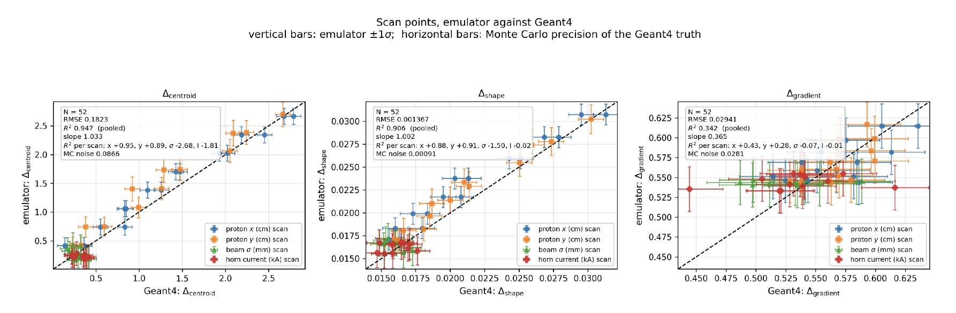
Bayesian Exploration with a Physics Informed Emulator for LBNF
Curtesy of S. Ganguly
Plots demonstrate that the physics informed emulator approximates high-fidelity Geant4 responses across beamline parameter scans
Fast inference enables Bayesian exploration and feedback for beam tuning

Slide 8
Advancing AI for High-Power-Target Design
AI replaces routine evaluations inside a validated domain; selected and high-risk cases return to physics
DEFINE → GENERATE → PREDICT & OPTIMIZE → GATE → VALIDATE
01
02
03
04
05
Define
Generate
AI predict
Screen
Validate
Geometry · material
beam · cooling
Parametric concepts
feasible candidates
Validated surrogates
+ uncertainty
Optimize · constraints
UQ · novelty · risk
Selected high-fidelity
simulation · experiment
validated evidence retrains surrogates and expands their domain
What the model explores (Define + Generate)
What makes a candidate viable (Optimize / Gate)
Geometry, material, beam parameters, and cooling configuration
OBJECTIVE
Maximize physics performance and service lifetime
What the model predicts (AI predict)
CONSTRAINTS
Particle yield, temperature, stress, fatigue, radiation damage, and physics uncertainty
Temperature · stress · cooling capacity · manufacturability · safety

Slide 9
AI/ML Test Facility: Validating Predictions and Calibrating Uncertainty
Controlled beam tests establish AI performance under realistic operating conditions
Why a test facility is needed
What the test facility must evaluate
AI development requires frequent, short beam-access periods
Controlled scans and off-normal conditions exceed the risk tolerance of most user operations
Upstream beam instruments and downstream detectors require a common time base and shared metadata
Real hardware and controls are necessary to close the simulation-to-reality gap
AI-ready benchmark datasets and common interfaces support reproducibility and transfer to other facilities
Prediction error against independent accelerator and detector measurements
Calibration and coverage of prediction intervals
Robustness across operating conditions, machine drift, and faults
Detection of extrapolation and safe fallback outside the validated domain
Improvement in experimental performance and tuning or recovery time
Realistic beam tests measure prediction error, calibrate uncertainty, and provide operational evidence for safe AI deployment

Slide 10
Summary
The experimental configuration defines the accelerator AI priority: rapid beam-state reconstruction for single-pass experiments and continuous phase-space control for circular colliders
Our approach connects accelerator instrumentation, physics models, target systems, and HEP detectors to optimize experimental performance
The LBNF case study combines synchronized measurements, Bayesian exploration, and an emulator to constrain beam-related neutrino-flux uncertainty
Target AI applies validated surrogate models and uncertainty quantification to accelerator-component design
An AI/ML Test Facility provides flexible beam access, integrated AI-ready data, and controlled experiments to validate predictions, calibrate uncertainty, and establish evidence for safe deployment

