Slide 1


30th July 2026 – ITA (Zaragoza)
ITAINNOVA activities for the CMS high luminosity upgrade and ECFA DRDs
PID2023-148418NB-C43
IP: Fernando Arteche
Instituto Tecnológico de Aragón (ITA)
Research Team: Dr. F.Arteche (1), Dr. A.Pradas (1),Dr. Javier Galindo(0.5) , Dr. I.Echeverria (0.5), Ruben Gonzélez (0.5)
Work Team: Dr. C.Rivetta, A.Gimeno, P.Lainez, J. Marqués
Project Main Data - Meeting - Zaragoza
Total Researchers: 5+3 EDPs: 3,5
Budget: 182.000 € Term: 3 years
Key Words: LHC, CMS, Particle Detectors, Physics Analysis, Dark Matter, Pixel Silicon Detectors, Power Distribution

Slide 2
1. Introduction
ITA contribution is focused on WP4, WP5,WP2
WP4 – R&D on detector electronics for 4D tracking and high data density detectors:
  Develop innovative power distribution schemes (GaN DC-DC, serial powering, supercapacitors) to improve efficiency and robustness of future high-density detectors.
  Implement high-precision timing distribution techniques (White Rabbit) to achieve sub-nanosecond synchronization for 4D/5D detector systems.
  Alignment with DRD7 (Electronics Systems R&D collaboration):
    Contributes to Theme DRDT7.1 → Advanced technologies for higher data density & power efficiency.
    Contributes to Theme DRDT7.3 → Development of high-precision timing distribution for 4D/5D techniques.
WP2 - Sensor production, module assembly, and hybrid testing for CMS ETL)
  Associate to ETL activities
WP5 - Advanced detector characterization techniques).
  Alignment with DRD3
These activities has started 2.5 years ago – GANCAP4CMS, PC, AIDAINNOVA & EUROLABS

Slide 3
1. Introduction
ITA leads Work Package 4 (WP4) – R&D on detector electronics for 4D tracking and high-data-density detectors (DRD7 collaboration).
  WP4.O1 – High-efficiency power distribution with GaN DC-DC converters.
    Task WP4.T1: Development of a new GaN-based DC-DC converter for serial powering architectures.
  WP4.O2 – High-precision and deterministic reference distribution with White Rabbit.
    Task WP4.T2: Development of a distributed synchronization architecture based on WR for timing detectors.
Collaborative contributions:
  WP2 (Sensor production, module assembly, and hybrid testing for CMS ETL).
    Task WP2.T2: Final qualification of LGAD+ETROC hybrids (support in grounding, EMC, noise characterization).
  WP5 (Advanced detector characterization techniques).
    Task WP5.T2: Upgrade and improvement of EMC test systems (noise transfer function measurement, conducted emission in radiation environments).

Slide 4
2. WP4 High-efficiency power distribution with GaN DC-DC converters
The main goal of WP4 is to improve energy efficiency of next-generation detector systems.
  Reduce material budget while ensuring robust and reliable power distribution.
  Explore GaN-based DC-DC converters and supercapacitors for serial powering systems.
  Address design challenges: radiation hardness, EMI filter sizing, PCB layout optimization..
One task is planned (Task WP4.T1) focused on the development of a new GaN-based DC-DC converter
  Define key parameters for detector power distribution.
  Design and prototype an ultra-compact GaN converter.
  Perform preliminary radiation hardness assessment.
  Study PCB design strategies for robustness and EMI control.
  Evaluate integration of supercapacitors in high-radiation environments

Slide 5
2. WP4 High-efficiency power distribution with GaN DC-DC converters
First GaN-based DC-DC current-source prototype developed and tested.
Prototype specifications: 12–24 V input, up to 10 A output, 200 W, 2 MHz switching frequency.
Electrical and EMC modelling performed using HFSS-SiWave, PSIM and PSpice.
Functional tests completed: efficiency, thermal behaviour, start-up, dead-time and ringing mitigation.
Conducted EMI measurement setup developed and validated for time/frequency-domain characterization.
Radiation campaign performed at IPHC-Strasbourg with 25 MeV protons up to 30 Mrad.
No relevant degradation or clear EMI changes observed after irradiation.

Slide 6
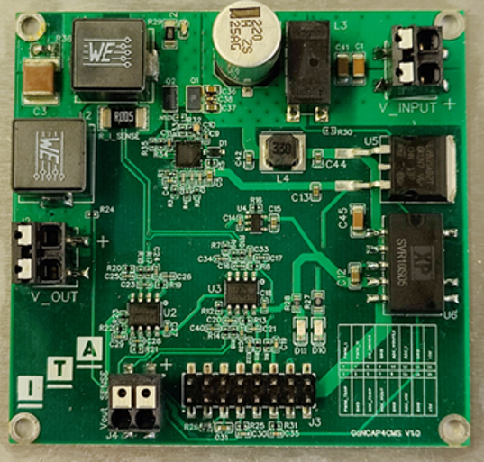
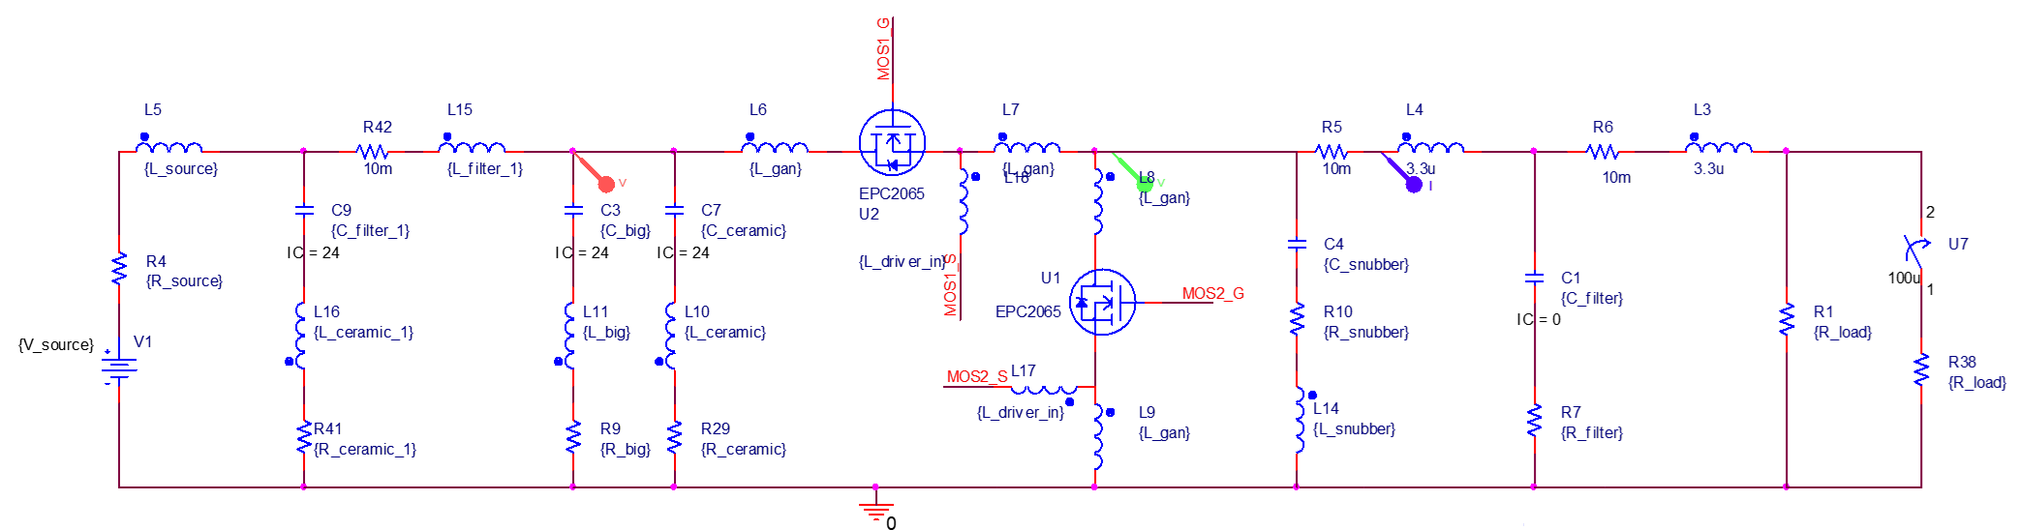
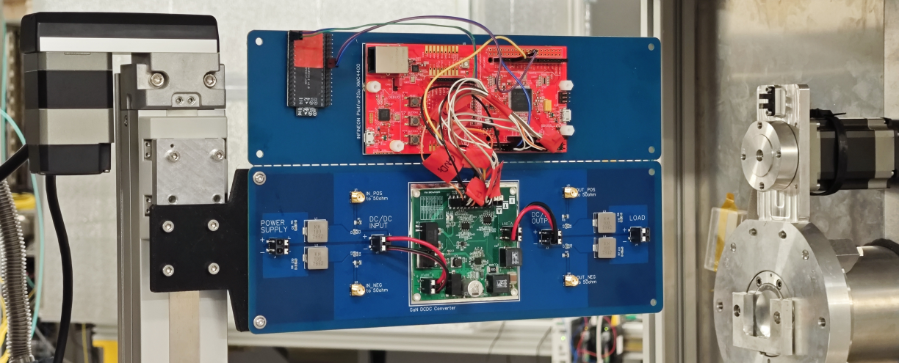
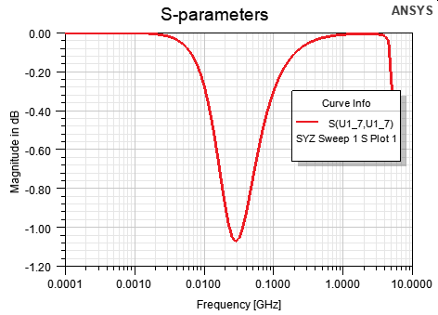
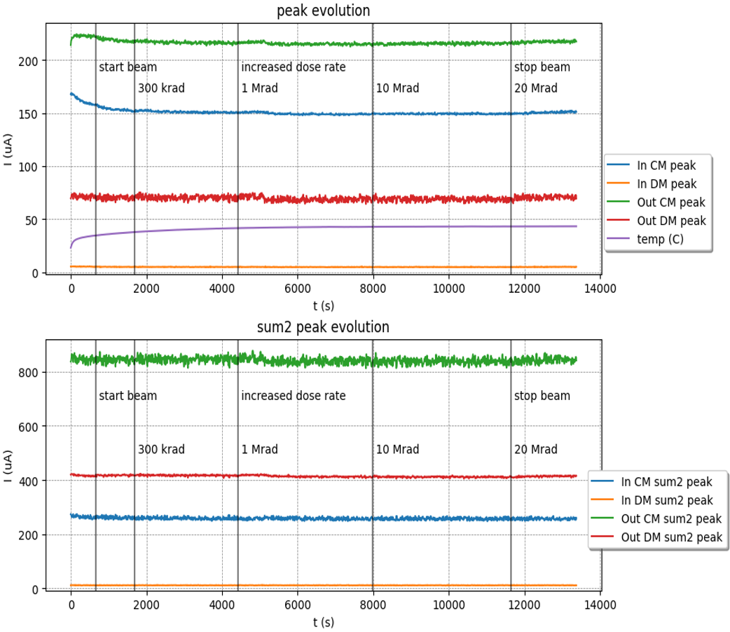
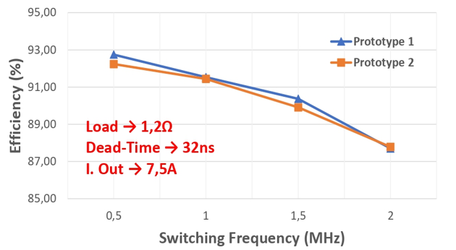
2. WP4 High-efficiency power distribution with GaN DC-DC converters

Slide 7
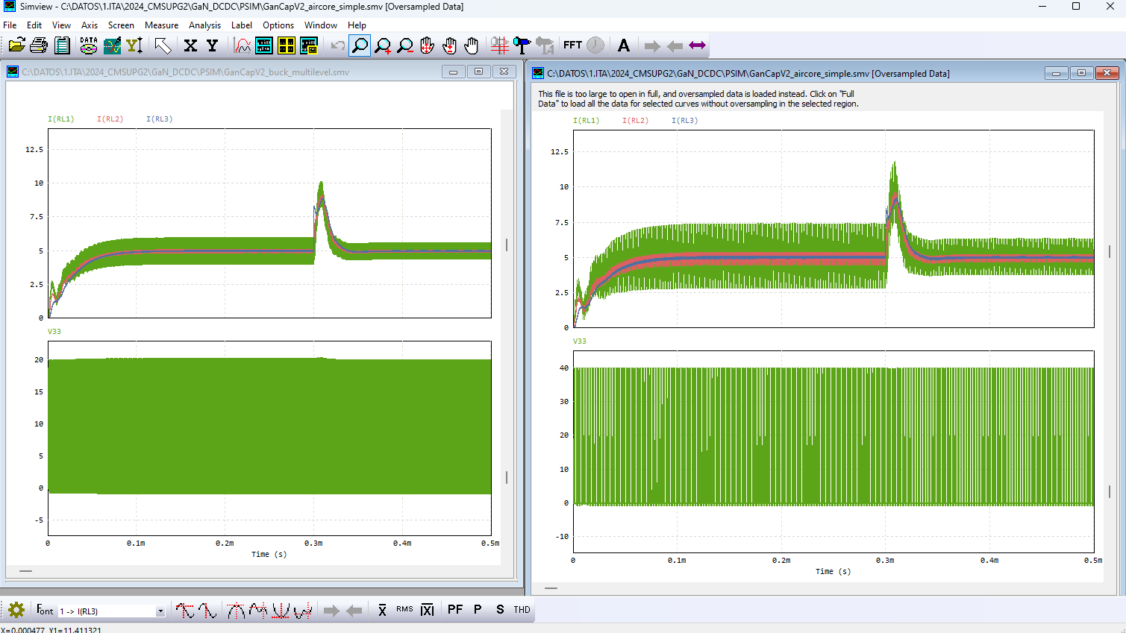
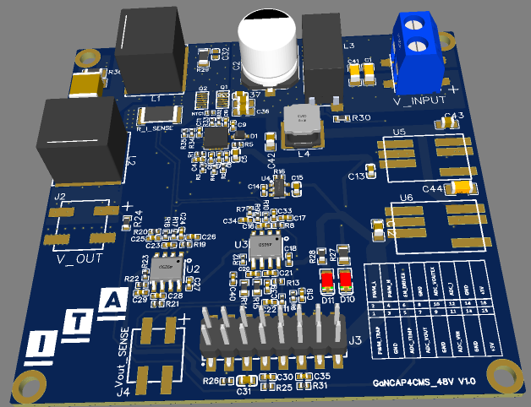
2. WP4 High-efficiency power distribution with GaN DC-DC converters
New 48 V prototype has been developed, focused on compactness, filtering, COTS components and scalability.
  Multilevel (2/3) topologies and modular/multiphase architectures
2-level DCDC
3-level DCDC

Slide 8
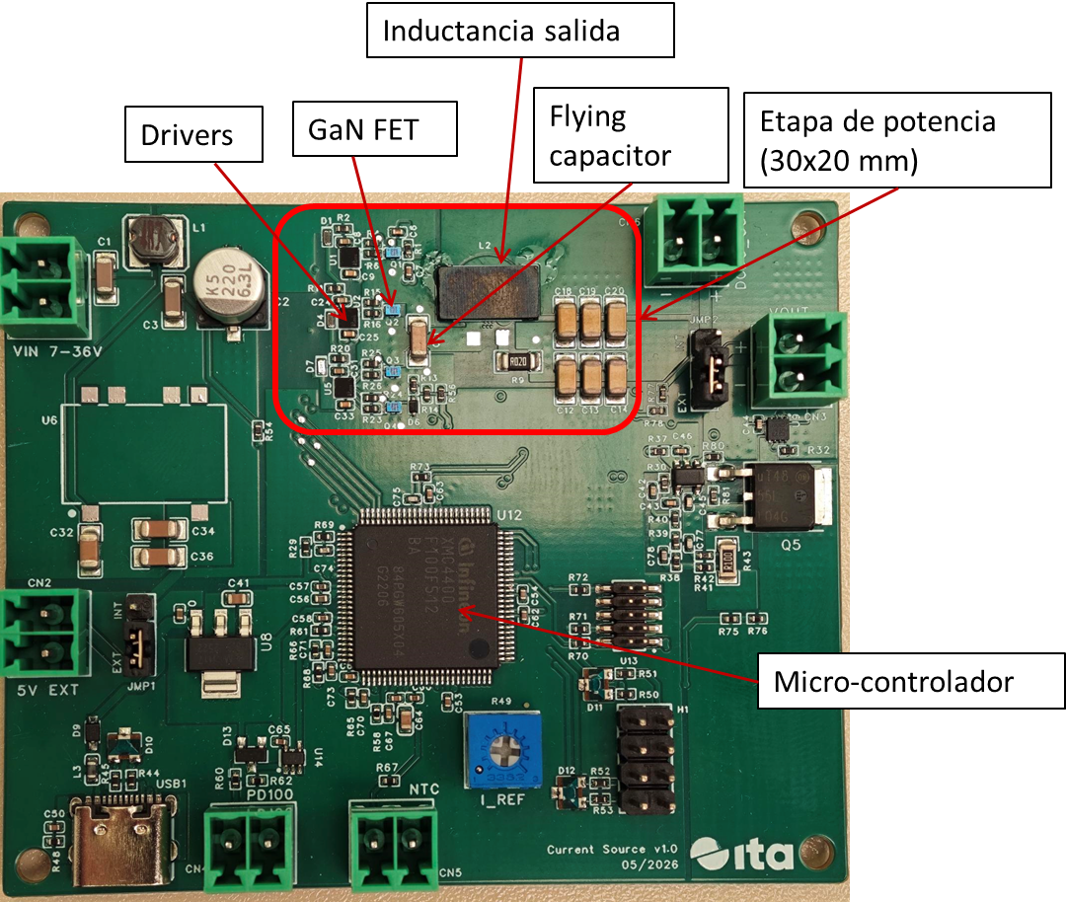
2. WP4 High-efficiency power distribution with GaN DC-DC converters
The new GaN DC-DC current-source prototype characteristics – 3 Level topology validation
  Three-level step-down multilevel flying-capacitor topology.
  Input voltage range: 10–48 V.
  Output current: up to 3 A, around 100 W.
  Switching frequency: 1–5 MHz.
  Effective output ripple frequency: 2 × fsw.
  Reduced transistor voltage stress: Vin/2.
  Peak efficiency above 90%.
  Fully based on COTS components.
  Output filter inductance integrated in the PCB.

Slide 9
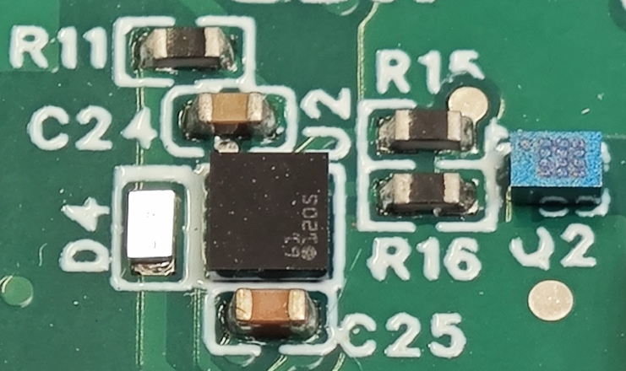
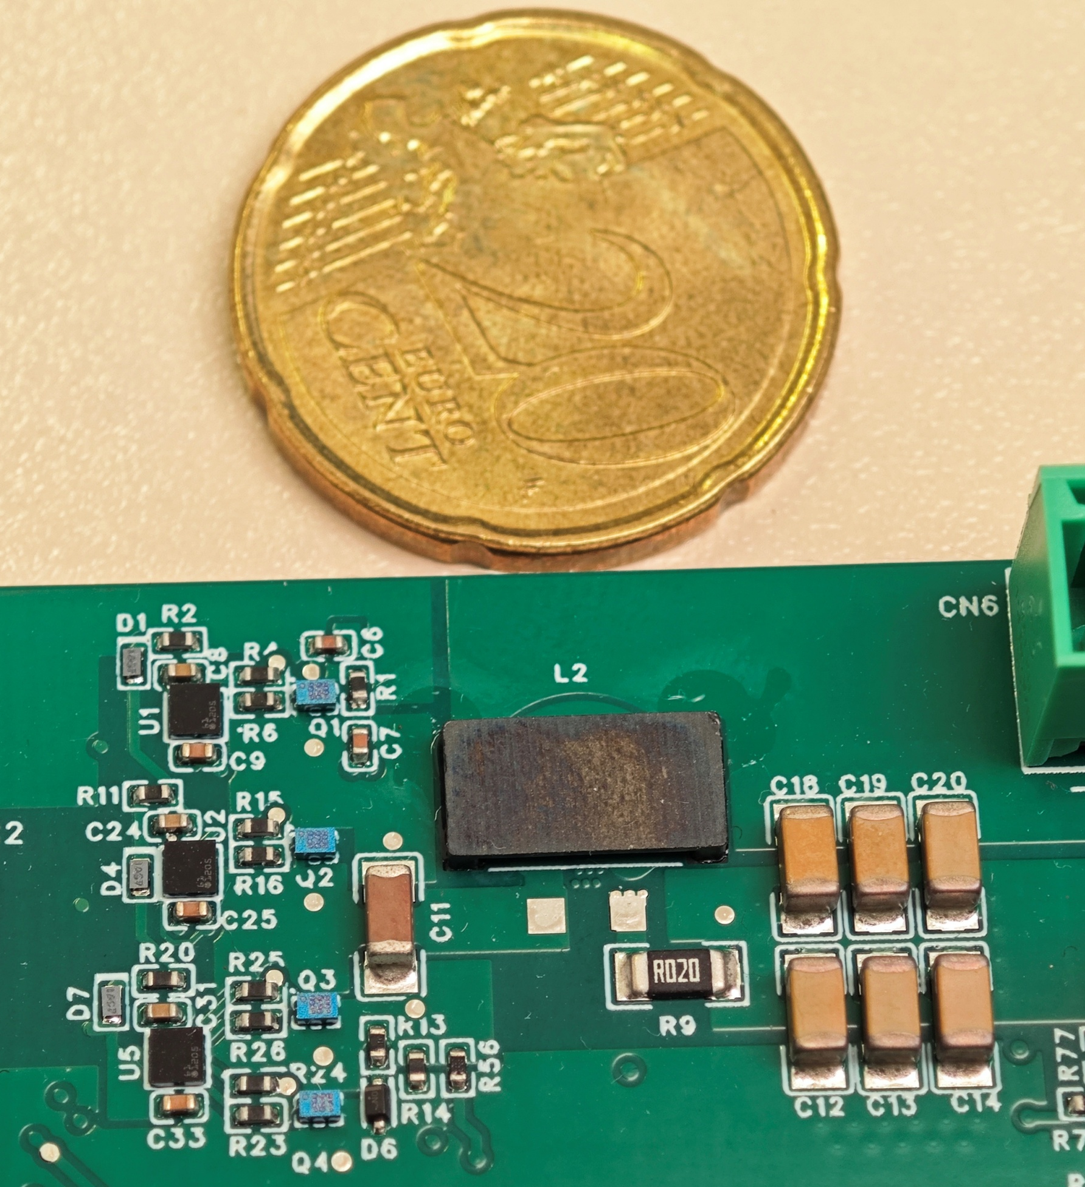
2. WP4 High-efficiency power distribution with GaN DC-DC converters
Design upgrades for final prototype is planned for September
  Radiation-tolerant GaN transistors and drivers.
  Increased output capability:
    Up to 10 A, 300–400 W.
  Optimized layout to reduce parasitic inductance, EMI, overshoot and ringing.
  More compact power stage by removing auxiliary elements.
  Analog controller implementation.
  Improved robustness against TID and single-event effects
  Optimized input and output filtering

Slide 10
3. WP4.O2 – High-precision & deterministic reference distribution with WR
Evaluate feasibility of the White Rabbit (WR) protocol for future 4D/5D detector reference.
  Provide sub-nanosecond synchronization across distributed detector systems.
  Address limitations of current WR COTS in terms of jitter, phase stability, and determinism.
  Identify required hardware and component improvements for detector-grade performance.
One task is planned (Task WP4.T2) focused on the development of a distributed synchronization architecture
  Define the architecture and implement a system demonstrator using LGAD sensors + ETROC2 readout chip synchronized via WR.
  Perform functional tests to measure the reference performance for multiplane detectors systems syncrhonization.
  Identify performance bottlenecks and propose hardware/firmware improvements.
  Validate applicability of WR to large-scale timing detector architectures.

Slide 11
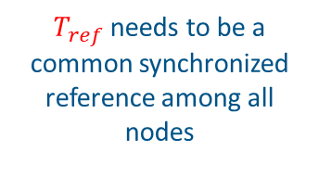










3. WP4.O2 – High-precision & deterministic reference distribution with WR​
Main activity aims to design and evaluate a prototype of a distributed clock network based on White Rabbit Technology to measure the time of flight of particles with accuracies in the sub-nanosecond range.
We want to measure $∆t:$ Time of Flight (TOF)
We measure 2 Time Of Arrival (TOA) w.r.t ref. clock
DETE. F-E
DETE. F-E
particle
particle
Trigger
Trigger
$$T_{i}$$
$$T_{O}$$
Front
End
Front
End
TDC
∆𝑡: Time of Flight between detector planes
T_{i} ,T_{o} :absolute event times
TDC
$∆t$ = $To−Ti$
$$Tref abs$$
TOA_{i}
TOA_{o}
$τ_{I}$
𝑇_{𝑟𝑒𝑓 i}
$τ_{O}$
𝑇_{𝑟𝑒𝑓 o}
Clock
ToF MEASUREMENT
𝜏 _{x}: delay in the clock path x T_{ref x} : delayed reference clock at node x
Synchronization: We need a clock distribution ensuring accuracy, precision and coping skew
We use a local reference clock
(T _{ref x} )
Particle
Threshold
Phase of the Ref clock at Detectors
$T_{i}=$ $T_{ref i}+{TOA}_{i}$
Trigger
𝑇_{𝑟𝑒𝑓 i}
$T_{ref}$ needs to be a common synchronized reference among all nodes
Clock
𝑇_{𝑟𝑒𝑓 o}
High Accuracy profile
t
TOA
0x0000
0x00F3
$$τ_{s}$$
t
$$\text{Clock} \text{Skew}$$
$$τ_{s}=\left(τ_{0}−τ_{i}\right)$$

Slide 12
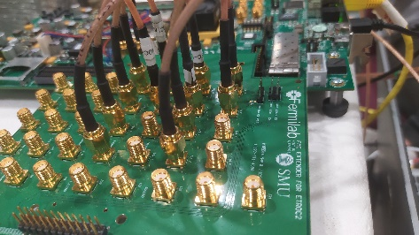
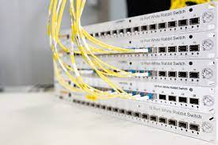

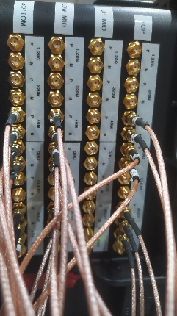
3. WP4.O2 – High-precision & deterministic reference distribution with WR
The timing architecture aims to distributed a reference signal to synchronize different FEE (sensors +hybrids)
  Simple open loop approach with regular coax cable / optical fibers
  Study new timing solutions as IEEE1588 PTP (White Rabbit – Developed at CERN)
Standard - Non self-calibrating system
WR - Self-calibrating system
Traditional solutions require multiple coaxial cables or fibers calibrated and with temperature compensation to cope with jitter, wander… to achieve deterministic and synchronous clock/timing distribution
The White Rabbit Project originated the High Accuracy profile under the IEEE 1588 standard: Ethernet based technology for deterministic distribution of timing and data.

Slide 13
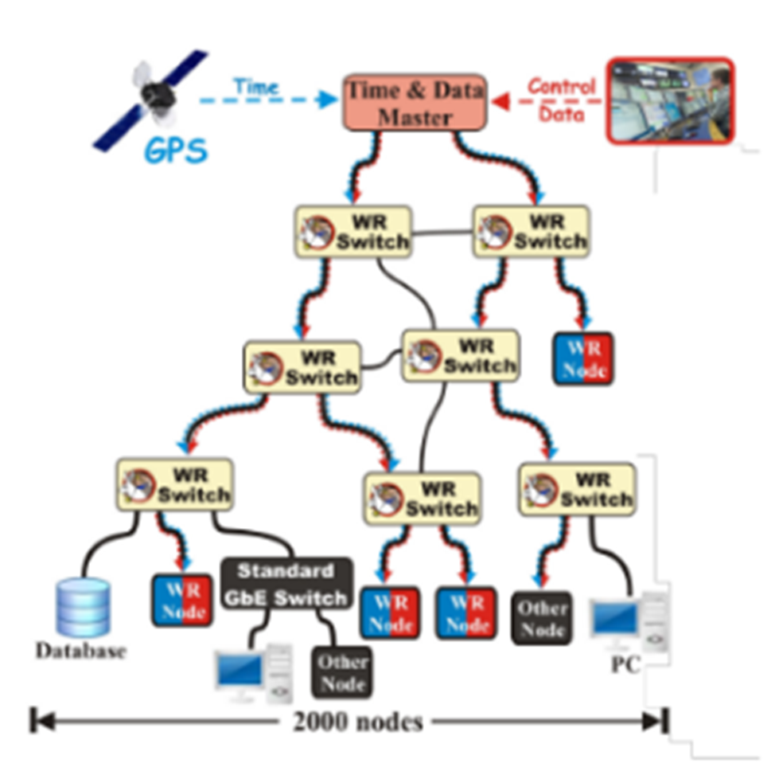
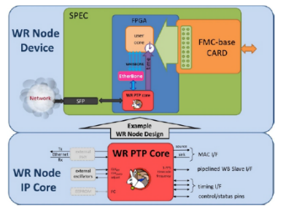
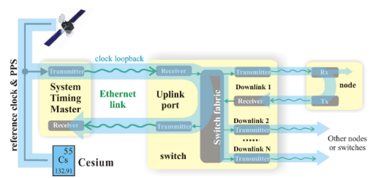
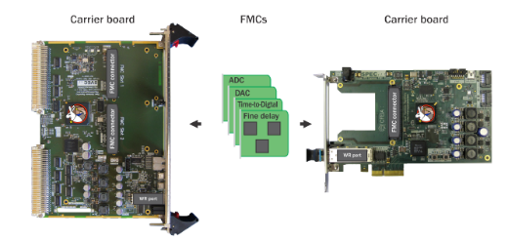
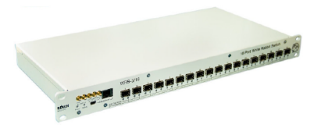
3. WP4.O2 – High-precision & deterministic reference distribution with WR​
White Rabbit is a synchronization system designed as an extension of PTP (Precision Time Protocol ).
It is able to achieve sub-nanosecond accuracy over a multi-level tree of nodes.
Hardware;
Carrier Board, application FMC,
Computer, Cabling, Powering, Ref.
Gateware;
HDL for the FPGA (WR PTP Core)
Firmware;
C code for the LM32 Softcore
Software;
Scripts and interpreter
IT/Infrastructure;
Computer(s) for FPGA programming,
clocking and Pyhton interpreter
WR physical layer ( clocks )
WR PTP Core
Getting familiar with the WR technology, nodes and flow
WR compliant node devices (hardware, firmware…)

Slide 14
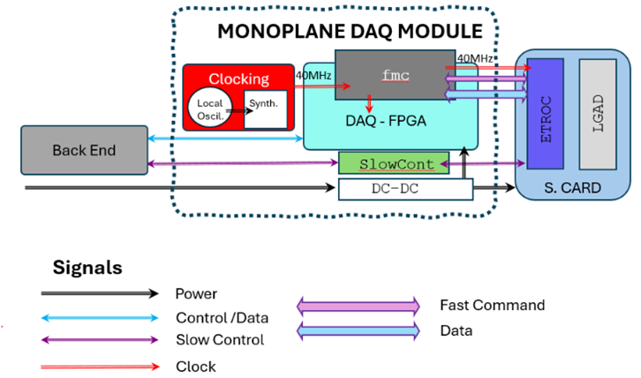
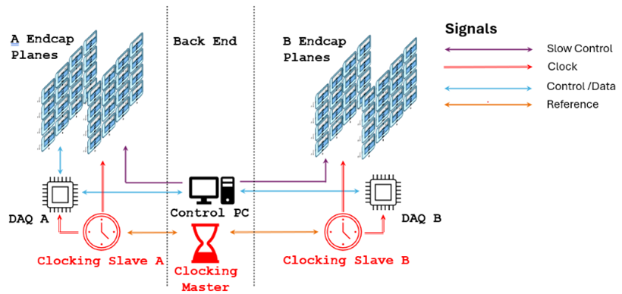
3. WP4.O2 – High-precision & deterministic reference distribution with WR
White Rabbit test infrastructure implemented using CERN SPEC boards, WR switch, optical links, FMCs and the WR PTP Core.
Incremental synchronization architecture developed and validated:
  V1 – Single-plane, free-running: validation of the DAQ chain and local clock generation using HMC7044.
  V2 – Multi-plane, open-loop: 40 MHz clock distribution over coaxial links using Si5338 PLL/jitter cleaners.
  V3 – Multi-plane, closed-loop WR: 125 MHz distribution over optical fibre with local regeneration of 40 MHz for ETROC.

Slide 15
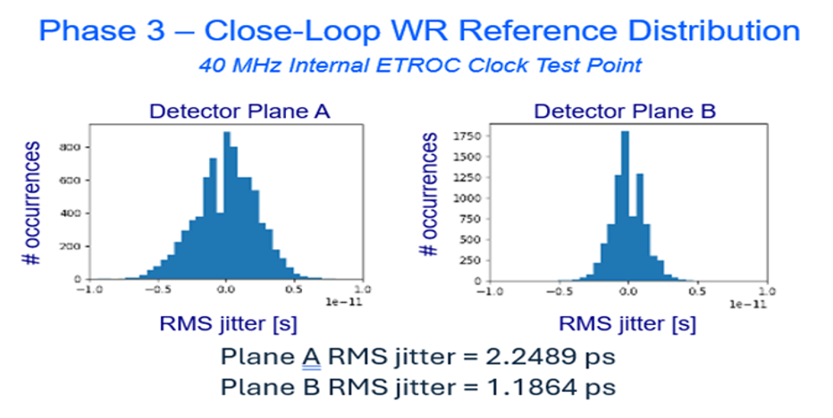
3. WP4.O2 – High-precision & deterministic reference distribution with WR
Characterization of clock quality, phase stability, skew and Time Interval Error performed at different points of the reference path.
Measured jitter (RMS-TIE) at the ETROC internal clock:
  Approximately 1.5 ps RMS for the coaxial V2 configuration.
  Approximately 1–2 ps RMS for the White Rabbit V3 configuration.
Overall jitter below 10 ps RMS demonstrated at the ETROC frontend, confirming the feasibility of WR for sub-nanosecond detector synchronization.
Main technical limitations identified: PLL phase-reset management, phase coherence, deterministic start-up and hardware/thermal dependence of residual skew.
Next activities has been focused on complete integration with LGAD–ETROC detector planes and validation under representative operating conditions.

Slide 16
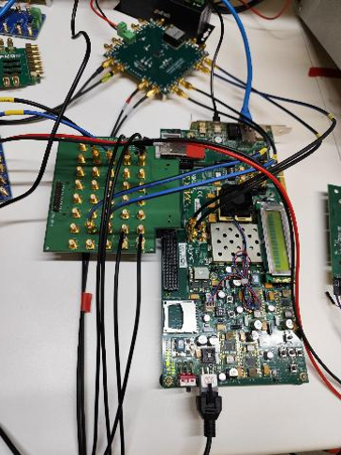
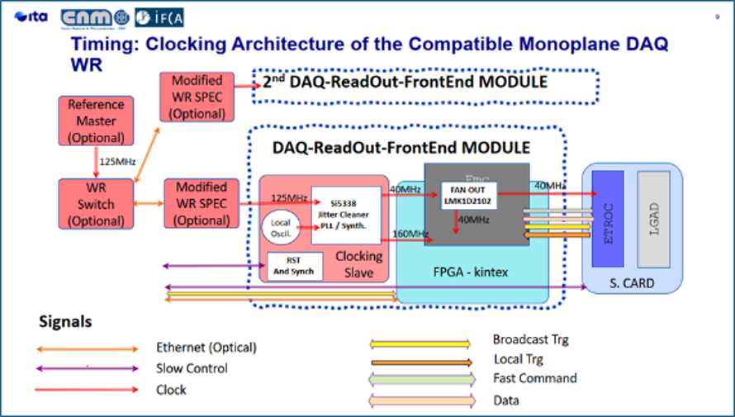
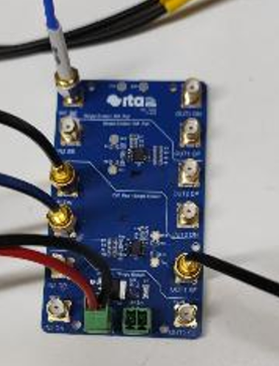
3. WP4.O2 – High-precision & deterministic reference distribution with WR
The first set of activities of the final demonstrator preparation have been focused on Advanced DAQ and FEE architecture ETROC2-based
  FPGA-based DAQ implemented on AMD Kintex-7 KC705.
  Fast commands, serial data decoding, local trigger detection and Ethernet data transmission integrated.
  Scalable architecture: up to 512 pixels per DAQ module, extendable with additional modules.
  Auxiliary FMC, fan-out and ITA-SE-DIFF boards developed for system interoperability

Slide 17
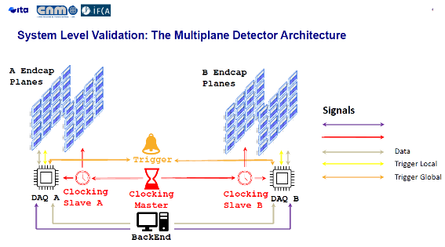
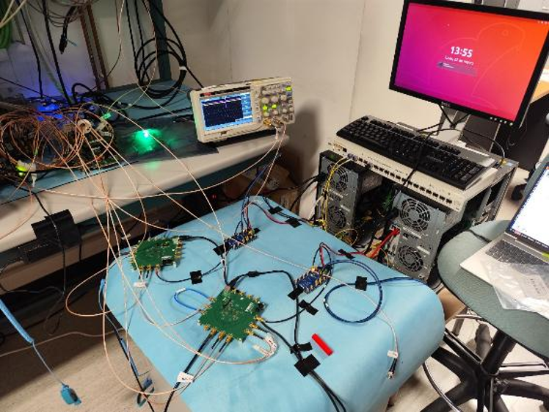
3. WP4.O2 – High-precision & deterministic reference distribution with WR
Distributed timing architecture based on White Rabbit.
  Closed-loop synchronization selected to improve jitter, skew and scalability.
  SPEC-based WR implementation with local Si5338 clock generation.
  TIE jitter below 10 ps rms experimentally demonstrated.
  Global trigger logic implemented in FPGA with configurable coincidence, AND/OR and masking functions.

Slide 18
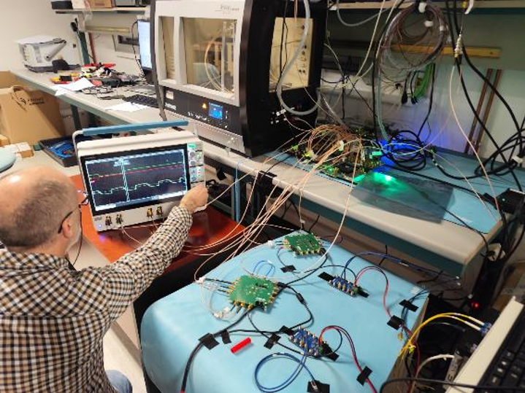
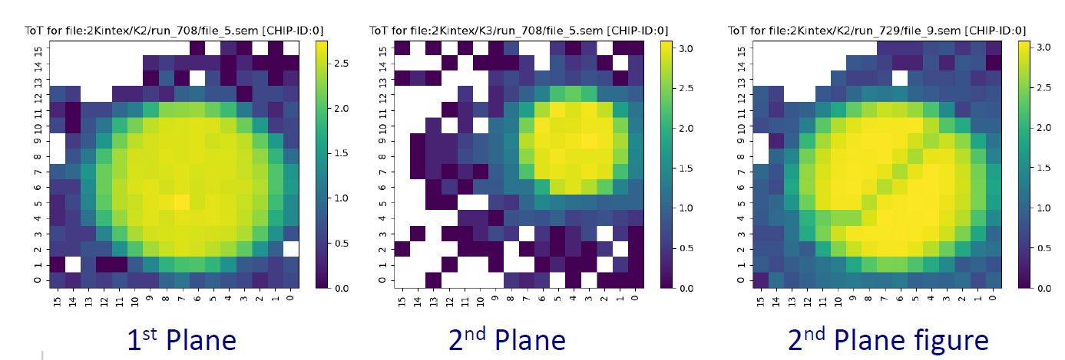
3. WP4.O2 – High-precision & deterministic reference distribution with WR
Demonstrator integration and validation
  Four-plane demonstrator architecture specified and integrated.
  Electronics integrated with DAQ, trigger and WR timing subsystems.
  Laboratory validation performed with X-ray setup at IFCA.
  CERN test-beam support provided for DAQ, timing and trigger operation with LGAD/ETROC planes.

Slide 19
4. WP2.O2 – Final qualification of LGAD+ETROC hybrids
The main goal is to validate the performance of LGAD sensors + ETROC readout ASICs in final prototype form.
  Ensure compliance with ETL technical specifications (timing resolution, radiation hardness, noise).
  Assess grounding, noise behavior, and overall system stability.
  Provide input for the transition to full module production.
Task WP2.T2 – Qualification in test beams and irradiation campaigns
  Test LGAD+ETROC hybrids in dedicated beam facilities (DESY, Fermilab, CERN).
  Characterize noise, grounding, and timing performance under different radiation levels.
  Perform irradiation campaigns before test beams to assess radiation tolerance.
  Collaborate with ITA and CNA experts for EMC, grounding, and irradiation support.
Activity linked to EUROLABS project - TA from FERMILAB / PORTUGAL

Slide 20
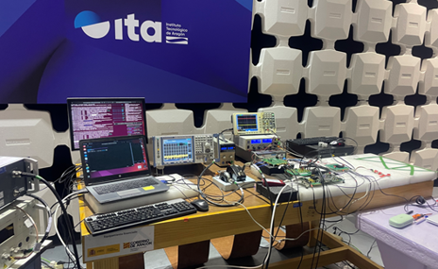
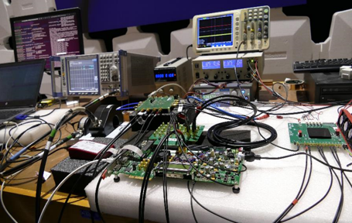
4. WP2.O2 – Final qualification of LGAD+ETROC hybrids
EMC/noise susceptibility characterization of ETROC2 has been performed.
  Focus on realistic operating conditions and picosecond-level timing constraints.
Evaluation of EMI impact on:
  Timing resolution.
  Jitter.
  Data integrity.
Conducted noise injected into different ETROC test-board coupling ports.
  Frequency range covered: 100 kHz – 100 MHz.
Tests performed at the ITA EMC laboratory

Slide 21
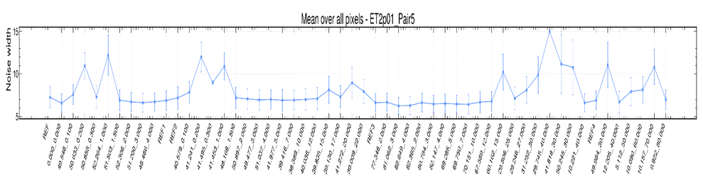
4. WP2.O2 – Final qualification of LGAD+ETROC hybrids
Preliminary results shows that the Noise response strongly depends on the injection point.
Most critical coupling paths identified: VDDA and VDDD power lines & Clock inputs.
Noise width and baseline fluctuations increase with injected noise amplitude and frequency.
The measurements confirm the sensitivity of the analog front-end to conducted noise.
Measurable noise propagation has been observed through the power distribution network.
These effects may compromise supply stability and the locking performance of the internal ETROC2 PLL.
A detailed analysis of the complete dataset is still pending and has been assigned to Jordi.

Slide 22
5. WP5.O2 – Upgrade of the EMC laboratory for ECFA DRD activities
The main goal is enhance EMC test capabilities to support detector electronics development.
Improve automatic Transfer Function (TF) measurement system for detectors FEE
Extend testing capacity for power supplies in radiation environments.
Provide robust EMC support for DRD3 and DRD7 detector R&D.
One task has been planned (WP5.T2) focused on the improvement of EMC test systems
  Upgrade the automatic TF noise measurement system with improved GUI and cold box.
  Refine the portable bench for conducted noise emission tests of power supplies in irradiation facilities.
    Ensure compatibility with multiple radiation labs (CNA and others).
    Collaboration between CNA and ITA to design and validate robust test setups.

Slide 23
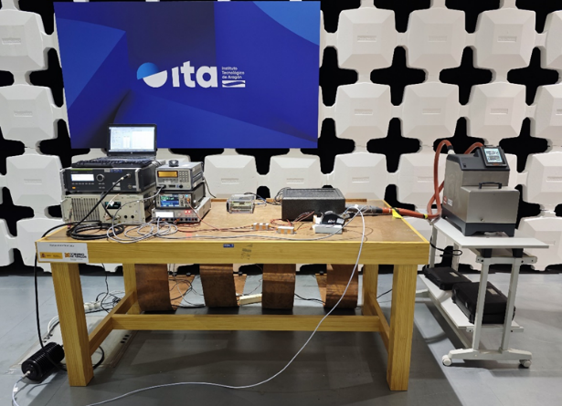
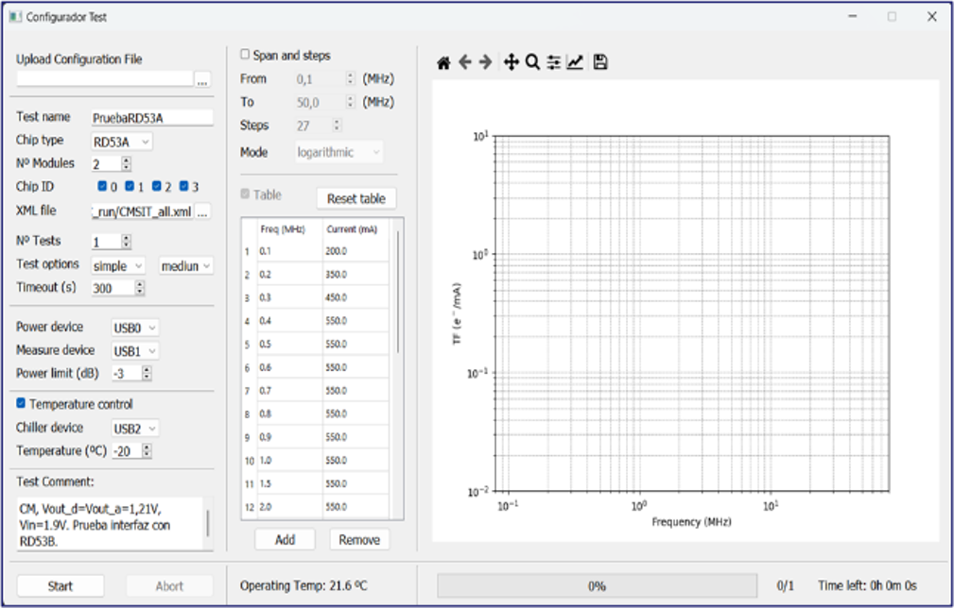
5. WP5.O2 – Upgrade of the EMC laboratory for ECFA DRD activities
The first activity has been focused on the upgrade the automatic TF noise measurement system with improved GUI and cold box is totally operational

Slide 24
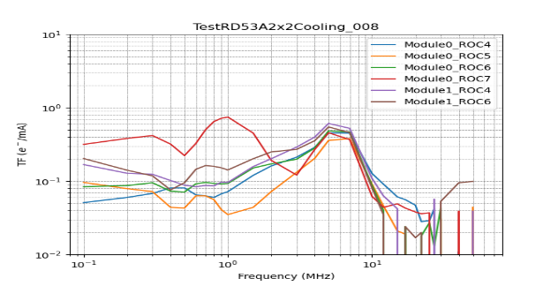
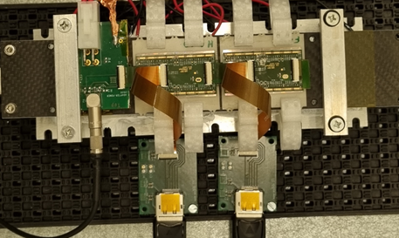
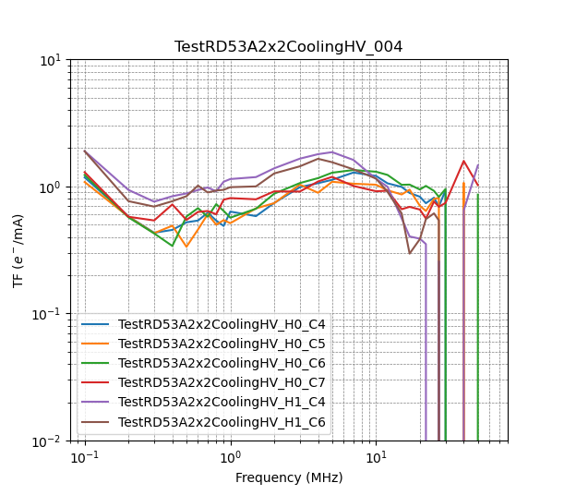
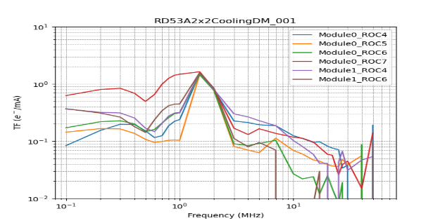
5. WP5.O2 – Upgrade of the EMC laboratory for ECFA DRD activities
Both systems have been validated by testing a serial chain of two prototype of tracker barrel pixel modules with (2x2) RD53A readout chips (2x2 TBPX RD53A modules) with planar sensors

Slide 25
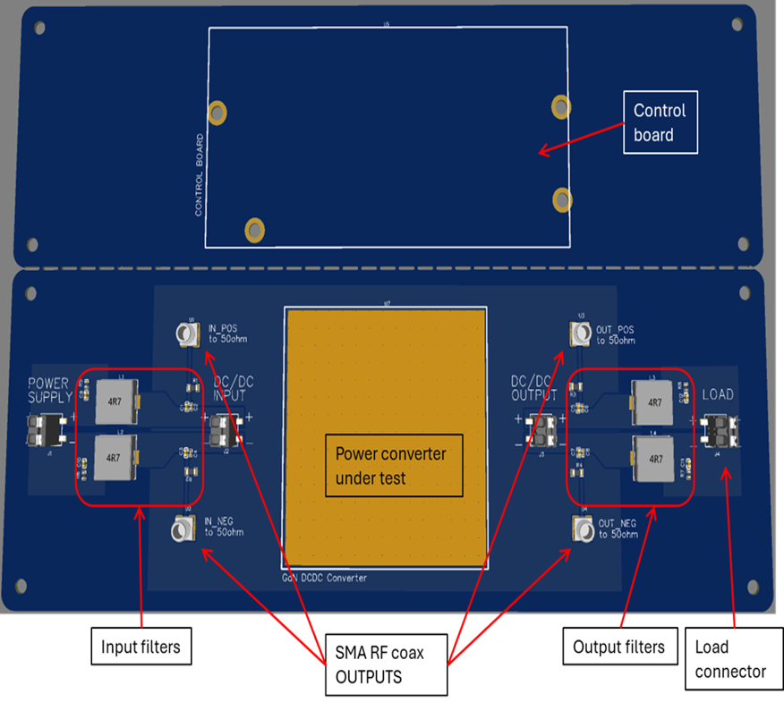
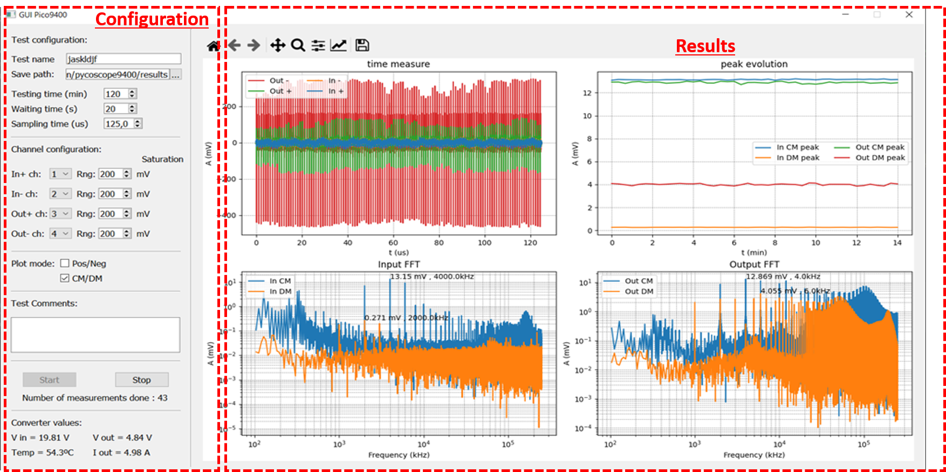
5. WP5.O2 – Upgrade of the EMC laboratory for ECFA DRD activities
The second activity has been focused on the development of a customized portable test bench, designed to perform in-situ conducted EMC emission measurements of power supplies in IRRAD configurations.
The system has been developed and tested. – IPHC – We will repeat the test at CNA

Slide 26
5. WP5.O2 – Upgrade of the EMC laboratory for ECFA DRD activities
Future Plans – Two main activities within the project:
Collaboration with CNA
  Address noise issues at CNA facilities.
  Test and validate the EMC irradiation test bench at CNA.
Joint development with ITA, IFCA, and CNA
  Design RF-compatible experimental platforms.
  Focus on low-noise, high-speed electronics optimized for pulsed signal techniques (IBIC, TPA-TCT).
  Coordinate this work with activities planned in the OTELLO 2 project.

Slide 27
6. Summary
ITA’s activities within CMSUPG2
  Progressing rapidly and well aligned with DRD priorities.
  Over 90% of planned work has already been achieved and justified.
  Strong alignment with other European and national projects has been crucial for success.
Future plans
  Development of a new GaN-based DC-DC converter. (Rad – 3 level)
  Design of RF-compatible experimental platforms with low-noise, high-speed electronics.
  Strengthened collaboration with CNA on EMC and irradiation test activities.

Slide 28



¡Thank you!
This project has received funding from CMSUPG2 programmes under Grant Agreements PID2023-148418NB-C43.

