Slide 1

TCAD simulation of
CMOS LGAD
E. G. Villani
E.G.Villani, Oxford, Sep. 2021

Slide 2
Overview
Introduction: UFSD based on LGAD for HGTD
Initial investigation on Thin LGAD: TCAD process and simulation
Summary and Conclusions
E.G.Villani, Oxford, Sep. 2021
1

Slide 3
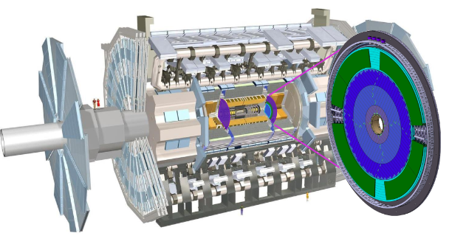
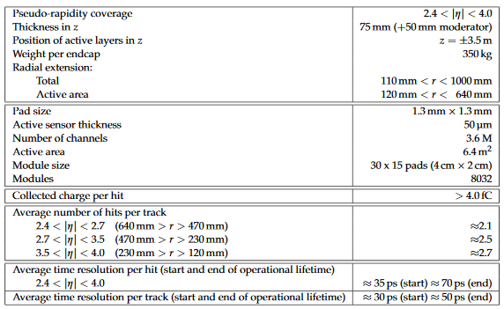
  LGAD for HGTD
ATLAS HGTD aimed at suppressing pile up effects in ITK
Individual sensor size of HGTD 1.3 x1.3 mm2, for a total area 6.4 m2 and 3.6 Mchannels
Timing measurement at track level, rather than at individual hit
‘Real’ 4D tracking would require higher spatial resolution, increasing power requirement and RO complexity
Ultimately a monolithic approach, combining sensors and RO on the same substrate, might offer the solution
E.G.Villani, Oxford, Sep. 2021
1

Slide 4
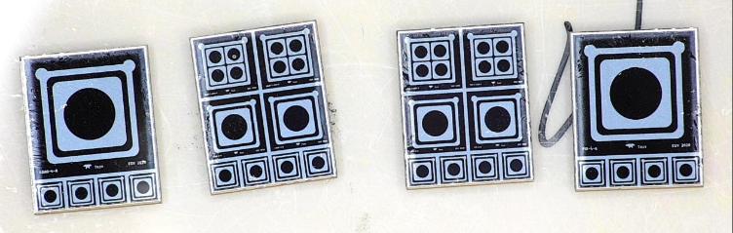
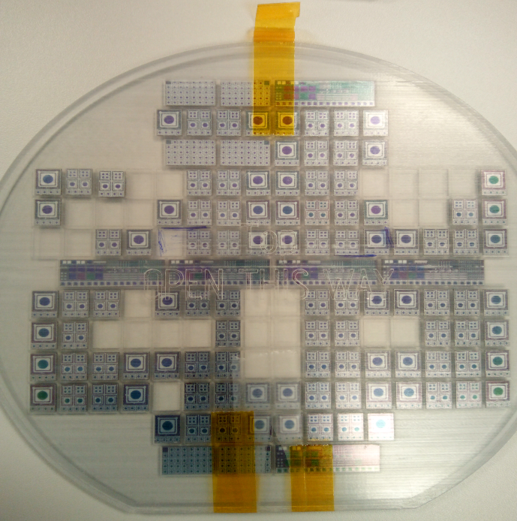
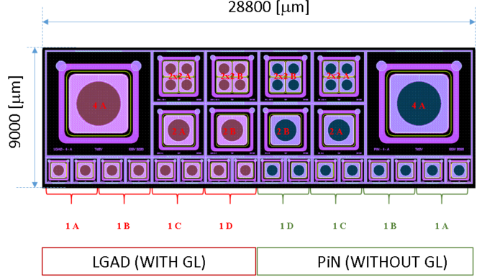
  LGAD for HGTD
2x2-1 mm
4 mm
2 mm
1 mm
LGAD project (Oxford, RAL, Birmingham, OU) with foundry Te2v focused on HGTD specs (ATLAS – CMS?):
currently testing the fabricated devices
A number of different commercial foundries propose SiPM for imaging, TOF
WF2 diced
E.G.Villani, Oxford, Sep. 2021
2

Slide 5
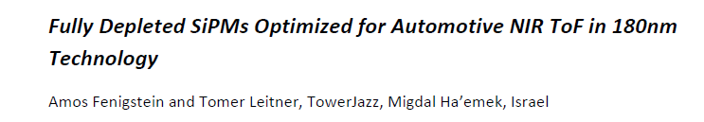
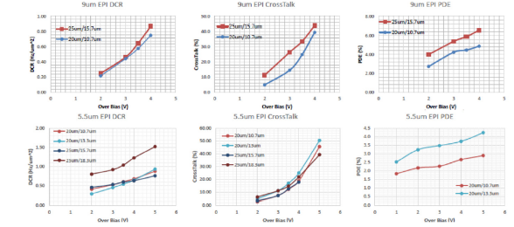
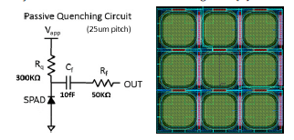
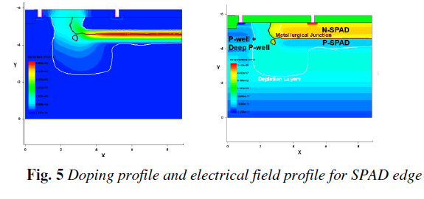
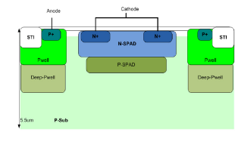
TJ SiPM made of SPADs arrays with pull-up resistor. Fully depleted SPAD using HR epi material in 180 nm CMOS process. Epitaxial thickness of 5.5 – 9 um
Investigation using TCAD of possible performances of similar solution
E.G.Villani, Oxford, Sep. 2021
3

Slide 6

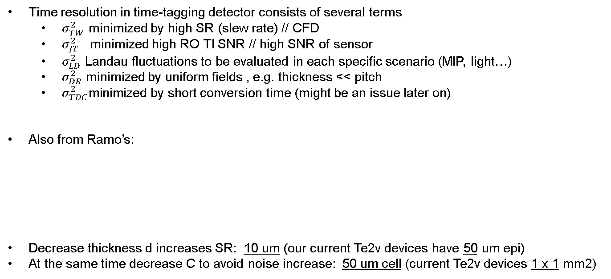

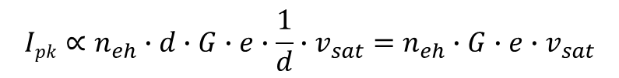
  ‘Thin’ LGAD
$$σ_{t}^{2}=σ_{TW}^{2}+σ_{LD}^{2}+σ_{JT}^{2}+σ_{DR}^{2}+σ_{TDC}^{2}$$
Time resolution in time-tagging detector consists of several terms
  $σ_{TW}^{2}$ minimized by high SR (slew rate) // CFD
  $σ_{JT}^{2}$ minimized high RO TI SNR // high SNR of sensor
  $σ_{LD}^{2}$ Landau fluctuations to be evaluated in each specific scenario (MIP, light…)
  $σ_{DR}^{2}$ minimized by uniform fields , e.g. thickness << pitch
  $σ_{TDC}^{2}\text{minimized} \text{by} \text{short}$conversion time (might be an issue later on)
Also from Ramo’s:
Decrease thickness d increases SR: 10 um (our current Te2v devices have 50 um epi)
At the same time decrease C to avoid noise increase: 50 um cell (current Te2v devices 1 x 1 mm2)
$$Ipk∝n_{eh}∙d∙G∙e∙\frac{1}{d}∙v_{sat}=n_{eh}∙G∙e∙v_{sat}$$
E.G.Villani, Oxford, Sep. 2021
4

Slide 7
  TCAD Simulation
SUBS
EPITAX growth
10 um
Oxidation
Resist depo
JTE etch
Strip resist
JTE P31 IMPLANT (7,27)
JTE drive in
Resist depo
Pstop implant
Strip resist
Resist depo
ACTIVE etch
Strip resist
Oxidation
LGAD only
Resist depo
B11 GL implant
Strip resist
DRIVE IN [GL implant]
Resist depo
SHN implant (A&JTE)
Strip resist
LTO deposit
ACTIVATION
LTO DENSIFICATION
Resist depo
CONTACTS ETCHING
Strip resist
METAL DEPOSITION
Electrodes with Al WF
in SDEVICE
REMESHING FOR DEVICE
SIMULATION
IV plots
Charge collection
SDEVICE
SPROCESS
Started from real Te2v process information
Modified some steps (i.e. avoid excessive substrate diffusion, reduce GL/JTE doping)
This process should be available by most CMOS foundries
E.G.Villani, Oxford, Sep. 2021
5

Slide 8
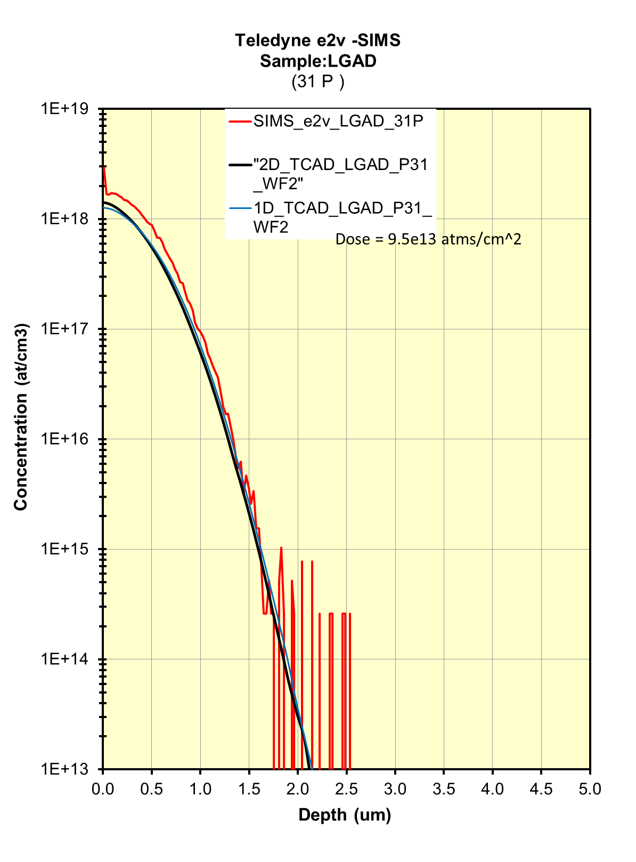
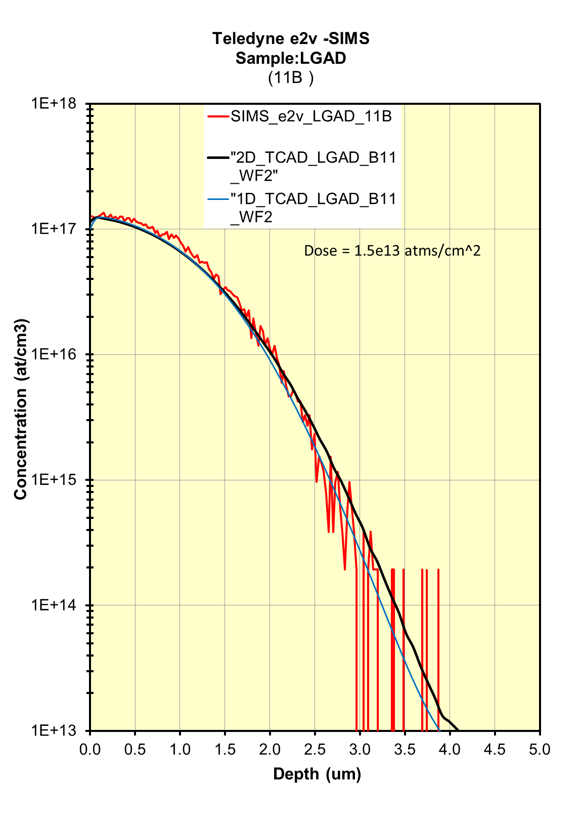
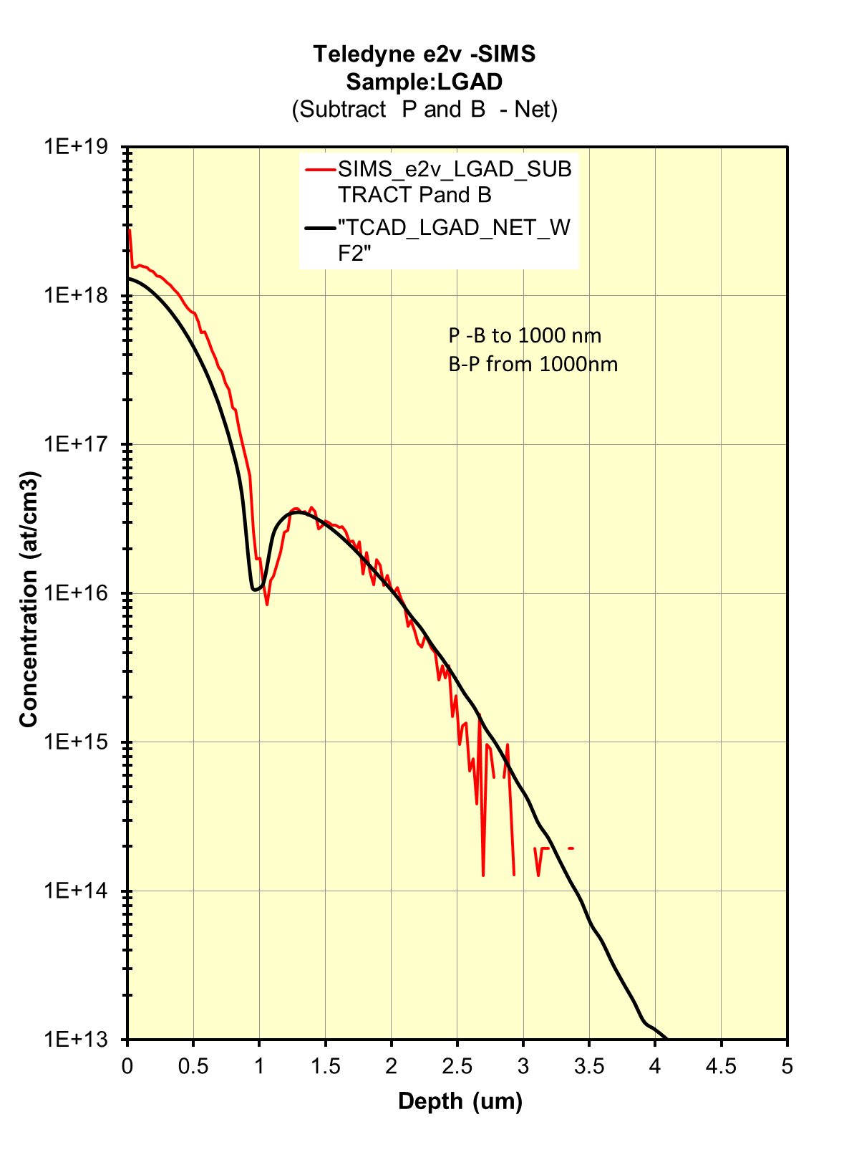
  TCAD Simulation
TCAD simulations compare well with Te2v process
Thermal oxide growth, MC B implantation, Analytical P/As implantation have been SIMS compared
E.G.Villani, Oxford, Sep. 2021
6

Slide 9
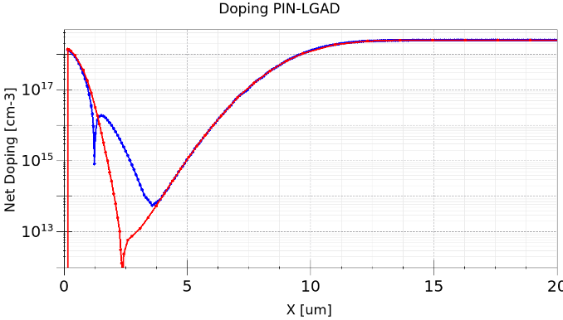
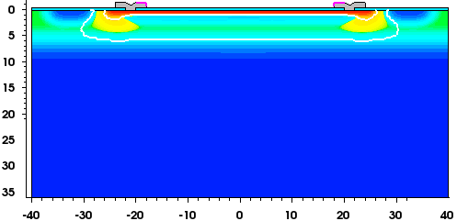
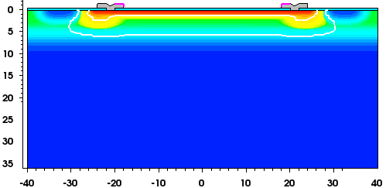
  Thin epitaxial LGAD
P-stop
Cathode
50 um
JTE
Epi
Epi
10 um
Substrate
GL
LGAD
PIN
P⁺⁺
LGAD 1.35e13 200
Vbias 40 V
50 um cell, with 10 um HR epitaxial thickness
Diffusion from substrate into the epitaxial affects its overall doping :change the drive in to reduce it
Effective epi thickness < 10 um, with depletion at relatively low voltage
JTE still needed to increase the BV
For array one might reduce p-stop width to achieve total depletion, but need to investigate X-talk
PIN
P⁺⁺
E.G.Villani, Oxford, Sep. 2021
7

Slide 10
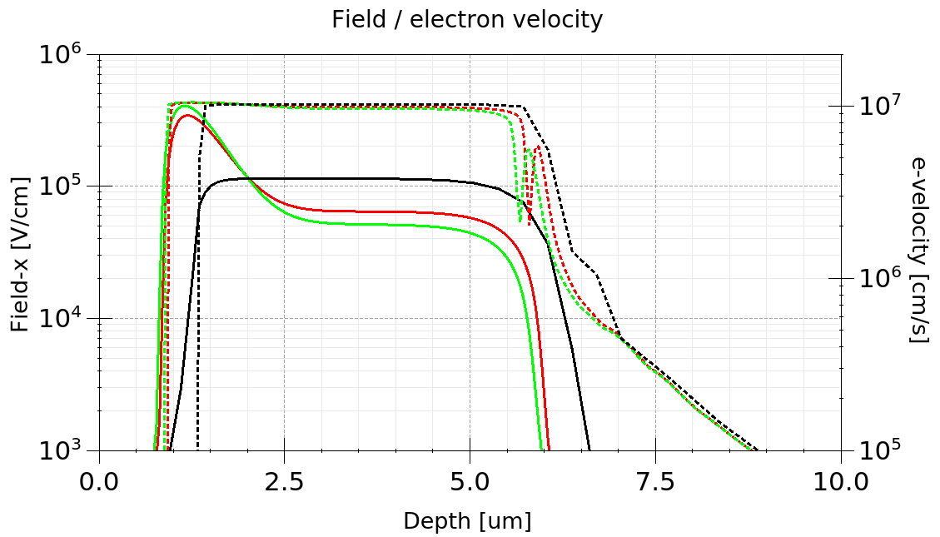
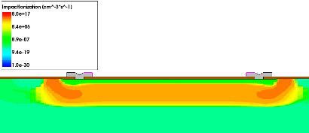
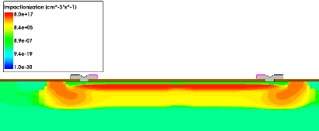
  Thin epitaxial LGAD simulation
V_{bias}
GL @ different Vbias
2
LGAD
1
PIN
GL
LGAD
Around 5 um of epi are fully depleted ∼ 30 V
to maximise speed of response the velocity of carriers should be saturated (F >= 1e4 V/cm)
JTE effective but can be optimized
Vbias 40 V
PIN
Vbias 40 V
LGAD
E.G.Villani, Oxford, Sep. 2021
8

Slide 11
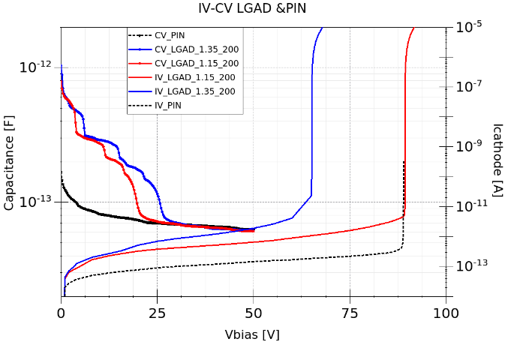
  Thin epitaxial LGAD simulation
  DC and CV
F = 1e4 Hz
T = 300 K
IV plots show BV around 50 V for LGAD 1.35 200 and around 90 V for PIN
CV @ depletion around 50 fF
E.G.Villani, Oxford, Sep. 2021
9

Slide 12
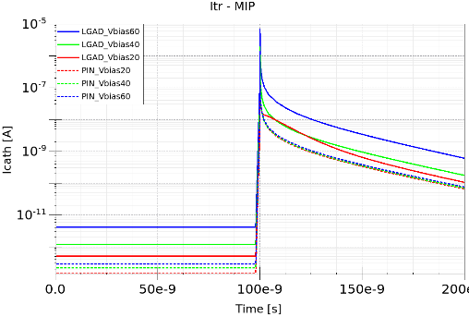
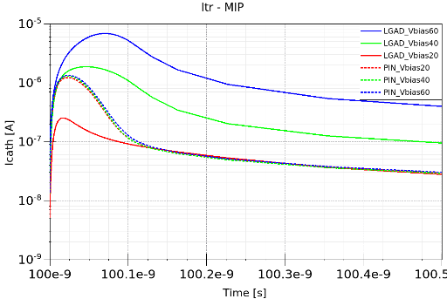
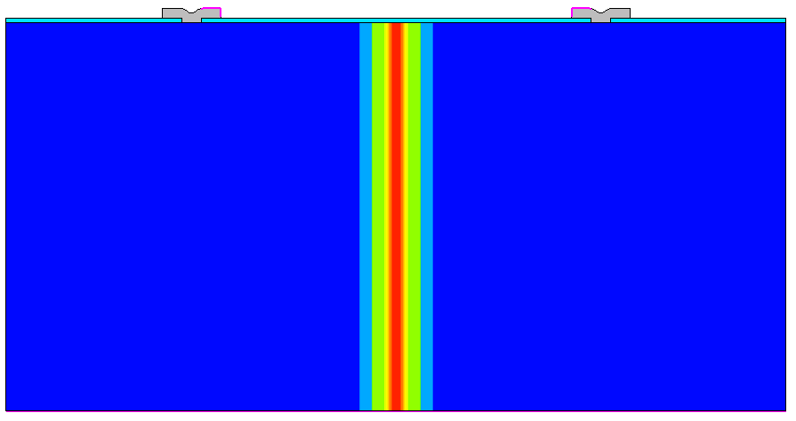
  Thin epitaxial LGAD simulation
  Slew rate
T = 300 K
Initial transient of 100 ns to bias the device
Central ∼ MIP hit @ 100 ns ( constant 80 e/um)
Peak current I_{pk} for PIN ∼ 1.3 uA
Peak current I_{pk} for LGAD increases with Vbias
SR = dI/dt : SR(I)_{MAX} up to 138 nA/ps
Vbias [V] | Ipk [uA]PIN | SR max [nA/ps] | Ipk [uA] LGAD | SR max [nA/ps]
20 | 1.21 | 118 | .25 | 28
40 | 1.28 | 127 | 1.86 | 105
60 | 1.33 | 130 | 6.9 | 138
E.G.Villani, Oxford, Sep. 2021
10

Slide 13
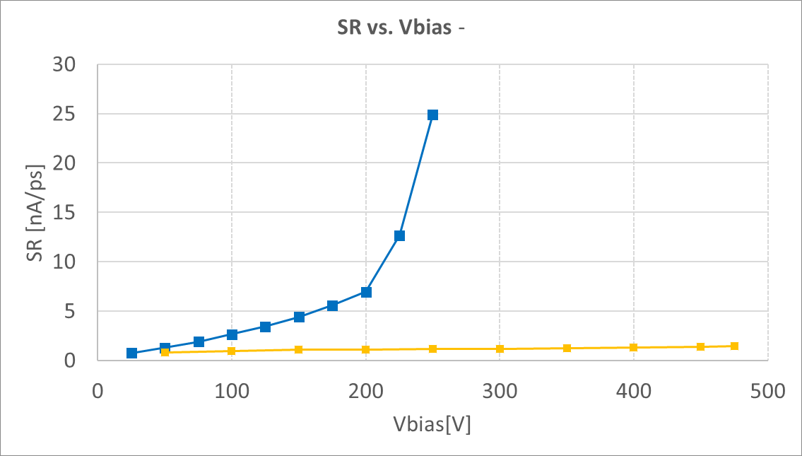
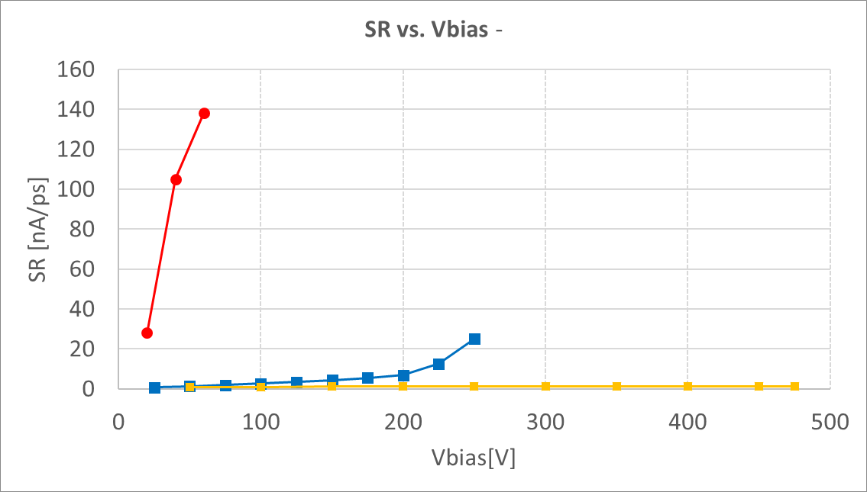
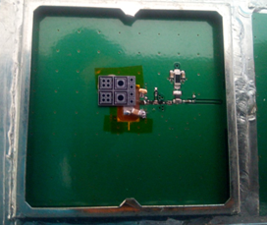
  Thin epitaxial LGAD simulation
  Slew rate
Te2v 1mm LGAD
Thin 5 um LGAD (TCAD)
Te2v 1mm PIN
Te2v 1mm LGAD
T = 300 K
1mm LGAD
SR comparison with Te2v devices
Predicted increased SR ∼ x 5
E.G.Villani, Oxford, Sep. 2021
11

Slide 14
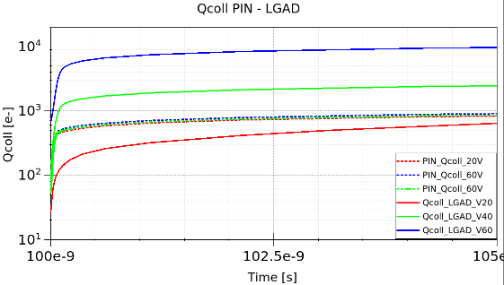

  Thin epitaxial LGAD simulation
  collected charge
$$\int{Idt}$$
T = 300 K
Collected charge from integration of device current
Around 10 gain charge max w.r.t. PIN
Vbias [V] | Qcoll PIN [e]@ 5ns | Qcoll LGAD [e] @5ns
20 | 830 | 640
40 | 857 | 2542
60 | 905 | 9680
E.G.Villani, Oxford, Sep. 2021
12

Slide 15
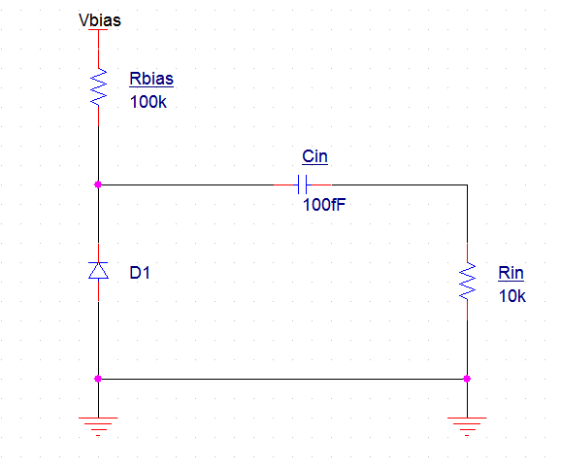
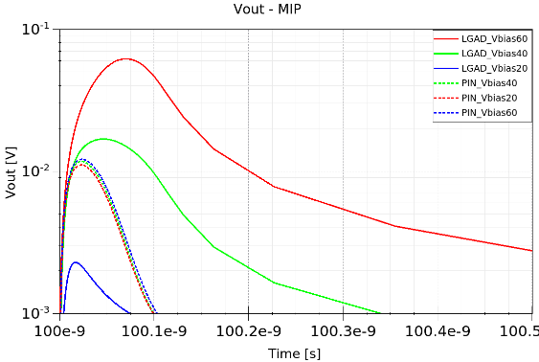

  Thin epitaxial LGAD simulation
  RO requirements
T = 300 K
The RO (integrated or not) is AC coupled from the UFD
C_{in} ∼ C_{UFD} (also area limitations)
R_{in} : S/N ∼ 10 for I_{pkmin}
transient voltage across Rin
(SR_{LGAD} / SR_{PIN} )_{MAX} ∼ 3.5
(SR_{LGAD} )_{MAX} ∼ 0.9 mV/ps
Vbias [V] | Vpk [mV]PIN | SR max [V/ps] PIN | Vpk [mV] LGAD | SR max [mV/ps] LGAD
20 | -11 | -0.23 | -2.2 | -0.03
40 | -11 | -0.24 | -16.8 | -0.19
60 | -12 | -0.25 | -61.2 | -0.88
E.G.Villani, Oxford, Sep. 2021
13

Slide 16

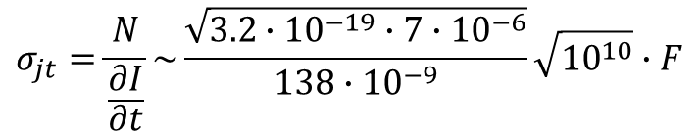
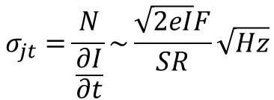
  Thin epitaxial LGAD simulation
  DC and CV
‘Ultimate’ time resolution dictated by the jitter of the sensor
overestimated jitter (F: excess noise factor)
$$σ_{jt}=\frac{N}{\frac{∂I}{∂t}}\sim \frac{\sqrt{2eI}F}{SR}\sqrt{Hz}$$
$$σ_{jt}=\frac{N}{\frac{∂I}{∂t}}\sim \frac{\sqrt{3.2∙{10}^{−19}∙7{∙10}^{−6}}}{138∙{10}^{−9}}\sqrt{{10}^{10}}∙F$$
$$σ_{jt}\sim 1.1∙F\left[ps\right]$$
E.G.Villani, Oxford, Sep. 2021
14

Slide 17
  Summary and Conclusions
Some initial studies on high granularity and very thin CMOS LGAD with a view to investigate 4D tracking
Cell investigated is 50 um size for 10 um epitaxial thickness
TCAD simulations built on ‘real’ process, used for current LGAD devices (Te2v)
Two different GL profiles investigated, minimum BV ∼ 62 V for LGAD and ∼ 90 V for PIN
Preliminary simulations show around 138 nA/ps SR (i.e. ∼ x5 than our current LGAD) and gain .w.r.t. PIN in charge collected around 10
Sensor’s jitter < 1 ps achievable
Additional studies on array of cells / 3D cells are planned
THANK YOU
E.G.Villani, Oxford, Sep. 2021
15

