Slide 1
Medipix in Space
OPMD mini seminar
10th September 2021

Slide 2
Background
A bit about Medipix and the development of Timepix
The LUCID project & other Amazing outreach
  How a secondary school gets its own space program
Space Dosimetry with Timepix
  Issues compared to ground based dosimetry
  Ongoing current work

Slide 3
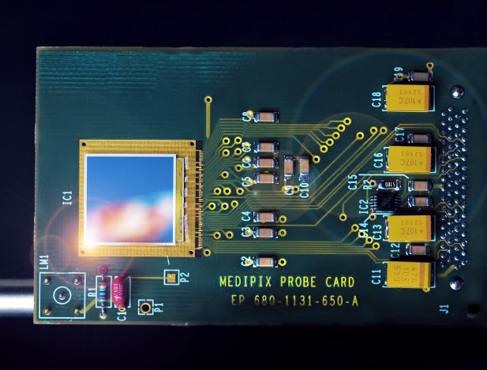
Medipix2 Capabilities
Medipix2 was the first useable hybrid photon counting detector.
  Medipix1 was a proof of concept but its pixels were too large to be really useful
Developed as a very low noise x-ray camera
256 by 256 matrix of 55um square pixels
frame based readout with a ‘shutter’ signal with ~ms readout dead time
13bit (nearly) counter depth
Two thresholds to allow energy windowing
Optimised for x-ray imaging
X. Llopart, M. Campbell, Et Al,. (2002). Medipix2: A 64-k Pixel Readout Chip With 55-um Square Elements Working in Single Photon Counting Mode. Nuclear Science, IEEE Transactions on. 49. 2279 - 2283. 10.1109/TNS.2002.803788.

Slide 4
1st Digression: Photon Counting
Photon counting is very interesting in low to mid flux x-ray applications as it allows very high dynamic range.
Previous x-ray imagers had been integrating detectors that stored charge in capacitors in pixel and then read that out.
This is prone to charge bleeding out into neighbouring pixels and to dark noise in long exposure
Because a photon c outing detector digitally counts each time the pixel goes past threshold you can have 100k counts in one pixel and zero in the neighbouring one.
This allows us to see very faint features near very bright ones (for example in crystallography) and in medical imaging to get a sharper image with less dose to the patient

Slide 5
Invention of Timepix
Medipix2 had to go through a couple of design revisions to make the front end more stable.
Jan Jakubek from CTU Prauge (now at Advacam) discovered he could put the front end of the early version of the chip in state where each pixel would oscillate with a set frequency if it was triggered by a hit form a particle.
The pixel’s counter would then count the number of oscillations until the shutter was closed and the pixel read out effectively timestamping the event
All unstable and bit random but a very nice proof of concept
Initially funded by EuDET as a TPC readout Medipix2 was modified to have a proper clock signal distributed to all pixels, this was the birth of the Timepix chip

Slide 6
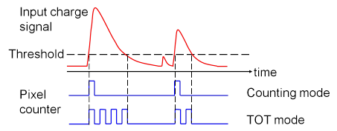
Time to Energy
With a very small addition of in-pixel logic, a time imaging chip, can also be an energy imaging chip.
Rather than count the clock ticks from the start of the hit signal to the end of the shutter, count the clock ticks from the start to the end of the hit signal.
Timepix could now:
  count the number of hits in a pixel,
  or the time of each hit,
  or how much energy was left in a hit
Revolutionarily versatile, and was used in a huge variety of scientific applications. Became the most referenced article in Nuclear Instruments and Methods for several years.

Slide 7
LUCID… beginnings
By 2007 the Meidpix group was regularly doing demonstrations for the school visitors to CERN. A good example of KT and as an easy to demonstrate pixel system.
After a visit by a 6th form class from the Simon Langton School (in Kent) we received an unusual request…
SSTL (Surrey Satilites) was running a competition for a school to design a concept for an experiment to fly on their upcoming spacecraft TechDemoSat1. Langton asked if they could propose something with Timepix on to measure ‘space weather’.
They came second but SSTL liked the proposal so much it was added to the mission. Significant technical work then followed….
In the meantime Simon Langton School Joined the Medipix2 collaboration and set up a mission control in their teaching labs!
The Langton Ultimate Cosmic-ray Intensity Detector LUCID was going to space.
They gave regular presentations to the Medipix Collaboration and even hosted one of the open meetings.

Slide 8
Beginnings…

Slide 9

LUCID, CERN@School, and IRIS
LUCID led to the CERN@School program which gave Timepix detectors to a number of schools to study radiation and cosmic rays
This in turn led to the IRIS program (Institute For Research in Schools) that pairs schools with exciting research programs where they can contribute real science.
Very much the brainchild of Becky Parker (Prof. MInstP MBE) who as head of Simon Langton Physics used force of personality got everyone to work together on this

Slide 10
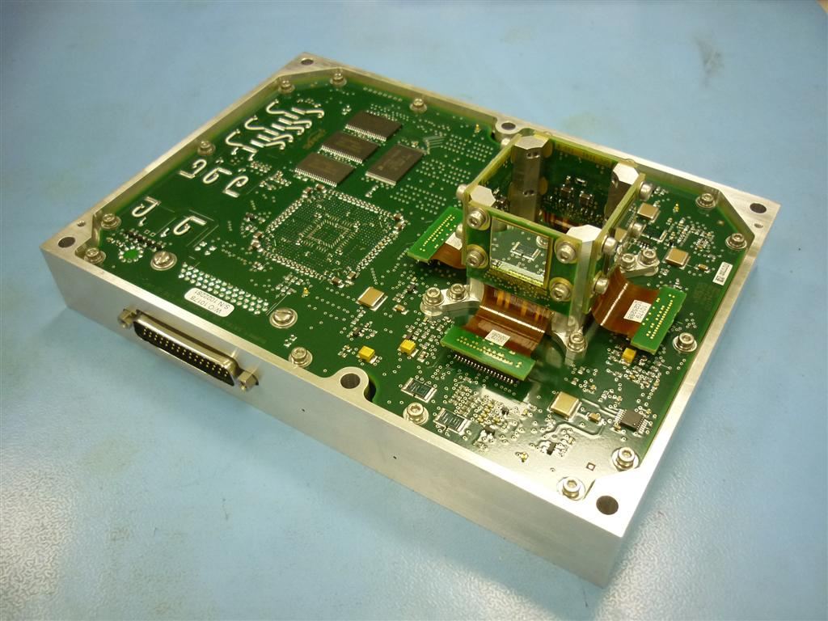
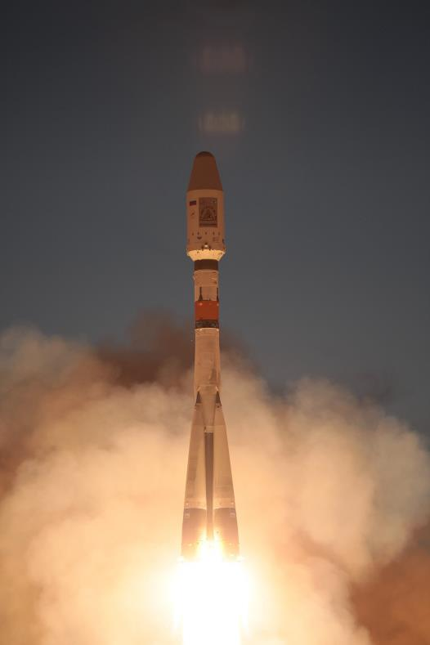
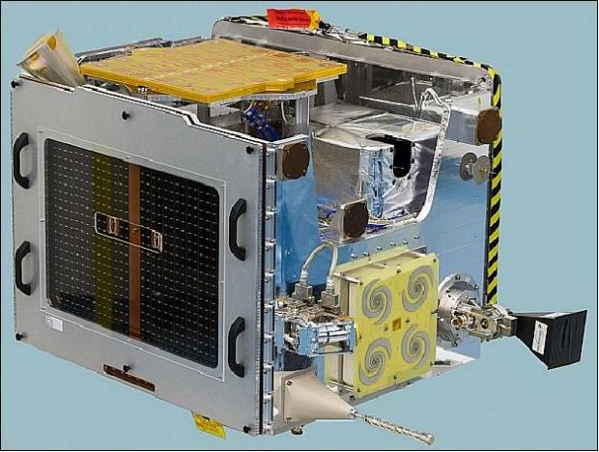
LUCID

Slide 11
Results from LUCID
Lucid launched in 2014 and collected Data to 2017
Limited by bandwidth and available spacecraft power
Generated a full map of charged particle events at the TDS-1 altitude.

Slide 12
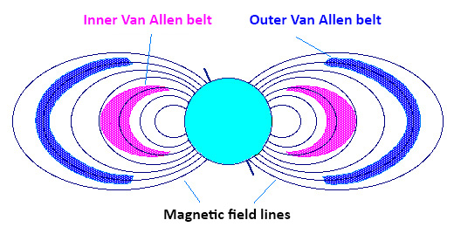
Space Weather
So what is Space Weather?
Charged particles from the sun, and those generated by interactions in the earths atmosphere are trapped by the earths magnetic field in the ‘Van-Allen’ belts
As seen by LUCID V-A belts contact most closely at the polar regions
Also the South Atlantic anomaly…

Slide 13
Space Weather Implications
Danger to spacecraft electronics and systems that rely on them
Danger to astronauts on the ISS
Time varying to a large degree – particular events like Solar storms and coronal mass ejections can significantly increase activity
Two fields where Timepix is now being used
Space Weather : for Spacecraft Safety
Space Dosimetry for Astronaut Safety (Timepix on the ISS)

Slide 14
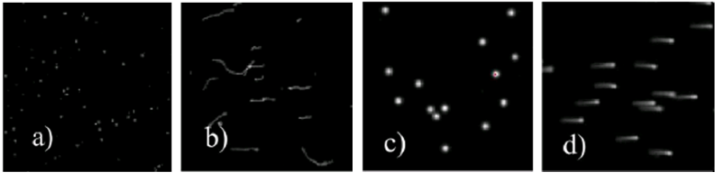
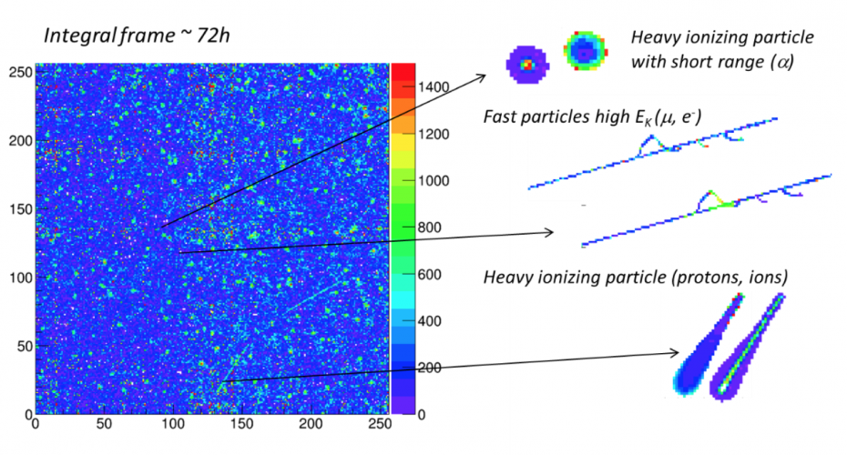
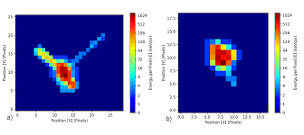
2nd Aside: Determining Particle Type with Timepix

Slide 15
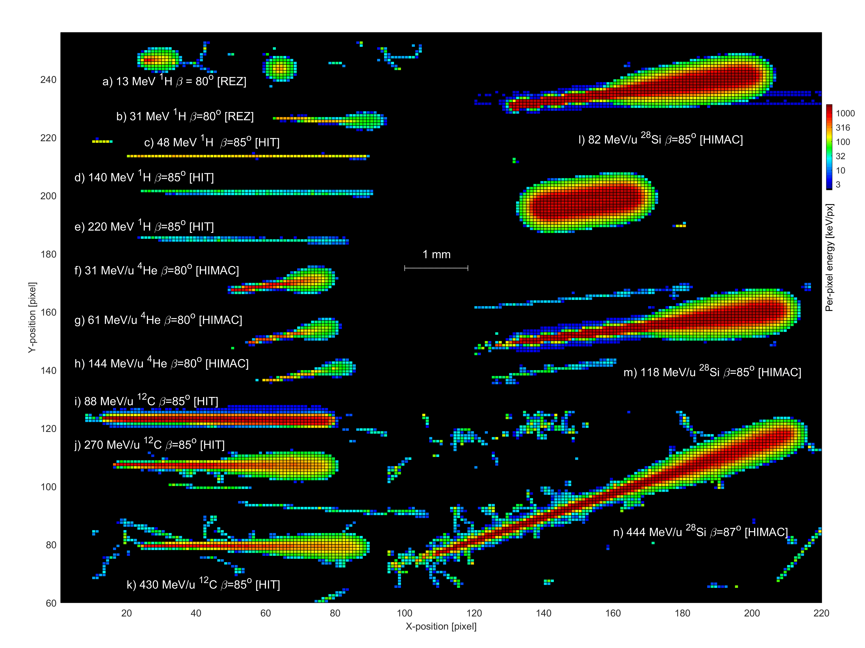
Then you get more advanced…

Slide 16
Space Dosimetry
The previous image was generated as part of work by U of Houson and the JPL (Larry Pinsky) as part of efforts to use Timepix as a space dosimeter.
Space Dosimitry is *MUCH* harder than normal dosimetry because you have to identify the particle species. Its also very useful to identify direction to be able to react and minimise dose.
Generally in ground based dosimetry you get a limited number of particles that you can assume a dose from based on the occupation of the person.
Significant work undertaken at medical accelerators looking at accelerated ion signatures in Timepix Carbon Silicon etc with multiply charged ions, to see if its possible to determine angle, and energy of heavily ionising ‘stopping’ particles that are rare in normal terrestrial actities.

Slide 17
Particle Species (4 sec exposure)

Slide 18
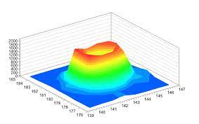
3rd digression: Effect on Timepix Design
The very high energy deposited by the heavy stopping particles goes beyond the linearity of the original Timepix’s analogue amplifier and causes a ‘volcano’ effect, where the centre of the peak is missing.
This application has pushed later chips Timepix3 and 4 to have significantly longer linear ranges than would otherwise have been foreseen

Slide 19
The Future
LUCIDs principal success is that many young people have been inspired to work in research – including at least one of our colleagues in the physics dept who was an original LUCID student.
IRIS is going from strength to strength inspiring new students to do science
Space weather continues to threaten astronauts and spacecraft and there is a major p[reject by NASA to use Timepix as a radiation monitor : Hybrid Electronic Radiation Assessor (HERA) to support Space Launch Systems Mission
Timepixs will also continue to fly on the ISS, and the RISESAT and FIRST orbital missions to track charged particles.

