Slide 1
Electron spin polarization preservation in the Electron-Ion Collider
Matt Signorelli
Postdoctoral Research Associate
Brookhaven National Laboratory
EIC Accelerator Collaboration Meeting on Polarized Beams and Polarimetry
September 8th, 2026

Slide 2
Overview
Background
Electron Storage Ring (ESR) of the Electron-Ion Collider (EIC)
Best Adjustment Groups for ELectron Spin (BAGELS)
Conclusions
New Software Plug: SciBmad
Relevant papers cited at bottom of slides
Also see my PhD thesis “Electron spin polarization preservation in the Electron-Ion Collider”
Notes:
1 min

Slide 3
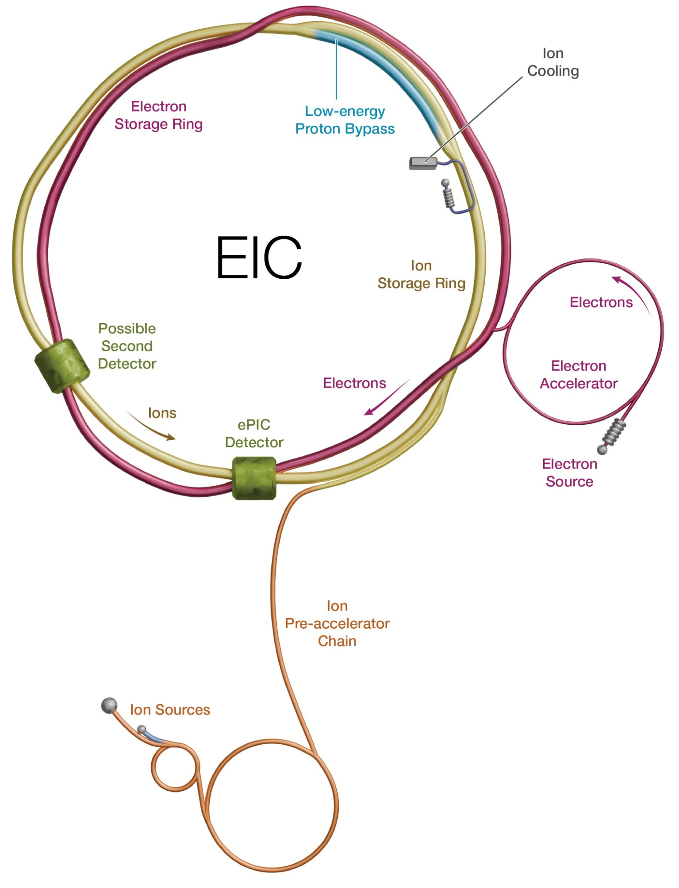
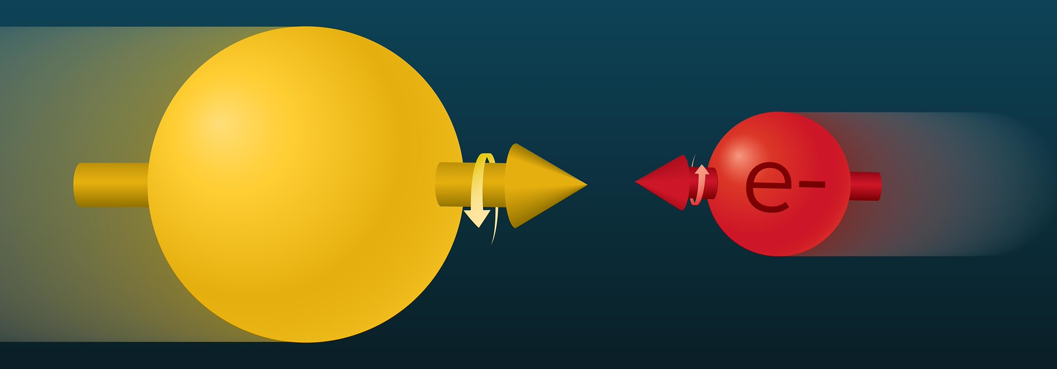
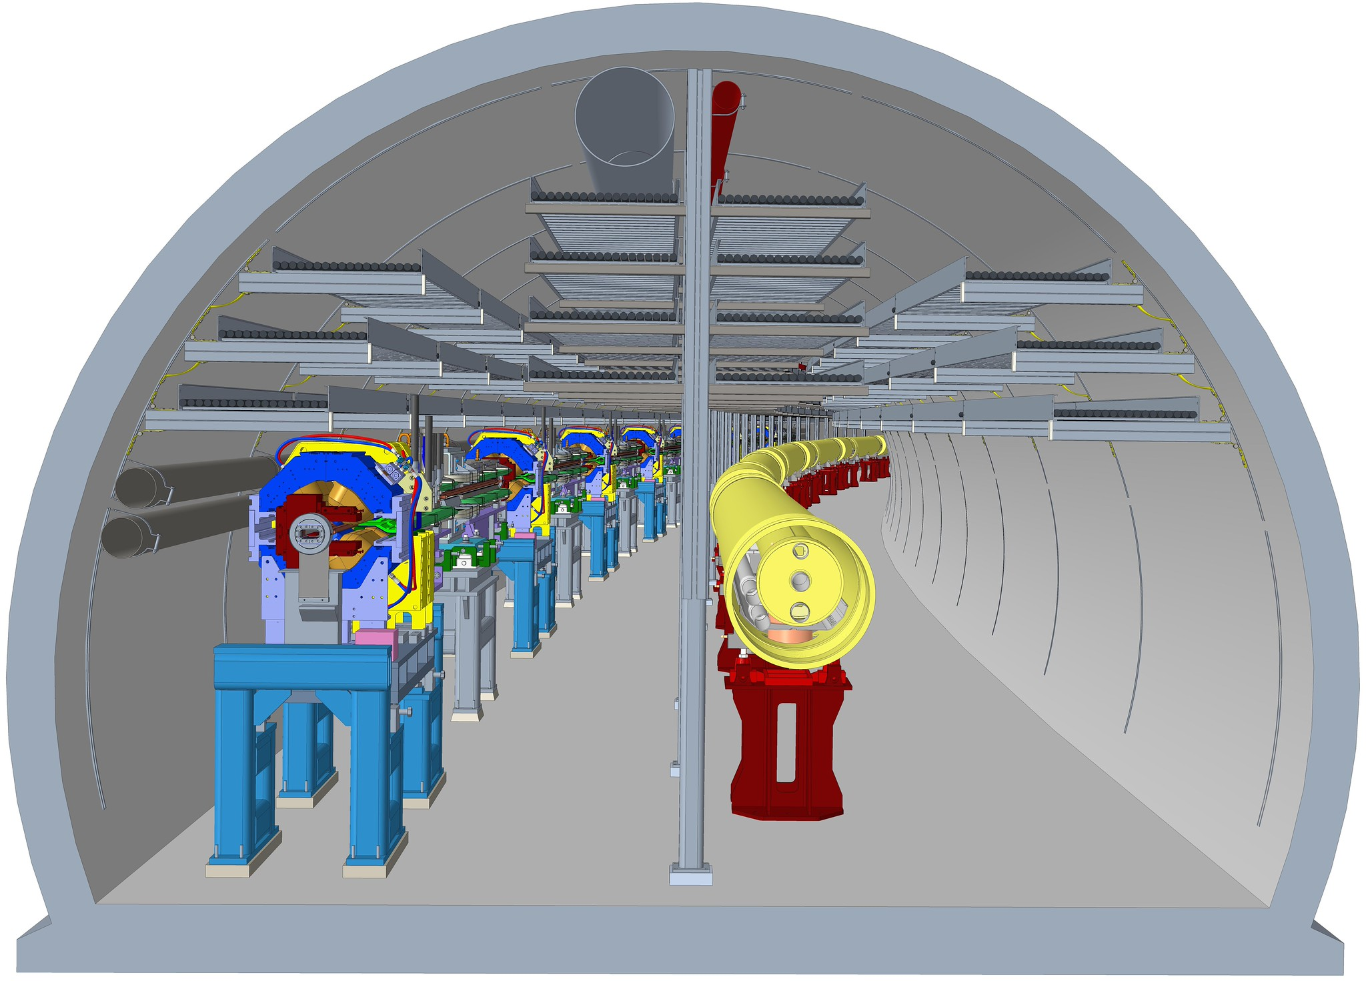
Background: What is the EIC?
Electron-Ion Collider (EIC)
  Collides spin-polarized hadrons (e.g. protons) with spin-polarized electrons for a wide range of energies
  Study origin of proton spin, among other outstanding Standard Model questions
Hadron Storage Ring (HSR)
  41, 100, and 275 GeV
Electron Storage Ring (ESR)
  5, 9, and 18 GeV
IP8
ESR
HSR
IP6
Notes:
Talk about how they go really fast and then smash with spins like that
Hadrons not
Red / pink think is PART of EIC

Slide 4
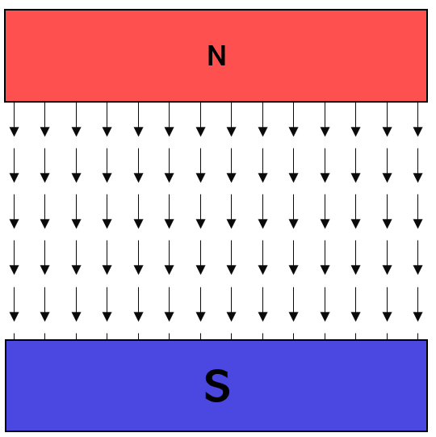

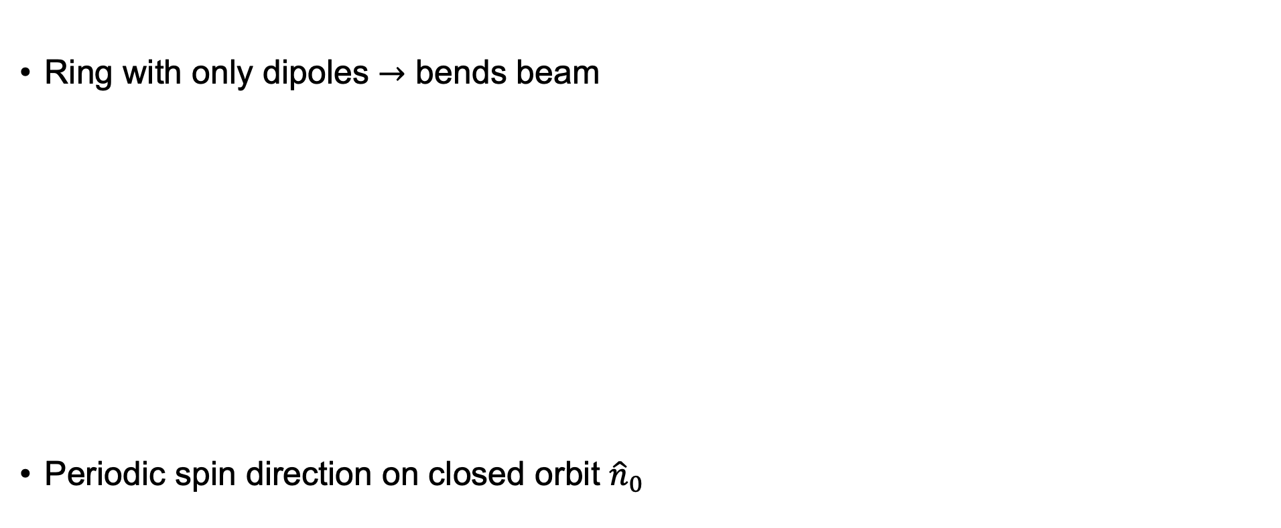





Background: Electron Spin Polarization
Ring with only dipoles $→$ bends beam
Periodic spin direction on closed orbit ${\hat{n}}_{0}$
$${\hat{n}}_{0}$$
$${\hat{n}}_{0}$$
Dipole
$${\hat{n}}_{0}$$
$${\hat{n}}_{0}$$
$${\hat{n}}_{0}$$
$${\hat{n}}_{0}$$
Notes:
Dipoles bend the beam

Slide 5
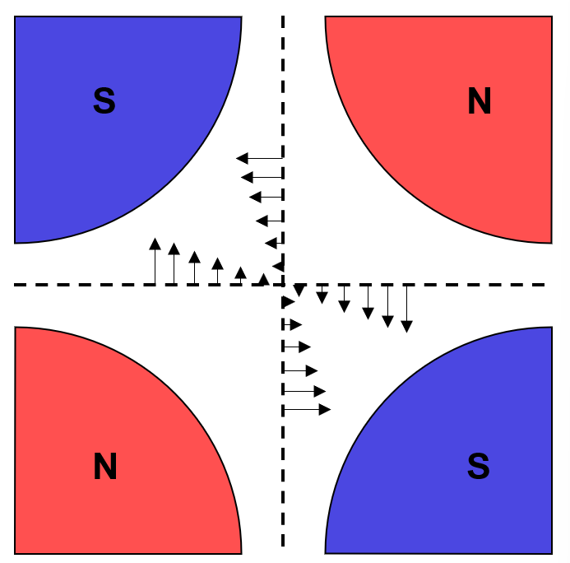

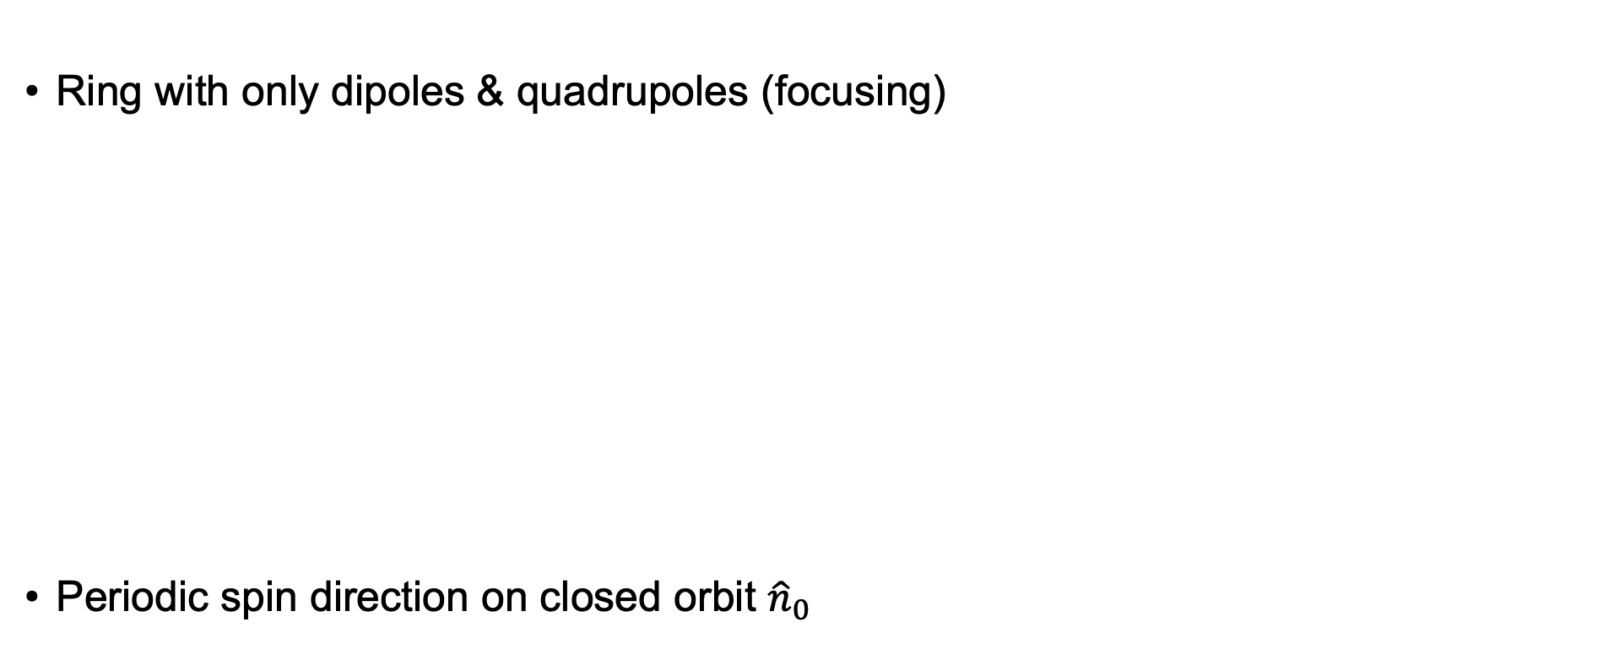





Background: Electron Spin Polarization
Dipole
Ring with only dipoles & quadrupoles (focusing)
Periodic spin direction on closed orbit ${\hat{n}}_{0}$
$${\hat{n}}_{0}$$
Quadrupole
$${\hat{n}}_{0}$$
$${\hat{n}}_{0}$$
$${\hat{n}}_{0}$$
$${\hat{n}}_{0}$$
$${\hat{n}}_{0}$$
Notes:
Make quad arrows bigger

Slide 6










Background: Electron Spin Polarization
What if we want longitudinal spin at the interaction point?
Use solenoids:
$${\hat{n}}_{0}$$
$${\hat{n}}_{0}$$
$${\hat{n}}_{0}$$
$${\hat{n}}_{0}$$
$$×$$
$${\hat{n}}_{0}$$
$${\hat{n}}_{0}$$
$$\vec{B}$$
$$\vec{B}$$
$${\hat{n}}_{0}$$

Slide 7
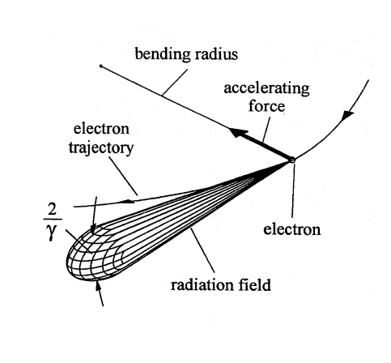
Background: Electron Spin Polarization
Is that it?
For hadrons, mostly. But…
Electrons emit a lot of synchrotron radiation!
Effects on polarization:
  Sokolov-Ternov (spin flip) effect
  Radiative Depolarization
  Kinetic effects (usually small)

Slide 8

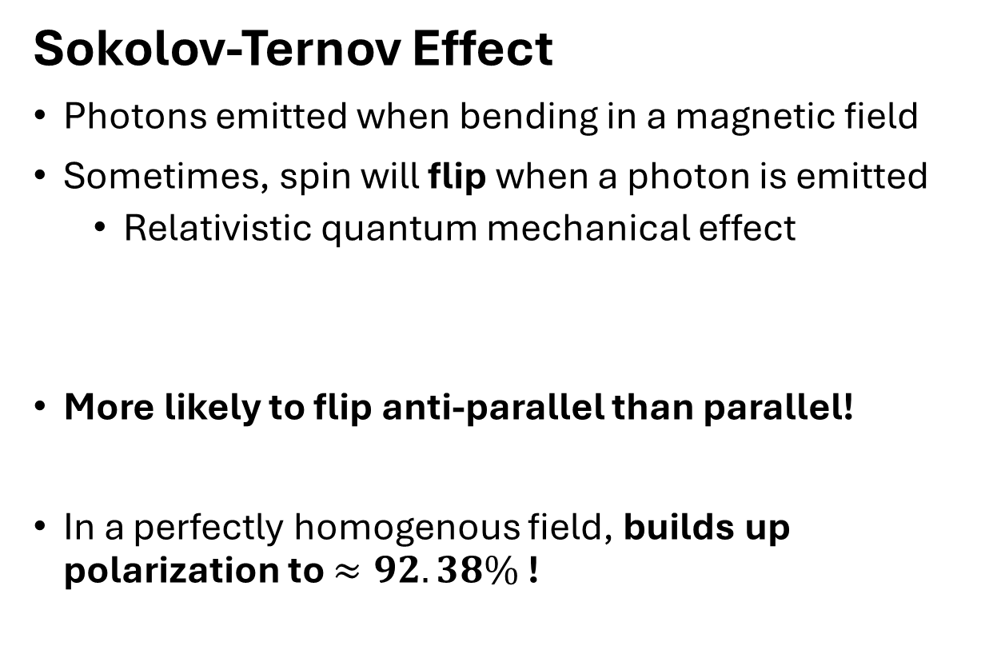




Background: Electron Spin Polarization
Sokolov-Ternov Effect
Photons emitted when bending in a magnetic field
Sometimes, spin will flip when a photon is emitted
  Relativistic quantum mechanical effect
More likely to flip anti-parallel than parallel!
In a perfectly homogenous field, builds up polarization to $≈92.38\%$ !
$$\vec{B}$$
$$\vec{S}$$
$$\vec{B}$$
$$\vec{S}$$

Slide 9



Background: Electron Spin Polarization
Radiative Depolarization (a simplistic picture)
Ring with only dipoles and quadrupoles
No depolarizing effects in a perfectly planar ring
$$\vec{S}$$
Dipole
Quadrupole
$$\vec{S}$$
$${\hat{n}}_{0}$$

Slide 10









Background: Electron Spin Polarization
Radiative Depolarization (a simplistic picture)
Electron stochastically sees different magnetic fields
Depolarizes an electron bunch!
How to remedy this? Traditionally, “spin matching” is used…
$${\hat{n}}_{0}$$
$${\hat{n}}_{0}$$
$${\hat{n}}_{0}$$
$${\hat{n}}_{0}$$
$$\vec{S}≠{\hat{n}}_{0}$$
$${\hat{n}}_{0}$$
$${\hat{n}}_{0}$$
$${\hat{n}}_{0}$$
$$\vec{S}$$

Slide 11




Background: Electron Spin Polarization
“Spin Matching”
$${\hat{n}}_{0}$$
$$\vec{S}$$
$$β$$
$$α$$

Slide 12






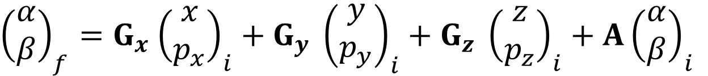


Background: Electron Spin Polarization
“Spin Matching”
$${\vec{S}}_{f}$$
$${\hat{n}}_{0}(s_{f})$$
$${\hat{n}}_{0}(s_{i})$$
$${\vec{S}}_{i}$$
Magnet
$$β_{f}$$
$$α_{f}$$
$$β_{i}$$
$$α_{i}$$
${\left(\begin{matrix}α \\ β\end{matrix}\right)}_{f}=G_{x}$ ${\left(\begin{matrix}x \\ p_{x}\end{matrix}\right)}_{i}+G_{y} {\left(\begin{matrix}y \\ p_{y}\end{matrix}\right)}_{i}+G_{z} {\left(\begin{matrix}z \\ p_{z}\end{matrix}\right)}_{i}+A{\left(\begin{matrix}α \\ β\end{matrix}\right)}_{i}$
Horizontal
Vertical
Longitudinal
Closed orbit precession

Slide 13








Background: Electron Spin Polarization
“Spin Matching”
$$G_{x,y,z}(s_{i}→s_{f})=0$$
$$s_{i}$$
$$s_{f}$$
$${\hat{n}}_{0}$$
$$\vec{S}={\hat{n}}_{0}$$
$${\hat{n}}_{0}$$
$$\vec{S}$$

Slide 14
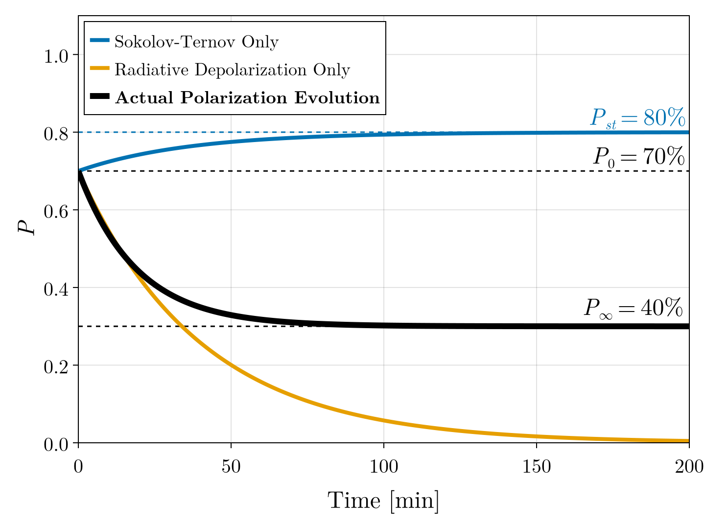
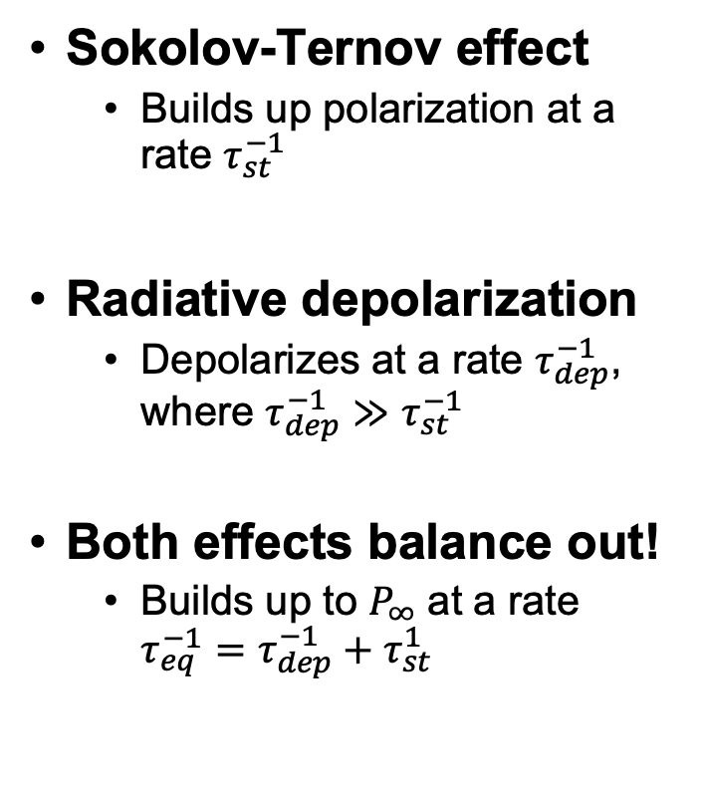
Background: Electron Spin Polarization
Sokolov-Ternov effect
  Builds up polarization at a rate $τ_{st}^{−1}$
Radiative depolarization
  Depolarizes at a rate $τ_{dep}^{−1}$, where $τ_{dep}^{−1}≫τ_{st}^{−1}$
Both effects balance out!
  Builds up to $P_{∞}$ at a rate $τ_{eq}^{−1}=τ_{dep}^{−1}+τ_{st}^{1}$

Slide 15
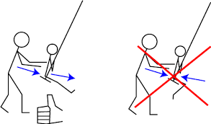
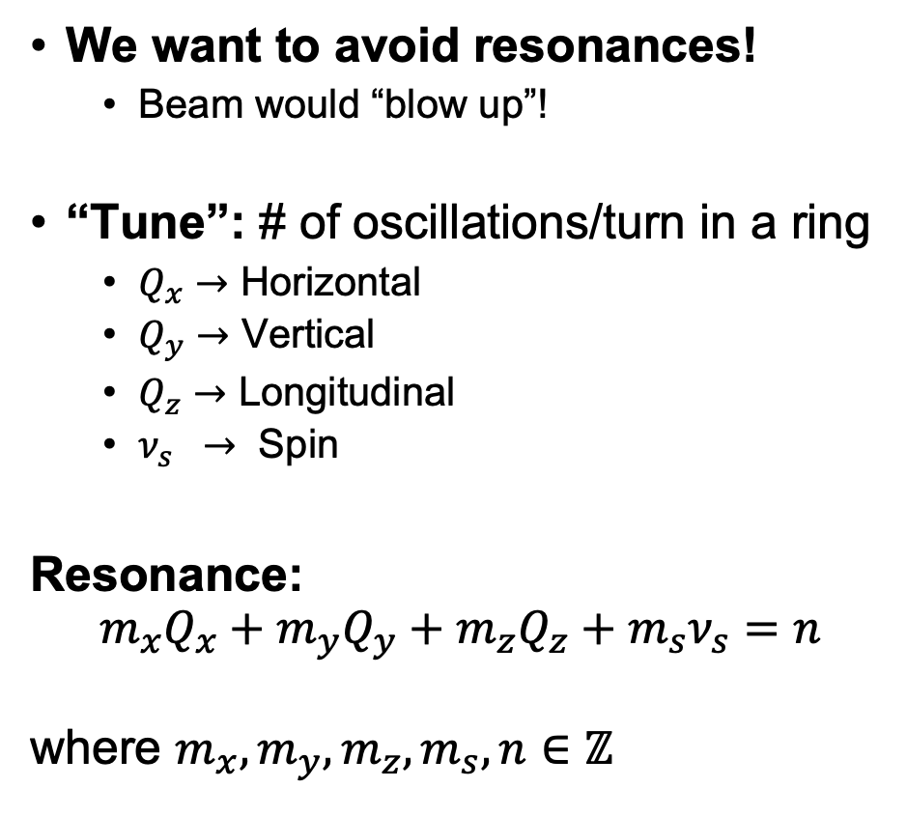
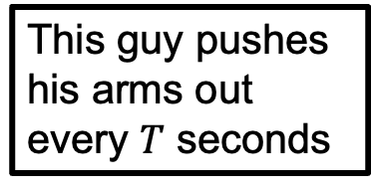
Background: Resonances
We want to avoid resonances!
  Beam would “blow up”!
“Tune”: # of oscillations/turn in a ring
  $Q_{x}→$ Horizontal
  $Q_{y}→$ Vertical
  $Q_{z}→$ Longitudinal
  $ν_{s} →$ Spin
Resonance:
$$m_{x}Q_{x}+m_{y}Q_{y}+m_{z}Q_{z}+m_{s}ν_{s}=n$$
where $m_{x},m_{y},m_{z},m_{s},n∈ℤ$
If the kid’s swinging is commensurate, resonance!
If not, then the kid won’t go very high
This guy pushes his arms out every $T$ seconds
Notes:
Beam will blow up
Integer multiples of the tunes -> blow up
Go one by one, oscillate in each plane

Slide 16
Electron Storage Ring of the EIC

Slide 17
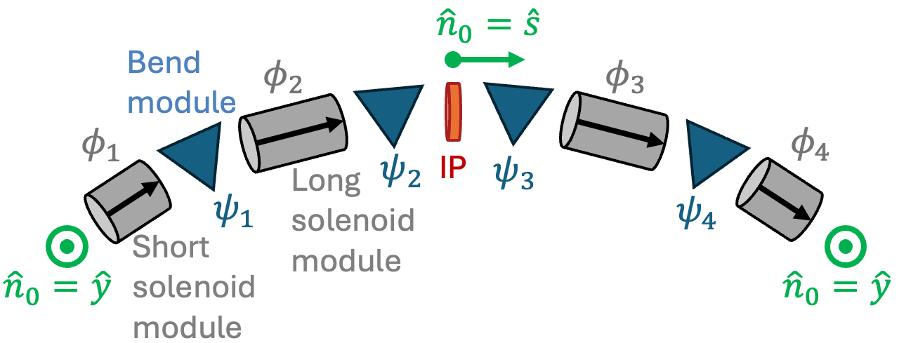
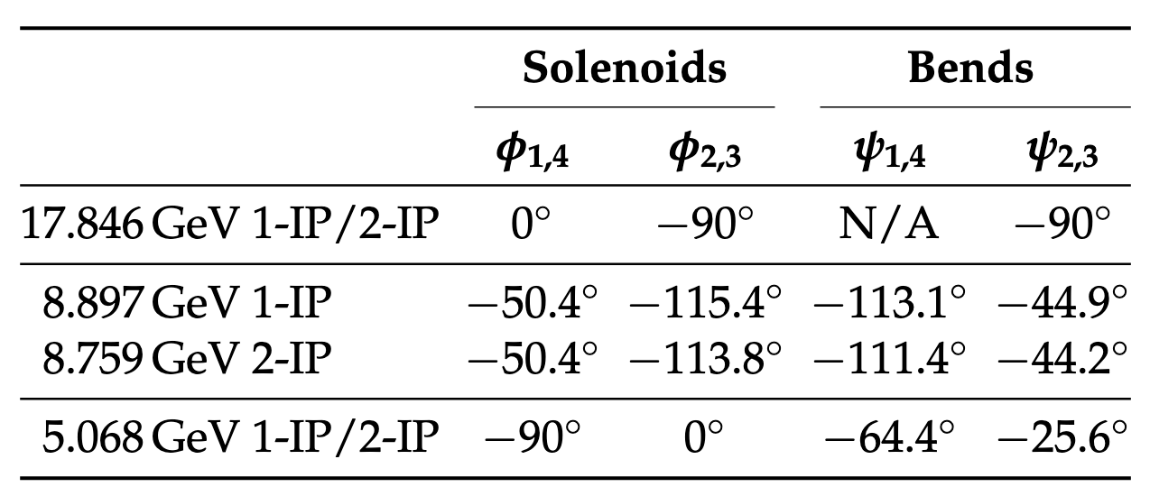
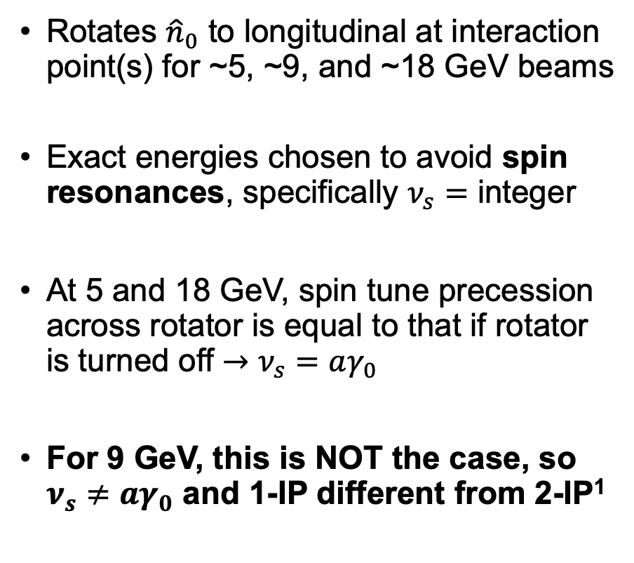
Electron Storage Ring of the EIC
Rotates ${\hat{n}}_{0}$ to longitudinal at interaction point(s) for ~5, ~9, and ~18 GeV beams
Exact energies chosen to avoid spin resonances, specifically $ν_{s}=$ integer
At 5 and 18 GeV, spin tune precession across rotator is equal to that if rotator is turned off $→$ $ν_{s}=aγ_{0}$
For 9 GeV, this is NOT the case, so $ν_{s}≠aγ_{0}$ and 1-IP different from 2-IP¹
1. M. G. Signorelli et al, “Polarization preservation methods for the Electron Storage Ring of the EIC”, MOPC83 IPAC ‘24
Notes:
Show with arms/hands how it rotates
Calculation not too fun so won’t detail

Slide 18
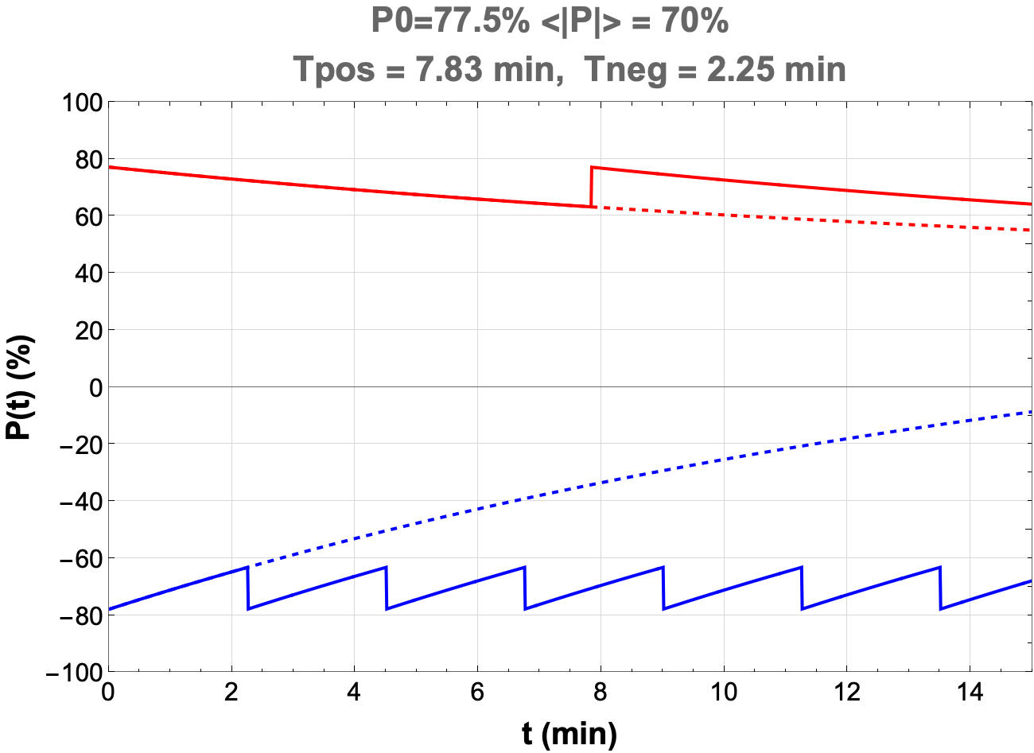




Electron Storage Ring of the EIC
Polarized bunches injected and swapped out when sufficiently depolarized
Simultaneously store bunches with both positive and negative helicity at the IP
Half of bunches polarized parallel to arc field, half anti-parallel
  Sokolov-Ternov works FOR anti-parallel
  Sokolov-Ternov works AGAINST parallel
$$\vec{S}$$
$$\vec{v}$$
$$\vec{S}$$
$$\vec{v}$$
Figure credit: Christoph Montag
Notes:
Show with arms/hands how it rotates
Calculation not too fun so won’t detail

Slide 19
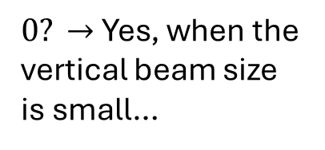
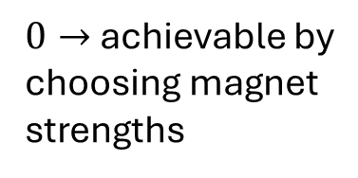
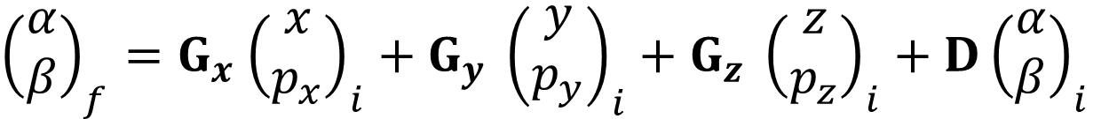
Electron Storage Ring of the EIC
Spin match?
Horizontal
Vertical
Longitudinal
${\left(\begin{matrix}α \\ β\end{matrix}\right)}_{f}=G_{x}$ ${\left(\begin{matrix}x \\ p_{x}\end{matrix}\right)}_{i}+G_{y} {\left(\begin{matrix}y \\ p_{y}\end{matrix}\right)}_{i}+G_{z} {\left(\begin{matrix}z \\ p_{z}\end{matrix}\right)}_{i}+D{\left(\begin{matrix}α \\ β\end{matrix}\right)}_{i}$
$0→$ achievable by choosing magnet strengths
$0? →$ Yes, when the vertical beam size is small…
It’s complicated…
Notes:
Now that we avoid resonances, what about the radiative depolarization?

Slide 20
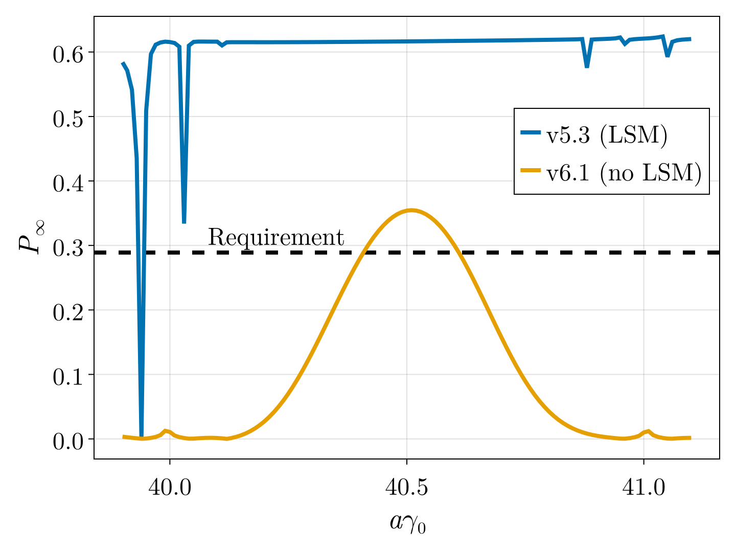
Electron Storage Ring of the EIC
5 and 10 GeV cases do not require a “longitudinal spin match” (LSM)
At 18 GeV, the effect on polarization is significant
For an LSM, we need solenoids that produce 11 T fields!
  Not feasible to engineer
A solution is needed…
Min

Slide 21
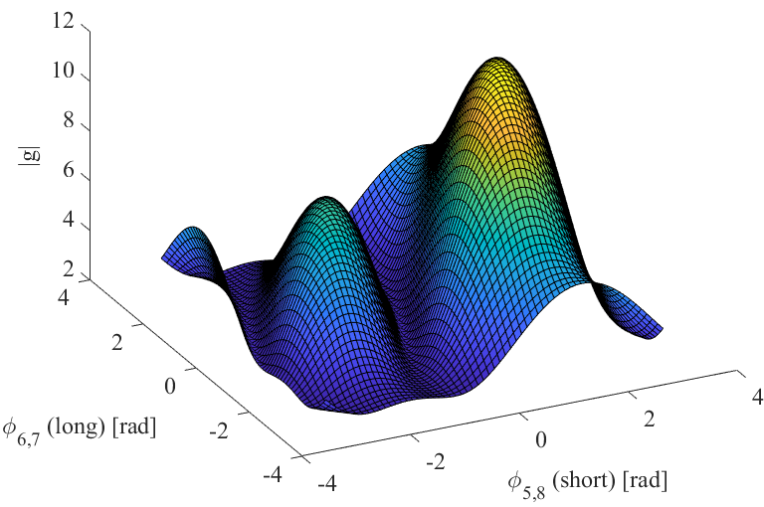
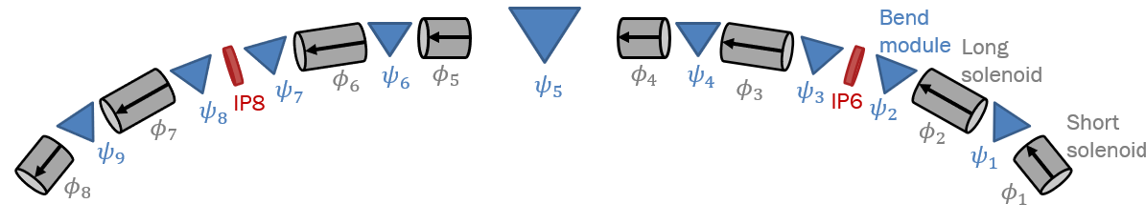
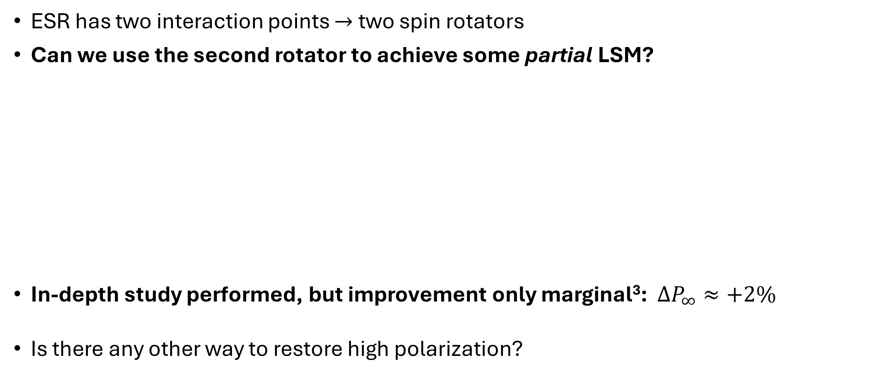
Electron Storage Ring of the EIC
ESR has two interaction points $→$ two spin rotators
Can we use the second rotator to achieve some partial LSM?
In-depth study performed, but improvement only marginal³: $ΔP_{∞}≈+2\%$
Is there any other way to restore high polarization?
No LSM
(Partial) LSM??
3. M. G. Signorelli et al, “Electron Polarization Preservation in the EIC”, MOPA052, IPAC ‘23

Slide 22
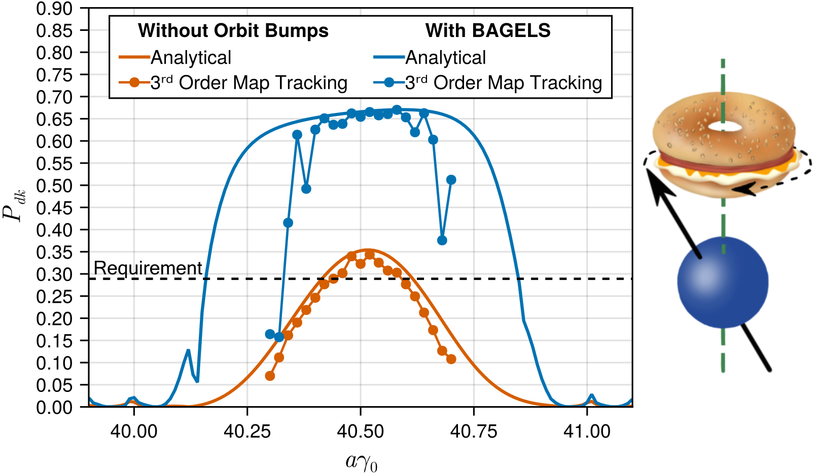
Best Adjustment Groups for ELectron Spin (BAGELS)
All work published in M. G. Signorelli and G. H. Hoffstaetter, “BAGELS for simultaneous polarization, orbit, and optics control in electron storage rings”, Phys. Rev. Accel. Beams 28, 031002 , Editor’s Suggestion

Slide 23


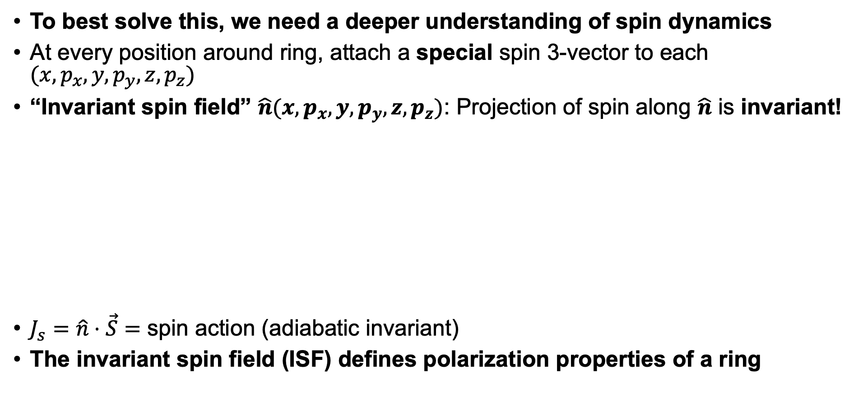








Best Adjustment Groups for ELectron Spin
To best solve this, we need a deeper understanding of spin dynamics
At every position around ring, attach a special spin 3-vector to each $(x,p_{x},y,p_{y},z,p_{z})$
“Invariant spin field” $\hat{n}(x,p_{x},y,p_{y},z,p_{z})$: Projection of spin along $\hat{n}$ is invariant!
$J_{s}=\hat{n}⋅\vec{S}=$ spin action (adiabatic invariant)
The invariant spin field (ISF) defines polarization properties of a ring
$$J_{s}$$
$$\hat{n}\left({\vec{z}}_{f}\right)$$
$${\vec{S}}_{f}$$
$$J_{s}=1$$
$$\hat{n}\left({\vec{z}}_{f}\right)={\vec{S}}_{f}$$
$${\vec{S}}_{0}$$
$$J_{s}$$
$$\hat{n}\left({\vec{z}}_{0}\right)$$
$$J_{s}=1$$
$$\hat{n}\left({\vec{z}}_{0}\right)={\vec{S}}_{0}$$

Slide 24







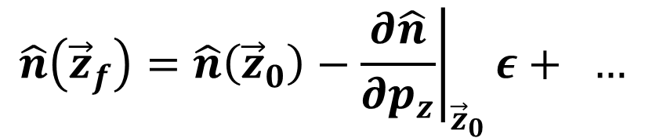


Best Adjustment Groups for ELectron Spin
Radiative depolarization (not simplistic)
Consider what happens to the spin action with photon emission
$$\vec{S}$$
$$γ$$
$$\vec{S}$$
$$\hat{n}\left({\vec{z}}_{0}\right)$$
$$\hat{n}\left({\vec{z}}_{f}\right)$$
$$J_{s,0}$$
$$J_{s,f}<J_{s,0}$$
$${\vec{z}}_{0}={\left(x,p_{x},y,p_{y}, z,p_{z}\right)}^{T}$$
$${\vec{z}}_{f}≈{\left(x,p_{x},y,p_{y}, z,p_{z}−ε\right)}^{T}$$
$$\hat{n}\left({\vec{z}}_{f}\right)=\hat{n}\left({\vec{z}}_{0}\right)−{\left.\frac{∂\hat{n}}{∂p_{z}}\right|}_{{\vec{z}}_{0}}ε+ …$$
To leading order, this is the bad thing!

Slide 25
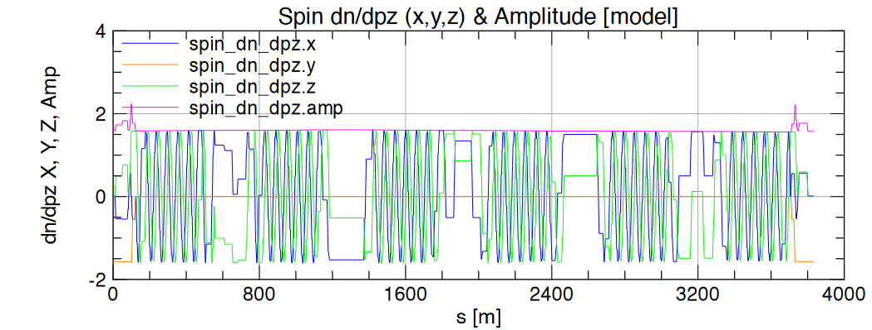
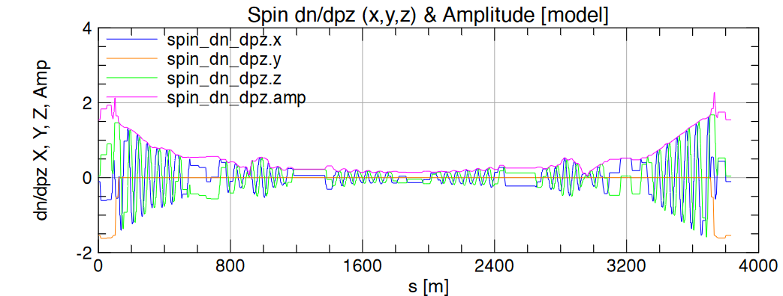

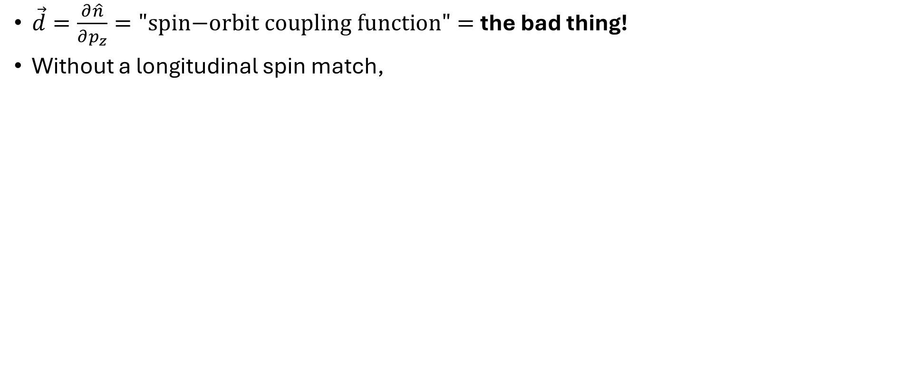

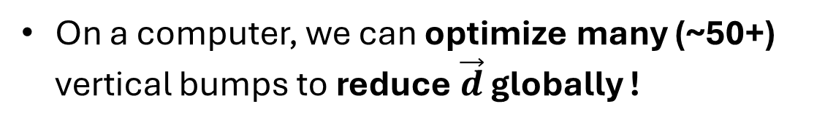
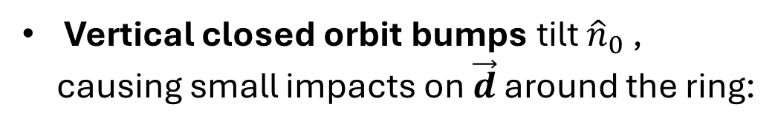
Best Adjustment Groups for ELectron Spin
$\vec{d}=\frac{∂\hat{n}}{∂p_{z}}=\text{"}\text{spin}\text{−}\text{orbit} \text{coupling} \text{function}"=$the bad thing!
Without a longitudinal spin match,
Vertical closed orbit bumps tilt ${\hat{n}}_{0}$ , causing small impacts on $\vec{d}$ around the ring:
Vertical bumps + optimizer
$${\hat{n}}_{0}$$
Turn on bump magnets
$$θ_{i}$$
On a computer, we can optimize many (~50+) vertical bumps to reduce $\vec{d}$ globally !
Notes:
Theta I is bump strength

Slide 26
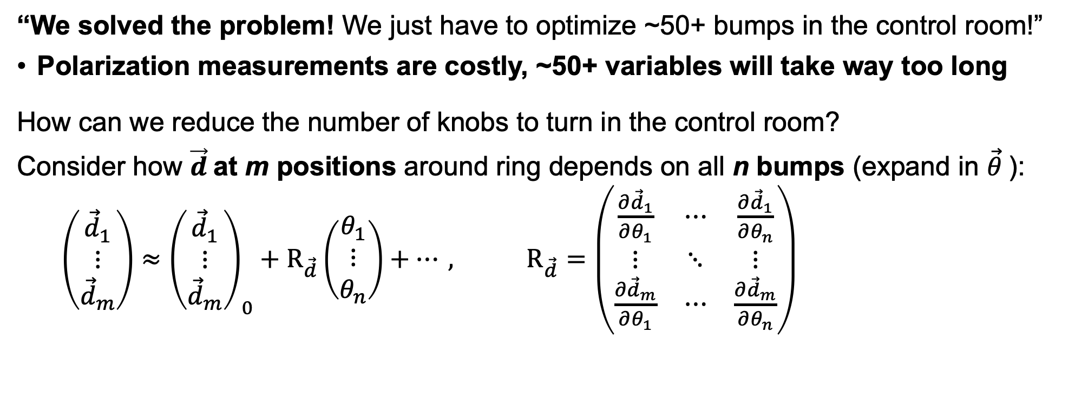

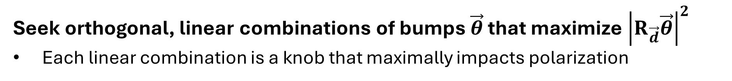
Best Adjustment Groups for ELectron Spin
“We solved the problem! We just have to optimize ~50+ bumps in the control room!”
Polarization measurements are costly, ~50+ variables will take way too long
How can we reduce the number of knobs to turn in the control room?
Consider how $\vec{d}$at m positions around ring depends on all n bumps (expand in $\vec{θ}$):
$\left(\begin{matrix}{\vec{d}}_{1} \\ ⋮ \\ {\vec{d}}_{m}\end{matrix}\right)≈{\left(\begin{matrix}{\vec{d}}_{1} \\ ⋮ \\ {\vec{d}}_{m}\end{matrix}\right)}_{0}+R_{\vec{d}}\left(\begin{matrix}θ_{1} \\ ⋮ \\ θ_{n}\end{matrix}\right)+…, R_{\vec{d}}=\left(\begin{matrix}\frac{∂{\vec{d}}_{1}}{∂θ_{1}} & ⋯ & \frac{∂{\vec{d}}_{1}}{∂θ_{n}} \\ ⋮ & ⋱ & ⋮ \\ \frac{∂{\vec{d}}_{m}}{∂θ_{1}} & ⋯ & \frac{∂{\vec{d}}_{m}}{∂θ_{n}}\end{matrix}\right)$
“Linear response matrix”
Which ${\vec{θ}}^{′}s$ make this term really big?
Seek orthogonal, linear combinations of bumps $\vec{θ}$ that maximize ${\left|R_{\vec{d}}\vec{θ}\right|}^{2}$
Each linear combination is a knob that maximally impacts polarization

Slide 27
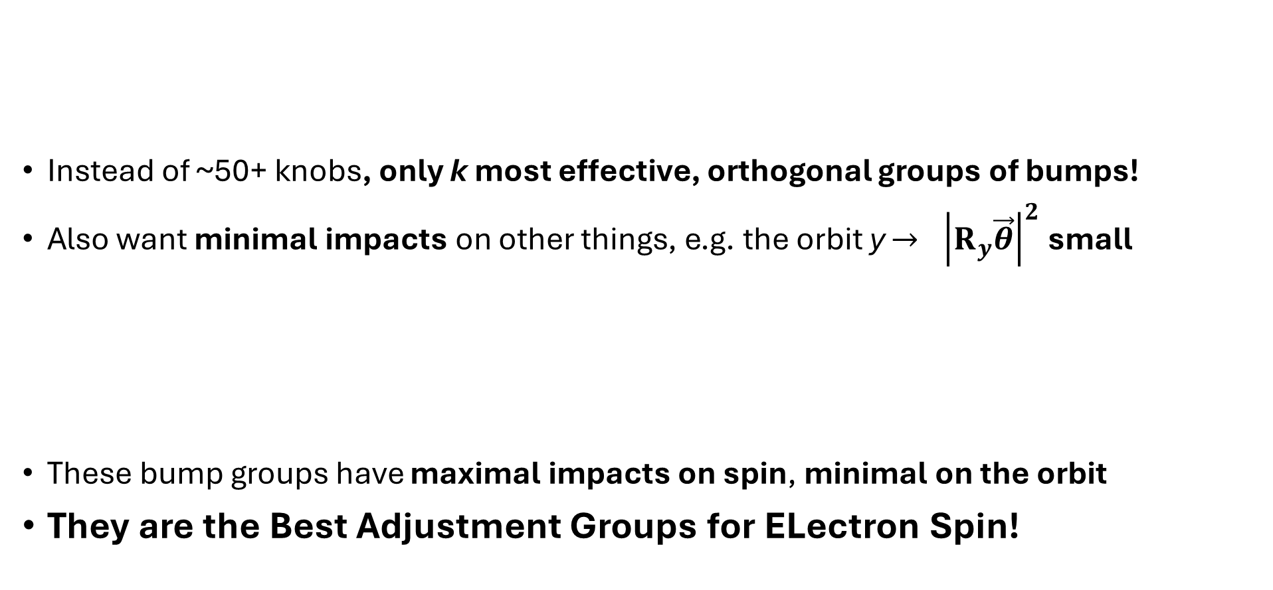
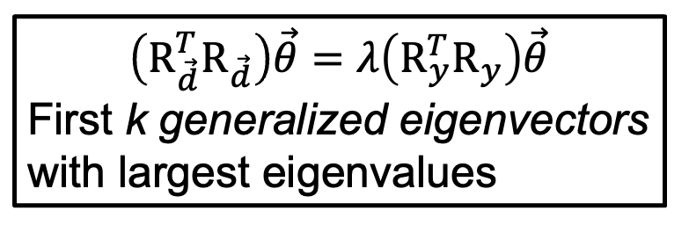
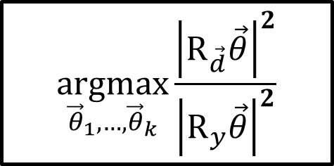
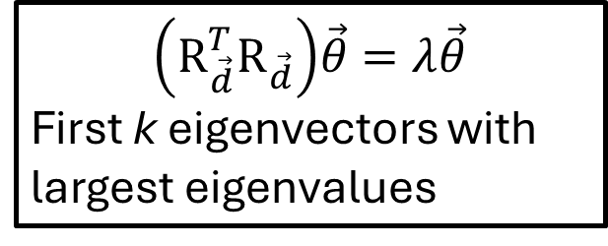
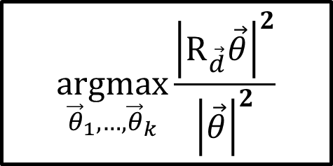
Best Adjustment Groups for ELectron Spin
$$\underset{{\vec{θ}}_{1},…,{\vec{θ}}_{k}}{argmax}{\frac{{\left|R_{\vec{d}}\vec{θ}\right|}^{2}}{{\left|\vec{θ}\right|}^{2}}}$$
$$\left({R_{\vec{d}}^{T}R}_{\vec{d}}\right)\vec{θ}=λ\vec{θ}$$
First k eigenvectors with largest eigenvalues
Instead of ~50+ knobs, only k most effective, orthogonal groups of bumps!
Also want minimal impacts on other things, e.g. the orbit y $→ {\left|R_{y}\vec{θ}\right|}^{2}$small
These bump groups have maximal impacts on spin, minimal on the orbit
They are the Best Adjustment Groups for ELectron Spin!
Lagrange multipliers
$$\underset{{\vec{θ}}_{1},…,{\vec{θ}}_{k}}{argmax}{\frac{{\left|R_{\vec{d}}\vec{θ}\right|}^{2}}{{\left|R_{y}\vec{θ}\right|}^{2}}}$$
$$\left({R_{\vec{d}}^{T}R}_{\vec{d}}\right)\vec{θ}=λ\left({R_{y}^{T}R}_{y}\right)\vec{θ}$$
First k generalized eigenvectors with largest eigenvalues
Lagrange multipliers
Notes:
More formally
pca

Slide 28
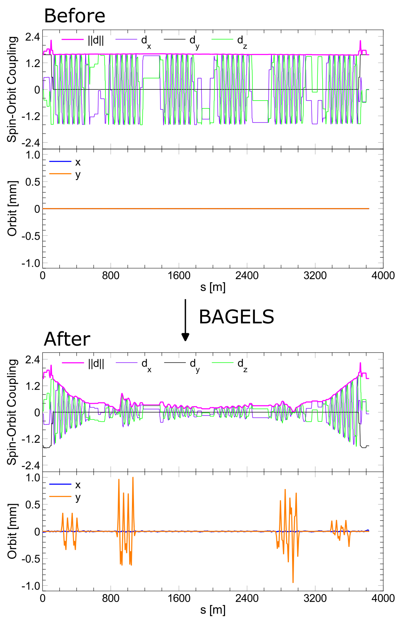
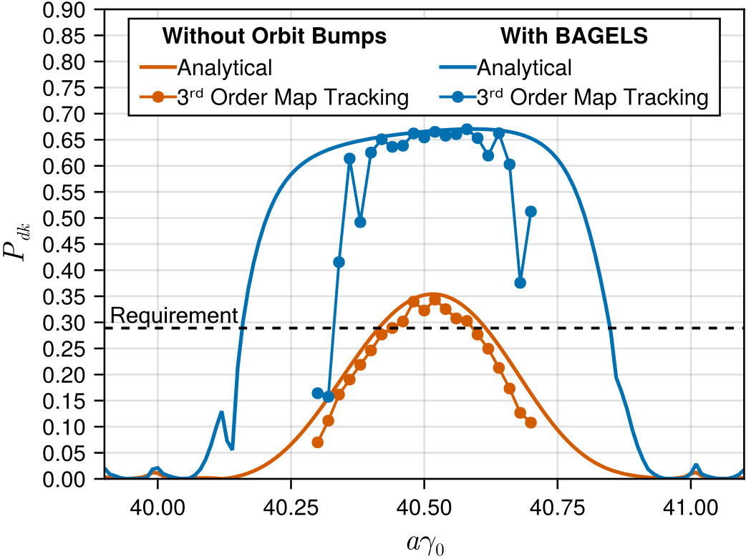
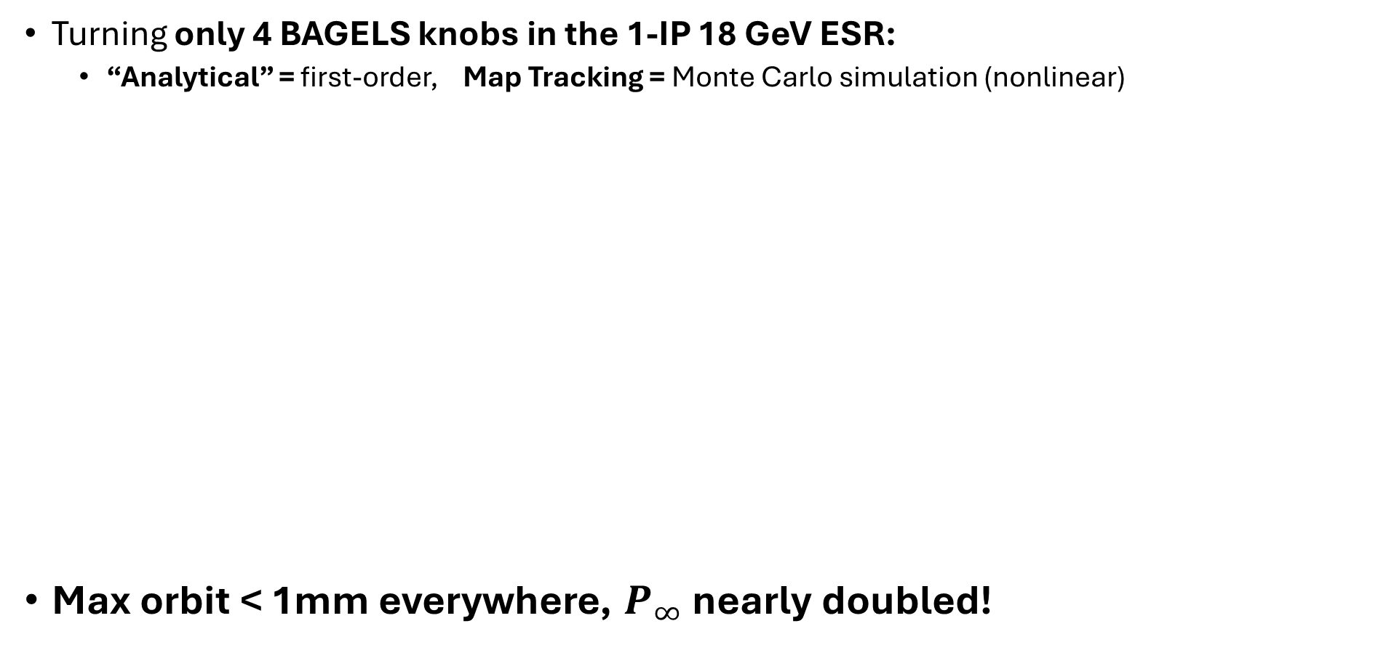
BAGELS: 1-IP 18 GeV ESR
Turning only 4 BAGELS knobs in the 1-IP 18 GeV ESR:
  “Analytical” = first-order, Map Tracking = Monte Carlo simulation (nonlinear)
Max orbit < 1mm everywhere, $P_{∞}$ nearly doubled!
Notes:
Monte carlo tracking result
Go slow here, talk about right plot

Slide 29
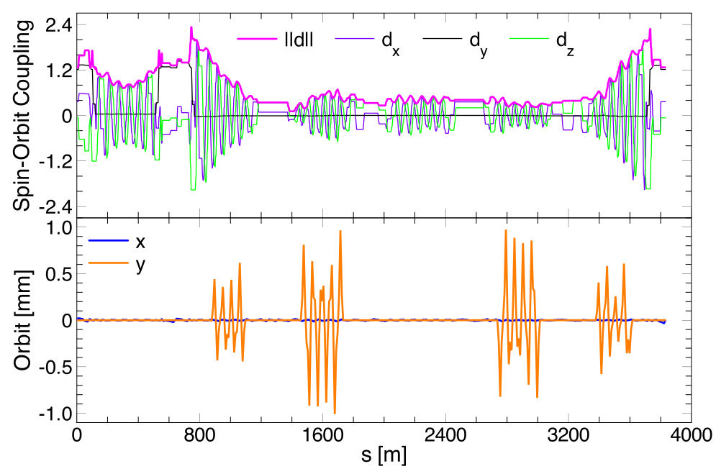
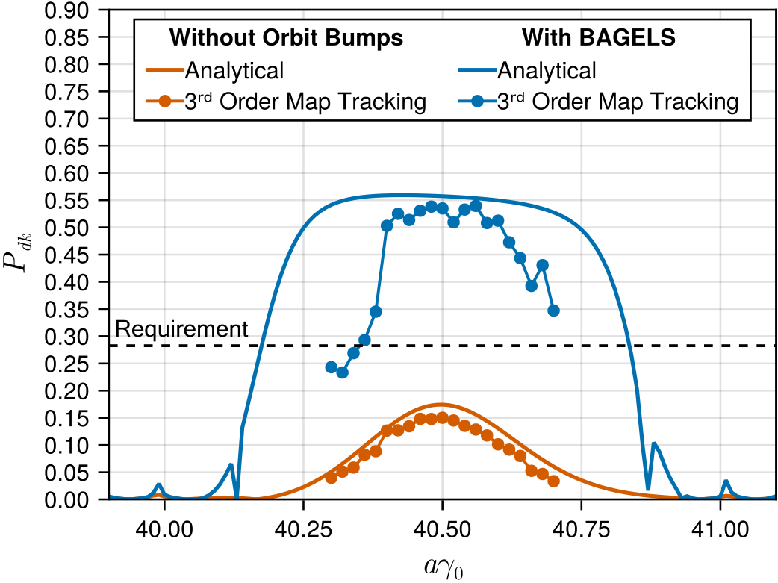
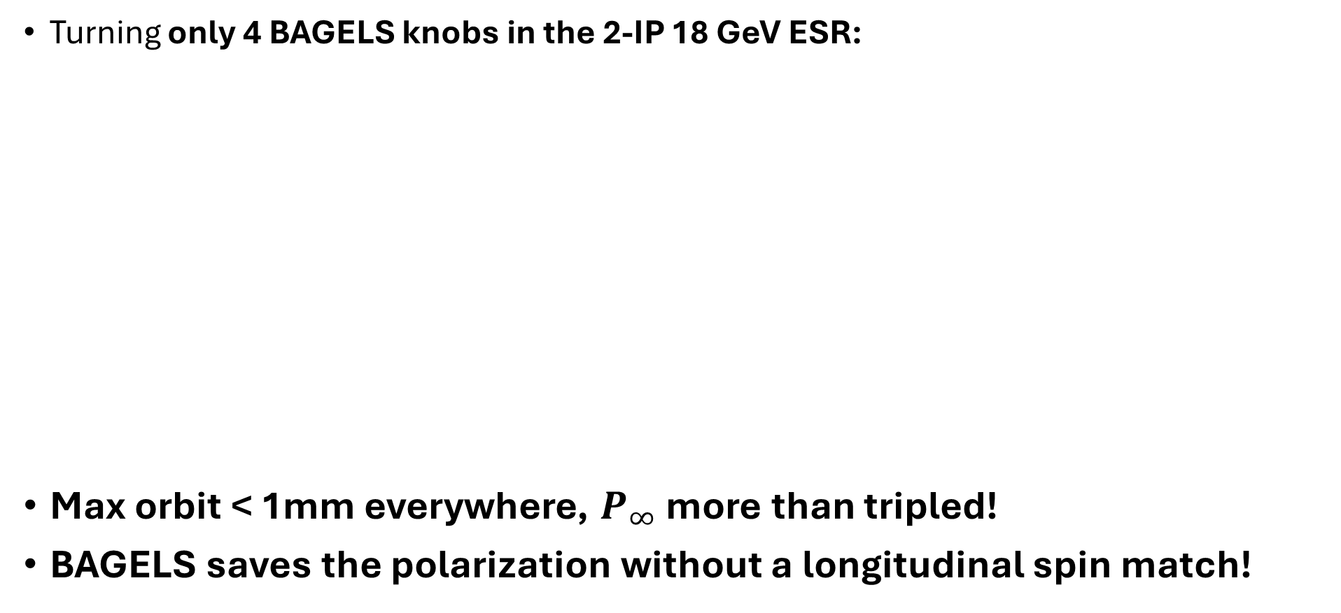
BAGELS: 2-IP 18 GeV ESR
Turning only 4 BAGELS knobs in the 2-IP 18 GeV ESR:
Max orbit < 1mm everywhere, $P_{∞}$ more than tripled!
BAGELS saves the polarization without a longitudinal spin match!
Notes:
Monte carlo tracking result
Go slow here, talk about right plot

Slide 30
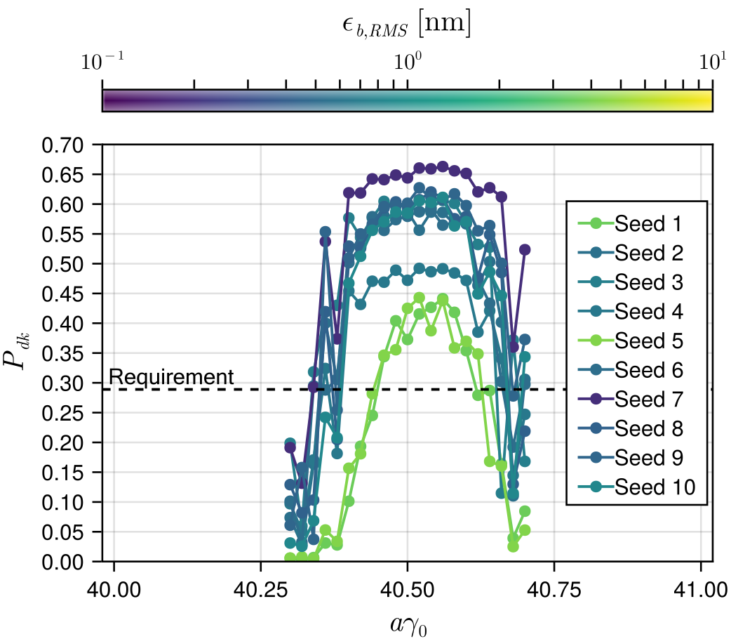
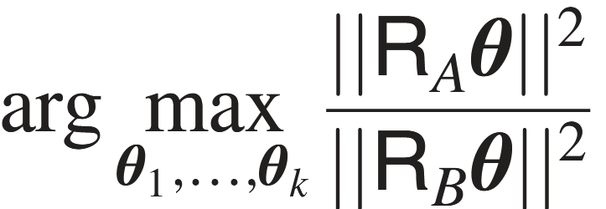


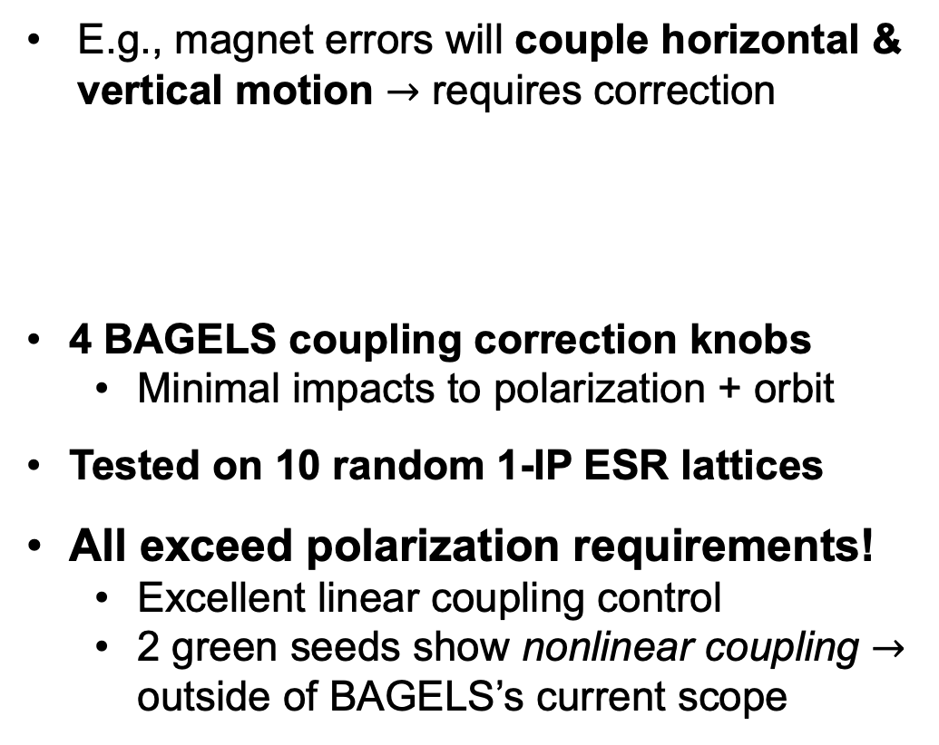

BAGELS: Polarization-Safe Error Correction
We can also use BAGELS to do something else and NOT affect polarization
E.g., magnet errors will couple horizontal & vertical motion $→$ requires correction
4 BAGELS coupling correction knobs
  Minimal impacts to polarization + orbit
Tested on 10 random 1-IP ESR lattices
All exceed polarization requirements!
  Excellent linear coupling control
  2 green seeds show nonlinear coupling $→$ outside of BAGELS’s current scope
$→$ Measure of coupling
= coupling matrix
= orbit y AND $\vec{d}$
Notes:
GO SLOWLY HERE. NOW d goes on BOTTOM
THIS SLIDE WILL TAKE 2-3 minutes
DESCRIBE PLOT IN DETAIL AND WHAT COLORS MEAN

Slide 31




BAGELS: Polarization-Safe Beam Size Match
What else can BAGELS do?
Remember the vertical spin match in the ESR?
Electron vertical beam size $σ_{y}$ is naturally ~zero, so we ignored this
To maximize collisions with the ions, we must increase $σ_{y}$ to match the ion beam
One way is to create vertical dispersion $η_{y}$
Slide 21
Vertical orbit excited with photon emission
Can be made using vertical orbit bumps
Will damage polarization if not careful
Must have $η_{y}=η_{y}′=0$ at the IP
$$\hat{y}$$
Notes:
Just know that the amount of photons emitted in the vertical correlated to vertical dispersion

Slide 32



BAGELS: Polarization-Safe Beam Size Match
Let’s apply BAGELS here:
Obtain 1 BAGELS polarization-safe beam-size matching knob, turn to achieve $σ_{y}$:
= vertical dispersion $η_{y}$ around the ring
= orbit y, spin-orbit coupling $\vec{d}$, $η_{y}, η_{y}′$ at the IP
Requirements exceeded with beam size match!
Notes:
Just know that the amount of photons emitted in the vertical correlated to vertical dispersion

Slide 33

Conclusions
EIC-ESR will provide 5, 9, 18 GeV spin-polarized electrons
Without longitudinal spin match, 18 GeV polarization is marginal, but…
Novel Best Adjustment Groups for ELectron Spin (BAGELS) method:
  Nearly doubles $P_{∞}$ in the 1-IP
  More than triples $P_{∞}$ in the 2-IP
  Provides knobs for correcting polarization in real life
  Provides polarization-safe knobs to correct coupling due to errors
  Provides polarization-safe knobs for beam-size matching
Notes:
1 min

Slide 34








New Software: SciBmad
New, CPU/GPU-accelerated, forwards-/ backwards-/ Taylor-differentiable accelerator physics code
Full suite of nonlinear analysis tools for design, e.g:
And super fast symplectic tracking:
18 GeV EIC-Electron Storage Ring DA
6,271 lattice elements
20,746 particles (64-bit precision)
2,000 turns including radiation damping
One resonance normal form
n^{th} order resonance driving terms / detune coefficients
Invariant spin field expansions
Amplitude-dependent tunes
8.2 minutes on one GPU

Slide 35



New Software: SciBmad
Parallelized over particles AND parameters (“batch” parameters):
  E.g. set a sextupole strength to be 100,000 different strengths:
  Currently being used for dynamic aperture optimization in the EIC-ESR
Arbitrary time-dependent parameters
  E.g., an AC-kicker (perhaps for RDP)
18 GeV EIC-ESR Radiative Depolarization
  6,271 lattice elements
  25,000 particles (64-bit precision)
  5,000 turns including radiation
100,000 different lattices on one GPU!
Also GPU-parallelized!
36.8 minutes on one GPU

Slide 36

New Software: SciBmad
SciBmad is fully documented and in a production-ready state
  https://bmad-sim.github.io/SciBmad.jl/
Project status is kept up-to-date
Currently being used in EIC design

Slide 37
Acknowledgements
Excited to have contributed significantly to the EIC during my PhD
Work would not have been possible without the help of many
Georg H. Hoffstaetter de Torquat
David Sagan
Christoph Montag
Vadim Ptitsyn
J. Scott Berg
Desmond P. Barber
Mike Blaskiewicz
Jorg Kewisch
Daniel Marx
Etienne Forest
Oleksii Beznozov
Laurent Deniau
Joe Devlin
Cornell ERL/EIC Group
All SciBmad contributors
And the rest of the EIC team
Notes:
1 min

Slide 38
Thank you!
Questions?

Slide 39





Backup Slides
N
$\vec{μ}$ = magnetic moment
$$\frac{d\vec{L}}{dt}$$
$$\frac{d\vec{L}}{dt}=\vec{μ}×\vec{B}$$
$$\vec{μ}$$
Magnet will rotate
S
Notes:
South repels south
North repels north

Slide 40








Backup Slides
$$\frac{d\vec{L}}{dt}=\vec{μ}×\vec{B}$$
N
For single particles,
$$\vec{L}∝\vec{μ}$$
$$\frac{d\vec{μ}}{dt}$$
$$\hat{z}$$
$$\vec{μ}$$
Spin precesses around magnetic fields
$$\frac{d\vec{μ}}{dt}∝\vec{μ}×\vec{B}$$
$$\hat{x}$$
$$\hat{y}$$
S
Notes:
30s

Slide 41







Backup Slides
Intentionally tilt ${\hat{n}}_{0}$ to cancel left-over spin-orbit coupling from rotator and random errors
Use least-invasive vertical orbit bump: “Opposing $π$ pair”
  Delocalized ${\hat{n}}_{0}$tilt, but localized $D_{y}$ and localized coupling
Can we just solve $−{\left(f_{d}\right)}_{0}=R_{d}θ$ for least squares?
  NO! Values for some $θ_{i}$ with little impact will exceed linear response regime
$$f_{d}≈{\left(f_{d}\right)}_{0}+R_{d}θ$$
$$f_{d}=\left(\begin{matrix}d_{1} \\ ⋮ \\ d_{m}\end{matrix}\right), R_{d}=\left(\begin{matrix}\frac{∂d_{1}}{∂θ_{1}} & ⋯ & \frac{∂d_{1}}{∂θ_{n}} \\ ⋮ & ⋱ & ⋮ \\ \frac{∂d_{m}}{∂θ_{1}} & ⋯ & \frac{∂d_{m}}{∂θ_{n}}\end{matrix}\right), θ=\left(\begin{matrix}θ_{1} \\ ⋮ \\ θ_{n}\end{matrix}\right)$$
$d$ at all $m$ bends
All opposing $π$ pair strengths
Linear response matrix $3m×n$

Slide 42

Backup Slides
PCA works well (as shown in all “old” BAGELS method results), but what if we also want to find knobs that minimize the orbit excursions at all elements while maximizing spin-orbit coupling in the bends? E.g., if $R_{y}$ is the response matrix of the orbit at all elements, we seek:
$$\underset{θ_{1},…,θ_{k}}{argmax}{\frac{{\left|\left|R_{d}θ\right|\right|}^{2}}{{\left|\left|R_{y}θ\right|\right|}^{2}}}=\underset{θ_{1},…,θ_{k}}{argmax}{\frac{{θ^{T}R_{d}^{T}R}_{d}θ}{θ^{T}R_{y}^{T}R_{y}θ}}$$
The quotient is called a generalized Rayleigh quotient. This problem can be equivalently expressed as maximizing ${θ^{T}R_{d}^{T}R}_{d}θ$ subject to $θ^{T}R_{y}^{T}R_{y}θ=1$. Letting $A=R_{d}^{T}R_{d}$ and $B=R_{y}^{T}R_{y}$
$$ℒ=θ^{T}Aθ+λ\left(θ^{T}Bθ−1\right). → \frac{∂ℒ}{∂θ}=2Aθ−2λBθ → Aθ=λBθ$$
Best Adjustment Groups for ELectron Spin are those generalized eigenvectors $v_{i}$ of $A$ and $B$ with largest eigenvalues! Use these to solve$−{\left(f_{d}\right)}_{0}=\tilde{R_{d}}w$

Slide 43




Backup Slides
One way to correct global delocalized coupling caused by random errors is with vertical orbits through the sextupoles, to create delocalized coupling which cancels out that leftover
Using the BAGELS method, we can calculate bumps which maximally impact the coupling $\overline{C}$ matrix components at all elements, while minimally impacting the spin-orbit coupling function at the bends and orbit excursion at all elements!
Basis bump which generates delocalized coupling only
“Equal $π$ pair”. Now seek:
Equal $π$ pair
$\underset{θ_{1},…,θ_{k}}{argmax}{\frac{{θ^{T}{\overline{R}}_{A}^{T}\overline{R}}_{A}θ}{θ^{T}{\overline{R}}_{B}^{T}{\overline{R}}_{B}θ}}$ where $R_{A}=R_{\overline{C}} , R_{B}=\left(\begin{matrix}R_{d}/\left|\left|R_{d}\right|\right| \\ R_{y}/\left|\left|R_{y}\right|\right|\end{matrix}\right)$
These knobs are the Best Adjustment Groups for ELectron Spin for global coupling correction using vertical orbit bumps!

Slide 44






Backup Slides
Another way to generate vertical emittance is with delocalized vertical dispersion so that a vertical amplitude is excited when a photon is emitted
Specifically we seek to maximize in the bends
Using the BAGELS method, we can calculate bumps which maximally create ${\overline{η}}_{b1},{\overline{η}}_{b2}$ in the bends while minimally impacting the spin-orbit coupling function at the bends and the orbit excursion at all elements, and generating no delocalized coupling
Basis bump which generates delocalized $η_{b}$ only
“2$π$ pair”. Now seek:
$2π$ bump
$\underset{θ_{1},…,θ_{k}}{argmax}{\frac{{θ^{T}{\overline{R}}_{A}^{T}\overline{R}}_{A}θ}{θ^{T}{\overline{R}}_{B}^{T}{\overline{R}}_{B}θ}}$ where $R_{A}=R_{({\overline{η}}_{b1},{\overline{η}}_{b2})} , R_{B}=\left(\begin{matrix}R_{d}/\left|\left|R_{d}\right|\right| \\ R_{y}/\left|\left|R_{y}\right|\right|\end{matrix}\right)$

