Slide 1
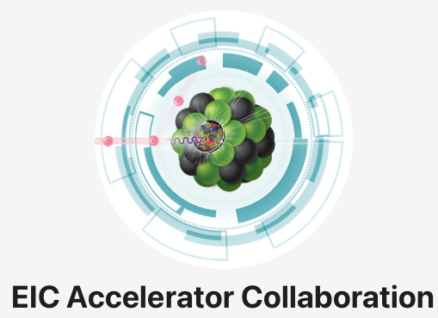

EIC Interaction Regions WG Kickoff
L. van Riesen-Haupt, T. Satogata

Slide 2
Overview of Scope
EIC Accelerator Collaboration
  Complement core project
  In close exchange with core project
Aim: Maximize realistic performance
  Improve realistic performance of primary IR
    Building on baseline project design
  Develop and maintain design for possible second IR
Maximized EIC Performance
Instrumentation
Corrections
Tradeoffs
Core EIC Project

Slide 3

Flight Simulator
Realistic high fidelity simulation backbone of efforts
Evaluating performance
  Luminosity, lifetime, polarization
  Under detector background and protection, and operational constraints
Applying perturbations
  Inherent e.g. detector magnets
  Errors e.g. magnet and alignment
Realistic measurements corrections

Slide 4
IR Measurements and Corrections
Establish measurement performance
  Test techniques e.g. beam sizes and dispersion in IP, emittance, polarization
  Establish resolutions and tolerances (and work arounds)
Develop corrections
  Implement and test individual correction methods
    Orbit, optics, tuning knobs, non-linear corrections
  Develop integrated correction strategy
    Possible AI driven approach
Prepare for operation
  Practice techniques for operation
  Build digital twin for online corrections

Slide 5
Instrumentation
Hardware extremely constrained
  Baseline layout of interaction region set
  Congested real estate needs of accelerator and detector
Open questions remain on placement instrumentation
  Monitors, correctors, magnet trims, lumi-meter…
Purposeful placement based on maximized utility
  Evaluate full performance under different configurations
  Consider hardware performance and establish needs
  Possible co-design approach using machine learning

Slide 6
Performance Targets and Trade-offs
Tie in nuclear physics community to establish targets
  Raw luminosity
  Reliability and fluctuations
  Spin requirements
  Special requirements e.g. luminosity calibration via van-der-Meer
Understand limits and trade-offs and communicate to stake holders
  Nuclear physics community
  Core accelerator project
Ensure efforts align with expectations of community

Slide 7
Second Interaction Region
Second IR outside of core EIC project
  Upgrade option to realize full performance potential
Baseline design exists for IR 8
  Substantial differences to first IR e.g. second low beta
Project optimization leads to move to IR 12
  New geometry and timing requirements etc.
Larger freedom to redesign second IR
  Possible co-design powered by flight simulator
Eventually apply same correction strategy as first IR

Slide 8
Actions
Shorter term actions
  Simulate key performance indicators under realistic conditions without corrections
  Establish understanding of project baseline hardware placement
  First implementations of single corrections
Longer term actions
  Optimize hardware and corrections simultaneously
  Develop integrated correction strategies
  Establish trade-offs and align direction with communities

