Slide 1
AI4EIC workshop summary
Kevin Brown & Weijian (Lucy) Lin
EIC-Beam AI WG meeting
July 28, 2026

Slide 2
AI4EIC workshops: 2021 — 2025
1st AI4EIC (virtual), Sep 7-10, 2021, Center for Frontiers in Nuclear Science, Stony Brook, NY
2nd AI4EIC, Oct 10- 14, 2022, William & Mary, Williamsburg, VA
3rd AI4EIC, Nov 28-Dec 1, 2023, Catholic University of America, Washington, D.C.
Joint Session between AI4EIC and Streaming Readout, Dec 2-4, 2024, Streaming Readout Workshop SRO-X
4th AI4EIC, Oct 27-Oct 30, 2025, IAIFI/MIT, Boston, MA

Slide 3
1st AI4EIC: AI for Accelerator Design – Todd Satogata, Yue Hao
Motivation
EIC design requires balancing many competing objectives including luminosity, beam stability, dynamic aperture, beam-beam effects, cooling, and engineering constraints.
Traditional optimization becomes computationally prohibitive because of nonlinear beam dynamics and large parameter spaces.
AI opportunities
Surrogate models to replace expensive beam dynamics simulations
Bayesian optimization and Gaussian Processes for accelerator parameter optimization
Neural networks and XGBoost for modeling machine performance
Reduced-order models and feature extraction for high-dimensional parameter spaces
Early demonstrations
Dynamic aperture prediction using surrogate models
Beam-beam interaction modeling
Machine tuning with LEReC/RHIC operational data
AI-assisted luminosity prediction and parameter ranking

Slide 4
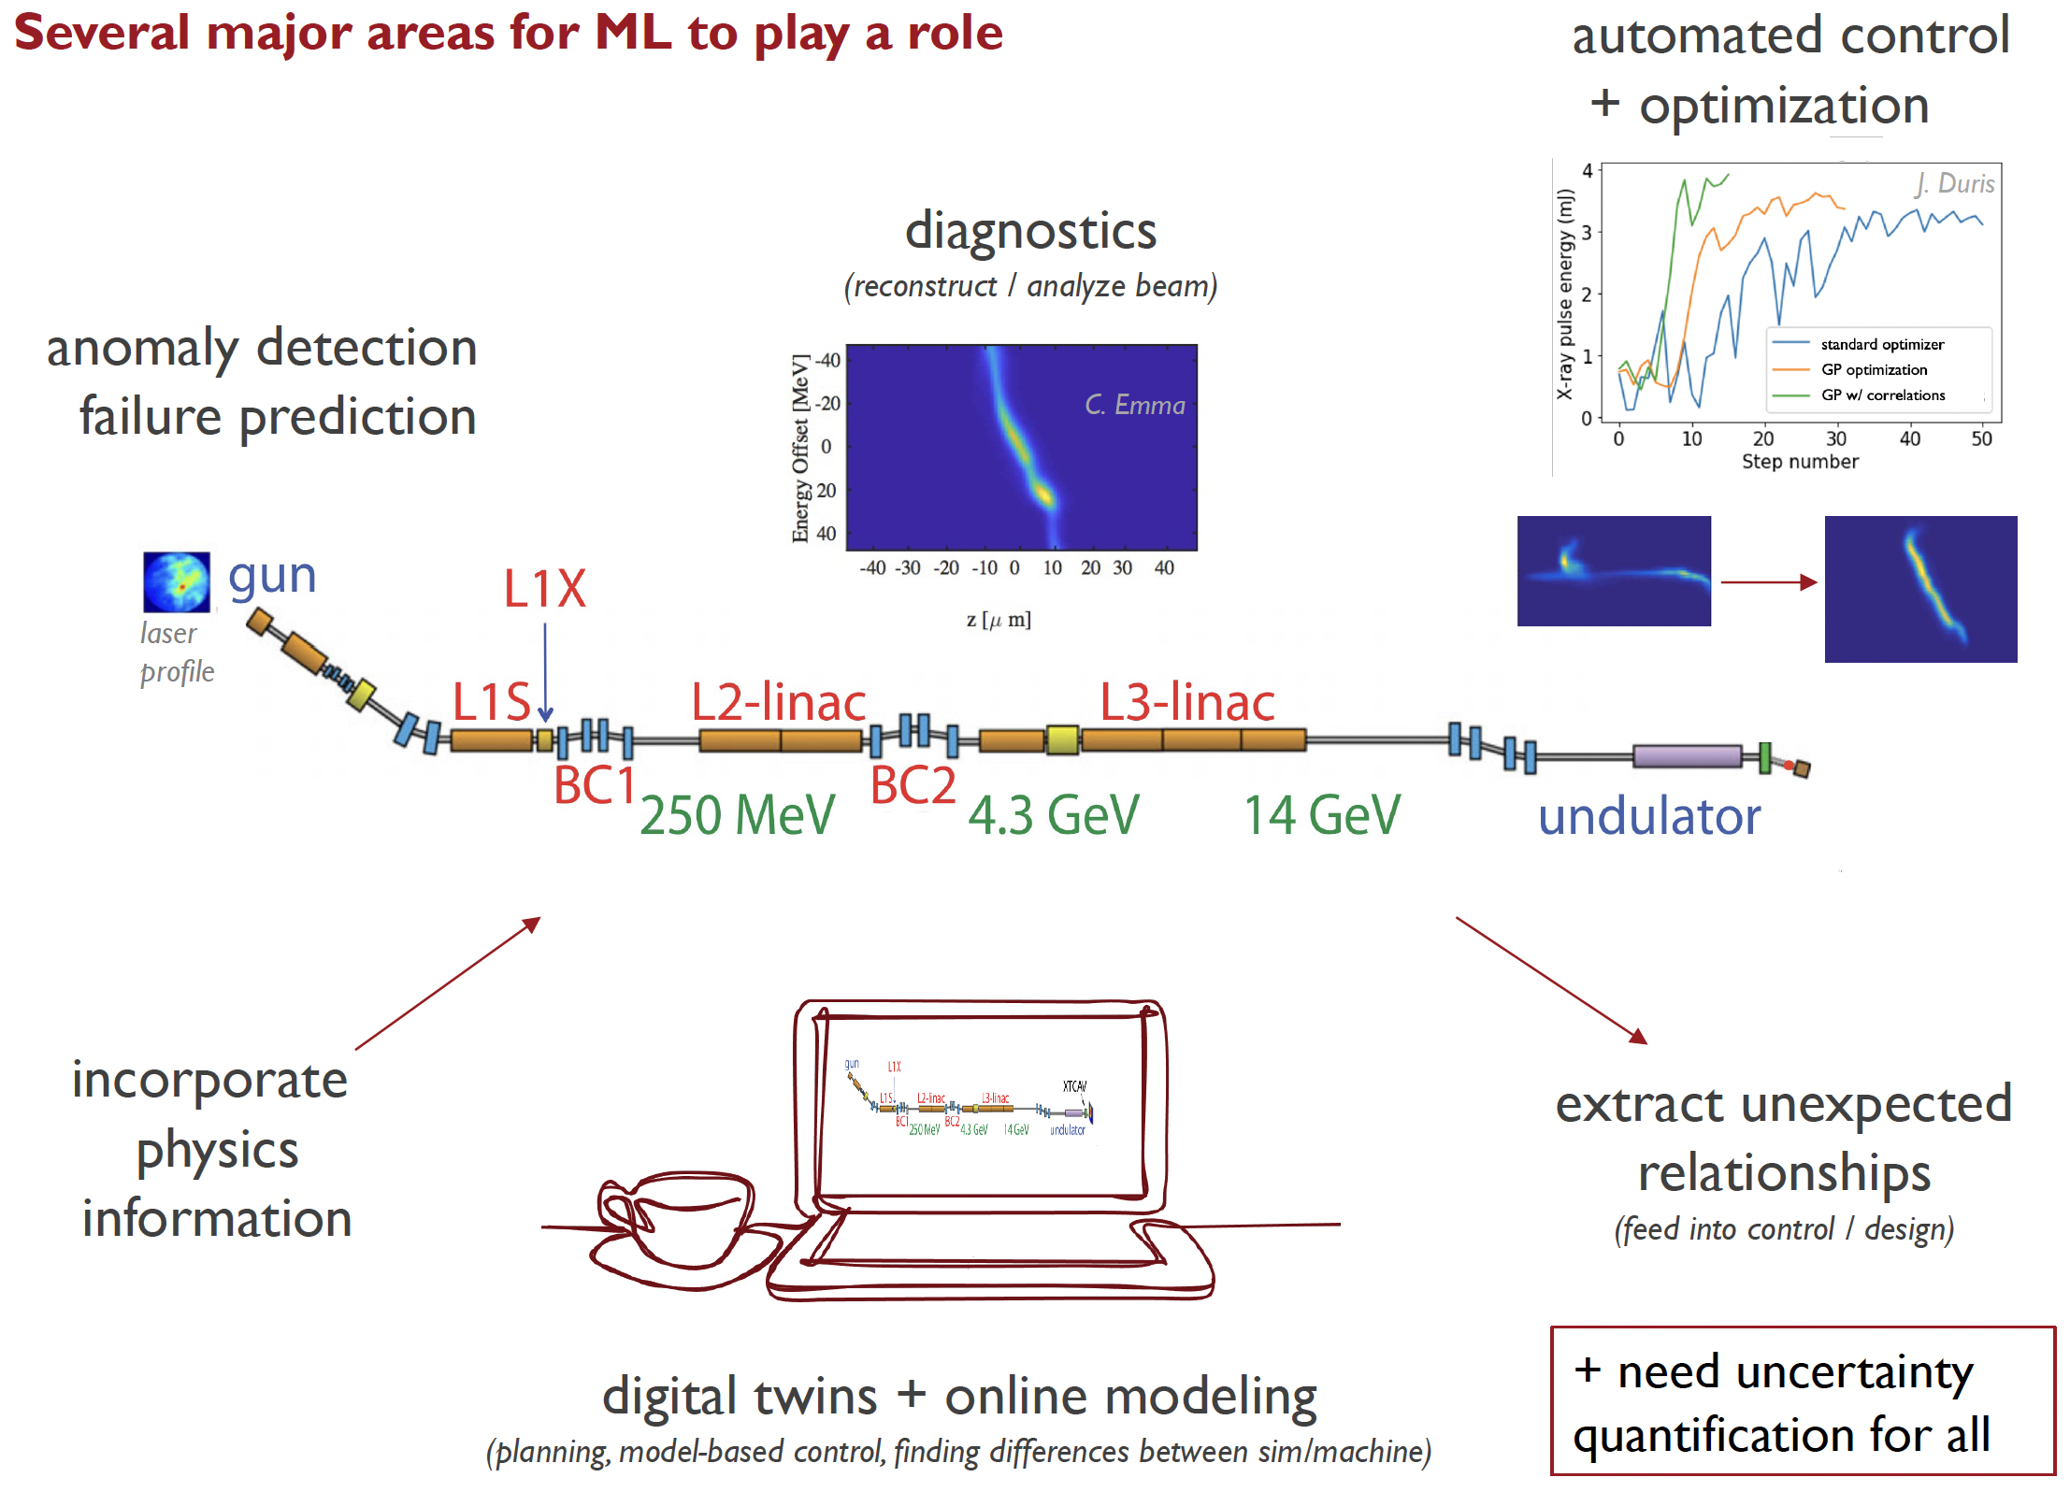
1st AI4EIC: Accelerator Control – Auralee Edelen
Motivation
Accelerator control involves nonlinear, time-varying systems with hundreds of controllable variables and diagnostics.
Manual tuning is costly and limits facility availability and scientific output.
Fast, accurate machine models are needed for real-time decision making and automation.
Emerging AI capabilities
ML surrogate models & digital twins
AI-assisted optimization
Virtual diagnostics
Machine health monitoring

Slide 5
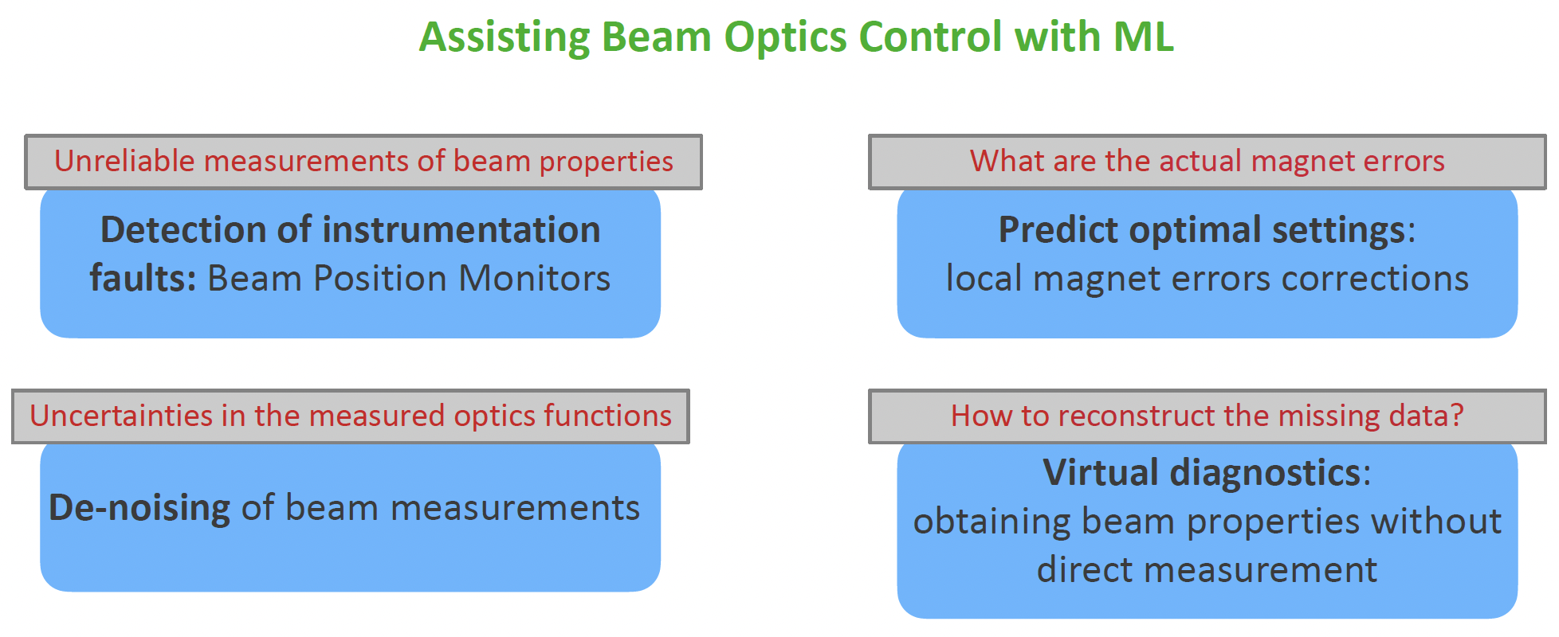
2nd AI4EIC: ML for LHC – Elena Fol
Fault detection
  Automatic identification of faulty BPMs using Isolation Forest
  Eliminated much of the manual data cleaning before optics analysis
Optics correction
  ML reconstructed quadrupole field errors from optics measurements
  Enabled simultaneous correction of multiple interaction regions during LHC commissioning
Virtual diagnostics
  Predicted optics quantities without dedicated measurements
  Reduced measurement time from minutes to seconds
Measurement enhancement
  Autoencoder-based denoising improved optics reconstruction
  Reinforcement learning explored for future HL-LHC optics control

Slide 6
2nd AI4EIC: AIML for Design – Todd Satogata
Established AI workflows
Multi-objective genetic algorithms (MOGA) for accelerator component optimization
Surrogate models for computationally expensive design studies
Human-guided optimization remains essential near design singularities and engineering constraints
Emerging Community vision (2022)
End-to-end virtual accelerators and digital twins
  Integrated modeling across the full accelerator lifecycle
AI-enabled design ecosystem
  Physics-informed surrogate models
  Advanced algorithms for nonlinear optimization
  HPC-enabled large-scale design-space exploration
Open software and data infrastructure
  Community frameworks
  Benchmark datasets
  Sustainable software ecosystem

Slide 7
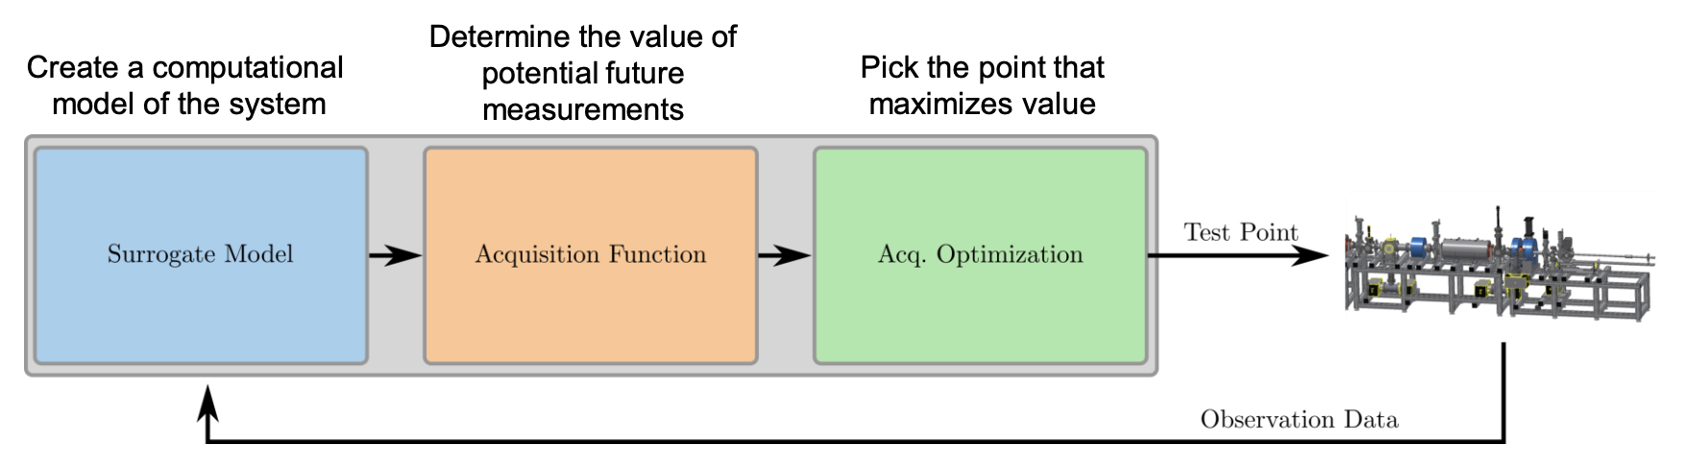
3rd AI4EIC: AI for Online Optimization and Accelerator Control
Talks
Bayesian Optimization Techniques for Accelerator Control and Characterization – Ryan Roussel
Machine Learning applications for collider luminosity maximization – Ji Qiang
Reinforcement Learning applications at Jlab – Malachi Schram
Main Messages
Bayesian optimization becoming the preferred online tuning algorithm
Multi-objective optimization for machine performance
Reinforcement learning beginning to be explored for sequential control
Human-guided optimization transitioning toward autonomous optimization

Slide 8
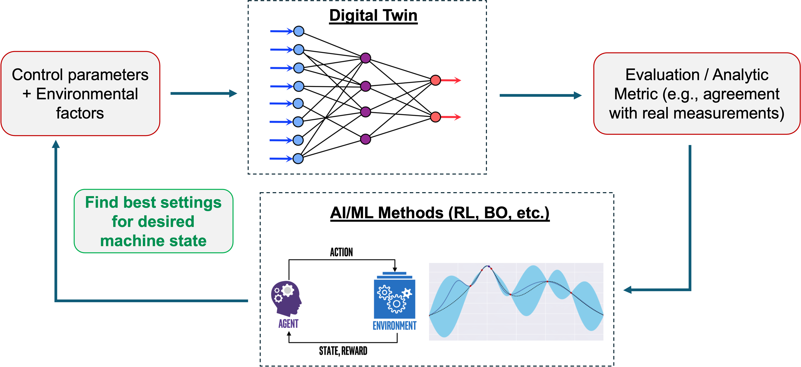
3rd AI4EIC: Digital Twins and Predictive Modeling
Talks
Digital twin development and polarization optimization at BNL – Lucy Lin
Beam Condition Forecasting at FACET-II – Matt Kilpatrick
Uncertainty estimation at JLab – Malachi Schram
Main Messages
Digital twins becoming operational tools rather than future concepts
Predictive ML models forecasting future machine behavior
Physics-informed models combined with uncertainty estimates
Growing emphasis on trustworthy AI

Slide 9
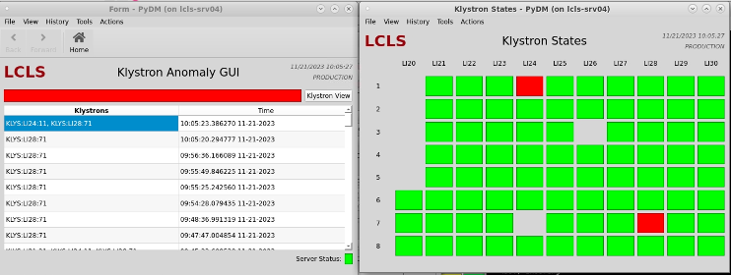
3rd AI4EIC: AI-enhanced Diagnostics and Beam Physics
Talks
Anomaly detection at an X-ray FEL – Daniel Ratner
Machine Learning to Improve Dynamic Aperture Estimates – Frederik Van der Veken
Main Messages
ML extracting information from complex diagnostics
Automatic anomaly detection
Surrogate models accelerating expensive beam physics calculations
AI supporting accelerator physics analysis in addition to control

Slide 10
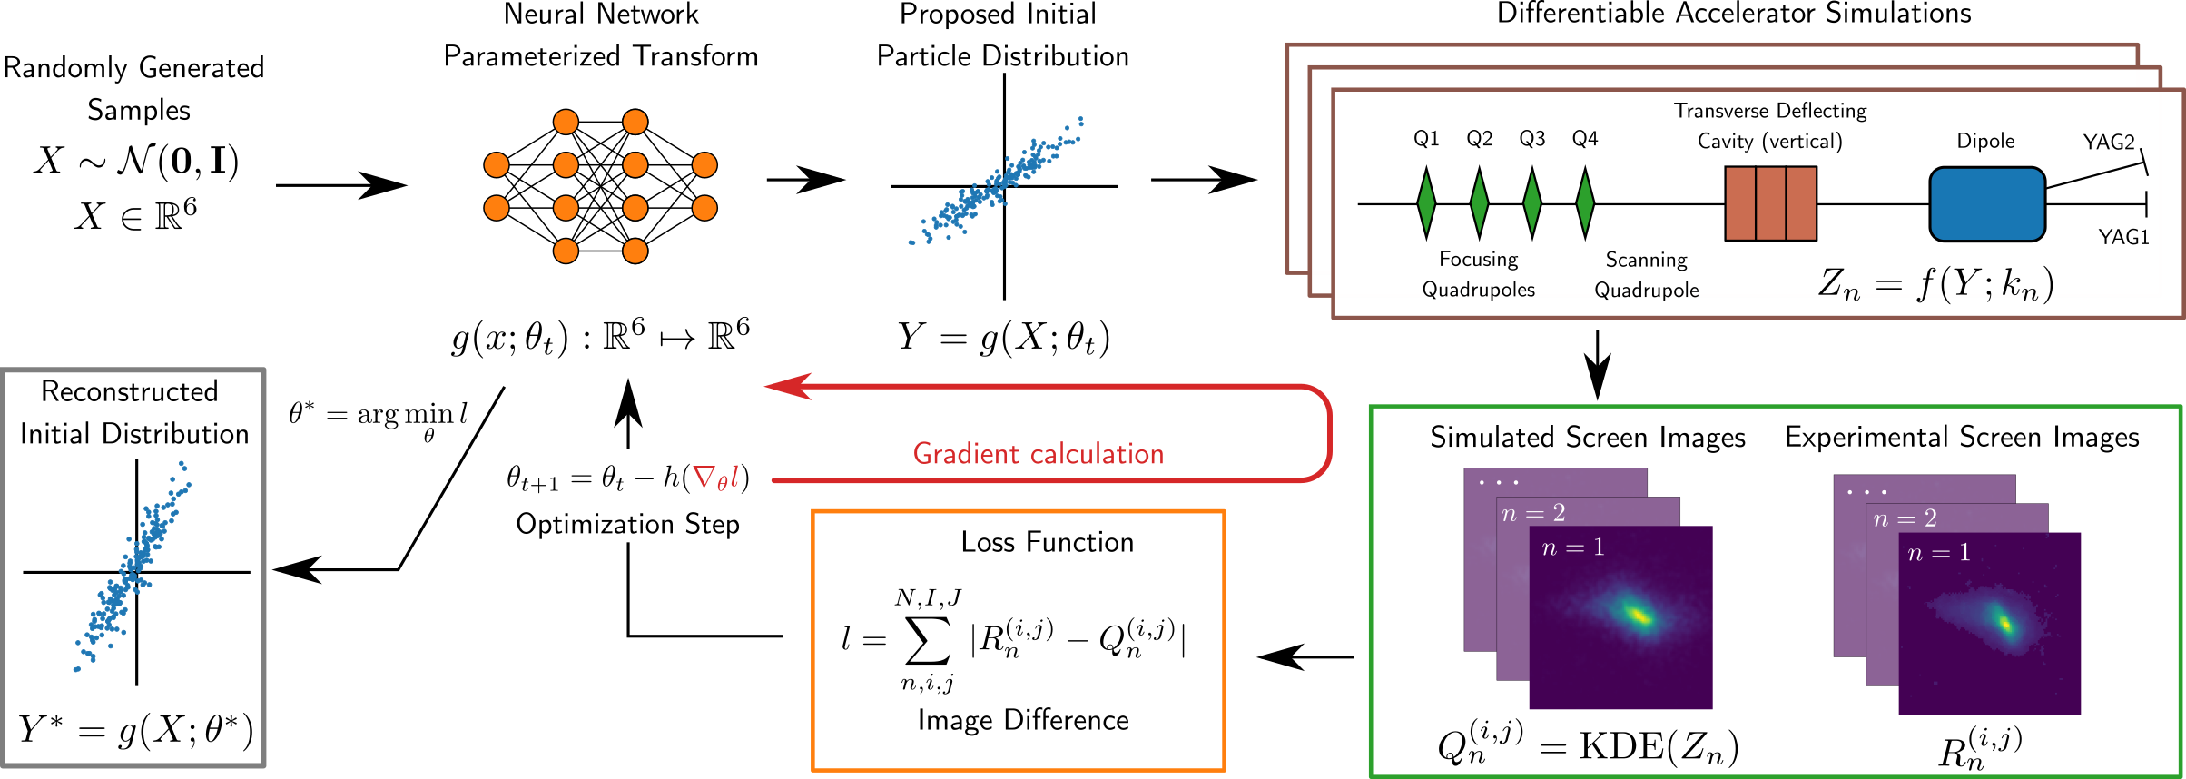
4th AI4EIC: Differentiable AI for Accelerator Modeling
Talks
Explainable and Differential Reinforcement Learning for Multi-Objective Optimization – Kishansingh Rajput
Differentiable beam dynamics codes – Chenran Xu
Symplectic machine learning model for fast space-charge simulation – Jinyu Wan
Main Points
Differentiable beam dynamics enables gradient-based optimization
Physics-preserving ML (symplectic networks) improves simulation fidelity
Explainable RL addresses multi-objective optimization while maintaining interpretability
Shift from black-box surrogate models toward physics-aware AI

Slide 11
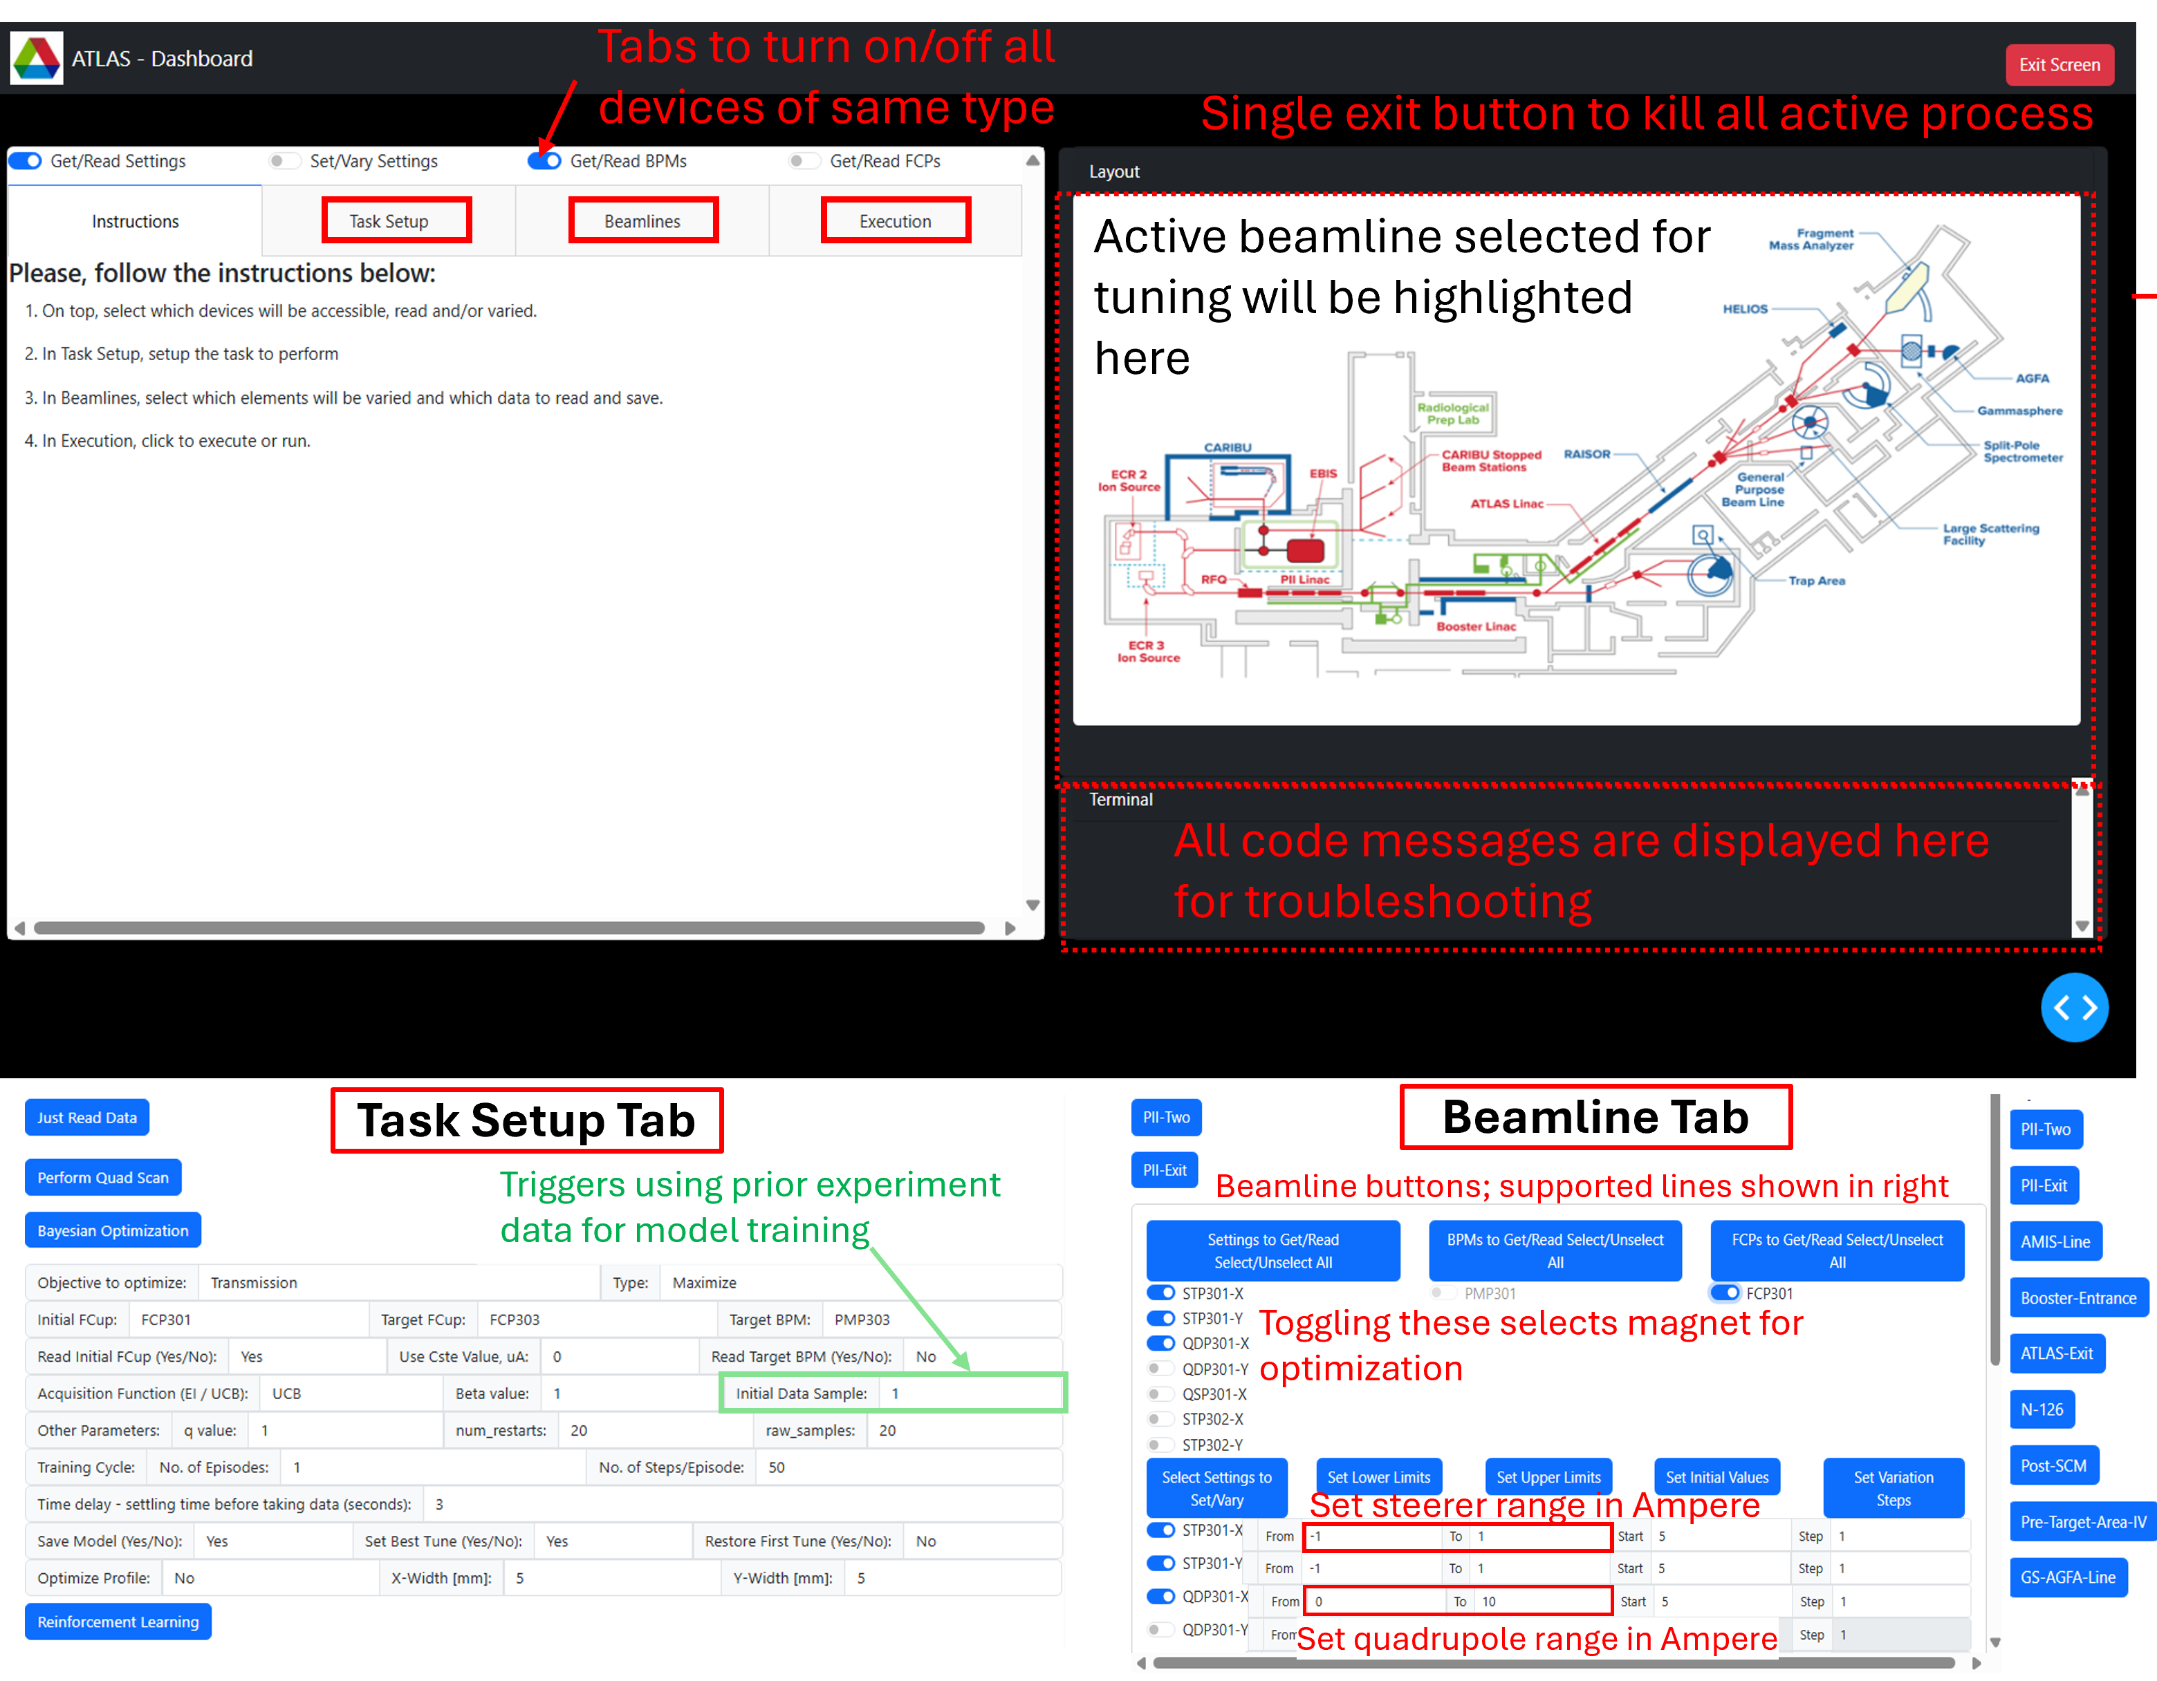
4th AI4EIC: Digital Twins Development
Talks
Framework for the Development of Virtual Accelerator Models – Adwaith Ravichandran
ML-Accelerated Bayesian UQ – Christopher Kelly
AI/ML for higher brightness and polarization – Eiad Hamwi
Improved Ion Profile Monitor Measurements – Christopher Hall
Main Points
Standardized frameworks for virtual accelerators
Bayesian uncertainty quantification for trustworthy digital twins
Digital twins supporting online optimization and control
Improved diagnostics provide higher-quality inputs for AI models

Slide 12
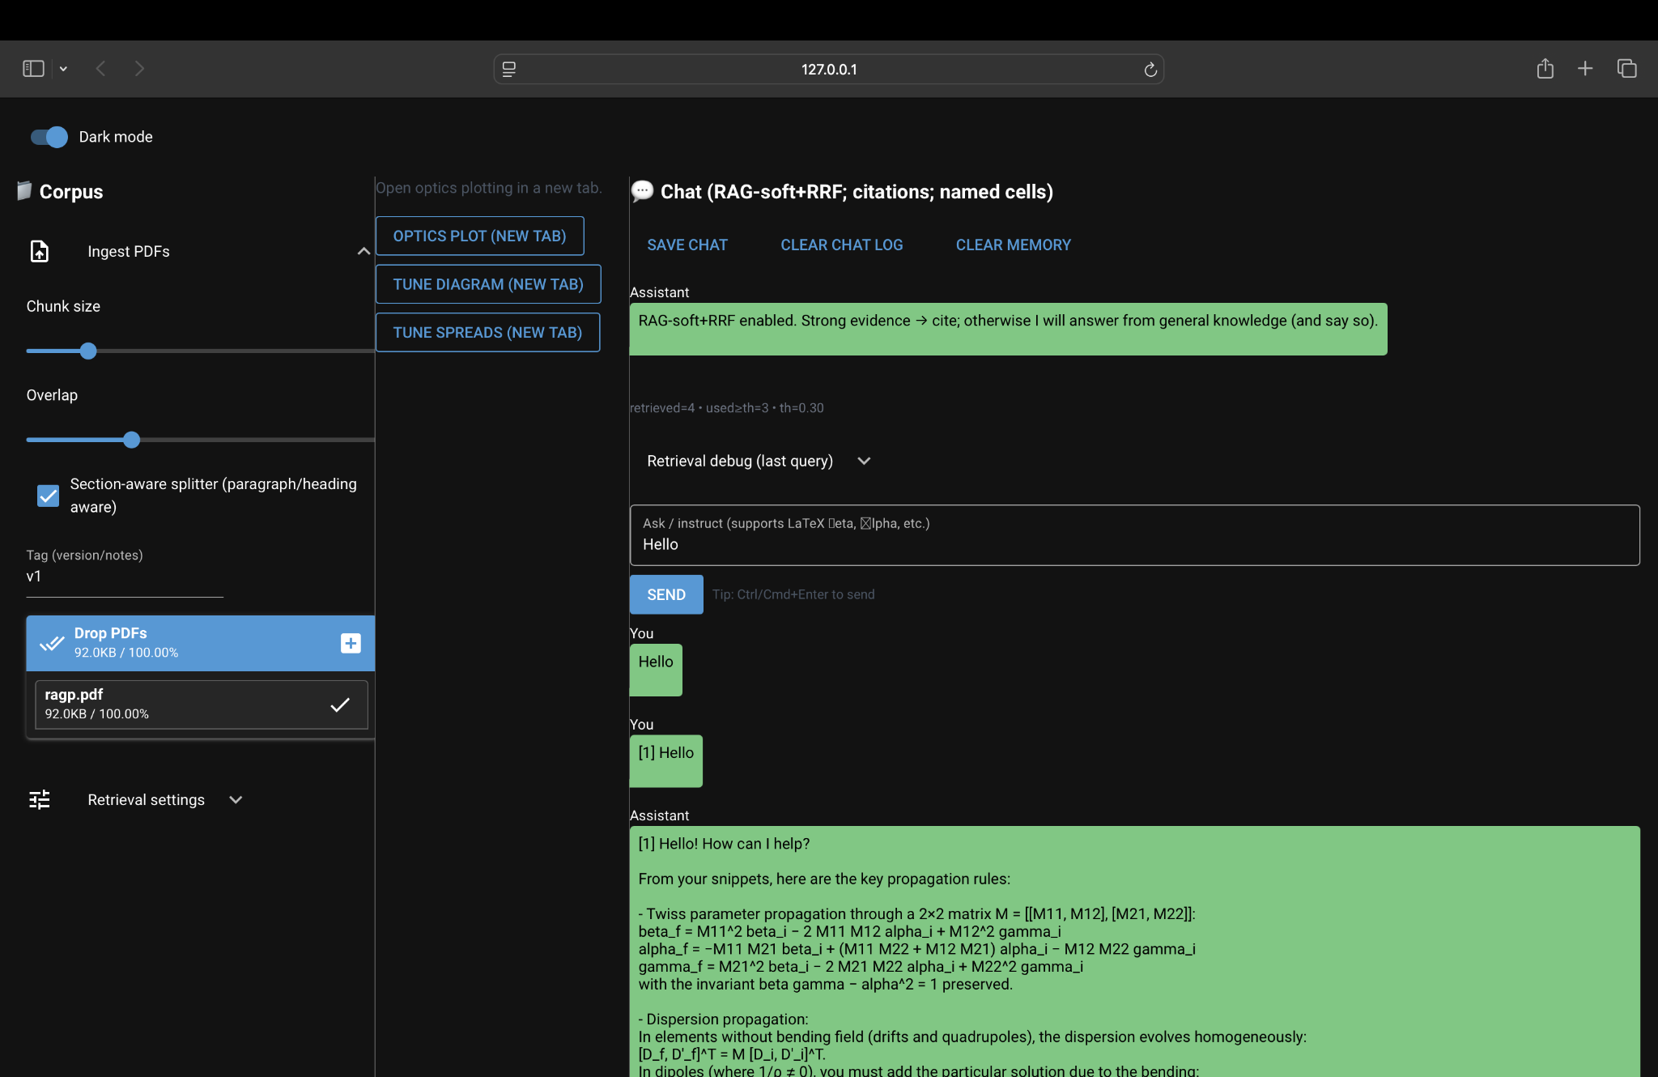
4th AI4EIC: Foundation Models and Generative AI
Talks
Use of Generative AI and LLMs for Accelerator Design – Onur Gilanliogullari
Main Points
LLMs begin assisting accelerator design workflows
Natural-language interfaces to simulation and accelerator software
Knowledge extraction from technical documentation
AI agents emerging as workflow orchestrators rather than standalone predictors

Slide 13
Evolution of AI for Accelerators (2021–2025)
Workshop | Main Focus | Representative Technologies
2021 | AI for accelerator design & control | Surrogate models, BO, GP, virtual diagnostics
2022 | AI deployment & community roadmap | LHC applications, digital twins, modeling ecosystem
2023 | AI-assisted accelerator operations | Online optimization, digital twins, forecasting, anomaly detection
2025 | AI-native accelerators | Differentiable physics, trustworthy digital twins, agentic AI
Overall trend: AI evolved from individual algorithms toward integrated AI-native accelerator ecosystems.

