Slide 1
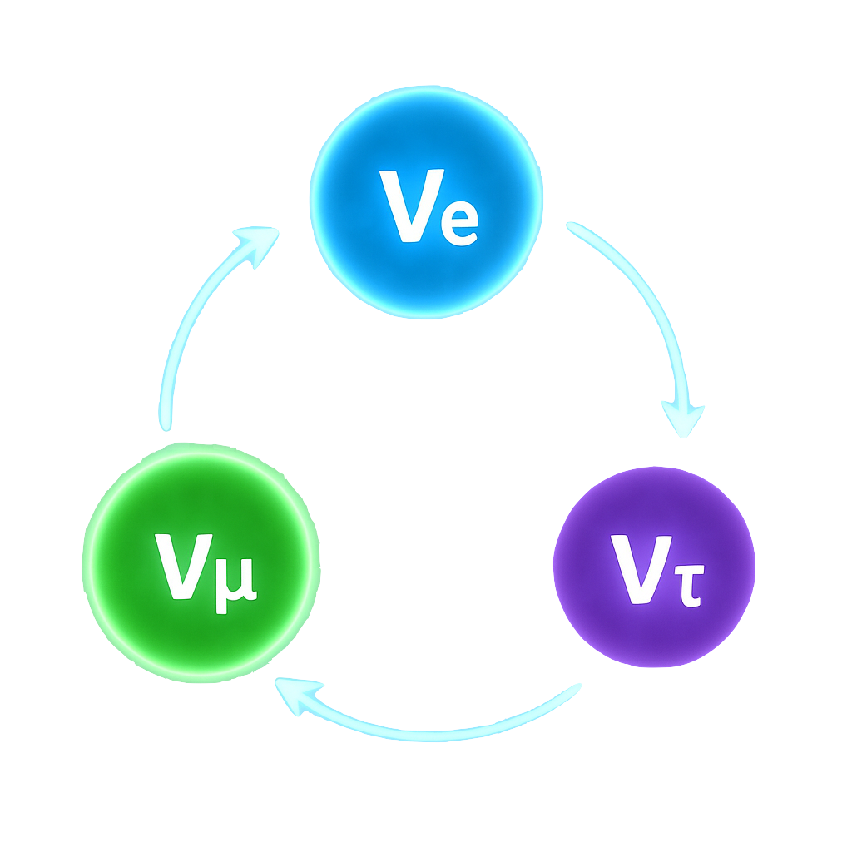
Neutrinos
Anyssa Navrer-Agasson
Imperial HEP Masterclass - 17/07/2026

Slide 2

What we know

Slide 3
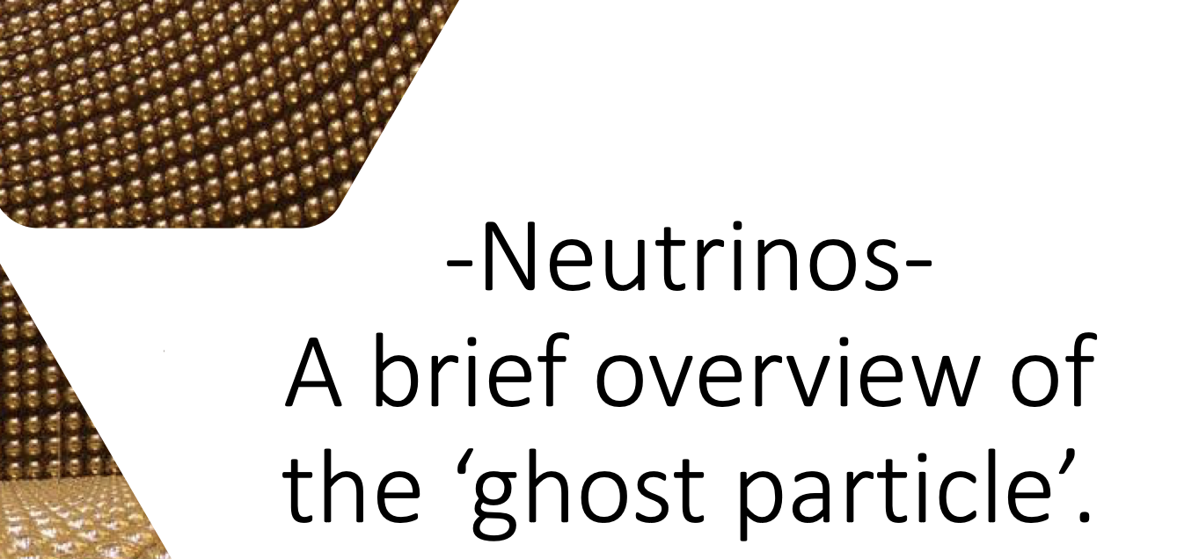

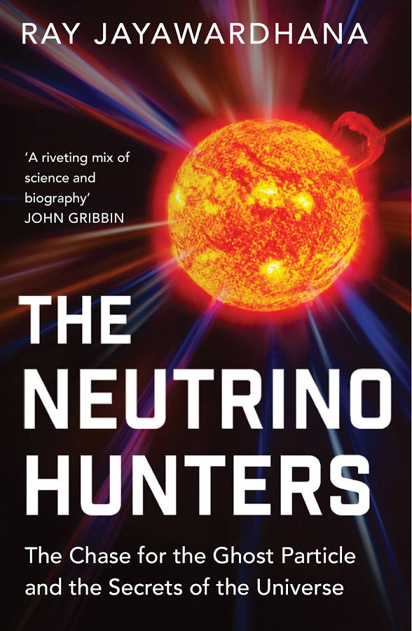
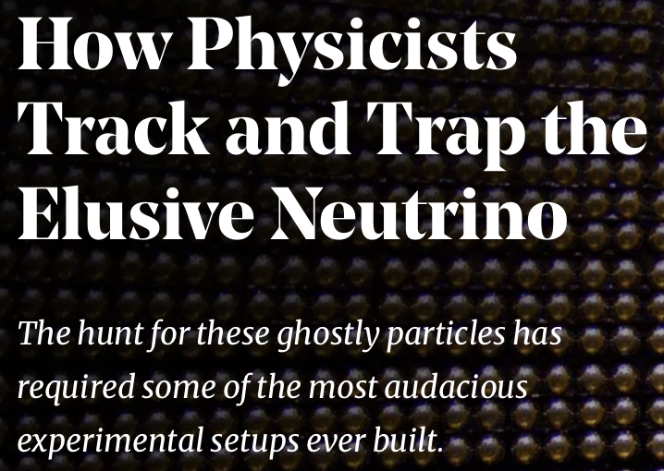

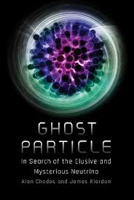


What is a neutrino?
Notes:
If you’ve ever heard about neutrinos before, I bet it was accompanied by the word elusive, or ghost as the book covers and article titles I show here illustrate. Tat’s because one of the main features of neutrinos is they are hard to catch. They interact so weakly with other particles, that 10^10 of lead wouldn’t even stop it .Actually at 60 billion neutrinos pass through the surface area of your thumb nail and you absolutely don’t feel it.

Slide 4
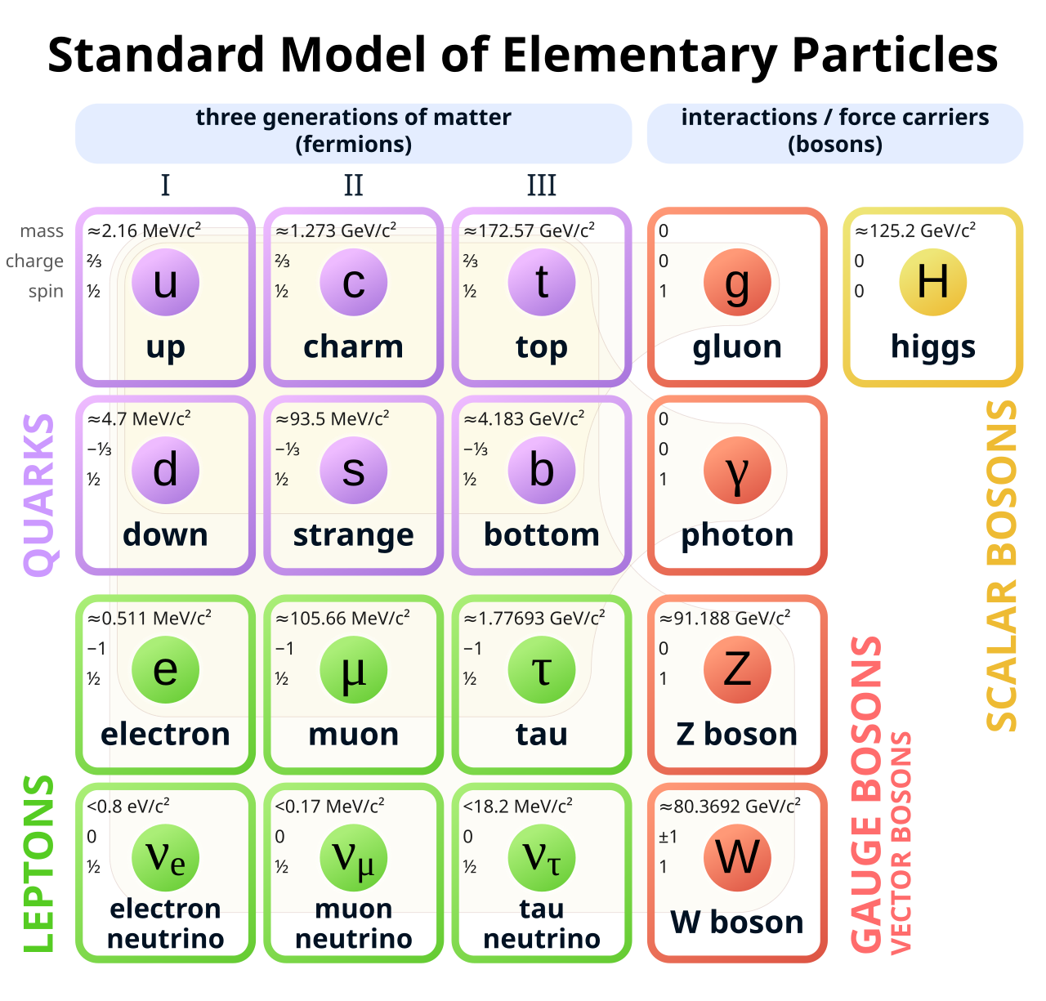
What is a neutrino?
It’s a particle, part of the standard model
There are three types (flavours) of neutrinos
Each associated with a specific lepton
They are neutral (no electric or colour charge)
Only interact via weak force (and gravity)
Produced in nuclear processes
There are A LOT of them:
~65 billion pass through every cm² of your body every second!

Slide 5
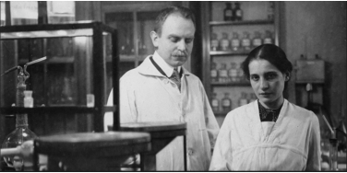
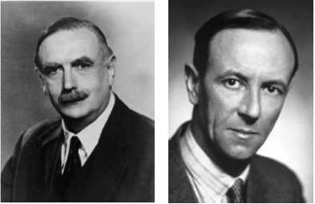
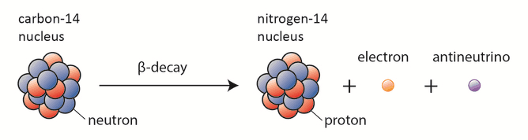
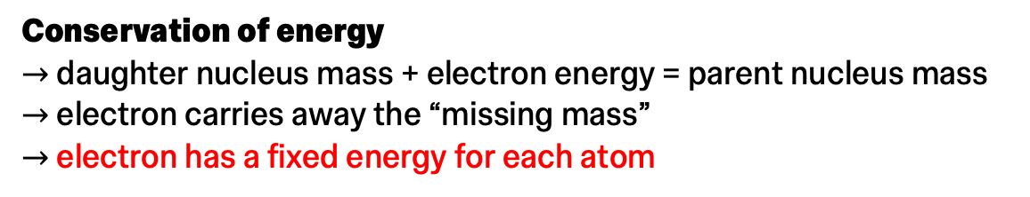
A little history
How did we even figure out neutrinos existed?
Meitner & Hahn
Ellis
Chadwick
Story begins with beta decays
Number of electrons
Observed
Expected
Neutron transforms into a proton, emits an electron
Conservation of energy
$→$ daughter nucleus mass + electron energy = parent nucleus mass
$→$ electron carries away the “missing mass”
$→$ electron has a fixed energy for each atom
Electron energy
How do we explain this?!
Notes:
You might wonder, “how did we even notice neutrinos existed if they have basically no influence on our everyday lives?” Well, you might not notice anything, but a physicist studying matter with high precision will. In particular, you may notice when your experimental results don’t match the theory. In the case of the neutrino, it all comes from radioactive decay experiments

Slide 6
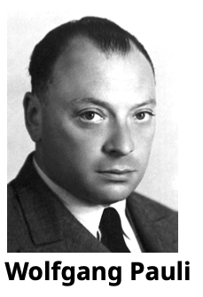
A little history
Two solutions:
    Throw energy conservation out the window
    Beta decay is a 3-body decay and there’s something else we didn’t see!
Correct beta decay
“I have done a terrible thing: I have postulated a
particle that cannot be detected. “
Pauli postulated the latter in a famous letter to the attendees of a conference Tübingen in 1930 — (he was attending a ball at the University of Zurich!!)
“Dear Radioactive Ladies and Gentlemen”
“Desperate remedy to save […] the law of conservation of energy”
“There could exist electrically neutral particles”
Notes:
Now once you postulate the existence of neutrinos, the next step is to try to observe one. But remember they are nototriously hard to catch. So what do wwe do. Well historically, the first observation of neutrinos was done by …..

Slide 7

How to catch a neutrino
As we’ve said before, neutrinos do not interact much with anything
1 light-year of lead would have a 50% chance to stop a neutrino.
In 1934, Enrico Fermi wrote a mathematical description of the $β$-decay with a neutrino
Able to infer the neutrino interaction probability from properties of 𝛽-decay
Neutrinos can create charged, detectable particles
Notes:
We’ve gotten a lot better at this now. Currently, neutrino experiments rely on a few different processes to study them:
Noble liquid TPC
Natural detectors (IceCube)
Water cherenkov

Slide 8
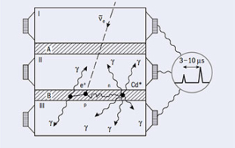
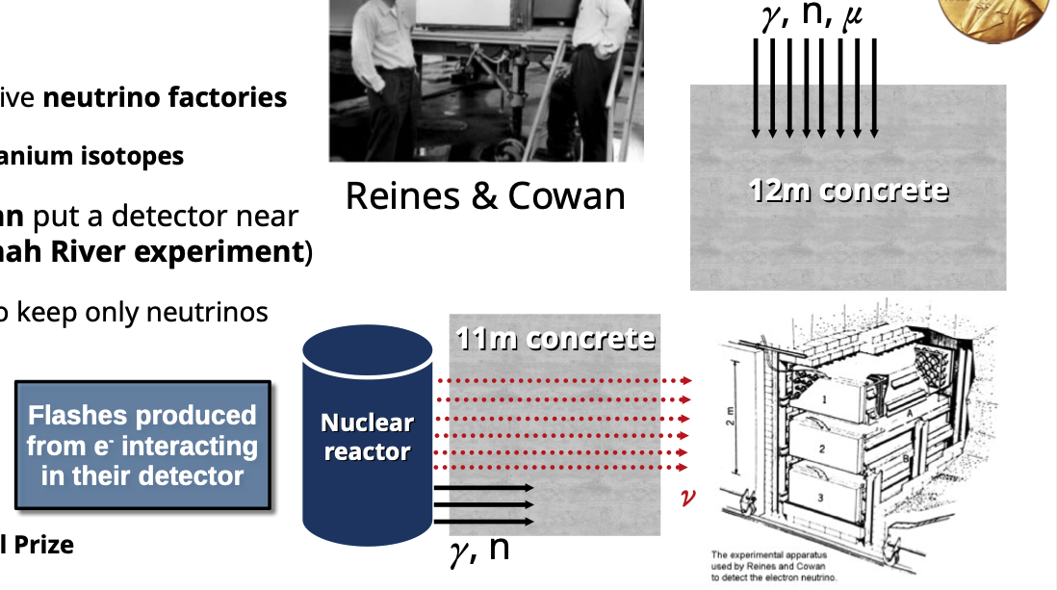

How to catch a neutrino
How do you detect a particle that nearly never interacts?
By creating a lot of them!!
What creates a lot of neutrinos?
Nuclear reactors!!
Brilliant idea:
Rely on the -decays of uranium isotopes in nuclear reactors to observe the first neutrinos
In 1956, Reines & Cowan put a detector near a nuclear reactor (Savannah River experiment)
What they saw:
Reactor ON: flashes
Reactor OFF: no flashes
Discovery won the Nobel prize in 1995
Notes:
We’ve gotten a lot better at this now. Currently, neutrino experiments rely on a few different processes to study them:
Noble liquid TPC
Natural detectors (IceCube)
Water cherenkov

Slide 9
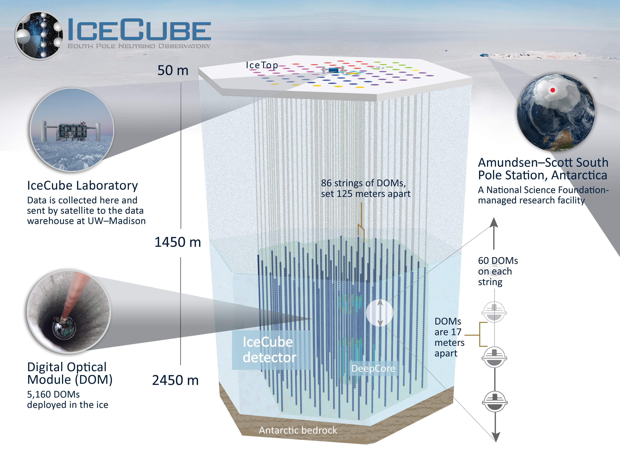
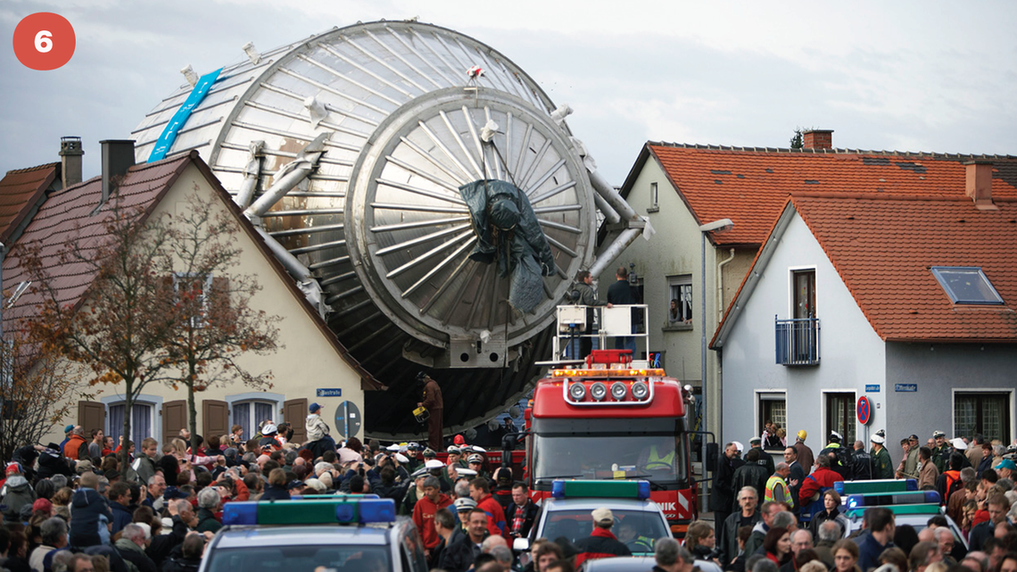
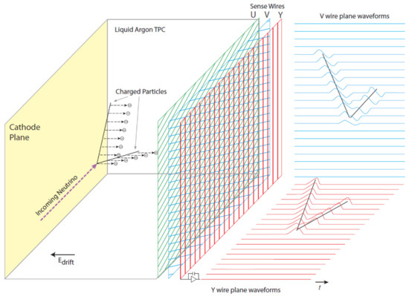
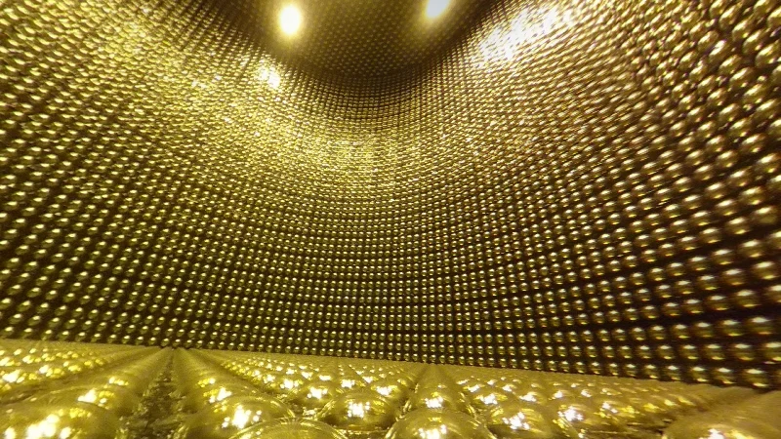
How to catch a neutrino
Modern detectors
Common feature: they are very large!
Notes:
We’ve gotten a lot better at this now. Currently, neutrino experiments rely on a few different processes to study them:
Noble liquid TPC
Natural detectors (IceCube)
Water cherenkov

Slide 10
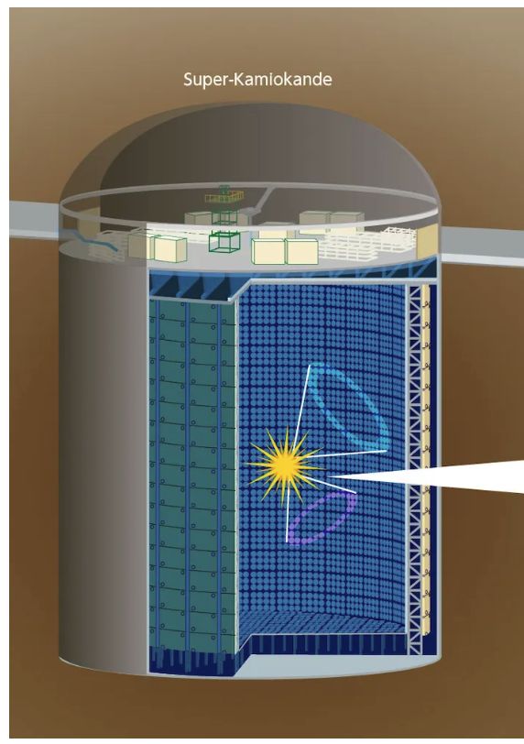
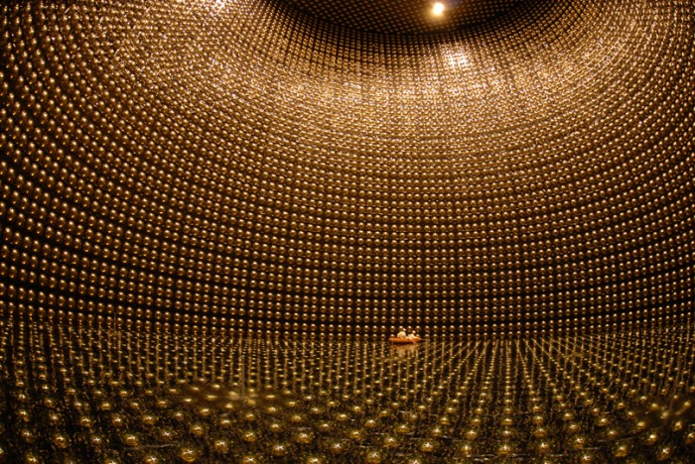
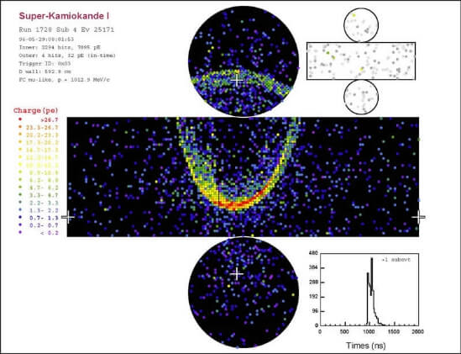
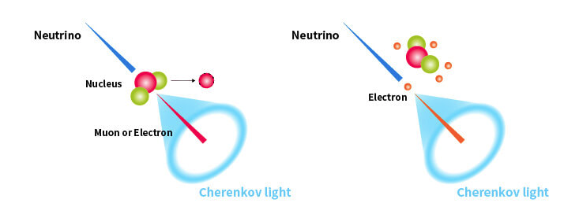
How to catch a neutrino
Modern detectors
Example: Super-Kamiokande
Located in Japan
50, 000 tons of water
Water Cherenkov detectors
Principle:
Large ultra pure water tank
When a charged particle traverses the water, Cherenkov light is emitted
Then collected on photon detectors placed on the walls
Anybody here watched
The three-body problem?
Notes:
We’ve gotten a lot better at this now. Currently, neutrino experiments rely on a few different processes to study them:
Noble liquid TPC
Natural detectors (IceCube)
Water cherenkov

Slide 11
How to catch a neutrino
Modern detectors
“Natural” detectors
Principle:
Instead of a water tank, put light detectors into large bodies of water/ice
Same detection principle as before
Example: IceCube
Located at the South Pole
Spans roughly 1 square-kilometer
Notes:
We’ve gotten a lot better at this now. Currently, neutrino experiments rely on a few different processes to study them:
Noble liquid TPC
Natural detectors (IceCube)
Water cherenkov

Slide 12
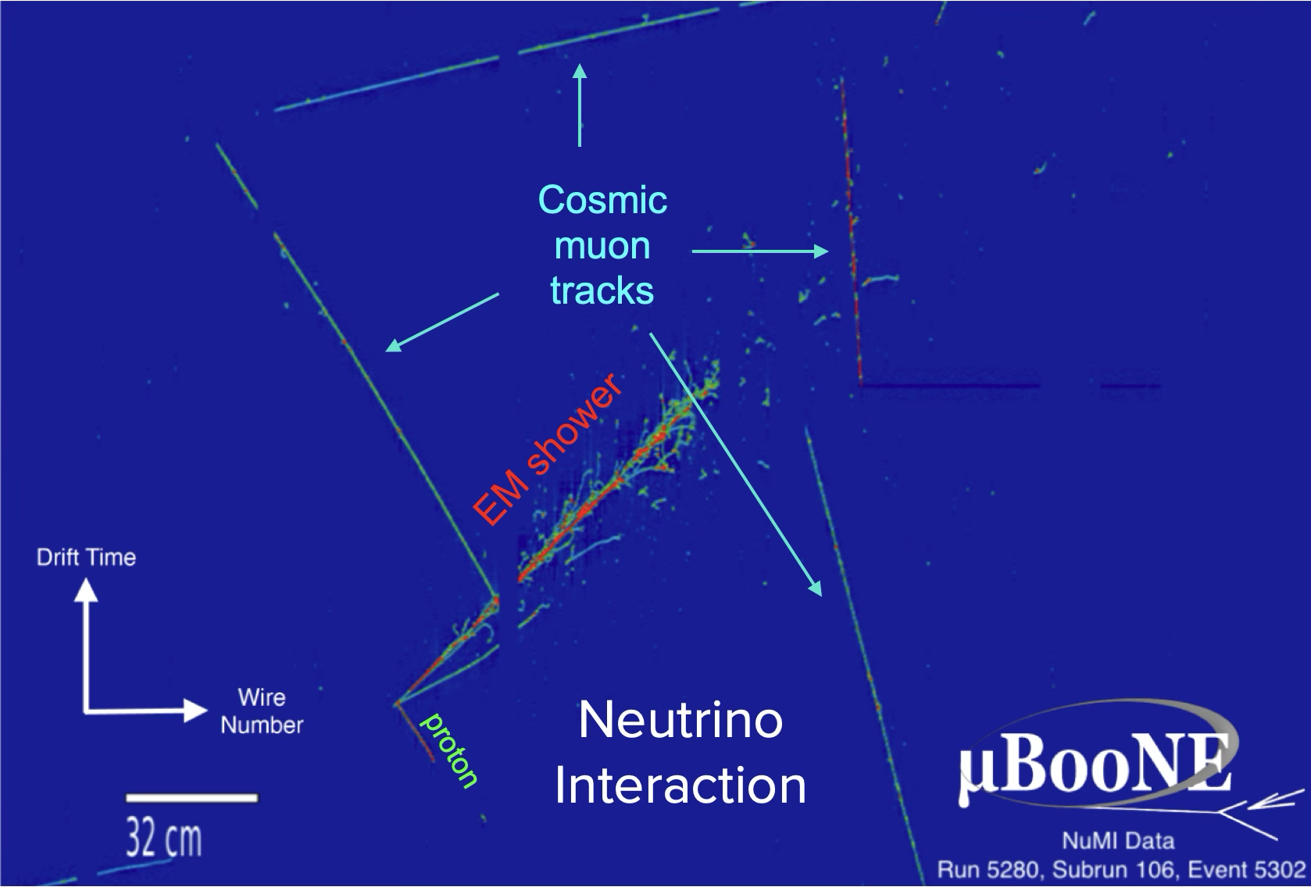
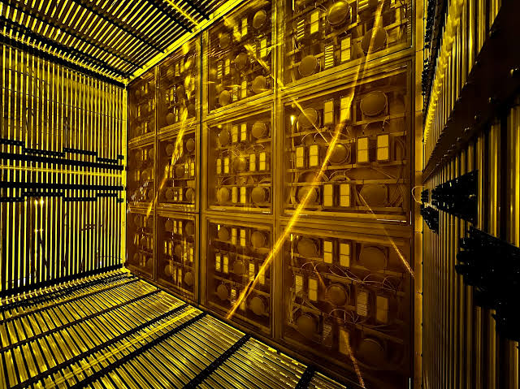
How to catch a neutrino
Modern detectors
Liquid argon time projection chambers
(LArTPCs)
Principle:
Large tank of liquid argon with ambient electric field
When charged particles cross the medium, they create secondary electrons
Electric field drifts the electrons to an anode place where they are collected
Example: SBND
Located at Fermilab (USA)
112 tons of argon
Notes:
We’ve gotten a lot better at this now. Currently, neutrino experiments rely on a few different processes to study them:
Noble liquid TPC
Natural detectors (IceCube)
Water cherenkov

Slide 13
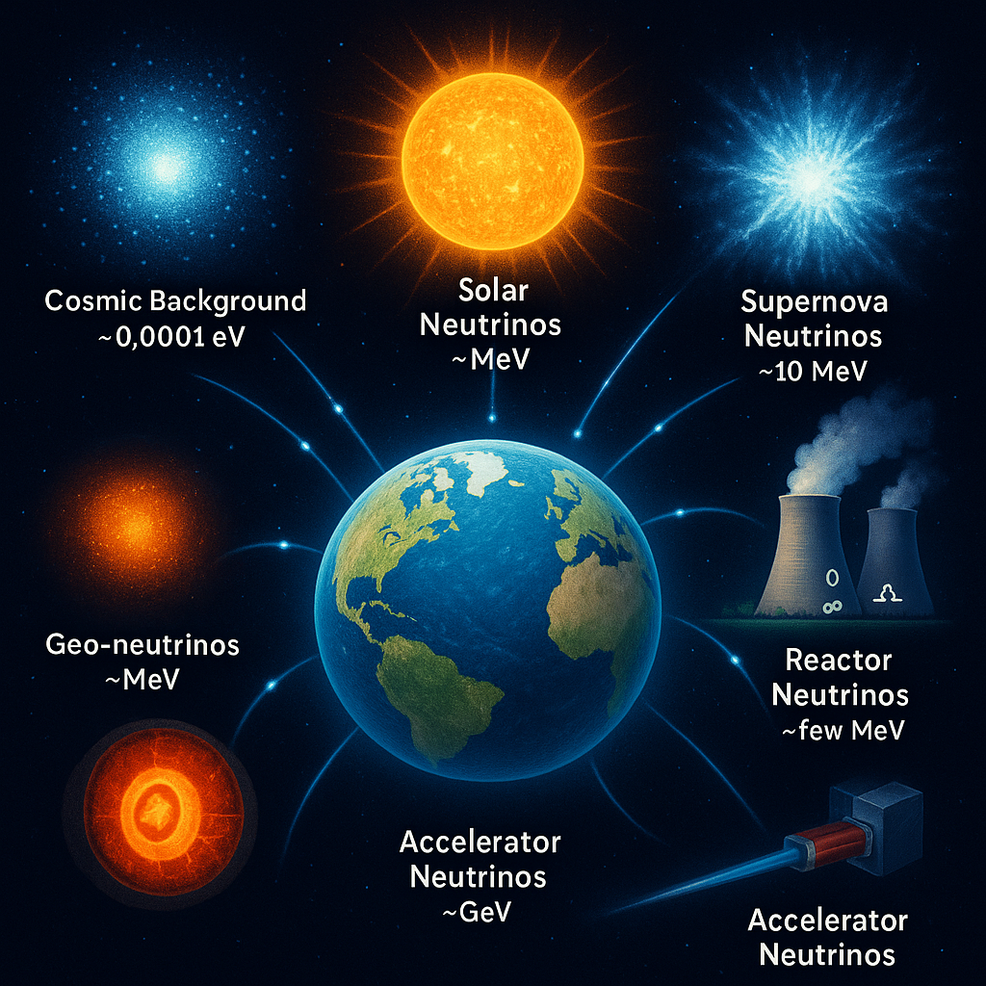
Where do they come from?
Already talked about nuclear reactors!
Cosmic Microwave Background is the largest source, but extremely low energy
Earth has many unstable materials with decays involving neutrinos
Cosmic ray interactions in the atmosphere also create neutrinos
We’ve learned how to make very intense neutrino beams from particle accelerators
Now let’s talk a little bit about the Sun!
Notes:
I’ve told you how we catch them, but not where we get them from. Once again, several sources

Slide 14
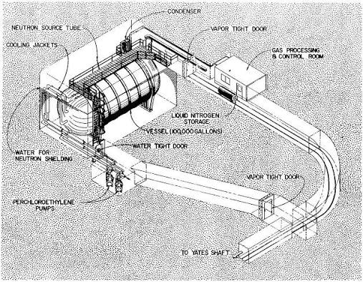
Neutrino Mystery nº1
The missing solar neutrinos
In the 60, the Homestake experiment tried to detect electron neutrinos from the Sun.
Problem: only saw 1/3 of what model of the Sun’s nuclear reactions predicted?
Where are the missing neutrinos?
Is the solar model wrong?
  Actual explanation is much weirder!
Notes:
This leads us to the first mystery physicist were confronted to: where are the neutrinos from the Sun. If physics works as we think it does, the should have measured a certain number of neutrinos coming from the sun. But they saw 50% less than they should. You’ll have to trust me when I say they triple checked their experiment and it wasn’t the issue. Some neutrinos had just disappeared. And that lead to the most shocking revelation about neutrinos

Slide 15
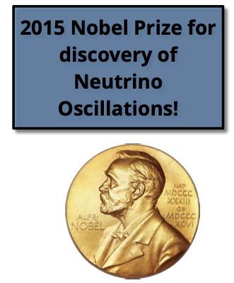

Neutrino oscillations
It turns out neutrinos can change flavour as they travel!
The process is called neutrino oscillation
In the 90s, experiments that could count the 3 flavours of neutrinos were built
      And they saw the correct number of neutrinos!
  Tells us that Neutrino mass ≠ 0 !
Notes:
Imagine you’re in the street and watch someone walk their dog. Let’s say a golden retriever. Then you look away for a moment and when you look again, that person is walking a chihuahua. Well that’s what happens to neutrinos. They change flavour as they travel. So the neutrinos from the Sun didn’t disappear, they just transformed into another type of neutrinos. Now, with more sophisticated experiments able to count neutrinos of several types and not one, you’re able to recover the correct number of measured neutrinos. But this discovery had huge consequences. Notably, it can only happen if neutrinos have a mass. But we have another problem here: didn’t the Standard Model say the neutrinos are supposed to be massless? Well this is one of the indications that the standard model is not a complete description of particle physics yet. This is the moment of the lecture where we’ll transition from what we know to what we don’t know, so let me make a little summary before we dive into more neutrino weirdness.

Slide 16
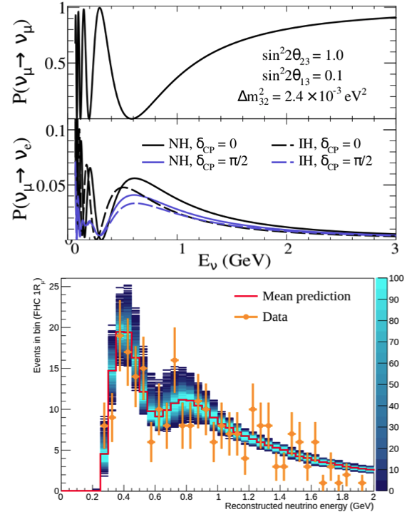
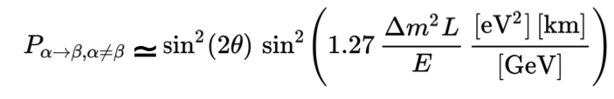
Neutrino oscillations
How do they work?
Formula governing the probability of transition from one flavour to another
Called “oscillations” because lots of sines and cosines in the equations!
Depends on distance traveled and difference between neutrino masses
Knowing the oscillation parameters = predict the number of each flavour of neutrinos at any distance from the source
Notes:
Imagine you’re in the street and watch someone walk their dog. Let’s say a golden retriever. Then you look away for a moment and when you look again, that person is walking a chihuahua. Well that’s what happens to neutrinos. They change flavour as they travel. So the neutrinos from the Sun didn’t disappear, they just transformed into another type of neutrinos. Now, with more sophisticated experiments able to count neutrinos of several types and not one, you’re able to recover the correct number of measured neutrinos. But this discovery had huge consequences. Notably, it can only happen if neutrinos have a mass. But we have another problem here: didn’t the Standard Model say the neutrinos are supposed to be massless? Well this is one of the indications that the standard model is not a complete description of particle physics yet. This is the moment of the lecture where we’ll transition from what we know to what we don’t know, so let me make a little summary before we dive into more neutrino weirdness.

Slide 17
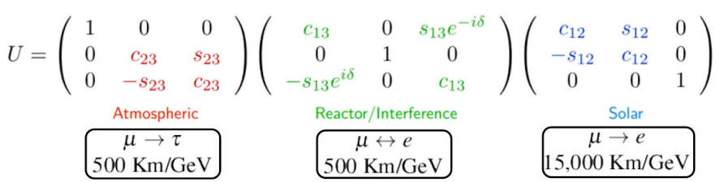
Neutrino oscillations
Measuring the parameters
Oscillation parameters summarized in the PMNS matrix
To measure a specific parameter, you “just” need to tune L (distance between source and detector) and E (neutrino energy)
        Short (low-L) and Long (high-L) experiments
        Can tell you about mass differences
Notes:
Imagine you’re in the street and watch someone walk their dog. Let’s say a golden retriever. Then you look away for a moment and when you look again, that person is walking a chihuahua. Well that’s what happens to neutrinos. They change flavour as they travel. So the neutrinos from the Sun didn’t disappear, they just transformed into another type of neutrinos. Now, with more sophisticated experiments able to count neutrinos of several types and not one, you’re able to recover the correct number of measured neutrinos. But this discovery had huge consequences. Notably, it can only happen if neutrinos have a mass. But we have another problem here: didn’t the Standard Model say the neutrinos are supposed to be massless? Well this is one of the indications that the standard model is not a complete description of particle physics yet. This is the moment of the lecture where we’ll transition from what we know to what we don’t know, so let me make a little summary before we dive into more neutrino weirdness.

Slide 18
Summary 1
What we know about neutrinos
Neutrinos exist!
3 flavours
They oscillate
They are not massless
Notes:
We know that:
Neutrinos exist! There are three flavours (types) of neutrinos, they can transform between flavours, which means they have a mass. That’s basically it.

Slide 19
What we don’t know
Notes:
Now onto what we don’t (and why I have a job)!

Slide 20

Open questions about neutrinos
What are the absolute masses of neutrinos?
Do we even know which is the heaviest?
How do they get their masses?
Why are they so light?
Are there only three neutrino types?
Do neutrinos and antineutrinos oscillate in the
same way?

Slide 21
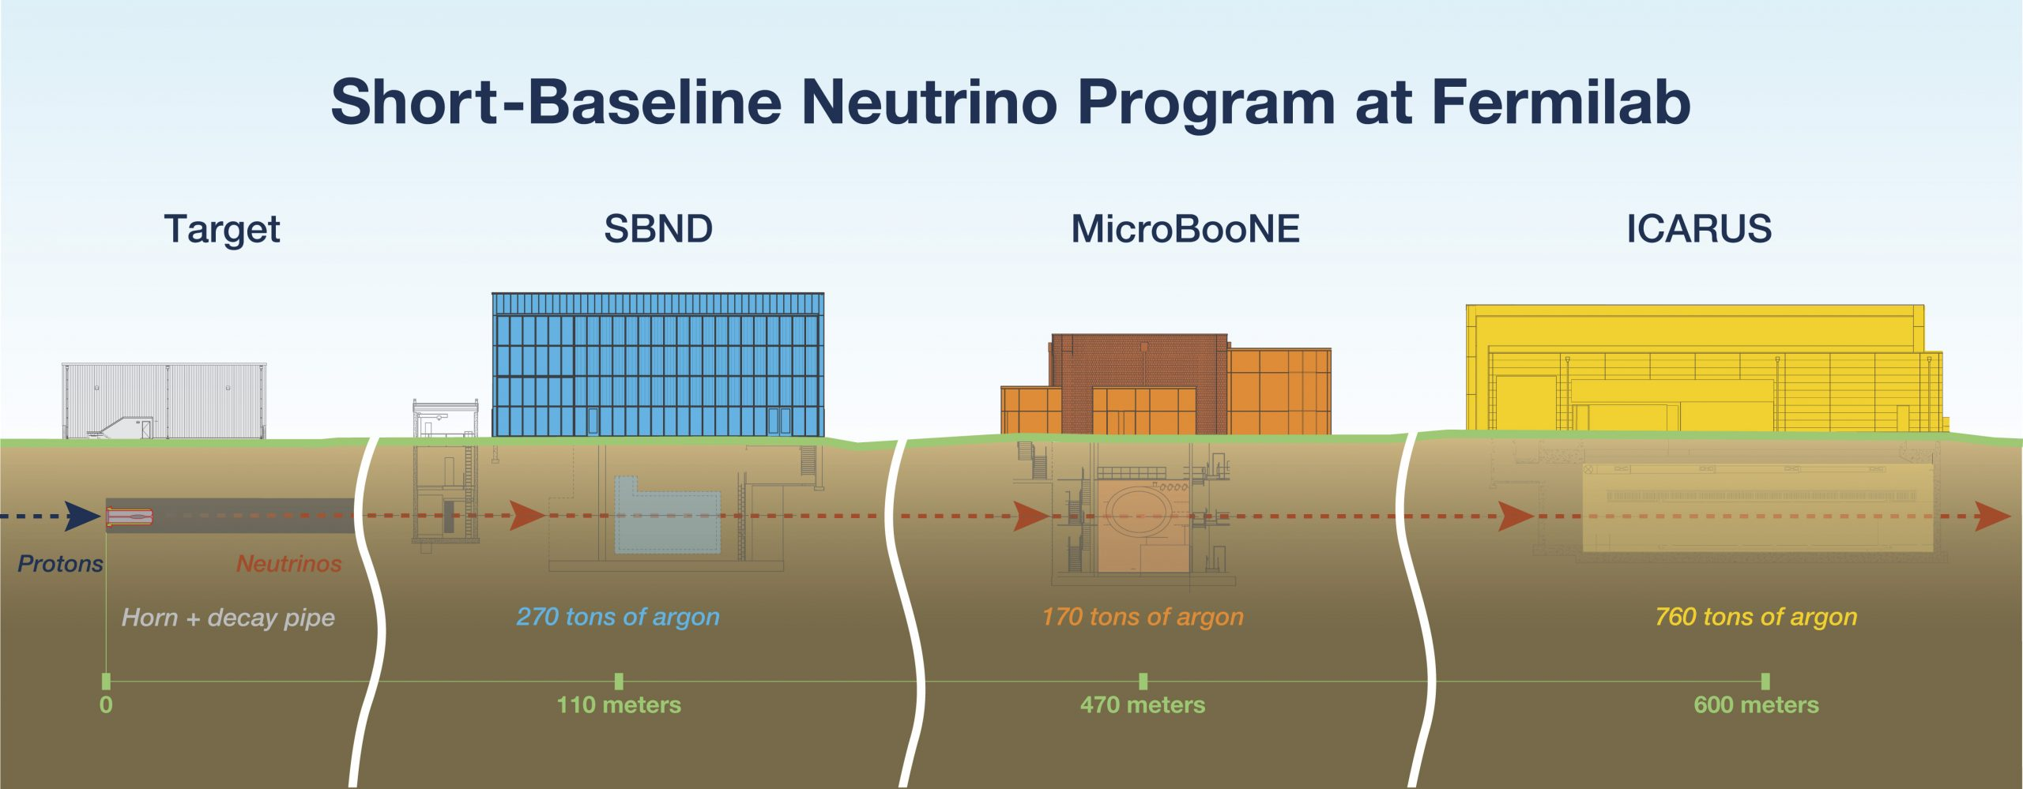
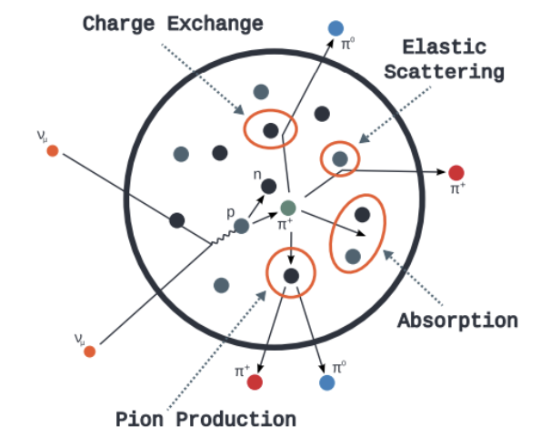
Neutrino interactions
What happens when neutrino meets something else?
Neutrino interactions are complicated processes
Involves a lot of nuclear physics
Need to be understood to reduce uncertainties on oscillation measurements
Current liquid argon experiments at Fermilab (USA) are exploring neutrino interactions using high-intensity neutrino beams
Detailed images from LArTPCs help reconstruct what happened during the neutrino interaction

Slide 22
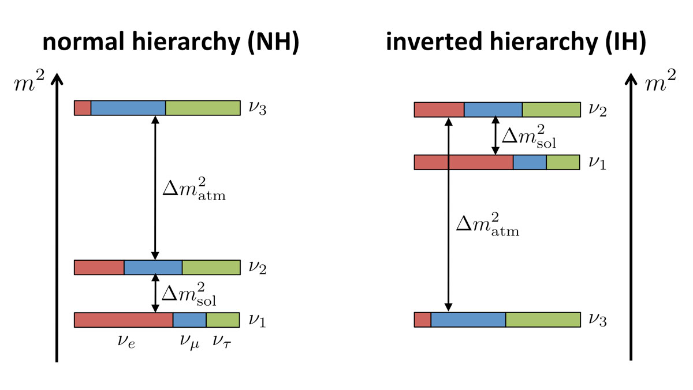
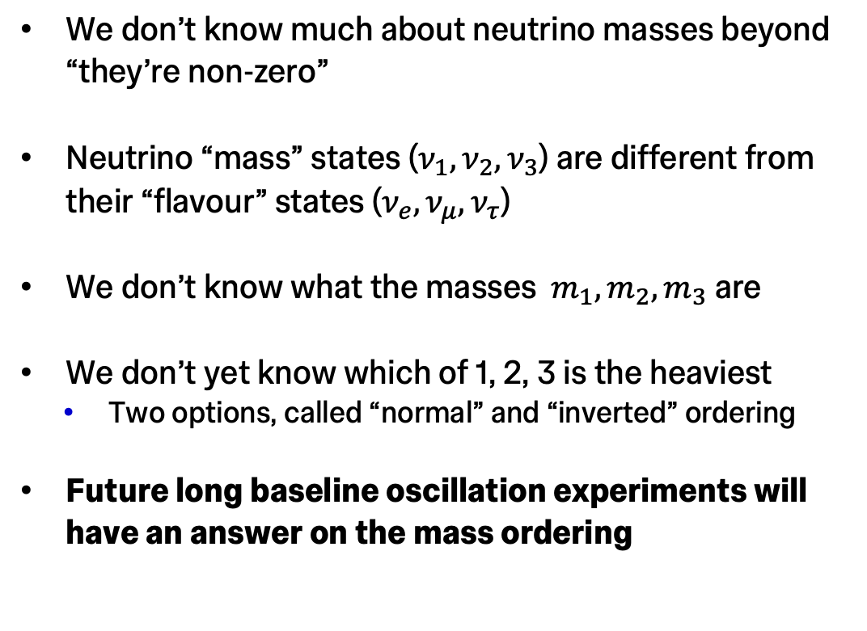
Neutrino masses
We don’t know much about neutrino masses beyond “they’re non-zero”
Neutrino “mass” states ($ν_{1},ν_{2},ν_{3}$) are different from their “flavour” states ($ν_{e},ν_{μ},ν_{τ}$)
We don’t know what the masses $m_{1},m_{2},m_{3}$ are
We don’t yet know which of 1, 2, 3 is the heaviest
      Two options, called “normal” and “inverted” ordering
  Future long baseline oscillation experiments will have an answer on the mass ordering

Slide 23

Matter-antimatter asymmetry
Why is there only matter around?
    When matter is created, so is antimatter
    Where did all the antimatter go?
Neutrinos may have the answer!
In the PMNS matrix, there is a special parameter called 𝛿_{CP}, which may create differences between neutrinos and anti-neutrinos
By measuring this 𝛿_{CP} parameter, we get hints on what happened to the antimatter

Slide 24
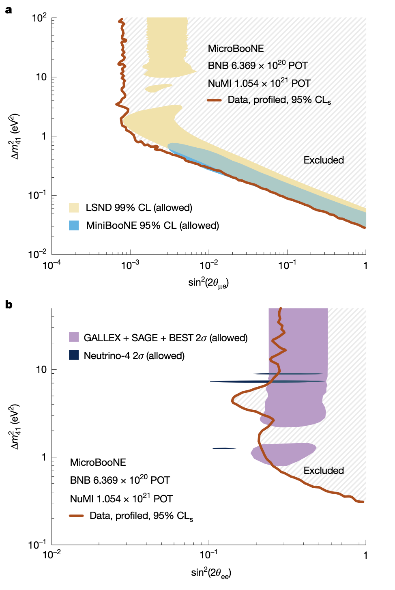
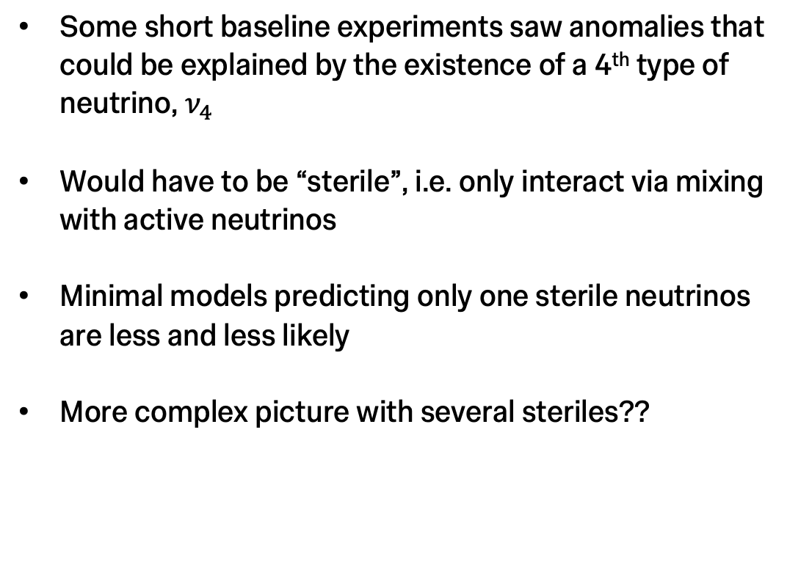
Sterile neutrino(s)?
Another neutrino mystery
Some short baseline experiments saw anomalies that could be explained by the existence of a 4th type of neutrino, $ν_{4}$
Would have to be “sterile”, i.e. only interact via mixing with active neutrinos
Minimal models predicting only one sterile neutrinos are less and less likely
More complex picture with several steriles??

Slide 25

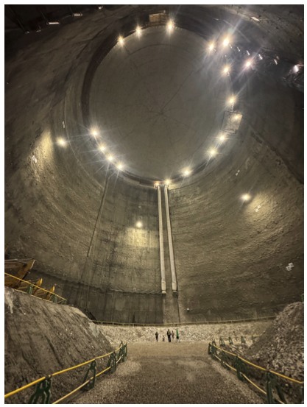
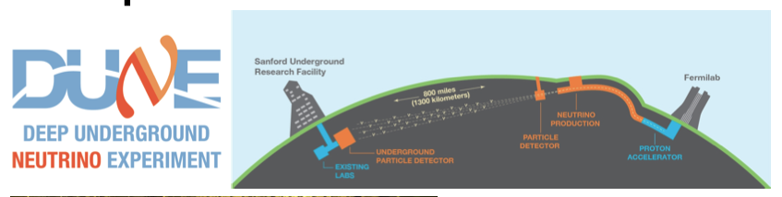
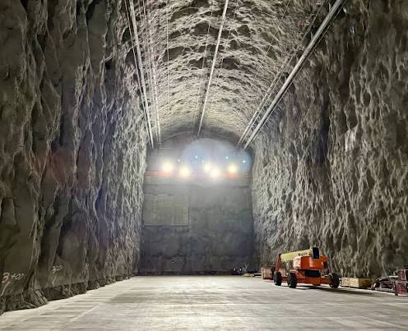
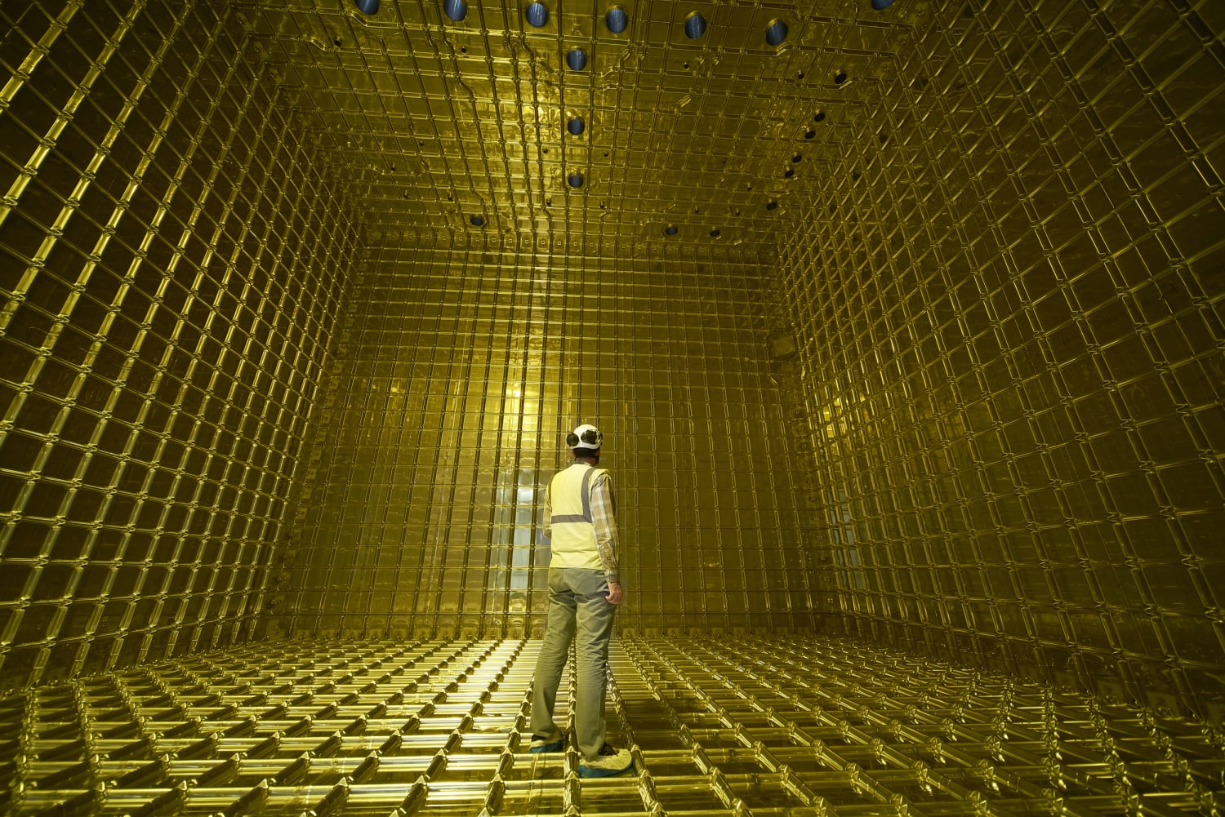
Future of neutrino experiments
Even. Bigger. Detectors.
Hyper-Kamiokande
Two giant experiments on the horizon:
      DUNE (liquid argon) and Hyper-K (water Cherenkov)
  Bigger detectors, higher intensity neutrino beams, more precise measurements!

Slide 26

Neutrinos
What you should remember!
Neutrinos are everywhere but very hard to detect!
There are 3 kind of neutrinos (flavours)
As they travel, neutrinos oscillate between flavours
Despite their ghostly nature, neutrinos may explain why there is more matter than anti-matter in the Universe
Measuring neutrino oscillations allows us to understand why the Universe has more matter than antimatter
Experiments currently under construction will answer many of the current open questions!
Neutrinos exist!
$$δ_{CP}$$
Neutrinos masses
Sterile neutrinos
Neutrino interactions

Slide 27
Any questions?

