Slide 1
Trigger Happy
Or
How & why we analyse a really, very large amount of data really, very fast
Andy Rose, Imperial College, London
awr01@imperial.ac.uk
www.hep.ph.ic.ac.uk/~awr01

Slide 2
Science: The basics
Science is the art of knowing what to record, and when

Slide 3
Science: The basics
Science is the art of knowing what to record, and when
Or being cynical, it's being in the right place at the right time

Slide 4
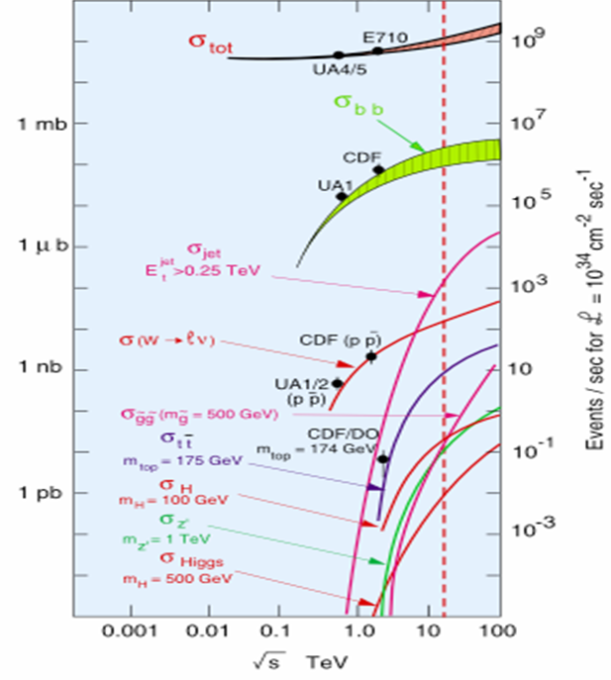
Science: The basics
Science is the art of knowing what to record, and when
With CMS & ATLAS in “discovery mode”, we care about the Higgs Boson or rarer
  Higgs Boson production is ten orders of magnitude below the total interaction rate

Slide 5
Science: The basics
10⁰(100%)
Science is the art of knowing what to record, and when
With CMS & ATLAS in “discovery mode”, we care about the Higgs Boson or rarer
  Higgs Boson production is ten orders of magnitude below the total interaction rate
10⁻²(1%)
10⁻⁴
Ten orders of magnitude
10⁻⁶
Probability
Events per second at LHC
10⁻⁸
10⁻¹⁰
10⁻¹²
Beam Energy

Slide 6
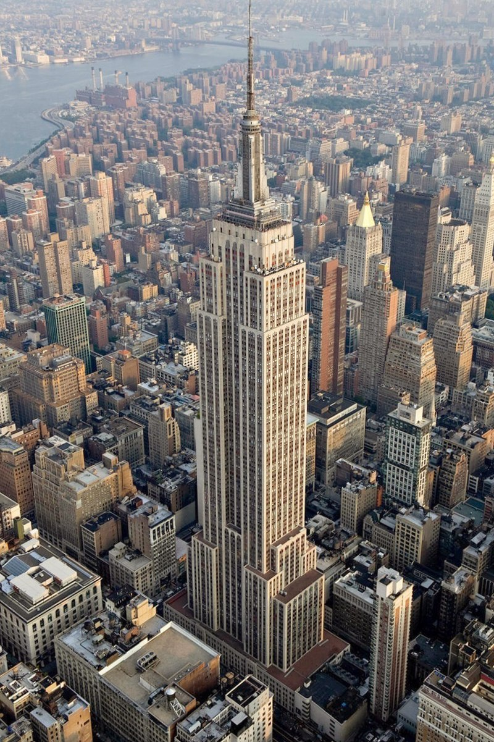

Science: The basics
Science is the art of knowing what to record, and when
With CMS & ATLAS in “discovery mode”, we care about the Higgs Boson or rarer
  Higgs Boson production is ten orders of magnitude below the total interaction rate
  That is a needle in a haystack the same mass as the
  Empire State Building

Slide 7
Science: The basics
Science is the art of knowing what to record, and when
With CMS & ATLAS in “discovery mode”, we care about the Higgs Boson or rarer
  Higgs Boson production is ten orders of magnitude below the total interaction rate
  That is a needle in a haystack the same mass as the
  Empire State Building
  Or if you collided protons once per second, that is one event every 316 years, 324 days (5 hours, 6 minutes and 17 seconds give or take)

Slide 8
Science: The basics
Science is the art of knowing what to record, and when
With CMS & ATLAS in “discovery mode”, we care about the Higgs Boson or rarer
  Higgs Boson production is ten orders of magnitude below the total interaction rate
  That is a needle in a haystack the same mass as the
  Empire State Building
  Or if you collided protons once per second, that is one event every 316 years, 324 days (5 hours, 6 minutes and 17 seconds give or take)
And one Higgs boson is pretty much
USELESS
We need loads of them to be able to study them…

Slide 9
This is why the LHC collides…
̴50 protons at a time
×
40 million times a second

Slide 10
This is why the LHC collides…
̴50 protons at a time
×
40 million times a second
1 Higgs boson every ̴5 seconds

Slide 11
This is why the LHC collides…
But this causes problems
̴50 protons at a time
×
40 million times a second
1 Higgs boson every ̴5 seconds

Slide 12
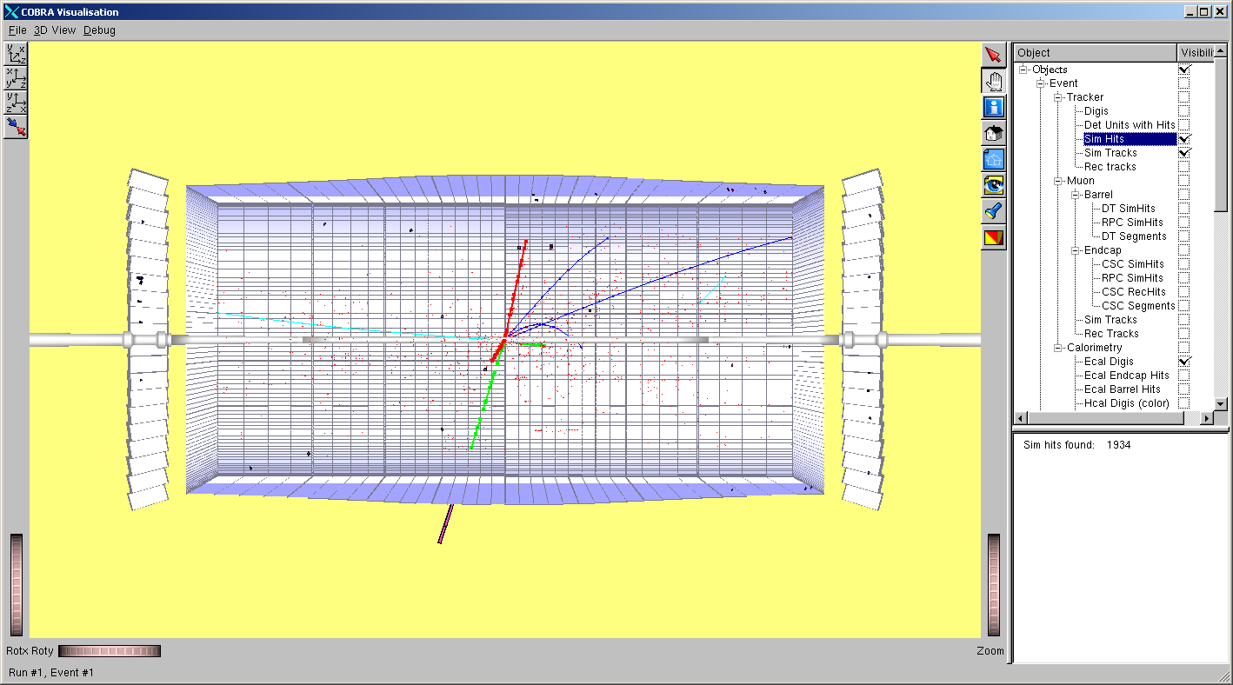
One proton-proton collision

Slide 13
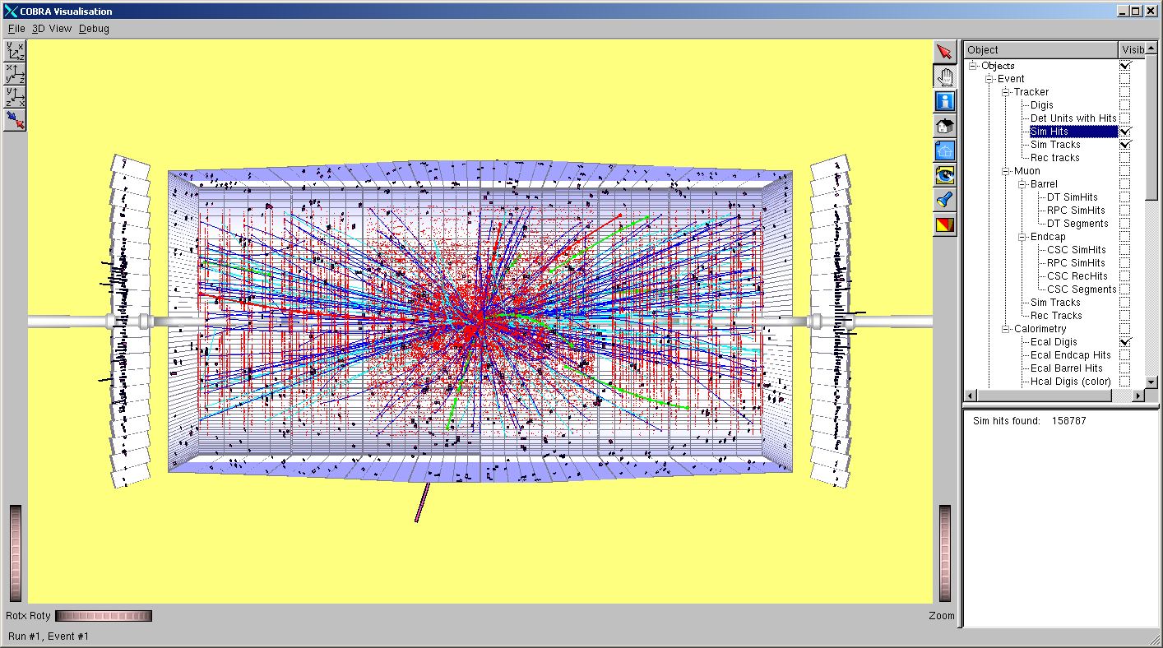
Many proton-proton collisions
25 proton-proton collisions

Slide 14
Many proton-proton collisions
Even if you get a Higgs boson, the
RUBBISH
makes it hard to find
25 proton-proton collisions

Slide 15
This is why the LHC collides…
But this causes problems
̴50 protons at a time
×
40 million times a second
1 Higgs boson every ̴5 seconds
This causes problems too

Slide 16
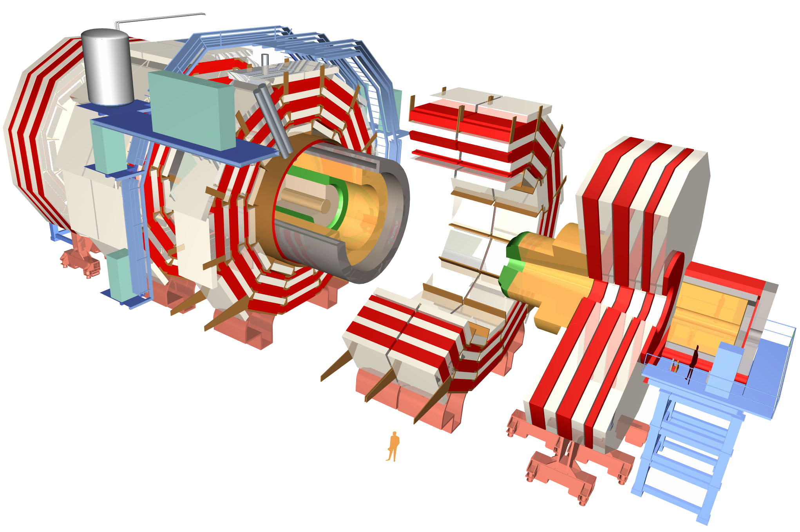
The CMS detector
~80k PbWO₄ Ecal Crystals
~15k channel Brass/Plastic sampling HCAL
~568k RPC/DT/CSC Muon channels
~65M Silicon Pixels
~10M Silicon Strips
~3500 physicists/engineers

Slide 17
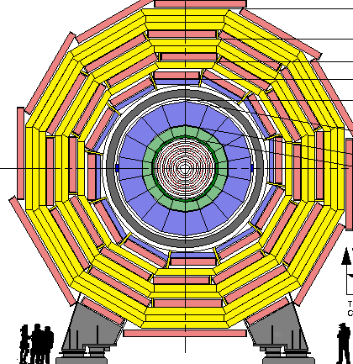
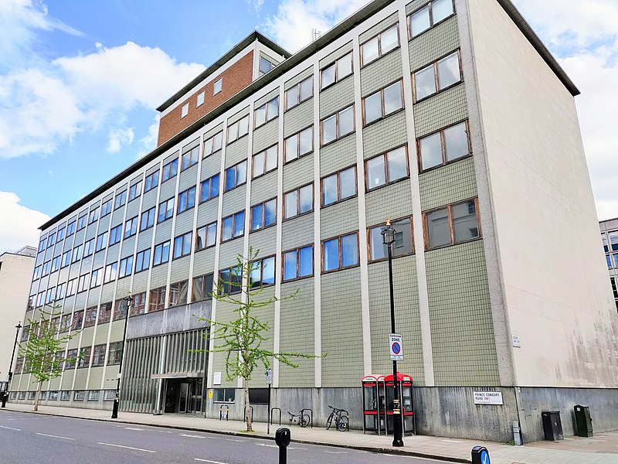
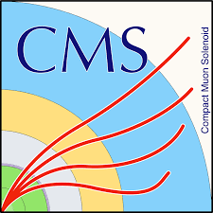
Big detectors for small particles

Slide 18
The CMS detector
~80k PbWO₄ Ecal Crystals
~15k channel Brass/Plastic sampling HCAL
~568k RPC/DT/CSC Muon channels
~65M Silicon Pixels
~10M Silicon Strips
~3500 physicists/engineers

Slide 19

The CMS detector
~80k PbWO₄ Ecal Crystals
~15k channel Brass/Plastic sampling HCAL
~568k RPC/DT/CSC Muon channels
~65M Silicon Pixels
~10M Silicon Strips
~3500 physicists/engineers

Slide 20
The CMS detector
~80k PbWO₄ Ecal Crystals
~15k channel Brass/Plastic sampling HCAL
~568k RPC/DT/CSC Muon channels
500M Swiss Francs
10 years to build
~65M Silicon Pixels
~10M Silicon Strips
~3500 physicists/engineers

Slide 21
The CMS detector
~80k PbWO₄ Ecal Crystals
~15k channel Brass/Plastic sampling HCAL
~568k RPC/DT/CSC Muon channels
Covers 205m2
Most intense radiation environment on the planet
Installation completed before release of 1st iPhone
And…
~65M Silicon Pixels
~10M Silicon Strips
~3500 physicists/engineers

Slide 22
The CMS detector
~80k PbWO₄ Ecal Crystals
~15k channel Brass/Plastic sampling HCAL
~568k RPC/DT/CSC Muon channels
× 40 million snapshots per second
~65M Silicon Pixels
~10M Silicon Strips
~3500 physicists/engineers

Slide 23
The CMS detector
~80k PbWO₄ Ecal Crystals
≡ 40 TBit per second
~15k channel Brass/Plastic sampling HCAL
≡ 10 TBit per second
~568k RPC/DT/CSC Muon channels
≡ 23 TBit per second
× 40 million measurements per second
~65M Silicon Pixels
≡ 21 PBit per second
~10M Silicon Strips
≡ 4 PBit per second
~3500 physicists/engineers

Slide 24
The CMS detector
~80k PbWO₄ Ecal Crystals
≡ 40 TBit per second
~15k channel Brass/Plastic sampling HCAL
≡ 10 TBit per second
~568k RPC/DT/CSC Muon channels
≡ 23 TBit per second
What does that even mean?
~65M Silicon Pixels
≡ 21 PBit per second
~10M Silicon Strips
≡ 4 PBit per second
~3500 physicists/engineers

Slide 25
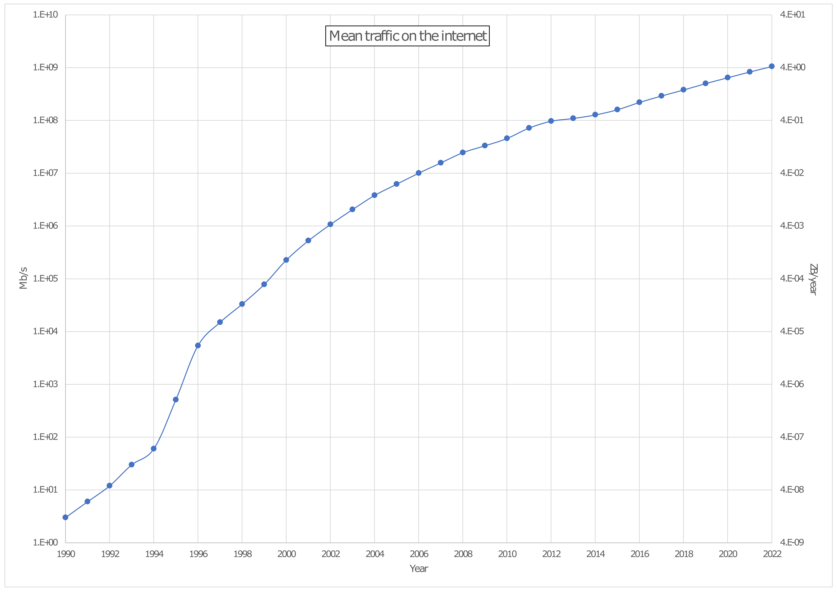
How much data?

Slide 26
How much data?
1 Pb/s
4 ZB/yr
CMS Raw
1 Tb/s
4 EB/yr
1 Gb/s
4 PB/yr
1 Mb/s
4 TB/yr

Slide 27
How much data?
1 Pb/s
4 ZB/yr
CMS Raw
1,000,000×
Home broadband
1 Tb/s
4 EB/yr
1,000×
Home broadband
1 Gb/s
4 PB/yr
CMS tape-store
1×
Home broadband
1 Mb/s
4 TB/yr

Slide 28
How much data?
1 Pb/s
4 ZB/yr
CMS Raw
1,000,000×
Home broadband
1 Tb/s
4 EB/yr
But do we need to store it all?
The Higgs is rare, after all
1,000×
Home broadband
1 Gb/s
4 PB/yr
CMS tape-store
1×
Home broadband
1 Mb/s
4 TB/yr

Slide 29
So what do we do?
We keep the data safe on the detector for several microseconds
We quickly analyse some fraction of the data and select the interesting crossings to keep

Slide 30
So what do we do?
We keep the data safe on the detector for several microseconds
We quickly analyse some fraction of the data and select the interesting crossings to keep
Called Triggering

Slide 31
So what do we do?
We keep the data safe on the detector for several microseconds
We quickly analyse some fraction of the data and select the interesting crossings to keep
uninteresting crossings to discard
The LHC is a discovery machine, after all
Called Triggering

Slide 32
But!
If you get it wrong
If your system fails you throw away your valuable physics
If you take too long

Slide 33
But!
If you get it wrong
If your system fails you throw away your valuable physics
If you take too long
And that is a *really, really* expensive mistake

Slide 34
This is why the LHC collides…
But this causes problems
̴50 protons at a time
×
40 million times a second
1 Higgs boson every ̴5 seconds
This causes other problems too

Slide 35
A note on timescales
At 40MHz BX rate, a 4GHz CPU could perform 100 CPU operations before the next data arrives
  Not enough to be useful
Compare that to the O(100M) detector channels

Slide 36

Sequential processing
6pm | 7pm | 8pm | 9pm | 10pm | 11pm | 12pm | 01am | 02am | 03am

Slide 37
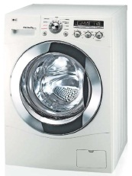
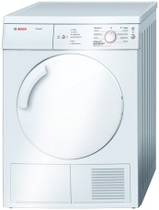

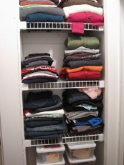
Sequential processing
6pm | 7pm | 8pm | 9pm | 10pm | 11pm | 12pm | 01am | 02am | 03am

Slide 38
Sequential processing
6pm | 7pm | 8pm | 9pm | 10pm | 11pm | 12pm | 01am | 02am | 03am
That would just be stupid

Slide 39
Sequential processing
6pm | 7pm | 8pm | 9pm | 10pm | 11pm | 12pm | 01am | 02am | 03am
That would just be stupid
But this is exactly what a PC does

Slide 40
Pipelined processing
6pm | 7pm | 8pm | 9pm | 10pm | 11pm | 12pm | 01am | 02am | 03am

Slide 41
Pipelined processing
6pm | 7pm | 8pm | 9pm | 10pm | 11pm | 12pm | 01am | 02am | 03am
So why doesn’t my PC do this?

Slide 42
Pipelined processing
6pm | 7pm | 8pm | 9pm | 10pm | 11pm | 12pm | 01am | 02am | 03am
So why doesn’t my PC do this?
Because writing code like this is
*really, really* hard

Slide 43
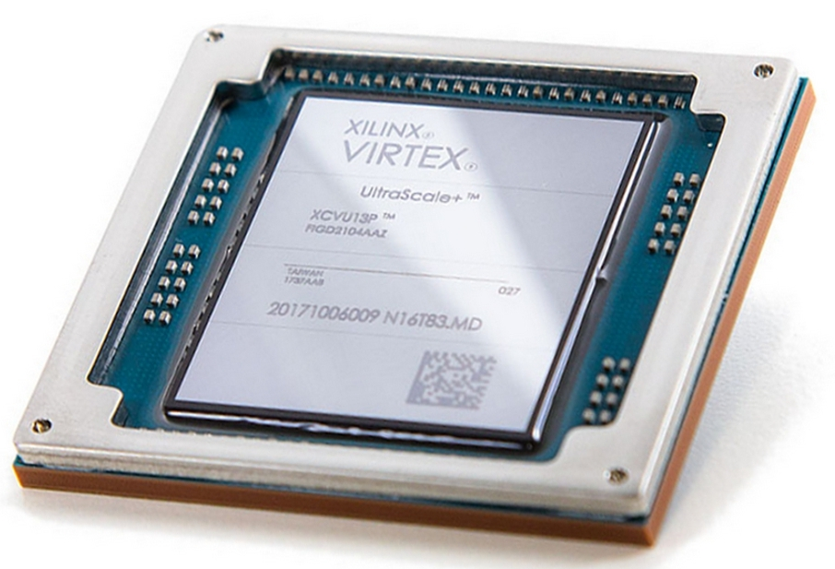
Field-Programmable Gate Arrays
Programmable circuit-on-chip
Upwards of 8.9 million logic cells & up to 12,000 “math” cells
  All clocked at ̴500MHz
Over O(10¹⁵) operations/second
  That is PetaBOps
Fully parallel and fully pipelineable

Slide 44
Field-Programmable Gate Arrays
Programmable circuit-on-chip
Upwards of 8.9 million logic cells & up to 12,000 “math” cells
  All clocked at ̴500MHz
Over O(10¹⁵) operations/second
  That is PetaBOps
Fully parallel and fully pipelineable
and *really, really* hard to program efficiently

Slide 45
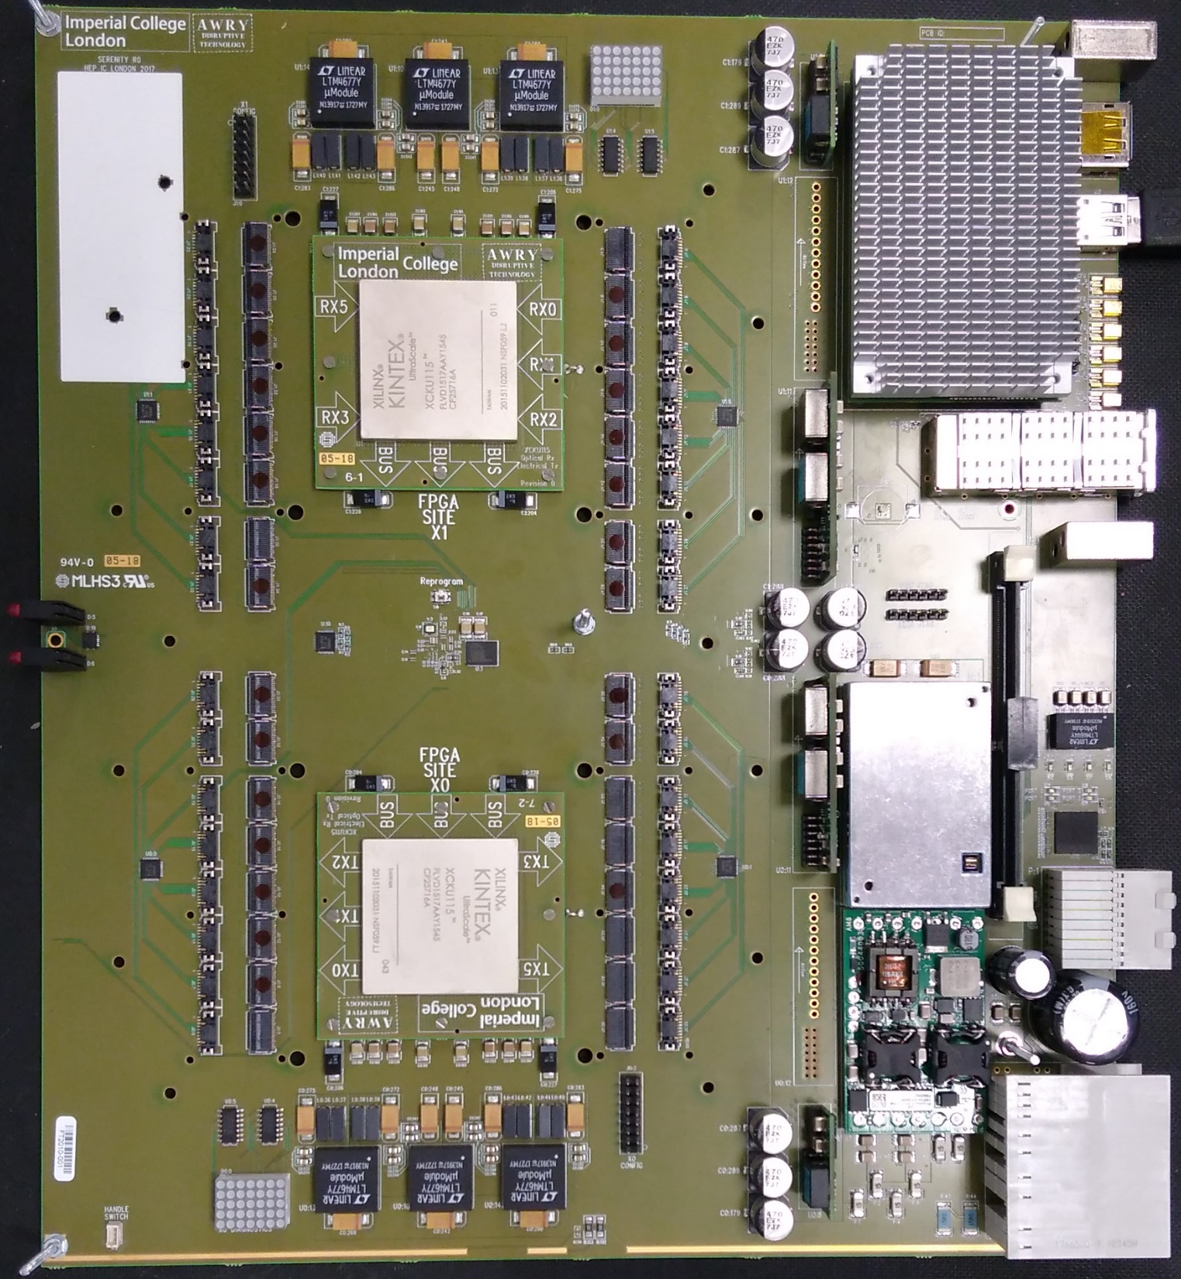
Field-Programmable Gate Arrays
A chip needs to be attached to something!
Imperial’s Serenity-Z platform
  208 optical transmit links &
  208 optical receive links
  @ 28.5Gbps =
  Skewable to
5.9 + 5.9 Tbps
7.0 + 4.8 Tbps

Slide 46
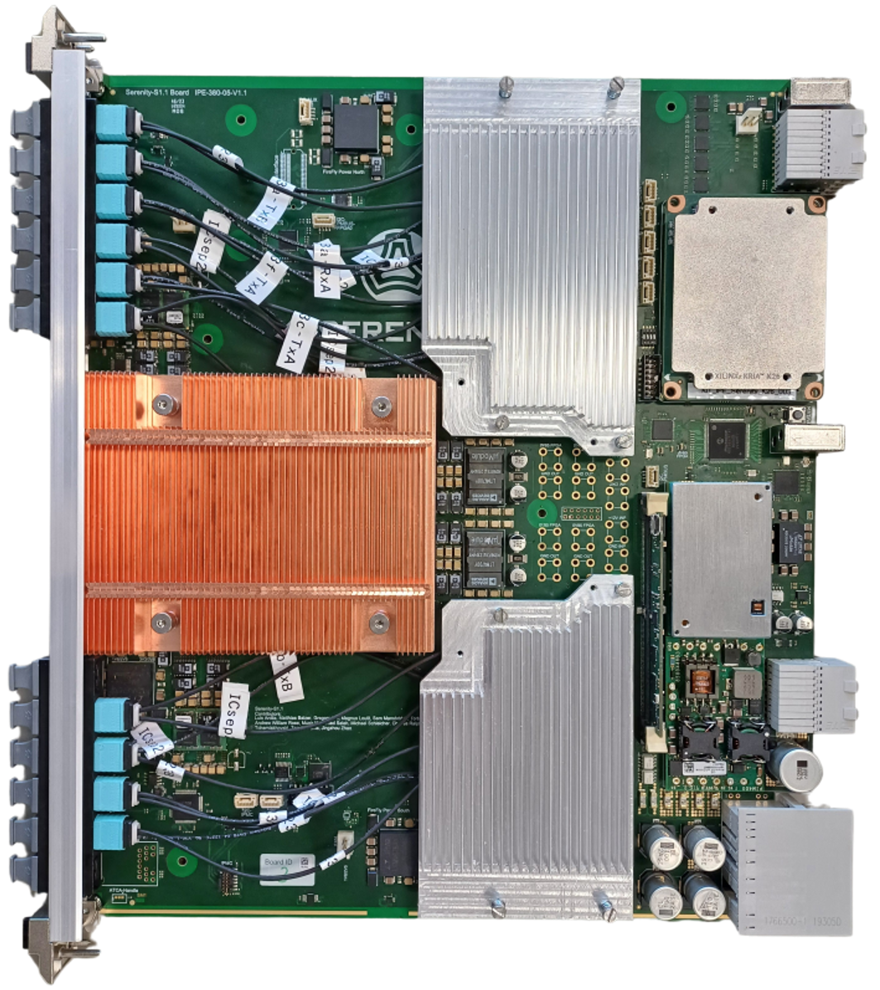
Field-Programmable Gate Arrays
A chip needs to be attached to something!
Imperial’s Serenity-S platform
  124 optical transmit links &
  124 optical receive links
  @ 28.5Gbps =
  Easier to manufacture
3.5 + 3.5 Tbps

Slide 47
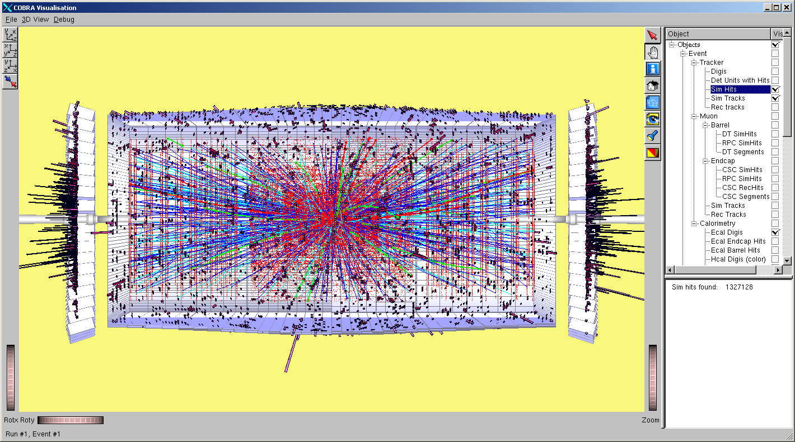
The future: High-luminosity LHC
150 proton-proton collisions
Averaging 250 proton-proton collisions per event
Really, really hard to find the interesting event under all that rubbish
Need to sift through 300Tbps to find the interesting events

Slide 48
But this is the 21st century…
How do you deal with hard problems and big data?

Slide 49
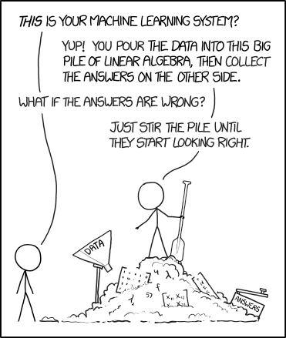

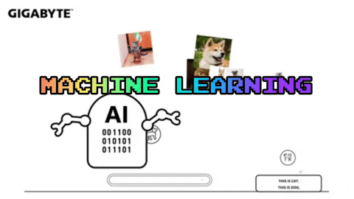
But this is the 21st century…
How do you deal with hard problems and big data?

Slide 50
But this is the 21st century…
How do you deal with hard problems and big data?
Ummm… It's not quite that simple

Slide 51
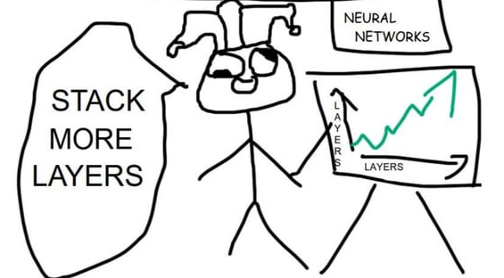
Why can't you just use Machine Learning at HL-LHC?
The data is still only safe on the detector for ~10 microseconds
  Not much time
The trigger is receiving ~100Tbps from the tracker, ~100Tbps from the barrel calorimeter and ~100Tbps from the endcap calorimeter
  AKA 1 hellavalotta data
Recall, that you can't see the data the trigger throws away…
  You need to be *REALLY* sure you know what your algorithm is doing.
The detector environment is always changing, inference may not look anything like your training data

Slide 52
Why can't you just use Machine Learning at HL-LHC?
The data is still only safe on the detector for ~10 microseconds
  Not much time
The trigger is receiving ~100Tbps from the tracker, ~100Tbps from the barrel calorimeter and ~100Tbps from the endcap calorimeter
  AKA 1 hellavalotta™ data
Recall, that you can't see the data the trigger throws away…
  You need to be *REALLY* sure you know what your algorithm is doing.
The detector environment is always changing, inference may not look anything like your training data

Slide 53
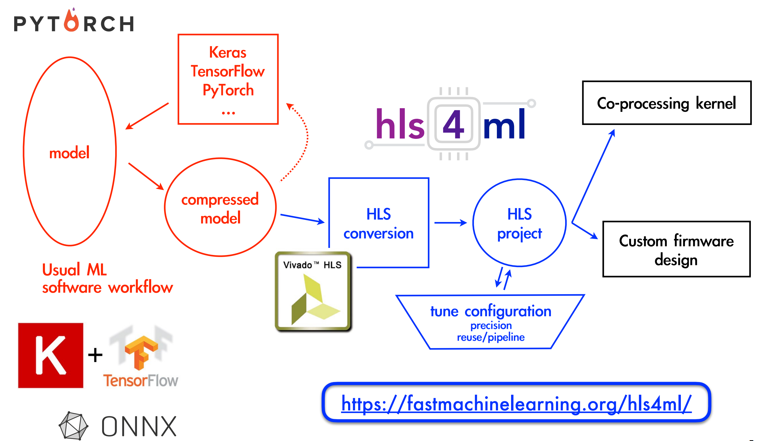
That said… if it works, why wouldn't you use it?
For certain, well-defined sections of the trigger chain, machine-learning is a useful and powerful tool
  Tools developed for translating Neural Networks for use in high-throughput and low-latency systems
Work being done in the area of understandable AI
Work being done in the area of continual learning

Slide 54
Conclusion
The hardware triggers at the LHC are some of the most computationally challenging problems on the planet
They are a great deal of responsibility

Slide 55
Conclusion
The hardware triggers at the LHC are some of the most computationally challenging problems on the planet
They are a great deal of responsibility
And, if you like puzzles,
a great deal of fun ☺

