Slide 1

Wirecell Group Update
Evander Espinoza
July 2nd, 2026
Louisiana State University

Slide 2
Added Michel region length + ”wiggle” cuts to charge-based tagging
Two issues which I didn’t account for previously in charge-based selection:
  Physics constraint: Assuming the energy deposition is constant (~2.2. MeV/cm), we know that Michel electrons can only travel a certain distance before stopping entirely (max energy is 60 MeV, divided by 2.2 MeV/cm ~ 30 cm)
  Since Michels are lighter, they tend to “wiggle” more than their parent muons, so I added an extra check that verifies linearity in Michel region is smaller than muon region
This further reduced inefficiencies (don’t have exact numbers this time, but all FPs that were present before have now been correctly rejected)

Slide 3
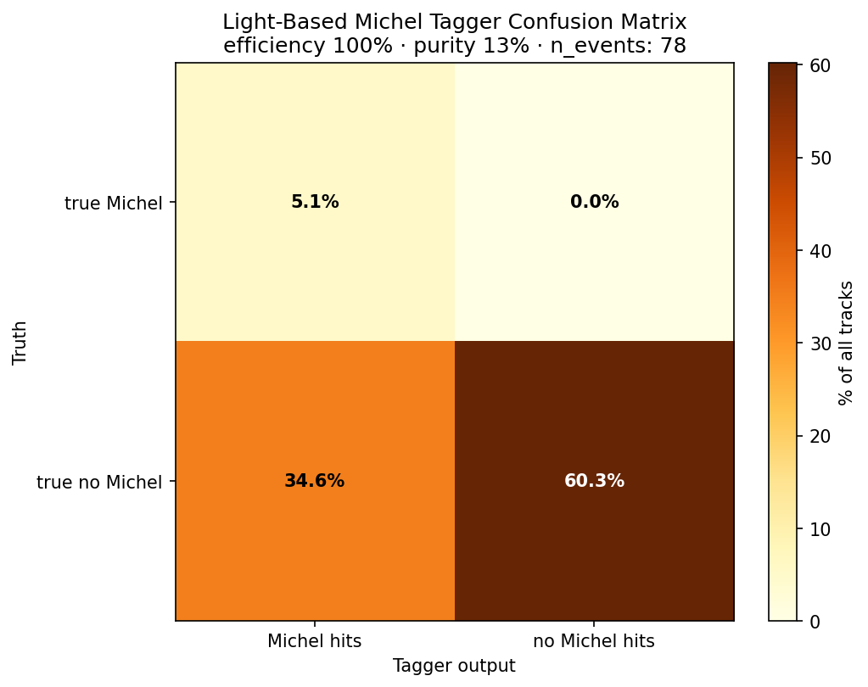
Revisiting light-based tagging
From same event sample
# correctly ID’d Michels/total Michels in truth: 80%
# correctly rejected tracks/true “non-Michels”: 63.5%
Accuracy ((TP+TN)/all events): 65.4%
False-positive rate (FP/(FP+TN)): 36.5%

Slide 4
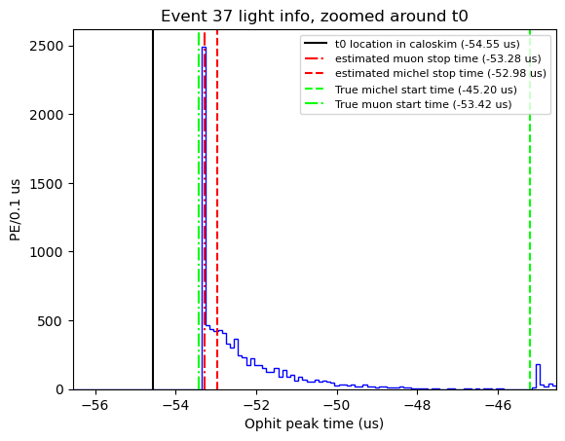
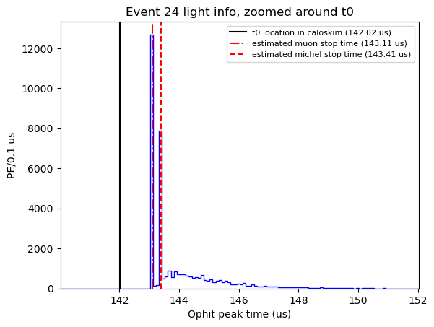
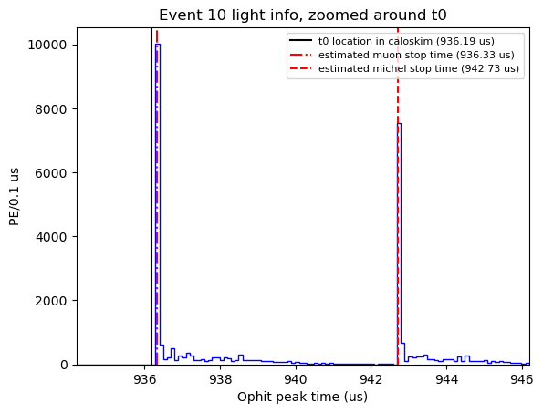
Revisiting light
Typically, there were 2 main failure modes, I noticed when hand-scanning:
Bump caught along muon’s “tail”
Pulse found later, usually due to a much brighter track

Slide 5
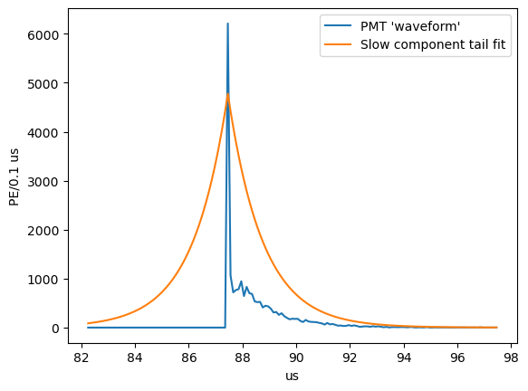
Tail subtraction
It’s known that there is a large scintillation tail between flashes, so what if I subtract this tail before looking for peaks?

Slide 6
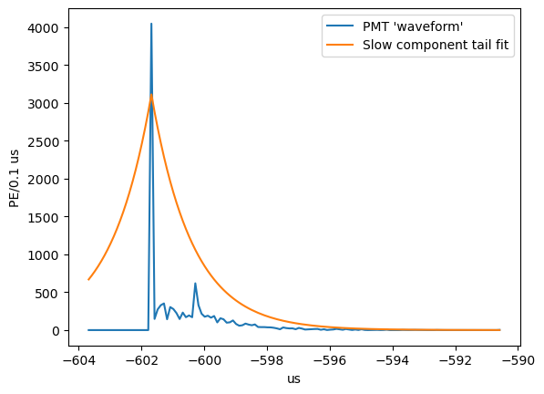
Tail subtraction
Good in cases where long tail fluctuates, causing misidentification of Michel pulse, eliminating a false positive
In other cases, the slow component tail “eats” Michel pulse in this case, creating a false negative

Slide 7
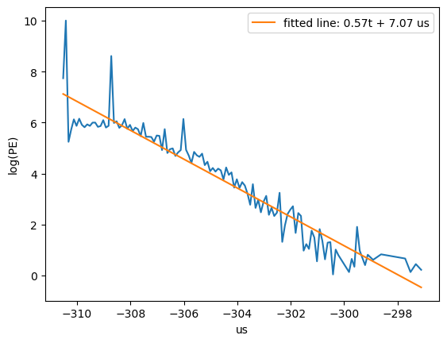
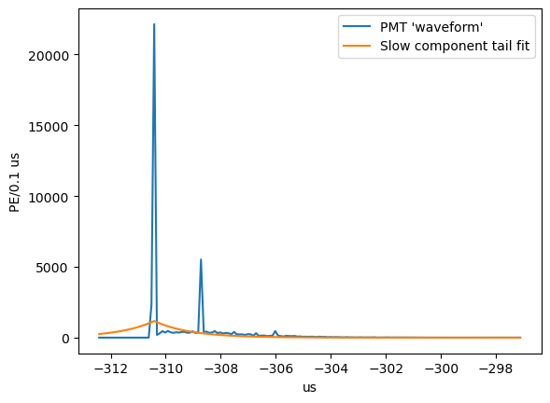
This could just be a fitting issue, since the choice in starting value is dependent on the waveform shape
Since the choice in coefficient is somewhat arbitrary, could try to fit the line then subtract to see any peaks

Slide 8
Tail subtraction
Good in cases where long tail fluctuates, causing misidentification of Michel pulse, eliminating a false positive
Slow component tail “eats” Michel pulse in this case, creating a false negative

Slide 9
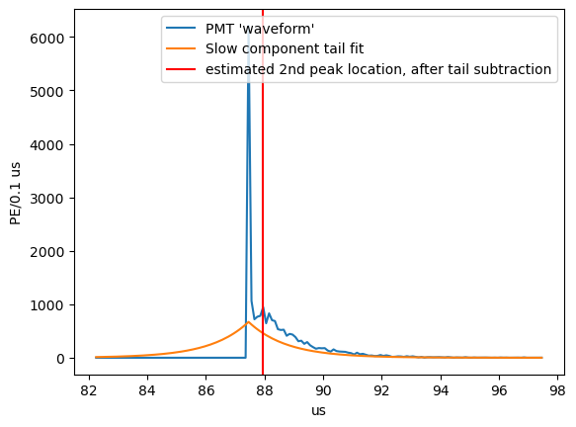
Despite this, there are still issues regarding using this method
Still not always accurate
Have to fit every time, which is computationally inefficient

Slide 10
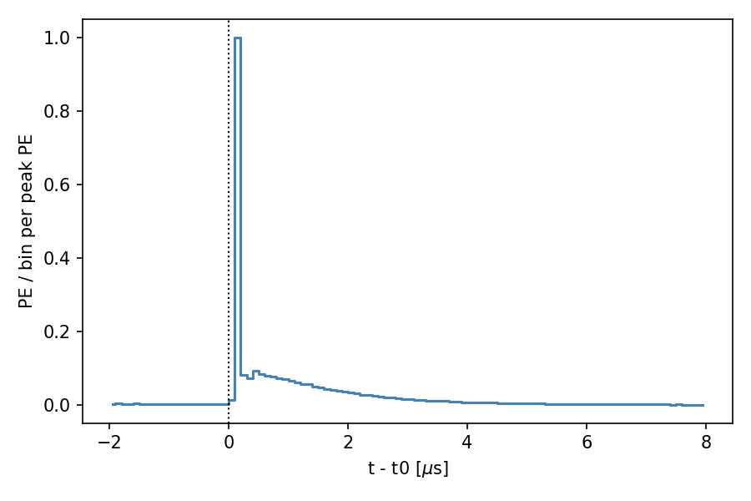
What if we got a prompt profile from many events?
Using many muon events, we can get a general “shape” of the pulse, then use that
  ideally only needs to be run once, then we have the data for use any time after
  Data-driven, so we don’t need to model anything additional, and can directly compare with MC
  This is (initially) done by:
    Selecting for stopping muons within a fiducial volume (z:[10,490], x: [-180,180], y:[-190,190]) with a minimum length cut (20 cm)
    Extracting t0 information and waveform for each event labeled as a stopped muon
    Rejecting waveforms which have secondary pulses
    Aligning and combining these waveforms, before normalizing
    Saving relevant information in a csv
(Waveform of 391 muon pulses)

Slide 11
How to improve this?
Using t0 to center on an event isn’t a very reliable anchor for light pulse identification
  Likewise, since the x-direction is dependent on interaction time, adding a cut for this can exclude a lot of events
  Thus, instead can scan over the entire event window, looking only for “muon-like” pulses

Slide 12
How to improve this?
Checking if a 2nd pulse is really there
  Right now, it calculates the standard deviation of a few bins before the candidate peak, to determine if the PE in the location determined by the peak finding algorithm is above this (and thus a true 2nd pulse). This is not always accurate, and since it follows Poisson statistics, a bit “overkill”
  Instead I can use linear extrapolation from the previous few bins. Since this pulse should follow an exponential decay, I can use a small linear approximation to “guess” the value at the peak PE, and compare this guess to the actual PE observed there to see if it deviates too much

Slide 13
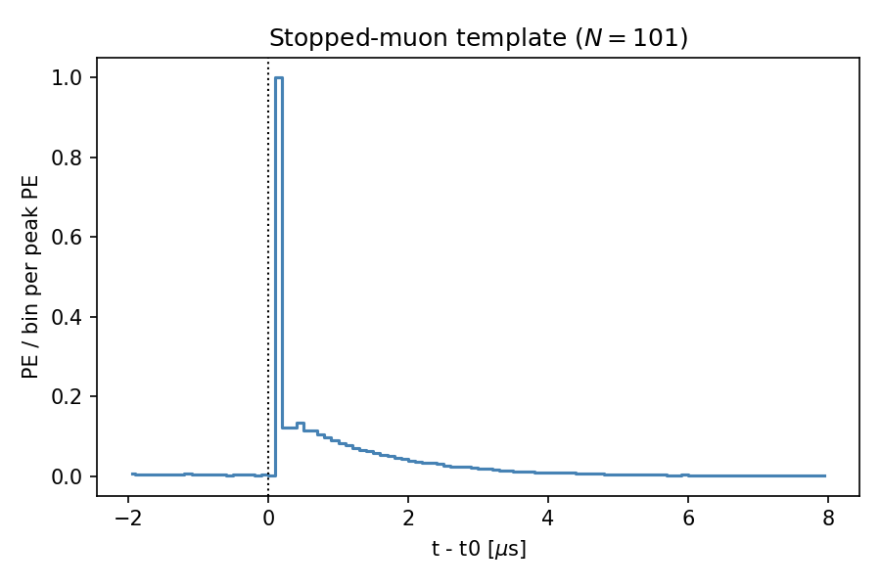
Using the linear extrapolation of previous bins to reject potential secondary pulses

Slide 14
What about a time-cut?

