Slide 1
Imperial Collaboration Meeting
Stefan Söldner-Rembold, Anyssa Navrer-Agasson, Alex Hergenhan, Beth Mountford

Slide 2

Imperial College
1907 Foundation: Formed by Royal Charter, merging the Royal College of Science, Royal School of Mines, and City and Guilds College; independent from University of London in 2007.
Prince Albert’s Vision: Established to fulfill his dream of a cultural and scientific hub in South Kensington (known as "Albertopolis").
Focuses on STEMB subjects (Science, Engineering, Medicine, Business).
The Physics Department has about 400 staff:
    Academic & Teaching Staff: ~140 faculty and teaching fellows.
    Research Staff: ~200 postdoctoral research associates and fellows.
    Professional & Technical Staff: ~90 technical operations and administrative support personnel
The Physics Department hosts roughly 1,400 total students:
    Undergraduates (BSc/MSci): ~1,000 students enrolled across all year groups.
    Postgraduate Taught (MSc/MRes): ~150 students.
    Postgraduate Research (PhD): ~250 doctoral student

Slide 3

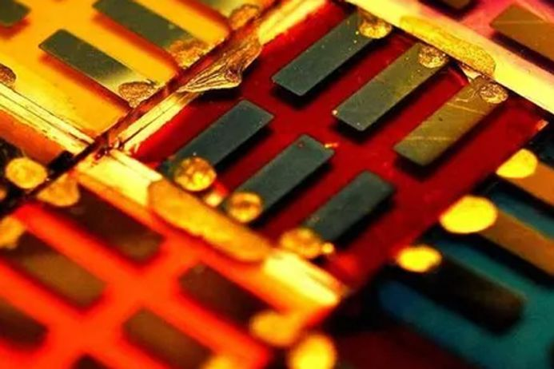
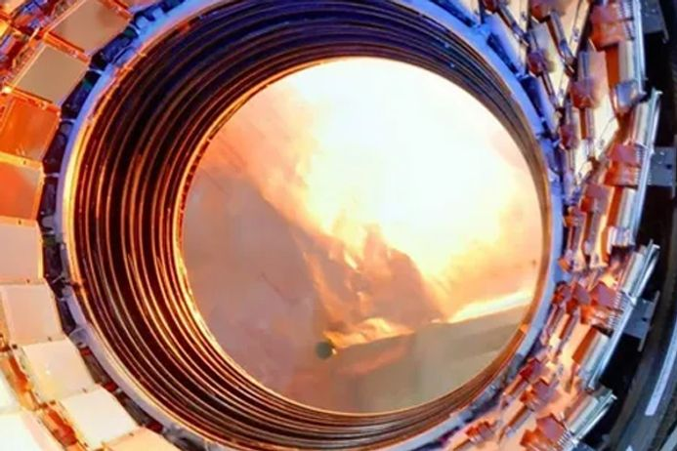


Light | Matter | Physics of Particles | Physics of Universe | Space, Plasma and Climate
Biomedical imaging and diagnosis Nanotechnology and nanophotonics Quantum optics Laser science | Renewable energy new materials Sensing and computation Novel quantum sensors and simulators | Particle interaction Search for new fundamental particles, new forces and new phenomena Accelerator and detector design | Dark matter New particles Cosmology Gravity Quantum theory | The quest for fusion energy Understanding changes in our planet’s climate system Hazardous space weather

Slide 4
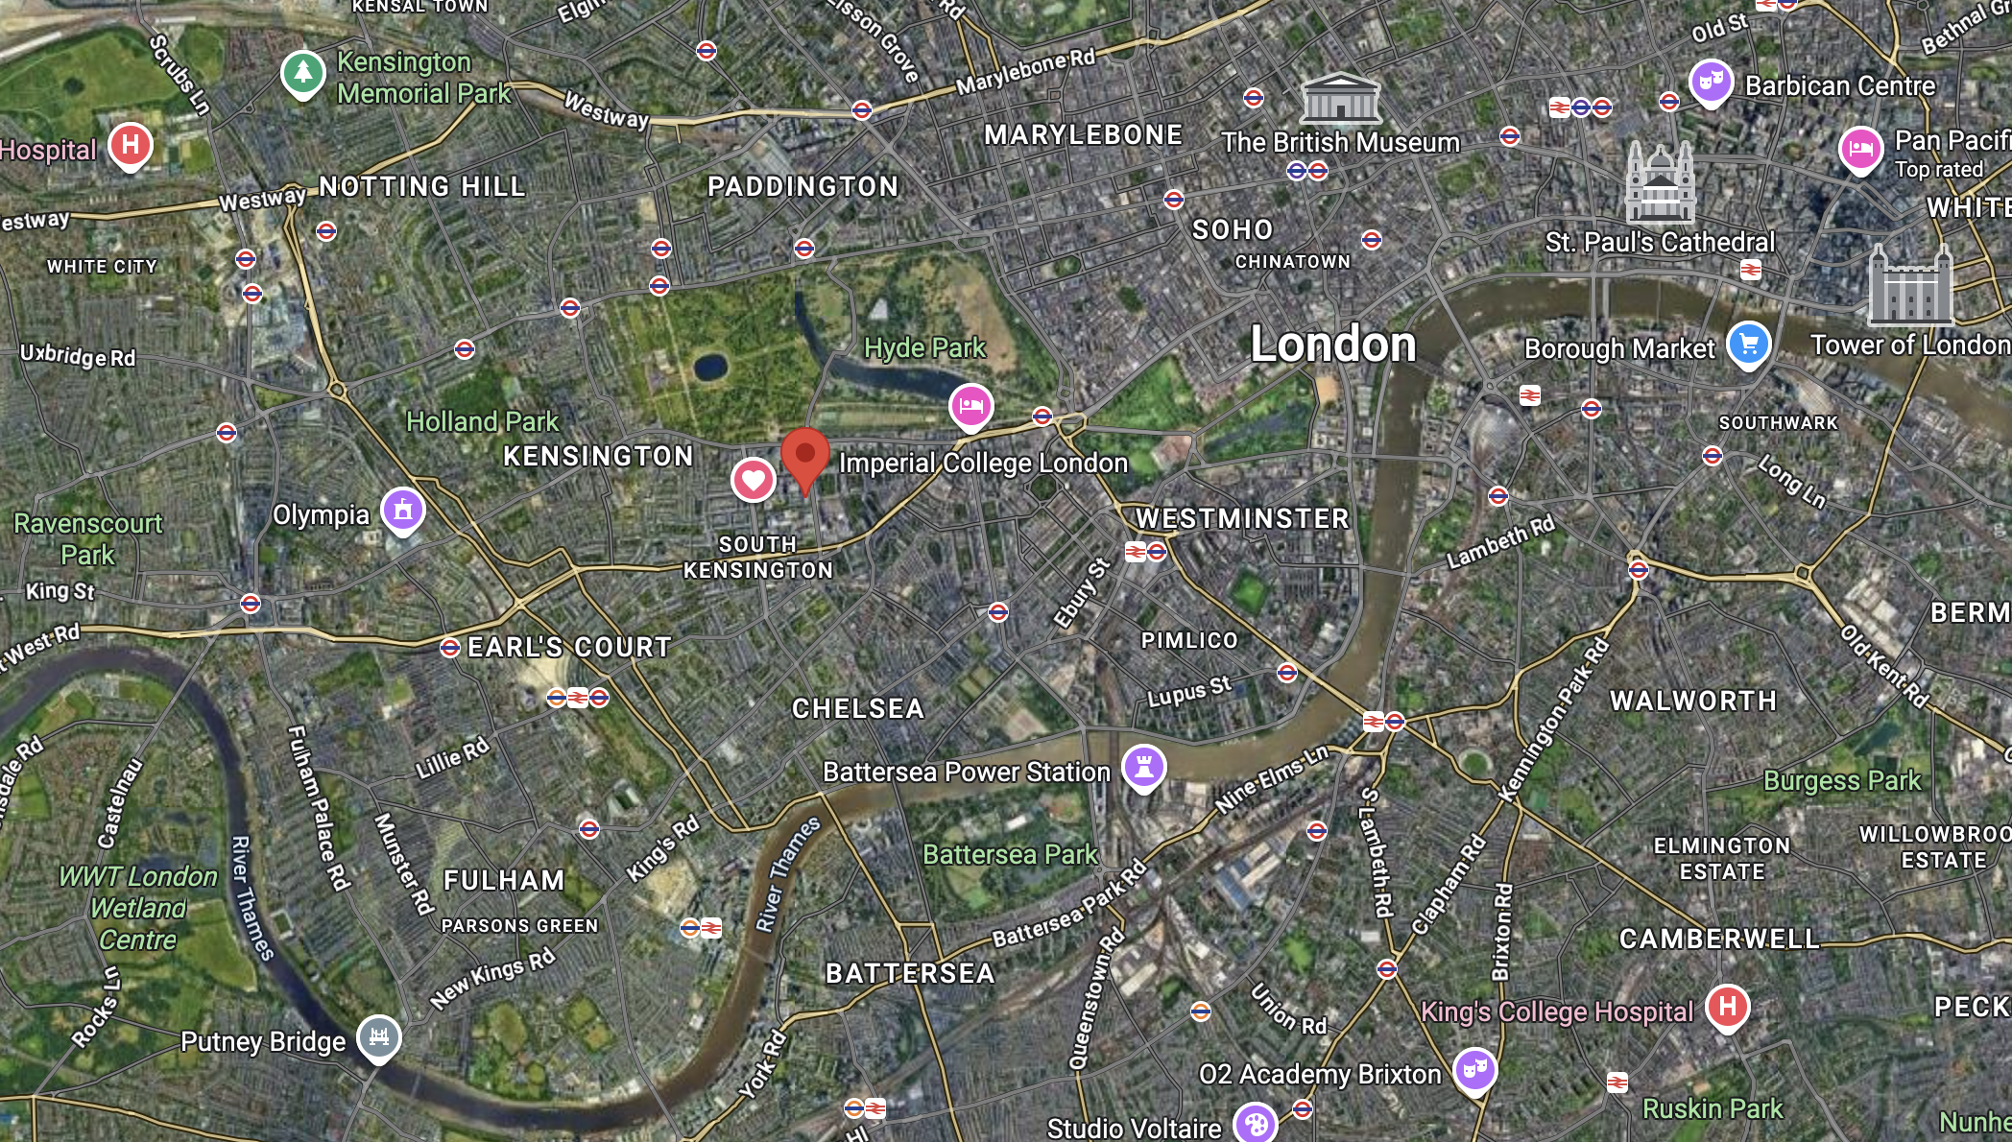
Location – in the centre of London

Slide 5
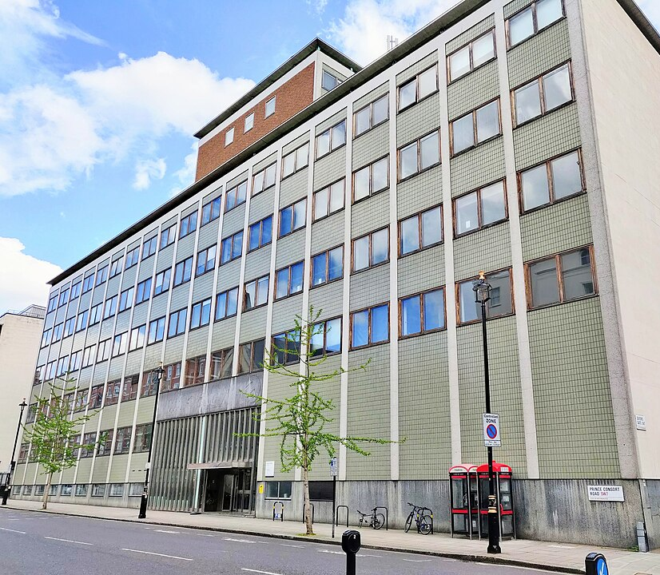
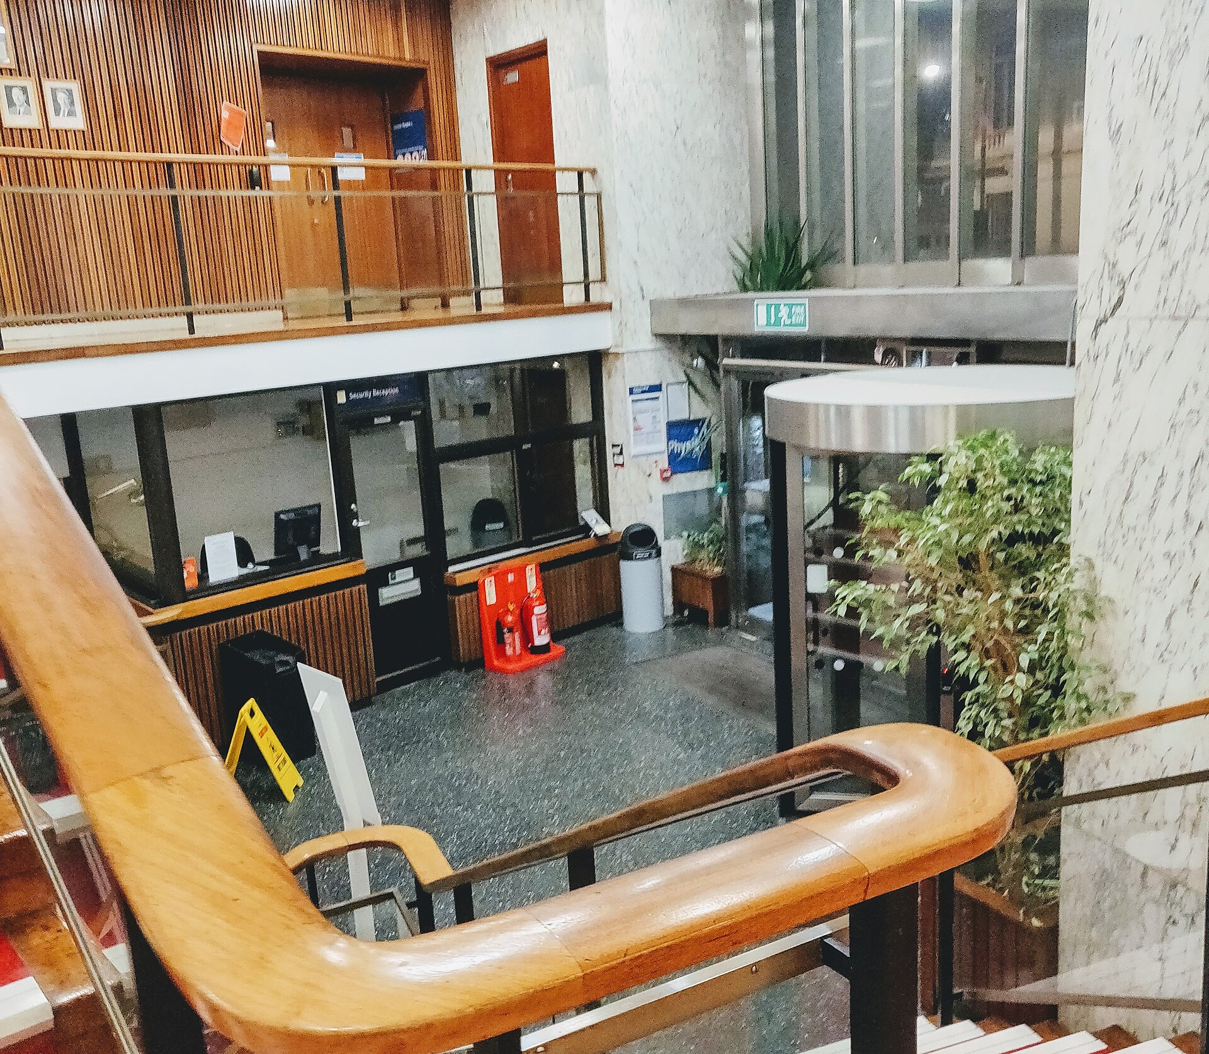
Blackett Laboratory

Slide 6
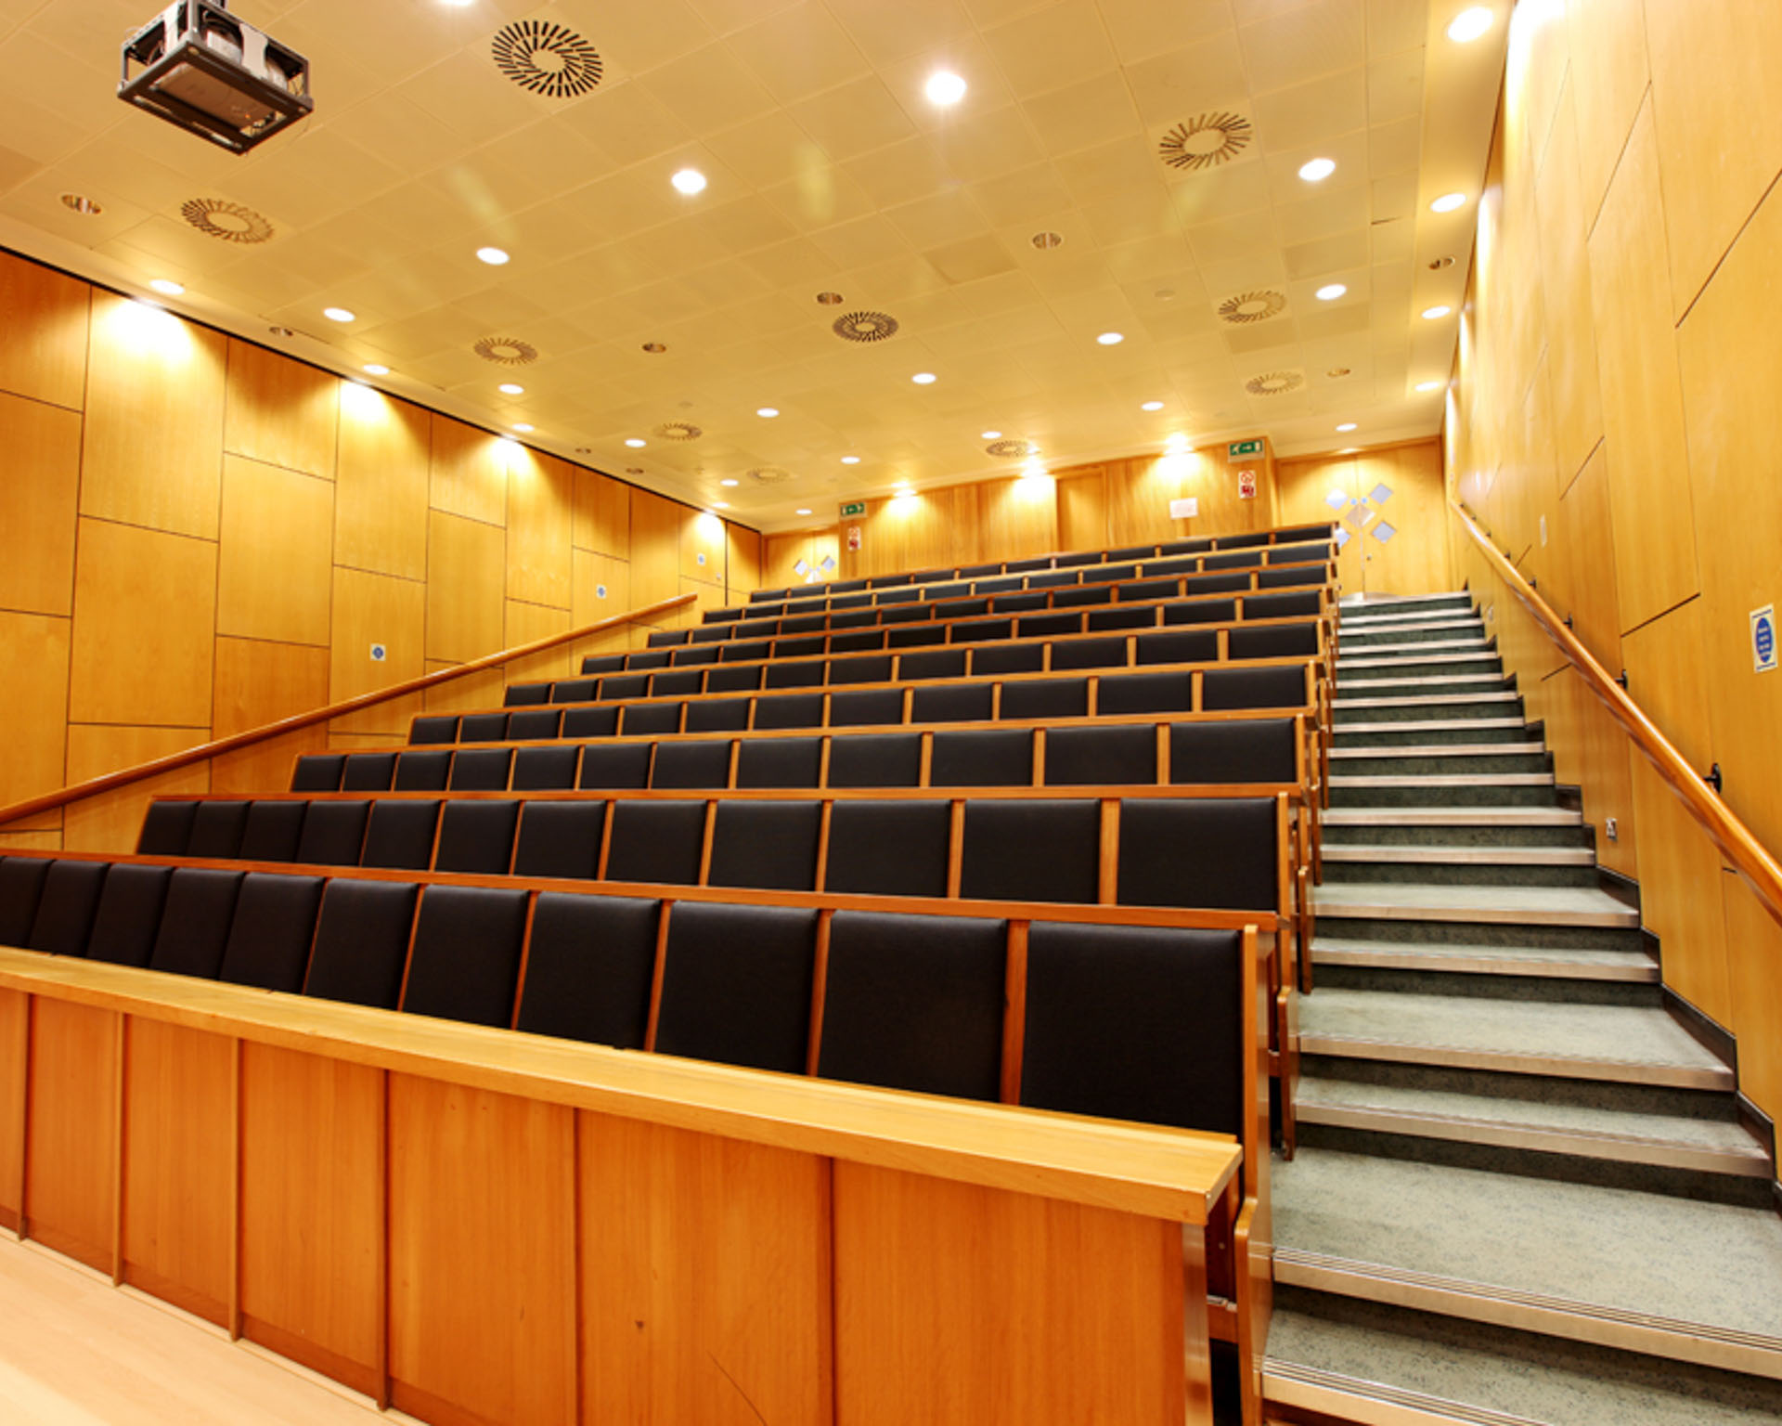
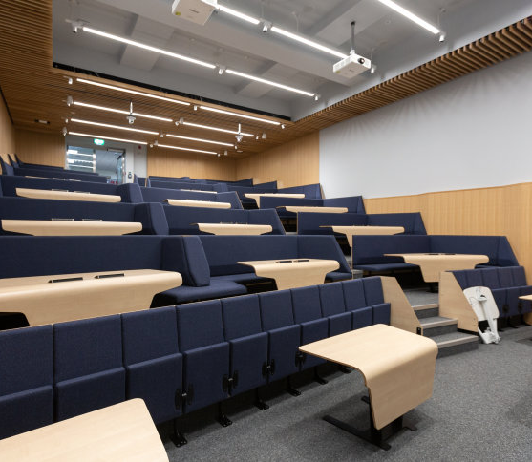
Lecture Theatres

Slide 7
Accommodation
You can use the usual hotel booking sites which provide a large number of hotels within London. You might want to chose a hotel that is easy to reach by public transport (bus or tube).
There are also several reasonably priced hotels north of Imperial (on the other side of Hyde Park, around Lancaster Gate/Paddington), which are within walking distance.
Right next to Imperial College is Princes Gardens, which is student accommodation: https://www.imperial.ac.uk/visit/summer-accommodation/
It can be booked through this website - but also on booking.com.
On the web page, we also have a selection of preferred hotels with a negotiated rate for Imperial guests along with instructions on how to access the negotiated rates. These hotels we would usually recommend for guests coming to campus but they are still somewhat more expensive than the options above.

Slide 8
Transport
London is connected through several airports and train connections. The best airport for Imperial College is Heathrow, but travel time from other London airports is also between 1 and 2 hours.
There is no need for rental cars. There are both black cabs and UBER. There are several bike rental services (Lime, Forest...).
When arriving at Heathrow, you can either use the tube (Piccadilly or Elisabeth Line) or the Express Train to Paddington. The express train to Paddington is only marginally faster (about 15 mins) but more expensive. It leaves from the same platform as the Elisabeth Line so be careful to board the right train.
When arriving at the airport, there is therefore no need to buy a train ticket. On all London public transport, you can use either an Oyster Card or any credit card. It is important that you stay consistent with the use of the card when tapping in and out, as it will automatically calculate the best tariff for you on a daily/weekly basis. More info on registration page.

Slide 9
Entering the UK
    You can find more information about entering the UK on these government web pages:
      https://www.gov.uk/uk-border-control/before-you-leave-for-the-uk and https://www.gov.uk/check-uk-visa
In general, citizens from the EU/EEA, Switzerland, the USA, Australia, Canada, and Japan will need an electronic travel authorisation (ETA). This list is not necessarily complete and you need to check for your country of citizenship. You will be able to apply for the ETA online. It costs £10 per applicant and is generally valid for multiple entries over a 2-year period.
Please note that dual citizens (with British Citizenship) can't use the ETA system (you will normally need your British passport to enter the UK).
If you need an invitation letter or other help, please contact Beth Mountford (ph.ea@imperial.ac.uk) with cc: to Stefan.Soldner-Rembold@imperial.ac.uk.

Slide 10
Registration Fee
We will need to charge a registration fee for coffee etc, and the dinner. The exact amount will be determined when we have better numbers, but it should be about £110.
We will send payment information later (no need to pay now).
Conference Dinner at Stein’s: https://berlininkensington.stein-s.com/
Please register now at https://indico.global/event/18420/ and book accommodation.
Contact us if you need help.

Slide 11
We look forward to welcoming you at Imperial.
17/07/2026

