Slide 1
Online computing
IRFU computing strategy workshop
Computing strategy for distributed,
heterogeneous and time-critical systems
Shebli Anvar & Ozgur Sahin

Slide 2
Online computing X distributed systems across scales
Distribution is necessary at every scale
CPUs, GPUs, FPGAs and ASICs must work as one scientific system.
Scale | Hardware | Dominant design constraints
Detector edge | FPGAs and ASICs | Nanosecond inference, fixed latency and synchronisation
Onboard systems | Embedded platforms | Power, telemetry and autonomy
Online farms | CPUs and GPUs | Throughput, data movement and load balancing
Compute sites | HPC / data services | Data locality, orchestration and reproducibility
Going down to nanosecond scale, links and synchronization becomes the biggest consumer of the budget.
Priorities: co-design, portable software and validation of the full chain

Slide 3
Online computing X
AI strategy at the LHC
CERN AI, ATLAS AI and CMS AI strategy groups
Next Generation
Triggers (NGT)
Puts strong emphasis on online computing and AI integration
Not only for data processing but also data quality monitoring and validation, detector operations: intelligent
A concrete R&D programme for
ATLAS and CMS at the HL-LHC
and beyond
Common software for
heterogeneous architectures
Genesis Mission (US DoE)
Hardware-aware AI and
fast inference on trigger systems
Connect scientific facilities, data
and AI/HPC resources

Slide 4
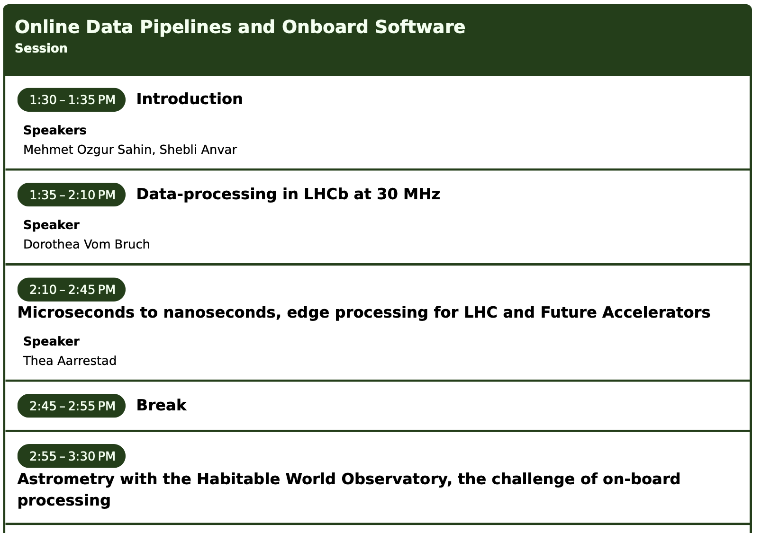
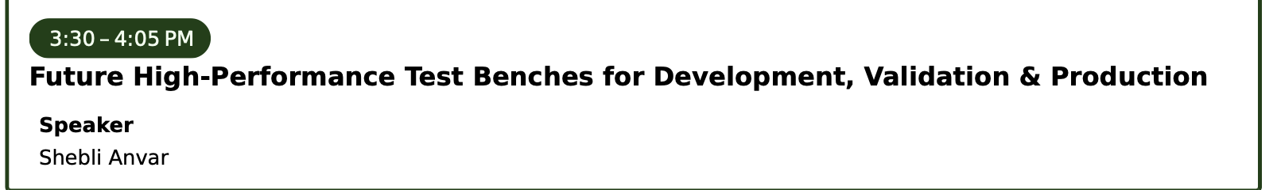
This afternoon’s programme
First speaker: Dorothea vom Bruch

