Slide 1
OPMD meeting
9th Aug 2021
E. G. Villani
OPMD meeting 9thAug2021

Slide 2
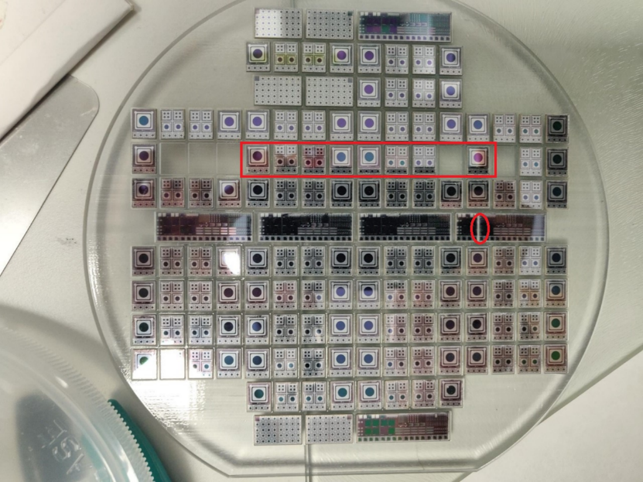
  LGAD WF2 diced tests
1
2 (Bham)
P/L
P/L
5
P/L
4
3
P/L
P/L
Gain test on Diced devices from WF2, position #5
Position 1,2,3,4 ready to test
OPMD meeting 9thAug2021
1

Slide 3
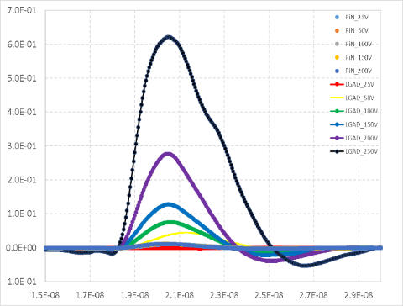
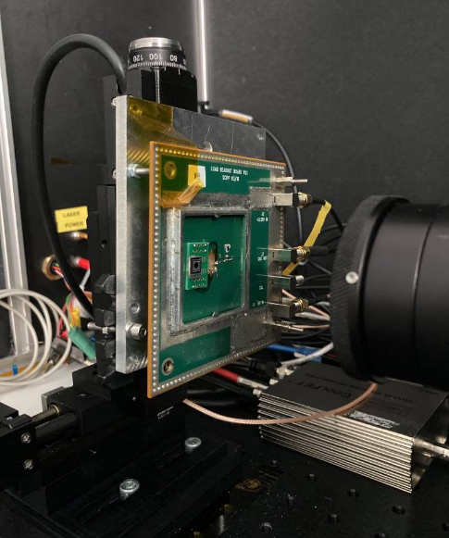
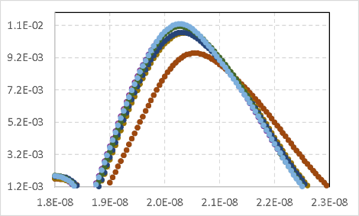
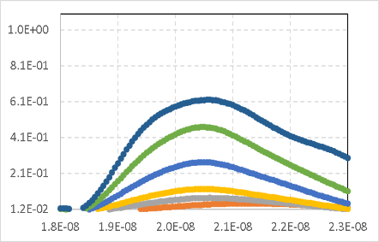
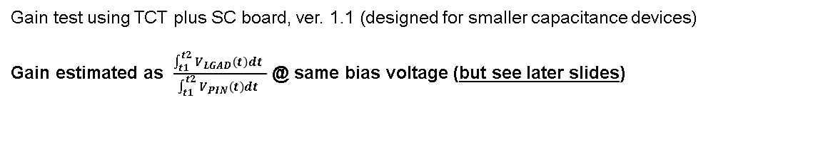
  LGAD WF2 diced tests
Vout [V]
LGAD - PIN
TCT
Vbias
Time [s]
DUT
Vout [V]
Vout [V]
230V
Vbias
PIN
LGAD
SC board
230V
Vbias
50V
50V
Time [s]
Time [s]
Gain test using TCT plus SC board, ver. 1.1 (designed for smaller capacitance devices)
Gain estimated as $\frac{\int_{t1}^{t2}{V_{LGAD}\left(t\right)dt} }{\int_{t1}^{t2}{V_{PIN}\left(t\right)dt} }$ @ same bias voltage (but see later slides)
OPMD meeting 9thAug2021
2

Slide 4
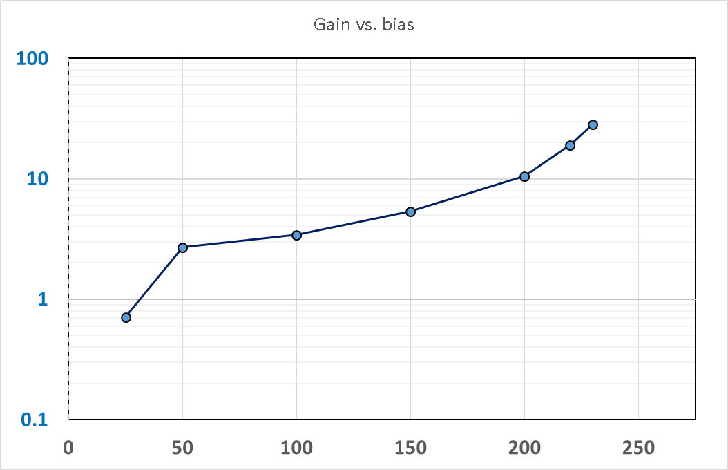
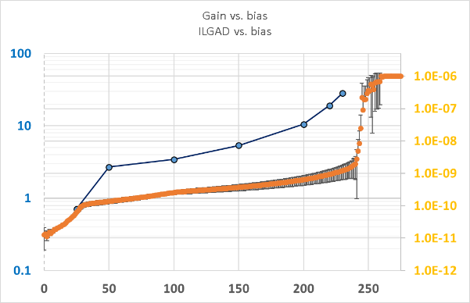
  LGAD WF2 diced tests
Gain [A.U]
Gain [A.U]
I [A]
<Ilk> of 5 LGADs
Vbias [V]
Vbias [V]
LGAD 4mm gain vs. bias voltage for TCT DAC setting =1980
Need to test with other TCT settings
Hint of TI saturation at higher signal output
* Charge collected estimated by dividing area by TI gain (see later)
OPMD meeting 9thAug2021
3

Slide 5
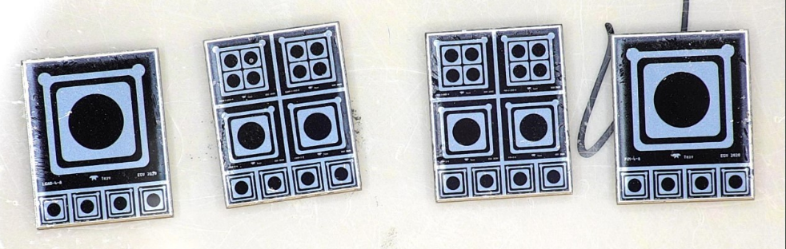
  LGAD dicing
From Scitech:
“(omissis) We have our second laser online now. (omissis)..we can dedicate this laser (this is UV laser though, n.d.r) for your work whilst using the other one for all our other projects. Meaning we should be able to deliver you the 2 wafers without any delay”
WF3 (Birmingham) and WF10 (Oxford) given to Scitech last week for dicing
WF3 first, we’ll test it to check all ok then proceed with WF10
OPMD meeting 9thAug2021
4

Slide 6
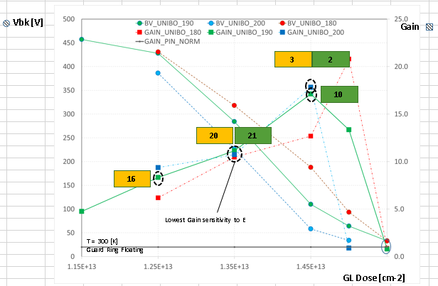
  LGAD Wafers
High Gain region
Focusing on the ‘highest’ gain region at the moment
Currently testing diced WF2 (Oxf)
Dicing WF3 and WF10
WF10 will be tested at Oxf
WF3 will be sent back to Bham for irradiation
WF3 (Birmingham) and WF10 (Oxford) given to Scitech last week for dicing
OPMD meeting 9thAug2021
5

Slide 7
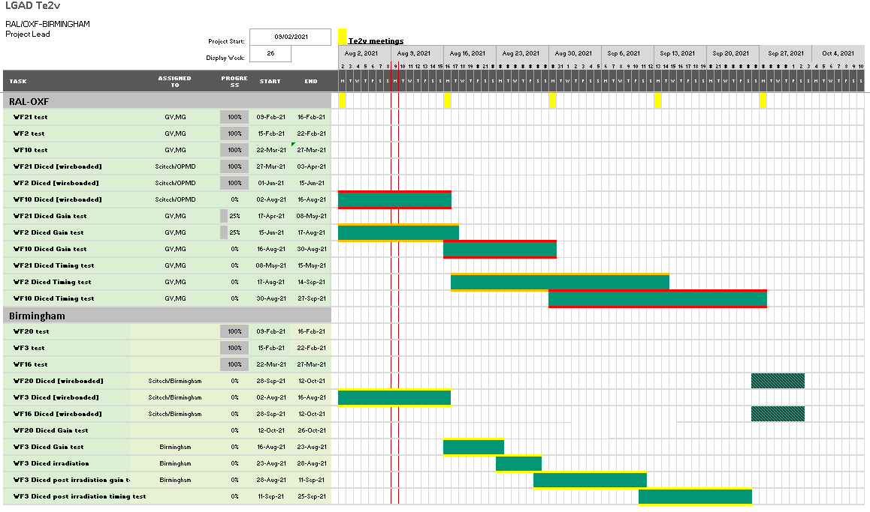
  LGAD plan
Plan is to get end of Sept with WF2/3 pre-post irradiation tested (gain and timing) and WF10 pre-irradiation gain and timing tested
OPMD meeting 9thAug2021
6

Slide 8
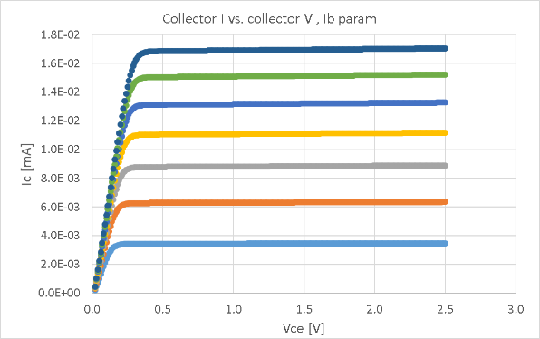
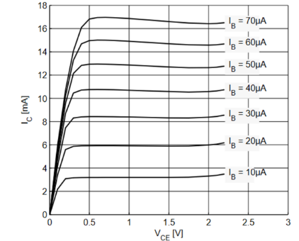
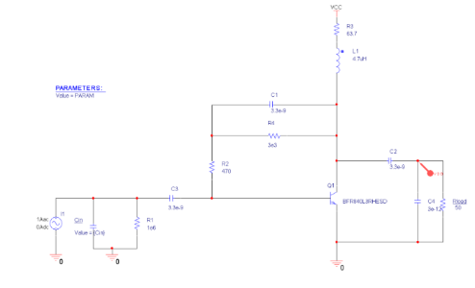
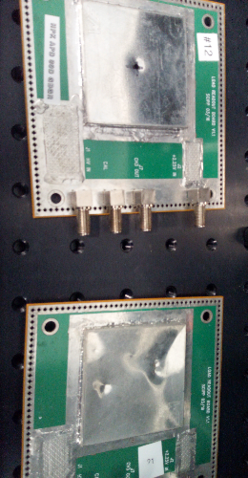
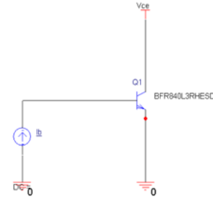
  SPICE simulation of SC board ver. 1.1
Ib=70uA
Ib=60uA
Ib=50uA
Ib=40uA
Ib=30uA
Ib=20uA
Ib=10uA
From Infineon BFR840L3RHESD Datasheet
Cadence Orcad 16.6 ver. Simulation
DC simulation of SiGe NPN transistor used on SC board ver. 1.1
SC ver. 1.1. schematic
OPMD meeting 9thAug2021
7

Slide 9
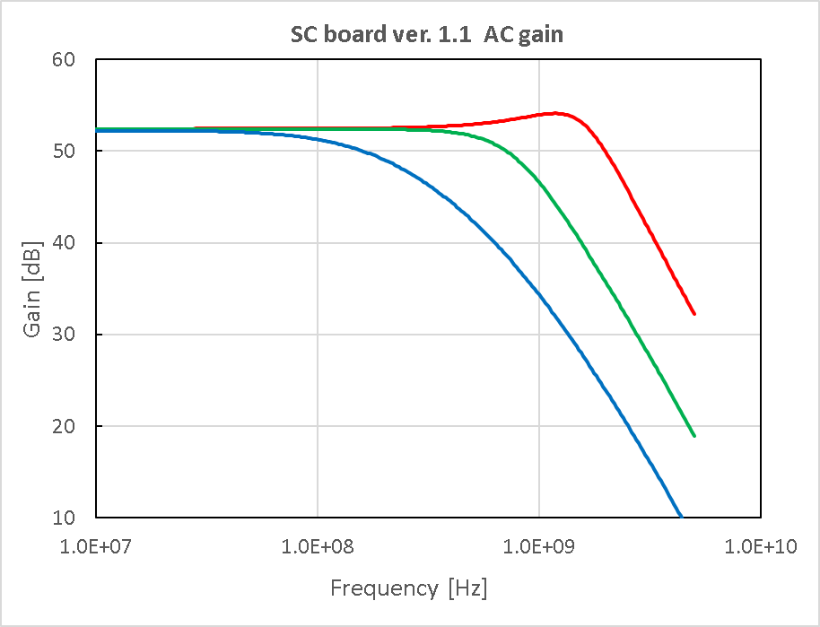
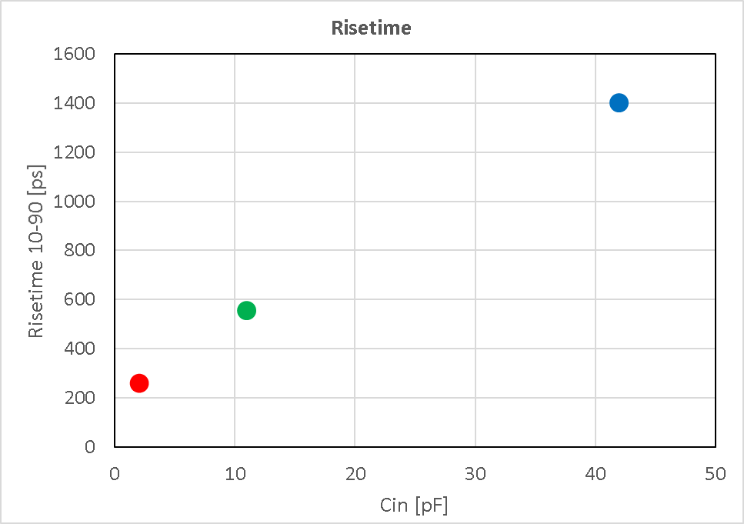
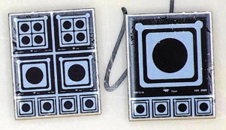
  SPICE simulation of SC board ver. 1.1
Cin = 2 pF BW[-3dB] ∼2 GHz
LGAD 4mm
Cin = 10 pF BW[-3dB] ∼0.8 GHz
Cin = 20 pF BW[-3dB] ∼0.2 GHz
LGAD 2mm
T = 25 C
Rl = 50 Ohm
LGAD 1mm
4mm
V-AC simulation of SC board ver. 1.1
Max gain around 52.4 dB or ∼ 417 [V/A] (might be too small)
BW around 2GHz for small Cin 2 pF (i.e. LGAD 1 mm)
BW decreases down to 0.2 GHz for 42 pF (i.e. bigger size LGAD 4mm)
Rise time vs. input capacitance decreases and, for 4 mm LGAD, is ∼ 1.4 ns
Investigating how this affects CCE
2mm
1mm
OPMD meeting 9thAug2021
8

Slide 10
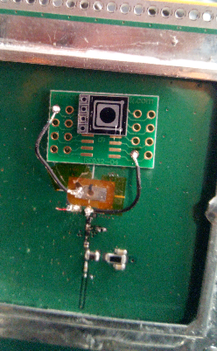
  SPICE simulation of SC board ver. 1.1
SMD carrier
SiGe NPN
Currently we have only 1 SC board that can be used (#8)
Board #1 has an issue with the SiGe NPN
The other 2 boards have HPK and CNM LGAD fitted
Purchased #10 SiGe NPN for replacement
Purchased #10 SMD carriers for device test
  #3 LGADs and #1 PIN ready to be glued and bonded
OPMD meeting 9thAug2021
9

Slide 11
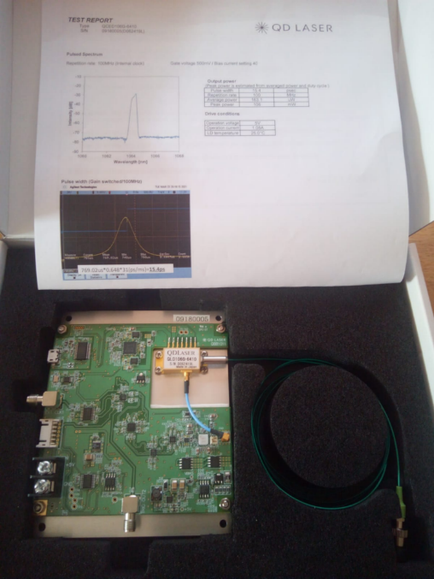
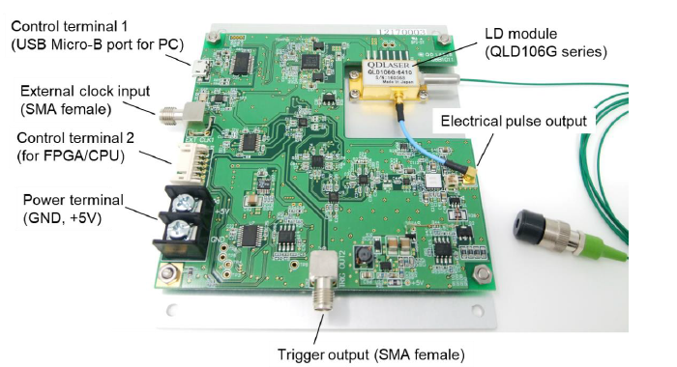
  15 ps Laser system
15 ps 1064 nm laser system just purchased
WIn10 GUI but with set of commands for remote control via USB
Internal and external trigger (0.012 - 200 /0.1 - 750 MHz)
OPMD meeting 9thAug2021
10

Slide 12
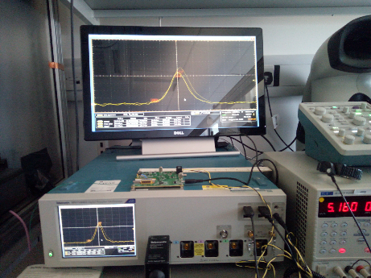
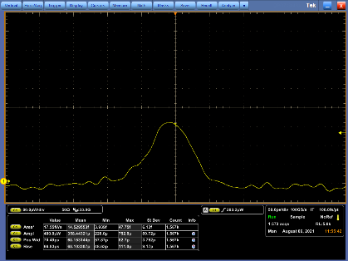
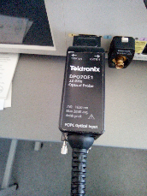
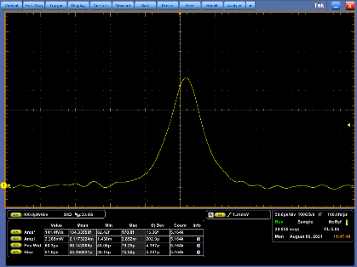
  15 ps Laser system
Vb 1005 Ibias = 6 mA 12 kHz
Vb 1130 Ibias = 9 mA 12 kHz
Trying various settings to check energy and timing
Energy deposited down to 14.5 fJ, rise time around 50 ps
OPMD meeting 9thAug2021
11

Slide 13
  Summary - Next step
  Gain test on WF2 devices just started, results seem to indicate G >10 for Vbias 200V
  NEXT
  Fix the SC board(s) / understand the RF amplifier we have
  Complete gain test in WF2 devices (4-2-1 mm), using SC board / TCT//Trilite system
  Dicing of WF10 and WF3 @ Scitech
  Start gain test of WF10 when available
  Start some gain test of WF3, then proceed with irradiation of diced devices from WF3 [alternatively irradiate some devices from WF10]
  Aim at getting complete characterization of WF2/3 and WF10 pre/post irradiation by end September
OPMD meeting 9thAug2021
12

