Slide 1




What does AI-Ready Accelerator Data mean?
Nuclear AI-Ready Accelerator Data (NARAD) — an operational-layer ontology and data standard for DOE accelerator facilities
01 · AGENTIC WORKFLOWS
FACILITY ONTOLOGY
Ontological input for agents (e.g. Osprey)
Databases/knowledge graphs that LLM agents can query to reason about device relationships, dependencies, and operational intent
Controls, lattice, diagnostics, signals, and operational context
02 · DIGITAL TWINS and CO-DESIGN
Element & signal semantics
Ontological channel-finding
Device → process → system hierarchy
Support live/archived data:
state, setpoints, readbacks
Provenance, units, uncertainty
Standards-based
Shared schema for digital twin frameworks
Common element, signal, and state vocabulary so twins can be populated, synchronized, and compared across facilities
03 · AMERICAN SCIENCE CLOUD
Export of facility state/context for publication
Structured, governed, FAIR publication of accelerator state and metadata so cross-facility AI can consume it at scale
Collaboration: JLab, BNL, LBNL, PNNL, and Cornell – funded FY26/FY27 through AmSC Data Provider Partnerships
Motivated substantially by Tennant arxiv “A Core Ontology for Particle Accelerators: Interoperable Data and Workflows...”
Notes:
Guidelines: 6-8 bullets per slide; Use sentence fragments for bullets

Slide 2


CEBAF Application (MaLAPA’26)
An authoritative facility database (CED) and an emerging community standard (PALS). Each solves half the problem.
CED
PALS
CEBAF Element Database
Particle Accelerator Lattice Standard
FACILITY-SPECIFIC
IN PRODUCTION
AUTHORITATIVE
FACILITY-AGNOSTIC
EMERGING STANDARD
LATTICE-FIRST
What it holds today
What it defines today
Element inventory: magnets, cavities, BPMs, correctors, diagnostics
Position, length, s-coordinate along the machine
EPICS PV names bound to many controllable devices
Calibration and survey data with provenance
Region and beamline groupings used by operations
Common element types, parameters, and lattice topology
  Basis for a lattice ontology but not controls ontology
Cross-code interchange (MAD-X, elegant, Bmad, ...)
Designed for cross-facility reuse and tooling
Active collaboration across DOE labs and universities
Extension points for facility-specific semantics
Gaps: no standard schema — CEBAF-shaped, with CEBAF-specific tables and conventions.
Gaps: no operational layer — no control channels, no live state, no EPICS bindings
CED IPAC’15 paper link
https://pals-project.readthedocs.io/en/latest/
Notes:
Guidelines: 6-8 bullets per slide; Use sentence fragments for bullets

Slide 3



CED + Extended PALS → NARAD for CEBAF Knowledge Graph
The integration pipeline: facility truth on the left, standards-based KG on the right, custom extensions in the middle.
SOURCE
BRIDGE
PRODUCT
CED
PALS + Extensions
Knowledge Graph
CEBAF Element Database
Standards + ontology add-ons
Devices, signals, regions as typed nodes
Device inventory & geometry
Some EPICS PV bindings
Region / beamline tables
Calibration, survey, provenance
PALS core lattice schema
EPICS → element mapping
Region / signal-type ontology
Unit, provenance, uncertainty
Typed nodes & typed edges
Cypher-queryable
Live state bound to devices
Machine-interpretable context
Facility truth, as it lives today
Reusable semantic/ontology layer
What agents actually consume
CED provides facility-specific content. PALS provides the shared grammar. Custom extensions map EPICS channels → lattice elements, yielding a NARAD KG that is both authoritative and standards-compliant.
Notes:
Guidelines: 6-8 bullets per slide; Use sentence fragments for bullets

Slide 4
Three-layer PALS-Ext architecture (MaLAPA’26)
Evolving Architecture
Separates facility-independent physics semantics from facility-specific controls implementation.
1
Facility Agnostic
PALS-Ext · RF cavity gradient · YAML
CAPABILITY LAYER
What a device can do or report
RFCavityGradientProfile:
kind: PALSExtProfile
PALSExtP:
capabilities:
- { id: cap:gradient_setpoint,
kind: setpoint,
quantity: cavityGradient,
units: MV/m }
- { id: cap:gradient_readback, … }
- { id: cap:gradient_max_hard, … }
signals:
- { id: sig:gradient:setpoint,
role: setpoint, units: MV/m,
implements: cap:gradient_setpoint }
- { id: sig:gradient:readback, … }
R221: # cavity 1 of CM22
kind: RFCavity
PALSExtP:
uses_profiles: [RFCavityGradientProfile]
bindings:
facility: CEBAF
control_system: EPICS
channels:
- { signal: sig:gradient:setpoint,
pv: "R221:GSET", direction: write }
- { signal: sig:gradient:readback,
pv: "R221:GMES", direction: read }
Quantities: cavityGradient, magnetCurrent, beamLossRate, …
Roles: setpoint, readback, status, limit · Units + constraint types
No facility naming, no PVs — just physics affordances of a device class
2
Facility Agnostic
INTEROPERABLE SEMANTIC SIGNAL LAYER
Interoperable interfaces for capabilities
Each signal = quantity + role + units + implements → capability
The unit of interoperability for tools, workflows, and agents
“All gradient-setpoint signals upstream of detector X” — no PV needed
3
Facility-Specific
FACILITY-SPECIFIC CONTROLS BINDING LAYER
Signals → concrete control-system channels
EPICS PVs, archiver keys, access protocols (CA, PVAccess, REST, ADO)
Permissions, cadence, operational metadata
Multiple bindings per signal: live / archive / simulation
Notes:
Guidelines: 6-8 bullets per slide; Use sentence fragments for bullets

Slide 5
Status and next steps (MaLAPA’26)
Where we are today, what’s coming, and how this feeds back into the NARAD framing.
TODAY
NEXT
THEN
CED + PALS subset, in hand
LinkML schema development
Cross-facility uptake
A CEBAF region lifted into PALS form, wired to EPICS through a custom ontology extension, exposed as a Cypher-queryable KG.
Develop a larger LinkML schema for verification and validation
Develop a framework for standards-based ontology and knowledge graphs
Implement the schema and patterns to partner facilities (BNL, LBNL, other volunteers) so NARAD evolves as a multi-facility standard
WHERE THIS PLUGS IN · back to the NARAD framing
01
Agentic workflows
02
Digital twins
03
American Science Cloud
Osprey and other LLM-driven optimizers query the KG for authoritative facility context.
Sample digital twins share the same vocabulary and ground truth so they can be populated and compared.
FAIR publication including via MOAT — facility state and context, consumable by cross-facility AI.
Notes:
Guidelines: 6-8 bullets per slide; Use sentence fragments for bullets

Slide 6
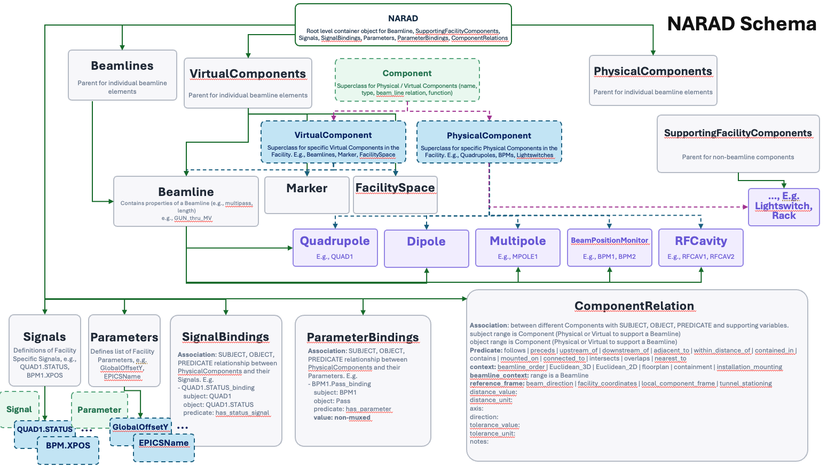
NARAD Schema Evolution (Diana McSpadden, JLab; Jun 29 2026)
https://github.com/MOAT-AI/NARAD-DataServices
Facility-independent base schema (“design, conventions, and standards”)
Facility-specific schema extensions (“implementation”)
Subject/Predicate/Object
triples for knowledge
graph ontology embedding
Balance
  Extensible: descriptive over proscriptive
  Standards-based for ontological portability

Slide 7
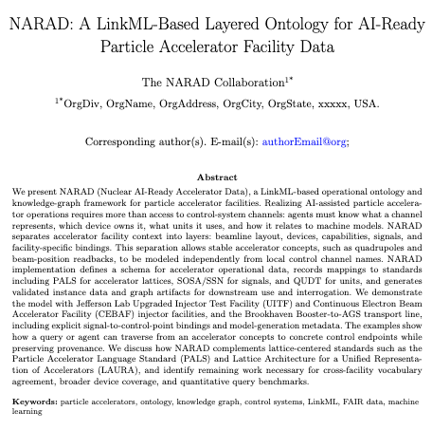
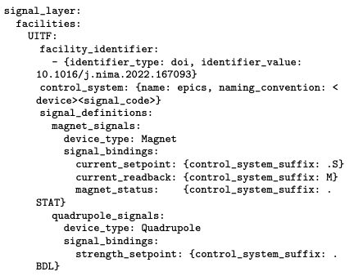
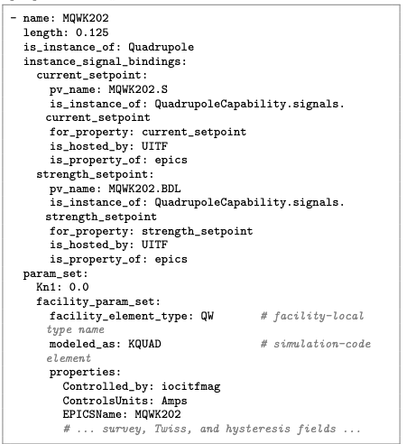
Draft paper for peer-reviewed submission
19pp at present, invited to special edition journal
Motivation, approach, innovations
  Target Use Cases
    facility AI-ready descriptions/channel finding
    facility context for published/exported accelerator data
    AI-ready facility ground truth for twins, co-design
  Design Principles: LinkML, layered ontology
  Example use case: JLab UITF facility

