Slide 1
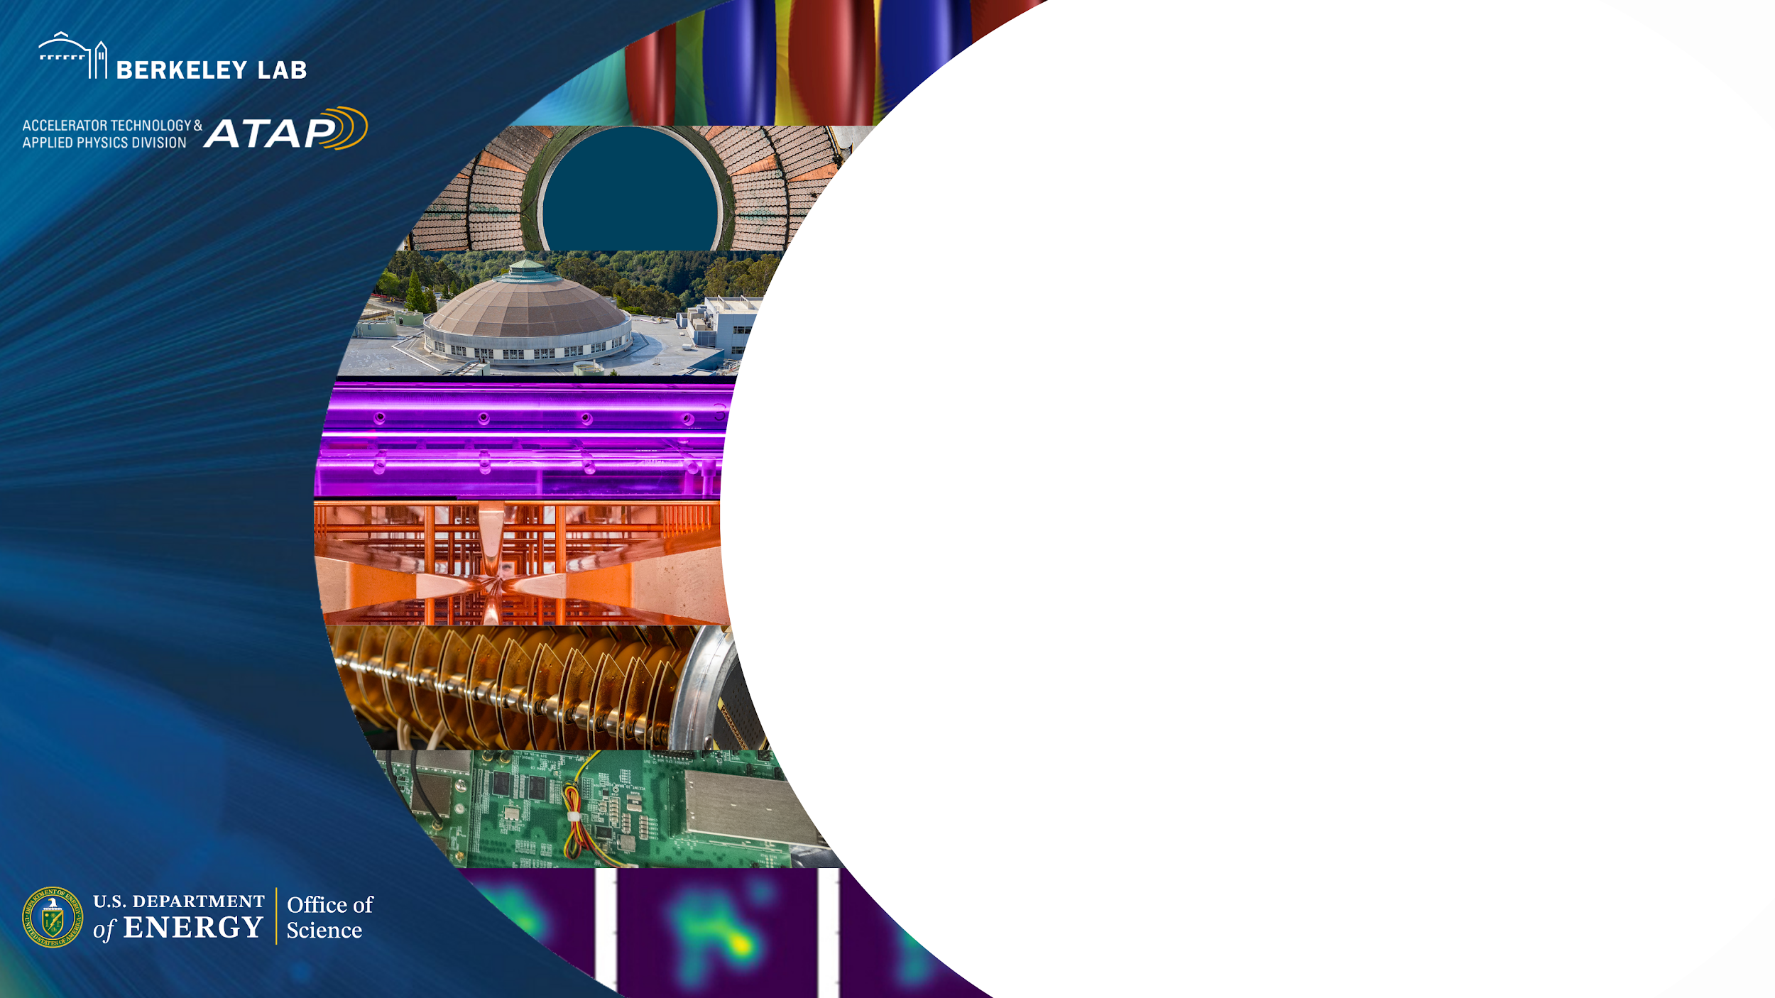

Jean-Luc Vay
Advanced Modeling Program
Accelerator Technology &
Applied Physics Division
Overview of the Multi-Office Accelerator Team (MOAT) collaboration activities
June 30, 2026 meeting
of the EIC-Beam AI WG
and the Accelerator sub-WG
of the AI4EIC WG of the EICUG

Slide 2
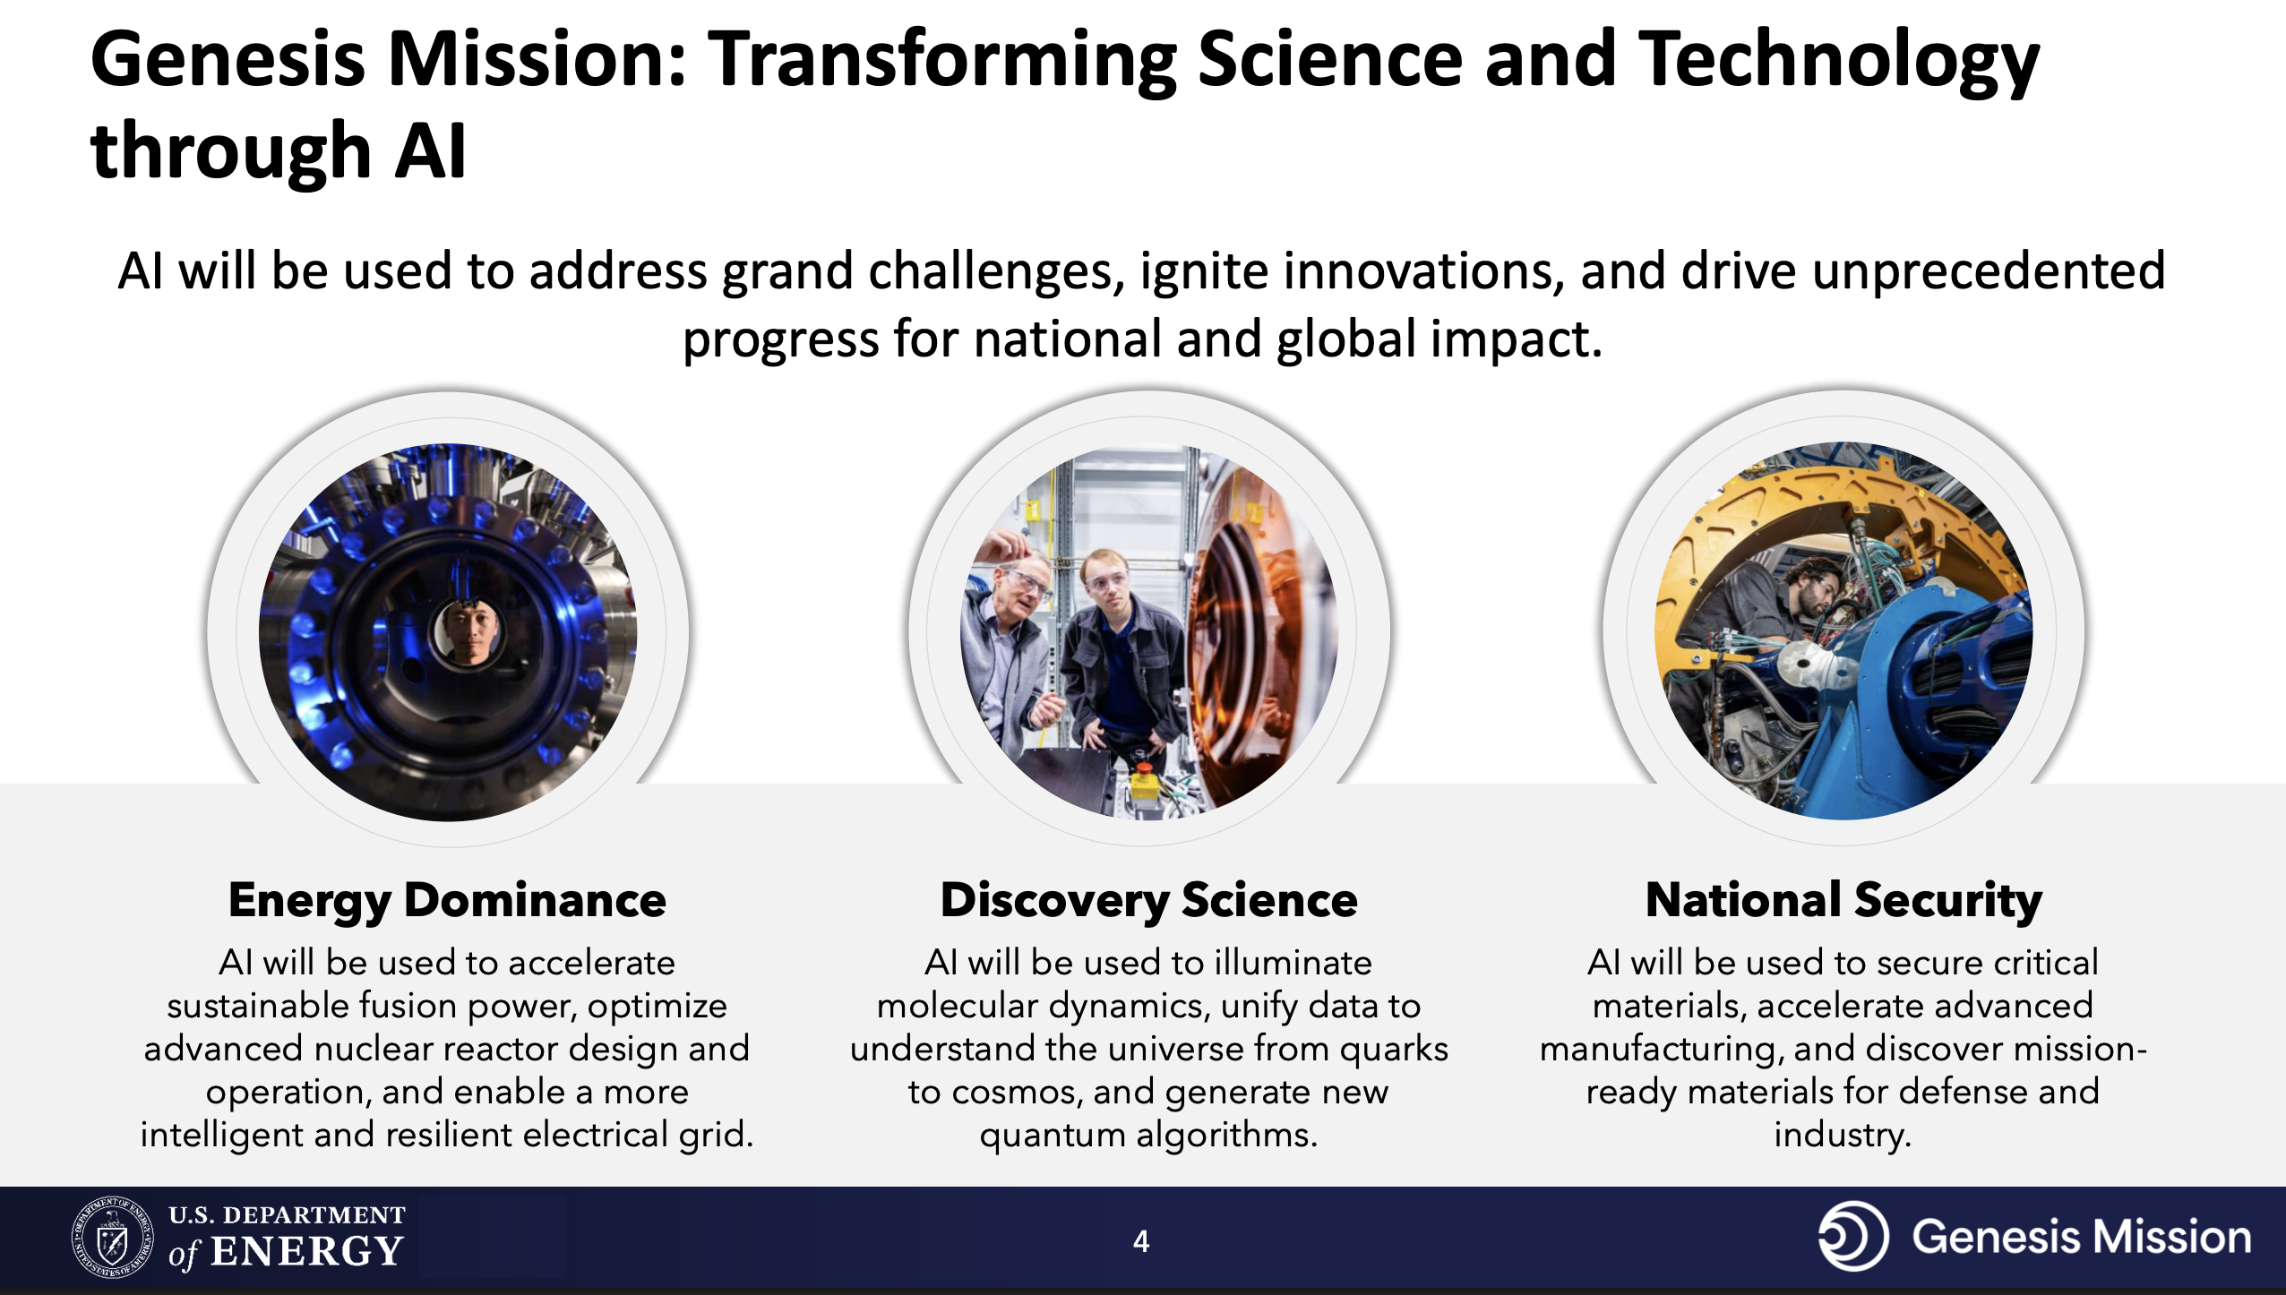
Genesis Mission: A National Mission to Accelerate Science Through AI
New applications require increasingly precise control and challenging-to-achieve beam characteristics
Fermilab
https://genesis.energy.gov
SNS
IOTA

Slide 3

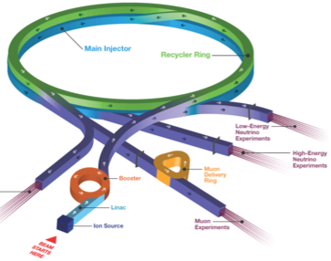
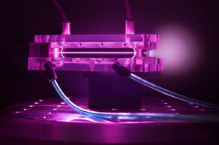


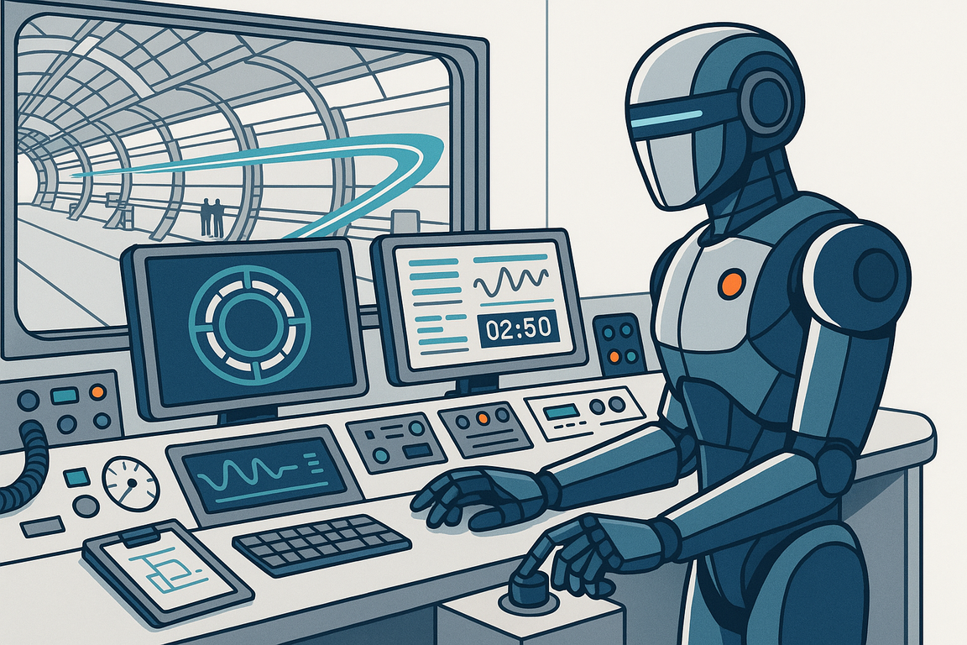

AI is Ideally Suited to Transform Accelerators and Applications
New applications require increasingly precise control and challenging-to-achieve beam characteristics
Long-term vision: AI becomes indispensable partner in accelerators
  Full lifecycle, from design to operation to R&D and workforce development
Many benefits expected to come from AI assistance and control, e.g.:
  Novel designs with integrated optimization
    Including end-to-end, detailed physics, cost, safety, etc
  Faster designs (spans years for largest accelerators, which are among the most complex machines)
  Higher efficiency and performance
  Unprecedented on-demand beam customization and beam quality
  Higher precision (control, pointing, etc)
  Automated failure prediction and prevention
  AI-assisted to fully autonomous operation
  Better colliders, light sources & accelerators for many applications, e.g.:
  DOE accelerator-based science
  Nuclear waste transmutation
  Advanced reactor and fusion concepts
  EUV lithography
  Advanced manufacturing
  Ultracompact accelerators for medical and industrial use
Fermilab
LCLS
SNS
IOTA

Slide 4
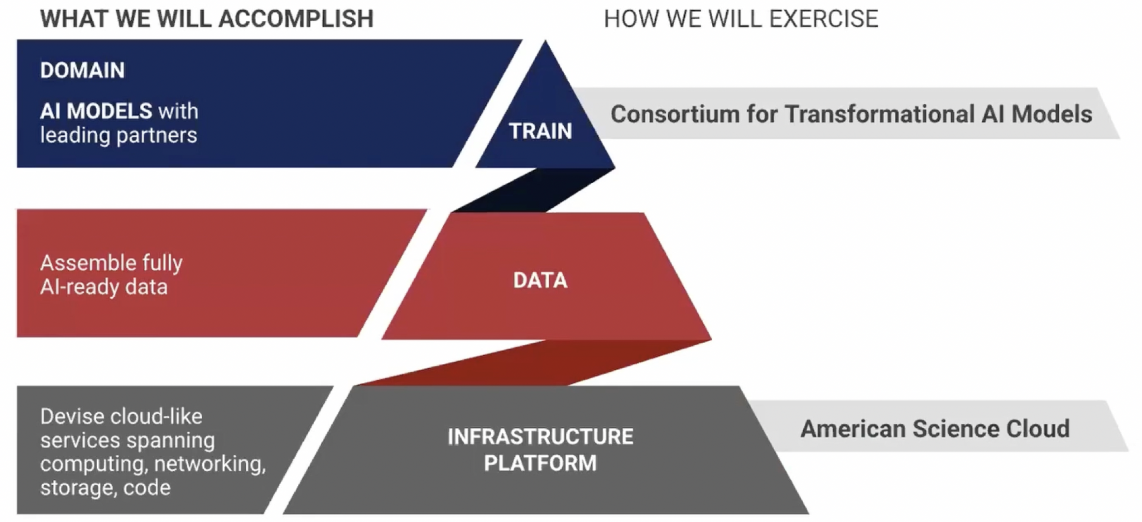
Genesis simplified structure*
(ModCon)
Standardization, AI-readiness
(DaPP)
(AmSC)
*From "Introduction to the American Science Cloud (AmSC) : Part One” – 11/13/2025
https://vimeo.com/1137699305

Slide 5
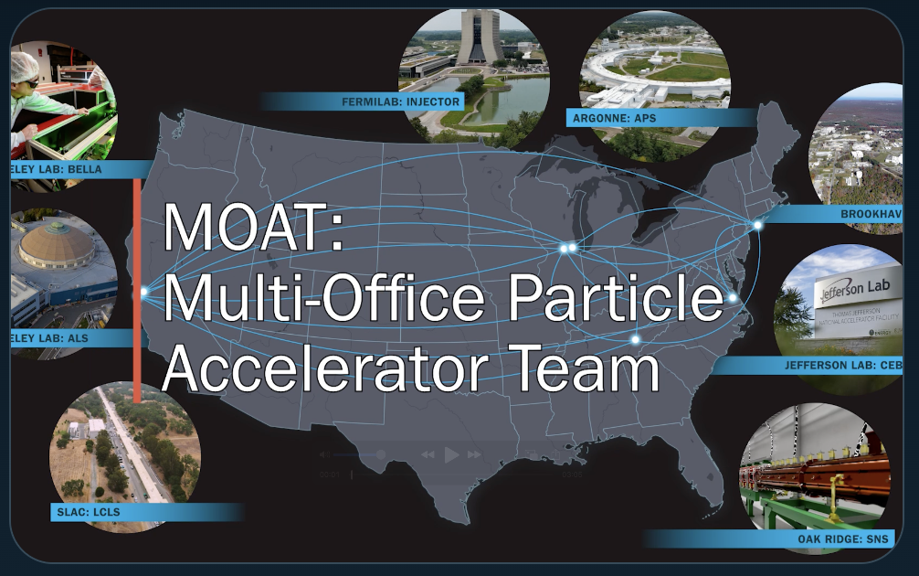
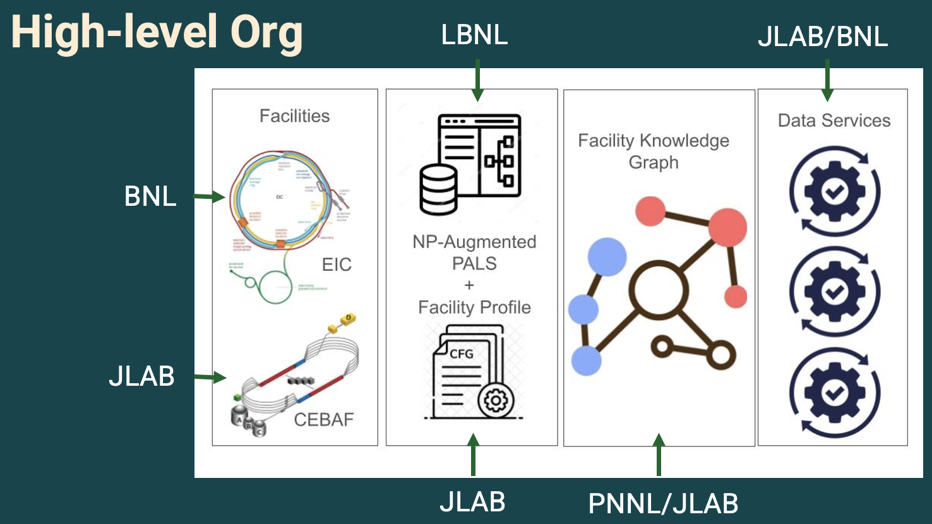
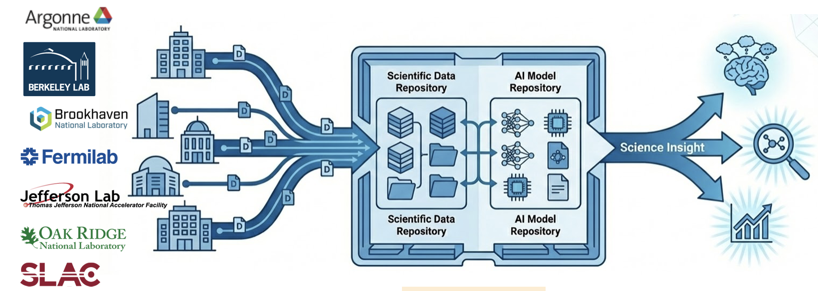
Initial accelerator projects embedded at all levels of Genesis
Multi-Office Accelerator Team (MOAT-seed)
LBNL, ANL, BNL, FNAL, JLAB, ORNL, SLAC (BES+HENP)
Deployment of shared accelerator agentic AI software across facilities (8 to date)
Deployment of digital twin prototypes across facilities (3 to date)
Nuclear Physics AI-Ready Accelerator Data (NARAD)
JLAB, BNL, LBNL, PNNL; (HE)NP-focused, but coordinating with all US accelerators
Augments the Particle Accelerator Language Standard (PALS) with facility‑specific profiles and a shared ontology; Delivers cross‑facility knowledge graph tools that supports subgraph extraction for diagnostics/optimization tasks
AmSC Scientific User Facility IP
LBNL, ANL, BNL, FNAL, JLAB, ORNL, SLAC
Establish Genesis as a shared platform to host and distribute AI models and scientific data for (mostly) accelerator-based BES, HEP, and NP Scientific User Facilities (SUFs), along with their industry and research partners

Slide 6
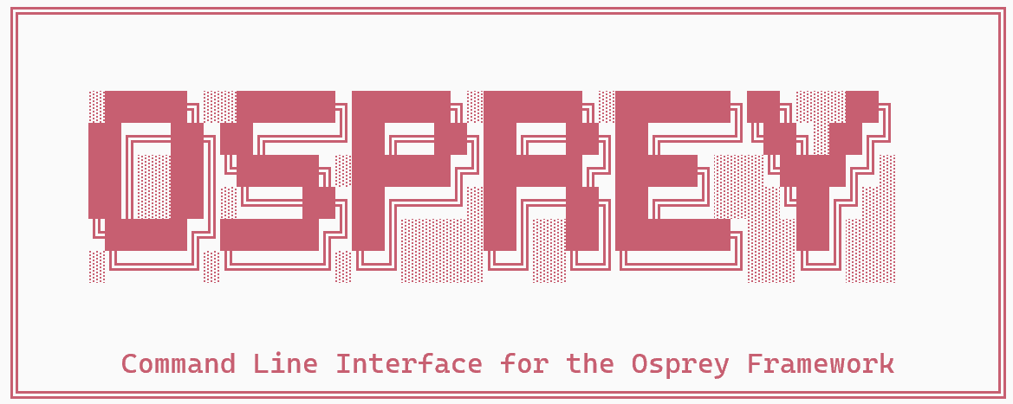
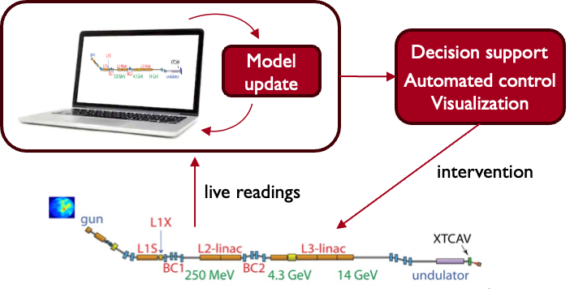


March Demo(s): MOAT in coordination with AmSC SUF
Deployment of agentic platform at 8 sites (MOAT), digital twins at 3 sites (MOAT+AmSC SUF IP)
Deployed agentic platform Osprey at multiple facilities
Supports accelerator operations @ LBNL (ALS, BELLA), FNAL (Accelerator Complex, FAST), ORNL (SNS), ANL, (APS), SLAC (LCLS), JLab (CEBAF, UITF), BNL (RHIC/EIC)
Uses MOAT’s Osprey framework (initially developed at LBNL/ALS)
⇒ outperform ad-hoc workflows based on fragmented institutional knowledge that operators currently rely on*
Operator query
Operator validates and executes
Agent retrieves and analyzes data (from archives, live control system, logbooks)
Agent proposes hypothesis or action
*”the preparation effort is reduced from what would typically take several hours of manual scripting and debugging to only a few minutes from a single natural language prompt—a speedup of 2 orders of magnitude.”
T. Hellert, PRR 8, L012017 (2026).
Digital twin demos at subset of facilities (collab. AmSC SUF IP)
HPC integration (e.g., IRI, Perlmutter@NERSC)
Deploying at LBNL (BELLA), FNAL (FAST), SLAC (LCLS)
Ongoing: ML model retraining (coord. w/ ModCon BASE SIM)
Ongoing: Linking digital twin to Osprey agents
6

Slide 7
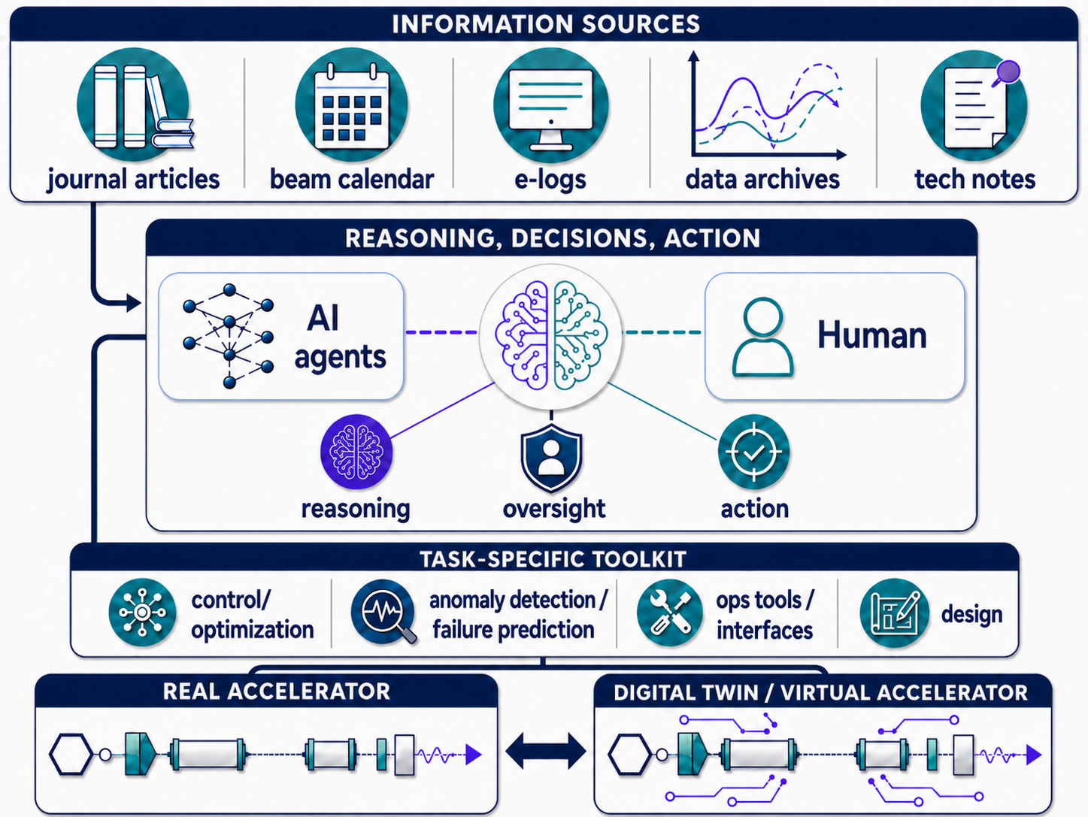
MOAT plans to expand scope of AI framework around Agentic AI
Codes
source/doc
AI agents use information sources and tools to assist accelerator activities:
design
tuning
anomaly detection & prevention
workforce development
…
*Powered by the LBNL-led Osprey agentic framework https://github.com/als-apg/osprey

Slide 8
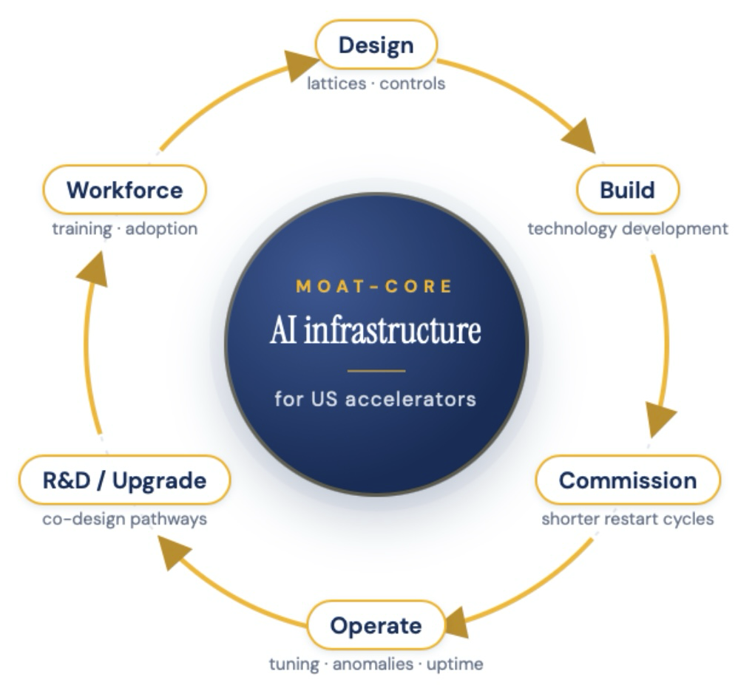
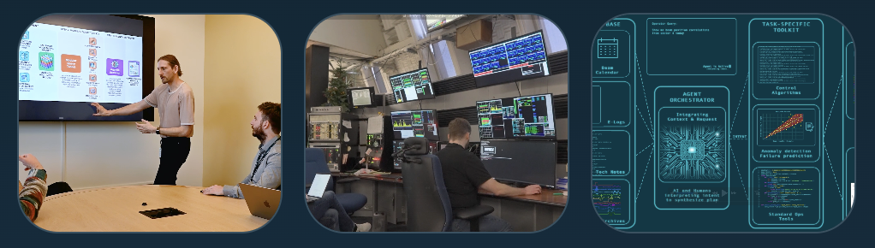
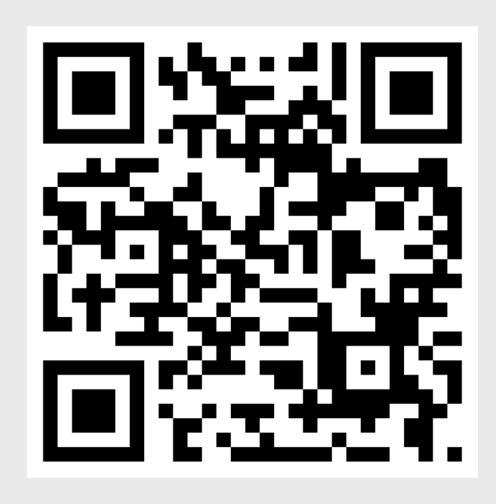
MOAT is expanding into a cross-projects, cross-facility collaboration extending to additional labs, universities and industry
The MOAT Collaboration
Collaboration focus: shared infrastructure
& coordination of AI-enabled accelerator work
MOAT connects institutions, workflows, tools, technical
knowledge so progress can be reused across facilities
More info: https://moat-ai.github.io
moat@lbl.gov

Slide 9
Thank You!

