Slide 1
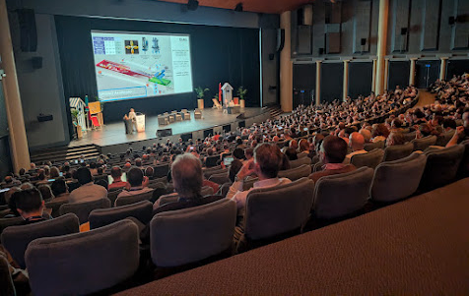
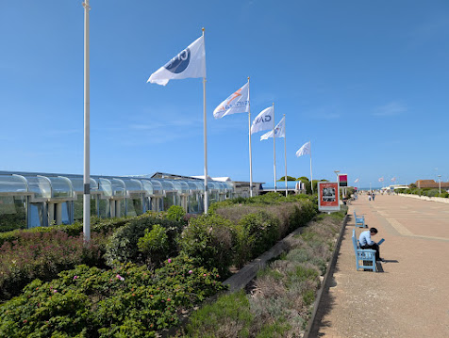
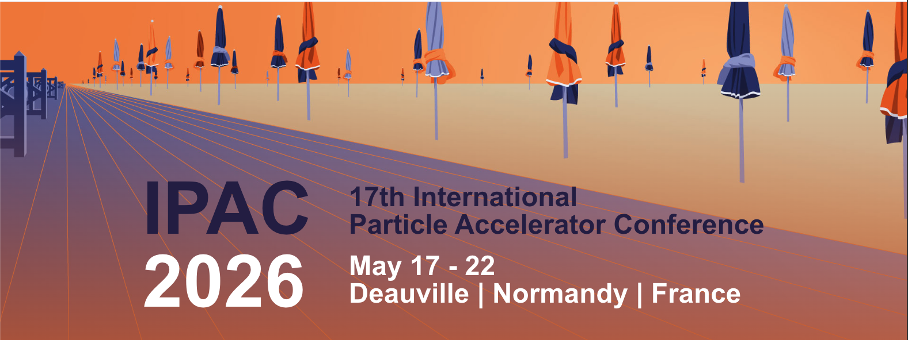
https://www.ipac26.org/
Pre-press proceedings at https://www.ipac26.org/prepress/ (not all papers; few if any slides yet)

Slide 2
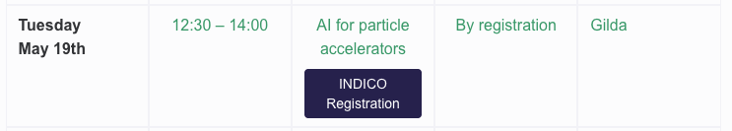
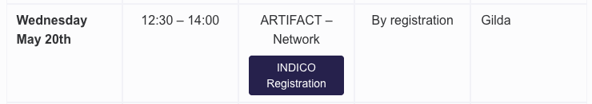
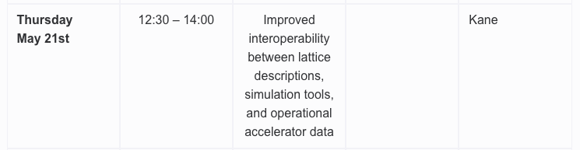
AI/ML Satellite Meetings
Lunch satellite meetings on AI almost every day
Tue General AI: Adnan Ghribi
  52 people in room (on floor)
  Recording and participants list available https://indico.cern.ch/event/1664807/
  Free discussion, e.g. roadmaps, value propositions
Wed ARTIFACT: Adnan Ghribi/Adrian Oeftiger
  Slides and participants list available https://indico.cern.ch/event/1664808/
Thu NARAD/MOAT: Todd/Jean-Luc
  Discussion of US Genesis, MOAT, NARAD efforts with European/Asian representatives
  Followup discussion with Adnan/Todd/Jean-Luc to form international coordination group or working group
Notes:
Meghan McAteer

Slide 3
IPAC’26 EIC Satellite Meeting
(Todd now member of EIC Accelerator Collaboration Board)
Weds May 20: EIC project and synergies with the Future Circular Collider studies
  Interest in FCC-ee device testing at EIC (similar to LHC testing of e.g. BBQ tunemeter at RHIC)
  Interest in CERN personnel collaboration/cross-training, e.g. sending CERN students to collaborate with EIC on commissioning and beam studies
  Previous EIC–FCC joint working groups identified many common technical areas, but most became inactive → more focused relaunch
    identify small number of concrete relevant topics with active champions/deliverables
  Topical thrusts:
    Beam dynamics, simulation, and benchmarking with new tools (e.g. Xsuite)
    Polarization and spin dynamics (previous success: spin tracking in Xsuite/Xtrack between CERN/BNL)
    RF, SRF, and crab cavities (ongoing collaboration on crab LLRF control aggressive requirements)
    Interaction region and MDI
    Diagnostics, controls, and AI-ready operation
      Beam diagnostics, BPM stability, beam-based phase loops, kickers, instrumentation, controls, and AI-assisted commissioning/operation came up repeatedly. “AI-ready accelerator” needs a technical strategy: data infrastructure, controls readiness, diagnostics, and integration. JLab has US/DOE leadership in this area.
    Magnets, vacuum, alignment, and hardware prototyping (ongoing collaborations)

Slide 4
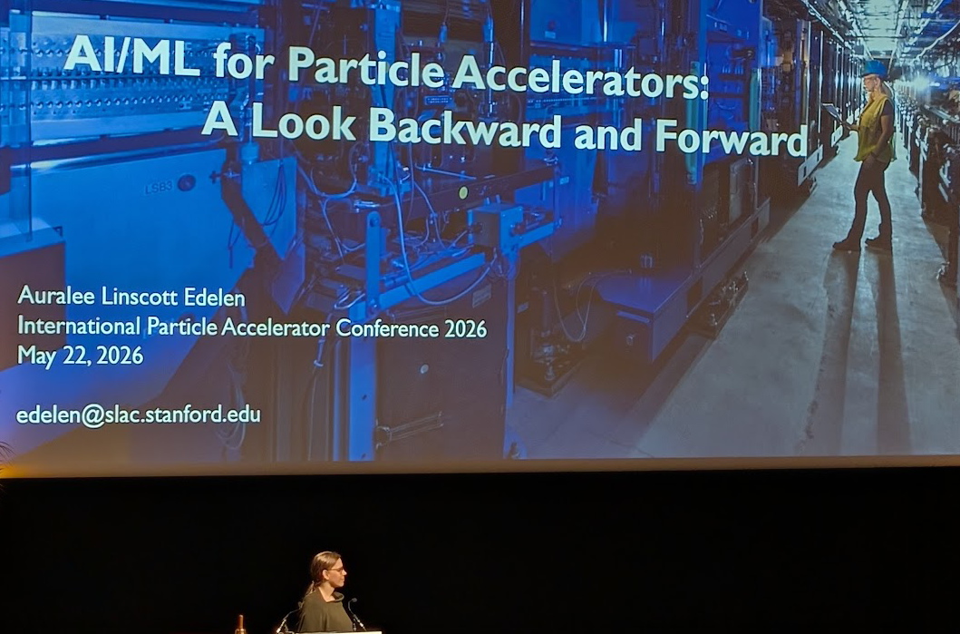
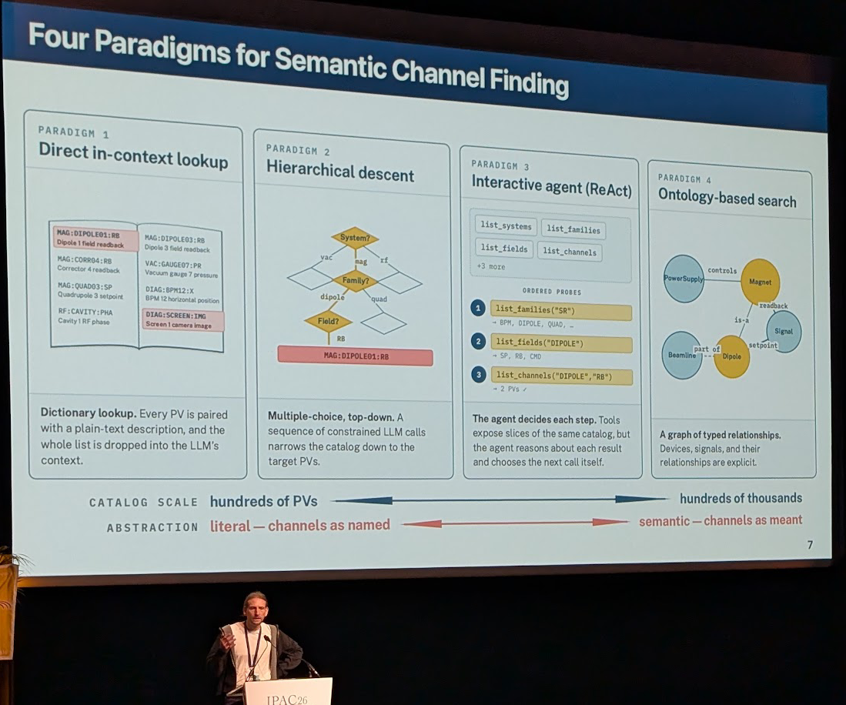
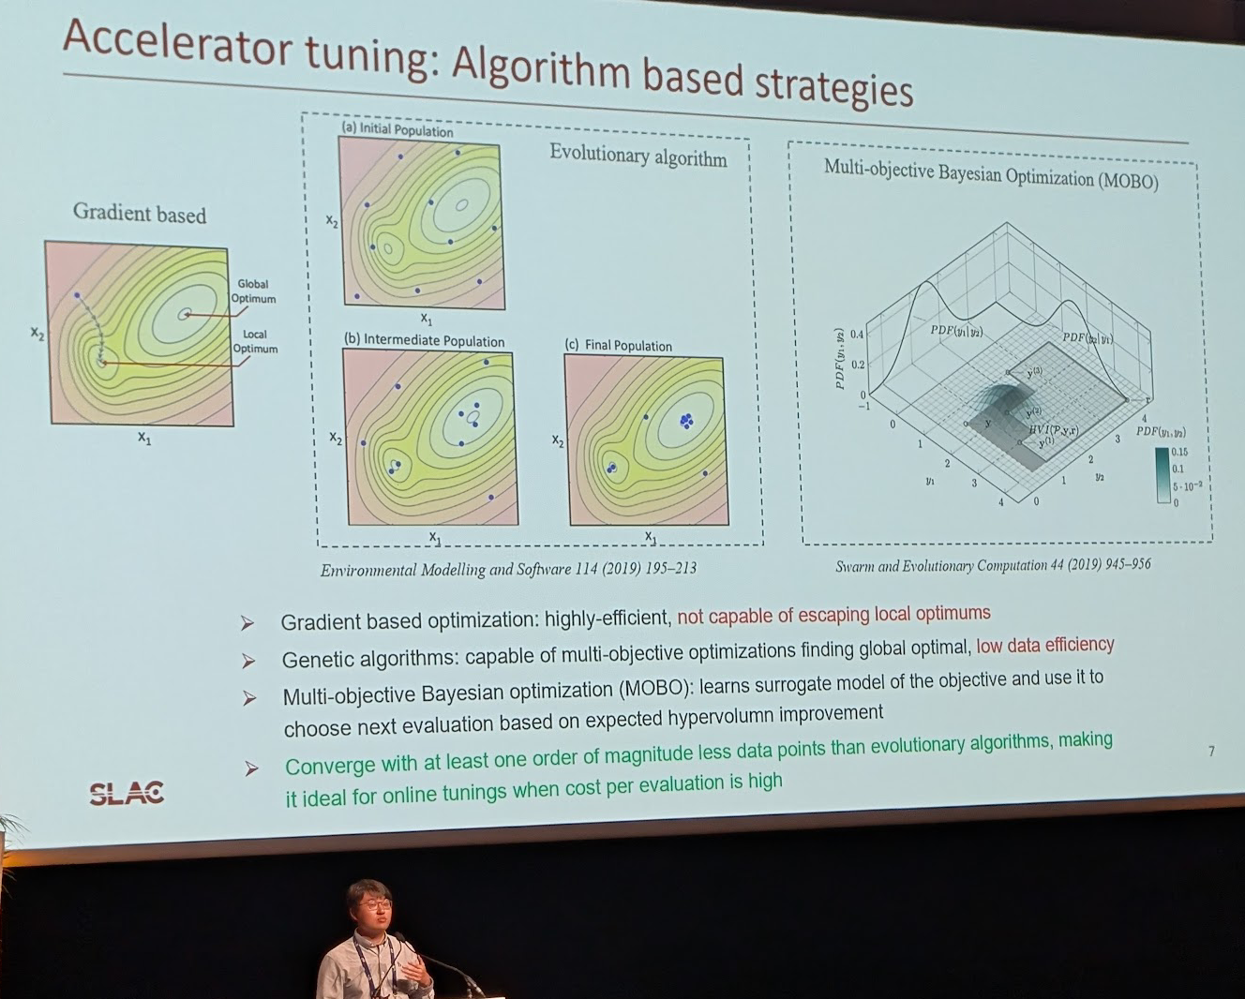
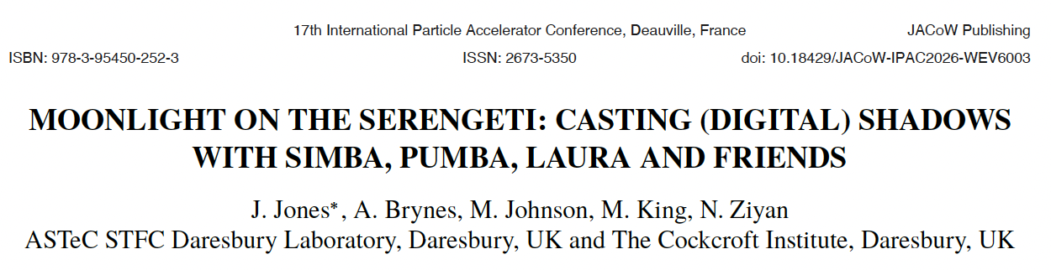
Great AI/ML Visibility
Auralee Edelen (SLAC):
Invited plenary
Thorsten Hellert (LBNL):
talk on semantic channel
finding for agentic workflows
“Invited” champagne-section poster:
Daresbury team on integrated modeling,
ontology, workflow framework for e.g. CLARA
Fuhao Ji (SLAC): AI/ML at
SLAC MeV-UED

