Slide 1

Wirecell Group Update
Evander Espinoza
June 18, 2026
Louisiana State University

Slide 2
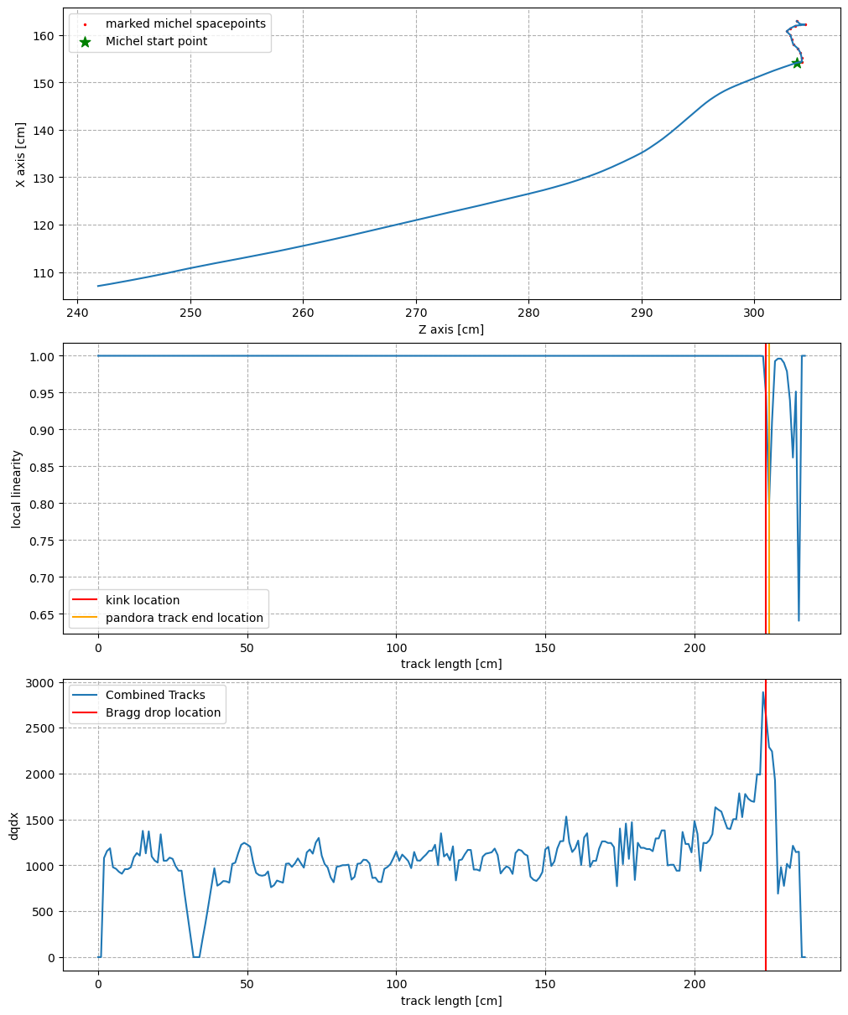
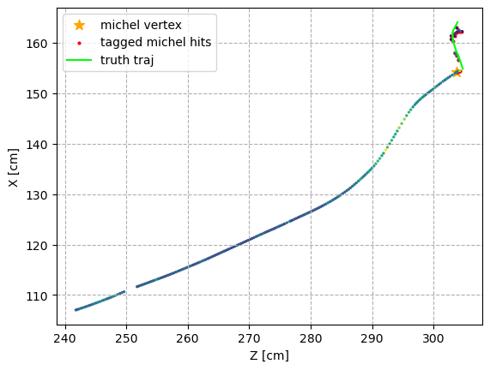
From the Collaboration Meeting…
I presented overall progress on Michel electron identification in calib ntuples using both charge and light information independently

Slide 3
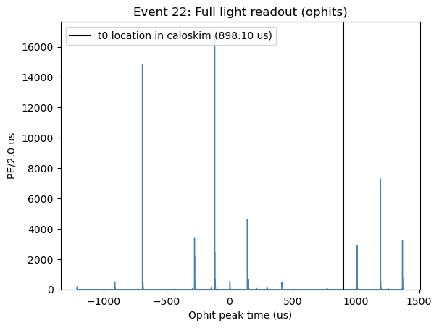
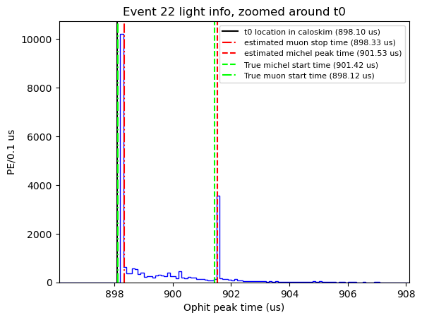
From the Collaboration Meeting…
I presented overall progress on Michel electron identification in calib ntuples using both charge and light information independently

Slide 4
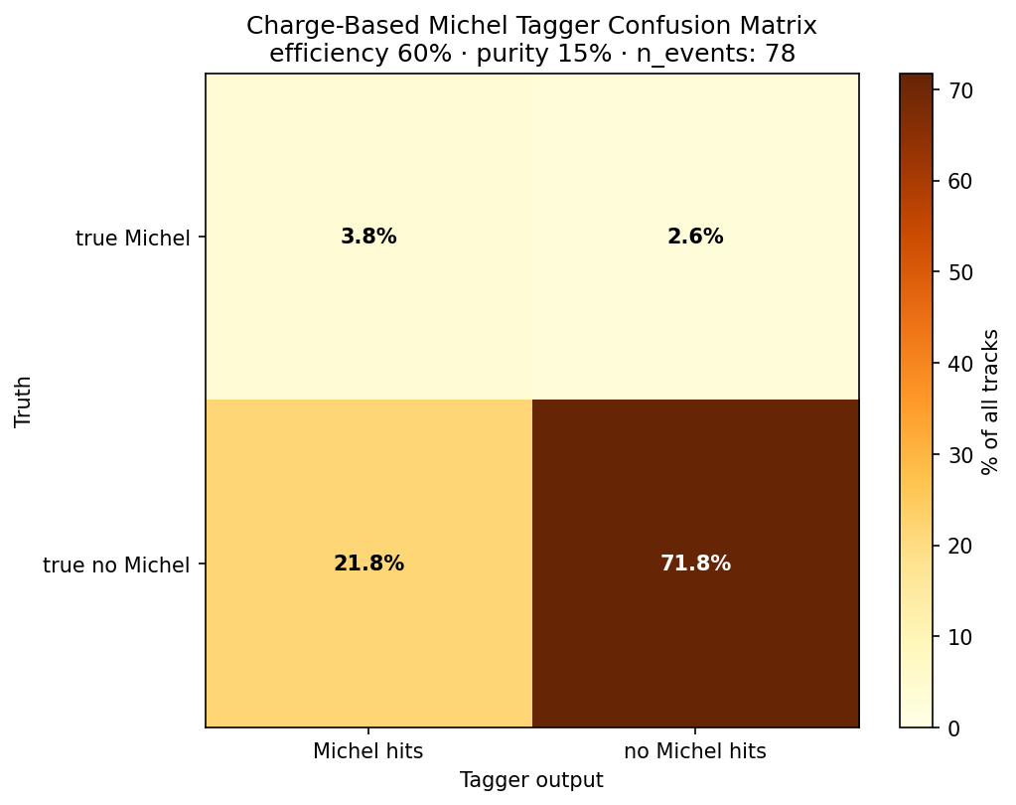
How does the charge-based tagging hold up?
From eye-scan (78 events), there is a significant percentage of false-positives!!!
Other metrics:
  # correctly ID’d Michels/total Michels in truth: 60%
  # correctly rejected tracks/true “non-Michels”: 76.7%
  Accuracy ((TP+TN)/all events): 75.6%
  False-positive rate (FP/(FP+TN)): 23.3%

Slide 5
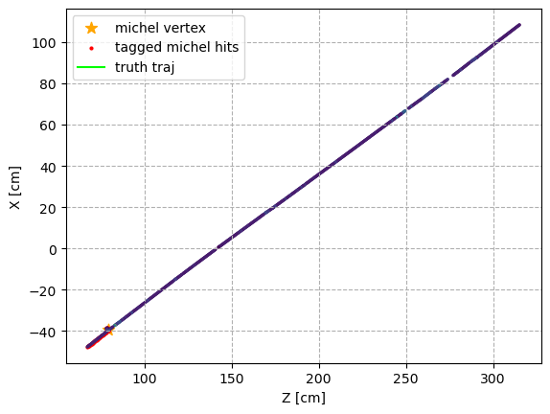
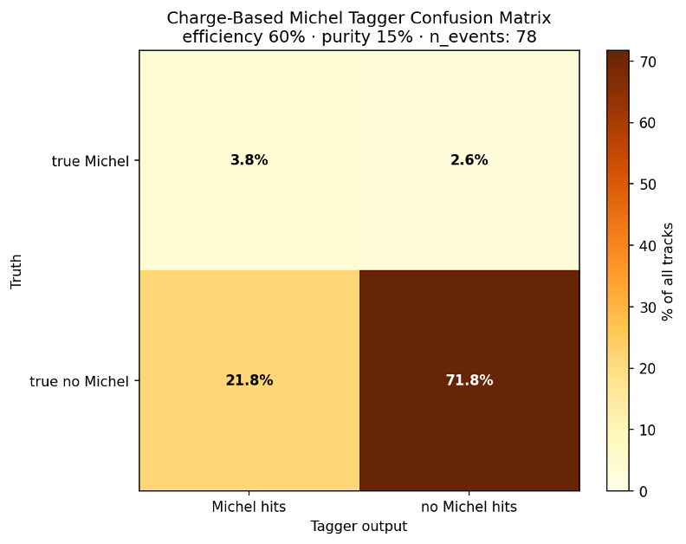
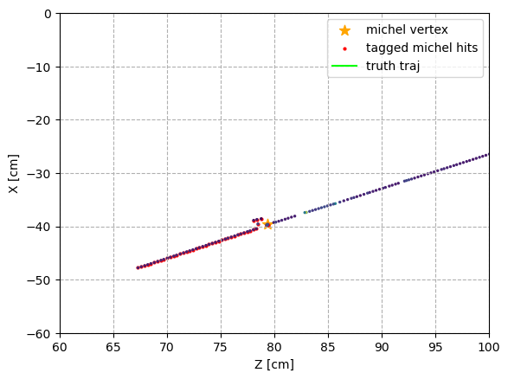
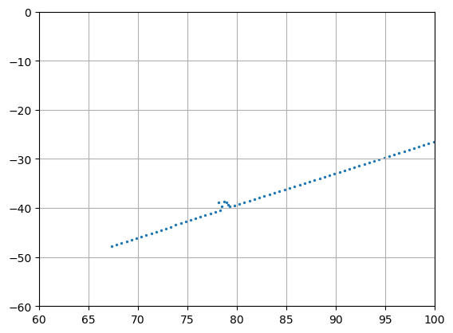
Additional failure mode correction
Old confusion matrix before correction, many more FPs
High # of false positives, due to spacepoints themselves fluctuating at times
Adding an extra discriminator (length-based cut between linearity-based and Bragg peak Michel regions) improved both efficiency and purity metrics
After Bragg/kink cut

Slide 6
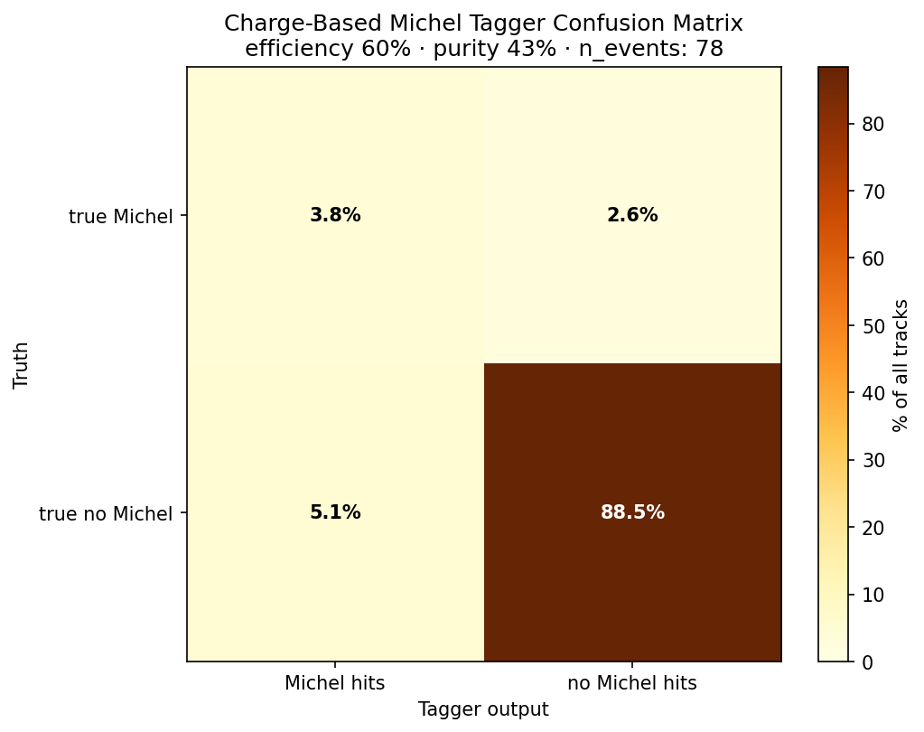
After failure mode correction
Large reduction in false-positives
What about the false negatives?
  So far, I’ve only seen it caused due to upstream rejection (i.e. shower rejection from ntuples). In practice, I don’t think the tagger would cause many false negatives in data, but efficiency due to this will drop.
  Should still verify on a larger dataset

Slide 7
After failure mode correction
# correctly ID’d Michels/total Michels in truth: 60%
# correctly rejected tracks/true “non-Michels”: 94.5%
Accuracy ((TP+TN)/all events): 92.3%
False-positive rate (FP/(FP+TN)): 5.5%
Notes:
Add Pandora track end cut OR Bragg end

Slide 8
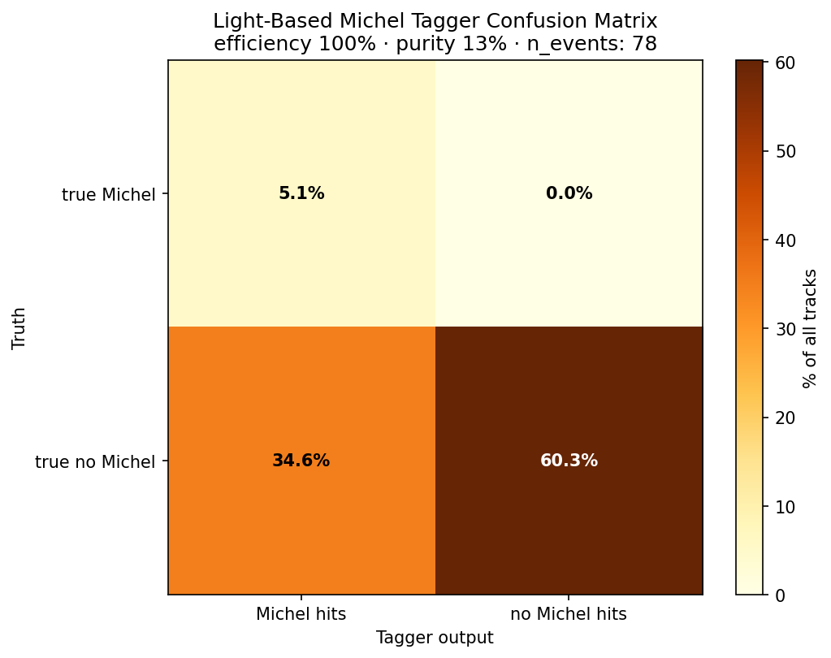
How does light-based tagging hold up?
From same event sample
Good at catching false-negatives in charge-based tagging, however too inclusive
  Essentilly, finds any pulses higher than median PE, spaced at least a distance away equal to standard deviation from previous peak
  This allows many more peaks than expected, including fluctuations
Some interesting things of note:
  Truth info often shows Michel time even when not present in other caloskim variables
  The eval metrics for some events don’t align with the charg-based ones

Slide 9
How does light-based tagging hold up?
From same event sample
# correctly ID’d Michels/total Michels in truth: 80%
# correctly rejected tracks/true “non-Michels”: 63.5%
Accuracy ((TP+TN)/all events): 65.4%
False-positive rate (FP/(FP+TN)): 36.5%

Slide 10
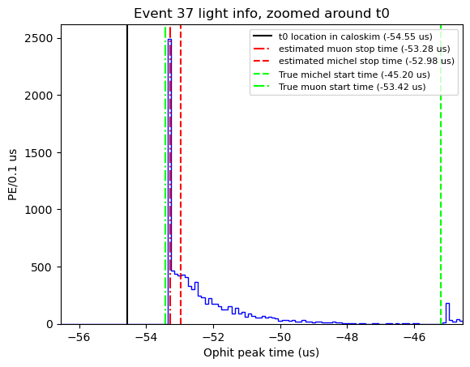
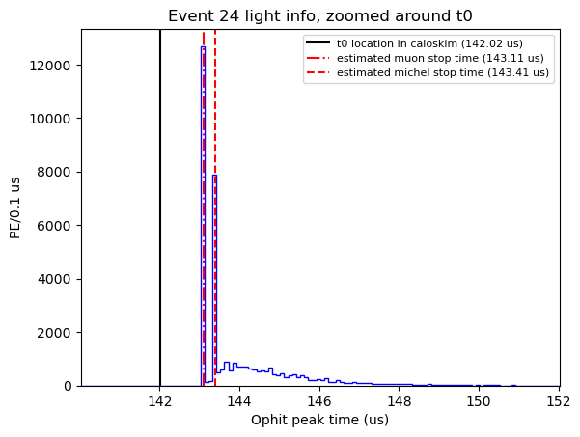
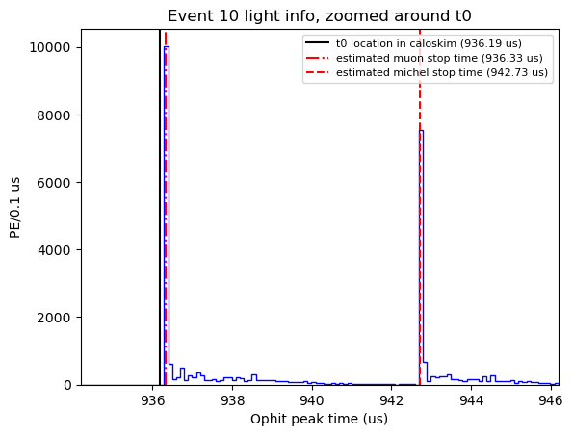
Michel failure mode correction
Typically, there were 2 main failure modes, I noticed when hand-scanning:
Bump caught along muon’s “tail”
Pulse found later, usually due to a much brighter track

Slide 11
