Slide 1


XVI NExT PhD Workshop
The Impact of Drell-Yan Data on
Four-Fermion SMEFT Operators
Martina Fusi
Ken Mimasu

Slide 2
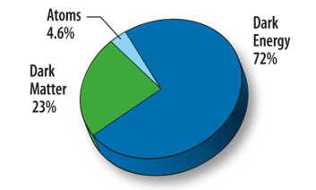
Standard Model Effective Field Theory (SMEFT)
SM is the most successful theory in particle physics
However, it cannot explain several observed phenomena
  Matter-Antimatter asymmetry
  Neutrino Oscillations
  Gravity
  Dark Matter
  Dark Energy
  ...
Martina Fusi - University of Southampton
2

Slide 3

Standard Model Effective Field Theory (SMEFT)
Many SM extensions predict heavy new particles
SMEFT extends the SM in a model-independent way
Λ is the energy scale of new physics (here fixed at 1 TeV)
C_{i} are the so-called Wilson coefficients
O_{i}⁽⁵⁾ and O_{i}⁽⁷⁾ are not considered because they violate either leptonic or baryonic number
Martina Fusi - University of Southampton
3

Slide 4
Standard Model Effective Field Theory (SMEFT)
We can search for SMEFT effects in precise measurements of SM processes
Computing the matrix element squared:
Linear / Interference
(c_{i} , …)
(~1/Λ²)
Squared / 'Pure SMEFT'
(c_{i} ² ,c_{i}c_{j} )
(~1/Λ⁴)
Martina Fusi - University of Southampton
4

Slide 5
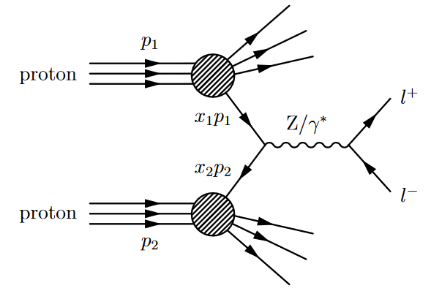
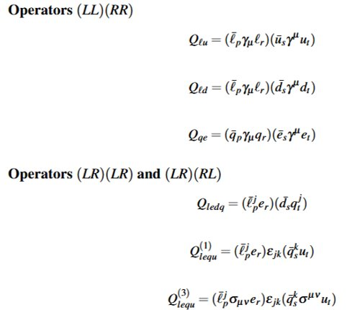
Previous works on the topic:
arXiv:2212.10497, 2103.10532, 2204.1312,
2008.12978, 2303.08257, 2502.12250, 2310.19638
  At dimension 6, there are 59 different operators
The Drell-Yan (DY) Process
  DY has a simple final state
  Many measurements of DY have been performed at colliders
  Only 10 relevant four-fermion operators
Neutral DY process
Martina Fusi - University of Southampton
5

Slide 6
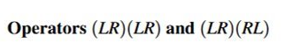
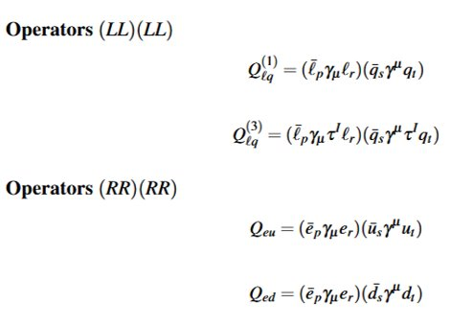
Four fermion operators in DY
  Only 10 relevant four-fermion operators
  Varying chirality, quark flavour, Lorentz structures
  Many free parameters include multiple measurements
Charged Current DY
Excluded in the linear
⁺ Dimension-Six Terms in the Standard Model Lagrangian - arXiv:1008.4884v3
Martina Fusi - University of Southampton
6

Slide 7
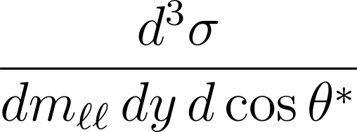
All four-fermion operators grow with mll
Up-type operators and down-quark operators have different y dependency
Right and left operators have different cosθ* dependency
Martina Fusi - University of Southampton
7

Slide 8
All four-fermion operators grow with mll
Up-type operators and down-quark operators have different y dependency
Right and left operators have different cosθ* dependency
Martina Fusi - University of Southampton
8

Slide 9
All four-fermion operators grow with mll
Up-type operators and down-quark operators have different y dependency
Right and left operators have different cosθ* dependency
Martina Fusi - University of Southampton
9

Slide 10
Input Observables and Measurements
Exp. | √s (TeV) | Type | Observable | Mass range (GeV) | L (fb⁻¹) | Ref.
ATLAS | 8 | NC | d²σ / (dm_{ll} dy) | 116–1500 | 20.3 | 1606.01736
ATLAS | 8 | NC | d³σ / (dm_{ll} dy dcosθ*) | 46–200 | 20.2 | 1710.05167
ATLAS | 13 | CC | d²σ / (dm_{T} dy) | 200-5000 | 140 | 2502.21088
CMS | 13 | NC | A₀, A_{FB} / dm_{ll} | 170–13000 | 140 | 2202.12327
CMS | 13 | NC | dσ / dm_{ll} | 122-6020 | 140 | 2103.02708
LEP, CHARM, VENUS, PDG and more | Low energy | Compilation of neutrino scattering ratio, atomic parity violation, quark pair production... |  | 0-209 | / | 1706.03783
  Considering only the electron channel and assuming flavour-universality
Martina Fusi - University of Southampton
10

Slide 11


Fitting strategy
For the fit, we use the signal strength µ:
And minimize the χ²:
Where:
  C is a vector of the Wilson coefficients
  V is the full covariance matrix
  µ_{th} is defined as:
For the linear terms, we can minimize the χ² analytically
Martina Fusi - University of Southampton
11

Slide 12
Input Observables and Measurements
Is it worth it to include lower energy datasets, now that we have 13 TeV measurements?
What's the optimal way to include 13 TeV data?
(Single differential vs angular coefficients)
Martina Fusi - University of Southampton
12

Slide 13
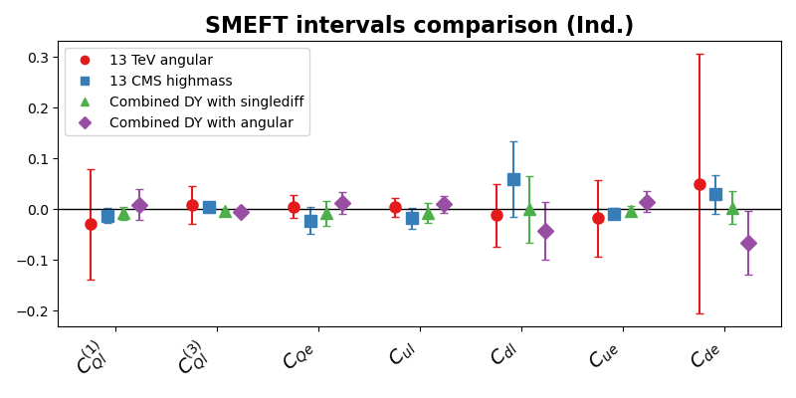
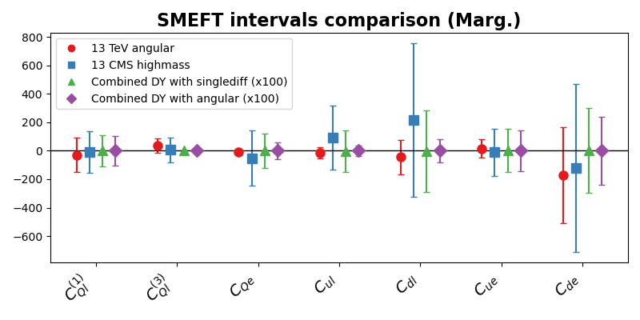
Results at linear level
For both individual (one parameter at a time) and marginalized (all parameters are allowed to vary) fits, 13 TeV datasets alone provide worst constraints
The single differential dataset gives best constraints on the individual bounds, the angular dataset on the marginalized ones

Slide 14
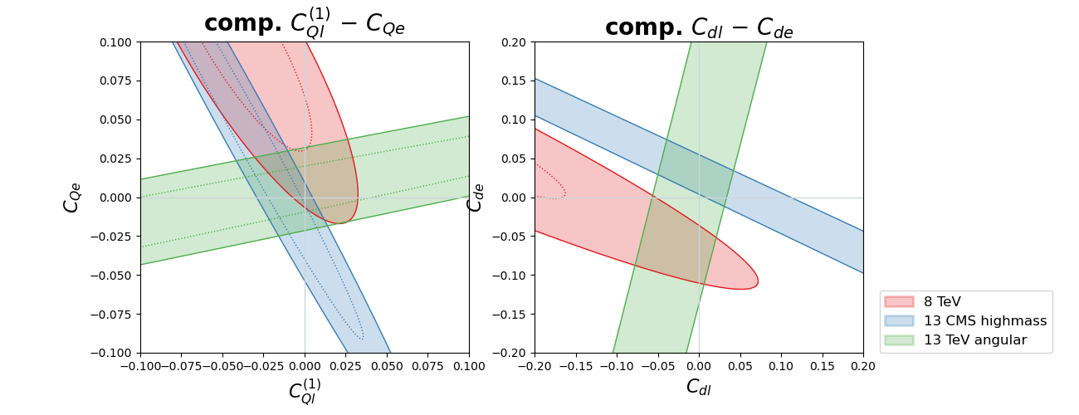
Results at linear level
The single differential dataset provides constraints in the same direction as the 8 TeV data
The angular dataset, on the other hand, provides information in the orthogonal direction

Slide 15
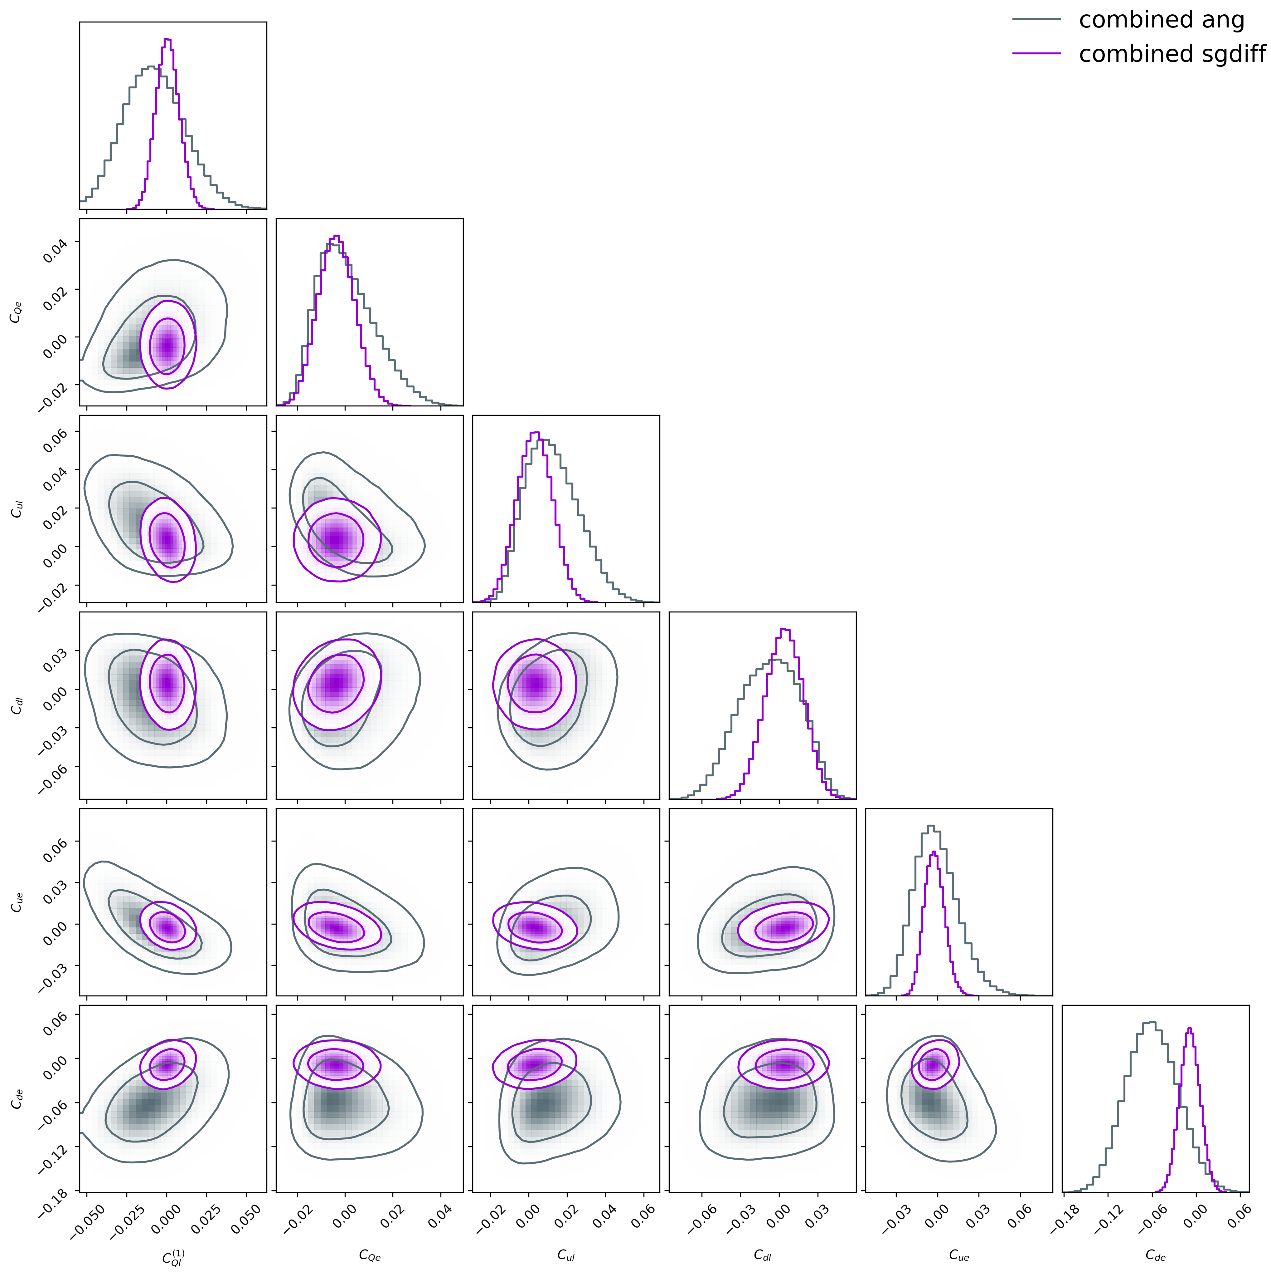
How do things change at quadratic level?
At quadratic level, comparing the lower energy data with single-differential cross section measurement at 13 TeV gives the best constraints
Combining the same data with the angular measurements results less powerful
This is probably due to the size of quadratic effects in the distribution tail
Preliminary

Slide 16
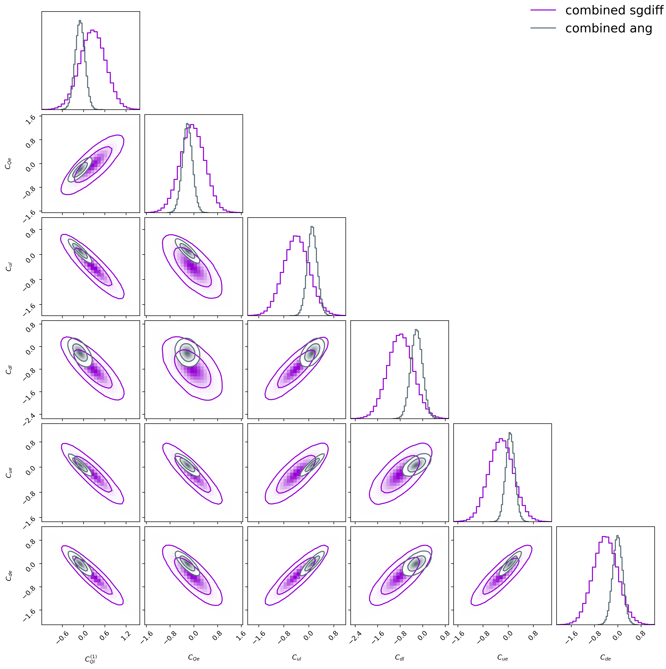
How do things change at quadratic level?
At linear level
At quadratic level, comparing the lower energy data with single-differential cross section measurement at 13 TeV gives the best constraints
Combining the same data with the angular measurements results less powerful
This is probably due to the size of quadratic effects in the distribution tail
Preliminary

Slide 17
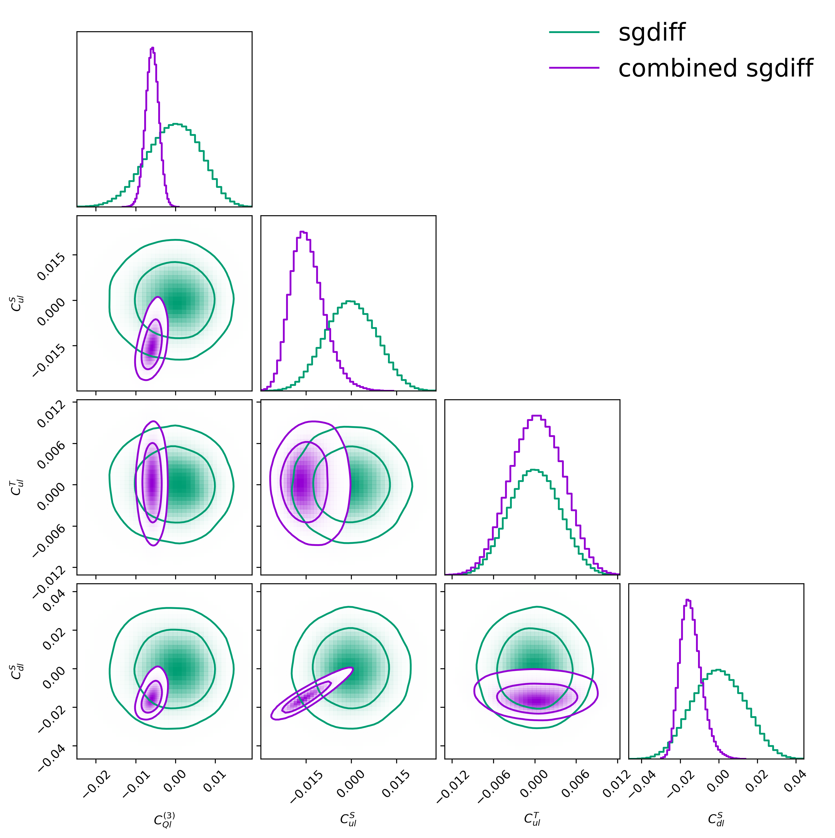
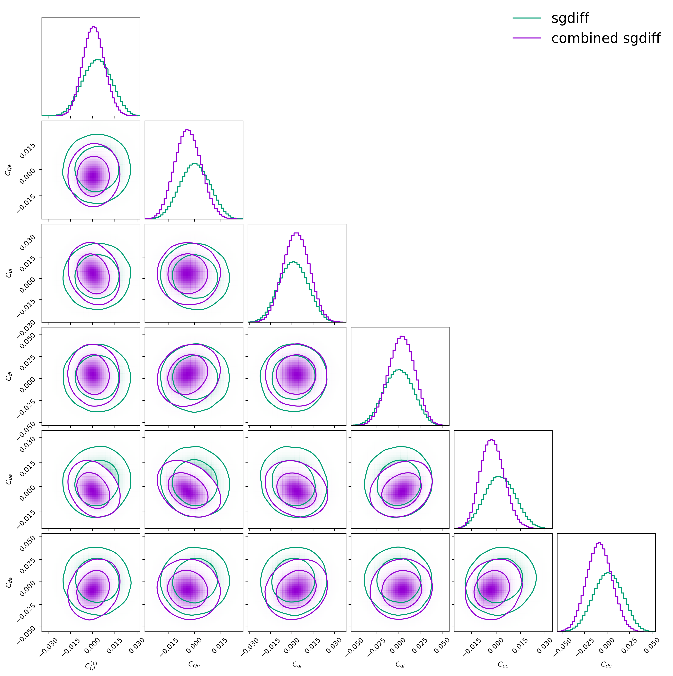
How do things change at quadratic level?
Lower energy data and 13 TeV charged DY constraint certain coefficients particularly well (cQl⁽³⁾, cult, culs, cdls)
This slightly improve the constraint on the other coefficients as well
It is worth it to include complementary datasets
Preliminary

Slide 18
Conclusion & Next Steps
I have presented results from a SMEFT fit to 8 TeV, 13 TeV Drell–Yan data and other low energy measurements
Highlighted the importance of complementary measurements, even when high energy data are available
Found that although measurements of angular coefficients constraint Wilson coefficients well at linear level, at quadratic level single differential cross section is more powerful
Outlook
Broaden the analysis including other operators relevant for DY
Quantify the impact of NLO SMEFT terms
Address flat directions further by including more LHC measurements (ATLAS)
Martina Fusi - University of Southampton
18

Slide 19
Backup Slides

Slide 20
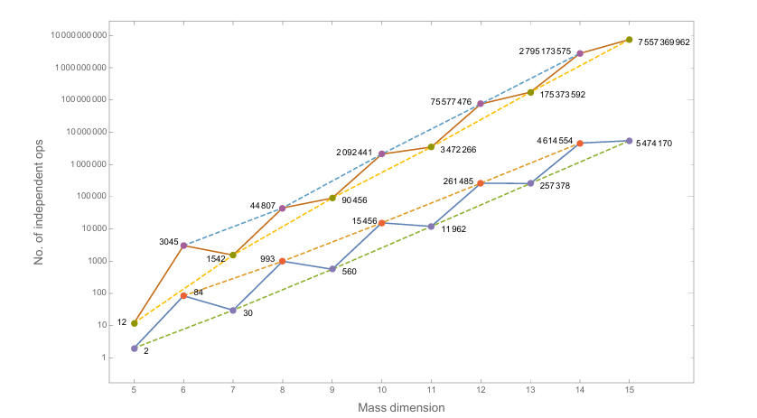
How many SMEFT operators?
Growth of the number of independent operators in the SM EFT up to mass dimension 15. Points joined by the lower solid line are for one fermion generation; those joined by the upper solid line are for three generations. Dashed lines are to guide the eye to the growth of the even and odd mass dimension operators in both cases.
Ref: arXiv:1512.03433v2
Martina Fusi - University of Southampton
20

Slide 21
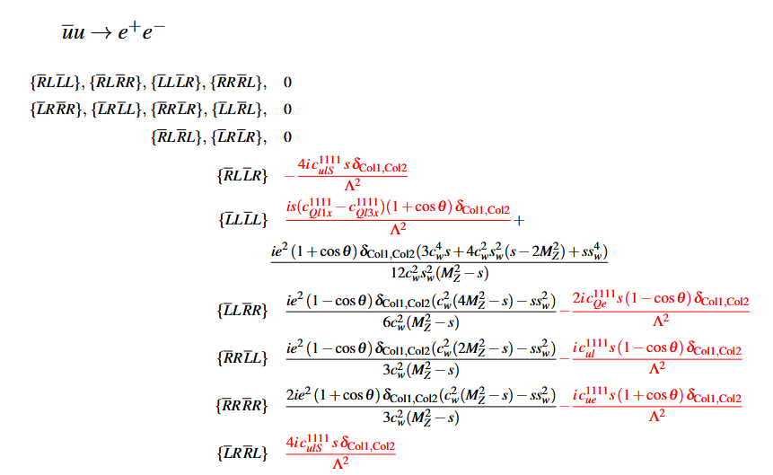
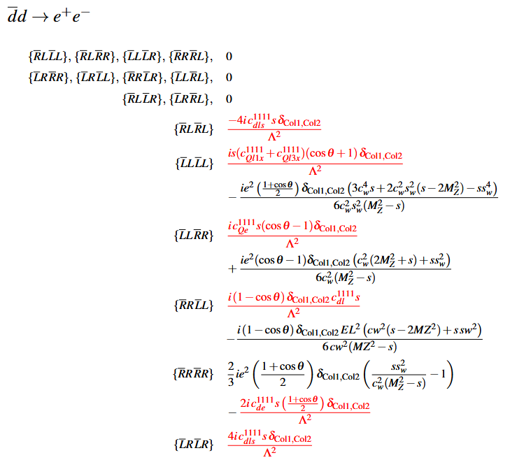
Helicity Amplitudes of DY Subprocesses
These are the subprocesses helicity amplitudes at order ~1/Λ²
(SM is marked in black, interference terms are in red)
21
Martina Fusi - University of Southampton

Slide 22
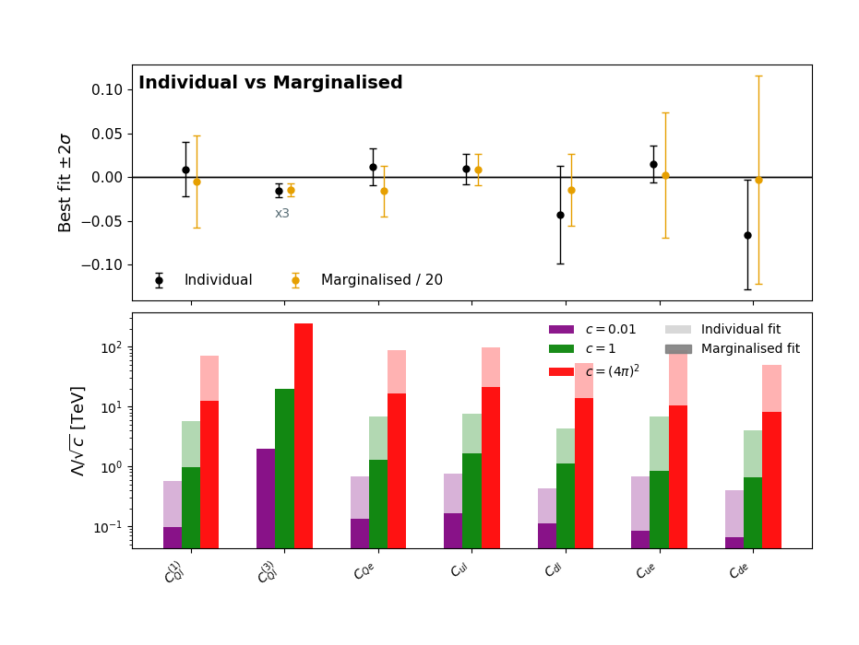
Results
Complete linear fit:
  Individual vs marginalised
New physics scale:
  Individual vs marginalised
  Different values of the coupling
Preliminary
Martina Fusi - University of Southampton
22

Slide 23
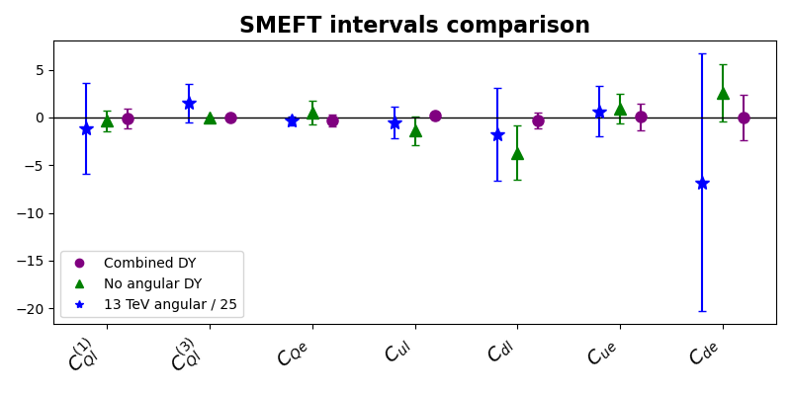
Preliminary
Results
We can compare the fit results with and without the dataset 'angular 13 TeV'
The 13 TeV angular data improves the marginalized fit substantially
Martina Fusi - University of Southampton
23

Slide 24
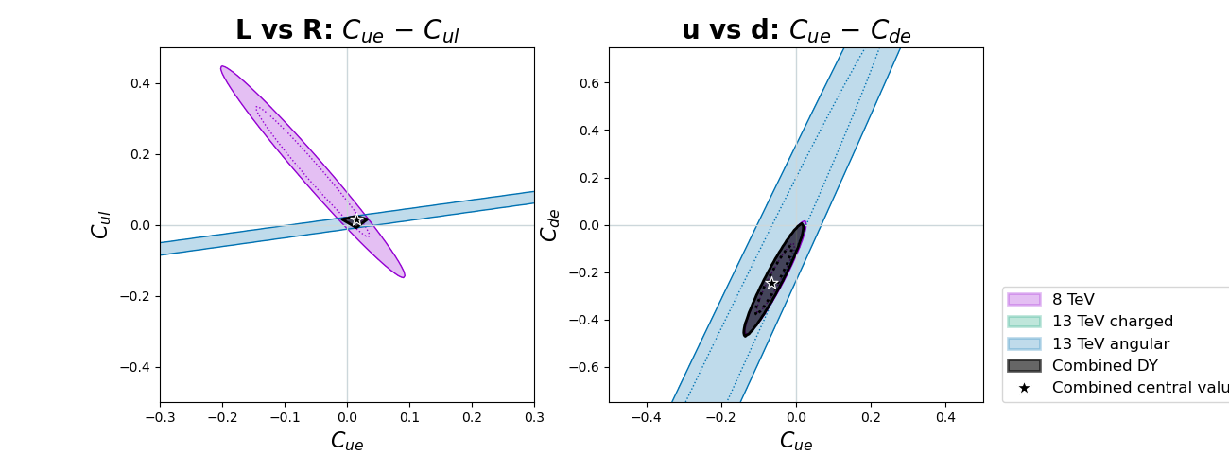
Results
Using differential observables helps to solve flat directions
This improves constraints significantly
13 TeV angular is not differential in y_{ll}
Preliminary
24

Slide 25
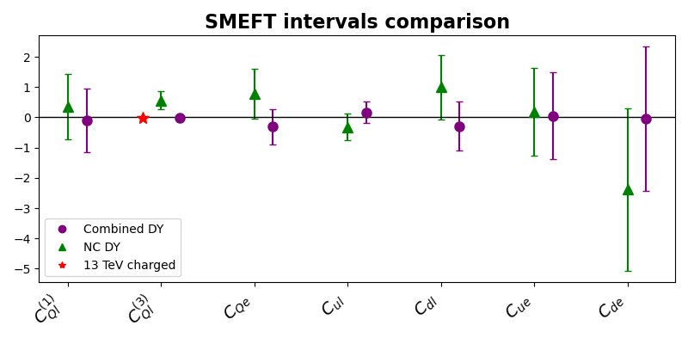
Impact of 13 TeV charged on the marginalized fit

Slide 26
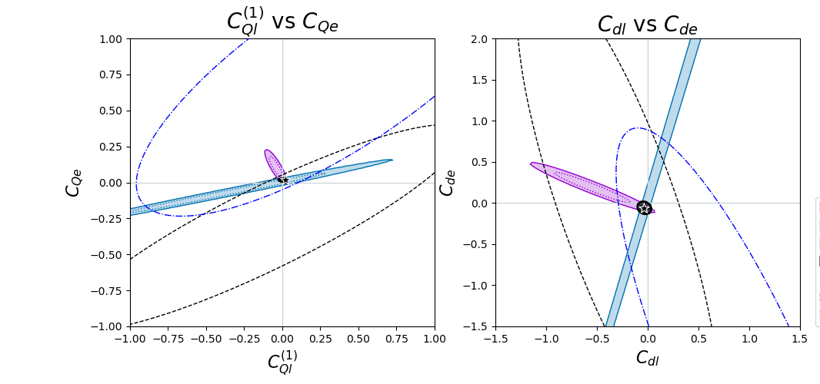
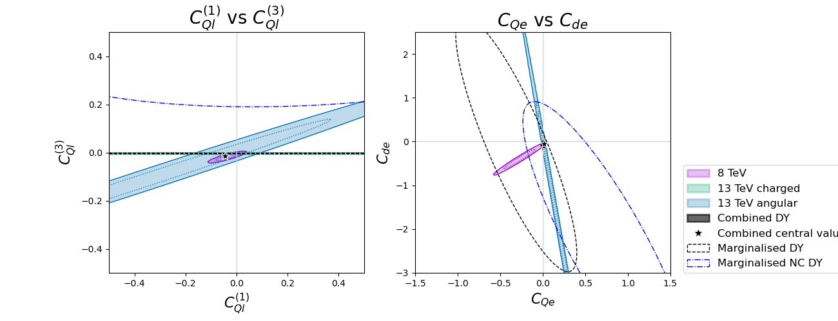
Results
Using different observables helps to solve flat directions
This improves constraints significantly
26

Slide 27
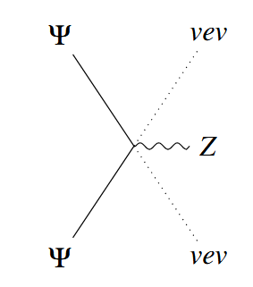
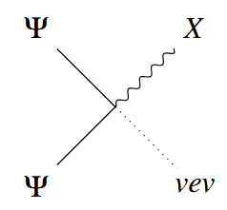
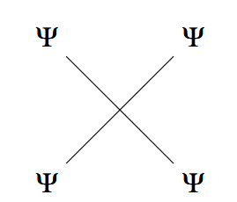
Dim-6 SMEFT Operators in DY
There are three classes of dim-6 operators for DY:
Ψ²φ²D: these operators include a single derivative, a Higgs doublet and two fermions
  They shift the SM coupling of the fermions to gauge bosons
  They have already been constrained at LEP
Ψ²Xφ: two fermions coupled to a gauge boson (X = B_{μν}, G_{μν}, W_{μν}) and a Higgs.
  They don’t interfere with the SM
Ψ⁴: four-fermion operators
  10 different operators (7 interfere with the SM)
  They grow with E²/Λ²
Martina Fusi - University of Southampton
27

Slide 28
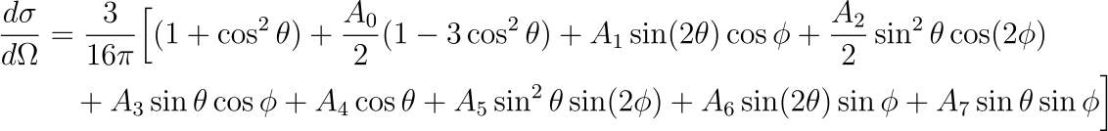
Lam-Tung Relation
At LO, for the Drell-Yan process:
  A0=A2=0
The only non-zero SMEFT contributions are:

Slide 29



Analytical Fit

Slide 30
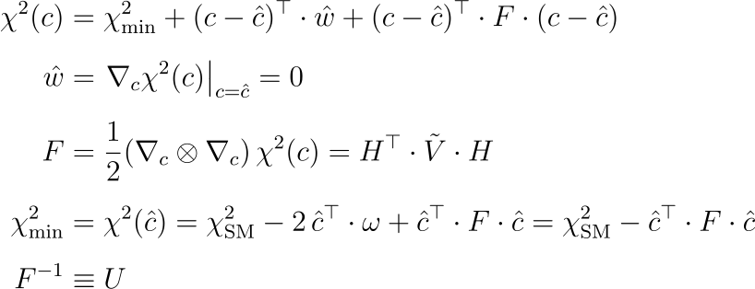
Analytical Fit

Slide 31
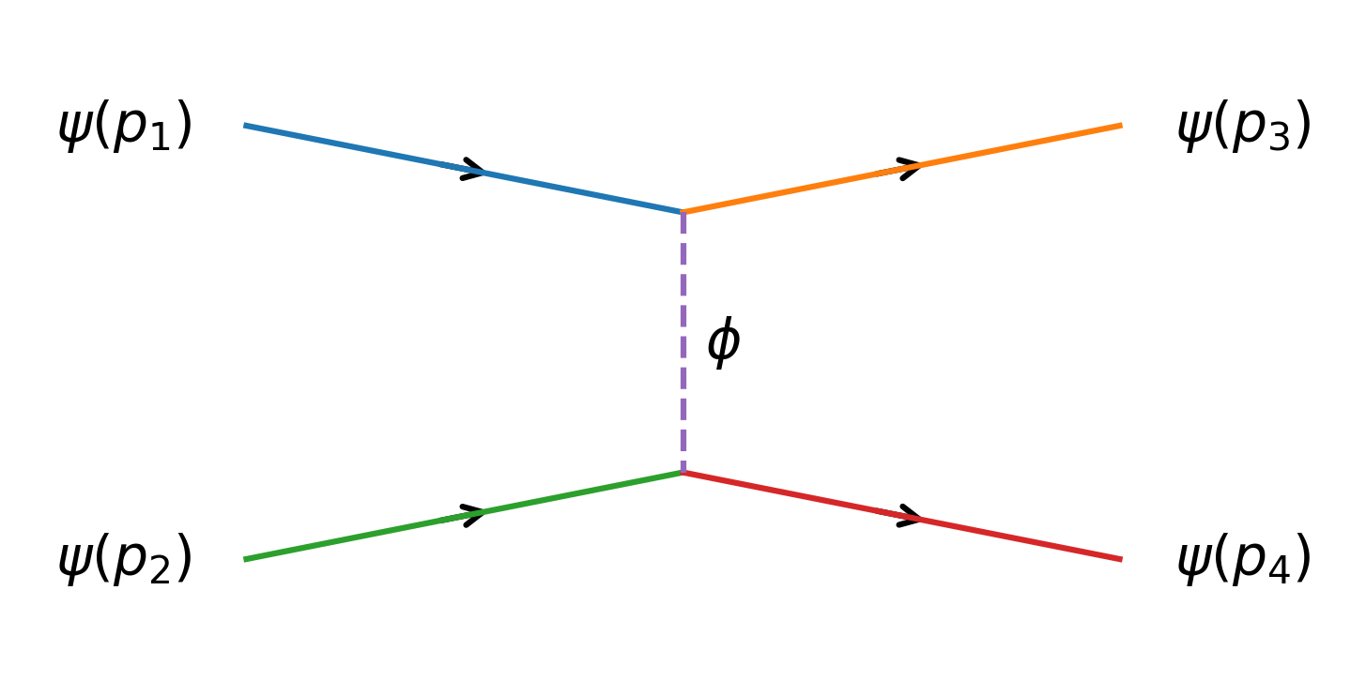
A Toy Effective Field Theory⁺
Let's consider this toy model:
Ψ is a fermionic field with small mass
Φ is a scalar field with high mass m << M
y, λ << 1 so that we can work in perturbation theory
The matrix element for an elastic scattering of two fermions is:
⁺An Introduction to Effective Field Theories - arXiv:2006.16285v1
Martina Fusi - University of Southampton
31

Slide 32

A Toy Effective Field Theory
The scalar propagator can be expanded in powers of momenta (considering m² ≪ p² ≪ M²).
The first term is:
We would have obtained the same result with the effective theory:
At low energy (E≪ M) the two theories are indistinguishable
The effective theory does not postulate a scalar boson
Martina Fusi - University of Southampton
32

