Slide 1
Investigating the Effect of Exotic Sources of Decoherence in Flavored Leptogenesis
An exploratory study of the simplest exotic-decoherence class
Frederick Wehlen, UCL · NeXT Workshop
Supervised by Frank Deppisch

Slide 2
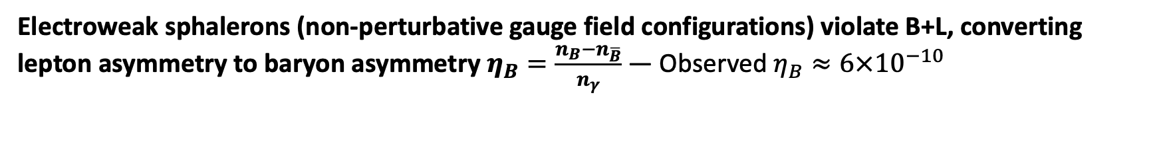
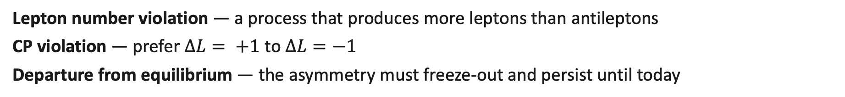
Vanilla Leptogenesis
How do we produce a baryon asymmetry? — e.g. Davidson et al. (2008), Buchmüller et al. (2004)
The Sakharov Conditions
Lepton number violation — a process that produces more leptons than antileptons
CP violation — prefer $∆L= +1$ to $∆L=−1$
Departure from equilibrium — the asymmetry must freeze-out and persist until today
Add two right-handed Majorana neutrinos $N_{i}$ to the Standard Model with large masses $M_{i}$
Electroweak sphalerons (non-perturbative gauge field configurations) violate B+L, converting lepton asymmetry to baryon asymmetry $η_{B}=\frac{n_{B}−n_{\overline{B}}}{n_{γ}}$ — Observed $η_{B}≈6×{10}^{−10}$

Slide 3
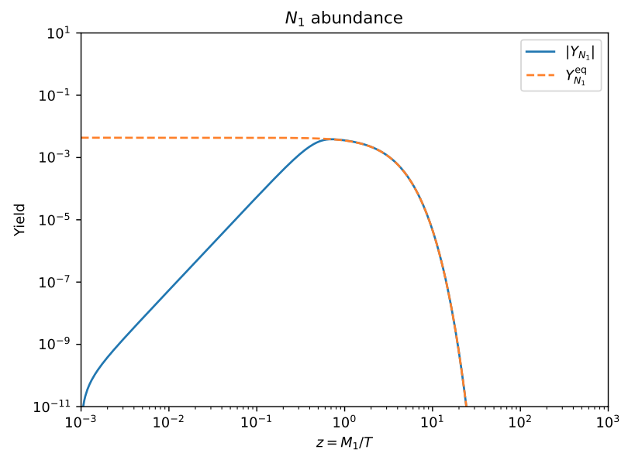
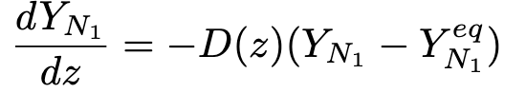
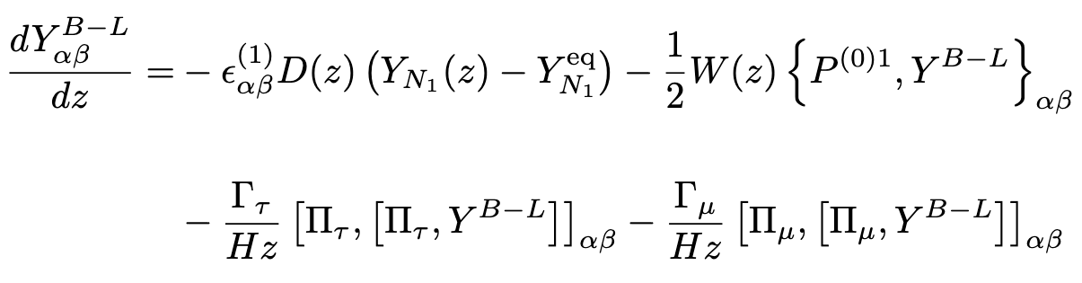
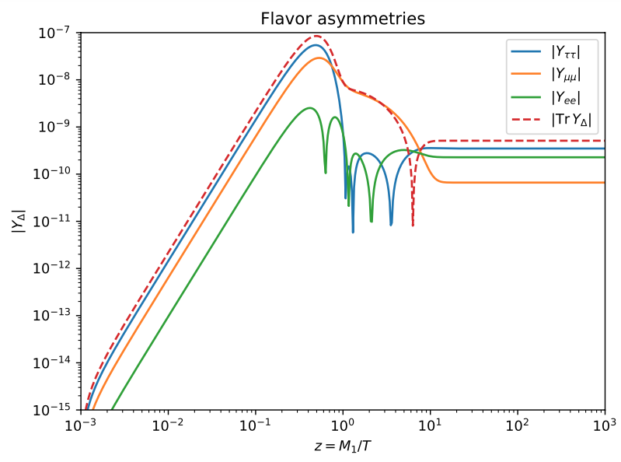
Vanilla Leptogenesis: Density Matrix Equations
How do we describe the asymmetry? — e.g. Blanchet et al. (2013), Dev et al. (2018)
Coupled differential equations describe the number density of leptons
Why density matrices?
Decay — sterile neutrinos decay into a superposition of flavor states
Charged lepton interactions — measure flavor, destroy coherences

Slide 4
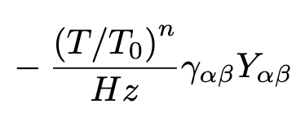
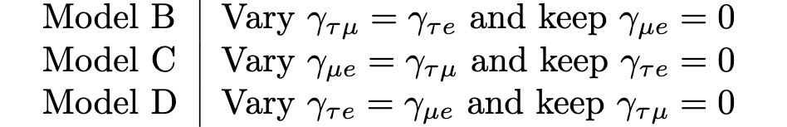

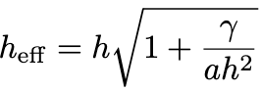
Exotic Decoherence Terms
In analogy with De Romeri et al. (2023), IceCube Collaboration (2024)
Add an exotic dephasing term
Motivation — generic expectation from Planck-scale physics: stochastic QG perturbations might introduce Lindblad-style dephasing
E.g. Ellis et al. (1984), Stuttard & Jensen (2022), Carlip (2023)
Two additional parameters — $γ, n$
No direct effect on lepton populations — diagonal terms 0 by construction
This talk will focus on n = 1
Key relationship: these correspond identically to strengthening SM interactions with effective Yukawa
Questions
How do these terms affect the evolution of Y?
How do these terms change$\left|η_{B}\right|$ and its sign?
Which flavor channels have the largest effect?

Slide 5
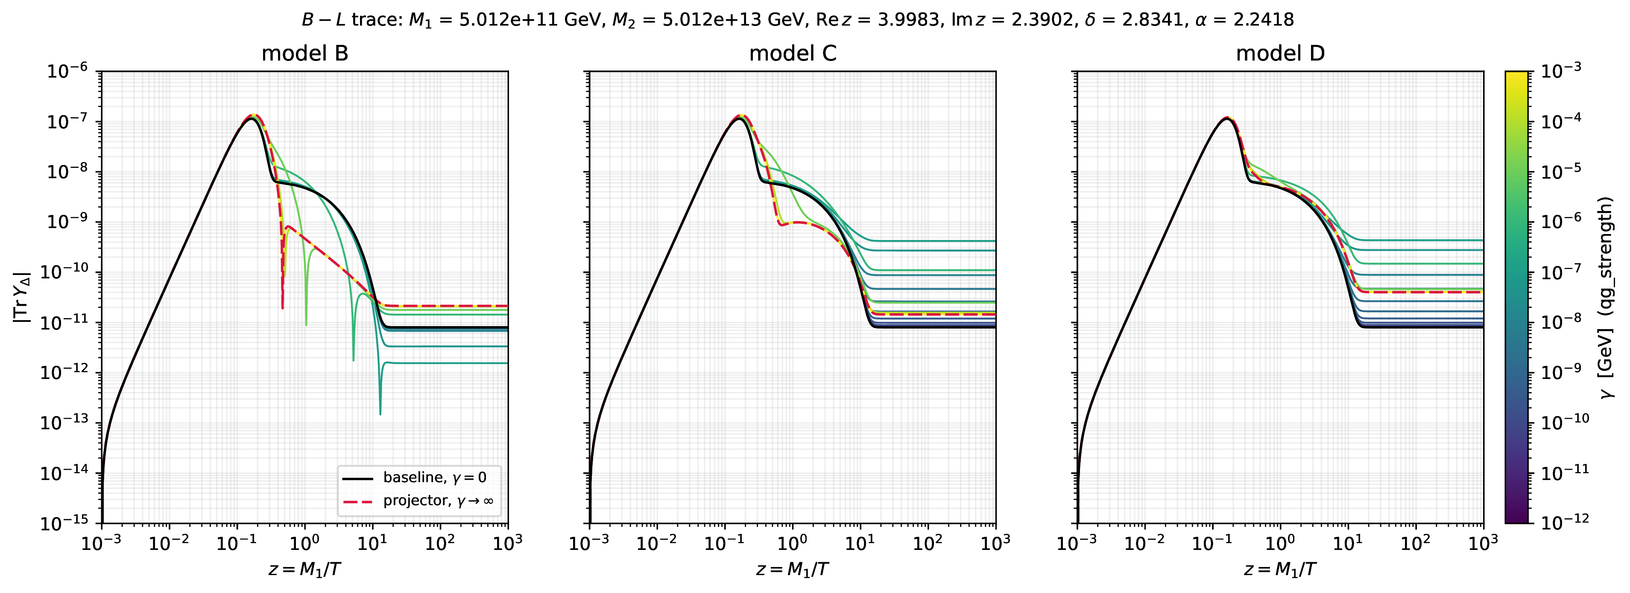
Evolution Examples
Input Parameters: M1 = 5.012e+11 GeV, M2 = 100*M1, Re[z] = 3.998, Im[z] = 2.390, $δ$ = 2.834, $α$= 2.242, n = 1
Strengthens $τ$ interaction Strengthens $μ$ interaction Strengthens $e$ interaction
Observations
Direction of shift — $γ$ can move $η_{B}$ in different directions as it strengthens
Limits — after a limiting $γ$, affected coherence term is sent to 0 immediately, so no further change in $η_{B}$

Slide 6
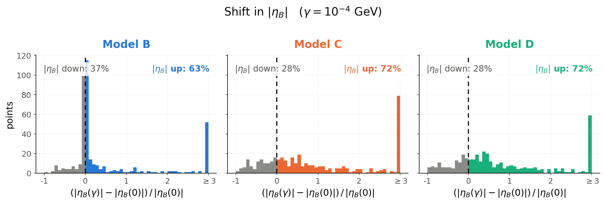
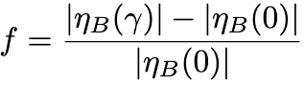
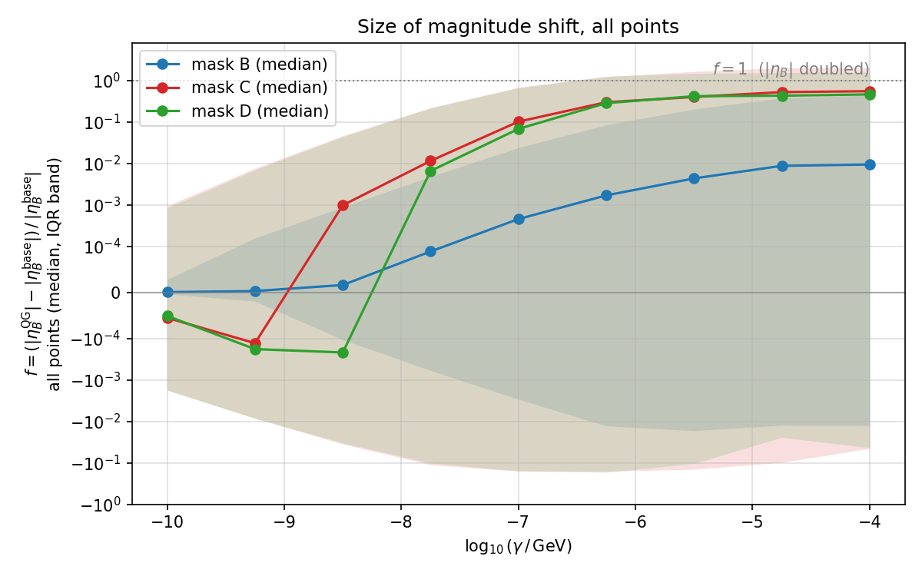
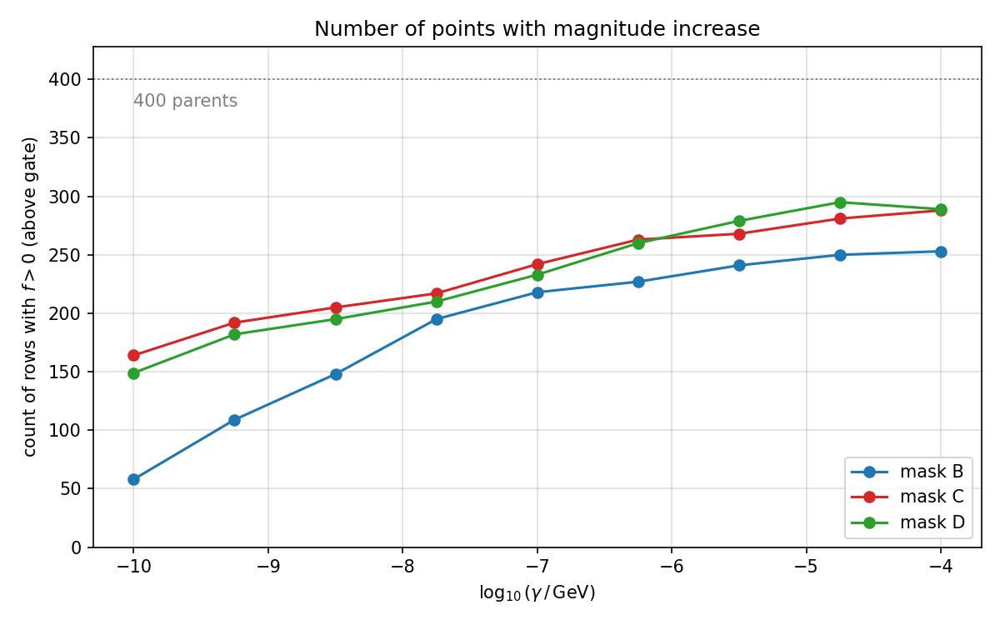
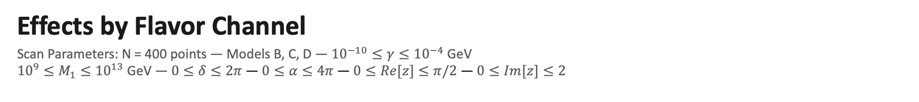
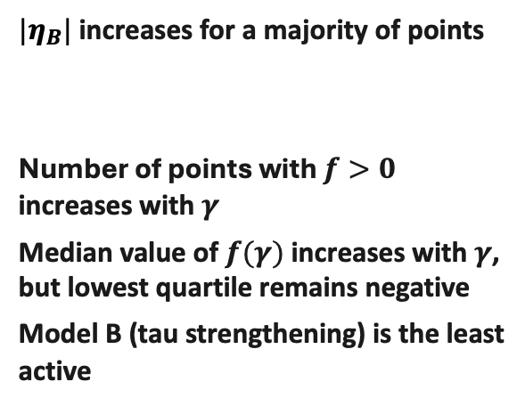
Effects by Flavor Channel
Scan Parameters: N = 400 points — Models B, C, D — ${10}^{−10}≤γ≤{10}^{−4}$ GeV
${10}^{9}≤M_{1}≤{10}^{13}$ GeV — $0≤δ≤2π$ — $0≤α≤4π$ — $0≤Re[z]≤π/2$ — $0≤Im[z]≤2$
Systematic increase in $|η_{B}|$
$|η_{B}|$increases for a majority of points
Number of points with $f>0$ increases with $γ$
Median value of $f(γ)$ increases with $γ$, but lowest quartile remains negative
Model B (tau strengthening) is the least active

Slide 7
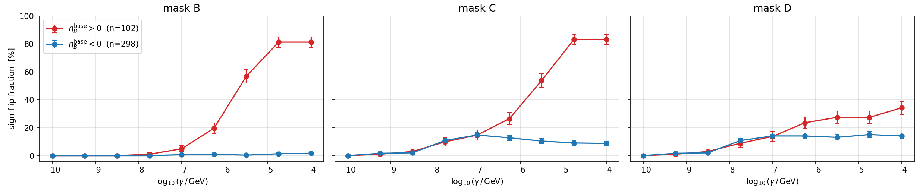
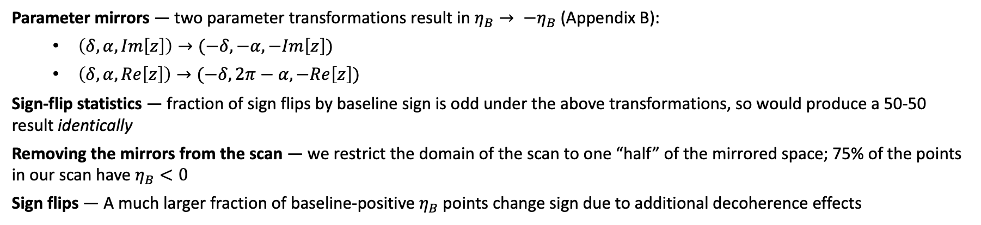
Effects by Flavor Channel
Scan Parameters: N = 400 points — Models B, C, D — ${10}^{−10}≤γ≤{10}^{−4}$ GeV
Sign-flips concentrate on the baseline carrying the domain-disfavored sign
Parameter mirrors — two parameter transformations result in $η_{B}→ {−η}_{B}$ (Appendix B):
  $\left(δ, α, Im\left[z\right]\right)→(−δ,−α,−Im\left[z\right])$
  $\left(δ, α, Re\left[z\right]\right)→(−δ,2π−α,−Re\left[z\right])$
Sign-flip statistics — fraction of sign flips by baseline sign is odd under the above transformations, so would produce a 50-50 result identically
Removing the mirrors from the scan — we restrict the domain of the scan to one “half” of the mirrored space; 75% of the points in our scan have $η_{B}<0$
Sign flips — A much larger fraction of baseline-positive $η_{B}$ points change sign due to additional decoherence effects
Fraction of sign-flips, split by baseline sign

Slide 8
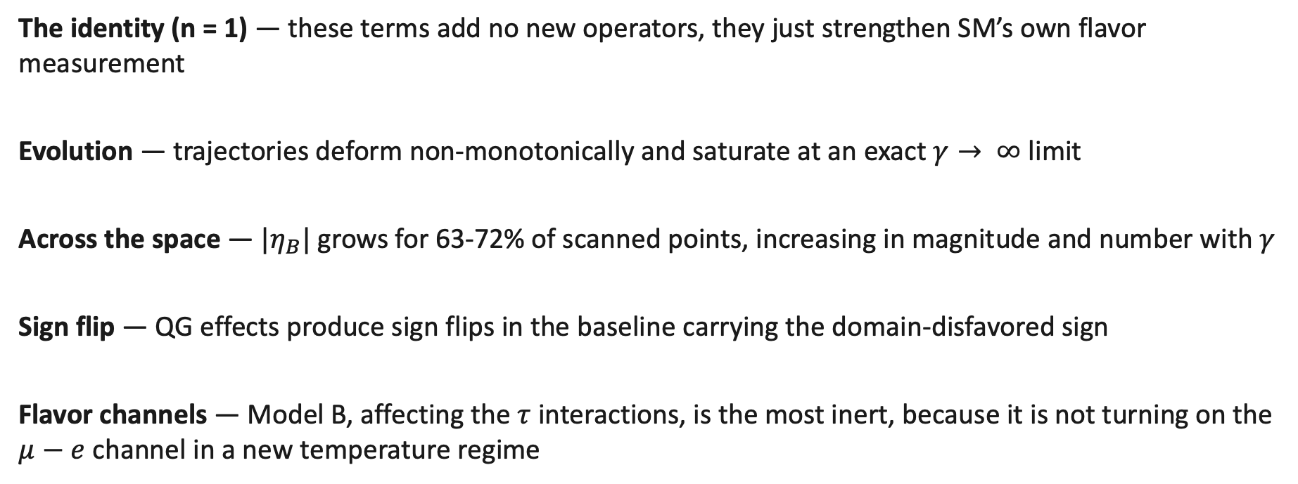
Summary & Conclusions
What we’ve seen
The identity (n = 1) — these terms add no new operators, they just strengthen SM’s own flavor measurement
Evolution — trajectories deform non-monotonically and saturate at an exact $γ→ ∞$ limit
Across the space — ${|η}_{B}|$ grows for 63-72% of scanned points, increasing in magnitude and number with $γ$
Sign flip — QG effects produce sign flips in the baseline carrying the domain-disfavored sign
Flavor channels — Model B, affecting the $τ$ interactions, is the most inert, because it is not turning on the $μ−e$ channel in a new temperature regime

Slide 9
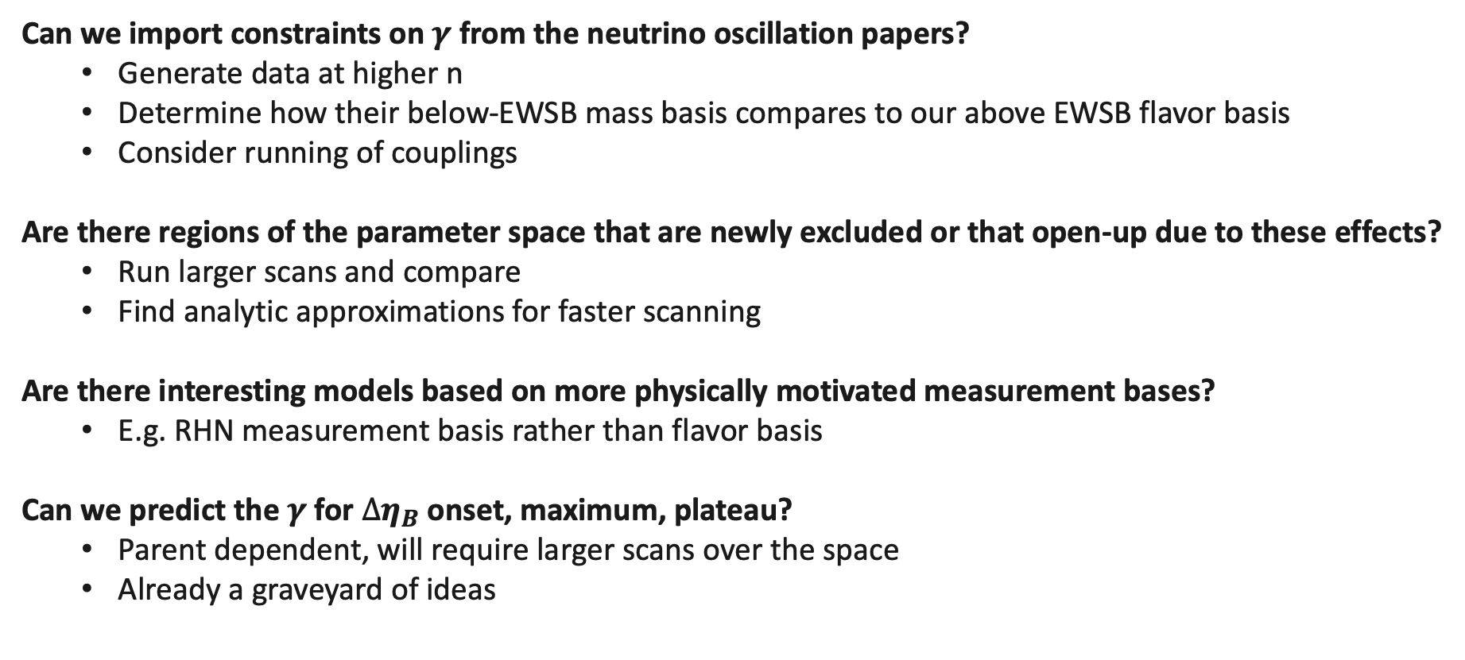
Future Work
Open questions
Can we import constraints on $γ$ from the neutrino oscillation papers?
  Generate data at higher n
  Determine how their below-EWSB mass basis compares to our above EWSB flavor basis
  Consider running of couplings
Are there regions of the parameter space that are newly excluded or that open-up due to these effects?
  Run larger scans and compare
  Find analytic approximations for faster scanning
Are there interesting models based on more physically motivated measurement bases?
  E.g. RHN measurement basis rather than flavor basis
Can we predict the $γ$ for $∆η_{B}$ onset, maximum, plateau?
  Parent dependent, will require larger scans over the space
  Already a graveyard of ideas

Slide 10
Backup

Slide 11
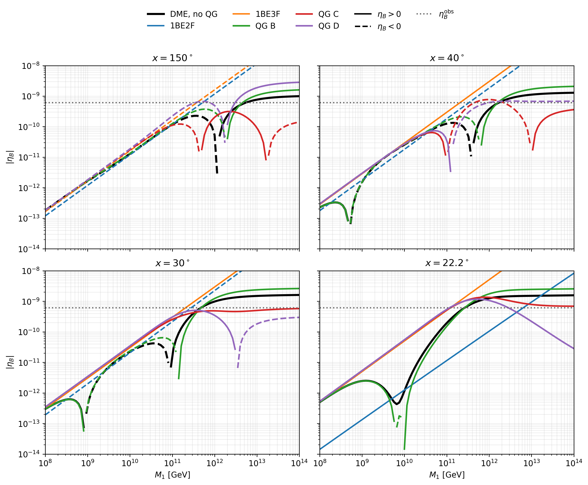
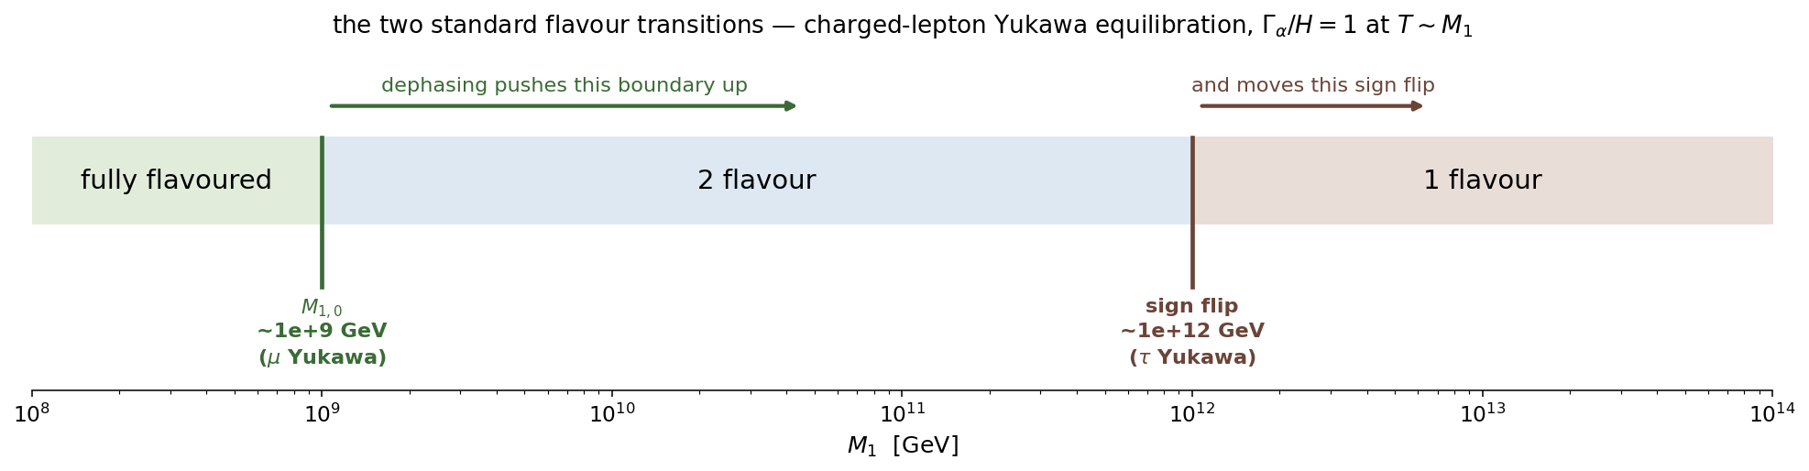
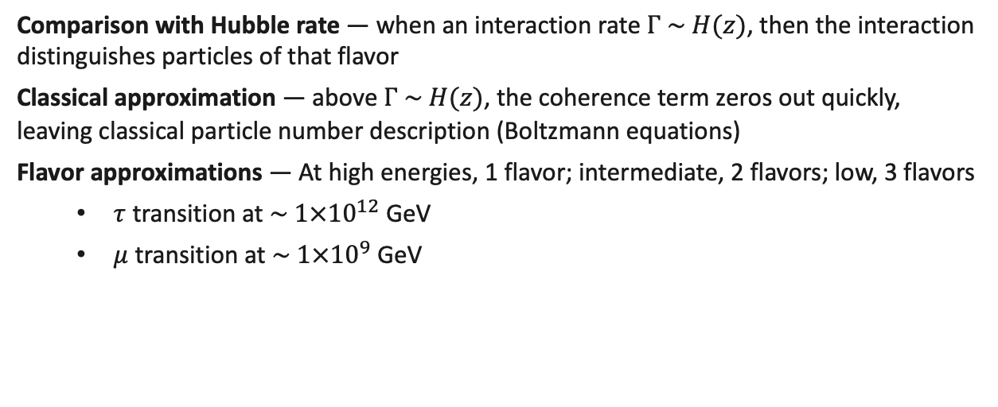
Landmarks in Ordinary Leptogenesis
What are some generic features of the leptogenesis parameter space? — Granelli et al. (2021)
Landmarks in the parameter space track flavor-transition regimes
Comparison with Hubble rate — when an interaction rate $Γ \sim H(z)$, then the interaction distinguishes particles of that flavor
Classical approximation — above $Γ \sim H(z)$, the coherence term zeros out quickly, leaving classical particle number description (Boltzmann equations)
Flavor approximations — At high energies, 1 flavor; intermediate, 2 flavors; low, 3 flavors
  $τ$ transition at $\sim 1×{10}^{12}$ GeV
  $μ$ transition at $\sim 1×{10}^{9}$ GeV

Slide 12
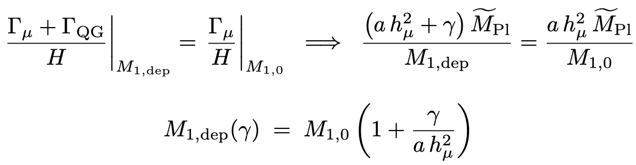
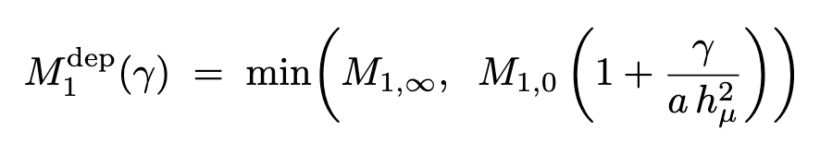

Landmark Shifting
The landmarks can be predicted algebraically
The 2-3 flavor transition landmark
Define $M_{1, dep}$— where the DME solution departs from the 3-flavor classical approximation
Compare SM + exotic strength with unperturbed rate
$γ→∞$ limit: $M_{1, ∞}$ — still makes physical sense! Zero-out the masked coherence terms through the entire evolution
Propose the relationship

Slide 13
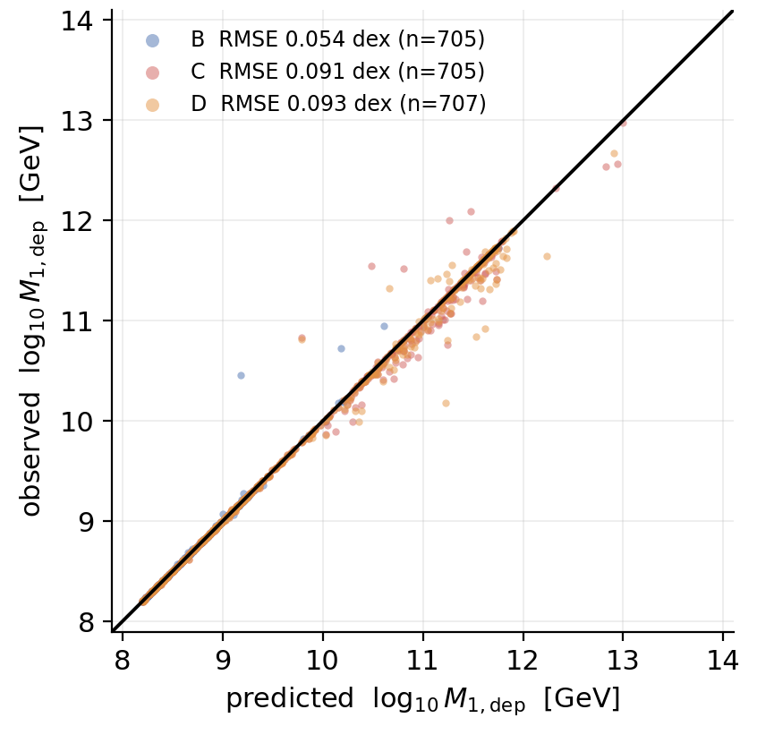
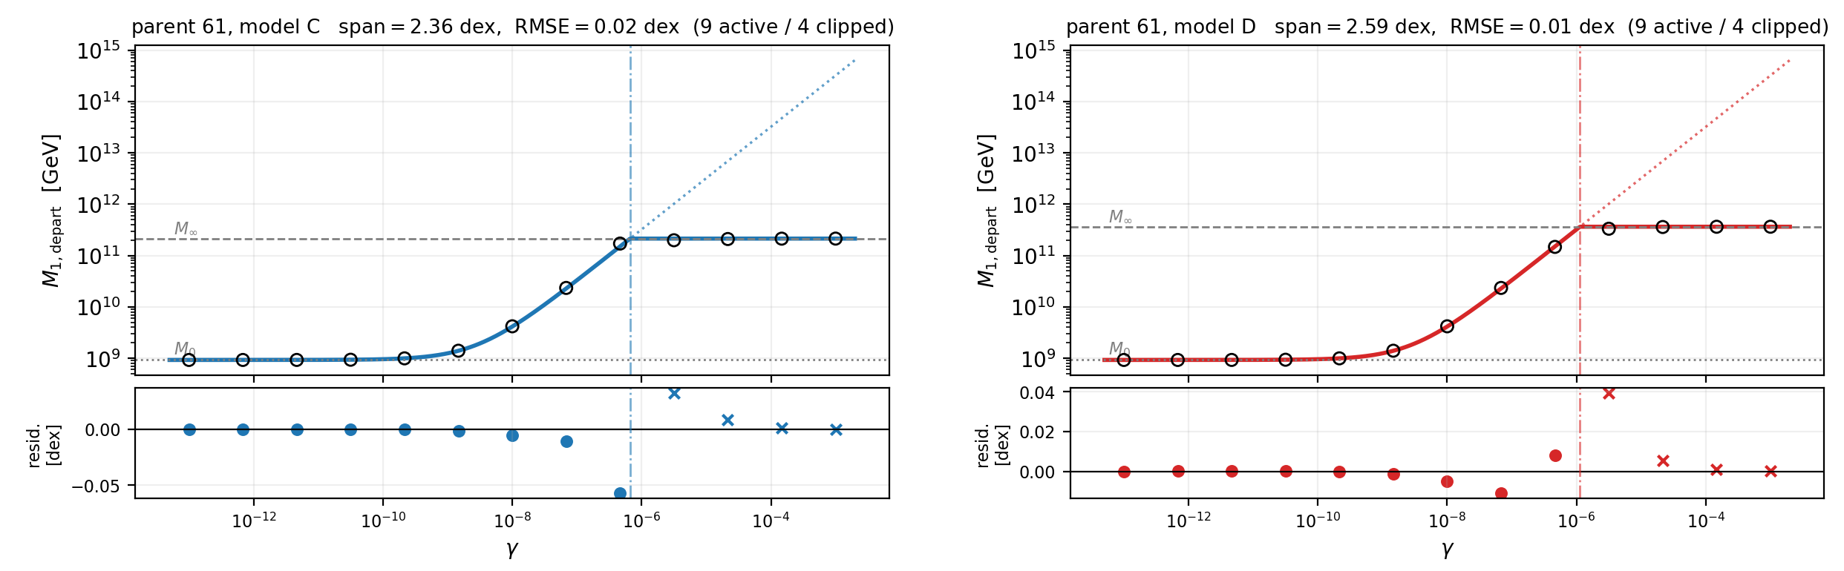
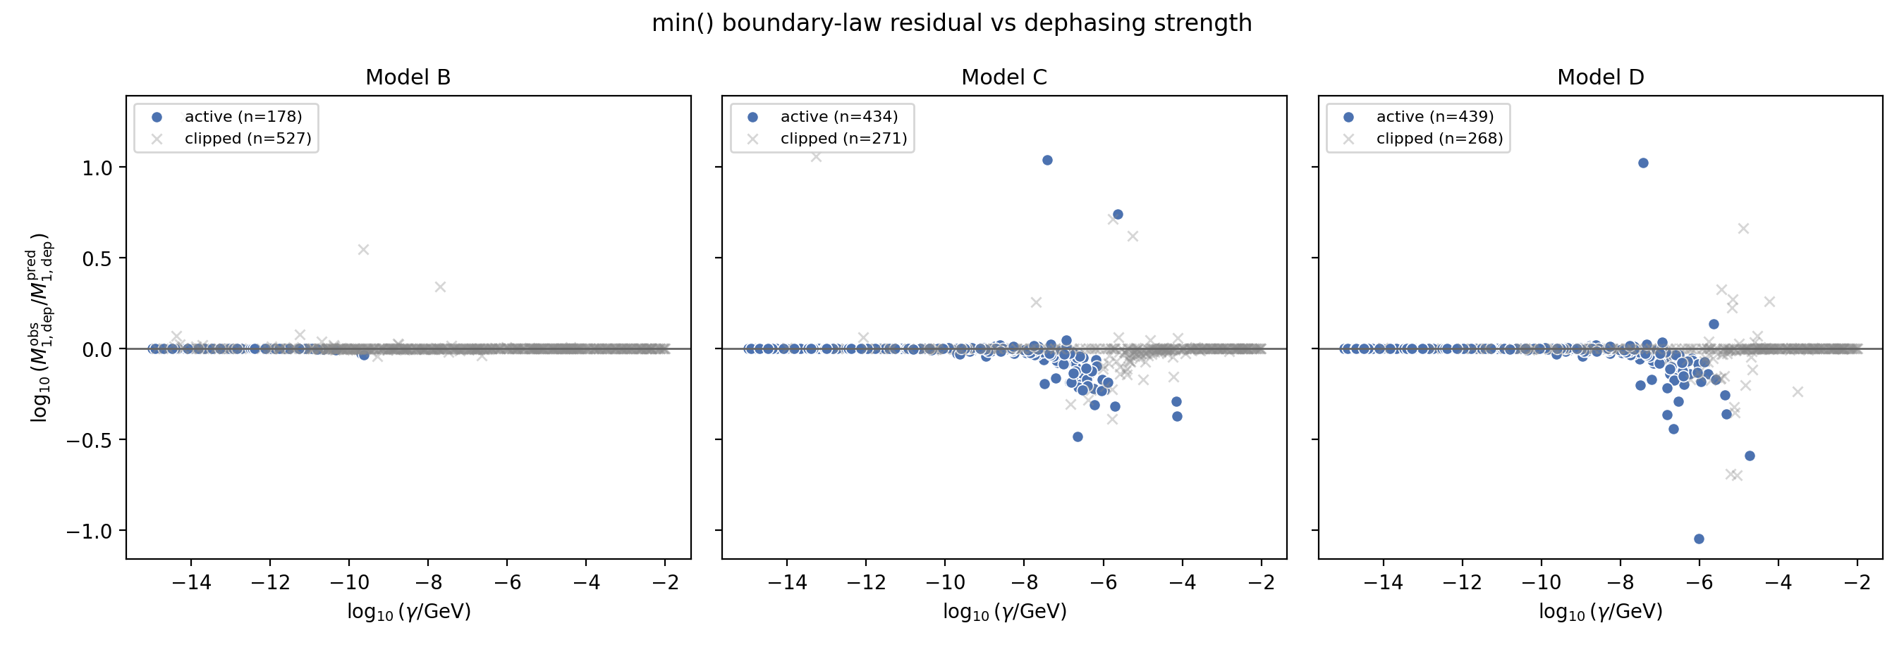
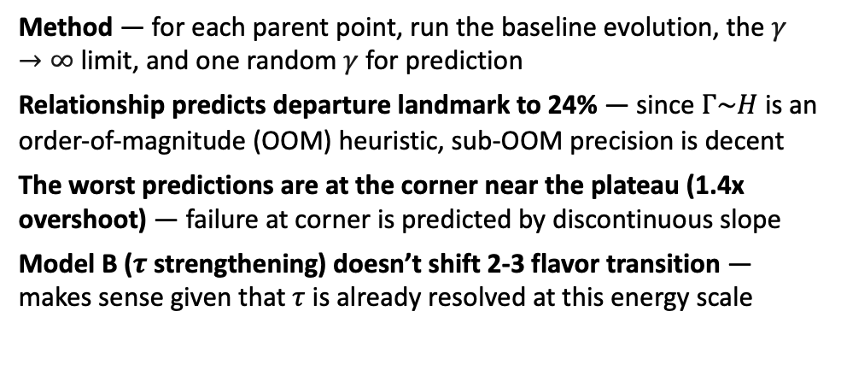
Testing the Landmark Shift: 2-3 Flavor Transition
The magnitude of the landmark shift can be predicted algebraically
Zero free-parameter prediction of shift
Method — for each parent point, run the baseline evolution, the $γ→∞$ limit, and one random $γ$ for prediction
Relationship predicts departure landmark to 24% — since $Γ\sim H$ is an order-of-magnitude (OOM) heuristic, sub-OOM precision is decent
The worst predictions are at the corner near the plateau (1.4x overshoot) — failure at corner is predicted by discontinuous slope
Model B ($τ$ strengthening) doesn’t shift 2-3 flavor transition — makes sense given that $τ$ is already resolved at this energy scale
Sigmoids — Zero parameter linear fit is 5-10% more precise than multi-parameter sigmoid fits

Slide 14
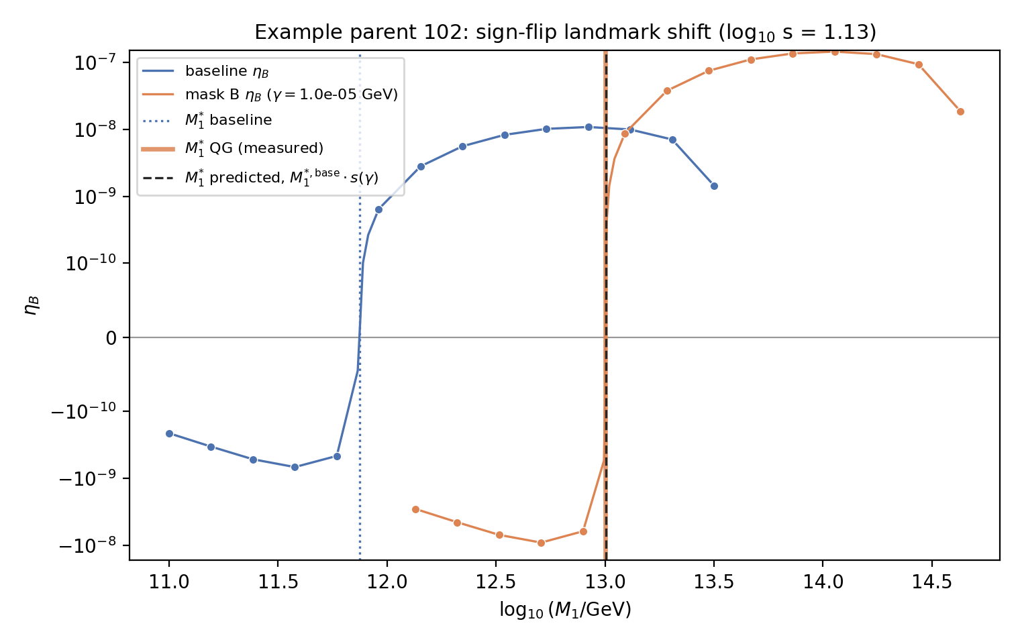
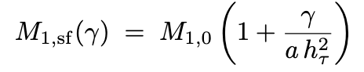
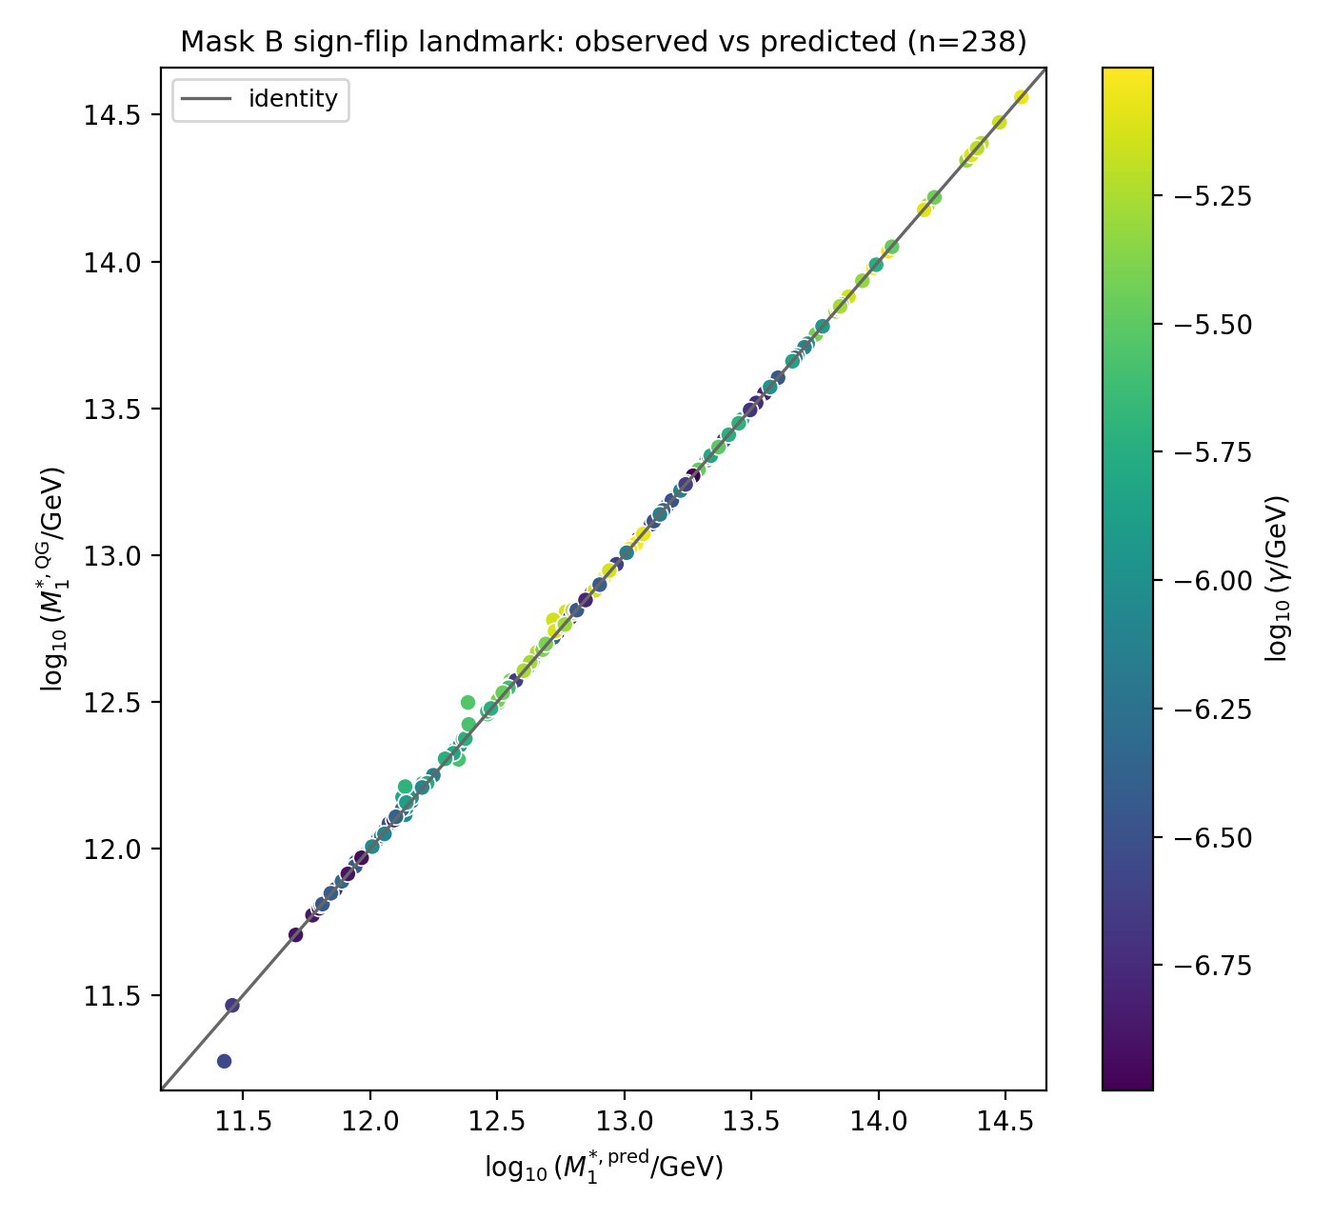
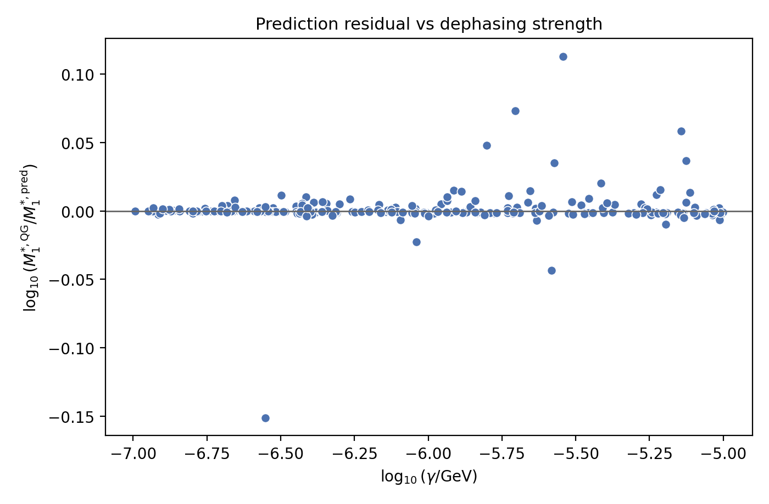
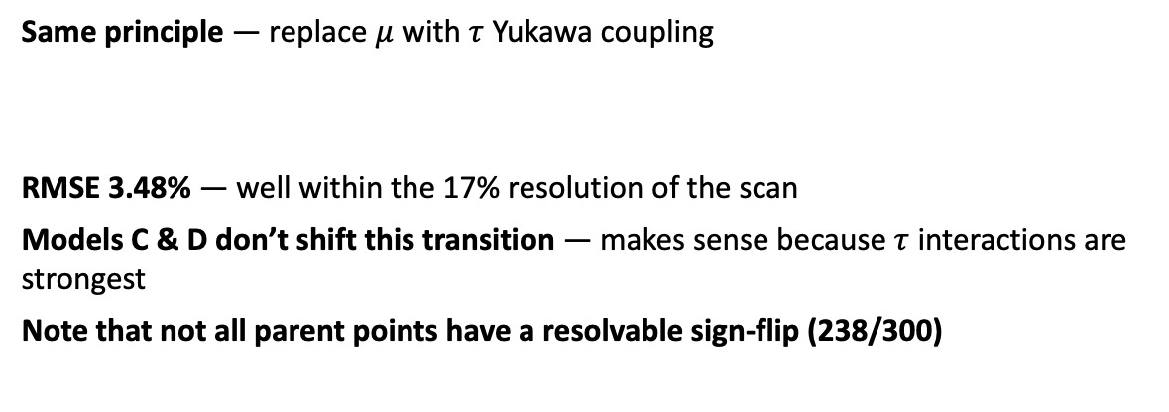
Testing the Landmark Shift: 1-2 Flavor Transition
The magnitude of the landmark shift can be predicted algebraically
Model B shifts sign-flip near ${10}^{12}$ GeV
Same principle — replace $μ$ with $τ$ Yukawa coupling
RMSE 3.48% — well within the 17% resolution of the scan
Models C & D don’t shift this transition — makes sense because $τ$ interactions are strongest
Note that not all parent points have a resolvable sign-flip (238/300)

Slide 15
Appendices

Slide 16
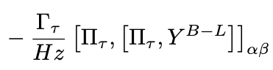
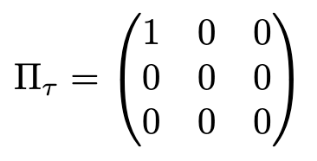

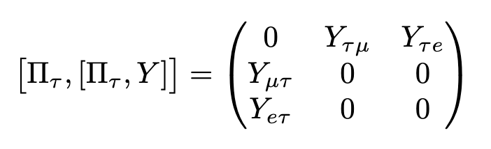
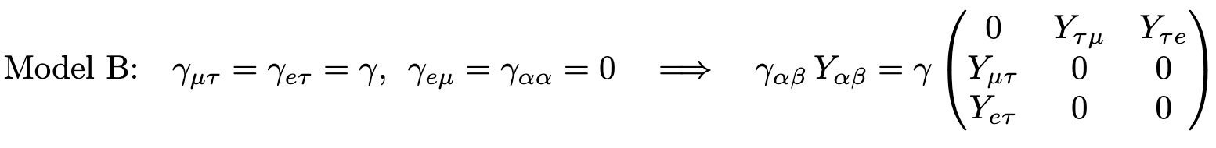
Appendix A: Equivalence of Exotic Decoherence and SM Strengthening
Only true for n = 1, models B (tau), C (mu), D (e)
Standard Model charged-lepton decoherence
Exotic dephasing
Identical operator structure for n = 1. Only the rate coefficients differ.
Interactions only damp the off-diagonal terms – no direct effect on lepton flavor populations
[Π_α,[Π_α,Y]] damps exactly the two coherences that involve flavour α, and touches nothing else. Models E, F and G are single channel, hence NOT equivalent to SM dephasing.

Slide 17
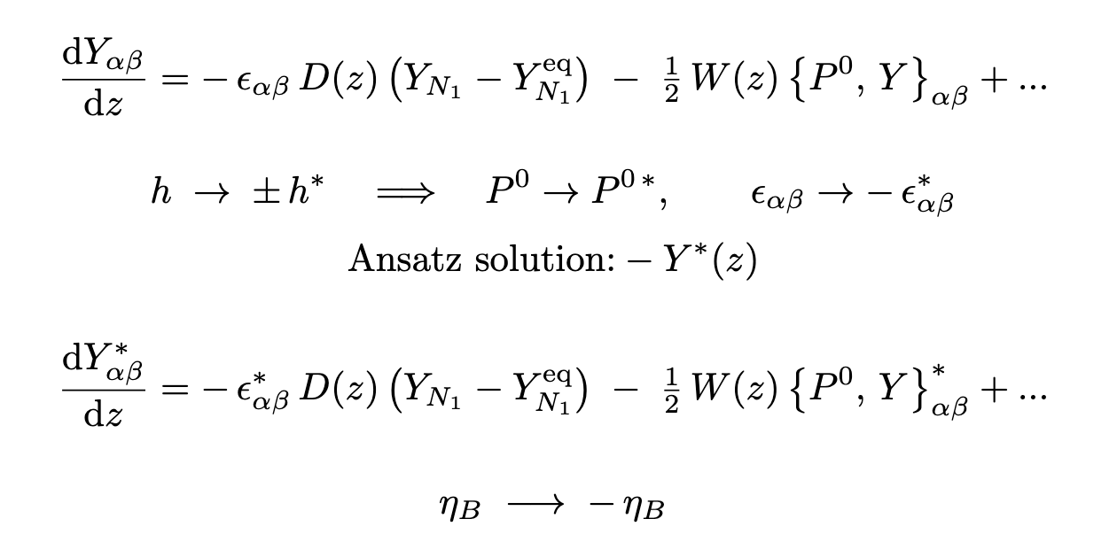
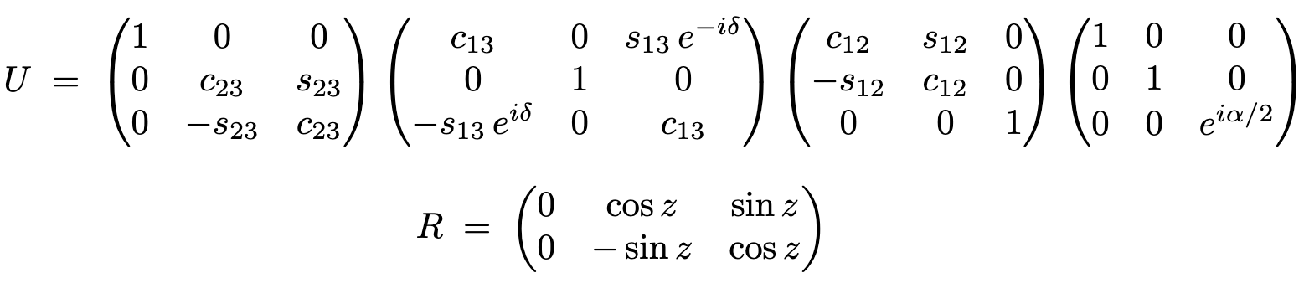
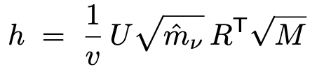
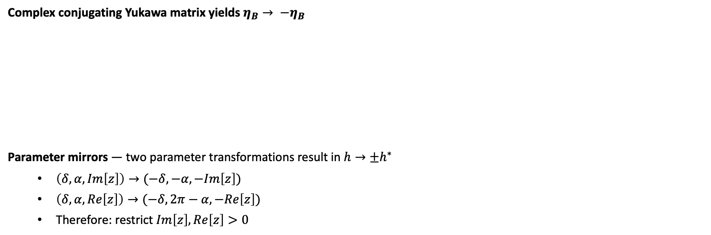
Appendix B: Mirrored Domain
Parameter space contains at least two exact mirrors
Casas-Ibarra Parametrization
Complex conjugating Yukawa matrix yields $η_{B}→ {−η}_{B}$
Parameter mirrors — two parameter transformations result in $h→±h^{∗}$
  $\left(δ, α, Im\left[z\right]\right)→(−δ,−α,−Im\left[z\right])$
  $\left(δ, α, Re\left[z\right]\right)→(−δ,2π−α,−Re\left[z\right])$
  Therefore: restrict $Im\left[z\right], Re\left[z\right]>0$

Slide 18
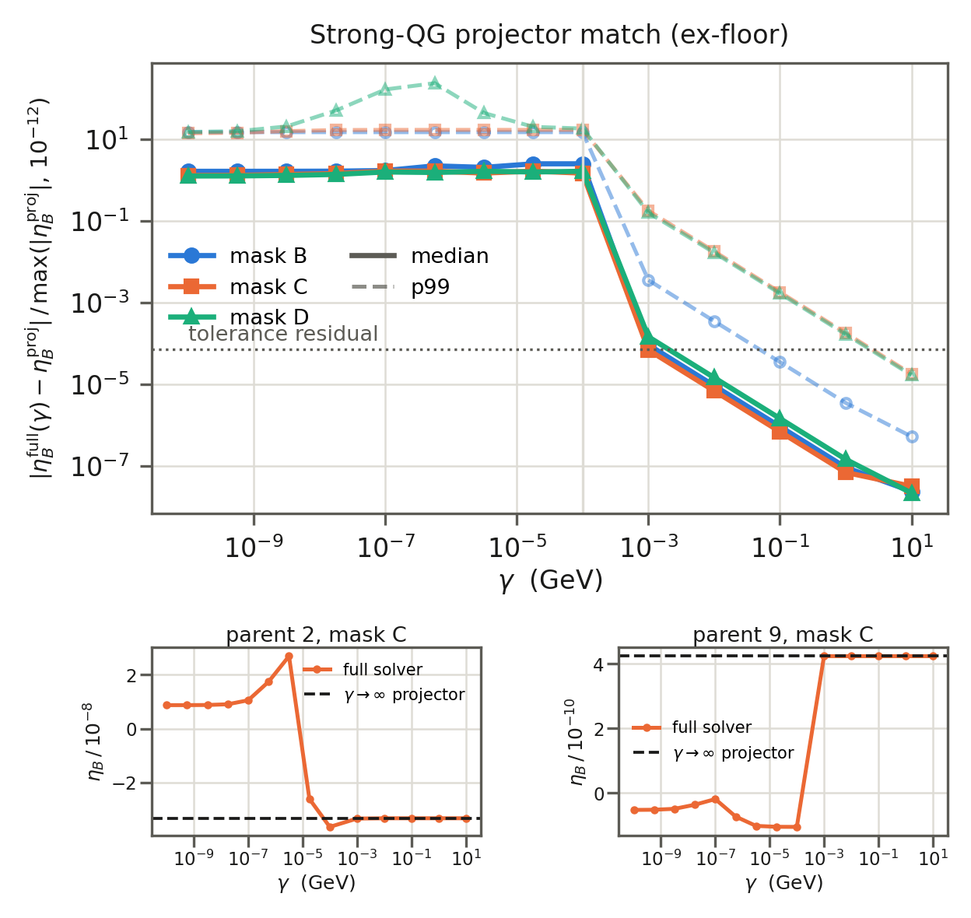
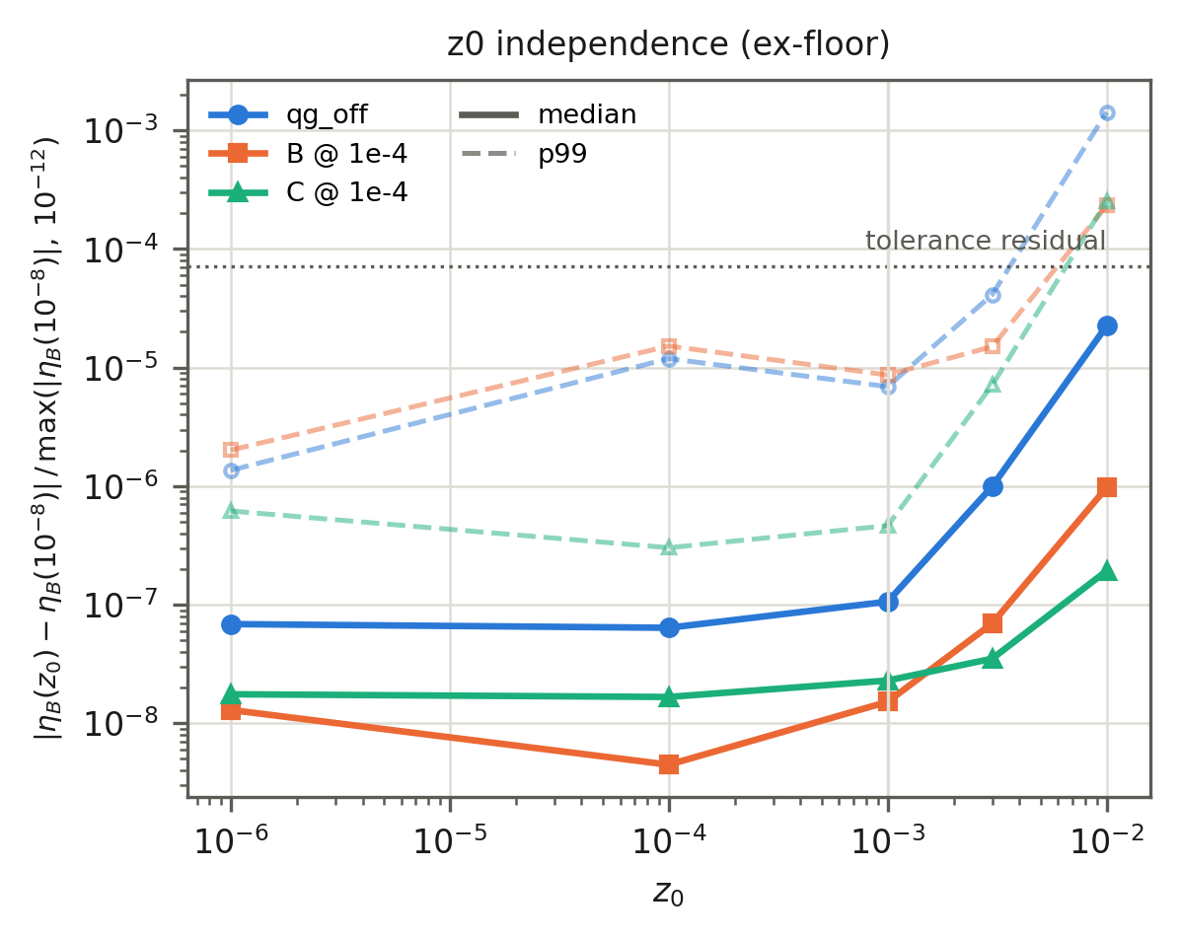
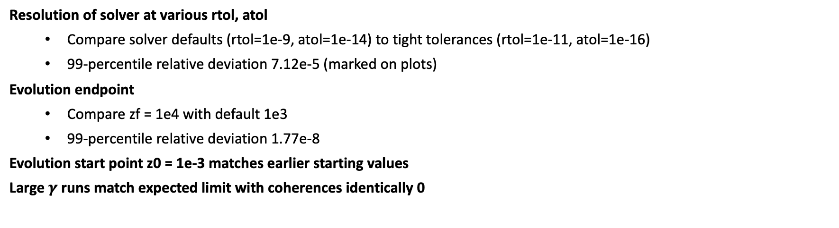
Appendix C: Solver Validation
DMEs are stiff; large $γ$ exacerbates the problem
Basic validation tests
Resolution of solver at various rtol, atol
  Compare solver defaults (rtol=1e-9, atol=1e-14) to tight tolerances (rtol=1e-11, atol=1e-16)
  99-percentile relative deviation 7.12e-5 (marked on plots)
Evolution endpoint
  Compare zf = 1e4 with default 1e3
  99-percentile relative deviation 1.77e-8
Evolution start point z0 = 1e-3 matches earlier starting values
Large $γ$ runs match expected limit with coherences identically 0

