Slide 1
Towards a Post-Quantum Theory of Gravity
Muhammad Sajjad

Slide 2
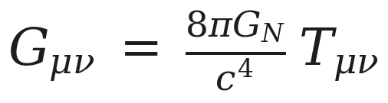
Motivation
Einstein's equation:
But the left-hand side is a c-number field and the right-hand side is an operator

Slide 3
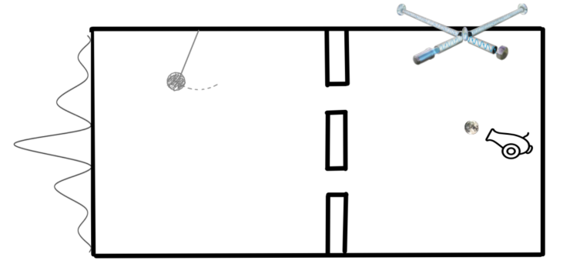
The split-slit gedanken experiment
A massive particle through the left slit sources a different field than through the right.
If that field is classical it can be measured to arbitrary accuracy
Measuring it gives which path information: no interference pattern
Feynman at Chapel Hill (1957), and Aharonov: gravity must be quantised.

Slide 4
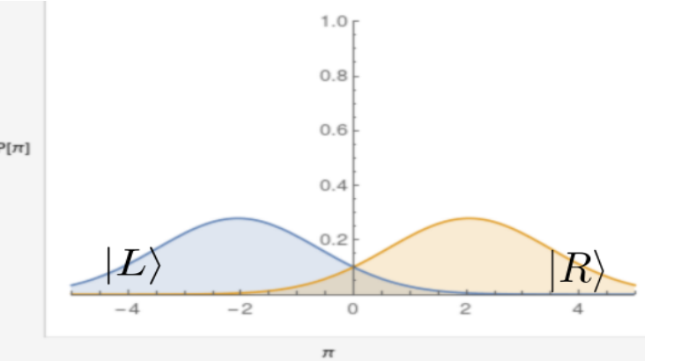
The hidden assumption
The classical field need not be sharp. It can be stochastic.
Then |L⟩ and |R⟩ give overlapping distributions for the conjugate momentum π of the pendulum.
Overlapping distributions carry no perfect which-path record, so the interference pattern survives.
Classical gravity can only be stochastic

Slide 5
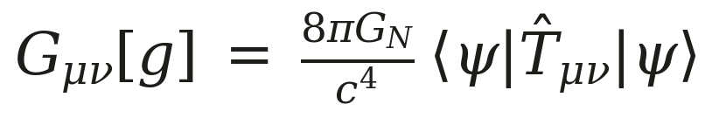
Semi-classical gravity is not good enough
Source the metric via the expectation value.
In a superposition the field then sits at the mean. The mass is here and there; the field is at neither.
Non-linear in the state, super-luminal signalling

Slide 6
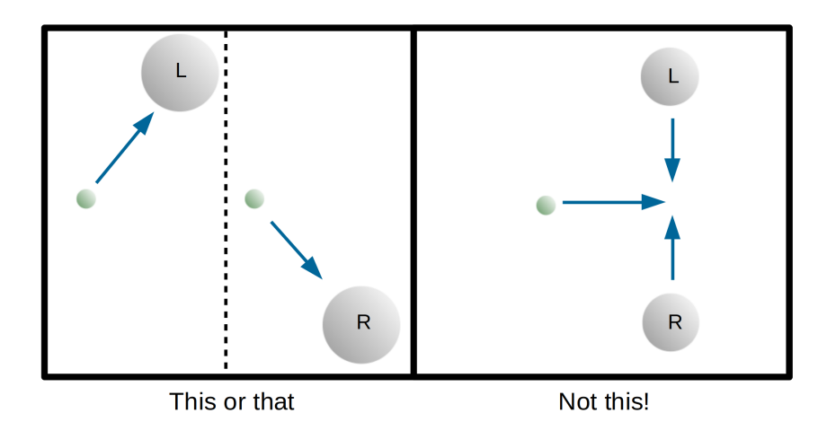
Here, not there
A classical field may be in the L configuration or in the R configuration, with probabilities.
What it cannot be is the average of the two.

Slide 7
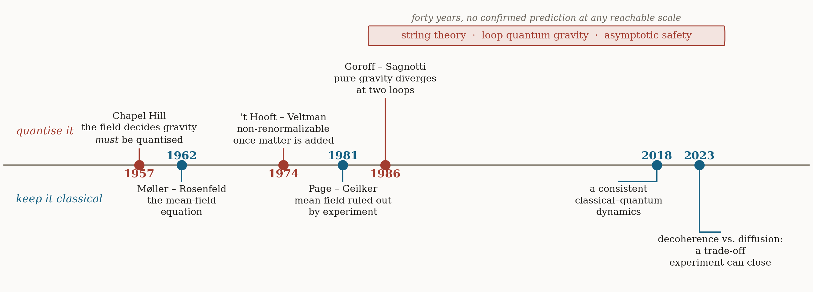
70 years since Chapel Hill
1957, UNC Chapel Hill: the field committed to quantising gravity on the strength of a gedanken experiment.
Perturbative quantisation: EH is non-renormalizable, QG is non-unitary etc.
No direct evidence of the quantum nature of gravity

Slide 8
Consistent classical–quantum dynamics
Evading the no-go theorem: the coupling can be neither unitary nor deterministic: drift sourced by average fields must cause quantum fields to decohere
Consistency requires the map on the hybrid state ϱ(z,t) to be completely positive and trace preserving.
Expanding the transition rates in moments of the classical jump gives three coefficients:
D₁: back-reaction — the classical field drifts under the quantum source.
D₂: diffusion — the classical field is noisy.
D₀: decoherence — the quantum state loses coherence in the source.

Slide 9
The classical–quantum state
A density matrix over the quantum fields, indexed by the classical configuration:
with components
φ⁺ and φ⁻ are the ket and bra fields, and may themselves depend on z, ż and t. The components evolve by a path integral:
with 1/N a normalisation constant, and the action splitting into three pieces:

Slide 10
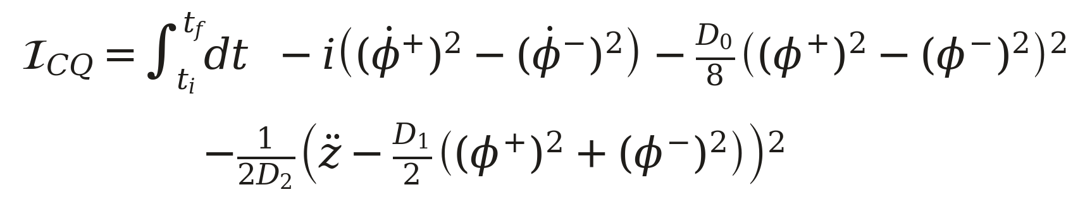
The Classical Quantum Action
The imaginary part, I_{Q}(φ⁺,φ⁻), — the unitary dynamics of the bra and ket fields.
I_{FV} — the Feynman–Vernon, or Schwinger–Keldysh, terms; these decohere. The first two pieces alone are the standard open-quantum-systems formalism.
I_{Diff} — the diffusive part, which carries the quantum back-reaction on the classical field. It is what is new.
A simple example, with φ and z a field and a classical variable (for fields, dt → d⁴x):
The imaginary part is I_{Q}; the D₀ term is Feynman–Vernon, decohering the field at a strength set by D₀.
The last term is a classical–quantum Onsager–Machlup functional: an equation of motion, squared. Small D₂ suppresses departures from it — stochastic kicks to the acceleration z̈.
If D₂ is not positive (not PSD, for a matrix of equations) the action is unbounded and wild paths dominate. D₁ sets the strength of the back-reaction.

Slide 11
The gravitational action
governing the evolution of the state through
T± is a function of φ±; G is the Einstein tensor of the metric g, and the gravitational path integral runs over continuous configurations, up to diffeomorphisms.
The Feynman–Vernon term decoheres the density matrix, damping its off-diagonal elements exponentially.
The last term is the Onsager–Machlup functional for Einstein's equations, with the classical G^{μν} sourced by the average of the bra and ket fields, T̄^{μν} = ½(T^{μν+} + T^{μν−}).
The classical field diffuses around its equations of motion, the covariance of the stochastic force being the diffusion matrix D₂.

Slide 12
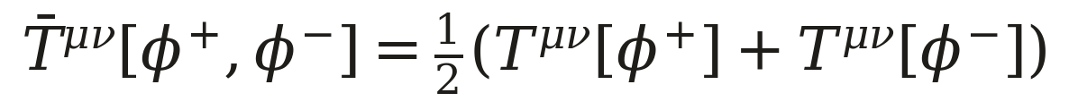
Drift, noise and Girsanov’s theorem
The classical field drifts under the quantum source and diffuses:
Girsanov: for D₂ > 0 the measures with and without the drift are equivalent — mutually absolutely continuous, not orthogonal:
No record of finite length separates them with certainty. The drift can only be estimated, and the variance of that estimate falls off only as 1/T:
Over any finite interval the branch driving the field is therefore undetermined, and the source that acts is the average of the two:
Only as T → ∞ do the measures become mutually singular.

Slide 13
Complete positivity and the decoherence–diffusion trade-off
Complete positivity of the hybrid map amounts to three conditions:
With back-reaction fixed by Newton's constant, D₁ ∝ 8πG_{N}, the third condition is a trade-off:
Decoherence and diffusion cannot both be small: an upper bound on one is a lower bound on the other.
The classical equations of motion favour anti-correlation of the two branches; the decoherence term counteracts it.
At saturation the entire positivity question collapses to positivity of the diffusion matrix:

Slide 14
Investigations: a renormalizable CQ action
Local and Lorentz covariant, built from the linearised Einstein tensor and the averaged source:
Four derivatives, so the propagator falls off like p⁻⁴ — power-counting renormalizable:
Two couplings, α and β, fix the diffusion and the decoherence

Slide 15
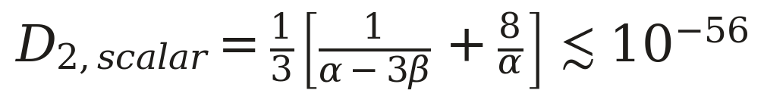
Scalar channel: LISA Pathfinder
The extra scalar mode diffuses, at a rate set by the two couplings:
The residual acceleration noise of LISA Pathfinder caps it, providing a floor for the couplings:

Slide 16
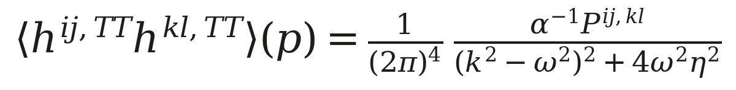
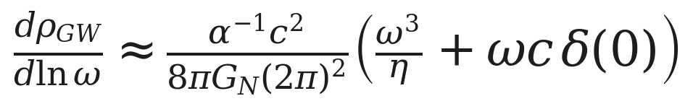
Tensor channel: the gravitational-wave background
The transverse-traceless two-point function of the diffusing metric:
Integrating it gives the stochastic background the diffusion must produce:

Slide 17
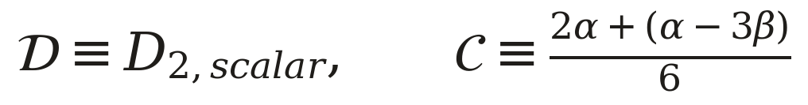
An upper bound on diffusion is a lower bound on decoherence
Write the trade-off in terms of the diffusion and the decoherence it forces:
The product has a floor at 25/18, so the LIGO cap on the diffusion turns into a floor under the decoherence:
Gravitationally induced decoherence predicts the lower bound for decoherence
Decoherence based experiments set an upper bound

Slide 18
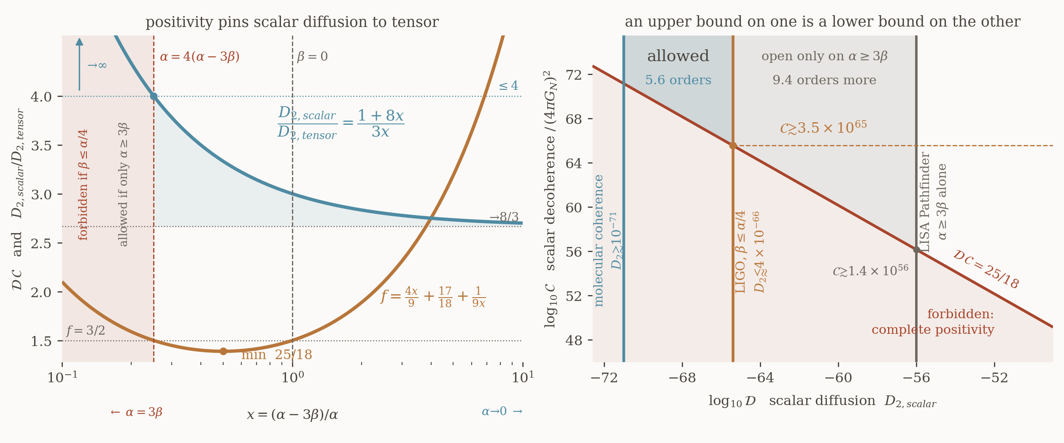
The trade-off
Left: positivity pins the ratio of scalar to tensor diffusion. Right: the excluded hyperbola, and the two windows that survive.

Slide 19
References
J. Oppenheim, “A post-quantum theory of classical gravity”, Phys. Rev. X 13, 041040 (2023); arXiv:1811.03116.
J. Oppenheim, C. Sparaciari, B. Šoda, Z. Weller-Davies, “Gravitationally induced decoherence vs space-time diffusion: testing the quantum nature of gravity”, Nat. Commun. 14, 7910 (2023).
J. Oppenheim and Z. Weller-Davies, on covariant path integrals for quantum fields back-reacting on classical spacetime (2023).
A. Grudka et al., “Renormalisation of postquantum–classical gravity” (2024)
R. P. Feynman and F. L. Vernon, Ann. Phys. 24, 118 (1963); L. Onsager and S. Machlup, Phys. Rev. 91, 1505 (1953).
A. Tilloy and L. Diósi, on measurement-and-feedback models of classical gravity.
D. N. Page and C. D. Geilker, “Indirect evidence for quantum gravity”, Phys. Rev. Lett. 47, 979 (1981).

