Slide 1
Freddie King
Line of Fixed Points and U(1) Chiral Symmetry Breaking in a 3D NJL-type Model
Based on work with Charlie Cresswell-Hogg and Daniel F. Litim:
F. King, C. Cresswell-Hogg and D. F. Litim, Line of Fixed Points and U(1) Chiral Symmetry Breaking in a 3D NJL-type Model (in preparation).

Slide 2
Four-fermion models
XVI NExT PhD Workshop
The Cosener’s House, Abingdon
25/08/26
Freddie King

Slide 3
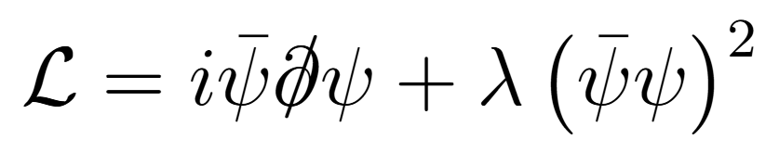
Four-fermion models
XVI NExT PhD Workshop
The Cosener’s House, Abingdon
25/08/26
Freddie King

Slide 4

Four-fermion models
XVI NExT PhD Workshop
The Cosener’s House, Abingdon
25/08/26
Freddie King

Slide 5
Four-fermion models
→ non-renormalizable in d=3,4?
XVI NExT PhD Workshop
The Cosener’s House, Abingdon
25/08/26
Freddie King

Slide 6
Four-fermion models
Not the case!!
XVI NExT PhD Workshop
The Cosener’s House, Abingdon
25/08/26
Freddie King

Slide 7
Four-fermion models
Not the case!!
→ Key is non-perturbative methods
XVI NExT PhD Workshop
The Cosener’s House, Abingdon
25/08/26
Freddie King

Slide 8
Four-fermion models
Not the case!!
→ Key is non-perturbative methods
1) 1/N expansion
e.g. Moshe, Zinn-Justin 2003
XVI NExT PhD Workshop
The Cosener’s House, Abingdon
25/08/26
Freddie King

Slide 9
Four-fermion models
Not the case!!
→ Key is non-perturbative methods
Number of fermion flavours
1) 1/N expansion
e.g. Moshe, Zinn-Justin 2003
XVI NExT PhD Workshop
The Cosener’s House, Abingdon
25/08/26
Freddie King

Slide 10

Four-fermion models
Not the case!!
→ Key is non-perturbative methods
Number of fermion flavours
1) 1/N expansion
e.g. Moshe, Zinn-Justin 2003
Gross, Neveu ’74
Gawedzki, Kupiainen ‘85
e.g. Gross-Neveu theory:
Flavour index
XVI NExT PhD Workshop
The Cosener’s House, Abingdon
25/08/26
Freddie King

Slide 11
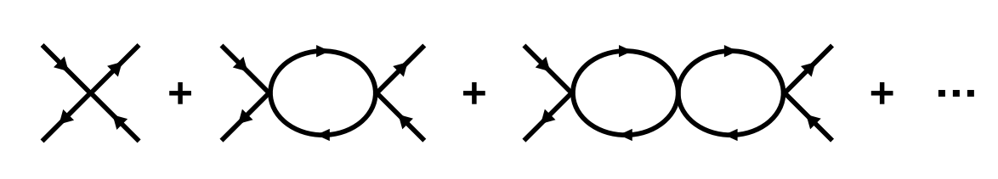
Four-fermion models
Not the case!!
→ Key is non-perturbative methods
Number of fermion flavours
1) 1/N expansion
e.g. Moshe, Zinn-Justin 2003
e.g. Gross-Neveu theory:
Gross, Neveu ’74
Gawedzki, Kupiainen ‘85
Flavour index
XVI NExT PhD Workshop
The Cosener’s House, Abingdon
25/08/26
Freddie King

Slide 12
Four-fermion models
Not the case!!
→ Key is non-perturbative methods
2) Functional Renormalisation Group
Wetterich ’93
Ellwanger ’93
Morris ‘93
XVI NExT PhD Workshop
The Cosener’s House, Abingdon
25/08/26
Freddie King

Slide 13
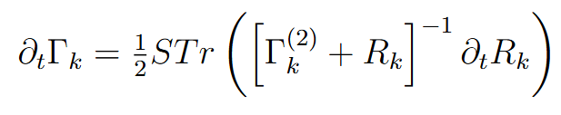
Four-fermion models
Not the case!!
→ Key is non-perturbative methods
2) Functional Renormalisation Group
Wetterich ’93
Ellwanger ’93
Morris ‘93
XVI NExT PhD Workshop
The Cosener’s House, Abingdon
25/08/26
Freddie King

Slide 14
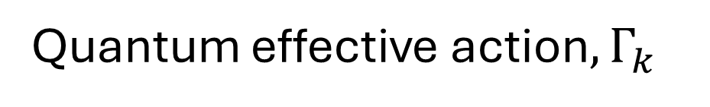
Four-fermion models
Not the case!!
→ Key is non-perturbative methods
2) Functional Renormalisation Group
Wetterich ’93
Ellwanger ’93
Morris ‘93
Quantum effective action$, Γ_{k}$
XVI NExT PhD Workshop
The Cosener’s House, Abingdon
25/08/26
Freddie King

Slide 15

Four-fermion models
Not the case!!
→ Key is non-perturbative methods
2) Functional Renormalisation Group
Wetterich ’93
Ellwanger ’93
Morris ‘93
Quantum effective action$, Γ_{k}$
RG scale$, t=ln⁡(k)$
XVI NExT PhD Workshop
The Cosener’s House, Abingdon
25/08/26
Freddie King

Slide 16
Four-fermion models
Not the case!!
→ Key is non-perturbative methods
2) Functional Renormalisation Group
Wetterich ’93
Ellwanger ’93
Morris ‘93
Quantum effective action$, Γ_{k}$
Hessian
RG scale$, t=ln⁡(k)$
XVI NExT PhD Workshop
The Cosener’s House, Abingdon
25/08/26
Freddie King

Slide 17
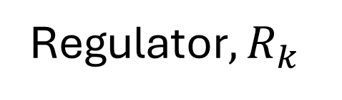
Four-fermion models
Not the case!!
→ Key is non-perturbative methods
2) Functional Renormalisation Group
Wetterich ’93
Ellwanger ’93
Morris ‘93
Quantum effective action$, Γ_{k}$
Hessian
RG scale$, t=ln⁡(k)$
Regulator$,R_{k}$
XVI NExT PhD Workshop
The Cosener’s House, Abingdon
25/08/26
Freddie King

Slide 18
Four-fermion models
What is known from this:
→ non-perturbatively renormalizable in d=3,4
Rosenstein, Warr, Park ’89, de Calan, Faria da Veiga, Magnen, Seneor ’91, Litim, Cresswell-Hogg 2026
XVI NExT PhD Workshop
The Cosener’s House, Abingdon
25/08/26
Freddie King

Slide 19
Four-fermion models
What is known from this:
→ non-perturbatively renormalizable in d=3,4
Rosenstein, Warr, Park ’89, de Calan, Faria da Veiga, Magnen, Seneor ’91, Litim, Cresswell-Hogg 2026
→ Interacting UV fixed point
→ finite # undetermined parameters!
(→finite dimensional UV critical surface)
XVI NExT PhD Workshop
The Cosener’s House, Abingdon
25/08/26
Freddie King

Slide 20
Four-fermion models
What is known from this:
• Combine 1/N and FRG?
XVI NExT PhD Workshop
The Cosener’s House, Abingdon
25/08/26
Freddie King

Slide 21

Four-fermion models
What is known from this:
• Combine 1/N and FRG?
$$V\left(\overline{ψ}ψ\right), no derivatives$$
→ RG flow of fermionic ‘potential’ = exact!
Fermions and the Renormalisation Group at Large N: 2502.04473
XVI NExT PhD Workshop
The Cosener’s House, Abingdon
25/08/26
Freddie King

Slide 22
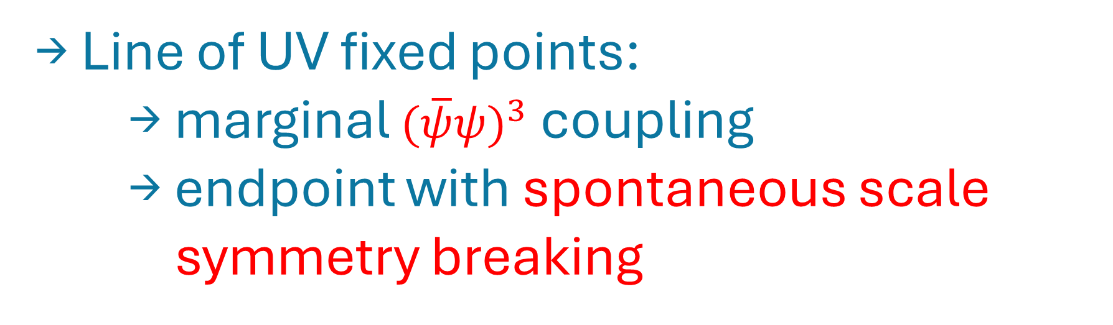
Four-fermion models
What is known from this:
• Combine 1/N and FRG?
$$V\left(\overline{ψ}ψ\right), no derivatives$$
→ RG flow of fermionic ‘potential’ = exact!
Fermions and the Renormalisation Group at Large N: 2502.04473
→ Line of UV fixed points:
→ marginal ${(\overline{ψ}ψ)}^{3}$ coupling
→ endpoint with spontaneous scale symmetry breaking
Line of Fixed Points in Gross-Neveu Theories : 2207.10115
Critical Fermions with Spontaneously Broken Scale Symmetry : 2212.06815
Fermion Mass Generation without Symmetry Breaking: 2406.00100
XVI NExT PhD Workshop
The Cosener’s House, Abingdon
25/08/26
Freddie King

Slide 23
NJL-type Model
What about my NJL-type model?
XVI NExT PhD Workshop
The Cosener’s House, Abingdon
25/08/26
Freddie King

Slide 24
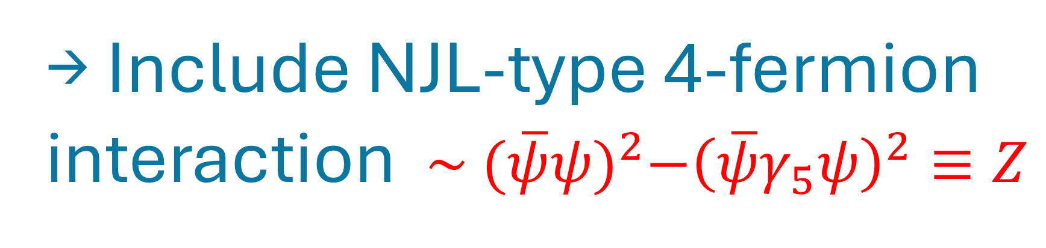

NJL-type Model
What about my NJL-type model?
→ Include NJL-type 4-fermion interaction ${ \sim (\overline{ψ}ψ)}^{2}−{\left(\overline{ψ}γ_{5}ψ\right)}^{2}≡Z$
New Dirac matrix $γ_{5}$ bilinear
XVI NExT PhD Workshop
The Cosener’s House, Abingdon
25/08/26
Freddie King

Slide 25
NJL-type Model
What about my NJL-type model?
→ Include NJL-type 4-fermion interaction ${ \sim (\overline{ψ}ψ)}^{2}−{\left(\overline{ψ}γ_{5}ψ\right)}^{2}≡Z$
(FRG+Large N still exact)
New Dirac matrix $γ_{5}$ bilinear
XVI NExT PhD Workshop
The Cosener’s House, Abingdon
25/08/26
Freddie King

Slide 26

NJL-type Model
What about my NJL-type model?
→ Include NJL-type 4-fermion interaction ${ \sim (\overline{ψ}ψ)}^{2}−{\left(\overline{ψ}γ_{5}ψ\right)}^{2}≡Z$
(FRG+Large N still exact)
New Dirac matrix $γ_{5}$ bilinear
→ additional axial ${U(1)}_{A}$ symmetry!
XVI NExT PhD Workshop
The Cosener’s House, Abingdon
25/08/26
Freddie King

Slide 27
NJL-type Model
What about my NJL-type model?
→ Include NJL-type 4-fermion interaction ${ \sim (\overline{ψ}ψ)}^{2}−{\left(\overline{ψ}γ_{5}ψ\right)}^{2}≡Z$
(FRG+Large N still exact)
New Dirac matrix $γ_{5}$ bilinear
→ additional axial ${U(1)}_{A}$ symmetry!
XVI NExT PhD Workshop
The Cosener’s House, Abingdon
25/08/26
Freddie King

Slide 28
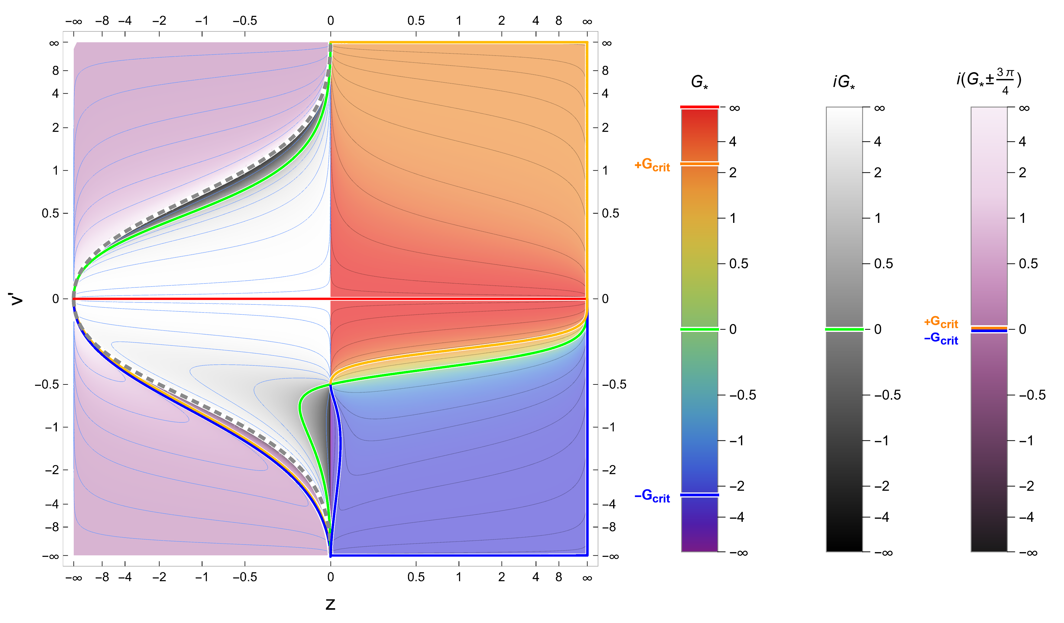
NJL-type Model
What about my NJL-type model?
XVI NExT PhD Workshop
The Cosener’s House, Abingdon
25/08/26
Freddie King

Slide 29
NJL-type Model
What about my NJL-type model?
XVI NExT PhD Workshop
The Cosener’s House, Abingdon
25/08/26
Freddie King

Slide 30
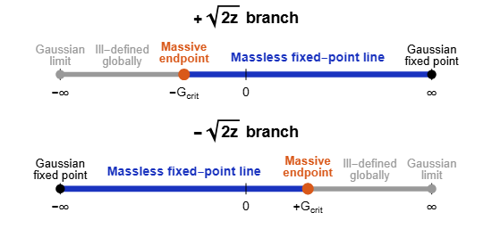
NJL-type Model
What about my NJL-type model?
XVI NExT PhD Workshop
The Cosener’s House, Abingdon
25/08/26
Freddie King

Slide 31
NJL-type Model
What about my NJL-type model?
→ A given branch has semi-infinite line of RG fixed points
(→related to non-analytic operators e.g $\sim z^{3/2}$)
XVI NExT PhD Workshop
The Cosener’s House, Abingdon
25/08/26
Freddie King

Slide 32
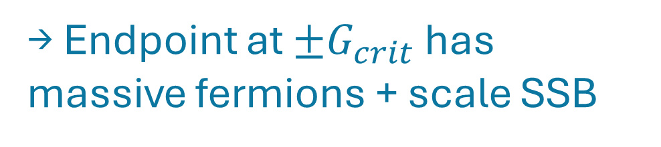
NJL-type Model
What about my NJL-type model?
→ A given branch has semi-infinite line of RG fixed points
(→related to non-analytic operators e.g $\sim z^{3/2}$)
→ Endpoint at ${±G}_{crit}$ has massive fermions + scale SSB
XVI NExT PhD Workshop
The Cosener’s House, Abingdon
25/08/26
Freddie King

Slide 33
NJL-type Model
And last: bosonisation
XVI NExT PhD Workshop
The Cosener’s House, Abingdon
25/08/26
Freddie King

Slide 34
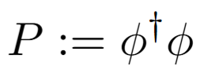
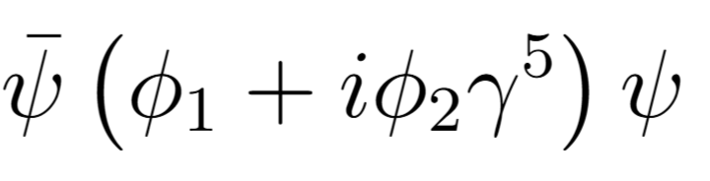
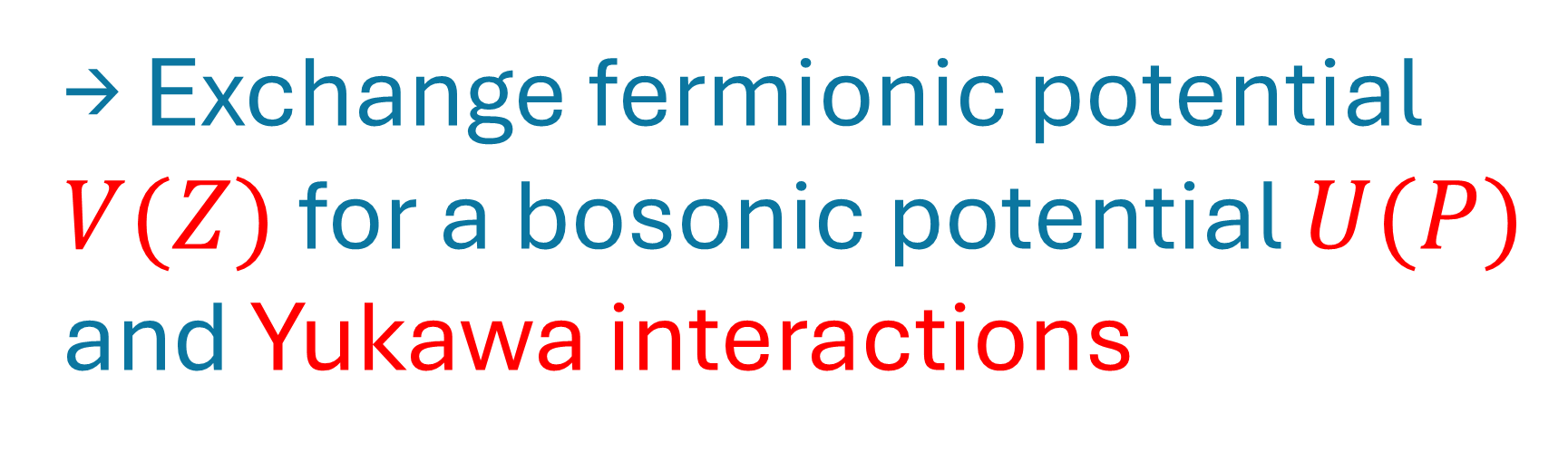

NJL-type Model
And last: bosonisation
→ Exchange fermionic potential $V(Z)$ for a bosonic potential $U(P)$ and Yukawa interactions
Preserves ${U(1)}_{A}$
XVI NExT PhD Workshop
The Cosener’s House, Abingdon
25/08/26
Freddie King

Slide 35
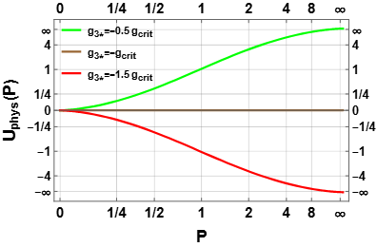
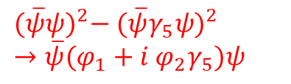
NJL-type Model
${(\overline{ψ}ψ)}^{2}−$ ${(\overline{ψ}γ_{5}ψ)}^{2}$
$→\overline{ψ}(φ_{1}+i$ $φ_{2}γ_{5})ψ$
And last: bosonisation: $V\left(Z\right)→U\left(P\right),$
XVI NExT PhD Workshop
The Cosener’s House, Abingdon
25/08/26
Freddie King

Slide 36
NJL-type Model
${(\overline{ψ}ψ)}^{2}−$ ${(\overline{ψ}γ_{5}ψ)}^{2}$
$→\overline{ψ}(φ_{1}+i$ $φ_{2}γ_{5})ψ$
And last: bosonisation: $V\left(Z\right)→U\left(P\right),$
→ Fermionic endpoint = flat bosonic potential!
XVI NExT PhD Workshop
The Cosener’s House, Abingdon
25/08/26
Freddie King

Slide 37
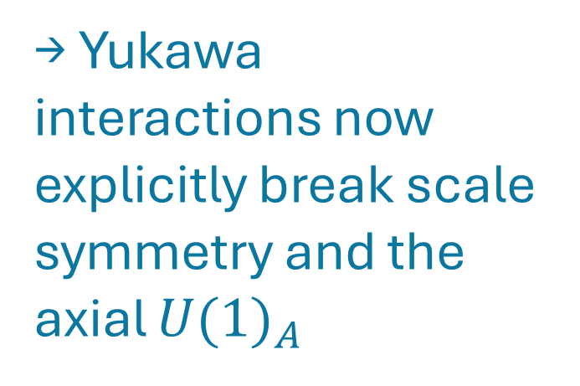
NJL-type Model
${(\overline{ψ}ψ)}^{2}−$ ${(\overline{ψ}γ_{5}ψ)}^{2}$
$→\overline{ψ}(φ_{1}+i$ $φ_{2}γ_{5})ψ$
And last: bosonisation: $V\left(Z\right)→U\left(P\right),$
→ Fermionic endpoint = flat bosonic potential!
→ Yukawa interactions now explicitly break scale symmetry and the axial ${U(1)}_{A}$
XVI NExT PhD Workshop
The Cosener’s House, Abingdon
25/08/26
Freddie King

Slide 38
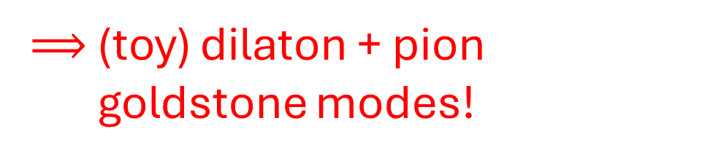
NJL-type Model
${(\overline{ψ}ψ)}^{2}−$ ${(\overline{ψ}γ_{5}ψ)}^{2}$
$→\overline{ψ}(φ_{1}+i$ $φ_{2}γ_{5})ψ$
And last: bosonisation: $V\left(Z\right)→U\left(P\right),$
→ Fermionic endpoint = flat bosonic potential!
→ Yukawa interactions now explicitly break scale symmetry and the axial ${U(1)}_{A}$
$⟹$ (toy) dilaton + pion …..goldstone modes!
XVI NExT PhD Workshop
The Cosener’s House, Abingdon
25/08/26
Freddie King

Slide 39
Thank you!
Based on work with Charlie Cresswell-Hogg and Daniel F. Litim:
F. King, C. Cresswell-Hogg and D. F. Litim, Line of Fixed Points and U(1) Chiral Symmetry Breaking in a 3D NJL-type Model (in preparation).
XVI NExT PhD Workshop
The Cosener’s House, Abingdon
25/08/26
Freddie King

