Slide 1









TRACK
Sen Zhao,On behalf of tracker team and Suyu Xiao

Slide 2





What For
Signal from detectors
Readout-board
DAQ
System level
Readout board:
BMOS v1
Trigger for BMOS
4 channels readout board
Tools:
LTSPICE: theory simulation
Function level simulation
HFSS: S parameters extraction
Transmission Line Theory and Impedance Matching
KICAD/JIALICHUANG: Layout design
DAQ:
BMOS FPGA
Tools:
VIVADO

Slide 3
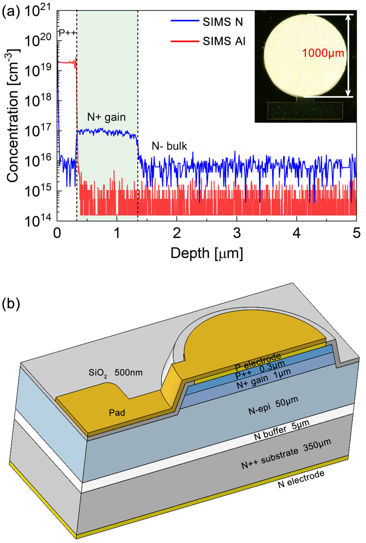
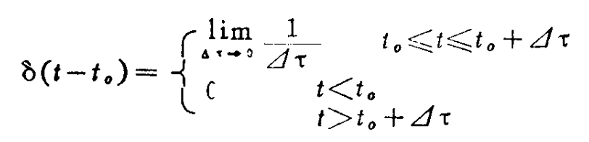
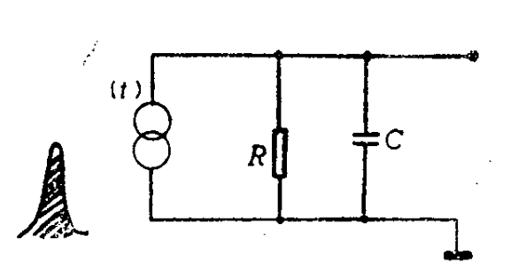


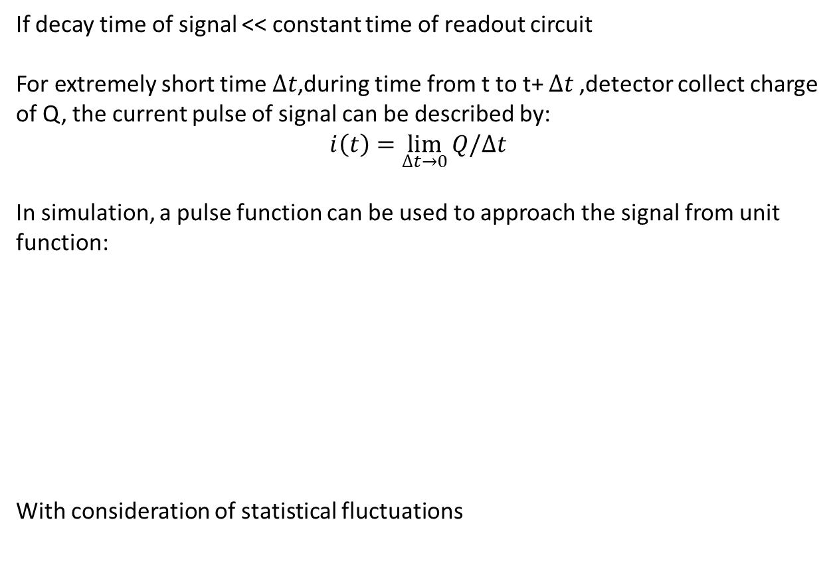
Detector: signal of detector
If decay time of signal << constant time of readout circuit
For extremely short time $∆t$,during time from t to t+ $∆t$,detector collect charge of Q, the current pulse of signal can be described by:
$$i\left(t\right)=\lim_{∆t→0}{Q/∆t}$$
In simulation, a pulse function can be used to approach the signal from unit function:
With consideration of statistical fluctuations

Slide 4
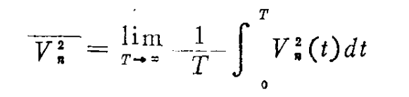
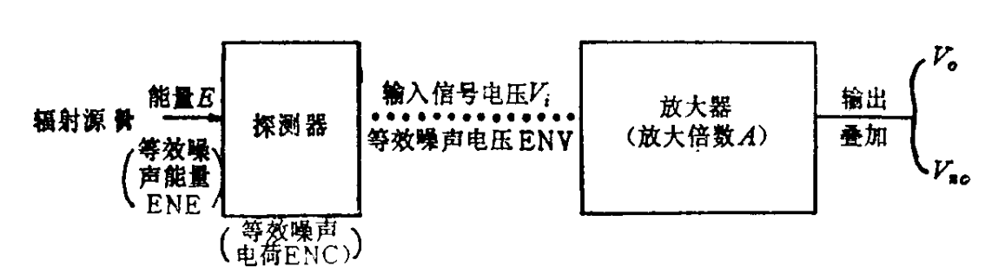
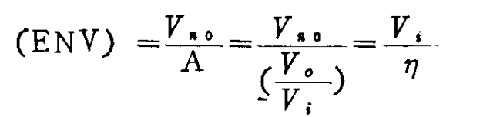
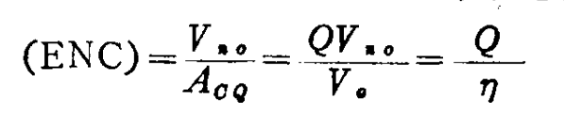
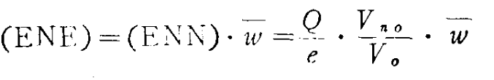

Readout-board : noise
The noise level of a system cannot​ be judged from the average but from the RMS , for the average of the noise is always 0.
From a typical detector system:
ENV,ENC, ENN and ENE can also reveal the noise level in a circuit including the amplifier.

Slide 5
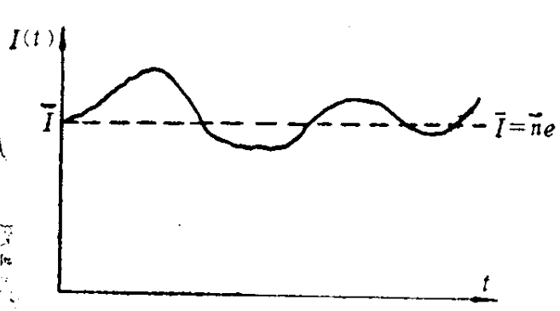


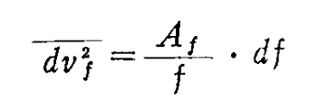


Readout-board : noise
Shot noise:
  Origin from the leakage current of detector
  For shot noise, a higher leakage current or​ a wider amplifier bandwidth results in​ higher noise.
    Shot noise from detector
    Shot noise from amplifier
Thermal noise:
  From the thermal movement of carriers
  For thermal noise, higher temperature results in higher noise.(also depends on the material due to different R)
Low-frequency noise
  For Low-frequency noise, higher the smallest limit frequency results in lower noise.

Slide 6
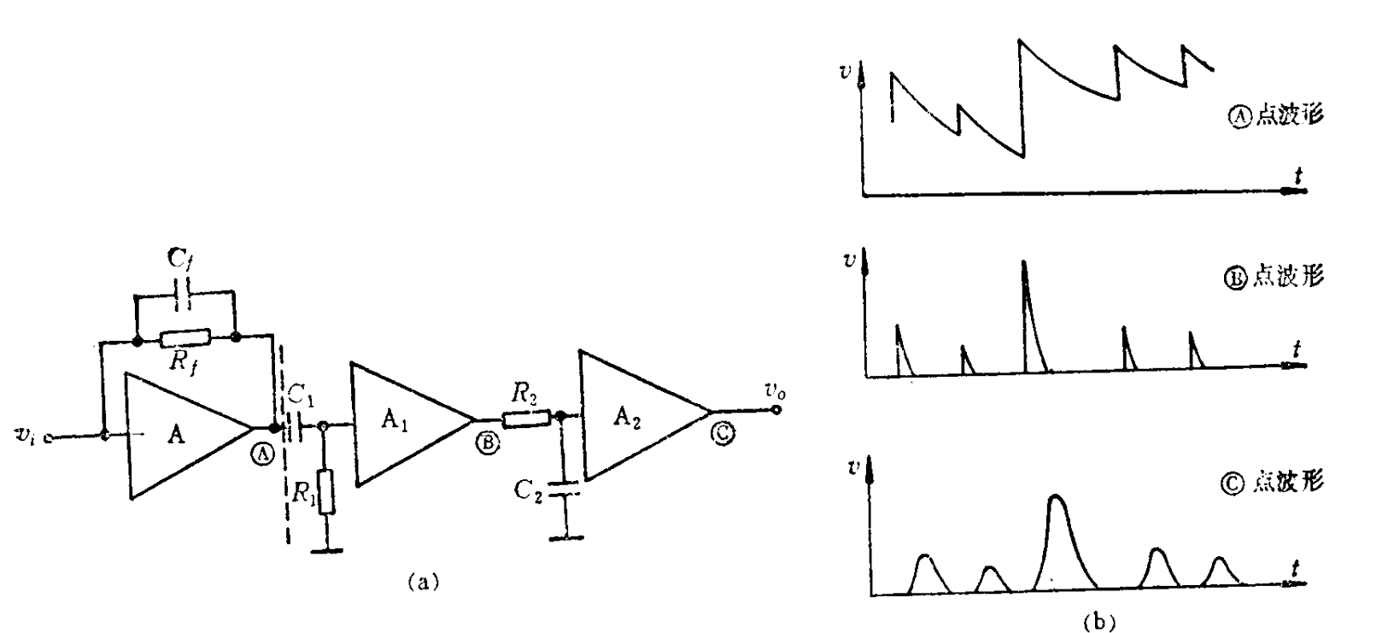
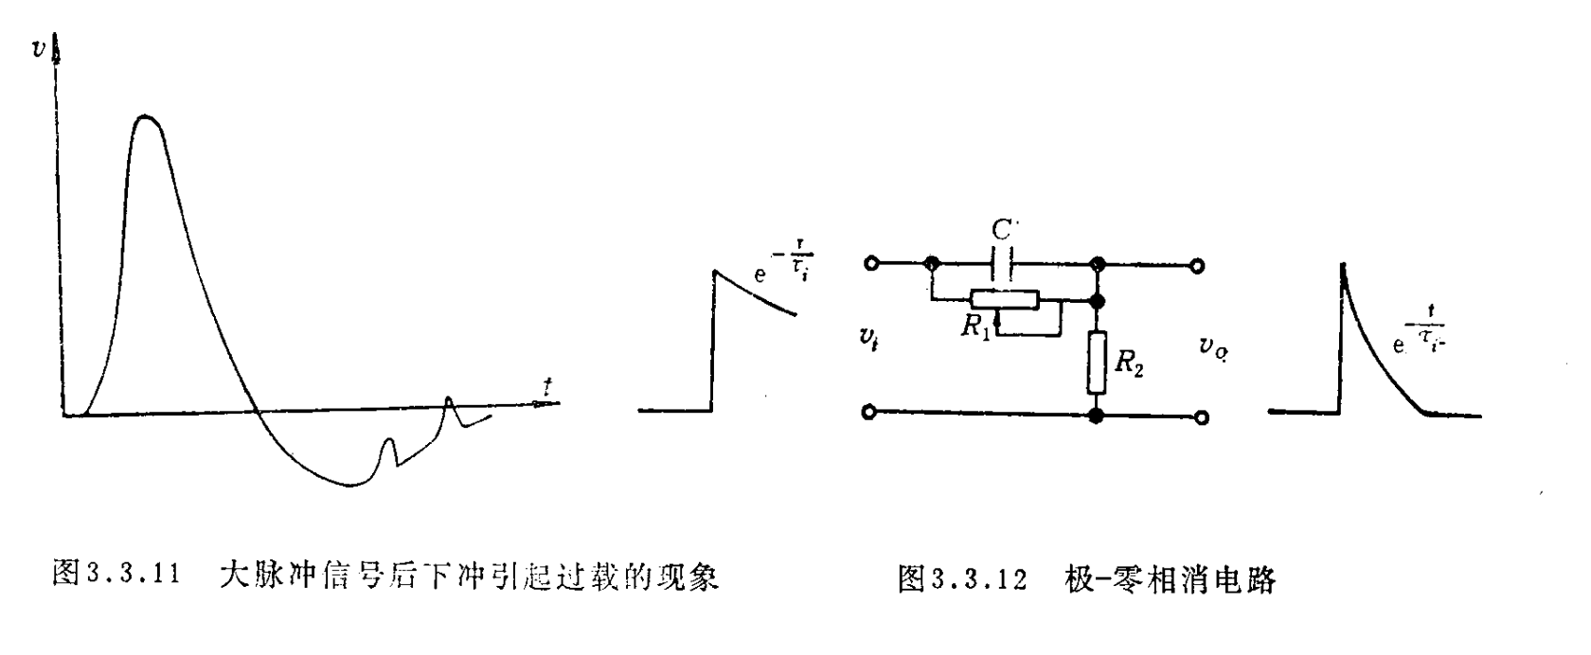
Readout-board : Filter and shaper circuit
For:
Reduce the noise in system
Reshape the signal from the detector
CR-RC CIRCUIT
Pole-Zero Cancellation Circuit​

Slide 7
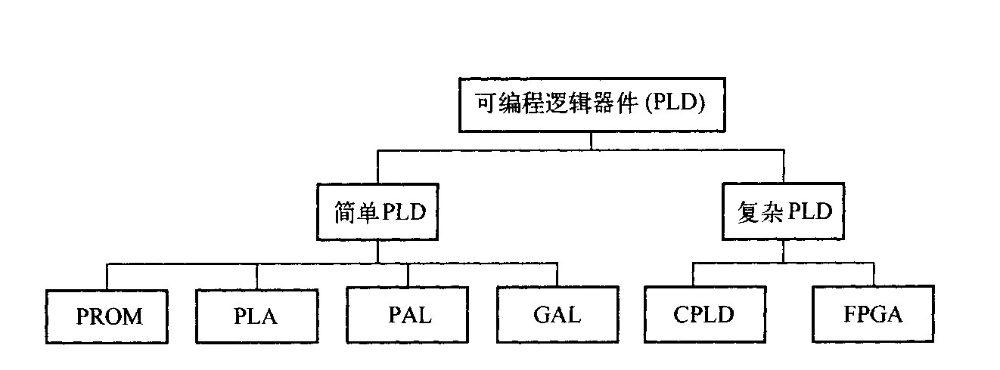
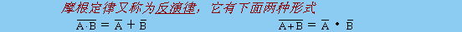
DAQ: FPGA
PLD(Programmable Logic Device)
De Morgan’s Theorems
&
Karnaugh Map
PROM: Programmable Read-Only Memory
PLA : Programmable Logic Array
PAL : Programmable Array Logic
GAL : Generic Array Logic
CPLD : Complex PLD
FPGA : Field Programmable Gate Array
"Any logic function can be simplified into a Sum of Products (SOP) logic equation.”

Slide 8
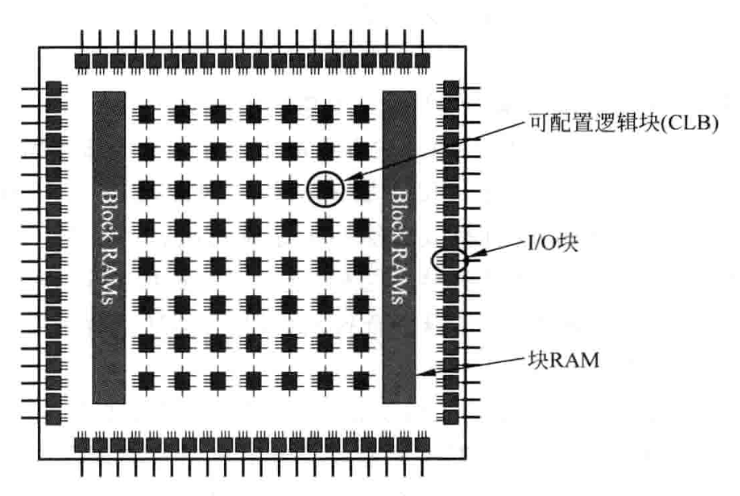
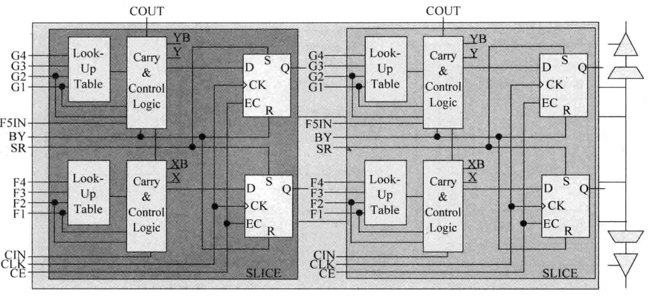
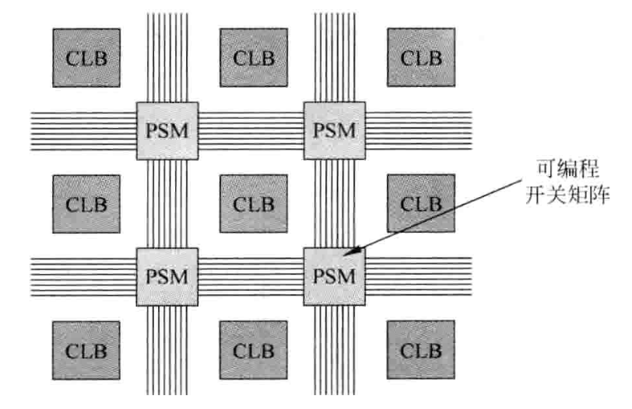
DAQ: FPGA Spartan II
CLB module
CLB primarily includes 2 LUT-FF pairs with carry logic and 2 global tri-state buffers (BUFT). A single LUT-FF consists of 2 4-input LUTs, 2 control and carry logic units, as well as 2 storage elements.

Slide 9
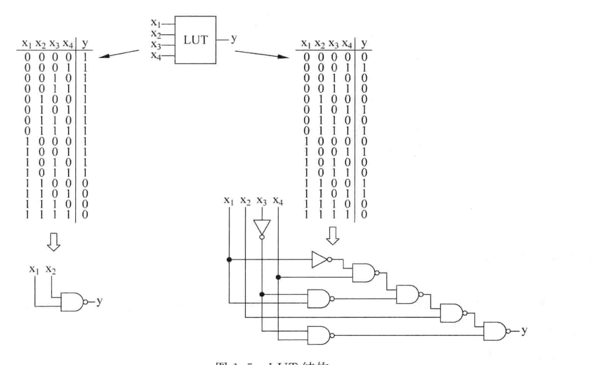
DAQ: FPGA Spartan II
The LUT (Look-Up Table) is the primary element for logic implementation, and each LUT can implement any 4-input function.

Slide 10
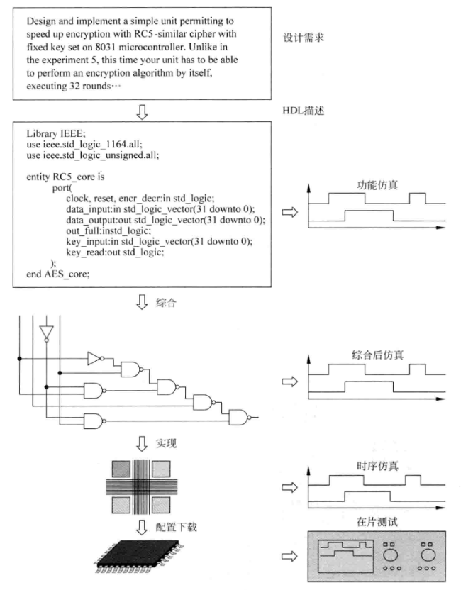
DAQ: FPGA Design
Demand analysis
Sub-module design
Pre-simulation
System simulation
Logic Synthesis
Layout
Simulation
Test

Slide 11
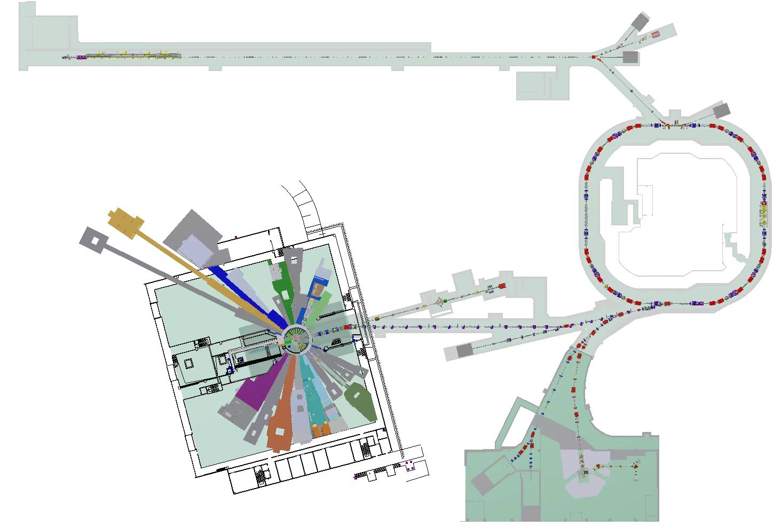
Phase II Spallation Project
Begin a project BMOS
China Spallation Neutron Source is located in Dongguan City, Guangdong Province, China. It mainly provides beams such as protons and neutrons.
Superconducting Linear Accelerator -300 MeV
The energy of the linear accelerator has been increased to 300 MeV.
The beam power has been increased to 500 kW.
The neutron flux has reached 1×10⁸ n/cm²/s
A total of 11 new neutron spectrometers and experimental end stations have been added and constructed.
  A high-energy proton experimental station (HPES) capable of providing a 1.6 GeV test beam.
  A surface muon source (MELODY)
Rapid-Cycling Synchrotron -500 kW
High-Energy Proton
Experimental Hall
11 Neutron Spectrometers and Experimental End Stations

Slide 12
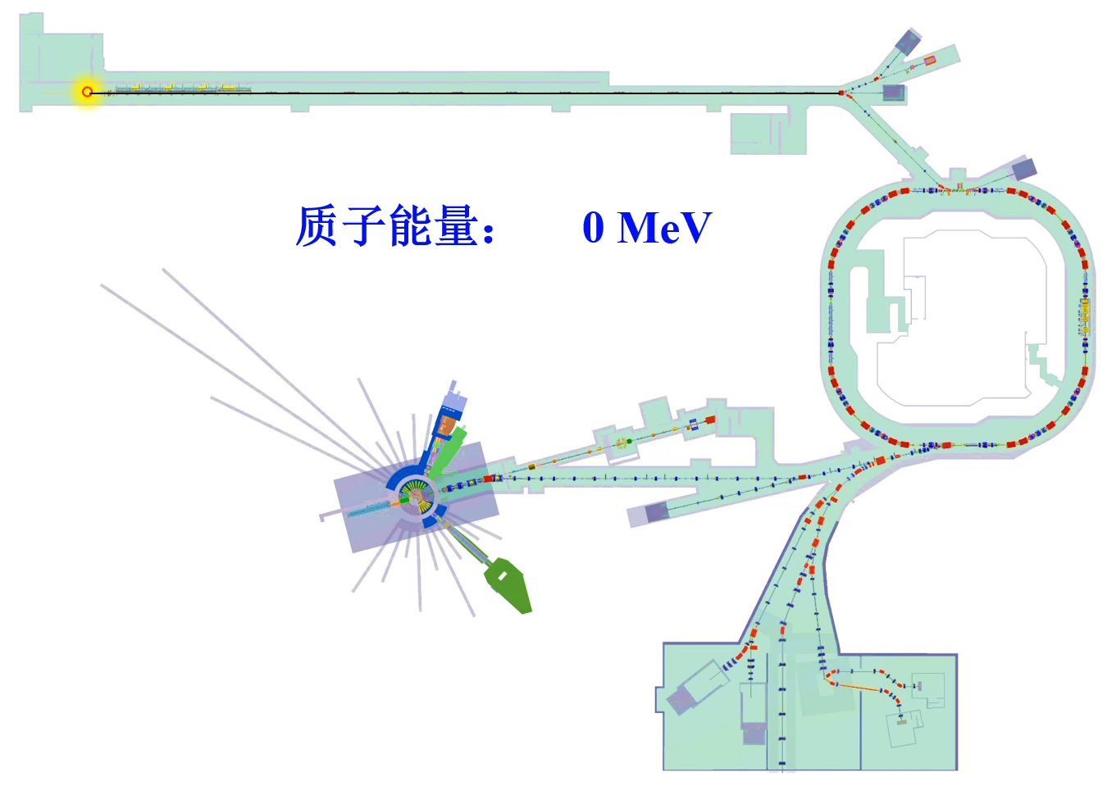
Phase II Spallation Project
Begin a project
High-Energy Proton Experimental Station (HPES)
According to testing requirements, both low-intensity and high-intensity proton test beams are provided.
Parameter | Design Targets
Proton Energy Range | 0.8-1.6 GeV
Beam Pulse Frequency | 24 Hz
High-Intensity Beam Flux | 10⁶-10⁹ p/s
Low-Intensity Beam Flux | 10³-10⁴ p/s
Proton ENERGY

Slide 13
Phase II Spallation Project
Begin a project
Macro Pulse Period: 40 ms
1 ms
…
Macro Pulse Interval: 39 ms
…
410ns
Time
410ns
80ns
Schematic Diagram of Micro Pulse Time Structure
Due to the beam characteristics of CSNS, the proton beam exhibits a two-level bunch structure in time ：
  Macro Pulse Frequency: 25 Hz (24 Hz effective)
  Macro Pulse Length: 1 ms, Interval: 39 ms
  Micro-pulse in macro-pulse
  Micro-pulse period: 410 ns，Micro-pulse Length : 80 ns

Slide 14
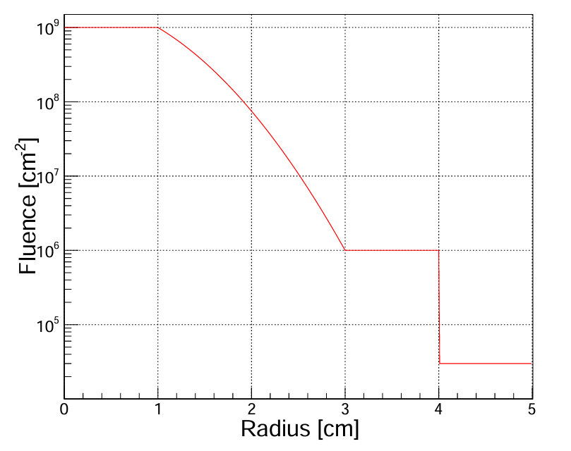
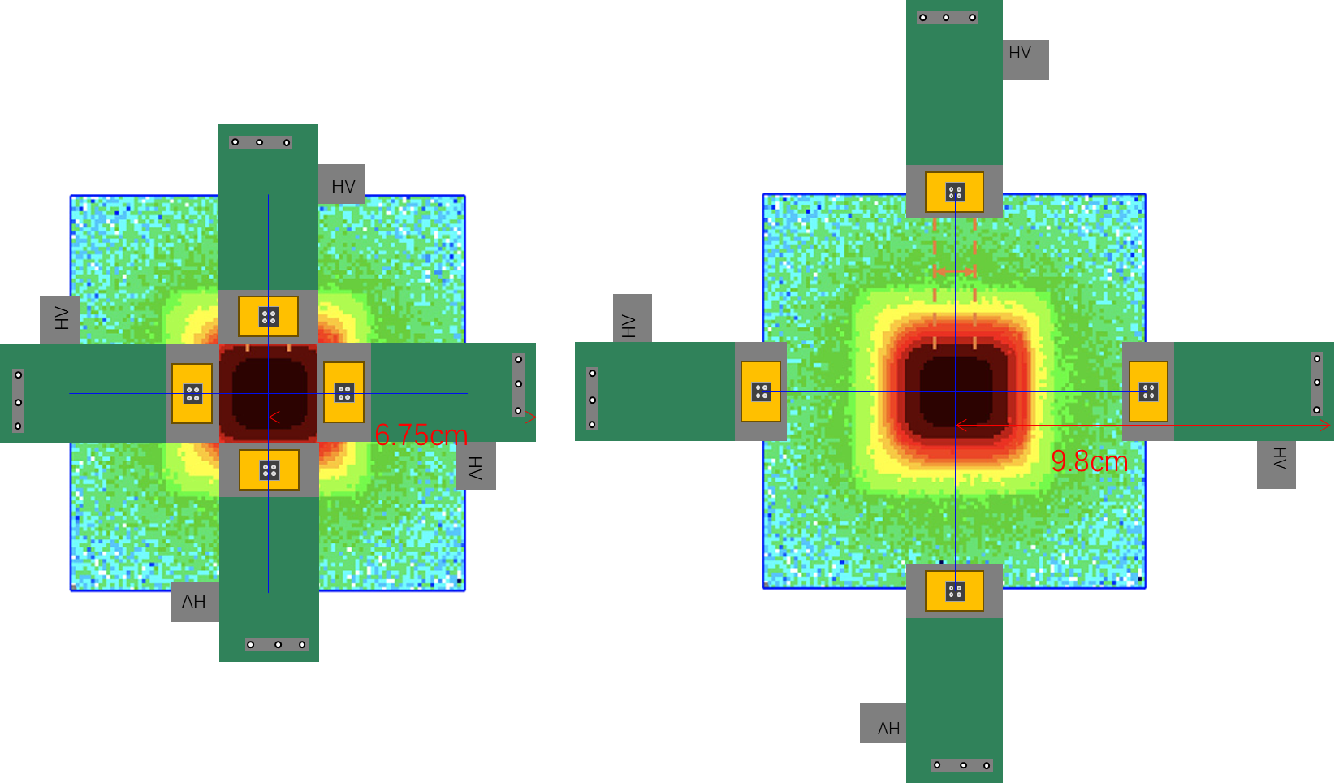
Phase II Spallation Project
Begin a project
BMOS ---- Beam Monitor Online System
Design target
Real-time monitoring of beam intensity, position,
and uniformity
Design life：5000 hours/year
Detection Strategy: Indirect Measurement Method
  Place the detector at the adjustable edge of the beam center to avoid the high-dose irradiation zone, thereby ensuring detector lifespan and beam stability.
  1. Effective Beam Working Area:​​ A central 2cm × 2cm square.
  2. ​Detector Layout:​​ Located in the edge non-direct irradiation zone.

Slide 15
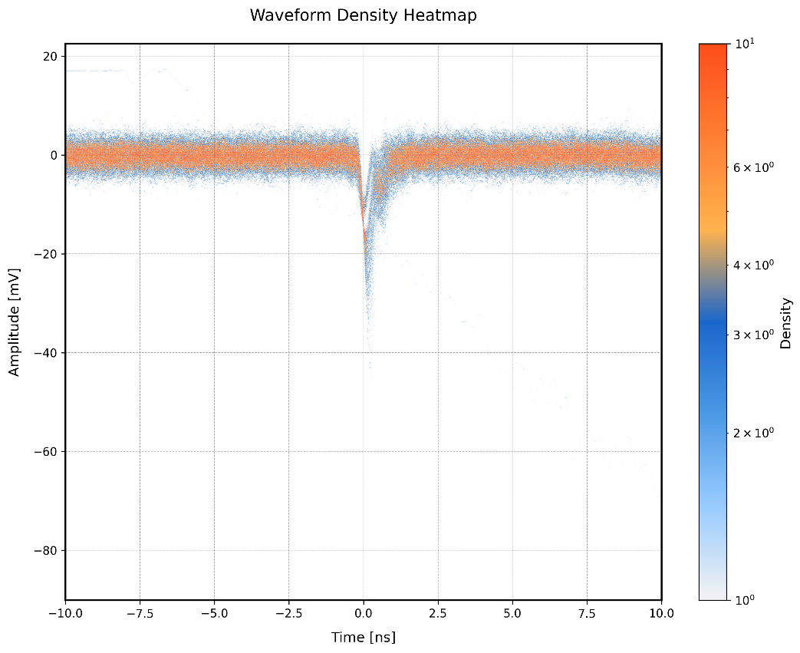
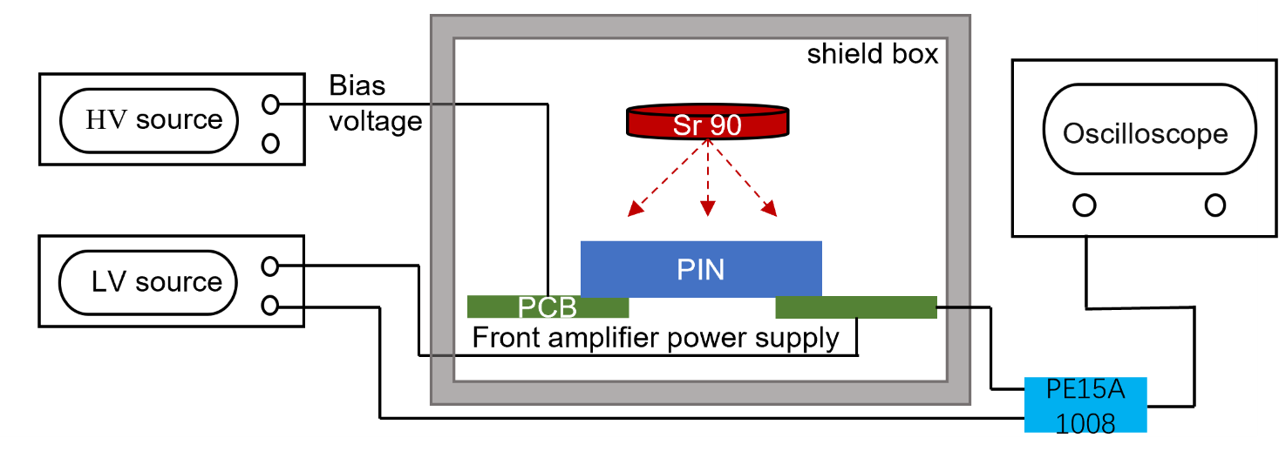
Phase II Spallation Project
Begin a project
Experimental Verification
Test Platform：Based on IHEP SiC-PIN detector + UCSC board, for testing responses to different particles.
Beta particles:​​ 90Sr radiation source (approaching Minimum Ionizing Particles, MIPs, for validating low-energy signal response).
Test Results
signal peak ~ 20mV
amplifier gain ~ 18
Board Rf ~ about 400 Ohm
SiC Peak of Intrinsic Current Signal~2 uA

Slide 16
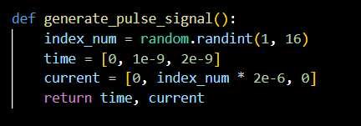
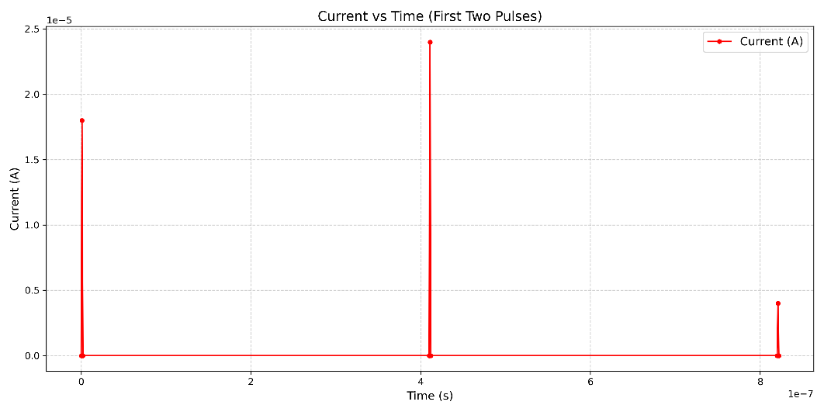
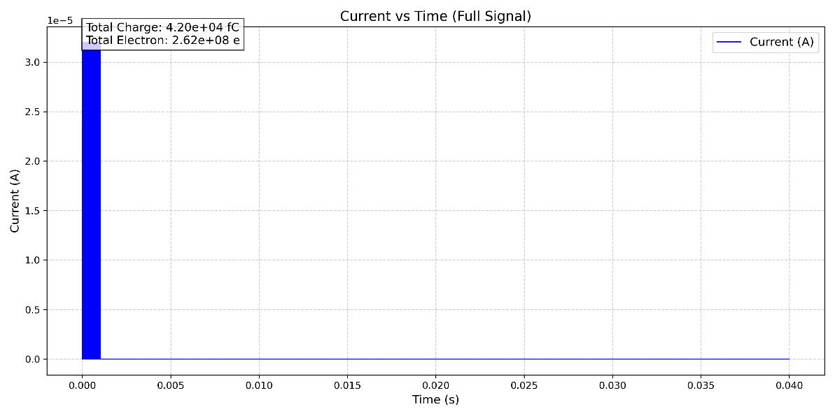
Phase II Spallation Project
Begin a project
Micro-pulse Intrinsic Current Signal
(ignoring the 80ns micro structure)
Signal Response per Micro-pulse:​
Pulse information for 1–16 protons is generated using random numbers.
Each proton excites a peak current of 2 μA (intrinsic signal for 1.6 GeV proton incidence).
Macro Pulse Period: 40 ms
Macro-pulse Intrinsic Current Signal
1 ms
…
Macro Pulse Interval: 39 ms
…
410ns
Time
1ms intrinsic current signal
410ns
80ns

Slide 17
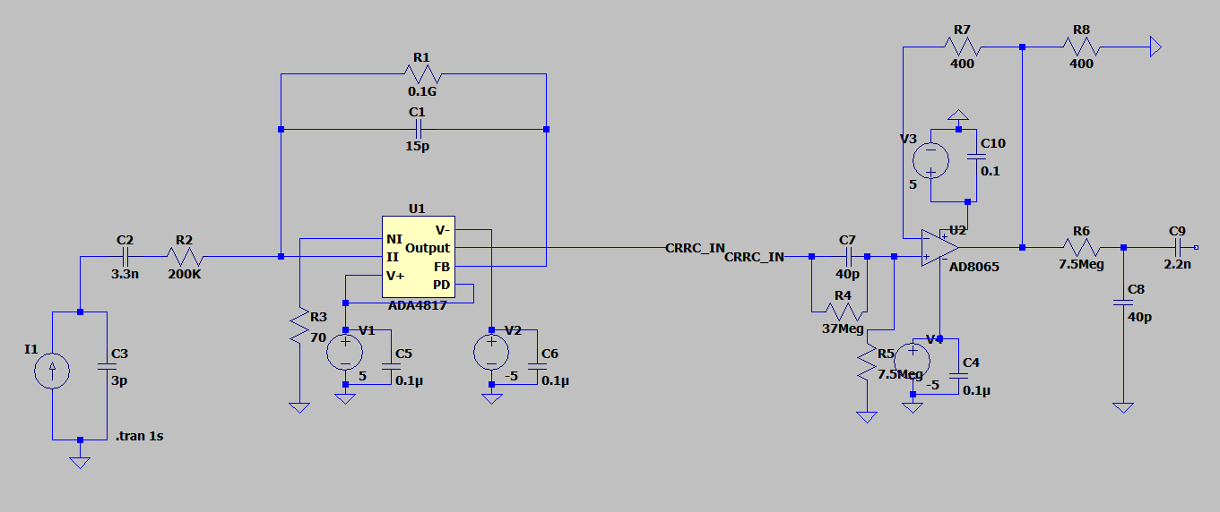
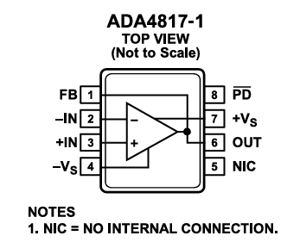
Phase II Spallation Project
Begin a project
The BMOS PCB design employs a charge integration circuit and a first-order CRRC shaper circuit.
Core Circuit Parameter Design：
Integration capacitance: 10 pF
Discharge time: 15 ms (considering parasitic capacitance of 2~5 pF)
Key configure of ADA4817
Input resistance ~ 500 GOhm
Open-Loop Gain ~ 65 dB

Slide 18
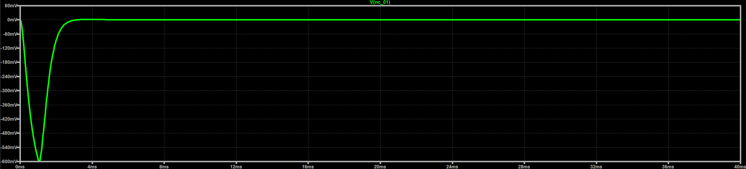
Phase II Spallation Project
Begin a project
Signal of output
  More than 600 mV
  4 ms zeroing time
Considering the ADC and FPGA , the total system can be reset within 40 ms

Slide 19
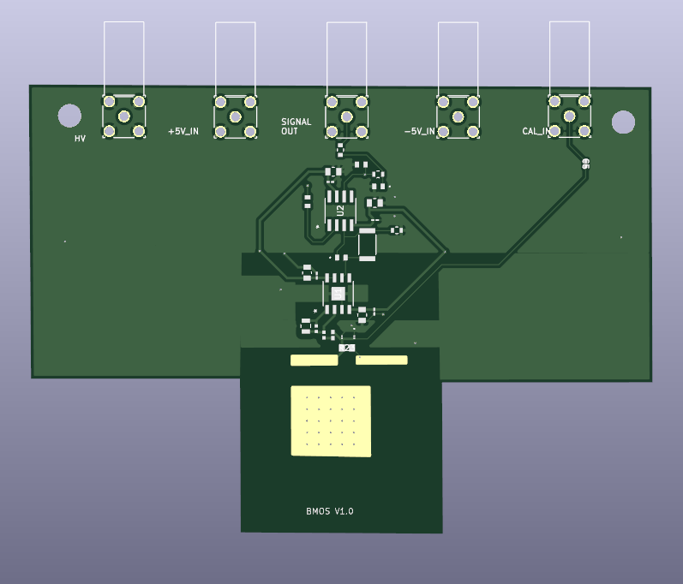
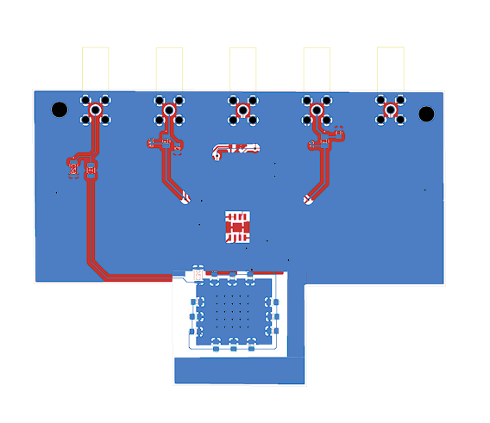
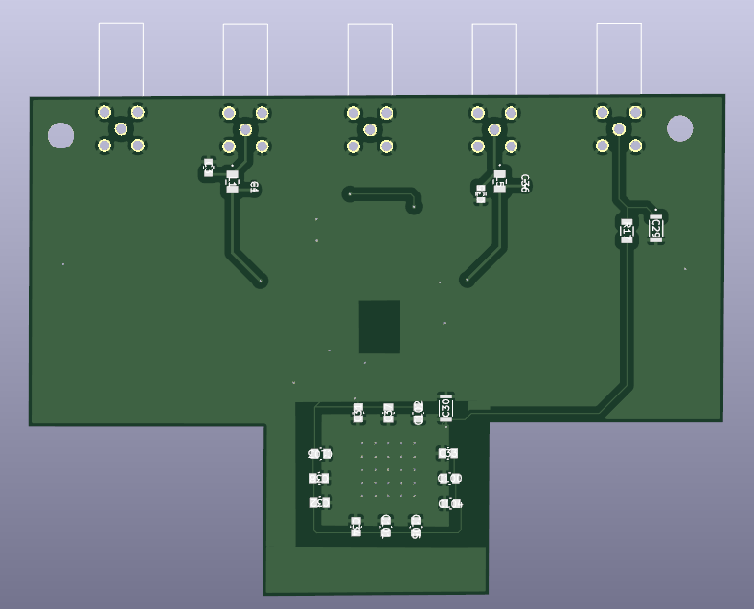
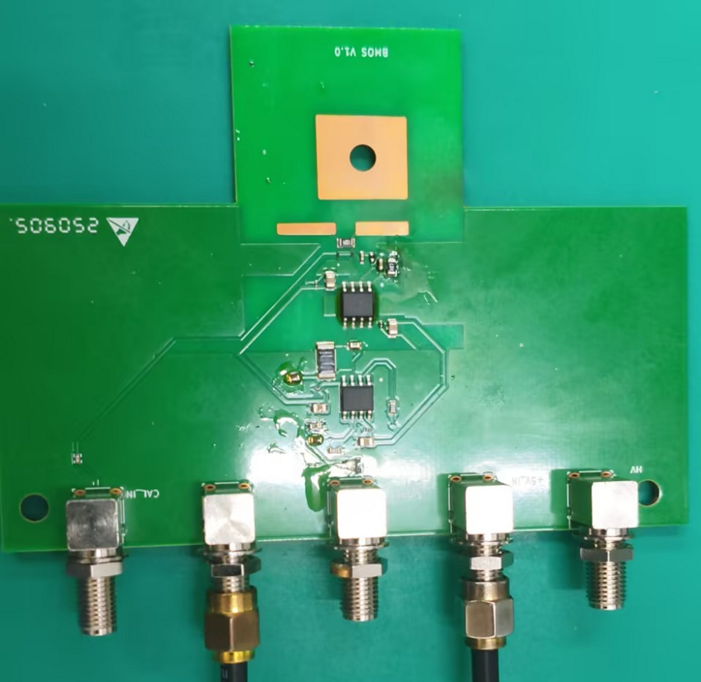
Phase II Spallation Project
Begin a project
Rear View
Front View
High-voltage traces should be kept away from signal traces.
Power supply traces should be thicker.
No ground plane is provided for high-bandwidth chips.
Signal bonding pad
HV pad
Signal grond bonding pad

Slide 20
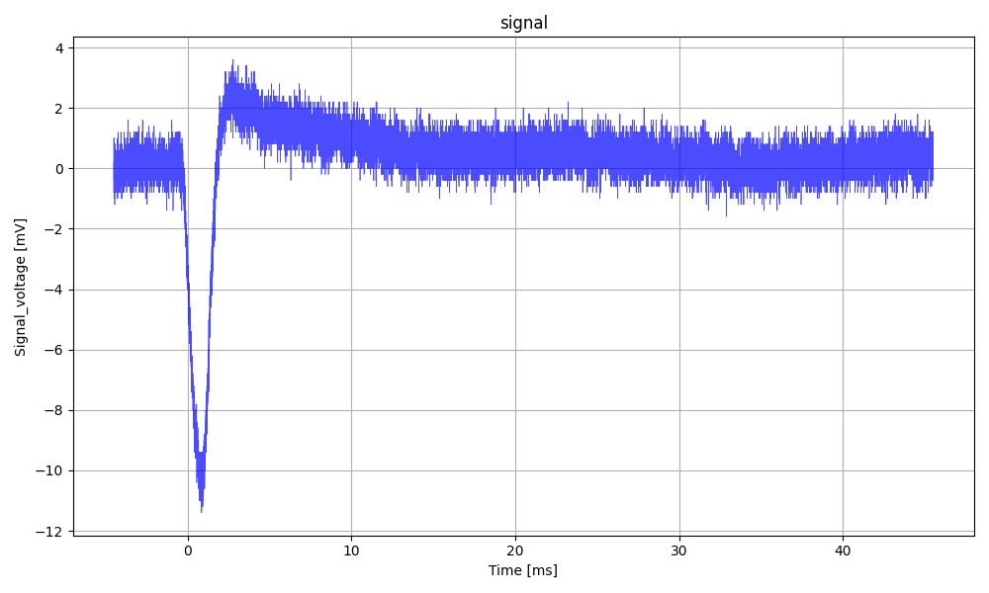
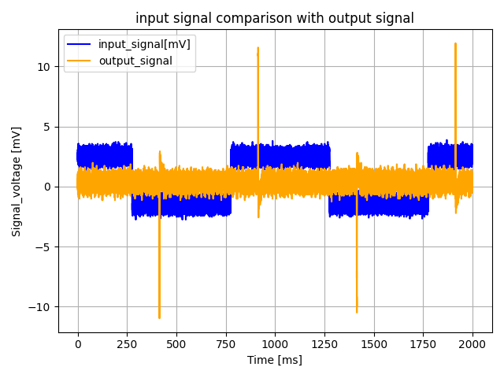
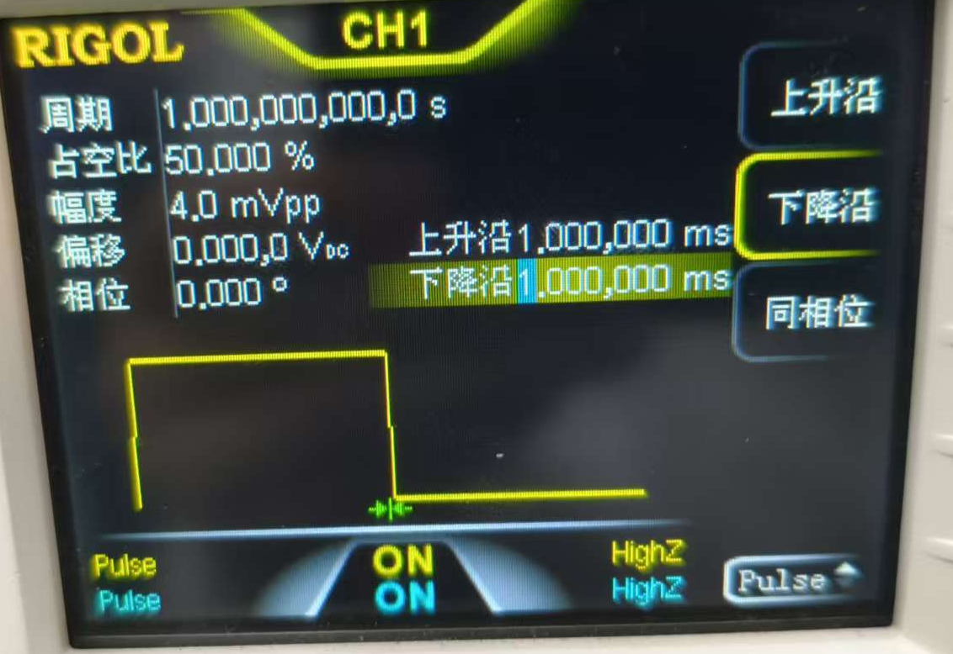
Phase II Spallation Project
Begin a project
CAL_IN test
Inject 42pC of Charge
Cal_in:10nF
Cal_in:4mV

Slide 21
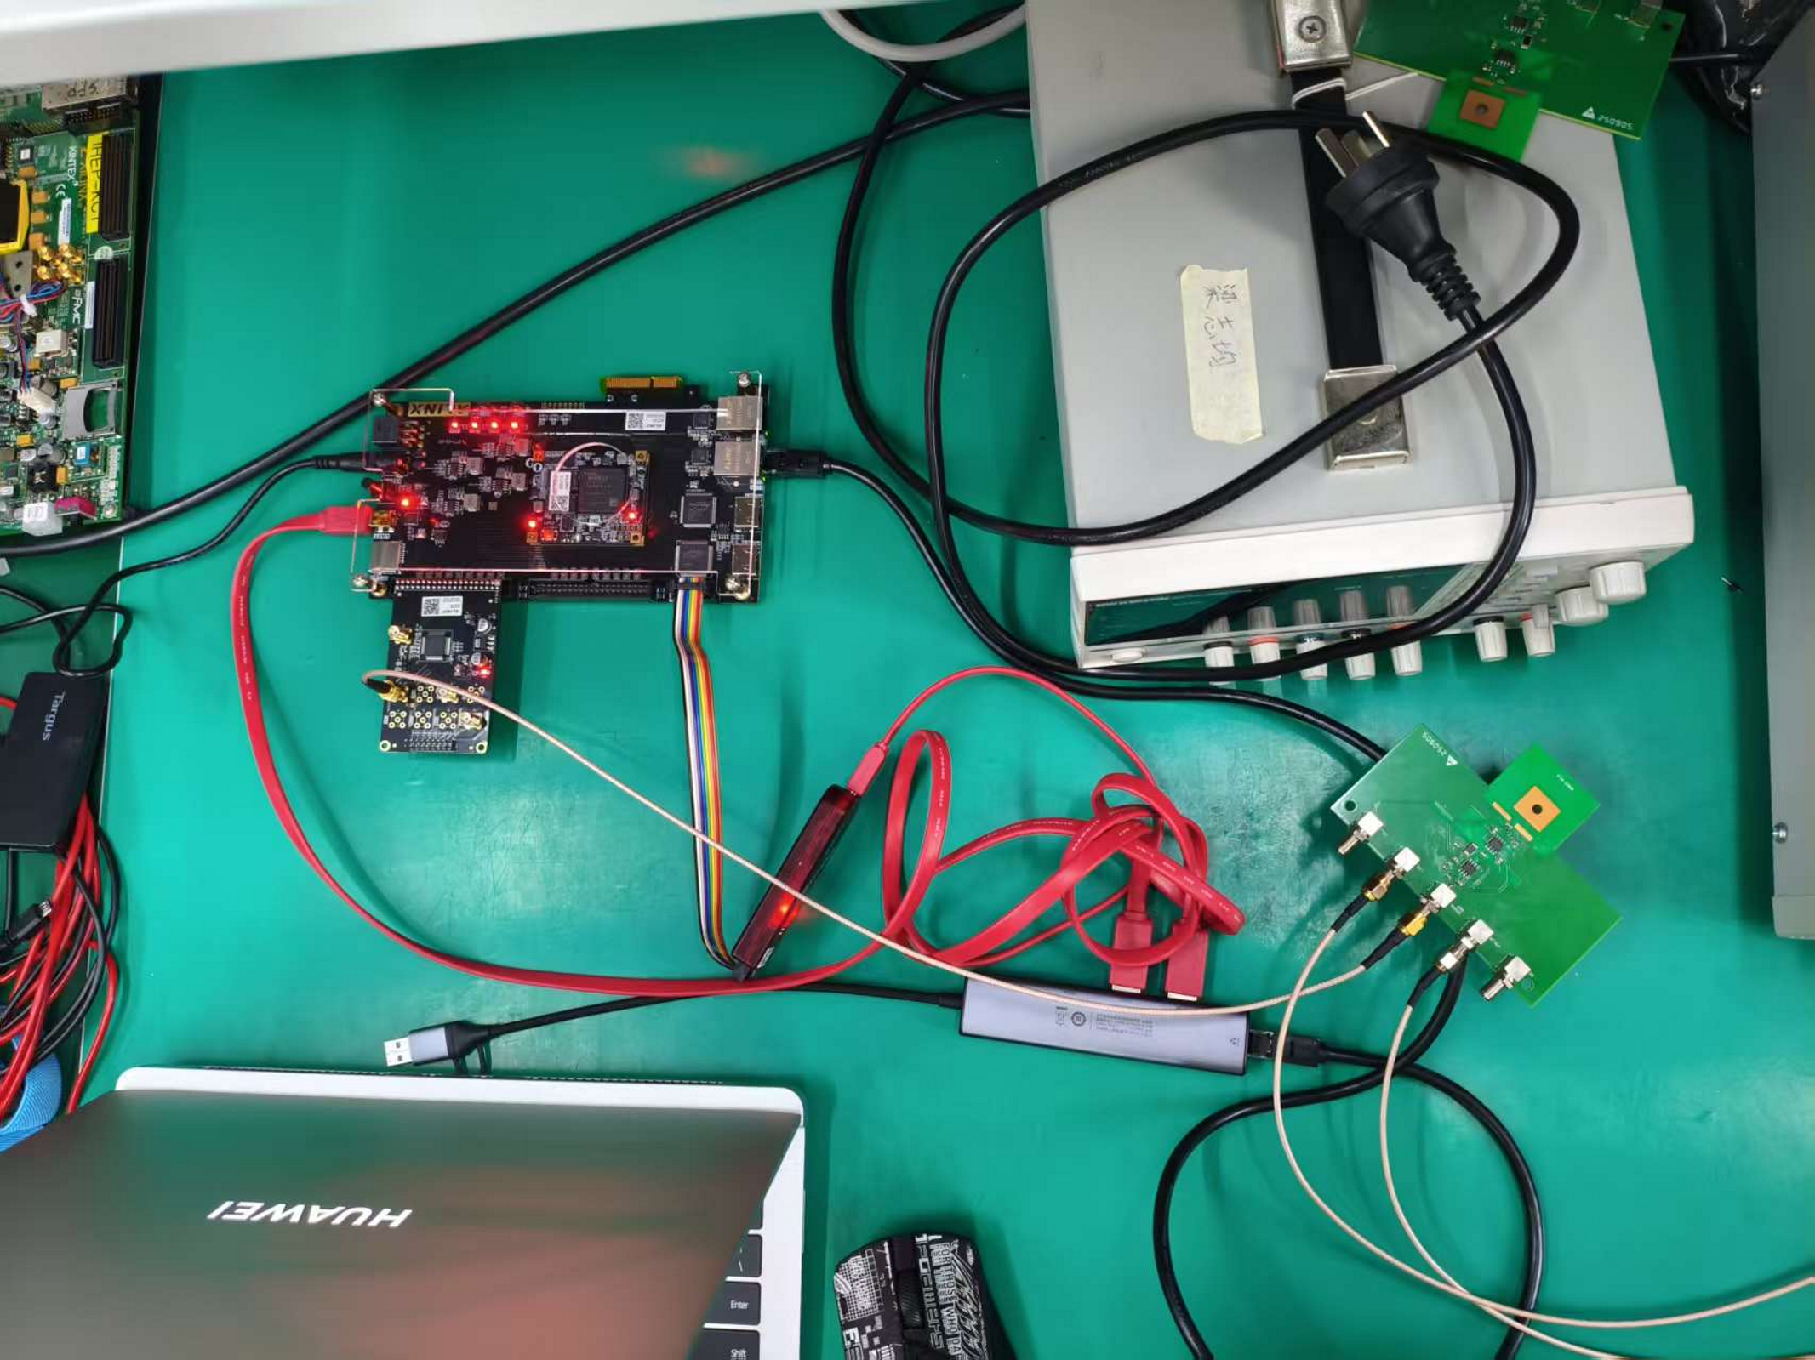
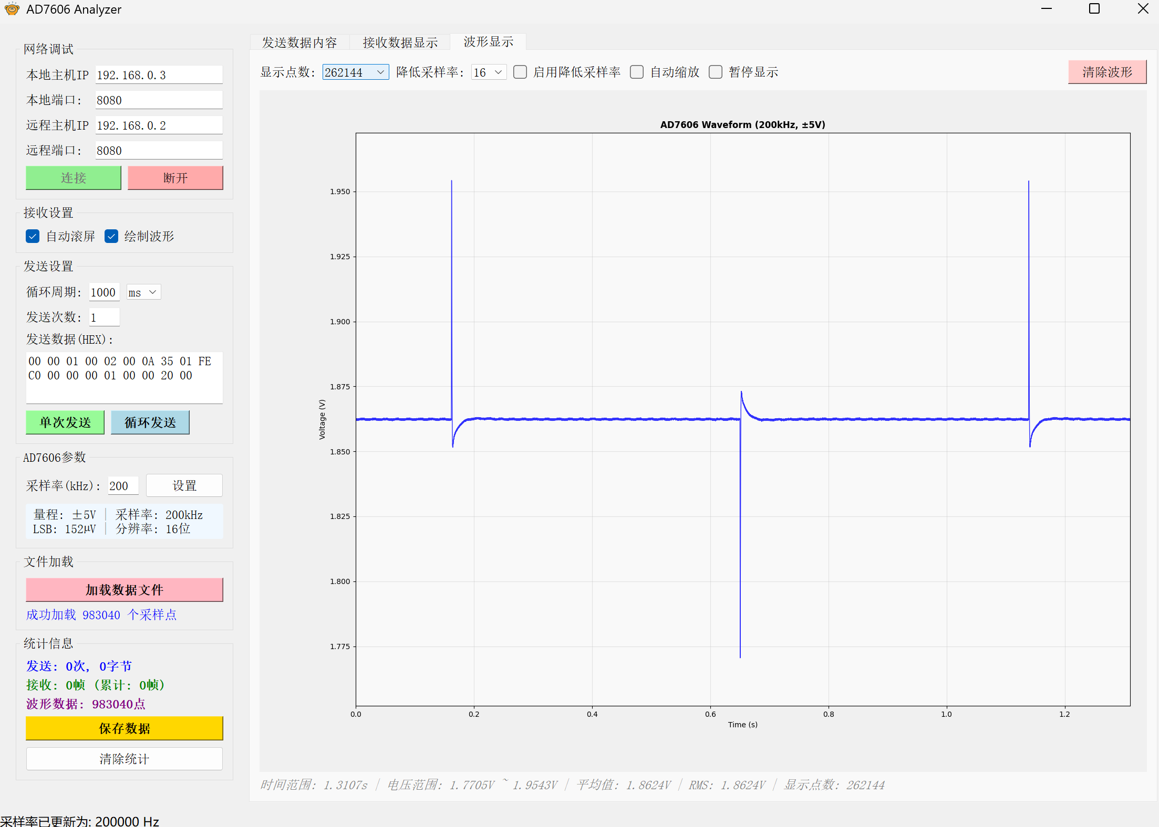
Begin a project

Slide 22
Begin a project
Send data (UDP Data)
2*32bit
Header
Command Code
FPGA MAC
Channal Sel
Sample Num
FIFO 16-64
64bit
DDR3
64bit
FIFO 64-16
1byte
4byte
6byte
4byte
4byte
Eg :00 00 01 00 02 00 0A 35 01 FE C0 00 00 00 01 00 00 40 00
16bit
16bit
Receive data(Ethernet Frame)
Send command
ADC 16bit
FPGA TOP
Ethernet
Ethernet Header
IP header
UDP header
Config
ADC Data
FCS
14byte
20byte
8byte
5byte
1024byte
4byte
Receive data
(UDP Data)
Send
Command
Receive data
ADC Data
512 Sample Count
Analyzer
1024byte
Sample Num
16384 Sample count
32 Frame Count
00 00 40 00
4byte

Slide 23
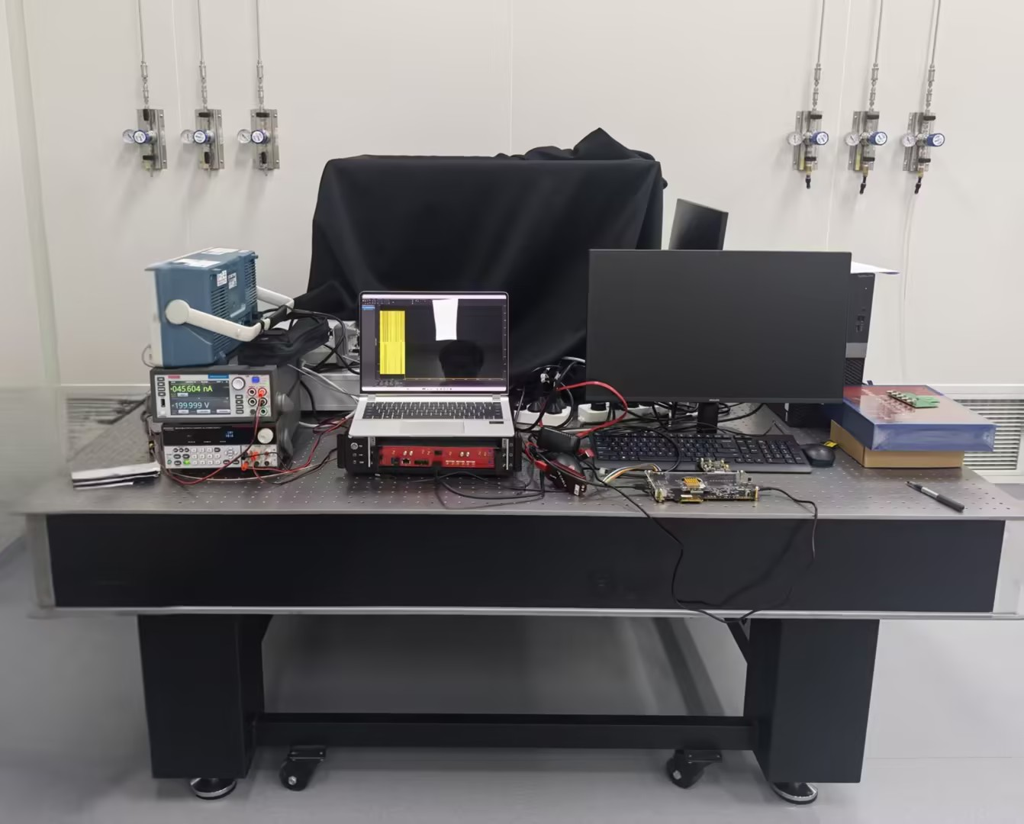
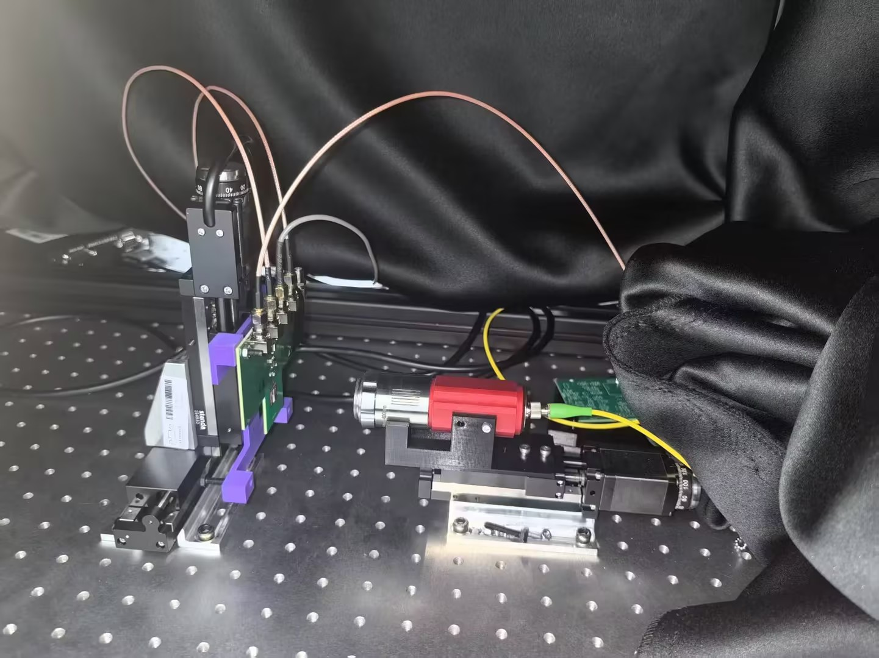
Phase II Spallation Project
Begin a project

Slide 24
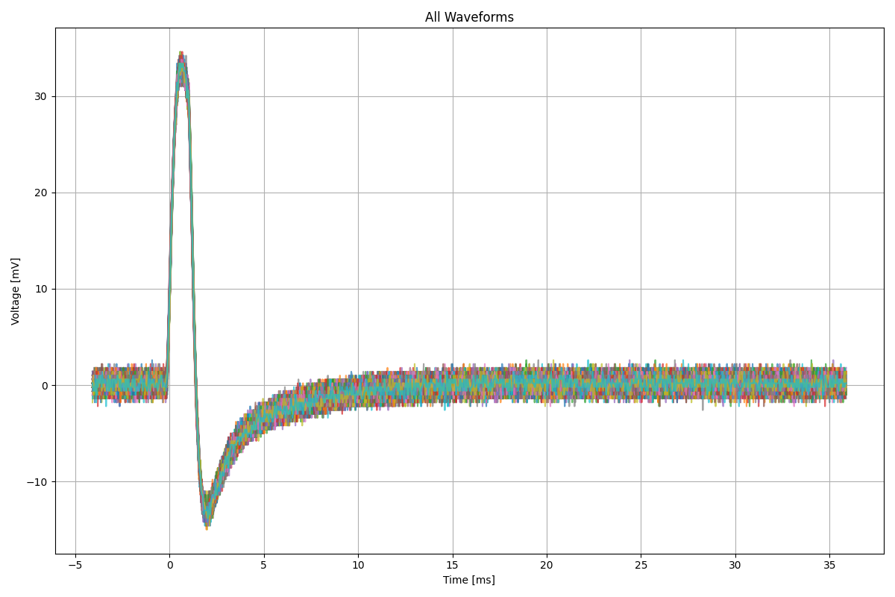
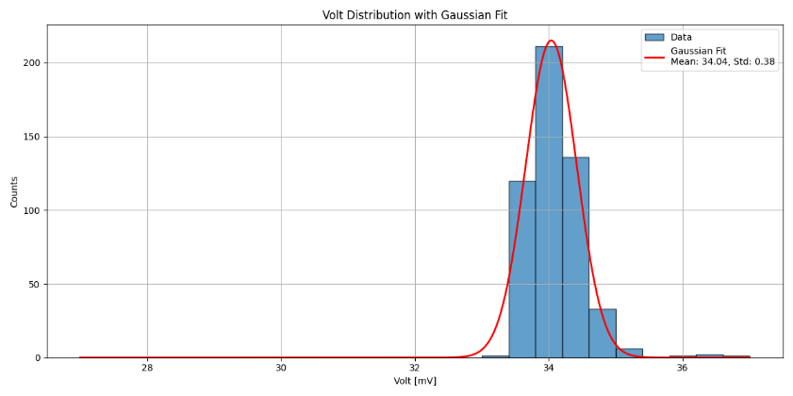
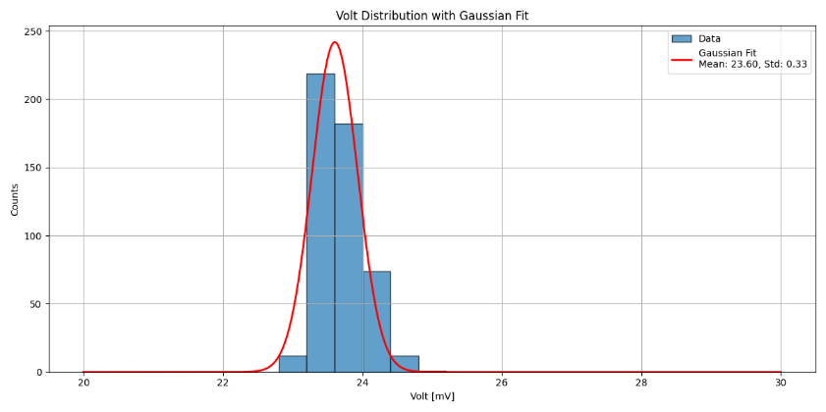
Phase II Spallation Project
Begin a project
Tune = 0： peak：34.04mV
Tune = 30： peak：23.60mV

Slide 25
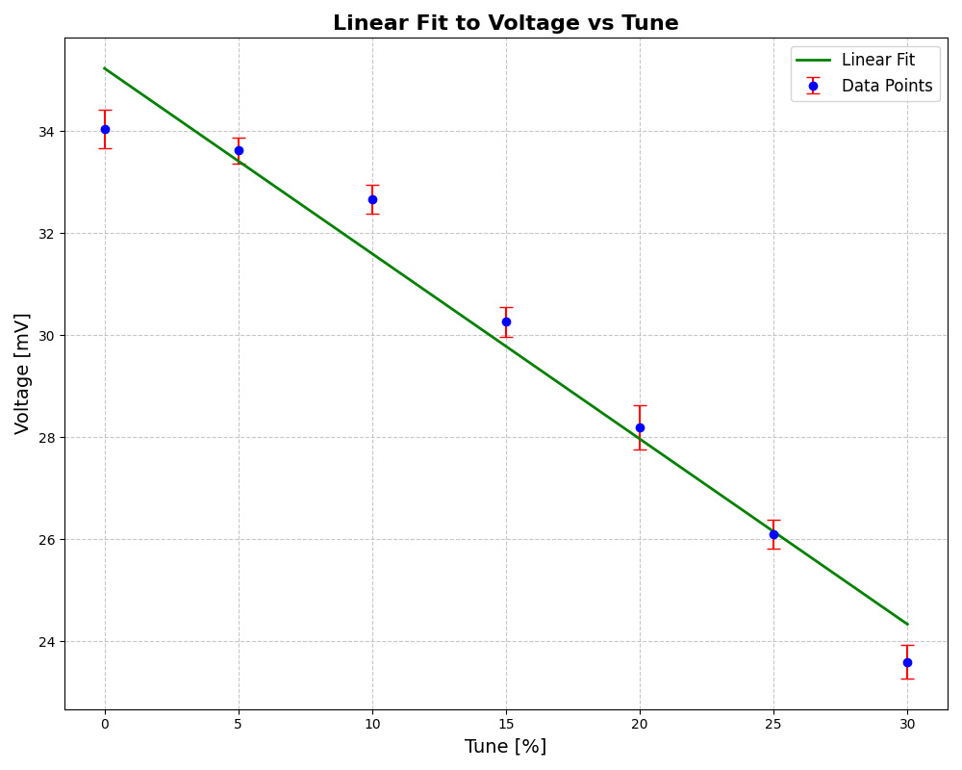
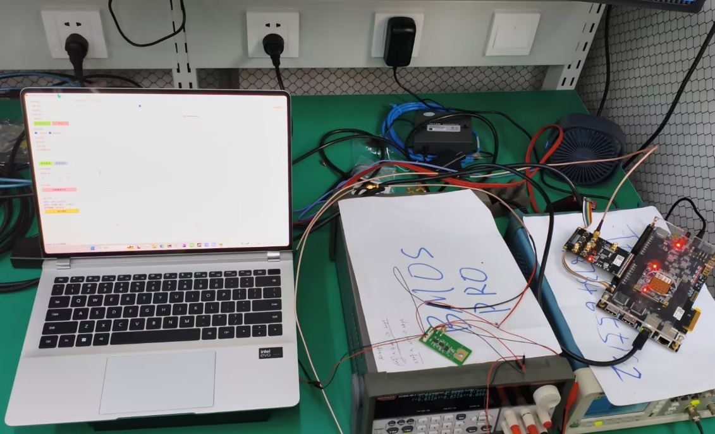
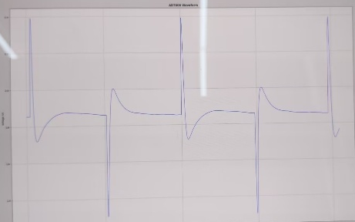
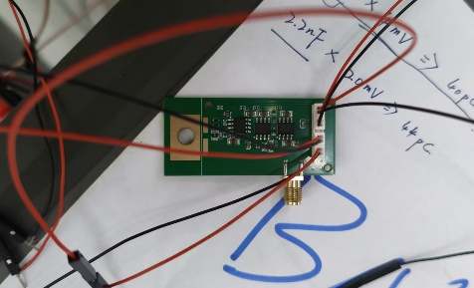

Begin a project
BMOS system
Reach :
Stable long time monitor
Linear relation with e/h pairs

Slide 26





Begin a project
ADC
使能
模拟信号
GPIO+升压
Adc数据进入core进行处理：电荷，展宽，峰值
Core
HV
高压控制
LV
低压控制
温度，电流，
工作状态
监控

Slide 27

Begin a project
Track upon the trace.
Welcome to join us!

