Slide 1
HEP InP Update
June 22, 2026

Slide 2
Undoped Structure
Anode
y
L = 5mm
InP
350µm
x
Cathode

Slide 3
Importing Optical Generation Profile into SDE
;;; 4. Load optical generation profile
;; -- Get the node number of the opticalprofile tool for this experiment --
(define ref_node "@node|opticalprofile@")
;; -- Construct path to the scaled optical generation file --
(define OptFile (string-append "scaled_Gopt_node" ref_node ".plx"))
;; -- Define the 1D external profile --
(sdedr:define-1d-external-profile "1d_opt_def" OptFile
"Scale" 1.0 "Range" 0 T)
(sdedr:define-refeval-window "globalopt_window" "Line"
(position 0 0 0)
(position L 0 0))
;; "Positive" = profile runs from Y=0 upward (cathode to anode)
(sdedr:define-analytical-profile-placement "1d_opt_place"
"1d_opt_def" "globalopt_window"
"Positive" "NoReplace" "Eval")
T = Thickness (350µm)
L = Lateral length of the device (5mm)

Slide 4
Importing Optical Generation into SDevice
File {
Grid = "@tdr@"
Parameters = "@parameter@"
Plot = "@tdrdat@"
Current = "@plot@"
Output = "@log@"
OpticalGenerationInput= "@tdr@"
}
#if "@light@" == "on"
Optics( OpticalGeneration( ReadFromFile() ) ) #endif

Slide 5
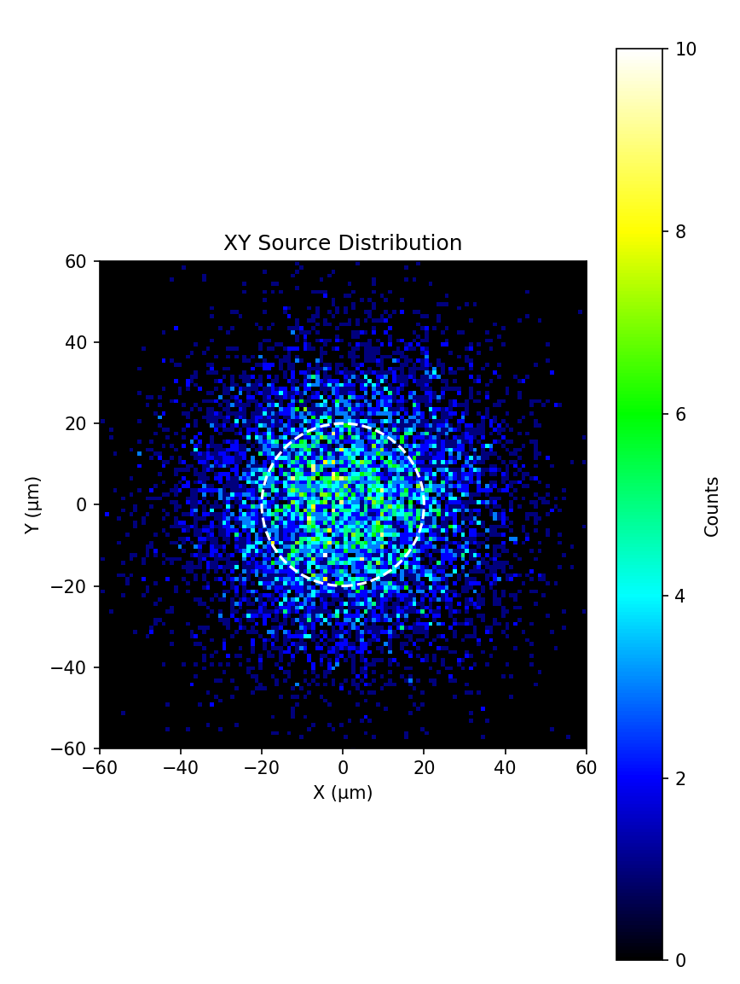

Slide 6
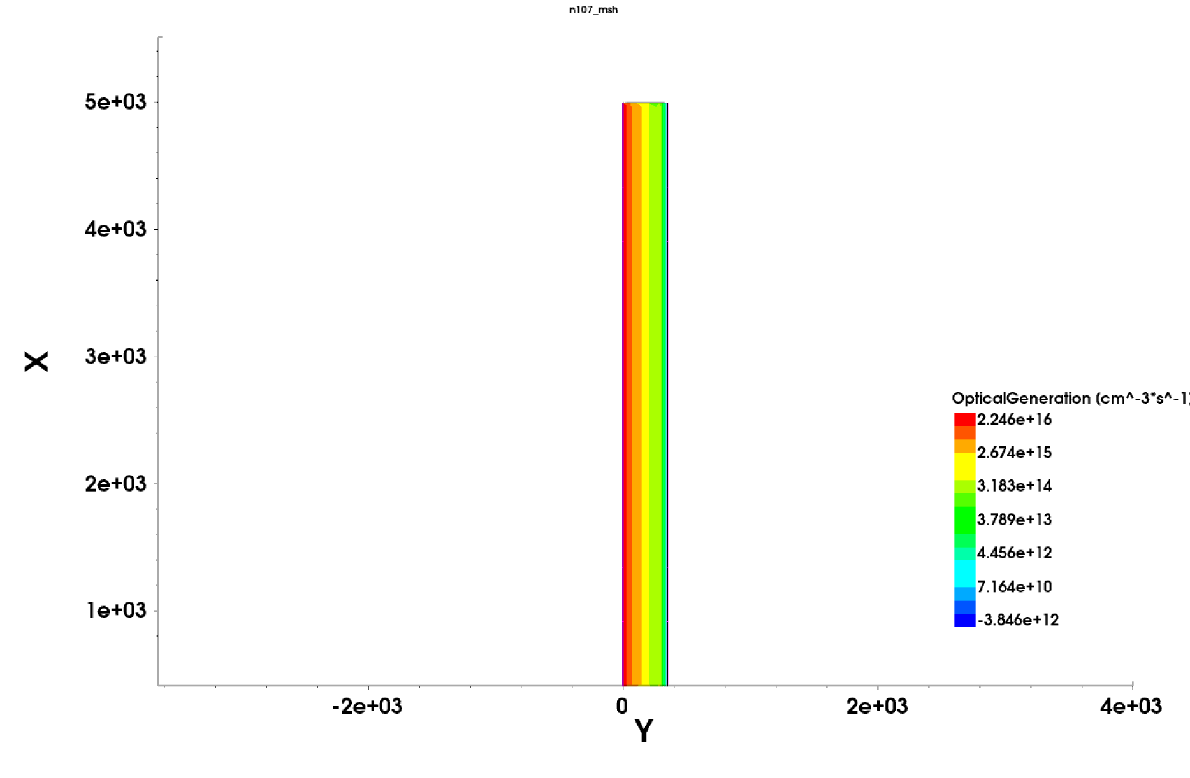
Anode is located at y=0
Cathode is located at y=350

Slide 7
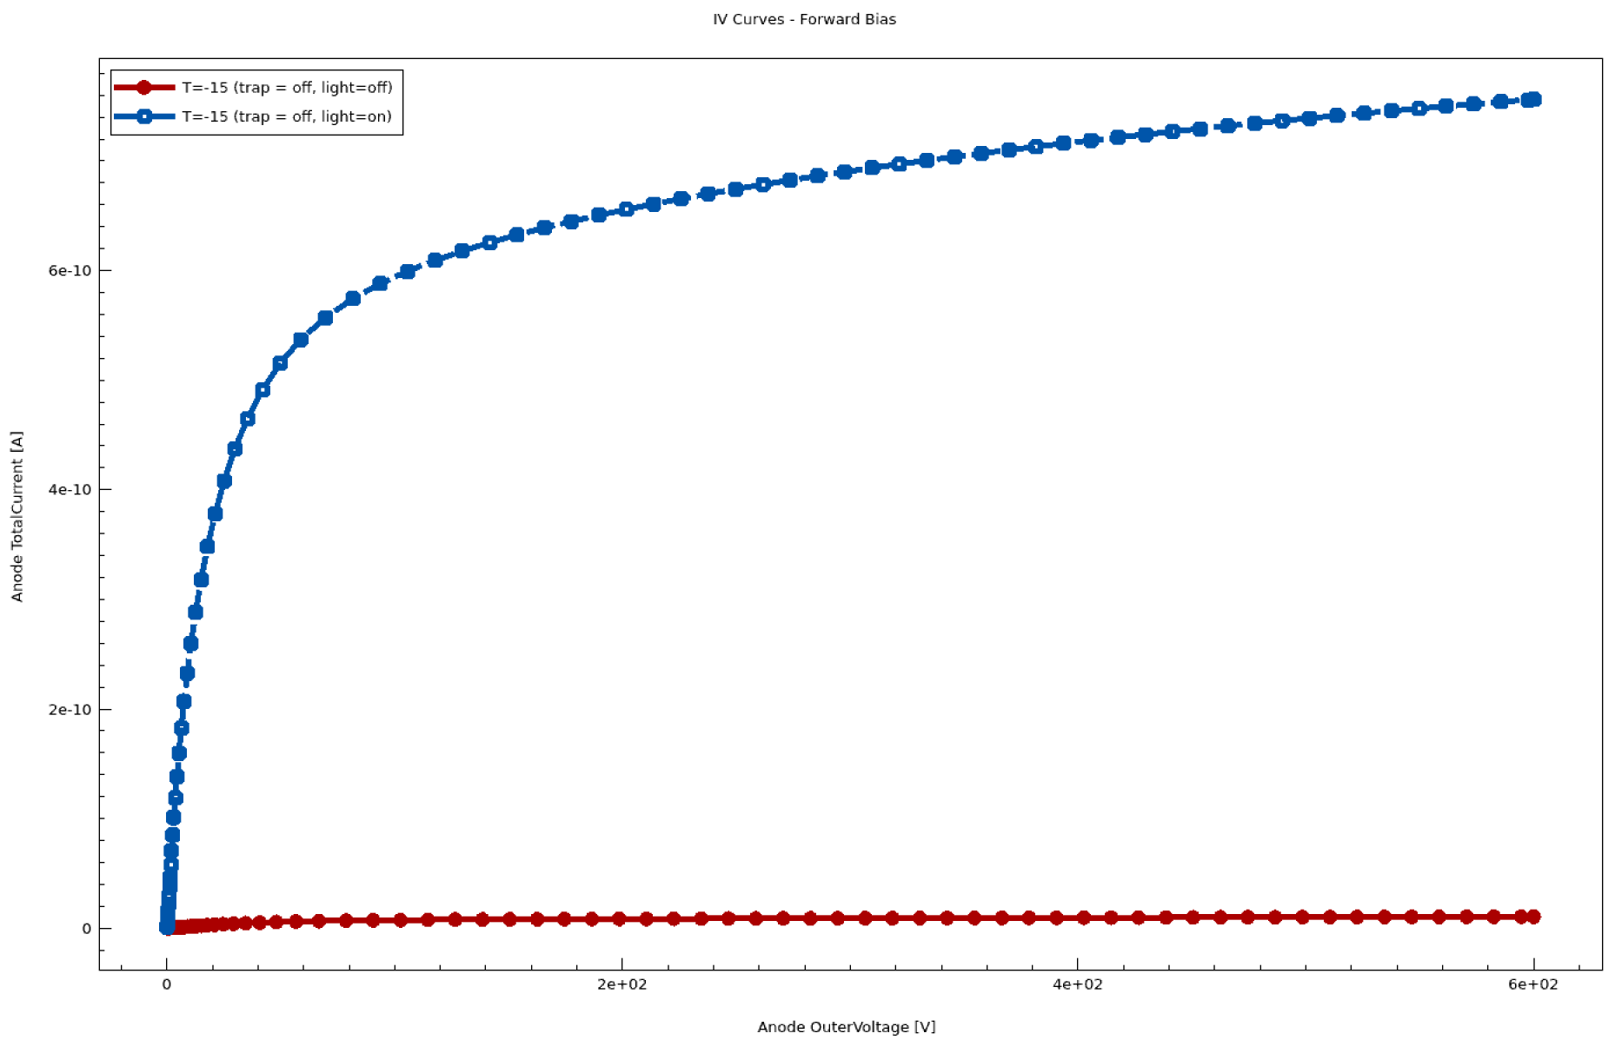
Temp = -15°C
Linear

Slide 8
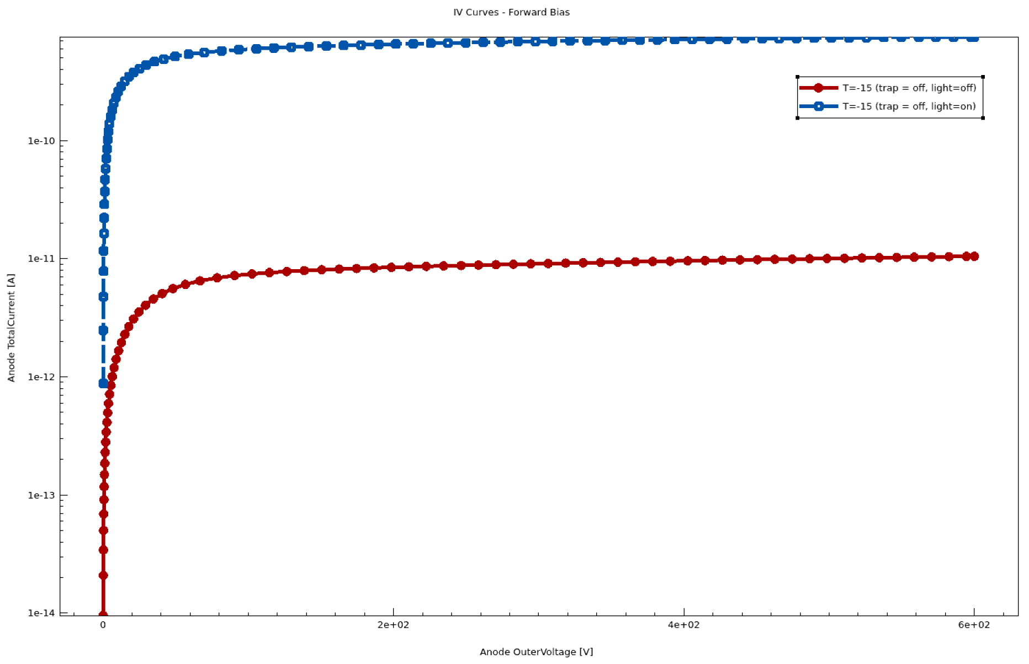
Temp = -15°C
Log

Slide 9
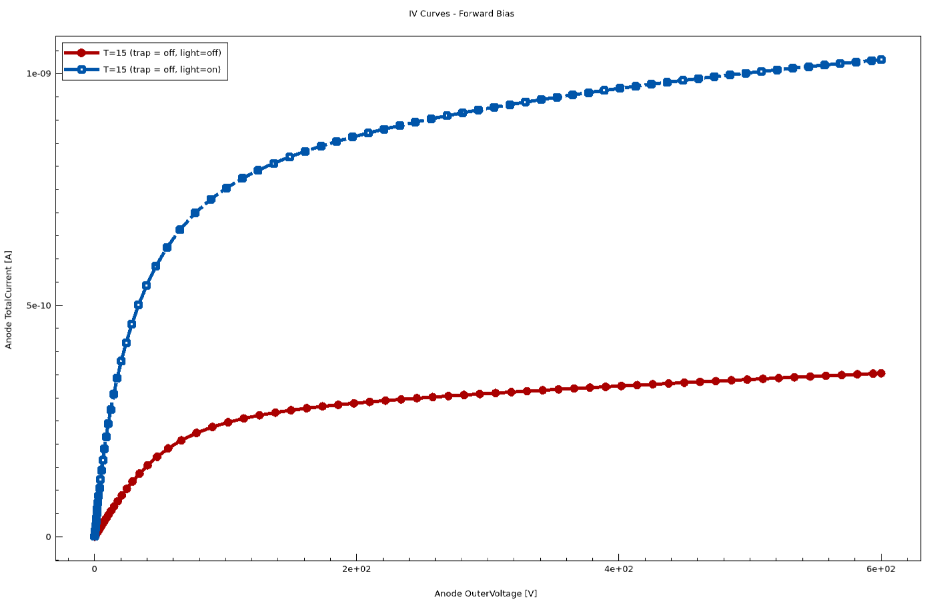
Temp = 15°C
Linear

Slide 10
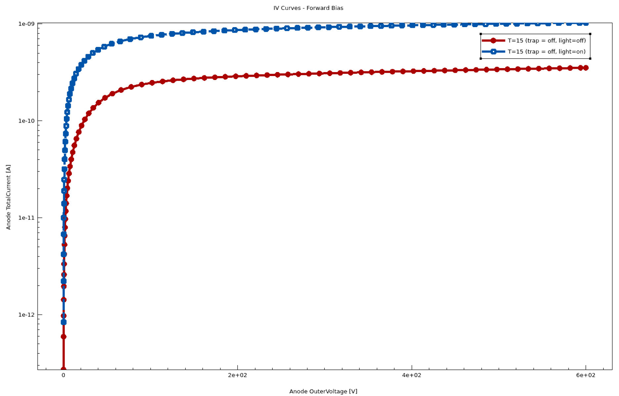
Temp = 15°C
Log

Slide 11
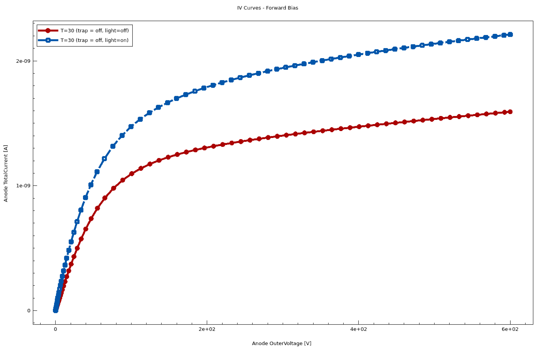
Temp = 30°C
Linear

Slide 12
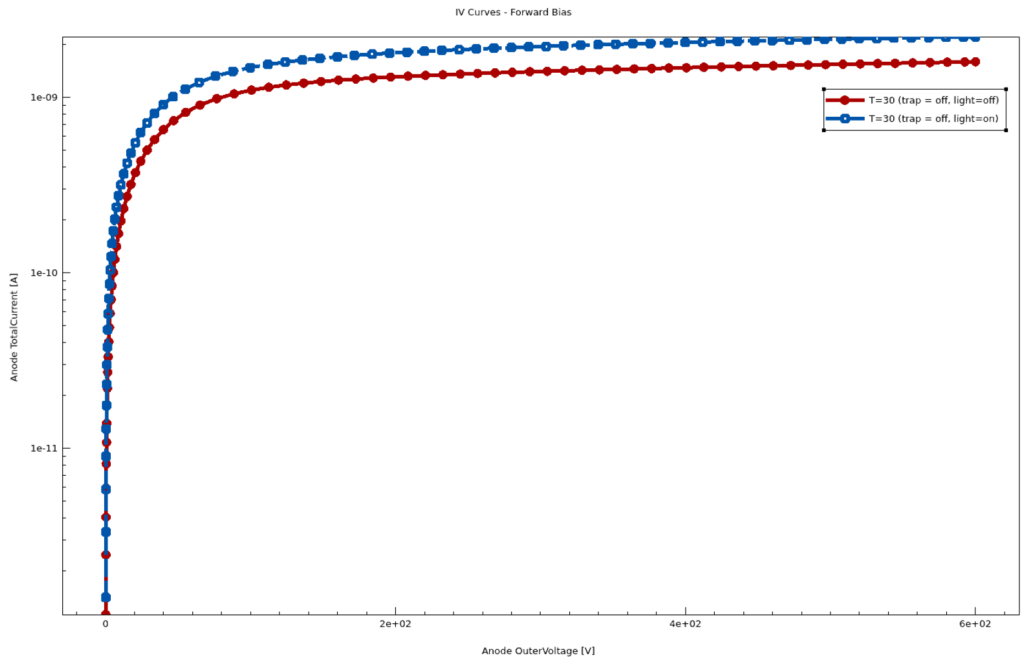
Temp = 30°C
Log

Slide 13
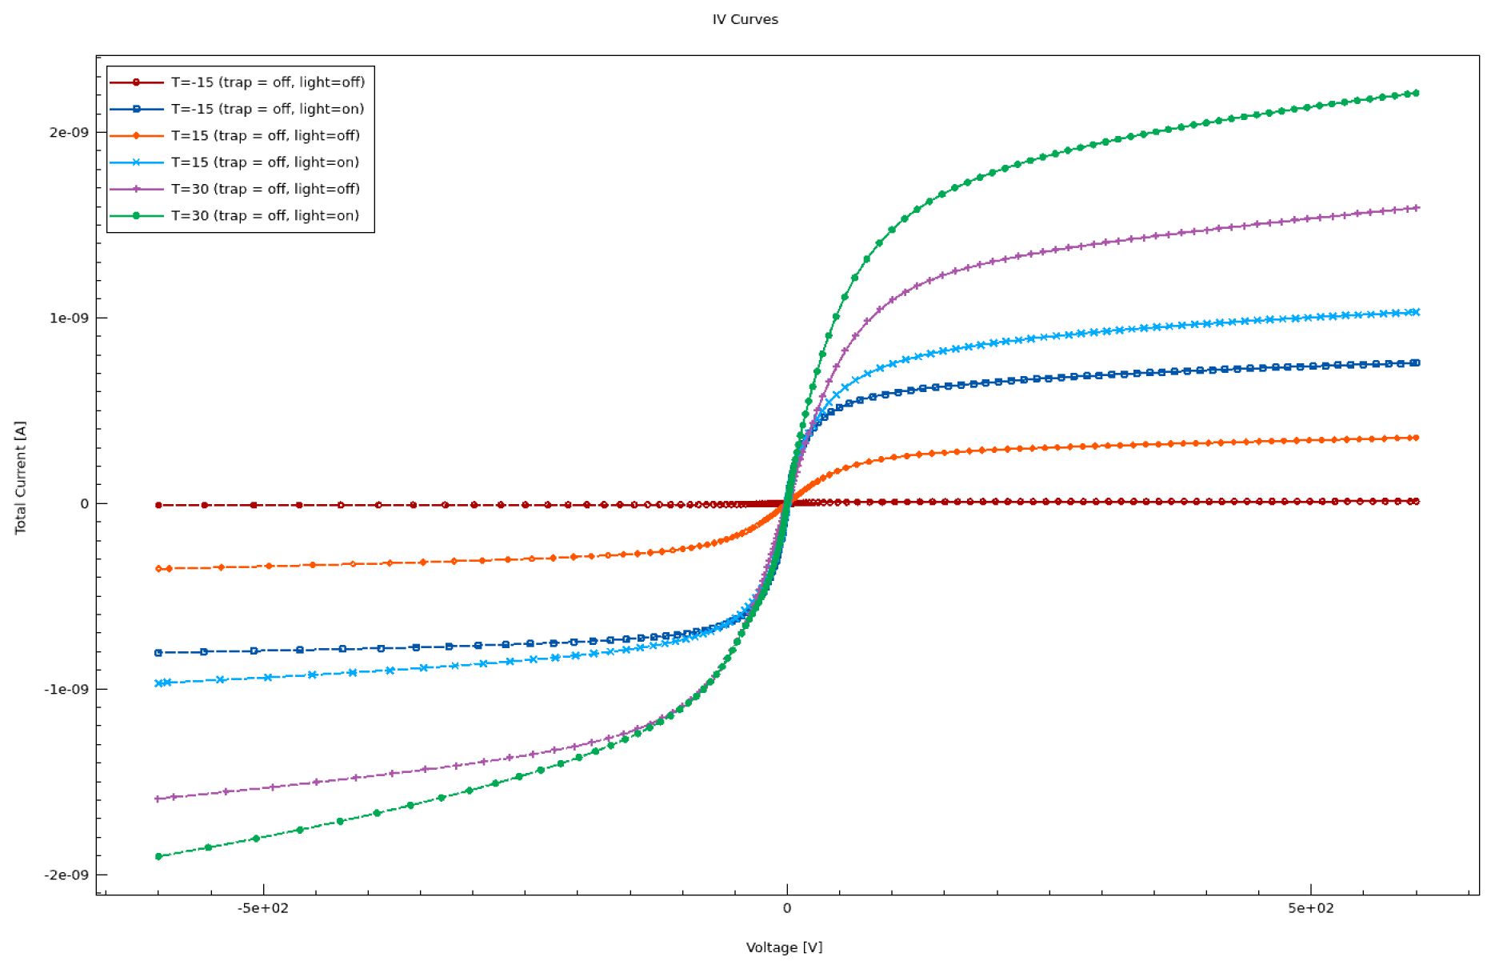

Slide 14
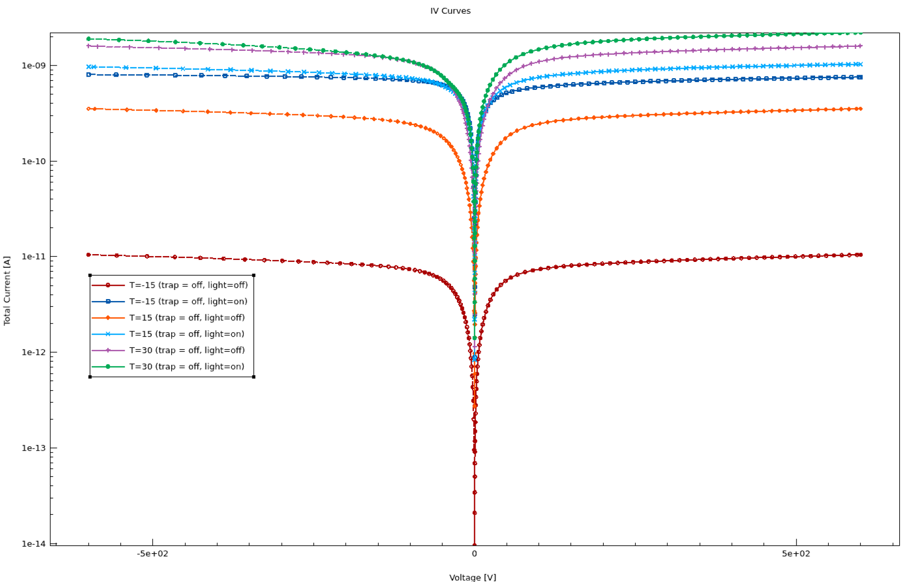

Slide 15
Still waiting for trap on simulation results

Slide 16
Basic Schematic
Incident Beam
2mm
Gold (100nm)
Chromium (10nm)
InP:Fe (350µm)
Chromium (10nm)
2mm
Gold (100nm)
5mm
5mm

Slide 17
2D TCAD Simulation
Anode
Gold
y
Chromium
InP
350µm
x
Chromium
10nm (0.01µm)
Gold
100nm (0.1µm)
L = 5mm
Cathode

Slide 18
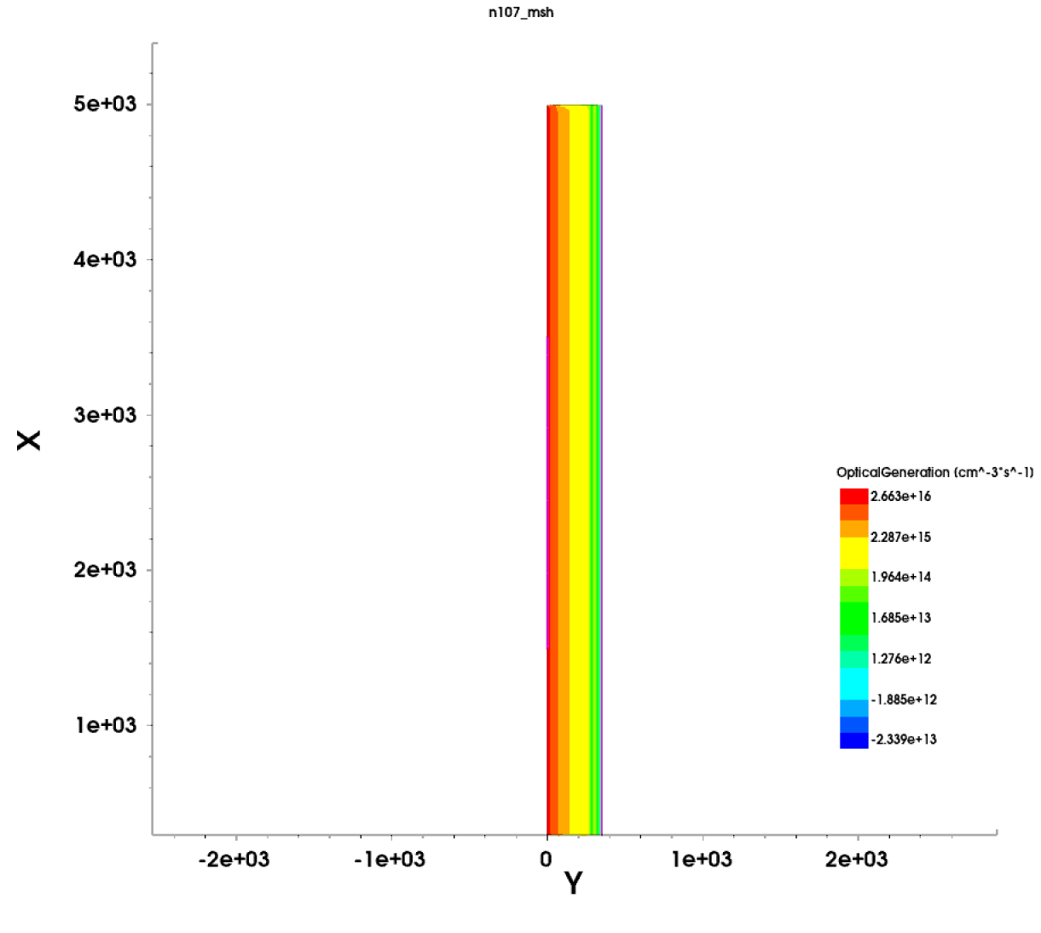

Slide 19
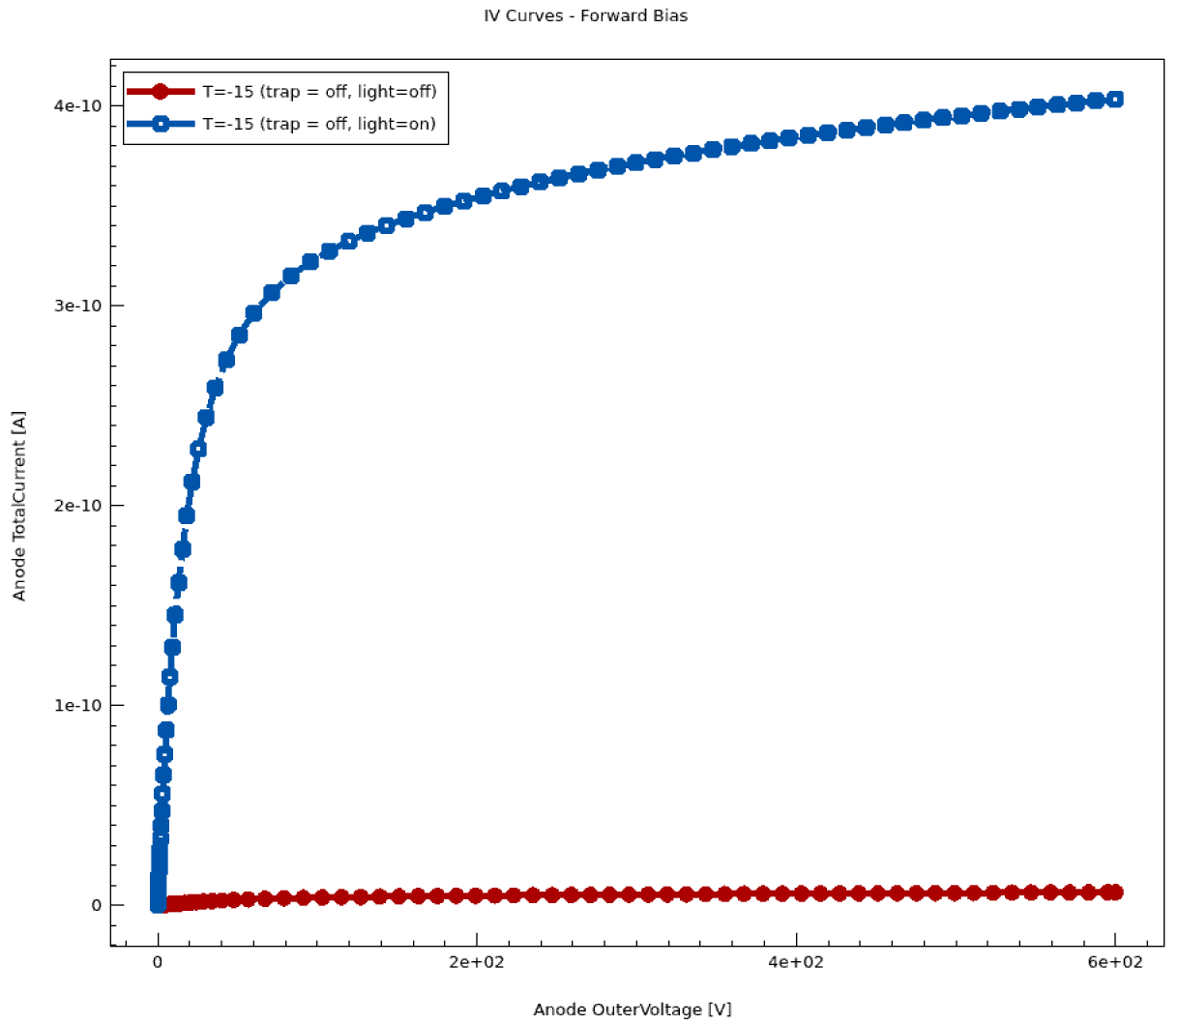
Temp = -15°C
Linear

Slide 20
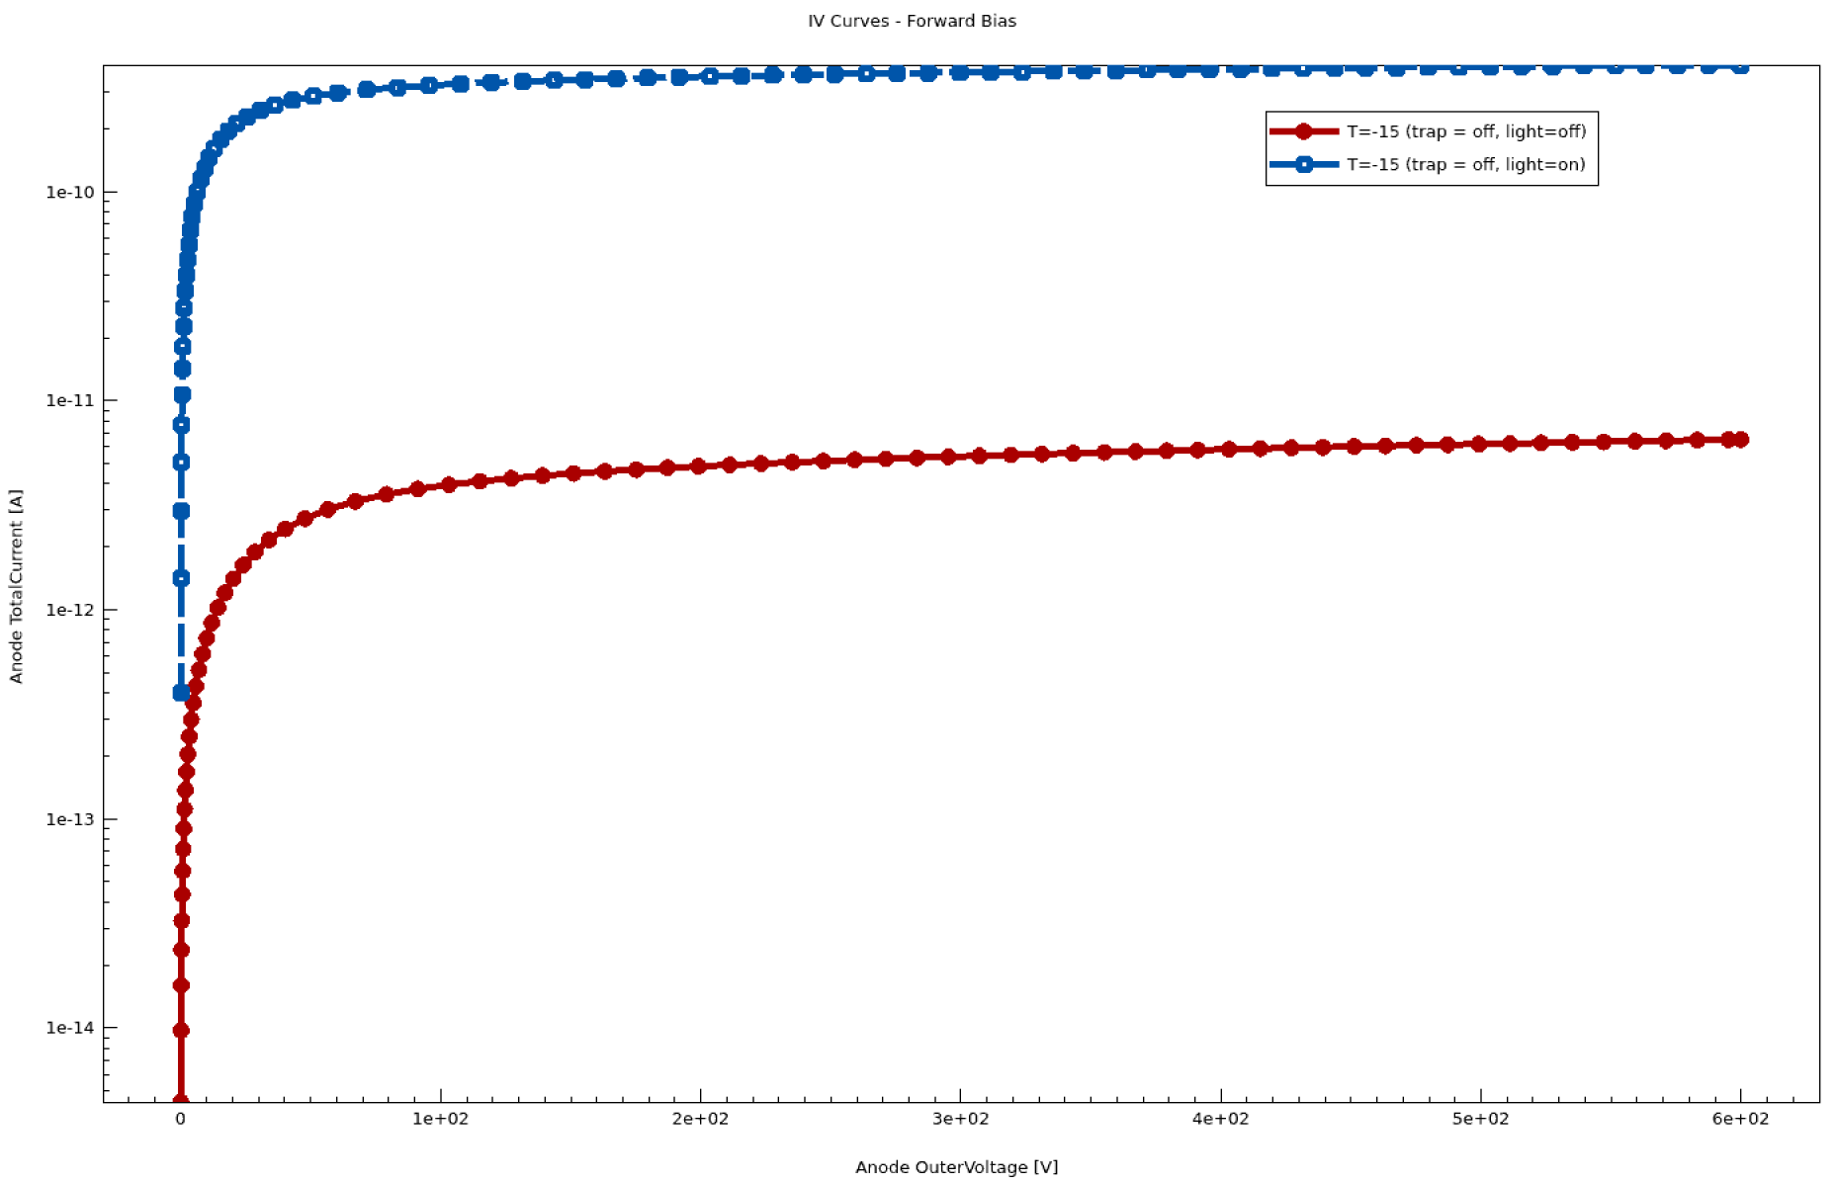
Temp = -15°C
Log

Slide 21
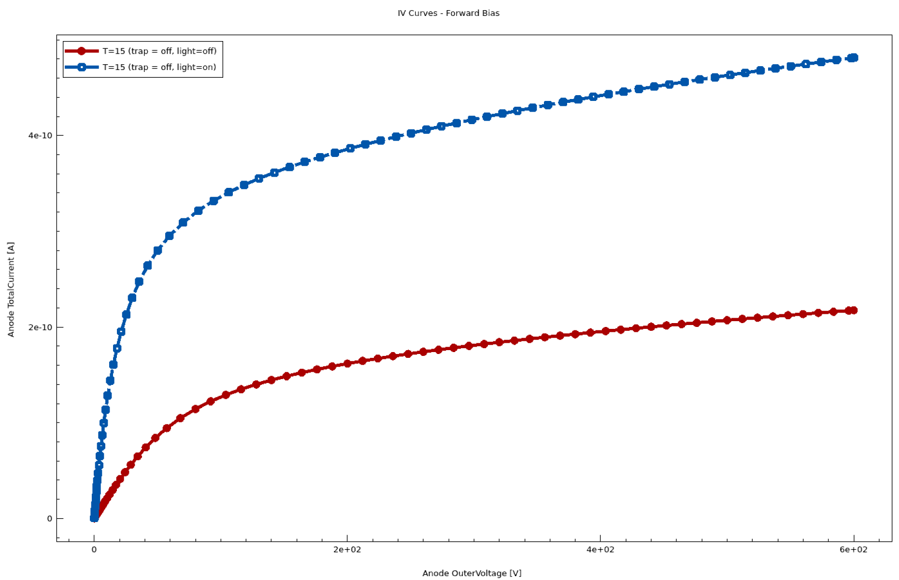
Temp = 15°C
Linear

Slide 22
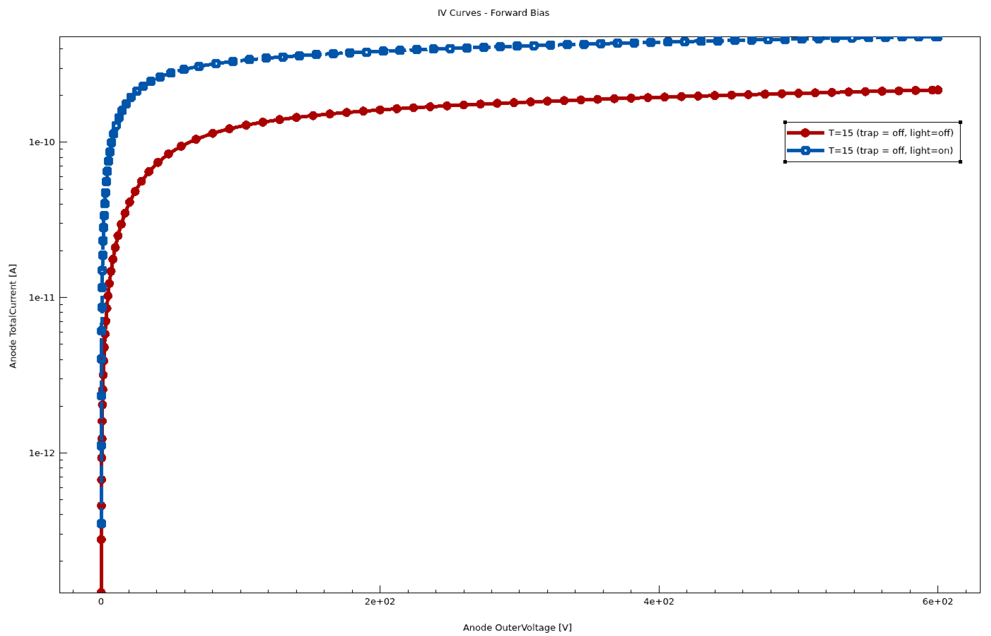
Temp = 15°C
Log

Slide 23
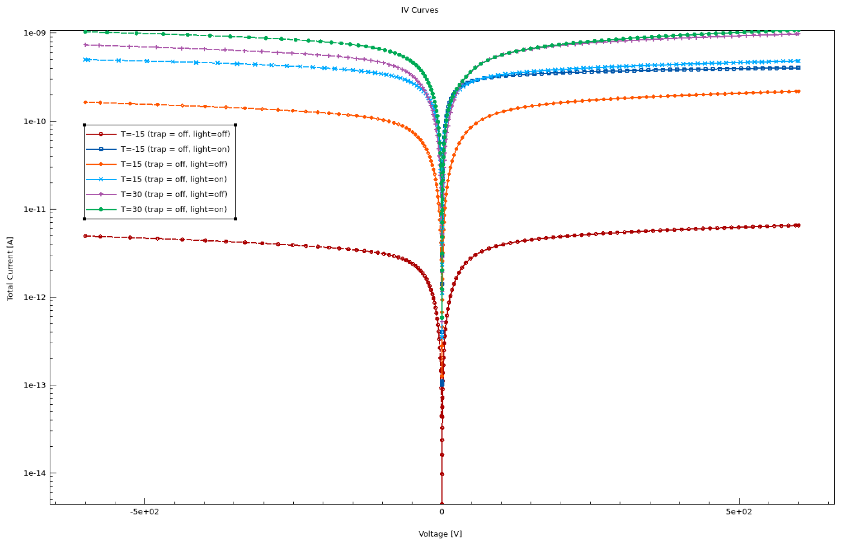
Log

Slide 24
Still waiting for trap on simulation results

Slide 25
Backup Slides

Slide 26
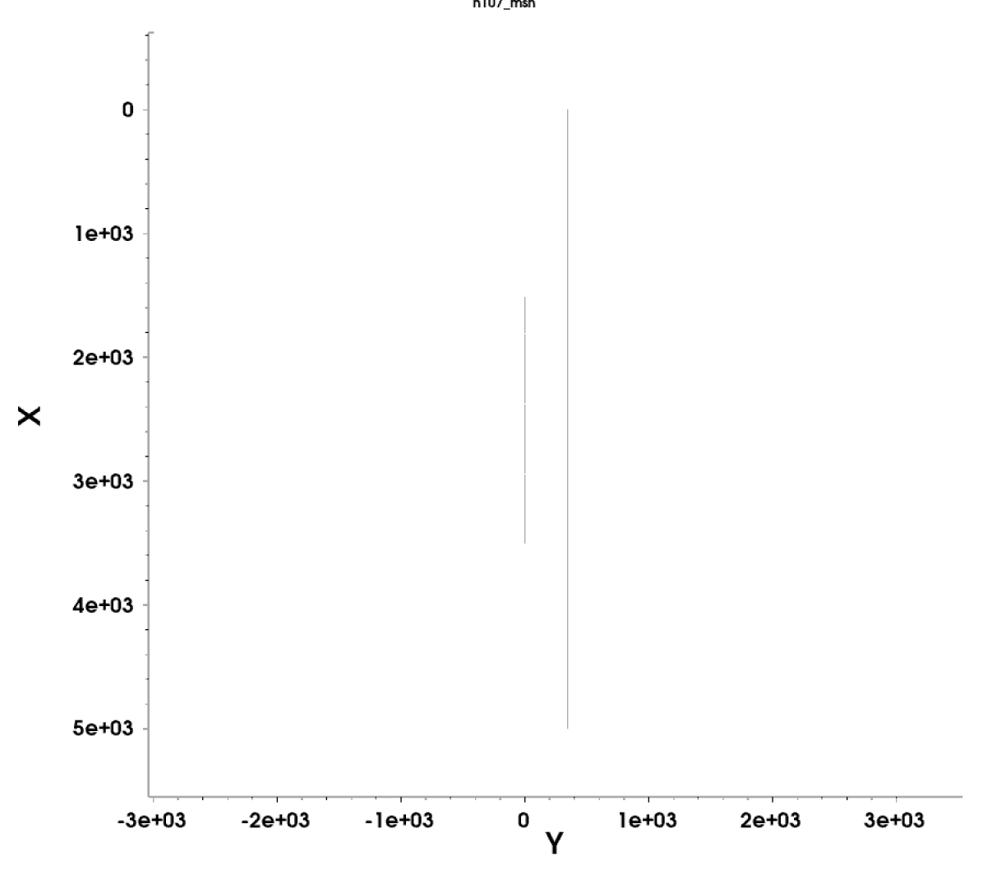
Contact Check
2mm
5mm

Slide 27
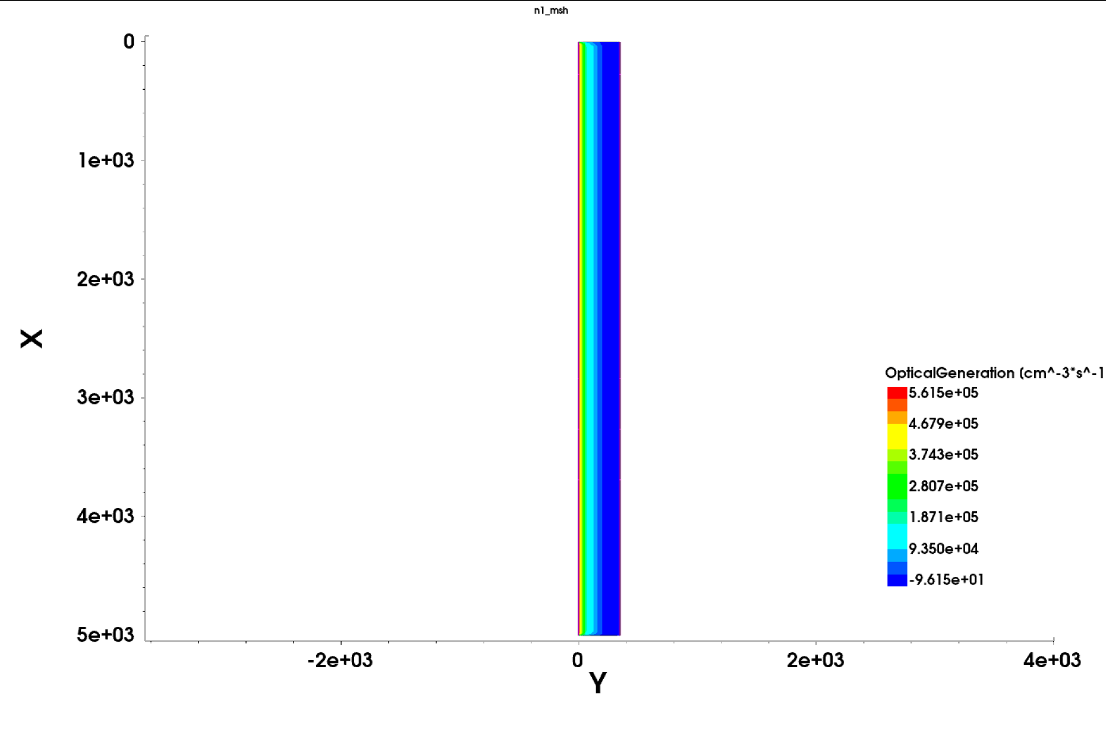
Anode is located at y=0
Cathode is located at y=350

