Slide 1



Phil Reed¹, Oliver Knodel², Carole Goble¹
TeSSHub4EOSC
TeSSHub4EOSC:
FAIR training catalogue infrastructure
1 The University of Manchester, UK
2 HZDR, Germany

Slide 2


TeSSHub4EOSC: Motivation
Distributed, FAIR-compliant catalogue infrastructure for training
Background: fragmented training resources across EOSC
Built on the OSCARS mTeSS-X Platform (evolution of TeSS)
TeSSHub4EOSC: EOSC Gravity inter-project
  A single, interoperable access point
  Complements existing discipline-specific catalogues (PaN-Training, ELIXIR)
  EOSC Nodes and clusters can have ”spaces”
Notes:
Training resources across the European Open Science Cloud remain fragmented, scattered across research infrastructures, universities, and domain-specific communities, making it difficult for researchers to discover relevant learning opportunities. The EOSC Gravity-funded TeSSHub4EOSC project addresses this gap by delivering a distributed, FAIR-compliant catalogue infrastructure that acts as a central training metadata backbone for the EOSC Catalogue.
Built on the mTeSS-X platform (itself an evolution of the established TeSS system, developed within the OSCARS Open Science project) TeSSHub4EOSC automates the harvesting, standardisation, and exposure of training metadata from diverse sources. The result is a single, interoperable access point that complements discipline-specific catalogues such as ELIXIR TeSS and PaN-Training, rather than replacing them. Crucially, the platform allows EOSC nodes, science clusters, and competence centres to spin up their own custom-branded "spaces" – each with distinct branding and content – without the burden of maintaining separate infrastructure.

Slide 3


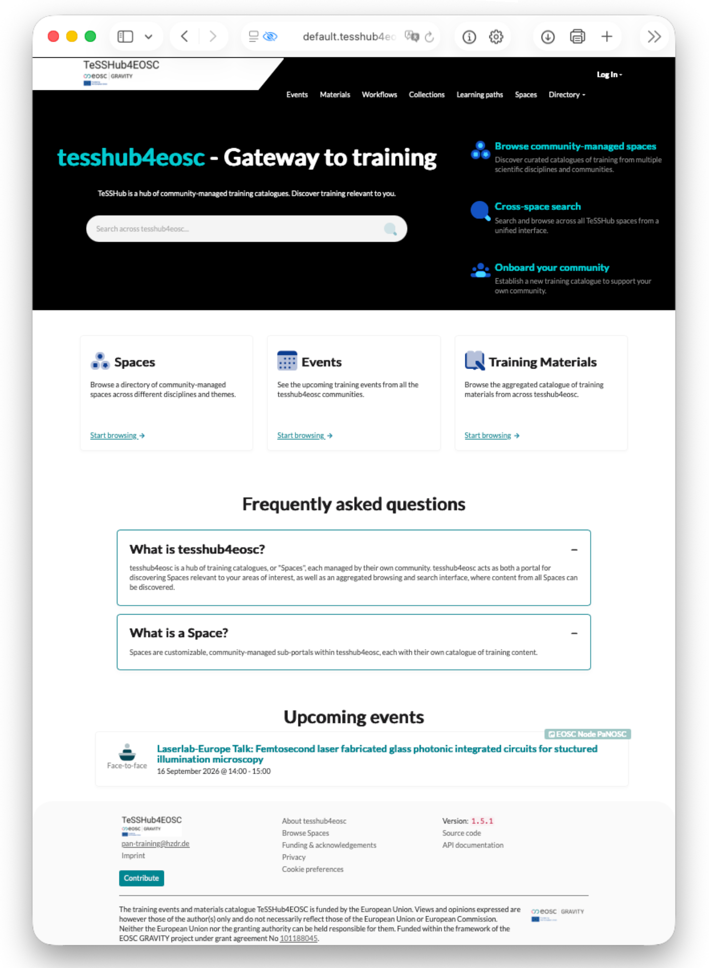
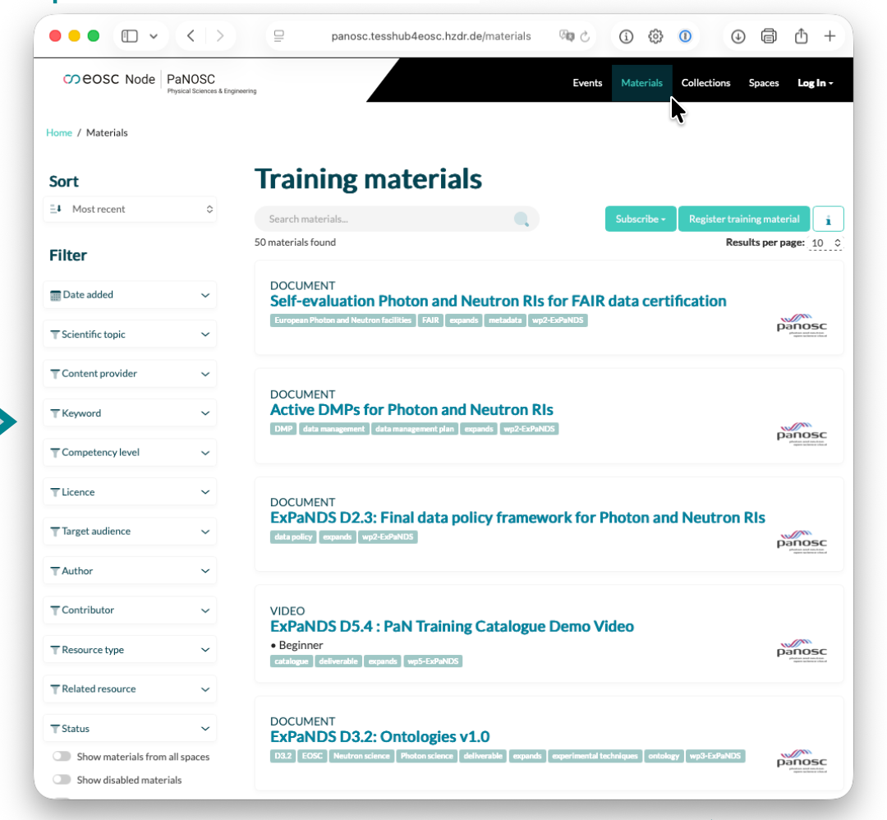
TeSSHub4EOSC: Outcomes (1)
tesshub4eosc.eu
panosc.tesshub4eosc.eu
Easily create spaces for training materials and events for EOSC Nodes
Notes:
We present the deployed central TeSSHub instance, its integration with EOSC-AAI for authentication, and the pilot onboarding of the service into existing EOSC Nodes, demonstrating a concrete, working example of federation in practice.
Access via the EOSC AAI and MyAccessID allows you to log in easily without having to register again for each space.
[CLICK TO REVEAL PaNOSC SPACE]
Create spaces for training materials and events for EOSC Nodes.

Slide 4
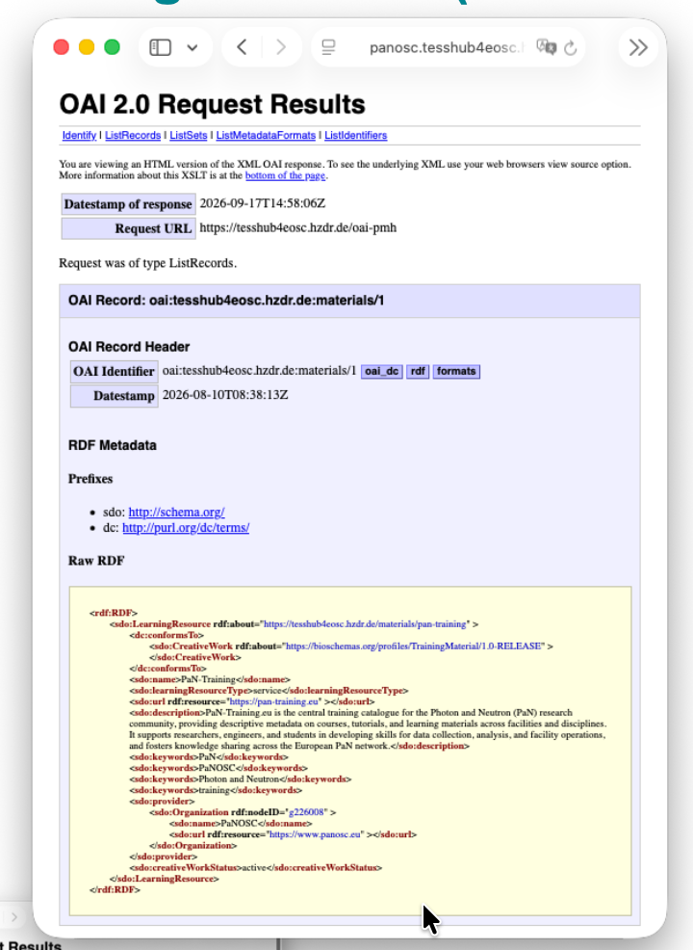
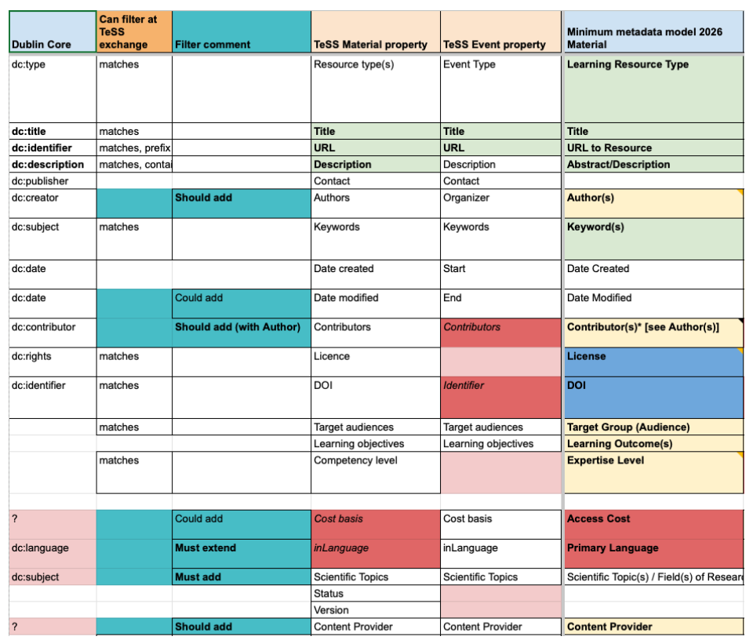
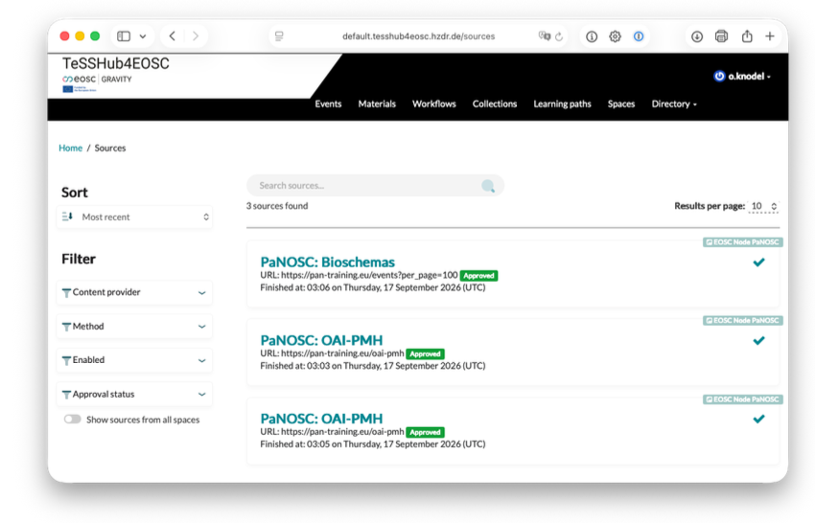
TeSSHub4EOSC: Outcomes (2)
tesshub4eosc.eu
panosc.tesshub4eosc.eu
Training Metadata (OAI-PMH)
Metadata is provided via a standardised interface and a defined set of metadata fields
Definition of
Metadata Sources
Metadata is collected from configurable third-party sources
Metadata Schema
In consultation with the EOSC Working Group on Training & Competencies
Notes:
[CLICK TO ADD SOURCES, OAI-PMH, THEN SCHEMA]

Slide 5
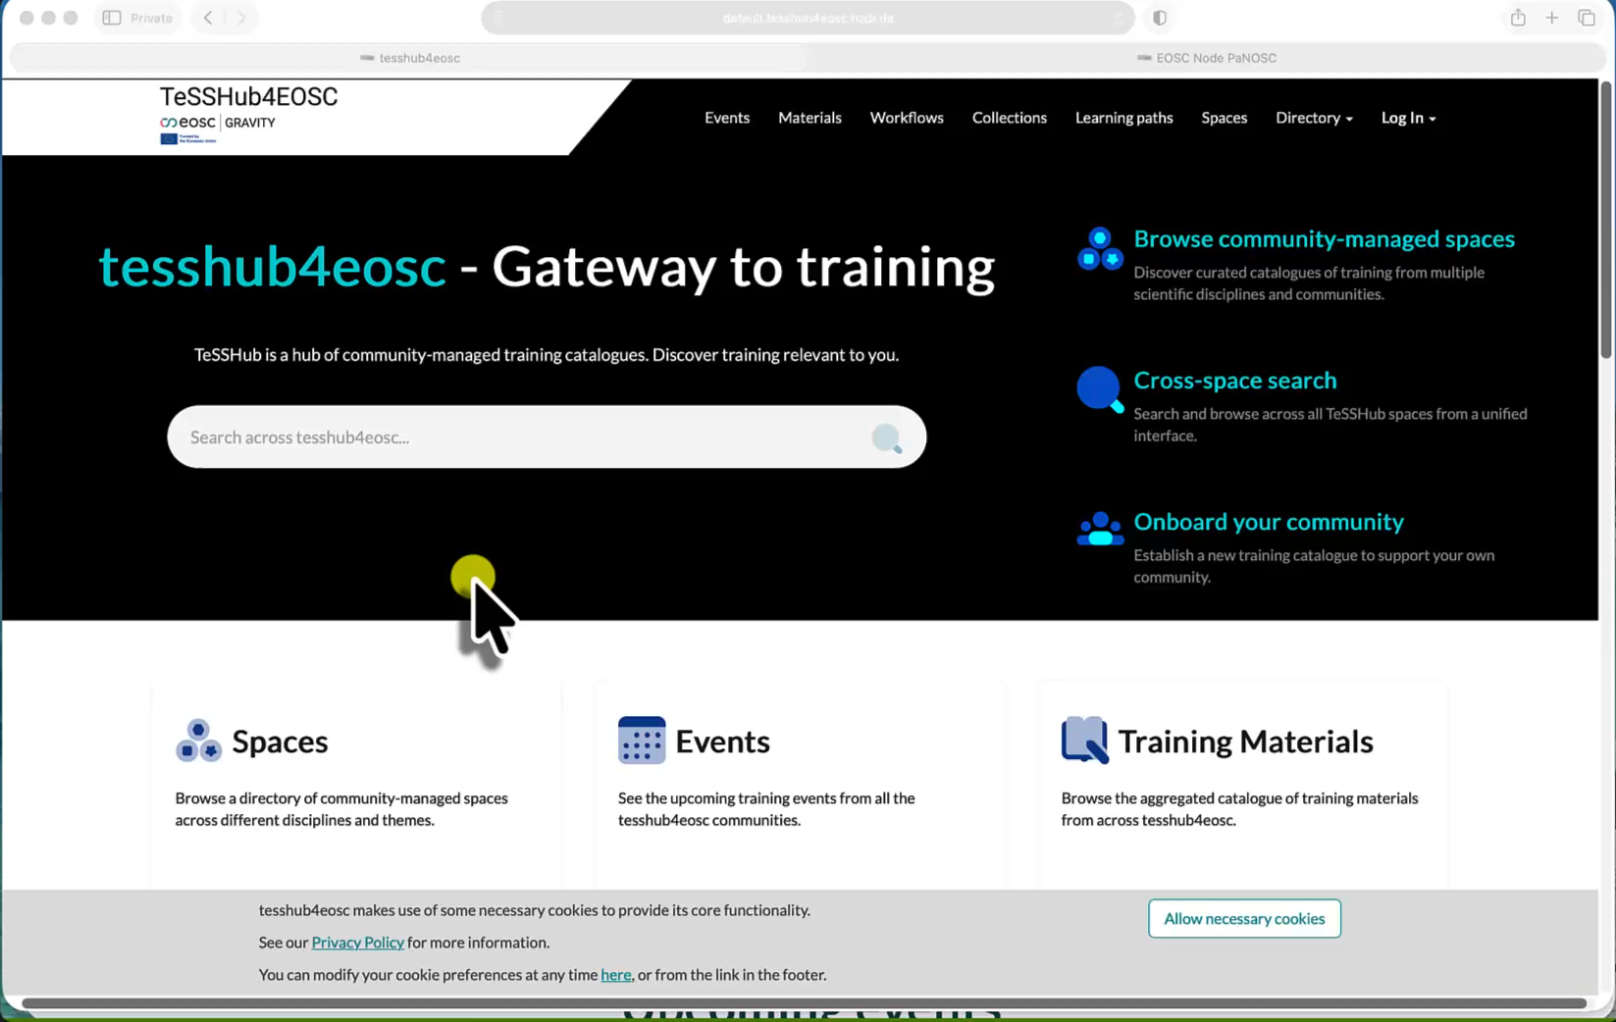
TeSSHub4EOSC: Demonstration
tesshub4eosc.eu – see it in action (administrator view)
(short video to go here)
Notes:
Let me give you a demonstration at tesshub4eosc.eu
* This is the homepage, familiar if you have used any TeSS instance before, with a menu for Events and Materials, a unified search box, and a highlight of providers which are primarily the nodes.
* Further down the homepage, we see upcoming events and latest materials, note the label showing their origin from ‘Spaces’; for this example event, we display the item in the global catalogue (the logo at the top left says: TeSSHub4EOSC), then we can display the material directly in the Space layout by clicking ‘View in Space’. After this, we can finally navigate to the Node Space landing page.
* Let’s see how it looks for managers. We can log in via EOSC AAI (note): this must be done via a Node AAI provider, and we have opted for PaNOSC’s UmbrellaID.
* Then, under ‘Manage Spaces’, you can see the currently available Spaces.
* Then, using PaNOSC as an example, see what is possible in the basic configuration, (more is possible); however, TeSSHub4EOSC adheres very closely to the design of EOSC Gravity to ensure a consistent appearance and branding across the nodes.
* Use ‘View Sources’ to see how we are currently exchanging the materials.
* If we go to edit an existing Source, we can see which protocols are available for exchange and that we can scrape content from structured websites.
* Finally, we can navigate back to the main space via Spaces… TeSSHub4EOSC has now been established in addition to other central catalogues such as ELIXIR TeSS and PaN-Training – which have been in production for years – as part of the GRAVITY project, and will therefore remain in place for the time being.
Possible playbook for video:
* First, an overview of the homepage, noting that the providers are primarily the nodes.
* Then display upcoming events and materials on the homepage, with a note on their origin from ‘Spaces’; via an entry, first display the item in the global catalogue (top left: TeSSHub4EOSC), then display the material directly in the Space layout by clicking ‘View in Space’, and finally navigate to the Node Space landing page.
* Following this, log in via EOSC AAI (brief note): this must be done via a Node AAI provider, and we have opted for PaNOSC’s UmbrellaID.
* Then, under ‘Manage Space’, show the currently available Spaces.
* Then, using PaNOSC as an example, demonstrate what is possible in the basic configuration, whilst noting that more is possible; however, TeSSHub4EOSC adheres very closely to the design of EOSC Gravity to ensure a consistent appearance and branding across the nodes.
* Use ‘View Sources’ to show how we are currently exchanging the materials.
* Note which protocols are available for exchange and that we can scrape content from structured websites.
* Navigate back to the main space via Spaces and note that TeSSHub4EOSC has now been established in addition to other central catalogues such as ElIXIR TeSS and PaN-Training – which have been in production for years – as part of the GRAVITY project, and will therefore remain in place for the time being.

Slide 6
TeSSHub4EOSC: Value for ESOC
Directly strengthens the EOSC Federation
Lowers technical barrier for Nodes
Possible future option to advance EOSC strategic objectives
Curated, standardised metadata for EOSC Catalogue
Lessons from the pilot
Open-source architecture enables incremental adoption
Roadmap for embedding TeSSHub
Notes:
TeSSHub4EOSC directly strengthens the EOSC Federation by lowering the technical barrier for nodes and communities to expose their training offerings through a shared, standardised, machine-readable interface. It provides a possible future option that advances EOSC's strategic objectives around FAIRness, interoperability, and sustainable service federation, while reducing duplicated infrastructure effort across the landscape. By feeding curated, standardised metadata into the EOSC Catalogue and supporting the EOSC Academy, the project contributes a suggested reusable building block for scalable, community-driven training discovery; a capability currently missing at federation scale.
We have learnt that setting up a catalogue is not a problem. The challenge lies in defining appropriate terms and conditions, which is something we have also addressed in the project. One unexpected challenge here is the processes within the nodes involved in deciding on a space in TeSSHub4EOSC and selecting and curating materials and events to be made available via a shared system with an EOSC focus.

Slide 7


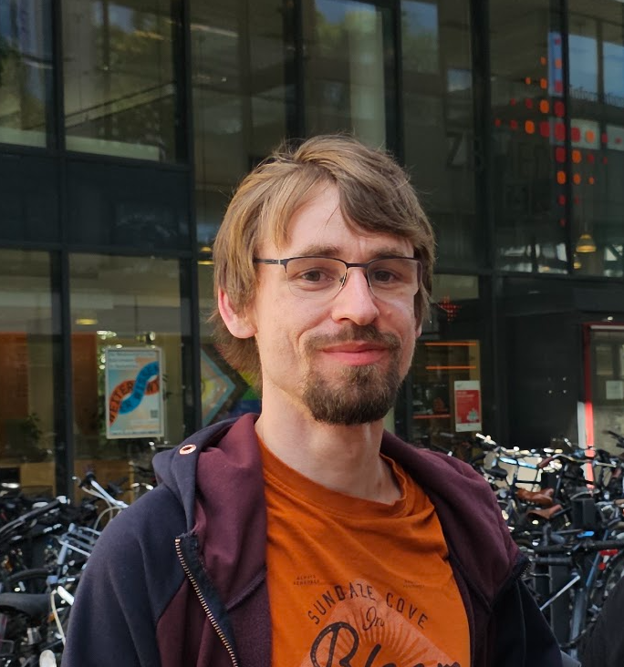



Thanks to:
EOSC Training & Competencies WG
mTeSS-X Focus Group
Gravity project: PATH2EOSCUK
Nodes: PaNOSC, LSC, CERN, EUDAT
The TeSSHub4EOSC team
Oliver Knodel
Phil Reed
Martin Voigt
Finn Bacall
Munazah Andrabi
Carole Goble
Co-Lead, HZDR
Project Coordinator, UNIMAN
Research Software Engineer, HZDR
Senior Research Software Engineer, UNIMAN
Life Sciences Informatics Manager, UNIMAN
Co-Lead, UNIMAN

